Slide 1
SPARC/FIFO status
2024-05-17
Ch. Flouzat
Notes:
1

Slide 2
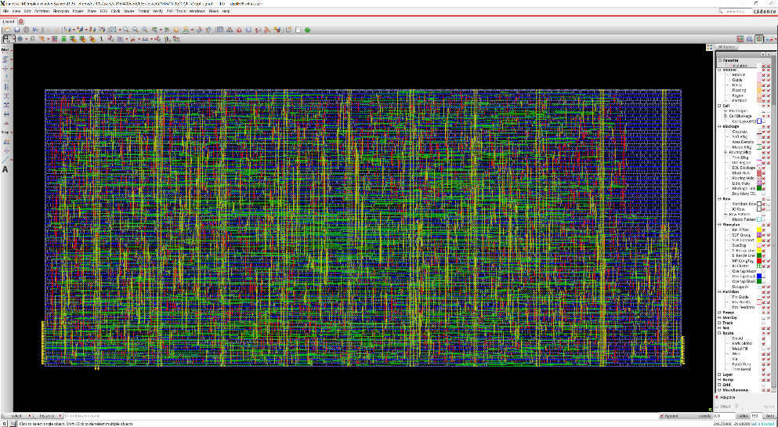
First version of the FIFO/Serializer
https://cernbox.cern.ch/files/spaces/eos/user/c/cflouzat/SPARC
pop_error
pop_full
pop_af
pop_hf
pop_ae
pop_empty
push_error
push_full
push_hf
push_ae
push_empty
clk_pop_fifo
data_out[2]
data_out[1]
data_out[0]
push_af
clk_pop
size WxL=460x200
data_in[23]
data_in[22]
…
data_in[2]
data_in[1]
data_in[0]
RN
clk_push
-------------------------------------------------------------------------------------------------------------------------------------------------------------------------------
| Snapshot | WNS (ns) | TNS (ns) | FEPS | WNS_R2R (ns) | TNS_R2R (ns) | FEPS_R2R | DRV(T) | DRV(C) | POWER(L) | UTIL | INSTS | AREA (um^2) | DRC | WALL (s) |
| | | | | | | | Tran (ns) | Load (pF) | Leakage (mW) | Density (%) | | | | |
|-------------+----------+----------+------+--------------+--------------+----------+-----------+-----------+--------------+-------------+-------+-------------+-----+----------|
| syn_generic | 0.890 | 0 | 0 | 0.890 | 0 | 0 | 0 | 0 | 0.02 | 0.00 | 10096 | 116959 | | 0:01:54 |
| syn_map | 0.002 | 0 | 0 | 0.002 | 0 | 0 | 0 | 0 | 0.01 | 0.00 | 2937 | 46194 | | 0:02:01 |
| syn_opt | 0.002 | 0 | 0 | 0.002 | 0 | 0 | 0 | 0 | 0.01 | 0.00 | 2929 | 46175 | | 0:01:46 |
| floorplan | | | | | | | | | | 50.52 | 2929 | 46175 | | 0:02:01 |
| prects | 0.424 | 0 | 0 | 0.424 | 0 | 0 | 0 | 0 | 0.01 | 50.72 | 2997 | 46354 | | 0:03:14 |
| cts | 0.271 | 0 | 0 | 0.271 | 0 | 0 | 0 | 0 | 0.01 | 53.29 | 4555 | 48700 | 0 | 0:05:04 |
| postcts | 0.271 | 0 | 0 | 0.271 | 0 | 0 | 0 | 0 | 0.01 | 53.74 | 4632 | 49118 | | 0:03:16 |
| route | 0.084 | 0 | 0 | 0.084 | 0 | 0 | 0 | 0 | 0.01 | 53.74 | 4629 | 49114 | 0 | 0:08:01 |
| postroute | 0.295 | 0 | 0 | 0.295 | 0 | 0 | 0 | 0 | 0.01 | 54.34 | 4817 | 49667 | 0 | 0:06:10 |
| signoff | 0.542 | 0 | 0 | 0.542 | 0 | 0 | | 1545 | | | | | | 0:04:40 |
| opt_signoff | 0.295 | 0 | 0 | 0.295 | 0 | 0 | 0 | 0 | 0.01 | 54.34 | 4817 | 49667 | 0 | 0:11:45 |
-------------------------------------------------------------------------------------------------------------------------------------------------------------------------------
2
Notes:
2

Slide 3
Serializer Implementation
FIFO
23..16
ser 8b→1b
out[2]
data_in
24
24
15..8
ser 8b→1b
out[1]
7..0
ser 8b→1b
out[0]
empty
pop
load
serializer_fsm
clk_pop_fifo
(==N-2)
&& empty
EMPTY
TX
(==N-2)
&& !empty
<N-2
!empty
LOAD
TX0
serializer_load
FIFO_pop
BIT0
BIT1
BIT2
BIT3
BIT4
BIT5
BIT6
BIT7
BIT0
BIT1
BIT2
BIT3
BIT4
BIT5
BIT6
BIT7
3
Notes:
3

