Slide 1
Experimental Conclusion
SungWoo YOUN
On behalf of Exp. speakers
Axion Quest 2024
09. 08. 2024, ICISE, Quy Nhon, Vietnam

Slide 2
Introduction = Conclusion (?)
Y. Semetzidis

Slide 3
Experimental talks
31 talks (out of 49)!
6 review talks (30’)
25 individual experiment talks (20’)

Slide 4
Particle physics frontiers
Axion
Axion
Axion
Nature
Axion
Axion
Axion

Slide 5
Axion (ALP) frontiers
Accelerator
Collider
Fixed target
Beam dump
Telescope
Axion
(ALP)
LSW
EDM
CLFV
Haloscope
Helioscope
Magnetometer
Underground
Axion echo

Slide 6
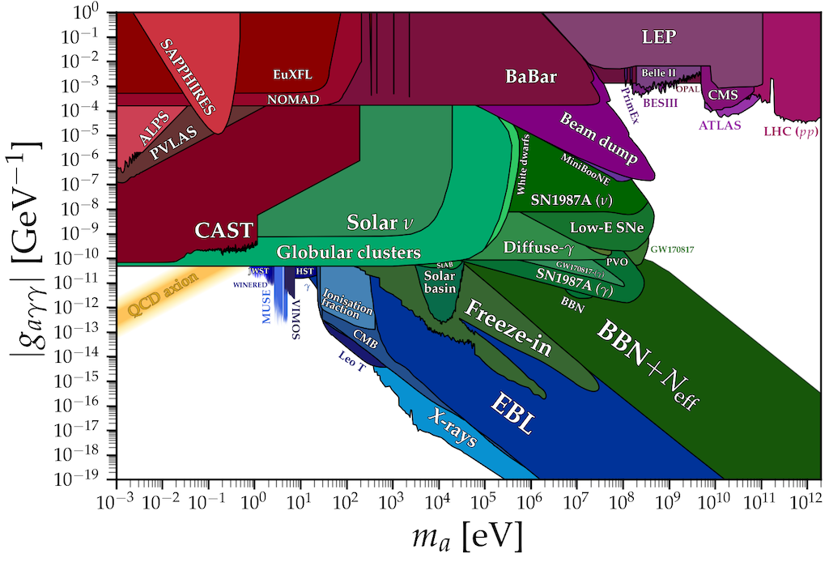
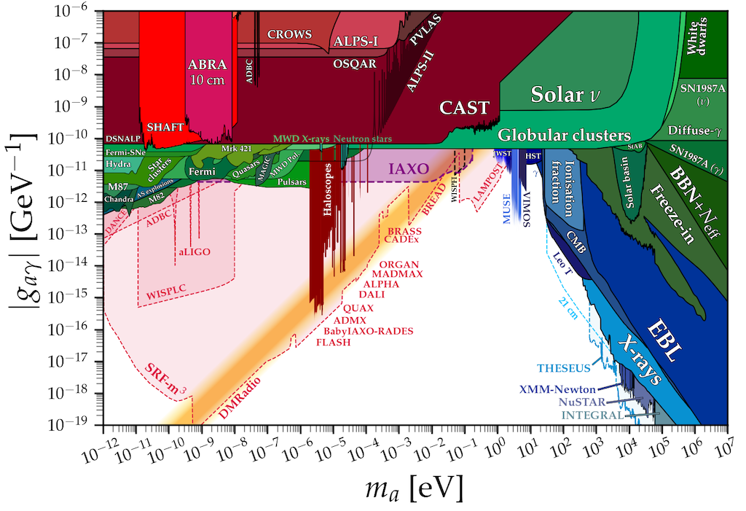
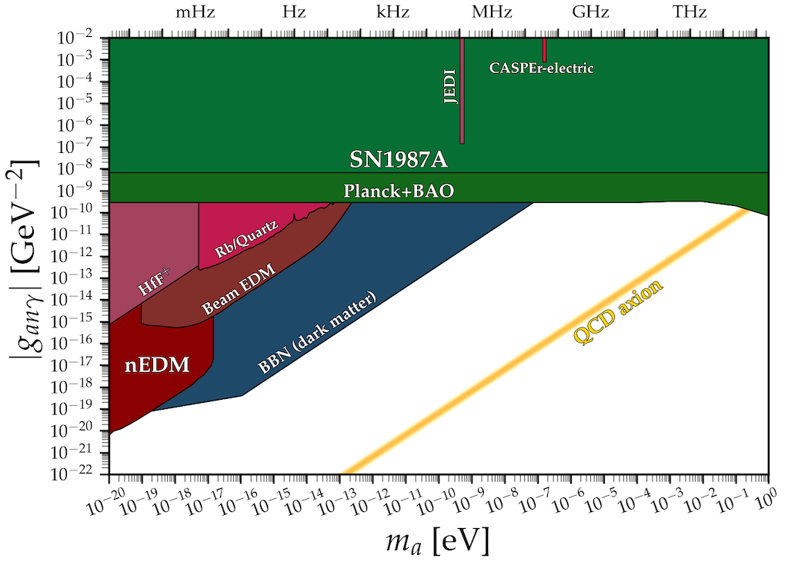
Axion mass
High mass
Colliders
Fixed targets
Beam dump
Intermediate mass
Halsoscope
Helioscope
Photon regeneration
Axion mediator
Low mass
EDM
Magnetometer

Slide 7
Cosmic frontier
Haloscope
ADMX (Nick Du)
CAPP (Saebyeok Ahn, Danho Ahn, SungWoo Youn, Boris Ivanov)
MADMAX (Anton Ivanov)
ORGAN (Aaron Quickamp)
GrAHal (Pierre Pugnat)
Helioscope
(Baby) IAXO (Christoph Wiesinger)
XENONnT @ LNGS (Jingqiang Ye)
Axion echo
Axion streams (Ariel Arza)

Slide 8
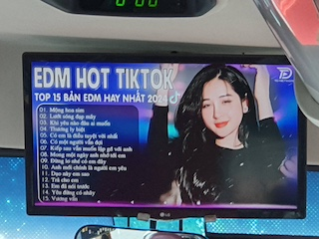
Intensity frontier
Photon regeneration
OSQAR-LSW, -CHASE at CERN (Pierre Pugnat)
EDM
Permanent/oscillating nEDM at PSI (Gilles Ban, Guilaume Pignol)
Beam EDM at ILL (Ivo Schulthess)
Storage ring EDM by JEDI at COSY (Aleksandra Wronska)
CLFV (μ→e)
MEG II at PSI (Toshinori Mori)
COMET at J-PARC (Thomas Bouillaud)
EDM HOT AXION
Notes:
Possible upgrade,

Slide 9
Energy frontier
Accelerator-related
Comprehensive review (David d'Enterria)
Fixed targets / beam dump
Proton (DarkQuest, SHiP) / electron (NA64, LDMX) (Stefania Gori)
FASER (II) (Shunliang Zhang, Xin Chen)
LUXE-NPOD (Ivo Schulthess)
Kaon factories (Evgueni Goudzovski)
pp (PbPb) colliders
CMS/ATLAS at LHC (Jeremi Niedziela)
LHCb (Louis Henry)
e⁺e⁻ colliders
B/charm factories (Belle II, BaBar, and BESIII) (Marcello Campajola)
ALP production at Belle (II) (Daniel Marcantonio)
Notes:
Photon, top, bozon icoupling, higher cross-section with Pb
B-factory (Y) and Charm (J/psi) factory

Slide 10
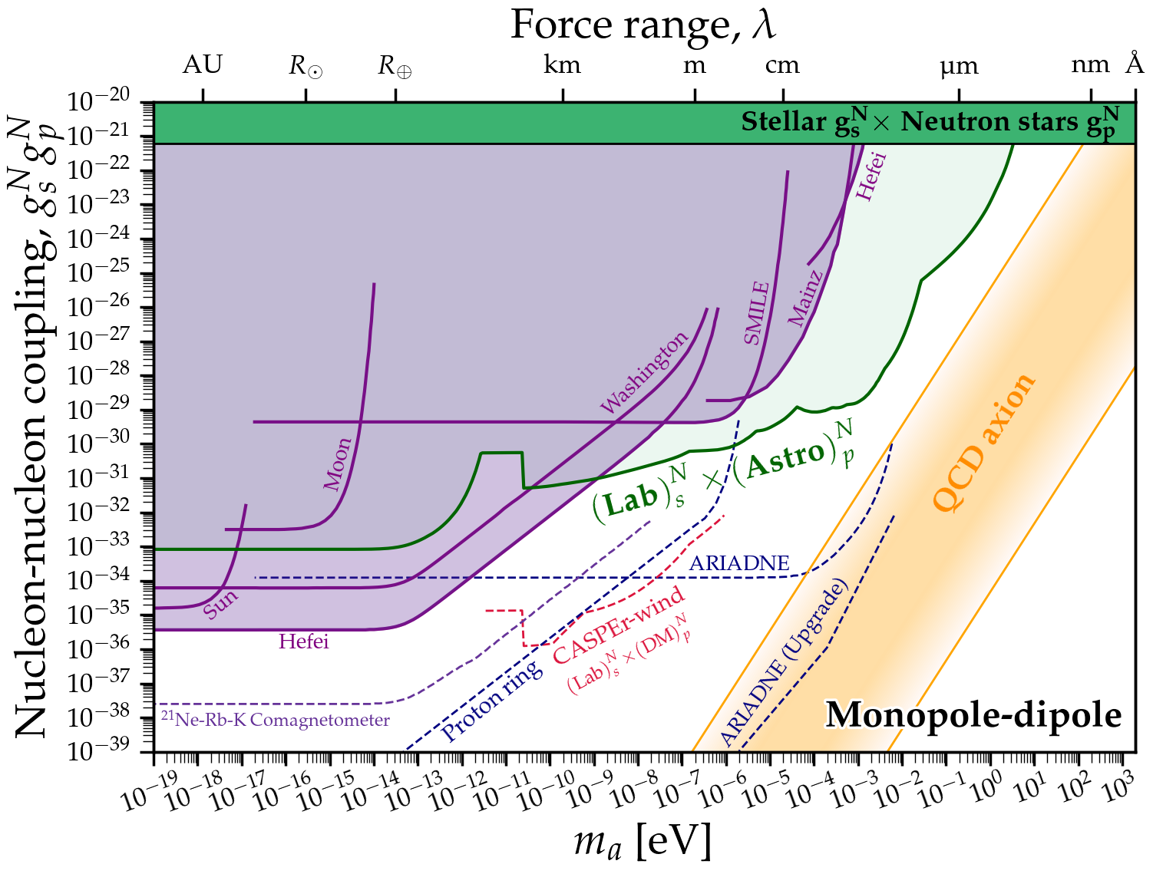
Other frontier
Atomic/molecular clocks
Fundamental constants (Dmitry Budker)
Global network
GNOME/interferometer (Daniel Gavilan Martin)
ALP as a mediator
ARIADNE (Yun Chang Shin)
UCN at PSI (Pin-Jung Chiu)
¹²⁹X-¹³¹Xe-Rb comagnetometer (Dong Sheng)

Slide 11
Axion research frontiers
Other fronteier
(5)
Accelerator
Collider
(5)
Fixed target
Beam dump
(5)
Telescope
(0)
Axion
(32)
LSW
EDM
CLFV
(6)
Haloscope
Helioscope
Magnetometer
Underground
(10)
Axion echo
(1)

Slide 12
Axion business is expanding
I. Ripp-Baudot

Slide 13
Experiment map
C. O’Hare (2020)
Axion is theoretically well-motivated
but experimentally very challenging
Axion community is getting larger
Next few decades must be exciting/crucial

Slide 14
Deep gratitude to
I. Ripp-Baudot

Slide 15
Deep gratitude to

