Slide 1
Search for New Physics using a ¹²⁹Xe-¹³¹Xe-Rb Comagnetometer
Dong Sheng
University of Science and Technology of China

Slide 2

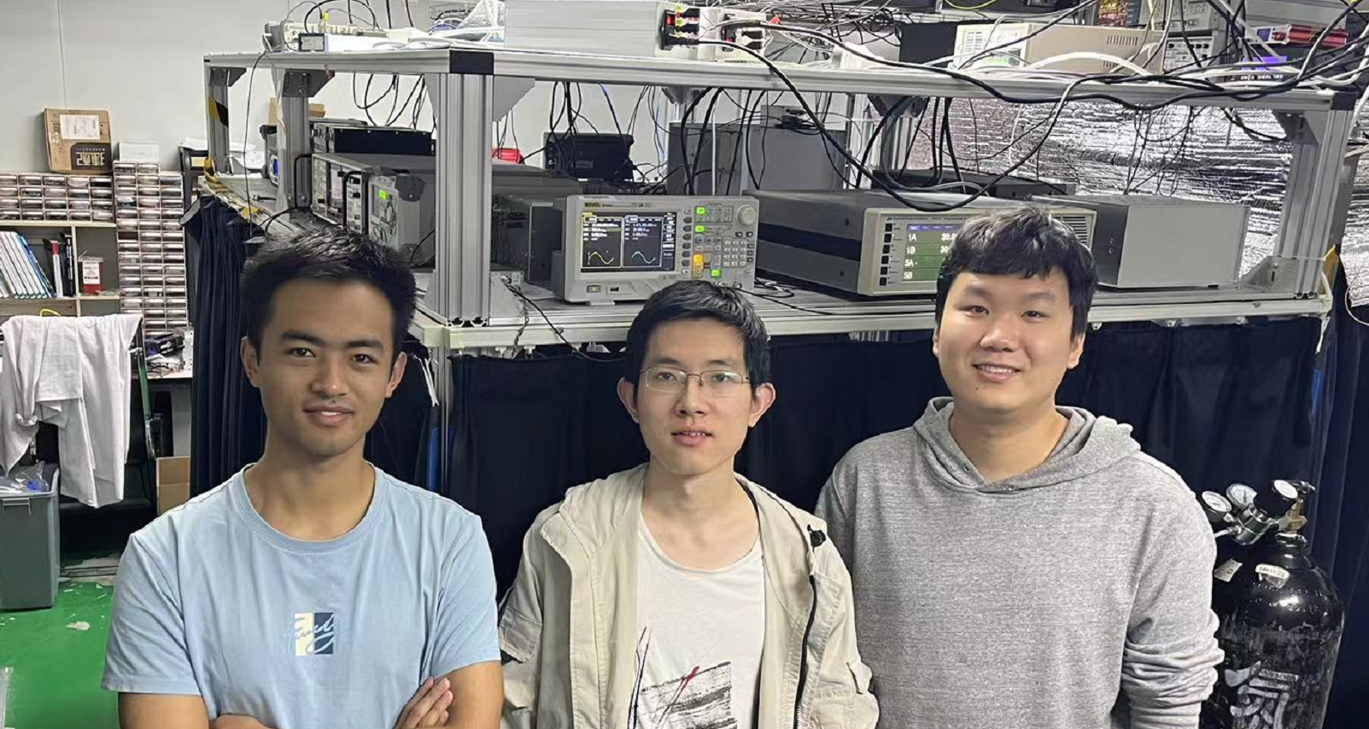

Collaboration and group members
In collaboration with Prof. Zheng-Tian Lu.
Students: Yukun Feng, Shaobo Zhang, Denghui Ning, Zengli Ba

Slide 3
Outline
Monopole-dipole interactions
¹²⁹Xe-¹³¹Xe-Rb comagnetometer
Search for new physics using the comagnetometer

Slide 4


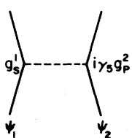
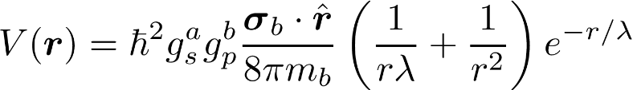
Monopole-dipole interactions
The monopole-dipole interaction
  P-odd and T-odd
  Can be viewed as a spin-mass coupling
  Can be propagated by axions or axion-like particles (ALP)
J. E. Moody and F. Wilczek, Phys. Rev. D 30, 130 (1984)

Slide 5
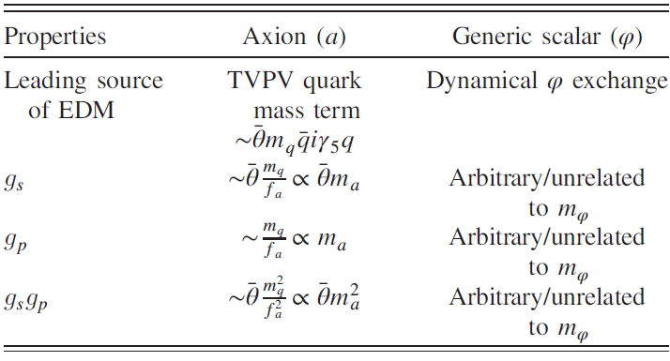


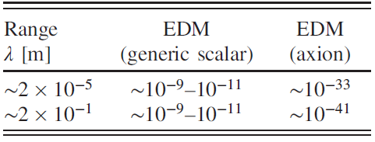
Constraints from EDM results
There are two ways to determine the coupling constants
  EDM experiments (depending on whether the propagator is QCD axion or ALP)
  Other dedicated experiments (5th force experiments)
S. Mantry, M. Pitschmann, and M. Ramsey-Musolf, Phys. Rev. D 90, 054016 (2014)

Slide 6
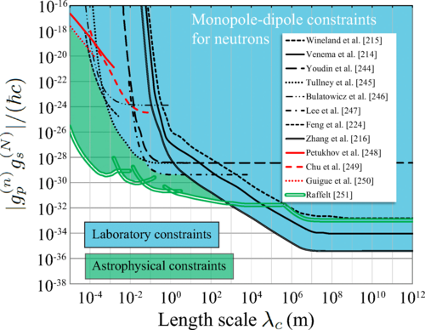
Current Status
D. F. J. Kimball, D. Budker, T. E. Chupp, A. A. Geraci, S. Kolkowitz, J. T. Singh, and A. O. Sushkov, Phys. Rev. A 108, 010101 (2023)

Slide 7
Current Status
D. F. J. Kimball, D. Budker, T. E. Chupp, A. A. Geraci, S. Kolkowitz, J. T. Singh, and A. O. Sushkov, Phys. Rev. A 108, 010101 (2023)

Slide 8
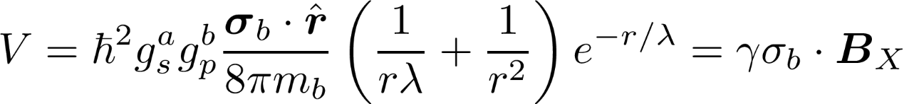
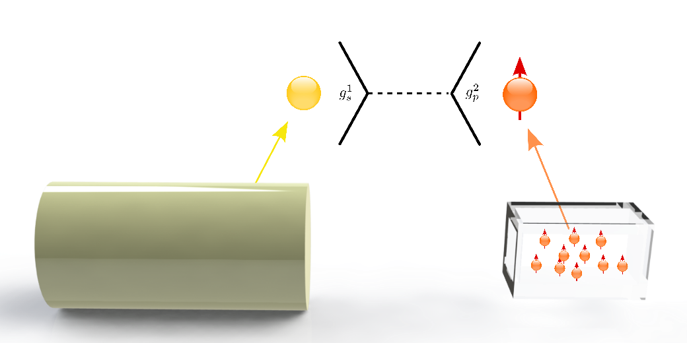
Effective magnetic field

Slide 9
Atomic magnetometer
For each gas spin atom, its spin precession frequency has three contributions:
  Larmor frequency (γB)
  Rotation frequency of the system (spin-rotation coupling, Ω_{r})
  Anomalous couplings (X)

Slide 10
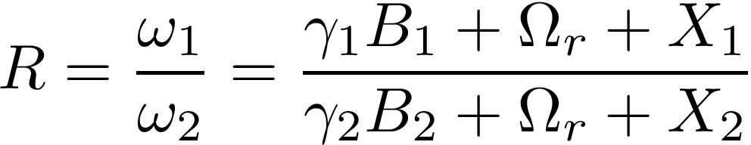
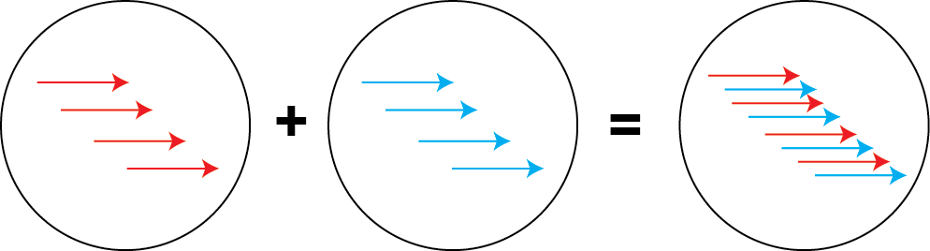
Atomic comagnetometer
To extract the new physics, we need to first suppress the fluctuation/drift of the bias field
Two kinds of atoms simultaneously measure the bias field in the same space, we can assume B₁=B₂=B
Nuclear spin：Long coherence time.

Slide 11
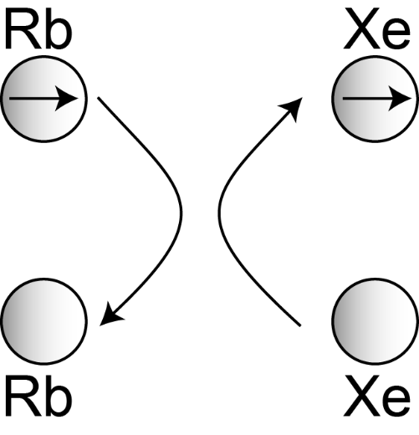
Add a third kind of atom
Polarized electron spin atoms
  Hyper-polarize nuclear spin atoms (Bouchiat et al., PRL 5, 373 (1960)).
  Probe the polarized nuclear spin signals as an in-situ magnetometer (Grover, PRL40, 391 (1977)).
Nuclear spin signals detected by the Rb magnetometer are amplified by a factor of κ₀ due to Fermi-contact interactions

Slide 12
¹²⁹Xe-¹³¹Xe-Rb comagnetometer
Pros of the ¹²⁹Xe-¹³¹Xe-Rb system：
  Collisional frequency shifts between Xe isotopes and Rb are very similar.
  Xe atoms can be polarized in a short time.
  κ₀ is large (~500) for the Xe-Rb system

Slide 13
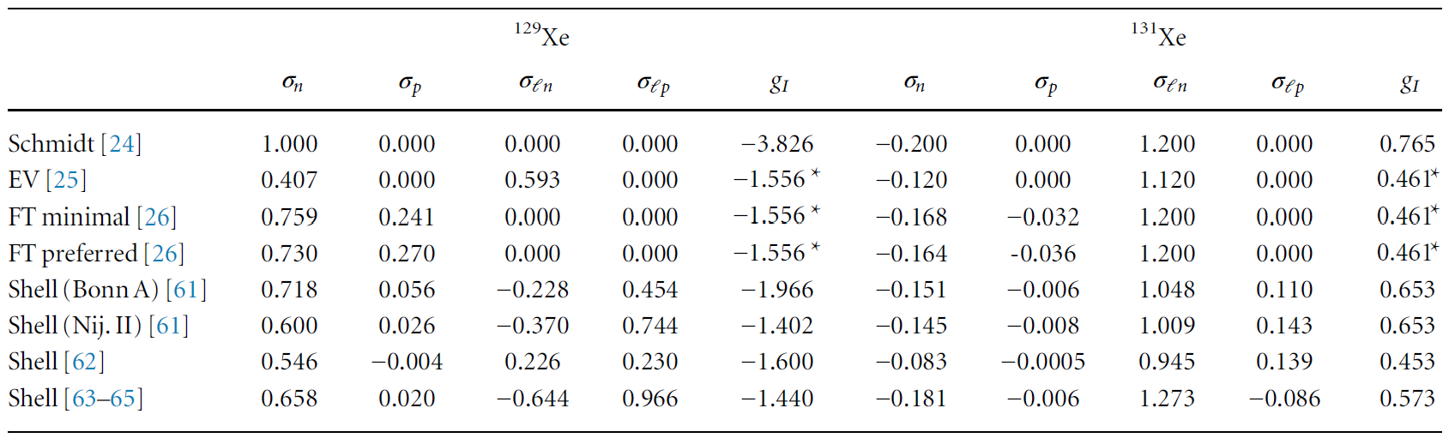
Spin components
D. F. J. Kimball, New J. Phys. 17, 073008 (2015)

Slide 14


Implementation
Pump-probe scheme
B
B
¹³¹Xe
B
¹³¹Xe
Rb
$$ω_{2}$$
Rb
Rb
B
¹³¹Xe
¹²⁹Xe
¹²⁹Xe
$$ω_{1}$$
¹²⁹Xe
Rb
Pump beam
π/2 pulse

Slide 15
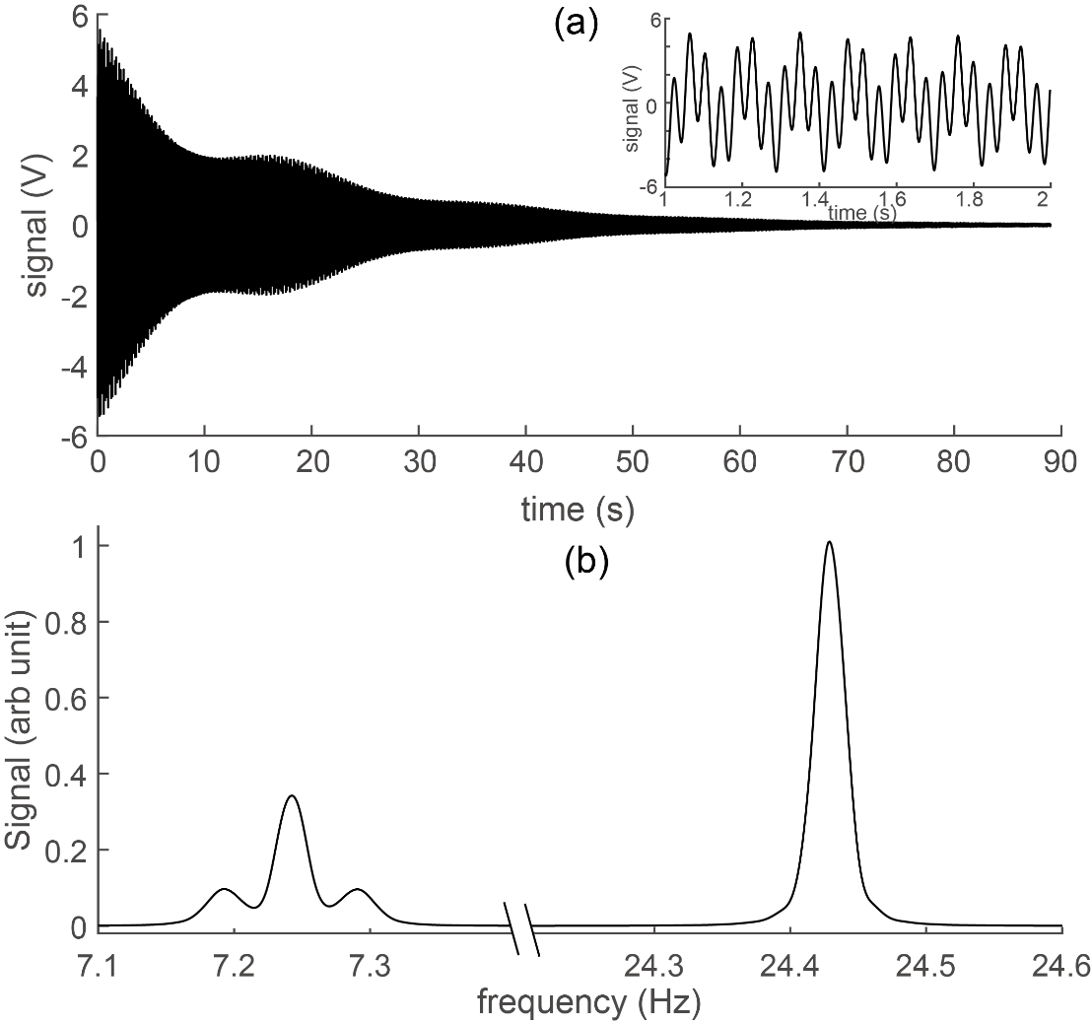
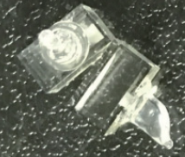
Typical signals

Slide 16
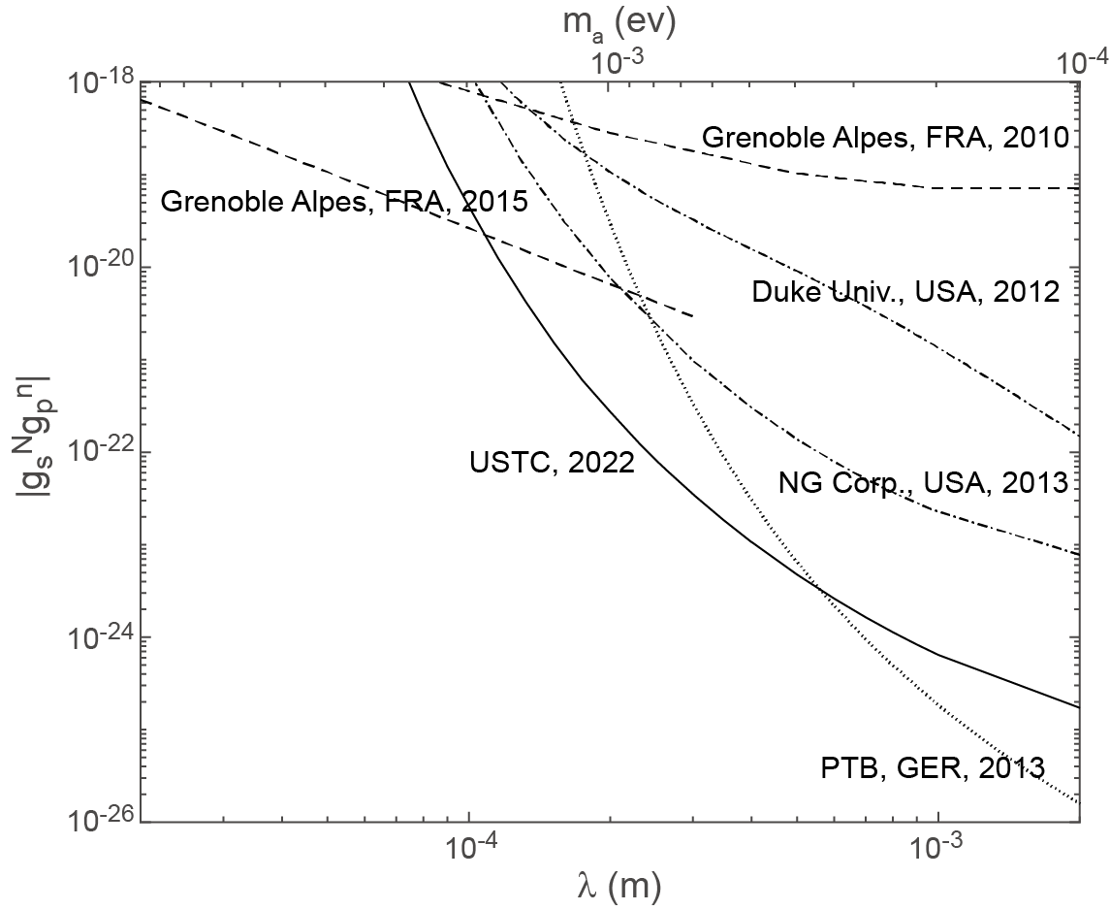
Experiment result
Feng et al., PRL 128, 231803 (2022)

Slide 17
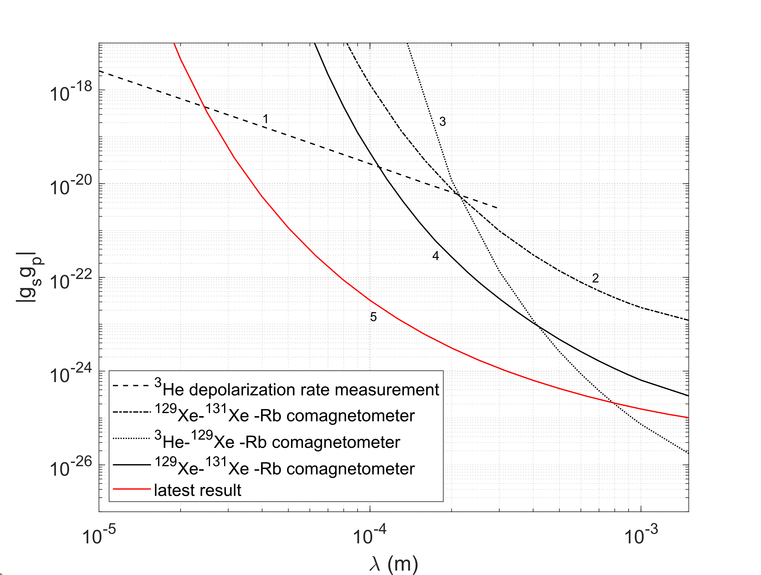
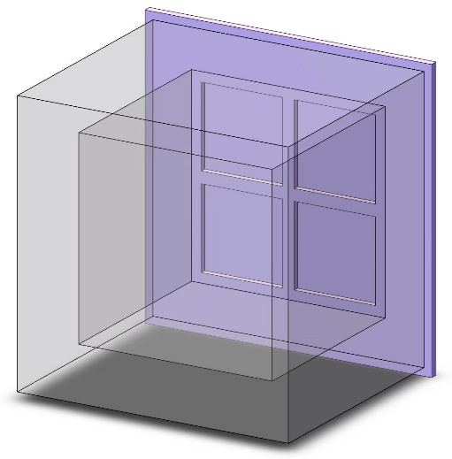
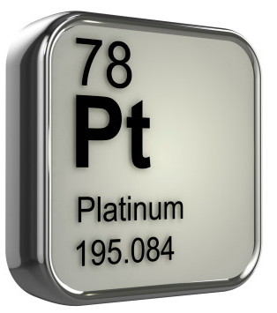
Upgraded Experiment

Slide 18
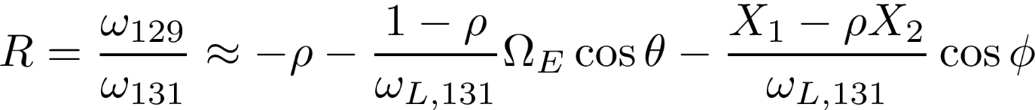
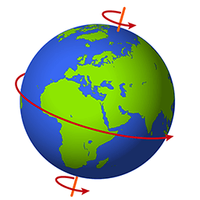

Earth radius range
New physics is extracted by comparing R at two different directions of the bias fields
θ (φ) is the relative angle between Earth rotation axis (gravity) and the bias field direction.
To extract the new physics
  Earth rotation effect has to be precisely subtracted
  It requires to align the bias field with Earth rotation axis.
$$θ_{E−B}$$
Spin

Slide 19
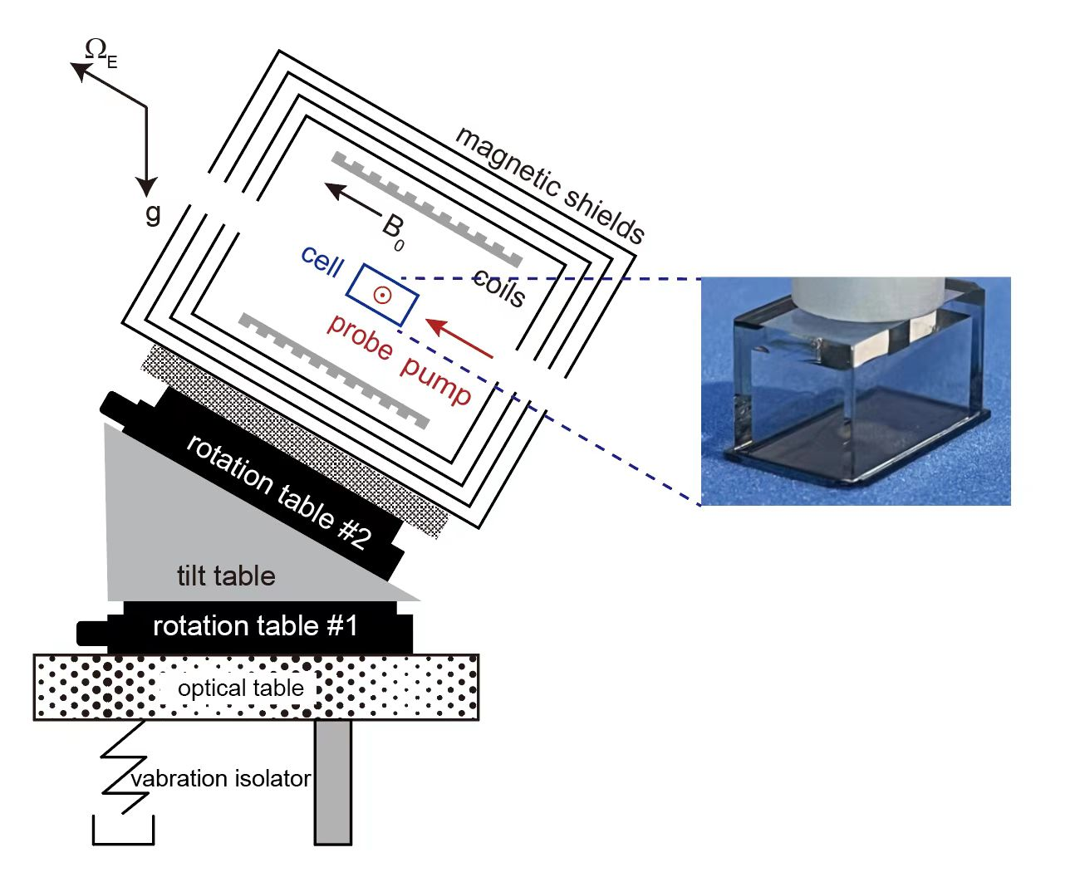
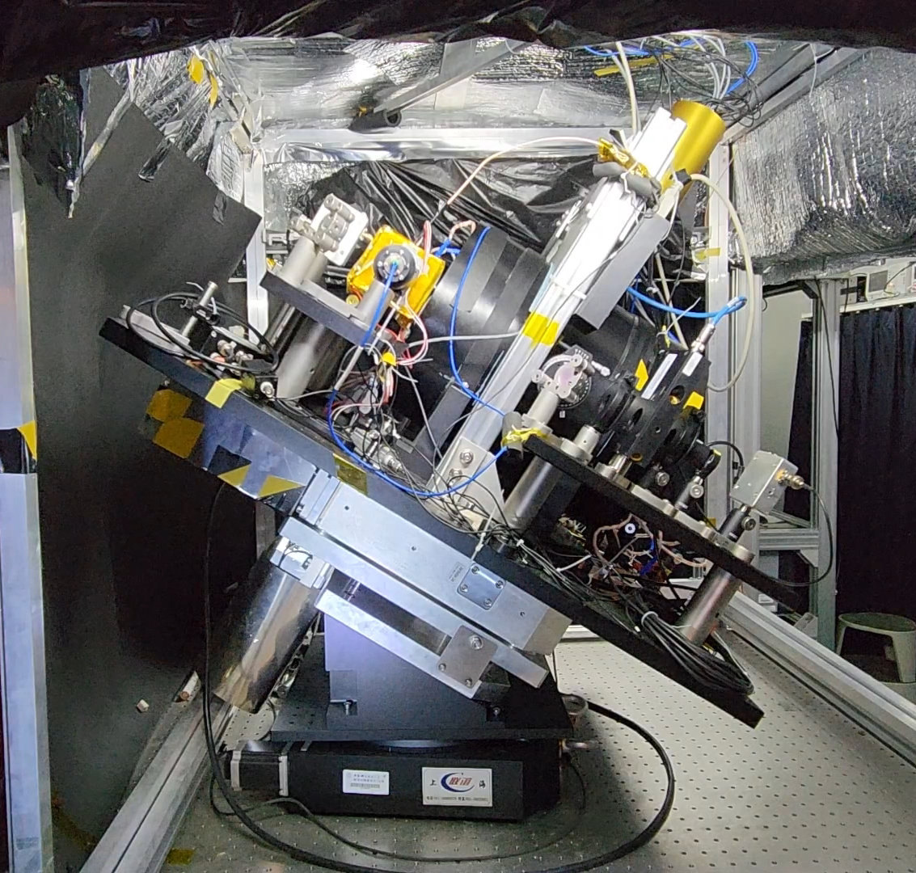
Coordinates

Slide 20
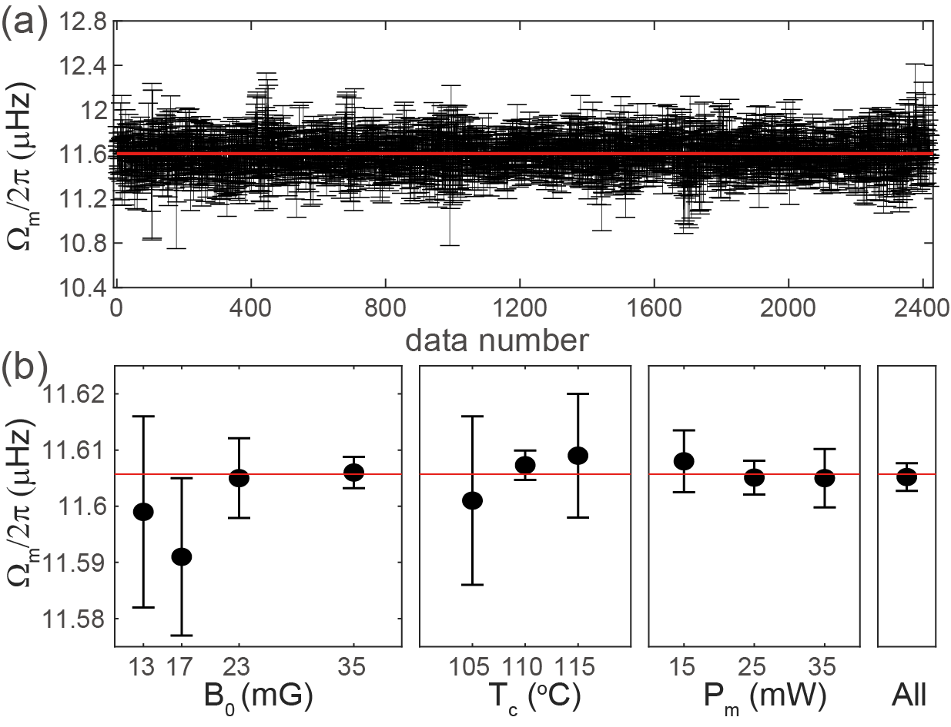
Equivalent measurement of Earth rotation
Zhang et al., PRL 130, 201401 (2023)
E. Groten, Report of special commission 3 of IAG, Int. Astron. Union Colloq. 180, 17 (2000)

Slide 21
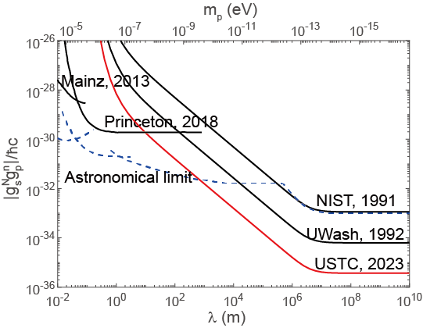
Constraints on new physics
Zhang et al.,
PRL 130, 201401 (2023)

Slide 22
Conclusion
Search for monopole-dipole interactions is an indirect method to search for ALPs
We have developed a ¹²⁹Xe-¹³¹Xe-Rb comagnetometer for this kind of precision measurement, and set new constraints on neutron-spin related monopole-dipole interactions at the sub-mm range and Earth radius range.

Slide 23
Thanks

Slide 24
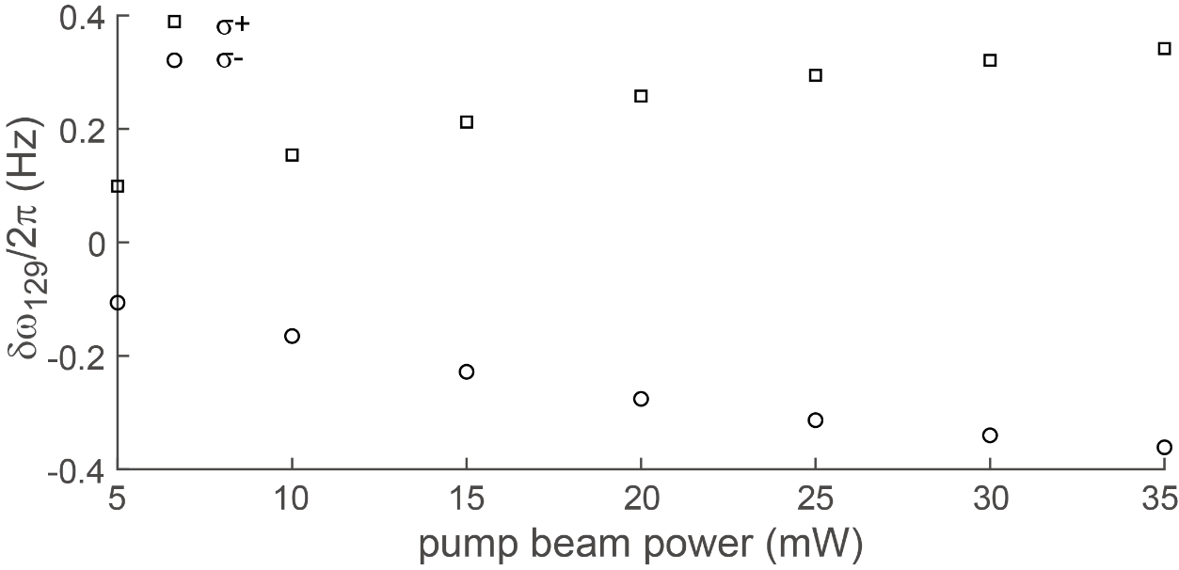
Δκ
The other main systematic effect in this hybrid system is from the polarized Rb atoms, due to Δκ=κ_{129Xe,Rb}−κ_{131Xe,Rb}
Though Δκ/κ is less than 1%, it is not small enough as the measurement precision increases. It leads to a systematic effect correlated with the static Rb polarization (pump beam power).

Slide 25
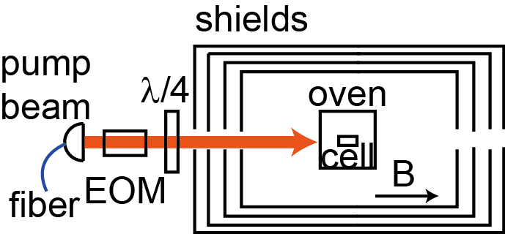
Modulating Rb polarization
Rb polarization is needed for the magnetometer, but this polarization needs not to be static
  Rb polarization can be modulated by modulating the pump beam polarization.
  If the modulation frequency is larger than Xe precession frequencies, the effect from polarized Rb atoms can be time averaged out.

Slide 26
Reduced field gradient from Rb
Rb magnetometer without modulations
Rb magnetometer with modulations

Slide 27
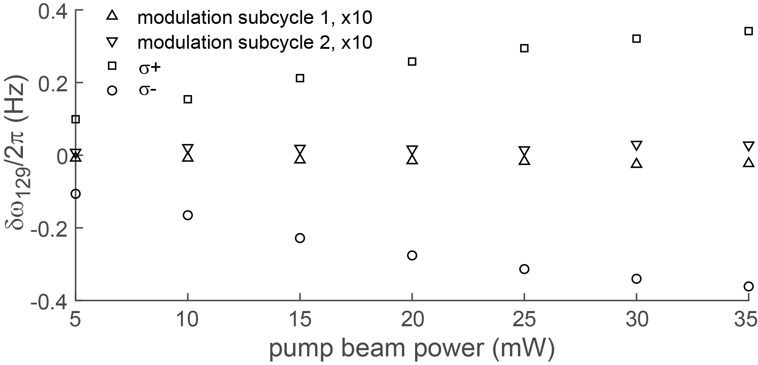
Reduced frequency shift
Y.-K. Feng et al., PRL 128, 231803 (2022)

