Slide 1
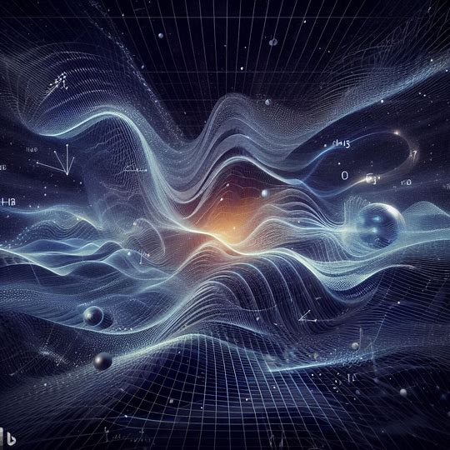
Fast oscillating fundamental “constants”
Fast oscillating fundamental “constants”
Made by Bing Image Creator
Powered by DALL·E 3
Dmitry Budker
Helmholtz Institute, Johannes Gutenberg University, Mainz & UC Berkeley
Rencontres du Vietnam, August 2024

Slide 2

Dark matter: an elephant in the room
Cover image from D. Budker and A. O. Sushkov, Physics on Your Feet; Second Edition, 280 pp, OUP 2021

Slide 3
What can DM be ?
Ultralight bosonic particles
  Axions (pseudoscalar)
  ALPs (pseudoscalar)
  Dilatons (scalar)
  Vector particles
Antiquark Nuggets (AQN)
Millicharged particles
Not even particles
A gross misunderstanding of gravity (MOND, …) ???
Proca MHD (finite photon mass) ☹?
Black holes, dark planets, interstellar gas, … ☹?
WIMPS ☺
Relaxions (mixed)
Bosonic fields oscillate at the Compton frequency
☞ apparent oscillation of fundamental constants

Slide 4


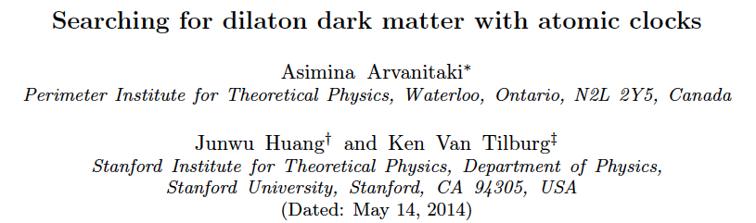
Dilaton DM ?
Notes:
The presence of the dilaton field causes oscillation of \alpha at a frequency equal to the mass of the dilaton
Franceso d’Eramo

Slide 5

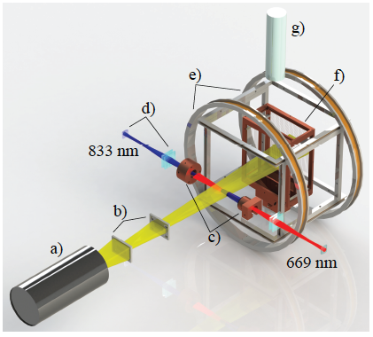
Dy as “Alpha Variometer”
Δ➔3 MHz – 2 GHz
A
B
Δ(t)
transitions
in 5 isotopes
dΔ/dt ~2.0 x 10¹⁵ Hz
Ÿ
V. Dzuba et al, Phys. Rev A 77, 012515 (2008)
Limits on alpha variation
Dependence on gravitational potential
Lorentz-Invariance violation (for electrons)
…
Notes:
Dysprosium is, in effect, a differential atomic clock
Regarding the Lorentz Invariance tests

Slide 6
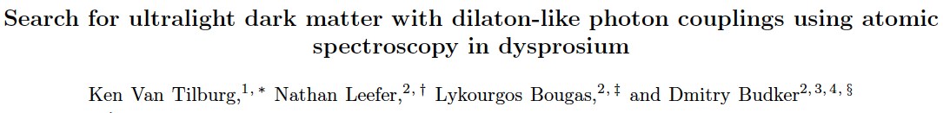

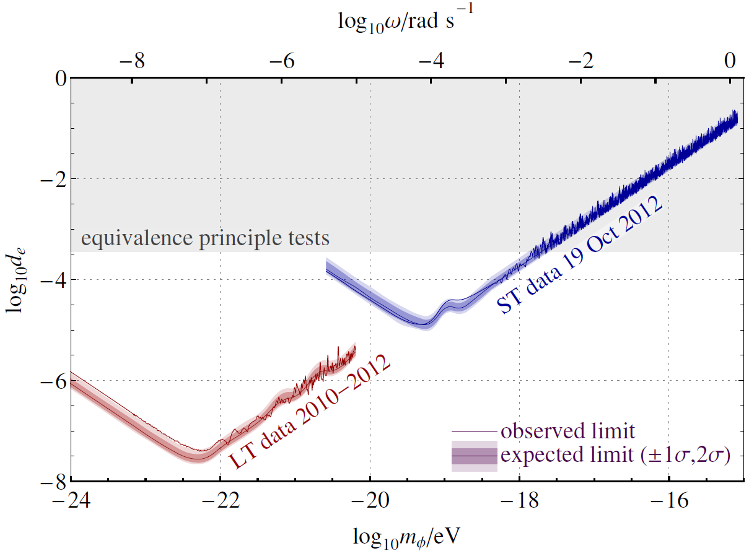


Phys. Rev.Lett.
115, (2015)
Limit of best clocks
arXiv:1503.06886
Notes:
Equivalence principle tests are from the E¨ot-Wash experiment and Lunar Laser Ranging.
Below

Slide 7
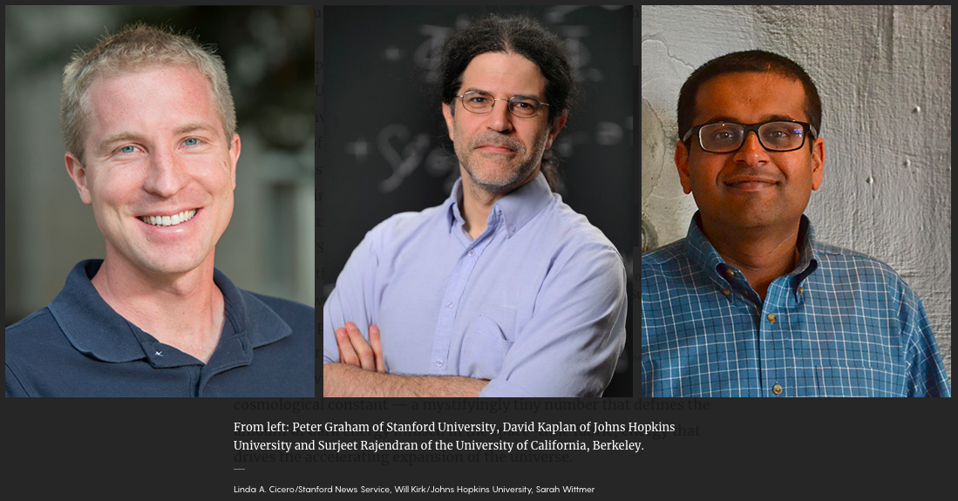
Relaxions in the dark
Gilad Perez
Weizmann Institute

Slide 8

relaxion
♦ Relaxion => solves hierarchy and strong CP problems
Graham, Kaplan & Rajendran (15); Hook,Marques-Tavares; Gupta, Komargodski, Perez & Ubaldi (16);
Davidi, Gupta, Perez, Redigolo & Shalit; Gupta; Nelson & Prescod-Weinstein (17)
♦ Axion-like particle but mixes with the Higgs => has scalar interactions
Flacke, Frugiuele, Fuchs, Gupta & Perez; Choi & Im (16)
♦ Minimal model provides viable axion-like dark matter (DM);
for:
$${10}^{−10}eV≲m_{φ≡relax}≲{10}^{−3}eV$$
Banerjee, Kim & Perez (18)
♦ DM can form stars & halos around Earth \w large over densities
Relaxion stars and their detection via atomic physics
Abhishek Banerjee, Dmitry Budker, Joshua Eby, Hyungjin Kim & Gilad Perez
COMMUNICATIONS PHYSICS (2020) 3:1 arXiv:1902.08212

Slide 9


Fast changing “constants” ?
Jun Ye et al: cavity-clock comparison
Even faster: A “weekend” experiment @ Mainz ?
Dr. Dionysis Antypas Oleg Tretiak Prof. Roee Ozeri Antoine Garcon
Helmholtz Institute, JGU Mainz HIM, JGU Mainz Weizmann Institute HIM, JGU Mainz
Univ. of Crete
Banking industry

Slide 10
FAST OSCILLATING SCALAR DM
Weekend Relaxion Search Laboratory

Slide 12
Cs D2 line (852 nm)
D. Antypas et al, PHYSICAL REVIEW LETTERS 123, 141102 (2019); arXiv:1905.02968
* Sensitive to variation of 𝛂 and m_{e}

Slide 13

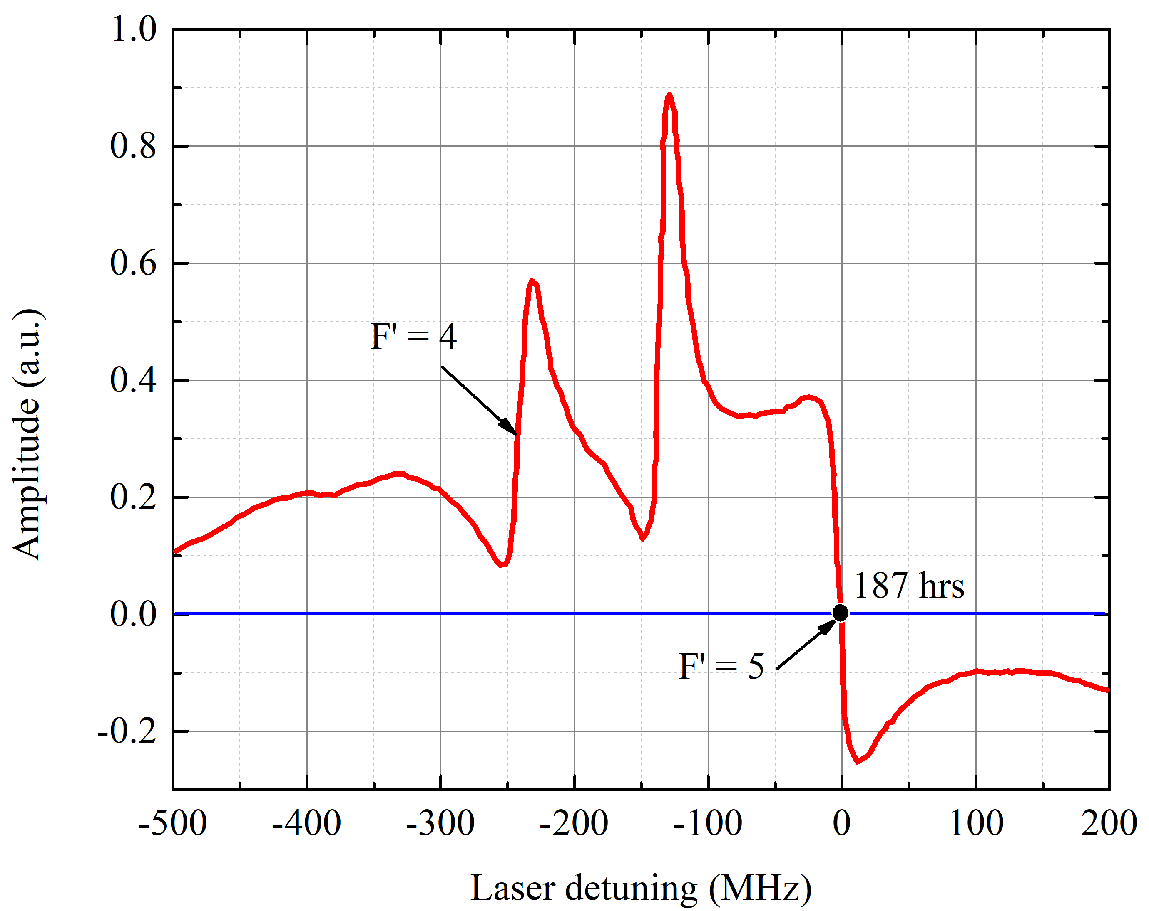
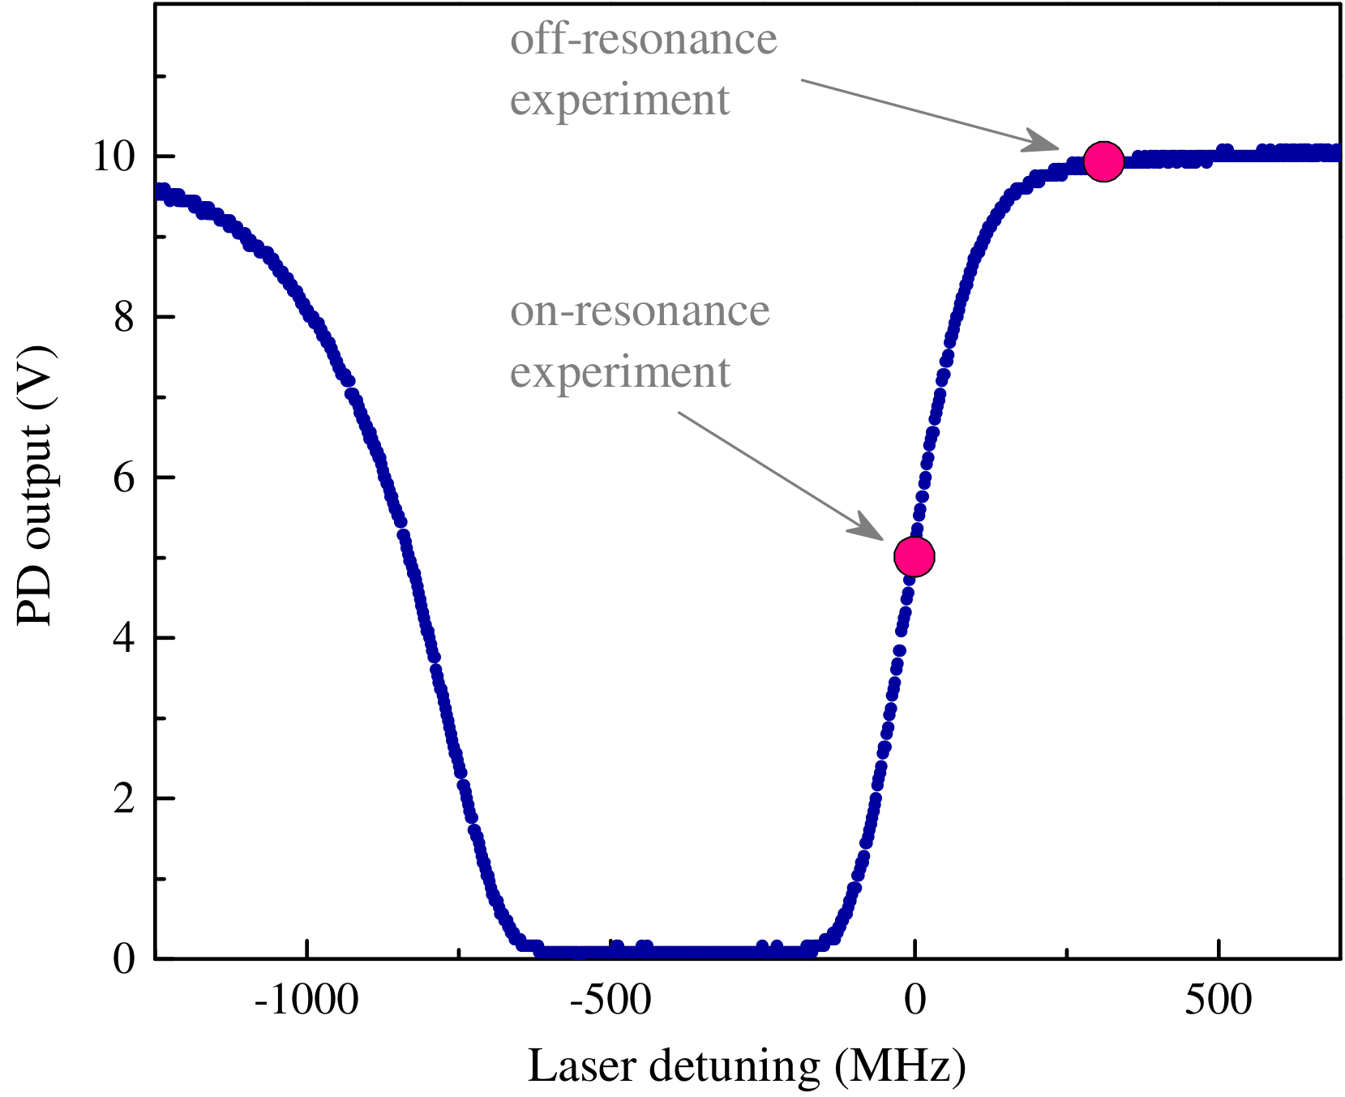
The latest:
O. Tretiak, et al. Phys. Rev. Lett. 129, 031301 (2022)
Doppler-free polarization spectrum
Doppler-broadened spectrum
Experiment A
Experiment B
113 hrs
113 hrs.

Slide 14
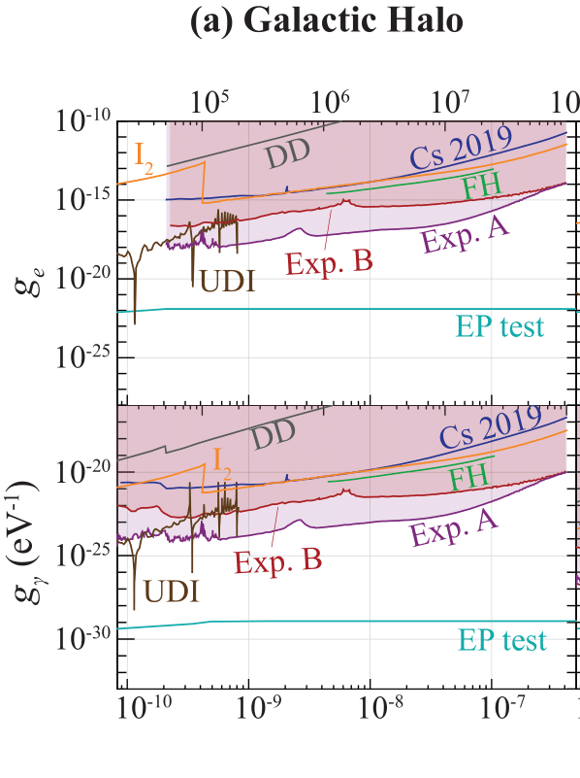
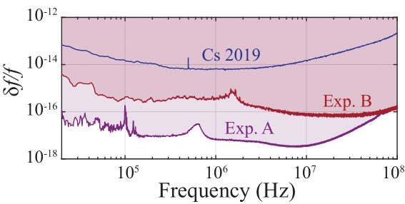
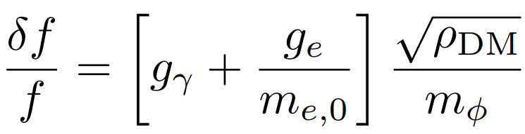
The latest:
O. Tretiak, et al. Phys. Rev. Lett. 129, 031301 (2022)
Exclusion limits on fractional frequency oscillations at 95% C.L.
Frequency (Hz)
Frequency, Hz
More impressive with
Earth and Solar
halo enhancements
Boson mass, eV
m_{ϕ} (eV)
Constraints on the UBDM couplings to α, m_{e}

Slide 15
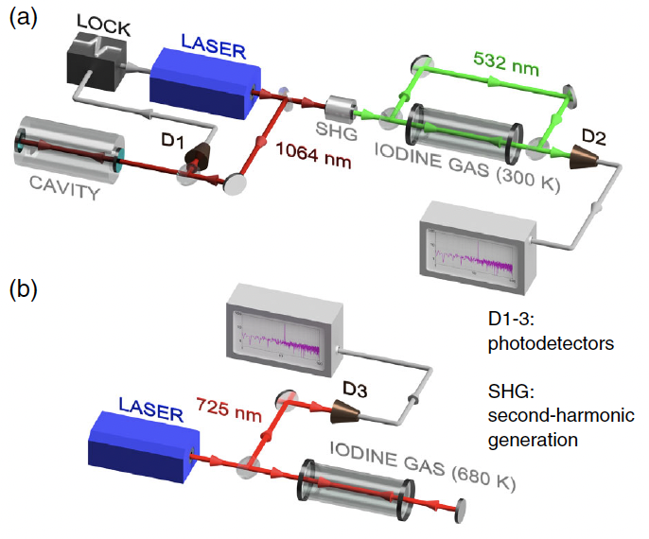
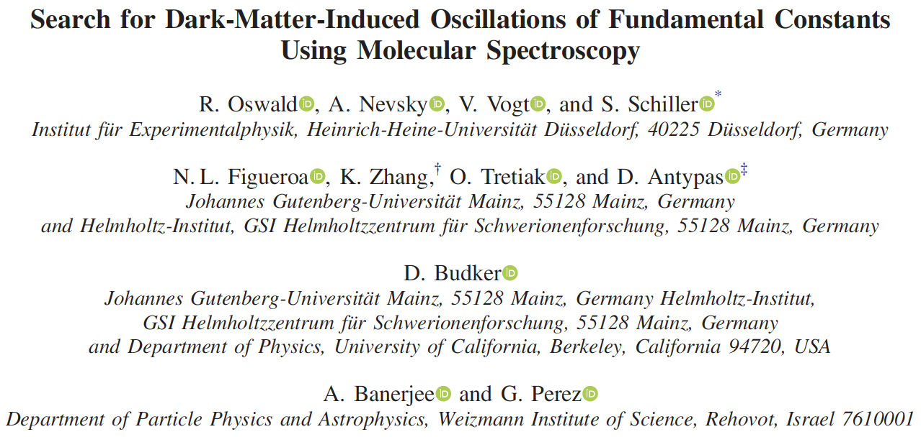
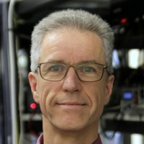
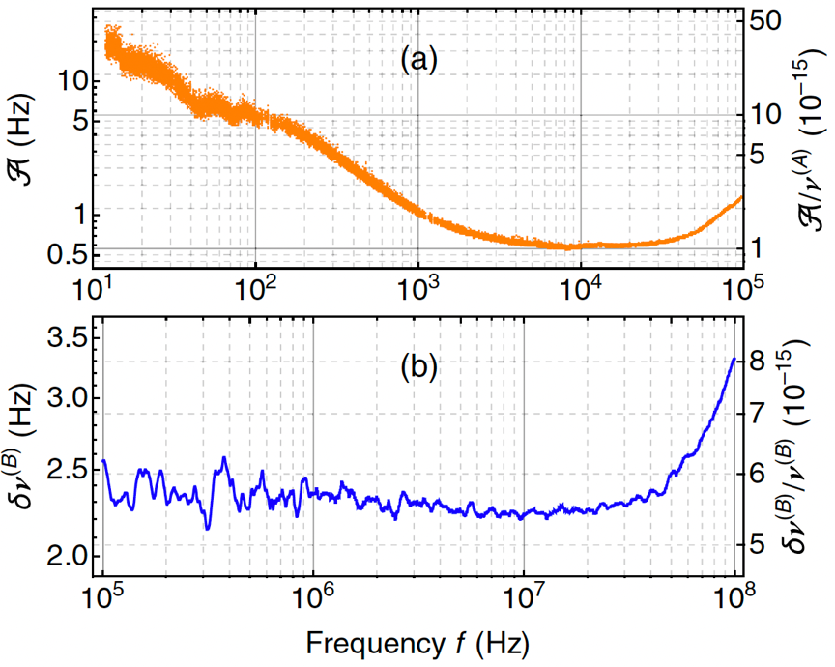
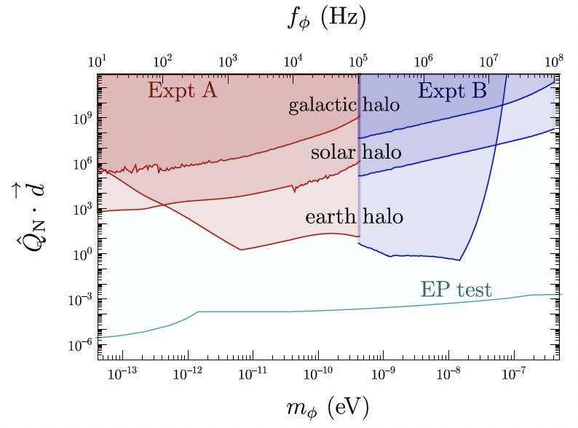
Sensitive to variation of nuclear mass
QCD couplings
Comparisons with EP are model-dependent
Lots of room for improvement it experiments!
Notes:
In apparatus A we use saturation spectroscopy on the X-B transition R.56.32-0 at 532 nm (v=00, v’=32); 10 Hz to 100 kHz
In apparatus B: R.122.2-10 at 725 nm (v=10, v’= 2); 100 kHz–100 MHz

Slide 16
Some new experiments, ideas, approaches…

Slide 17
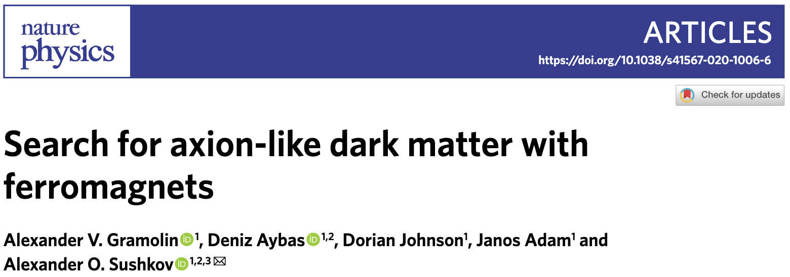
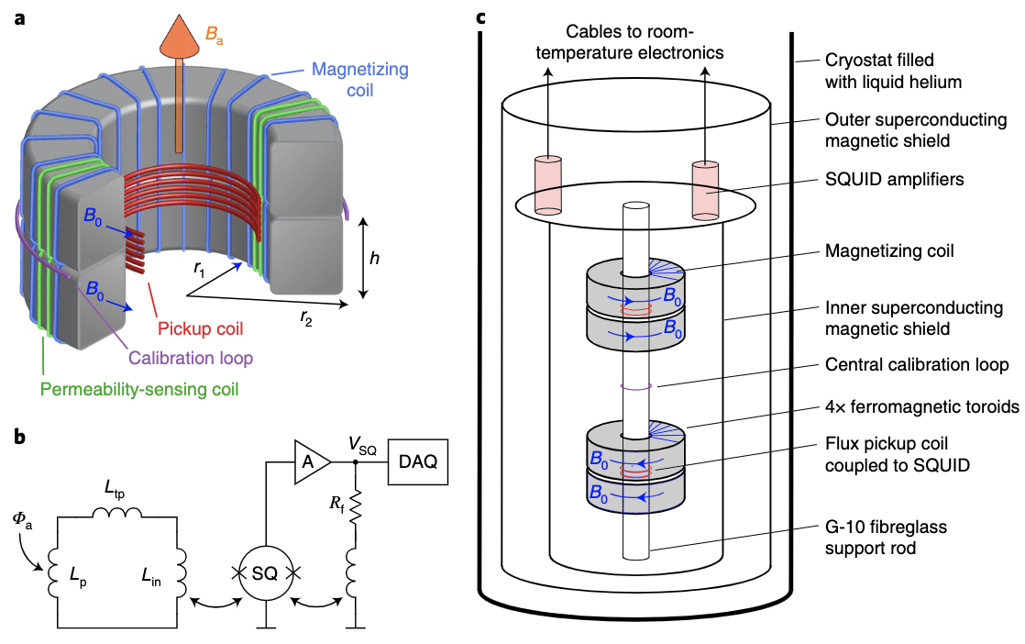
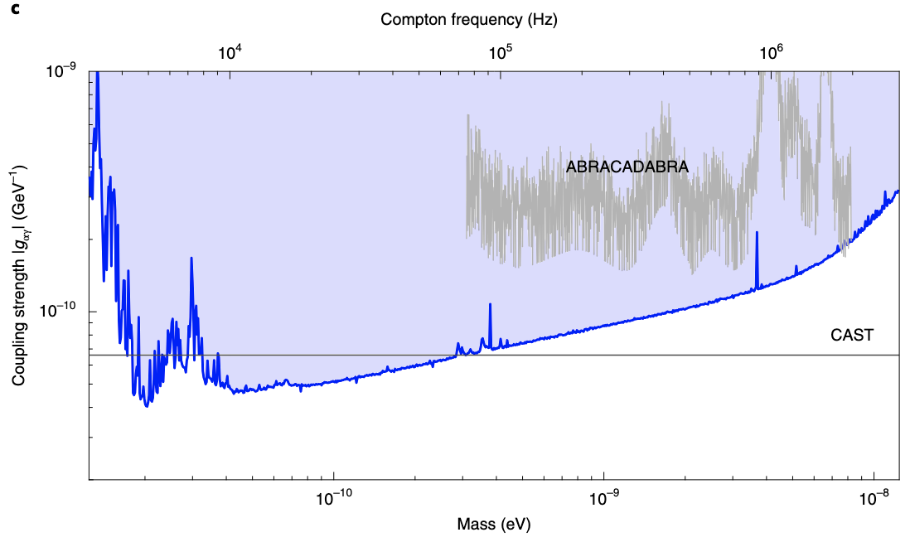
WReSL-SHAFT hybrid sensor “network”
WReSL-SHAFT joint test run
Data being processed
Hybrid-sensor search: motivated by relaxions

Slide 18

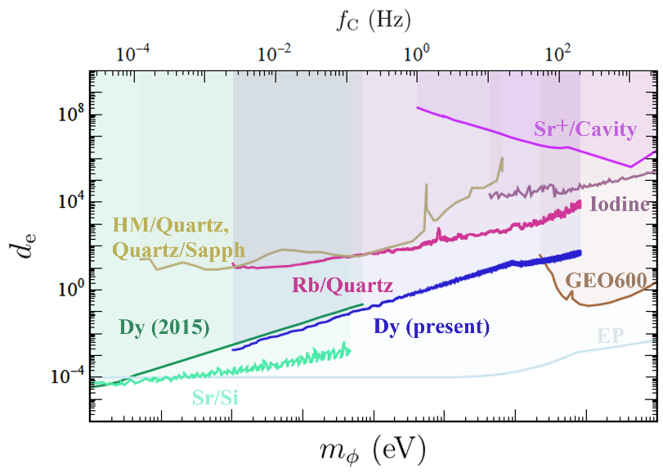
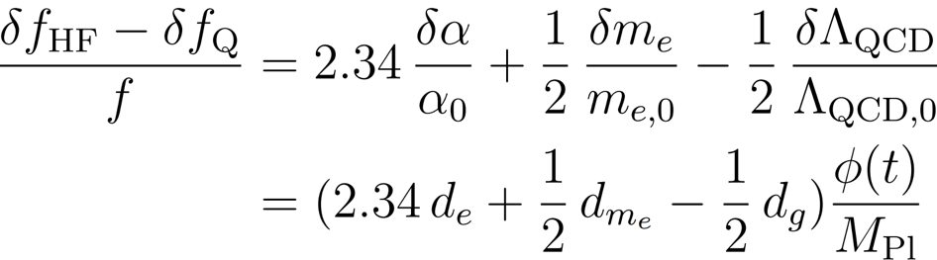
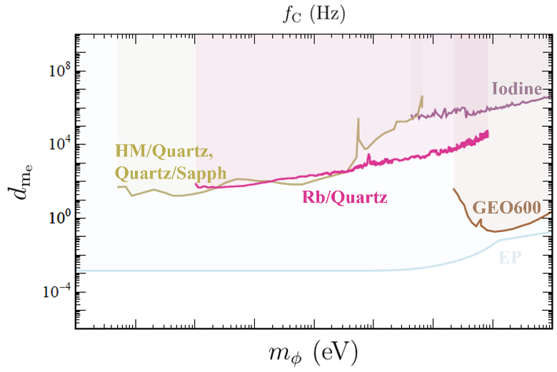
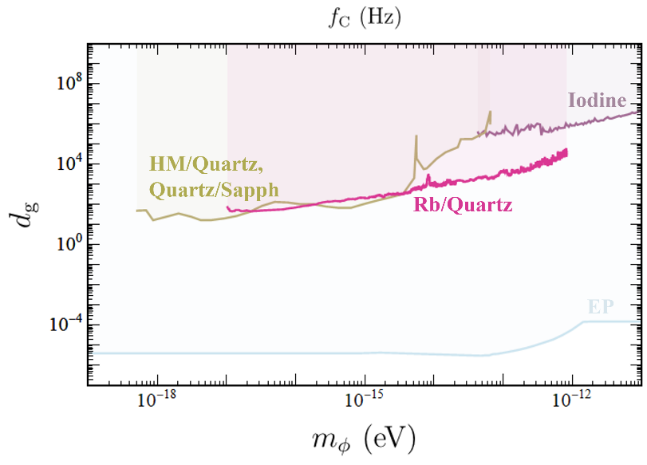
Rb-quartz; Dy
X. Zhang, et al. Phys. Rev. Lett. 130, 251002 (2022)
Constraints on the UBDM scalar couplings to
α, m_{e}, and Λ_{QCD}

Slide 19

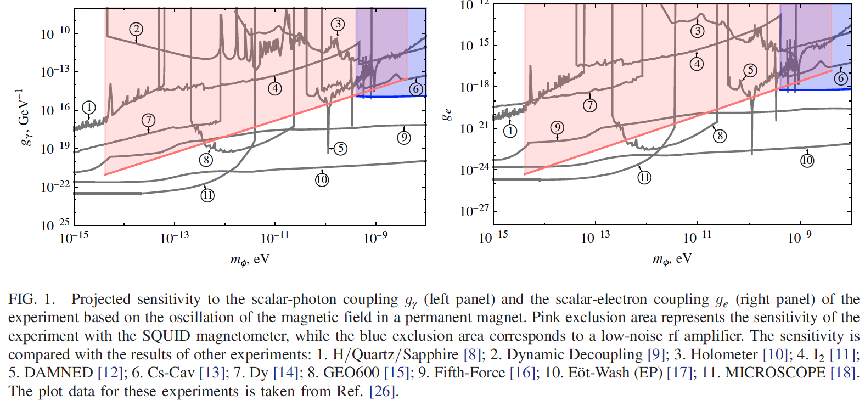
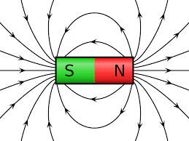

Slide 20
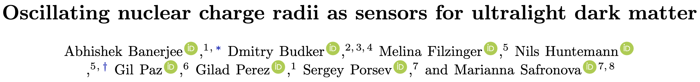



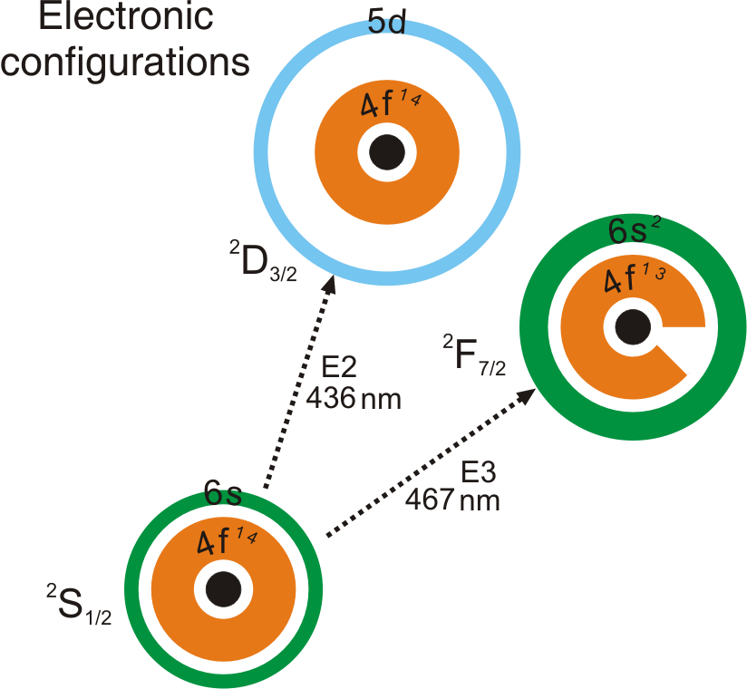
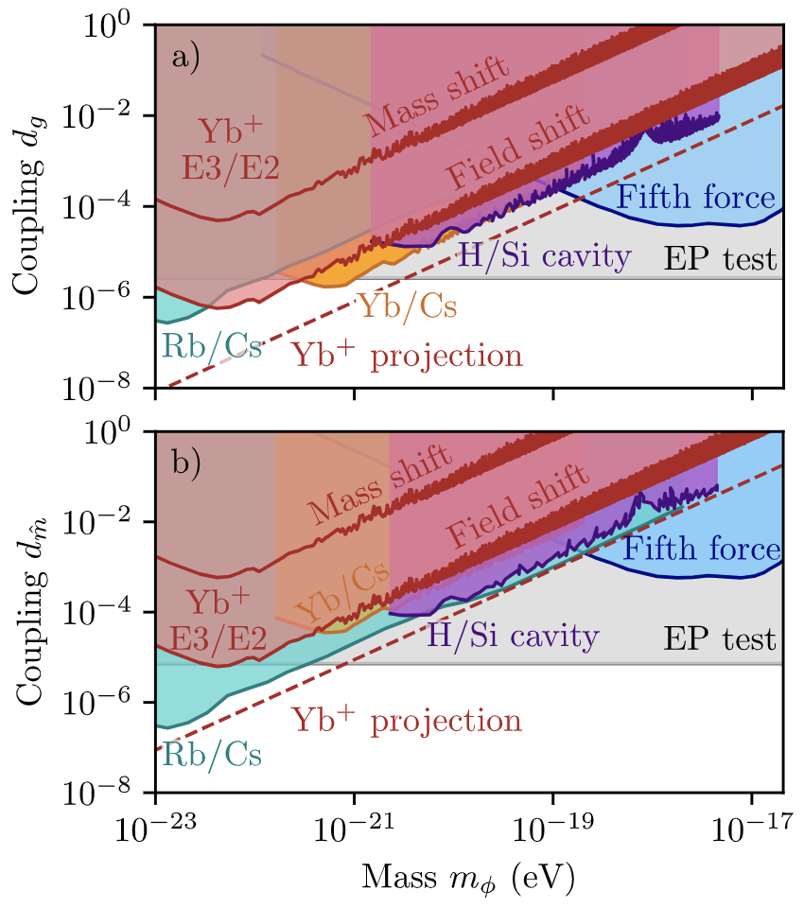
¹⁷¹Yb⁺ ion clock @ PTB
Abhishek
Melina Nils
arXiv:2301.10784(2023)
Notes:
Exclusion plot for the linear scalar DM coupling
a) to the gluons dg and b) to the quark masses d ˆm as a
function of DM mass mφ. Using the field shift effect, lim-
its at the 95% confidence level from long-term measurements
of the frequency ratio νE3/νE2 in a single-ion optical clock
are shown in dark red. Based on the same experiment, the
much weaker limit from the mass shift is shown for reference.
The dashed line shows a projection assuming amplitude lim-
its at the 1 × 10−18-level. The grey and the blue lines depict
the strongest EP bound [57] and the bound from various fifth
force searches [58], respectively. Bounds from existing spec-
troscopy experiments are also shown: Rb/Cs [12] (turquoise),
Yb/Cs [14] (orange), H/Si [13] (purple).

Slide 21
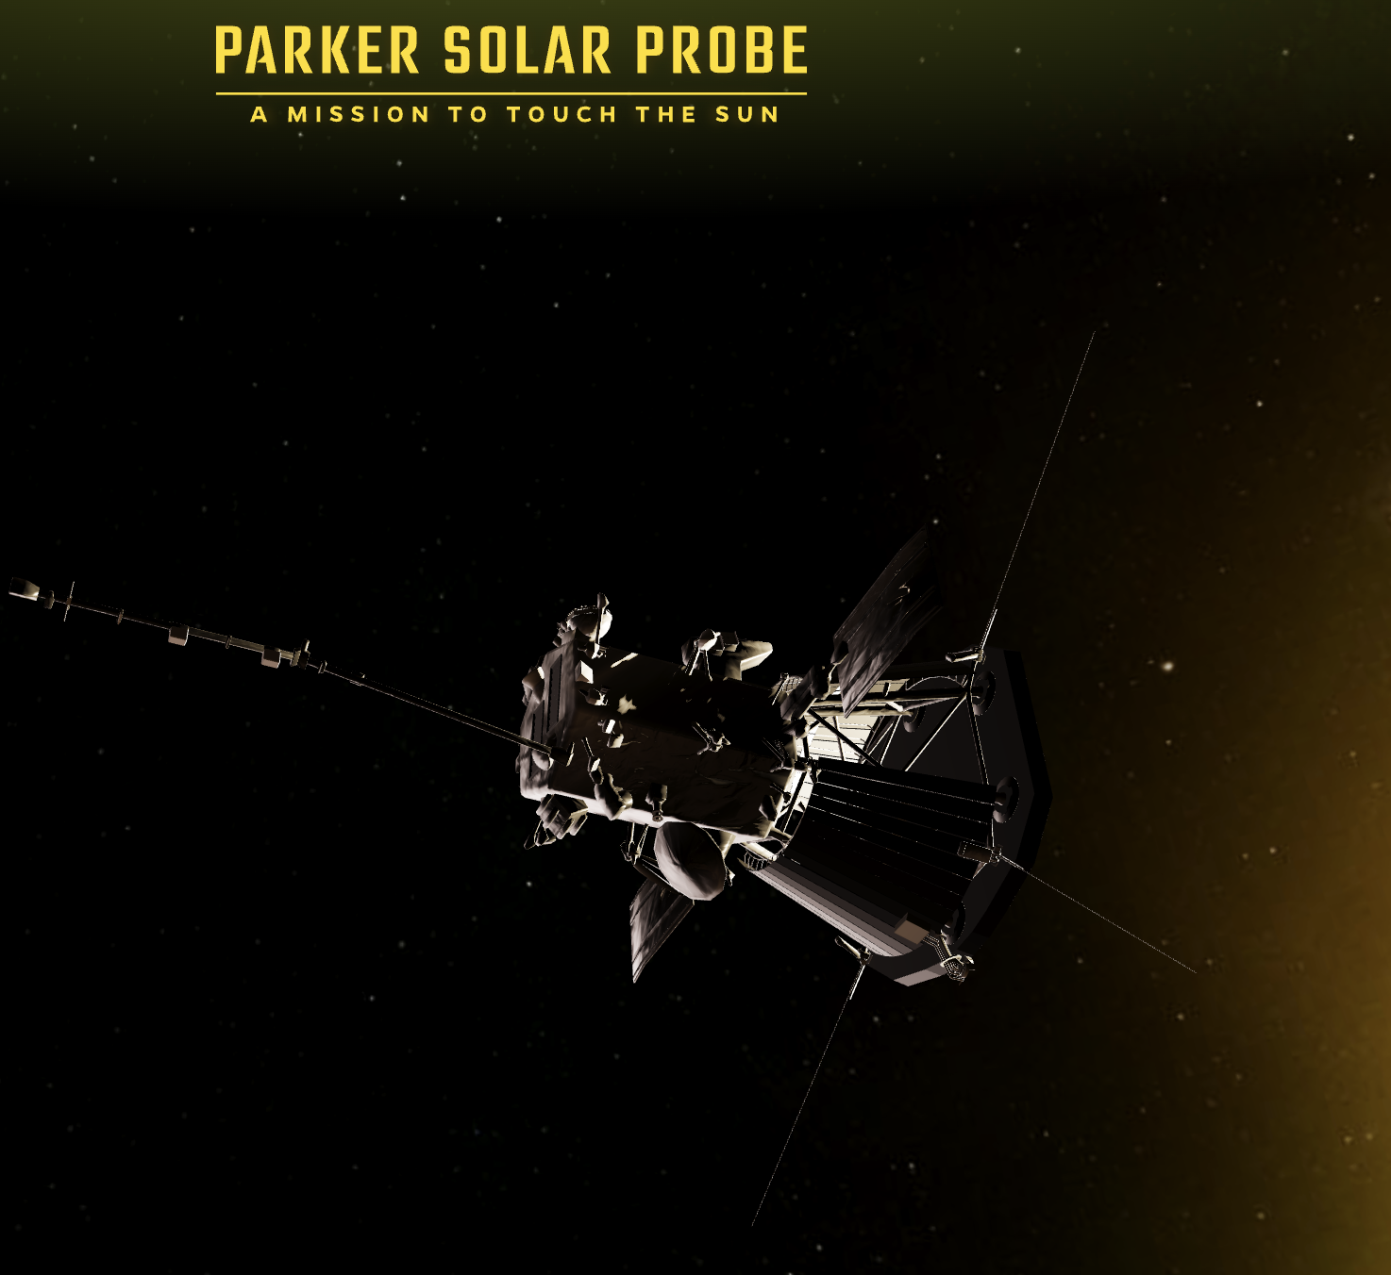
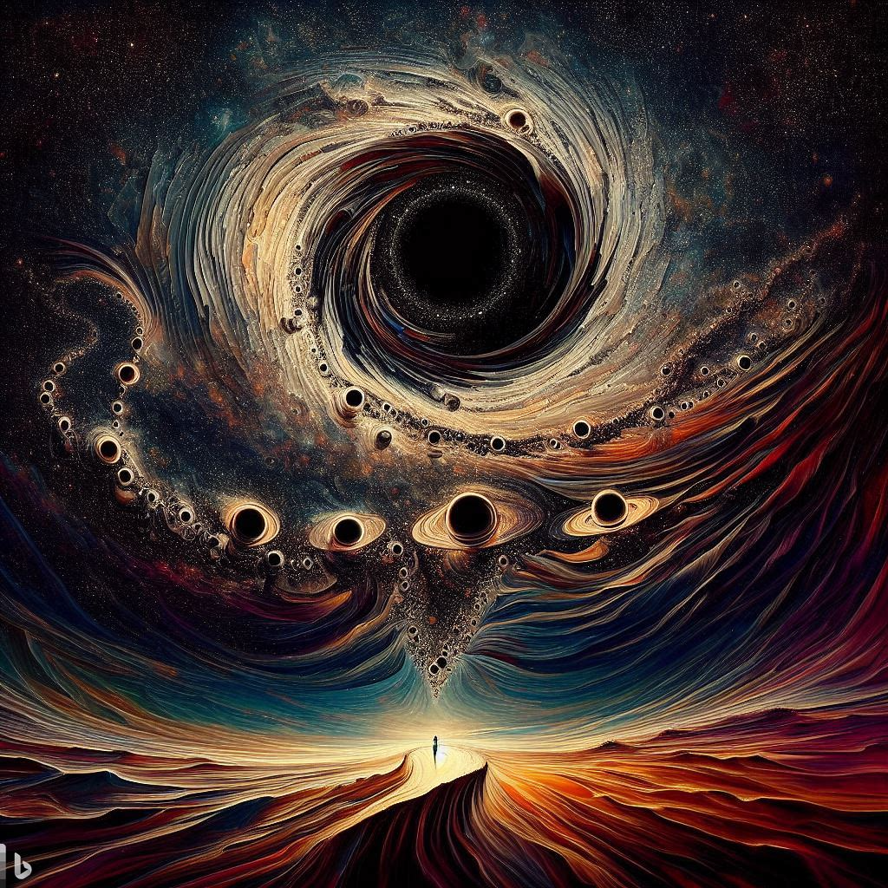
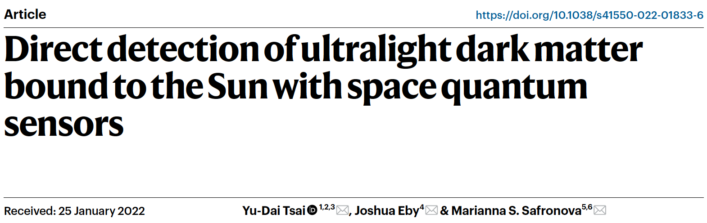
Sensors in space ?
https://parkersolarprobe.jhuapl.edu/
“Dark matter halo in the style of Salvador Dali”
Made with Bing Image Creator. Powered by DALL-E

Slide 22
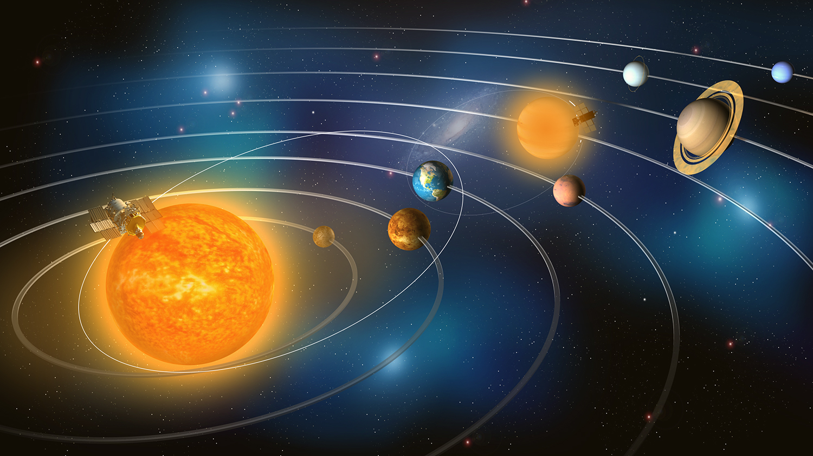

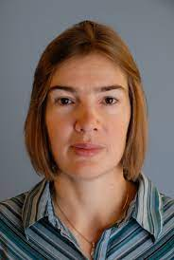

Slide 23
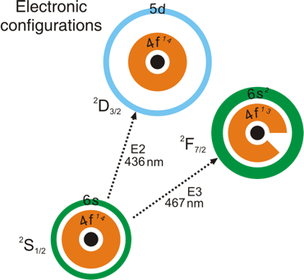
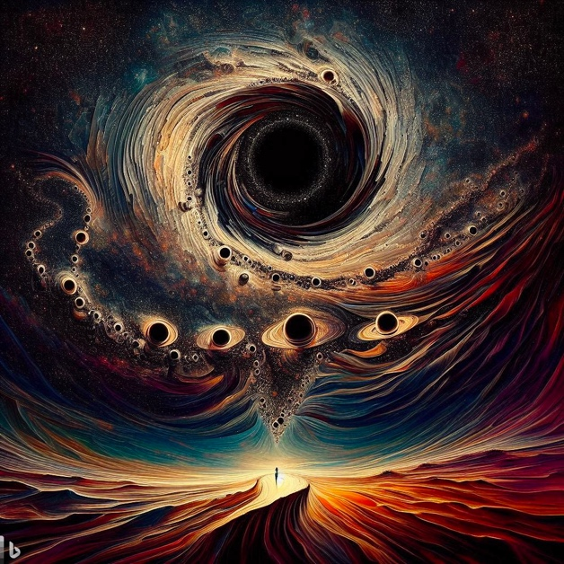

Conclusions
Scalar Dark Matter mimics oscillation of fundamental constants
OK to talk about fast oscillation of constants with dimensions (e, m_{e} ...)
First experiments with Dy: time scales of days and months
Advanced clocks are now doing much better
Spectroscopic tests with atoms and molecules
Near DC-100 MHz➙1 GHz; pushing $δf/f\sim {10}^{−18}$
DM overdensities due to Earth and Sun halos
Space-borne probes

Slide 25
Atomic clock searches for scalar DM
Key idea:
Scalar DM “looks like”
oscillation of fundamental constants

Slide 26
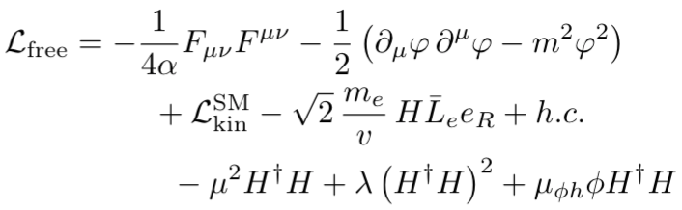


Fast Variation of Fundamental “Constants”
Dionysios Antypas, Dmitry Budker, Victor V. Flambaum, Mikhail G. Kozlov, Gilad Perez, and Jun Ye
ANNALEN DER PHYSIK 2020, 1900566; arXiv:1912.01335
Old thinking: only dimensionless constants may vary
New thinking: m_{e} /< m_{e} >; 𝛂/< 𝛂 >, ... are OK
Origin of apparent variations: bosonic fields
BSM (and BBSM) physics is tricky!
V.V. Flambaum
M.G. Kozlov
Gilad Perez
Jun Ye

Slide 27
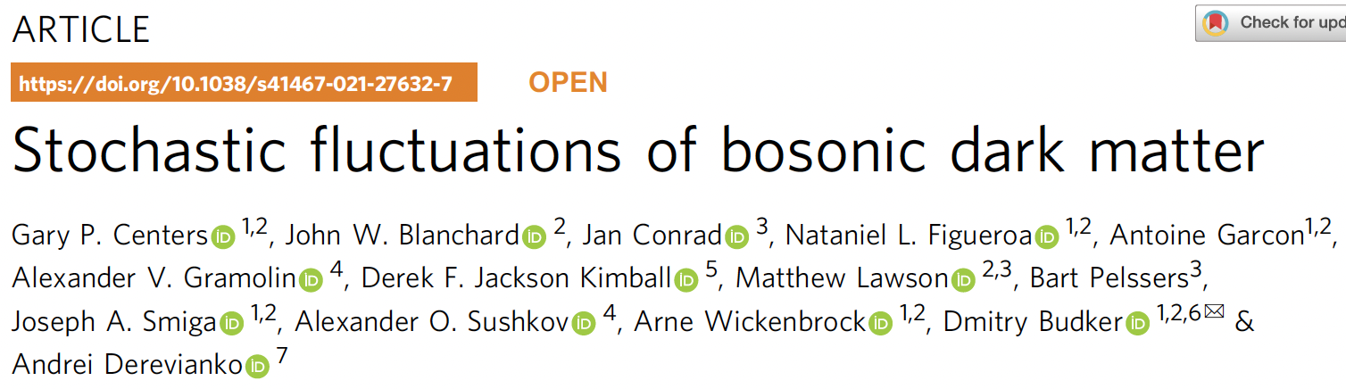

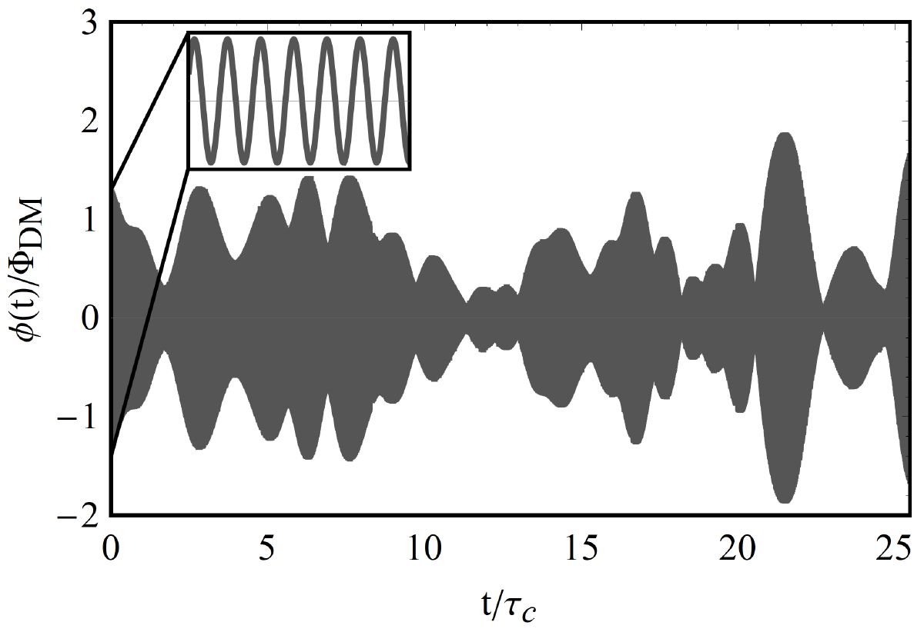
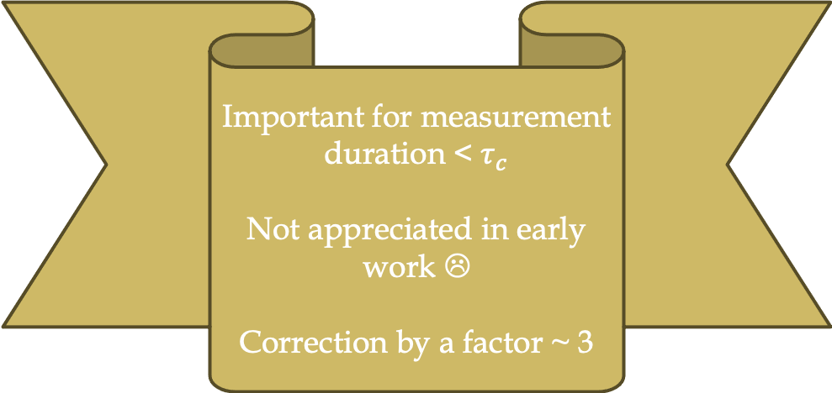
NATURE COMMUNICATIONS 2019
https://doi.org/10.1038/s41467-021-27632-7
Important for measurement duration < $τ_{c}$
Not appreciated in early work ☹
Correction by a factor ~ 3
Notes:
Stochastic corrections were not appreciated in early work!

