Slide 1
Two-dimensional Core-collapse Supernova Models with Heavy Axion-like Particles
Kanji Mori (森寛治)
Division of Science, National Astronomical Observatory of Japan
KM, Takiwaki, Kotake, & Horiuchi PRD 105 (2022) 063009; 108 (2023), 063027

Slide 2
Contents
Introduction on supernovae
ALPs from supernovae
Supernova models with ALPs

Slide 3
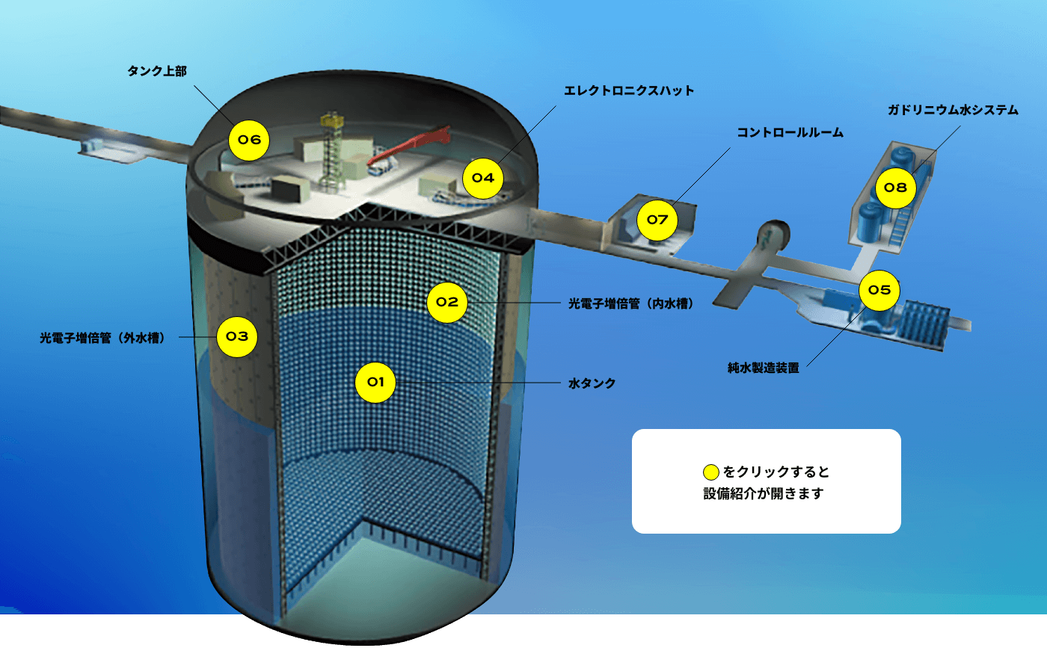
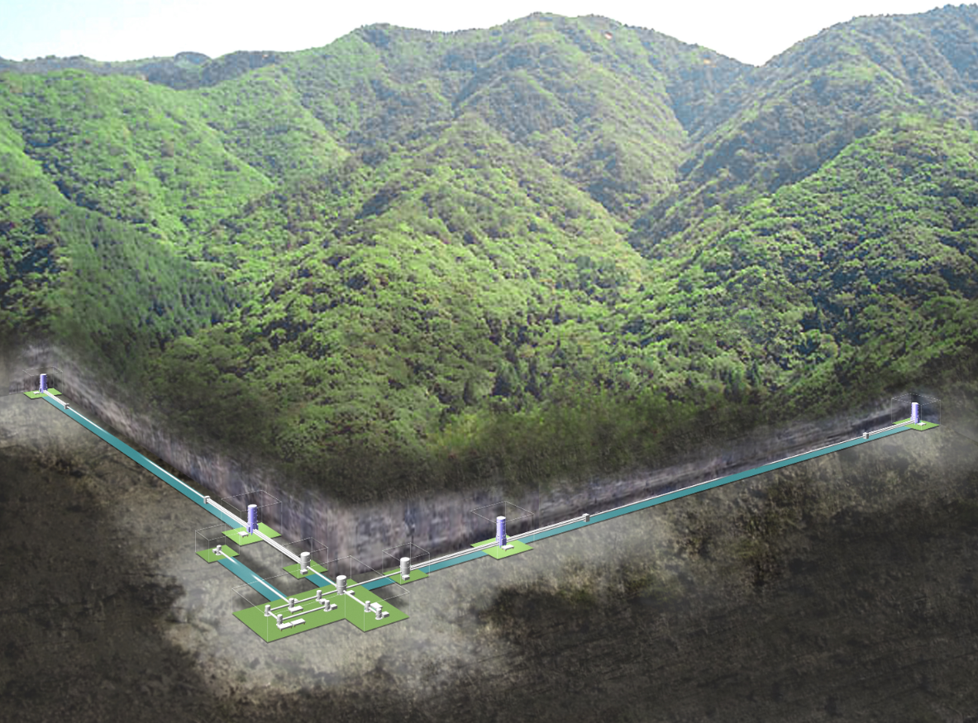
Messengers from a Supernova
Known particles
Exotic particles
Photons
Axions (ALPs)
γ
SN 1987A
a
e.g. KM et al., PRD 105 (2022) 063009;
108 (2023) 063027
Betranhandy & O’Connor PRD 106 (2022) 063019
Fischer et al. PRD 104 (2021) 103012
ⒸNAOJ
Sterile neutrinos
Neutrinos
ν_{s}
ν
e.g. KM et al., PRD 110 (2024) 023031
Rembiasz et al. PRD 98 (2018) 103010
Warren et al. PRD 90 (2014) 103007
Ⓒ東京大学宇宙線研究所
© Australian Astronomical Observatory
…
Gravitational waves
Ⓒ東京大学宇宙線研究所

Slide 4
Explosion Mechanism of Core-collapse SNe
Core collapse
Core bounce
Shock propagation
~1000 km
~10 km
Shock
ν
ν
Fe
ρ_{c}~3×10¹⁴ g/cm³
Fe
PNS
ν
ν
Bounce shock
~1 s
SN explosion
Shock breakout
Shock
~a few days
PNS
PNS

Slide 5
Energetics of Core-collapse SNe
Gravitational energy release
Kinetic energy
Radiation
Neutrino (SN 1987A obs.)
≈ 10⁵³ erg
10⁵³ erg
Energy budget: E_{g} = E_{k} + E_{r} + E_{ν}
~1%
~0.01%
~99%
Neutrino heating

Slide 6
Neutrino Heating Mechanism
[e.g. Bethe & Wilson, ApJ 295 (1985) 14]
Shock wave
Neutrino cooling rate = C ∝ T ⁶
Neutrino heating rate = H ∝1/R ²
←
Heating region
←
C=H
Mass
accretion
Cooling region
ν
ν
ν-sphere
v_{adv}
ν
ν
In general, C decreases faster than H
→ Heating is dominant at R>R_{gain}
~50 km
R_{gain}~100 km
R_{shock}

Slide 7
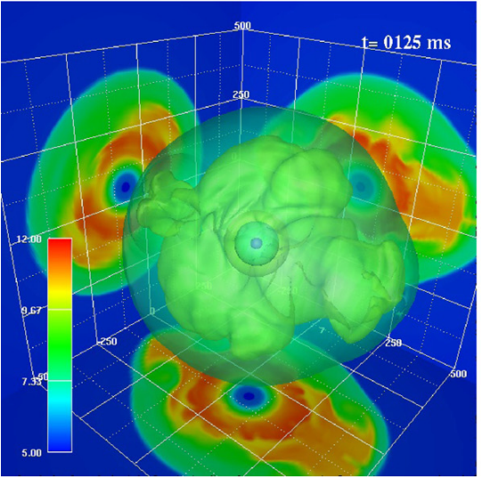
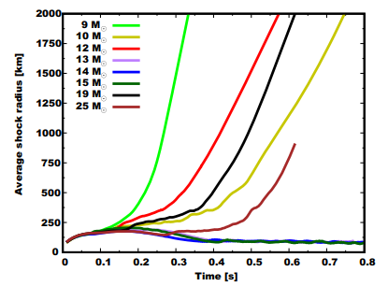
Current Status: Multi-D Models
3D models
Takiwaki et al. ApJ 749 (2012) 98
Nagakura et al. MNRAS 500 (2021) 696

Slide 8
Contents
Introduction on supernovae
ALPs from supernovae
Supernova models with ALPs

Slide 9
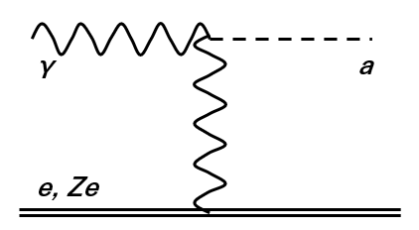
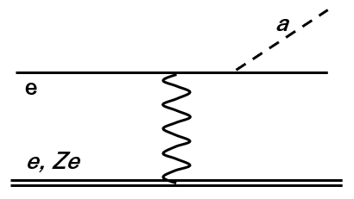
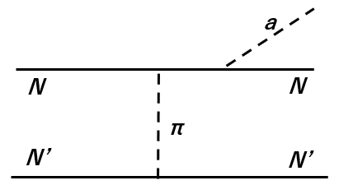
ALP Interaction with SM particles
Primakoff process
ALP-photon coupling
ALP-electron coupling
ALP-nucleon coupling
electron-ion bremsstrahlung
e.g. Lucente & Carenza PRD 104 (2021) 103007
nuclear bremsstrahlung
e.g. Carenza et al. JCAP 10 (2019) 016
Turner, PRL 60 (1988) 1797

Slide 10
ALP Production Processes
[e.g. di Lella et al. PRD 62 (2000) 125011.]
Primakoff process
Photon coalescence
γ
a
γ
a
e, Ze
γ
k: photon wave number in plasma
p: ALP momentum
κ: Debye-Hückel scale
ω_{pl}: plasma frequency
Possible only when m_{a}>2ω_{pl}

Slide 11
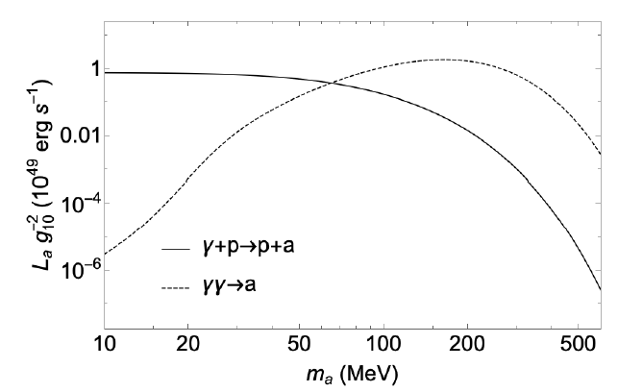
ALP Luminosity from a SN
Primakoff
Photon coalescence
t_{pb}=1 s
[Lucente et al. JCAP 12 (2020) 008.]
Supernovae can create ALPs lighter than ~300 MeV.

Slide 12
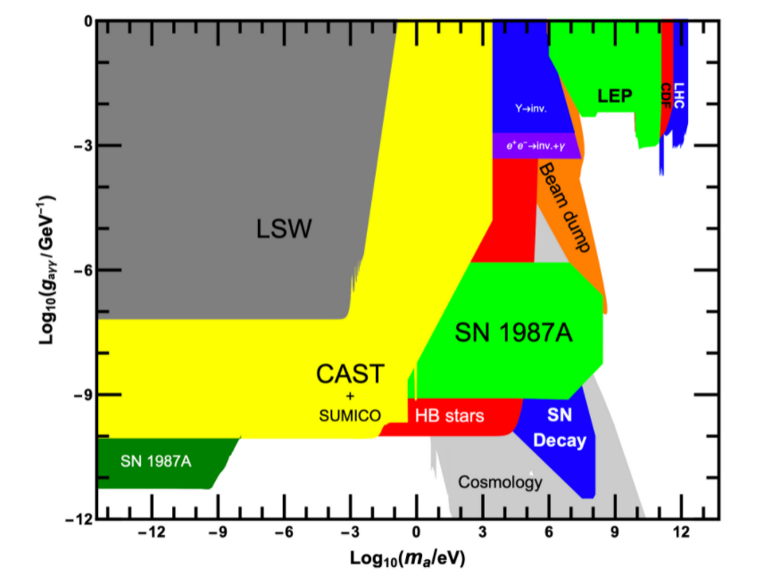
Constraints on ALPs
The ALP-photon coupling g_{aγ} has been explored experimentally and astrophysically
SN 1987A limits
γ-ray limits
Energy-loss argument
Jaeckel & Spannowsky PLB 753 (2016) 482

Slide 13
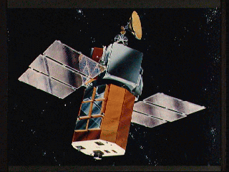
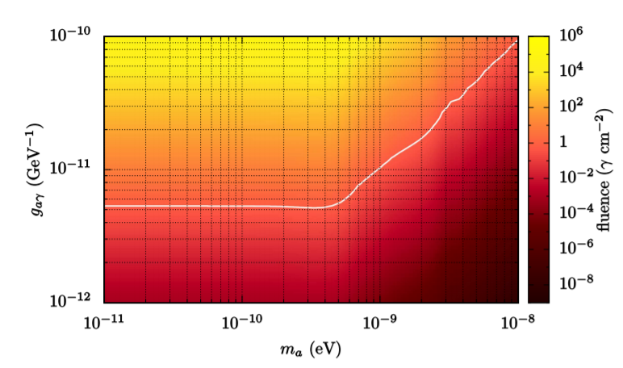
γ-ray Limit on ALPs
SN
ALP
ALP
γ
B
ⒸNASA
Observation: F(25-100 MeV)<0.6 γ/cm²
[Chupp, Vestrand & Reppin PRL 62 (1989) 505]
Theory
Observation
Non-detection of γ-rays from SN 1987A has provided constraints on ALPs
Payez et al., JCAP 1502 (2015) 006

Slide 14
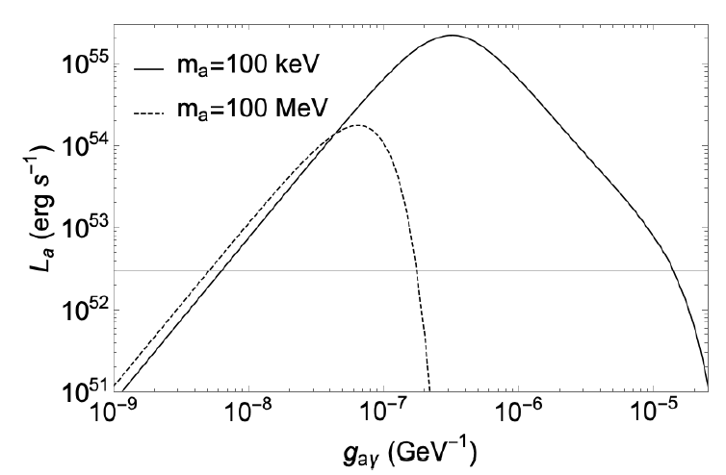
Additional Energy Loss from Proto-NS
Lucente et al. JCAP 12 (2020) 008.
The ALP luminosity L_{a} is so large that the neutrino burst duration (~10 s) from SN1987A cannot be explained.
L_{ν}
Free-streaming
Trapped in the core
Jaeckel & Spannowsky PLB 753 (2016) 482

Slide 15
Contents
Introduction on supernovae
ALPs from supernovae
Supernova models with ALPs

Slide 16
Beyond Post-processing
Previous calculations are mainly performed with post-process: hydrodynamics and ALPs are decoupled
In order to predict the signature of ALPs in neutrino and gravitational wave signals, one should go beyond post-processing
We developed a new method to calculate the backreaction of ALPs
Hydro info
This work
SN model
Temperature
Density
Composition
ALPs
Production rate (->cooling)
Absorption rate (->heating)
Backreaction

Slide 17
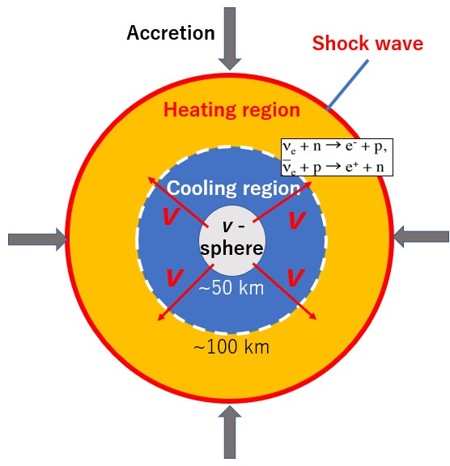
Radiative Decay of Heavy ALPs
Heavy ALPs are unstable:
Mean free path:
When ALPs are heavy enough, ALPs decay in a star
→Effect on SN dynamics?
a→γ+γ
a
a
a→γγ

Slide 18
SN Simulation Coupled with ALPs
Code: 3DnSNe [Takiwaki, Kotake & Suwa MNRAS 461 (2016) L112]
with IDSA [Liebendörfer, Whitehouse, & Fischer ApJ 698 (2009) 1174]
Dimension: 2D EoS: LS220 Progenitor: 20M☉
ALP production:
Primakoff process
Photon coalescence
[Woosley & Heger Phys. Rep. 442 (2007) 269]
ALP absorption:
Inverse Primakoff process
Radiative decay
discretize
ALP production
ALP absorption
for the i-th cell
Modification on internal energy:

Slide 19
SN Models
Model with ALPs
(m_{a}=200 MeV, g_{aγ}=1×10⁻⁹ GeV⁻¹)
Model without ALPs
ALPs can assist SN explosion!

Slide 20
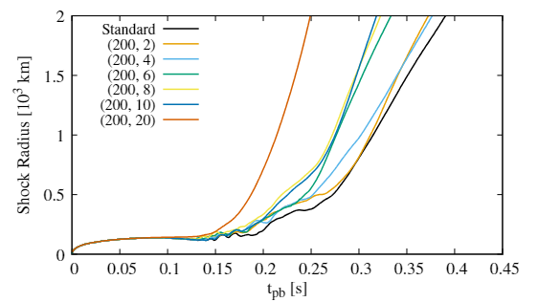
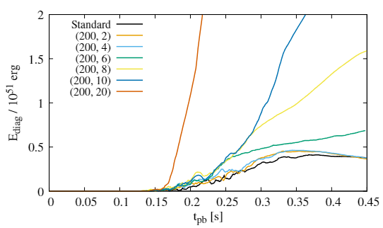
Shock Radius & Explosion Energy
Shock radius
Explosion energy
(m_{a} [MeV], g₁₀)
g₁₀=g_{aγ}/(10⁻¹⁰ GeV⁻¹)
m_{a}=200 MeV
KM, Takiwaki, Kotake, & Horiuchi PRD 108 (2023) 063027
ALPs assist the explosion!
Explosion energy exceeds 10⁵¹ erg if g_{aγ}>~6×10⁻¹⁰ GeV⁻¹.

Slide 21
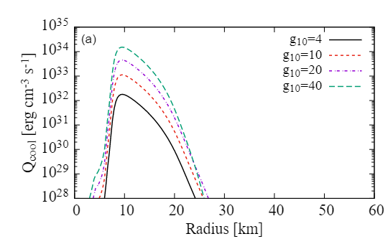
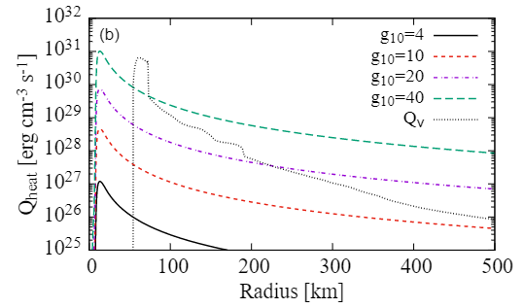
ALP Cooling & Heating Rates
[KM, Takiwaki, Kotake, & Horiuchi PRD 105 (2022) 063009]
g₁₀=g_{aγ}/(10⁻¹⁰ GeV⁻¹)
m_{a}=100 MeV,
t_{pb}=200 ms
Cooling rate
Heating rate
Q_{cool}∝g²
Q_{heat}∝g⁴

Slide 22
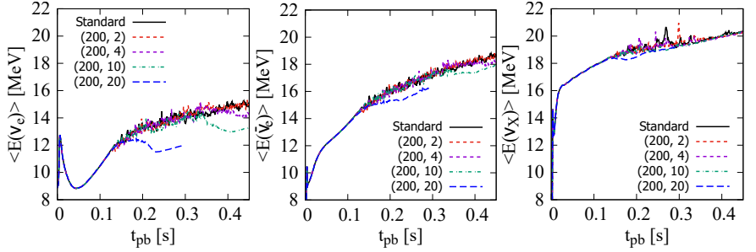
Neutrino Signals
m_{a}=200 MeV
Both neutrino luminosity and mean energy decrease because of ALPs.
ALP production prevents mass accretion and induces additional cooling of PNS.
KM, Takiwaki, Kotake, & Horiuchi PRD 108 (2023) 063027

Slide 23
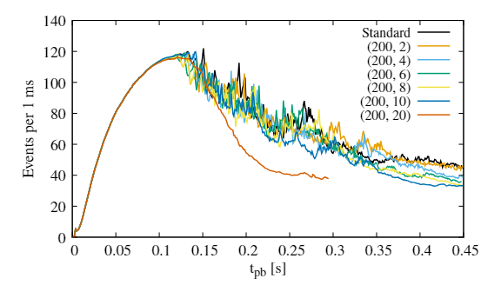
Neutrino Signals
Hyper-Kamiokande, inverse β-decay, D=8.5 kpc (i.e. Galactic center)
Normal mass hierarchy
Neutrino events from a nearby SN event decrease!
m_{a}=200 MeV
KM, Takiwaki, Kotake, & Horiuchi PRD 108 (2023) 063027

Slide 24
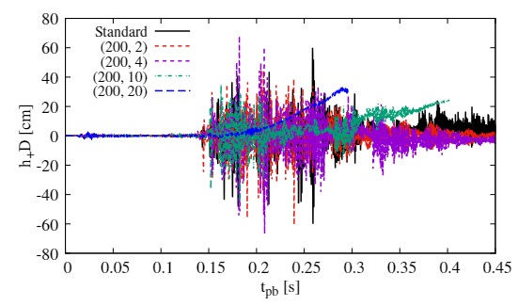
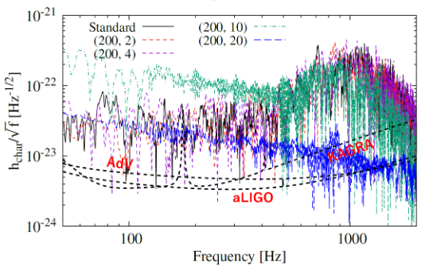
Gravitational Wave Signals
D=8.5 kpc
KM, Takiwaki, Kotake, & Horiuchi PRD 108 (2023) 063027
GW signals are weakened.
ALP heating prevents the mass accretion.

Slide 25
Summary
Astrophysical objects such as core-collapse SNe offer unique opportunities to explore ALPs.
Heavy ALPs with m_{a}~100 MeV can assist the shock revival in SNe.
If the ALP-photon coupling is large enough, the explosion becomes more energetic than observed events.
Both neutrino and GW signals are weakened (but still observable!).

