Slide 1
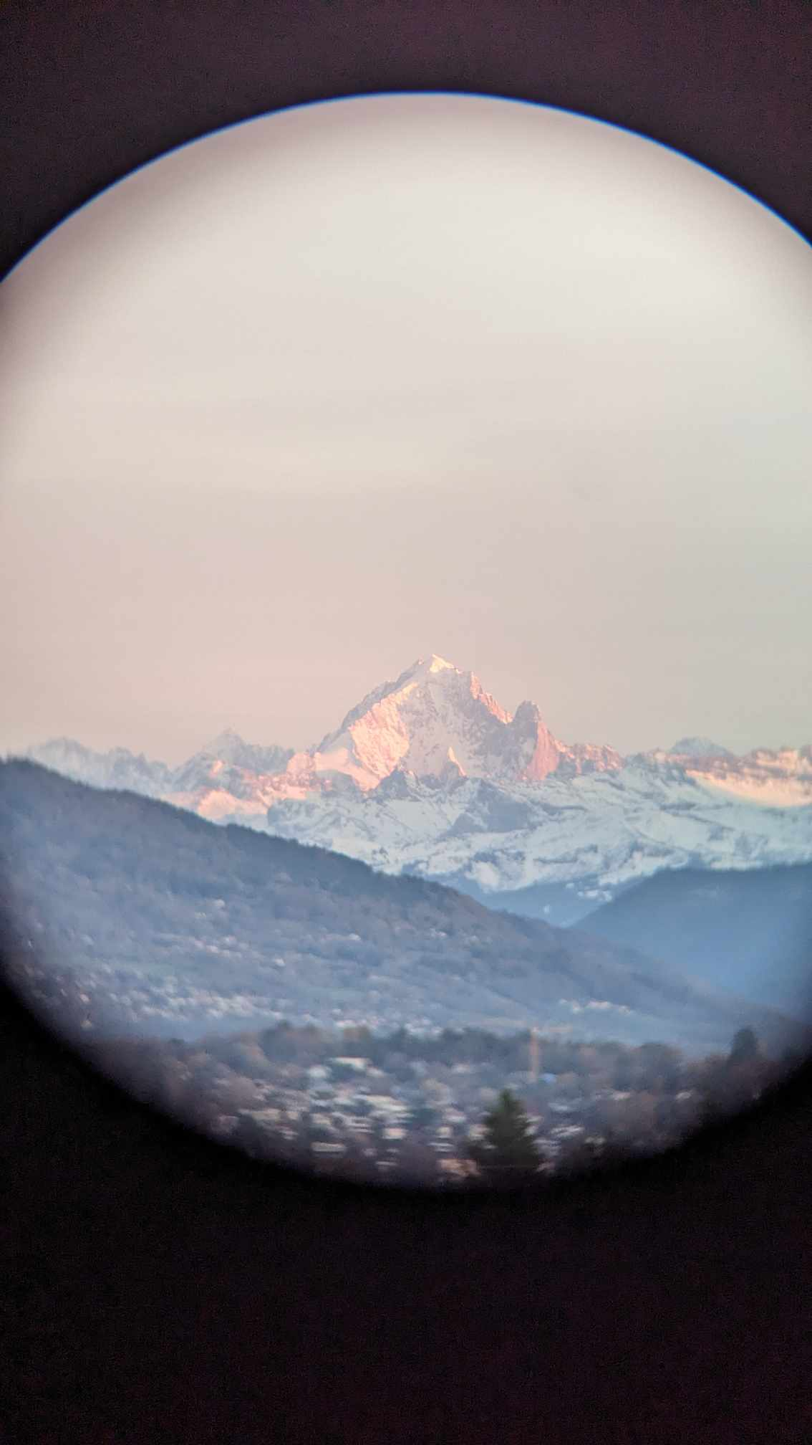
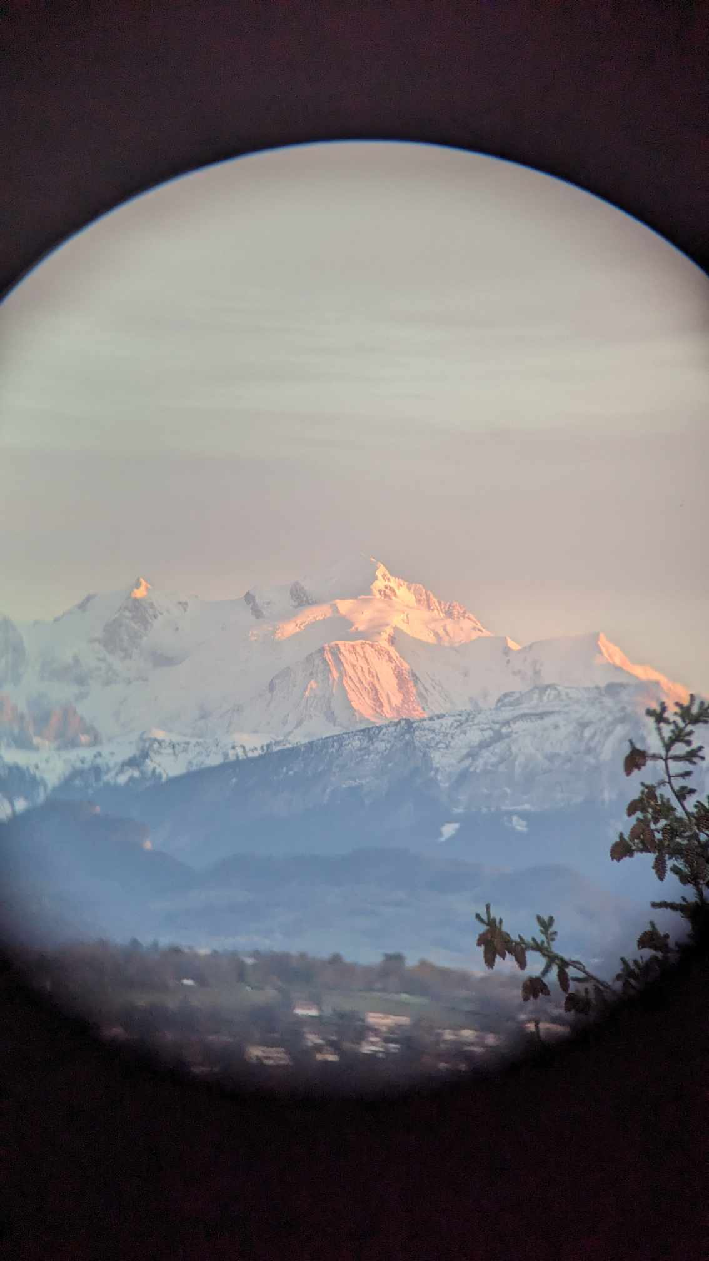


Amplitude analysis tools
Spectroscopy in decays & in femtoscopic correlations
GDR QCD, InF and Gluodynamics
Orsay, 16-17 December 2024
Elisabeth Maria Niel
CERN

Slide 2
Amplitude Analysis Techniques
Powerful tool for different physics cases
The complexity of three body decays is counterbalanced by the richness of these decays
Outline
Physics cases
Dalitz plots and decay amplitude
Hadronic resonances
Polarization
Isobar model
Model building
Physics examples: CP violation and exotic states

Slide 3
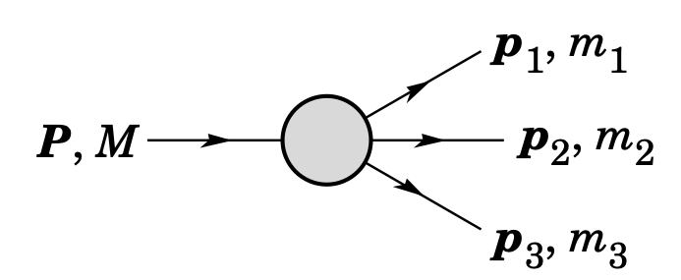
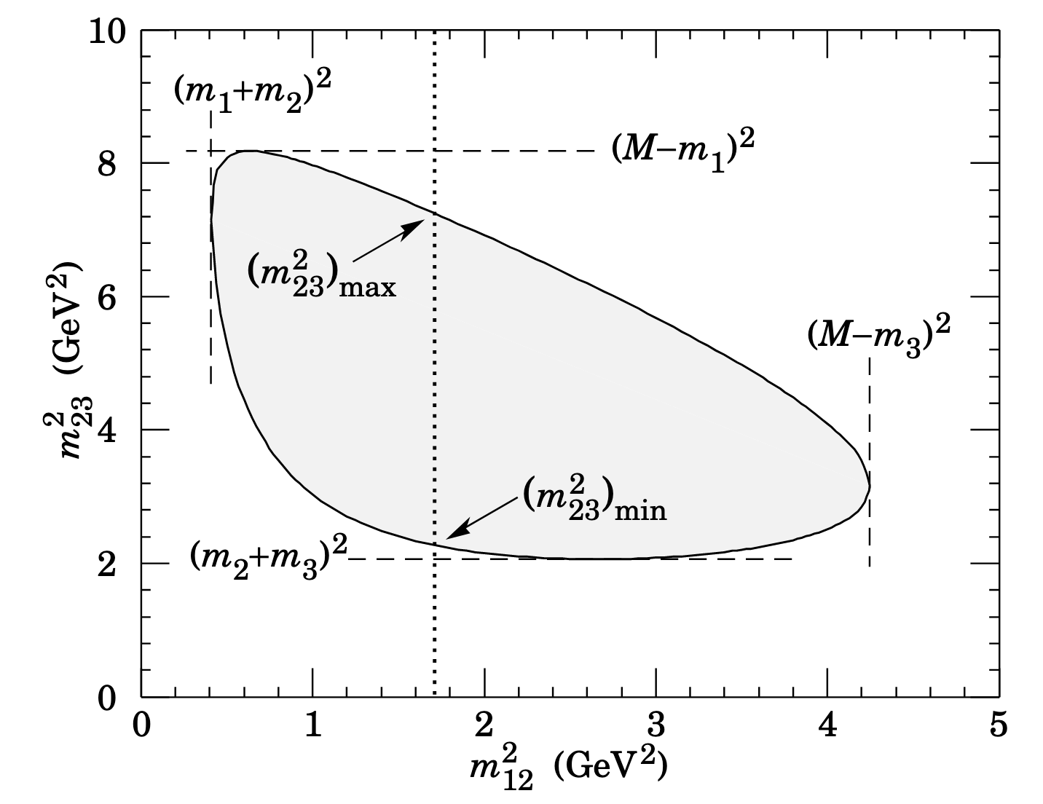
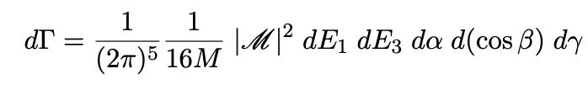
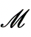


The physics reach of multi-body decays
Study multi-body decays on the Dalitz plane: $M→1+2+3$
Address different physics cases with this technique:
  Polarization measurements in three-body decays :
  [$Λ_{c}^{+}→pK^{−}π^{+}]$
    →crucial input for the charm magnetic dipole moment measurement
  Study of CP violation in 3-body decays :
  [D mesons decays]
    CPV in charm sector discovered only in 2019 for 2-body decays
    Local enhancement due to interference expected
  Search for new resonances and exotic states :
  [B mesons / $Λ_{b}$ baryons decays]
    no clear picture describing these states
    pentaquarks/tetraquarks, are those molecular or compact states?
Dalitz plane
Total amplitude
Notes:
the way I challenge the SM :
MAKE CLEAR YOU WILL SPEAK ABOUT ALL OF THE 3
EXPERIMENTAL TECHNIQUES SAME ON DIFFERENT OHYSICS CASES
I study multi-body decays (more than two particles in the final state)
We study it in Dalitz plane , where the dynamic of the decay appears as non uniformity on this plane
Study the amplitude of the physcis process by studying each point of this plane
These decays allows to address some of the most important questions still unanswered in particle physics:
Pola,
CPV,
origin of exotics
---------------------------------------------------------------------------------------------------------
Narrow widths→compact
usually an heavy quark inside creating a part with cc other light and pio. exchange
Some prediction good (like the quark nmodel spectrum)

Slide 4
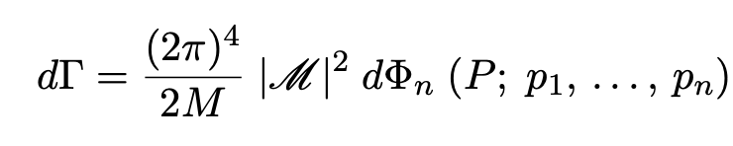
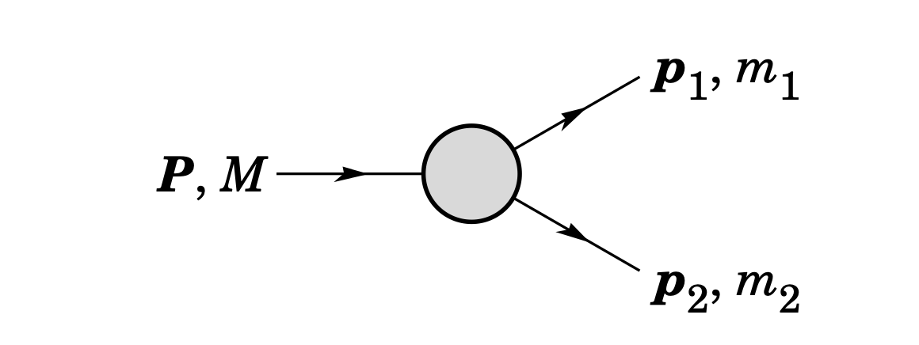
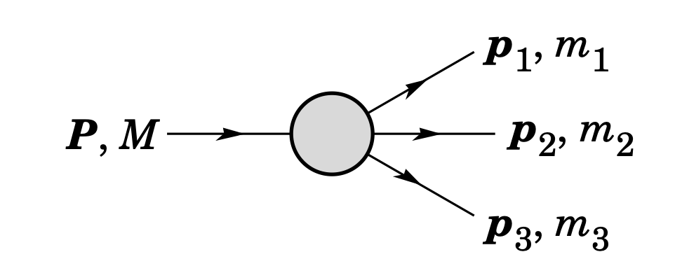
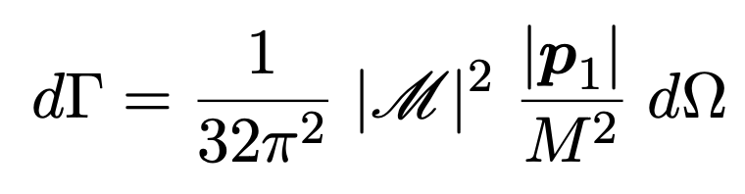
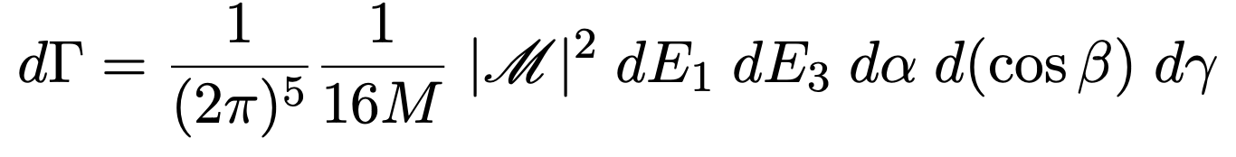
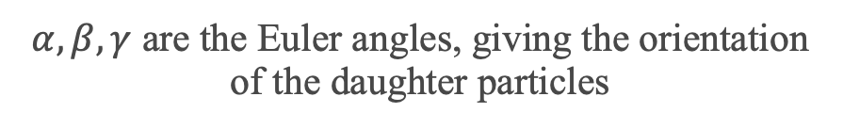
Amplitude Analysis
Partial decay rate of a particle of mass M into n bodies in its rest frame is given in terms of the
Lorentz-invariant matrix element
2-body
3-body
$α,β,γ$ are the Euler angles, giving the orientation of the daughter particles

Slide 5
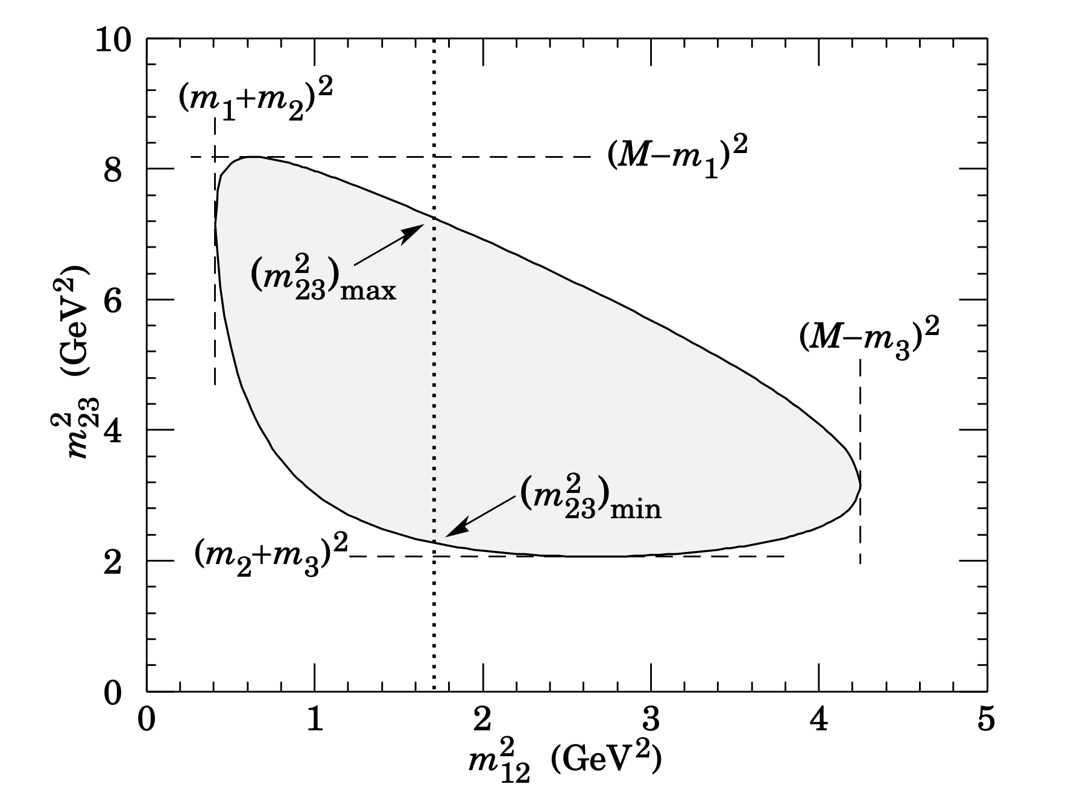

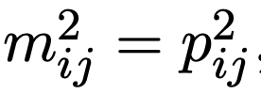
Dalitz plot and decay amplitude
The phase space
4-momenta
conservation of 4-momenta

Slide 6
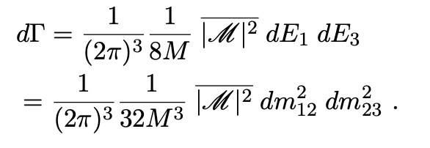
Dalitz plot and decay amplitude
The phase space
4-momenta
conservation of 4-momenta
Spinless particles and constant amplitude

Slide 7
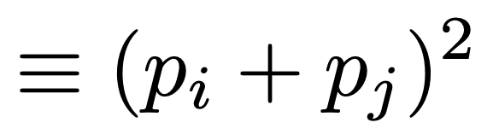
Dalitz plot and decay amplitude
The phase space

Slide 8
Dalitz plot and decay amplitude
The phase space

Slide 9
Dalitz plot and decay amplitude
The phase space

Slide 10
Dalitz plot and decay amplitude
The phase space

Slide 11
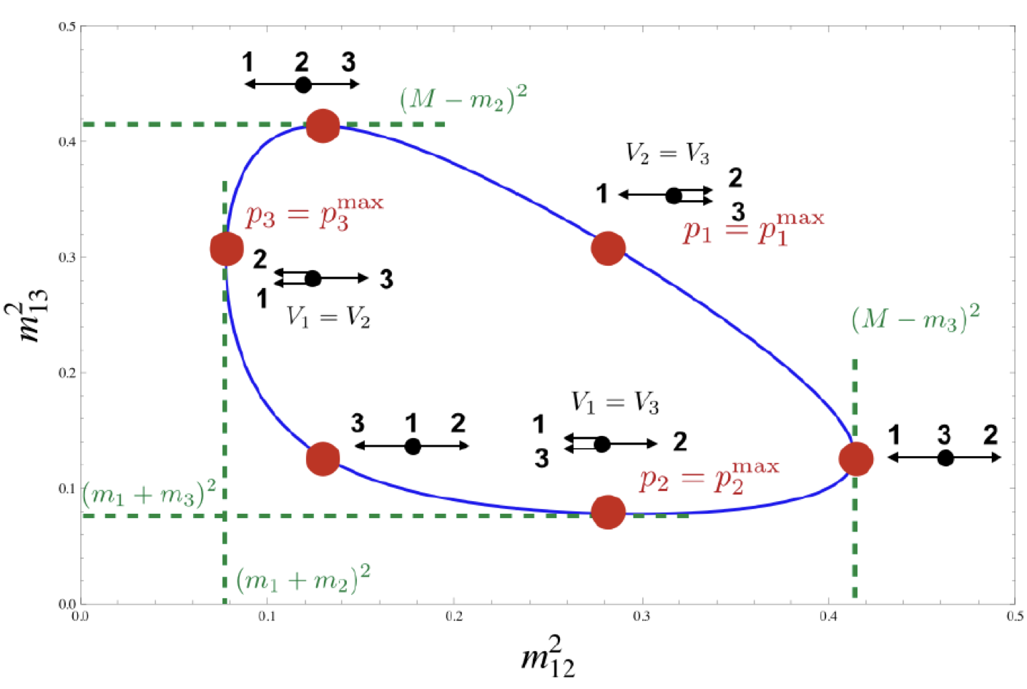
Dalitz plot and decay amplitude
The phase space
Different positions in the phase space → different configurations of momenta

Slide 12
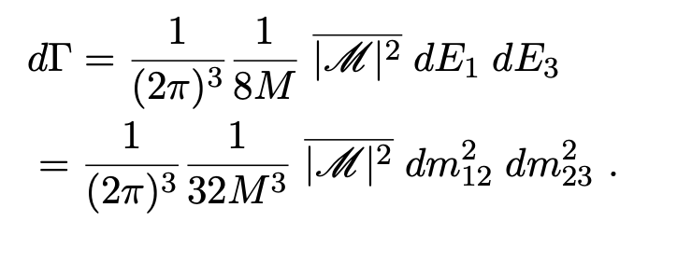
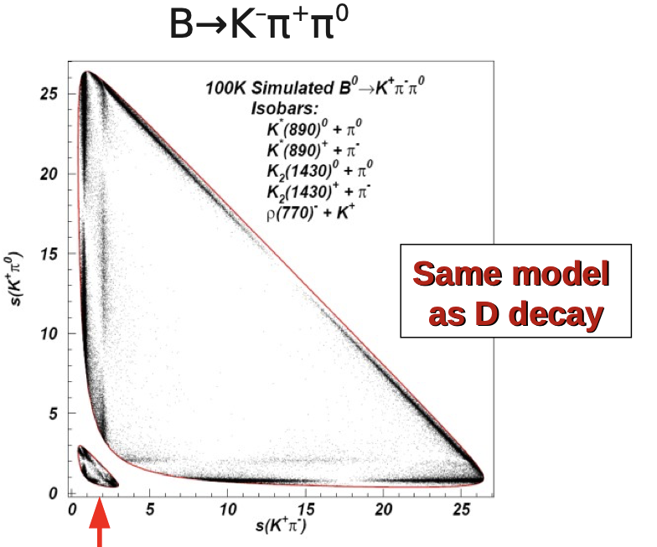
Phase space
Size of the Dalitz plot
Credits for the plot:
T. Gershon and
B. Meadows

Slide 13
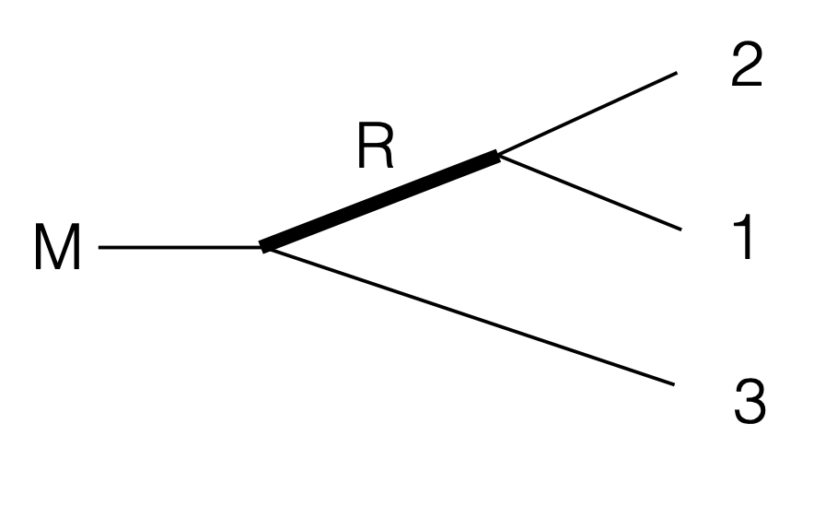
Resonances
Amplitude with intermediate resonance states appears as bands on the Dalitz plot
Shape of theses bands depends on the spin of the resonance

Slide 14
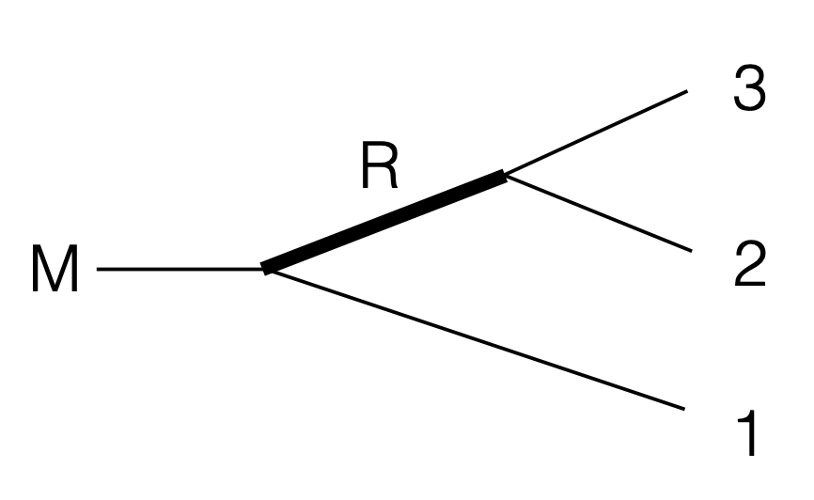
Resonances
Amplitude with intermediate resonance states appears as bands on the Dalitz plot
Shape of theses bands depends on the spin of the resonance

Slide 15
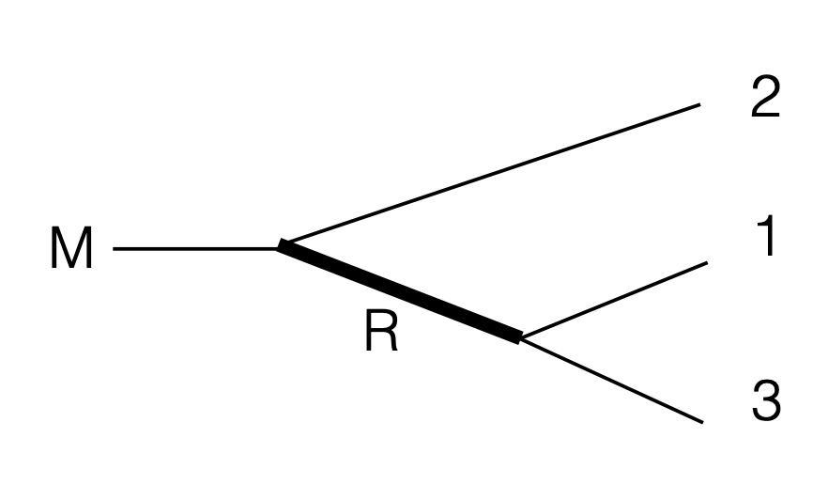
Resonances
Amplitude with intermediate resonance states appears as bands on the Dalitz plot
Shape of theses bands depends on the spin of the resonance
When ”crossing” resonance can interfere

Slide 16
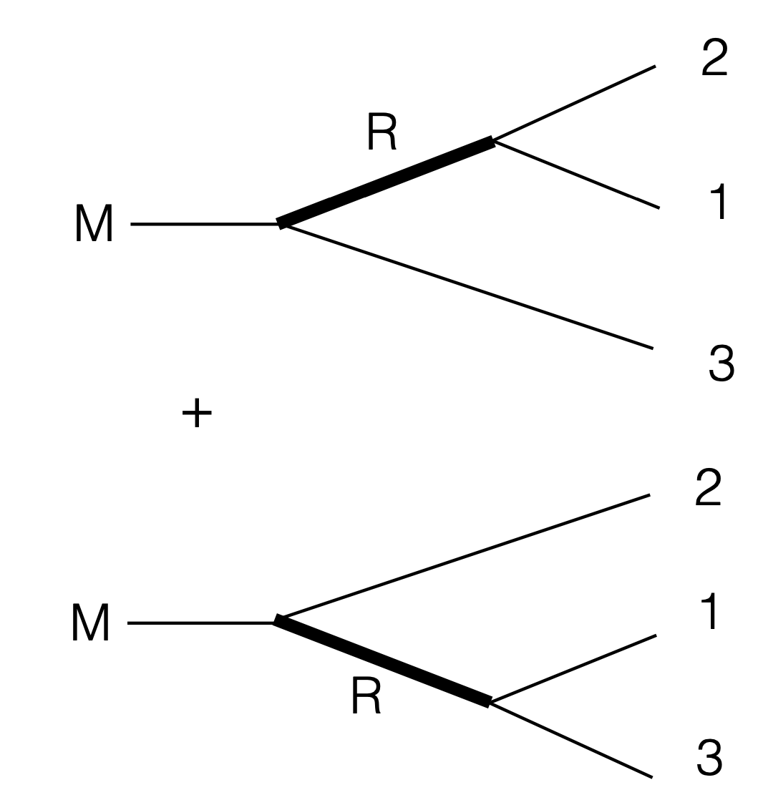
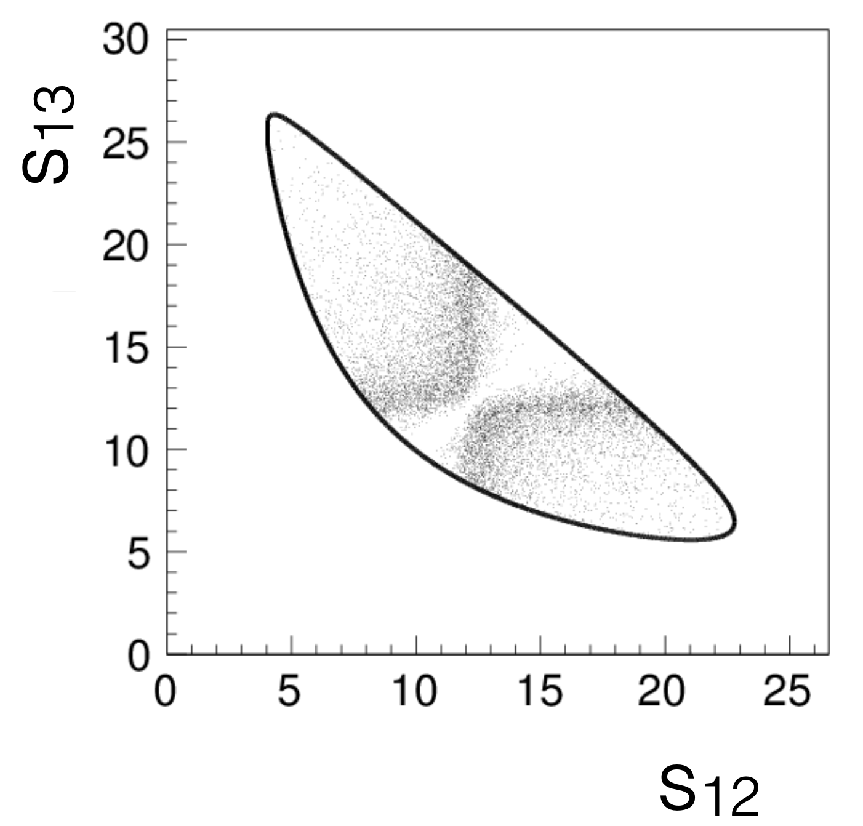
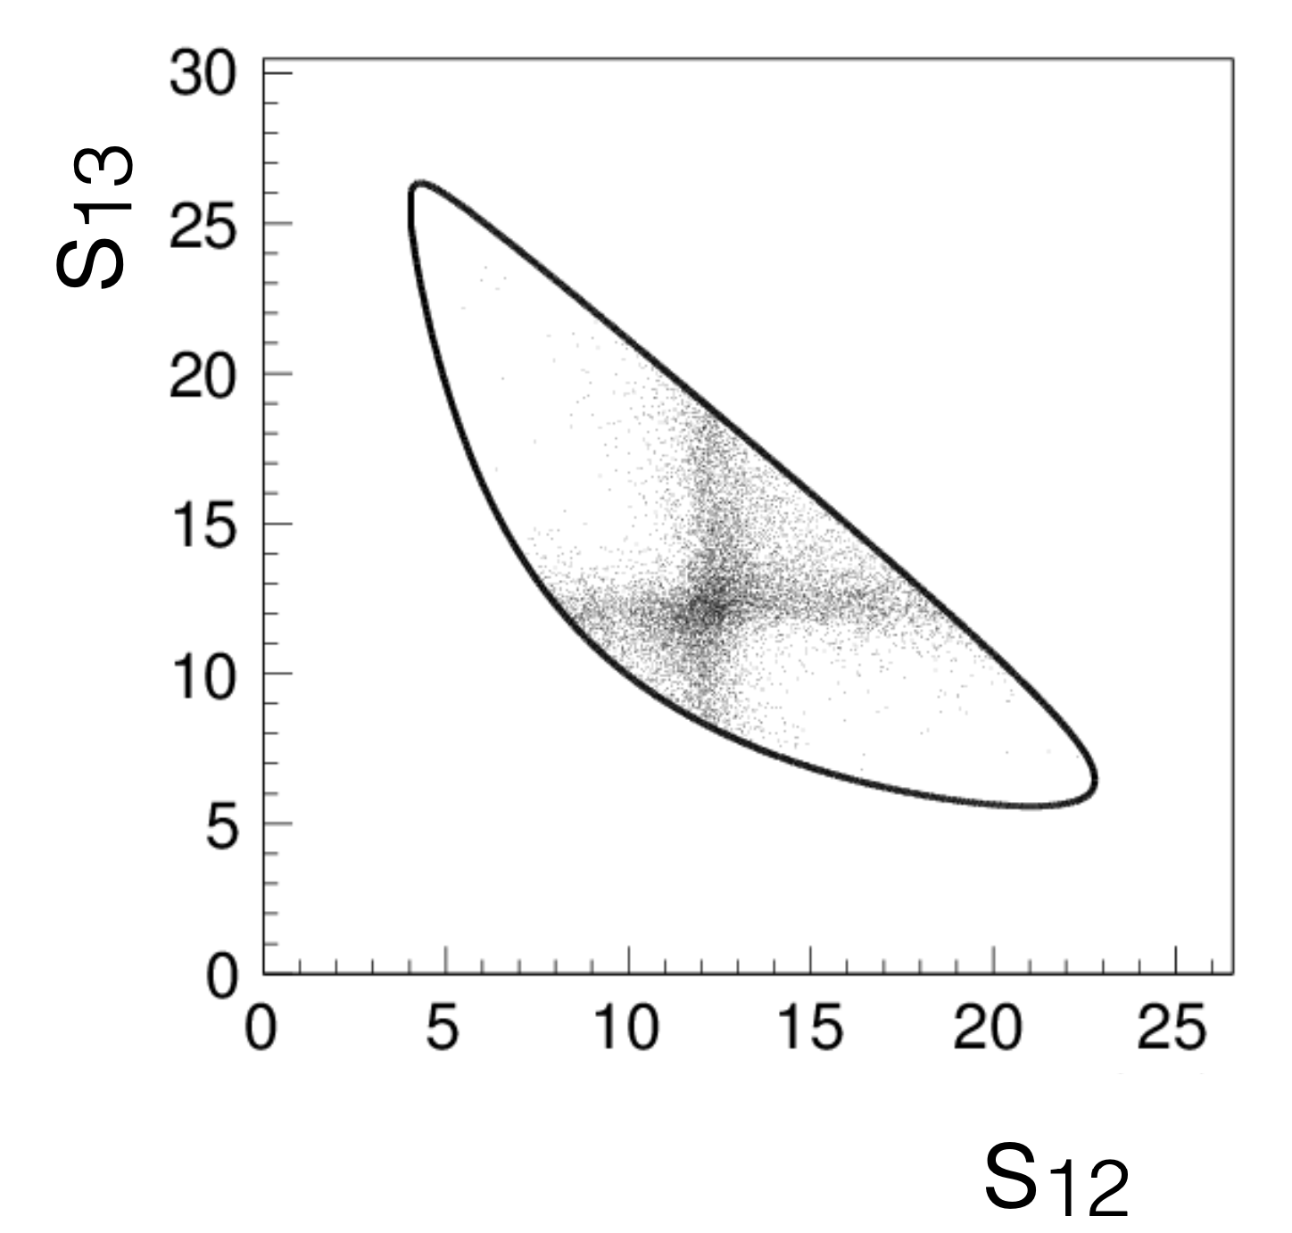
Interferences of resonances
More resonances from
different chains
Coherent sum over all resonant states→ resonances can interfere
Destructive interference
Constructive interference

Slide 17
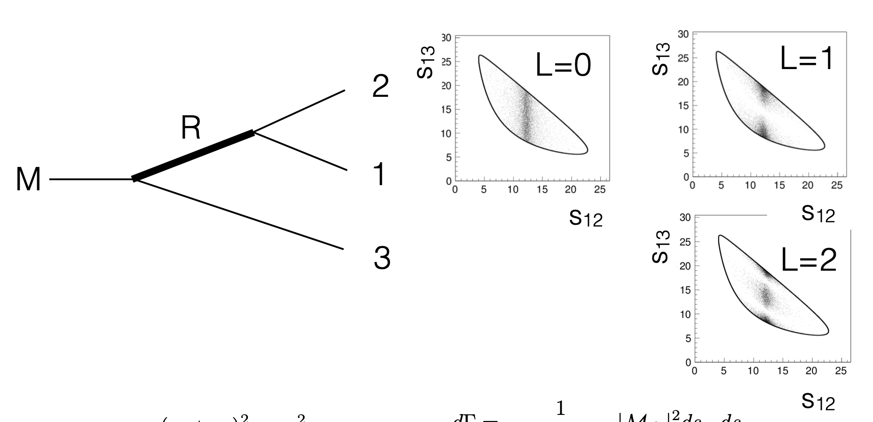
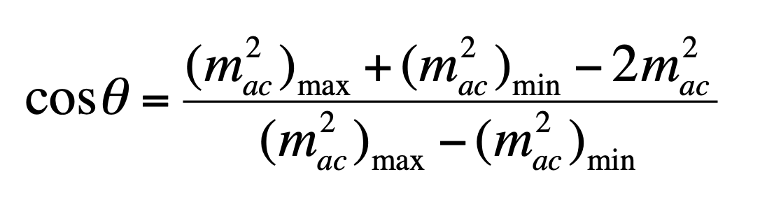
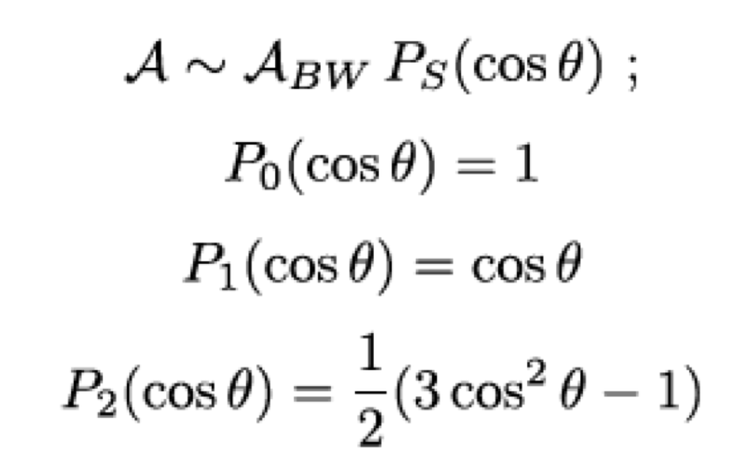




Resonances spin
Depending on the spin of the resonance, different shapes on the Dalitz plot
$$cosθ$$
$$−1$$
$$0$$
$$+1$$

Slide 18
Resonances spin
Depending on the spin of the resonance, different shapes on the Dalitz plot
$$cosθ$$
$$−1$$
$$0$$
$$+1$$

Slide 19
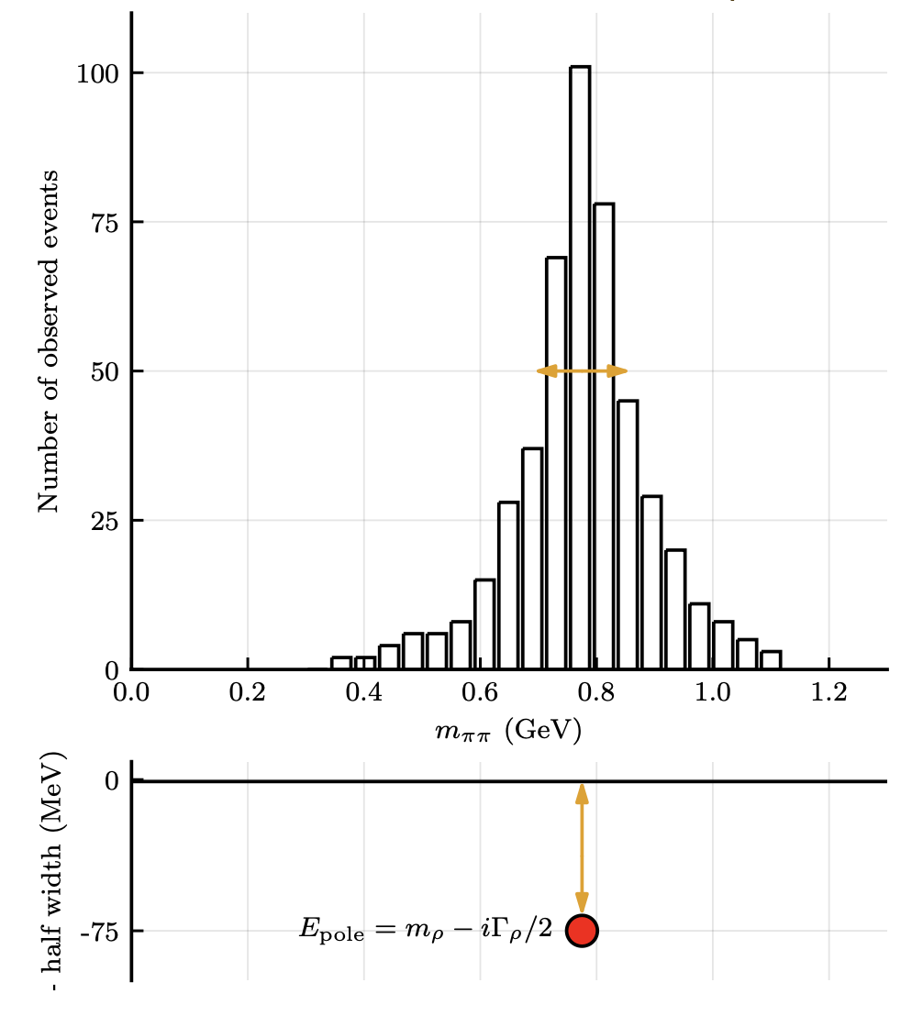
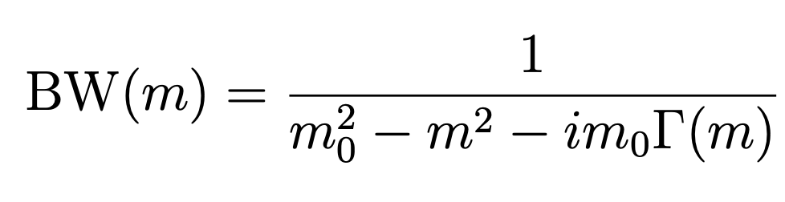
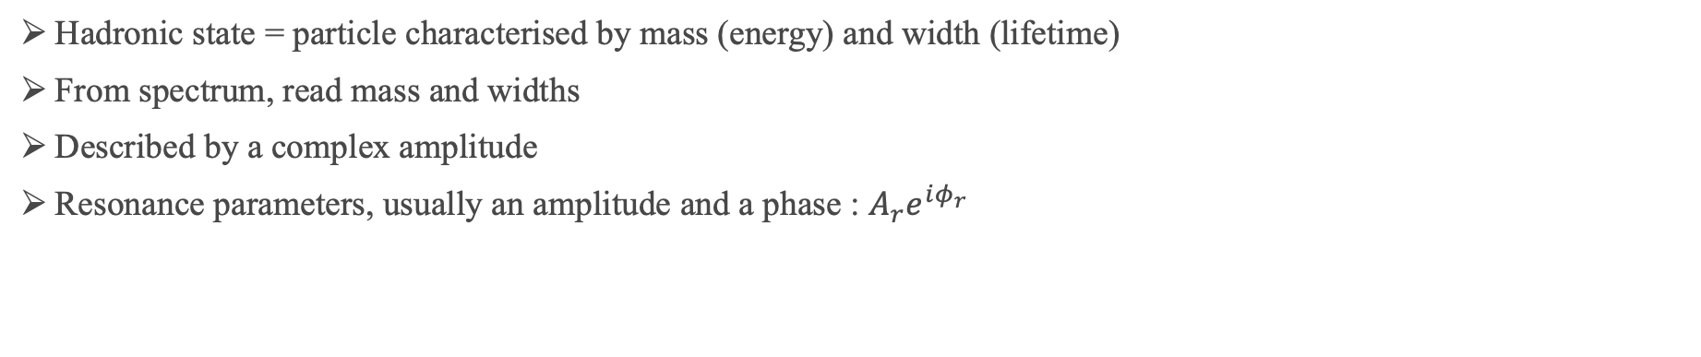
Description of resonances
Hadronic state = particle characterised by mass (energy) and width (lifetime)
From spectrum, read mass and widths
Described by a complex amplitude
Resonance parameters, usually an amplitude and a phase : $A_{r}e^{iφ_{r}}$
plot credit: M.Mikashenko
Breit-Wigner
Resonant state are poles of the scattering amplitude

Slide 20


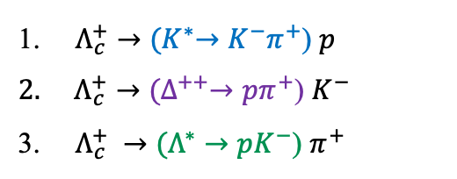





Description of resonances
Hadronic state is a particle charact by mass (energy) and width (lifetime)
From spectrum, read mass and widths
Described by a complex amplitude
$Λ_{c}^{+}→{(K}^{∗}→K^{−}π^{+}$) $p$
$Λ_{c}^{+}→{(Δ}^{++}→pπ^{+}$) $K^{−}$
$Λ_{c}^{+} →(Λ^{∗}→pK^{−}$) $π^{+}$
$Λ_{c}^{+}→p { K}^{−} π^{+}$
Breit-Wigner
$$K^{∗}→K^{−}π^{+}$$
$$Δ^{++}→pπ^{+}$$
$$Λ^{∗}→pK^{−}$$
$$Δ^{++}\left(1232\right)$$
Mass: 1232 MeV
Width: 117 MeV
$$Λ^{∗}\left(1520\right)$$
Mass: 1519 MeV
Width: 15.6 MeV
  $$K^{∗0}\left(890\right)$$
  Mass: 892 MeV
  Width: 50 MeV

Slide 21
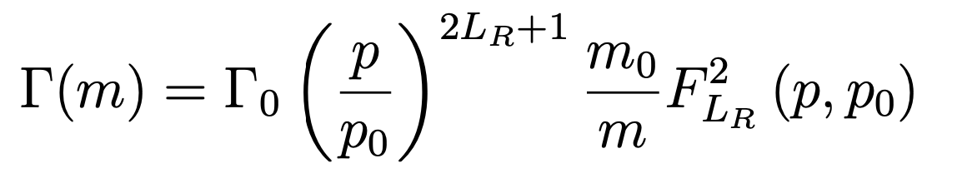


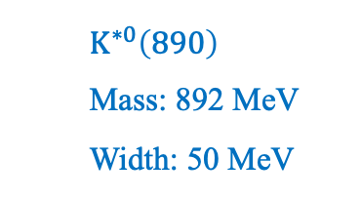
Description of resonances
Hadronic state is a particle charact by mass (energy) and width (lifetime)
From spectrum, read mass and widths
Described by a complex amplitude
Breit-Wigner
Mass dependent width
$$K^{∗}→K^{−}π^{+}$$
$$Δ^{++}→pπ^{+}$$
$$Λ^{∗}→pK^{−}$$
  $$K^{∗0}\left(890\right)$$
  Mass: 892 MeV
  Width: 50 MeV
$$Δ^{++}\left(1232\right)$$
Mass: 1232 MeV
Width: 117 MeV
$$Λ^{∗}\left(1520\right)$$
Mass: 1519 MeV
Width: 15.6 MeV

Slide 22
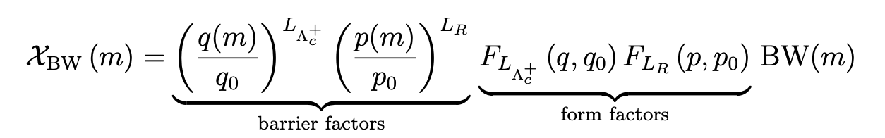
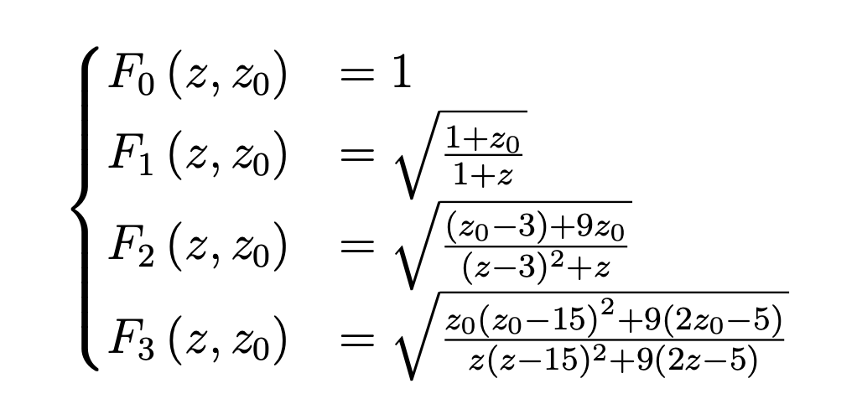
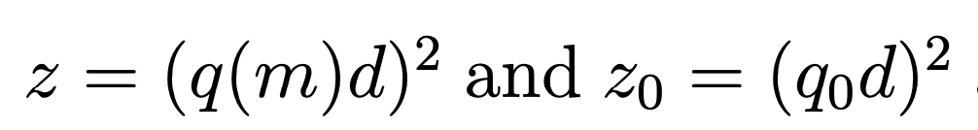
Description of resonances
Hadronic state is a particle charact by mass (energy) and width (lifetime)
From spectrum, read mass and widths
Described by a complex amplitude
a
M
R
b
c
Relativistic Breit-Wigner
break-up momentum in restframe of decaying resonance
Angular Momentum Dependence
included using Blatt-Weisskopf
Barrier factors or ”angular momentum barrier”:
suppress the amplitude at low values of break-up momenta and increasing L
→Higher angular momentum states require greater kinetic energy to overcome the centrifugal barrier
d =The barrier radius with typically values around 1-2 fm (typical size of hadrons)
Notes:
account for the angular momentum and the finite size of the decaying particle

Slide 23
Description of resonances
a
Hadronic state is a particle charact by mass (energy) and width (lifetime)
From spectrum, read mass and widths
Described by a complex amplitude
M
R
b
c
Relativistic Breit-Wigner
$$K^{∗}→K^{−}π^{+}$$
$$Δ^{++}→pπ^{+}$$
$$Λ^{∗}→pK^{−}$$

Slide 24
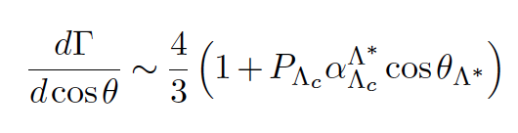
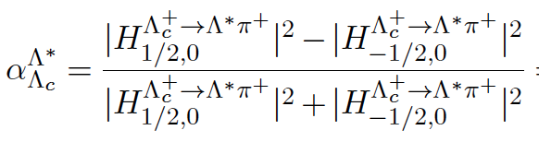
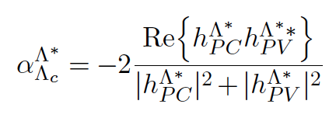
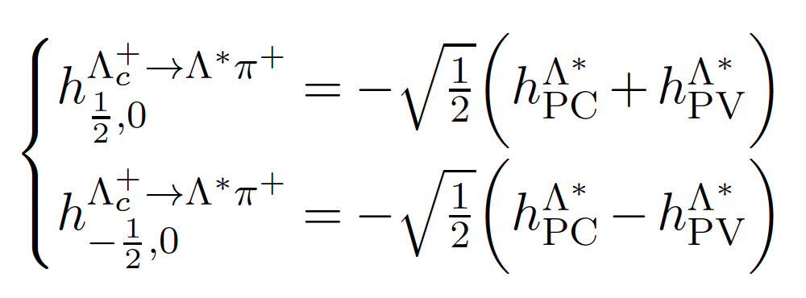
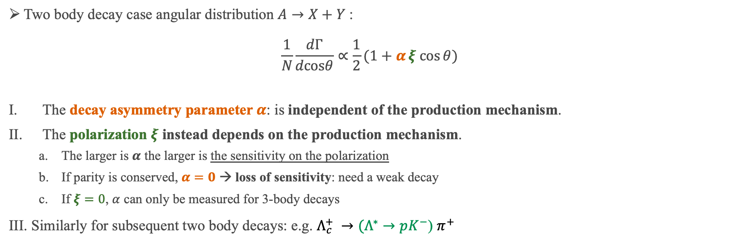
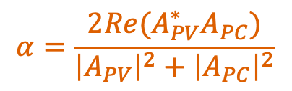

A word on polarization
For particles with non-zero spin in the final state a more complex angular dependance
Additionally, mother particle can be polarized
$$α=\frac{2Re(A_{PV}^{∗}A_{PC})}{{\left|A_{PV}\right|}^{2}+{\left|A_{PC}\right|}^{2}}$$
Two body decay case angular distribution $A→X+Y$:
$$\frac{1}{N}\frac{dΓ}{dcosθ}∝\frac{1}{2}(1+αξ cos{θ})$$
The decay asymmetry parameter $α$: is independent of the production mechanism.
The polarization $ξ$ instead depends on the production mechanism.
  The larger is $α$ the larger is the sensitivity on the polarization
  If parity is conserved, $α=0$ → loss of sensitivity: need a weak decay
  If $ξ=0$, $α$ can only be measured for 3-body decays
Similarly for subsequent two body decays: e.g. $Λ_{c}^{+} →(Λ^{∗}→pK^{−}$) $π^{+}$
$A_{PV}$= parity violating
$A_{PC}$ = parity conserving

Slide 25





A word on polarization
Polarization included via spin density matrix,
for spin ½ is a 2x2 Matrix
Final amplitude including intermediate states had a non trivial angular distribution:
$$dΓ \sim \sum_{m,m^{′}}{ρ_{m,m^{′}}}\sum_{λ_{p}}{A_{m,λ_{p}} A_{m^{′},λ_{p}}^{∗}}$$
Kinematics of $Λ_{c}^{+}→pK^{−}π^{+}$ described by 5 variables :
$m_{pπ}^{2}={\left(P_{p}+P_{π}\right)}^{2}$ and$m_{pK}^{2}={\left(P_{p}+P_{K}\right)}^{2}$
${(θ}_{p}$ , $ϕ_{p})$ : polar and azimuthal angle of the
proton at $Λ_{c}^{+}$ rest frame
$χ$ : angle between the planes formed by the proton
direction and the $z$ axis and $K^{−}$ and $π^{+}$ directions
The 3 Euler angles give the orientation of the plane.
Polarization may introduce a non-trivial angular dependence.

Slide 26



Isobar model
“Isobar” model: describes decays as series of 2-body processes
Usually: each resonance described by Breit Wigner lineshape (or similar) times factors accounting for spin.
Isobar decomposition: factorize the amplitude in angular part (helicity amplitudes) and dynamic part (lineshapes):
$Λ_{c}^{+}→{(K}^{∗}→K^{−}π^{+}$) $p$
$Λ_{c}^{+}→{(Δ}^{++}→pπ^{+}$) $K^{−}$
$Λ_{c}^{+} →(Λ^{∗}→pK^{−}$) $π^{+}$
Important differences:
Each chain can interfere with the others
Each chain has a large number of resonances
$Λ_{c}^{+}→p { K}^{−} π^{+}$

Slide 27








Alternatives to Breit-Wigner: QMIPWA
Alternative approaches:
Quasi-Model independent for the S-waves, represented over a been phase space by
Higher waves using Isobar model
The total amplitude is partially model independent
JHEP 06 (2023) 044
$ω−ρ$ mixing

Slide 28







Alternatives to Breit-Wigner: K-matrix
For single channel it reproduces Breit Wigner
Adapted from scattering processes $cd→ab$
Can be generalised to production cross-sections
using a production amplitude vector P [Aitchison, 1972]
Find a parametrization for K
summation over the poles :
residue functions
centrifugal damping factor
Online K matrix notebook

Slide 29


Model building
The model building remains one of the highest sources of uncertainties in amplitude analysis
Quickly very high number of resonances some of which poorly known
Systematic studies with well defined metrics necessary to discard models:
  Quality of the fit
  Penalization factor for high complexity (LASSO)
  Reasonable fit fractions overall
  Only keep resonances that are significant
JHEP 06 (2024) 098

Slide 30


Model building: additive approach
List of known resonances large, all possibly contributing
Model building: assess which resonances contribute to the fit
Strategy:
  Add resonances which are visible by eye
List of known resonances
my PhD thesis
P.A. Zyla et al. (Particle Data Group), Prog. Theor. Exp. Phys. 2020, 083C01 (2020) and 2021 update.

Slide 31

Model building: additive approach
List of known resonances large, all possibly contributing
Model building: assess which resonances contribute to the fit
Strategy:
  Add resonances which are visible by eye
$Λ_{c}^{+}→{(K}^{∗}→K^{−}π^{+}$) $p$:
  $K^{∗0}(890)$
my PhD thesis

Slide 32

Model building: additive approach
List of known resonances large, all possibly contributing
Model building: assess which resonances contribute to the fit
Strategy:
  Add resonances which are visible by eye
$Λ_{c}^{+}→{(K}^{∗}→K^{−}π^{+}$) $p$:
  $K^{∗0}(890)$
$Λ_{c}^{+}→{(Δ}^{++}→pπ^{+}$) $K^{−}$:
  $Δ^{++}(1232)$
my PhD thesis

Slide 33

Model building: additive approach
List of known resonances large, all possibly contributing
Model building: assess which resonances contribute to the fit
Strategy:
  Add resonances which are visible by eye
$Λ_{c}^{+}→{(K}^{∗}→K^{−}π^{+}$) $p$:
  $K^{∗0}(890)$
$Λ_{c}^{+}→{(Δ}^{++}→pπ^{+}$) $K^{−}$:
  $Δ^{++}(1232)$
$Λ_{c}^{+} →(Λ^{∗}→pK^{−}$) $π^{+}:$
  $Λ^{∗}\left(1520\right)$
  $Λ^{∗}\left(1670\right)$
my PhD thesis

Slide 34



Model building: additive approach
List of known resonances large, all possibly contributing
Model building: assess which resonances contributes to the fit. Strategy:
  Add resonances which are visible by eye
  Model building, add resonances iteratively:
    For each model N fits with randomized
    initial values
    Compare $χ^{2}/ndf$: the smallest value preferred
Notes:
Fix masses and widths of resonances

Slide 35




Model building
Start from full model with all possible resonances
Includes poorly known resonances
From model with all resonances
start systematically removing resonances
with lower significance
$$\frac{χ^{2}}{ndof}$$
$$ΔNLL$$
Removing resonances
Removing resonances
$$sum of FF$$
Removing resonances

Slide 36





CP violation searches with amplitude analysis
CP violation in charm sector: discovered only in 2019, LHCb in $D^{0}→K^{−}K^{−}$ and $D^{0}→π^{+}π^{−}$
→measured $ΔA_{CP}=−15.4±29 ×{10}^{−4}$
CPV in three body decay, local CPV :
  Higher sensitivity possible by searching for local CPV in multibody decays
  Large interference contributions as the strong phase varies across the phase space (PHSP)
Different methods to extract CPV information : Bin-Flip method, double-dalitz , Miranda method
Nuisance parameters: different production cross-section, reconstruction efficiencies, left/right detector asymm.
V_{cd}
$$D^{0}→π^{+}π^{−}π^{0}$$
LHCb preliminary
V*_{ud}
Notes:
To observe CP violation, at least two interfering amplitudes with
different weak phases AND different strong phases

Slide 37
Exotics states
Large number of new hadrons discovered at the LHC
Classical hadrons
→ mesons [quark + antiquark]
→ baryons [3 quarks]
Exotic hadrons
→ in principle, anything else :
Glueballs, hybrids, tetraquarks, pentaquarks, hexaquarks
Studied by different experiments:
LHCb, BESIII, ATLAS, CMS, Belle,
Belle II, BaBar, CDF, D0, ALICE …
We will hear more about interpretations
at this workshop!
http://www.koppenburg.ch/particles.html
Despite the limitation discribed above, amplitude analysis main tool of these discoveries.

Slide 38


What if available resonances do not fit?
Amplitude analysis of $B^{−}→J/ψΛ \overline{p}$
Fit with only the known K* resonances
This model does not describe the data well
Phys. Rev. Lett. 131 (2023) 031901
χ²/ndf = 123/46
Nominal fit
$$Ξ_{c}^{+}D^{−}$$

Slide 39









New peaks: not described by known resonances
Fit Fractions
A new narrow pentaquark state observed
Close to the mass threshold $Ξ_{c}^{+}D^{−}$
First observation of pentaquark with strange content
Previous analysis by CMS JHEP12(2019)100
“We conclude that none of the three mass spectra can be adequately described by a pure three-body nonresonant phase space decay hypothesis, which is an indication of more complex dynamics in the $B^{−}→J/ψΛ \overline{p}$ decay »
$$[c\overline{c}uds]$$
Phys. Rev. Lett. 131 (2023) 031901
arXiv:2210.10346v1
$$Ξ_{c}^{+}D^{−}$$

Slide 40



New peaks: doubly charged tetraquark
Expected resonant content
arXiv:2212.02717v1
Decay : $B^{0}→{\overline{D}}^{0}D_{s}^{+}π^{−}$ and $B^{+}→D^{−}D_{s}^{+}π^{+}$
Model:
Only expect $\overline{D^{∗}}$ resonances
Spin parity of $\overline{D}{\left(3000\right)}^{0}$ determined : 4⁺
$\overline{D}π$ S-wave with quasi Model Independent splines
Peak at 2.9 GeV not described
Notes:
New doubly charged and neutral open charmed tetraquarks observed in
Require $m_{{\overline{D}}^{0}π^{+}}>2050$MeV to veto $D^{∗}\left(2010\right)$

Slide 41












New peaks: doubly charged tetraquark
Simultaneous fit of both channels with isospin relation between two states enforced
→Model with $T_{c\overline{s}0}^{a}{\left(2900\right)}^{0}$ and $T_{c\overline{s}0}^{a}{\left(2900\right)}^{++}$ preffered
arXiv:2212.02717v1
Name | Decay | Content
$$T_{c\overline{s}0}^{a}{\left(2900\right)}^{0}$$ | $B^{0}→{\overline{D}}^{0}D_{s}^{+}π^{−}$ | $$c\overline{s}\overline{u}d$$
$$T_{c\overline{s}0}^{a}{\left(2900\right)}^{++}$$ | $$B^{+}→D^{−}D_{s}^{+}π^{+}$$ | $$c\overline{s}u\overline{d}$$
$$B^{+}→D^{−}D_{s}^{+}π^{+}$$
$$B^{0}→{\overline{D}}^{0}D_{s}^{+}π^{−}$$
Common mass and widths is:
$$T_{c\overline{s}0}^{a}{\left(2900\right)}^{++}$$
$T_{c\overline{s}0}^{a}{\left(2900\right)}^{0}$
Significance estimated from $2ΔLL$
New state has 9 $σ$
Spin parity: 7.5 $σ$ 0⁺ vs 1⁻

Slide 42

Conclusions
Amplitude analyses are a powerful tool
Allowing to address different physics cases: CPV, classical and exotics spectroscopy
Dalitz plots and decay amplitude requires a model dependent description
Quasi-model independent approaches allows to release some of the modelling constraints
There is no such a thing as “The model”, just what we think is the best interpretation of our data

