Slide 1
Unveiling the Progenitors of Gamma-ray Bursts
Binbin Zhang
Nanjing University

Slide 2
东东
Q: What is that thing before it becomes a gamma-ray burst?
Ultimate Goal
of
GRB Research

Slide 3
Q: What is that thing before it becomes a gamma-ray burst?
Sub-Q: What makes a gamma-ray burst?

Slide 4
Q: What is that thing before it becomes a gamma-ray burst?
Sub-Q: What makes a gamma-ray burst?
Sub-Ans:
Newborn System
(1) Hyper-Accreting Black Hole
(2)Hyper-Accreting Magnetar
(3)Rotating Magnetar

Slide 5
Q: What is that thing before it becomes a gamma-ray burst?
Sub-Q: What makes a gamma-ray burst?
Sub-Ans:
Newborn System
(1) Hyper-Accreting Black Hole
(2)Hyper-Accreting Magnetar
(3)Rotating Magnetar
Existing System
(1) Magnetar Gaint Flare (200415A, 231115A)

Slide 6
Q: What is that thing before it becomes a gamma-ray burst?
Newborn System
(1) Hyper-Accreting Black Hole
(2)Hyper-Accreting Magnetar
(3)Rotating Magnetar
Existing System
(1) Magnetar Gaint Flare (200415A, 231115A)
Collapsar
Compart-Star Merger

Slide 7
Q: What is that thing before it becomes a gamma-ray burst?
Newborn System
(1) Hyper-Accreting Black Hole
(2)Hyper-Accreting Magnetar
(3)Rotating Magnetar
Existing System
(1) Magnetar Gaint Flare (200415A, 231115A)
Collapsar
Compart-Star Merger

Slide 8
Q: What is that thing before it becomes a gamma-ray burst?
Newborn System
(1) Hyper-Accreting Black Hole
(2)Hyper-Accreting Magnetar
(3)Rotating Magnetar
Existing System
(1) Magnetar Gaint Flare (200415A, 231115A)
Collapsar
Compart-Star Merger

Slide 9
How to distinguish mergers and collapsars [for accretion-powered central engine]
 | Duration | Total Energy | Spectral Peak | Counterpart | GW | Host | Other
Collapsar
Merger

Slide 10
How to distinguish mergers and collapsars [for accretion-powered central engine]
 | Duration | Total Energy | Spectral Peak | Counterpart | GW | Host | Other
 | usually long | high, e.g, 1e50-54 erg
 | usually short | low , e.g, 1e49 erg
Collapsar
Merger

Slide 11
How to distinguish mergers and collapsars [for accretion-powered central engine]
 | Duration | Total Energy | Spectral Peak | Counterpart | GW | Host | Other
 | usually long | high, e.g, 1e50-54 erg | lower Ep; softer spectra
 | usually short | low , e.g, 1e49 erg | higher Ep; harder spectra
Collapsar
Merger

Slide 12
How to distinguish mergers and collapsars [for accretion-powered central engine]
 | Duration | Total Energy | Spectral Peak | Counterpart | GW | Host | Other
 | usually long | high, e.g, 1e50-54 erg | lower Ep; softer spectra | core-collapse supernova
 | usually short | low , e.g, 1e49 erg | higher Ep; harder spectra | r-process kilonova
Collapsar
Merger

Slide 13
How to distinguish mergers and collapsars [for accretion-powered central engine]
 | Duration | Total Energy | Spectral Peak | Counterpart | GW | Host | Other
 | usually long | high, e.g, 1e50-54 erg | lower Ep; softer spectra | core-collapse supernova | N/A
 | usually short | low , e.g, 1e49 erg | higher Ep; harder spectra | r-process kilonova | LIGO GW
Collapsar
Merger

Slide 14
How to distinguish mergers and collapsars [for accretion-powered central engine]
 | Duration | Total Energy | Spectral Peak | Counterpart | GW | Host | Other
 | usually long | high, e.g, 1e50-54 erg | lower Ep; softer spectra | core-collapse supernova | N/A | younger, SFR high, small offset
 | usually short | low , e.g, 1e49 erg | higher Ep; harder spectra | r-process kilonova | LIGO GW | older, SFR low, large offset
Collapsar
Merger

Slide 15
How to distinguish mergers and collapsars [for accretion-powered central engine]
 | Duration | Total Energy | Spectral Peak | Counterpart | GW | Host | Other
 | usually long | high, e.g, 1e50-54 erg | lower Ep; softer spectra | core-collapse supernova | N/A | younger, SFR high, small offset | e.g., follow collapsar-type GRB correlations
 | usually short | low , e.g, 1e49 erg | higher Ep; harder spectra | r-process kilonova | LIGO GW | older, SFR low, large offset | e.g., follow merger-type GRB correlations
Collapsar
Merger

Slide 16
How to distinguish mergers and collapsars Smoking Guns
 | Duration | Total Energy | Spectral Peak | Counterpart | GW | Host | Other
 | usually long | high, e.g, 1e50-54 erg | lower Ep; softer spectra | core-collapse supernova | N/A | younger, SFR high, small offset | e.g., follow collapsar-type GRB correlations
 | usually short | low , e.g, 1e49 erg | higher Ep; harder spectra | r-process kilonova | LIGO GW | older, SFR low, large offset | e.g., follow merger-type GRB correlations
Collapsar
Merger

Slide 17
How to distinguish mergers and collapsars Smoking Guns
 | Duration | Total Energy | Spectral Peak | Counterpart | GW | Host | Other
 |  |  |  | core-collapse supernova
 |  |  |  | r-process kilonova | LIGO GW
Collapsar
Merger

Slide 18
How to distinguish mergers and collapsars Smoking Guns with trouble makers
 | Duration | Total Energy | Spectral Peak | Counterpart | GW | Host | Other
 | usually Long short |  |  | core-collapse supernova
 |  |  |  | r-process kilonova | LIGO GW
Collapsar
Merger

Slide 19
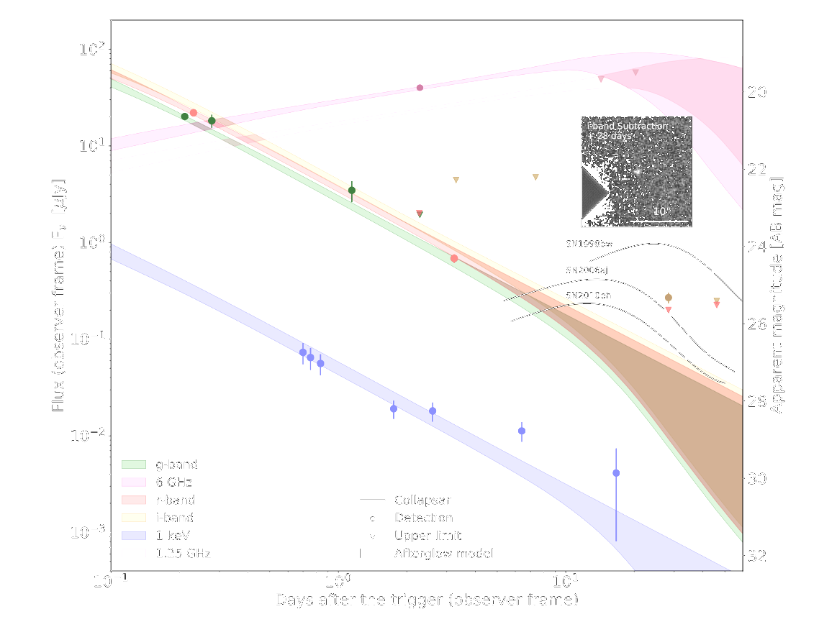
A 1-s GRB from core-collapse
GRB 200826A
Zhang,B.-B et al 2021,Nature Astronomy, Tomas et al.. 2021,Nature Astronomy,

Slide 20
What Collapses?
- Still a standard massive star Two options to make a 10-s Collapsar GRB short:
Increase baryon flavors in the jet (week jet; low S/N)
Allocate dedicated 9s to facilitate breakout (coincidence)
Zhang,B.-B et al 2021,Nature Astronomy, Tomas et al.. 2021,Nature Astronomy,

Slide 21
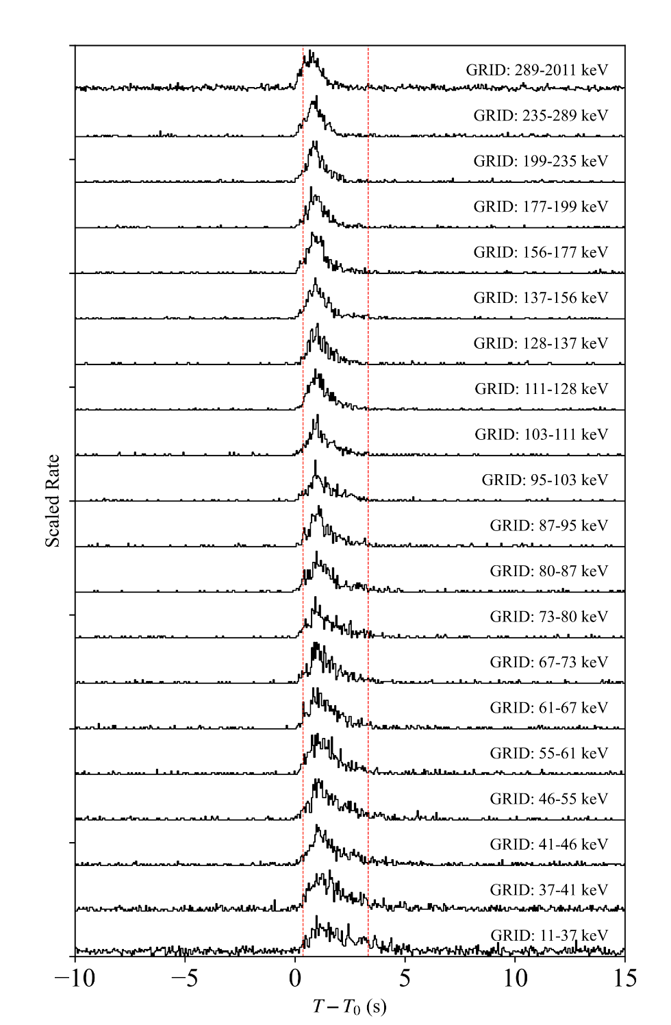
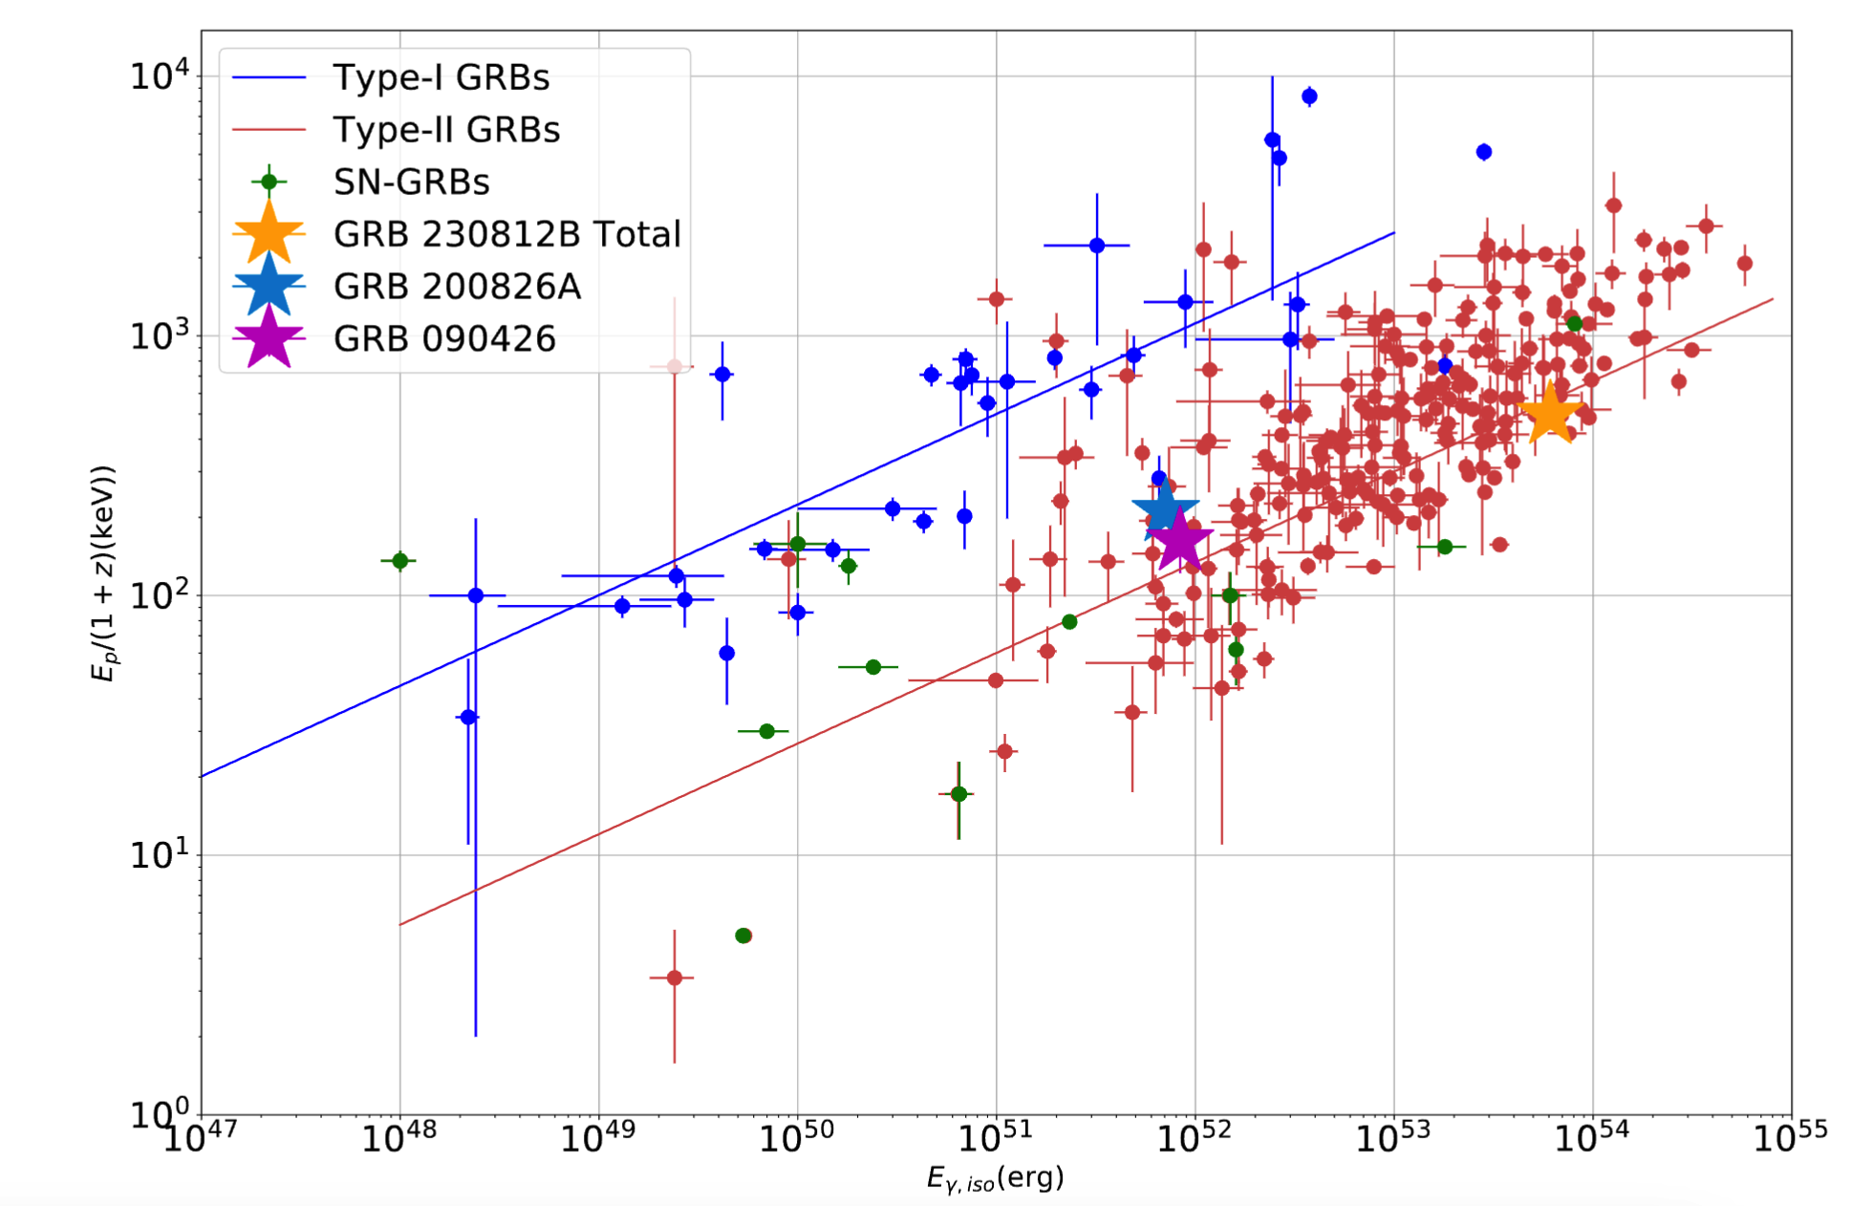
What Collapses?
- Still a standard massive star Two options to make a 10-s Collapsar GRB short:
Increase baryon flavors in the jet (week jet; low S/N)
Allocate dedicated 9s to facilitate breakout (coincidence) if 10-9 = 1, why not 10-7=3?
GRB 230812B, Wang, C.-Y. et al. 2024, in prep; GRID GRB

Slide 22
What Collapses?
- Still a standard massive star Two options to make a 10-s Collapsar GRB short:
Increase baryon flavors in the jet (week jet; low S/N)
Allocate dedicated 9s to facilitate breakout (coincidence)
- A Non-standard collapsar
$t_{ff}∼(\frac{3π}{32Gρ})^{1/2}∼210s\left(\frac{\overline{ρ}}{100gcm^{−3}}\right)$^{-0.5}
$∼a few s\left(\frac{\overline{ρ}}{ρWD}\right)$^{-0.5}
GRBs from Collapse of Thorne–Żytkow–like Objects as the Aftermath of WD-NS Coalescence

Slide 23
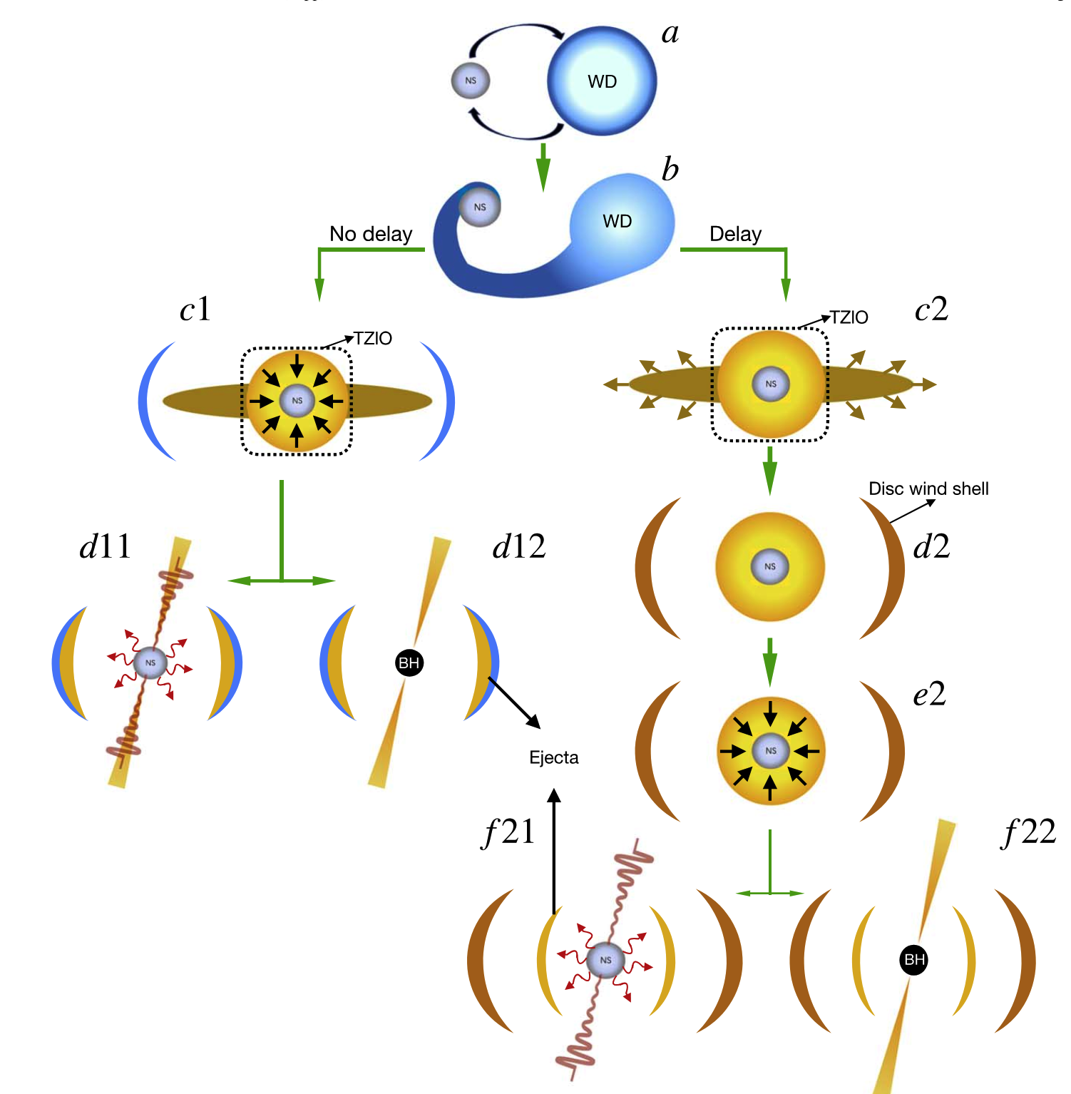
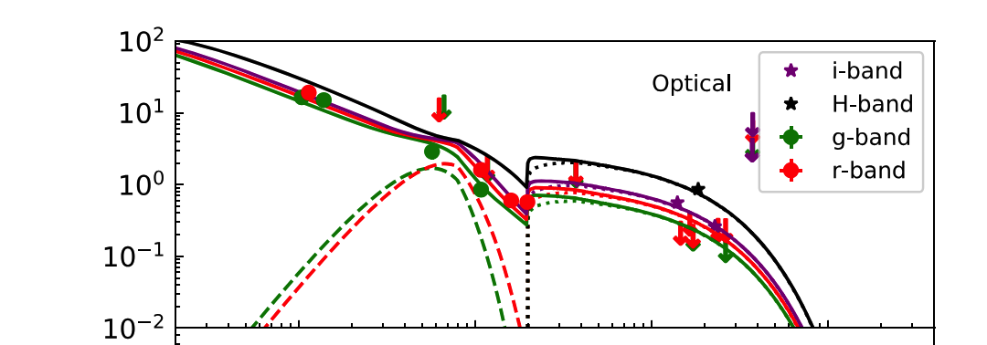
GRBs from Collapse of Thorne–Żytkow–like Objects as the Aftermath of WD-NS Coalescence
Case f21:
The ejected material can be further heated by the magnetic dipole radiation of the central magnetar and radiate as an optical bump in observation. Furthermore, the ejected material can also interact with the disk wind shell at a larger radius and produce an additional late-time bump in the optical band.
Peng, Z.-K. Liu, Z.-K., Zhang, B.-B., and He Gao et al, 2024, ApJ 967, 156

Slide 24
What Collapses?
- Still a standard massive star Two options to make a 10-s Collapsar GRB short:
Increase baryon flavors in the jet (week jet; low S/N)
Allocate dedicated 9s to facilitate breakout (coincidence)
A Non-standard collapsar from a TZlO after NS-WD merger
What about if it is not short at all ?

Slide 25
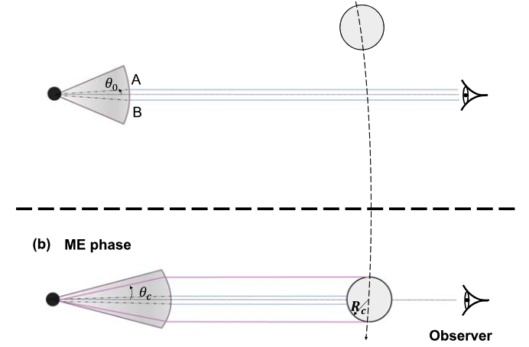
What Collapses?
- Still a standard massive star Two options to make a 10-s Collapsar GRB short:
Increase baryon flavors in the jet (week jet; low S/N)
Allocate dedicated 9s to facilitate breakout (coincidence)
A Non-standard collapsar from a TZlO after NS-WD merger
What about if it is not short at all ?
not short in gamma-ray, but blocked or due to jet precession (coincidence and/or in multibody system, Wang, X. I et al. 2022 )

Slide 26
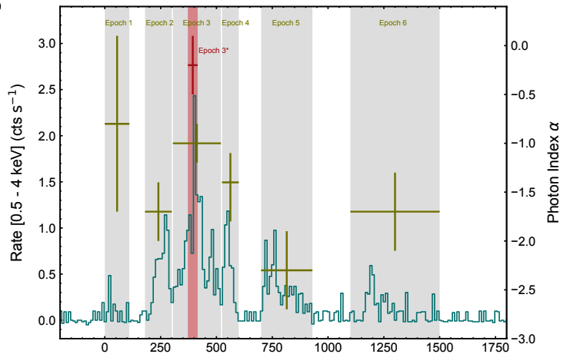
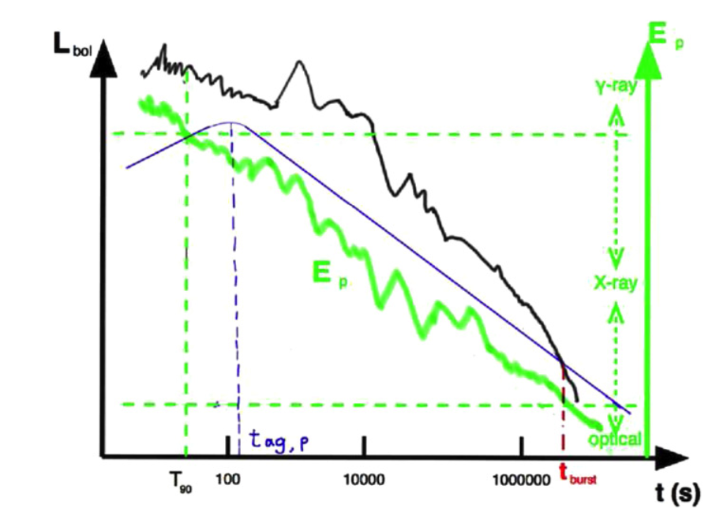
What Collapses?
- Still a standard massive star Two options to make a 10-s Collapsar GRB short:
Increase baryon flavors in the jet (week jet; low S/N)
Allocate dedicated 9s to facilitate breakout (coincidence)
A Non-standard collapsar from a TZlO after NS-WD merger
What about if it is not short at all ?
not short in gamma-ray, but blocked or due to jet precession (coincidence and/or in multibody system, Wang, et al. 2022 )
not short in other wavelength so the CE time scale is much longer (e.g, EP240315a)
(Liu, Y. et al. 2024, Zhang, B.-B. et al. 2014)
SVOM & EP will help to pin down these possibilities

Slide 27
How to distinguish mergers and collapsars Smoking Guns with trouble makers
 | Duration | Total Energy | Spectral Peak | Counterpart | GW | Host | Other
 | usually Long short |  |  | core-collapse supernova
 | usually Short long |  |  | r-process kilonova | LIGO GW
Collapsar
Merger

Slide 28
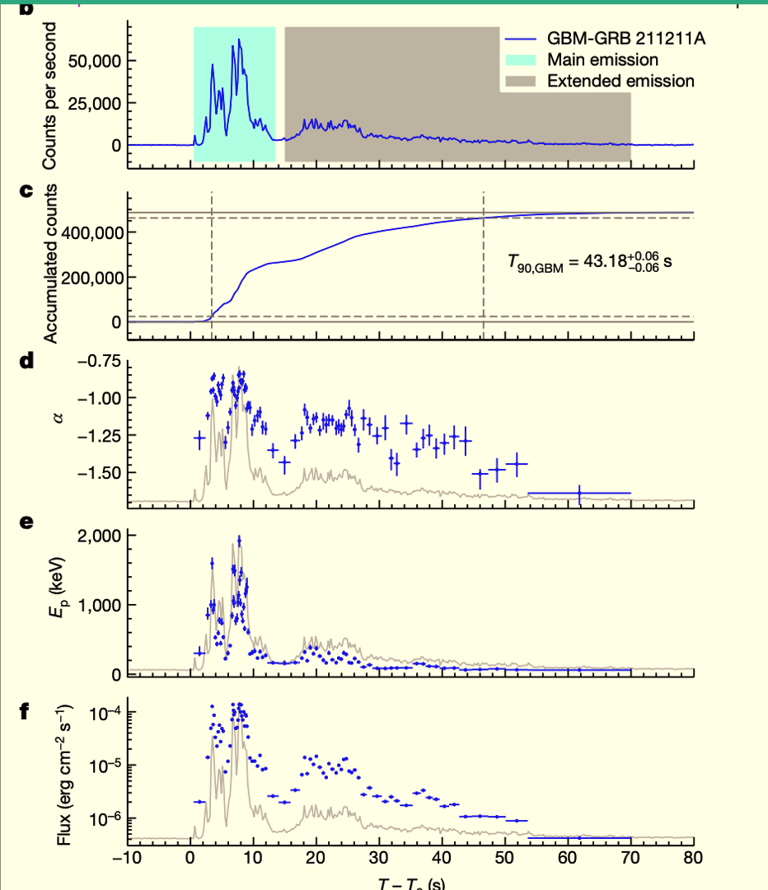
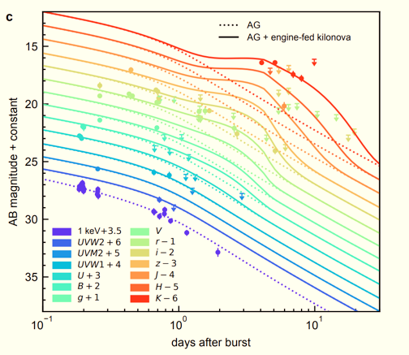
A 1-min GRB from merger
GRB 211211A
Yang, J., Ai, S, Zhang, B.-B. et al. 2022, Nature

Slide 29
What kind of mergers produce GRB-211211A-like events?
NS-NS timescale difficulties

Slide 30
What kind of mergers produce GRB-211211A-like events?
NS-NS timescale difficulties
NS+BH + fallback(+MAD)
Zhu, J.-P. et al. 2023
Gottlib, O. et al. 2023
But difficult on anti-correlation between luminosity and duration of X-ray plateau

Slide 31
What kind of mergers produce GRB-211211A-like events?
NS-NS timescale difficulties
NS+BH + fallback(+MAD)
NS-WD (case d11, immediate merger)

Slide 32
What kind of mergers produce GRB-211211A-like events?
NS-NS timescale difficulties
NS+BH + fallback(+MAD)
NS-WD (case d11, immediate merger)
rare NS-WD combination : requires q=mWD/mNS~1; produces a magnetar; neutron-rich wind launched during AIC of the WD to the NS.
ME — initial accretion phase (few sec)
EE — magnetic bubbles (Kluźniak & Ruderman 1998; Ruderman 2000)
X-ray Plateau — spin-down power of the long lasting central engine
KN — engine-fed kilonova; energy injection from the magnetar central engine

Slide 33
What kind of mergers produce GRB-211211A-like events?
NS-NS timescale difficulties
NS+BH + fallback(+MAD)
NS-WD (case d11, immediate merger)
rare NS-WD combination : requires q=mWD/mNS~1; produces a magnetar; neutron-rich wind launched during AIC of the WD to the NS.
ME — initial accretion phase (few sec)
EE — magnetic bubbles (Kluźniak & Ruderman 1998; Ruderman 2000)
X-ray Plateau — spin-down power of the long lasting central engine
KN — engine-fed kilonova; energy injection from the magnetar central engine

Slide 34
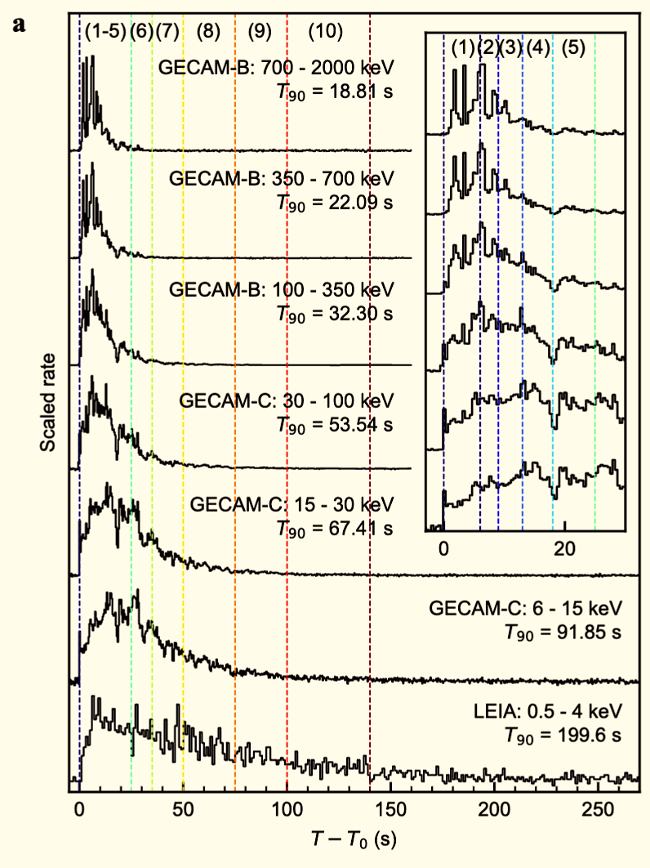
What kind of mergers produce GRB-211211A-like events?
NS-NS timescale difficulties
NS+BH + fallback(+MAD)
NS-WD additional support from GRB 230307A (long duration, with KN and magnetar )
Sun, H. et al. 2024 under revision

Slide 35
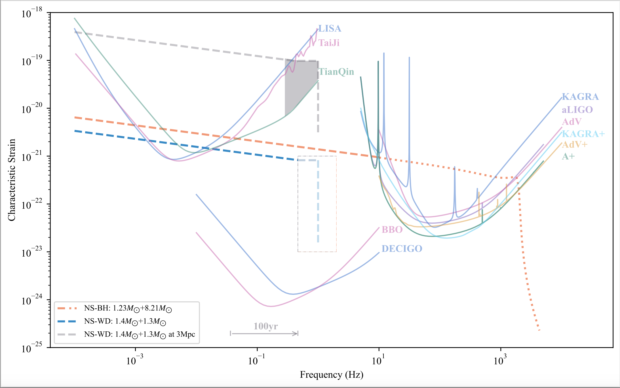
What kind of mergers produce GRB-211211A-like events?
NS-NS
NS+BH
NS-WD
GW can tell
___
detectors noise
- - - - - - - -
GW signals
Yin , Y. I. et al. 2023

Slide 36
How to Unveil the Progenitors of GRBs?
 | Duration | Total Energy | Spectral Peak | Counterpart | GW | Host | Other
 | usually long | high, e.g, 1e50-54 erg | lower Ep; softer spectra | core-collapse supernova | N/A | younger, SFR high, small offset | e.g., follow collapsar-type GRB correlations
 | usually short | low , e.g, 1e49 erg | higher Ep; harder spectra | r-process kilonova | LIGO GW | older, SFR low, large offset | e.g., follow merger-type GRB correlations
Red Flag
Clear Evidence
Smoking Gun
Clear Evidence
Collapsar
Merger

Slide 37
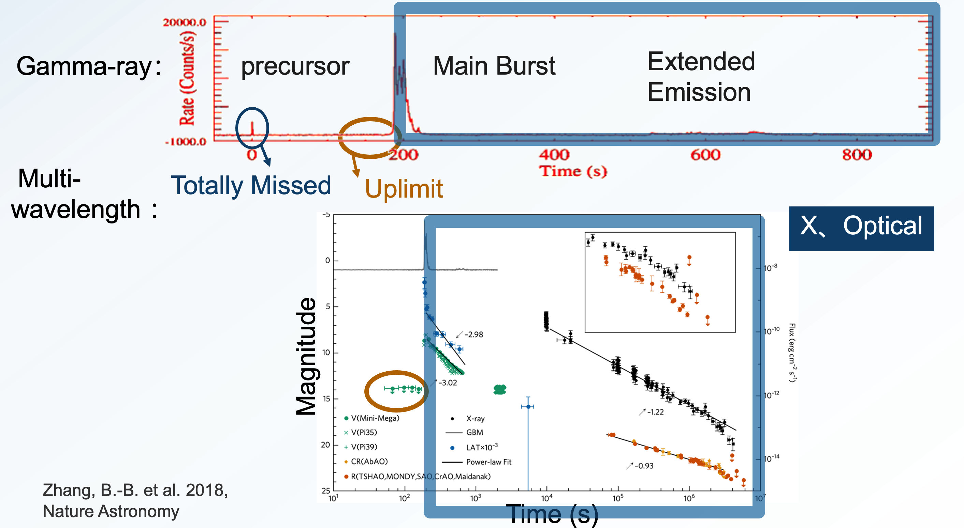
How to Unveil the Progenitors of GRBs?
 | Duration (and how we measure it)
 | usually long
 | usually short
Multi-wavelength observations
with full-time coverage
are key to unveiling GRB progenitors
Red Flag
Collapsar
Merger

Slide 38
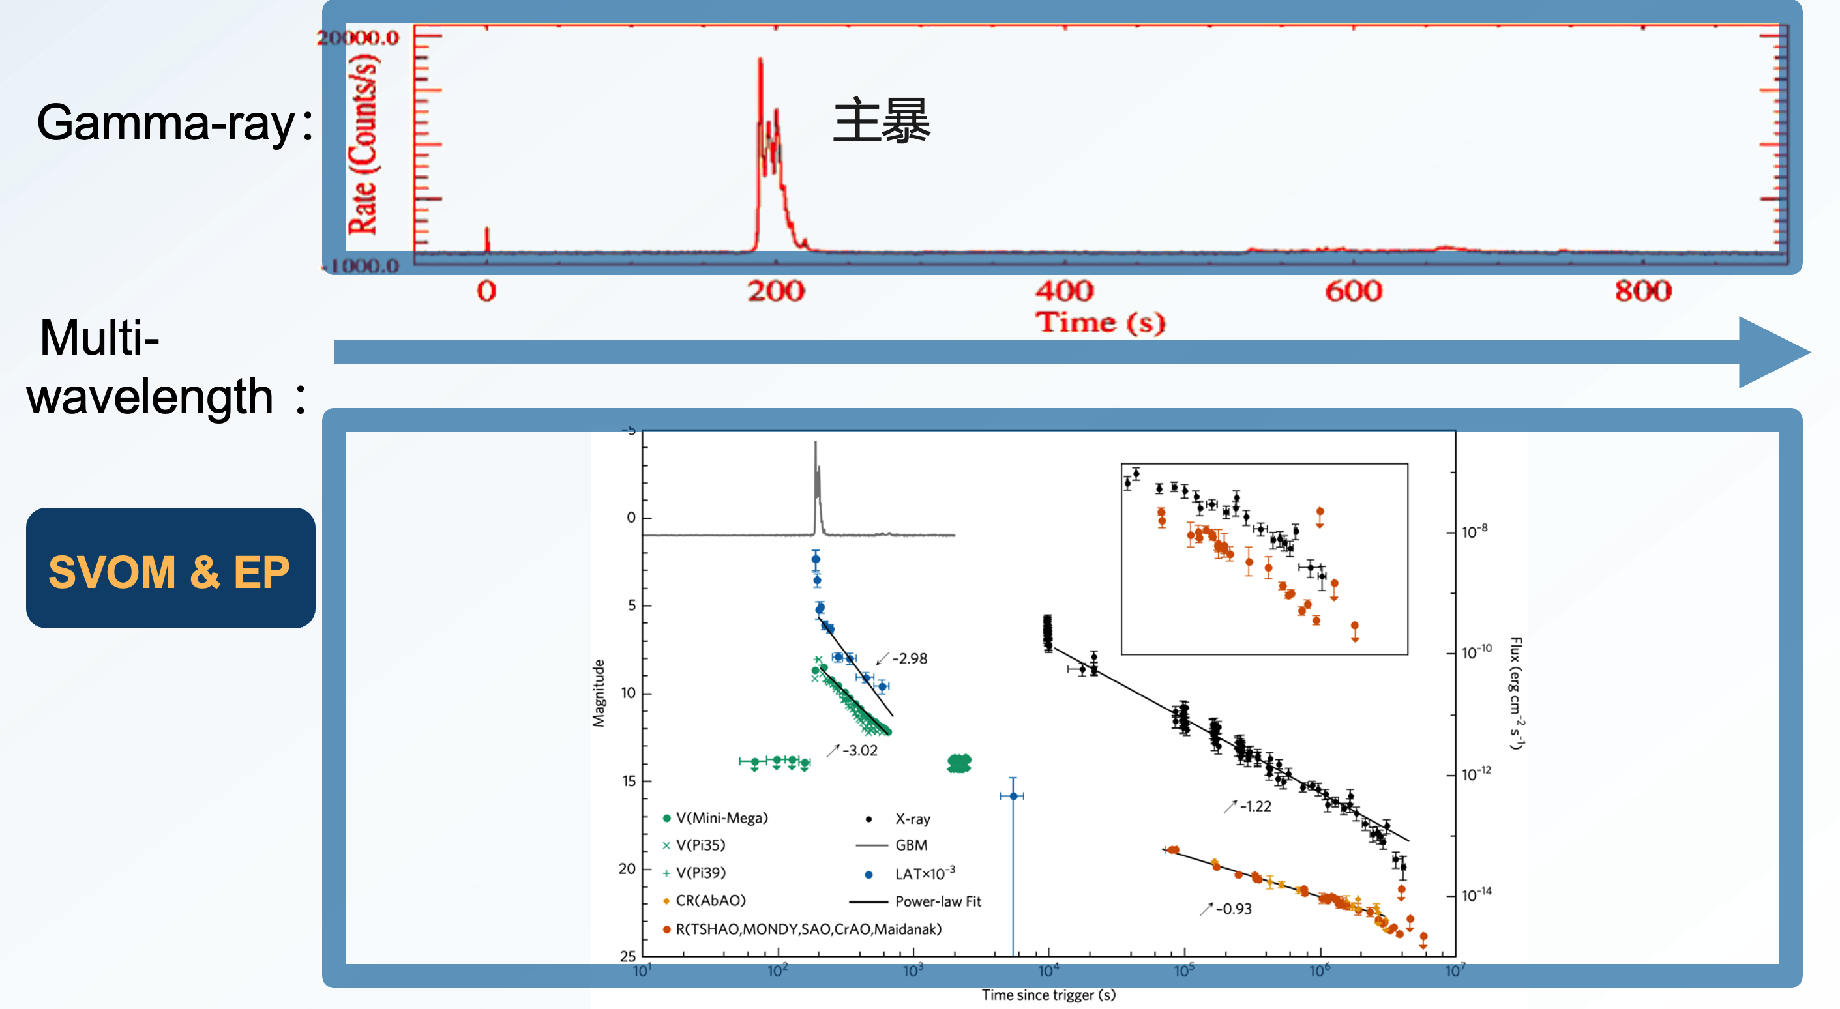
How to Unveil the Progenitors of GRBs?
 | Duration (and how we measure it)
 | usually long
 | usually short
Multi-wavelength observations
with full-time coverage
are key to unveiling GRB progenitors
Red Flag
Collapsar
Merger

Slide 39
Open Questions/Alternative models :
BH-WD mergers
Supra-Massive Neutron Stars Collapse (a middle step of merger or collapsar)
Induced Collapse of NS binary due to gravitational perturbations or tidal forces from its companion
Primordial Black Holes – NS merger
Strange Star/Quark Star binary
Neutron Star Crust Collapse/Strangulation
Charged BH-BH NS-BH Binary
Cosmic String Interactions
GRB progenitor with a companion
Non-GRB progenitor (but producing GRB like events): Magnetar Flares (GRBs 200415A, 231115A), TDEs
Progenitors of GRB Progenitors

Slide 40
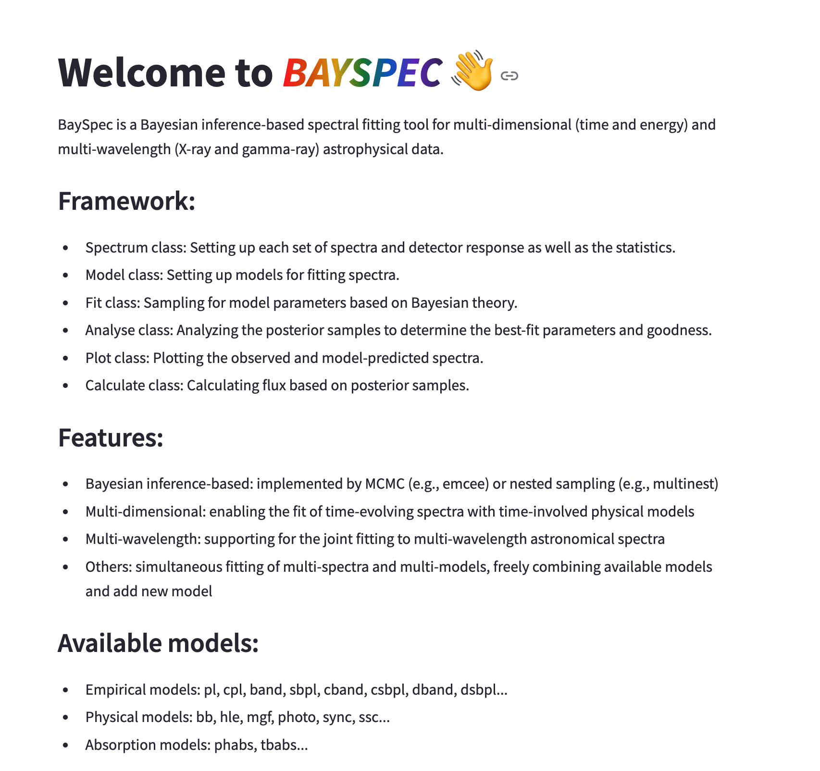
Thanks!

Slide 41
