Slide 1
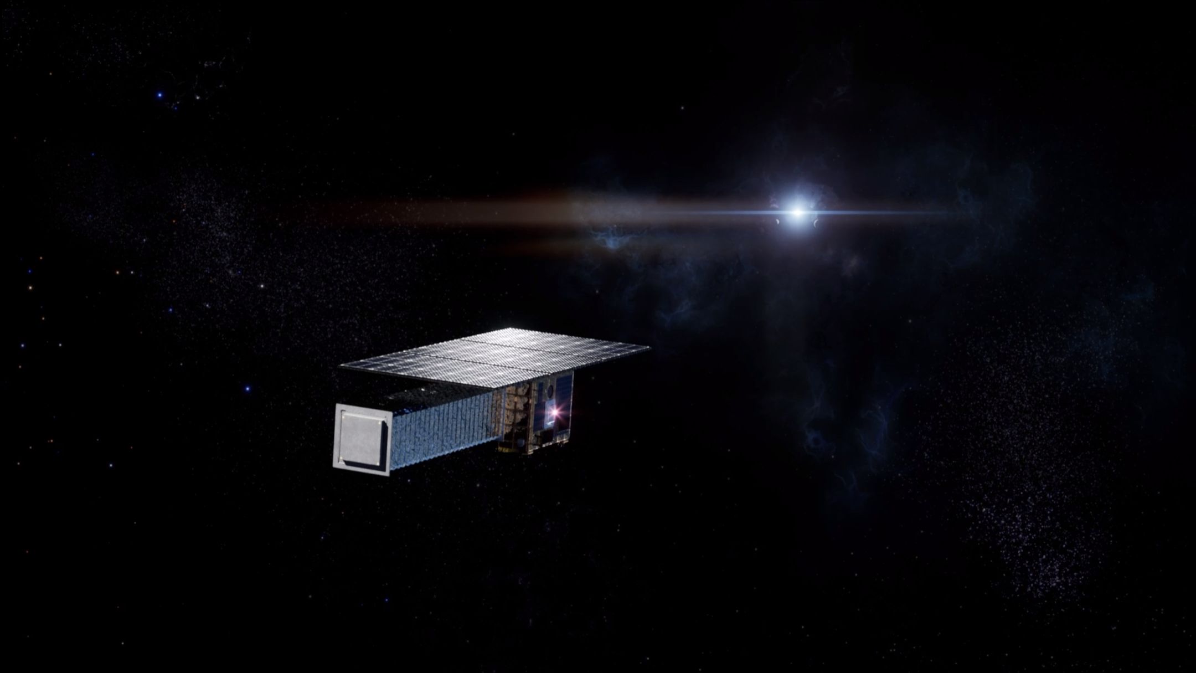
The CATCH mission, objectives of the Pathfinder-A and link with SVOM
TAO, Lian (taolian@ihep.ac.cn)
on behalf of the CATCH team
2024.6.23

Slide 2
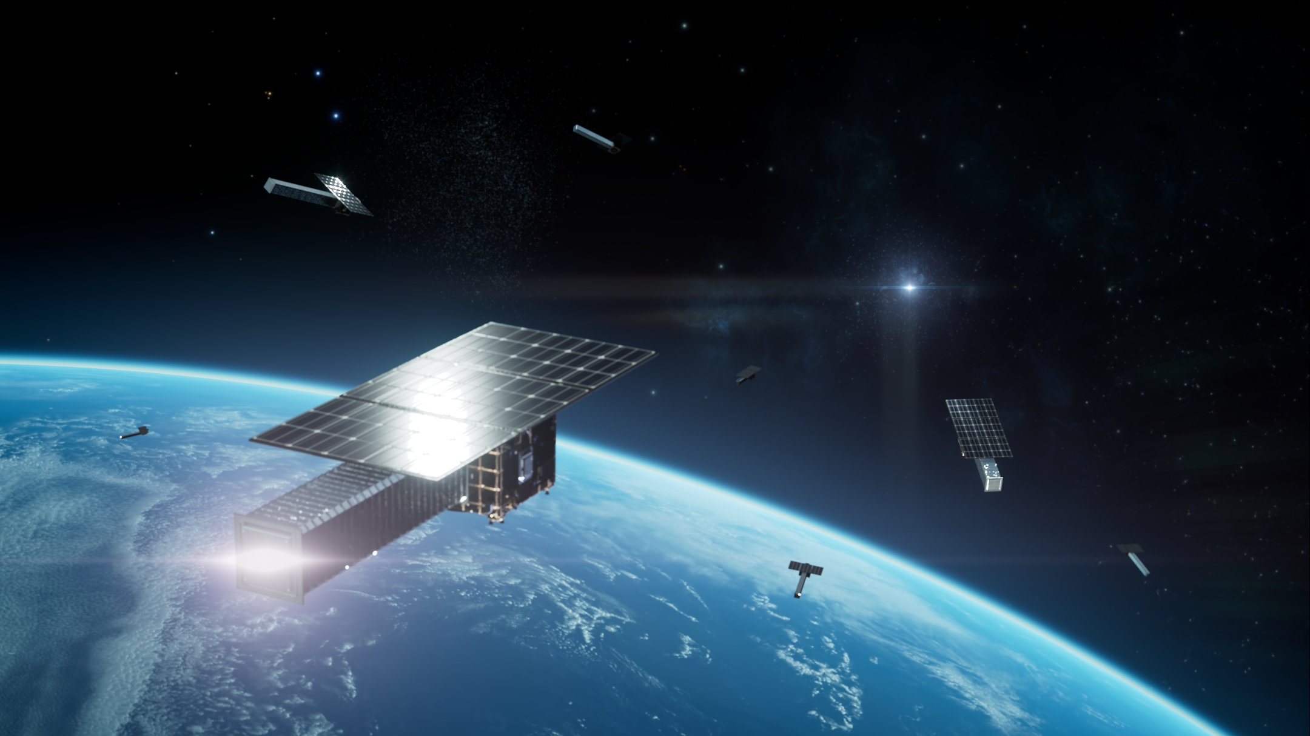
Chasing All Transients Constellation Hunters (CATCH)
“全变源追踪猎人星座”计划
An X-ray astronomical constellation composed of
hundreds of microsatellites
More information:
arXiv: 2210.06109
arXiv: 2305.08589
arXiv:2402.15275

Slide 3

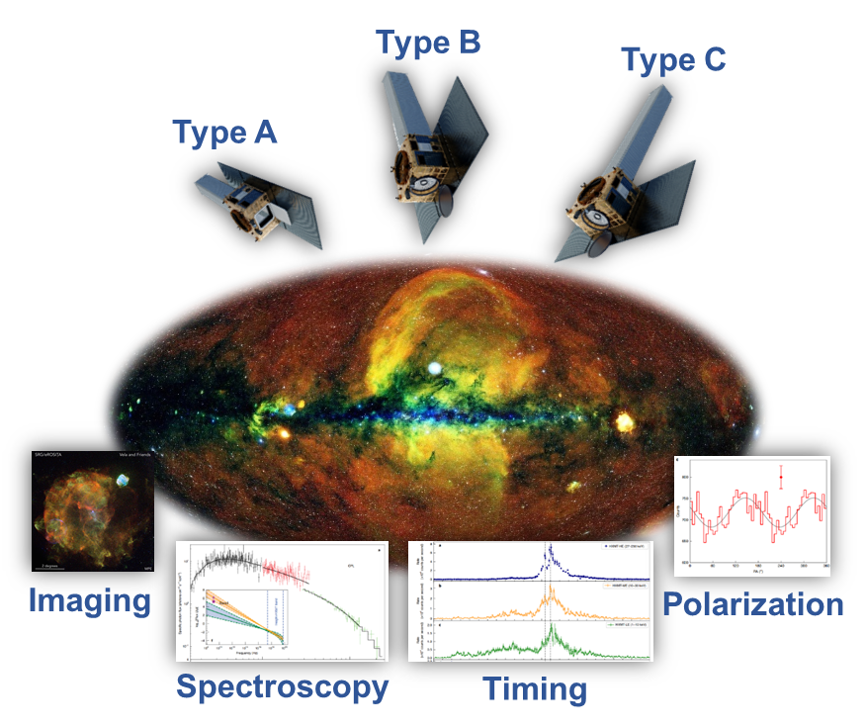
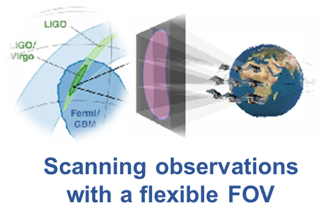
Chasing All Transients Constellation Hunters (CATCH)
What is CATCH?
  Intelligent X-ray constellation that consists of 126 microsatellites in 3 types
  3 orbital planes, 550 km, inclination 29⚬
  perform follow-up observations for transients
  What CATCH will do?
  Controlled by the intelligent system
  CATCH will perform:
  Uninterrupted monitoring
  All-sky follow-up observations
  Scanning observations with
  flexible field of view (FOV)
  Multi-parameter observations:
  Imaging, spectroscopy, timing, polarization
arXiv:2210.06109 for more info
CATCH will be a powerful mission to study the dynamic universe!

Slide 4
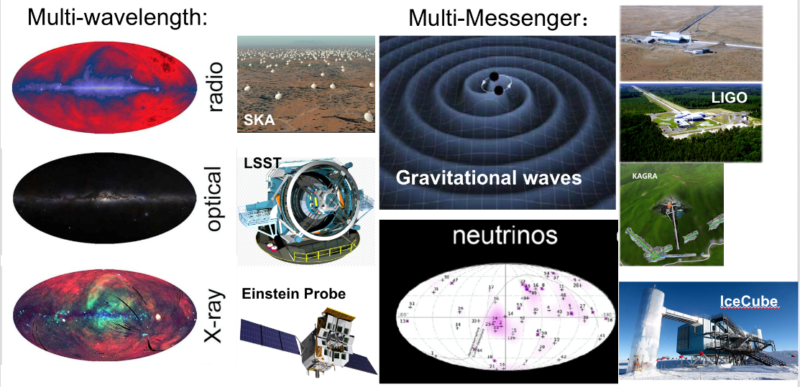
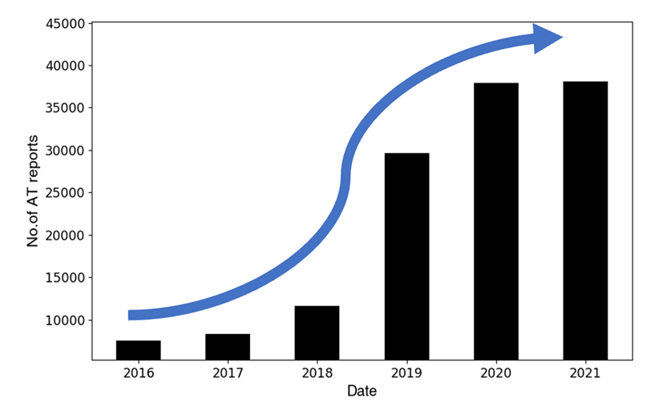
Why we need CATCH?
The catalog of transients is growing rapidly
Challenge: How to conduct follow-up observations for such a large number of transients?
Before June 2024, China has only two X-ray astronomic satellites (Insight-HXMT and EP)
There are only a handful of X-ray astronomic satellites in the world
Because of such a satellite:
  The cost ranges from several hundred million to tens of billions of US dollar
  Development and launch time ranges from several years to decades
  Run by a team of dozens to hundreds of people
  Lifespan ranges from 0 years (launch failure) to around ten years (perfect)
Growth in the number of transients in the Transient Name Server (TNS)

Slide 5
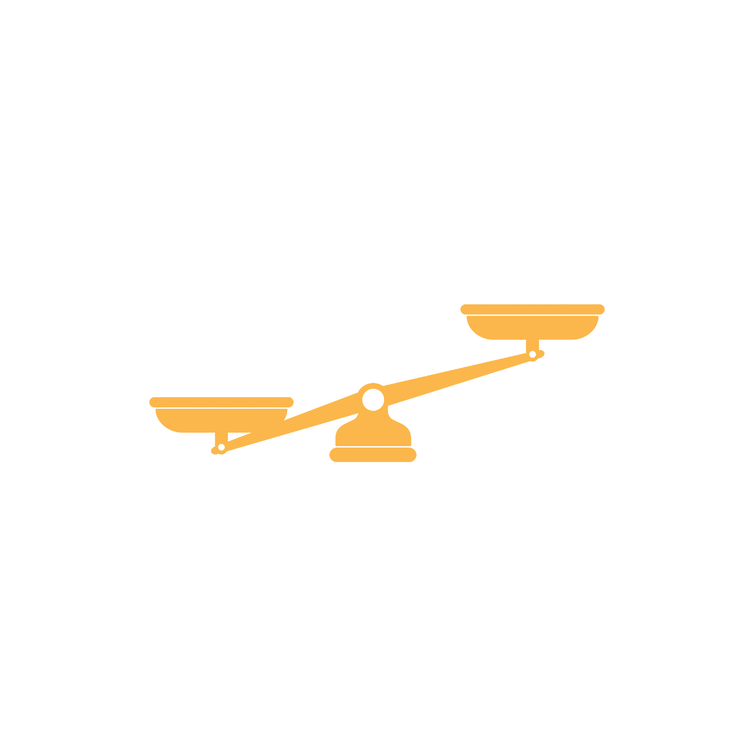

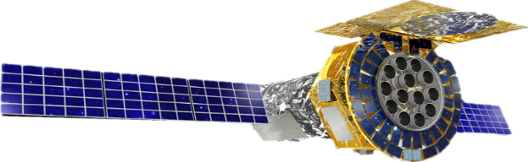
Break the unbalance!
Why we need CATCH?
Regular X-ray satellites:
The cost ranges from several hundred million to tens of billions of US dollar
Development and launch time ranges from several years to decades
Run by a team of dozens to hundreds of people
Lifespan ranges from 0 years (launch failure) to around ten years (perfect)
CATCH:
The cost of a single satellite runs into 1-2 million US dollar
Mass production，development and launch period 2-3 years
Intelligent control operations are essential for managing the constellation
Replacing disabled satellites, and ensuring the success rate and longevity of the mission.
follow-up mission (scarce)
large amounts of transients

Slide 6
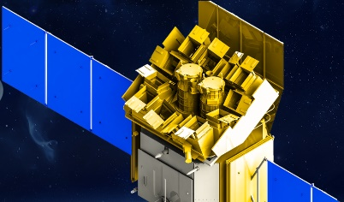


Why we need CATCH?
Survey telescopes: find transients
CATCH: performs follow-up observations
Observatories: do fine measurements
CATCH could bridge the survey telescopes and large observatories.

Slide 7
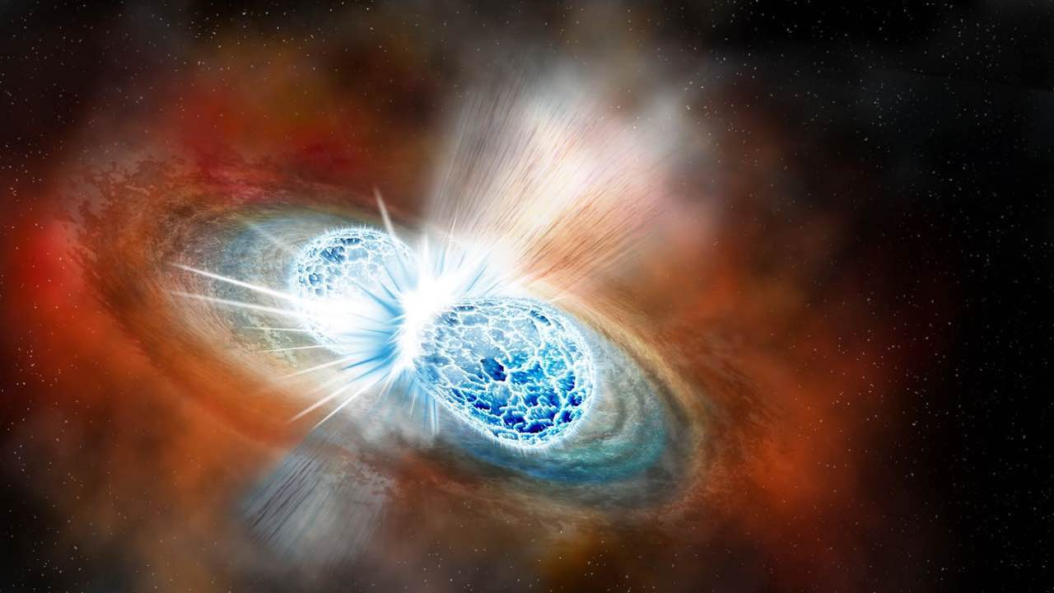
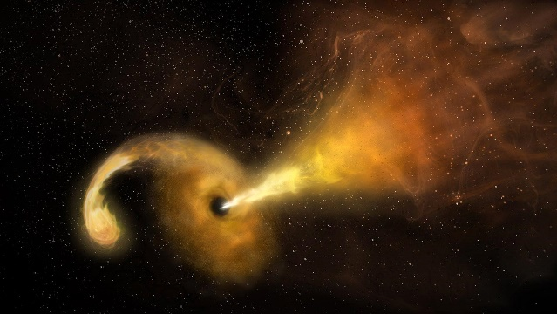
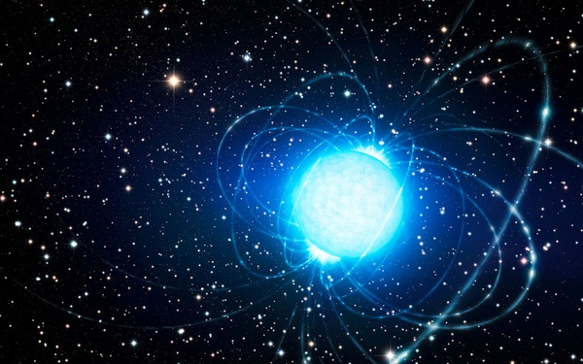
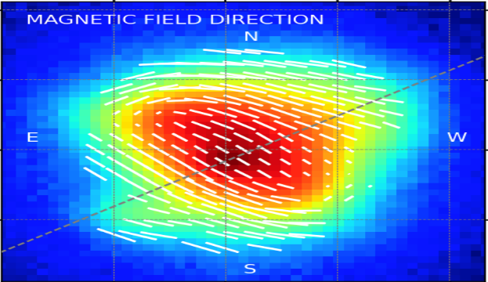
Scientific goals
  To study the Dynamic Universe via X-ray follow-up observations of transients
  CATCH not only has the ability to screen important targets for large observatories through follow-up observations, but it is also very powerful, including
Efficient search for electromagnetic counterparts of GWs (multi-messenger events):
How do compact objects merge?
How is the electromagnetic radiation produced?
Most complete follow-up observations of multi-wavelength transients:
Search for high-energy radiation of multi-wavelength transients
Discover hidden compact objects or physical processes
Highest cadence monitoring of extreme outbursts:
Reveal the physical origin of short-timescale bursts, such as fast radio bursts
Understand the physical processes under extreme magnetic fields, gravity, and density
Multi-parameter properties of extreme objects:
Understand the accretion geometry and magnetic field structure of compact objects

Slide 8
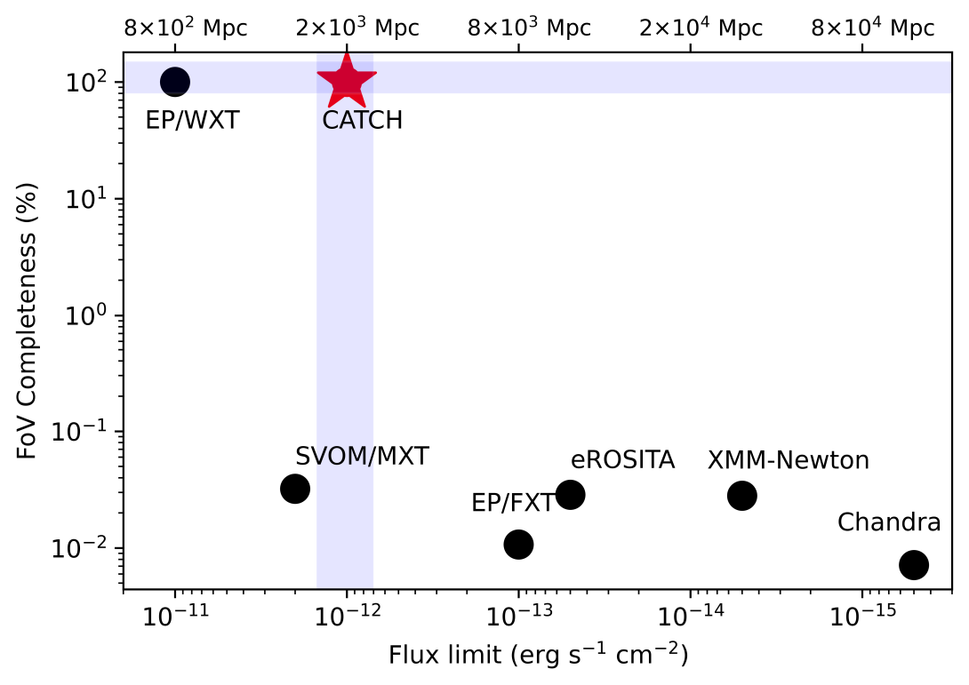
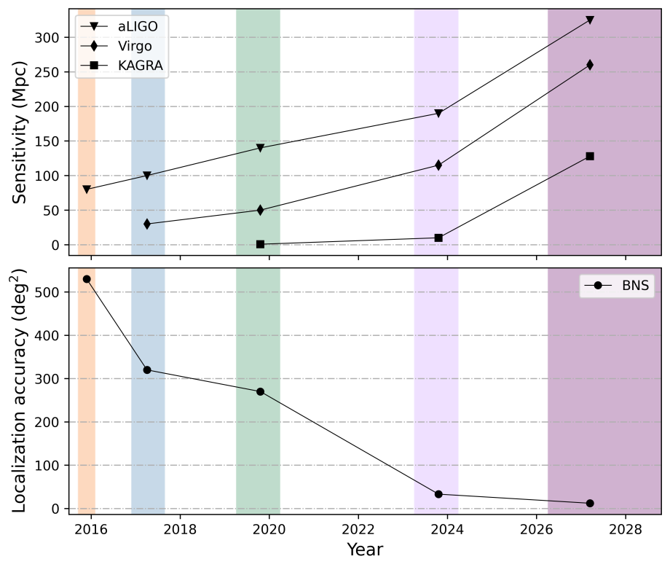
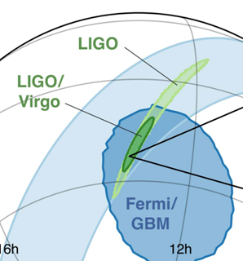
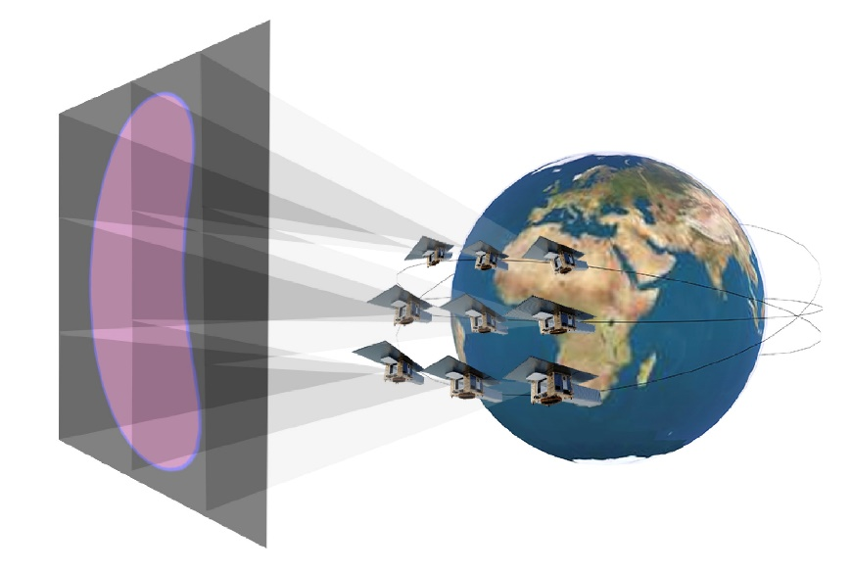
Scanning observations with a flexible FOV
Most efficient search for electromagnetic counterparts of GWs (multi-messenger events)
Covering 100% of the GW localization region
Better sensitivity than all-sky monitors
By 2030s, the localization of GW ~ 10-20 degree²:
10-20 CATCH satellites can cover the region
multiple satellites form a “large” telescope, with the FOV similar to the localization region

Slide 9
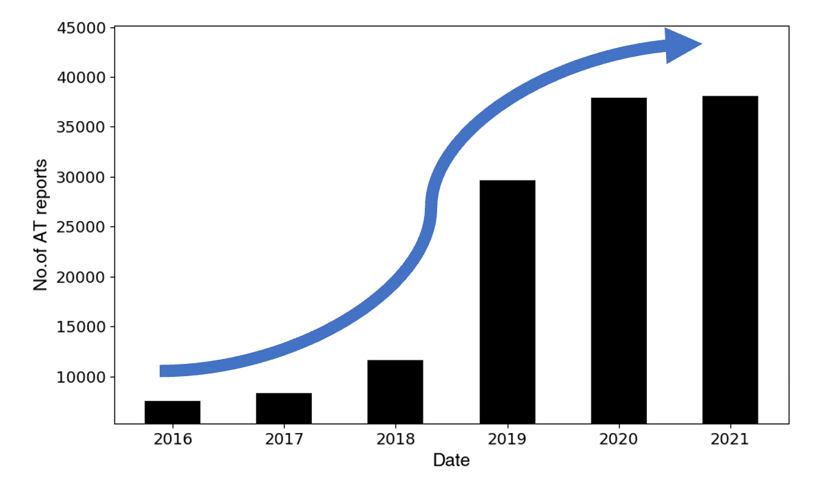
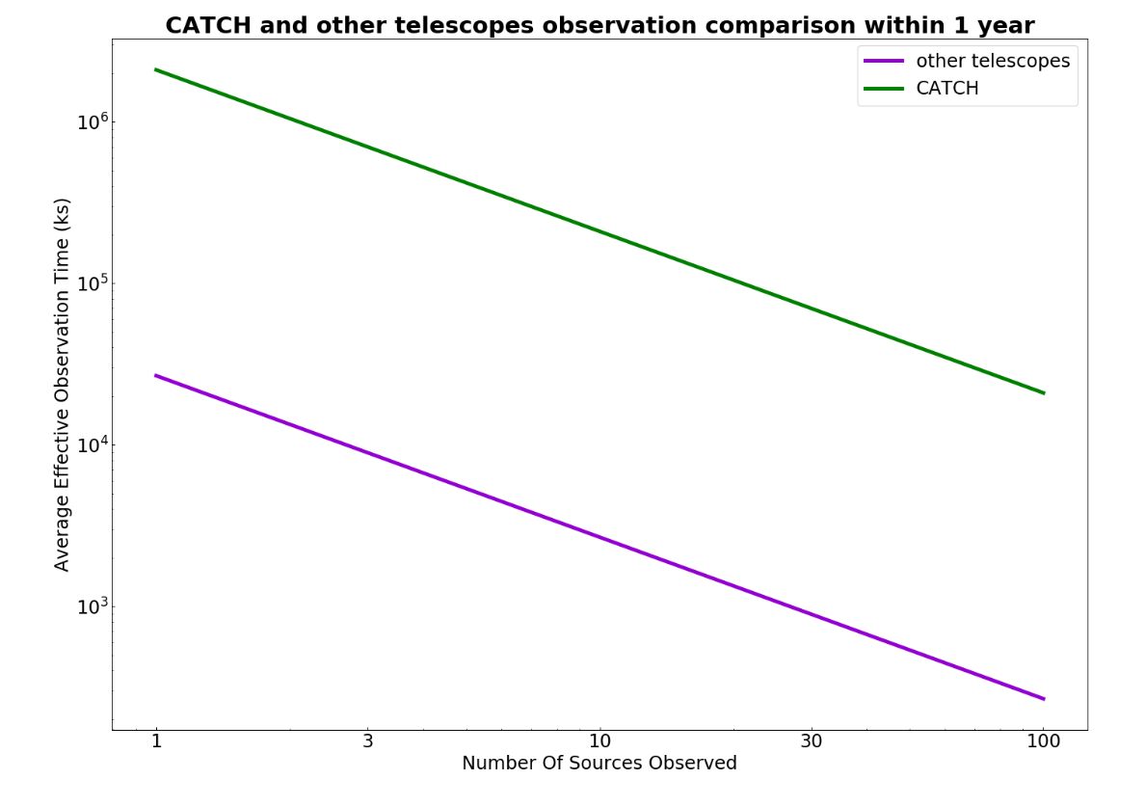
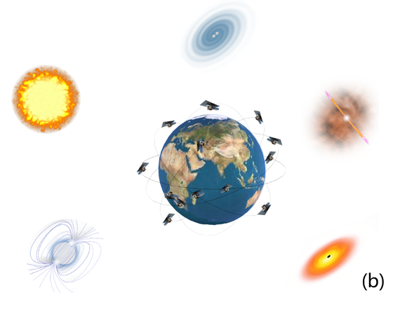
All-sky follow-up observations
Most complete follow-up observations of multi-wavelength transients
CATCH
other telescopes
Transient number in TNS
  Increase the number of follow-up sources: 2 orders of magnitude
    find high-energy radiation of multi-wavelength transients
    discover hidden extreme objects
Performing observations in different sky regions

Slide 10
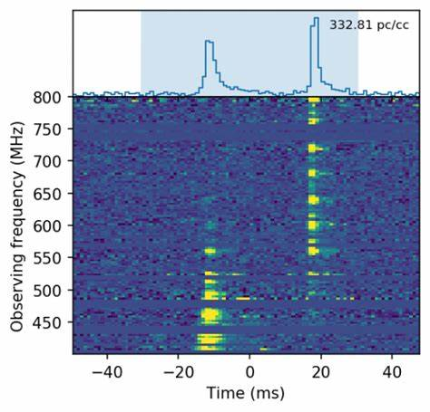
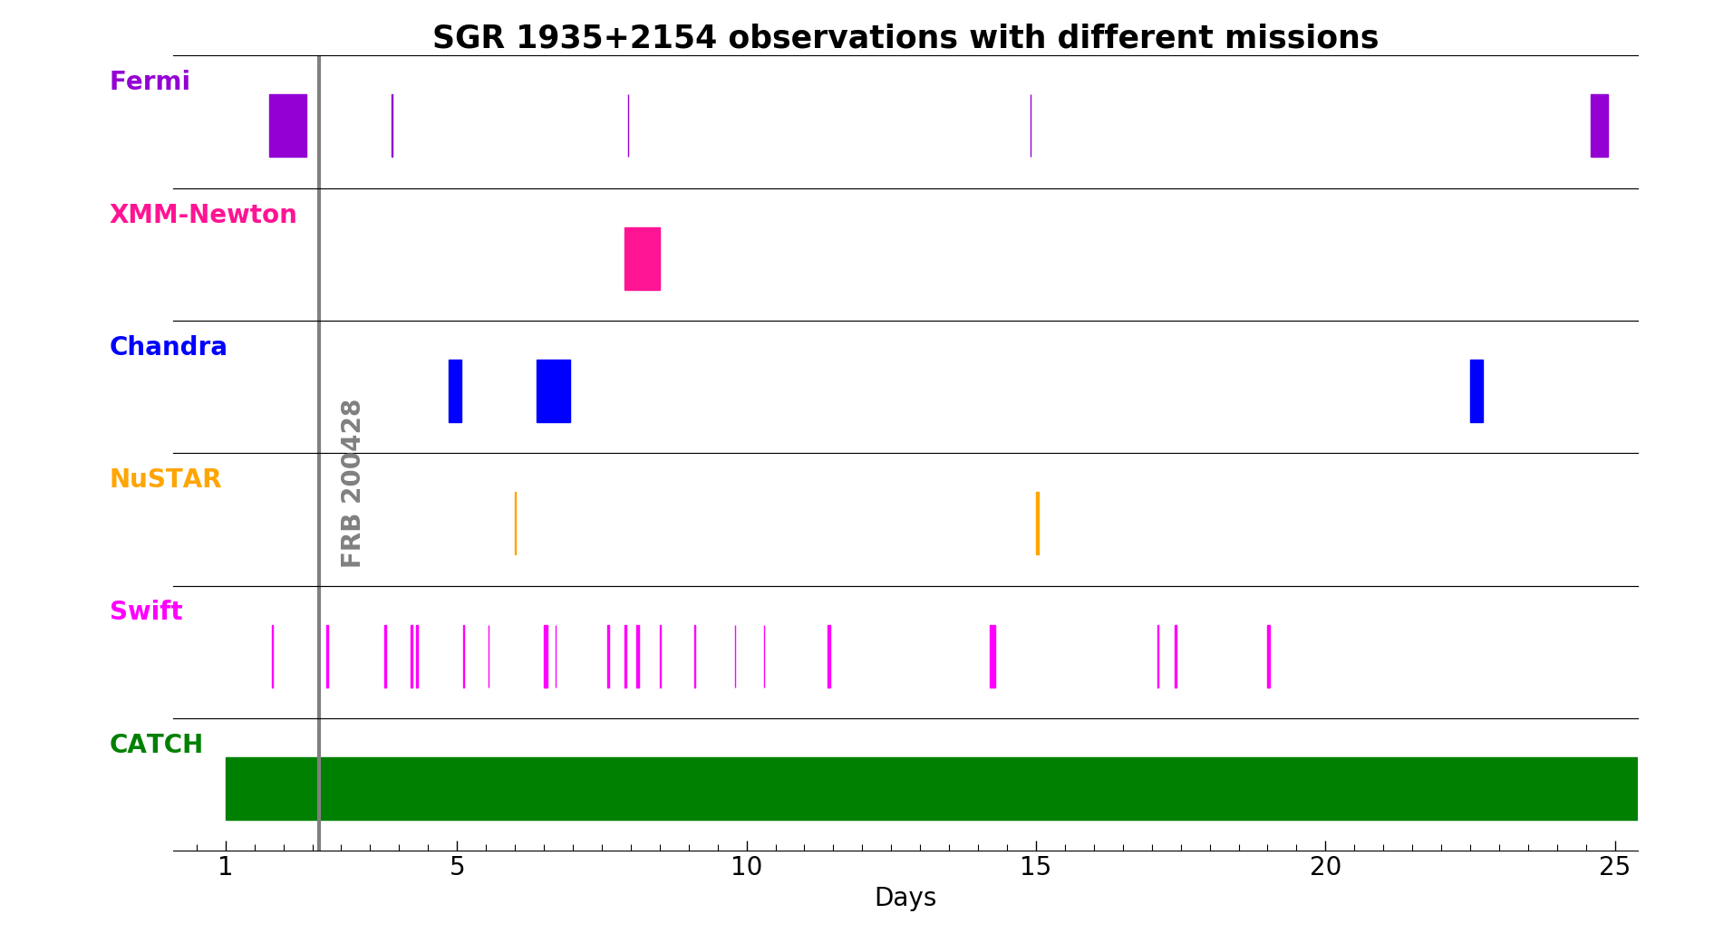
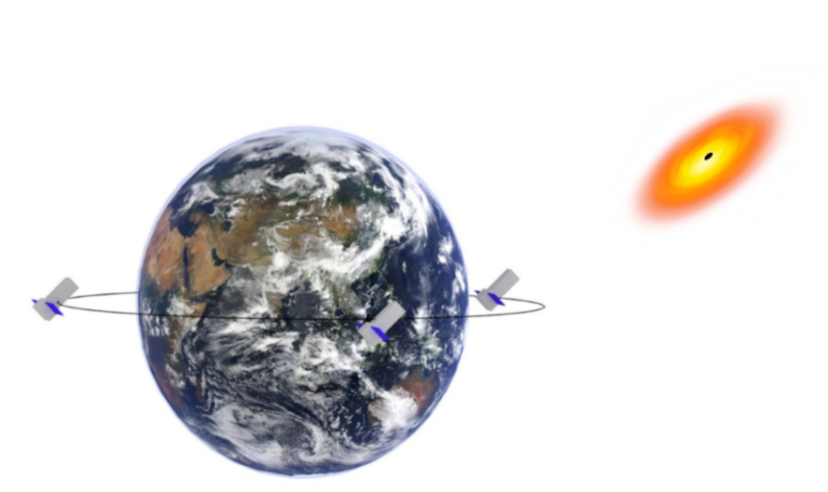
Uninterrupted (long-term) monitoring
Highest cadence monitoring of extreme outbursts
Take FRB 200428 as an example:
long-term, uninterrupted observations are needed
Perform relay coordinated observations: when one satellite enters into the SAA region or is blocked by the Earth, another satellite will take over its job.
  the first mission can perform uninterrupted, long-term monitoring:
    reveal physical origin of short burst phenomena : such as FRBs

Slide 11
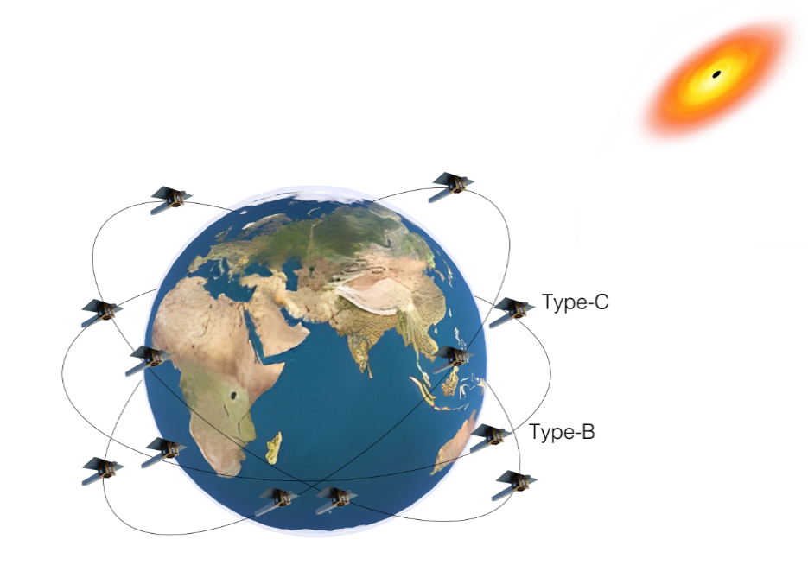
Multi-parameter observations
Multi-parameter (imaging, spectroscopy, timing and polarization) properties of extreme objects
 | timing (µs) | spectroscopy | imaging | polarization
CATCH | ✓ | ✓ | ✓ | ✓
eXTP | ✓ | ✓ | ✓ | ✓
IXPE | ☓ | ✓？ | ✓ | ✓
Chandra | ☓ | ✓ | ✓ | ☓
HXMT | ✓ | ✓ | ☓ | ☓
NICER | ✓ | ✓ | ☓ | ☓
Swift | ☓ | ✓ | ✓ | ☓
EP | ✓ | ✓ | ✓ | ☓
Capabilities of CATCH
Type-A: timing
Type-B: imaging, spectroscopy, timing
Type-C: polarization
  In addition to eXTP, the second X-ray mission: timing, spectroscopy, imaging, and polarization
    more flexible for transients (microsatellites)
    understand the accretion geometry and magnetic field structure of transients

Slide 12
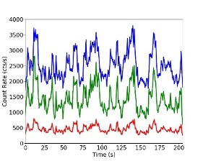
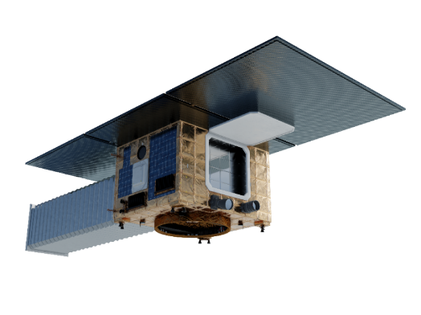
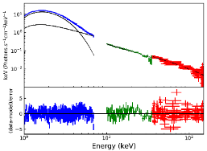
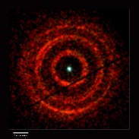
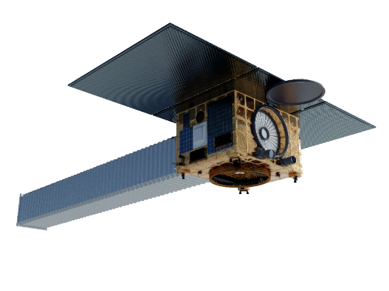
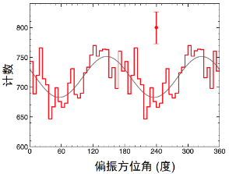
Preliminary design (full constellation)
Scientific ability
Satellite type
Satellite platform configuration
Timing
Type-A
108 satellites
Spectroscopy
Type-B
9 satellites
Imaging
Type-C
9 satellites
Polarization

Slide 13
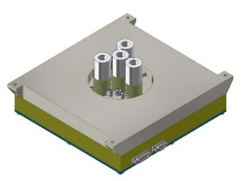
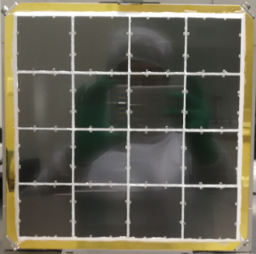
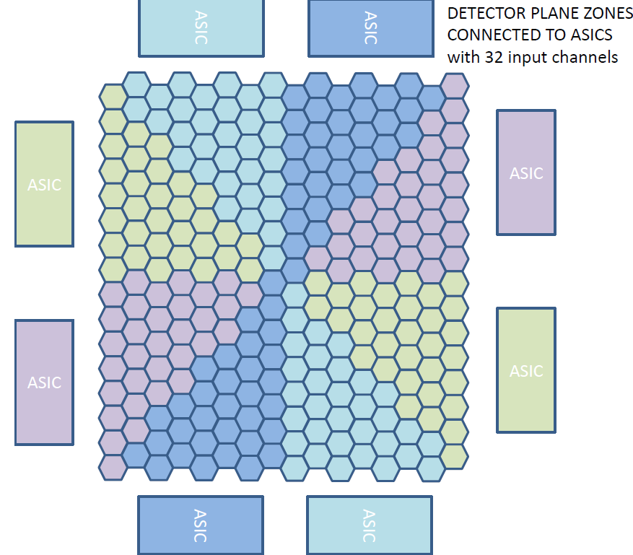
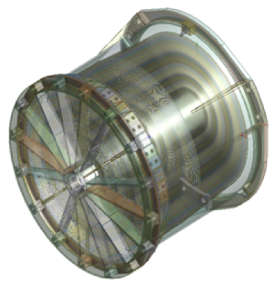
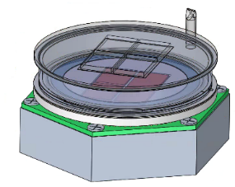
Preliminary payload plan
X-ray optics
Satellite type
Detector system
Narrow FoV MPO, compared to EP/WXT:
small FoV, longer focal length, larger effective area (~1 order of magnitude larger)
4-pixel SDD array, read quickly, pile-up free
Type-A
timing
256-pixel SDD array:
Offers positional resolution, good energy resolution
An alternative is pnCCD
Type-B
Timing, imaging, spectroscopy
Lightweight Wolter-I, good angular resolution
Inherit from EP/FXT and eXTP/SFA
Type-C
polarization
Gas polarization detector GMPD or GPD
lightweight, large effective area

Slide 14
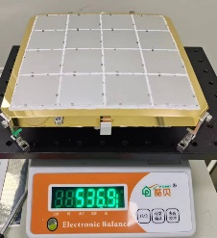
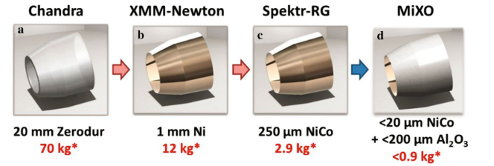
Lightweight X-ray optics
Lightweight X-ray optics enables high-sensitivity X-ray observations on small satellite platforms.
MPO:
  Glass (micro-pore), very lightweight < 1 kg
Lightweight Wolter-I (< 10 kg):
  Nickel cobalt (NiCO) alloy replaces the Nickel base, reducing the lens weight to 1/4
  NiCo+Al₂O₃ replaces the Ni base, reducing the lens weight to 1/12
Mass per unit effective area @ 1keV: at least 1 order of magnitude lower than traditional satellites!
Chandra | XMM-Newton | Type-A | Type B and C
Wolter-I | Wolter-I | MPO | Lightweight Wolter-I
18500 kg/m² | 2300 kg/m² | <250 kg/m² | <400 kg/m²

Slide 15
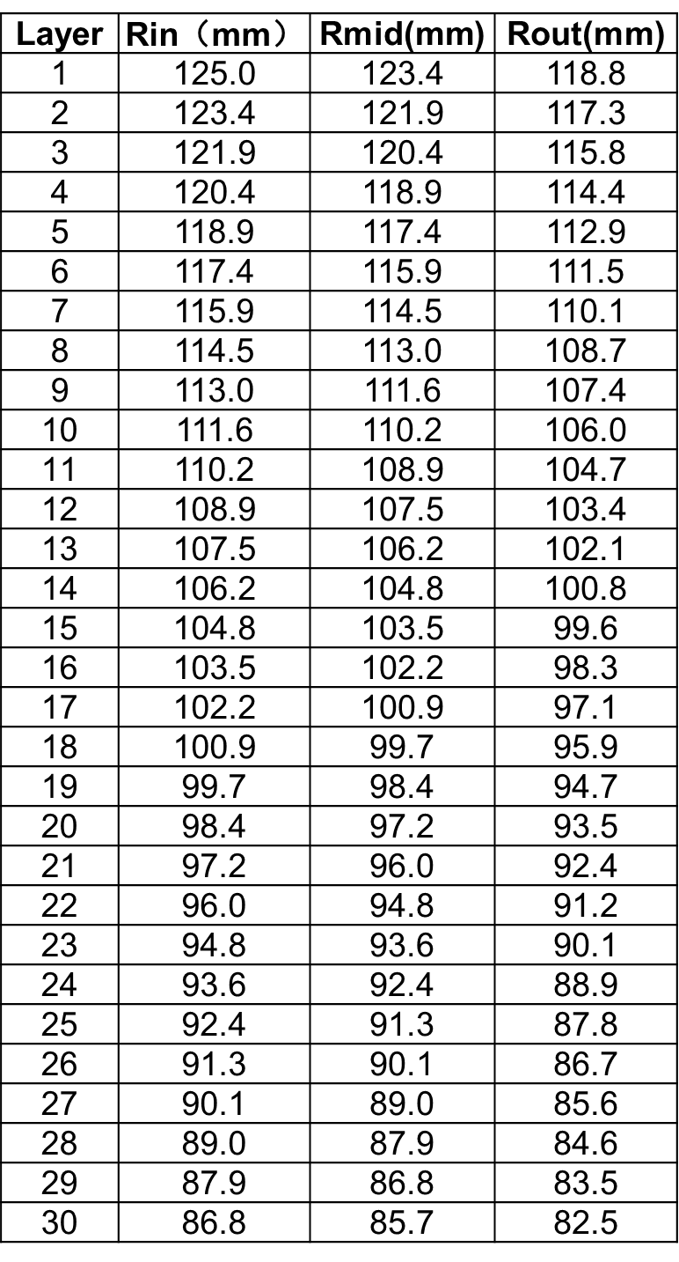
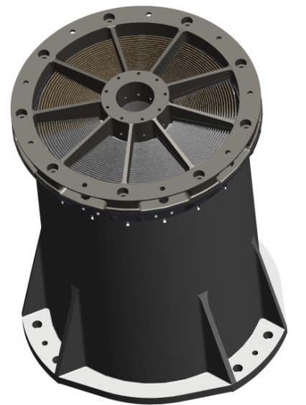
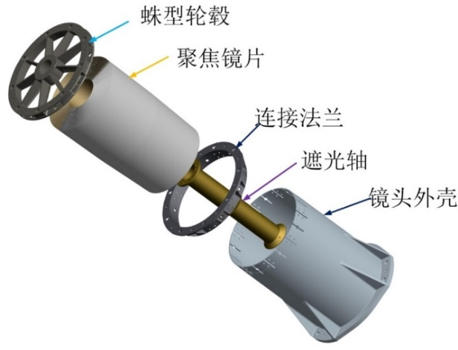
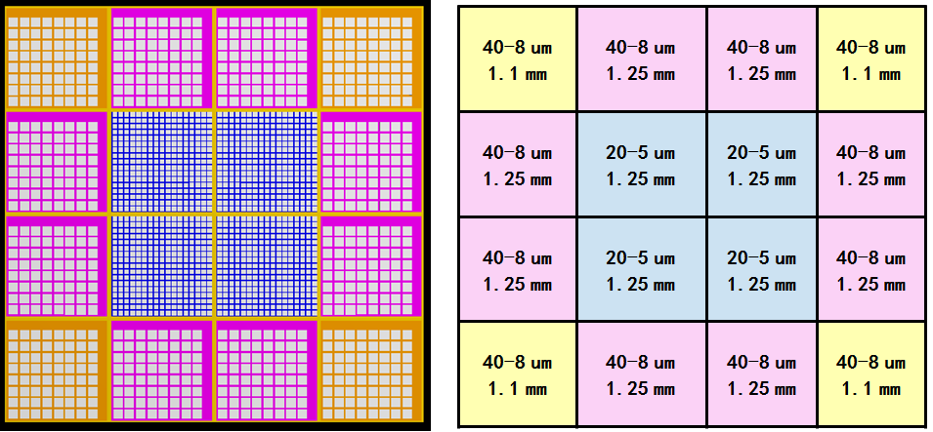
Design of the lightweight X-ray optics
Parameters of each layer of Wolter-I
Parameter | Type-A | Type-B | Type-C
Energy band | 0.5-4 keV | 0.3-10 keV | 2-8 keV
optics | MPO | Wolter-I | Wolter-I
Focal length | 1 meter | 2 meter | 3 meter
Effective area (optics) | >40 cm²@1keV | >120 cm²@1keV | >120 cm²@4.5keV
FoV | 1⚬×1⚬ | 0.5⚬×0.5⚬ | 0.25⚬×0.25⚬
Angular resolution | <5 arcmin | <2 arcmin | <1 arcmin
MPO piece parameter

Slide 16
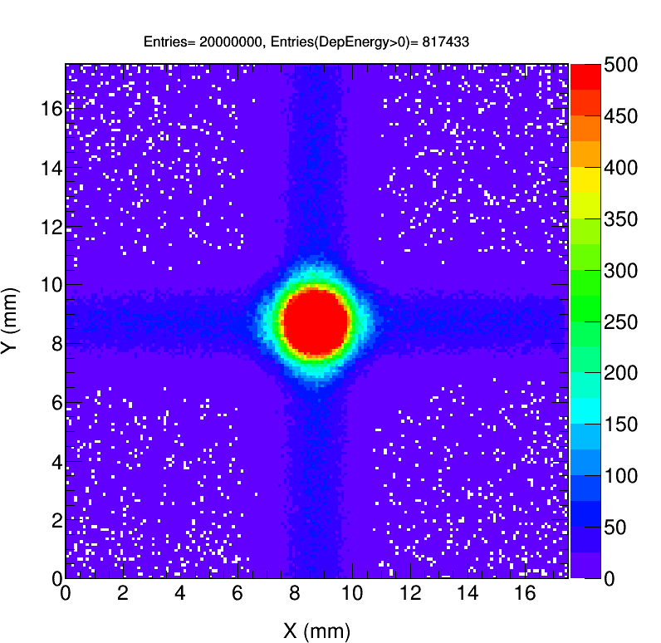
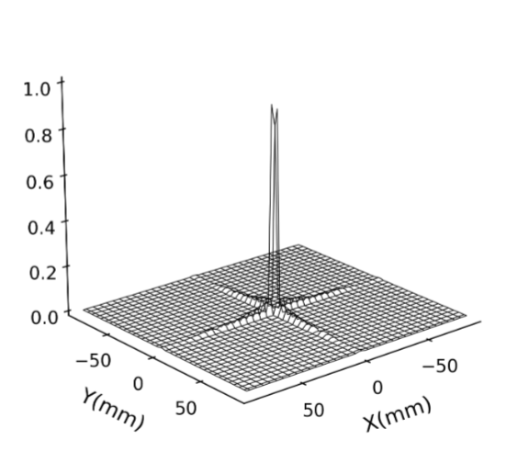
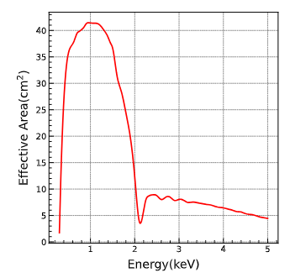
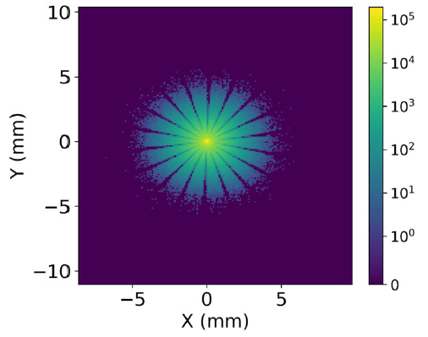
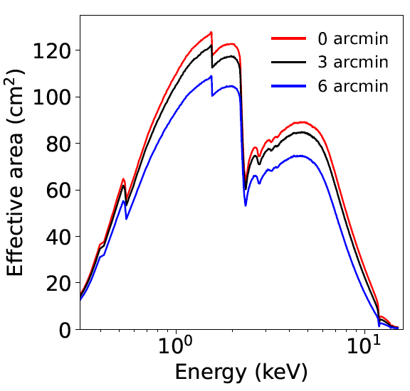
Simulation results of X-ray optics
Type-A
>40 cm²@1keV
Type-A
Angular resolution ~5’
Type-B & C
Type-B
Type-C
Angular resolution~ 1-2’
>150 cm²@4.5keV
>120 cm²@1.5keV

Slide 17
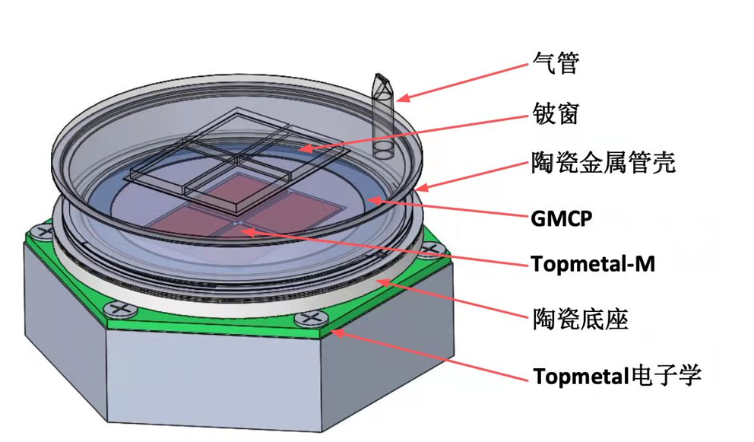
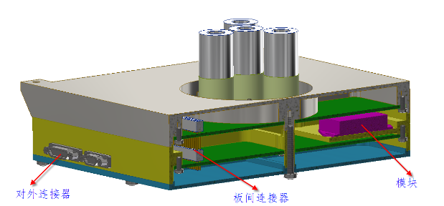
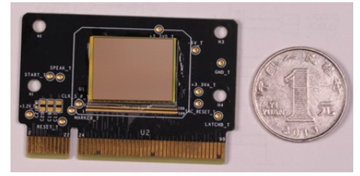
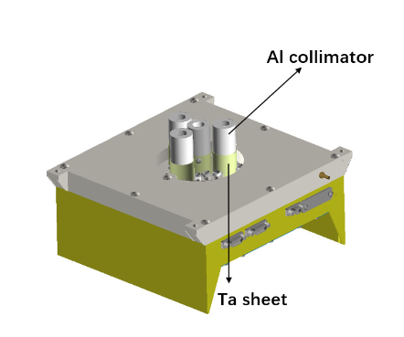

Design of the detector system
4-pixel SDD array (type-A) 256-pixel SDD array (type-B) Gas polarization detector (type-C)
main detector
Localization
Background
Gas Electron Multiplying Microchannel Plate GMCP
Single pixel：
Detector area: 13.84 mm×16 mm
Multi-anode amplification readout array chip Topmetal-M
Pixel: 40µm Detection area: 18mm×23mm
Modulation factor: >0.4@4.5keVDetection
efficiency: >10%@4keV
Cooperate with CEA, CNES, and MPE

Slide 18




Chasing All Transients Constellation Hunters (CATCH)
Preliminary designs:
  Each satellite will use a deployable mast to increase the focal length
Type A
Type B & C
Size: similar to a microwave oven
Before launch
arXiv:2210.06109 for more info
After launch
deployable mast

Slide 19



Design of the deployable mast
Deployable truss, compression release and deployable multi-layer
After launch: the release device is unlocked and the passive deployment mechanism drives the truss to deploy
Overall side swing simulation of the bracket (5.24Hz)
The deployable structure is clad in multi-layer

Slide 20


Design of satellite platform and Carrier rocket
Satellite platform:
Carrying Beidou GPS receiver: do very quick follow observations (in several minutes) with triggers from survey telescopes
Quick slew ability: 45 degrees/minute
On-orbit deployable mast: The detector is deployed in orbit to increase the focal length.
Carrier rocket:
Using CZ-2D, launched in Xichang with an orbital height of 550km and the inclination of 29°
3 rockets, 42 satellites in one rocket
Schematic diagram of CATCH satellite structure and its subsystems
Schematic diagram: CZ-2D rocket with multi-satellite launch

Slide 21




Preliminary design of the CATCH constellation
Distribution of the highest effective observation time ratio across the entire sky (3 orbital planes)
Plan to deploy 126 satellites across 3 orbital planes
With 36 type-A satellites, 3 type-B satellites, and 3 type-C satellites on each orbital plane
The multi-orbit satellites can perform "relay observation"
Apply the WALKER constellation design concept.
CATCH constellation configuration
CATCH constellation configuration
Rely observations

Slide 22







Preliminary Design of Intelligent Control System for the Constellation
Accept task
Accept task
Do not accept task
2. Upload strategies for each satellite
4. Distributed real-time decision-making and execution
1
2
3
4
1. Ground concentrated training
3. Release of observation tasks
B
B
B
A
A
A
A
A: Observation tasks issued by ground-based stations
B: Observation commands quickly released by Beidou
MADDPG multi-agent deterministic gradient strategy deep network
State attention decision network structure

Slide 23





Chasing All Transients Constellation Hunters (CATCH)
Timeline
First Step: CATCH-1 (Funded by CAS, NSFC, and IHEP)
Third Step
  Perform technical verification
  Verify the intelligent control module： decision-making tests for transient observation
  Conduct joint observations: SVOM, EP, HXMT…
  Undertake scientific observations
Second Step
First Step
0+
2+8 Mini CATCH Constellation

Slide 24



First step: Type-A pathfinder (CATCH-1)
Parameter | Type-A pathfinder
X-ray optics | MPO
Focal length | 1 m
FOV | 0.4°×0.4°
Effective area (cm²) | ~20@1keV (40@1 keV for optics)
Angular resolution (optics) | 5 arcmin
Energy band (keV) | 0.5-4
Detector | 4-pixel SDD array
Sensitivity | ~10⁻¹²erg/cm²/s@1keV
Timing resolution | <10 µs
Solar avoidance angle | ≥26°
Slew ability | 45°/ min
Detector system
Deployable mast
X-ray Optics

Slide 25






X-ray optics
MPO pieces
Roughness of MPO piece
MPO frame
The X-ray optics:
Weighing approximately 500g
Before the launch, the Calibration and mechanical experiments have been completed
Mechanical testing
Flight module

Slide 26






X-ray optics
In Calibration
On-axis PSF
Angular resolution 6’@Cu 0.93keV 5’@Ag 2.98keV 5’@Ti 4.51keV

Slide 27

X-ray optics
CATCH
Chandra | XMM-Newton | CATCH-1
Wolter-I | Wolter-I | MPO
18500 kg/m² | 2300 kg/m² | 135 kg/m²
Optics mass per effective area@1keV:
At least 1 order of magnitude less than traditional optics!
Effective area：
  ~40 cm² @ 1keV
  Swift/XRT：110 cm²@ 1.5 keV
Different from Swift (CCD), CATCH-1 uses SDD (fast readout, strong source is not saturated)

Slide 28

X-ray optics
Focal length
After correcting the phase difference, the focal length measured using the laser tracker is 1003.087mm, while the theoretically expected focal length is 1003.5mm.

Slide 29









Detector system
H50 and H20 from KETEK
Digital board
Front-end electronics
Design
In stalling
Shielding film
Flight module

Slide 30





Detector system
Thermal test
Thermal Vacuum test
Mechanical experiments
In testing

Slide 31




Calibration results of the detector system
4 μs
Timing resolution | 4.0 us
Energy resolution @5.9keV | 140 eV
Energy band | 0.3-10keV
E-C relation
energy resolution
time resolution

Slide 32





Combination of the X-ray optics and detector system
The difference between the system effective area and the mirror effective area is attributed to:
the transmission of the film on the collimator
the transmission of
the window on the detector
the detection efficiency of the detector

Slide 33




Deployable mast
The qualification model have been available in January 2023 and were assembled and tested in May 2023.
The flight module has been tested in April 2024.
The high and low-temperature expansion tests have been successfully completed.
The deployable mast

Slide 34


Platform
During ground testing, all platform hardware is in good condition.
The mechanical, thermal, EMC, and magnetic experiments on the platform have been successfully completed prior to the launch.
X-ray optics
Detector

Slide 35




Cooperation: SVOM & CATCH-1 (MoU signed)
Visible Sky region
high timing resolution: bright sources
Triggered by SVOM
Extended X-ray follow-up observation capabilities
Visible Sky region
The CATCH pathfinder can perform follow-up observations for alerts detected by the ECLAIRs onboard trigger.
Perform joint analysis of CATCH data together with MXT data to enhance spectra of commonly observed sources.
Plan to joint in follow-up observations with MXT for Multi-Messenger alerts.
CATCH can observe some sources detected by ECLAIRs, but the solar angle is too small for MXT and VT.
Optimize the observation strategy between SVOM and the CATCH pathfinder.
SVOM
CATCH-1

Slide 36




Cooperation: Test Plans between SVOM & CATCH-1
Successive observations with SVOM
Test of trigger from ECLAIRs alerts on request:
  End of August
  Two levels of triggers:
    Level 1, just optical telescope do follow-up;
    Level 2, space- and ground-base telescope do follow-up.
Join in the Commissioning phase of SVOM :
  Begin of September
  Test of ex-ToO
Join the tests for GW events
  Mid-September
  Different pointing (around 50 pointing), MM-ToO
Joint scan of GW region with SVOM & CATCH-1

Slide 37

Future: 2+8 Mini CATCH Constellation (second step of CATCH)
The China-France joint science team proposed the 2+8 mini CATCH constellation, coordinating with SVOM to make highly significant contributions to the field of time-domain astronomy.

Slide 38




News about CATCH-1
SVOM
SVOM & CATCH-1
2024.06.22
CATCH-1
GRID (0.5 U, GRB detector)
Telemetry results indicate that CATCH-1 is operating smoothly in orbit:
Solar panels have been successfully deployed.
Electricity, thermal regulation, and satellite attitude are all within normal parameters.
SVOM & CATCH-1

Slide 39
Summary
Constellation: perform follow-up observation for a lot of transients
new mission:
  each satellite: carry lightweight focusing X-ray optics
  Constellation: controlled by the intelligent system
    chase a lot of transient events: BHs, pulsars, GRBs, GWs…
    imaging, spectral-timing and polarization observations simultaneously
    all-sky and uninterrupted observations
    flexible fields of view
  First pathfinder (2024 June): type-A (has successfully lunched)
  Mini CATCH constellation (2030+): 2+8 satellites
  ……
Thank You!

