Slide 1
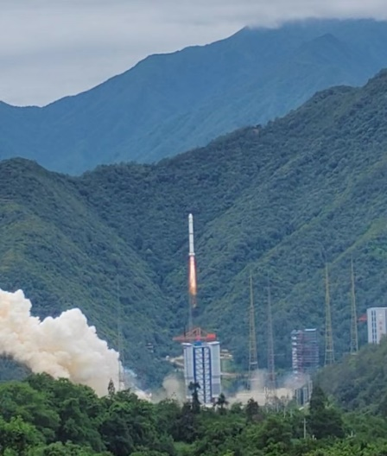

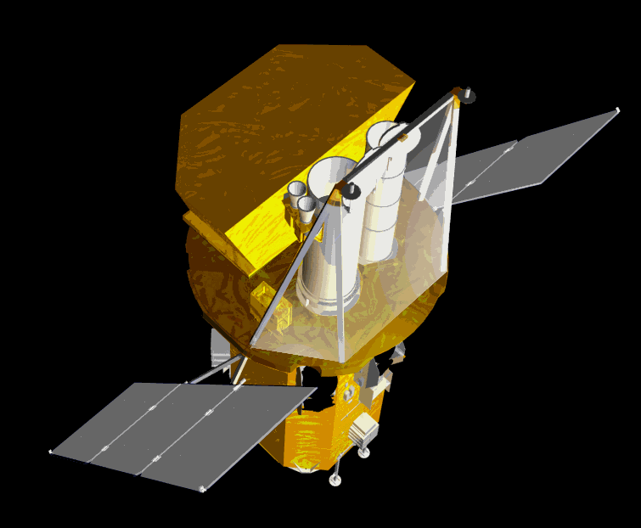
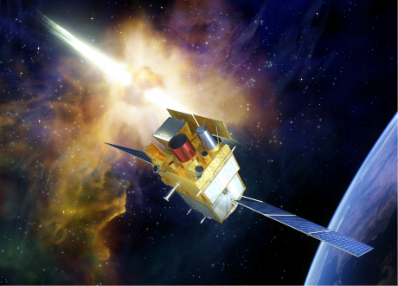
From Swift to SVOM Mission:
Progress on GRB Afterglow Observations
En-Wei Liang（Guangxi University）
lew@gxu.edu.cn
SVOM Scientific Workshop
Xichang 2024.06.23
2004
2024
Notes:
Good morning, everyone. I am Enwei-Liang, from Guangxi University. Thanks for Jianyan and Organizers’ invitation to give me a talk at this exciting meeting. Yesterday, we had a very nice experience watching the successful launch of the SVOM satellite. We all know that twenty years ago, the multiple-wavelength mission Swift opened a new era of gamma-ray observations. The Swift mission made a lot of discoveries and indeed refreshed our understanding the nature of GRBs in many aspects. The SVOM is exactly a new generation of multiple-wavelength GRB mission. In this talk, I would like to briefly summarize the progress on GRB afterglow observations and made some prospects of the GRB afterglow observations in the new era of SVOM.

Slide 2
Outlines
X-Ray Afterglows
Optical Afterglows
Sub-TeV & TeV Afterglows
New Opportunity with SVOM
Notes:
This is the outline of my talk.

Slide 3
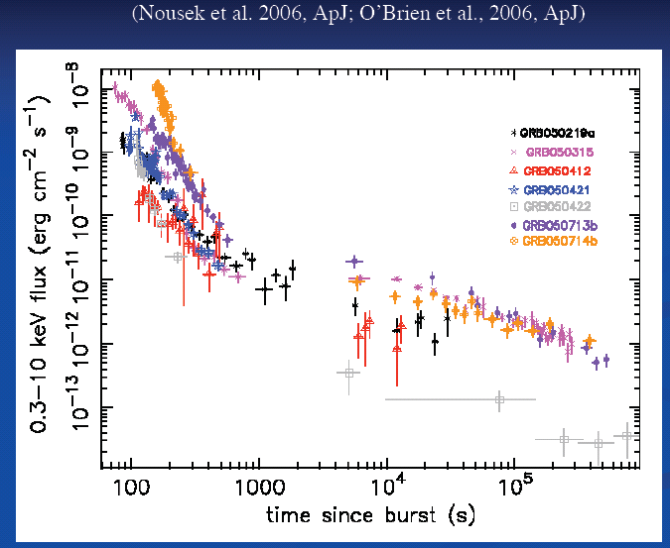
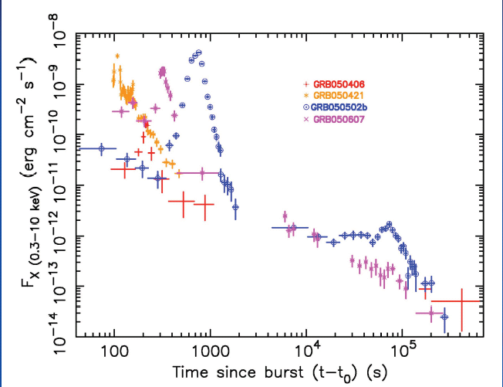
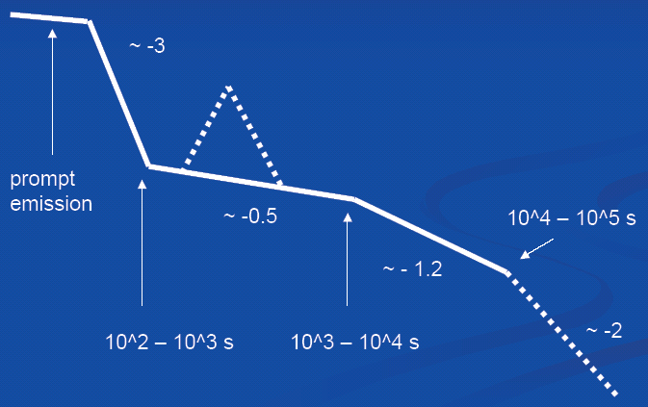
1. X-ray Afterglows: Canonical X-ray LC
Swift/XRT:
Energy Band: 0.3-10 keV
Promptly slewing→~ 90 % Swift GRBs have XRT Observations
A canonical XRT lightcurve:
Steep Decay → shallow decay → normal decay → Jet break
Erratic X-ray flares
Zhang et al. 2006; Nousek et al. 2006; O’Brien et al. 2006
Notes:
Firstly, I talk about the X-ray afterglow observations. The Swift X-ray telescope successfully catches the very early X-ray afterglows of Swift GRBs. Its energy band in 0.2-10 keV. Benefiting from its promptly slewing capacity, the X-ray afterglows of about 90% of Swift GRBs were observed by the XRT. Some findings are very interesting. Bing summarized a canonical XRT lightcurves. About half of the XRT light curve shows such features. These XRT lightcurves usually start with a steep decay segment, then follow a shallow decay segment or a plateau, and then to a normal decay segment. Flares are also usually found.

Slide 4
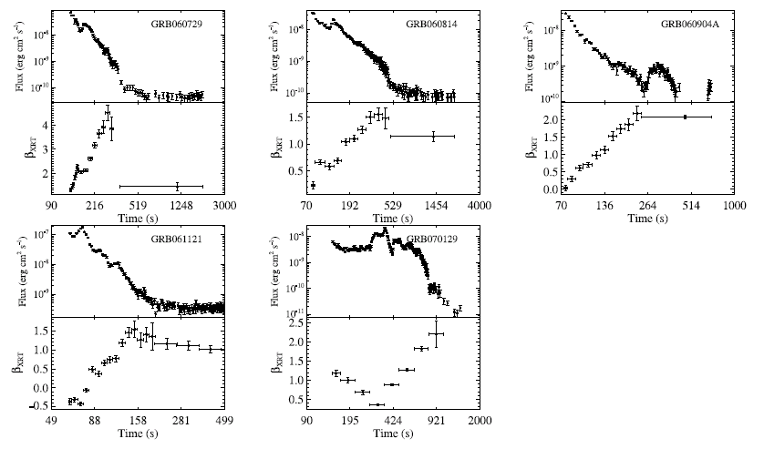
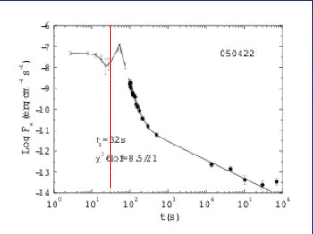
1. X-ray Afterglows: The Steep Decay segment
The steep decay parts are consistent with the prediction of the curvature effect
Zero Time effect
Strong spectral evolution
F∝t^{-(2+β)}
→Prompt gamma-ray emission from high latitude of the emitting fireball
Liang et al. 2006; Zhang, Liang, Zhang 2007
Notes:
The steep decay segment usually has strong spectral evolution. They are consistent with the prediction of the curvature effect. This suggests that Tail prompt gamma-ray emission from the high latitude of the emitting fireball

Slide 5
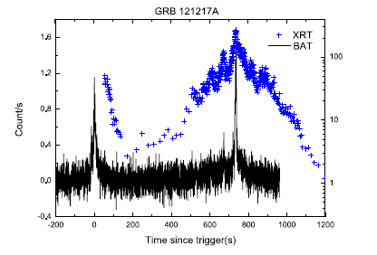
1. X-ray Afterglows: X-ray Flares
Late X-ray flares are of internal origin
X-ray flares may signal the global activity of the GRB central engine!
Peng, LEW et al. 2014, ApJ
Hu, LEW, et al. 2014, ApJ,789,145
Notes:
It is usually believed that the flares are of internal origin. X-ray flares may gives the global activity of the GRB central engine!

Slide 6
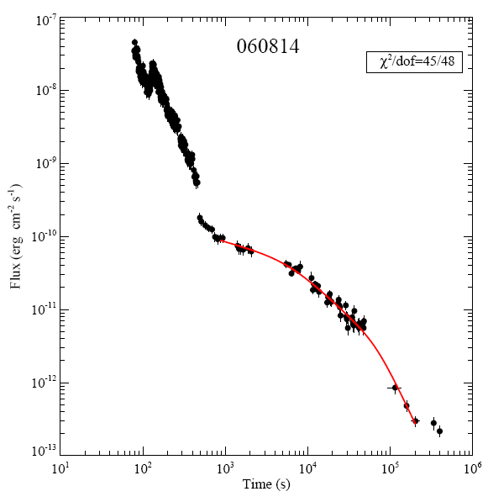
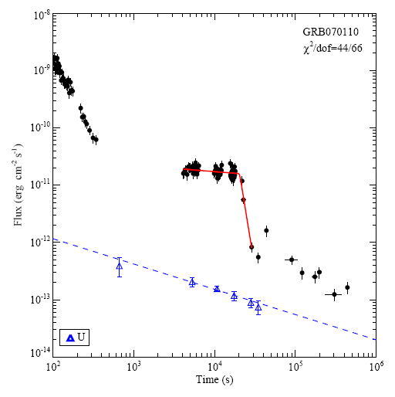
1. X-ray Afterglows: Shallow Decay Segment
Late Energy injection or an independent emission component from the central engine?
→ The X-ray plateau with a sharp flux drop indicates internal origin of the plateau!
Zhang, Liang, Zhang 2007; Troja et al. 200
Notes:
For the shallow decay segment. It can result from the refreshed external shocks due to the late energy injection. But, the X shallow decay segments of some GRBs are a plateau with a sharp flux drop. This indicates that they are of internal origin! This speculation is consistent with the scenario of a magnetar as the central engine of these GRBs.

Slide 7
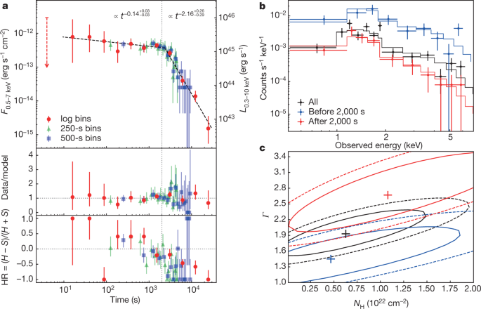
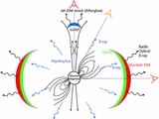
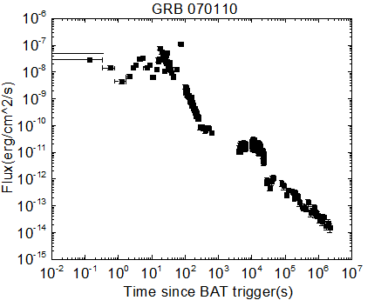
Evidence of Newly-Born Magnetar as some GRB Central Engine
Newborn Magnetar as remnant of Binary Neutron Star Merger and Massive star collapse→ XTs associated GRBs or orphan XTs
GRB
XT
Gao et al. 2015
Troja et al. 2007, ApJ; Xue et al.2019, Nature
Notes:
The picture like this. The magnetar central engine powers a jet to make the GRBs, and the dipole radiation of the magnetar powers a wind ejecta to make the shallow decay segment. Therefore, the early X-Ray Plateau may be a probe for the newly-born Magnetars. We try to investigate the properties of the magnetars with the early X-ray data of such kind of GRBs.

Slide 8

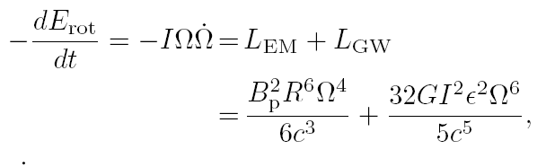
Magnetar Spindown
Rotation Energy of a Magnetar:
Energy Lost of a Magnetar:
ElectroMagnetic (EM) radiation
GW emission
Notes:
The spin-down of a magnetar may lost its rotation energy via dipole radiation and gravitational wave emission. The EM emission from the Dipole radiation wind strongly depends on the magnetic field strength and the period of the magnetar, and the GW emission depends on the epllicity and the period of the magnetar. In a generic case, the spindown is made by both the EM and GW emission. The mix of the dipole radiations with the GRB afterglows may make the complexity of the observed shallow decay segments.

Slide 9
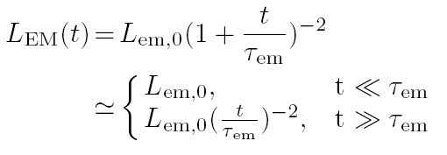
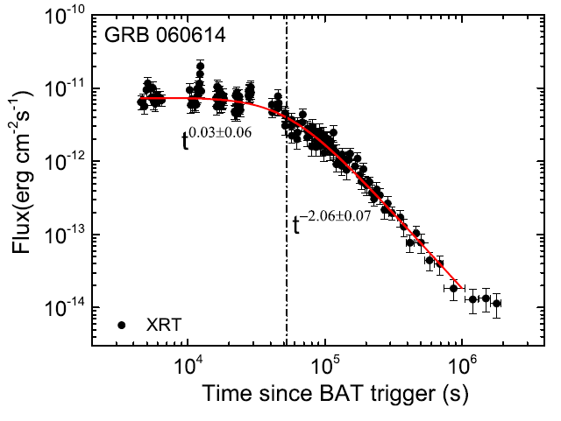
Afterglow Lightcurve in EM dominated Scenario
Example: GRB 060614
Cartoon Picture
LV + 2018, MNRAS.480.4402
Notes:
In the EM dominated Scenario, mixing of both the jet afterglow emission and dipole radiation would make an observed lightcurve as shown in this cartoon picture. Here, the red dashed line is for the dipole radiation, and the purple dashed-dot line is the afterglow of jet emission in this thin shell case. The grey line is the sum of the two components. One example is the XRT lightcurves of GRB 060614. You can see that it matchs the cartoon LC.

Slide 10
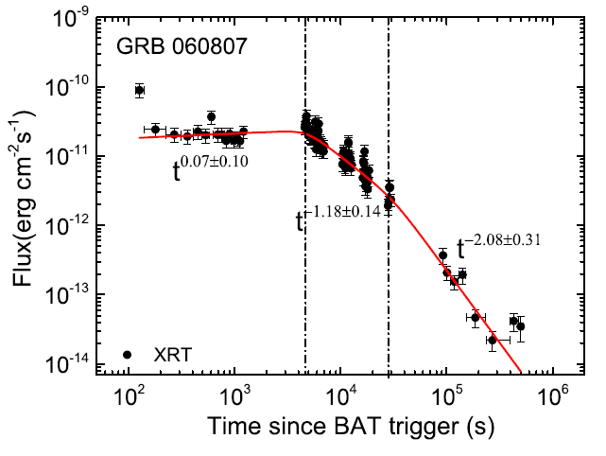
GW dominated→ EM dominated
Lightcurve of GW emission dominated
Cartoon Picture
Example： GRB 060807
LV + 2018,MNRAS.480.4402
Notes:
This is a cartoon pacture of this scenario. GRB 060807 is a good case as shown here. Its XRT lightcurve has a plateau then decays with a slope of -1.2, and transist to -2.1. Of cause one may also explain such kind of transition with the jet break effect of the GRB jet. However, we do not find such a achromatic break in this optical lightcurve. Therefore, we suggest such a transition may be due to the transition from the GW emission to the DP emission.

Slide 11

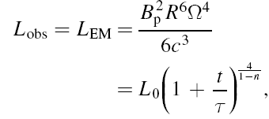
Magnetar Spindown braking index
n= 3: Spindown dominated by dipole radiation
n= 5: Spindown dominated by GW radiation
n=7: Spindown dominated by unstable r modes
Zou et al. 2021, MNRAS
Lv et al. 2019
Notes:
Based on the X-ray lightcurves, one may also estimate the breaking index of the magnetar. It is found that the indices of most GRBs are in the range of 3-5. In comparison with stable pulsars in our galaxies, the break indices are systematically larger than the stable magnetars. As you see here, for the stable pulsars, the breaking indices are in the rage of 1.5 to 3.5. Form theorical point of view, in the scenario that the dipole radiation dominates the spindown, the break index is 3, and it is 5 for GW radiation dominated and een 7 for unstable r model. So our results support the idea that both the dipole radiation and the GW emission gover that spindown of newly born magnetars.

Slide 12
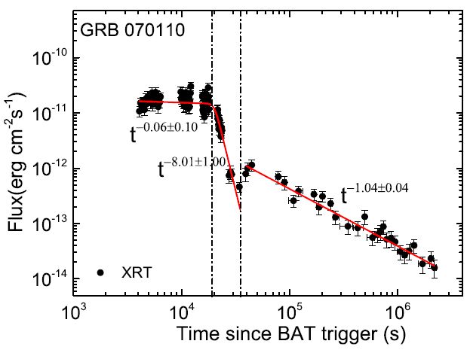
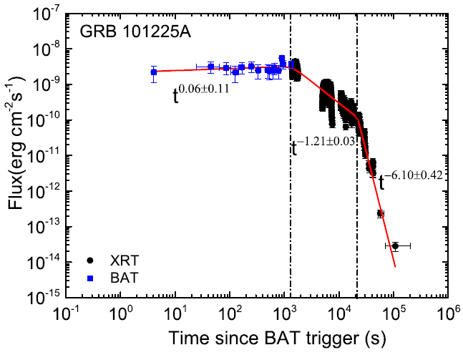
Collapse of Newly-Born Magnetar
Evidence： Internal X-ray plateau with a sharp drop → A magnetar may be collapsed prior to its spin-down characteristic timescale
Collapse
Jet afterglows
Cartoon Picture
GW dominated
Collapse
LV + 2018,MNRAS.480.4402
Notes:
It is also found that the X-ray lightcurves of some GRBs have a so-called internal X-ray plateau. It has a very sharp drop, and this feature cannot be explained with any related to external medium. This is a cartoon picture of this scenario. We show here two cases. One is GRB 070110. The information that what may dominate the spindown of the magnetar is tally lost since we have no signature of characteristic times and the flux decay behavior post the characteristic timescale. We find also another case, GRB 101225A. It is XRT lightcurve looks like this. .The first break would be the characteristic timescale of GW emission, and the second break would be the collapse of the magnetar. The famous Christmas burst seems to be powered by a massive magnetar. Its soft gamma-ray and X-ray flux keep keeps almost constant then transit to decay with a power-law index of -1 then rapidly drops.

Slide 13
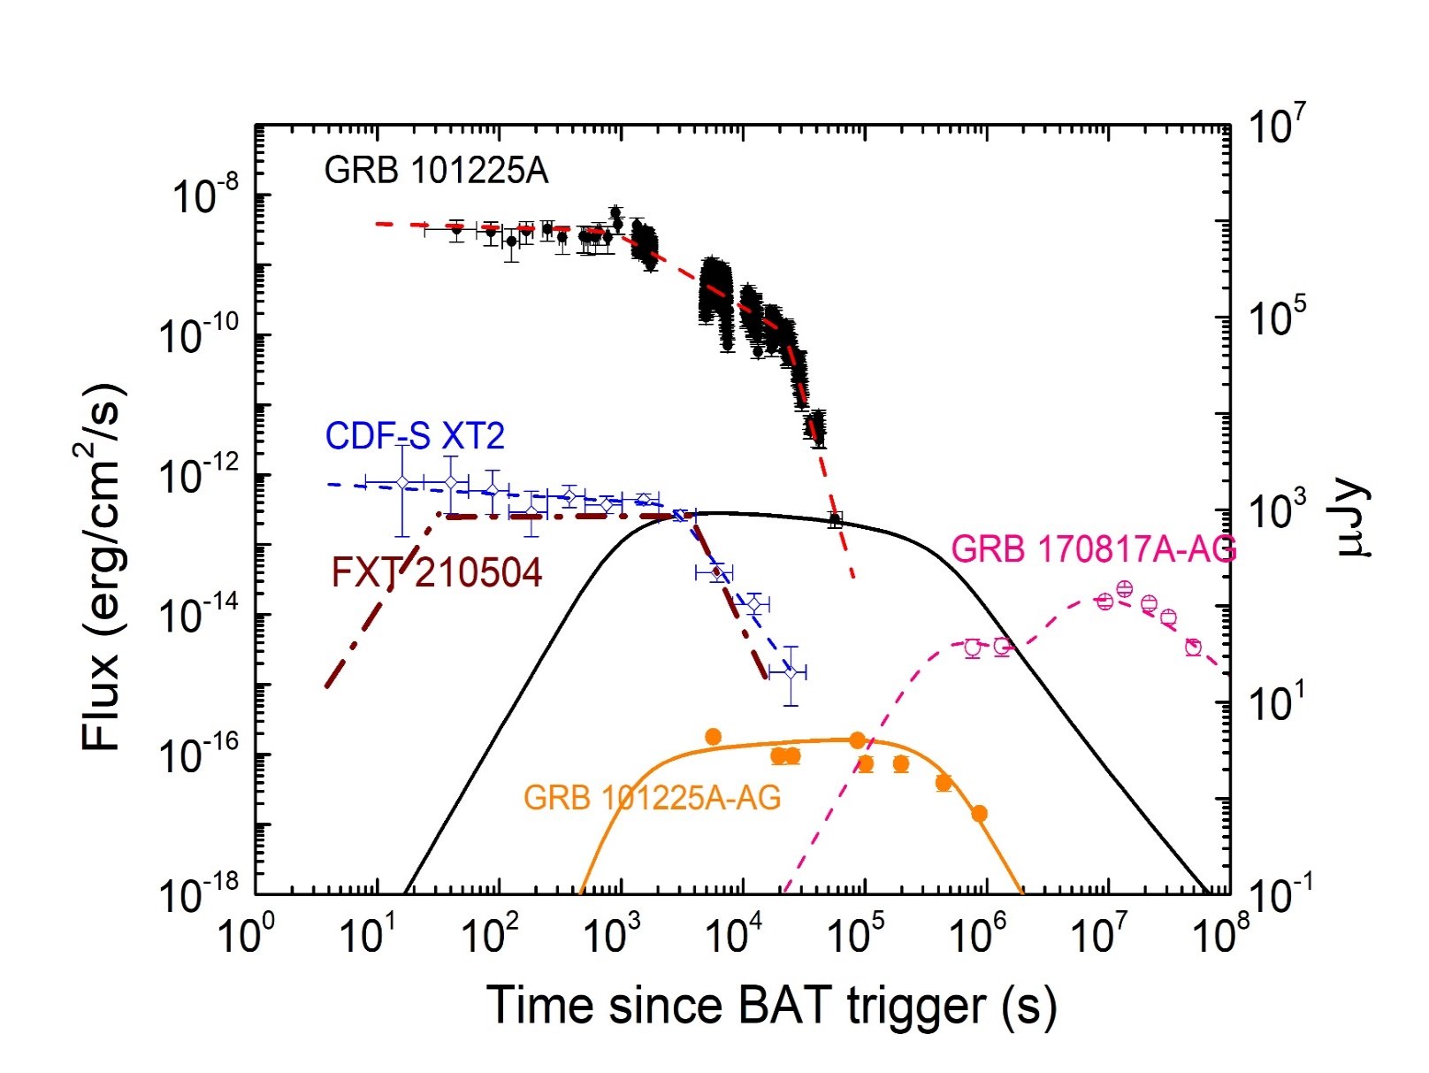
GRB 101225: Powered by a massive Magnetar ?
OFF-AXIS GRB 101225:
Orphan Optical Afterglows of its Jet and Dipole Radiations of its Precession Rotation Driven by Gravitational Wave Emission
Zou et al. 2021, ApJL
Xue et al. 2019, Nature; Lin et al. 2021, GCN
Notes:
We suspect the GRB is a of-axis GRBs. We missed its jet emission, and the observed soft gamma-ray /X-rays are from the wind powered by its dipole radiations. Initially, the GW emission dominates the spindown of the magnetar, then collapses before the characteristic time scale of the spindown.

Slide 14
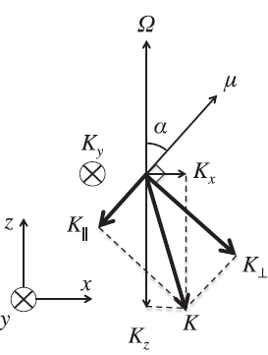
Precession Motion of Newborn Magnetar in GRB 101225
Orphan Dipole Radiations of a newborn magnetar with Precession Rotation Driven by Gravitational Wave Emission
Zou et al. 2021, ApJL
Notes:
We also find QPO feature in its bright X-ray flares. We model the QPO with the precession motion of the magnetar.

Slide 15
Precession Motion of Newborn Magnetar in GRB 180620A——Early Evolution
Zou, LEW 2022, MNRAS Lett.
Notes:
Similar case is GRB 180620A.

Slide 16
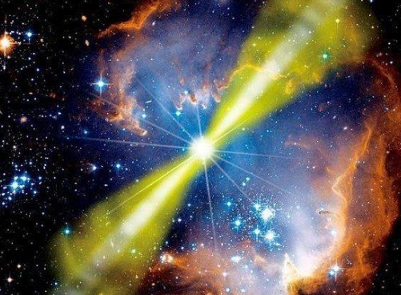
Magnetar-Jet-Dipole Wind Connections
E_{iso,jet} is typically larger than E_{wind} with 2 orders of magnitude.
Jet
Wind
Wind
Jet
Zou + 2019, ApJ
Notes:
Next, we show possible connection between magnetar spin, the jet , and the dipole radiation wind. From an energy release point of view, E_{iso,jet} is typically larger than E_{wind} with 2 orders of magnitude.

Slide 17
Energy Partition between Jet and Dipole Wind
E_{iso,jet} is tightly correlated with E_{wind}
Implication: Quasi-universal energy partition (R~ 0.03) between the jet and Dipole radiation wind.
Zou + 2019, ApJ
Notes:
And, we find that isotropic jet energy and dipole wind energy are tightly corrected. Acutally, they are almost propotional. We define a ratio of Ewind/over Ejet to measure the energy partion between jet and wind. We get R is clustaered at around 0.03. Considering the geometrallly-correlation to the jet emission with an opening angle of about 10 degrees, and the diople wind may be almost isotropic, the energy partion between the jet and windis comparable.

Slide 18
Relation between Jet Energy and the Spin Speed
Magnetar period derived from the X-ray plateau
Implication: A newly-born magnetar with a faster ration speed should power a more energetic jet!
Zou + 2019, ApJ
Notes:
We also try to find the renation between the spin period and the jet energy. As shown in this plot, P0 is tightly correlated with the jet energy. This relation suggest that A newly-born magnetar with a faster ration speed should power a more energetic jet!

Slide 19
Outlines
X-Ray Afterglows
Optical Afterglows
Sub-TeV & TeV Afterglows
New Opportunity with SVOM

Slide 20
2. Optical Afterglows: Generic optical LC
Statistics: 30% onset bump, 25% shallow decay
Wang, LEW, et al. 2013，ApJ
Li, LEW et al. 2012, ApJ
Notes:
The generic optical afterglows are something like that canonical X-ray lightcurves. Satistical analysis for a sample 146 GRBs optical aftwerglow lightcurves show that about 30% early optical LCs show a clear onset bump, as predicted by the deceleration of the standard fireball, and the early optical afterglow of about 25% LCs show a shallow decay segment.

Slide 21
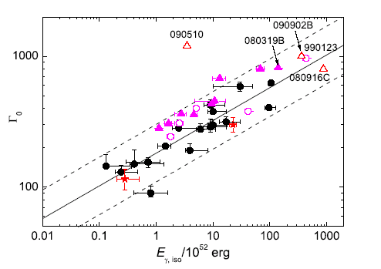
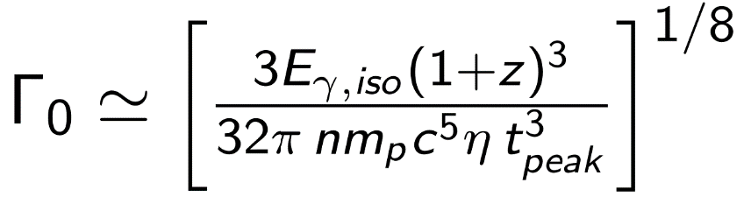
E_{iso} -Γ₀ Relation
Afterglow Onset → Deceleration of the Fireball → Γ₀ of GRB jets (e.g.,Sari & Piran 1999)
A tight correlation between the E_{iso} and the Lorentz factor of GRB fireball
Liang et al. 2010，2013, ApJ
Notes:
We estimate the Lorentz factors of these GRBs and find that they are correlated with the Isotropic gamma-ray energy and luminosity.

Slide 22
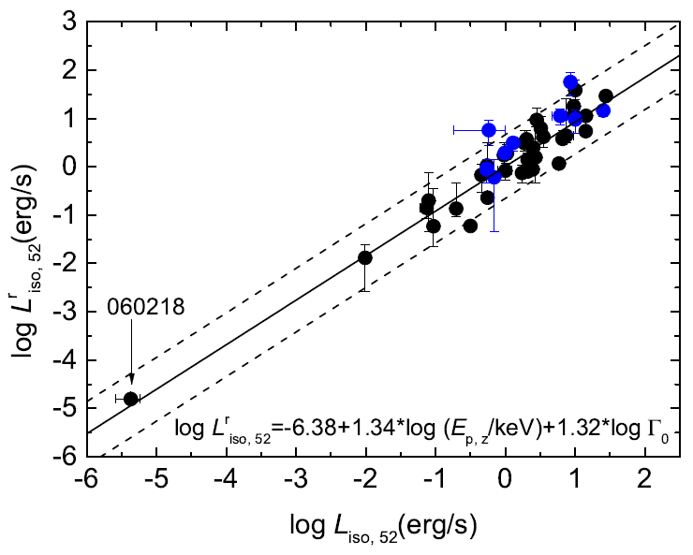
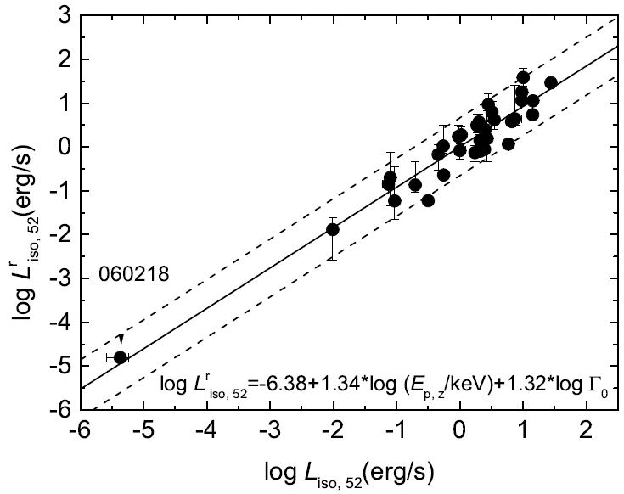
A tight Liso-Ep,z-Γ0 relation
GRB 060218: Γ₀ ~ 2.3
（Soderberg + 2006）
Blue data: Γ₀ is derived from the spectral cutoff energy observed with Fermi/LAT (Tang et al. 2016)
Liang + 2015, ApJ
Notes:
We make regression analysis for deriving a correlation among these parameters. A much tighter correlation is found. For extending the range of this relation, we also include low-luminosity GRB 060218 in our sample. The Lorentz factor of this GRB is derived from radio data and its value is 2.3.
22

Slide 23
Outlines
X-Ray Afterglows
Optical Afterglows
Sub-TeV & TeV Afterglows
New Opportunity with SVOM

Slide 24
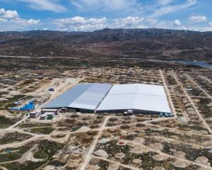
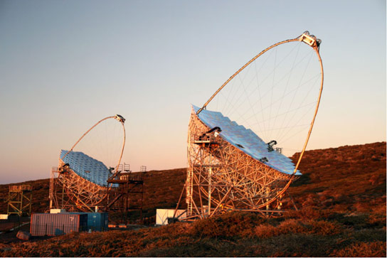
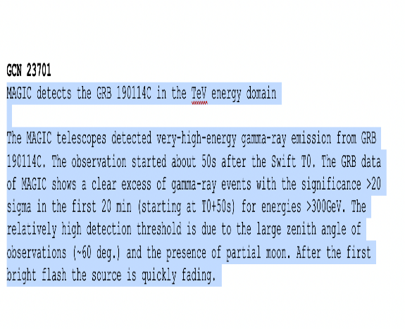
3. GRB Afterglows: VHE afterglows
MAGIC detection at sub-TeV GRB afterglows：GRB190114C
HESS:GRB180720B @ t=10 h
Breakthrough: LHAASO detected >10 TeV gamma-ray afterglows of the brightest GRB 221009A(z=0.151)
TITLE: GCN CIRCULAR NUMBER: 32677 SUBJECT: LHAASO observed GRB 221009A with more than 5000 VHE photons up to around 18 TeV DATE: 22/10/11 09:21:54 GMT
RB 221009A is detected by LHAASO-WCDA at energy above 500 GeV, centered at RA = 288.3, Dec = 19.7 within 2000 seconds after T0, with the significance above 100 s.d., and is observed as well by LHAASO-KM2A with the significance about 10 s.d., where the energy of the highest photon reaches 18 TeV. This represents the first detection of photons above 10 TeV from GRBs.
Notes:
The most significant progress on the GRB afterglow observation in recent years should be the discovery of VHE afterglows by MAGIC, HESS, and LHAASO telescope, especially the TeV gamma-ray afterglows of the brightness GRB 221009A.

Slide 25
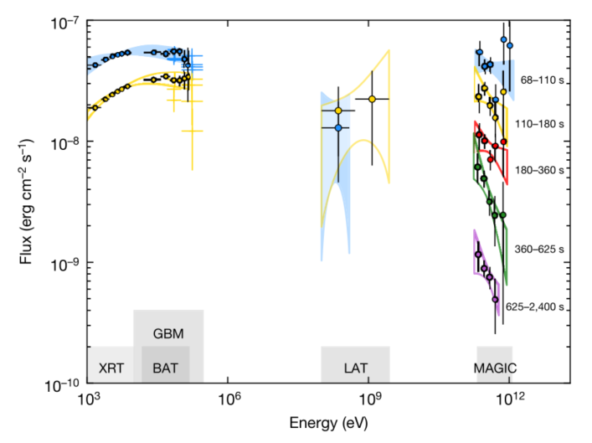
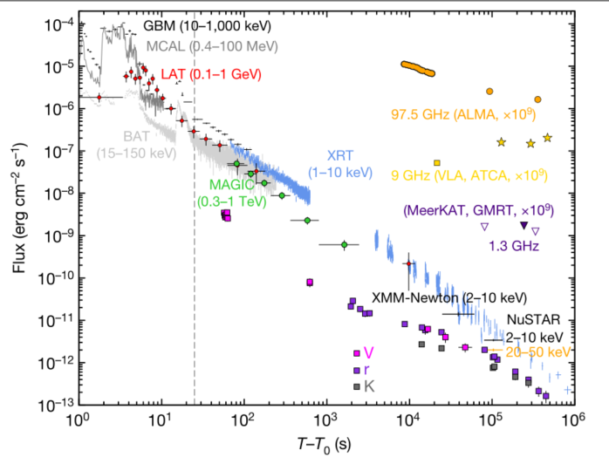
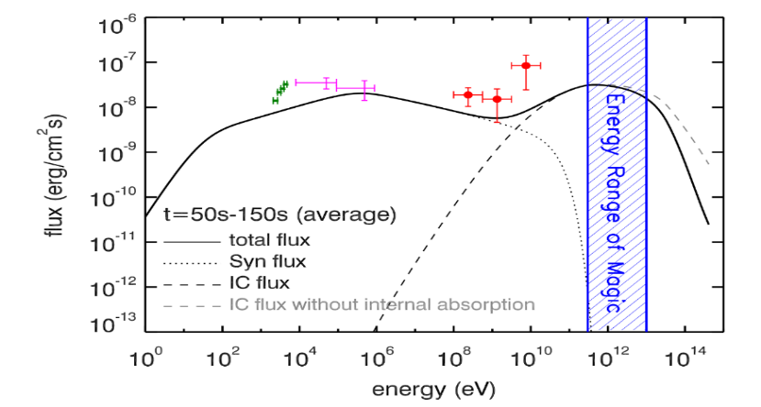
GRB 190114C
First sub-TeV afterglow detection in >5σ
Redshift: 0.45
Multi-band afterglow lightcurve
Bimodal SEDs: Syn+SSC? √
MAGIC Collaboration , 2019, Nature;Wang et al. 2019, ApJL; Joshi et al. 2021
Notes:
The first detection of VHE afterglow in a high confidence level is for GRB 190114C. The sun-TeV gamma-ray AG was detected by MAGIC in a confive level much larger than 5sigma. This picture shows the multi-band afterglow lightcurves. IT spectral energy distribution show a bomodal feature that can be well fit the synchrotron radiation and SSC models.

Slide 26
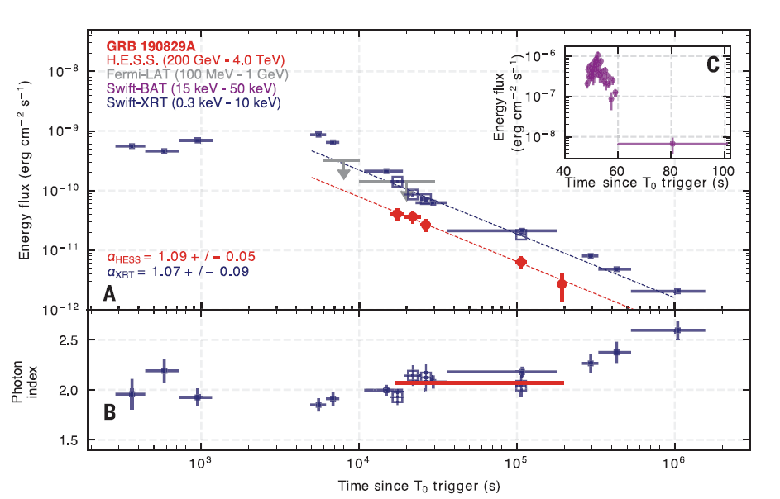
GRB 190829A
First TeV afterglow detection in >5σ
Nearby GRB: z=0.085
Sub-energetic:
Afterglow LCs
SED
syn+SSC? X
H.E.S.S. Collaboration et al., Science 372, 1081–1085 (2021)
Notes:
The detection of TeV gamma-ray afterglow is for GRB 190829A. It is a nearby GRB at redshift 0.085. It is a sub-eneergy burst. Its isotropic gamma-ray energy is about 10 to 50 ergs. Here is its LCs and SED. The HESS colla. Suggested that its TeV emission spectrum is hard, and the SSC model cannot fit the data.

Slide 27
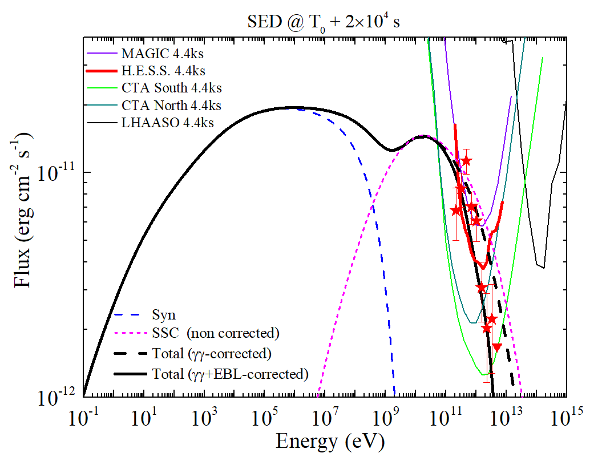
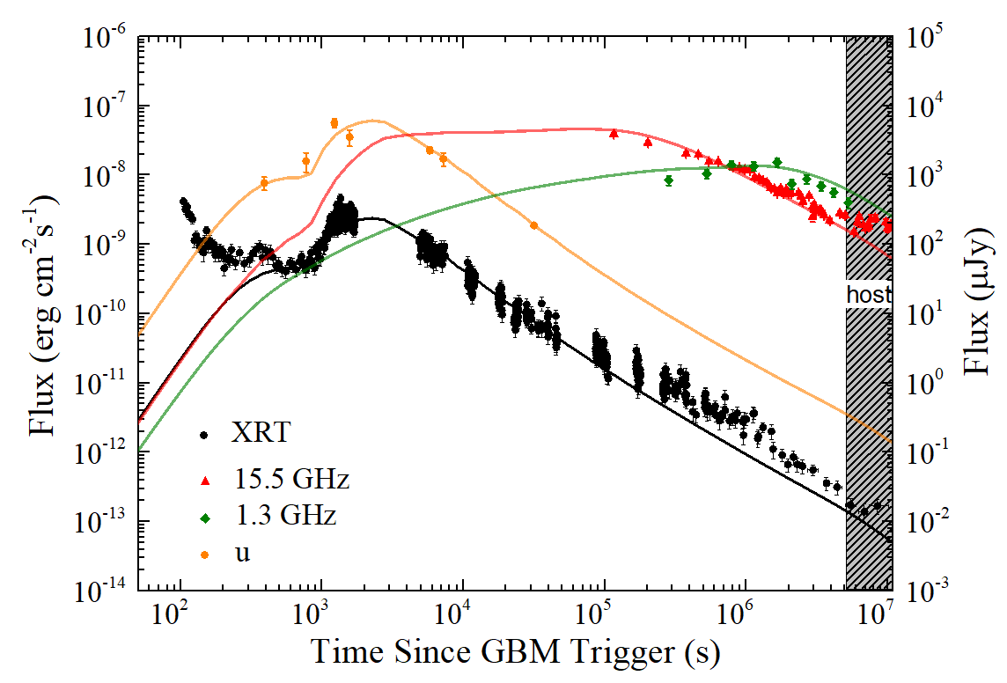


GRB 190829A
The syn+SSC models can fit the radio-optical-X-ray-TeV afterglow lightcurves, but the spectral hardening cannot be well explained.
VHE AG
Zhang et al. 2021，ApJ

Slide 28
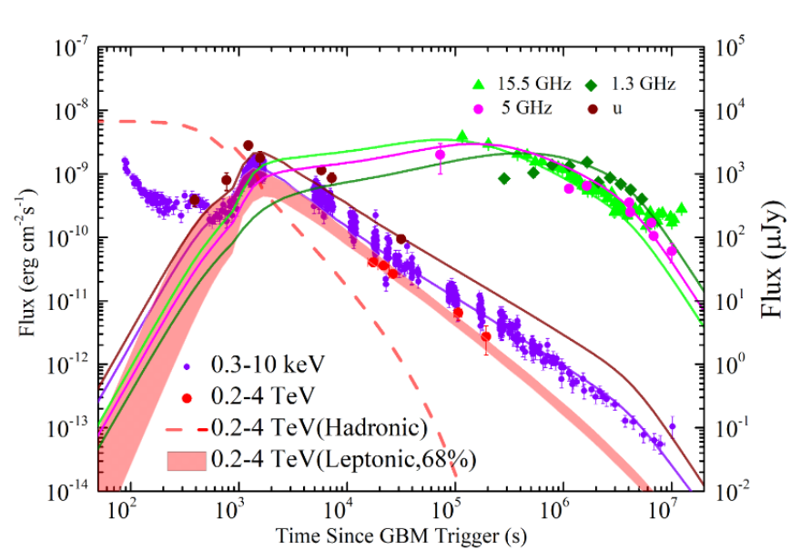
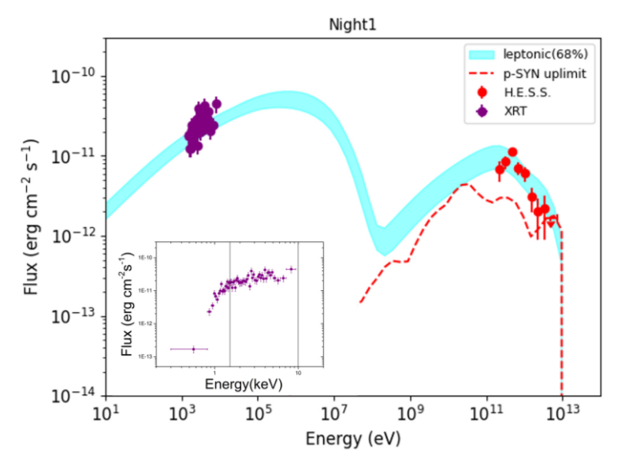
GRB190829A: Signature of UHE protons?
What can made the spectral hardening?
GRB jets are potential accelerator of ultra-high energy (E~ 10²⁰ eV) cosmic rays (Waxman 1995 ). Can UHE proton synchrotron radiations in the afterglow fireball make the spectral hardening ?
Pre-accelerated UHE protons in the internal shocks are cooled in the external shocks during their escape.
Huang + 2023, ApJ

Slide 29

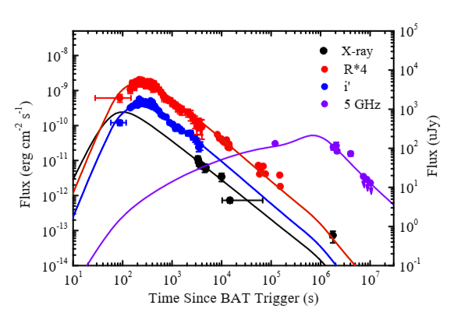
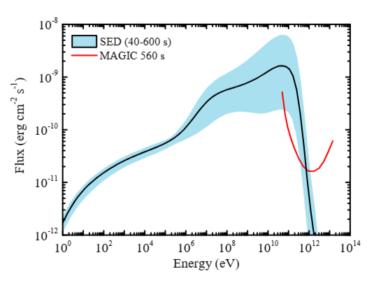
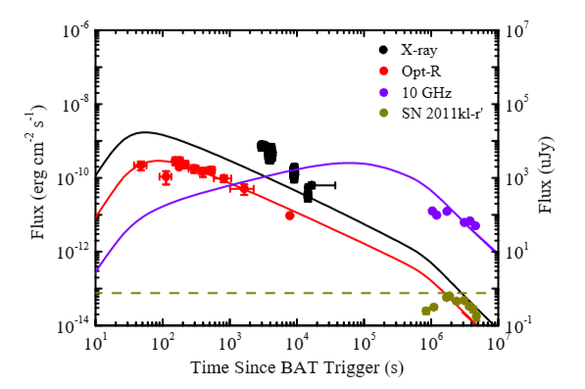
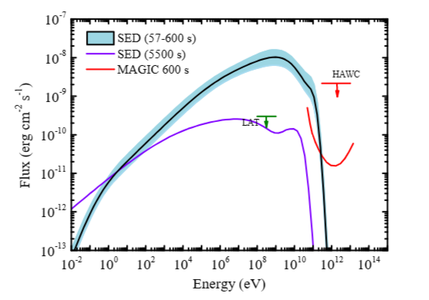
GRB 201015A & 201216C:
GRB 201216C (z=1.1)
Notes:
Sub-TeV gamma-ray afterglows are also detected for GRB 201015 and 201216C with low confidence level. The highest redshift one is GRB 201216C. Its redshift is 1.1. The syn+SSC model still can explain the data.

Slide 30
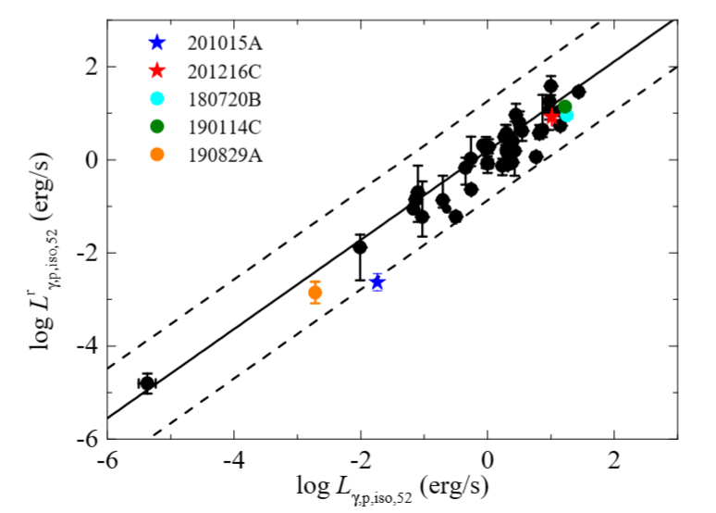
Current GRBs with detection VHE afterglows
GRBs 130427A,190114C,180720B, 190829A (z=0.0785)，201015A, 201216C (z=1.1)
Zhang et al. 2023, ApJ; Huang et al. 2020, ApJ Letters
Notes:
Current GRBs with detection VHE afterglows well follow the tight

Slide 31
GRB 221009A—TeV gamma-ray afterglows
LHAASO Observations:
More than 64,000 photons (above 0.2 TeV) were detected within the first 3000 seconds.
The TeV photon flux began several minutes after the GRB trigger, then rose to a flux peak about 10 seconds later.
Jet-break: at ∼ 650 s after the peak. The emission can be explained with a relativistic jet model with half-opening angle ∼ 0.8◦.
LHAASO Collaboration Science, 380, 6652, 1390-1396 (2023).
Notes:
LHAASO Observations: More than 64,000 photons (above 0.2 TeV) were detected within the first 3000 seconds.
The TeV photon flux began several minutes after the GRB trigger, then rose to a flux peak about 10 seconds later.
Jet-break: at ∼ 650 s after the peak. The emission can be explained with a relativistic jet model with half-opening angle ∼ 0.8◦.

Slide 32
GRB 221009A—TeV gamma-ray afterglows
Intrinsic VHE spectra of GRB 221009A corrected for EBL absorption.
Photons with above 10 TeV are detected.
LHAASO Collaboration Science Adavance 2023

Slide 33
GRB 221009A—Afterglow Modeling
The radio to TeV afterglows seems can be model with the external shock model, but requiring structured jet and distinctive transition of the burst
environment from uniform to wind-like
Ren + 2024, ApJ
Notes:
The radio to TeV afterglows seems can be model with the external shock model, but requiring structured jet and distinctive transition of the burst
environment from uniform to wind-like

Slide 34
Outlines
X-Ray Afterglows
Optical Afterglows
Sub-TeV & TeV Afterglows
New Opportunity with SVOM

Slide 35
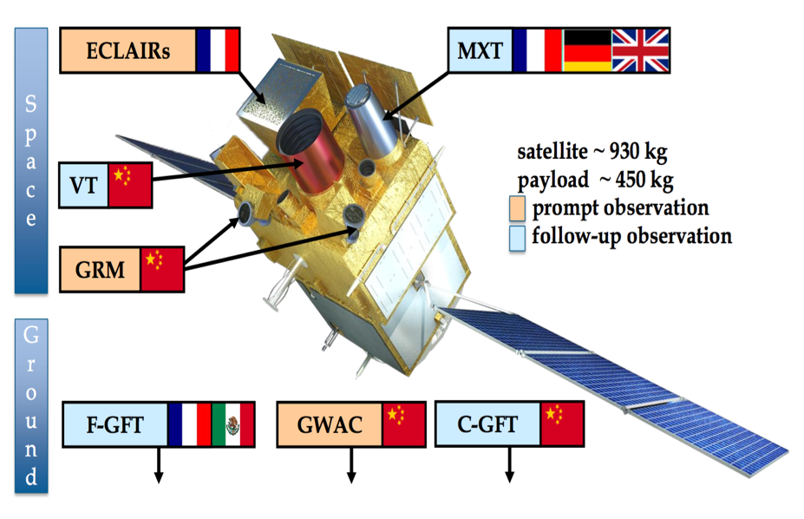
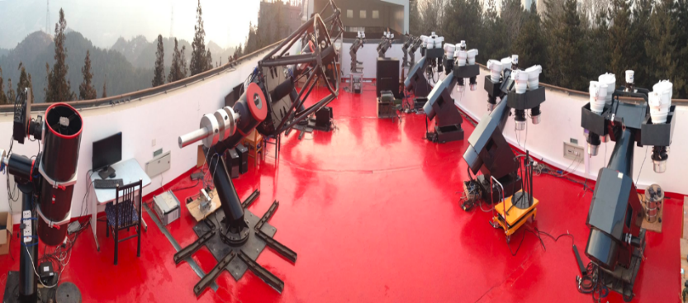
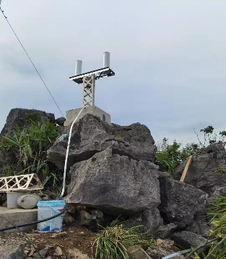
New Opportunity with SVOM
SVOM
SVOM GRM + Éclair = Swift/BAT +Fermi/GBM: Much broader energy coverage for trigger GRB and XRFs
SVOM/VT+GWAC+GFT: Very powerful for catching the prompt and very early optical afterglow emission.
SVOM VT+MXT: optical & X-ray afterglow simultaneous observations
SVOM-VHF station @ Guangxi Univ.

Slide 36
Prompt optical & Very Early Optical Afterglows
First exciting result with GWAC+F60
Make a uniform & large early optical LC sample
SVOM+GWAC+GFT→ Opening New Era for the prompt optical and very early optical & X-ray afterglow simultaneous observations
Key Science:
Prompt emission radiation physics
Reversed shock emission
?
Xin +, Nat. Astro. 2023

Slide 37
A tight Liso-Ep,z-Γ0 relation
SVOM+GWAC+GFT+C→
Tigger more X-ray flashes (XRFs) and measure their Γ0 values for examining the tight Liso-Ep,z-Γ0 relation.
Key Science:
The physics behind the
Liso-Ep,z-Γ0 relation
?
Liang + 2015, ApJ
Notes:
37

Slide 38


