Slide 1
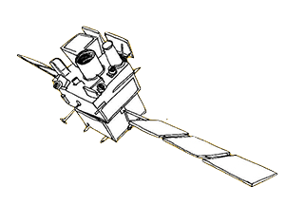
Validation of an ECLAIRs trigger by the Burst Advocates
Wenjin XIE (NAOC, CEA); Damien TURPIN (CEA)
2024.06.25 Xichang workshop
Notes:
What are the different diagnosis to ensure the astrophysical origin of a SVOM trigger

Slide 2
Outlines:
Overview of SVOM onboard detection process
ECLAIRs trigger by a new transient : key diagnosis
Excluding false triggers caused by non-astronomical sources
Summary

Slide 3
SVOM onboard detection process
ECLAIRs (wide FOV) : Trigger, alert, slew request
MXT: : Follow up in X-ray T0 + few minutes
VT: Follow up in optical wavelength T0 + few minutes
GRM particle monitor (plastic scintillator)
GRM (wide FOV) : Trigger, alert, but not send slew request.

Slide 4
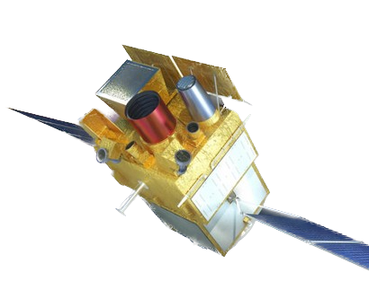
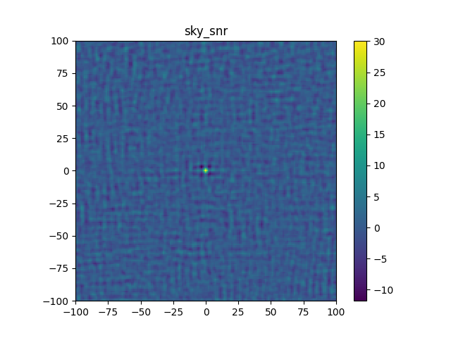
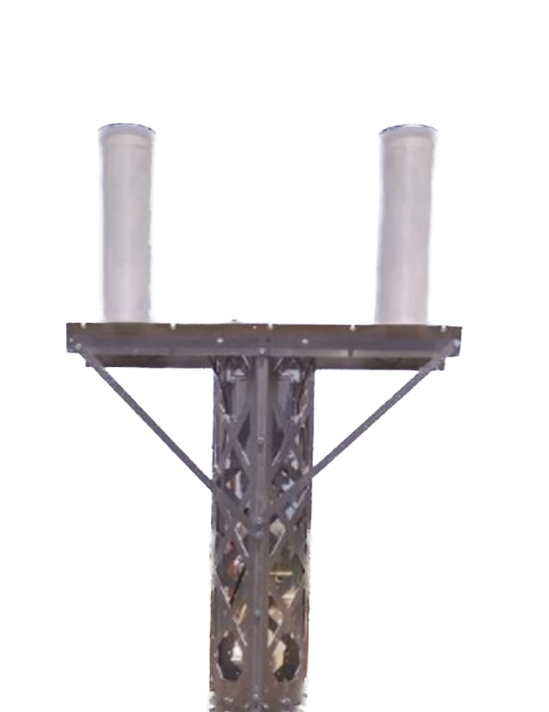
SVOM onboard detection process (ECLAIRs trigger)
SNR/std
Satellite accept slew
SNR/std > 8.0 request slew
Observed data
SNR/std > 6.5
Set alert to the ground
~ 2 s each cycle
(std represent standard deviation of sky SNR map
taking into account bkg fluctuation)
(Trigger algorithm could be found in Stephane’s talk)

Slide 5
SVOM onboard detection process (ECLAIRs trigger)
ECLAIRs detect a transient source with high SNR (not catalog sources)
SNR/std > 6.5 → Trigger alert → VHF receive alert → detaile check
SNR/std > 8.0 (adjustable) → slew request → request rejected (due to satellite technical setting)
SNR/std > 8.0 (adjustable) → slew request → request accepted

Slide 6
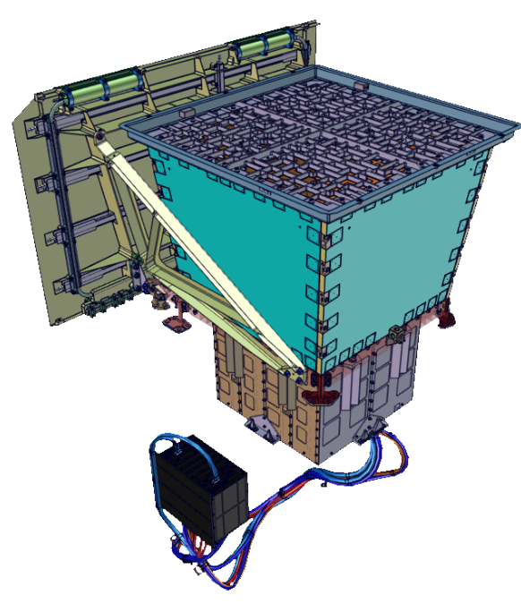
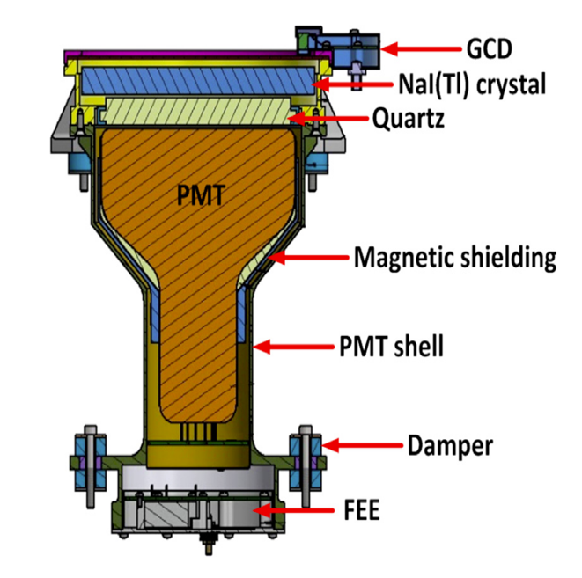
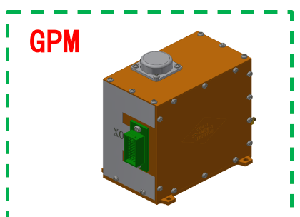
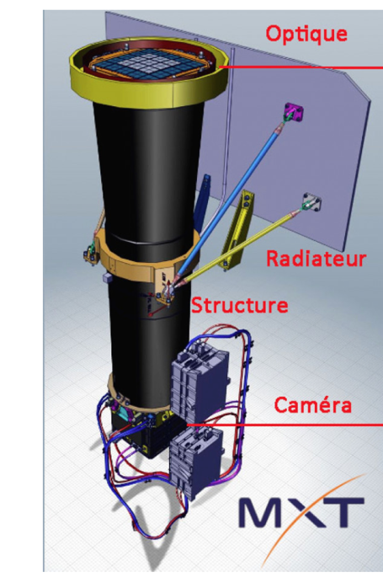
Trigger diagnostics
Dataset we could obtain in ~30 minutes
ECLAIRs SNR , Position
ECLAIRs light curve
ECLAIRs, background, counts properties
GRM light curve, background
GRM particle Monitor counts
MXT X-ray counterpart (if satellite slew)
localization
Light curve
(Detail hands on section see in Damien’s talk)

Slide 7
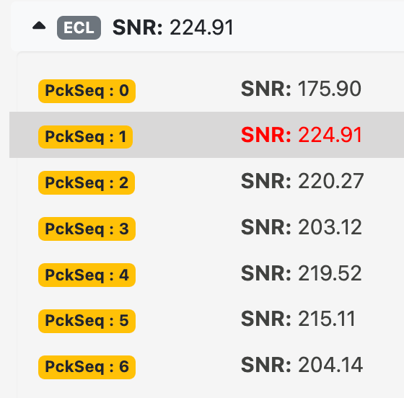
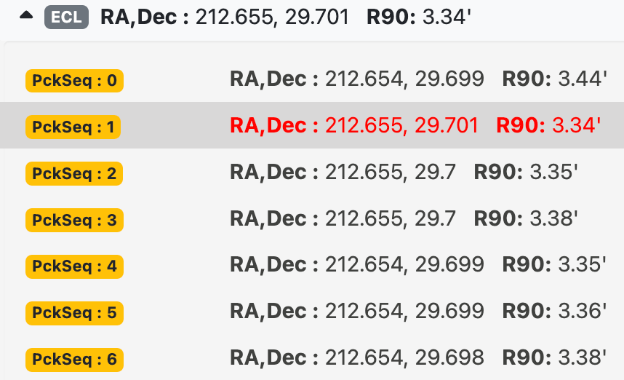
Burst indicate by ECLAIRs : SNR, position (T0)
SNR and SNR/std
The higher SNR value, the higher probability of a transient detection
SNR changing with the time, and the position keep in the same region (< 1 degree)
Notes:
https://fsc-integration.svom.org/ifsc-tools/grb/vhf-eclgrm/sb24062001

Slide 8
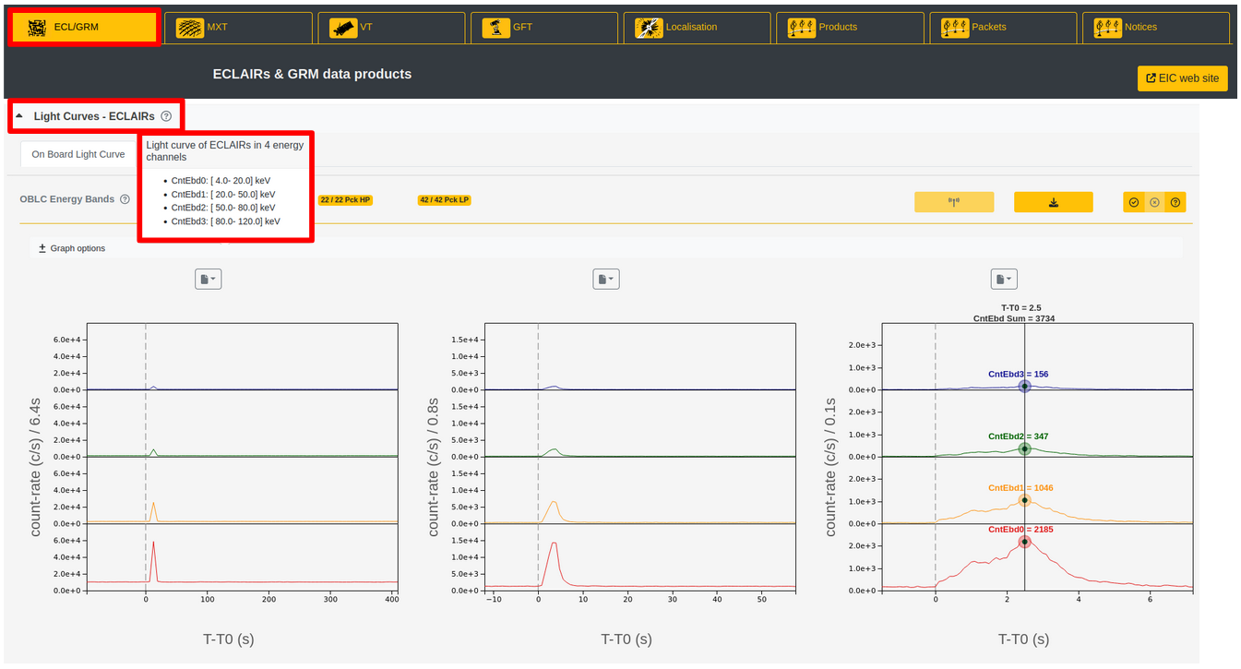
Burst indicated by ECLAIRs : light curve (T0)
Pulse rise up in the light curve figure

Slide 9
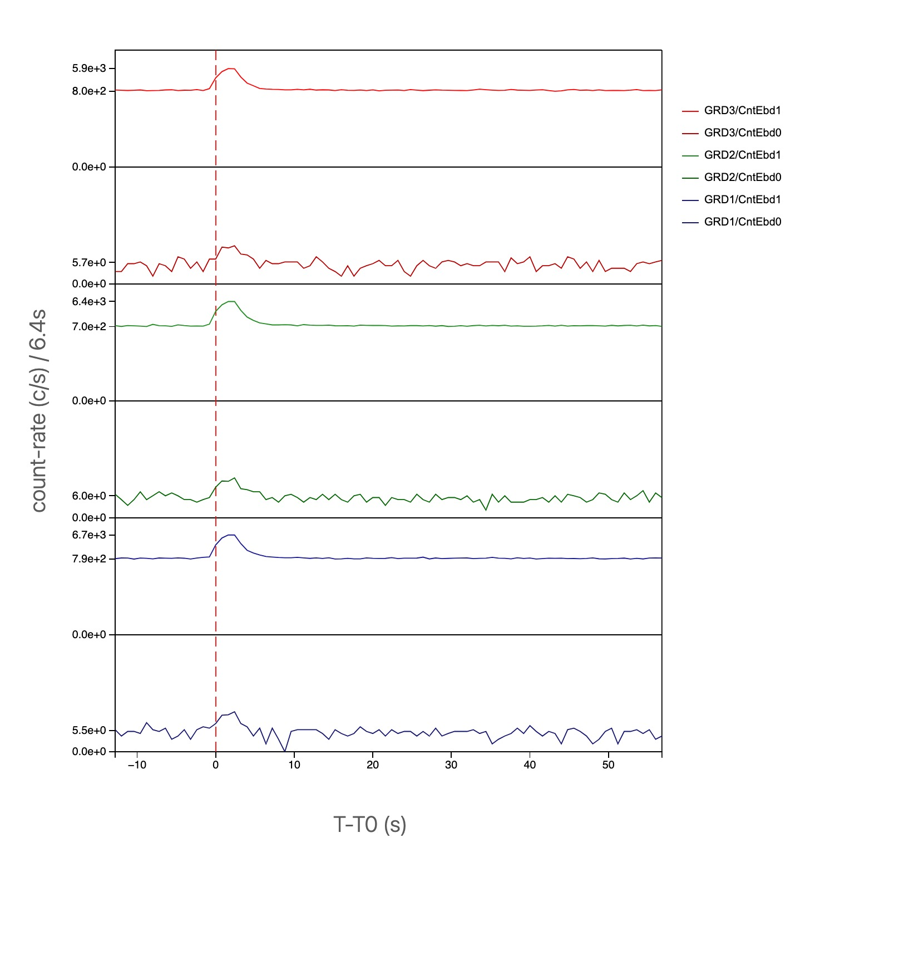
Burst indicated by GRM: light curve (T0)
GRM: 3 detector
iFSC-Tool show in tow energy band:
50 – 300 keV
300 – 700 keV
GRM count arise during the ECLAIRs trigger
Roughly follow the shape of ECLAIRs

Slide 10
Burst indicated by MXT: light curve, positions (T0+few minute)
A decay light curve of MXT
XRT position located in the ECLAIRs region (90%)

Slide 11
Excluding false triggers caused by non-astronomical sources
Particle background
ECLAIRs saturanting and multiple count
GRM particle Monitor counts (GPM counts)
Kp index – space environment (See in Arnaud Claret talk in next)
SAA Edge Area region, by the satellite position
Others …... like detector noise..
Notes:
single count saturant, how to separate the GRB photons ??

Slide 12
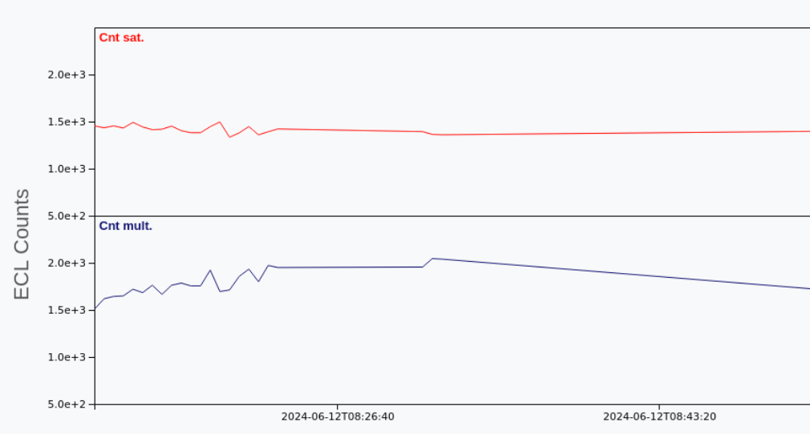
ECLAIRs multiple count and saturant count
6400 CdTe pixels In ECLIARs detection plane
Many counts that are clustered in a very short time scale (1micro sec)
If a particle event hits the detector it is going to produce an increase of the multiple counts and saturant counts (E > 150 keV)
This is very useful in case we are entering in SAA or if there are solar flares events.

Slide 13
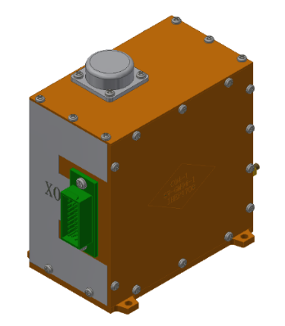
GRM Particle Monitor counts
GRM Particle Monitor counts the number of high-energy particles
A fake trigger could be occur if there is high count-rate in GRM particle Monitor

Slide 14
Space environment index Kp
If kp > 5, Take care the data of the instruments
See Arnaud’s talk (next)
Credit: https://fsc.svom.org/ifsc-tools/mission/instruments

Slide 15
Summary
Diagnosis of a new transient:
ECLAIRs : High SNR , positions around the same region, count rate rise up in the light curve
GRM light curve rise up and roughly follow ECLAIRs
MXT X-ray counterpart (if satellite slew)
- faiding light curve
- localization local in the ECLAIRs (90%)
Excluding false triggers
ECLAIRs, background, counts properties (Saturated and multiple count)
GRM particle Monitor counts increase
Space environment index Kp
Note: if Burst weak, detail analysis of the X-band data is need.
Notes:
https://forge.in2p3.fr/projects/burst-advocates/wiki/Validate_the_high-energy_(HE)_trigger_AND_produce_the_HE_GCN_Circular_(iFSC-tools)
https://fsc.svom.org/home
https://svom.lam.fr/ifsc-tools-doc/grb/

Slide 16
Thank you!
Congratulation on the successful launch of SVOM satellite !

