Slide 1
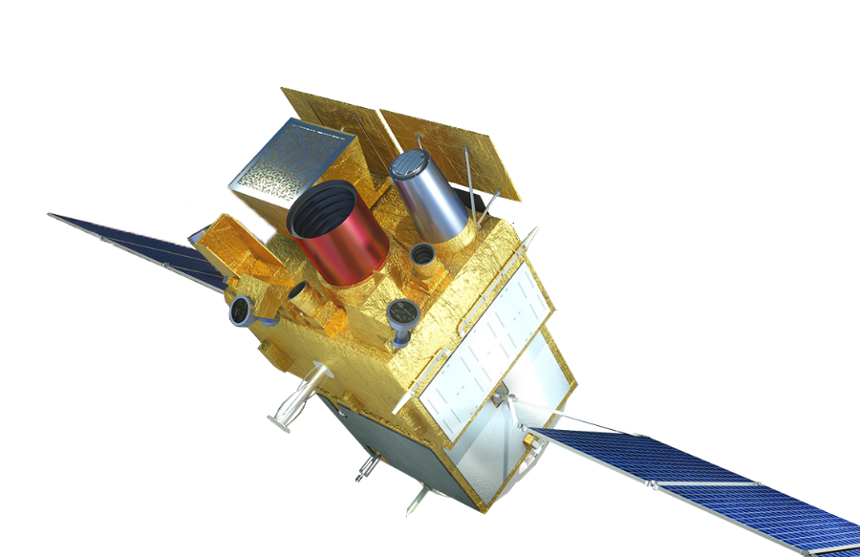
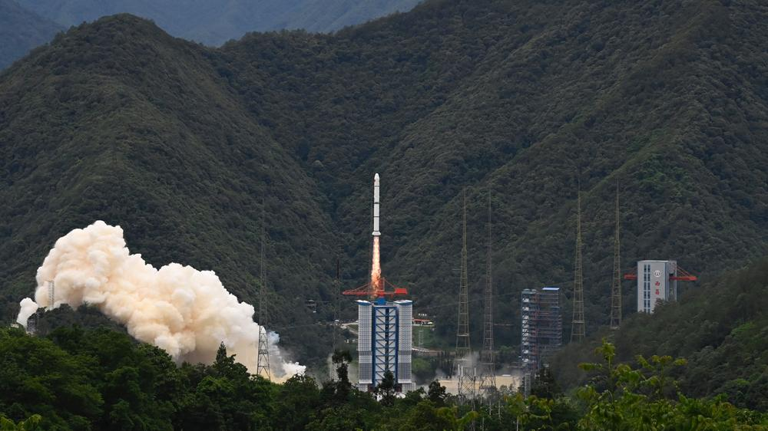



ECLAIRs
Trigger
SVOM
The SVOM ECLAIRs UGTS
and Trigger overview
Stéphane Schanne
Astrophysics Department
CEA Paris-Saclay / IRFU
2024/06/25, Xichang, China
SVOM post-launch Scientific Workshop

Slide 2

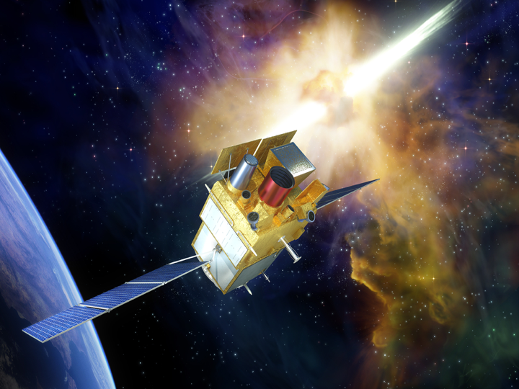
SVOM mission objectives
Space-based Variable Objects monitor
Space mission dedicated to the detection and study of Gamma Ray Bursts for astrophysics and related cosmology
Build a sample of well characterized GRBs (~200 in 3yrs)
with spectral and temporal coverage
of the prompt and afterglow phases,
permitting their redshift (distance) determination
GRB Trigger objectives
[2] –Xichang Svom Meeting - 2024/06/25 - S. Schanne
Prompt emission observation:
  trigger on all types of GRBs, including X-ray rich, short & long duration, and high-z
  fast and reliable (<12 arcmin) positions to repoint satellite for follow-up
  and send Alert ground community (<30 s).
  from Visible to MeV, timing and spectrum
Afterglow follow-up observation:
  from Visible (near-IR) to X-rays, accurate (~arcsec) GRB positions
  permit redshift measurement for large fraction of triggered GRBs (~1/2)
Transient events mission within the community (GW, LSST, CTA, SKA, Neutrinos…)
  send Alerts (GCN, VO-events)
  accept and perform ToO observations

Slide 3
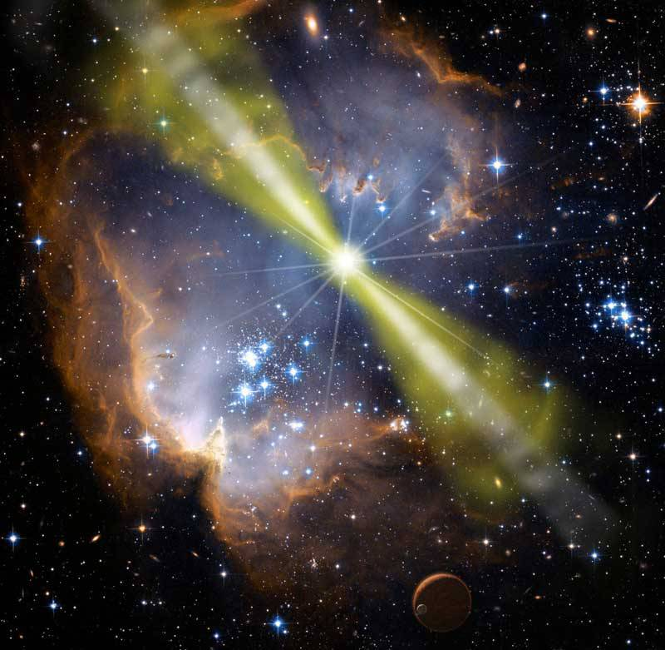
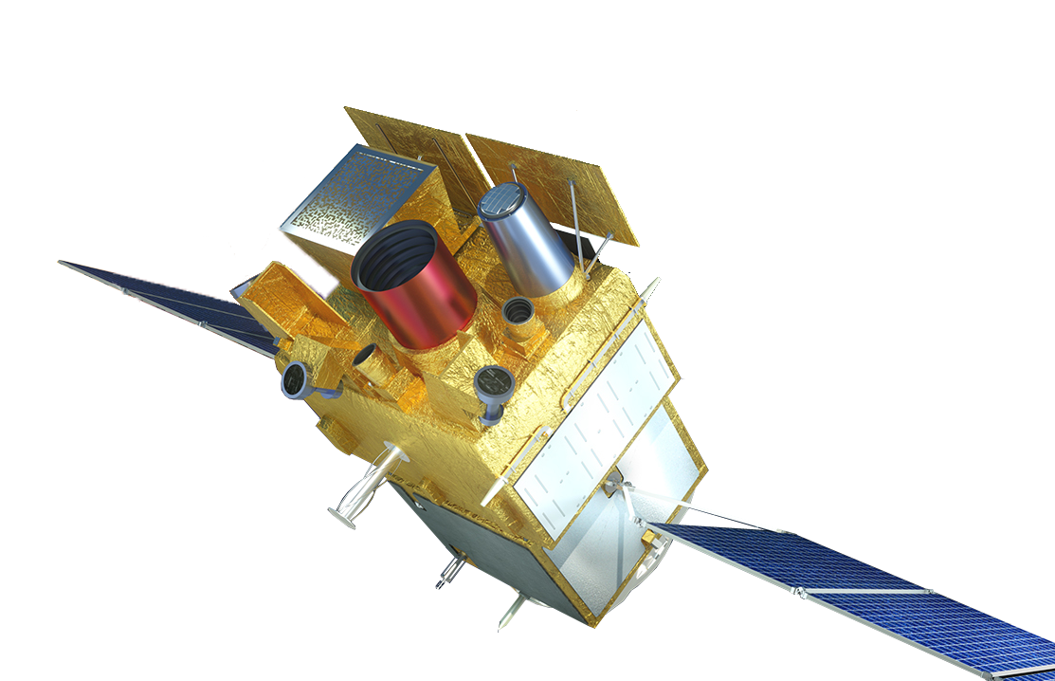
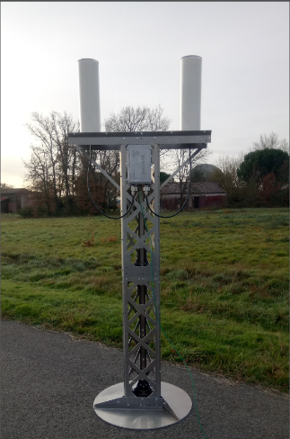
SVOM mission overview
Space-based Variable Objects Monitor
Prompt, Large FoV
ECLAIRs french
X/γ telecope (4-120 keV), FoV(2 sr)
Localisation of GRB (<12 arcmin)
Onboard trigger Alert to ground
Satellite repointing
[3] –Xichang Svom Meeting - 2024/06/25 - S. Schanne
SVOM
GRB
Trigger
GRM chinese
Spectrometer γ (30 keV-3 MeV)
GWAC chinese
Ground wide angle camera
Notes:
3

Slide 4
SVOM mission overview
Space-based Variable Objects Monitor
Delayed, Narrow FoV
MXT french (+german & british)
X-ray telescope
Fine localization (<1 arcmin)
[4] –Xichang Svom Meeting - 2024/06/25 - S. Schanne
VT chinese
Visible Telescope
(magnitude~23)
GFT french + chinese
Ground folow-up telescopes
Notes:
4

Slide 5
ECLAIRs instrument
Soft gamma-ray spectroscopic imager
[5] –Xichang Svom Meeting - 2024/06/25 - S. Schanne

Slide 6
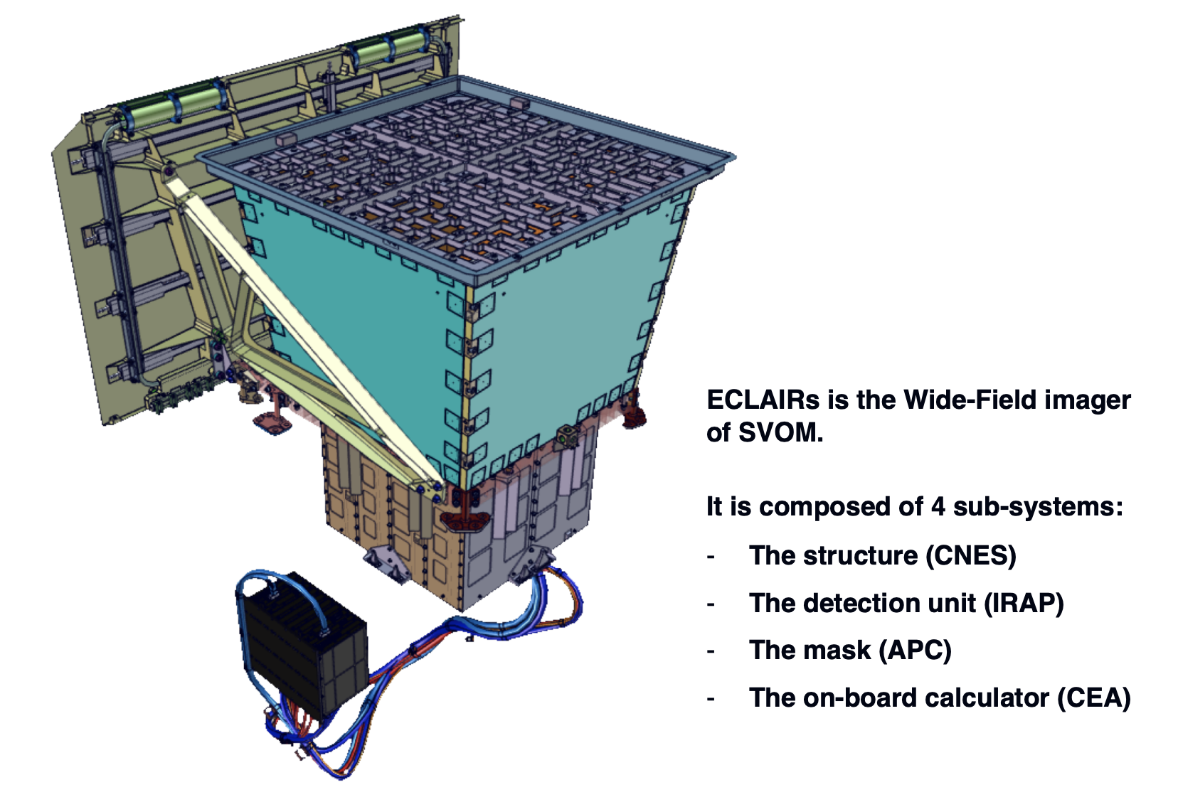
ECLAIRs instrument
Coded mask-imager
with large field of view,
and spectroscopy in the
soft gamma-ray band
60 cm
[6] –Xichang Svom Meeting - 2024/06/25 - S. Schanne
Energy range 4 – 150 keV
Energy resolution 1.6 keV (at 60 keV)
Detectors 6400 CdTe (200 modules)
Detecting area 1000 cm²
Mask open fraction 40%
Field of view 2 sr (total, 1/3 of visible sky)
Localization accuracy 11.5 arcmin (at SNR=8)
Effective area ≥ 340 cm² (10-50 keV)
≥ 200 cm² (at 6 keV)
Sensitivity 2.5 10⁻⁸ erg cm⁻² s⁻¹ (1 s, 5-50 keV)
Time resolution 20 μs
Dead time < 5% (for 10⁵ count/s)
Data rate < 18 Gb/day (X-band)
80 cm
On-board Trigger
expect ~ 50-70 GRB/yr

Slide 7
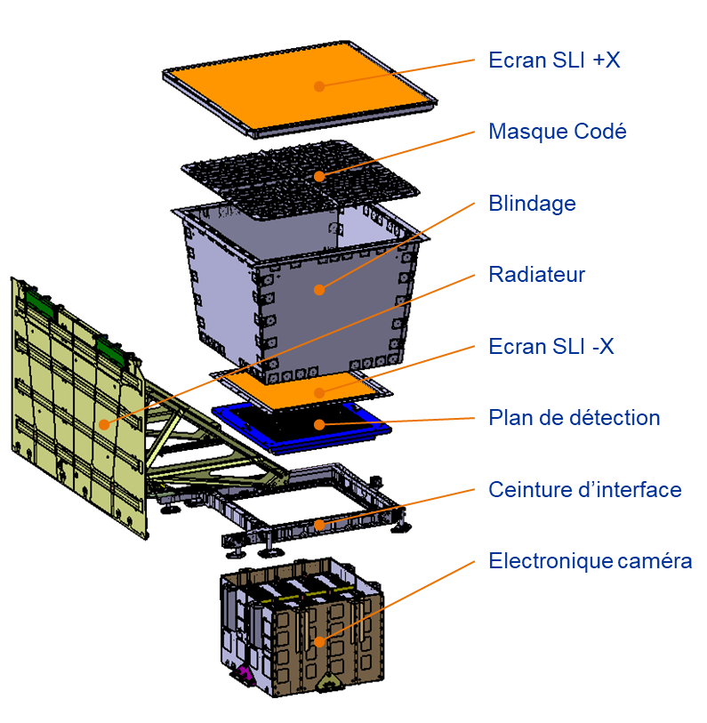
ECLAIRs instrument
Coded mask-imager
with large field of view,
and spectroscopy in the
soft gamma-ray band
Optical screen
Coded mask (Ta)
Shield (Pb+Cu)
Radiator
Optical screen
Detector plane
Interface belt
Camera electronics
Trigger & Control
Unit (UGTS)
4 main subsystems:
Structure and shielding (CNES)
Coded mask (APC)
Detection Unit (IRAP)
On-Board Software of UGTS
Trigger & Control Unit (CEA)
[7] – Xichang Svom Meeting - 2024/06/25 - S. Schanne
expect ~ 50-70 GRB/yr

Slide 8
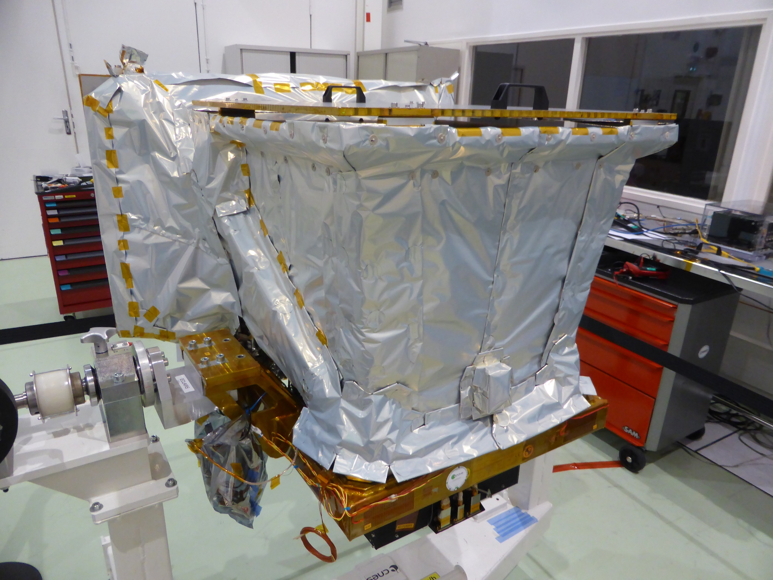
ECLAIRs flight model
CNES
ECLAIRs at CNES Toulouse, July 2022
[8] – Xichang Svom Meeting - 2024/06/25 - S. Schanne

Slide 9
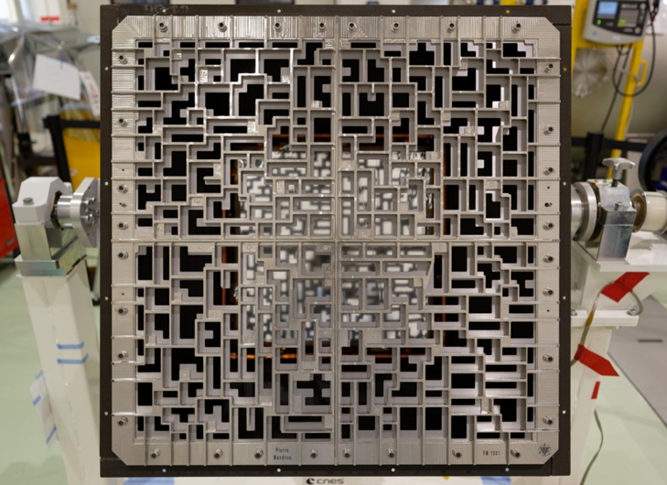
ECLAIRs coded mask
APC
Mask
self-supporting
40% open
Ta 0.6 mm
sandwhiched
between
Ti structure
56x56 cm
46x46 pixels
+ central cross
[9] – Xichang Svom Meeting - 2024/06/25 - S. Schanne

Slide 10

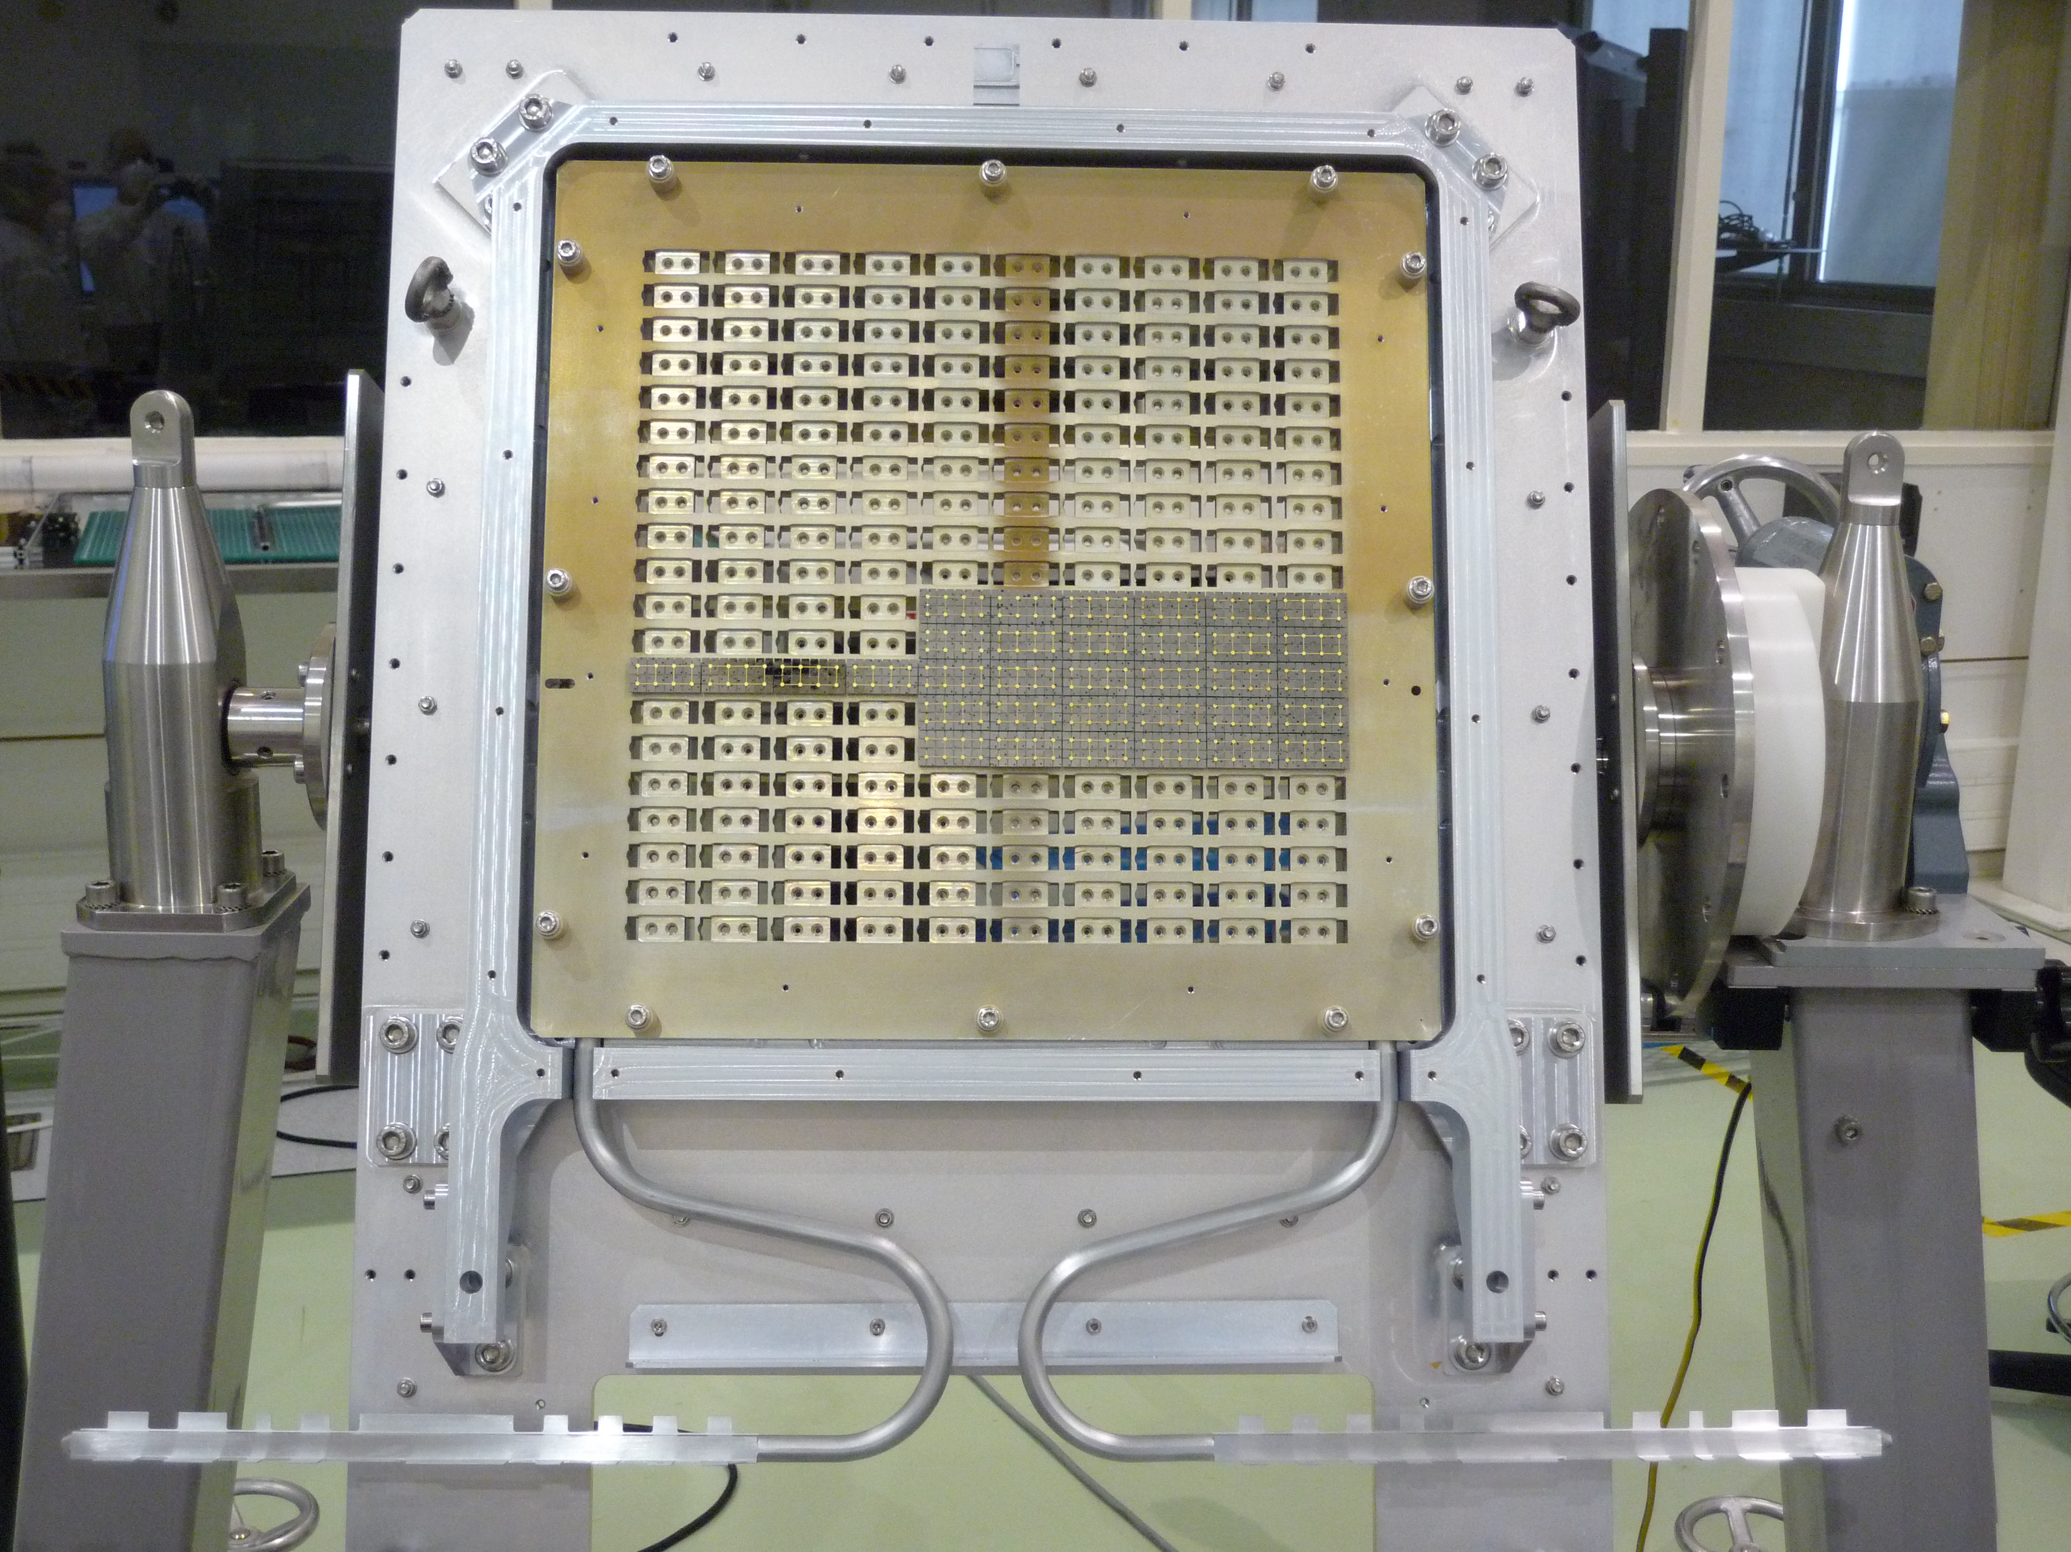

ECLAIRs detection unit
IRAP
XRDPIX module
(4x8 CdTe pixels)
200 modules
arranged in
8 sectors
Detection plane FM
[10] –Xichang Svom Meeting - 2024/06/25 - S. Schanne
8 sector-readout electronics (ELS)

Slide 11
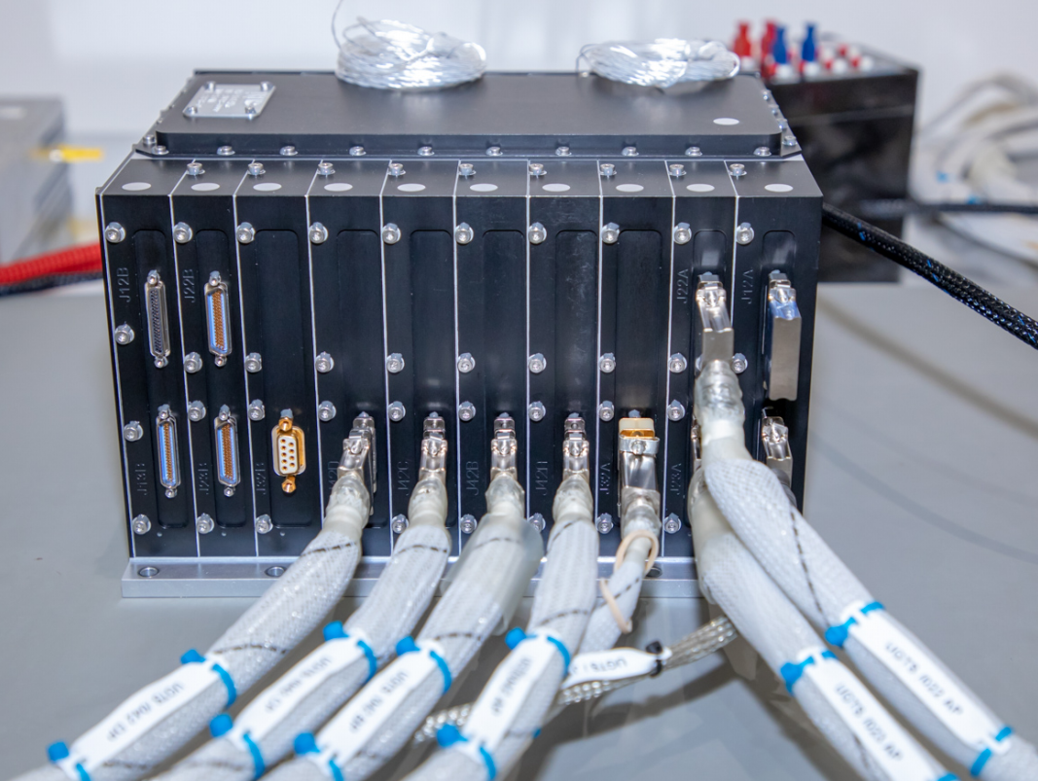

ECLAIRs trigger & control unit (UGTS)
Functions
Control of instrument (cmd/ctrl, HK, FDIR,
thermal ctrl, noisy pixels) + Power supply
Data acquisition: all detected counts
→ RawData packets → mass-memory
GRB Trigger Scientific Processing
(detection and localization of new source,
based on coded mask image deconvolution)
  Alert messages to ground (via VHF)
  Slew requests to satellite
Hardware : rad tolerant, ITAR-free, cold-redundant
I/O board (×2) + Power supply (×2+4)
CPU board (with FPGA and CPU) (×2)
FPGA : data acquisition and pre-processing
CPU: dual-core, 80 MHz, 2×50 Mflops
OS : time partitioning hypervisor
On-Board Software + Firmware : CEA
CNES, CEA
[11] –Xichang Svom Meeting - 2024/06/25 - S. Schanne
Image Reconstruction on UGTS CPU: ~ 1 s

Slide 12
Handover to Hervé

Slide 13
The ECLAIRs UGTS
FPGA data preprocessing
2024/06/25, Xichang, China
SVOM Scientific Workshop
Hervé Le Provost
DEDIP
CEA Paris-Saclay / IRFU
ECLAIRs
Trigger
SVOM

Slide 14
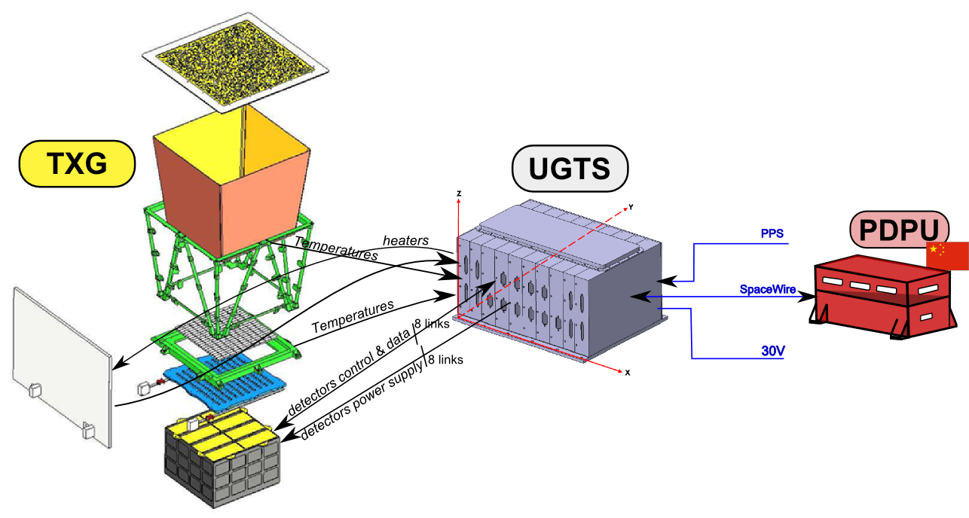
ECLAIRs trigger & control unit (UGTS) UGTS:
Unité de Gestion et de Traitement Scientifique
ECLAIRs data acquisition
GRB Trigger
  Satellite repointing
  VHF alert messages
Scientific and Technological Housekeeping
ECLAIRs camera management
  Control/Configuration, thermal control
  Noisy pixels switch off/on
Synchronization , FDIR…
Camera power supply
UGTS functions
[14] –Xichang Svom Meeting - 2024/06/25 – H. Le Provost

Slide 15
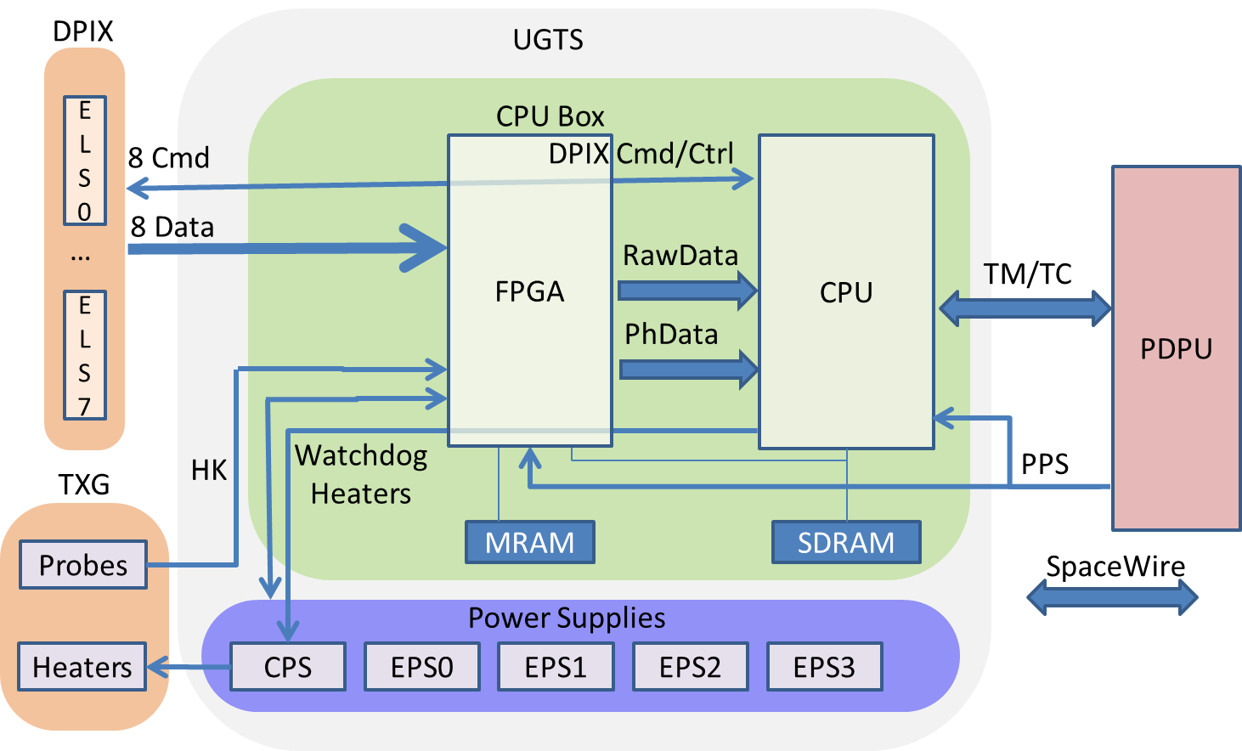
UGTS hardware architecture
FPGA = Field Programmable Gate Array (cabled logic, no update from ground)
Data Acquisition
Preprocessing
[15] –Xichang Svom Meeting - 2024/06/25 – H. Le Provost

Slide 16
UGTS raw data (for X-band & trigger)
Some events coming from a sector of 800 pixels (3 out of 7 physics types)
(default flight configuration)
Single Event within energy Band 0-3 (SEB)
pixel number (1 out of 6400)
Front-end time stamping
Energy band and coded Energy
➔ events used for GRB trigger
Single Event with energy Underflow or Overflow (SEU or SEO)
pixel number (1 out of 6400)
Front-End time stamping
Energy band and coded Energy
➔ Energy underflow or overflow detected by front end
(event not used for GRB trigger, used for Light Curves and Rec2)
Multiple Event with Coded energy (MEC)
pixel number (1 out of 6400)
Front-End time stamping
Energy band and coded Energy
➔ Multiple events detected by front end
(event not used for GRB trigger, used for Light Curves and Rec2)
5 keV 8 keV 20 keV 50 keV 120 keV
Eband0
Eband1
Eband2
Eband3
SEU SEB0 SEB1 SEB2 SEB3 SEO
[16] –Xichang Svom Meeting - 2024/06/25 – H. Le Provost

Slide 17
UGTS firmware processing: Xoff
XOFF all links
Flow control by individual Event type mask or inputs general XOFF
Camera
Events
UGTS
CPU
(2 cores)
SEB
MEC
SEU
SEO
EES
MEA
MEE
Event type | Mask
SEB | 0/1
MEC | 0/1
SEU | 0/1
SEO | 0/1
SES | 0/1
MEA | 0/1
MEE | 0/1
Raw Data
MEC
SEU
SEO
SES
MEA
MEE
SEB
Masked
Raw Data
To XBand
[17] –Xichang Svom Meeting - 2024/06/25 – H. Le Provost
VHFL alert
Light curves
Photon
Data
SEB encoding
(noPhSeb 0/1)
Trigger
Processing
Light curves counters
SpaceWire
FPGA

Slide 18
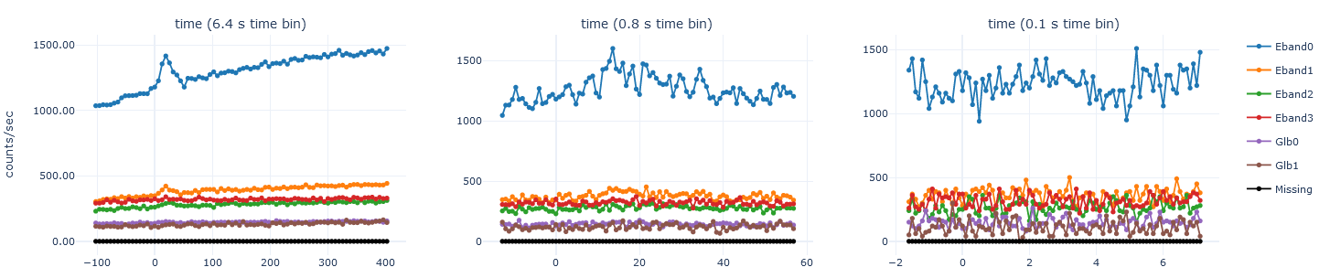
UGTS firmware processing: GlobalCnt
Camera
Events
UGTS
(default flight configuration)
SEB
MEC
SEU
SEO
SES
MEA
MEE
Event type | Counting enable
SEB | 0
MEC | 0
SEU | 0
SEO | 1
SES | 1
MEA | 0
MEE | 0
CPU
(2 cores)
MEC
SEU
SEO
SES
MEA
MEE
SEB
Trigger
Processing
Counters accumulate
Global
Counter #0
[18] –Xichang Svom Meeting - 2024/06/25 – H. Le Provost
(saturating)
Event type | Counting enable
SEB | 0
MEC | 1
SEU | 0
SEO | 0
SES | 0
MEA | 1
MEE | 1
VHF Light curves
and
VHF Rec2
Global
Counter #1
FPGA
(multiples)
SpaceWire

Slide 19
UGTS firmware processing: PixMask
Camera
Events
SEB Pixel can be mask by energy band dynamically
(default configuration: mask pixels known to be noisy)
XOFF all links
UGTS
SEB
MEC
SEU
SEO
SES
MEA
MEE
CPU
SEB Pixel mask by energy band
0
Raw Data
Pixel #0
[19] –Xichang Svom Meeting - 2024/06/25 – H. Le Provost
Photon
Data
Pixel #6399
Trigger
Processing
SEB encoding
SpaceWire
FPGA

Slide 20
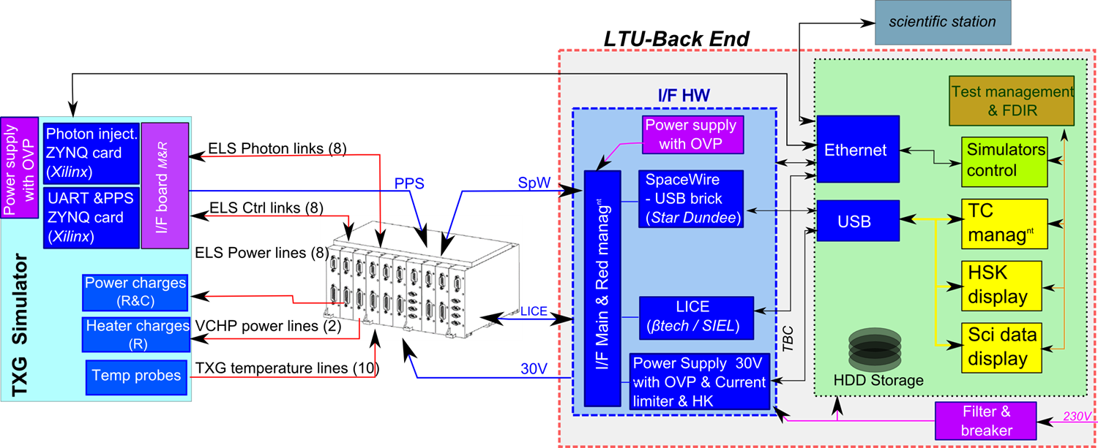
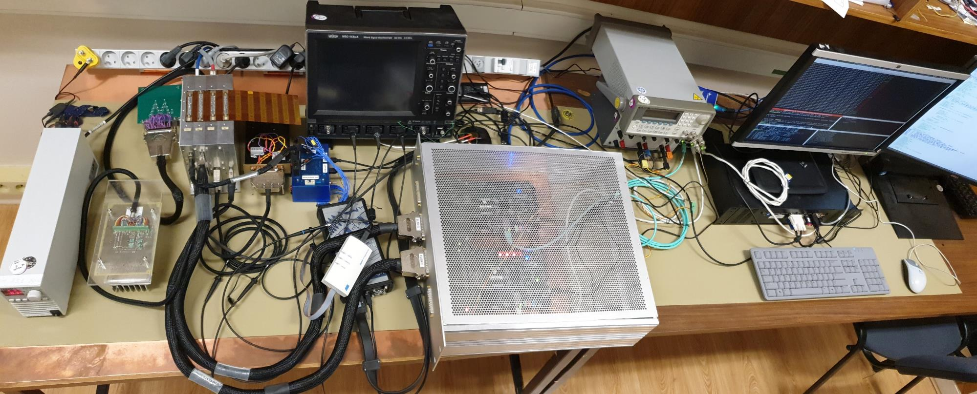
UGTS at CEA: Local Test Unit (LTU)
[20] –Xichang Svom Meeting - 2024/06/25 – H. Le Provost
UGTS
(model BB1)
ELS simulator (with photon injector)
Host computer

Slide 21
Handover to Stéphane

Slide 22
Focus on the ECLAIRs UGTS
Trigger Algorithms
2024/06/25, Xichang, China
SVOM Scientific Workshop
Stéphane Schanne
Department of Astrophysics
CEA Paris-Saclay / IRFU
ECLAIRs
Trigger
SVOM

Slide 23
ECLAIRs coded mask imaging illustration
Sky image reconstruction by
Detector image deconvolution
[23] –Xichang Svom Meeting - 2024/06/25 - S. Schanne

Slide 24
ECLAIRs imaging: on-axis source
[24] – Xichang Svom Meeting - 2024/06/25 - S. Schanne

Slide 25
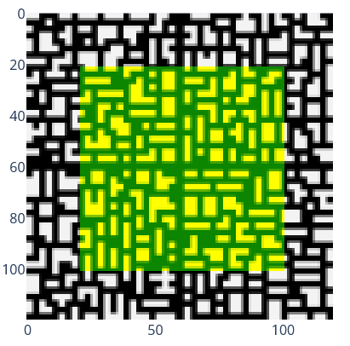
ECLAIRs imaging: on-axis source
[25] – Xichang Svom Meeting - 2024/06/25 - S. Schanne

Slide 26
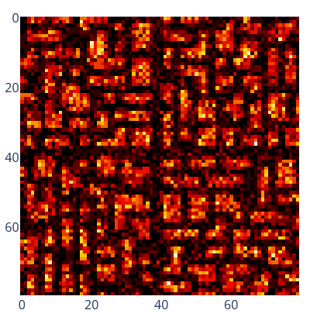
ECLAIRs imaging: on-axis source
[26] – Xichang Svom Meeting - 2024/06/25 - S. Schanne

Slide 27
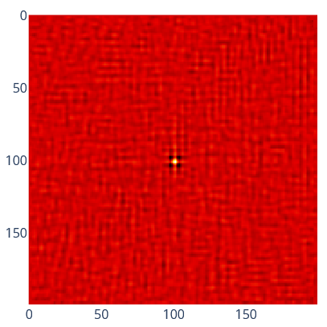
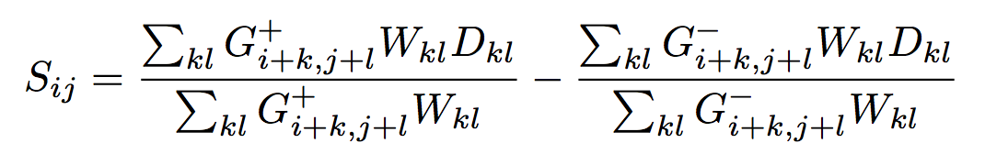
ECLAIRs imaging: on-axis source
[27] – Xichang Svom Meeting - 2024/06/25 - S. Schanne
[27] – Xichang Svom Meeting - 2024/06/25 - S. Schanne
Deconvolution

Slide 28
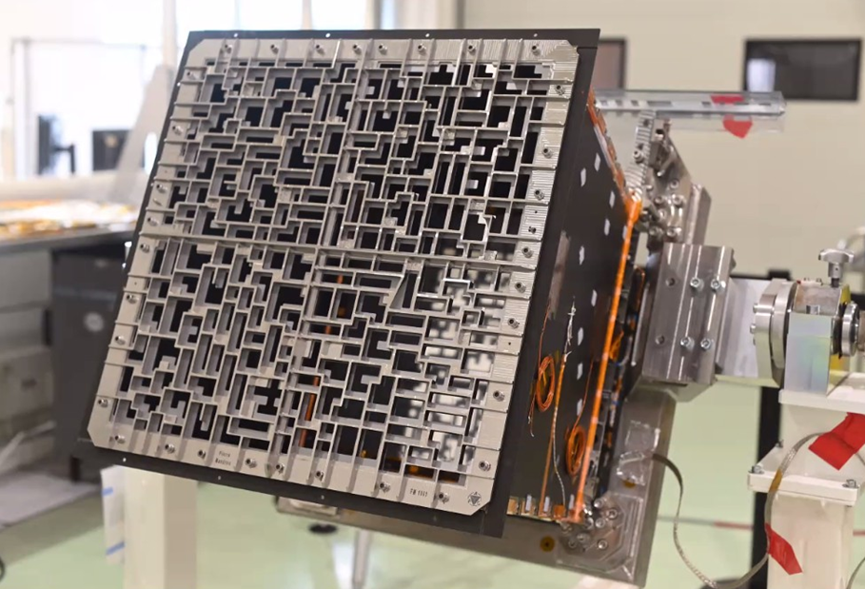
ECLAIRs imaging: off-axis source
[28] – Xichang Svom Meeting - 2024/06/25 - S. Schanne

Slide 29
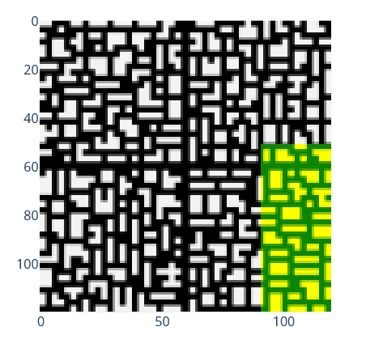
ECLAIRs imaging: off-axis source
[29] – Xichang Svom Meeting - 2024/06/25 - S. Schanne

Slide 30
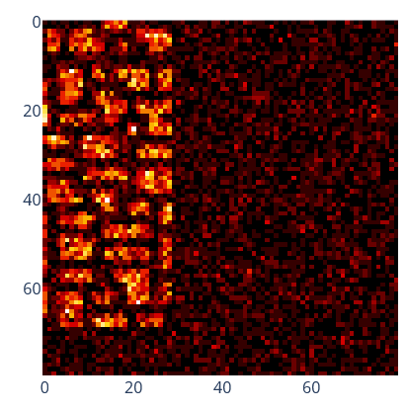
ECLAIRs imaging: off-axis source
[30] – Xichang Svom Meeting - 2024/06/25 - S. Schanne

Slide 31
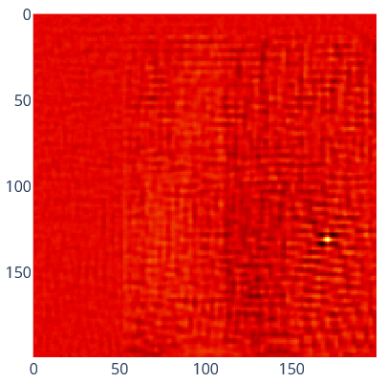
ECLAIRs imaging: off-axis source
[31] – Xichang Svom Meeting - 2024/06/25 - S. Schanne
Deconvolution

Slide 32
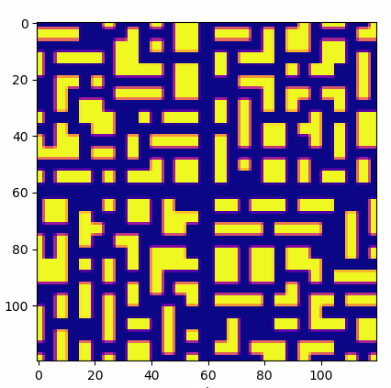
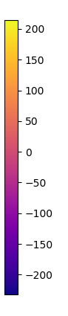
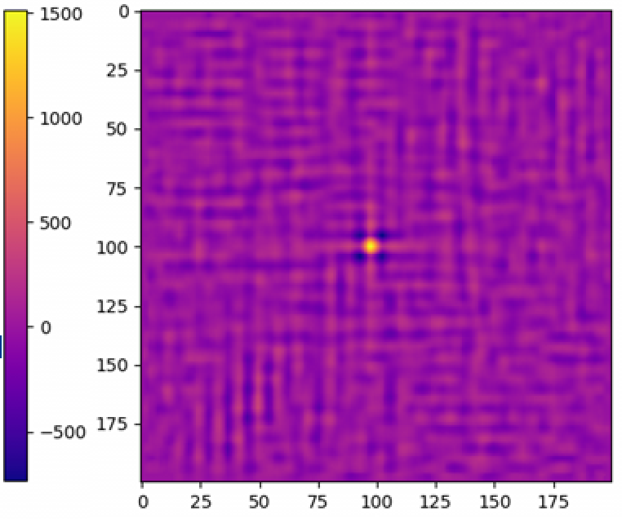
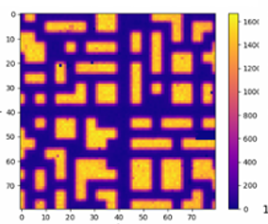
ECLAIRs FM: first imaging test
Mask zoom=1.66
CNES Toulouse (May 2021)
ECLAIRs FM in Thermal Chamber, mask mounted
⁵⁷Co + ²⁴¹Am radioactive sources
at 115 cm in front of ECLAIRs detection plane
UGTS V4.0.1 (data acquisition & imaging software)
[32] – Xichang Svom Meeting - 2024/06/25 - S. Schanne

Slide 33
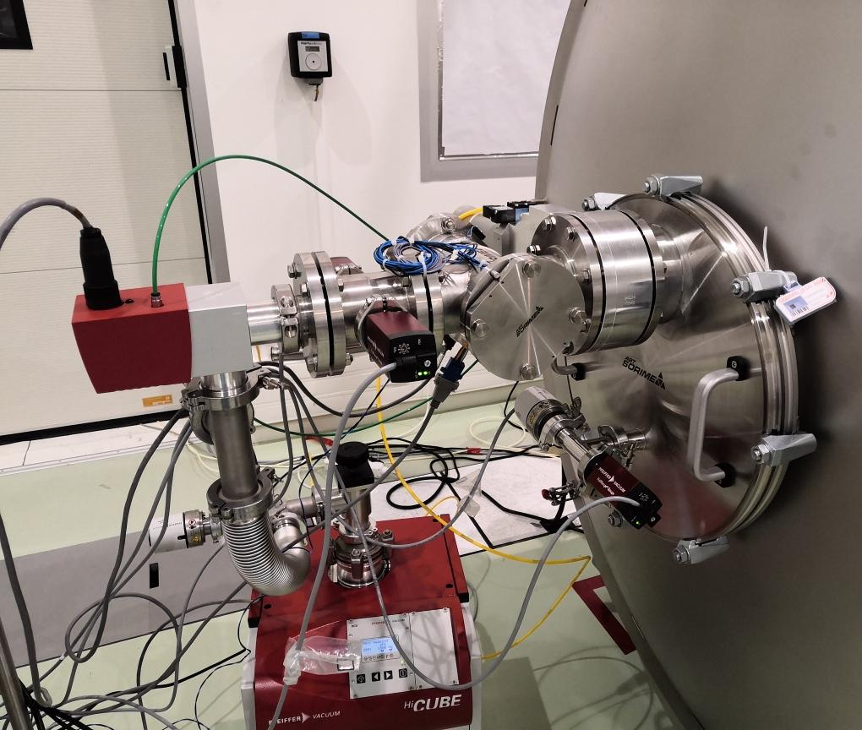
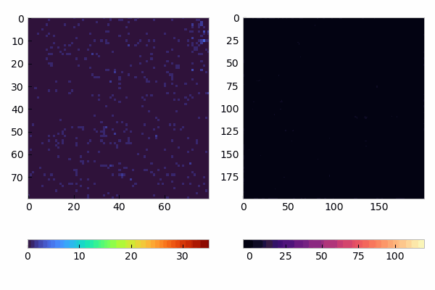
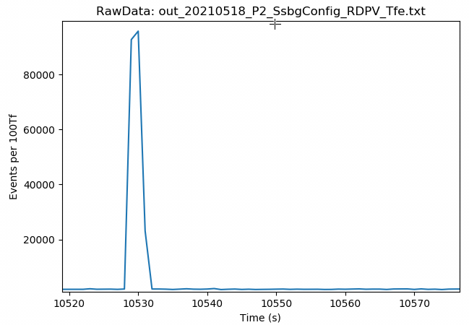
ECLAIRs FM: first transient source detection
CNES Toulouse (May 2021)
ECLAIRs FM in Thermal Chamber,
mask mounted
Artificial “GRB” simulated with X-ray generator
(duration ~2 s)
Detector image (counts/pixel) Sky image (SNR)
[33] – Xichang Svom Meeting - 2024/06/25 - S. Schanne
target: Cu (8 keV line)
intensity change by changing current of X-ray generator
Events/s
animation with RawData output
10 s (20 images of 0.5 s exposure)
Deconvolution with zoom=1.38 (distance of source: 1.71 cm from detector)
UGTS V4.0.1 (data acquisition & imaging)

Slide 34
ECLAIRs trigger algorithms
constraints
[34] –Xichang Svom Meeting - 2024/06/25 - S. Schanne

Slide 35
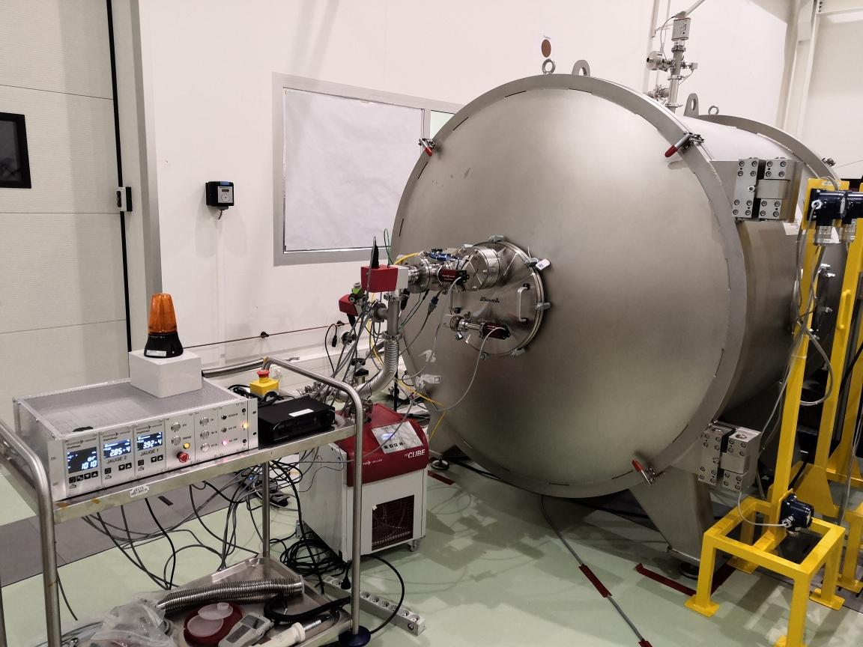
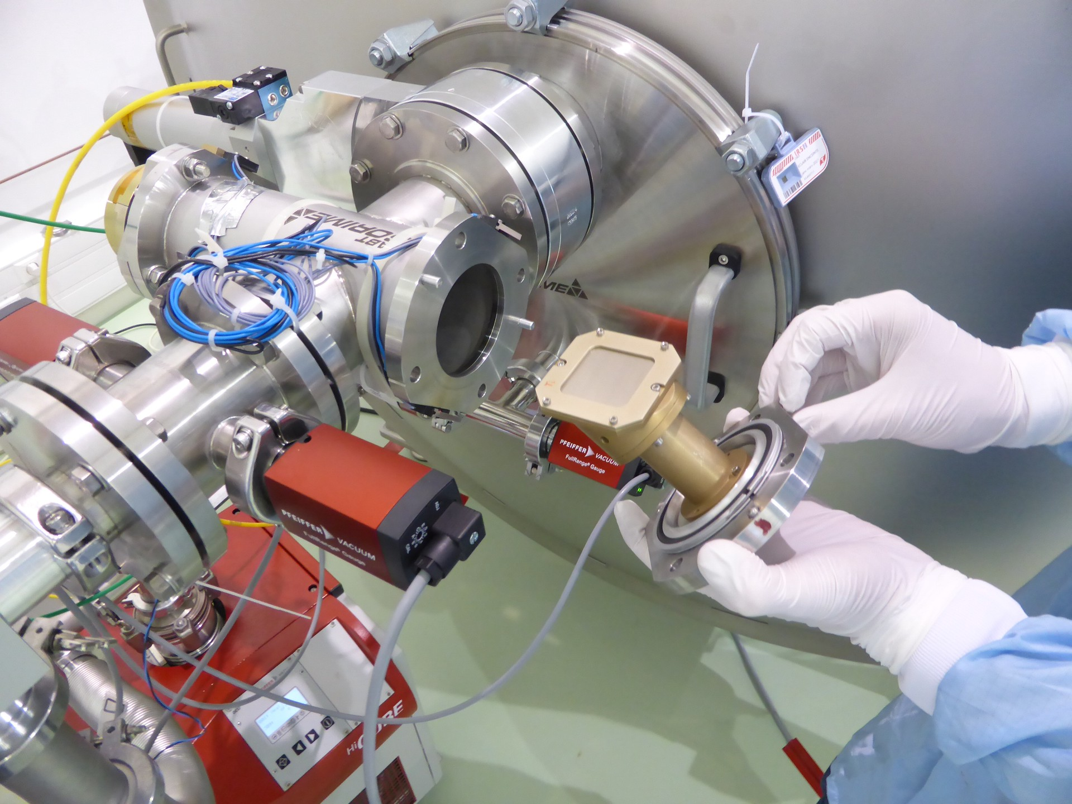
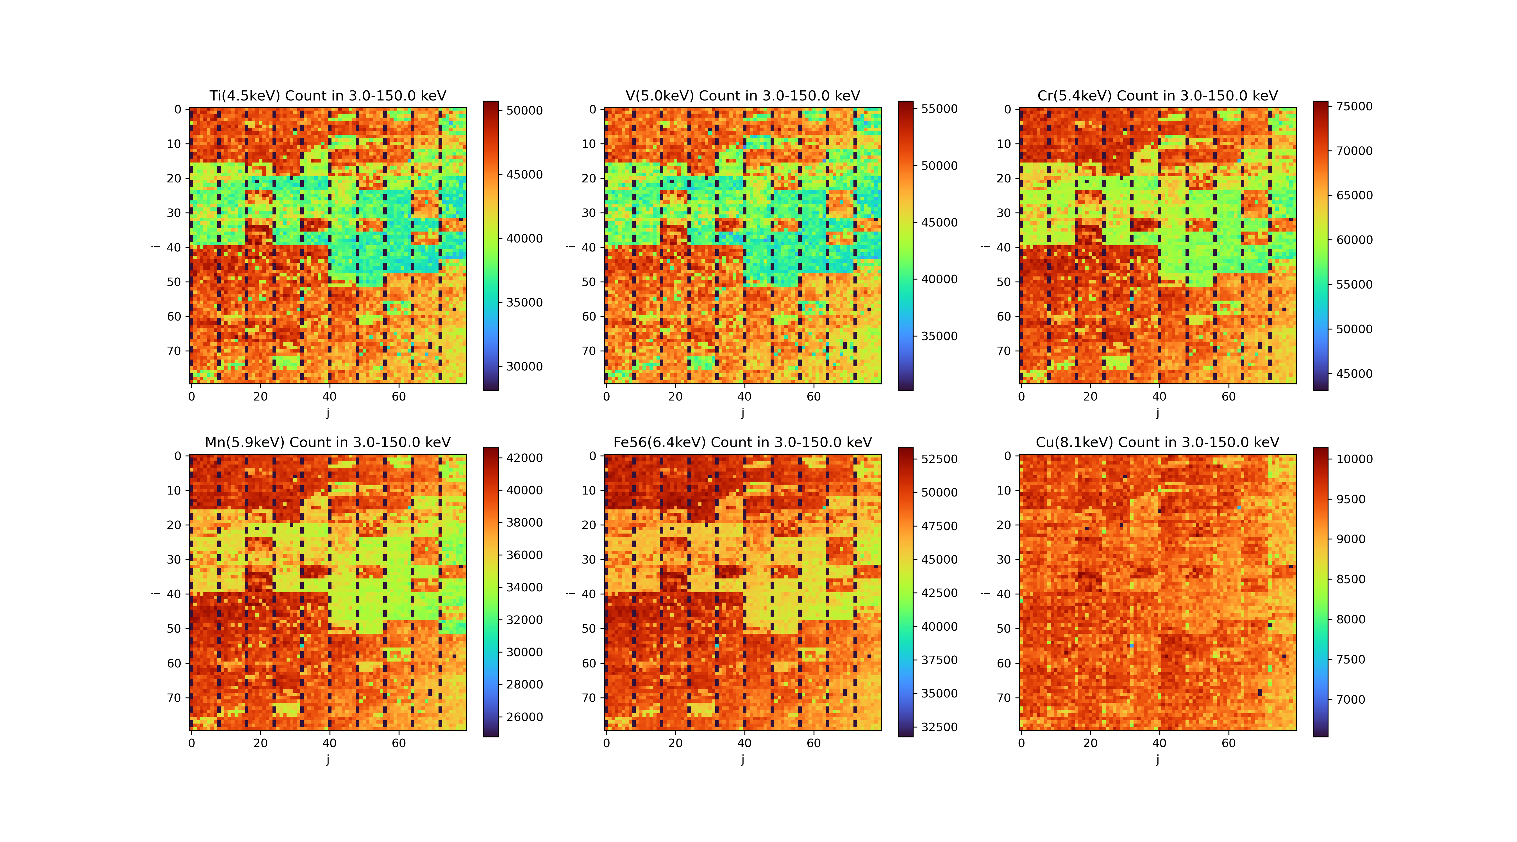
UGTS trigger: detector instrumental effects
CNES Toulouse ECLAIRs (March 2021)
ECLAIRs FM without mask
Thermal Vac.
X-ray generator
Targets
Fluoresc. lines
[35] –Xichang Svom Meeting - 2024/06/25 - S. Schanne
Wenjin Xie (CEA, thesis 2021-2024)
W. Xie et al A&A arXiv 2401.13619 (2024)
Vanadium (5.0 keV)
Copper (8.1 keV)
Detection plane inhomogeneity
at low Energy (4 to 8 keV)
Config UGG_TRIG table
Estrip def for flight:
  Estrip 0,1,2 > 8 keV
  Estrip 3: 5-8 keV
Efficiencies and weights for UGTS deconvolution
Noisy pixel management

Slide 36
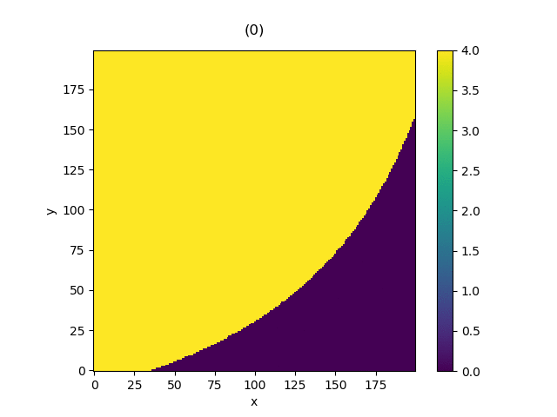
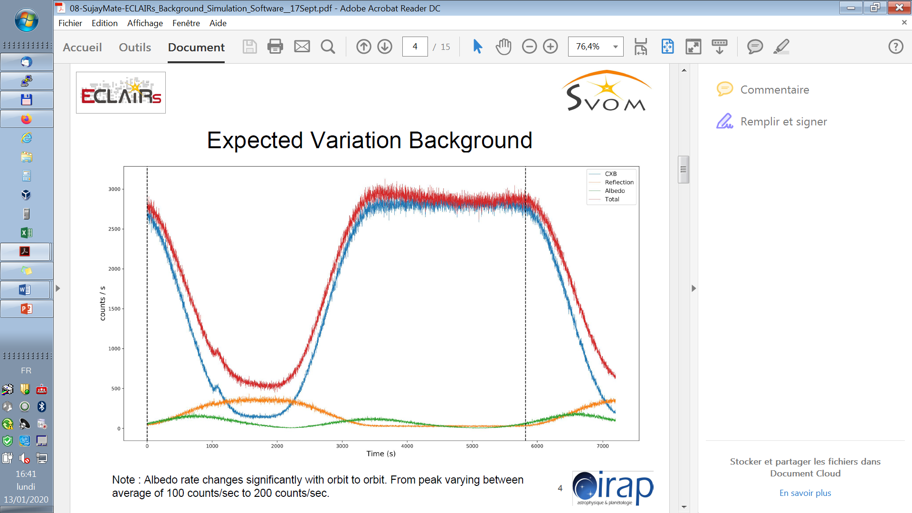
UGTS trigger: variable background
Background expected :
- CXB (cosmic X-ray background)
- Reflection (of CXB on athmosphere)
- Albedo (of cosmic rays in athmosphere)
Earth Transit in FoV ➔ modulation of bkg
Temporal and Spatial (on detector plane)
➔ modelled in trigger algorithms
PIRA
simulation
(IRAP)
[36] –Xichang Svom Meeting - 2024/06/25 - S. Schanne
Earth transit trough FoV
(1 frame = 20 s, 270 frames/orbit)
N. Dagoneau (CEA)
S. Mate (IRAP)

Slide 37
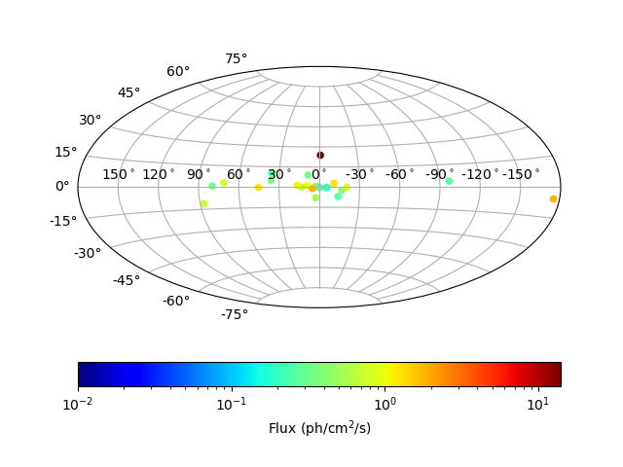
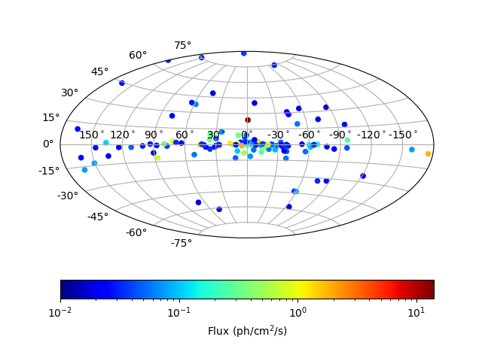
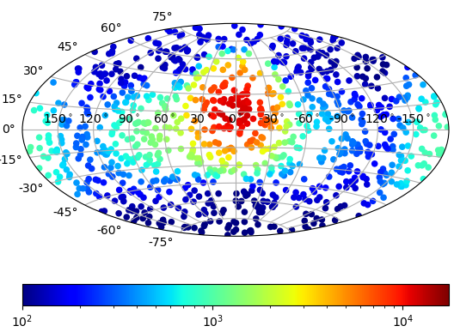
UGTS trigger: known sources catalog
Nicolas Dagoneau (CEA, thesis 2017-2020)
N. Dagoneau, S. Schanne et al A&A 645A (2021)
using 425 sources from MAXI (2-20 keV) + Swift/BAT (15-195 keV)
spectra modelled (broken-powelaw), flux over ECLAIRs 4-120 keV band
24 sources : SNR > 6 in 20 s 122 sources : SNR > 6 in 20 min
[37] –Xichang Svom Meeting - 2024/06/25 - S. Schanne
counts/s on detector for given sky pointing (optical axis)
Most of sources excluded by B1 pointing law ( |b|>10° & Sco X-1 avoidance)
But we may be outside B1 law during >¼ of the time (GRB 14 orbits follow-up & ToO)
➔ Onboard source Catalog included for trigger algorithms

Slide 38
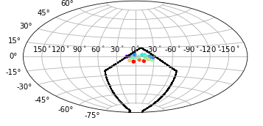
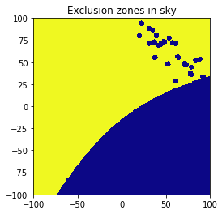
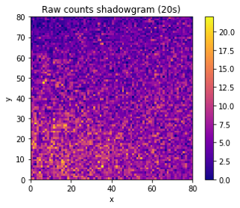
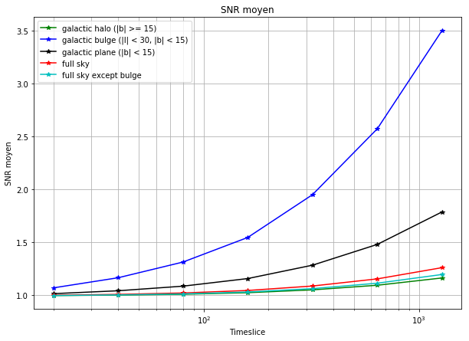
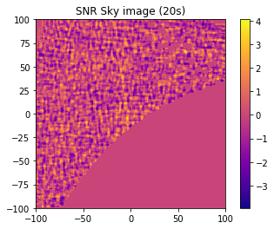
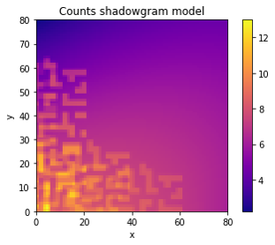
UGTS trigger > 20s: fit bkg & strong sources
ECLAIRs UGTS: onboard Trigger
N. Dagoneau & S. Schanne A&A 665A (2022)
Nicolas Dagoneau (CEA, thesis 2017-2020)
Sources in FoV (example with Gal. bulge)
Raw shadowgram
(20 s, sources +
Earth modulated CXB)
[38] –Xichang Svom Meeting - 2024/06/25 - S. Schanne
Sky exclusion region
Galactic bulge
in FoV
Width of SNR distribution (stdev)
1 2 3
Model fit to shadowgram:
CXB 6 par + 1 par/source
(max 5 sources fitted)
Sky SNR image
(20 s, Earth exclusion)
B1 pointing
20 100 1000
Timescale (s)

Slide 39
ECLAIRs trigger algorithm
“explained for dummies”
[39] –Xichang Svom Meeting - 2024/06/25 - S. Schanne

Slide 40
UGTS trigger: driven by GRB diversity
GRBs appear randomly on the sky
search in full FoV (2 sr, taking into account position of Earth and known sources)
Faint GRBs are the most numerous ones
➔ AlertThresh, SlewThresh as low as possible (with acceptable false alarm rate)
GRB spectral diversity (normal, XRF, high-z)
4 Energy strips
GRB durations and variability
➔ All Time-scales from 10 ms to 20 min
(17 powers of 2)
5 keV 8 keV 20 keV 50 keV 120 keV
Estrip 0
Estrip 1
Estrip 2
Estrip 3
[40] – Xichang Svom Meeting - 2024/06/25 - S. Schanne
    But sky-image computation takes ~1 second on UGTS hardware!
    ➔ Two trigger algorithms running in parallel (each on 1 CPU core):
    - “Image Trigger” on long time-scales (> 20s), 1 step:
    build sky images every 20 s, stack up to 20 min, search for new source
    - “Count-Rate Trigger” or short time-scales (< 20 s), 2 steps:
    first select time window with count-rate increase,
    then build sky image and search for new source
Notes:
40

Slide 41
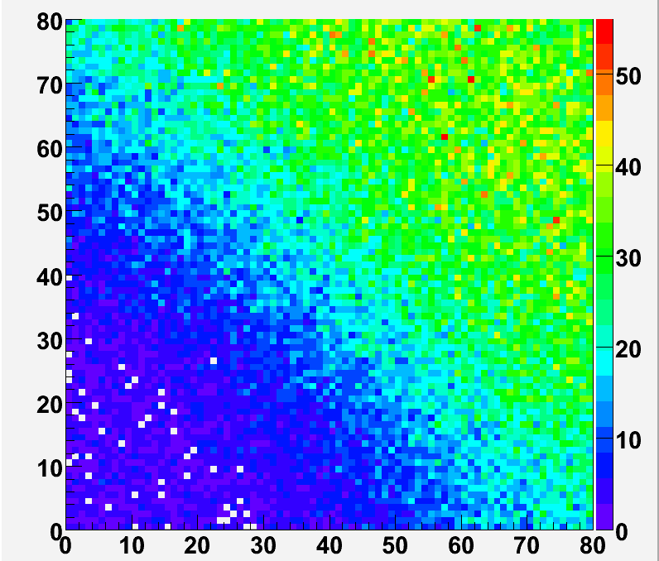
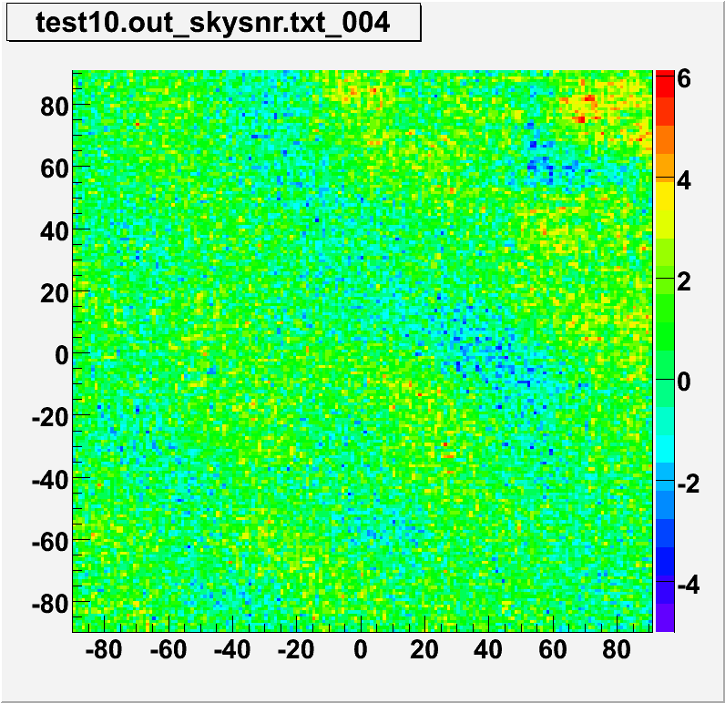
UGTS: Image Trigger (IMT) algorithm
Cyclic process every 20 s, in 4 Estrips
- build detector image and clean noisy pix
- fit & subtract background shape
(Earth modulated CXB + bright sources)
- deconvolution (using mask pattern)
⇒ Sky Images of 20 s duration (remove part behind Earth)
Earth
Raw shadowgram
Reconstructed sky
time
[41] – Xichang Svom Meeting - 2024/06/25 - S. Schanne
- Summation of sky images (using sky image history)
→ Sky-images up to 20 min duration (7 time scales: 20 s to about 20 min)
- Search in each sky image: pixel SNRmax (for which SNRmax/stdev > thresh)
if not in known source catalogue, fit peak to get precise position.
if SNRmax > AlertThresh ➔ GRB-Alert to VHF
if SNRmax > SlewThresh ➔ GRB-Alert to VHF with satellite slew request
if at known source position: if SNRmax > CatThresh ➔ CAT-source Alert with slew req.

Slide 42
UGTS: Count-Rate Trigger (CRT) algorithm
Cyclic process every 2.5 s
First step: detect excesses in count-rate
- background estimate (from temporal bkg-model)
- build counts in all Time-Windows from 10 ms to 20 s (in 4 Estrips, and in 9 detector zones)
- compute count excess significance: SNRcnt > CntThresh ➔ stored into buffer
Second step: imaging of best excess detected up to now
- search best excess present in buffer (not too old, not yet processed)
- build detector image of best excess (over its TimeWindow and in its Estrip) and clean noisy pix
- deconvolution➔ sky Image
- search in each sky image: pixel SNRmax (for which SNRmax/stdev > thresh)
if not on Earth and not in known source catalogue, fit peak to get precise position.
if SNRmax > AlertThresh ➔ GRB-Alert to VHF
if SNRmax > SlewThresh ➔ GRB-Alert to VHF with satellite slew request
[42] – Xichang Svom Meeting - 2024/06/25 - S. Schanne

Slide 43
ECLAIRs trigger output
[43] –Xichang Svom Meeting - 2024/06/25 - S. Schanne

Slide 44
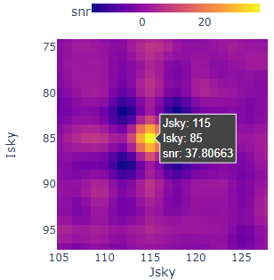
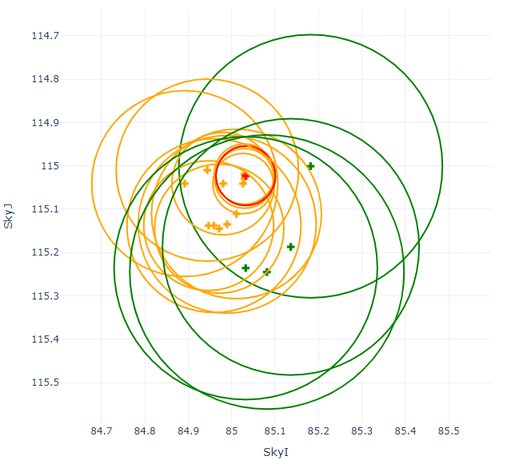

UGTS: Alert output to VHF & Beidou
Tb
T0 (PktTime)
Sequence of Alert packets (dozen of packets):
ObsNumber (Alert Sequence Number) + ObsType (GRB or CAT)
Trigger Time-Window (Tb, Exposure)
SNRmax in image (and Energy range)
Detection quality (image stdev…)
Position (local coordinates in FoV)
Satellite attitude and satellite position
Slew Request
[44] – Xichang Svom Meeting - 2024/06/25 - S. Schanne
SNR
(sigma)
Max (SNR)
Max/Std
Std
Number of Aller packet in Sequence

Slide 45

UGTS: LightCurve output to VHF
LO-RES
MID-RES
HI-RES
LightCurveTb
Hi-Priority Low-Priority
[45] – Xichang Svom Meeting - 2024/06/25 - S. Schanne
Light-Curve around Trigger Time Window (64 packets)
Time since LC-Tb (s)

Slide 46

UGTS: End of AlertSequence output to VHF
best Alert
Alert Descriptor packets (AD1: best Alert, AD2-3: CRT, AD4-5: IMT)
Details about best Alert found (+ info if Slew accepted or time-out)
[46] – Xichang Svom Meeting - 2024/06/25 - S. Schanne
Shadowgram or Subimage around best Alert in sequence (49-64 packets)

Slide 47

UGTS: VHF post-processing at CEA (EIC/ETC)
STT: Svom Trigger Targets
a.k.a Sub Threshold Targets
UGTS VHF packets used to create STT messages
  VHF Rec1 (CRT, IMT), Alert, AlertDescr1
  Create Json message strings
  Main info for Target:
    Time Tb and Exposure
    Localization (Rad/Dec/R90)
    SNR + SlewRq …
    + Satellite Long/Lat, Earth fraction…
STT realtime service of EIC/ETC, running at FSC
  Listen for arrival of VHF pkt
  Create STT json (if needed)
  Send STT on « science.eclairs »
  Forward to GWAC (over MQTT)
Depending on filter used, we can have several STTs (up to 2/min from Rec1)
ETC = ECLAIRs
Trigger Control
[47] – Xichang Svom Meeting - 2024/06/25 - S. Schanne

Slide 48
ECLAIRs trigger simulations & tests
[48] –Xichang Svom Meeting - 2024/06/25 - S. Schanne

Slide 49


UGTS: Development and test (LTU at CEA)
Simulated satellite pointing, Earth passages,
satellite slews and SAA passages
Simulated photon data: GRBs from previous
missions through ECLAIRs response + CBX bkg
+ instrumental bkg from TVAC tests
Data injected into UGTS hardware model BB1
Running UGTS software ➔ telemetry (CCSDS)
Example: 2 orbits with 4 GRBs (3h30)
UGTS triggers (2 algorithms running in parallel, coded in C++, running in hypervisor on CPU):
UGTS BB1
[49] –Xichang Svom Meeting - 2024/06/25 - S. Schanne
Count-rate trigger (CRT) :
search count excesses (10 ms - 20 s)
in 4 Energy strips and 8 detector zones,
imaging of best excess (each 2.5 s).
Image trigger (IMT) :
systematic imaging (20 s)
in 4 Energy strips,
sum images up to 20 min (each 20 s)

Slide 50





UGTS-output: X-band UssMessages + DuplicVhf
CRT excesses (in SNR counts, before imaging)
IMT excess in SNR sky image
(Run through UGTS acquired on LTU : example of 2nd GRB)
(2.56 sec / CRT cycle)
(20.48 sec / IMT cycle)
[50] –Xichang Svom Meeting - 2024/06/25 - S. Schanne
VHF alert sequence (output products built)
Localisation error circles of alerts in sequence
Lightcurves (3 resolutions):
High/Mid/Low (0.1/0.8/6.4 s binning)
Each: 4 Ebands + Saturating + Multiples
Sub-image from IMT, Best alert
49 packets (8x8 pixels each)
Below slew threshold
Above slew threshold
Slew requested
Earth
Seconds after TimeTb
Flight software V7.0.3 (CEA delivered to CNES 2023 / 2 / 14)

Slide 51
Conclusions
[51] –Xichang Svom Meeting - 2024/06/25 - S. Schanne

Slide 52


UGTS: Conclusions (as of day 4 of SVOM life)
SVOM launched successfully (many thanks to all involved) !
ECLAIRs/UGTS will start soon the hunt for GRBs
and deliver Alerts to the satellite and the world!
Many Thanks to Application Software Team at CEA (since 2017):
Project: F. Daly (manager), S. Schanne (resp. scientist)
Hardware architect and FPGA firmware dev: H. Le Provost
Onboard software architect and dev: F. Château, C. Tahoulan, USS-dev: S. Sch, P. Kestener.
Ground test software (USS: ssbpy/ssbg): N. Dagoneau, S. Sch.
Ground data analysis: W. Xie
Local Test Unit (LTU) dev and test campaigns: S. Anvar + 8 more persons
+ Thanks also to CNES support team: Ph. Guillemot, MC. Charmeau, J. Galizzi, F. Gonzalez et al.
* have left | * still there
[52] –Xichang Svom Meeting - 2024/06/25 - S. Schanne
New tasks in flight! ➔ ECLAIRs Trigger Control (ETC)
In-flight Commissioning Phase starts tomorrow !
  first ECLAIRs data acquisition in cold case, pointing test: mid July
  Trigger tuning: July-September, first Alerts maybe beg. August,
  first SlewRequests maybe beg. September
Replay of in-flight data on ground (LTU, BSV) → tune trigger parameters
Delivery of Svom Trigger Targets (aka Sub-Threshold Targets → GWAC+
Surveillance of the onboard Trigger during operations:
  IS support to BA: team at CEA (+ W. Xie and D. Zhao at NAOC).

Slide 53
backup

Slide 54

UGTS trigger prototype: Estimate Num GRBs
Sarah Antier (CEA, thesis 2013-2016)
B. Cordier, J. Wie, et al (astroph) White paper SVOM
Database of ~2000 GRBs detected by Batse, Fermi/GBM, Swift/BAT, and Hete-II
→ GRBs with light curves, extrapolated to ECLAIRs band (4-120 keV)
Background: 100 periods of 1500 s of CXB with Earth, chosen in 1 yr B1 law
For each GRB, chose Bkg period and 70 positions in FoV outside Earth in 1yr B1 law ➔ though CxgSim (counts) ➔ through both Triggers (SSM)
using detection efficiency, BATSE GRB/yr norm,
ECL FoV = 1.83 sr, Duty cycle = 54% (Earth, SAA)
 | Expected ECLAIRs GRB rates (GRB/yr)
 | > AlertThr (6.5 σ) | > SlewThr (10 σ)
BATSE S+L GRBs | 46 – 57 ±8 | 40 – 49 ±8
bonus low E (XRR GBM, XRF Hete) | 4 – 10 ±1 | 4 – 9 ±1
bonus ImageTrig (low fluence LGRBs Swift) | 4 – 5 ±1 | 4 - 5 ±1
Total | 54 – 72 ±10 | 47 – 63 ±7
[54] –Xichang Svom Meeting - 2024/06/25 - S. Schanne
6.5 sigma
Alert Thresh.
10 sigma
Slew Thresh.
SNRmax Thresh (σ)

Slide 55
Tuning prior to launch using Testruns
[55] –Xichang Svom Meeting - 2024/06/25 - S. Schanne

Slide 56
Example Testrun
Testrun-TS-USS-03
[56] – Xichang Svom Meeting - 2024/06/25 - S. Schanne

Slide 57
Count-Rate Trigger
Chronograms from Xband UssMessages
[57] –Xichang Svom Meeting - 2024/06/25 - S. Schanne

Slide 58


CRT: background fit and excesses
[58] – Xichang Svom Meeting - 2024/06/25 - S. Schanne

Slide 59

CRT: shadowgrams produced
[59] – Xichang Svom Meeting - 2024/06/25 - S. Schanne

Slide 60


CRT: sky analysis, Earth and sources
[60] – Xichang Svom Meeting - 2024/06/25 - S. Schanne

Slide 61



CRT: sky analysis, SNR and Alerts
[61] – Xichang Svom Meeting - 2024/06/25 - S. Schanne

Slide 62
Image Trigger
Chronograms from Xband UssMessages
[62] –Xichang Svom Meeting - 2024/06/25 - S. Schanne

Slide 63


IMT: shadowgram build, clean, bkg fit
[63] – Xichang Svom Meeting - 2024/06/25 - S. Schanne

Slide 64



IMT: deconvolution, sky sum, analysis
[64] – Xichang Svom Meeting - 2024/06/25 - S. Schanne

Slide 65
Trigger Output to VHF
[65] –Xichang Svom Meeting - 2024/06/25 - S. Schanne

Slide 66



VHF Alert: TimeWindows
[66] – Xichang Svom Meeting - 2024/06/25 - S. Schanne

Slide 67



VHF Alert: SNR and SlewRequests
[67] – Xichang Svom Meeting - 2024/06/25 - S. Schanne

Slide 68


VHF Alert: LightCurve and SubImage
[68] – Xichang Svom Meeting - 2024/06/25 - S. Schanne

Slide 69

VHF Recurrent2: Count-Rates
[69] – Xichang Svom Meeting - 2024/06/25 - S. Schanne

Slide 70


VHF Recurrent1: Sky Targets
[70] – Xichang Svom Meeting - 2024/06/25 - S. Schanne
➔ Svom Trigger Targets (a.k.a Sub Threshold Triggers)
(json messages sent out for GWAC and others interested)

Slide 71

VHF Recurrent1: Satellite path (1 min)
[71] – Xichang Svom Meeting - 2024/06/25 - S. Schanne

Slide 72

X-band: Satellite path (1sec)
[72] – Xichang Svom Meeting - 2024/06/25 - S. Schanne

