Slide 1
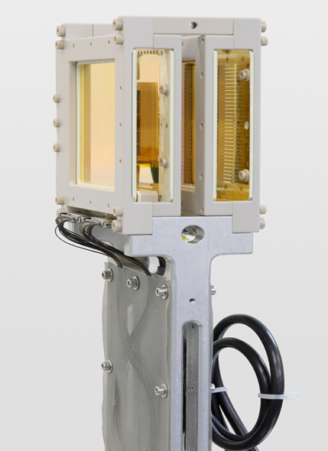
PEPITES an Ultra-thin monitor for charged particle beams
By : Sara Boumaiza / Supervisor : Christophe Thiebaux

Slide 2
PEPITES an Ultra-thin monitor for charged particle beams
FUN FACTS ABOUT ME ! SECTION :
My Journey:
Background:
Bachelor degree in radiation physics
Master degree in medical physics
Research work on thin films
Current occupation:
Student at Paris Physics Master program at Université Paris Cité
Goal:
Research work in the development of diagnosis and therapy methods and equipment for cancer treatment

Slide 3
PEPITES an Ultra-thin monitor for charged particle beams
My work :
analysis of the data collected during the first tests of PEPITES with therapeutic carbon ion beams at CNAO, to evaluate the response of the detector and its performance at several energies of the beam.

Slide 4
TABLE OF CONTENTS
01
02
03
04
05
06
WHAT ?
AIM
DESCRIPTION
WHERE?
CNAO
HOW?
STRUCTURE
PRINCIPLE
WHAT?
MEASUREMENTS
HOW?
DATA ANALYSIS
RESULTS
WHERE?
PROSPECTS
FUTURE WORK

Slide 5
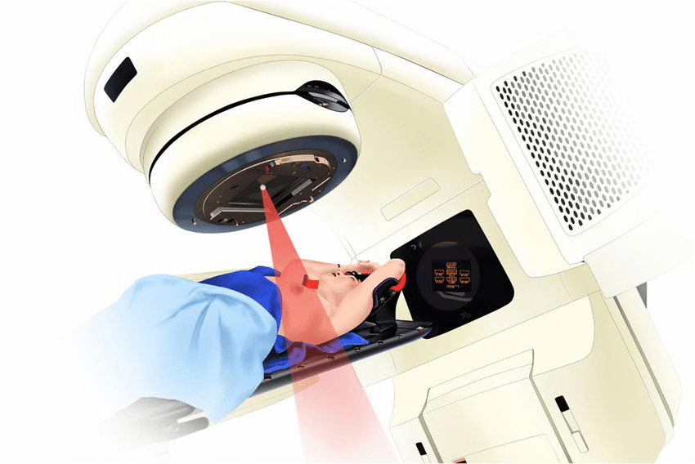
00
SMALL DETOUR
Radiotherapy:
Cancer treatment via external radiation beams targeted at the patient
Types of beams used :
X-rays
gamma rays
electron beams
proton beams
carbon ion beams
01/30

Slide 6
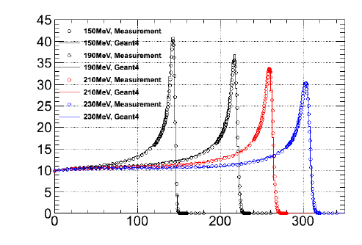
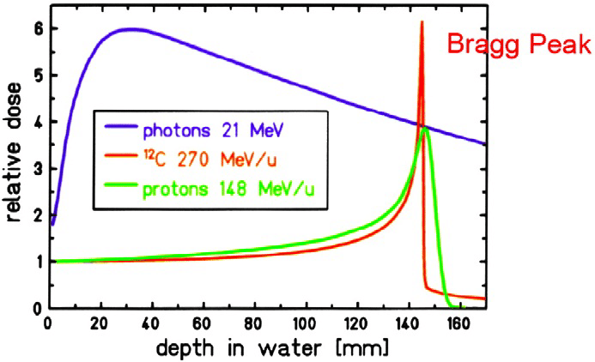
00
SMALL DETOUR
Hadrontherapy:
A therapy method that consists of the use of hadrons (protons, carbon) as beams for cancer treatment
02/30

Slide 7
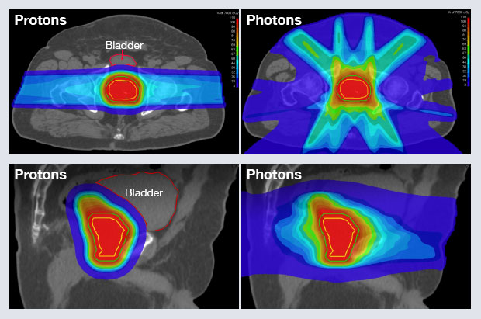
00
SMALL DETOUR
Advantages of hadrons vs photons:
Less dose to healthy tissue
More effective against tumors resistant to X-rays
Precise allowing higher dose delivery
03/30

Slide 8
00
SMALL DETOUR
Killing Mechanisms:
Directly through the damage of DNA or indirectly through the creation of free radicals (HO)
04/30

Slide 9
01
WHAT IS PEPITES ?
05/30

Slide 10
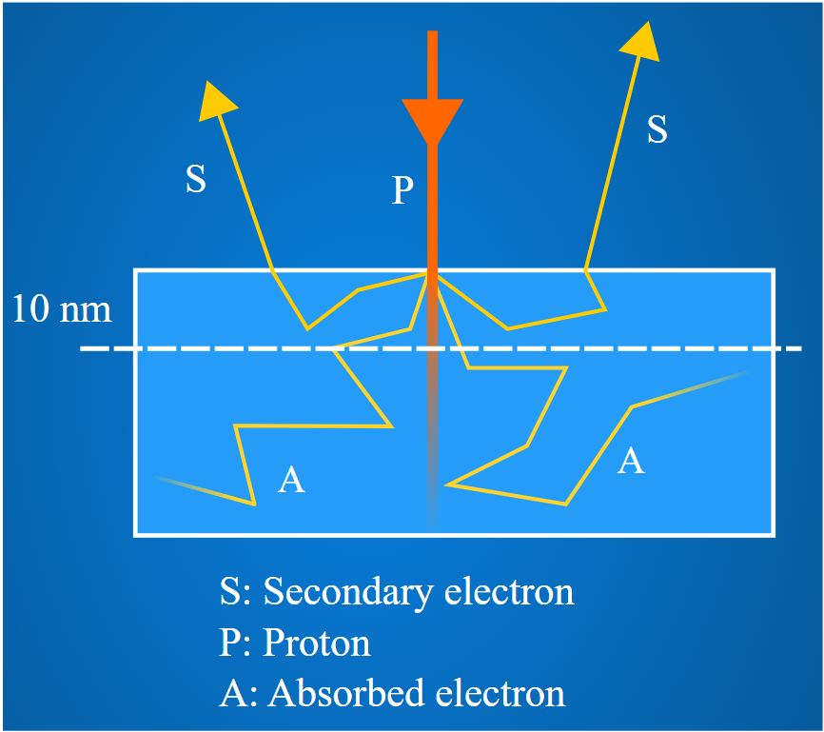
01
WHAT IS PEPITES ?
Objective:
Obtain a monitor used with mid-energy charged particle accelerators to continiously measure beam parameters
An ultra-thin profiler with minimum beam perturbation and high radiation resistency
Technology:
Use thin film techniques for detector construction and low noise electronics for readout.
Principle:
Signal generated by secondary electron emission (SEE), which is a surface phenomena that needs very little matter
06/30

Slide 11
02
HOW IS IT BUILT ?
07/30

Slide 12
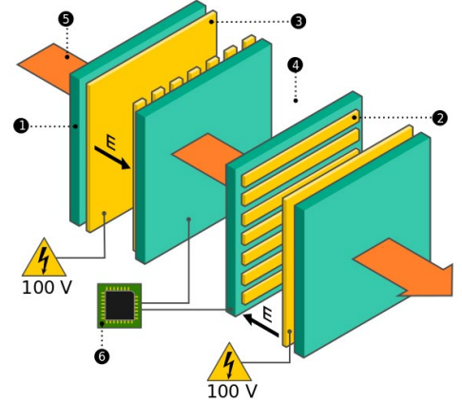
02
HOW IS IT BUILT ?
08/30

Slide 13
02
HOW IS IT BUILT ?
CP1 polyimide substrate :
Excellent radiations resistance
Ultra thin ( 1,5 μm )
09/30

Slide 14
02
HOW IS IT BUILT ?
32 horizontal (vertical) gold strips of length 70 mm, width 1.85 mm, and thickness 50 nm representing the cathodes. The strips emit the secondary electrons. The signal (current from each strip) provide the horizontal (vertical) profile
10/30

Slide 15
02
HOW IS IT BUILT ?
A 70 x 70 mm square thin film of thickness 50 nm representing the anode that collects the SEE .
11/30

Slide 16
02
HOW IS IT BUILT ?
The process is done in vacuum insuring the integrity of the signal
12/30

Slide 17
02
HOW IS IT BUILT ?
A beam of energy ranging from 10 MeV to 100 MeV will penetrate the profiler and create SEE .
13/30

Slide 18
02
HOW IS IT BUILT ?
The readout is done by a low-noise and high dynamic Application
Specific Integrated Circuit (ASIC) developed at CEA
14/30

Slide 19
03
WHERE IS IT USED ?
15/30

Slide 20
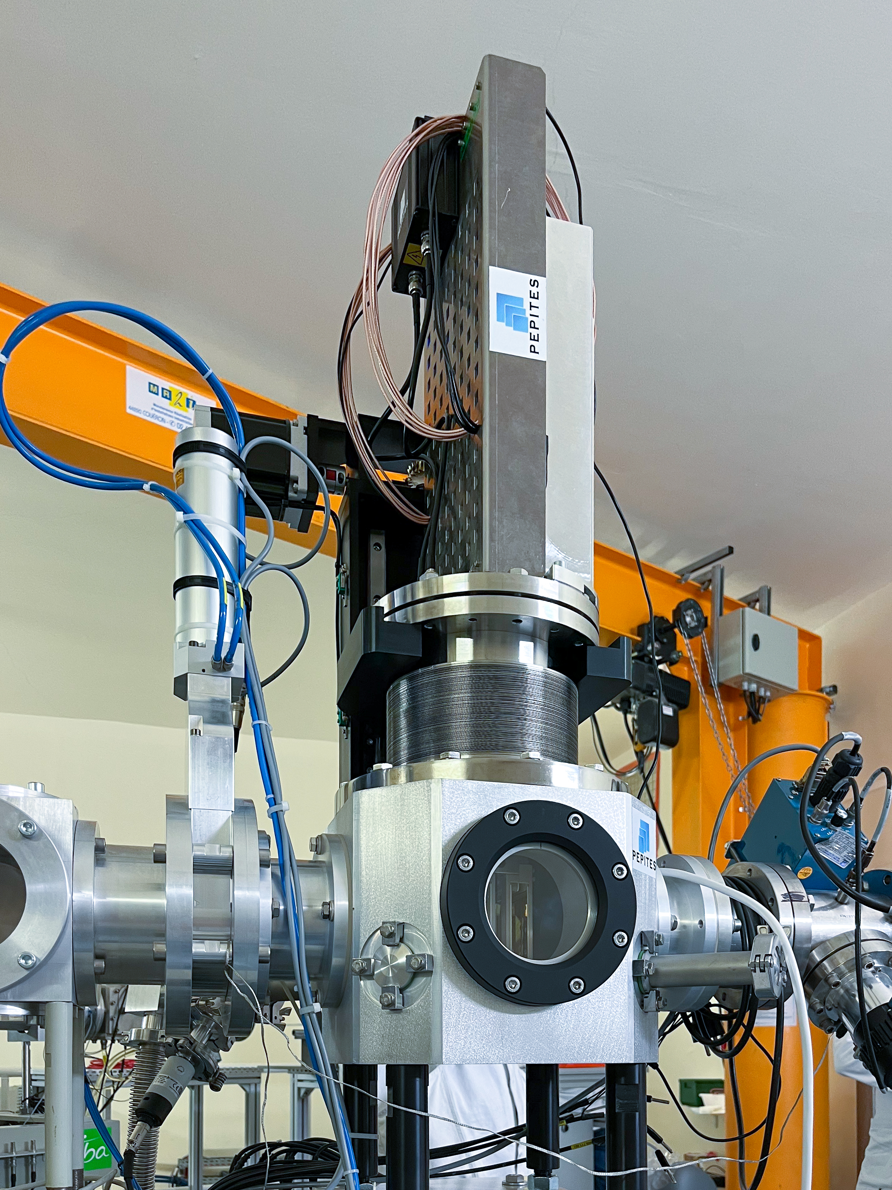
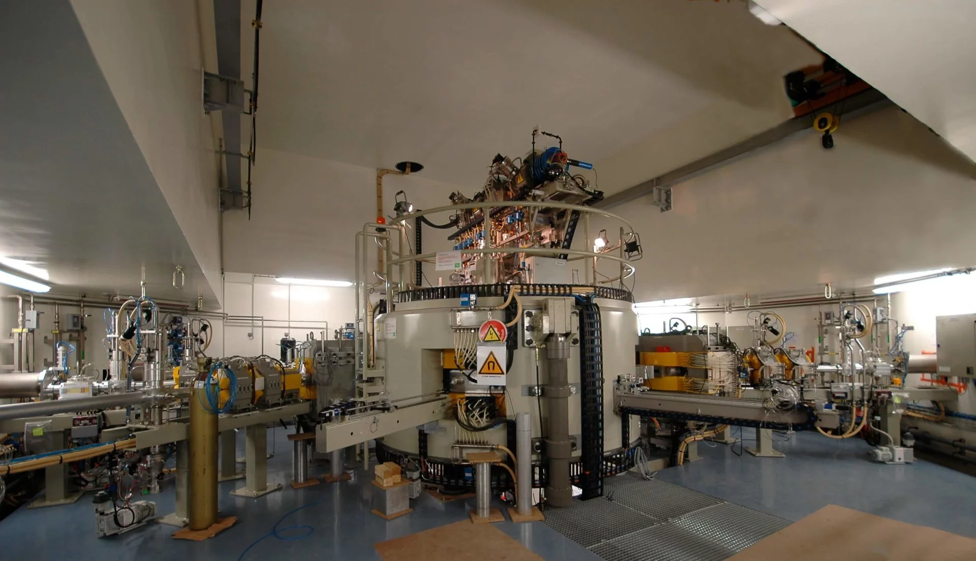
03
WHERE IS IT USED ?
Manipulator
ARRONAX Nantes :
first profiler installed for permenent use
Bellow
16/30

Slide 21
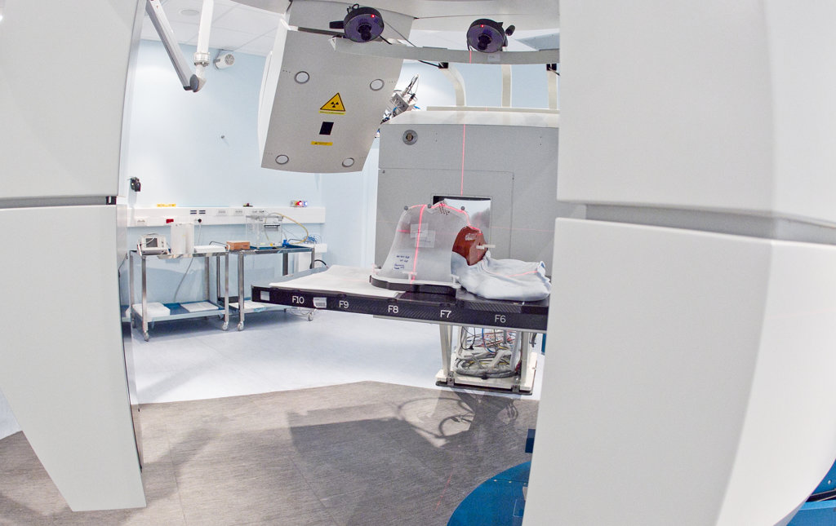
03
WHERE IS IT USED ?
CNAO : first collaboration between CNAO and LLR to develop a monitor
CNAO :
national center for hadrontherapy and oncology, Pavia, Italy
17/30

Slide 22
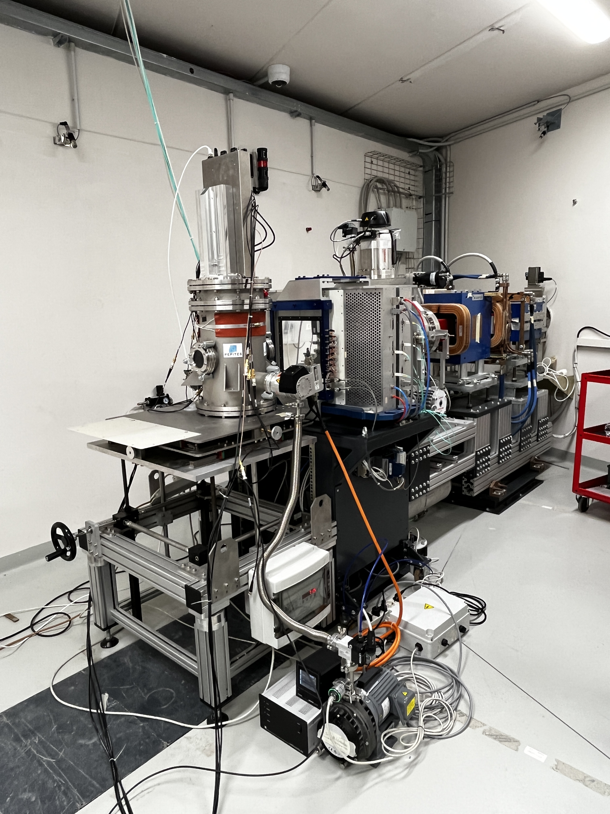
04
WHAT DID WE OBTAIN ?
Electronic read-out
Beam route
Vacuum chamber
Vacuum pumps
18/30

Slide 23
04
WHAT DID WE MEASURE ?
19/30

Slide 24
03
WHERE IS IT USED?
ION SOURCE
LINAC :
Linear accelerator
SYNCHROTRON
BEAM SIGNAL
t(s)
2s
20/30

Slide 25
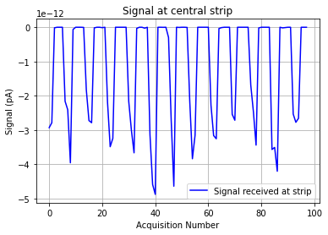
04
WHAT DO WE OBTAIN ?
Total measurement time : 500 s
Pulse duration : 2 s
Number of measurements : 200
Every 200 mesurements gives one aquisition
$N_{aq}$
21/30

Slide 26
05
HOW WE TREAT IT ?
22/30

Slide 27
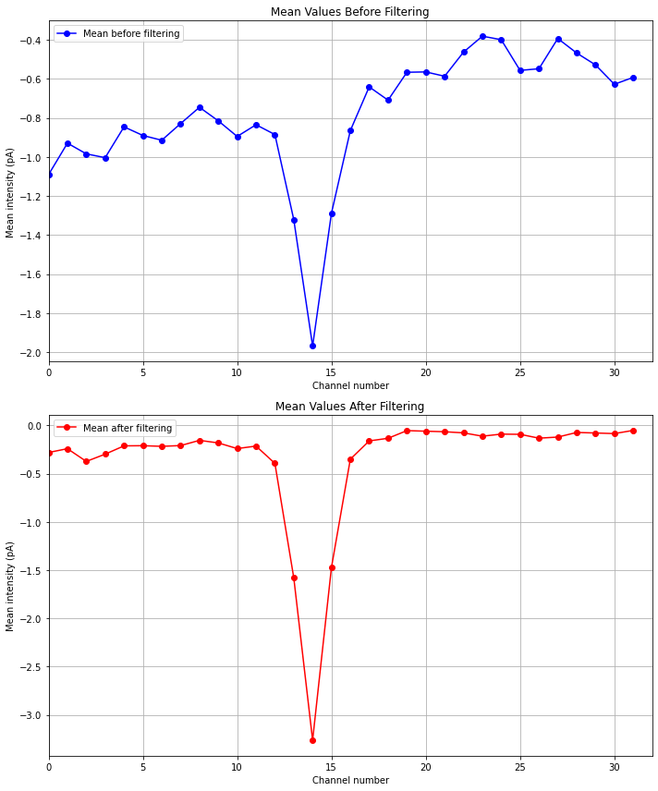
05
HOW WE TREAT IT ?
For each channel :
Background noise substraction
Data extracting
Mean calculation
The following data represent the measurements on a 115 MeV Carbon beam :
23/30

Slide 28
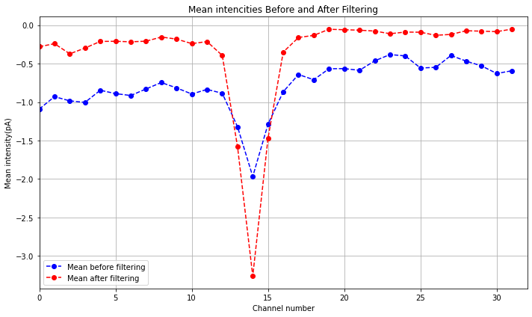
05
HOW WE TREAT IT ?
24/30

Slide 29
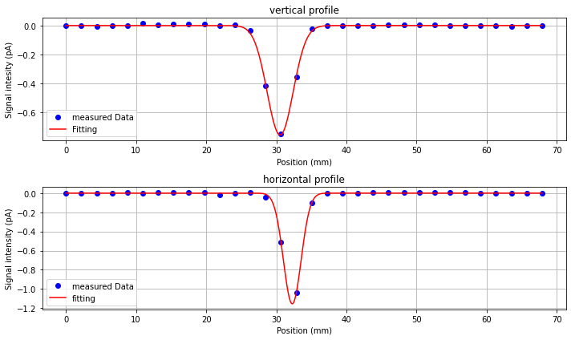
05
HOW WE TREAT IT ?
The data is fitted to a Gaussian representing the profiles
25/30

Slide 30
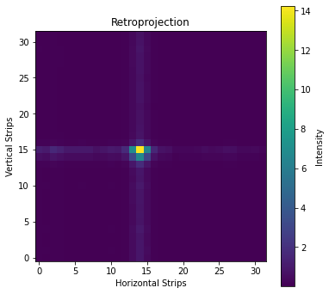
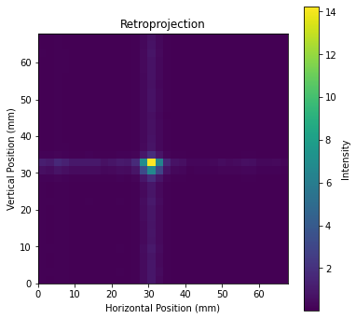
05
HOW WE TREAT IT ?
We obtain a precise representation of our beam in space
26/30

Slide 31
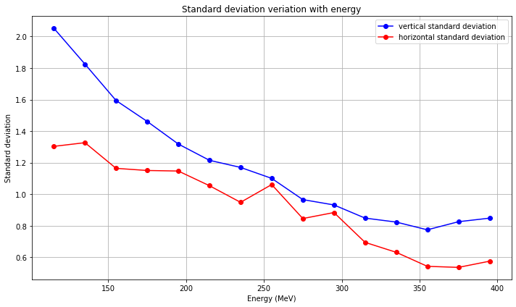
05
HOW WE TREAT IT ?
27/30

Slide 32
05
HOW WE TREAT IT ?
Conclusion :
I successfully analyzed the first measurements carried out with a carbon ion beam on PEPITES:
The data showed a good agreament with the signal caracteristics
I obtained a precise visualization of my beam in space
I showed the increase in precision when the energy increases
28/30

Slide 33
06
WHERE WILL IT GO ?
29/30

Slide 34
06
WHERE WILL IT GO ?
Comparision with CNAO profiler measurements
Data acquisition with external trigger
The aim is to obtain a fully functionning Ultra-thin monitor for charged particle beams for clinical use
30/30

Slide 35
THANK YOU

