Slide 1
PEPITES
Measurement of secondary electron emission rates from ultrathin gold foil bombarded by protons at intermediate energies for the development of PEPITES, an ultra-thin beam monitor for hadron therapy.
Tingzhen Xiao
Supervisor: Christophe Thiebaux
Co-supervisor: Alexandre Esper
Notes:
Hi, I am Tingzhen, I am currently working with Multi-disciplinary team on PEPITES.
Today, my topic is the "Measurement of Secondary Electron Emission Rates from Ultrathin Gold Foil Bombarded by Protons at Intermediate Energies.“
This work is aimed at developing PEPITES, an ultra-thin beam monitor for hadron therapy.
My supervisor is Christophe Thiebaux and co-supervisor is Alexandre Esper

Slide 2
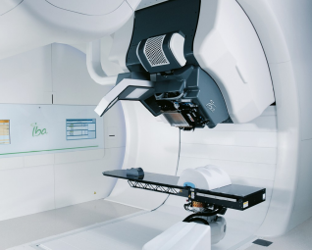
Context
Hadron therapy: Cancer treatment with hadron beams at intermediate energy (about 100 MeV).
Goal: Continuous monitoring, minimal beam disturbance.
Innovative Monitor: Ultra-thin, radiation-resistant for mid-energy accelerators.
Notes:
This research is crucial for advancing the technology used in hadron therapy to ensure precise treatment delivery for cancer patients.
In the context of hadron therapy, which utilizes hadron beams for cancer treatment, continuous monitoring of the beam with minimal disturbance is crucial.
Our goal is to develop an innovative beam profiler that is ultra-thin and resistant to radiation, making it suitable for mid-energy accelerators.
This profiler needs to be highly sensitive and capable of withstanding the challenging environment of hadron therapy.
The development of PEPITES aims to meet these requirements, providing a reliable tool for improving cancer treatment outcomes.

Slide 3
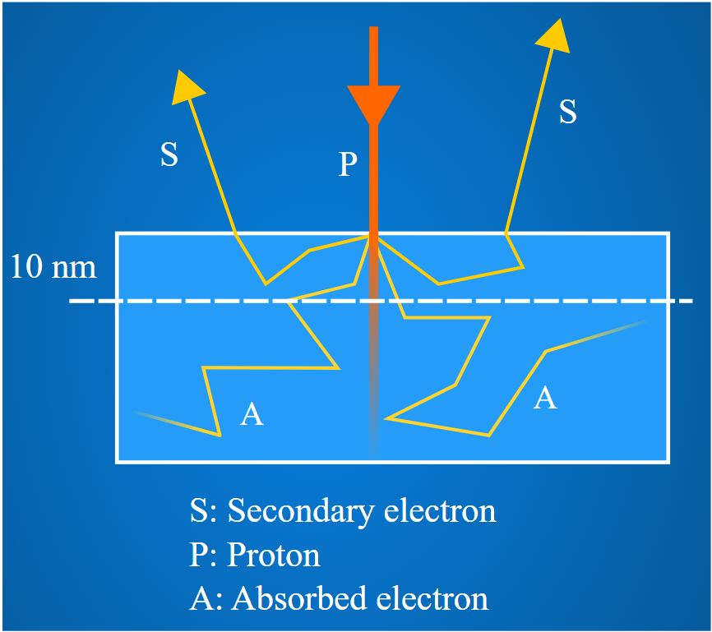
Principle
Signal: Utilizes Secondary Electron Emission (SEE) for precise beam profiling which proportional to dE/dx of the charged beam particles since it is a surface phenomenon.
Design: 50 nm Gold as electrodes, since its high Z(79）produces large number of SEE. Proton beam sensitivity, non-oxidizing.
Substrate: 1.5 µm CP1 (colorless polyimide) membranes. High radiation tolerance.
Notes:
The principle behind our design relies on utilizing Secondary Electron Emission (SEE) for precise beam profiling.
SEE is proportional to the energy loss (dE/dx) of the beam particles, making it an effective method for surface-level detection.
We use 50 nm gold electrodes due to gold's high atomic number (Z=79), which generates a large number of secondary electrons.
Additionally, gold is non-oxidizing, ensuring long-term stability and sensitivity to proton beams.
The substrate consists of 1.5 µm WET CP1 colorless polymide membranes, chosen for their high radiation tolerance.
This design ensures that our profiler can accurately measure the beam's characteristics while maintaining durability under high radiation conditions.
#of gold deposited

Slide 4
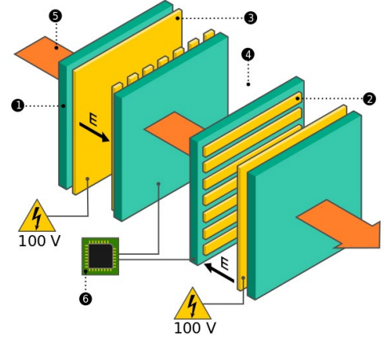
PEPITES Layout
Four Electrodes Design: Two segmented cathodes, two anodes, 15 mm gap.
SEE Collection: Anodes biased at 100 V.
Sensitive areas: 32 gold strips for cathodes, fully metallized anodes.
Mechanically Independent Blocks: For X and Y beam position and shape measurements..
Notes:
Our prototype features a four-electrode design, consisting of two segmented cathodes and two anodes with a 15 mm gap.
The SEE collection is facilitated by biasing the anodes at 100 V, ensuring efficient capture of secondary electrons.
The sensitive areas comprise 32 gold strips for the cathodes and fully metallized anodes, maximizing the detection area and sensitivity.
The prototype is designed with mechanically independent blocks, allowing separate measurements of the X and Y beam positions and shapes. This modular design enhances the versatility and precision of our beam profiler, making it suitable for various experimental setups and beam conditions.

Slide 5
My Work—Measure SEE Rate
Why? To calibrate the detector and for further development of PEPITES.
Calculate with the test beam data from 13 and 14 December 2018 at ARRONAX.
Electron going the same direction of the beam=Forward
Electron going opposite direction of the beam=Backward
No measurement available for E>20MeV.
Rate = Nse/Np
Backward
100 V
Forward
100 V
Notes:
My primary task was to measure the Secondary Electrons Emission rate, which is crucial for calibrating the PEPITES detector.
The SEE rate is defined as the ratio of secondary electron emission current (Ise) to the proton beam current (Ip), expressed as Ise/Ip = Qse/Qp=Nse/Np, where Nse and Np represent the number of secondary and proton particles, respectively. Evaluating this rate is essential for the accurate calibration and further development of the detector.
The measurements was conducted on the 13th and 14th of December 2018, collecting data that provides insight into the detector's performance and efficiency.
This work forms the foundation for optimizing PEPITES and ensuring its reliability in cancer treatement.

Slide 6
Experimental setup for SEE rate measurement
Vacuum chamber
BEAM STOP
Notes:
This slide presents the setup of our experiment.
When the beam enters the chamber, it interacts with two gold planes, where generating secondary electrons.
By applying a voltage to one end of the planes, we can control the direction of the secondary electrons.
For example, if we set the voltage of Plane 1 to 100V and Plane 2 to 0V, the current will flow from 1 to 2, which we call the forward direction.
If I switch the voltage, so that Plane 1 is at 0V and Plane 2 at 100V, we refer to this as the backward direction and the Secondary electrons will flow from plane 2 to 1.
On the far left, we have a beam stop, which helps us measure the proton beam current, denoted as I_beamstop​. This setup allows us to analyze the behavior of the secondary electrons under different direction flow (either forward or backward emission), providing critical data for our research.

Slide 7
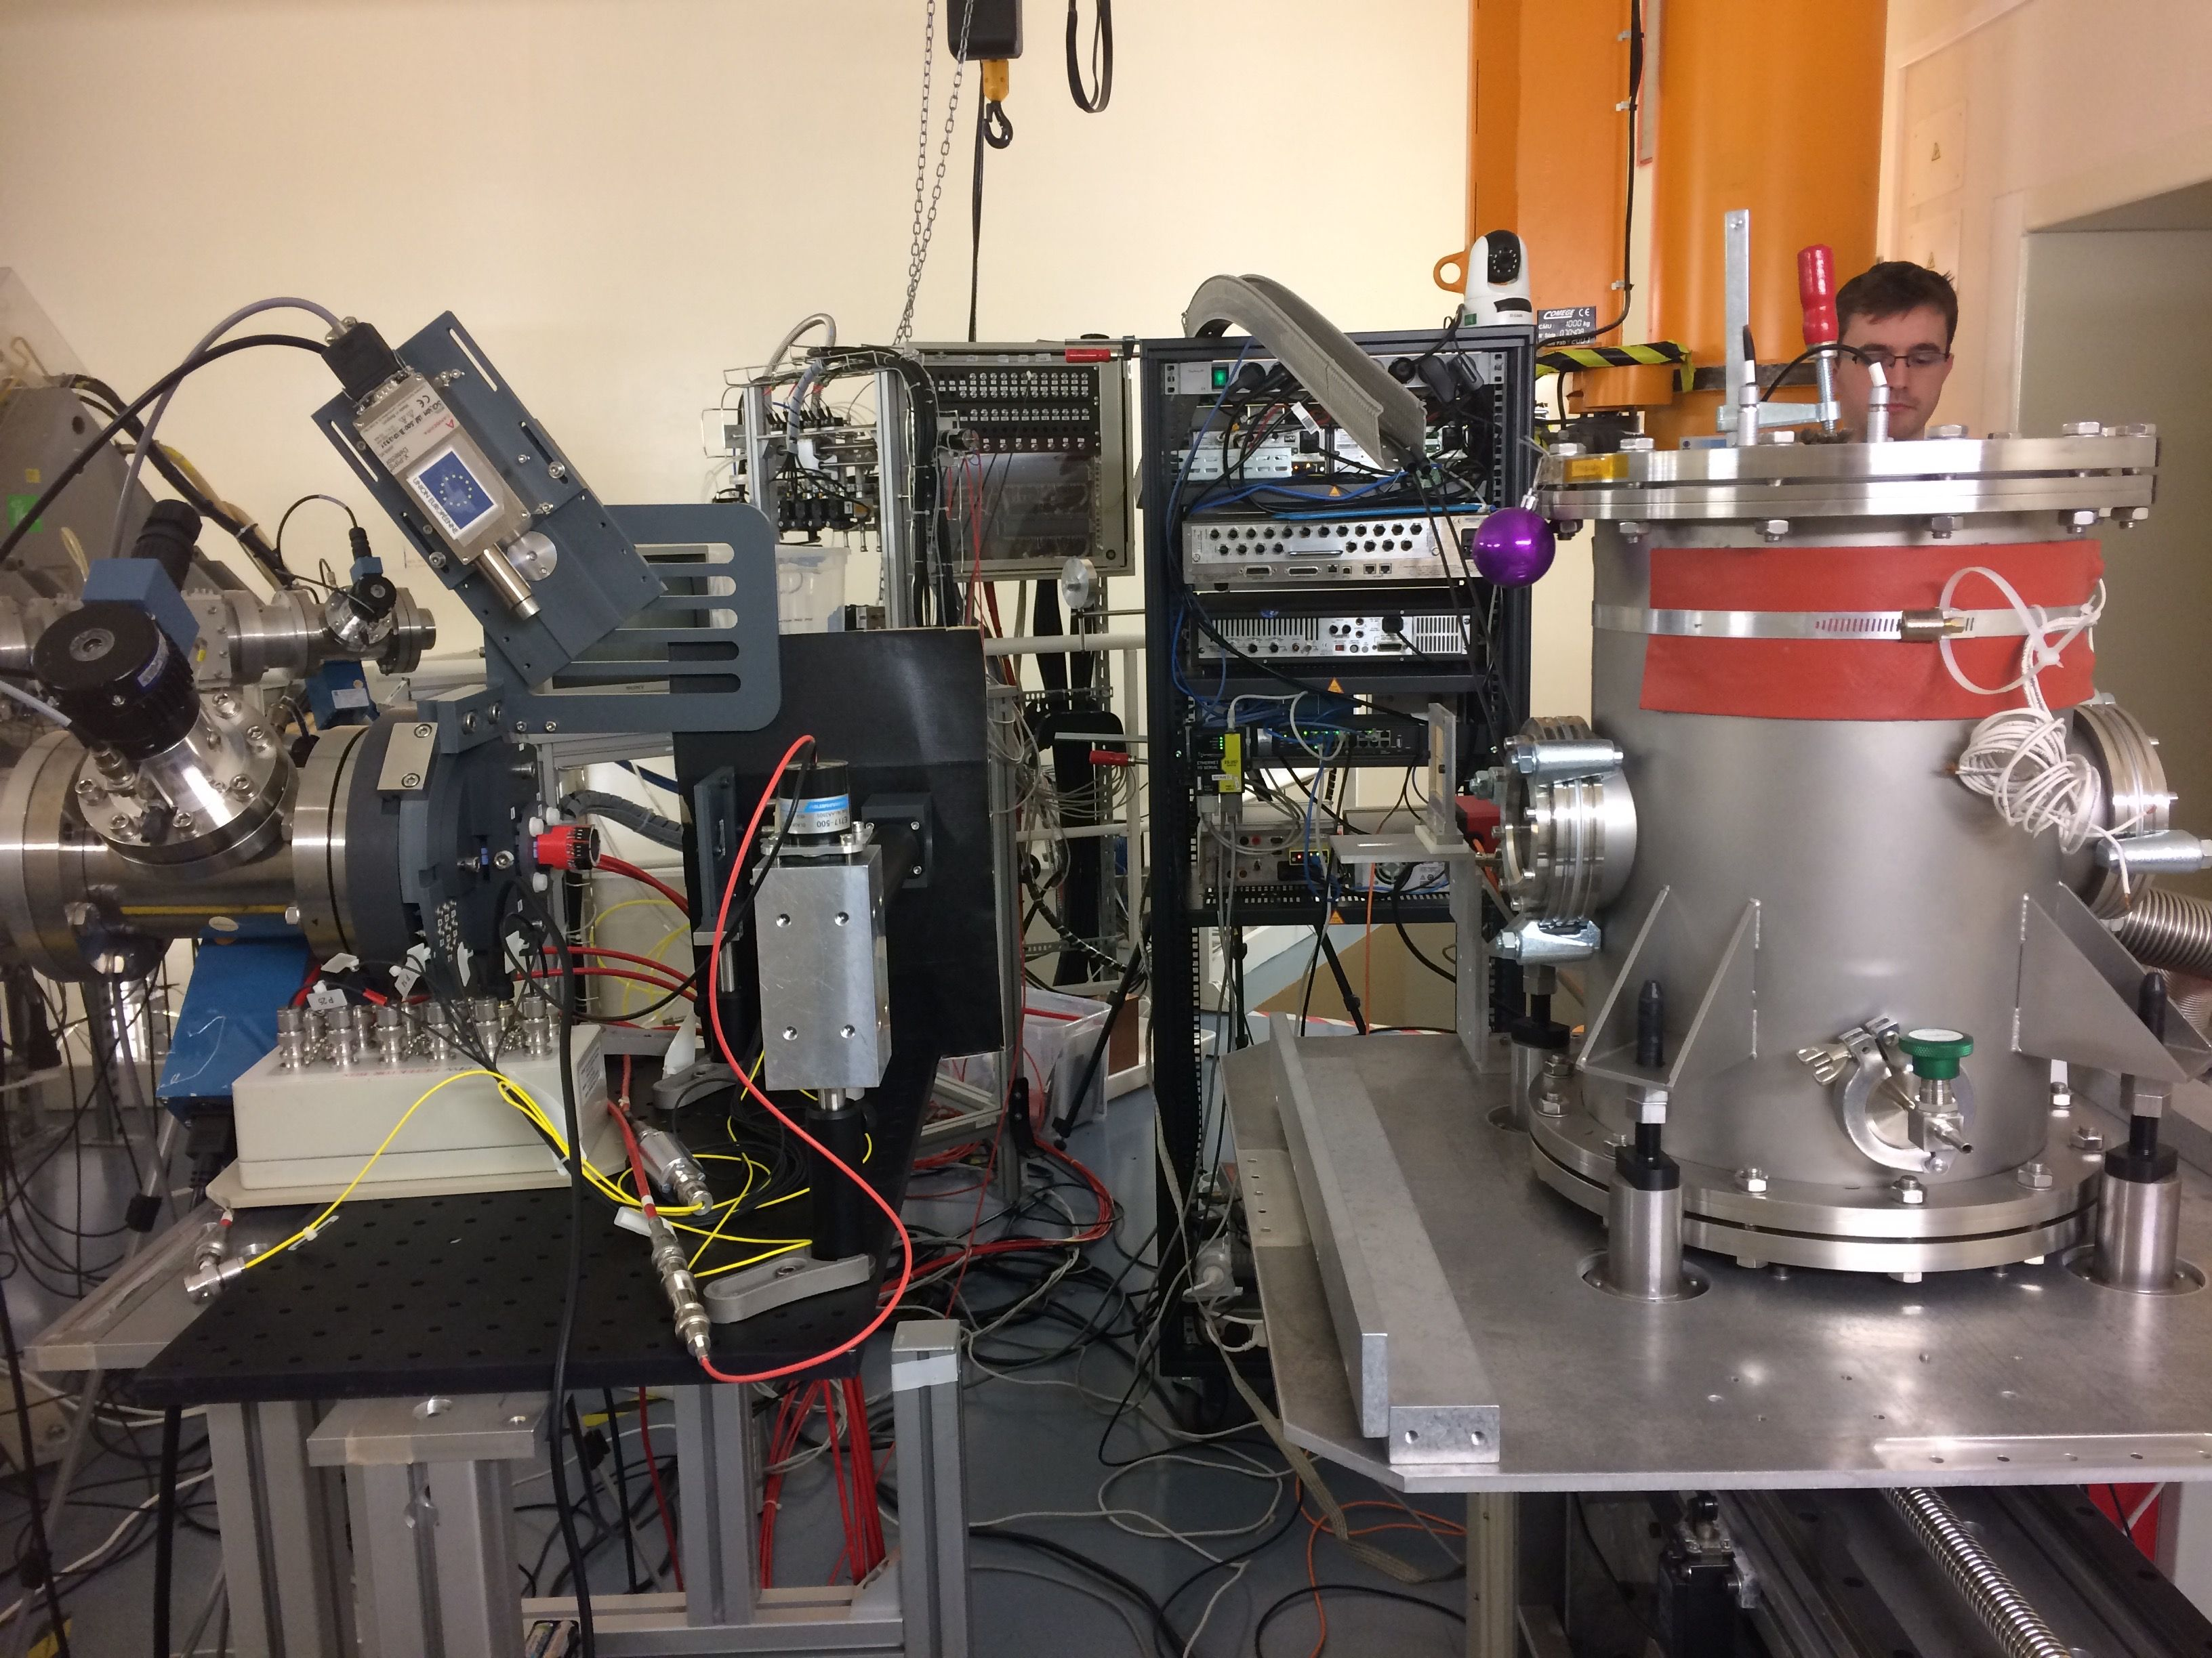
ARRONAX experimental setup
Charge measurement systems
Vacuum chamber
protons

Slide 8
Beam stop

Slide 9
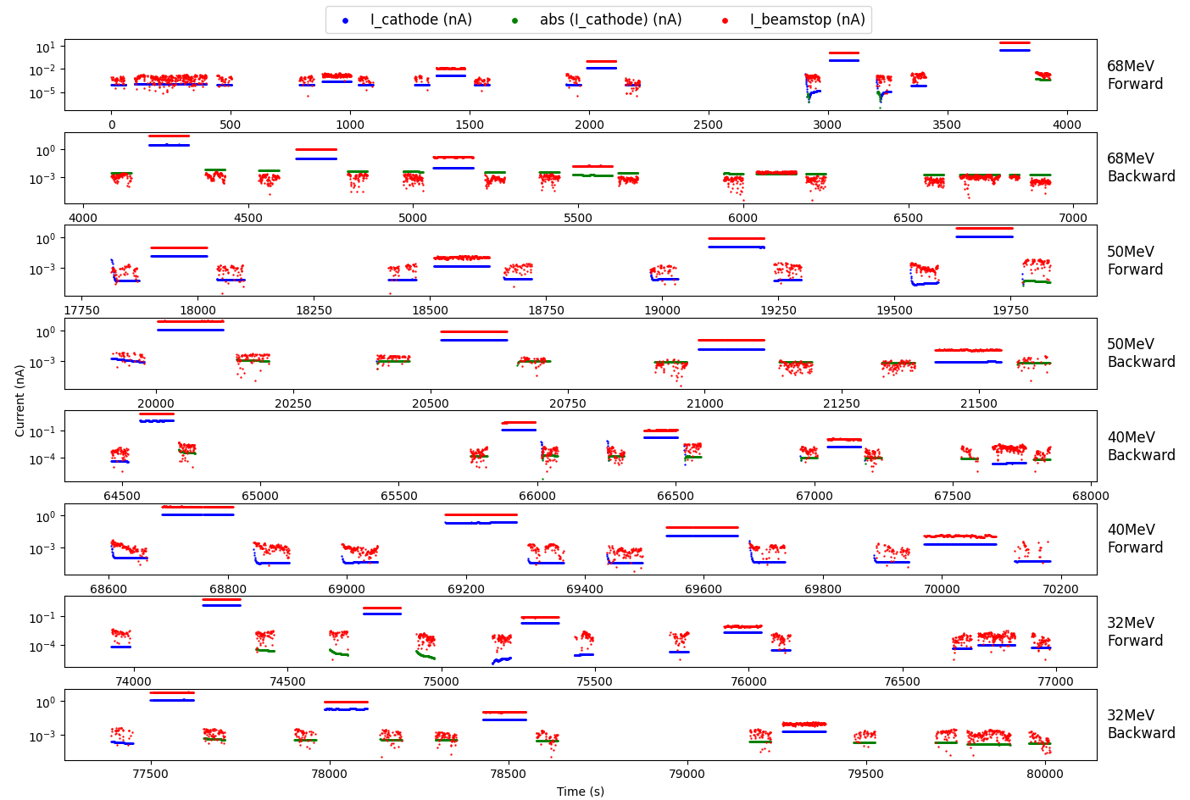
Result: Data Taking “History”
Notes:
This figure shows the results for different beam energies, including 68 MeV, 50 MeV, 40 MeV, and 32 MeV, in both forward and backward directions.
Each plot corresponds to a specific beam energy and direction.
Additionally, we noticed that some data sets exhibit significant fluctuations at the beginning.
These fluctuations are likely due to errors when the electrometer starts up, so we have discarded these(about 20 points) invalid points to ensure accuracy.
We can observe the signal which is the middle data set. We should subtract the background noise from this value, to obtain the true SEE current.
These values are essential for precise measurements and calculations.
A specific note about the 40MeV plots: the time sequence for the forward and backward directions is reversed, although this reversal doesn't affect the analysis but is an important observation to consider when interpreting the results.

Slide 10
Result: Current values of SEE in forward direction at 68 MeV for Proton beam
Notes:
This figure presents the current of the secondary electron emission (SEE) corresponding to a 68 MeV proton beam directed forward.
The data is grouped in a set of three sub-data, with each set representing different incident current levels, which will be further illustrated in subsequent slides.
For each group, the first and last data sets show background noise which is obtained without any beam, while the middle one represent SEE currents with the proton beam.
In the figure, blue points indicate secondary electron emission current.
Red points show the current of the proton measured by the beam stop which I mentioned before.
Sometimes, the noise of I_cathode may appear as negative, so I have plotted their absolute values as green points.
The y-axis uses a log scale.
The mean and error values were calculated. Due to the large number of measurements, the error is very small. I did a zoom here in this figure, where we can see the error bar.

Slide 11
Result: Beam’s current measurements for different current
Notes:
This figure shows the results after dividing the previous graph for each current group at 68 MeV and fitting the background noise with a linear model.
We can see the current levels for each group from top to bottom are 250 fA, 1 pA, 10 pA and 100 pA etc.
At 250 femtoA, both I_cathode and I_beamstop are very close to the noise level, making it difficult to distinguish between the signal and noise.
As we move to higher currents, the difference between the current signals and the noise becomes more apparent.
By subtracting the background noise from the current, we obtain the true current values of the proton beam.
With this figure, we can now proceed to calculate the secondary electron emission rates using two different methods.
The first method we used to calculate R_SEE involves subtracting the background noise from each I_cathode data point and averaging the results .
We do the same for I_beamstop data points, and then we divide the averaged of I_cathode by the averaged I_beamstop to get R_SEE for each current group.

Slide 12
Analysis: SEE(I) Rate Forward vs. Backward
Notes:
In this slide, I present a series of plots showing the relationship between R_SEE (Secondary Electron Emission Ratio) and I_Beamstop (beamstop charge) for four different energy levels for forward and backward directions.
Each plot corresponds to a specific beam energy and direction (forward or backward). The x-axis represents the I_Beamstop in nanocoulombs (nC) using a logarithmic scale, while the y-axis shows the R_SEE values.
We observed that at lower incident currents, larger errors are likely because the noise level is high, making it difficult to distinguish between the signal and noise.
For the same energy and direction, the R_SEE values are almost equal. However, as the energy decreases for the same direction, R_SEE gradually increases.

Slide 13
A different way measure the rates
Use of ARRONAX charge (Q) measurements system instead of beam stop
Avoid « bad » Beam Stop measermet at low current
We need to transform the measured intensity I_cathode into a charge Q_cathode
Q = I * T
Notes:
Previously, we calculated R_SEE using the ratio of I_cathode​ to I_beamstop​. Now, we will discuss an alternative method.
In the Arronax laboratory, we obtained the total proton charge (Q) data before measurement. Knowing that I=dQ/dt, we can calculate Q_cathode​ by integrating I_cathode​ over time.
Since our data consists of discrete points rather than a continuous function, direct integration is not feasible. Therefore, we approximated the integral using two methods: the Riemann sum and interpolation with a cubic polynomial.
The first graph shows the Riemann sum approximation. This method provides a step-wise approximation of the integral, which is straightforward but may not capture all the nuances of the data.
The second graph depicts the interpolation method. This method fits a cubic polynomial between data points, offering a smoother and potentially more accurate representation of the integral.
Both methods yielded very similar results, differing only at the sixth decimal place (like famous saying by Lord Kelvin).
Given the high consistency between these methods, we decided to adopt the interpolation method for our calculations, as it provided a more refined approximation.
By using these integration techniques, we can more accurately determine Q_cathode​, and subsequently, the R_SEE, enhancing the reliability of our measurements and the overall accuracy of our beam profiling system.

Slide 14
Analysis: SEE(Q) Rate Forward vs. Backward
Notes:
The x-axis represents the Q_Beamstop in nanocoulombs (nC) using a logarithmic scale, while the y-axis shows the R_SEE values.
By dividing Q_cathode​ by Q_Arronax​, we obtain R_SEE using charge (Q) calculations. This figure shows the results of R_SEE calculated using this method for different energies and directions.
The same as before, expect the x-axis represents the Q_Arronax in nanocoulombs (nC).
Compared to the previous method of using current (I) to calculate R_SEE, we observe that the errors are significantly reduced. This improvement allows for a clearer understanding of the relationship between R_SEE and different energy levels and directions.
It is evident that for the same energy and direction, R_SEE values are almost identical, regardless of the incident current.
This consistency validates the reliability of our alternative method for calculating R_SEE and highlights the effectiveness of using charge-based measurements in reducing errors and improving accuracy.

Slide 15
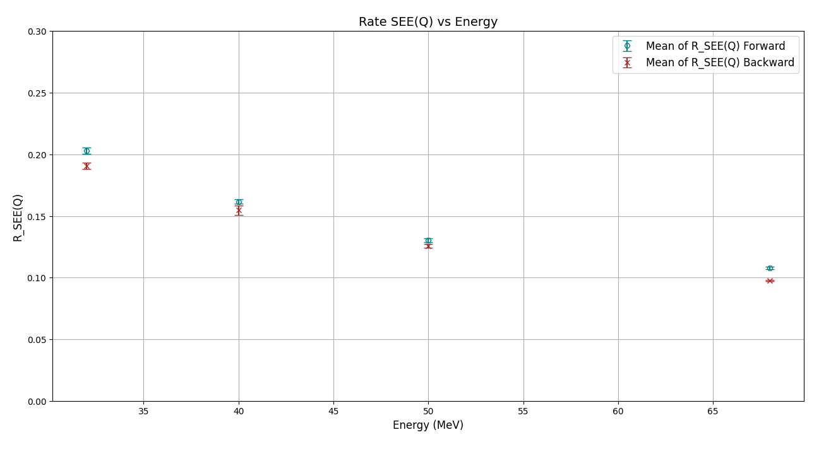
Analysis: SEE(Q) Rate for different Energies
Notes:
Using the same method as before, we now present the distribution of R_SEE calculated using charge (Q) with respect to energy and direction. This figure allows us to visualize the trends of R_SEE more clearly.
As we observed in the previous figures, this distribution further confirms that R_SEE decreases with increasing energy.
Additionally, for the same energy, the forward direction consistently shows slightly higher R_SEE values compared to the backward direction.
These results reinforce the conclusions drawn from our earlier analysis, highlighting the reliability and accuracy of using charge-based calculations for determining R_SEE.

Slide 16
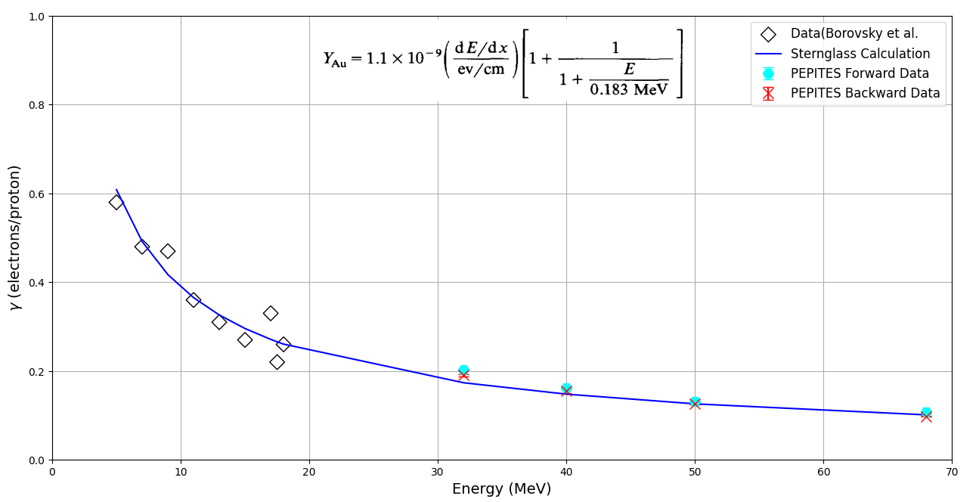
Analysis: SEE(Q) Rate compared with Sternglass calculation
PEPITES
PRELIMINARY
First Time Ever!

Slide 17
Alpha Particles
Notes:
Finally, let's use the same methods to analyze alpha particles at 68 MeV. These figures show the currents for alpha particles in both forward and backward directions.
The first figure illustrates the data for the forward direction, while the second represents the backward direction.
As before, we have plotted I cathode​ and I beamstop​, including their mean values and standard errors.
#By applying the same analytical techniques, we can observe the behavior of alpha particles under different charge conditions.

Slide 18
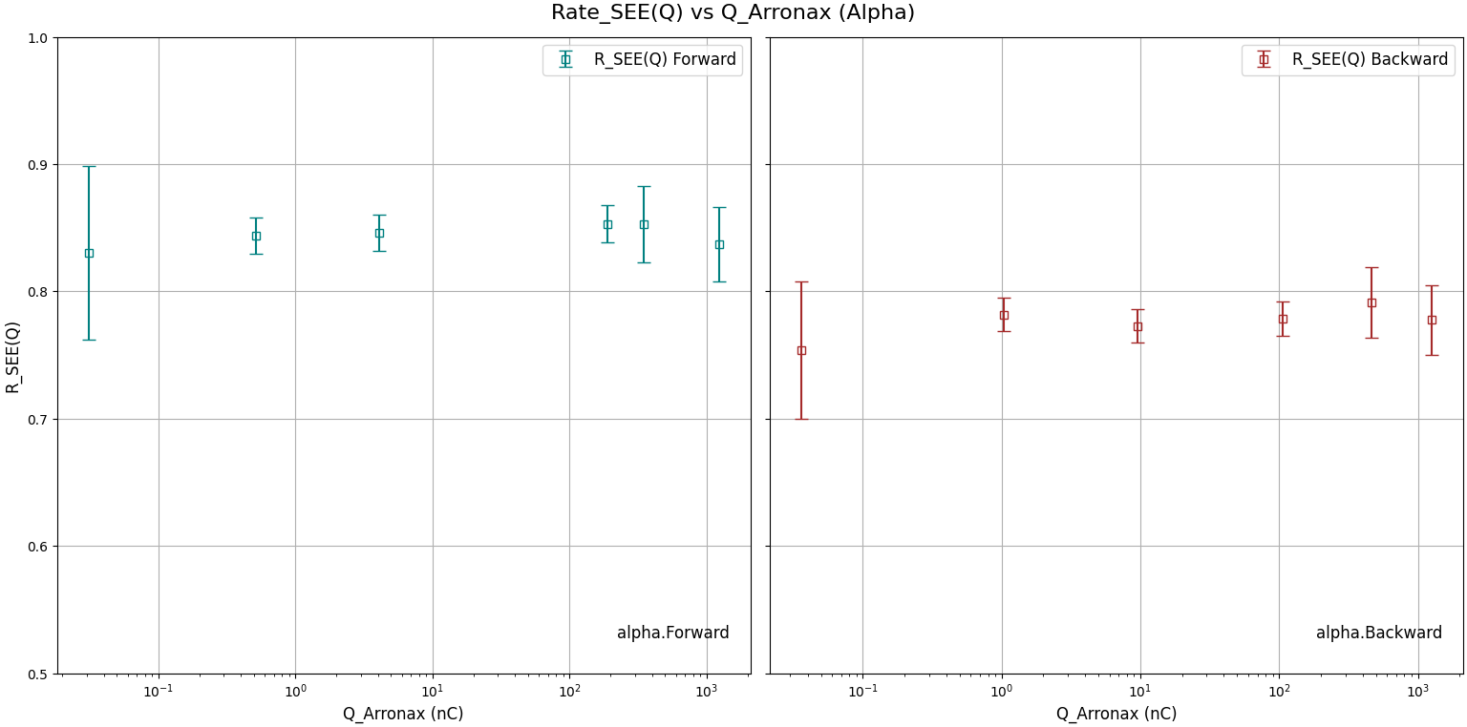
Analysis: SEE(Q) Rate Forward vs. Backward
First Time Ever!
PEPITES
PRELIMINARY
PEPITES
PRELIMINARY
Notes:
Using the same method as before, we calculated R_SEE for alpha particles at 68 MeV with different incident currents (charges). This figure displays the results.
It is evident that the R_SEE in the forward direction is consistently higher than in the backward direction as expected, with values around 0.8.
As we can see from the lower graphs, for protons at the same energy, R_SEE values were around 0.1.
The significant difference in R_SEE between alpha particles and protons can be attributed to the differences in their mass and charge.
Alpha particles, being heavier and doubly charged, interact more strongly with the gold foil, resulting in higher secondary electron emission rates.
This analysis highlights the importance of considering particle type and energy when evaluating secondary electron emission, as these factors significantly influence the results.
This comparison helps us understand the differences and similarities in secondary electron emission rates between protons and alpha particles at this energy level.

Slide 19
Conclusion
Consistency in R_SEE Calculations:
Both current (I) and charge (Q) based methods provided consistent R_SEE values, Charge-based calculation shows reduce error margins.
Linearity
Secondary electron emission rate does not depend on beam intensities.
PEPITES could still work with very high beam intensities.
SE Directional Flow Dependence:
For both protons and alpha particles, the R_SEE in the forward direction was consistently higher than in the backward direction for all energy levels.
Energy Dependence:
As the energy increased, the R_SEE values for protons decreased.
Particle Type Differences:
Alpha particles exhibited significantly higher R_SEE values compared to protons at the same energy levels.
Thank you
Notes:
In conclusion, our research has effectively measured the secondary electron emission (SEE) rates from ultrathin gold foil bombarded by protons and alpha particles at intermediate energies. Through a series of experiments, we analyzed the SEE rates for various energies and directions, utilizing both current-based and charge-based calculation methods.
Key findings from our experiments include:
Consistency in R_SEE Calculations:
Both current (I) and charge (Q) based methods provided consistent R_SEE values.
However with charge-based calculation the error margins were reduced.
Directional Dependence:
For both protons and alpha particles, the R_SEE in the forward direction was consistently higher than in the backward direction. This was observed across different energy levels.
Energy Dependence:
We have observed that As the energy increased, the R_SEE values for protons decreased. This trend was clearly visualized in our energy vs. R_SEE plots.
Particle Type Differences:
Alpha particles exhibited significantly higher R_SEE values compared to protons at the same energy levels. As stated before this difference is attributed to the higher mass and charge of alpha particles, leading to stronger interactions with the gold foil.
These findings enhance our understanding of secondary electron emission in hadron therapy and support the development of more accurate and reliable beam monitoring systems. The methods and insights gained from this research can be applied to further improve the precision of beam profiling in clinical and experimental settings.
Thank you for your listening. Are there any questions?

Slide 20
BACKUP SLIDES

Slide 21
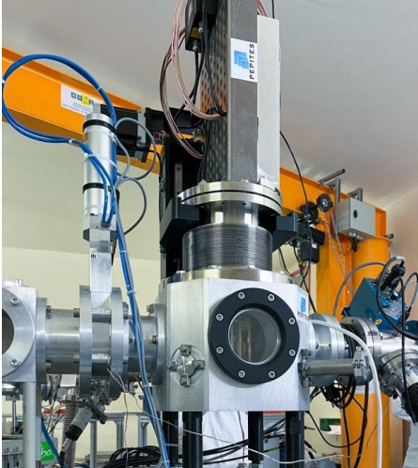
PEPITES Prototype
Installation: ARRONAX, vacuum chamber with a translation system for beam path engagement.
Advantage: Detector is free of mechanical constraint.
Implementation: Proven success at ARRONAX, paving the way for long-term applications.
Notes:
The PEPITES prototype was successfully installed in the ARRONAX vacuum chamber, equipped with a translation system to engage the beam path accurately.
One of the key advantages of our detector is its freedom from mechanical constraints, allowing it to operate without interference in the challenging environment of a vacuum chamber.
The successful implementation and operation at ARRONAX demonstrate the prototype's robustness and effectiveness, paving the way for long-term applications in hadron therapy.
This success highlights the potential of PEPITES to become an integral part of beam monitoring systems in medical accelerators.

Slide 22
Comparing the 2 methods
Notes:
In this figure, we use Q_arronax as the x-axis and plot the R_SEE values calculated using both current (I) and charge (Q).
By comparing these points, we can observe the consistency between the two methods.
Overall, the differences between the points calculated using current and charge are minimal.
This comparison confirms the reliability of both methods for calculating R_SEE.
However, at lower energies, we can observe that the R_SEE values calculated using current tend to be slightly higher than those calculated using charge. This highlight the importance of choosing the appropriate method based on the specific experimental conditions and requirements.

Slide 23
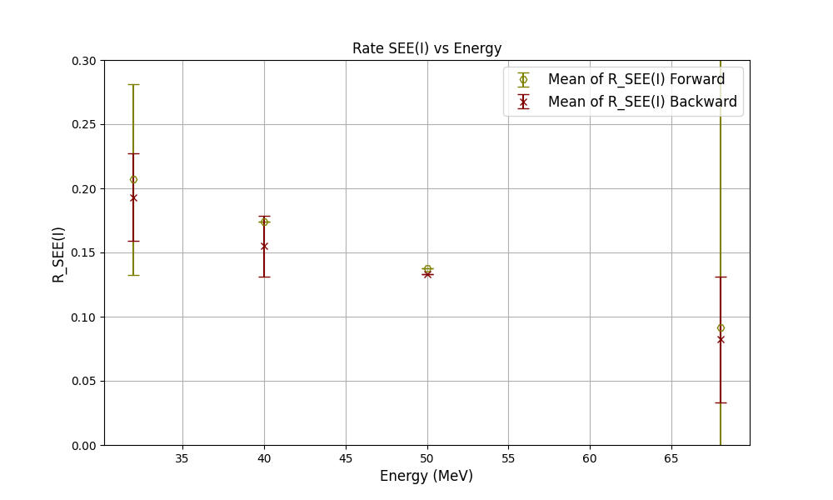
Analysis : SEE(I) rate for different Energies
Notes:
Next, we calculated the average R_SEE for specific energies and directions. By plotting energy on the x-axis and using different colors to represent the forward and backward directions, we obtained this graph.
Although the errors for 32 MeV and 68 MeV are quite large,
we can observe that the R_SEE in the forward direction is consistently higher than in the backward direction, as expected.
As the energy increases, it is evident that R_SEE decreases continuously.
#This graph shows that the energy of the beam significantly impact the secondary electron emission rates, which is crucial for accurate beam profiling and detector calibration.
#However, the direction of the secondary electrons doesn’t seem to influent significantly the SEE.

