Slide 1

New telescope for follow-up observations at Maidanak
Yusuf Tillayev
Ulugh Beg Astronomical Institute
(UBAI)
Online talk (Wednesday, July 03)
GRANDMA Workshop
1–4 Jul 2024 IPHC

Slide 2
Outline
Introduction
  UBAI and Maidanak observatory
  New telescope – ASA EQ800 f2.26 prime focus telescope
  CMOS camera
  Filter wheel
  Conclusion

Slide 3

Ulugh Beg Astronomical Institute
(UBAI)
UBAI is one of the oldest institutions of Uzbekistan
It was founded in 1873 as the Tashkent Astronomical Observatory.
Main observational facility is Maidanak.

Slide 4
UBAI: main fields of research
Solar physics, helioseismology
Theoretical astrophysics (compact objects, GR, etc.)
Minor planets
Physical variable stars, close binary systems and exoplanets
Extragalactic objects (AGN, GLS)
Space geodynamics
Site testing (aka astroclimate)

Slide 5
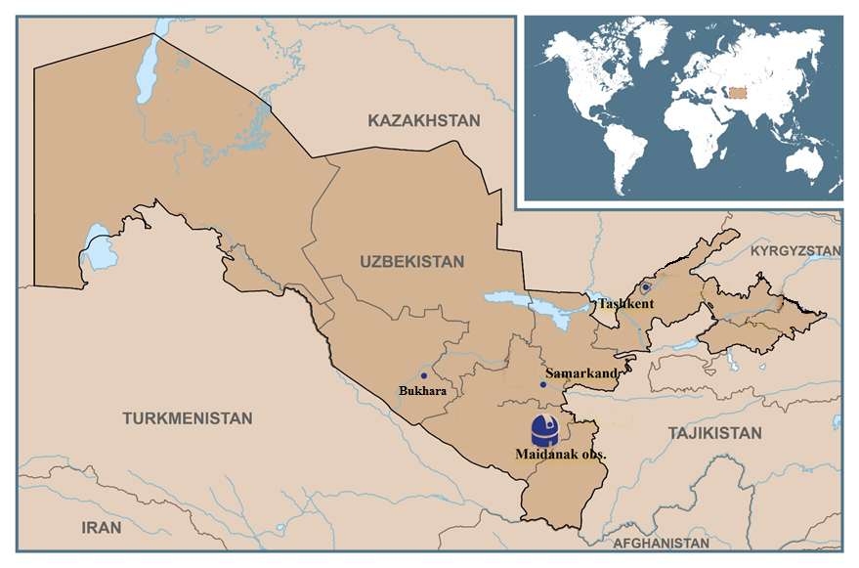
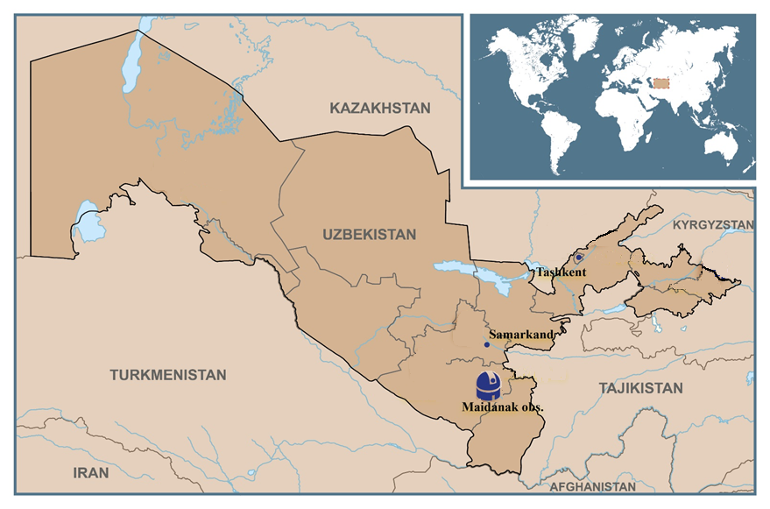
Uzbekistan

Slide 6
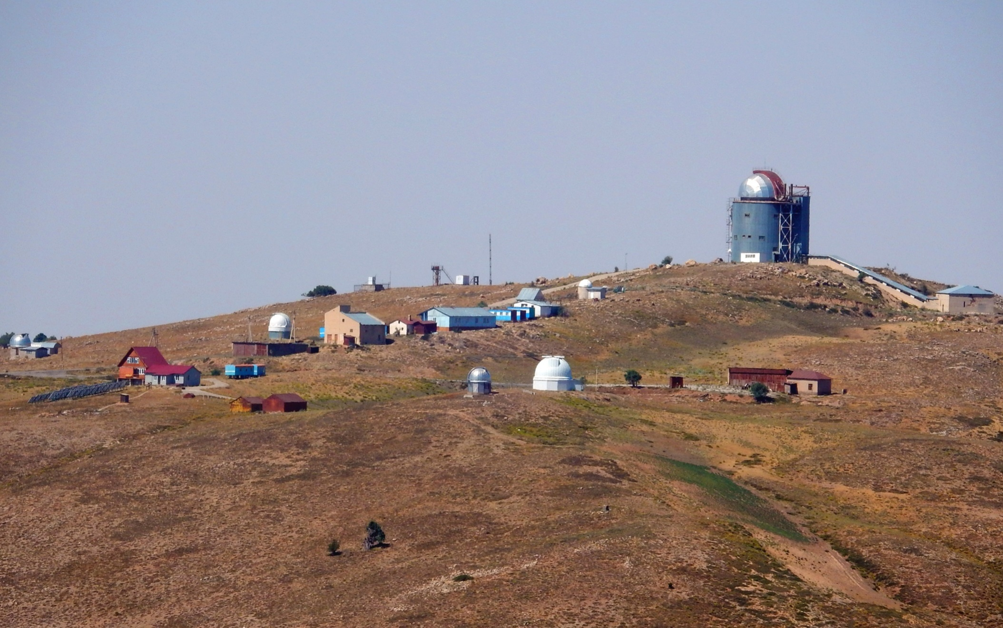
Maidanak, 2700 a.s.l.
Total 7 telescopes:
1.5 m, 1m, three 0.6 m, refractor
One remotely controlled telescope of 40 cm

Slide 7
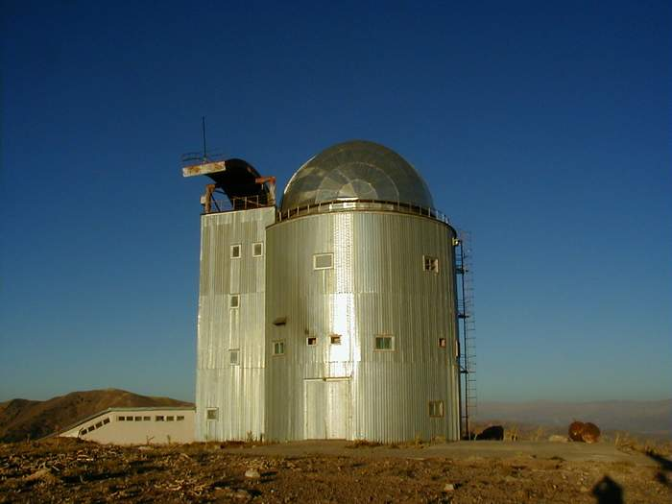
AZT-22 – 1.5m telescope
Optical configuration:
Ritchey-Chretien f/7.74, D=1.5m
Equipment:
SI 600 Series 4096x4096 CCD (SNUCAM)

Slide 8
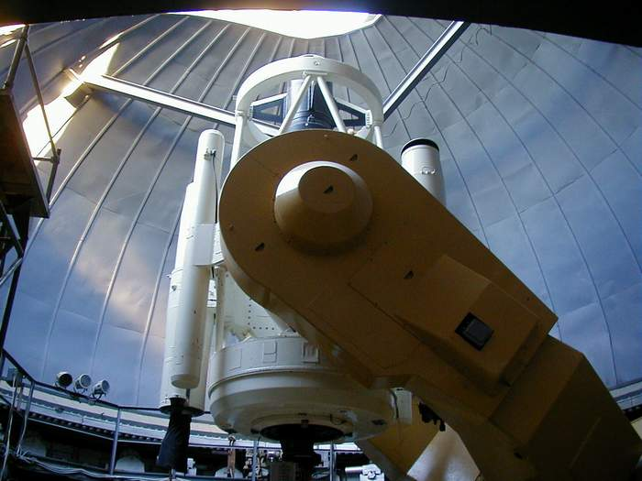

Slide 9
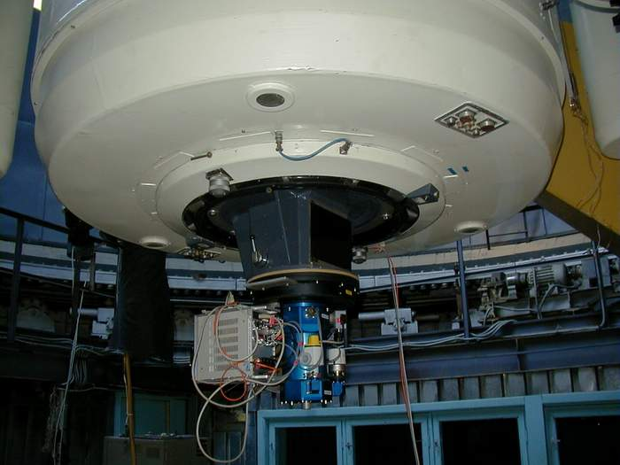

Slide 10
New telescope project

Slide 11
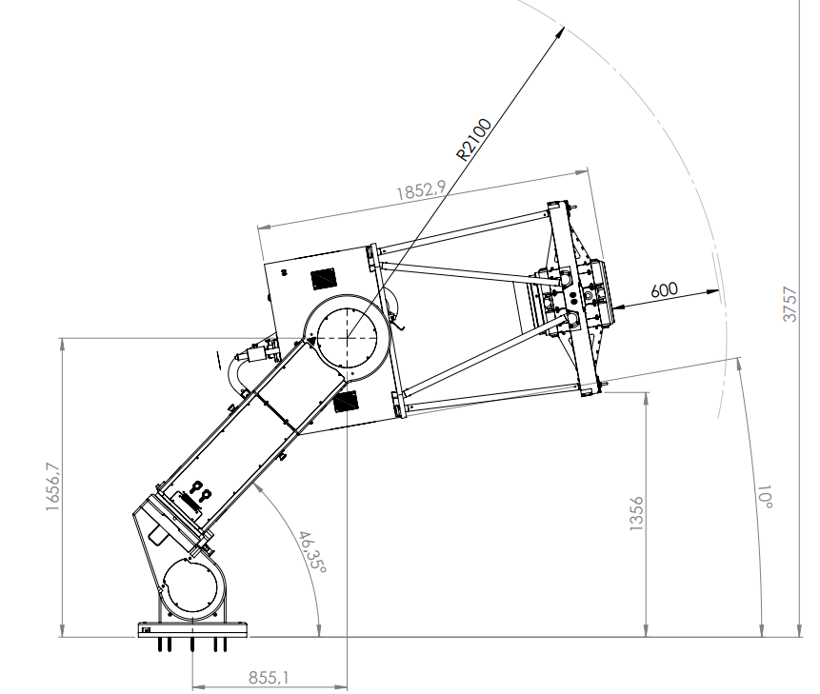
  EQ800PF f2.26 prime focus telescope
ASA EQ800 f2.26
Full FOV is more than 3 degrees
With a chip Sony IMX411 the FOV will be 2x2 degrees
Credits: Astrosysteme-Austria

Slide 12
EQ800PF f2.26
Credits: Astrosysteme-Austria

Slide 13
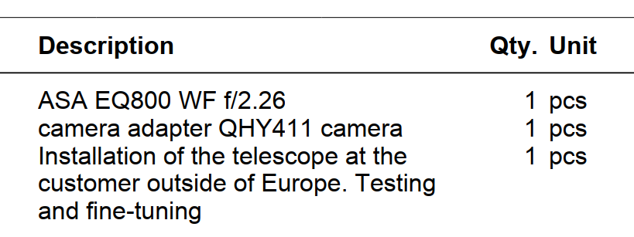
EQ800PF f2.26
Credits: Astrosysteme-Austria

Slide 14
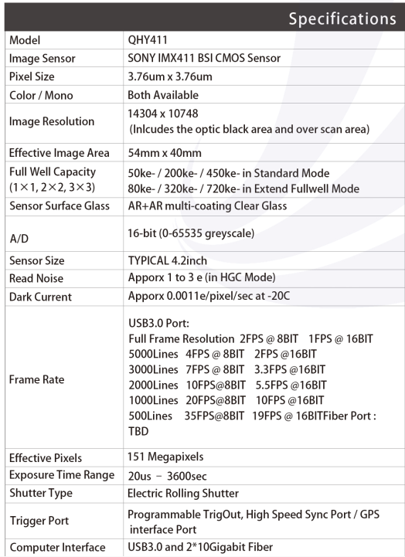
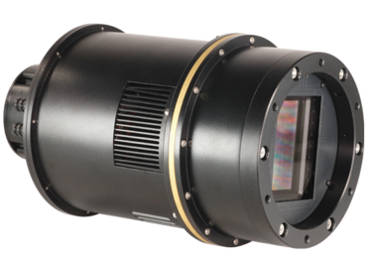
Camera –
QHY 411

Slide 15
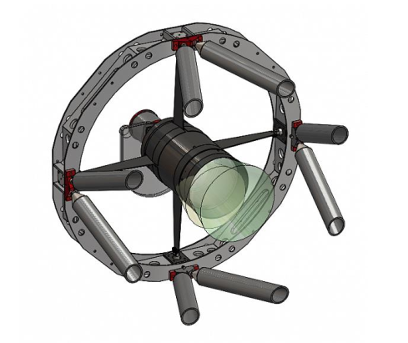
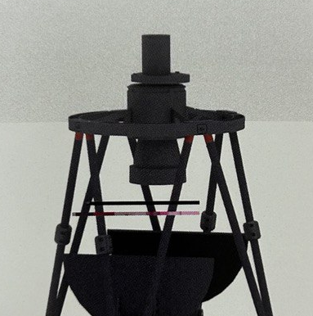
Filter wheel
Obscuration of the pupil due to the camera and the filter wheel in the primary focus

Slide 16
Photometric system
Initially UBVRI was planned
Sloan filter (s) will be used

Slide 17
Discussions
With Antonio via Zoom (thanks!)
With ASA and QHY representatives during the SPIE Yokohama symposium
The distance between the chip and filters must be minimal
QHY can produce a custom made filter wheel, just we need to provide our requirements about distances
Minimal obscuration caused by the WF

Slide 18
Conclusions
ASA EQ800 wide field prime focus telescope with
CMOS camera, the most probably QHY411
Custom made filter wheel, or no wheel at all
One or a few Sloan filters
An agreement has been signed for purchase and installation last week
Expected first light date – June 2026

Slide 19
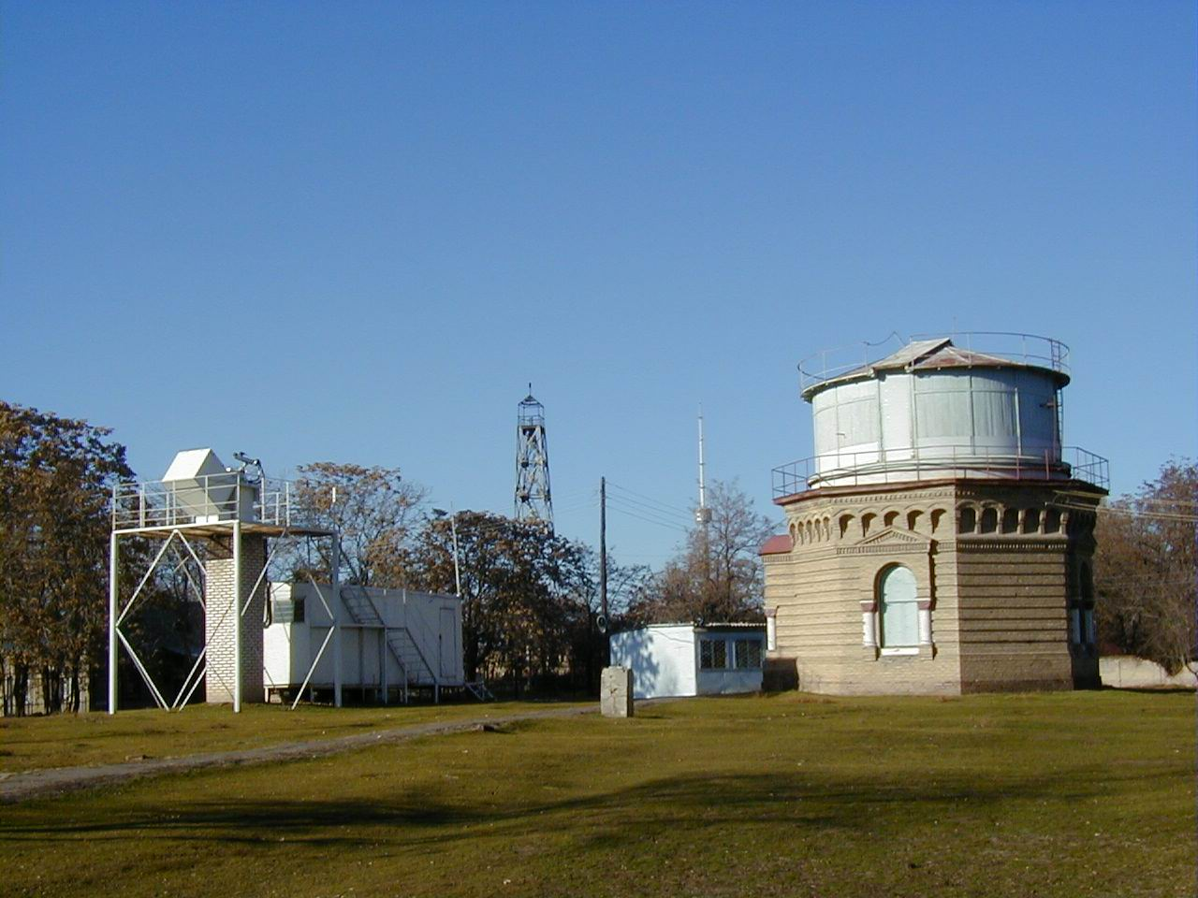
Thanks for your attention!

