Slide 1


Slide 2
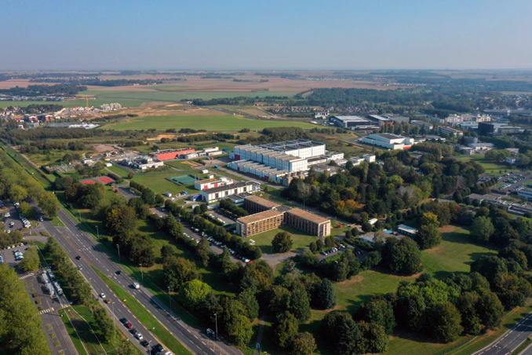
SCIENTIFIC OPPORTUNITIES FOR AGATA @

Slide 3
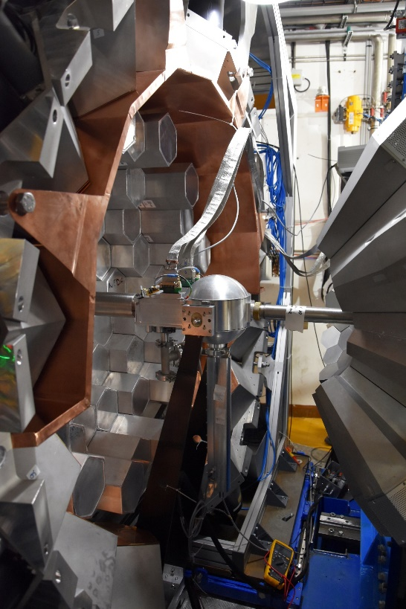
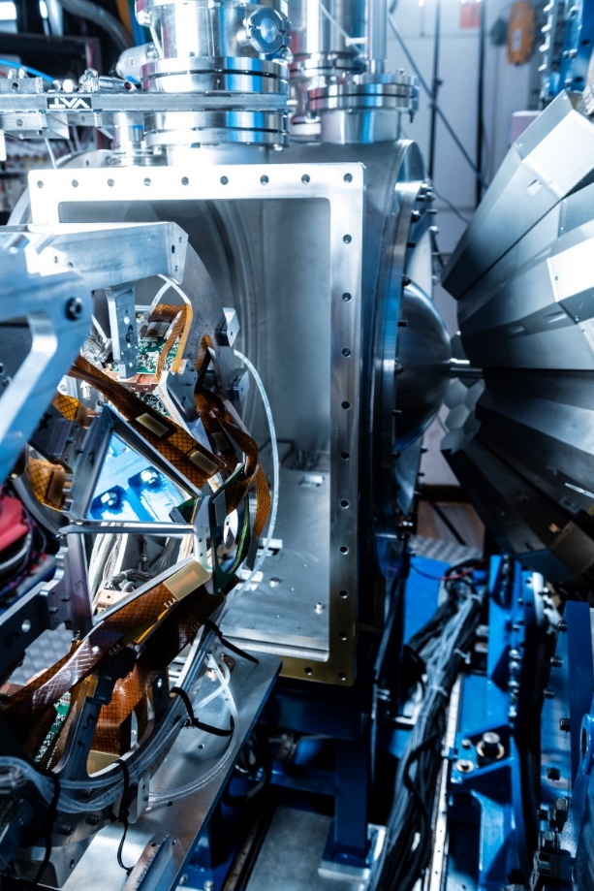
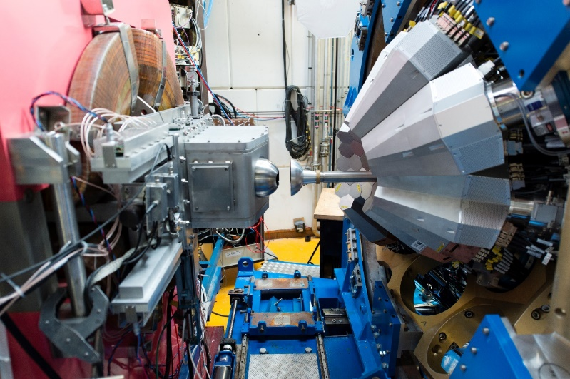
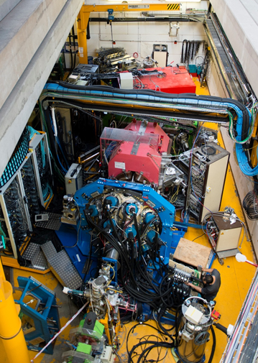
AGATA@GANIL.1 were many sub-campaigns
2018
2019-2021
2015-2017
2021
24-34 capsules
AGATA coupled to VAMOS, FATIMA, PARIS
36 capsules
40-41 capsules
Exotic nuclei spectroscopy by MNT transfer and fission reaction
AGATA coupled to NEDA- DIAMANT
N~Z nuclei spectroscopy by fusion evaporation
AGATA coupled to VAMOS MUGAST
40-41 capsules
AGATA coupled to VAMOS, EXOGAM, 2nd Arm, LEPS
40-41 capsules
927 UT have been approved
821 UT have been performed over 29 experiments ( 90 % done)
Exotic nuclei spectroscopy by transfer reaction using RIB
Exotic nuclei spectroscopy by MNT transfer

Slide 4
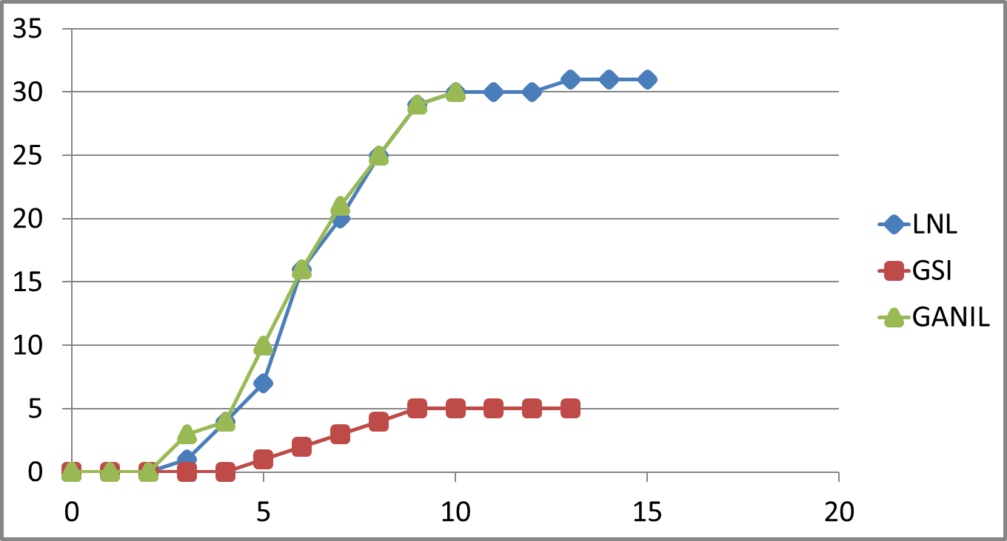
PRODUCTION GANIL.1
https://www.agata.org/list_of_publications
Integrated in-beam
peer-review publications
Year after first experiment

Slide 5
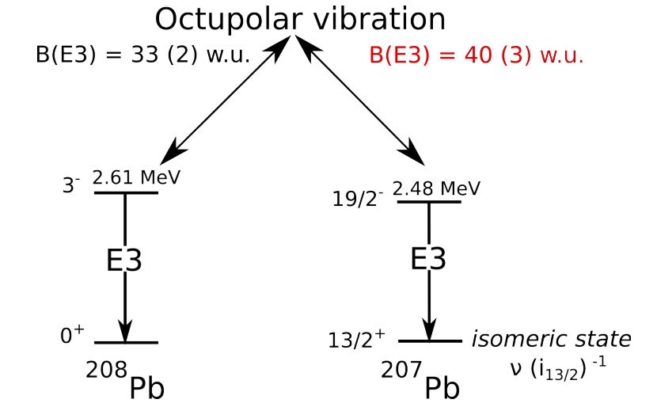
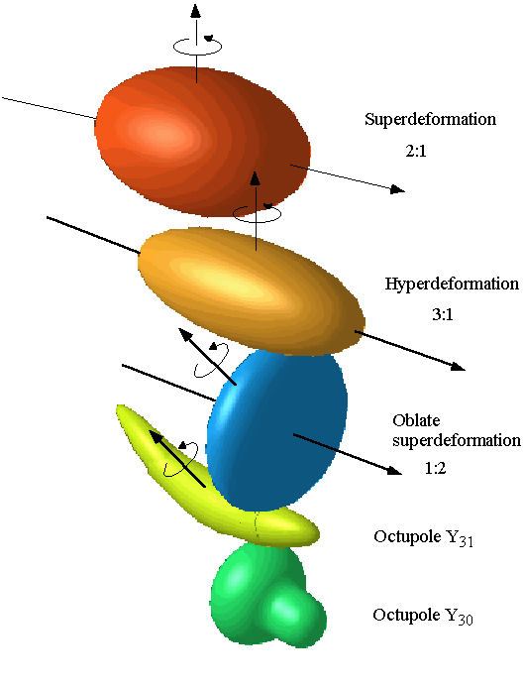
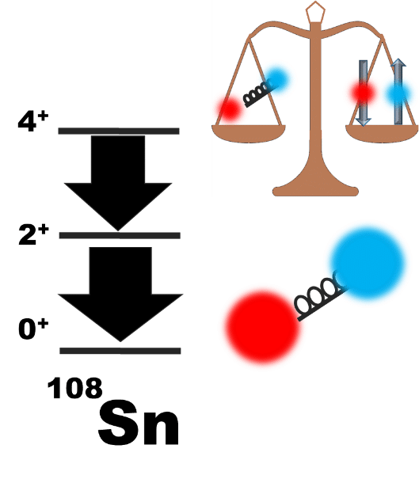
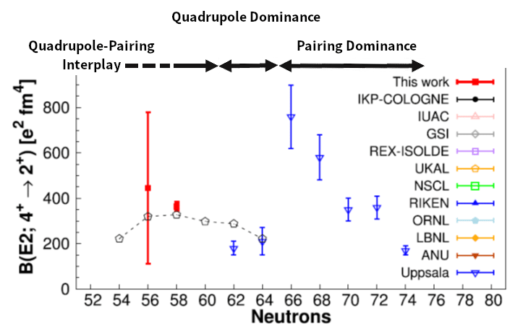
Some highlights of AGATA@GANIL.1
Evidence of octupole-phonon at high spin in ²⁰⁷Pb : Study of the octupole phonon in the ²⁰⁸Pb region.
Constraining the ²²Na(p, γ)²³Mg reaction from the spectroscopy of the 7785.0(7) keV resonance in ²³Mg.
Direct observation of a “delayed” rotational alignment in a deformed N = Z nucleus (⁸⁸Ru), in agreement with theoretical predictions related to the presence of strong isoscalar neutron-proton pair correlations.
B(E3) = 40 (8) w.u.
Ch. Fougère et al Nature Communications volume 14, 4536 (2023)
Success also thanks to
Surrounding
Auxillary collaborative detection
GANIL instrumentation
B. Cederwall et al, Phys. Rev. Lett. 124,062501 (2020)
D. Ralet et al Phys. Lett. B 797, 134797 (2019),
results agree well with predictions from ab initio VS-IMSRG for ²⁰O, showing that 3N interactions are needed to accurately describe electromagnetic observables
High-Precision Spectroscopy of 20O Benchmarking Ab Initio Calculations, I. Zanon, E. Clément, et al.
Phys. Rev. Lett. 131, 262501 (2023), I. Zanon, E. Clément, et al,.
M.Siciliano et al, Physics Letters B 806 (2020) 135474
2⁺ wave function is dominated by the p-n quadrupole interaction
4+ wave function is a balance between p-n quadrupole and pairing interactions
Revisit our predictions on the ¹⁰⁰Sn structure to be investigated at S3
M. Ciemala et al, Phys. Rev. C101, 021303(R) (2020)
Investigation of the Seniority Conservation in the πg_{9/2} shell
R.M. Pérez-Vidal et al, Phys. Rev. Lett 129, 112501 (2022)
Notes:
More accurate and holystique description from MUGAST-AGATA data,
Phys. Rev. Lett. 131, 262501 (2023), I. Zanon, E. Clément, et al.

Slide 6
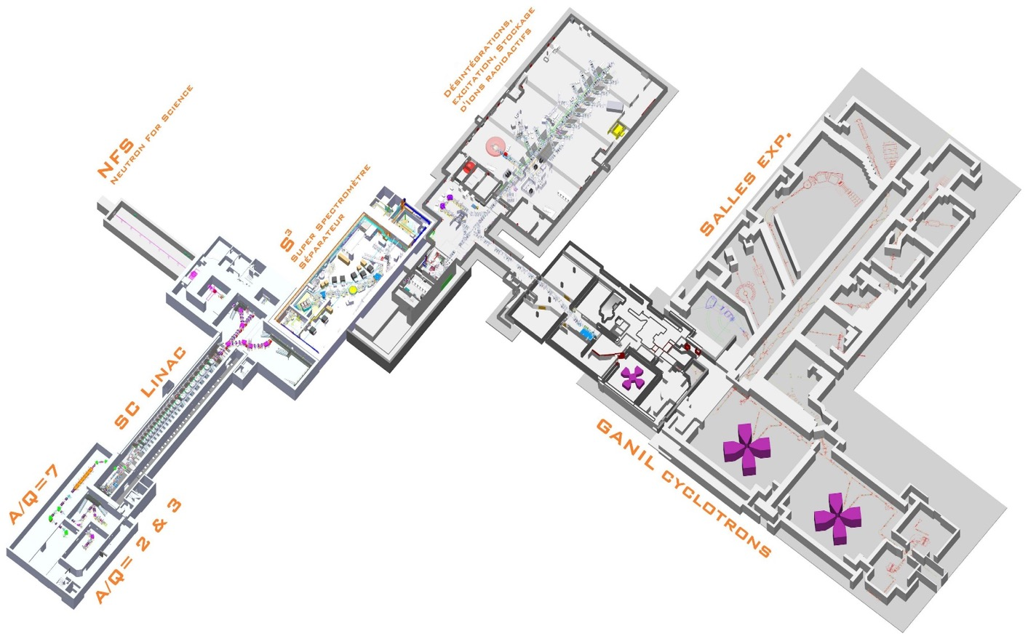
News of
GANIL-SPIRAL2
since AGATA left

Slide 7
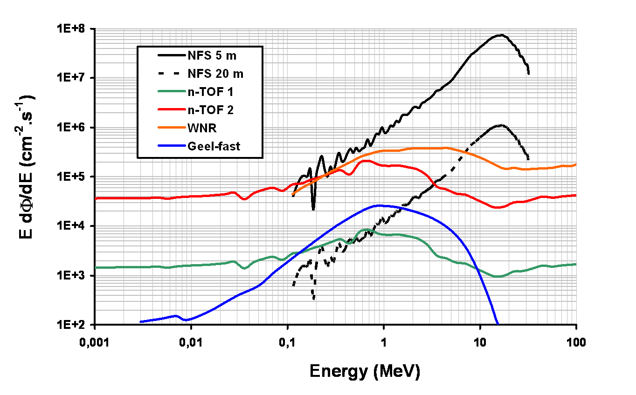
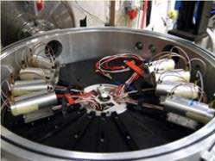
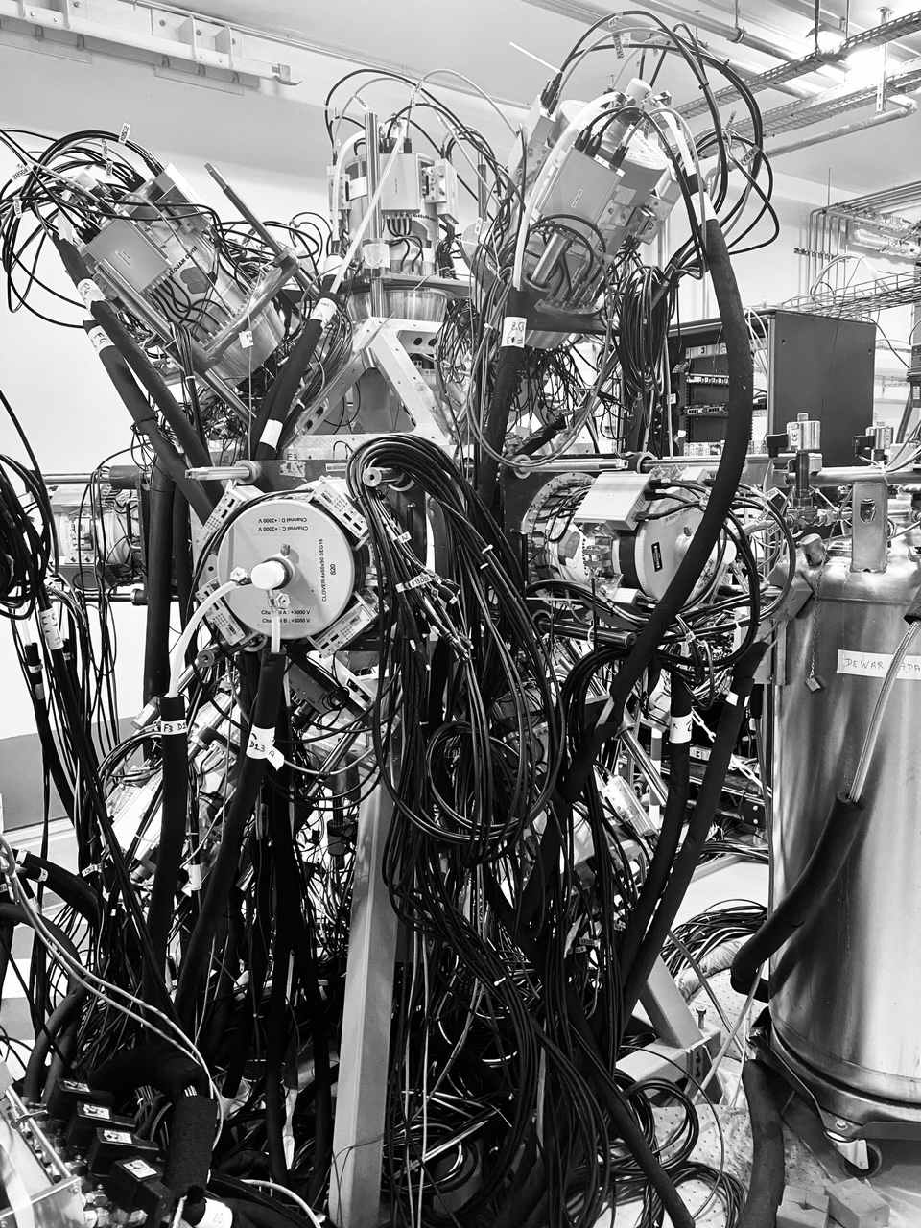
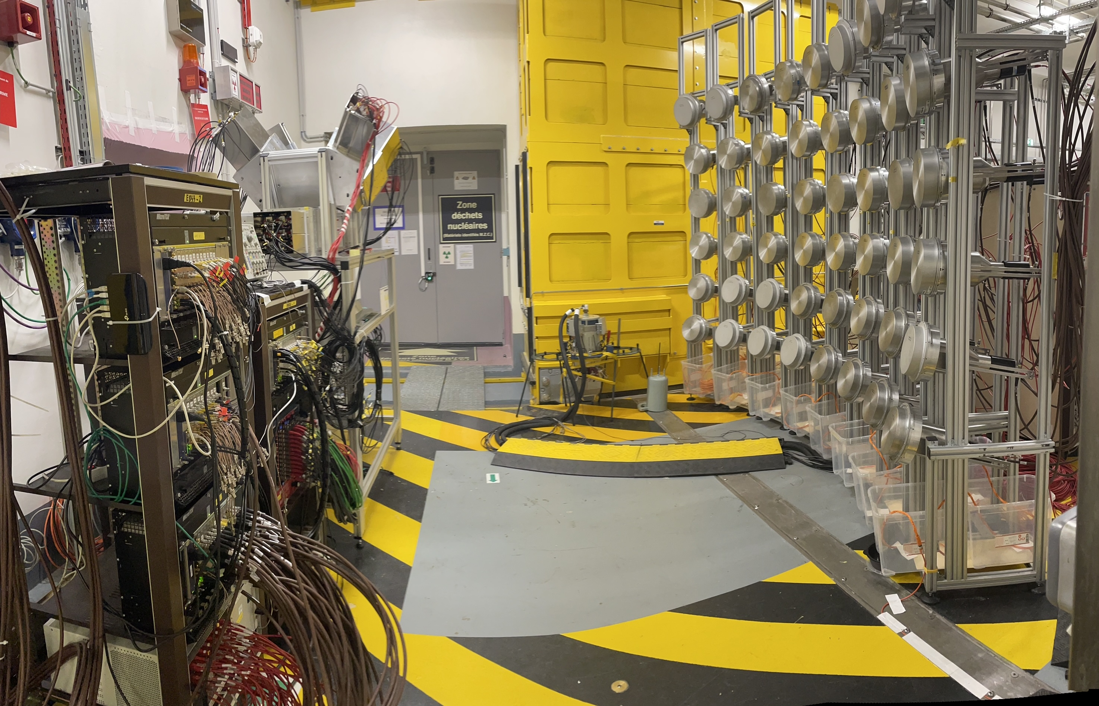
2022-23 NFS Experiments
LIONS: Light ions production studies with MEDLEY, Diego Tarrio et al
GARIC: Gas pRoduction in Chromium, Iron by neutrons, Diego Tarrio et al
(n,xn γ) reaction cross section measurements for nuclear energy, M. Kerveno
Pygmy dipole resonance in ¹⁴⁰Ce using the (n,n’γ) reaction, Marine Vandebrouck et al
²³⁵U
fission fragment
study with
FALSTAFF
D. Doré et al.
MEDLEY
Shedding new light
on the structure of
⁵⁶Ni using (n,3n)
reaction at NFS,
E. Clement et al

Slide 8
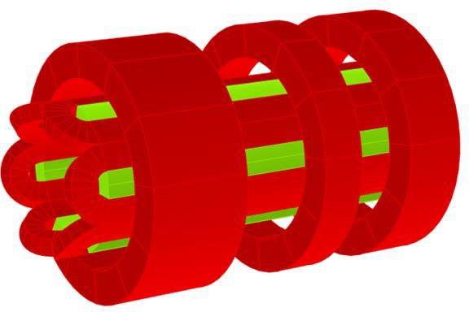

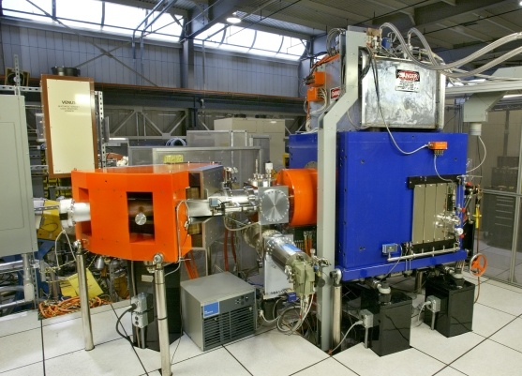
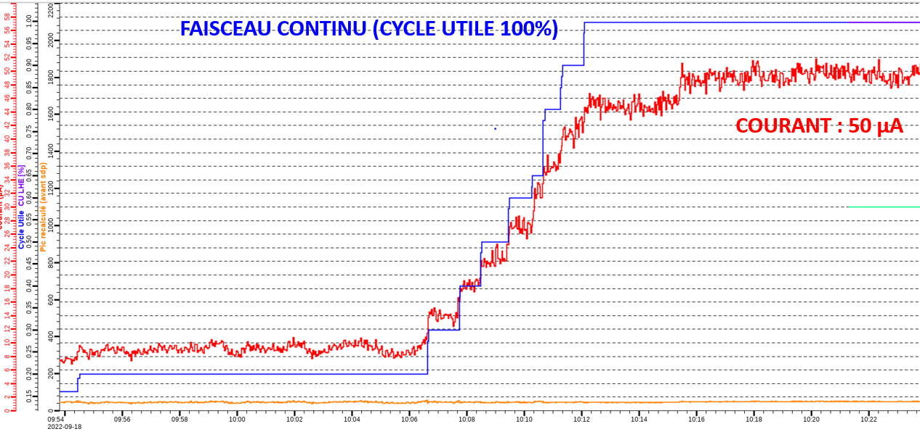

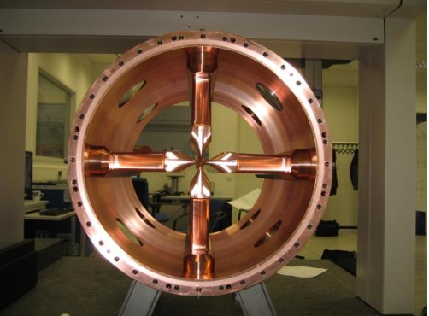
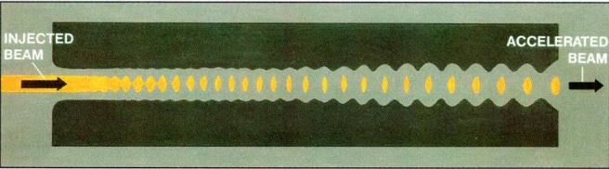
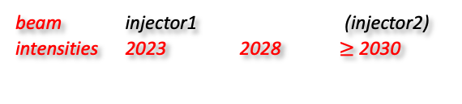
SPIRAL2 : on the way to heavy-ion beams
beam injector1 (injector2)
intensities 2023 2028 $≥$ 2030
Existing
Ions | Intensity (pµA) Phoenix V3 RFQ A/Q≤3 | Intensity (pµA) Phoenix V3 RFQ A/Q≤7 | Intensity (pµA) SC Ion Source RFQ A/Q≤7
¹⁸O | 80 | * | 375
¹⁹F | >15 | >40 | >40
³⁶Ar | 16 | 70 | 45
⁴⁰Ar | 3.6 | 70 | 45
³⁶S | 2.3 | * | *
⁴⁰Ca | 2.9 | 10 | 20
⁴⁸Ca | 1.2 | 10 | 20
⁵⁸Ni | 1.1 | 4 | 8
⁸⁴Kr | 0.1 | 10 | 20
¹³⁹Xe | 0.001 | 7 | >10
²³⁸U | <<0.001 | 0.1 | 6
Measured
NEWGAIN
Estimated
Main User
* -> no estimation
NEWGAIN
World-record intensities
supraconducting Source ASTERICS
RFQ for heavy ions
¹⁸O⁶⁺ 50μA, 7 MeV/u
⁴⁰Ar¹⁴⁺ 80μA, 7 MeV/u

Slide 9
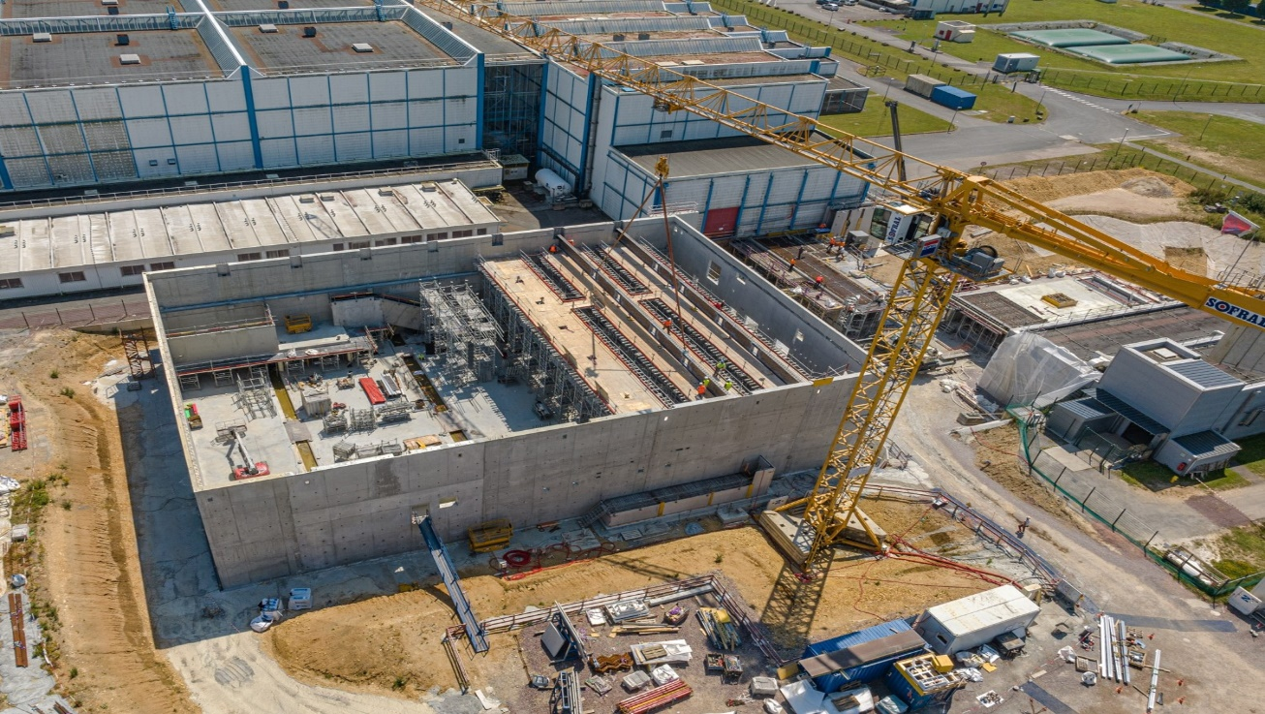
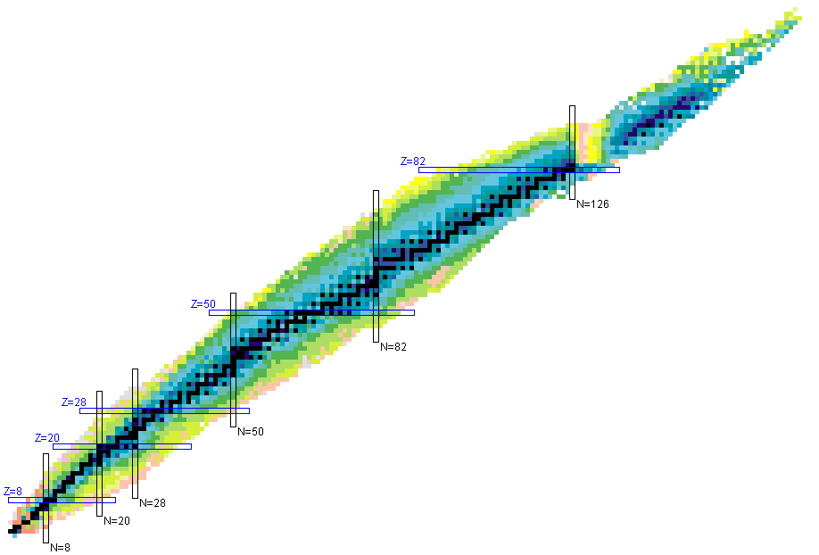

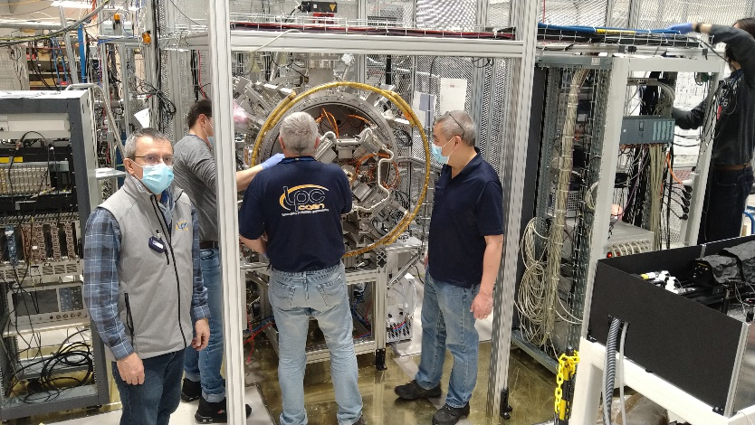
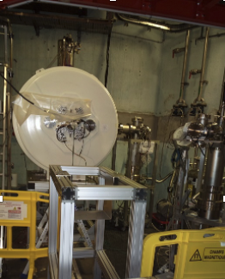
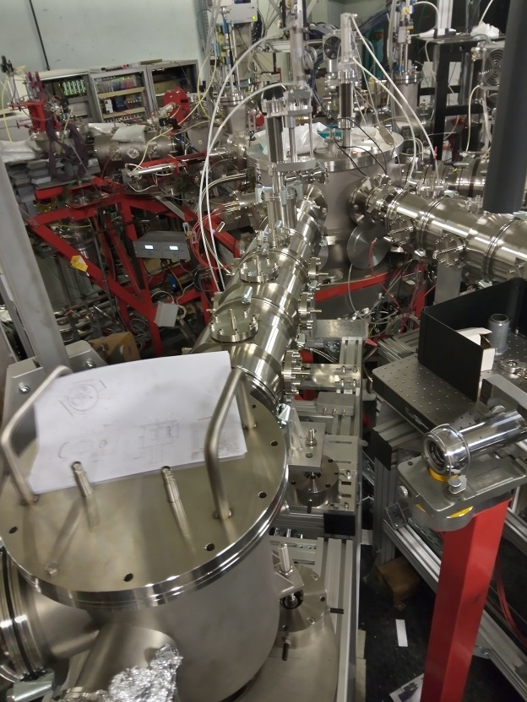
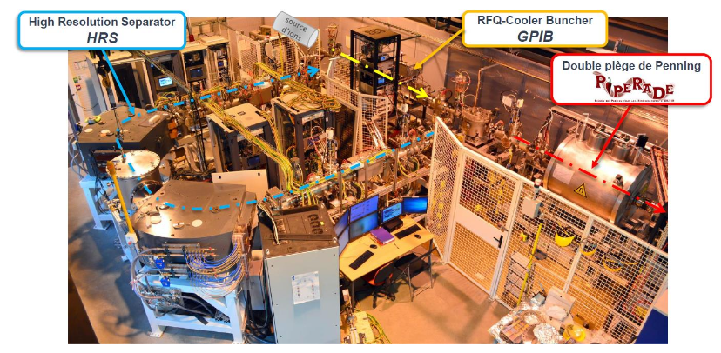


DESIR hall under construction
SPIRAL1
S³-LEB
SPIRAL2
  Fusion-evaporation
  (Multi-)nucleon Transfer
S³-LEB
Low-energy radioactive-ion-beam facility
Beams from SPIRAL1 and S³
Important beam preparation and purification capabilities
High resolution/precision experiments
Study of fundamental properties of nuclei : mass, life time, decay modes, spin, magnetic and quadrupolar moments
Nucleosynthesis
Fundamental interactions, tests of weak interaction standard model
SPIRAL 1 Upgrade
  Beam & target fragmentation
First experiments in 2027

Slide 10
GANIL
CYCLOTRONS
and experimental rooms

Slide 11
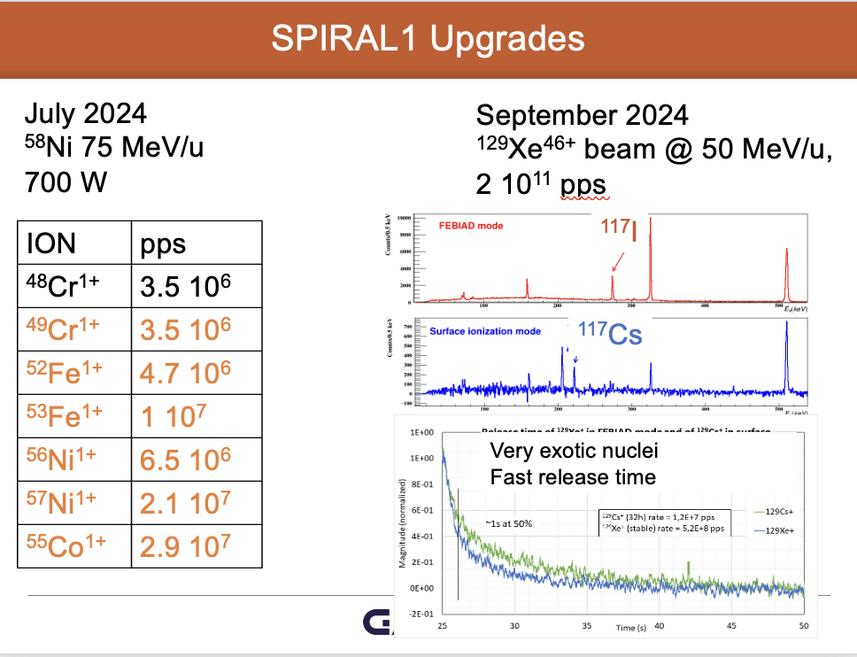
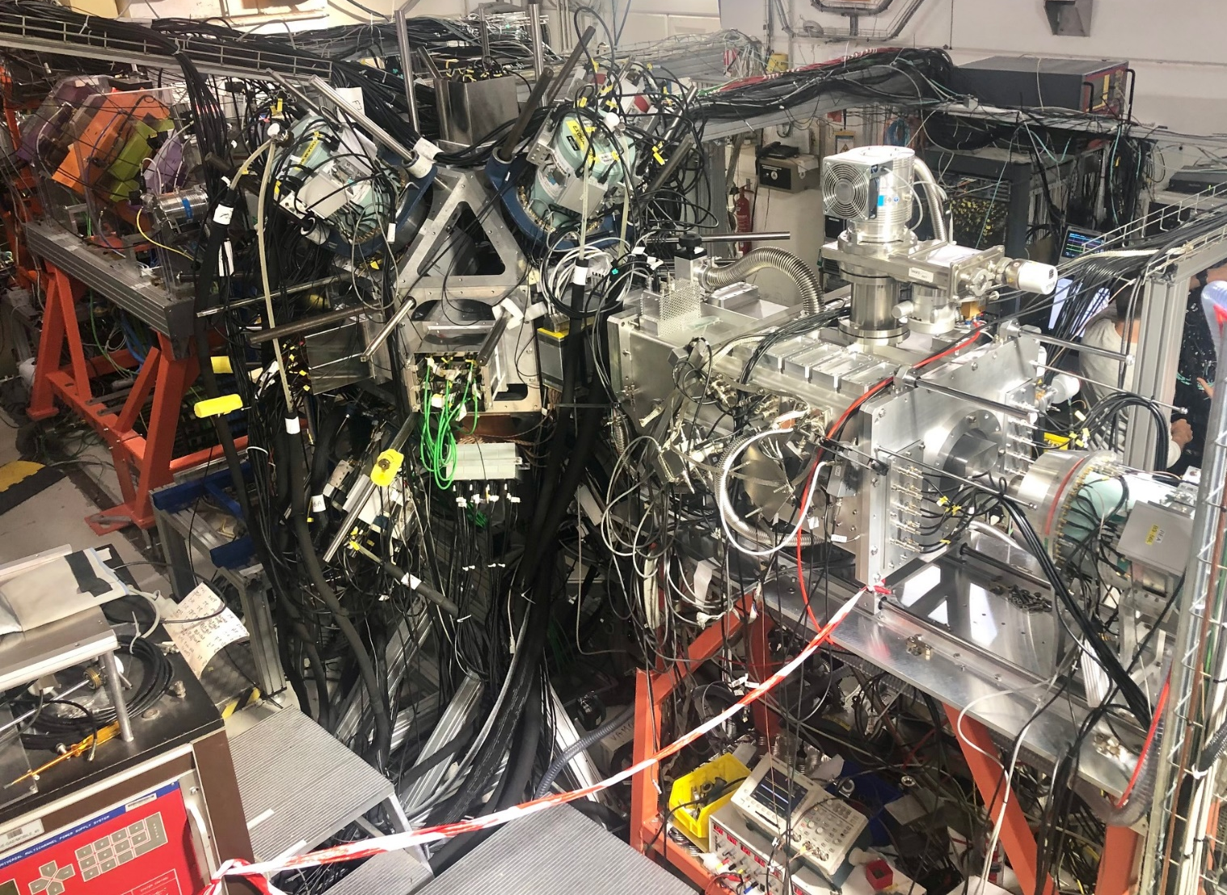
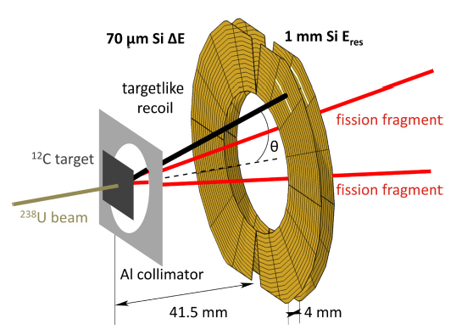
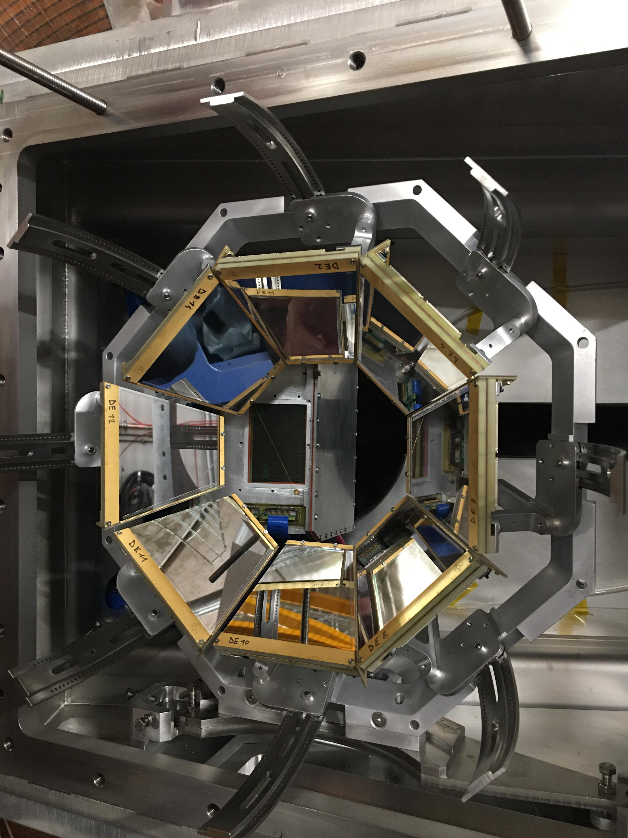
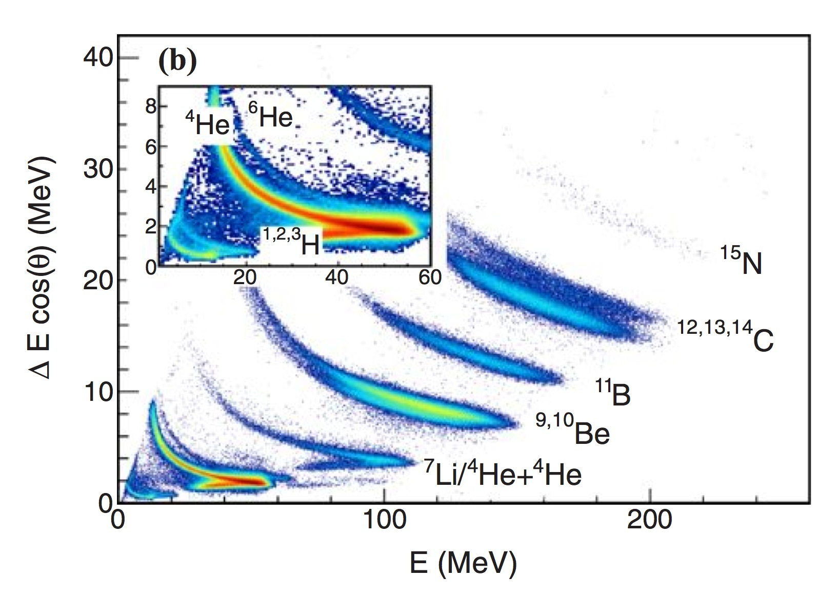
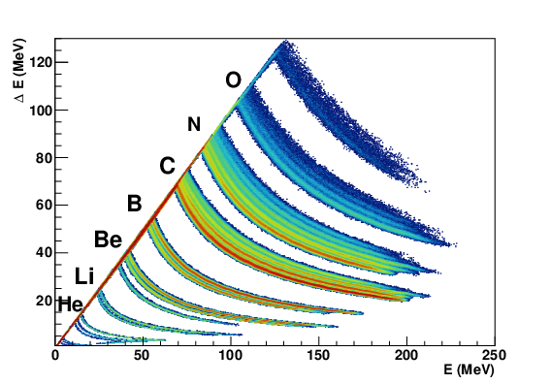
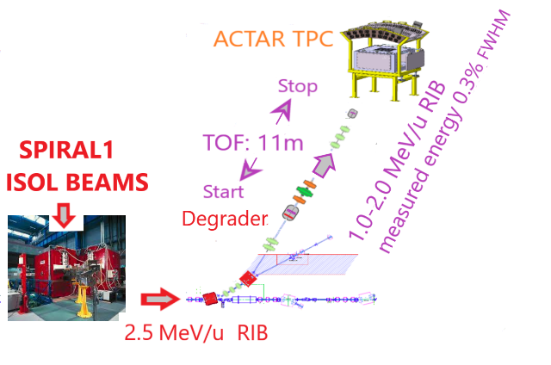
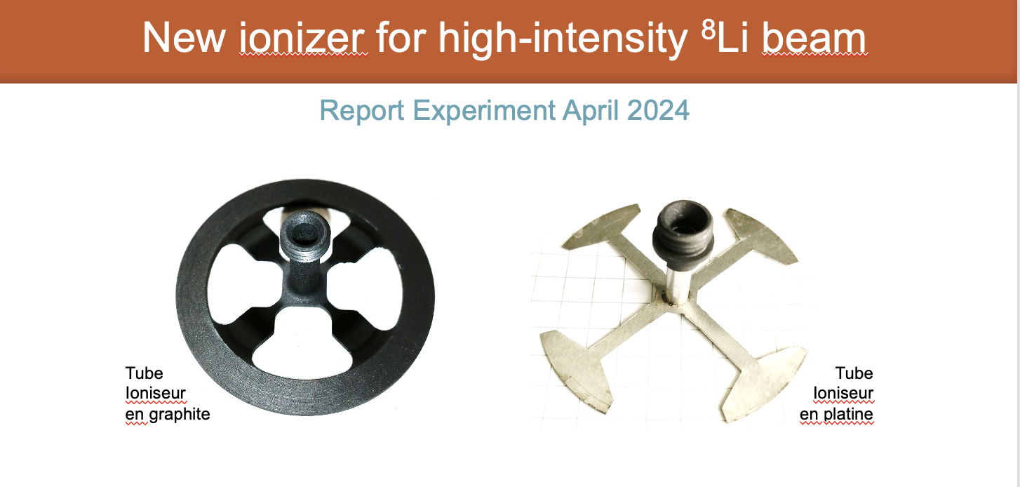
GANIL : a constant upgrade to meet users needs
LISE ZDD line-up experiments
Improvement of target-point detection set-up at VAMOS
New beam-line for
low-energy
astrophysics

Slide 12
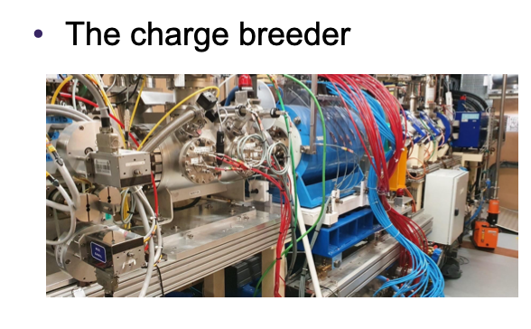
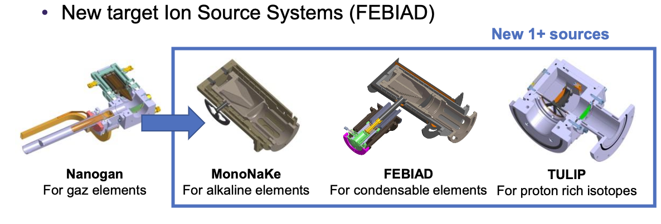
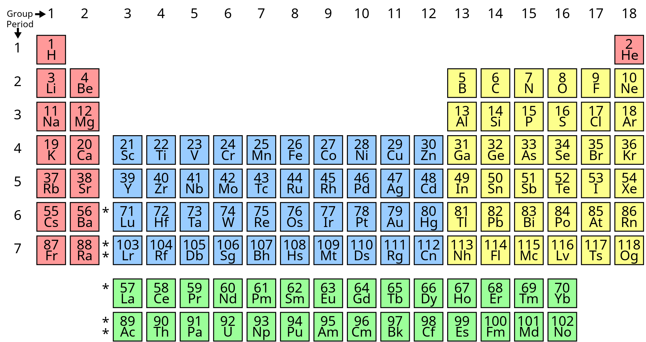
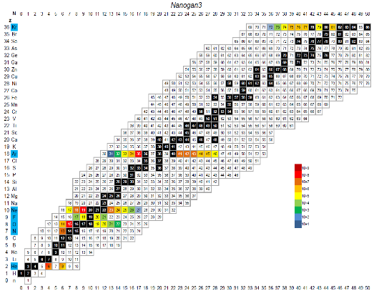
SPIRAL1 upgrade
Elements for which we observed a radioactive isotope
50 new isomers/isotopes
with intensities suitable for acceleration
- 35 isotopes > 1E+4pps
- 7 chemical elements
- T_{1/2}min : 100ms (8He)

Slide 13
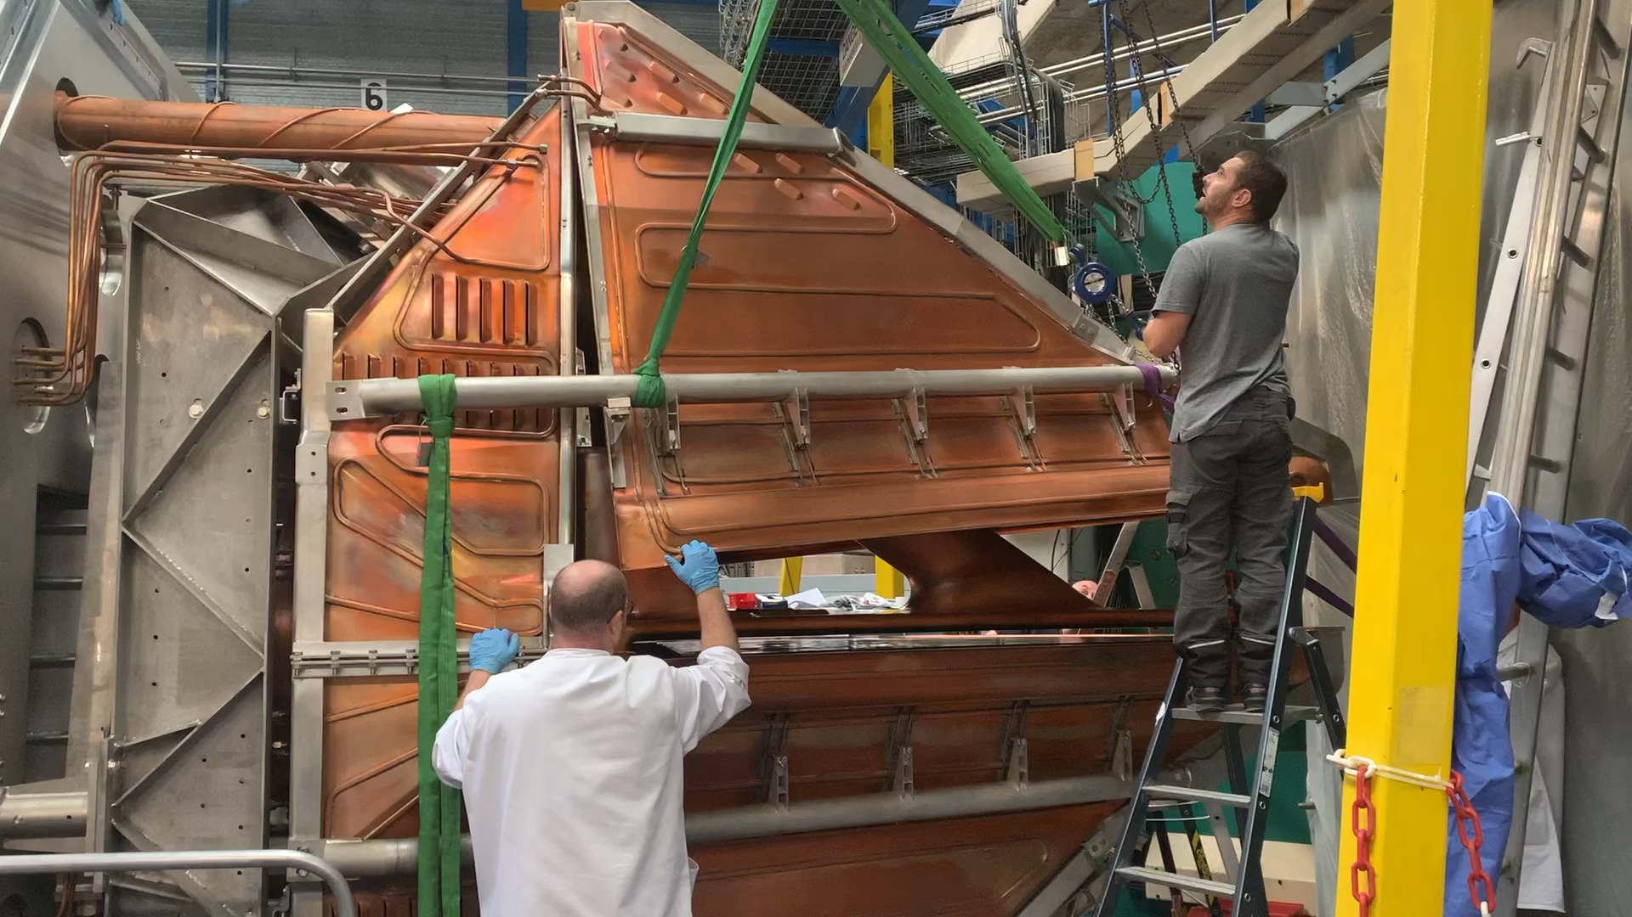
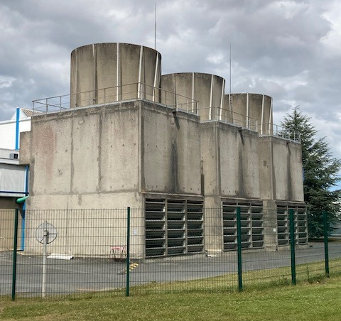
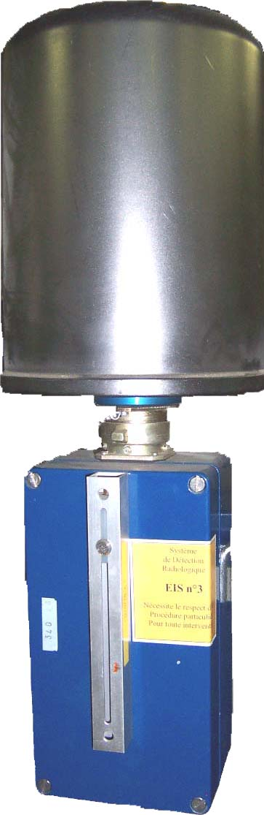
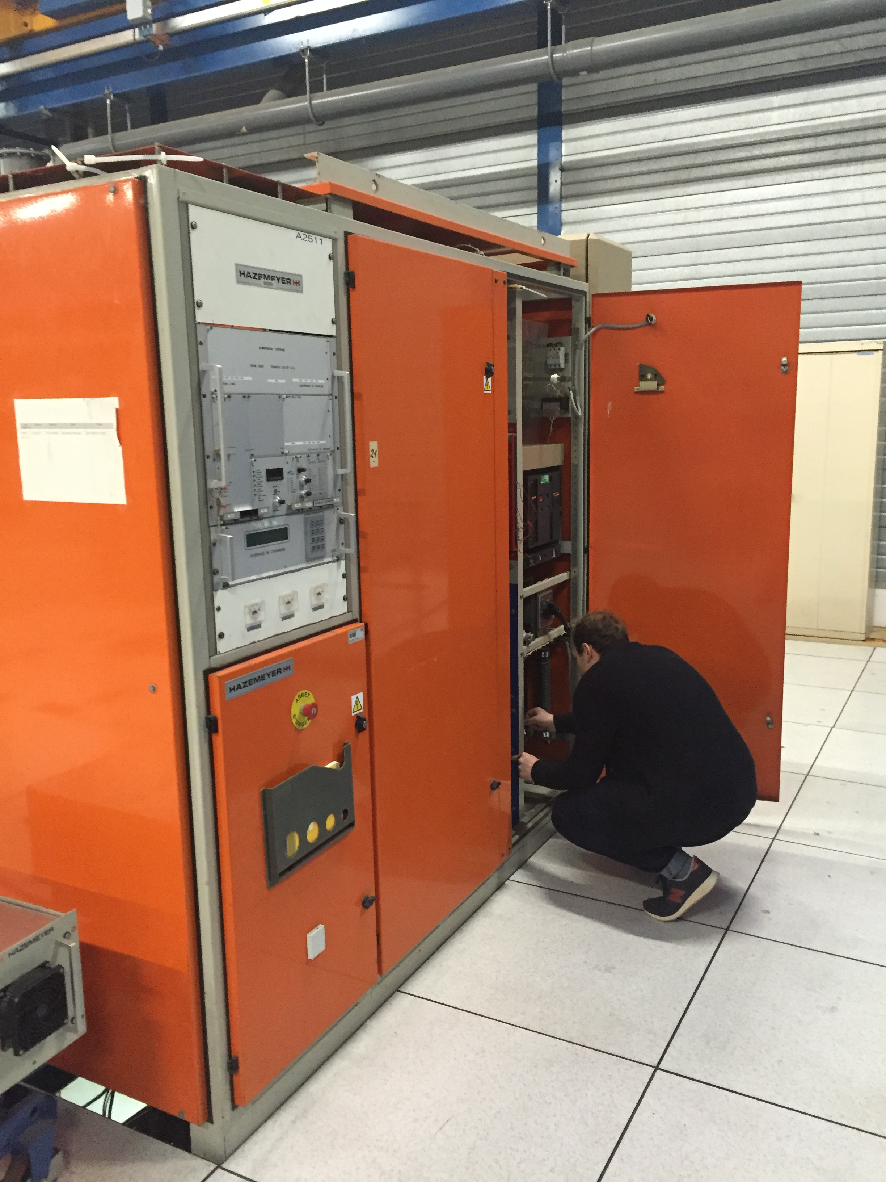
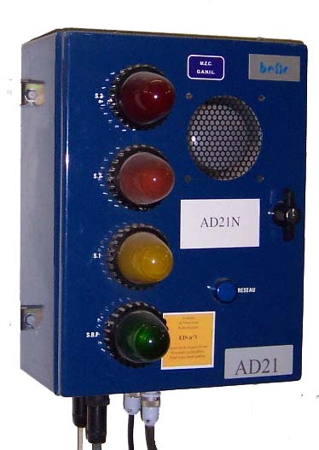
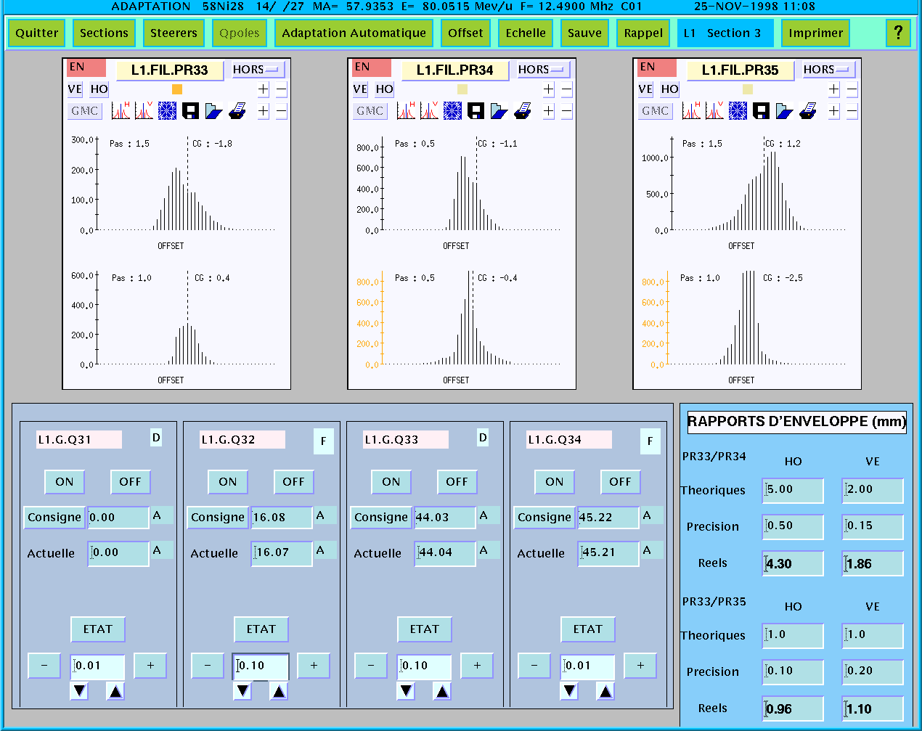
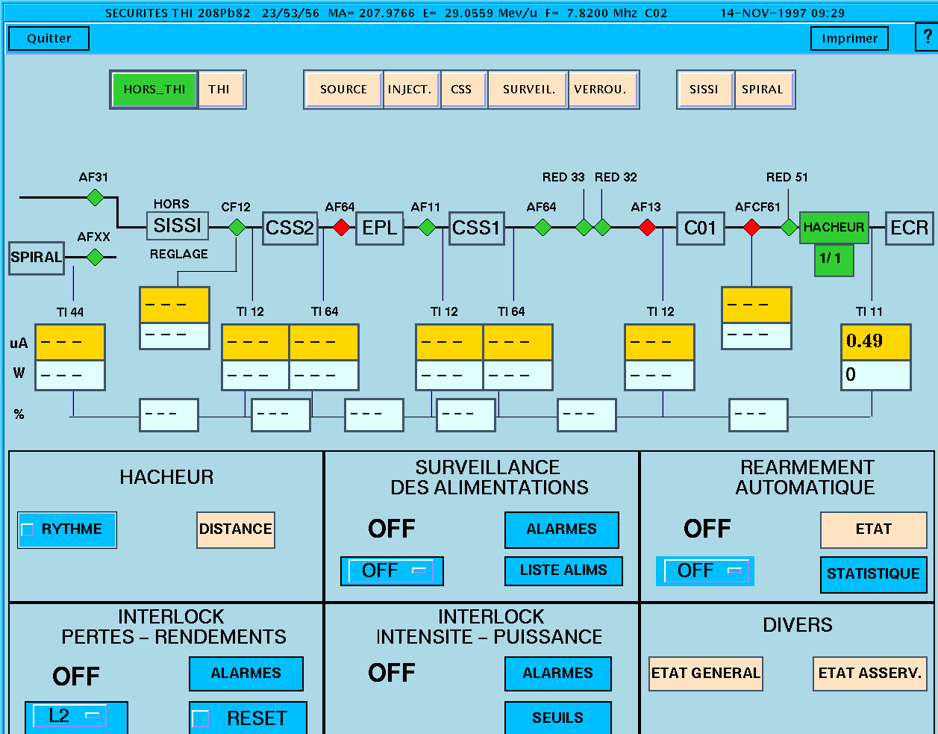
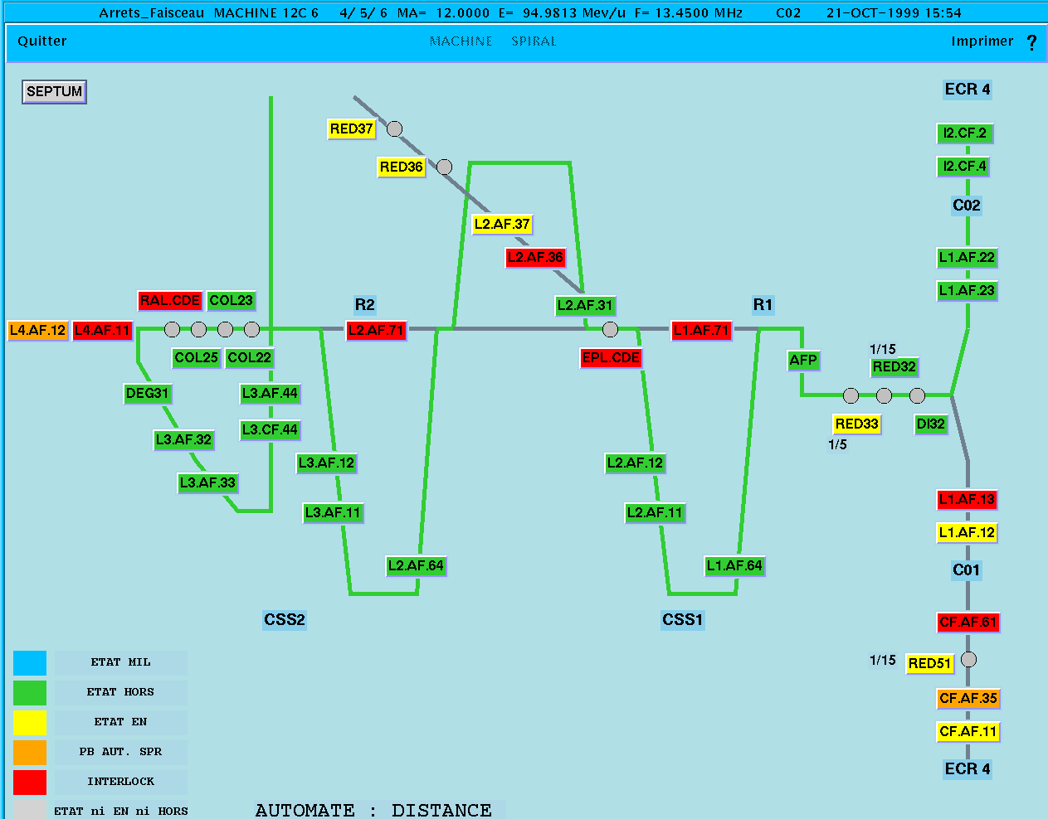
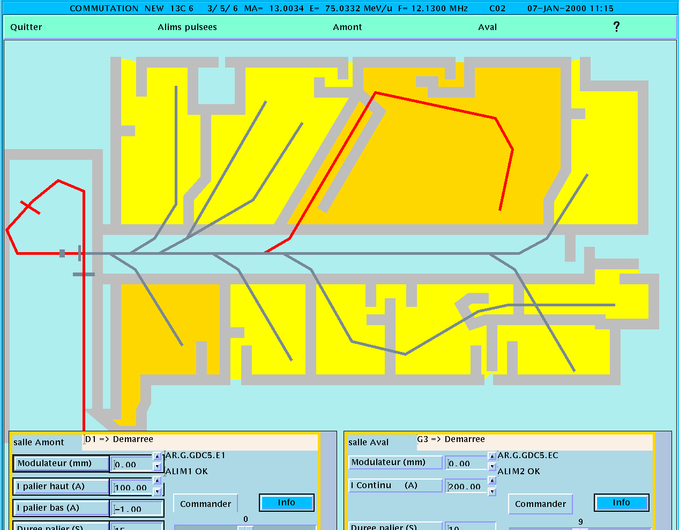
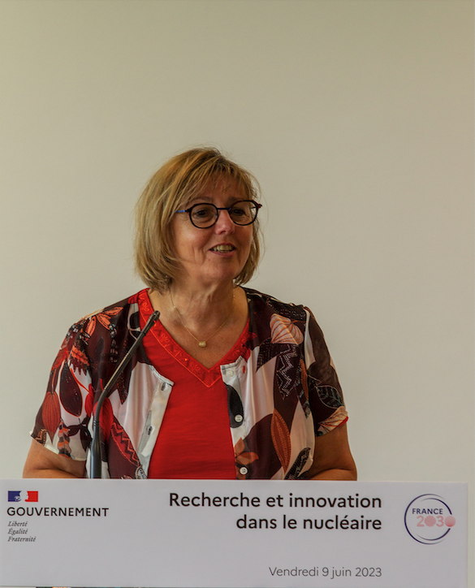
CYREN : a deep renovation ambition for GANIL
to maintain scientific objectives at the best level
cyclotrons
Infrastructure
Safety supervision
Minister for Research
confirmed an
endowment of 40 M€
for GANIL projects:
DESIR, NEWGAIN, CYREN
(11,2 ; 7,4 ; 21,4 )
2024-2033 renovation programme

Slide 14
Operation perspectives
17 annual weeks of GANIL cyclotrons operation until 2031
Increasing beam-time for SPIRAL2

Slide 15
AGATA Workshop, GANIL, May 2024
40 participants
Rich physics cases :
  Resonance and near threshold spectroscopy including cluster
  Charge exchange and pair transfer
  Nuclear structure of light exotic nuclei and ab-initio calculations
  Spectroscopy of exotic nuclei of interest for nuclear astrophysics
  Hauser-Feshbach formalism in exotic nuclei using surrogate reactions
  Nuclear deformation from low to high angular momentum using Coulomb excitation or fusion
  Multi-Nucleon Transfer with heavy beams for Super Heavy Elements
  Lifetimes of excited states using Doppler Shift Attenuation Methods in exotic nuclei produced in transfer reactions

Slide 16
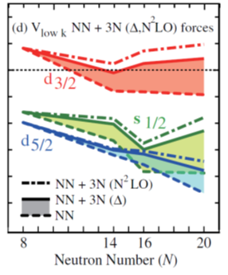


Study of the Heavy Fragment survival in Multi Nucleon Transfer reaction I. Stefan et al
Probing mixed-spin np pairing in the super-collective Z~60 and A~130 region, J. Dudouet al
Coulomb excitation of ⁴⁴Ti and ⁶²Zn,
K. Hadynska-Klek et al
Neutron-proton pairs in the self-conjugate Nuclei (Ti,Ni) of the fp-shell through two-nucleon; M. Assié, et al
Attacking the quasi-continuum & the entry distribution with AGATA Hyperdeformation hunting Superdeformation revisiting,
A. Korichi et al
Clustering in medium-mass proton-rich nuclei (Ar) studied
through Li-induced stripping reactions, D Beaumel et al
Spectroscopy of proton-rich nuclei using charge-exchange reactions and proton adding with a ³He target, B. Fernandez-Dominguez et al.,
Can AGATA extract an average lifetime of multiple states? S. Ota et al
SPECTROSCOPIC PROSPECTS IN ¹⁹Ne above the α-particle threshold,
F. De Oliveira et al
RIB from SPIRAL1
Ab-Initio test ²³Ne(d,p)²⁴Ne by DSAM on the 2⁺_{2,} E. Clément et al
Stable beam
Spectroscopy of unbound states in light nuclei. I Stefan et al
Studying X-ray Bursts with the AGATA-GRIT-VAMOS Setup G. Lotay et al

Slide 17
AGATA opportunities @GANIL :
« Data taking » between : March 2028 – July 2030
SUMMARY
Very successful previous campaign with high-impact publications
GANIL is an important partner of AGATA collaboration :
  50% of French contribution to AGATA is from GANIL
GANIL staff trained and operational on AGATA duties
Most of the campaign#1 infrastructures are still available
High-quality and new RIB from SPIRAL1
High-intensity and high-quality stable heavy-ion beams
State-of-the-art spectrometer and instrumentation
Surrounding collaborations with active and cryogenic targets (ATRACT) or particle detectors (MUGAST/GRIT)
Commitment of the GANIL management to dedicate at least 50% of the CYCLOTRON beam-time (when approved by PAC) : ~ 100 UT yearly : 2500 hours of beam on target !
Notes:
Lettres : 7/13 letters

Slide 18
Thank you for your attention
Welcome in GANIL !

