Slide 1
AGATA Project
EMC Visit @ LNL January 2024
N. Karkour and and R. M. PÉREZ VIDAL

Slide 2
EMC @ LNL January 2024
4 Visits @LNL . July 2021, November 2021 and April 2022 January 2024.
More than 100 test points per test
3 types of tests (4Wire resistance, Direct and indirect injection).
ALL 3 visits gave successful results.

Slide 3
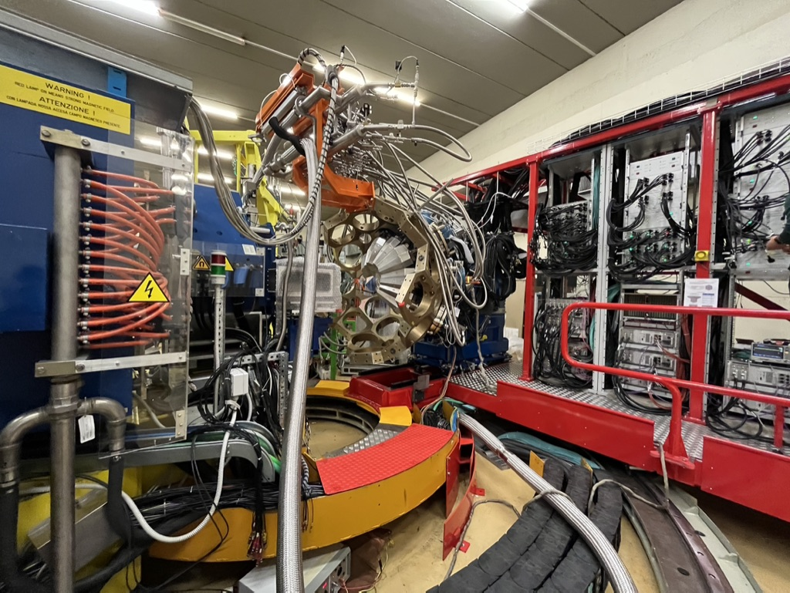
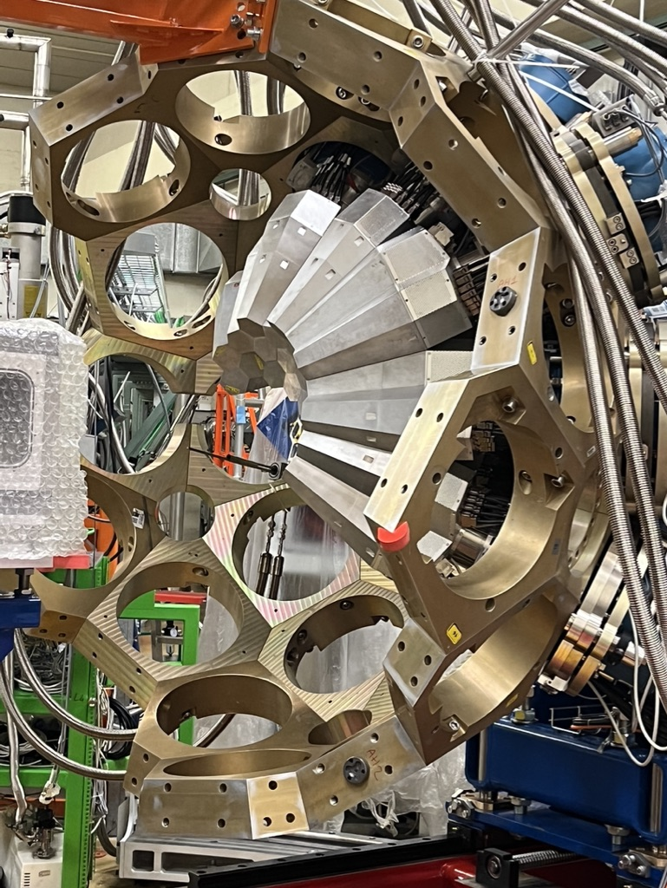
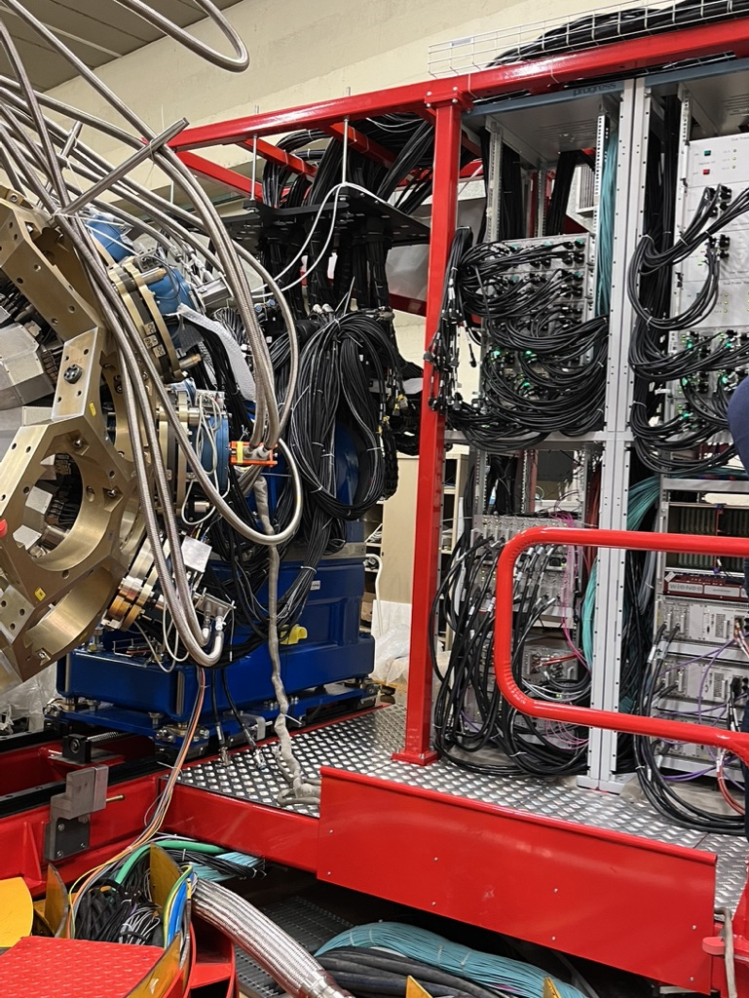
EMC @ LNL April 2022

Slide 4
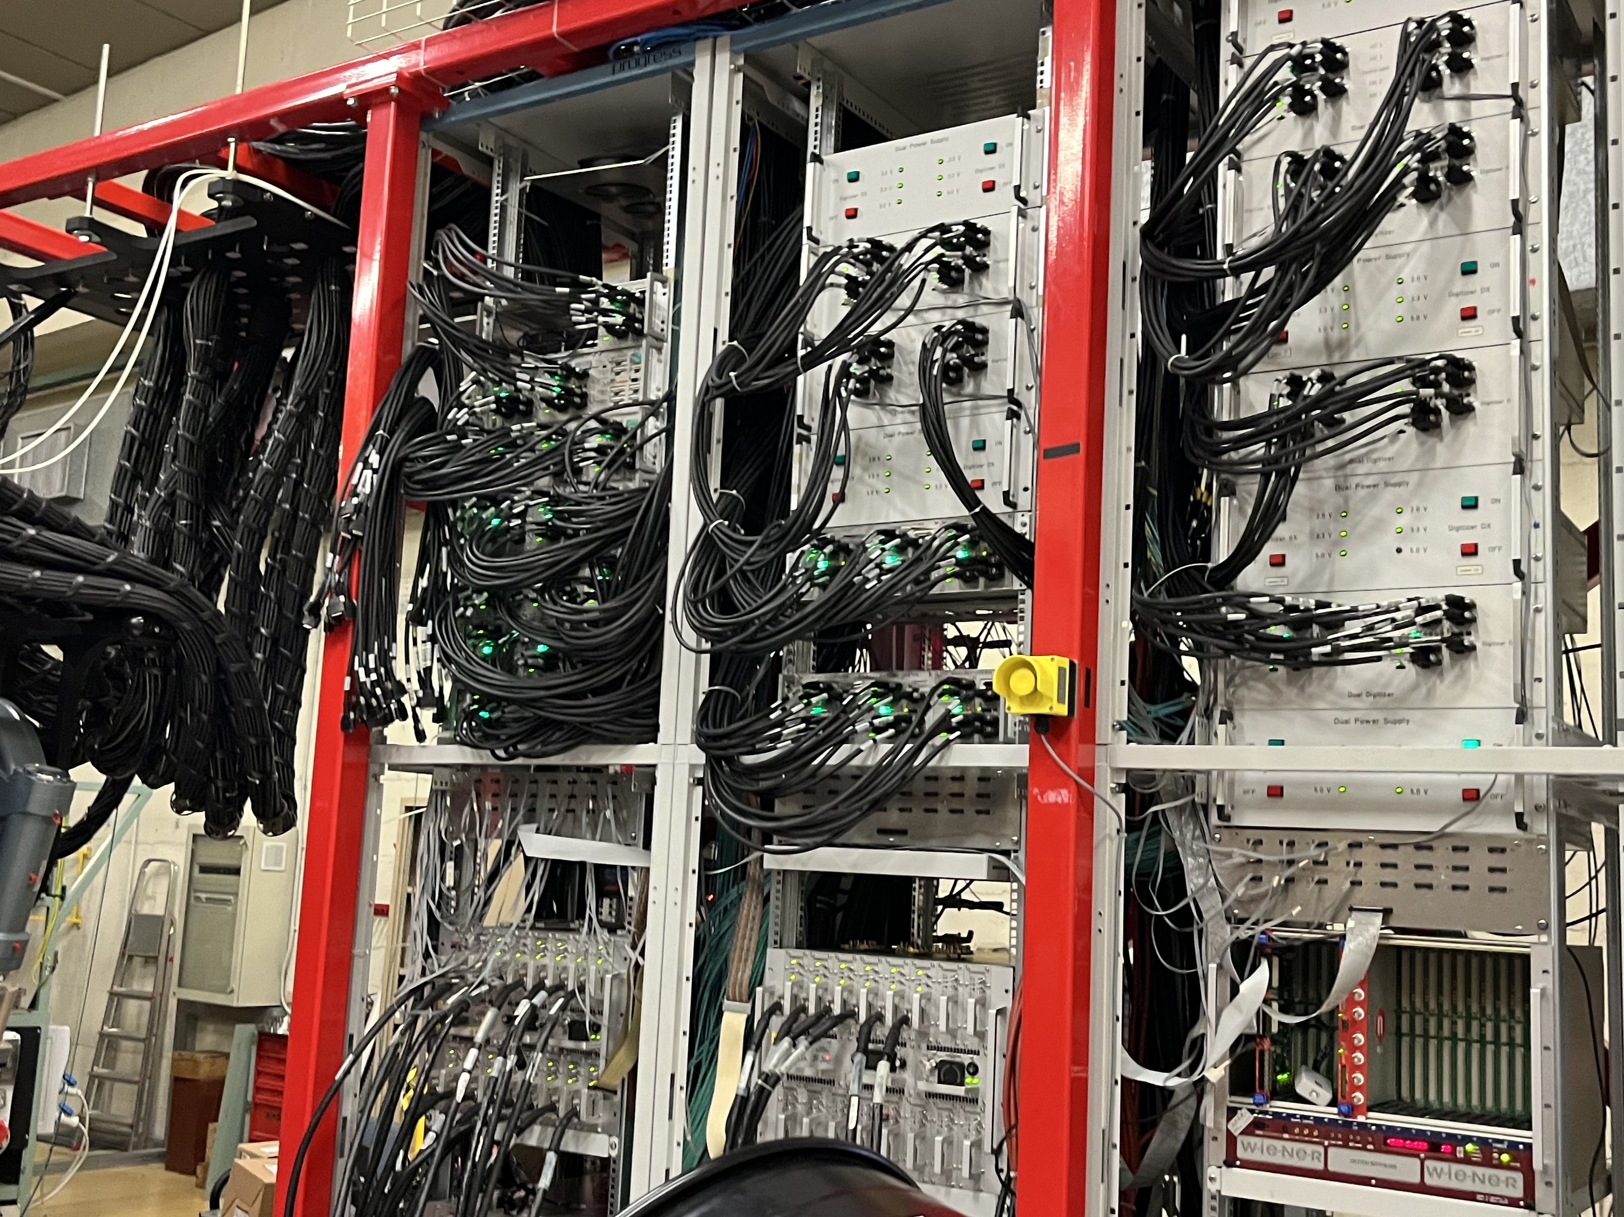
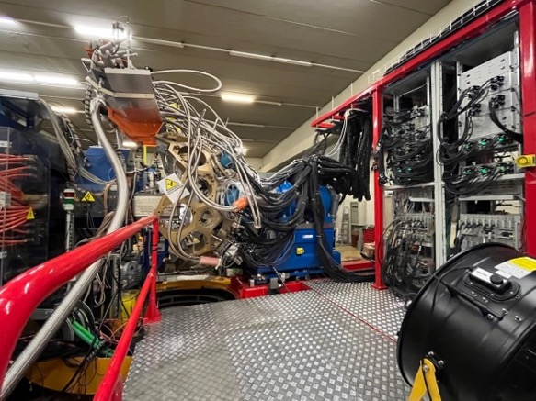
EMC @ LNL January 2024

Slide 5

EMC @ LNL January 2024

Slide 6
EMC @ LNL January 2024
More Crystals are installed (40) in April 2022 (21).
More cables and more power -> more noise risk
Capacitive injection tests on gamma or flat cables (lot of noise)
Direct injection noise 07B (lot of noise) since it was reported as noisy.
No data set from April 2022 to 07B.
the reference detector, 01A, was evaluated in 2022.

Slide 7
EMC @ LNL January 2024
Several tests to show noise effects in the signals of 07B (core and segment) are made
The tests injecting 2kV in direct mode in the same position as reference detector continued being different to the reference measurements in 2022.
Very similar effects to the previous tests in 2022 were found in detector 01A as expected.
The conclusion of these tests is that the effect of the injected noise depends on the position of the detector.
Moreover other direct injection tests were performed on detectors 05C and 11C.

Slide 8
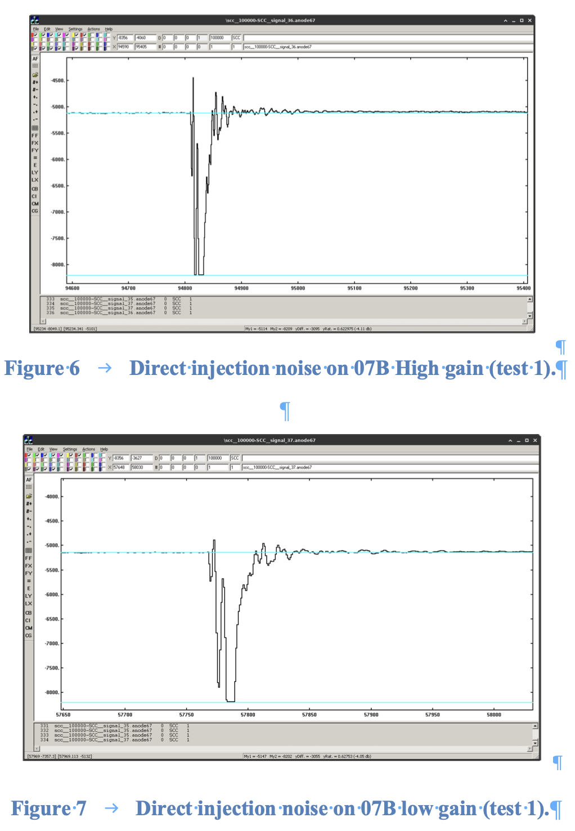
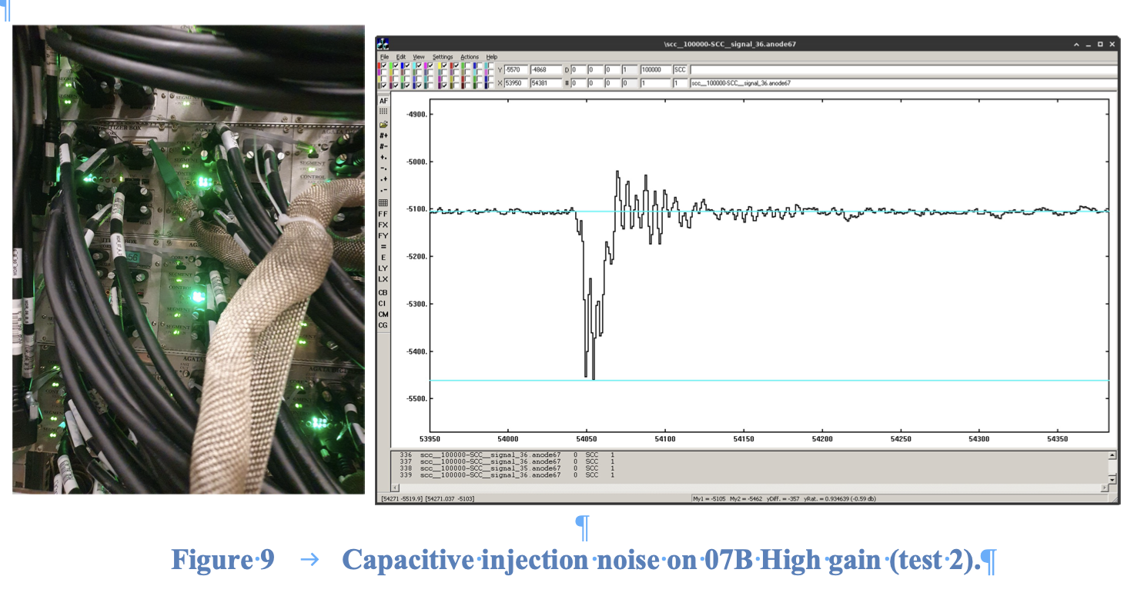
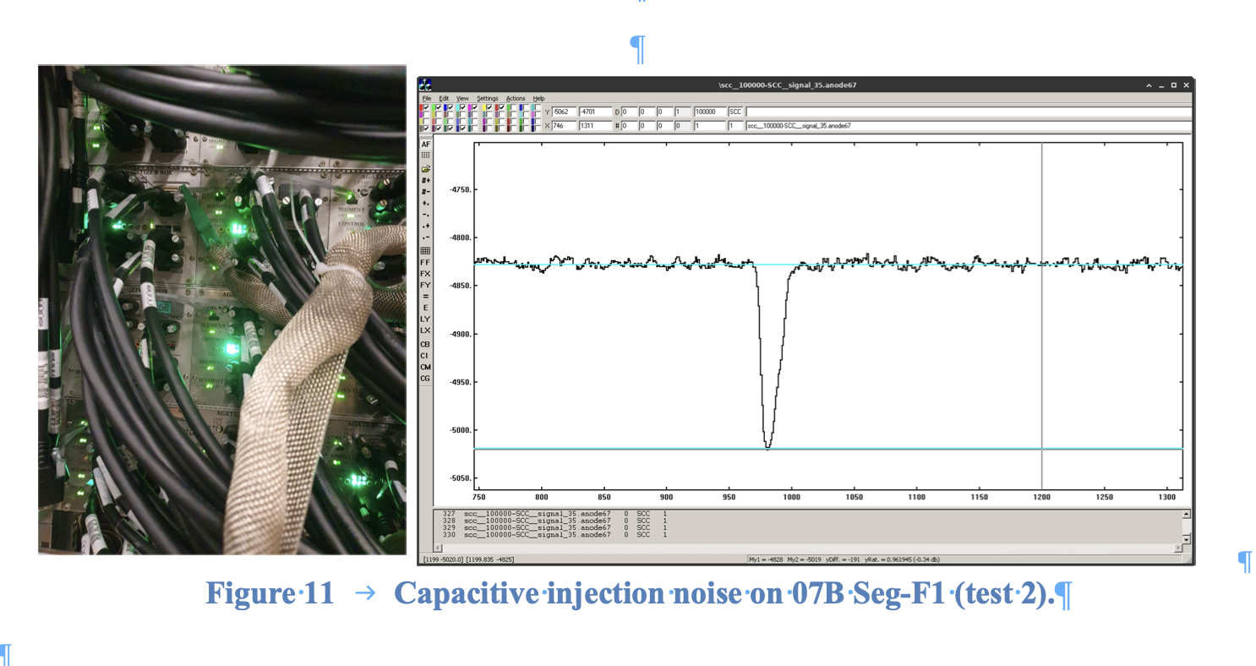
EMC @ LNL January 2024

Slide 9
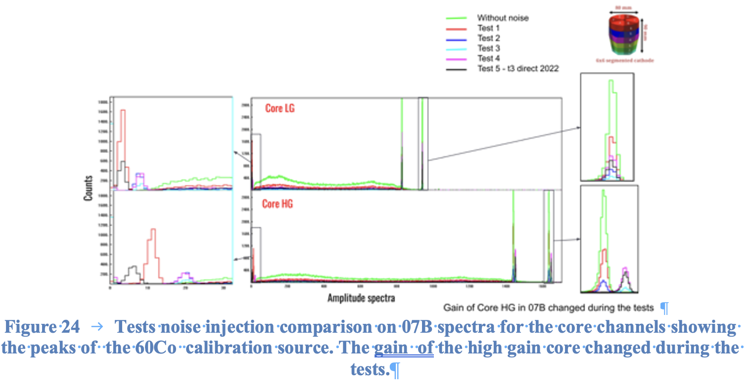
EMC @ LNL January 2024

Slide 10
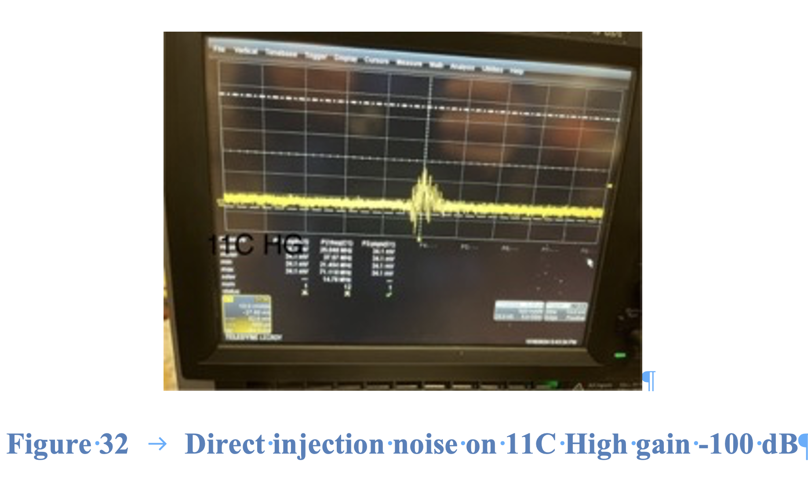
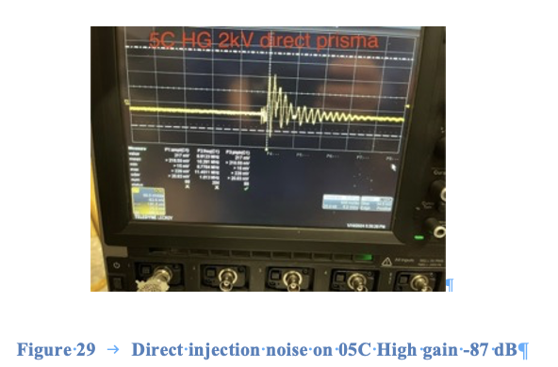
EMC @ LNL January 2024

Slide 11
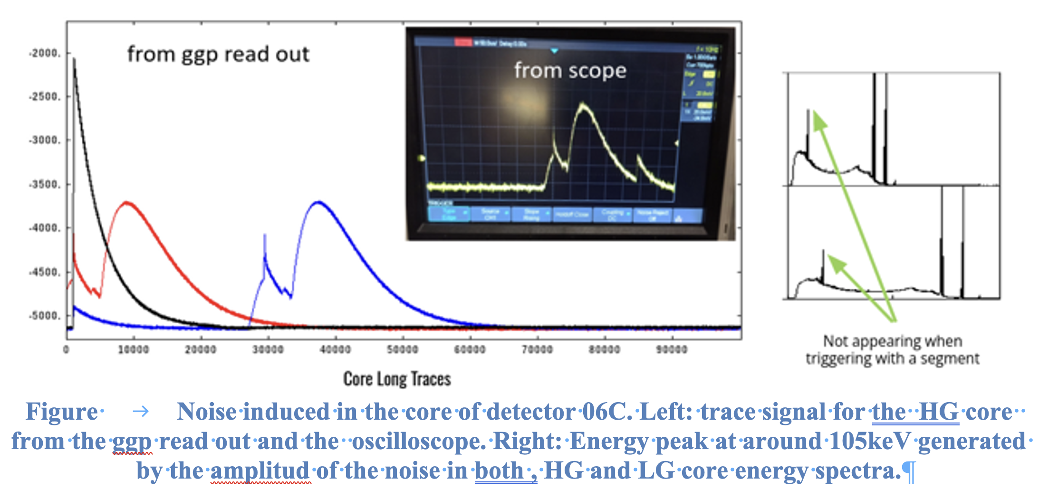
EMC @ LNL January 2024

Slide 12
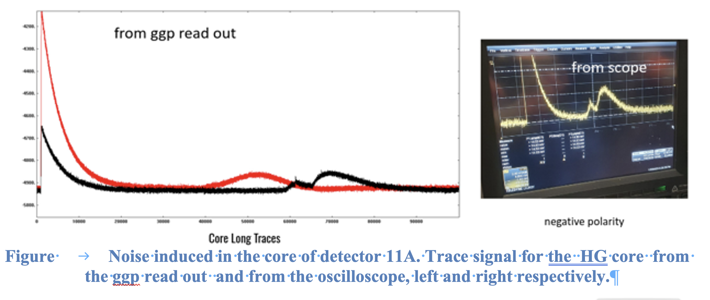
EMC @ LNL January 2024

Slide 13
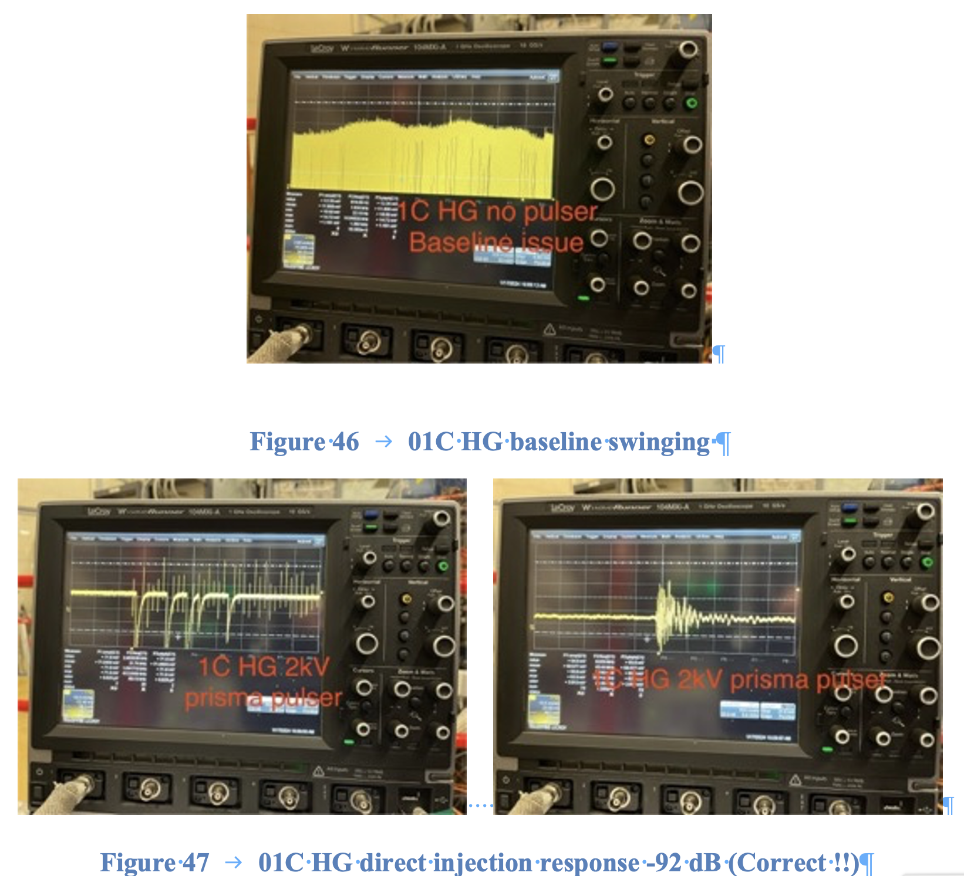
EMC @ LNL January 2024

Slide 14
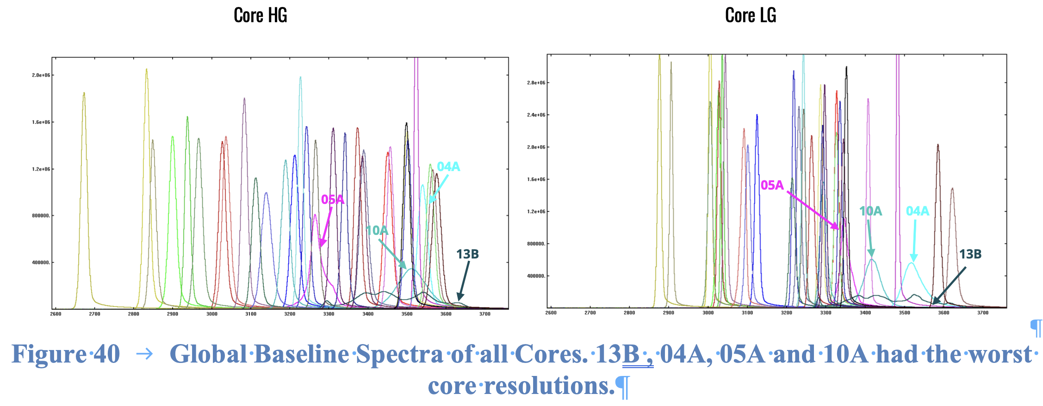
EMC @ LNL January 2024

Slide 15
EMC @ LNL January 2024
Noise origin is not known sometimes and sometimes after changing different modules or cables things might work.
Using passive lemo spy board while MDR cable is disconnected is not good. Impedance matching issues, risk of damaging opamps while disconnecting the MDR cables.
AGATA is becoming huge and not easy to manipulate and diagnose either during experiments or in between experiments

Slide 16
EMC @ LNL January 2024
Long traces and Scope signal monitoring is crucial, as well as other parameters like LVPS or HVPS or other parameters to measure.
We must have an eye on each part of AGATA without touching the instrument.
Monitoring MUST be made physically on the signals and without generating noise
We need detailed and synchronised monitoring of :
Low Voltage Power supplies for Preamps.
High Voltage Power supplies for detector biaising (Discussion started with CAEN).
ADC Long Traces and Preamplifier outputs.
Other parameters are needed (why peak shift for Co).
Many answers could be hidden within experts long time qualification and experiences

Slide 17
EMC @ LNL January 2024
Preamplifier signals must not be disconnected from the crates. ACTIVE spy modules to keep impedance matching is needed or analog inspection lines without disturbing the signal integrity since we are looking at few mV of noise.
ALL monitoring must be synchronised to check the LVPS HVPS and Preamplifiers at the same time.
Long traces are needed (8, 16 ? ..)
When more crystals are installed more random noise inspection will appear.

Slide 18
EMC @ LNL January 2024
ACTIVE SPY modules for LVPS and HVPS
LVPS module near detector should stay in place and SPY module inseted between the LVPS cable and the receiving module
HVPS SPY module must switch from one voltage to another reducing the time and not changing the cable position.
Installed cables position should be slightly change to avoid false analysis

Slide 19
Merci and Many thanks to Rosa without her these measurement wouldn’t be possible
Notes:
Après une phase de déomnstration de 2003 à 2008:
Photo of GANIL fall 2016 with 32 detectors – procurement of ~60 capsules by 2022. Already 47 in 2019 (Finalnd and Hungary have ordered – delivery 2019 of 4 capsules + UK should order 2 ATC if successful grant…)

