Slide 1

Mechanics
Zero-degree configuration
Considerations

Slide 2
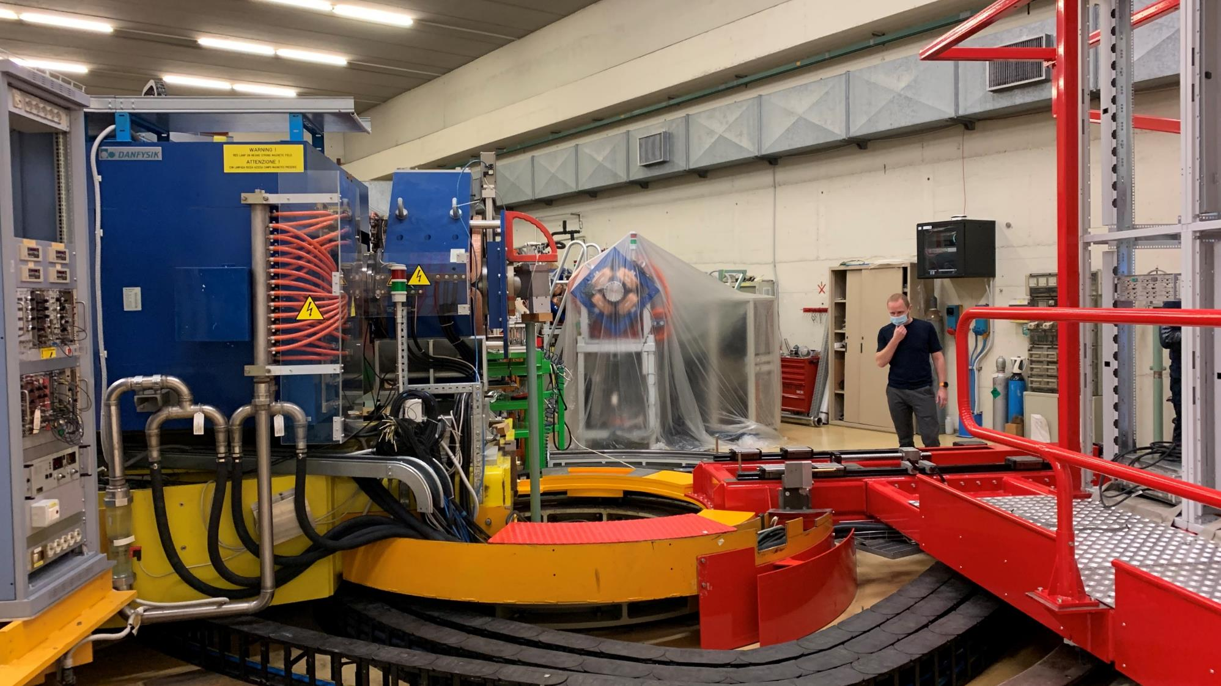
Zero-degree configuration

Slide 3
Zero-degree configuration

Slide 4
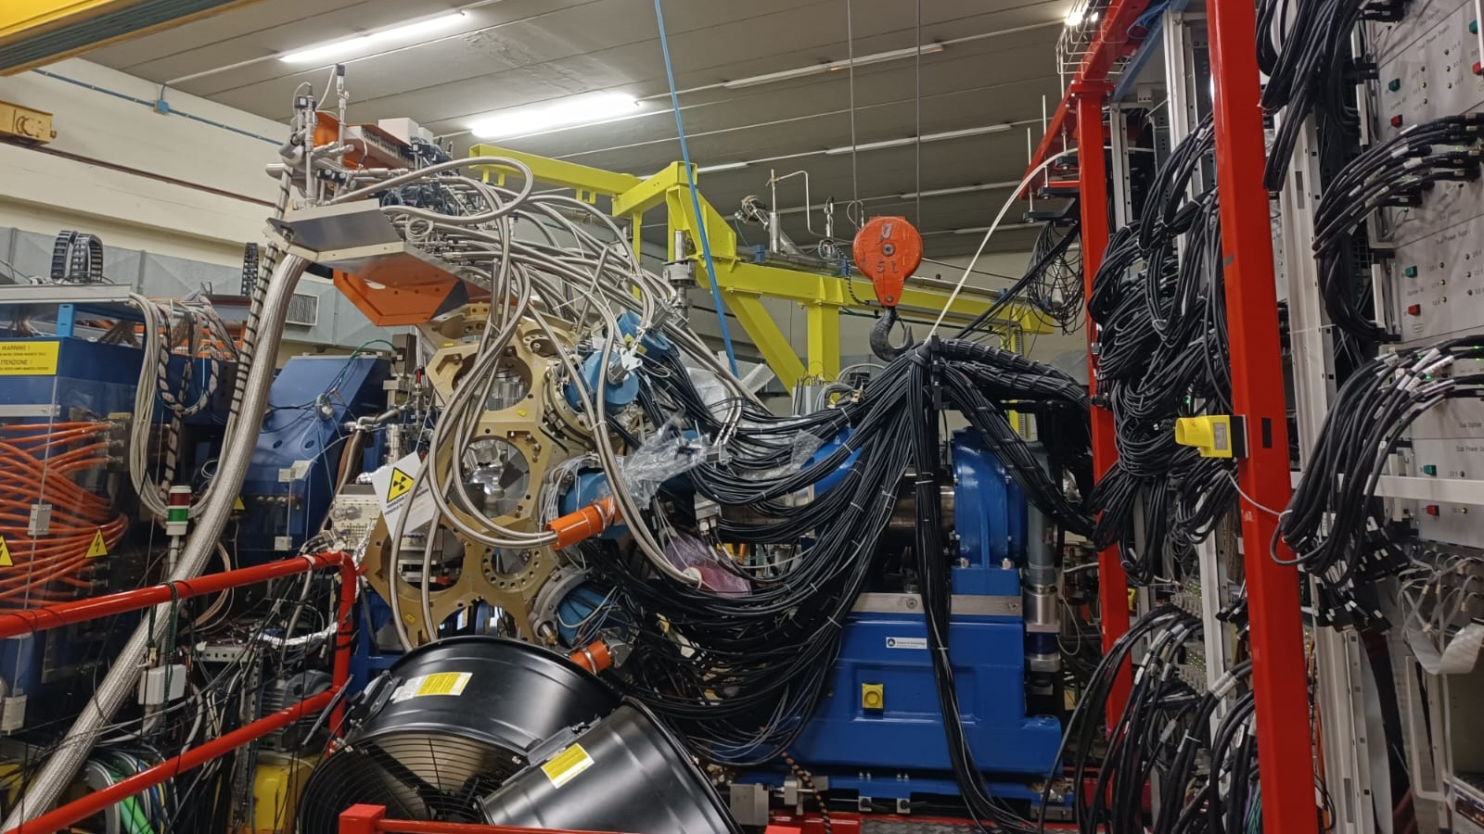
Zero-degree configuration

Slide 5

Zero-degree configuration
TASKS
TASKS
TASKS
TASKS

Slide 6
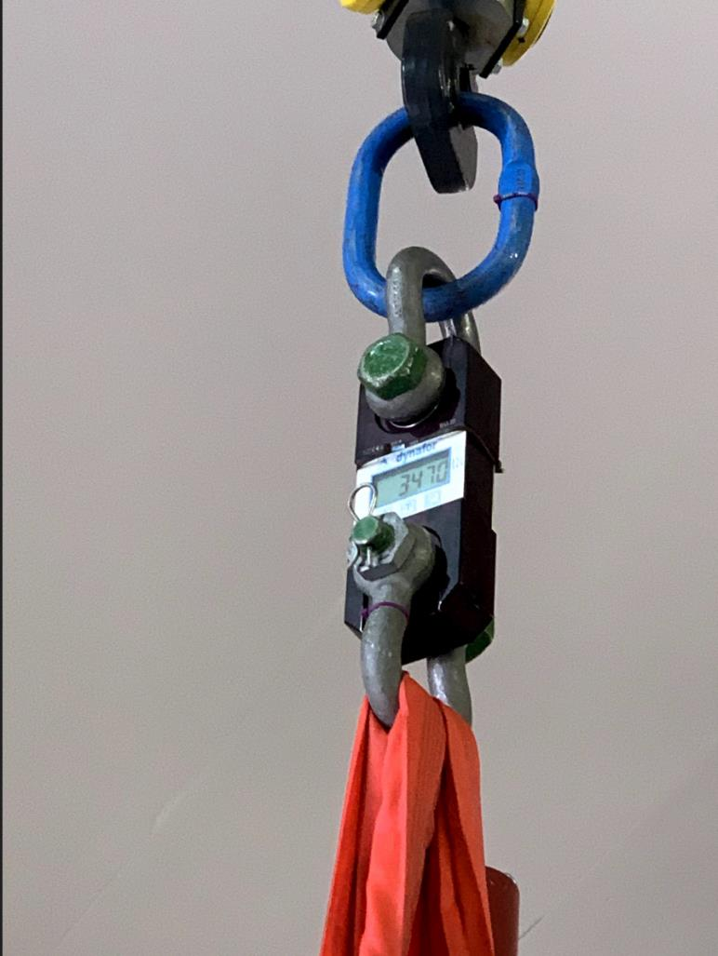
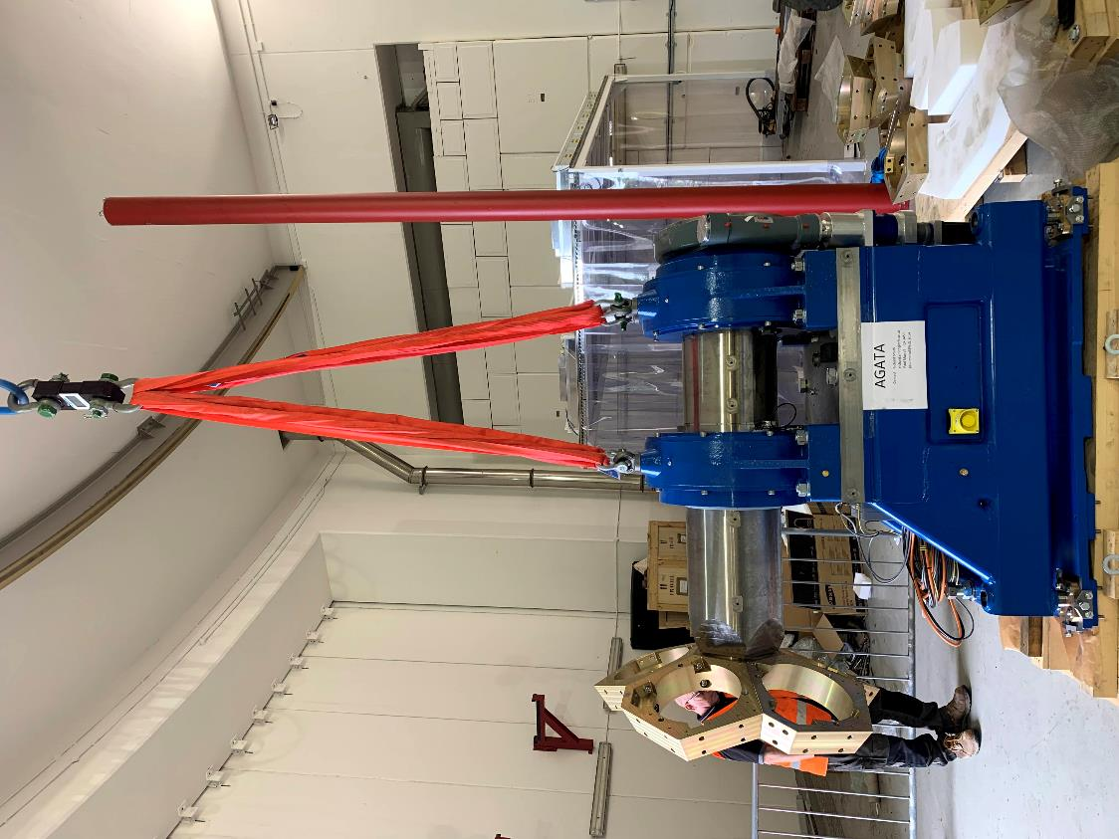

Lifting the support
3470kg

Slide 7
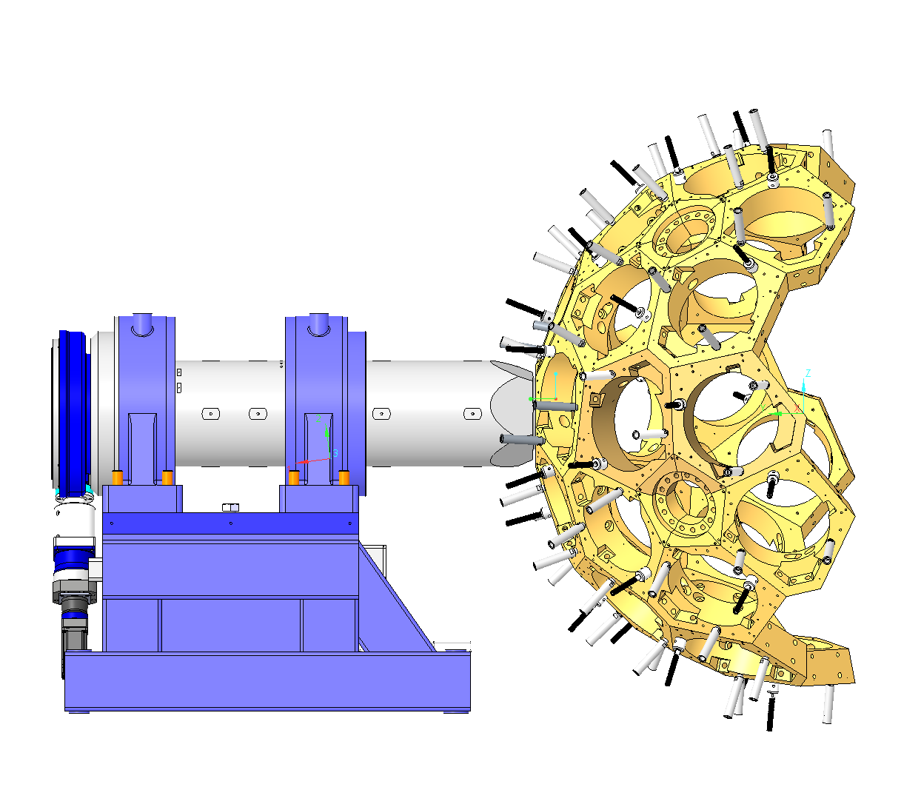
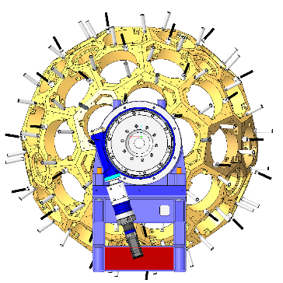
2750
950
1850
1350
950
Mass ~4000kg
Lift with the array to prevent realignment

Slide 8
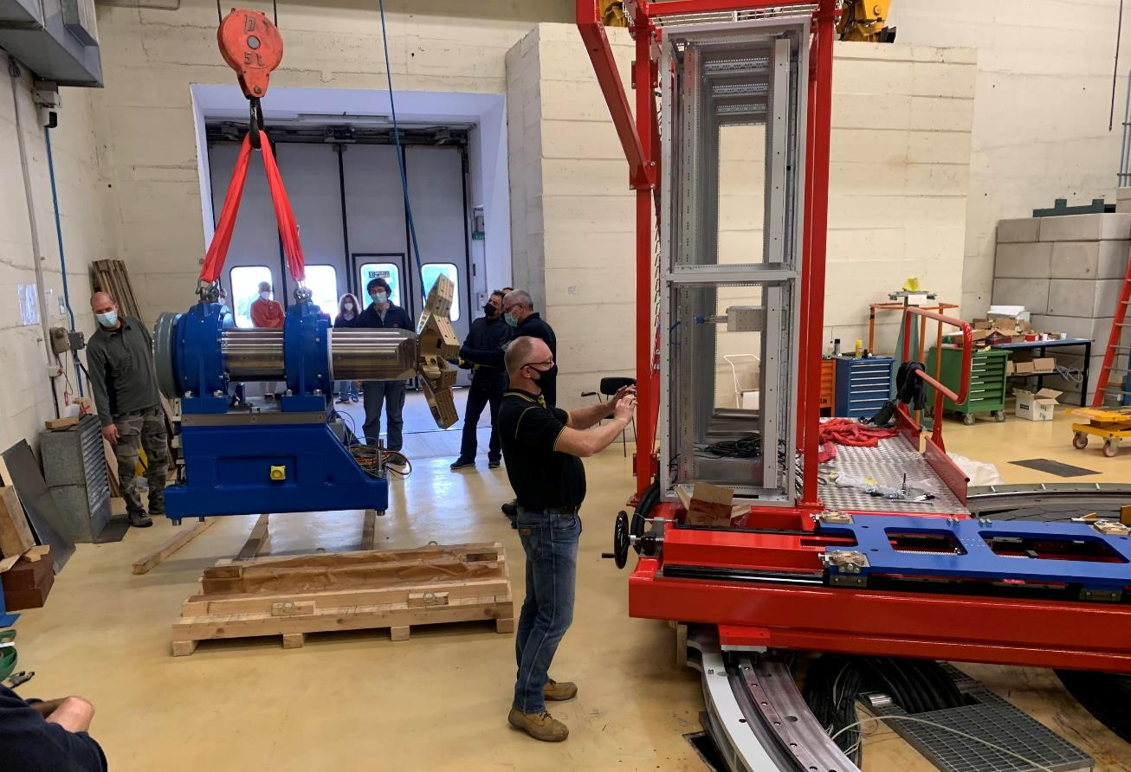
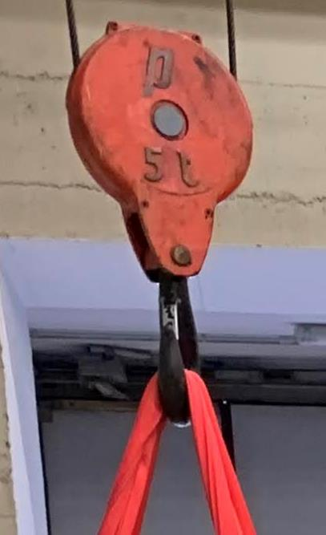
Lifting the support
Crane (Sala) max 5000kg

Slide 9

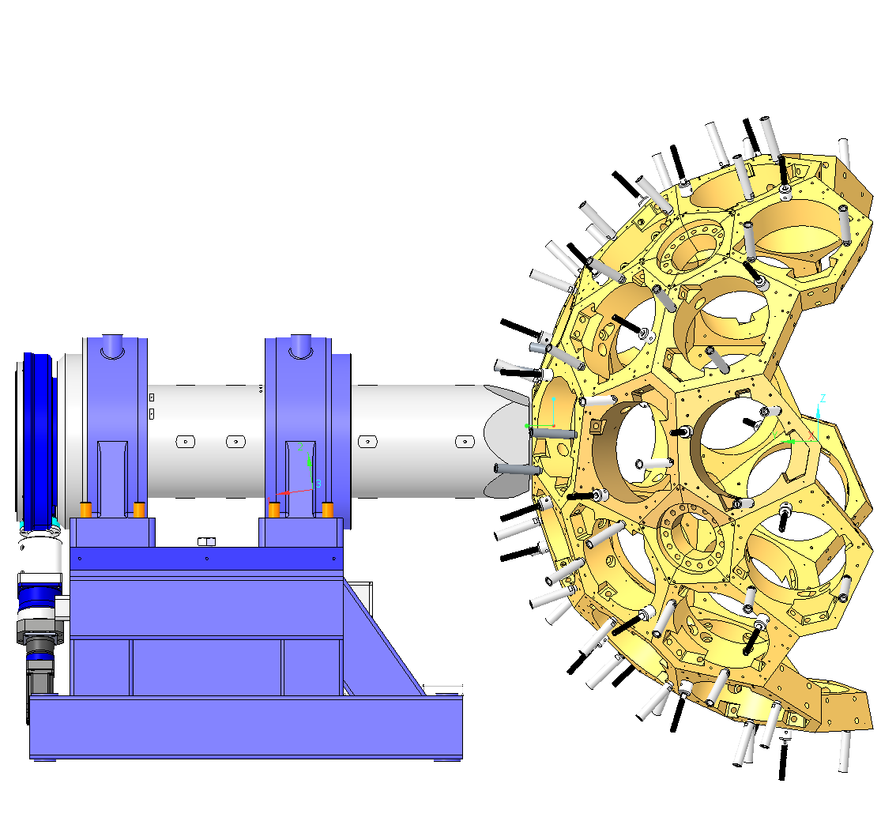

1600
1600 min
4300
2000
xxx
700

Slide 10
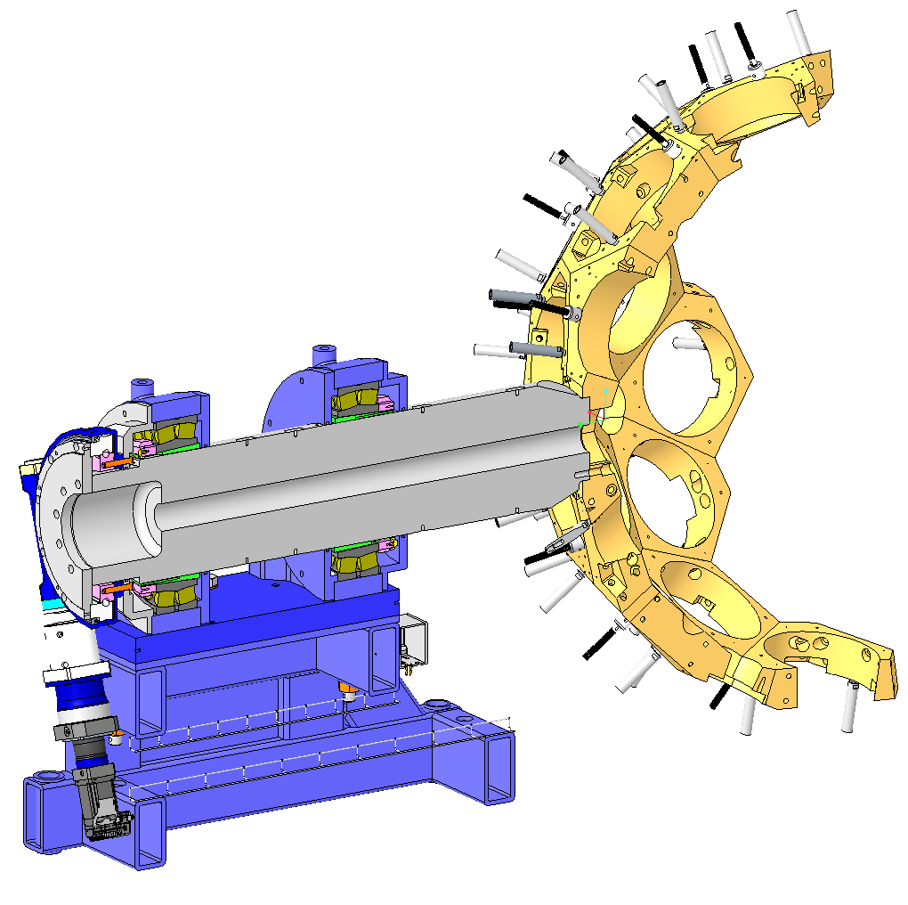
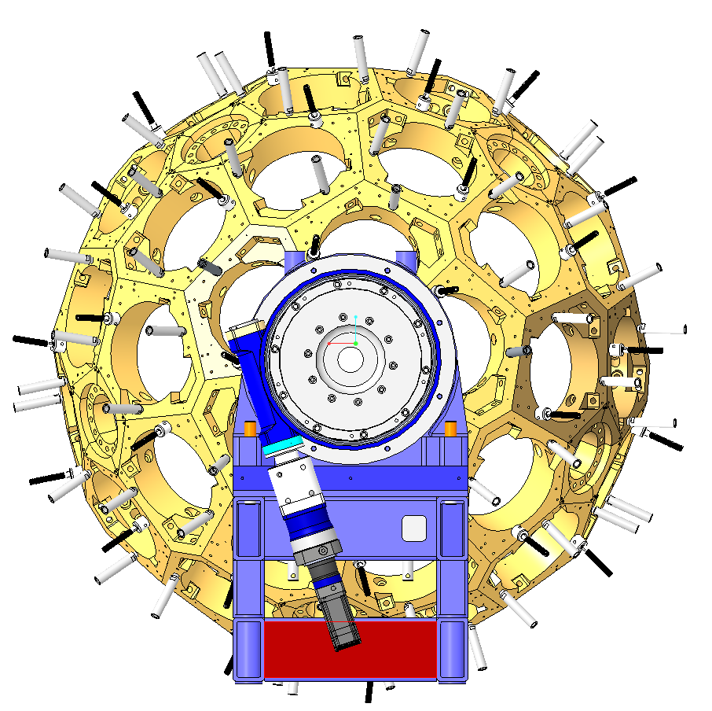
Zero-degree configuration
80mm diameter hole in shaft

Slide 11
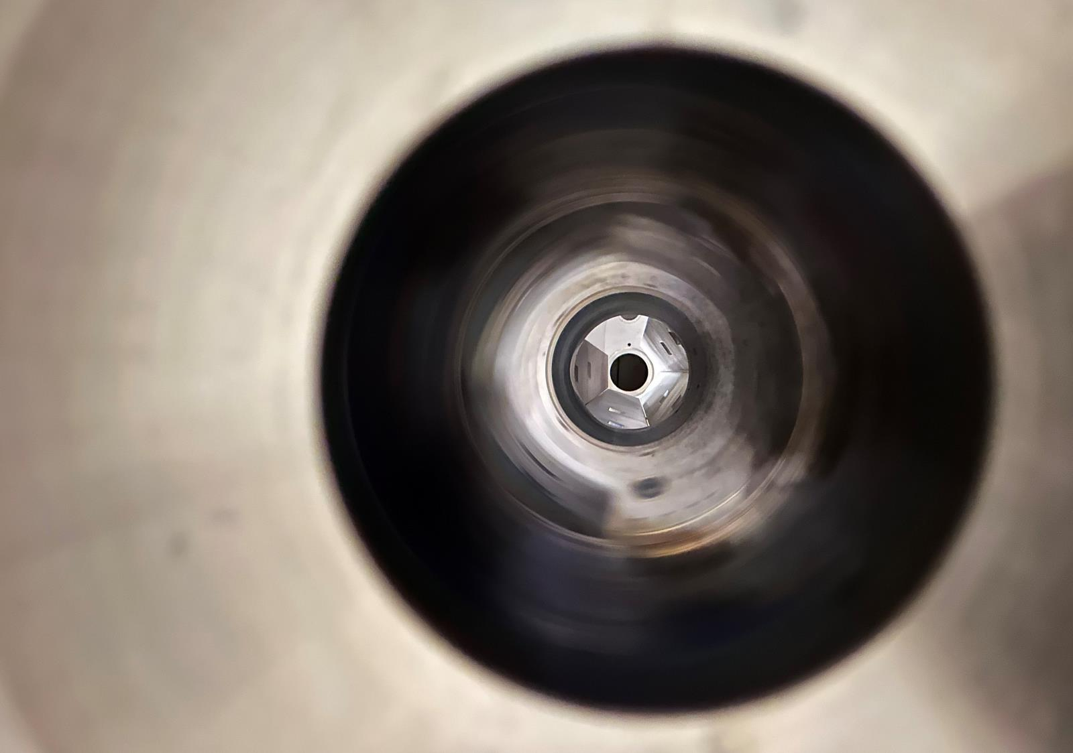
Zero-degree configuration
Hole in shaft

Slide 12

Zero-degree configuration
Remove all detectors
Strip back AGATA and all its services (cooling, comms etc.)
Figure out the best place to lift the structure
Store on original pallet?
Re-install at zero degrees
Survey the shaft in-line with the beam

