Slide 1
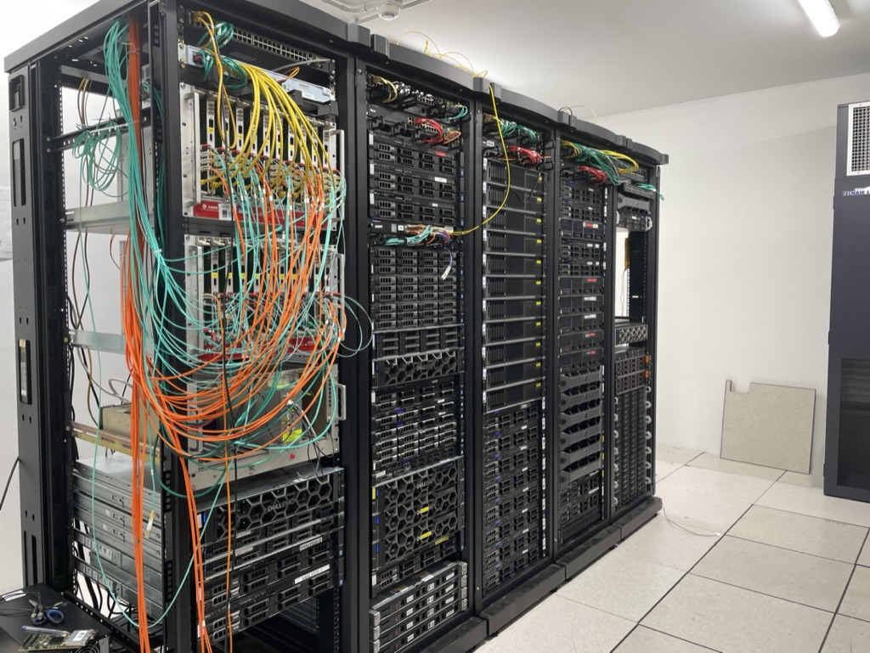

DAQ infrastructure @ LNL
Alain goasduff – INFN LNL

Slide 2
Dedicated network hidden behind a ovpn
Easier access to for the external users and experts (through registration to INFN AAI and security courses …)
Personal certificate (annual validity delivered on-demand)
Configurable gateway in terms of services (ntp, dns, dhcp, …)
Ancillary network included in the AGATA network (172.16.40.0/24)
4 high speed links for data upload to the grid
Easily extendable to the different parts of the lab through the laboratory switch VLAN configuration (e.g. AGATA network in hall 2, or near-line box)

Slide 3
The network extensions in 1 slide
Dedicated OM4 fibers
Lab infrastructure
Dedicated OS
Dedicated OM4 MTP-MTP
VAX Room
12 links
AGATA Control Room
AGATA Near-line box
Should we move the OS from hall 1 to 2 to check the two parallels output of the V2?
1 OF
24 links
HALL 1 / AGATA
EPICS LN2
12 links
HALL 1 / PRISMA
CAEN
Dig2
1 OF
HALL 2
Test bench detector + V2
4 OF
Laboratory
(Electronic + Anc. Det.)
4 OF

Slide 4
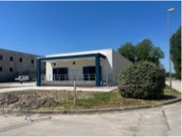
NEW DATA CENTER
DELIVERY SPRING 2025

Slide 5
VAX STATUS
Installation of first V2 channels in VAX is still possible

Slide 6
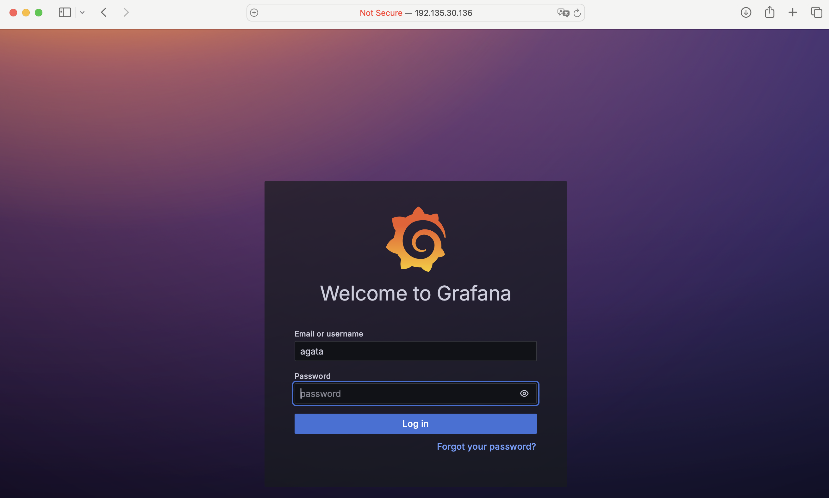
Monitoring of DAQ / ELECTRONICS and ELOG
Monitoring visualisation:
http://192.135.30.136:12888
Username: agata
Password: agata123
BIG CHANGE:
E-log has been moved to
http not https anymore
http://gal-serv.lnl.infn.it:20443

Slide 7
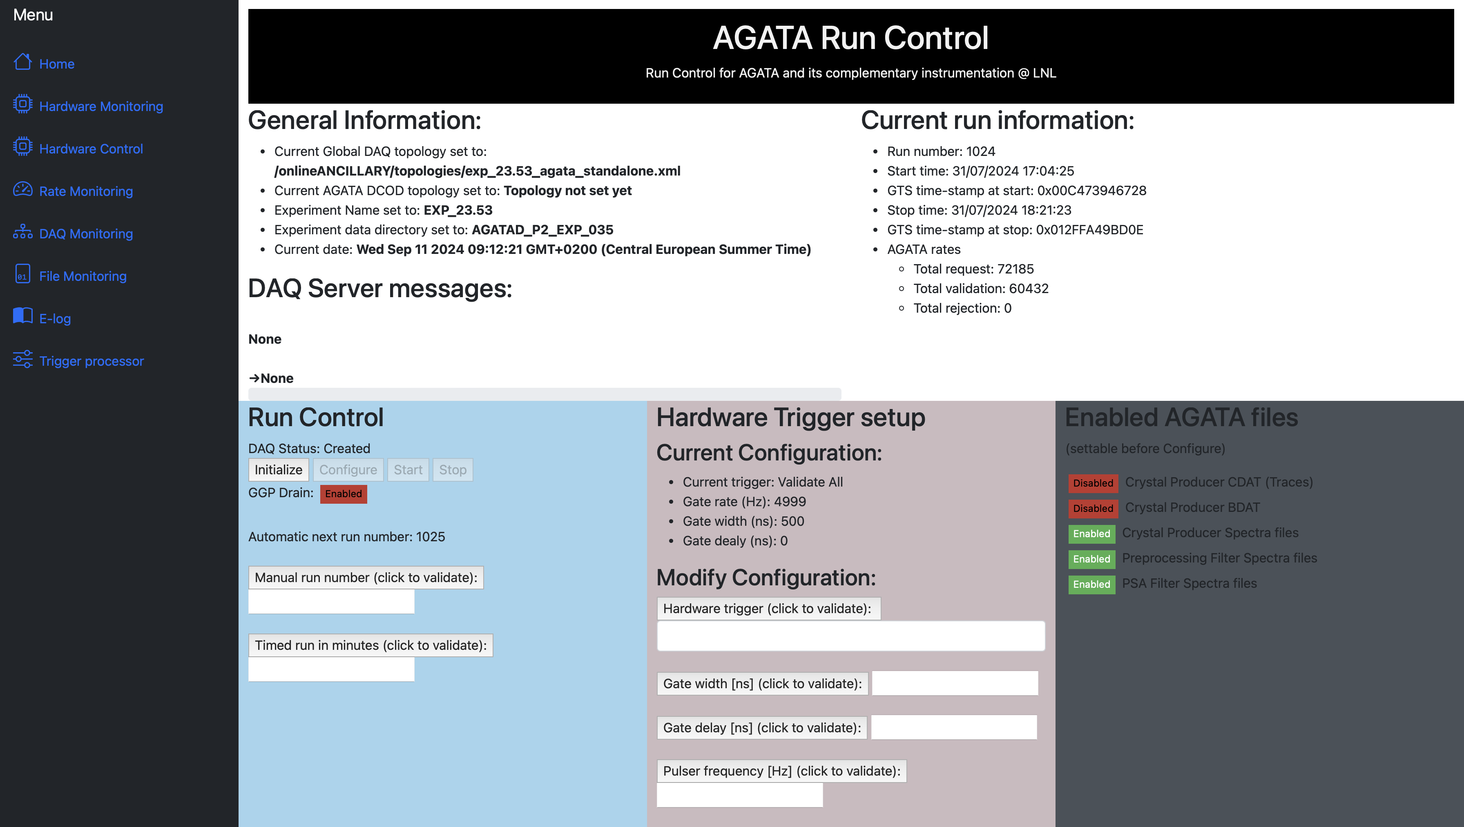
Run control upgrade
Slow control of the Hardware Trigger
Timed run
Automatic post to the elog at stop
Only present at HIL at the moment:
Export of the monitoring data base to CSV over the duration of the run
WHAT DO YOU WANT TO DO FOR AGATA?

Slide 8
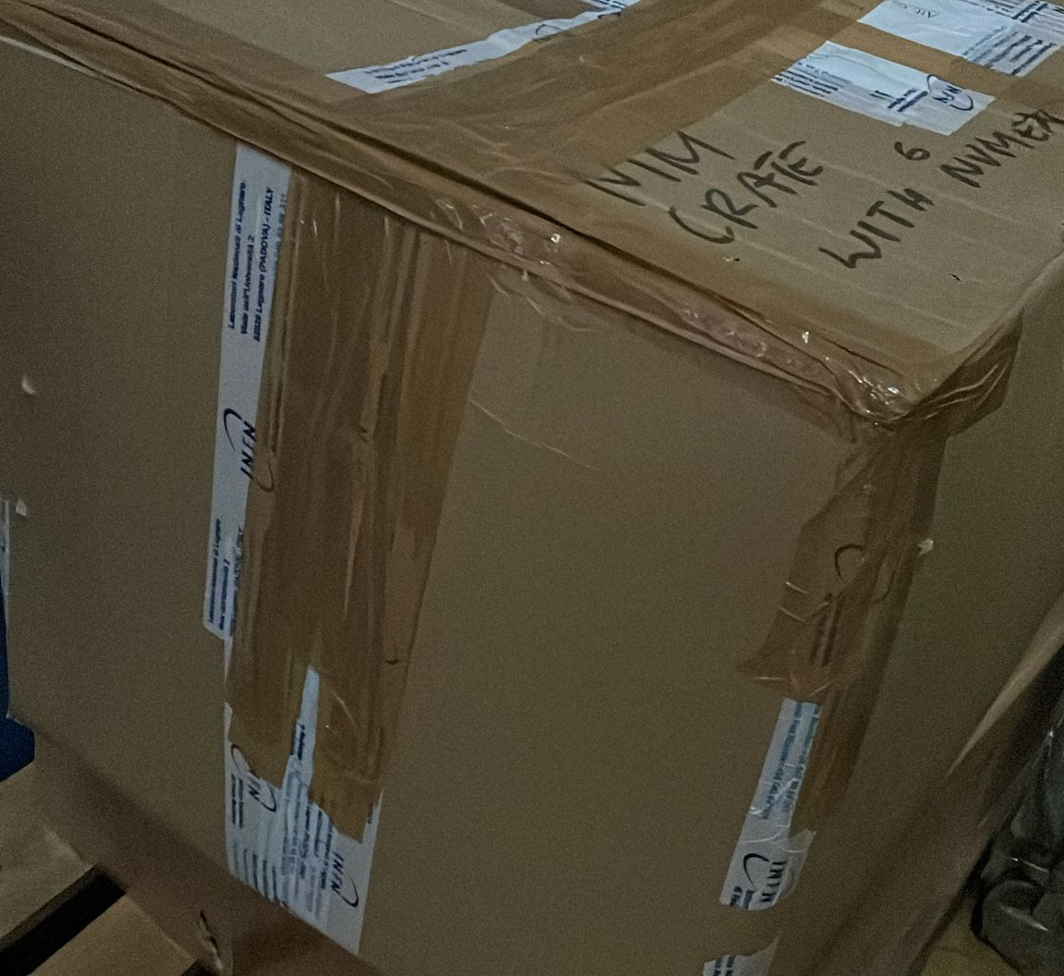
Zero degree configuration
All MPO fibers for the NUMEXO2 of NEDA are already installed
Upgrade of NEDA DAQ to XDAQ on-going at LNL
Tests foreseen for beginning of 2025
PARIS is already fully integrated in XDAQ
Extension of the GTS network and clock to hall 1 is done

Slide 9


