Slide 1
Status of the Triggers and Trigger Processor tests Status of the Phase 1 electronic at LNL
Alain goasduff – INFN LNL

Slide 2
STATUS of the Phase 1 electronic at LNL UP TO 39 channels

Slide 3
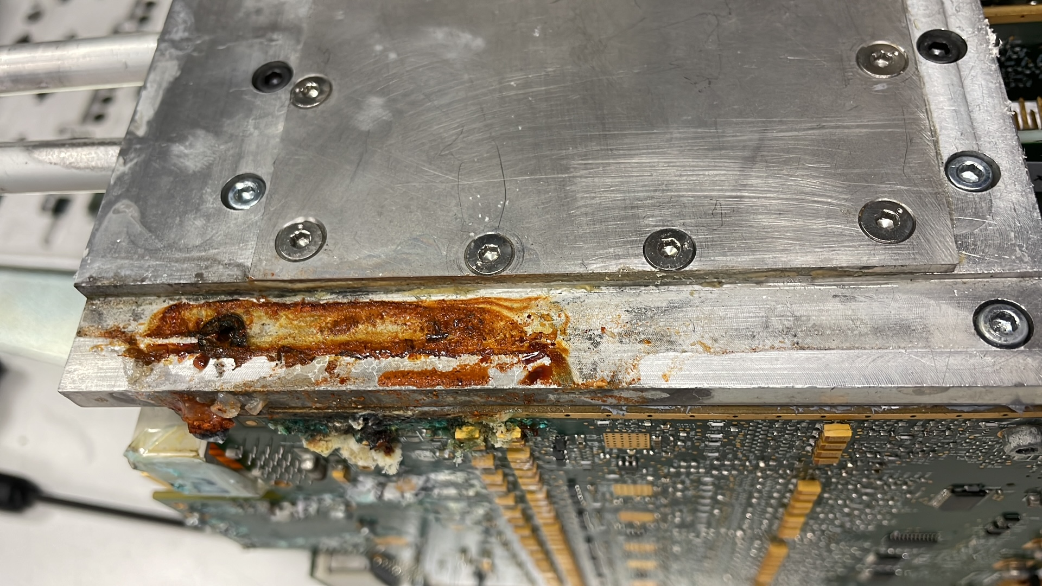
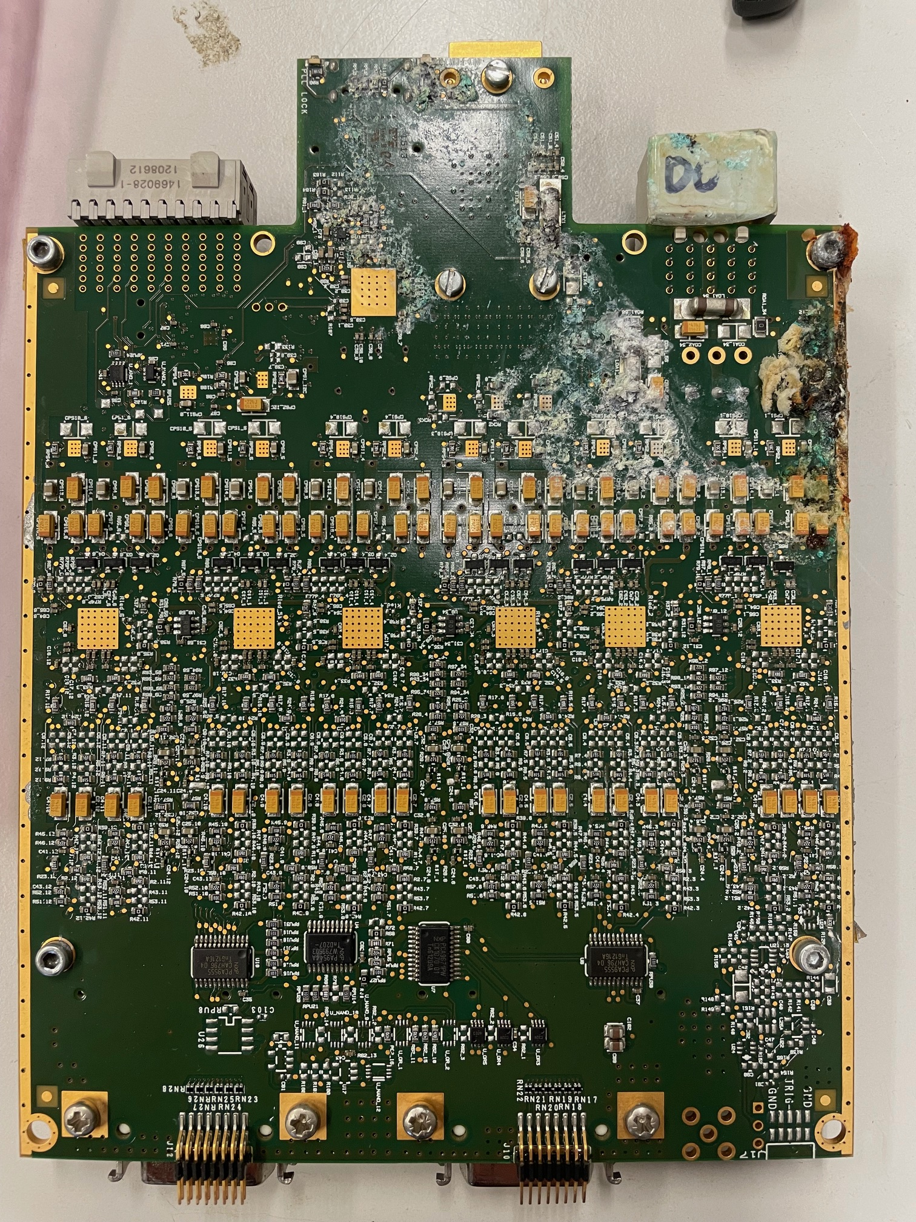
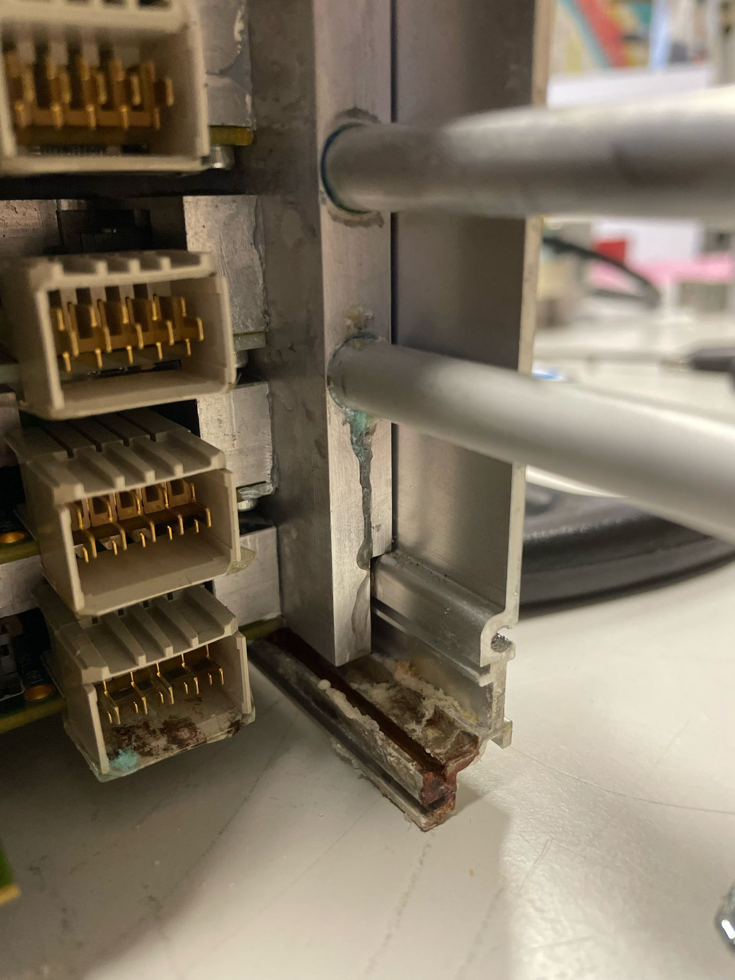
Cooling issue
Leaks found in several V1 digitizers:
Water used to cool down the digitizers common to all the lab
Water analyzed at Uni. Valencia … see previous talk
Issue has been resolved by:
Replacing all the cooling blocks
Circuit have been reorganized to avoid bending the pipes
Order placed to isolate the digitizer from the LNL common cooling water system (installation foreseen for fall 2024)

Slide 4
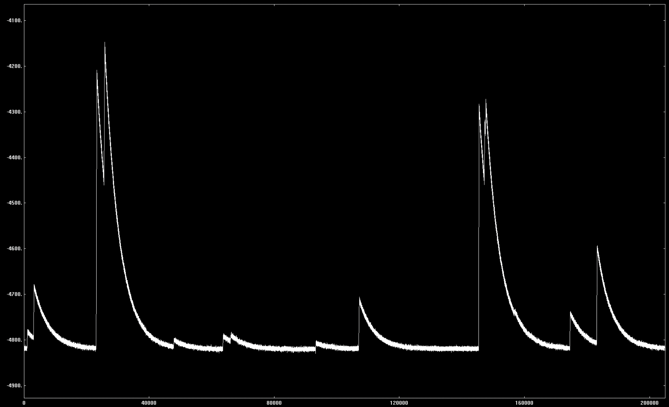
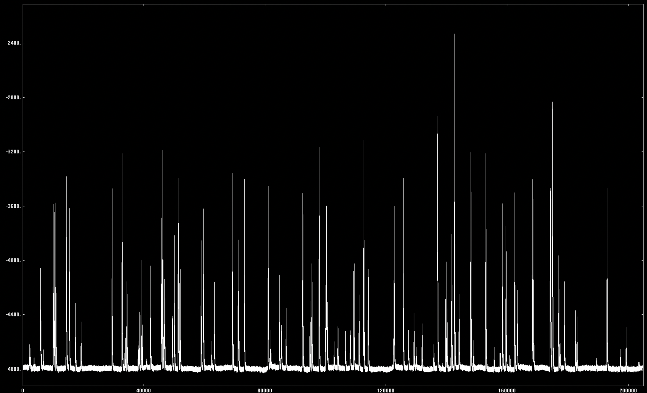
Recent upGRADES ON THE SYSTEM
All LVPS have been moved to the new systems delivered by Saclay.
Improvement of the diagnostic on the array:
Automatic monitoring and data logging of the boards, rates …. performed at the ggp_server level
Implementation of the slow control of the new ADCs board (S. Capra)
Implementation of the decimation for the long traces capture: (D. Bazzacco)
Allow to perform FT and check for low frequency noises (< 100 Hz to a few Hz)
Integration of the External trigger gate based on the development made for GALILEO sumbus board:
See slide 10 …

Slide 5
Status of the Triggers and Trigger Processor tests

Slide 6
GTS ROOT ISSUE?
Loss of events between the ROOT node and the Trigger Processor (idenpendantly of the TP) ???
This was NOT an issue of the GTS ROOT NODE …
GGPs have a local fifo able to store up to 8 events waiting for the GTS validation/rejection
After a SETTABLE thresholds the backpressure flag (BF) is sent to GTS ROOT
Once the BF is high → All the events coming to the ROOT are discarded, explaining the loss observed between the GGP GUI and TP monitor.
The threshold was set in the SLC to 4 events since the GANIL campaign.
We have modified the SLC to move the threshold to 7/8 events and recovered all the events at the TP

Slide 7
Limitations of the DEMONSTRATOR TP
Since the TP is performing time sorting and event reconstruction on the CPU -> limitation on the input rate
We have checked that the:
GGP trigger request rate
TP input rate
Sorted trigger rate
Are consistent
The loss is happening between the sorted trigger and the sumbus trigger when the CPU is entering into play.
After this loss the rates are again consistent, i.e. the GGPs are seeing all the validations.
TP Dead Time
Average crystal rate [kHz]

Slide 8
LIMITATIONS OF THE EXOGAM2 TP
During the in-beam experiments we observed (AGATA-PRISMA-LaBr₃ experiment):
Large fraction of AGATA events without PRISMA:
Issue in the PRISMA readout?
Issue in the event builder?
Issue on the GGP?
“Strange” ratio of efficiency between AGATA and the LaBr₃ in coincidence with PRISMA
Source measurement (⁶⁰Co): ε_{AGATA} = 6 x ε_{LaBr}
In-beam measurement: ε_{AGATA} = 0.1 x ε_{LaBr}
CLEAR FAILURE OF THE ACCEPTANCE / COMISSIONING TESTS OF THE NEW TP The issue on the fold was identified during the initial tests but the coincidence between partitions was not fully tested

Slide 9
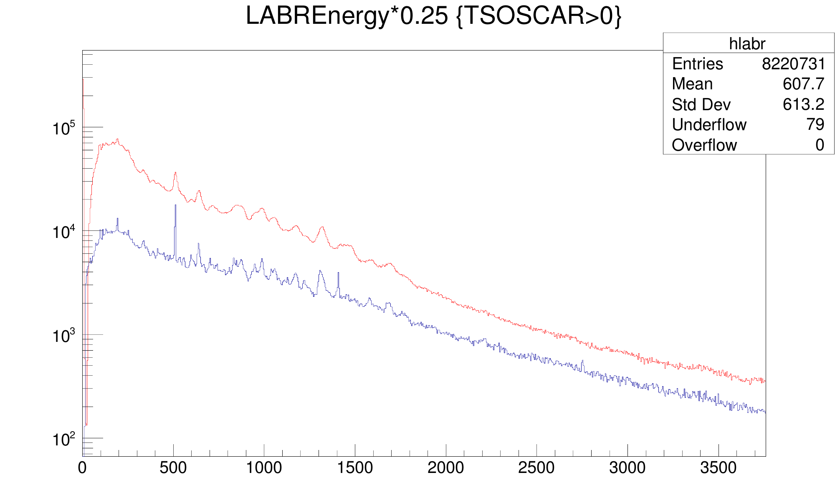
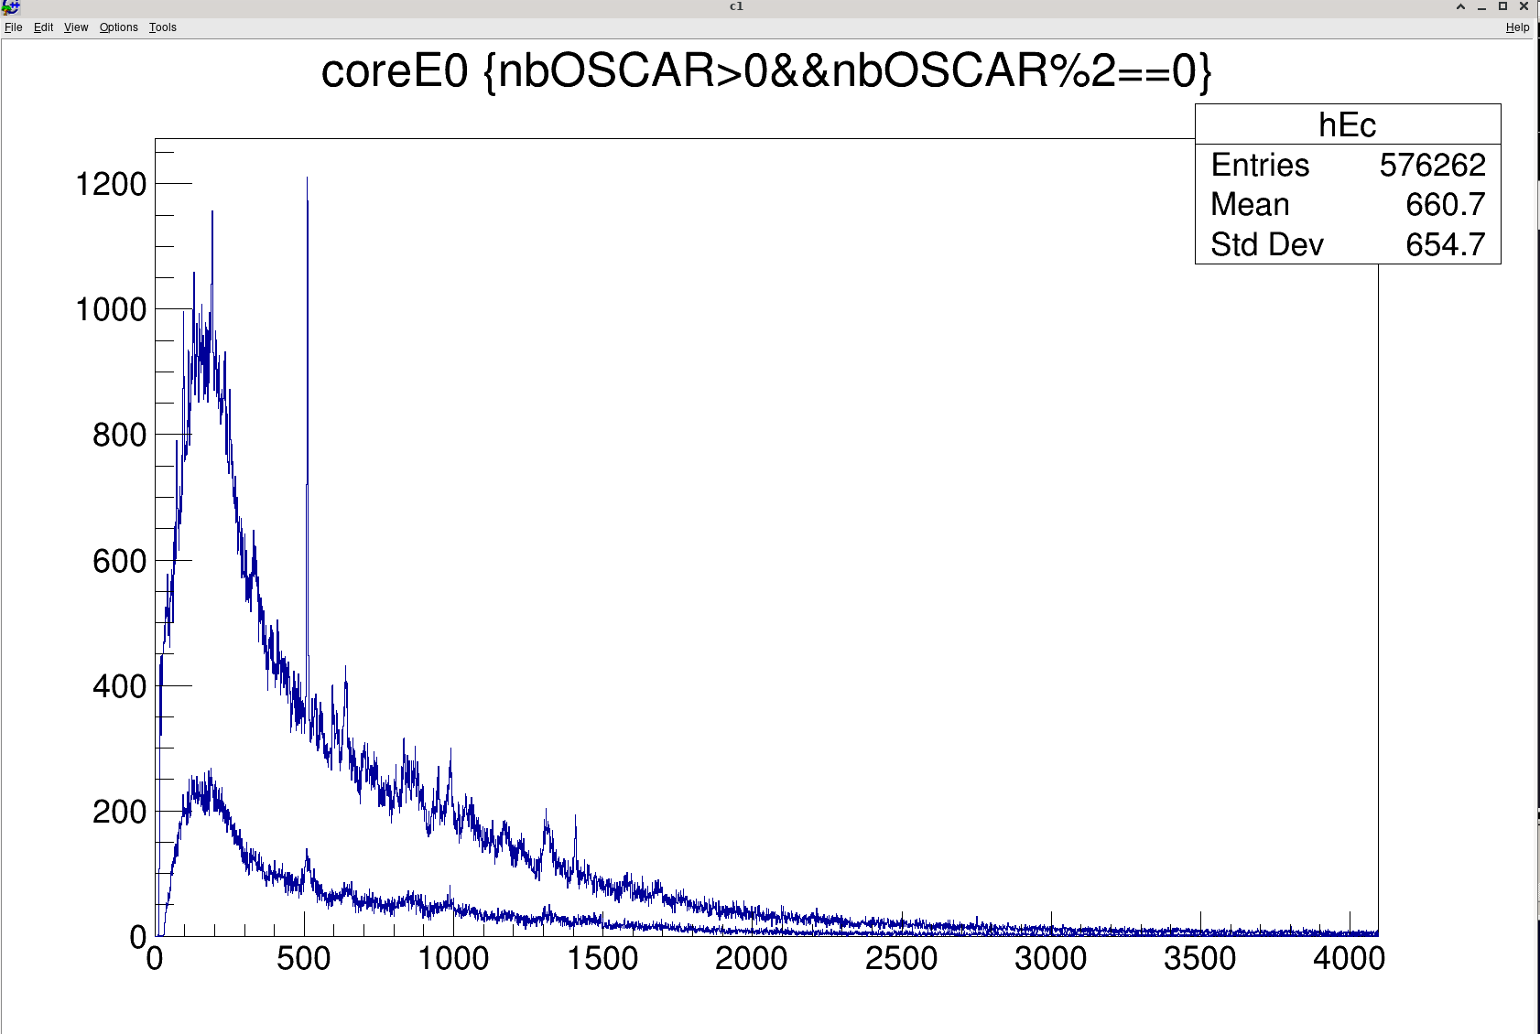
EXOGAM2 TP VS DEMONSTRATOR TP
Different issues were found working with Abderrahman and:
Initialization scripts of the TP were not fully stable (reset procedure)
Firmware issue was detected on the operation of the input FIFO:
Input FIFO was fully validated/rejected based on single events
NEW FIRMWARE VERSION DELIVERED AND (STILL) TO BE TESTED AT LNL

Slide 10
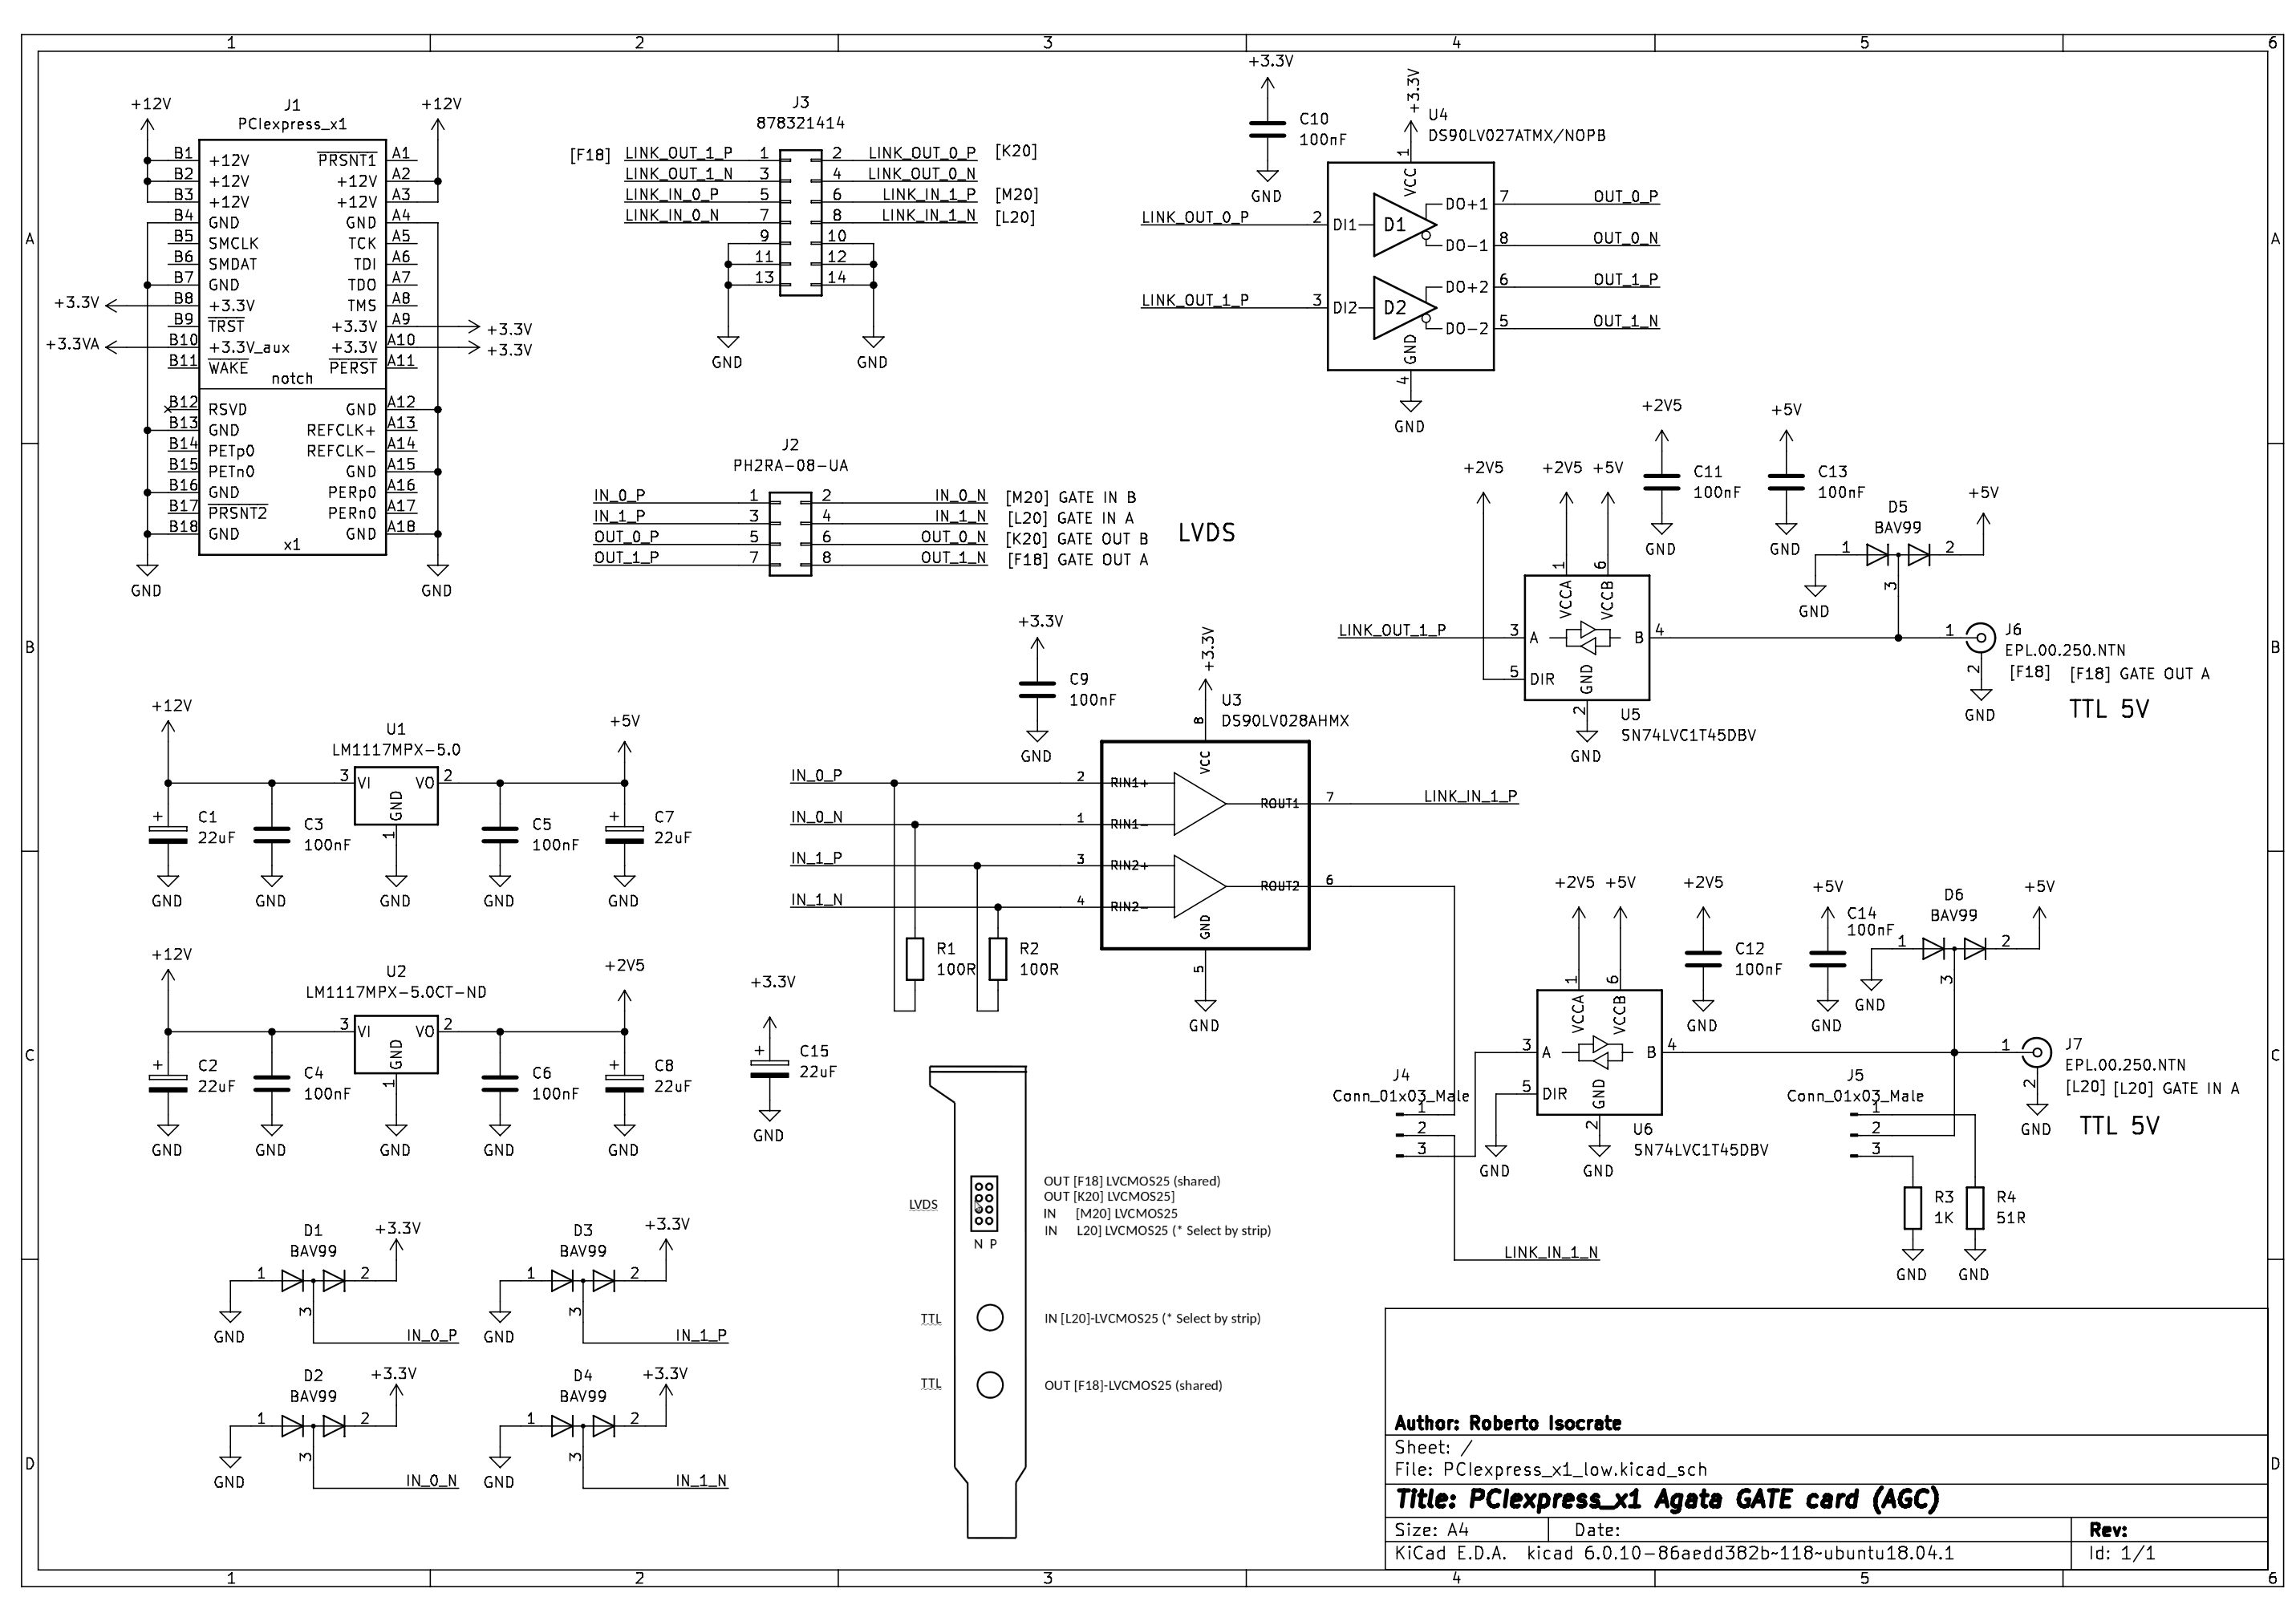
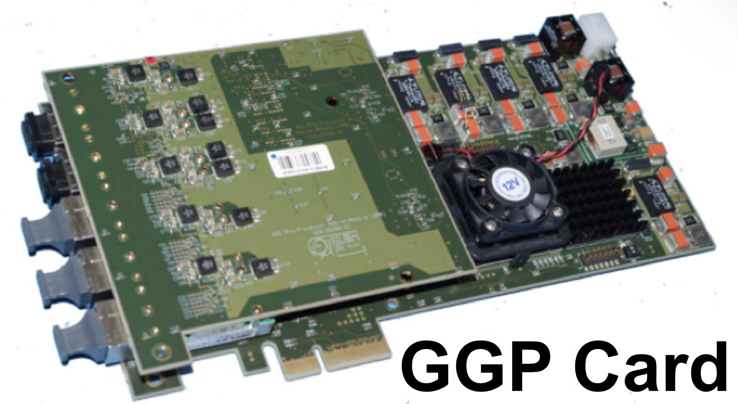
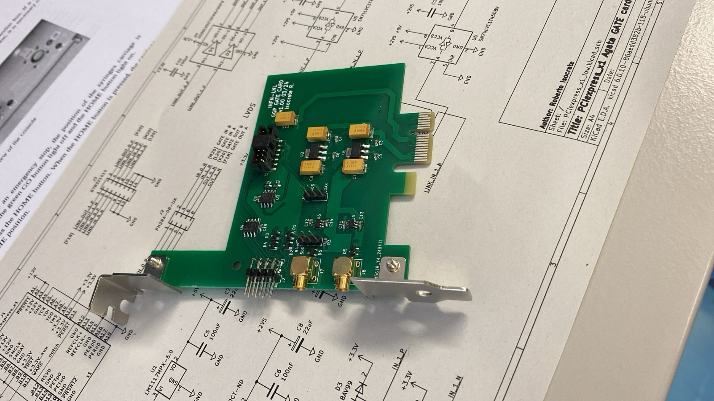
Hardware Trigger
New GGP add-on board:
2 LVDS inputs
2 LVDS outputs
Present version of the GGP FW:
Prompt external validation → Cutting down the trigger request
Delayed external validation → Cutting the down the events in the FIFO
Difficult to set and adjust but still feasible
Using a V2495 as FIFO to distribute the external signal to all the GGPs:
Adjustable delay and width of the signal
Validate/Reject all using slow control (To be used for beam on/beam off)
Internal pulser to validate the system

Slide 11
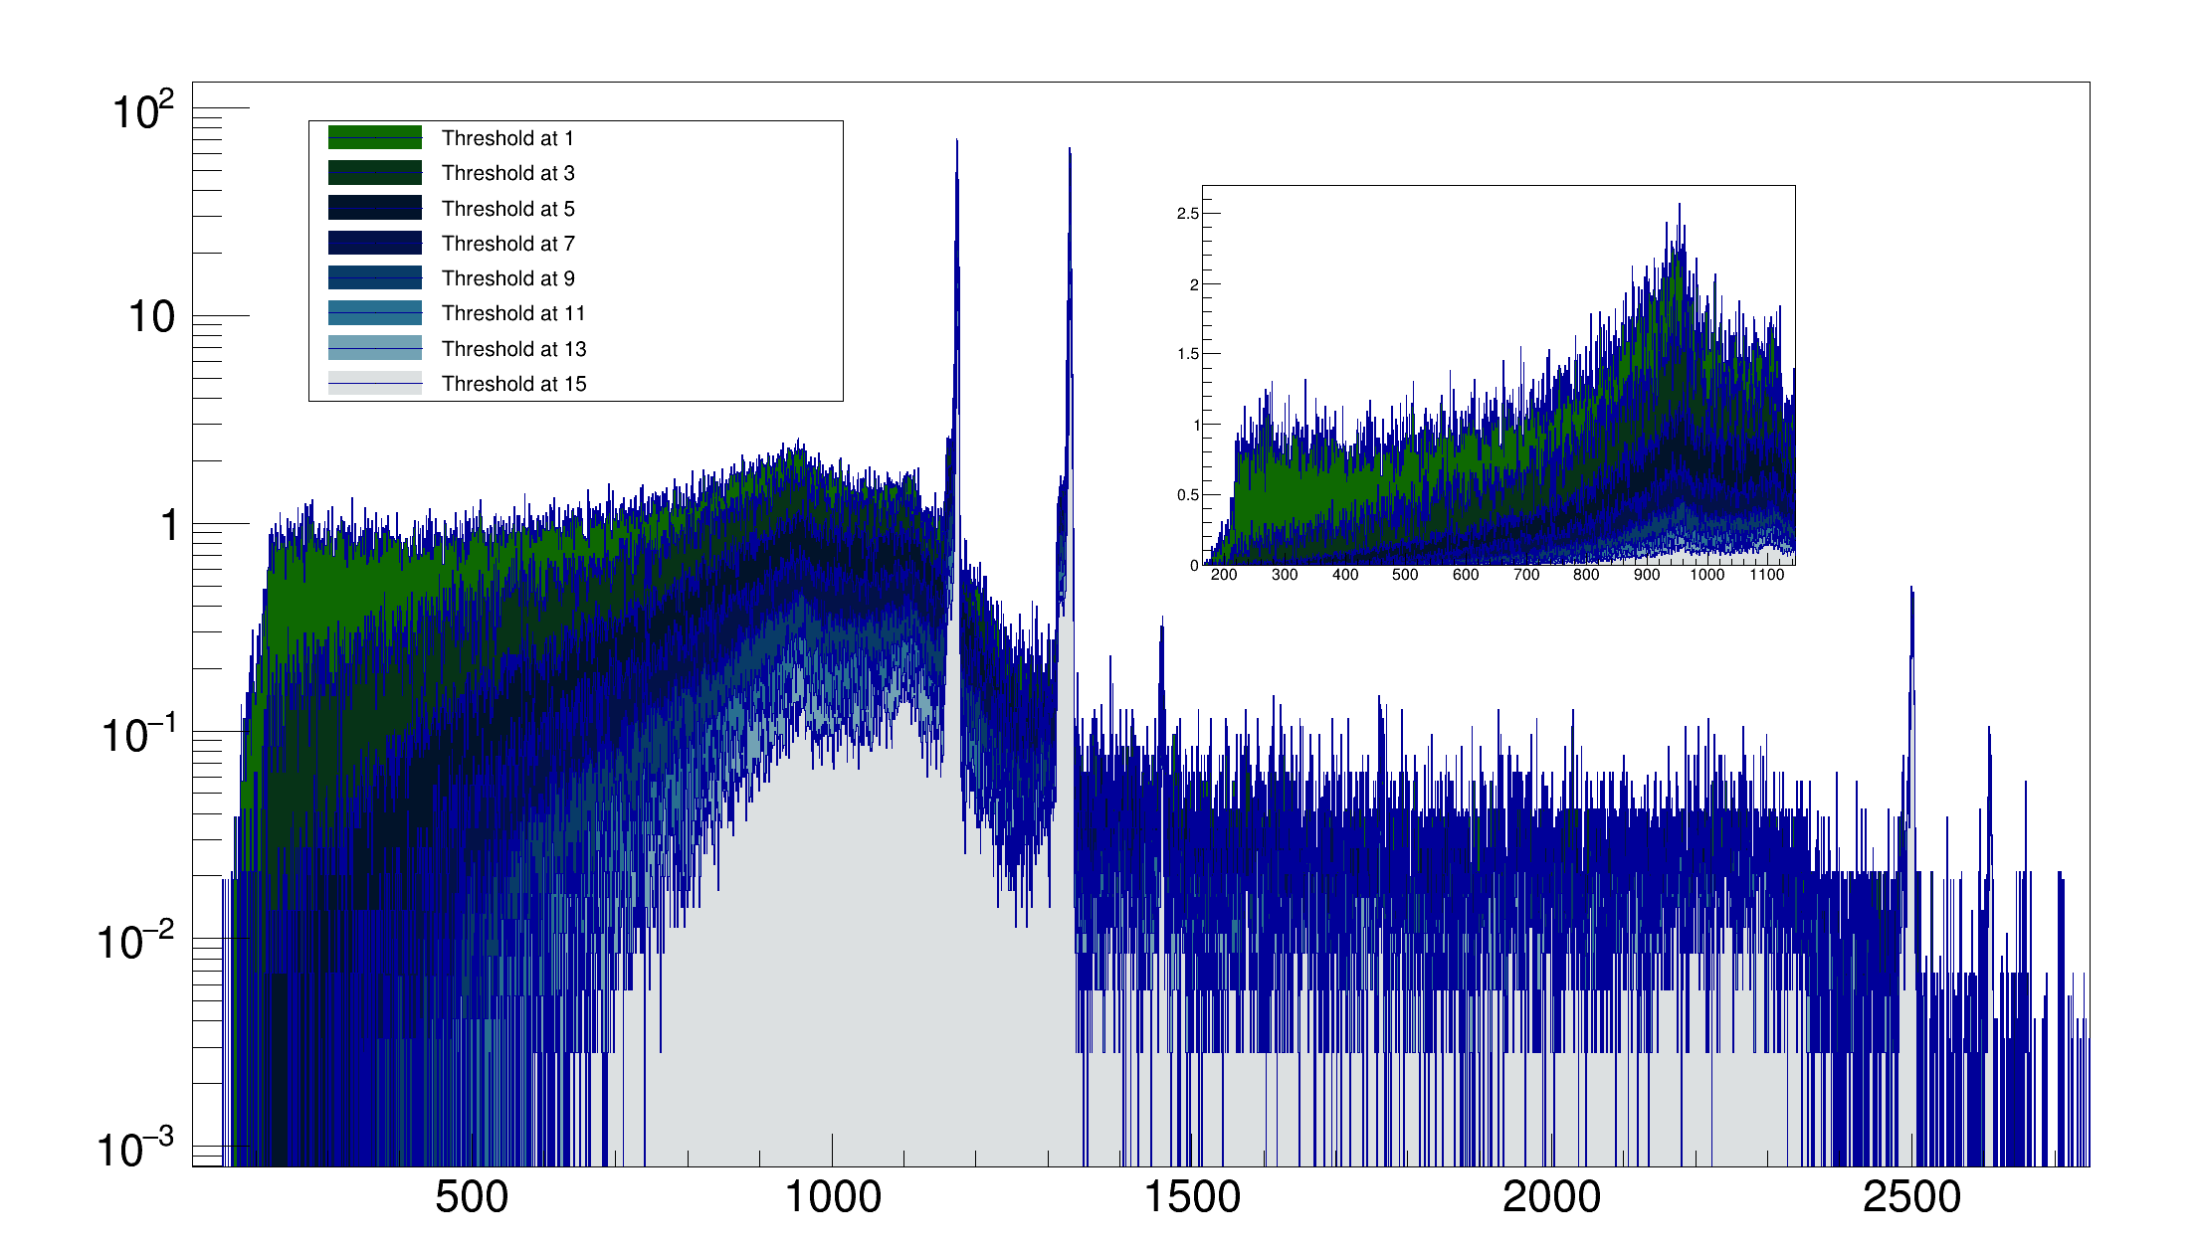
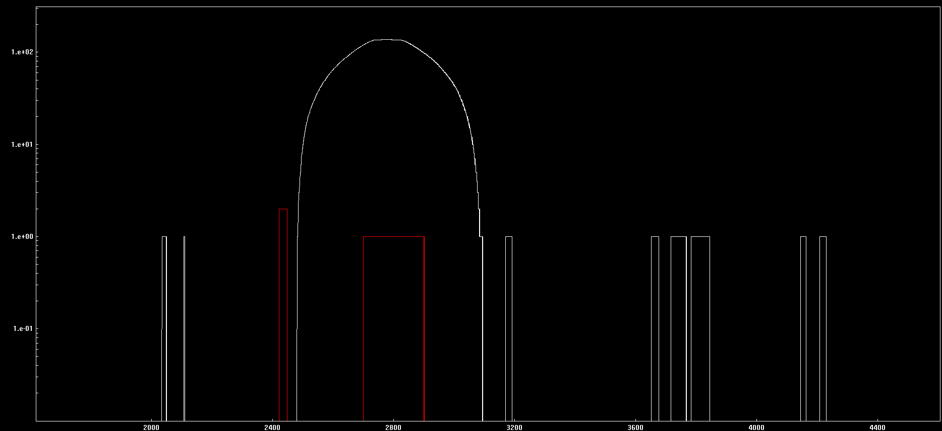
Hardware trigger
Using the core LVDS trigger output to the GGP

Slide 12
Combination of Hardware and TP
Typical experiment with 50 kHz / crystal
With 2π-array the TP would have to deal with 4.5 MHz ???
Hardware gate could be used to reduce the TR arriving to the TP
For VAMOS/PRISMA you will have that over the 50 kHz of TR only ~1-2% will be in coincidence with the spectrometer
Coincidence with the ancillary on the hardware condition
TP could be used for the FOLD selection online

Slide 13
Conclusions
Up to 39 channels of V1 available, 36 mounted on the array.
GGPs SLC and FW still being updated / upgraded to cope with the new ADCs board, trigger system
Investigation on the trigger boards:
Back-pressure issue on the GGP on the SLC … since???
Dead-time origin on the demonstrator TP → No possible solution
FW issue on the EXOGAM2 TP → New FW delivered to be tested
Hardware solution available for the V1, will we need it for the V2?

