Slide 1
AGATA Project
STARE (Serial Transfer And Readout over Ethernet)
N. Karkour X. Lafay et al.

Slide 2
Plan
STARE Production Status
STARE Firmware Status
Production Test Bench :
12 Links Bay for Future Development
QuadLink

Slide 3
Hardware General Layout
IJCLab Orsay
INFN & U. Milano
STARE
CAP
Hardware/Firmware: IFIC Valencia

Slide 4
STARE characteristics
Input data rate from pre-processing : 4 x 10 Gbps (2 for data, 1 for monitoring & 1 spare).
Spare LVDS I/O with the pre-processing for future use
Network Bandwidth up to 4 x 10 Gbps in parallel.
1 Gbps IPBus for slow control.
With this configuration it is absolutely easy to achieve continuous and comfortable 10 Gbps with monitoring and online analysis using multiple 10 Gbps Tx/Rx.

Slide 5
STARE characteristics
System On Module
STARE Data Readout FPGA
KINTEX7
XILINX
4x10Gb/s Tx/Rx
10 Gb Transceiver
CAP - FMC Interface
Power Manager
Readout data
4 x 10 Gbps Tx/Rx
Monitoring data
LVDS lines & IPbus
Futur use data flow
IPBUS Slow Control
SOM
UDP External Memory
RUDP External Memory (option)

Slide 6
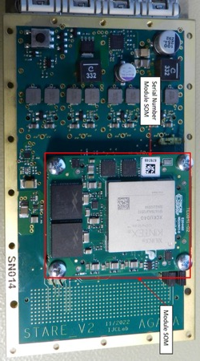
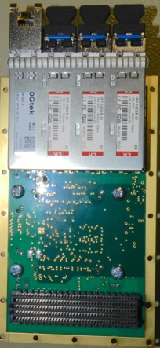
STARE Pre-Production
10 Pre-production (10 STARE V2): Delivery : March 2023.
Production ready since April 2023.
2 integration tests with 2 different CAP pcbs ok.
Waiting for the detector tests of CAP to launch production
Top side
Top side with SOM
Bottom side
Bottom side with SFP

Slide 7
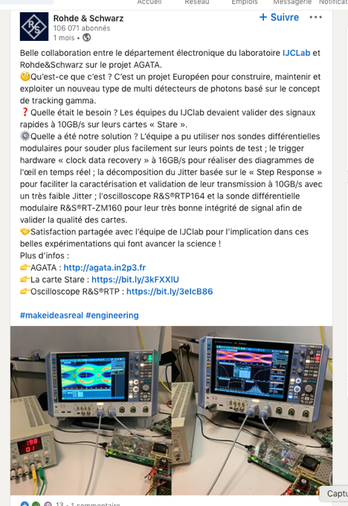
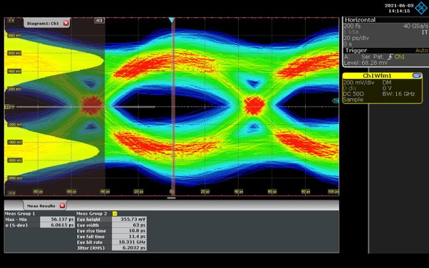
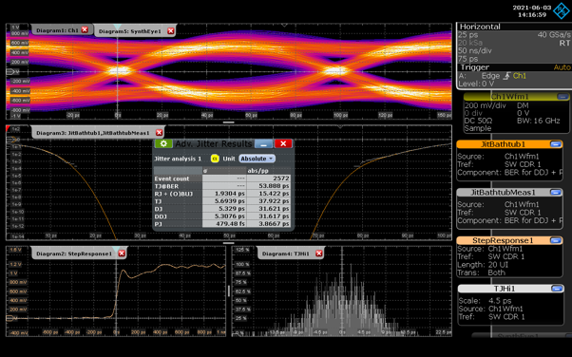
Eye diagram

Slide 8
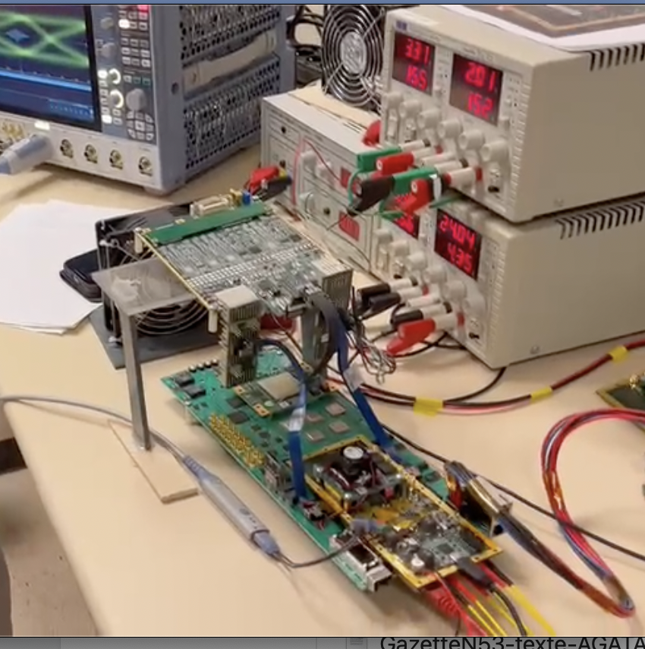
Eye Diagram on the PACE Stare Test Bench

Slide 9
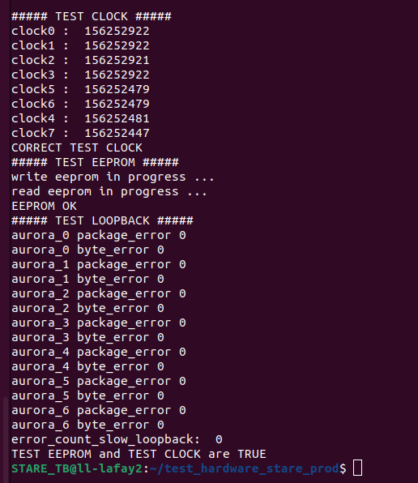
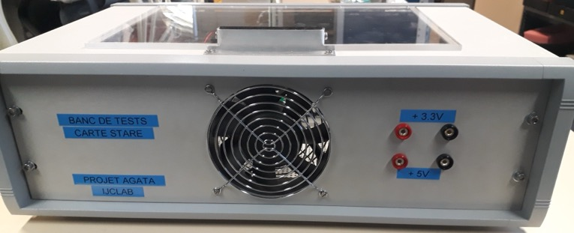
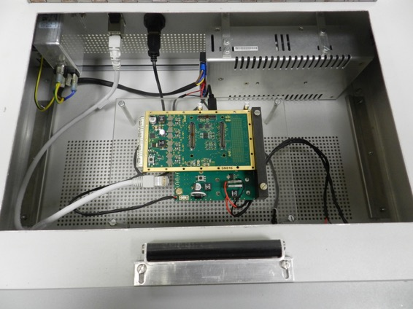
Production Test Bench
Front panel
STARE under tests

Slide 10
STARE Production
Pre production validated : no modification for production.
Production started March 2024. 150 STARE pcbs were ordered.
Only 37 SOM given to manufacturer.
error of packaging resistor : 100 ohms instead of 10K ohms, 8 resistor per card have been changed (1200 all done)
2 first SOM mounted, SFP UDP optical fibers output automatic test failed.

Slide 11
STARE Production
ALL Hardware tests were done by the manufacturer: Power supply OK ; enable/disable signal OK
One card sent to Orsay : FPGA’s internal PLL doesn’t lock using the same firmware as the preproduction which locks on all boards plus prototype boards.
The problem is not HARDWARE from STARE components or assembly or pcb production. It’s an internal firmware problem
It’s under investigation (change clock path inside FPGA). First tests are done the PLL locks again and the card test is ok now.
Need long time validation of 2 weeks to make sure that it is not only this board.
Possible reason for the issue is the timing tolerances in the different production date for the SOMs. Purchased over 3 years from different labs.
Tests will restart end Septembre for delivery mid October 2024.

Slide 12
STARE Production
Todays STATUS:
ALL 150 STARES pcbs are produced.
ONLY 37 SOMS are @ the manufacturers
Only 37 equipped STARES (pcb plus SOM) can be tested and delivered mid octobre 2024
The rest of the STARE pcbs will stay at the manufacturer.
The manufacturer will launch the bills to all labs who ordered even if the pcbs are not ready.
To deliver the STARE we need to mount the SOM on it.
Once the SOM is mounted you never dismount.

Slide 13
Firmware : data path
Aurora interface
64 bit
@156,25 Mhz
Data manger
Splicer
64 bit
@156,25 Mhz
UDP interface
(David Zidler – Munich)
10 Gb/s
Aurora
10 Gb/s
Ethernet SFP
Paquets of X KB
Y Paquets of 8 KB
Standalone data generator
_ Slow control
_ EEPROM
_ Clock manager
_ Event emulator
_ Spare LVDS links

Slide 14
Firmware : Aurora interface
Transmitter
Receiver
Serial link
Tlast signal = End of event
Tested on 4 lines @10Gb/s
20 hours => No error
End of event => receiver deduces the size

Slide 15
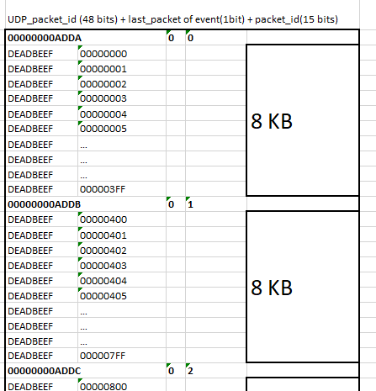
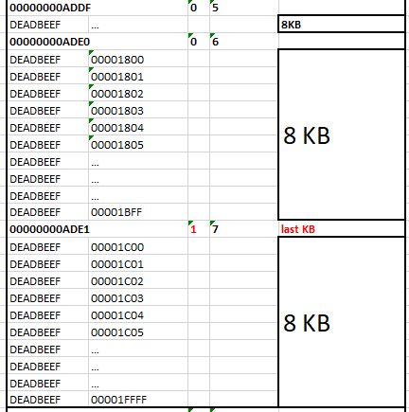
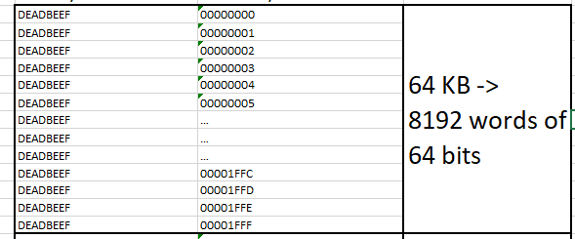
Splice X KB of one event on paquets of 8 KB
Add header
Sent paquets to UDP transmiter IP

Slide 16
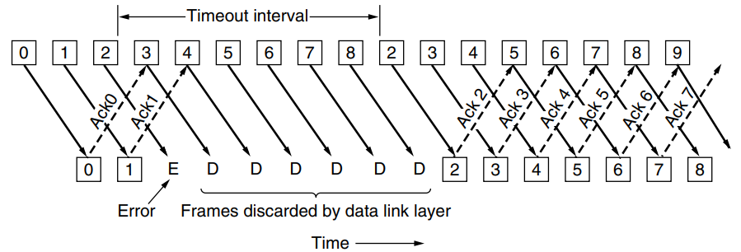
Firmware : UDP interface
Reuse of D.Zidler’s code
Modification of frame size (JumboFrame)
Managed by slowcontrol (via EEPROM) :
_ MAC @ of each SFP
_ IP @ of each SFP (no DHCP)
_ other network stuff (IP server, port, gateway, etc)
Later improvement : RUDP : resent lost paquets
64 bit
@156,25 Mhz
UDP interface
(David Zidler – Zurich)
10 Gb/s
Ethernet SFP
Y Paquets de 8 KB

Slide 17
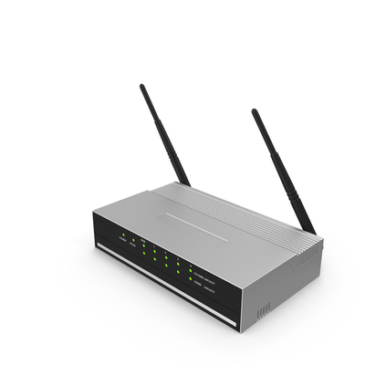
Firmware : IP_Bus SlowControl (CERN + LPSC Grenoble)
STARE
_XML module description
_Python scripts
_uHAL
IP Bus Protocol
Adress
Data
Ipbus interface
1G Ethernet
Ipbus fabric
Slave
EEPROM
network
Slave
Splicer
PACE
Slave
Slave
PACE_SPI_bridge
Slave
Ipbus fabric
Ipbus interface
SPI
SPI protocol
Slave

Slide 18
Firmware : improvements
Use DHCP for slow_control
Issue : communication between STARE and PACE via SPI had failure
solved in August (intern Ines) : acknowlege protocol modification
Data generator
Available :
Data_path_checker : produce known data and check integrity (all bits are tested) on computer ; data rate and event size parametrable
Counter
AGATA event : one event on memory can be sent with parametrable rate
Dt_h : asked by Olivier S.
TODO :
Possibility to change AGATA event on memory by SlowControl (training Ines)
FPGA reprogramming by SlowControl
RUDP (?)
One channel only

Slide 19
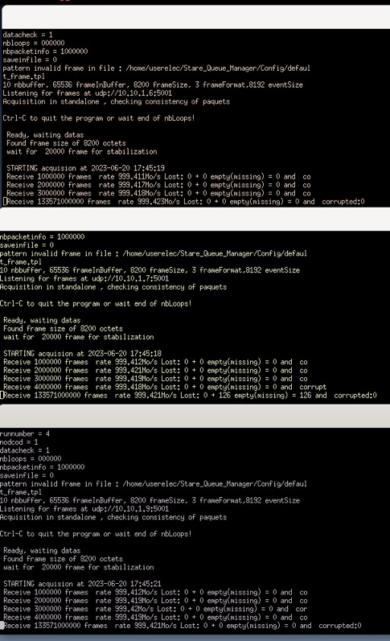
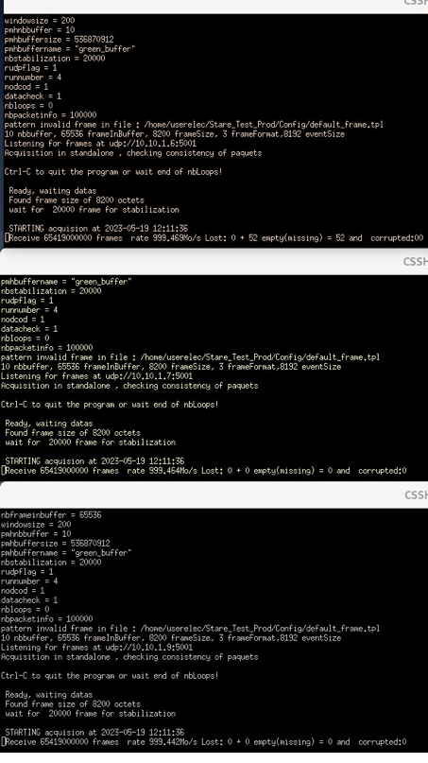
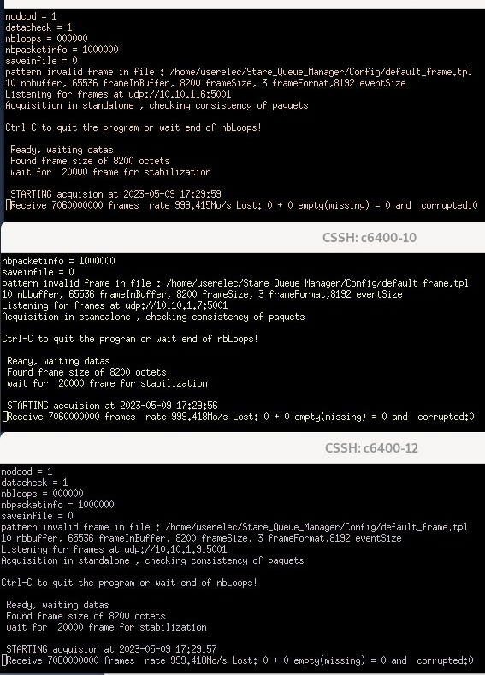
Pre production tests
Transfert @8Gb/s => Several weeks tests on 3 boards ; no bit error ; very little losses (<10e-9)

Slide 20
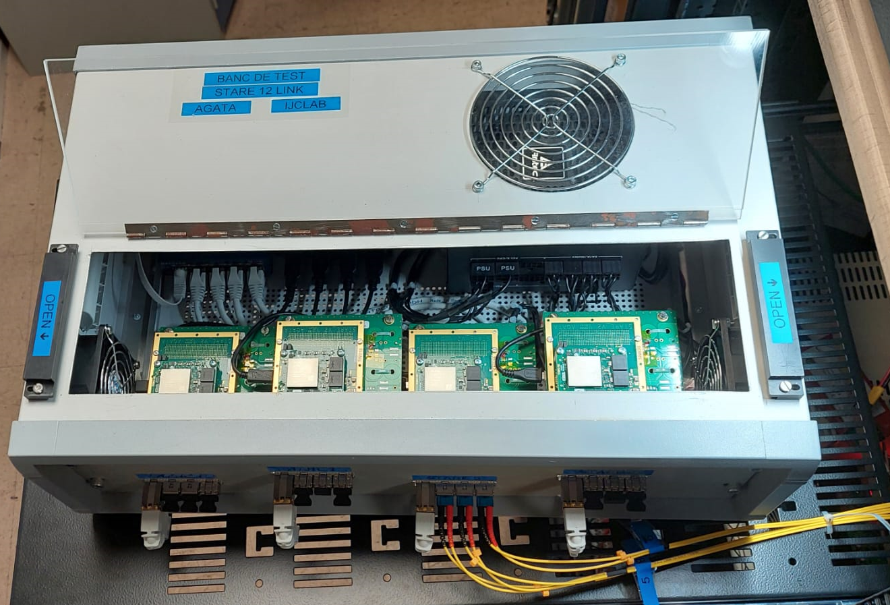
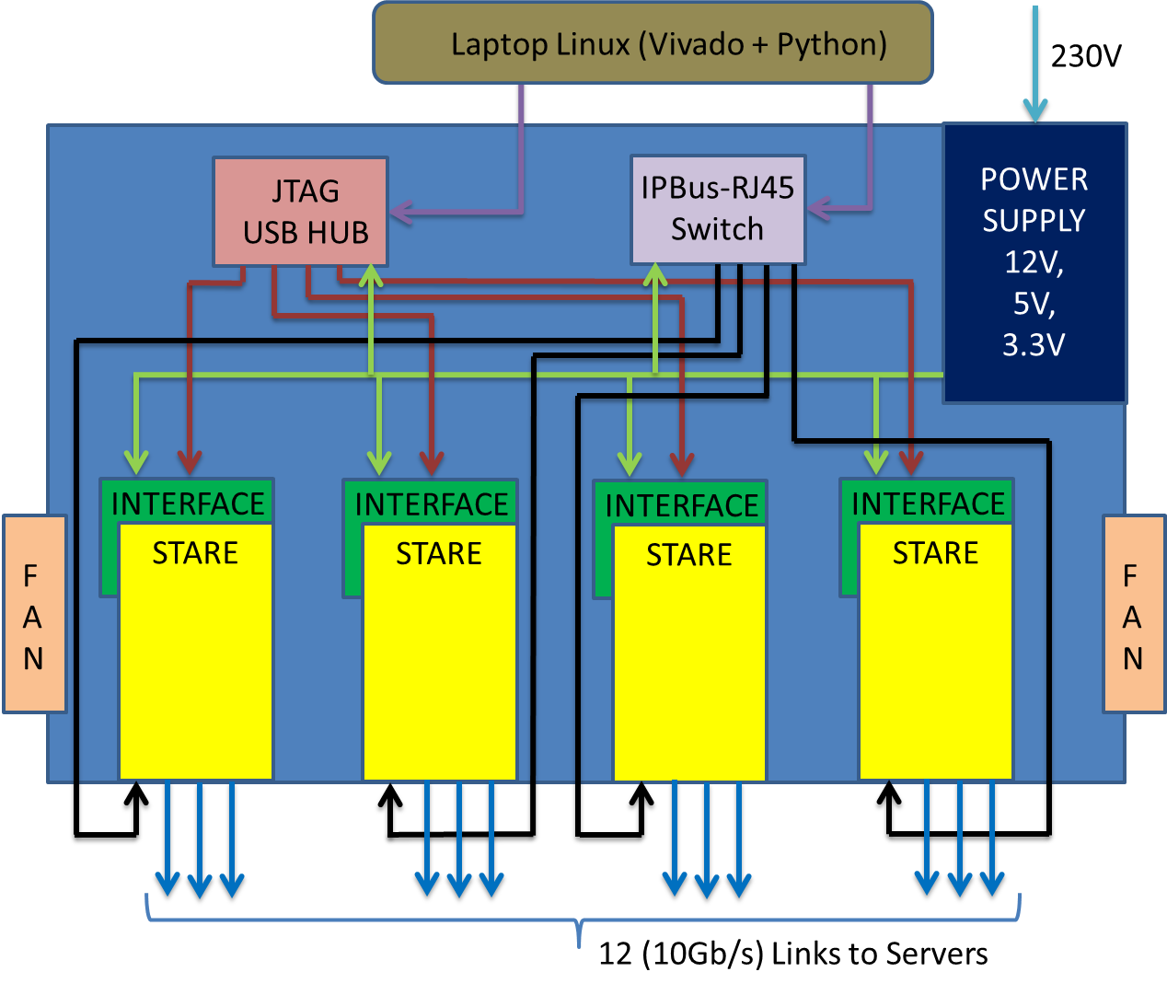
12 Readout Links Bench
Bloc Diagram
Designed to simulate actual and future 10 Ge crystals transferring up to 10 Gbps each or 4 Ge crystals transferring up to 30 Gbps each.
4 STARE V2 running: 12 optical links available (10 Gb/s each) for tests servers capabilities and server configurations for 10 Gbps receivers.
RUDP tests on multiple crystals. Check for Packets loss statistics and qualify RUDP utility for the project.
Back pressure program tests and qualification.
High transfer rate demonstrator
JTAG control for programming FPGAs.
IPBus access for slow control actions.

Slide 21
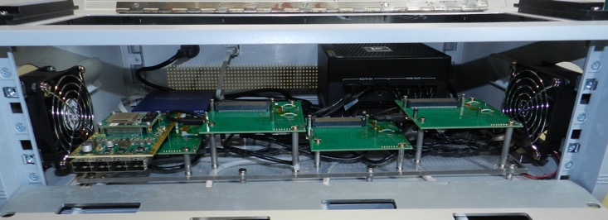
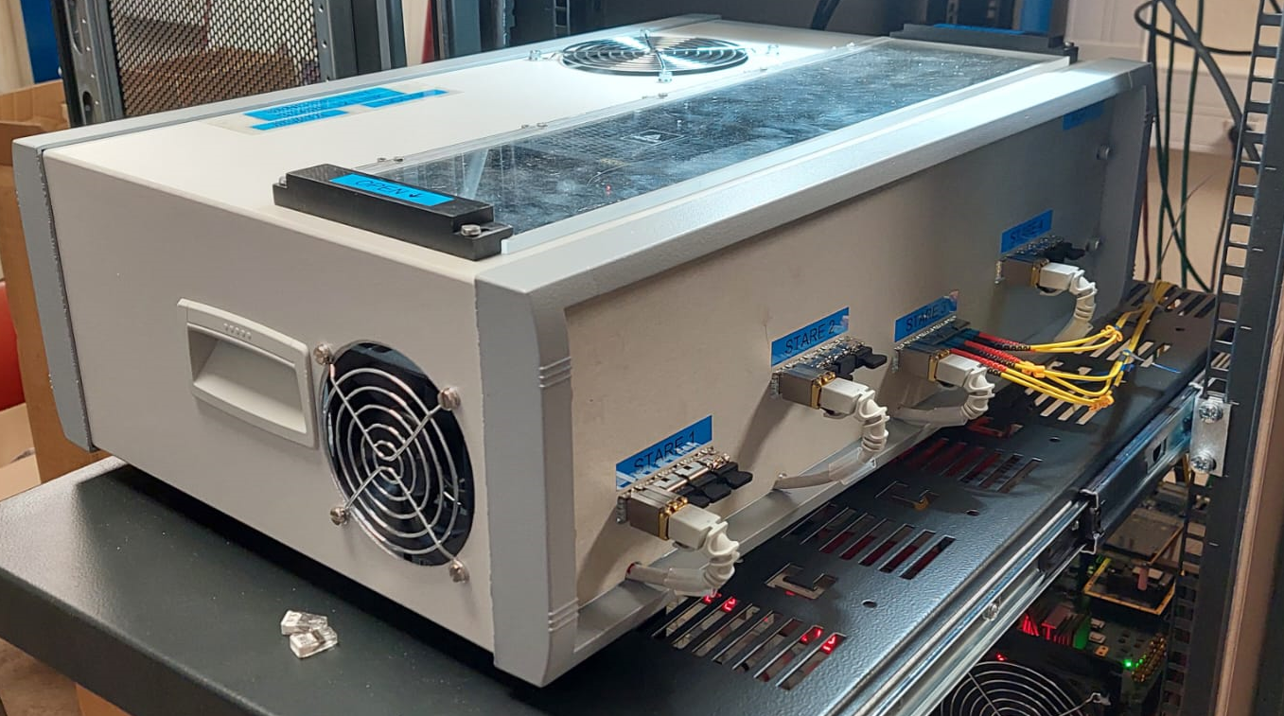
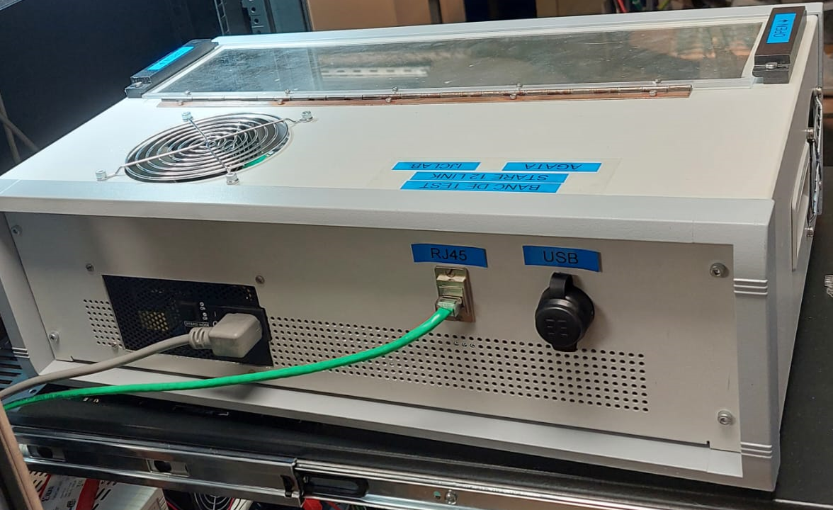
STARE 12 Links crate
IPBus access and switch
JTAG acces
3 optical links

Slide 22
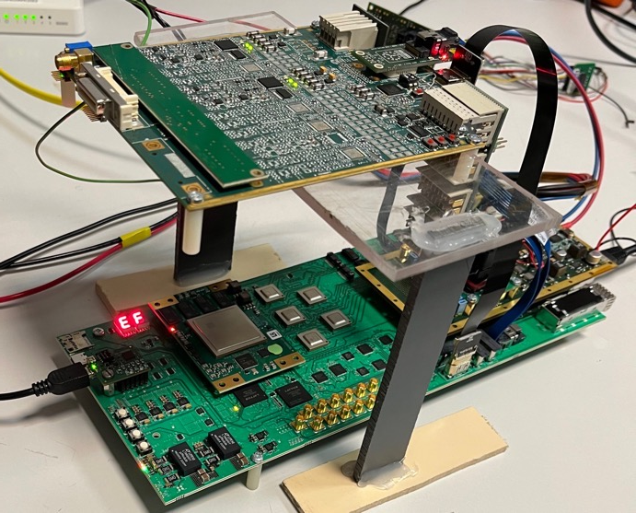
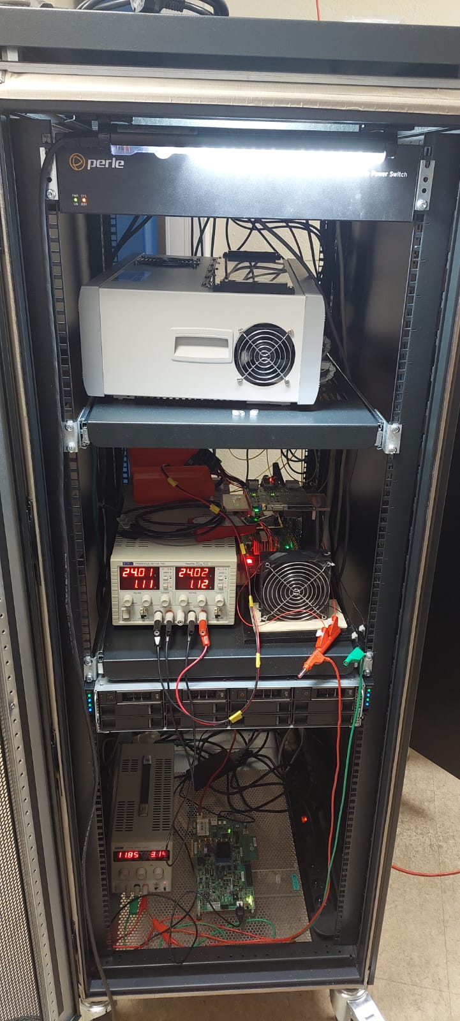
Available test benchs
3 Test benches in Orsay :
1 single standalone movable
12 link standalone in AP1 104 building (4 STAREs)
1 with CAP board in AP1 104 (update progress)
Tests bench are accessible remotly (Lyon, Valence,Strasbourg)
+ 1 for manufacturer

Slide 23
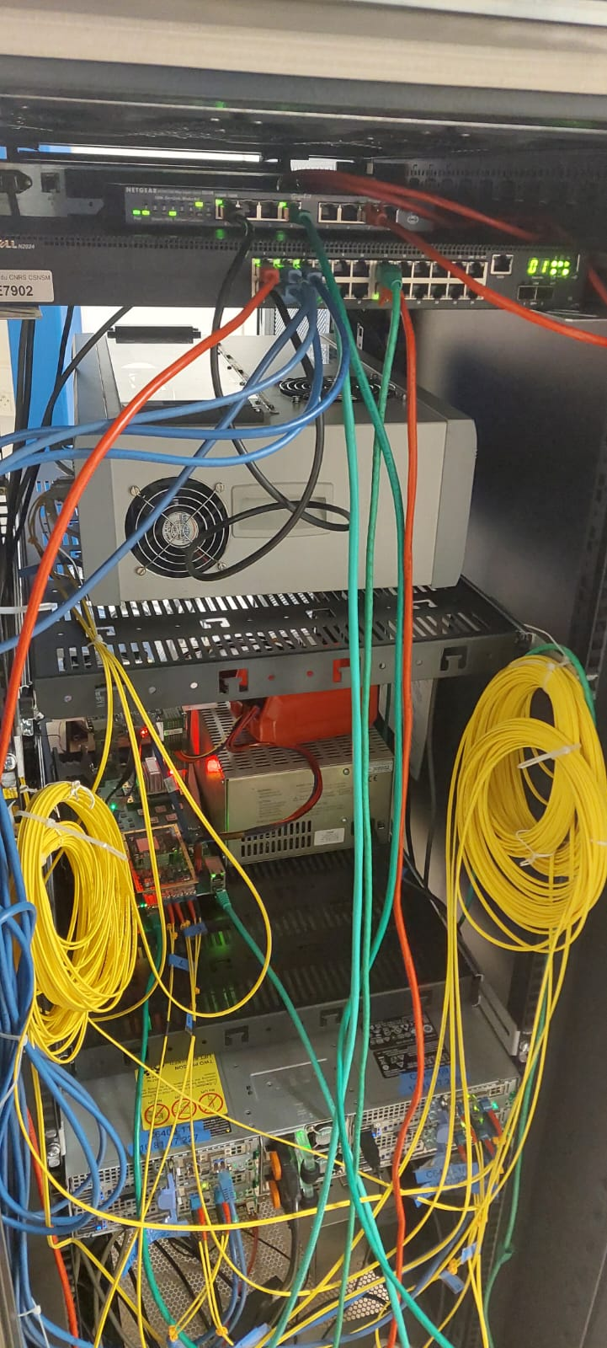
12 Links Bay for Future Development
STARE Data Readout
Power Switch to control from any PC
A new Bay to be designed to house all the STARE facilities (to be bought)
New PACE crate with Fans PS mechanics to fix the backplane and up to 38 channels.
12 links Stare bench (exists).
100 Gbps switches to be bought.
Optical fibers.
Power switch exists.
8 DAQ servers (4 are there already)
External control via mini-PC
100 Gbps Optical Switches (2 x 24 )
STARE 12 links
PACE Test Bench in a crate
Up to 2 Pizza boxes
(8 DAQ servers)
Other developements

Slide 24
12 Links Bay for Future Development
Bloc Diagram
Several types of data source from CAP board can be selected to be transferred to any of the 4 Aurora link
GUI developpement to make this facility ease of use.
Software developpement on the server side to accept the selected data .
Maintenance and monitoring and programmable data test generators.
IPBus access for slow control actions.
User can select the data source and the adequate software to make the appropriate analysis.
STARE Data Readout
4 x 10 Gbps UDP
10 Gbps SERVERs
QuadLink Mega Switch
Experiment data
4 x Aurora
Simulated ADC data
Continuous raw data
Programmable pulser
preprocession data
Ipbus Control

Slide 25
Thank you
Notes:
Après une phase de déomnstration de 2003 à 2008:
Photo of GANIL fall 2016 with 32 detectors – procurement of ~60 capsules by 2022. Already 47 in 2019 (Finalnd and Hungary have ordered – delivery 2019 of 4 capsules + UK should order 2 ATC if successful grant…)

