Slide 1
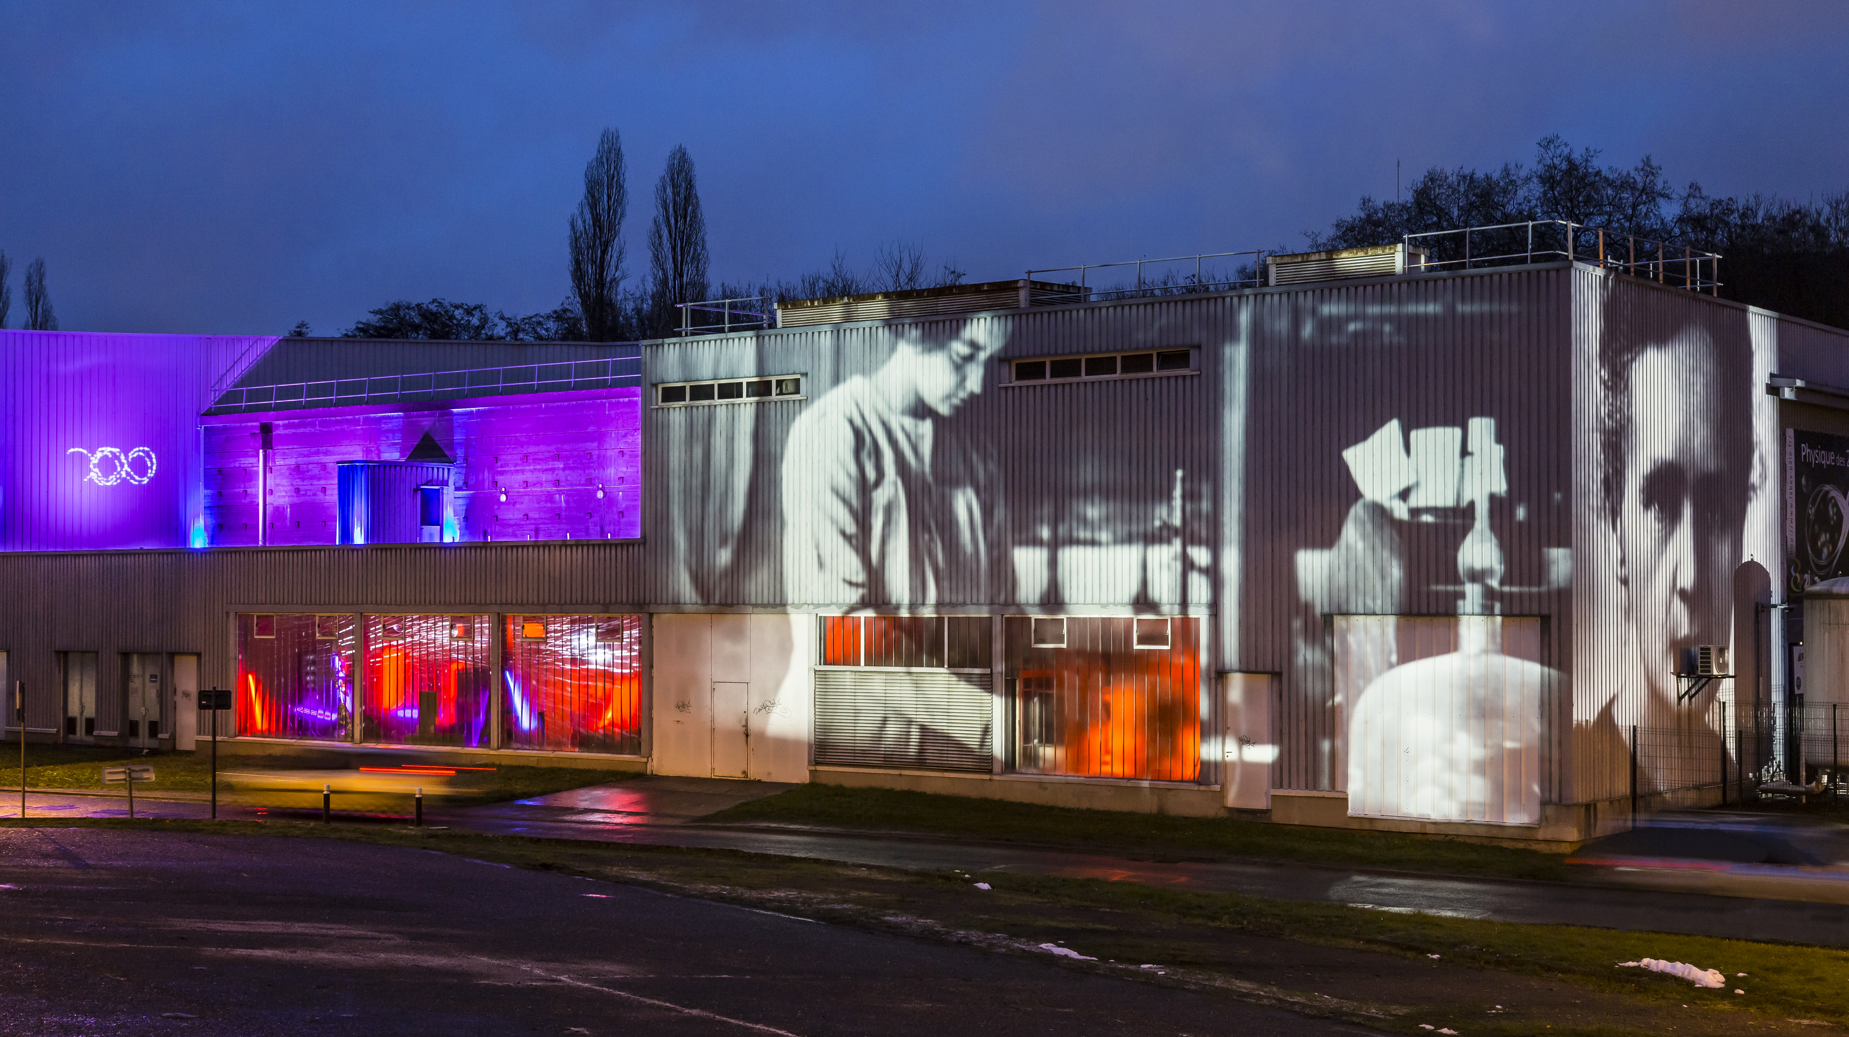
GDR SCIPAC: Atelier Calcul
Bienvenue à IJCLab

Slide 2

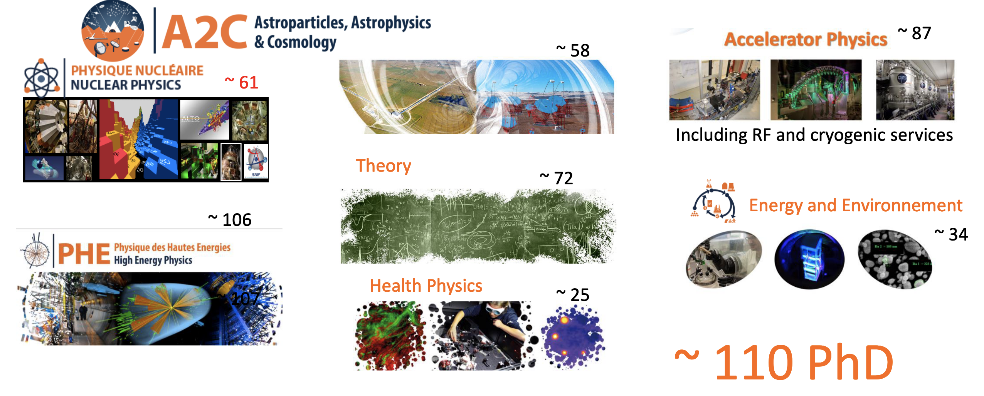
IJCLab in a nutshell
All the themes of the "physics of the two infinities" with the presence of strong historical/existing poles, emerging poles and activities at the interfaces.

Slide 3
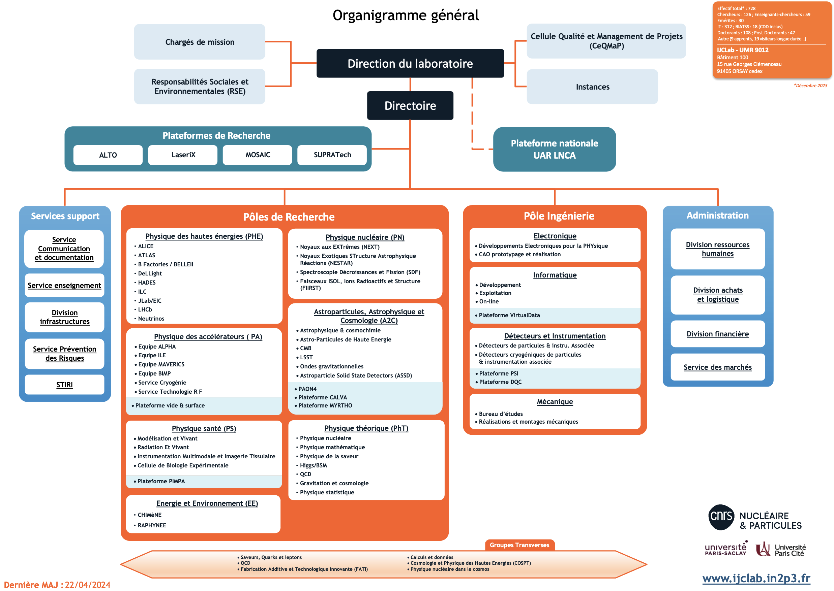
IJCLab Organisation

Slide 4
Accelerator Science & technology @ IJCLab
The main objectives of IJCLab regarding Particle Accelerators Science and Technology
To be a major actor on accelerator physics research in several key areas, selected for their strategic importance (potentiality for scientific and technological breakthrough) and our capacity to have an important and visible impact.
Increase our capacity to build accelerators : a clear strategy to have important contributions to international projects, allowing us to take part in the definition of large equipment roadmaps and thus to facilitate the positioning of our research teams
Develop and operate local accelerators and technological platforms: beside their primary goal to provide beam or technical resources to several scientific communities, it’ also a key to keep accelerators expertise, training capabilities, and insure visibility and attractiveness
Contribute to education in accelerator science and technology: Ph-D, internship, lectures & courses at several levels…

Slide 5
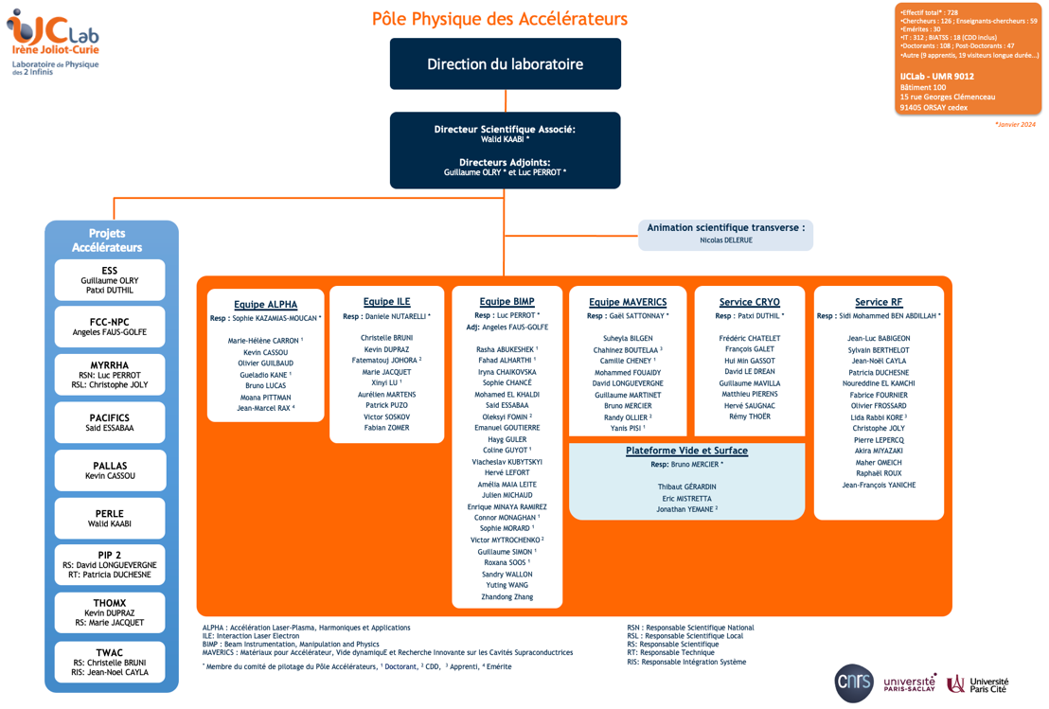
Structuration of Accelerator Physics Pole at IJCLab:
Accelerator pole is structured around:
4 Research teams
2 specialised technical services
1 Technological platform
Manpower indicators (01/12/2023) :
87 persons (65 permanent positions)
Gender balance M/F : 66 / 21,
7 HDR
Average age = 45 years
Categories :
9 teachers-researchers
7 researchers
51 technical persons: 35 IR, 9 IE, 7 AI
15 PhD, 3 Post-doc,
3 CDD, 2 apprentices
Affiliation (W/O PhD students) :
60 CNRS Staff
12 Paris-Saclay University

Slide 6
Structuration of Accelerator Physics Pole at IJCLab:
Structured around 4 scientific teams, 2 specialized groups and one technological platform
  ALPHA Research Team: Laser-Plasma Acceleration, Harmonics and Applications:
  Laser-plasma acceleration, high power laser system…
  ILE Research Team: Laser-Electron Interaction
  Compton sources for X and gamma ray production, Polarimetry, optical cavity development…
BIMP Research Team: Beam Instrumentation, Physics and Manipulation
Accelerator design and simulations, beam dynamics, beam monitoring and control, beam instrumentation, high power proton beams, positron sources, nano-beams…
MAVERICS research Team: Material for accelerators, dynamic vacuum and innovating research for SRF cavities
  Vacuum and surface physics, dynamic vacuum in accelerators, thin films (SRF, anti-multipacting, coating, getter…) photocathodes, surface characterization, SRF material preparation and development…
  RF Group: Specialized service for RF science and technology
  Conventional and superconducting RF structure design, preparation and operation; RF tuners, RF Power couplers, RF sources, low-level RF systems
Cryogenic Group: Specialized service for cryogenic science and technology
  Design and construction of cryogenic systems for particle accelerators (and beyond), operation of SupraTech cryogenic faciities
Vacuum and Surfaces Technological Platform
Platform dedicated to the characterization and analysis of material: UHV: mass spectrometry, degazing rate measurement, secondary electron yield rate, structural analysis: DRX, Morpho/topo (SEM, Confocal); composition (Sims, XPS, EDX…)

Slide 7
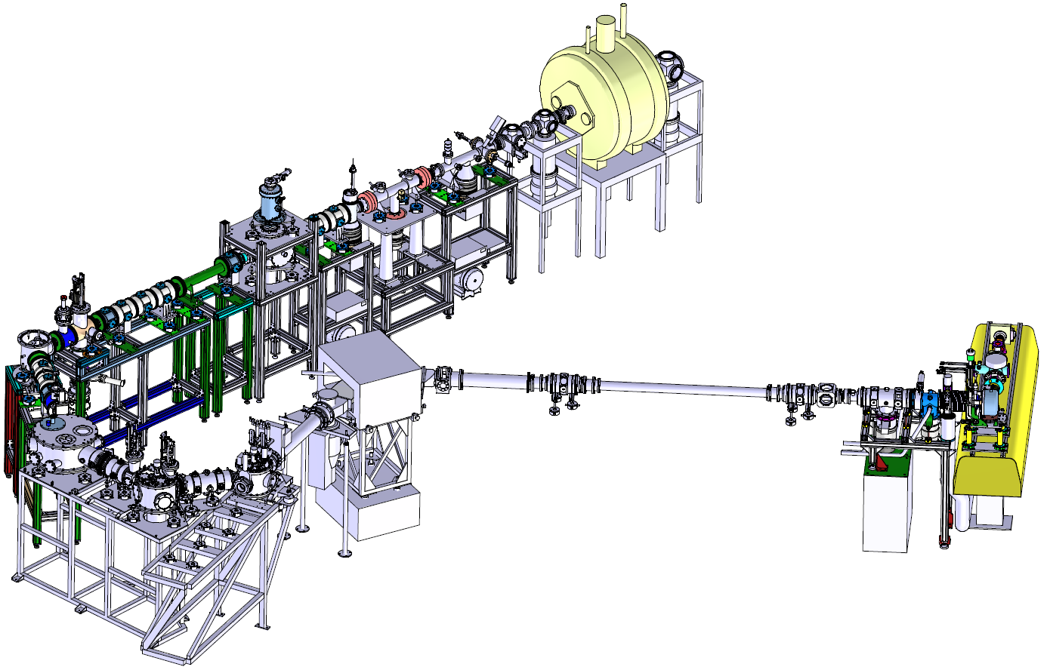
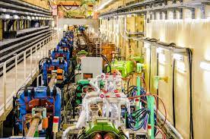
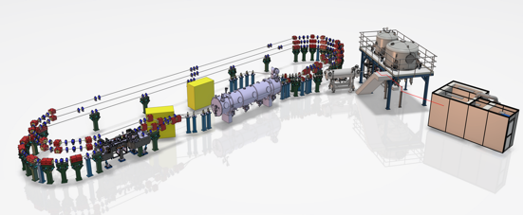
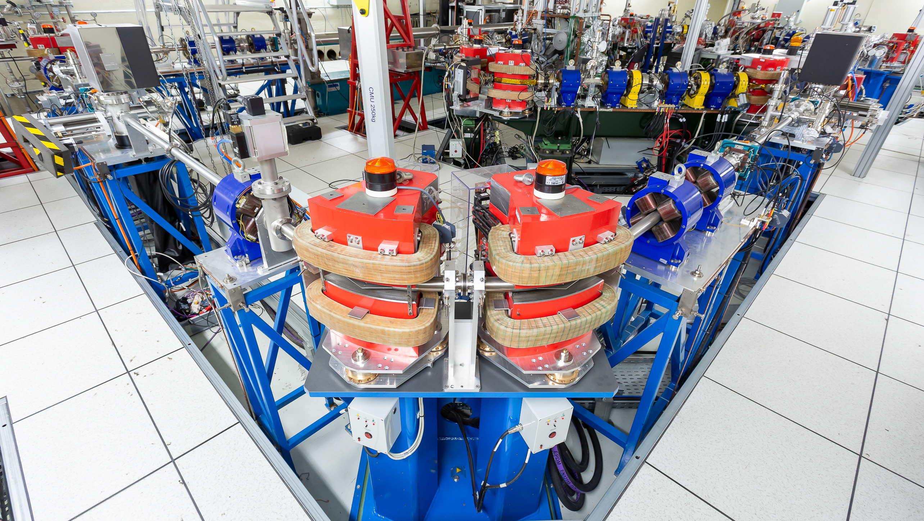
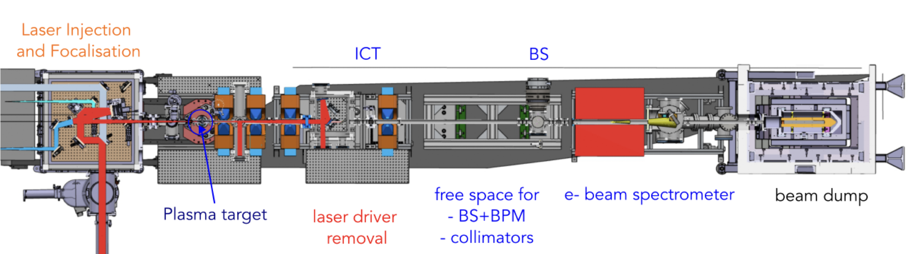
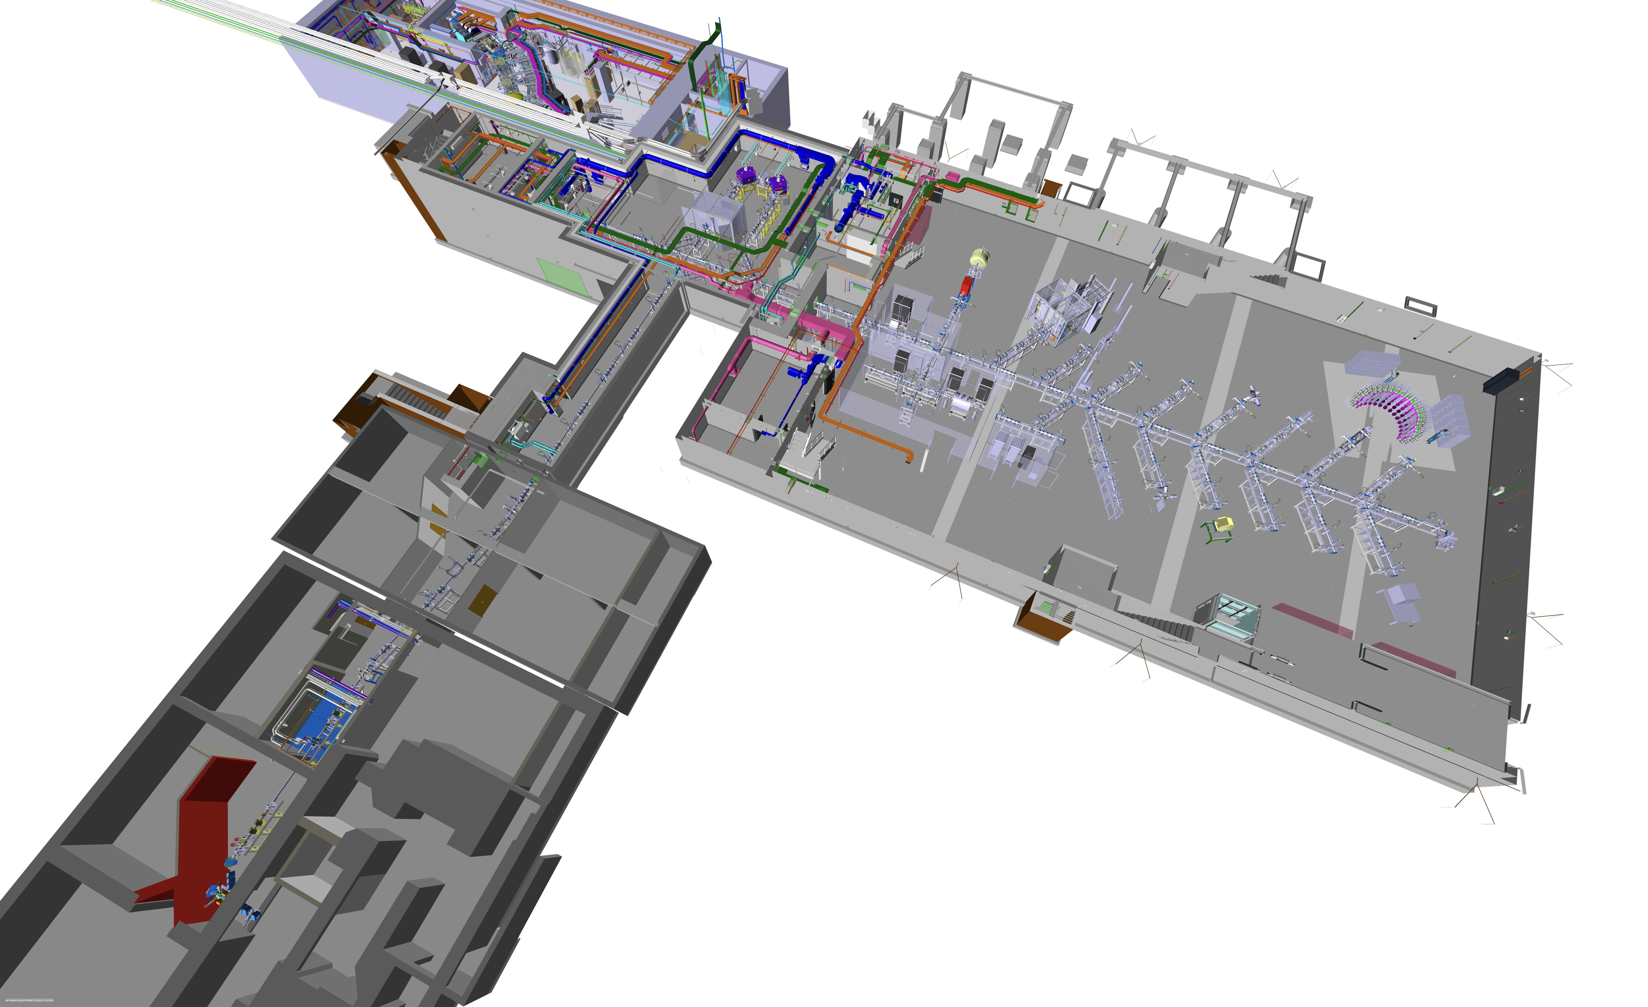
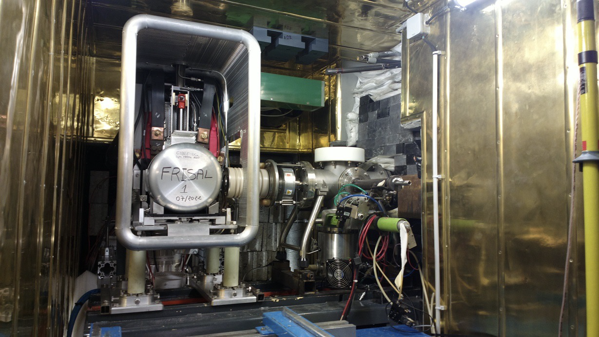
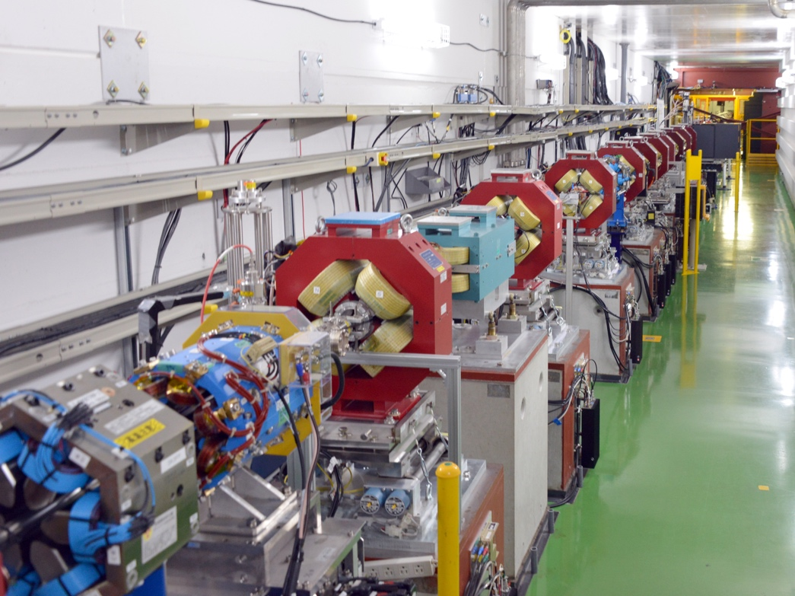
Projects and used codes
SPIRAL2
DESIR
FCC-NPC
ALTO
PERLE
MYRRHA
ThomX
MLLTRAP
PALLAS
Optics design
Beam dynamics
Material studies
Commissioning
Beam instrument.
Commissioning
Dosimetry
Optics design
Beam dynamics
Beam Instrumen.
Optics design
Beam dynamics
Magnet design
RF Design
Cryo design
Vacc. design
Radioprotection
Beam line design
Commissioning
Beam line design
Commissioning
Optics design
Beam dynamics
Beam Instrumen.
MATLAB
Acc. Toolbox
(IJCLab)
SMILEI
TraceWin
SIMION
OPERA
MadX
Xsuite
GuineaPig
RF-Track
Octave
ASTRA
Geant4
Mathematica (UPSay)
Anaconda
TRANSPORT
TOPAS
GATE
LabView (IN2P3)
Inventor (UPSay)
OPERA
LabView (IN2P3)
SIMION
Inventor (UPSay)
TraceWin
OPERA
BMAD
ASTRA
OPAL
FLUKA
DYVACS
ANSYS (Matlab Simulink)
TraceWin
SIMION
CST
COMSOL
OPERA
Mathematica (UPSay)
Overleaf (CERN)
PLM Latex (IN2P3)
ZOOM (IJCLab)
MS office (IJCLab)
Adobe Pro
ML Techniques for optimization in different projects
* Green : Open source
* Red : Payant
16/10/2024
GDR SCiPAC- Atelier calcul
7

