Slide 1
Calculation softwares for magnetic modelling at Synchrotron SOLEIL
M. VALLÉAU
Magnetism & Insertion Devices Group

Slide 2
Modelisation of the insertion devices

Slide 3
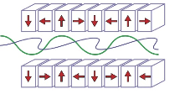
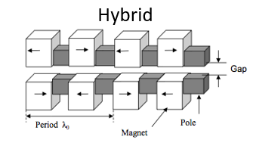
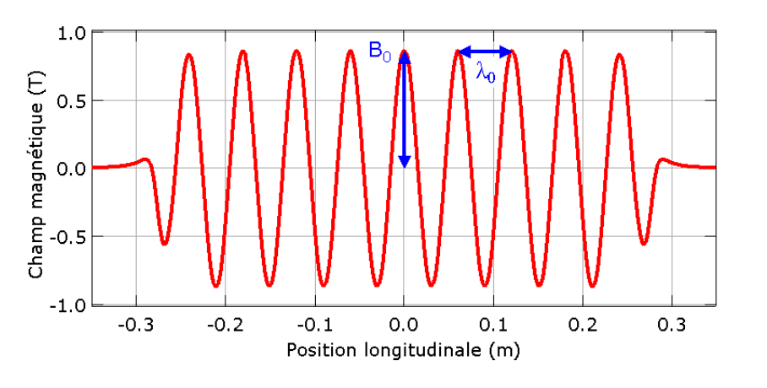
Introduction
User request
Spectral range, polarization, taper, aperiodicity, …
Design
Radiation : SRW, Spectra
Magnetic fields : Radia
Effects on the e-beam : Radia (kick cards)
Construction
IDBuilder, Radia, SRW
$$λu$$
: und. period
Electron beam
Radia
Photon beam
SRW, Spectra
$$Bux,Buz$$
: und. mag. fields
$$λn=\frac{λu}{2nγ2}\left(1+\frac{{Ku}^{2}}{2}+{θ2γ}_{}^{2}\right)$$
$$Ku$$
: deflection parameter
$$λu$$
: resonant wavelenght

Slide 4
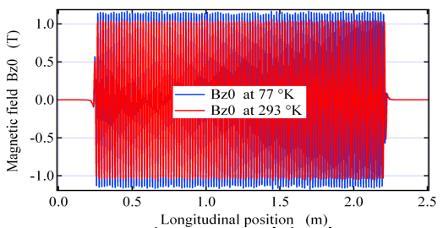
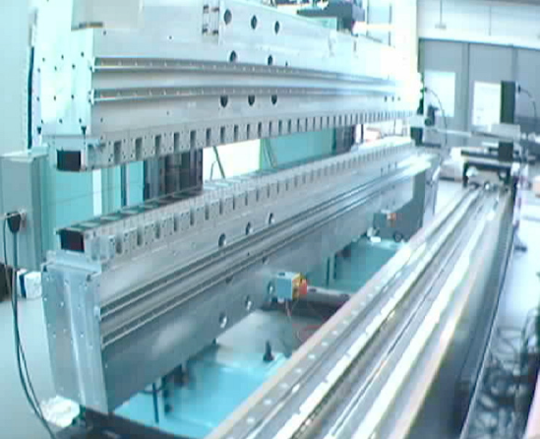
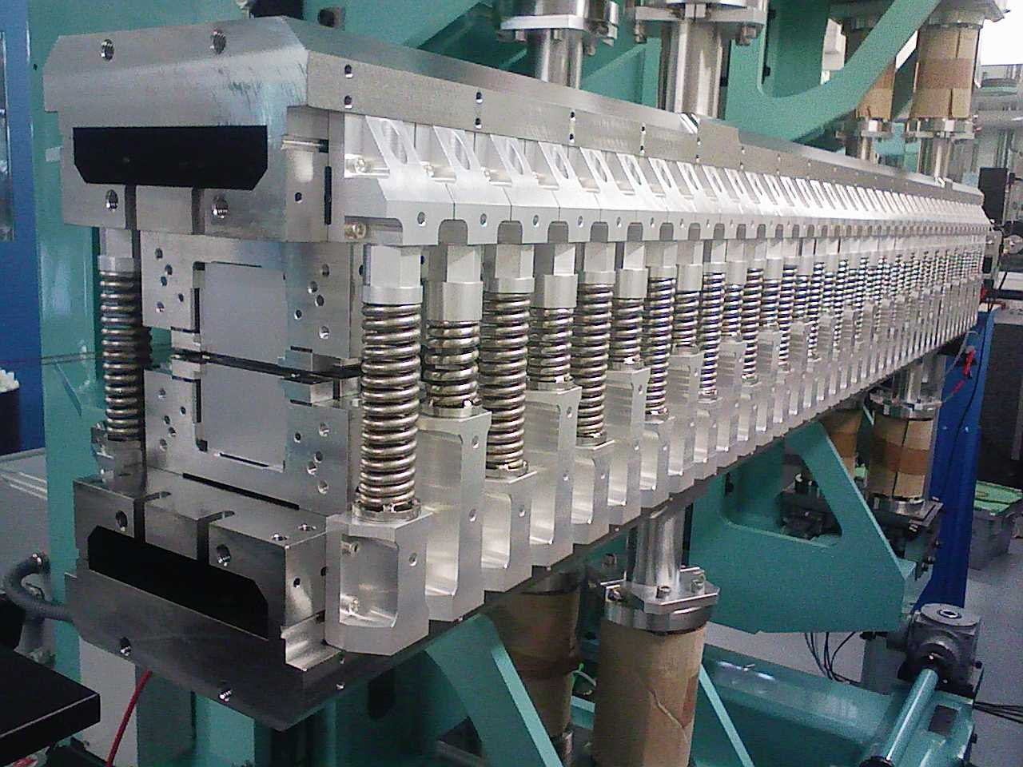
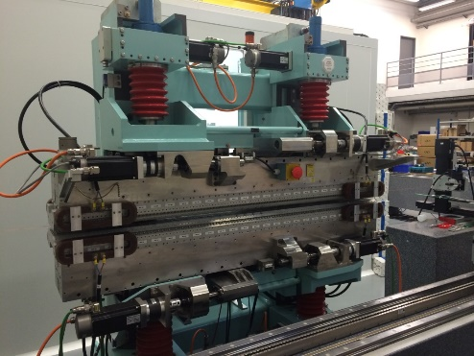
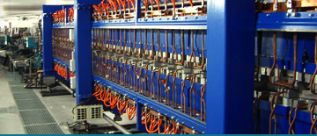
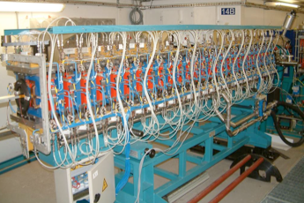
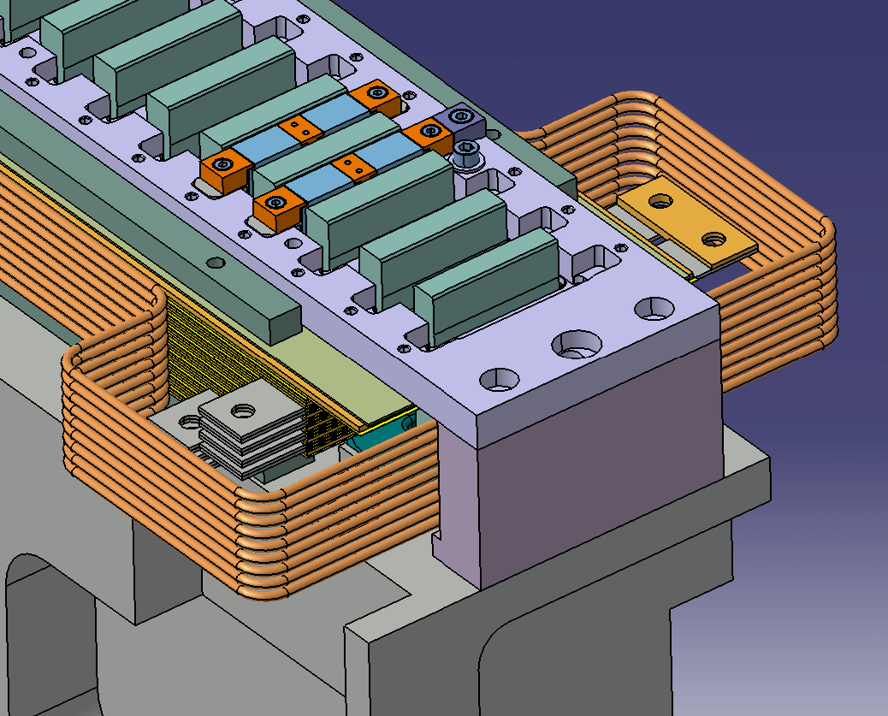
Introduction
In-vacuum Undulators
Cryogenic Permanent Magnet Undulators
Wigglers
In-vacuum Wigglers
Helical Undulators
Electro-magnetic Undulators
Electro-Magnetic Polarized Helical Undulators

Slide 5
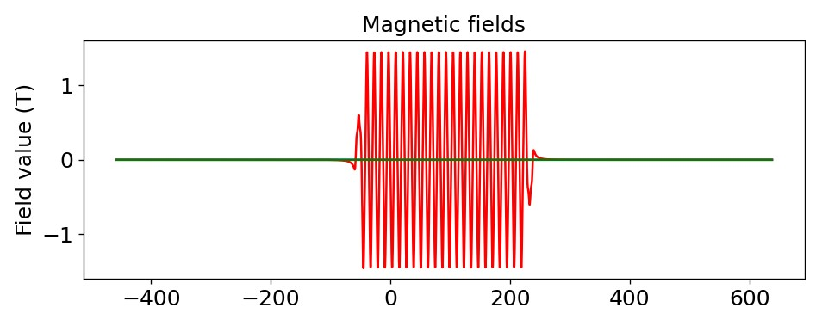
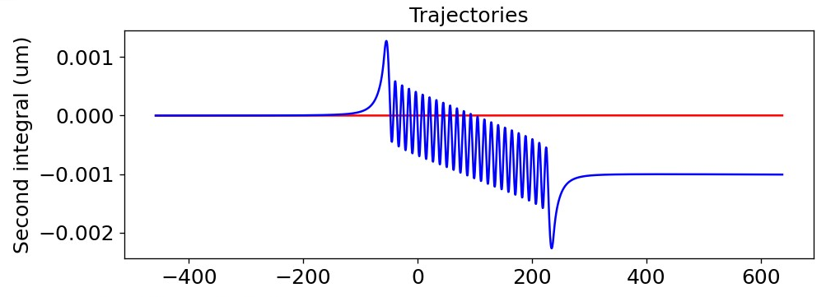
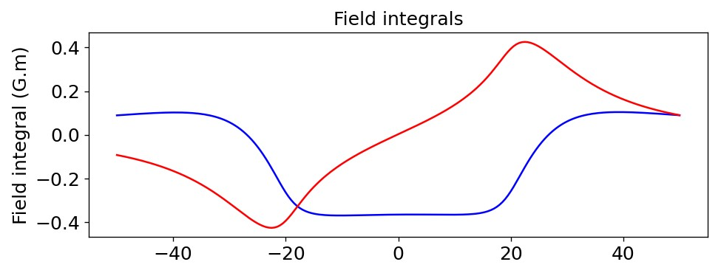
RADIA
RADIA ^{[1] [2]} is a three-dimensional magnetostatics computer code in C++ interfaced with Mathematica
(no more maintained), Igor pro and Python. Enables to solve magnetostatic problems for current-carrying
volumes and magnetized volumes (non-linear for iron and linear anisotropic for permanent magnets).
INPUTS : menu driven with self explained dialog boxes and/or command line interface for IgorPro and
functions for Mathematica and Python.
OUTPUTS : 3D Object, Igor Binary Waves, ASCII, csv, …
>> 3D magnetic fields, field integrals along a line, 3D forces and torques between elements, angles &
trajectories of the electrons, second order kick cards, …
[1] P. Elleaume, O. Chubar, J. Chavanne, "Computing 3D Magnetic Field from Insertion Devices", proc. of the PAC97 Conference May 1997, p.3509-3511.
[2] O. Chubar, P. Elleaume, J. Chavanne, "A 3D Magnetostatics Computer Code for Insertion devices", SRI97 Conference August 1997, J. Synchrotron Rad. (1998). 5, 481-484

Slide 6
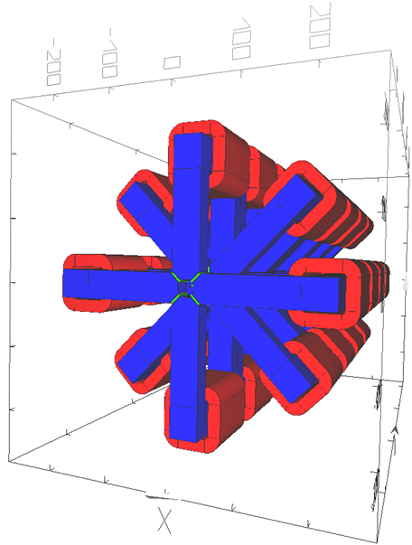
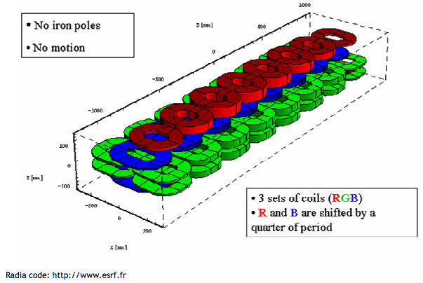
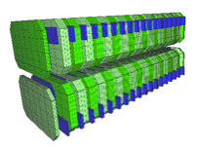
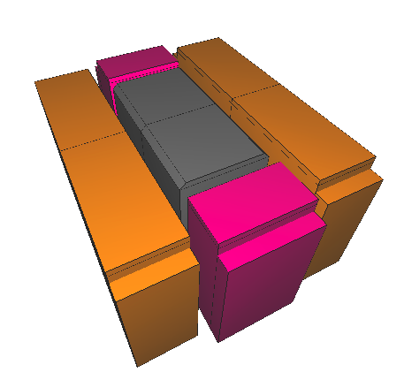
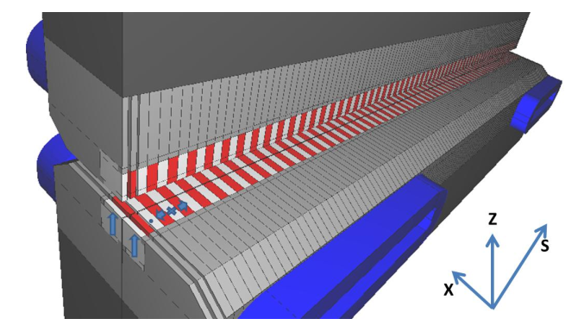
RADIA
Electro-magnetic Undulators
Hybrid Undulators & Wigglers
Pur Permanent
Magnets Undulators
[1] P. Elleaume, O. Chubar, J. Chavanne, "Computing 3D Magnetic Field from Insertion Devices", proc. of the PAC97 Conference May 1997, p.3509-3511.
[2] O. Chubar, P. Elleaume, J. Chavanne, "A 3D Magnetostatics Computer Code for Insertion devices", SRI97 Conference August 1997, J. Synchrotron Rad. (1998). 5, 481-484

Slide 7
IDBuilder
Insertion Device Builder ^{[3] [4] [5]} is an IGOR PRO plugin dedicated to the magnetic assembly and optimization of IDs based on a genetic algorithm.
Advantages :
object function, arbitrary search space, search from a population, mutation and cross-over
➔ global optimum, multi-modal/multi-objet
[3] ID Builder, Genetic Algorithm, O.Rudenko and O.Chubar, Proc. of 9th Int. Conf. on PPSN IX, p.362 (2006)
[4] O. Rudenko and O. Chubar, "An Evolutionary Approach to Shimming Undulator Magnets for Synchrotron Radiation Sources", Proc. of 9th Int. Conf. on Parallel Problem Solving from Nature PPSN IX, p.362 (2006)
[5] O. Chubar, O. Rudenko and al, Application of genetic algorithms to sorting, swapping and shimming of the SOLEIL undulator magnets, AIP Conf. Proc., 879, 359, (2007).

Slide 8
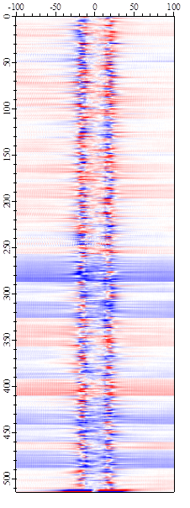
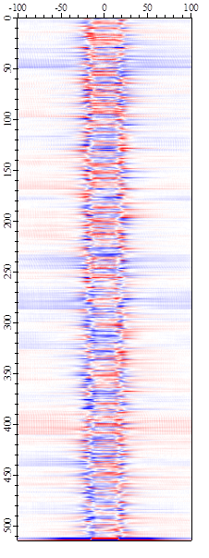
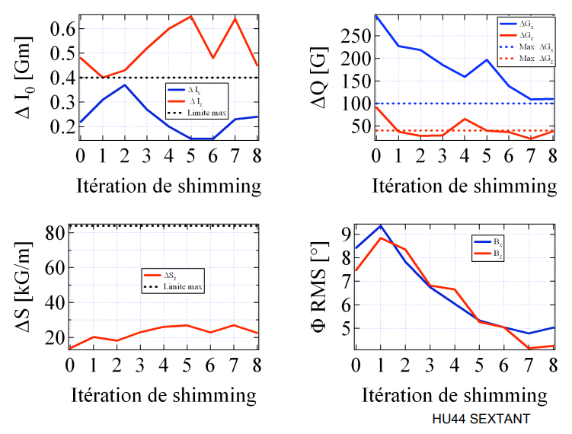
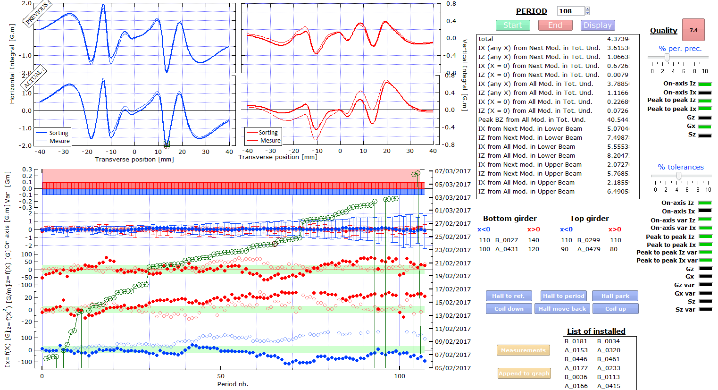
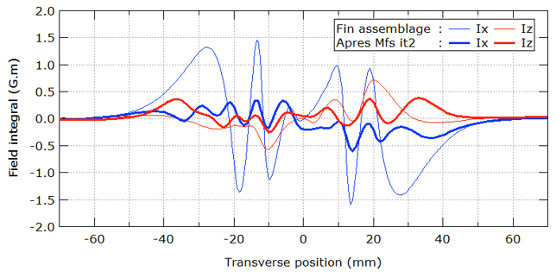
IDBuilder
Assembly process
Correction process
I_{z}
I_{x}
SHIMMING
Magic Fingers
[3] ID Builder, Genetic Algorithm, O.Rudenko and O.Chubar, Proc. of 9th Int. Conf. on PPSN IX, p.362 (2006)
[4] O. Rudenko and O. Chubar, "An Evolutionary Approach to Shimming Undulator Magnets for Synchrotron Radiation Sources", Proc. of 9th Int. Conf. on Parallel Problem Solving from Nature PPSN IX, p.362 (2006)
[5] O. Chubar, O. Rudenko and al, Application of genetic algorithms to sorting, swapping and shimming of the SOLEIL undulator magnets, AIP Conf. Proc., 879, 359, (2007).

Slide 9
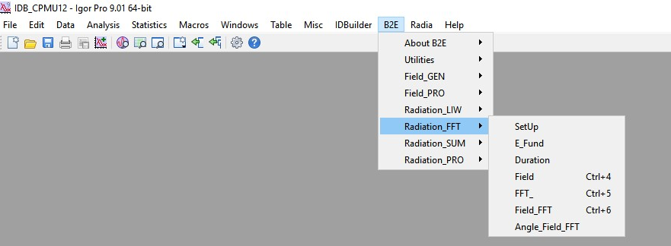
B2E
B2E ^{[6]} is an IGOR PRO plugin dedicated to the simulation of the Synchrotron Radiation produced by a relativistic single electron traveling through an arbitrary magnetic field.
INPUTS : menu driven with self explained dialog boxes and/or command line interface.
OUTPUTS : Igor Binary Waves
Automated functions to process the measured magnetic fields and evaluate the magnetic field errors
after magnetic measurements to compute their effect on the spectral performances
[6]

Slide 10
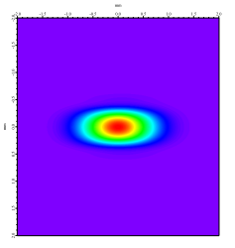
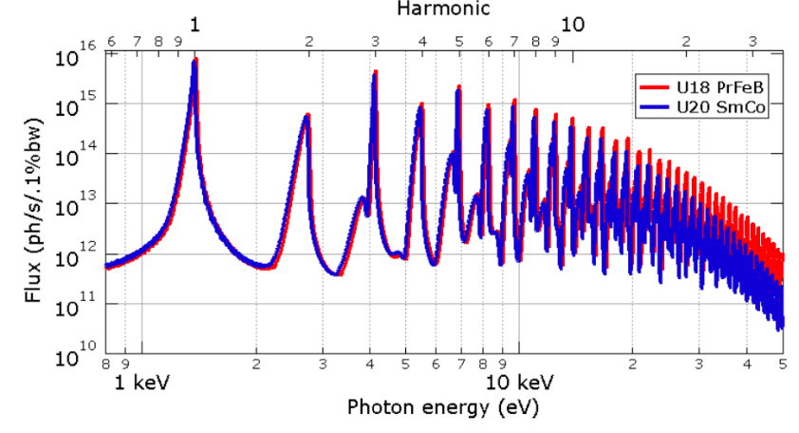
SRW & SIREPO
« Synchrotron Radiation Workshop ^{[7]} computes the synchrotron radiation from relativistic electrons with high
precision and efficiency in the near and far field range » ^{[X]}
Enables to compute for different beams :
Synchrotron Radiation for different types of sources (bending magnets, undulators, arbitrary fields)
Wavefront propagation (including mirrors, slits, mono), for end-to-end simulations for Beamlines
C++ source code with pluggins for
IGOR PRO
INPUTS : contextual menus, txt files, Igor Binary Waves
OUTPUTS : txt files, Igor Binary Waves
Automated functions to calculate SR directly after mag. Meas.
Python
INPUTS : functions, txt files
OUTPUTS : txt files, binary files, json,…
[7] O. Chubar, P. Elleaume, "Accurate And Efficient Computation Of Synchrotron Radiation In The Near Field Region",
proc. of the EPAC98 Conference, 22-26 June 1998, p.1177-1179

Slide 11
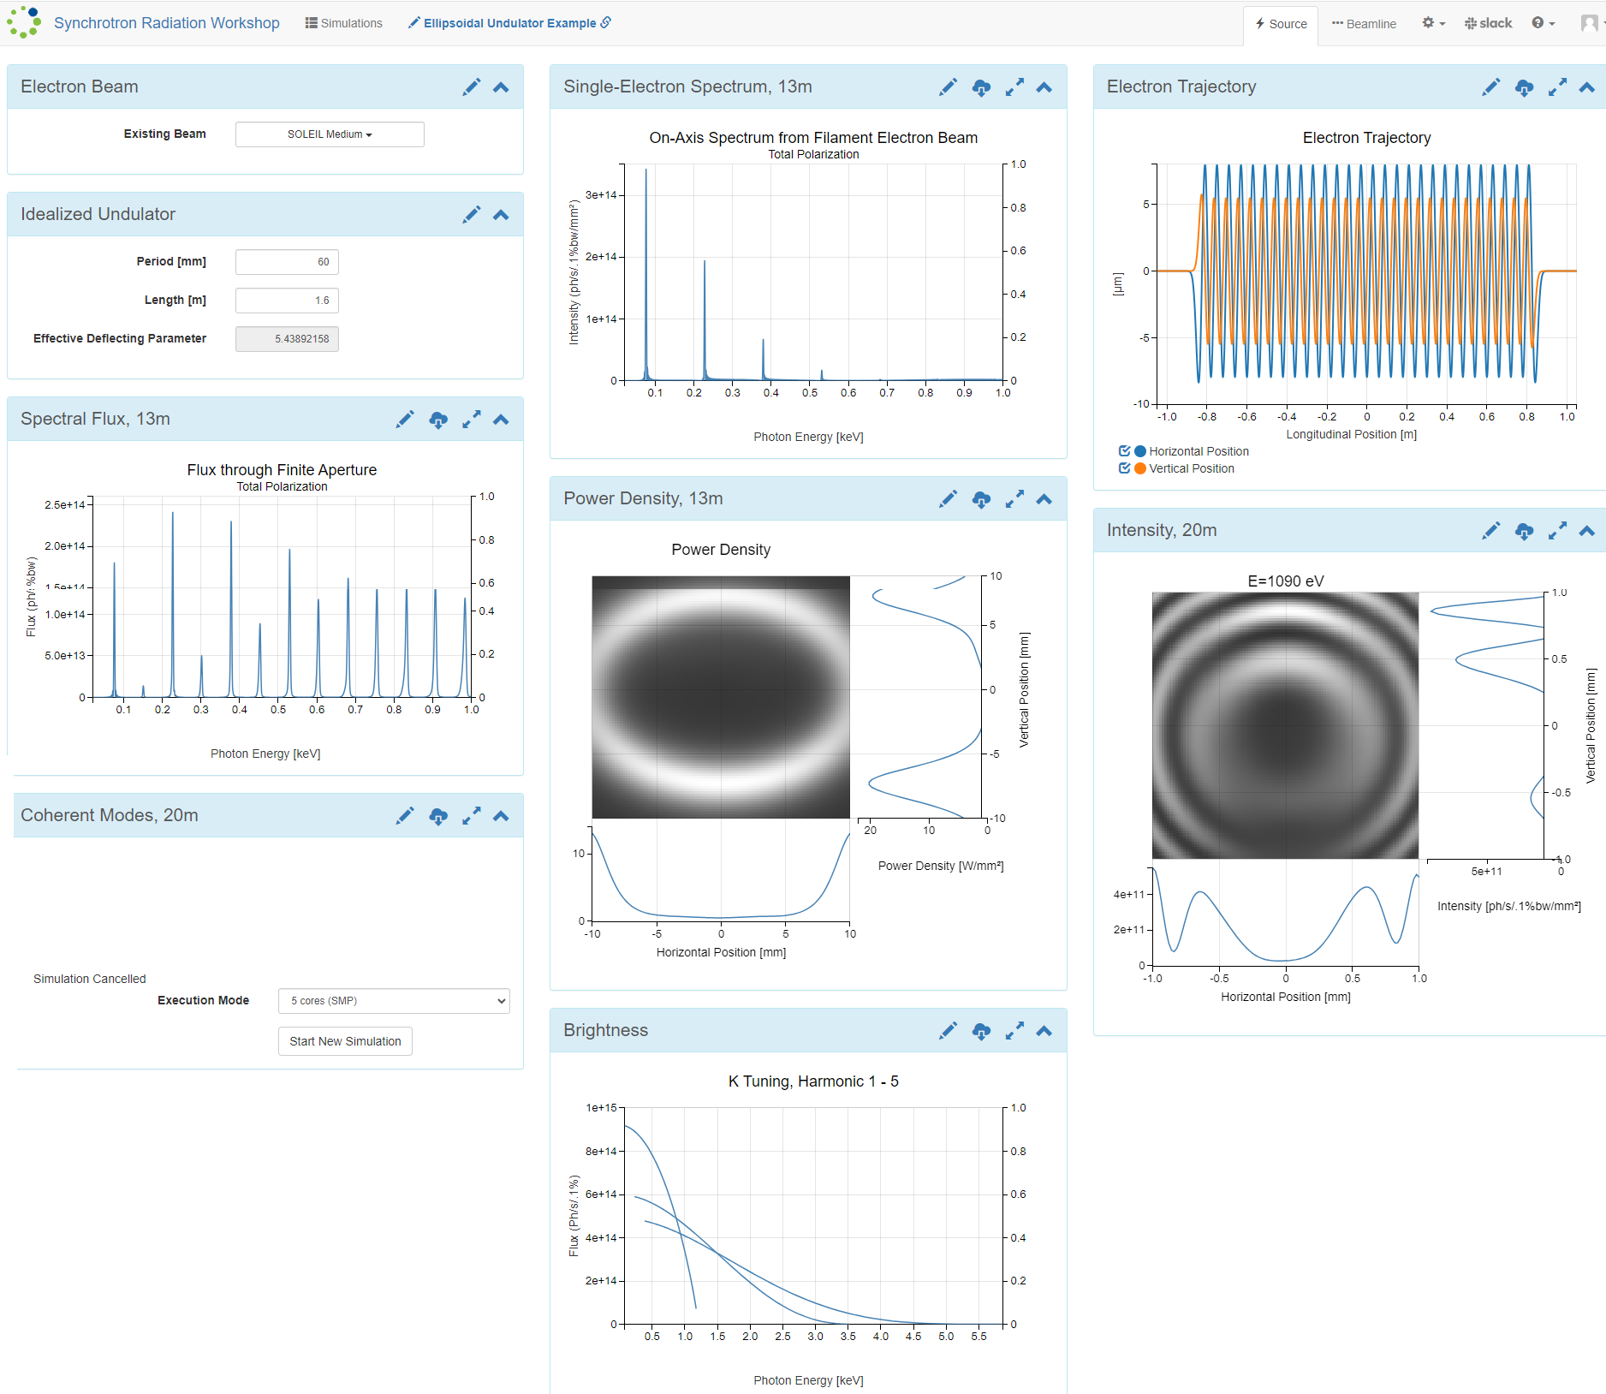
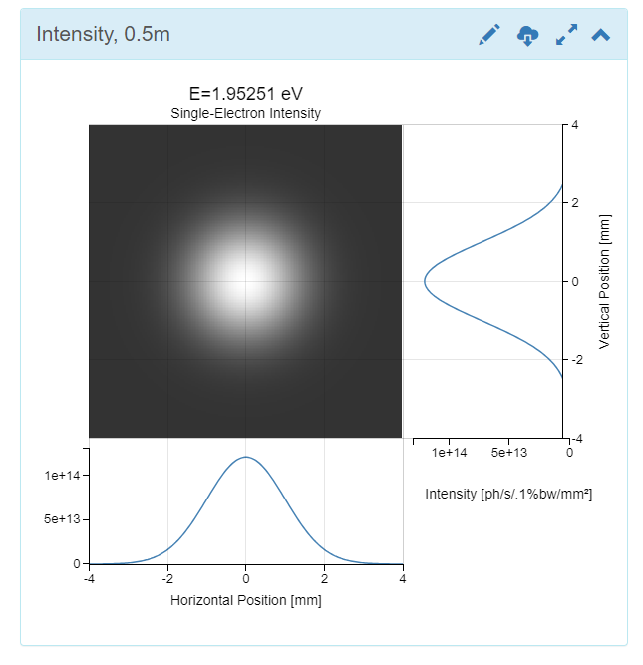
SRW & SIREPO
WebApp : https://www.sirepo.com ^{[8]}
[8] Maksim S. Rakitin, Paul Moeller, Robert Nagler, Boaz Nash, David L. Bruhwiler, Dmitry Smalyuk, Mikhail Zhernenkova and Oleg Chubar ,
Sirepo: an open-source cloud-based software interface for X-ray source and optics simulations
(2018). J. Synchrotron Rad. 25, 1877-1892.

Slide 12
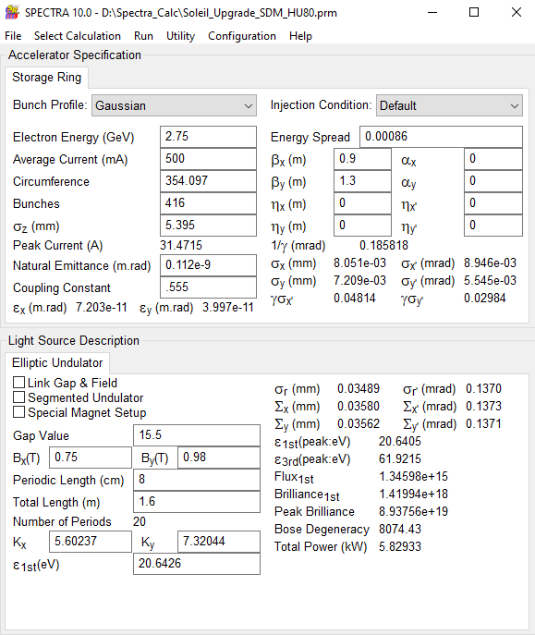
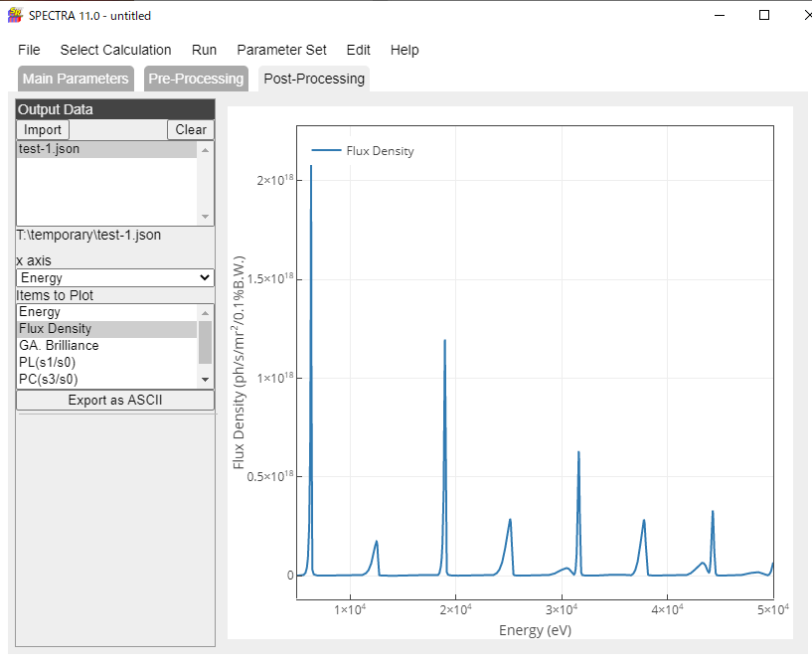
SPECTRA
SPECTRA ^{[9]} is used to calculate optical properties of SR
from bending magnets, wigglers and undulators and
arbitrary field distributions. Possibility to calculate
spectrum and power distributions after transmitting
through various filters and detectors
INPUTS : Graphical user interface, txt files, json
OUTPUTS : Graphical user interface, ASCII, …
[9] Tanaka, T. & Kitamura, H. (2001). SPECTRA: a synchrotron radiation calculation code. J. Synchrotron Rad. 8, 1221-1228.

Slide 13
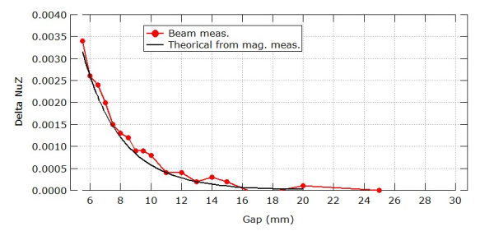
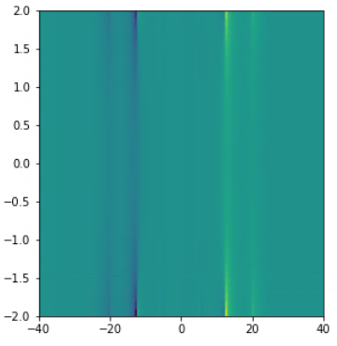
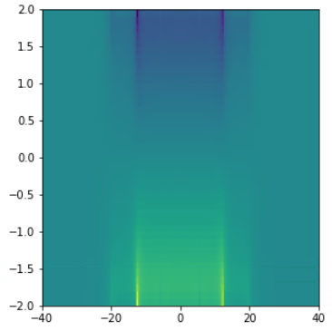
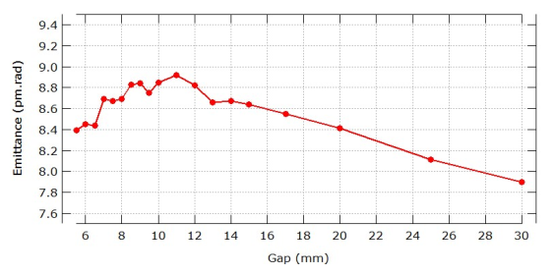
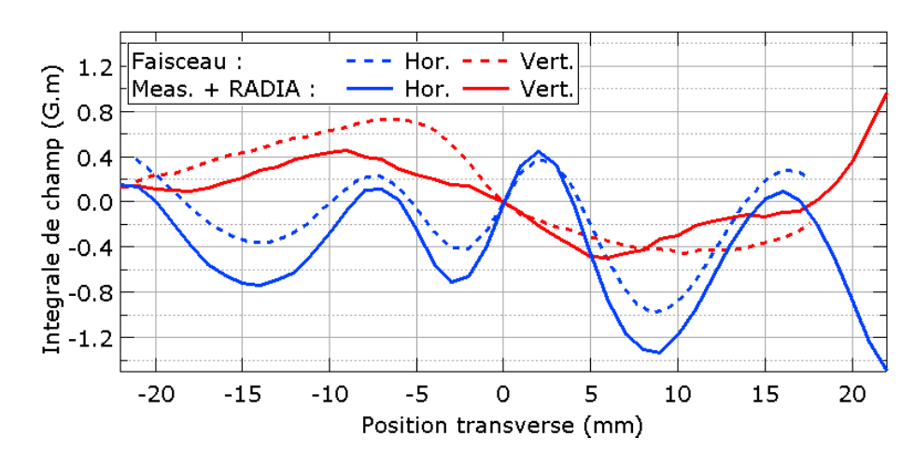
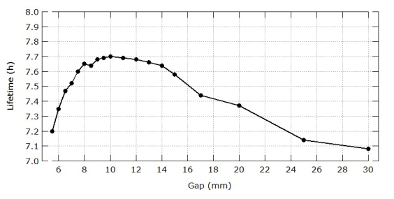
Validation of the models (with electron beam)
Hor. second order kicks
Ver. second order kicks
Vert. Position (mm)
Vert. Position (mm)
Hor. Position (mm)
Hor. Position (mm)

Slide 14
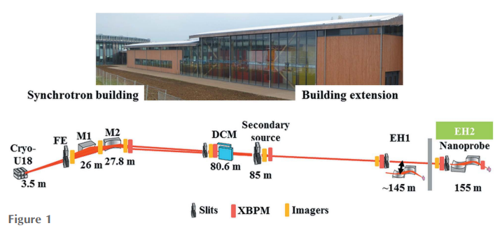
Validation of the models (with photon beam)
SRW is used to compute the effect of :
An ideal undulator (without phase errors)
The real undulator using magnetic measurements
Taking into account the optics of the machine, beam parameters,…
At SOLEIL, beamlines also uses SpotX ^{[11]} for radiation simulations including optical components of the beamline
[10] Somogyi, A et al. Journal of Synchrotron Radiation., 22(4): 1118-1129. (2015).
[11] MORENO, T. et IDIR, M. SPOTX a ray tracing software for X-ray optics. Le Journal de Physique IV, 2001, vol. 11, no PR2, p. Pr2-527-Pr2-531.
[12] C. Benabderrahmane, M. Valléau, M.-E. Couprie Development of a 2 m Pr2Fe14B cryogenic permanent magnet undulator at SOLEIL Proceedings of the 11th International Conference on Synchrotron Radiation Instrumentation, Lyon Journal of Physics Conference Series, volume 425, art. 032019, 2013

Slide 15
Modelisation of the magnets for the storage ring

Slide 16
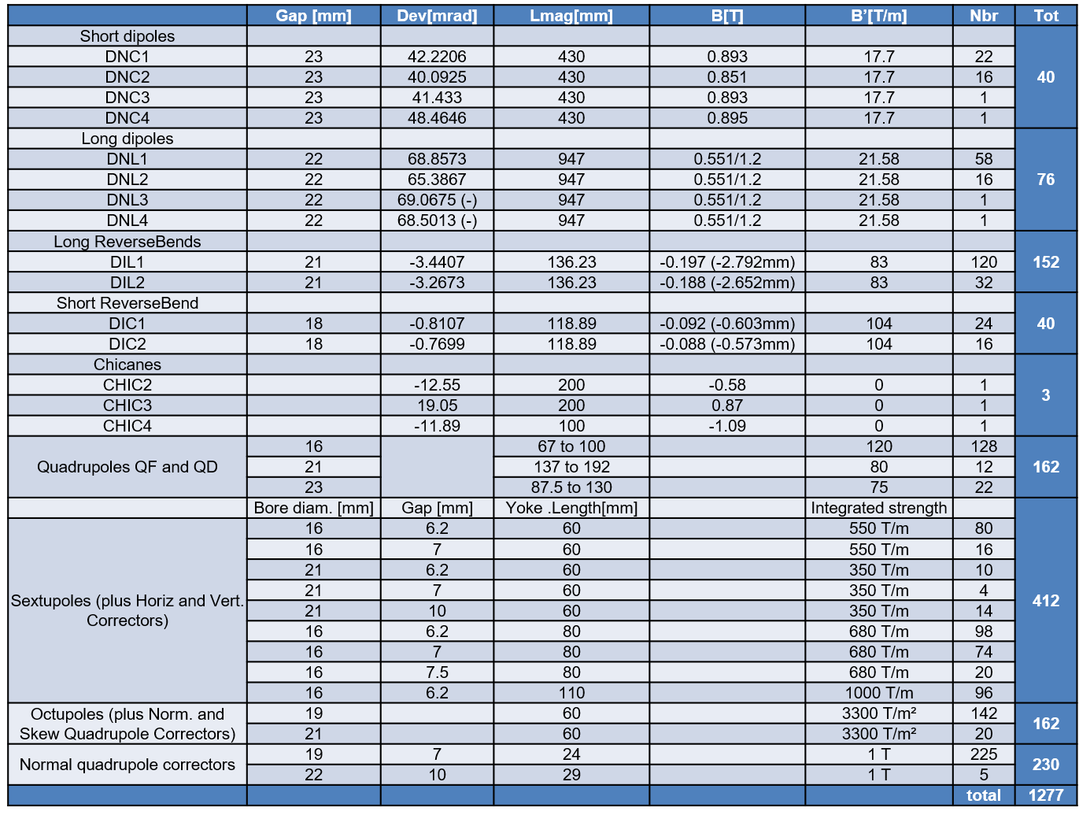
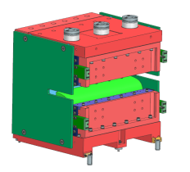
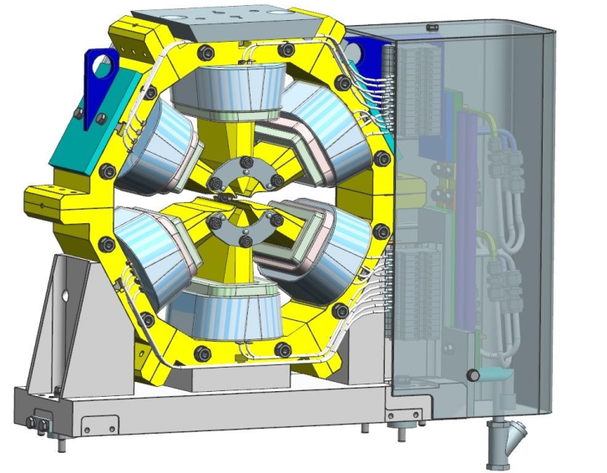
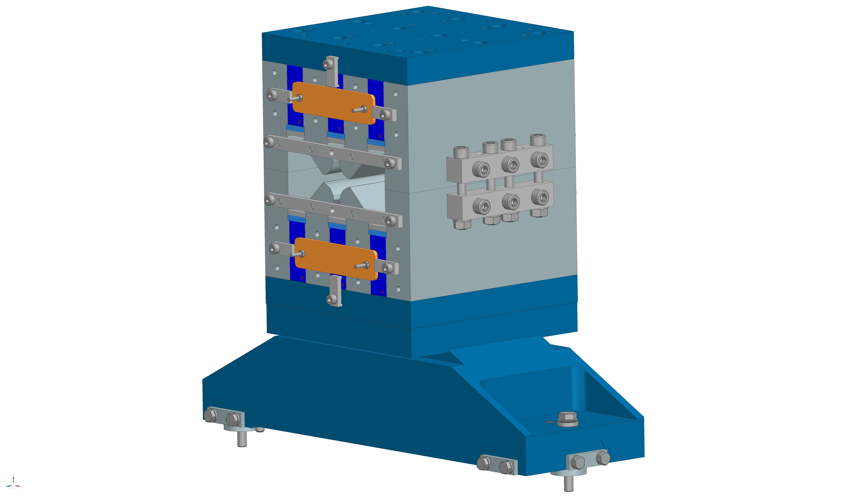
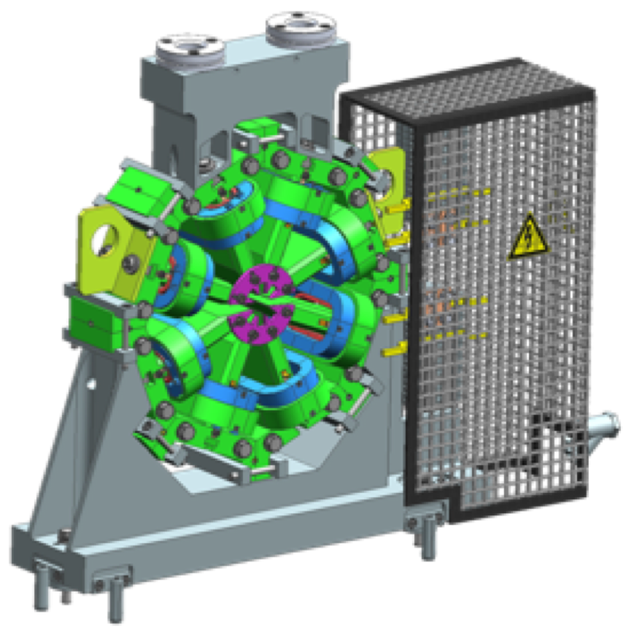
Introduction
Magnets for SOLEIL II

Slide 17
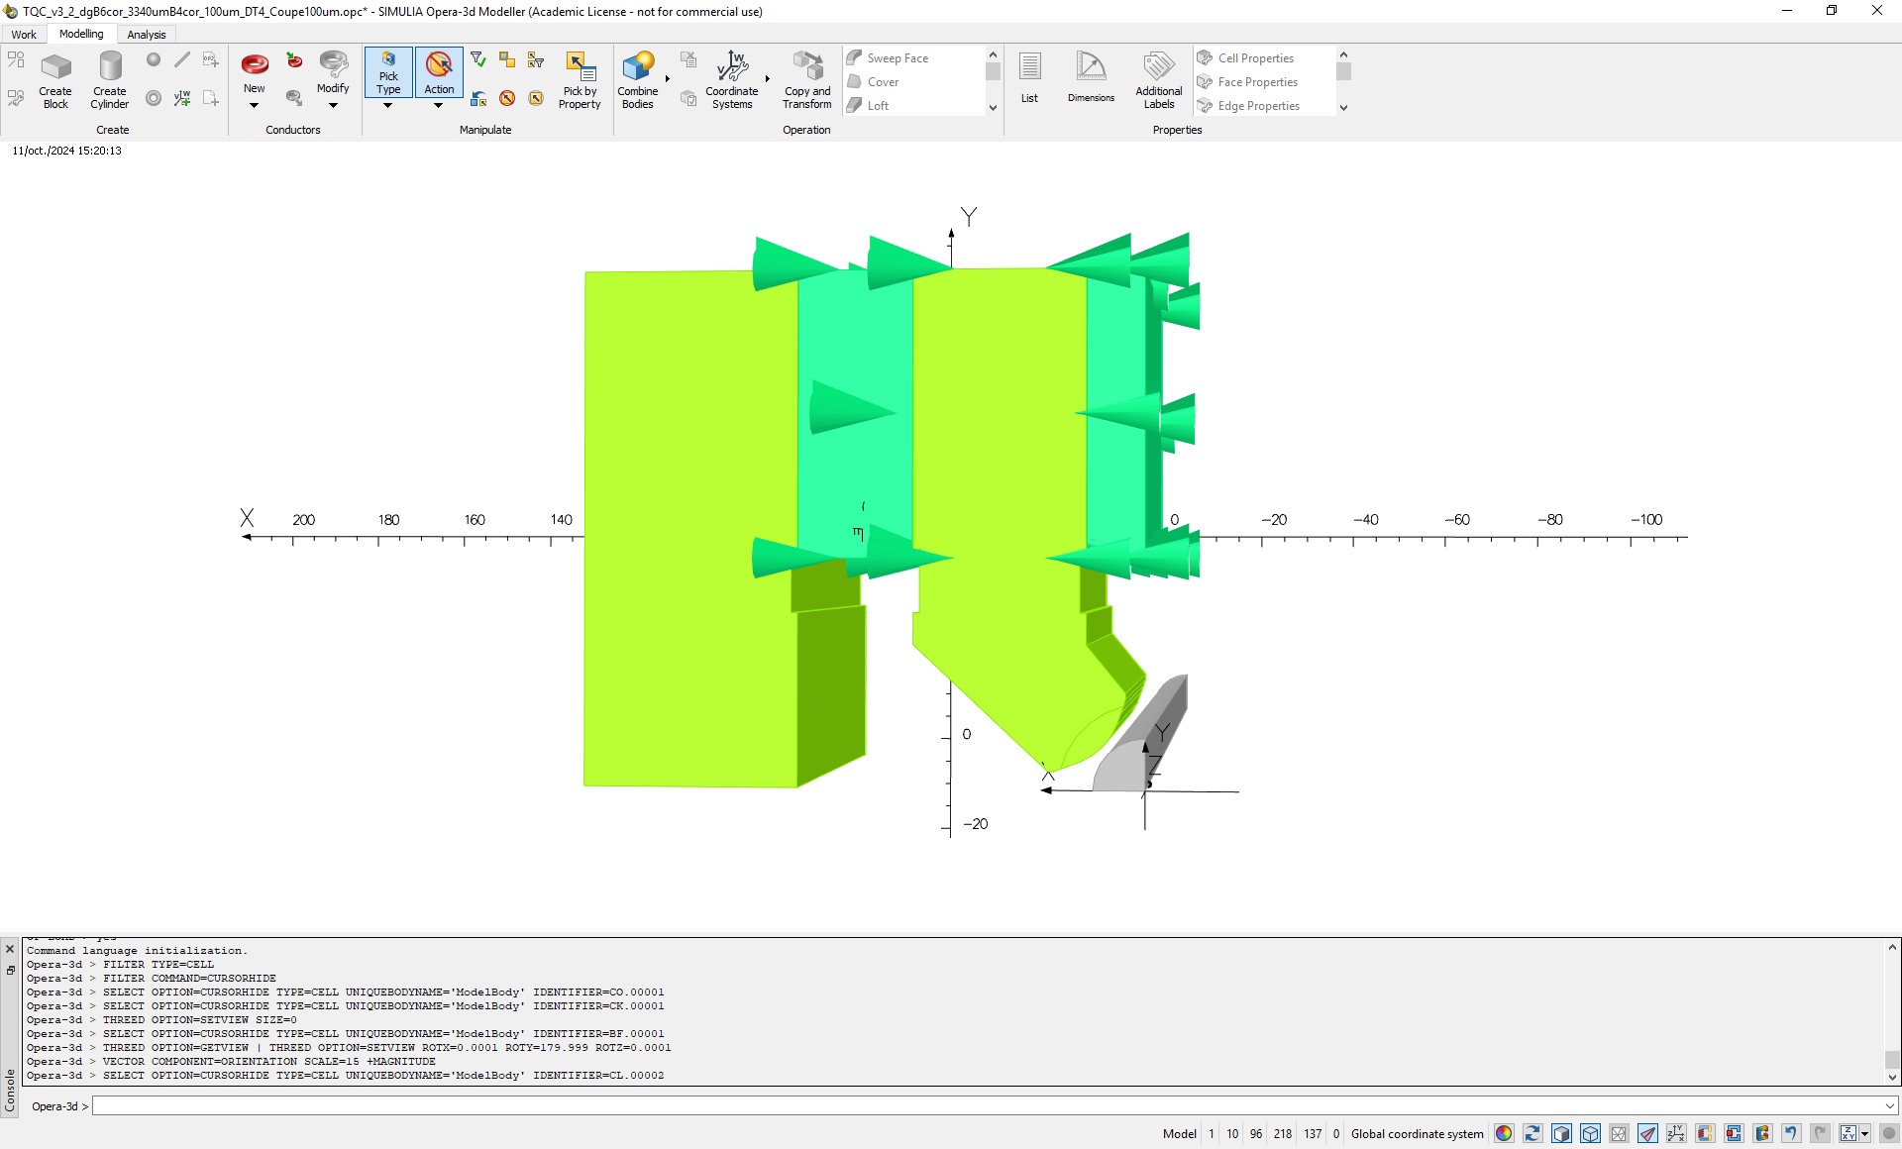
OPERA
OPERA Software (DASSAULT Systems):
Modeler
Static Solver
Dynamic Solveur
Particles tracking
Possibility to use/send step files
Transiant and frequency simulations
Thermal simulations
INPUTS : Graphical user interface, python interface
OUTPUTS : Graphical user interface, ASCII, …

Slide 18
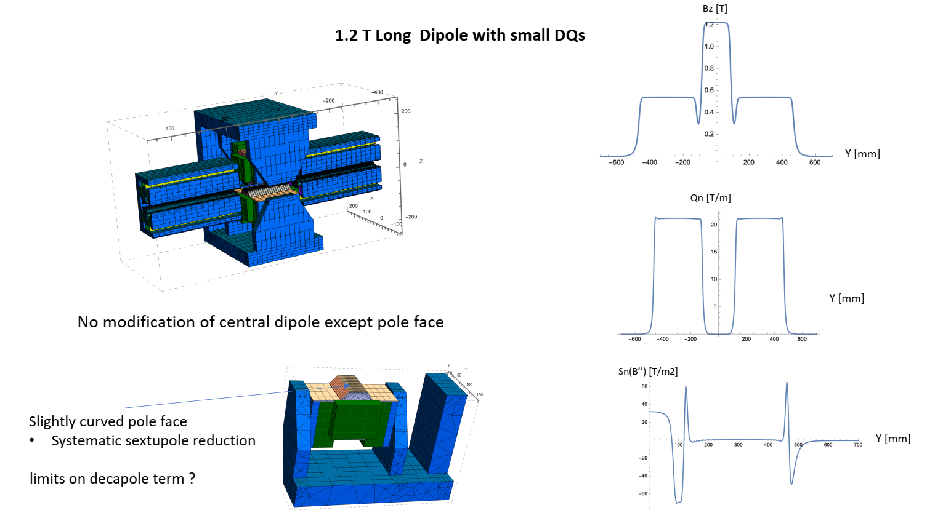
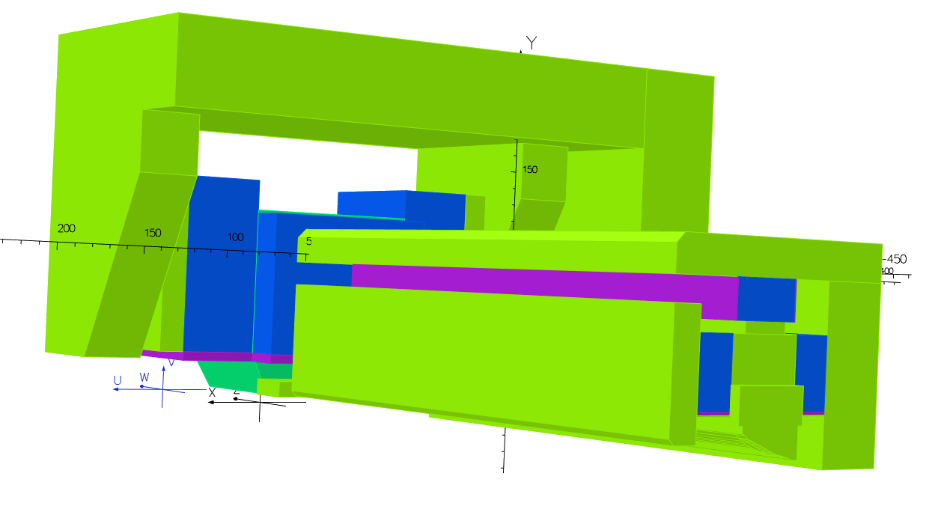
RADIA
OPERA model for comparison
(<0,5% diff with RADIA)
[1] P. Elleaume, O. Chubar, J. Chavanne, "Computing 3D Magnetic Field from Insertion Devices", proc. of the PAC97 Conference May 1997, p.3509-3511.
[2] O. Chubar, P. Elleaume, J. Chavanne, "A 3D Magnetostatics Computer Code for Insertion devices", SRI97 Conference August 1997, J. Synchrotron Rad. (1998). 5, 481-484

Slide 19
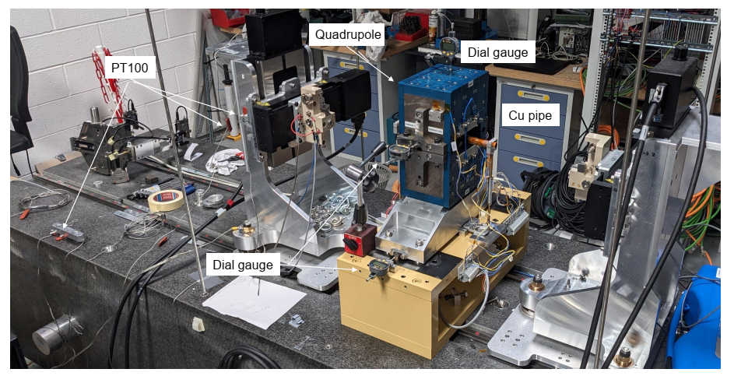
Validation of the models
Multiplar components @r=8mm (T.mm)
Difference of 0.147% between meas and
model (on the b2)
Few units of difference on b4 et b6
For n>10, noise on the measurements

Slide 20
Conclusion
Radia, B2E, IDBuilder and SRW are used intensively at SOLEIL for ID developments
have an interface with Igor Pro which is our main software for driving benches, storing and analysing datas
free software
dépendance with OS versions
Radia, and OPERA are used for the design of the magnets dedicated to new ring
Very good agrement between both softwares
The accuracy is dependant of the segmentation applied
OPERA remains very expensive
Non exhaustive list of softwares, only the ones that are used
in the ID Group at SOLEIL

