Slide 1
Methodology of electromagnet design
G. DILASSER

Slide 2
Presentation outline
Targets, constraints & variables
Legacy magnet design methodology
Numerical methods and software
Magnet design as an optimization problem

Slide 3
“Targets” & “Constraints”
“Targets”
“Project constraints”
“Physics constraints”
Desired properties of $\vec{B}$
Center field
Field harmonics
Some integral of $\left|\vec{B}\right|$
…
Fringe field
Conductor properties
Manufacturable length
Superconductor critical surface $\left(T_{c},B_{c},J_{c}\right)$
Thermal loads from experiment
Current ramp time
Superconducting magnet safety in case of quench
Hotspot temperature
Discharge voltage
Electromagnetism
Bore aperture
Outer dimensions
Maximum weight
Electricity
General / technical
Mechanical strength of the windings
Mechanics
$$$
Thermic
Material science

Slide 4
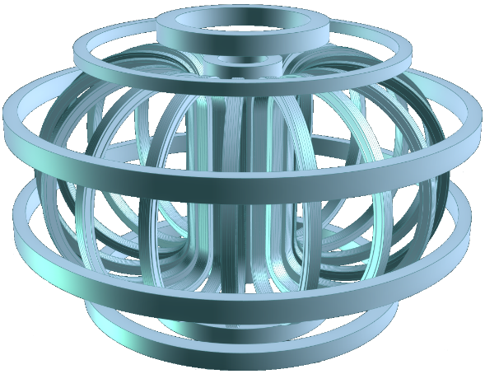
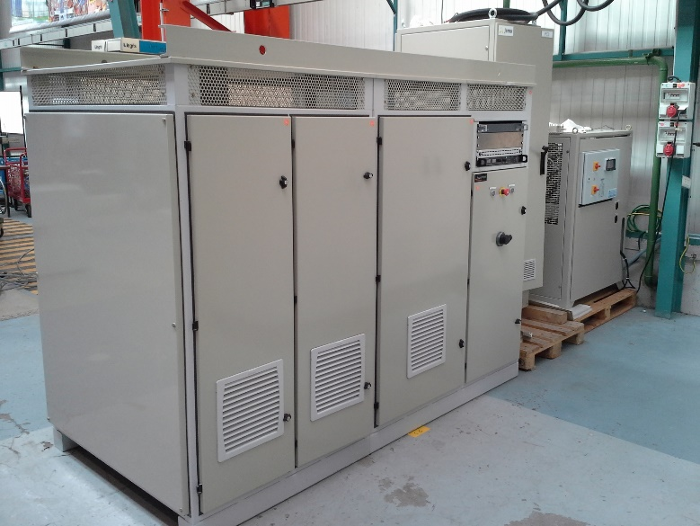
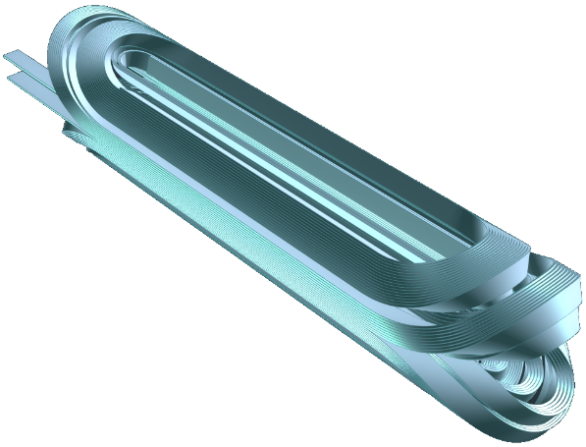
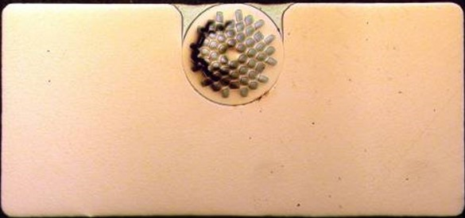
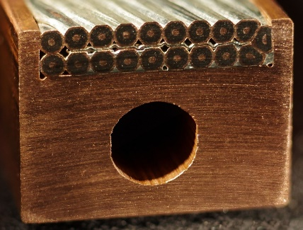
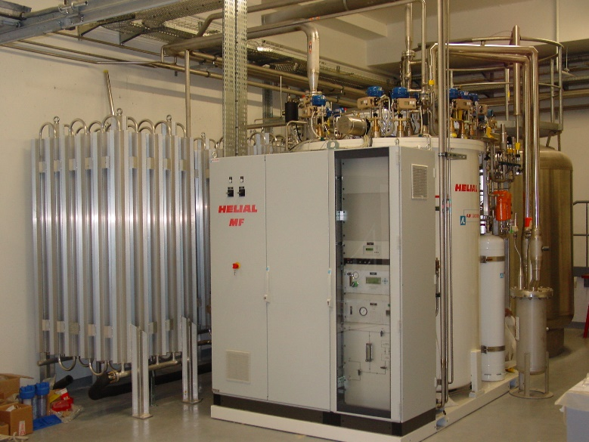
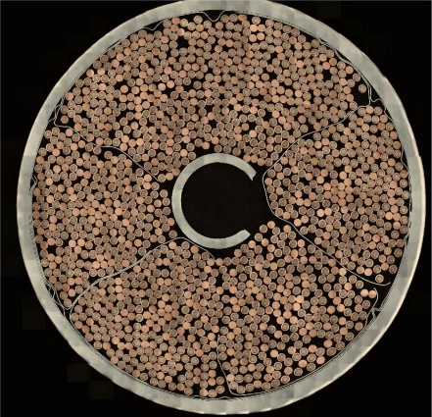
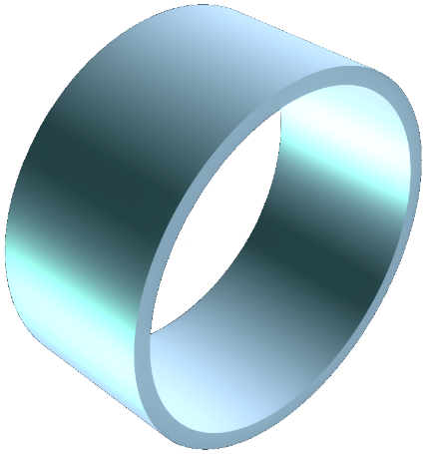
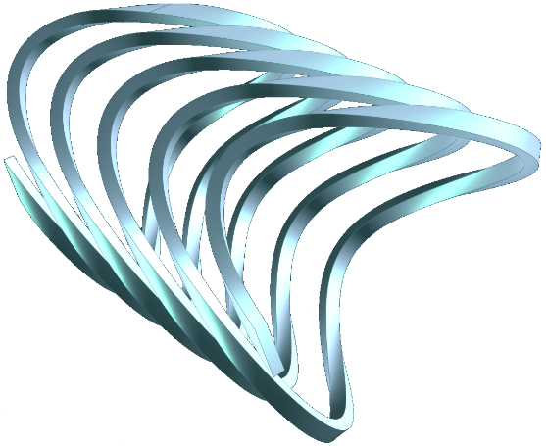
“Variables”
In fact, we are not only designing a magnet but an integrated system comprising:
One (or more) conductor(s) | Winding geometry | External servitudes (PSU, coolers, etc)
Overall dimensions?
Material fractions?
Coolant section?
Winding configuration?
Number of layers, turns?
Operating current?
Operating temperature?
Available refrigeration power?

Slide 5
Methodology for superconducting magnets
Homogenized properties
Known conductor properties
$$λ,μ$$
$$σ_{y}$$
Winding geom.
Laplace forces
START
Mechanical simulation
$u, σ$
Conductor
mechanic
Mechanical simulation
$$j_{E}$$
Target $\vec{B}$
Margins
Hotspot $T$
Discharge $V$
N
Magnetic simulation
OK?
Y
Magnetic simulation
Over-field
OK?
N
Eddy losses
Cool-down
Y
Conductor shape
Material %
Thermal simulation
END
$E_{mag}$
$B_{peak}$
Conductor design
$I_{n}$
Cooling
Electromagnetism
External circuits
Electricity
Mechanics
Thermic
Material science

Slide 6
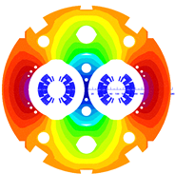
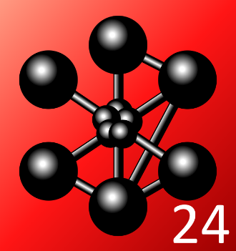
Coupled magnetic / mechanical design
Designing the winding shape is an iterative process:
Assumptions on homogenized winding properties (engineering current density, Young modulus, etc)
Magnetostatic simulations to get a winding shape generating the desired magnetic field
Simulations of the homogenized windings mechanical strength under the Laplace forces
Target $\vec{B}$
Constrained geometry
$$λ,μ$$
Material $σ_{y}$
Winding geom.
Laplace forces
$$j_{E}$$
Magnetic simulation
Mechanical simulation
$u, σ$
OK?
Y
START
N
Electromag. simulation software
Mechanical simulation software
Opera (Dassault)
Roxie (CERN)
RAT (Little Beasts Engineering)
Ansys (Ansys Inc.)
Cast3M (CEA)

Slide 7
Conductor definition
With $\vec{B}$ on the windings computed, we can also design a conductor:
SC + Cu
$T_{op}$ Hotspot $T$
Discharge $V$
LHe
Cu
$E_{mag}$
Discharge $V$
Margins
Design stabilizer
% Cu
Design insulation
Ins. thickness
$j_{E}$
$B_{peak}$
% SC
Quench
Design supercond.
Geometrical aspect
Defined conductor
AC/DC $T_{op}$
$${dI}/{dt}$$
Normal operation
$$T_{op}$$
Thermal loads
$$P_{th}$$
Conductor cryogeny
% cryo.
General / technical
Conductor
Electricity
Auxiliaries
Power supply
$I_{n}$
Thermic
Cryoplant
$$P_{cryo},\dot{q}$$
Material science

Slide 8
Thermal design
The thermal design depends on the resistive / superconducting nature of the magnet:
 | Superconducting magnet | Resistive magnet
Normal operation | Transient thermal losses (Eddy currents, stick-slip motions, etc.) Thermal loads from experiment (for ex. radiation from beam or plasma)
 | Cryostat losses (conduction & radiation) Magnet cool-down / warm-up time Choice and design of the cold source Minimization of the cryostat losses | Steady-state Joule losses Design of the continuous cooling (typ. water flowrate)
Default case | Simulation of quench dynamics (hotspot, thermal gradients, voltages) Area devoted to cryo in the conductor Design of the quench detection and protection systems

Slide 9
Numerical methods
Numerical techniques:
95% old-fashioned FEA in static cases
Some Fast Multipole Method (FMM) to speed up magnetostatic computation
Some Partial Element Equivalent Circuit (PEEC) for High-Temperature Superconductors
Major difficulties do not reside in the numerical methods:
Having good fits of material properties at low $T$ and under high $B$
Highly non-linear current-voltage law for superconductor $e\left(j\right)∝j^{n}$
Hardest problem to simulate remains the quench of superconducting coils:
Intrinsically dynamic
Coupled physics: electromagnetic + thermohydraulic + electrical network (+ mechanical)

Slide 10
Panorama of software used
Usage | Software | Editor | Usage
Magnetic simulations | Opera | Dassault Systèmes | Reference tool for magnetic simulations
 | Roxie | CERN | Used only for accelerator magnets
 | RAT | Little Beasts Engineering | Cheaper / free alternative to Opera gaining traction
Mechanical simulations | Ansys | Ansys Inc. | Reference tool for mechanical / thermal simulations
 | Cast3M | CEA (LM2S) | For specific mechanical simulations
Thermal simulations | THEA | CryoSoft | Thermo-hydraulic of magnet cooling and quenches
 | Comsol | Comsol Inc. | Mostly used for thermal simulations
Material properties | Hepak | Cryodata (formerly NIST) | Properties of Helium
 | Cryocomp | Eckels Engineering | Properties of solids at cryogenic temperatures
CAD | SolidWorks | Dassault Systèmes | CAD and light thermal / mechanical simulations
 | NX | Siemens PLM Software | CAD and technical drawing
Optimization | NAG Library | Numerical Algorithm Group Ltd. | Design optimization with mathematical programming
 | Alesia | CEA (LEAS) | Project management and evolutionary algorithms
Miscellaneous | Matlab, Python... | Various | Various in-house codes
Resistive magnets | HiFiMagnets | CNRS (LNCMI) | Toolchain to design resistive magnets based on C++ open-source library Feel++ used at LNCMI

Slide 11
Conventional sequential workflow
Laplace forces
Homogenized mechanical sim.
Stresses & deformations
Local stresses
Conductor mechanic
Cryostat thermal design
Overfield
Margins
Homogenized magnetic sim.
Winding geometry
Detailed magnetic sim.
Hotspot
Voltages
Peak field & Stored energy
Conductor & auxiliaries
Conductor geometry
Quench model
Design update

Slide 12
Some kind of optimization problem
Current tendency is to rephrase the design problem as optimization problem:
New design approach leverages evolutionary algorithms:
Population of design candidates combining magnet & conductor properties
Compute candidate fitness through parallel physic simulations
Recombine next generation from best current candidates and mutate
Methodology implemented in ALESIA with several algorithms
(genetic algorithm, particle swarm optimization, differential evolution, covariance matrix
adaptation evolution strategy, etc.)
Goal is either: Maximize some measurement of $\vec{B}$ Minimize magnet cost | Under many constraints but most notably: Laplace forces do not tear the windings apart Thermal losses do not make them burn

Slide 13
Optimization-based workflow
Material database
Parallel
Laplace forces
Mechanical simulation
Stresses & deformations
Population of candidate designs
Magnetic simulations
Peak field & Stored energy
Quench model
Hotspot temperature
Fitness computation
Optimized
solution
Magnetic field
Feature extraction
Field characteristics
Generate new population

Slide 14
Thank you for your attention; are there any questions?
CEA Paris-Saclay
Guillaume DILASSER
Bât. 123, p. 213c
Point courrier n°11
91191 Gif-sur-Yvette Cedex
guillaume.dilasser@cea.fr

Slide 15
Back-up slides
X

