Slide 1


A multiplatform toolbox for optics design, fast tracking, collimation and collective effects
G. Iadarola, R. De Maria, S. Łopaciuk,
A. Abramov, X. Buffat, D. Demetriadou, L. Deniau, P. Hermes, P. Kicsiny, P. Kruyt, A. Latina,
L. Mether, K. Paraschou, J. Salvesen, G. Sterbini, F. Van Der Veken, CERN, Geneva, Switzerland
P. Belanger, TRIUMF, Vancouver, Canada
D. Di Croce, T. Pieloni, L. Van Riesen-Haupt, M. Seidel, EPFL, Lausanne, Switzerland
P. Niedermayer, GSI, Darmstadt, Germany
Work supported by:
https://xsuite.web.cern.ch

Slide 2
Outline
Introduction
  Motivation
  Design goals and constraints
  Architecture
  Agile development
Lattice modeling, simulation and optimization
  Lattice modeling
  Single-particle tracking
  Dynamic parameter control
  Multi-objective optimizer
Simulation of specific processes
  Particle-matter interaction
  Synchrotron radiation
  Collective effects
Final remarks

Slide 3
Outline
Introduction
  Motivation
  Design goals and constraints
  Architecture
  Agile development
Lattice modeling, simulation and optimization
  Lattice modeling
  Single-particle tracking
  Dynamic parameter control
  Multi-objective optimizer
Simulation of specific processes
  Particle-matter interaction
  Synchrotron radiation
  Collective effects
Final remarks

Slide 4
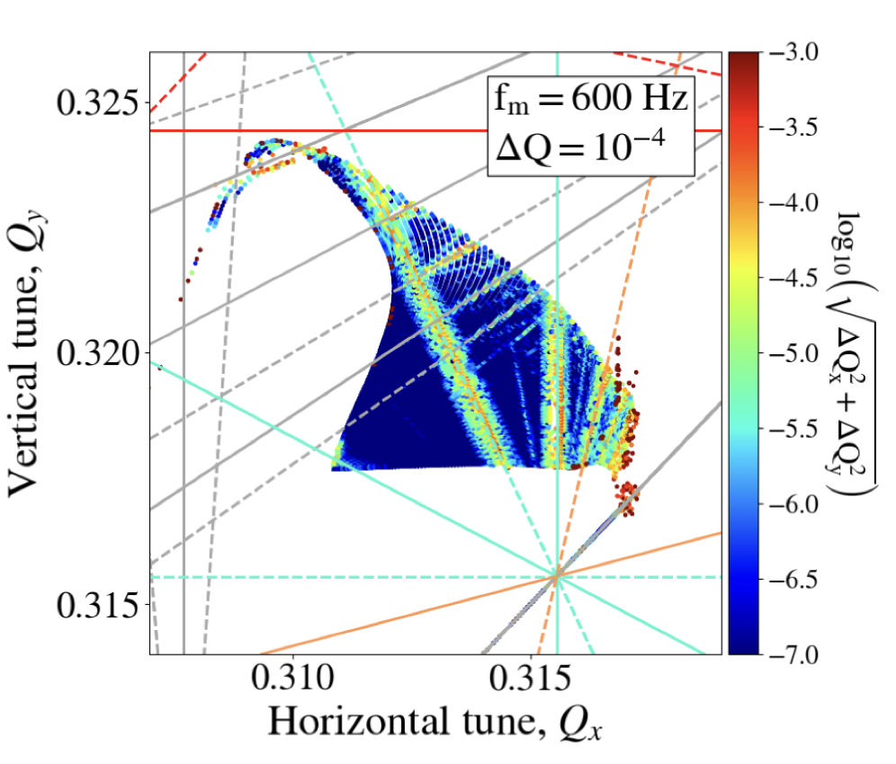
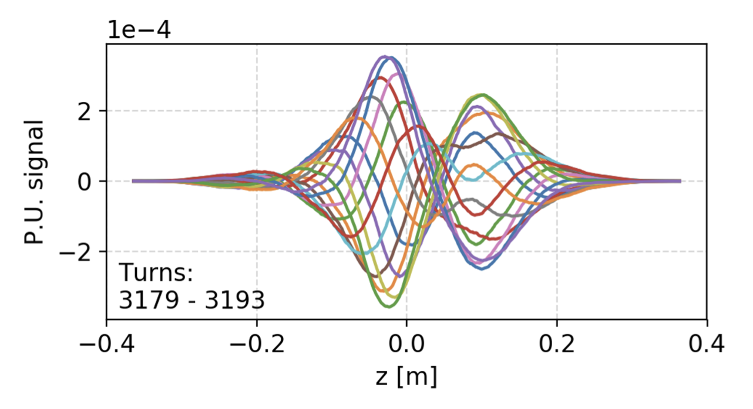
Introduction
CERN has a long tradition in the development of software tools for beam physics
Powerful tools provided to the user community:
MAD-X, standard for lattice description, optics calculation and design, tracking
Sixtrack, a fast-tracking program used mainly for long single-particle simulations
Sixtracklib, a C/C++library for single-particle tracking compatible with Graphics Processing Units (GPUs)
COMBI, for the simulation of beam-beam effects using strong-strong modelling
PyHEADTAIL, a Python toolkit for collective effects (impedance, feedbacks, space charge, and e-cloud).
Developed over decades, providing powerful features in their respective domains
4

Slide 5


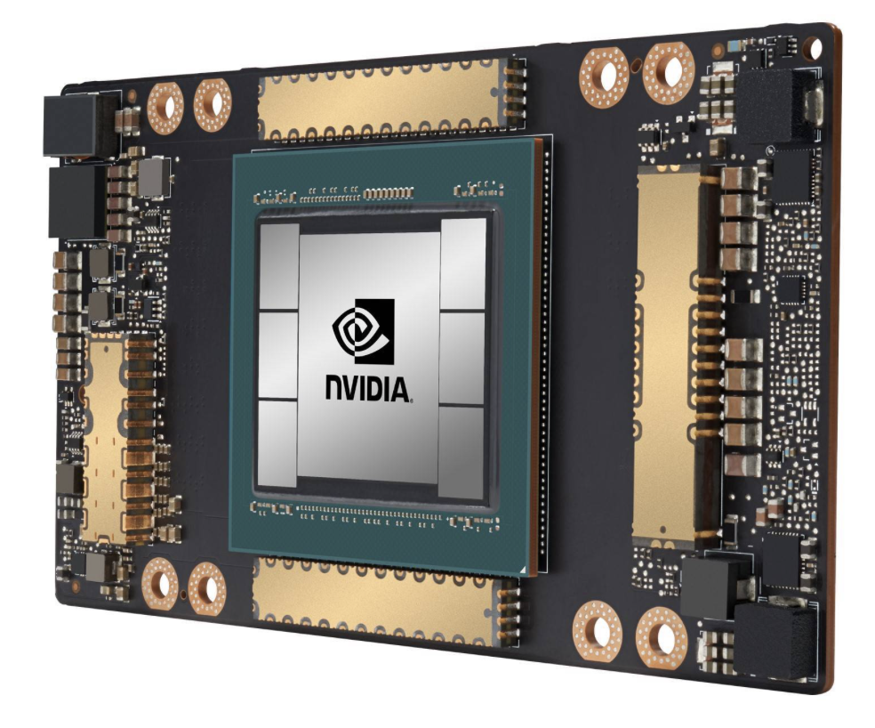
Motivation
Over the years we started to facing needs that could not be easily fulfilled with legacy tools:
Integration: very difficult to combine features from different codes to simulate complex heterogeneous effects
Extendability: difficult to extend to present needs (notably those coming from FCC-ee)
User interface: need to move away from custom interfaces (text files / ad-hoc scripting) towards standard Python packages
  Present de-facto standard in scientific computing
  Allows leveraging an ever-growing arsenal of general-purpose Python libraries (statistics, linear algebra, frequency analysis, optimization, plot, etc.)
GPU acceleration: mandatory for several applications but cumbersome to retrofit in the existing codes
5

Slide 6
Xsuite
This led to the launch of the Xsuite project in 2021
Main goal: bring into a modern Python toolkit the know-how built in developing MAD, Sixtrack, COMBI…
  Cover with one toolkit applications ranging from low-energy hadron rings to high-energy lepton colliders
Designed for seamless integration of components and for extendibility
Support different computing platforms, including multicore CPUs and GPUs from different vendors
Preserving experience and know-how, but not really reusing source code
Design constraints:
Need to grow the code in a “sustainable” way, being managed and maintained by a small core team integrating (in a clean way!) contributions by a wide developer community
Need developer learning curve to be short as possible
  Field specific features developed directly by field experts
6

Slide 7


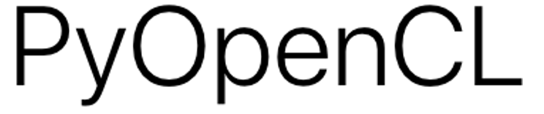



Xsuite – architecture
Xpart
generation of particles distributions
Xtrack
single particle
tracking engine
Xfields
computation of EM fields from particle ensembles
Xdeps
Dependency manager,
deferred expressions
Physics modules
Xcoll
Particle-matter interaction and collimation
Xobjects
interface to different computing plaforms
(CPUs and GPUs of different vendors)
Lower level libraries
(external, open source)
Hardware

Slide 8
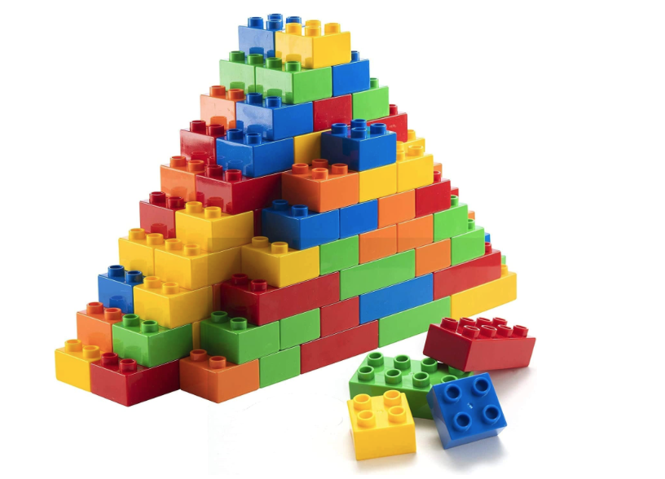
Orthogonal design
Project employs an “orthogonal” design strategy:
Ensure that each functional block remains well-isolated and interacts with the others through clearly defined interfaces
This approach has two key advantages:
  Enables contributors to modify or expand specific components without full knowledge of other parts nor of underlying software infrastructure
  Minimize codebase complexity, such that it increases linearly rather than exponentially as new features are added
8

Slide 9
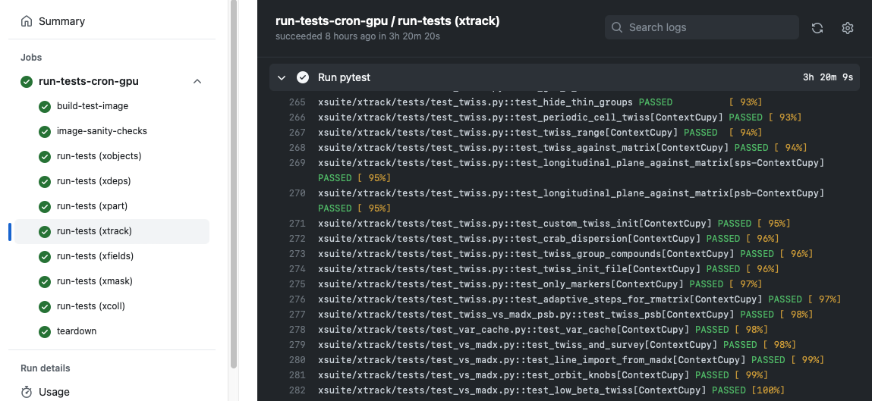
Development strategy
Our development follows the agile principles:
Since early development stages we engaged with the user community, encouraging and supporting users to test and exploit the code in full-scale studies
Code evolves incrementally, promptly applying needed fixes and improvements
  Rely on fast release cycle (new versions released multiple times per month) while ensuring no disruption due to version changes on the user’s side.
  Made possible by large investment automatic testing: each version of Xsuite undergoing over a thousand automatic checks (on CPU and GPU)
9

Slide 10
Outline
Introduction
  Motivation
  Design goals and constraints
  Architecture
  Agile development
Lattice modeling, simulation and optimization
  Lattice modeling
  Single-particle tracking
  Dynamic parameter control
  Multi-objective optimizer
Simulation of specific processes
  Particle-matter interaction
  Synchrotron radiation
  Collective effects
Final remarks

Slide 11
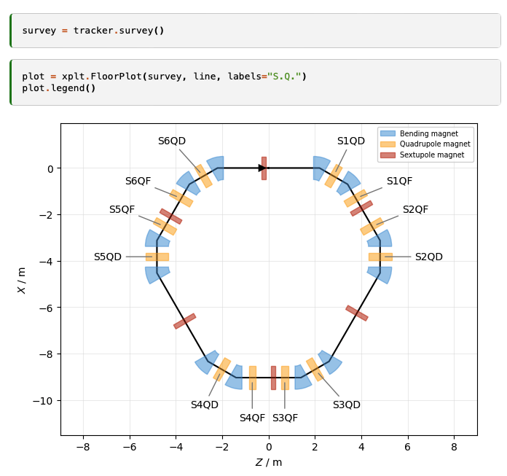
Lattice modelling
Xsuite model of a ring
(represented with the Xplt package)
The beam line is represented as a sequence of Python objects, each corresponding to an accelerator element or to other physical processes (e.g. magnets, cavities, aperture restrictions, etc.).
  Can be defined manually or imported from MAD-X
  Including tilts, misalignments and multipolar errors
We provide:
“Thin” lattice integration, largely based on the Sixtrack and Sixtracklib experience
“Thick” maps for bending and quadrupole magnets
Dipole edge effects including fringe fields can be modeled either in their linearized form or as full non-linear maps (same fringe model as in MAD-NG and PTC).
11

Slide 12
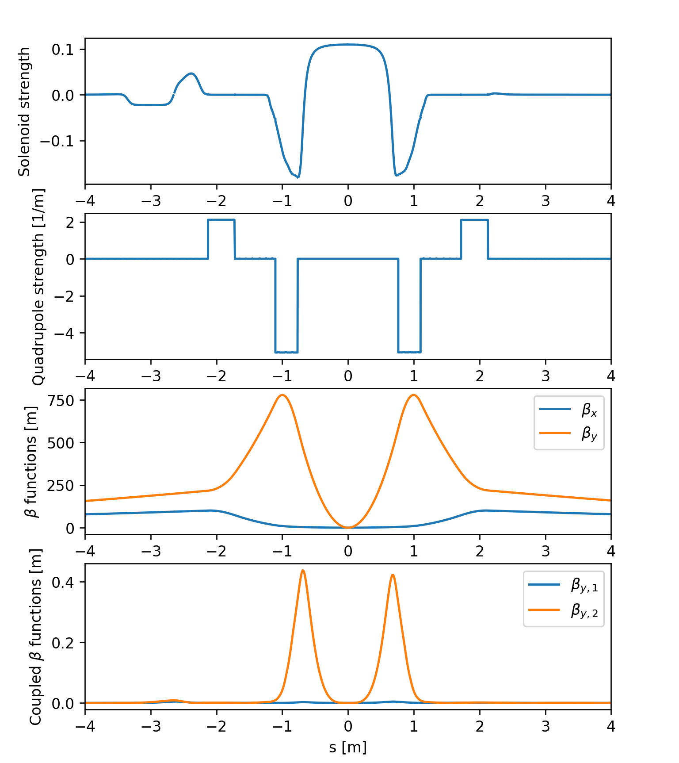
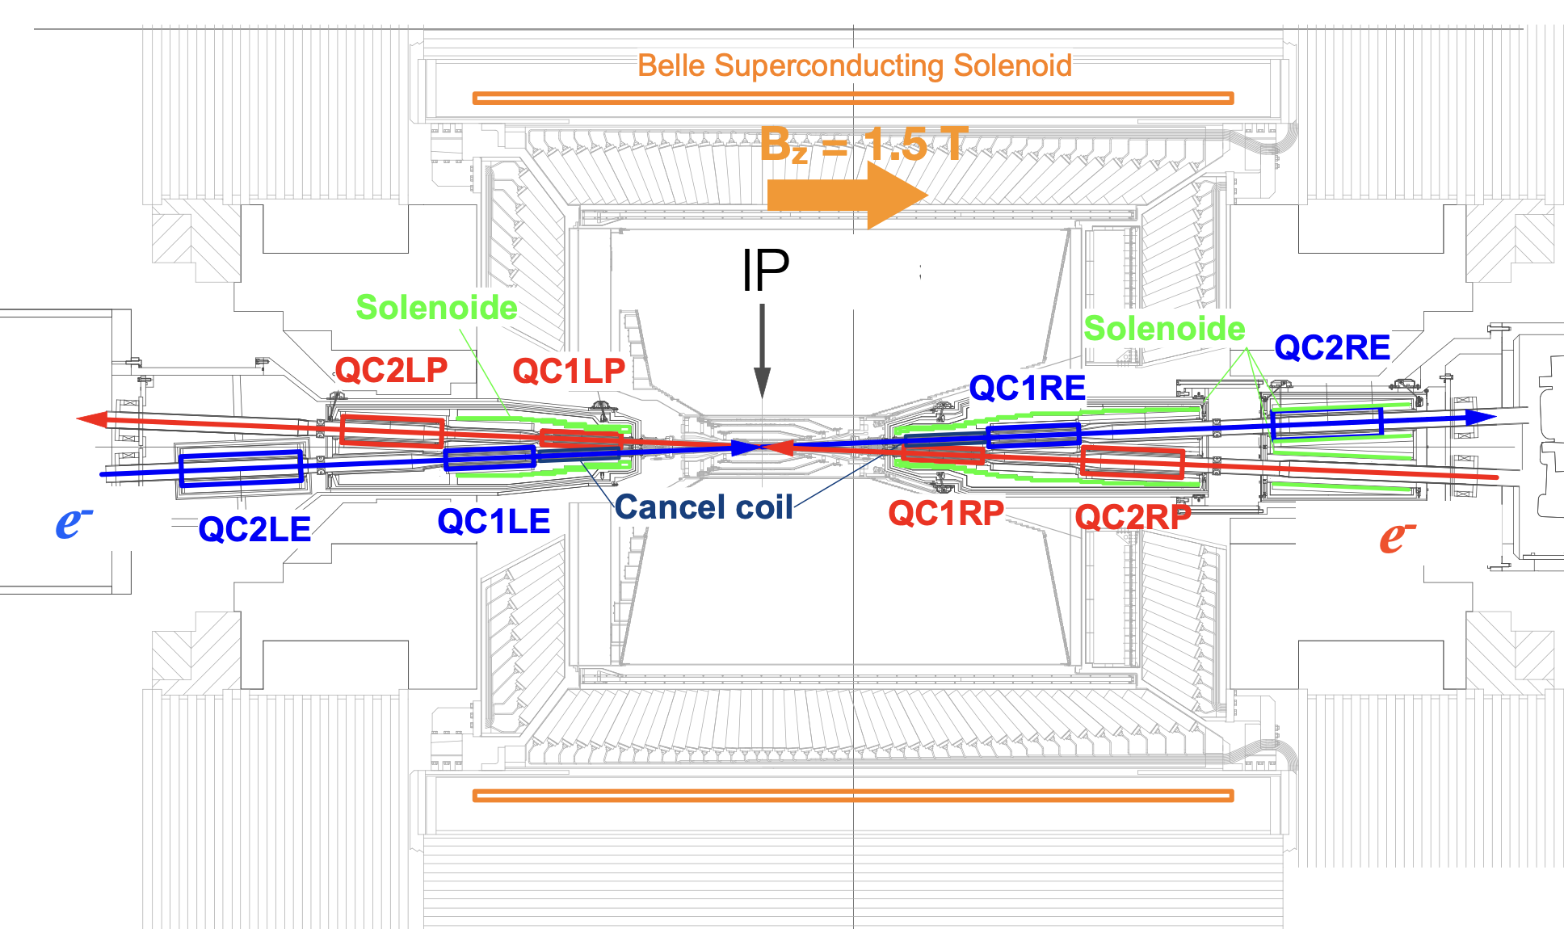
Solenoids and overlapping elements
SuperKEKb interaction region
Recent developments allow modelling of experimental solenoids of lepton colliders also in the presence of overlapping multipole fields
Tested on FCC-ee and SuperKEKb models
12
Many thanks to G. Broggi, J. P. Salvesen, KEK experts

Slide 13
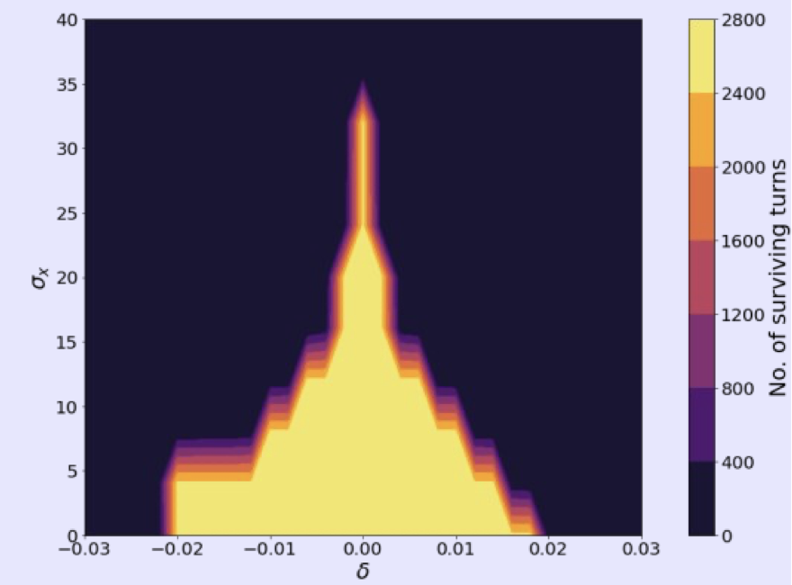
Single particle tracking
Multiturn element-by-element tracking speed is critical for several application
To speed up tracking simulations, Xsuite assembles and compiles a C kernel (callable from Python) optimized for the given beamline and specialized for the chosen platform (CPU or GPU)
  The tra cking speed is found to be similar to Sixtrack for single-core CPU and about two orders of magnitudes faster than that on high-end GPUs
Example: Xsuite simulations used to study FCC-ee DA and momentum acceptance
Tracking time for a typical LHC simulation
Platform | Computing time
CPU (single core) | 190 (μs/part./turn)
GPU (NVIDIA V100, cupy) | 0.80 (μs/part./turn)
GPU (NVIDIA V100 pyopencl) | 0.85 (μs/part./turn)
Courtesy M. Hofer
13

Slide 14
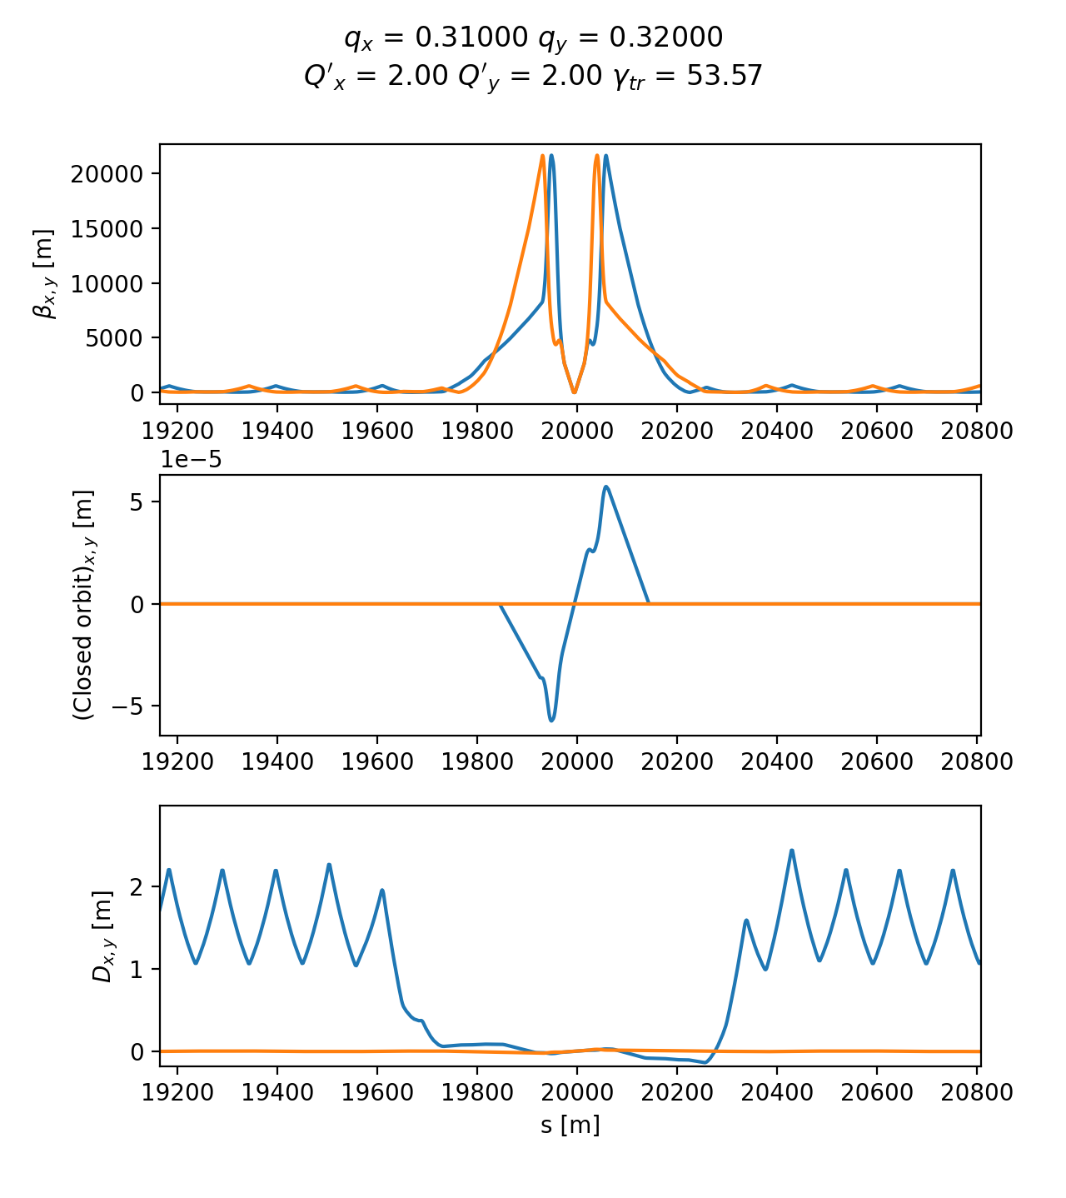
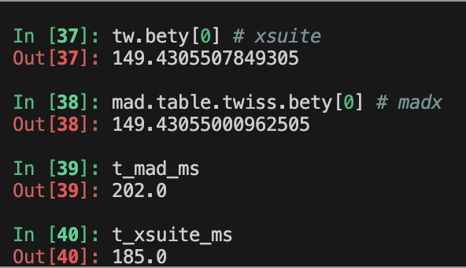
Twiss module
The Xsuite Twiss module can be used to extract lattice functions of a ring or a beamline
The calculation probes the lattice simply by tracking particles:
  Closed orbit obtained by applying a Python root finder on the tracking
  The Jacobian matrix obtained by tracking (central differences)
  Compute “Linear Normal Form” of the Jacobian matrix (diagonalization)
  Propagate eigenvectors by tracking
  Obtain from the eigenvectors Twiss parameters (𝛼, 𝛽, 𝛾) , dispersion functions, phase advances, coupling coefficients
Computation can be done with assigned beam momentum to get off-momentum beta-beating, non-linear chromaticity, non-linear dispersion, etc.
HL-LHC optics
Accuracy compared to MAD-X: Δβ / β << 10⁻⁴
Computation time is very similar
14
Example
14

Slide 15
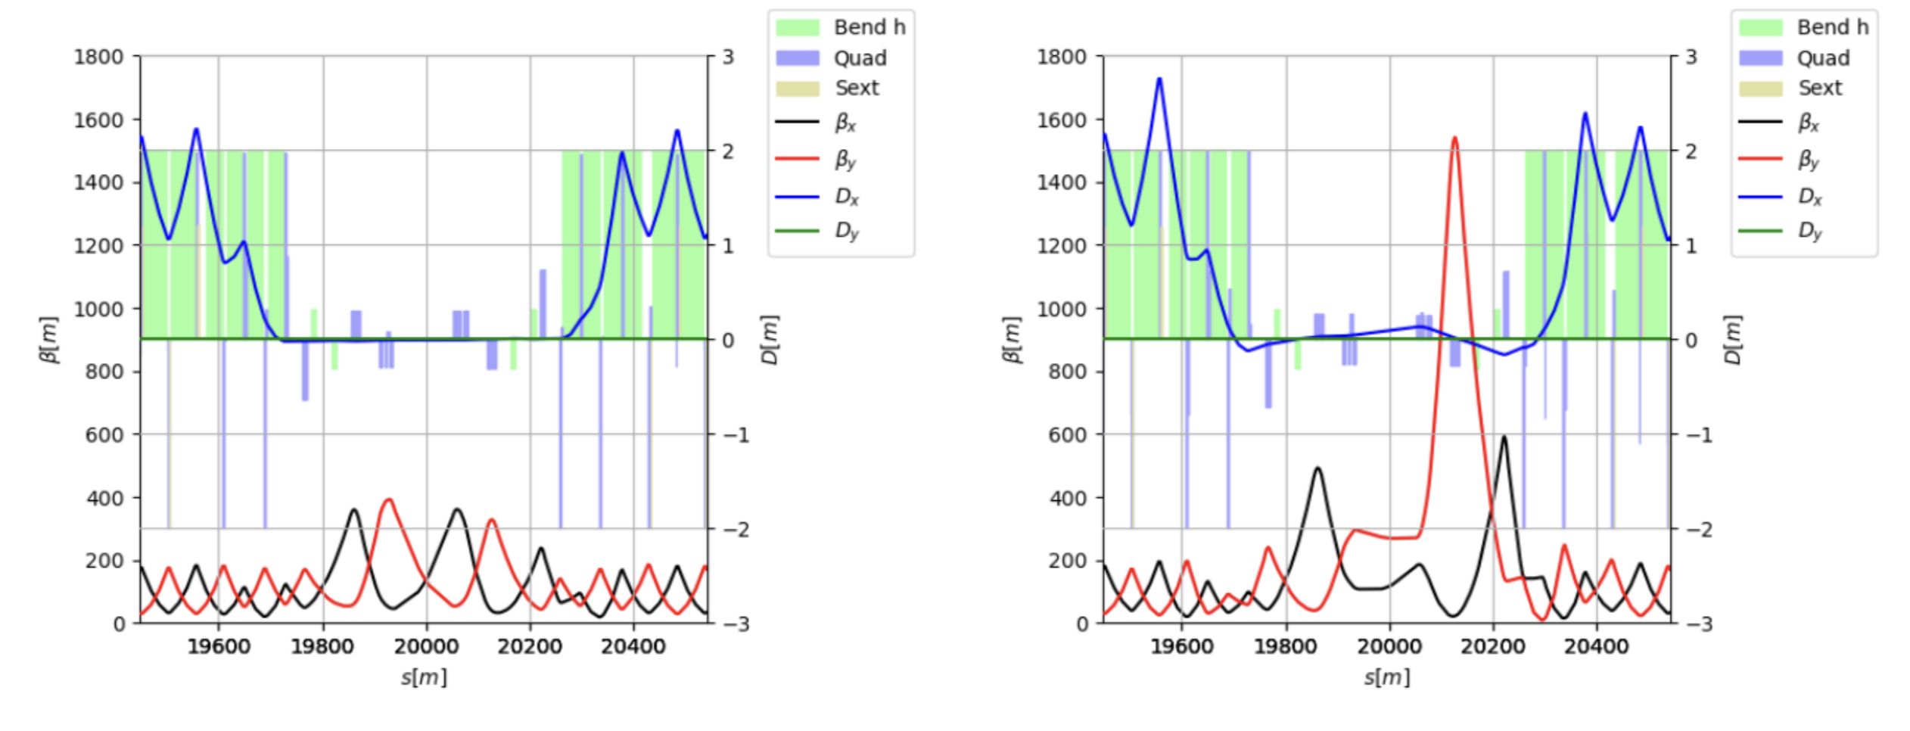
Optimizer
Xsuite provides a multi-objective optimizer to "match" model parameters to assigned constraints (e.g. control tunes, chromaticity, build orbit bumps, design the optics)
Based on the extensive experience of MAD-X → Uses the same optimization algorithm (Jacobian, proven robustness)
Interface designed for usage flexibility. Used for optics matching of the LHC and of FCC-ee colliders
  Proved capability of handling large problems with several constraints and degrees of freedom
IR7 (450 GeV)
IR7 (7 TeV)
First full cycle designed with Xsuite tested at the LHC in 2024
(including combined ramp&squeeze for all insertions)
Courtesy R. De Maria and B. Lindstrom
15

Slide 16
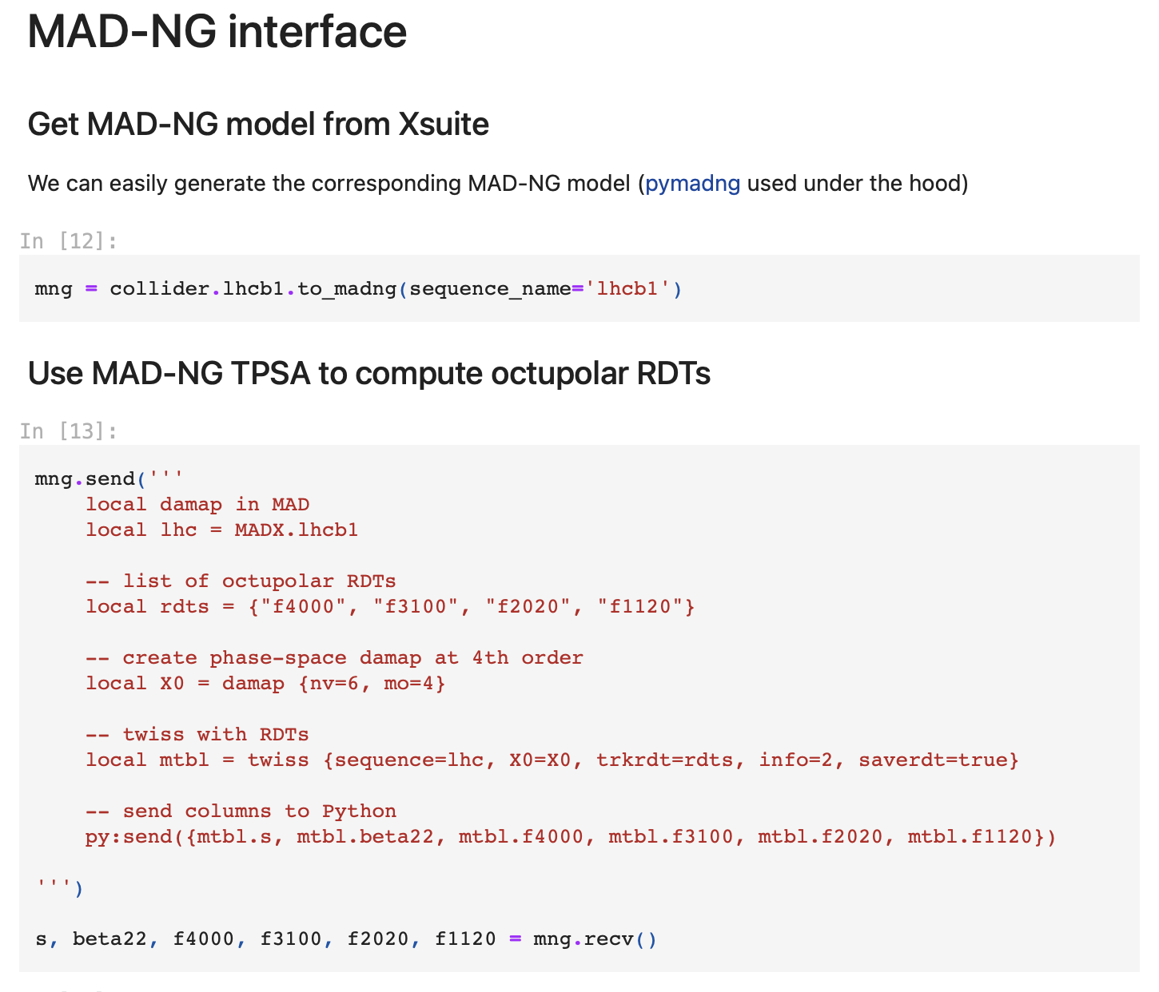
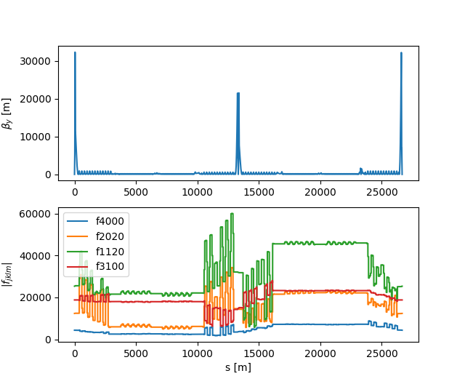
Interface to MAD-NG
An interface to generate a MAD-NG model from Xsuite is made available
Enables GTPSA computations, for example computation and parametric optimization of non linear properties (e.g. Resonant Driving Terms, RDT)
See also presentation by L. Deniau
16

Slide 17
Outline
Introduction
  Motivation
  Design goals and constraints
  Architecture
  Agile development
Lattice modeling, simulation and optimization
  Lattice modeling
  Single-particle tracking
  Dynamic parameter control
  Multi-objective optimizer
Simulation of specific processes
  Particle-matter interaction
  Synchrotron radiation
  Collective effects
Final remarks

Slide 18
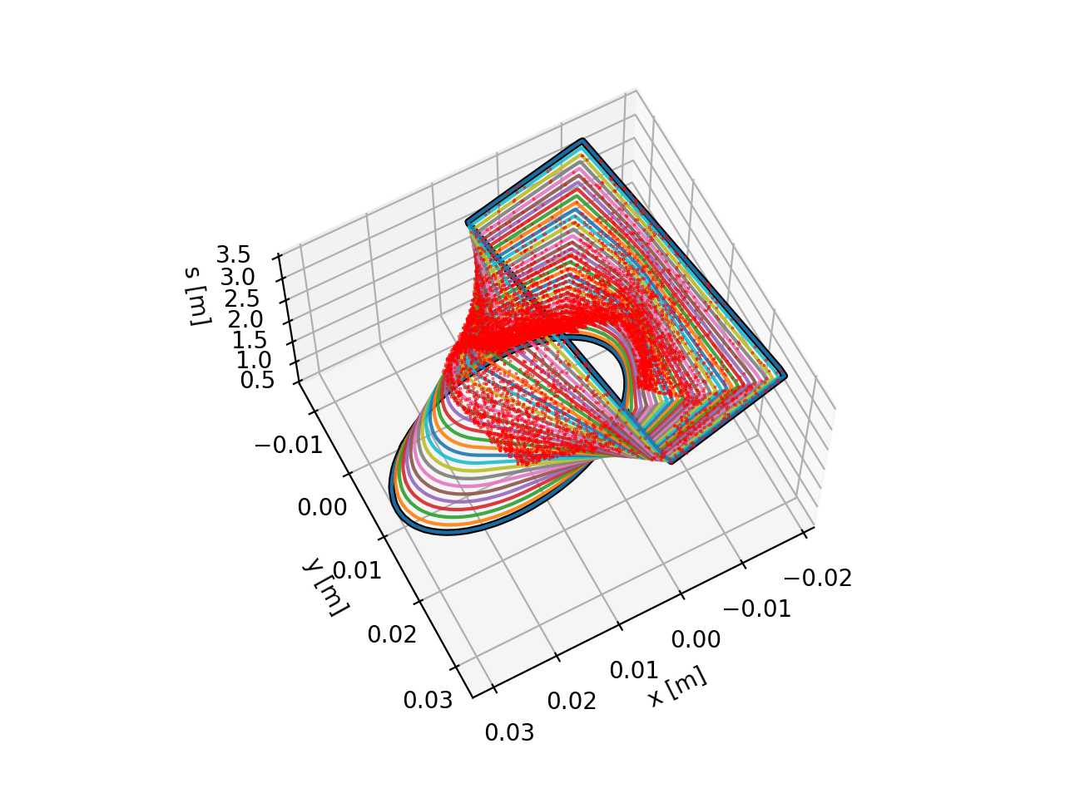
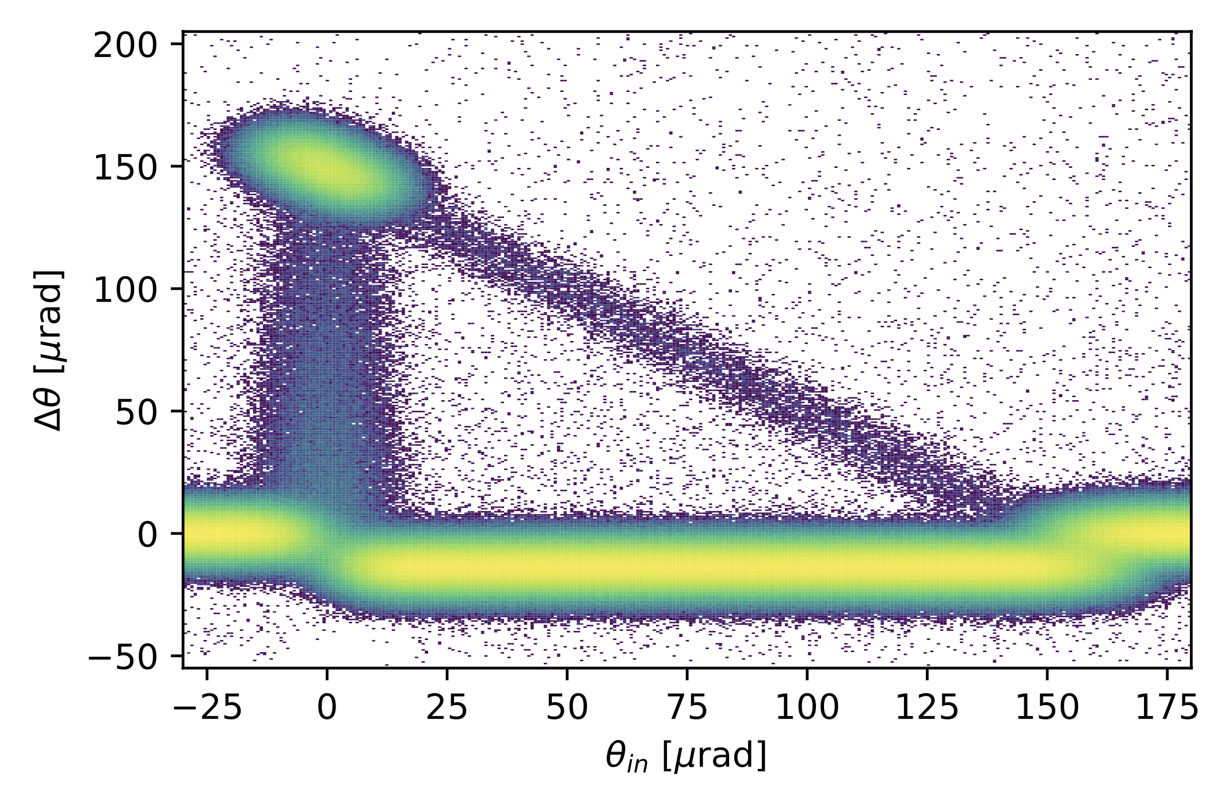
Particle-matter interaction
For collimation studies, the Xcoll module provides three particle-matter sim. engines:
The “Everest” engine embedded in Xcoll (evolution of K2 module from Sixtrack)
The “Geant 4” engine, based on an interface with BDSIM-Geant4
  Used for FCC-ee collimation studies (see presentation by G. Broggi)
The “FLUKA” engine, based on an interface with the FLUKA Monte Carlo code
To support collimation studies, Xsuite provides:
Support for complex aperture modelling and accurate localization of the lost particles along the beam line
Particle deflection from a bent crystal (Everest engine)
Localization of lost particles along a beam pipe with changing cross section
18
See also presentation by F. Van der Veken

Slide 19
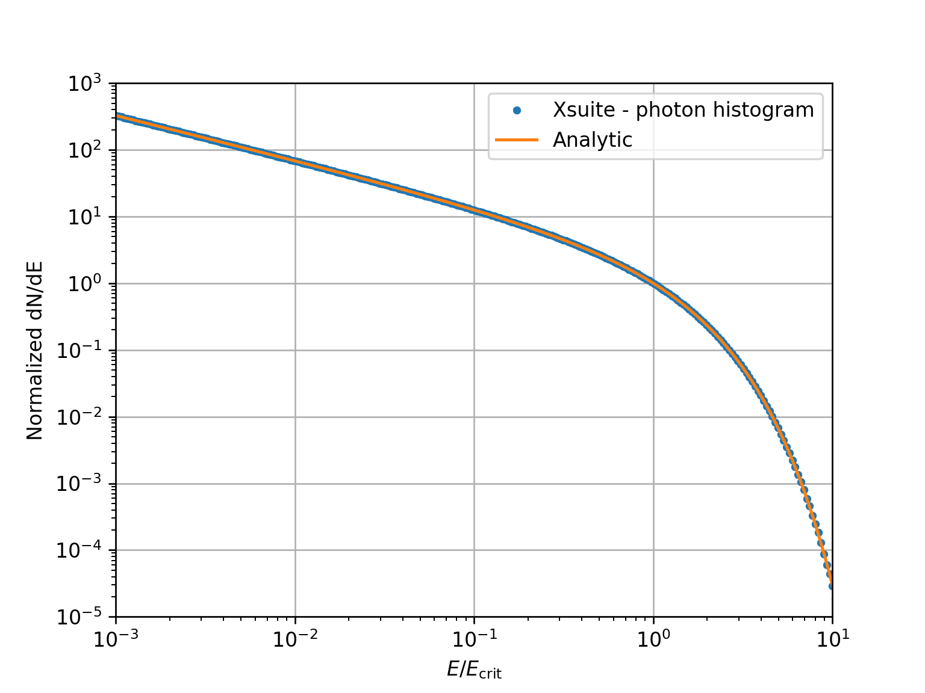
Synchrotron radiation
Validation against analytical photon spectrum
The effect of synchrotron radiation can be included in Xsuite tracking simulations. Two models available:
The “mean” model, for which the energy loss from the radiation is applied particle by particle without accounting for quantum fluctuations;
The “quantum” model for which the actual photon emission is simulated⁽¹⁾.
⁽¹⁾ Based on H. Burkhardt, “Monte Carlo generator for synchrotron radiation”, 1990. Implementation ported from PLACET (A. Latina)
⁽²⁾ E. Forest, From tracking code to analysis: generalised Courant-Snyder theory for any accelerator model. Springer, 2016
19

Slide 20
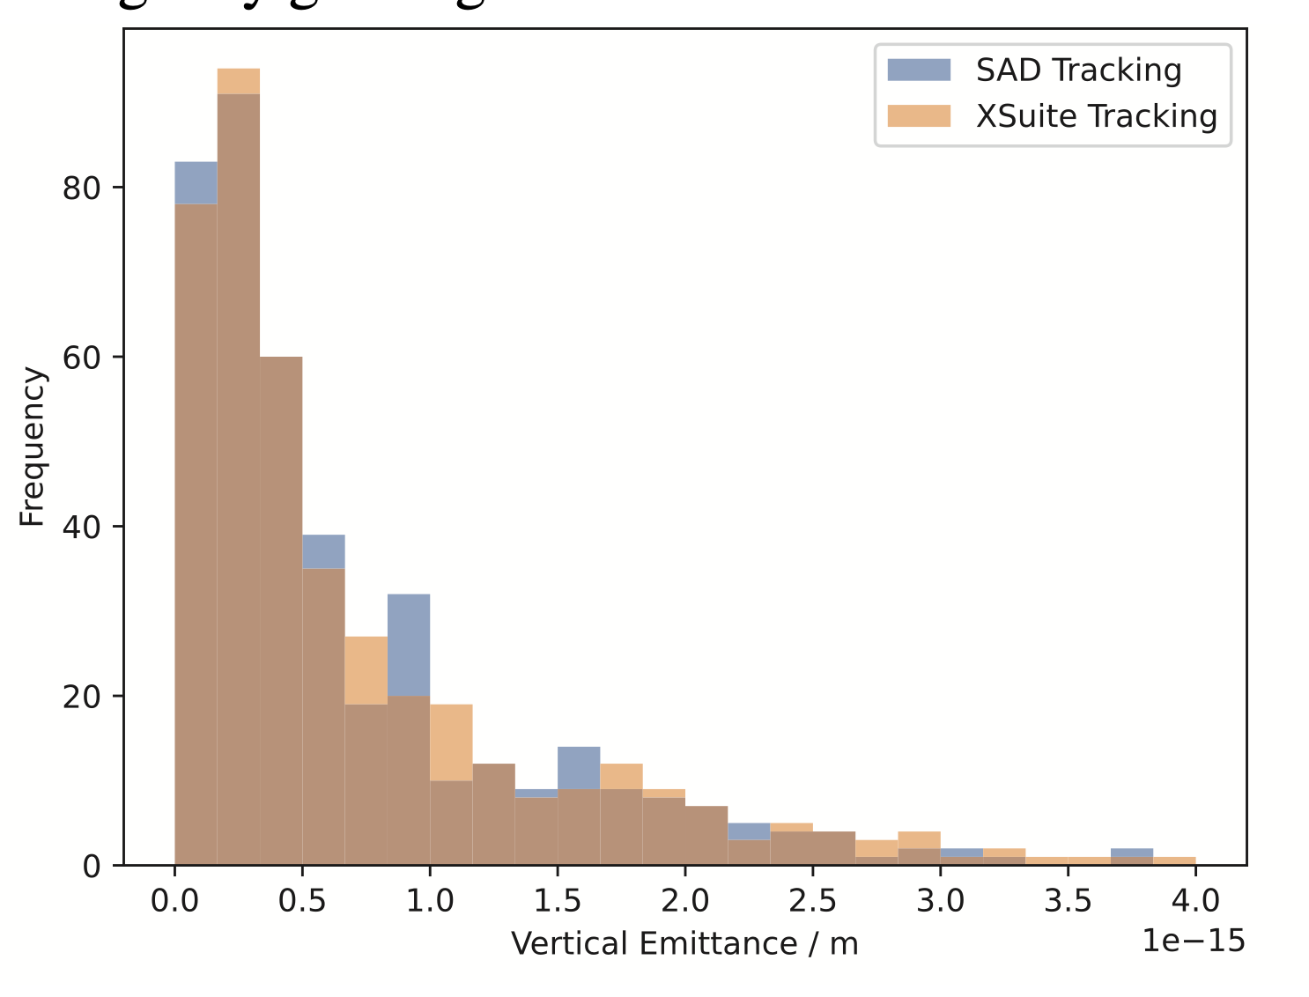
Synchrotron radiation
Benchmark of equilibrium emittaces from tracking (with lattice errors)
The effect of synchrotron radiation can be included in Xsuite tracking simulations. Two models available:
The “mean” model, for which the energy loss from the radiation is applied particle by particle without accounting for quantum fluctuations;
The “quantum” model for which the actual photon emission is simulated⁽¹⁾.
The Xsuite Twiss also includes:
Dedicated algorithm for non-symplectic one-turn map⁽²⁾
Computation of radiation energy loss, damping times and equilibrium emittances
An automatic tool is provided for phasing the RF cavities and adjusting magnet strengths to compensate the radiation energy loss (“tapering”)
L. Van van Riesen-Haupt , T. Pieloni, et al., EPFL
⁽¹⁾ Based on H. Burkhardt, “Monte Carlo generator for synchrotron radiation”, 1990. Implementation ported from PLACET (A. Latina)
⁽²⁾ E. Forest, From tracking code to analysis: generalised Courant-Snyder theory for any accelerator model. Springer, 2016
20

Slide 21
Collective effects
Space charge
Xsuite is designed to include collective effects in the simulations
Handling of collective elements is fully automatic → The Xtrack module identifies the collective elements and splits the sequence:
  The non-collective parts are handled asynchronously to gain speed
  The simulation of the collective effects is performed synchronously
Space-charge, beam-beam, IBS, e-cloud (weak-strong) are handled natively
Impedances and feedback systems are handled through an interface with PyHEADTAIL
  Native implementation coming soon
Lattice
Lattice
Space charge
Space charge
Lattice
Lattice
Impedance
Damper
Collective (synchronous)
Single-particle (asynchronuos)
21

Slide 22
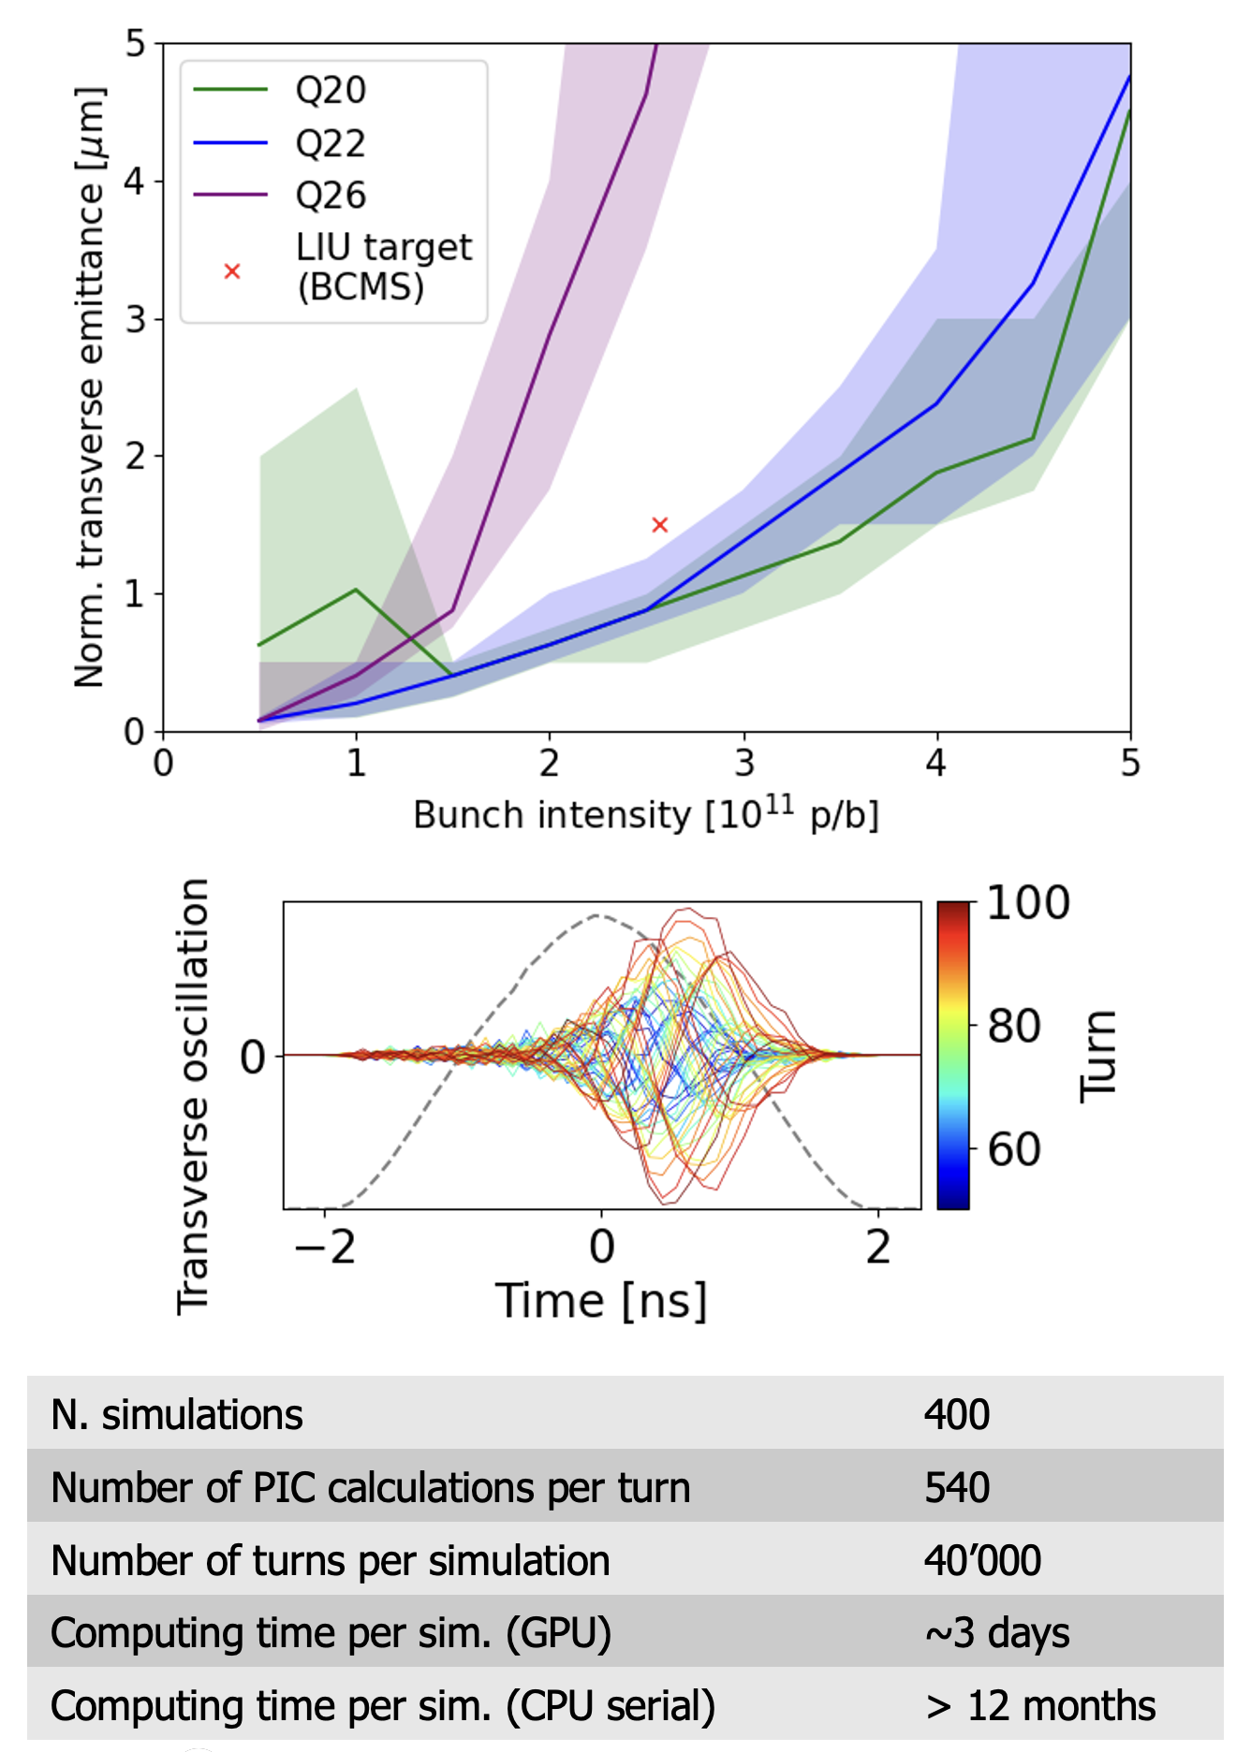
Space charge
Simulation campaign for the CERN SPS
including full non-linear lattice, space charge and wakefields
Different space-charge models are implemented:
The “frozen” model, in which particles interact with fixed charge distributions
The “quasi frozen” model that is a variant of the frozen model in which the beam intensity and beam sizes are recomputed at each interaction
The “Particle In Cell (PIC)” model:
  Charge of tracked particles distributed on a rectangular grid
  Fast Poisson solver based on FFT method with Integrated Green Functions
Space charge simulations strongly profiting from GPU acceleration
Courtesy X. Buffat
22

Slide 23
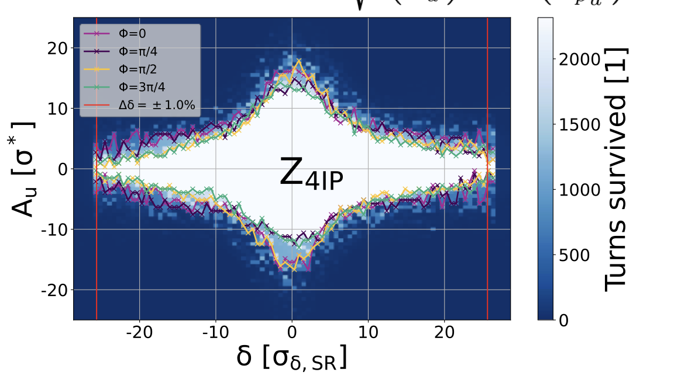
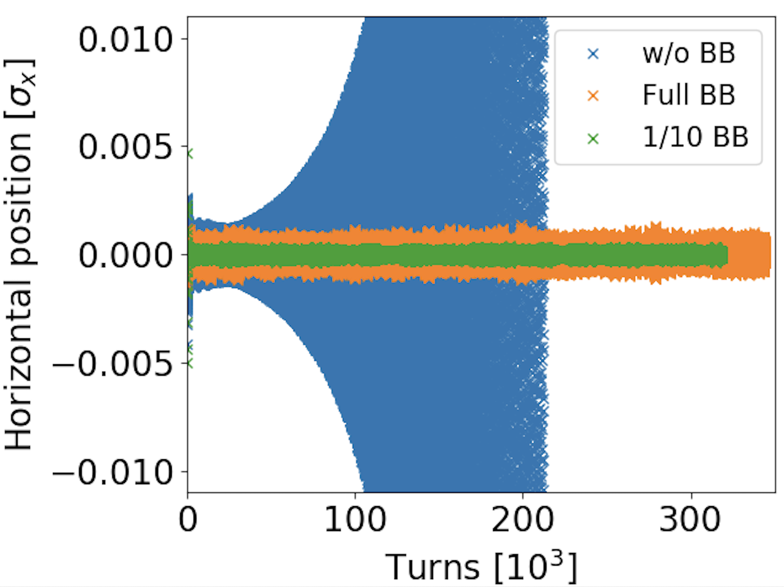
Beam beam effects
Xsuite beam-beam implementations by now have become workhorse for for LHC and FCC studies at CERN
Replacing Sixtrack and COMBI
Offering different models and capabilities:
Weak-strong model assuming Gaussian Transverse Beam Profile
  4D interaction (lumped transverse-only kick)
  6D interaction (Hirata approach, energy change)
Strong-strong modelling
  4D or 6D “soft Gaussian” approach
  Self-consistent Particle In Cell
GPU acceleration available for all models. MPI parallelization available for strong-strong.
FCC-ee DA studies (with bb)
P. Kicsiny et al.
Wakefield + beam-beam simulations for HL-LHC (strong-strong modelling)
For more information see presentation at BB24 workshop
23

Slide 24
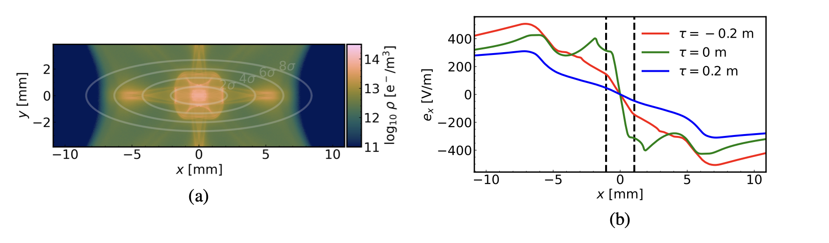
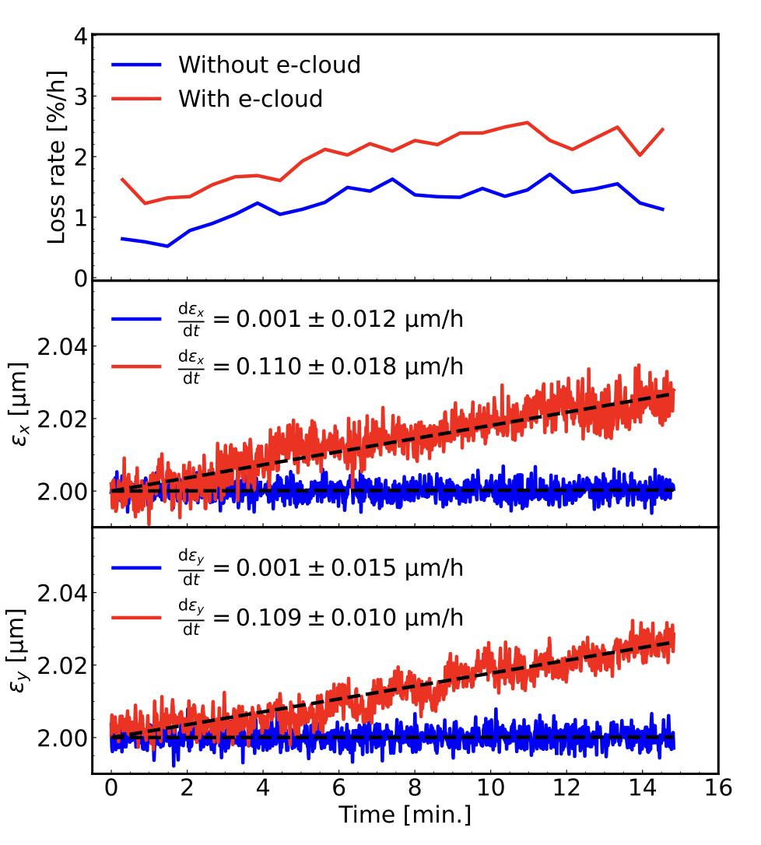
Electron cloud modeling
Xsuite has been exploited to study the effect of electron cloud on slow beam degradation (emittance growth, lifetime degradation).
Done by applying a high-order interpolation scheme to the e-cloud potential imported from a dedicated multipacting simulator.
  Scheme designed to preserve the symplecticity of the resulting map by ensuring the global continuity of the potential and required derivatives.
Use of GPUs is mandatory to simulate the required long time scales (>10⁶ turns).
See also presentation by K. Paraschou
24

Slide 25
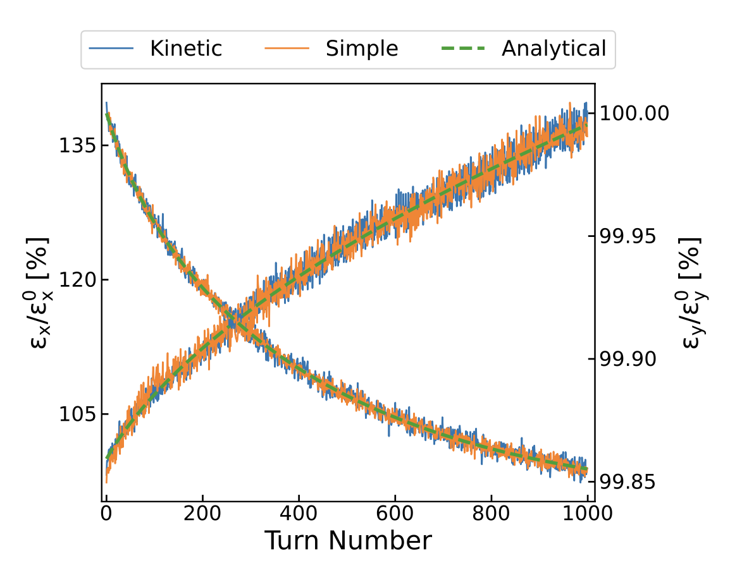
Intra Beam Scattering
Intra Beam Scattering (IBS) simulation capabilities have been recently introduced:
IBS growth rates computation from beam parameters and optics. Two methods available:
  Nagaitsev (very fast, vertical dispersion neglected)
  Bjorken-Mtingwa (slower, D_{y} correctly accounted)
Effect of IBS can be included in multiparticle simulations in combination with all other effects available in Xsuite. Two methods available:
  Effective kick
  Kinetic formalism
Benchmark case for the SPS ring (Pb ions)
Horizontal
Vertical
For more info: F. Soubelet et al., “Development of numerical tools for intra-beam scattering modelling”, IPAC24

Slide 26
Outline
Introduction
  Motivation
  Design goals and constraints
  Architecture
  Agile development
Lattice modeling, simulation and optimization
  Lattice modeling
  Single-particle tracking
  Dynamic parameter control
  Multi-objective optimizer
Simulation of specific processes
  Particle-matter interaction
  Synchrotron radiation
  Collective effects
Final remarks

Slide 27
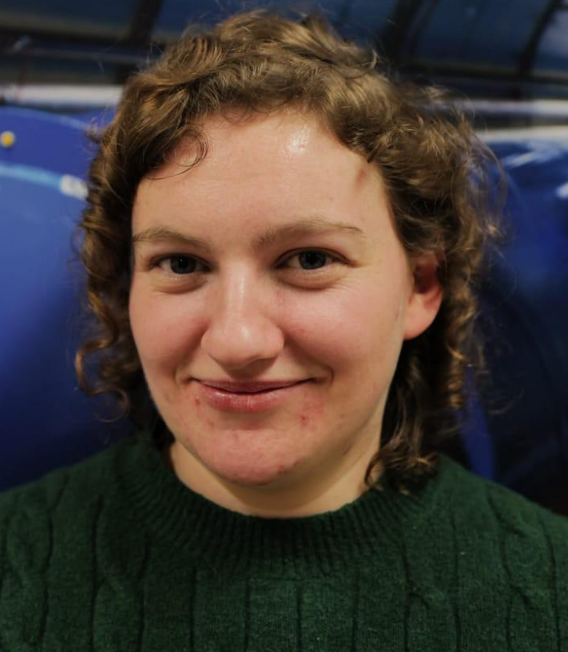
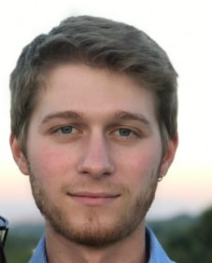


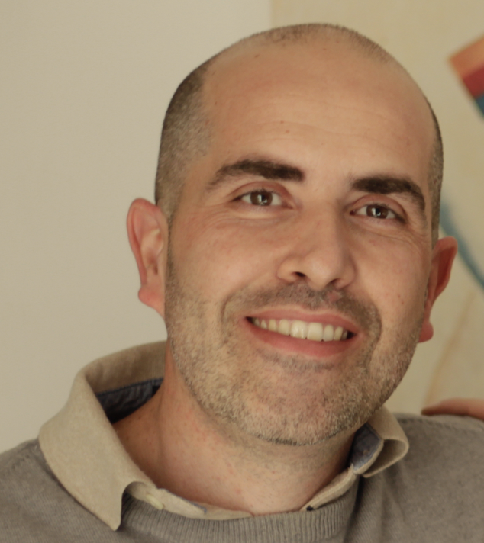
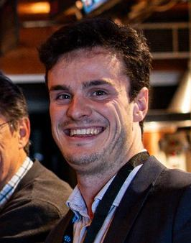
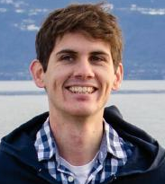
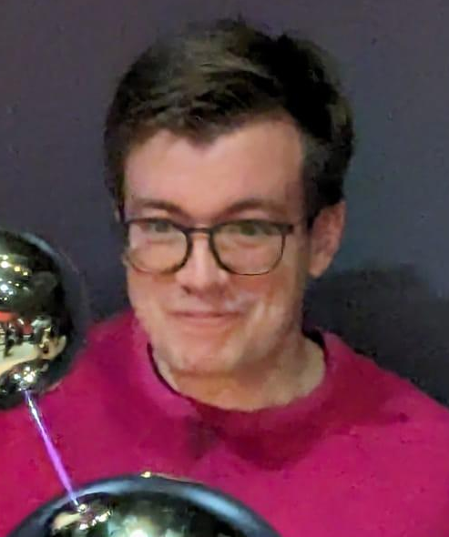
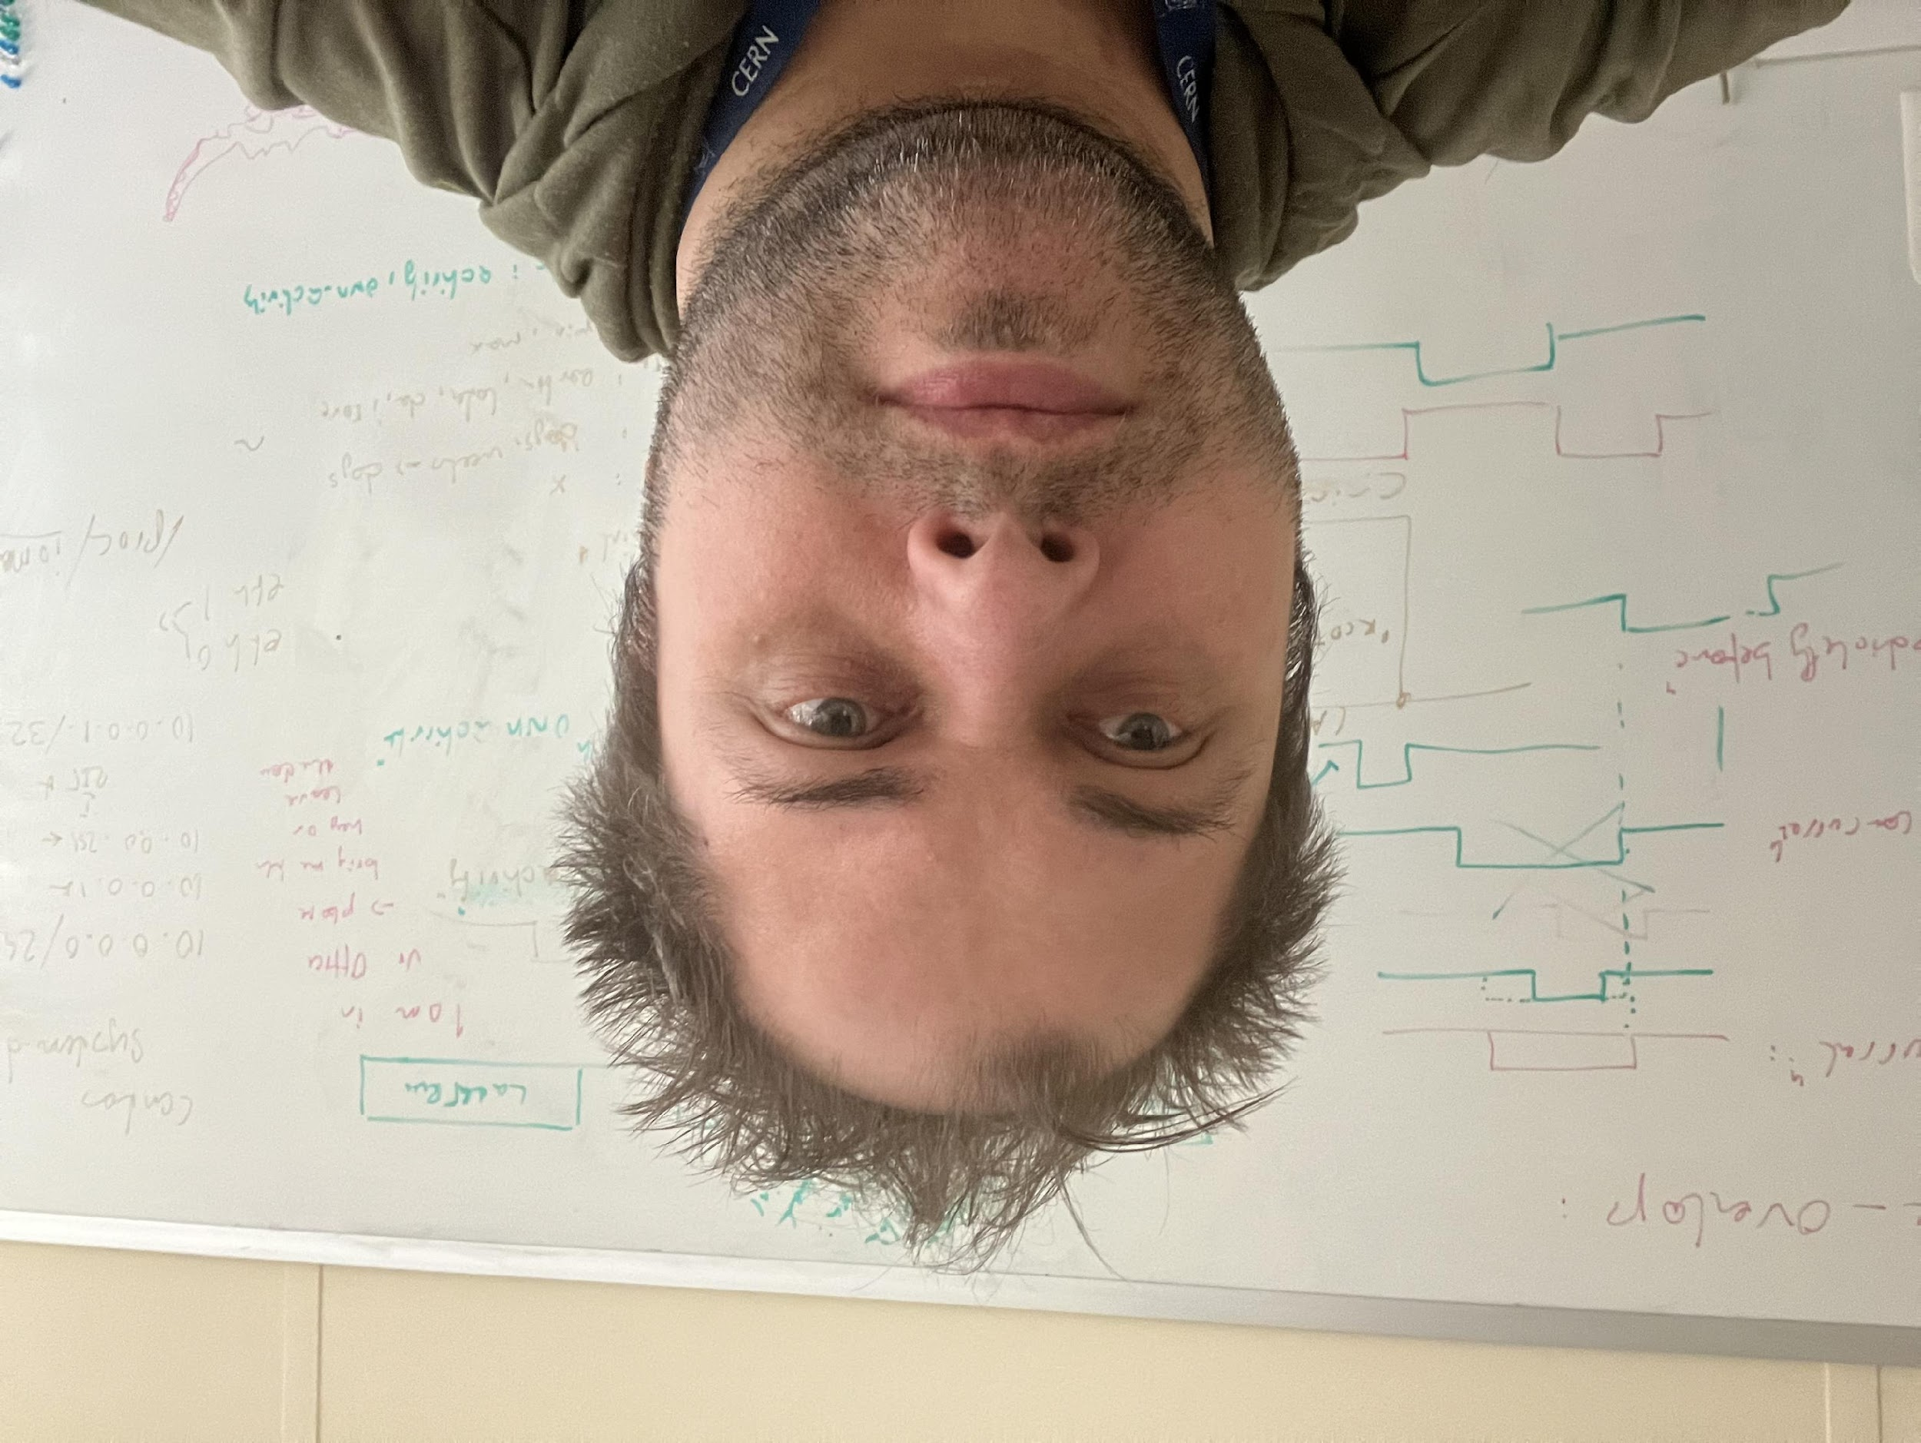
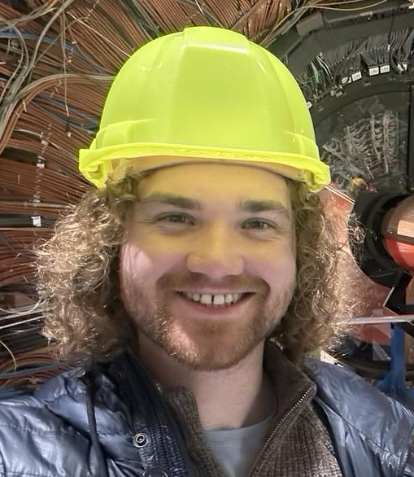

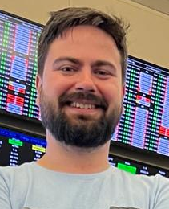
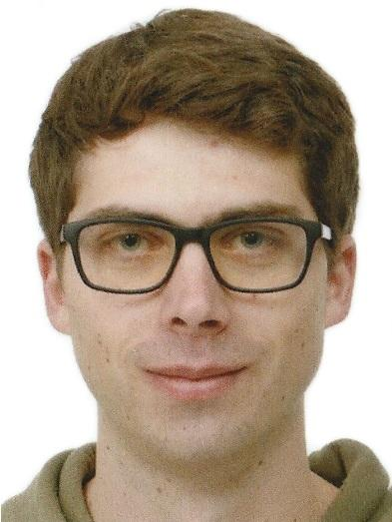
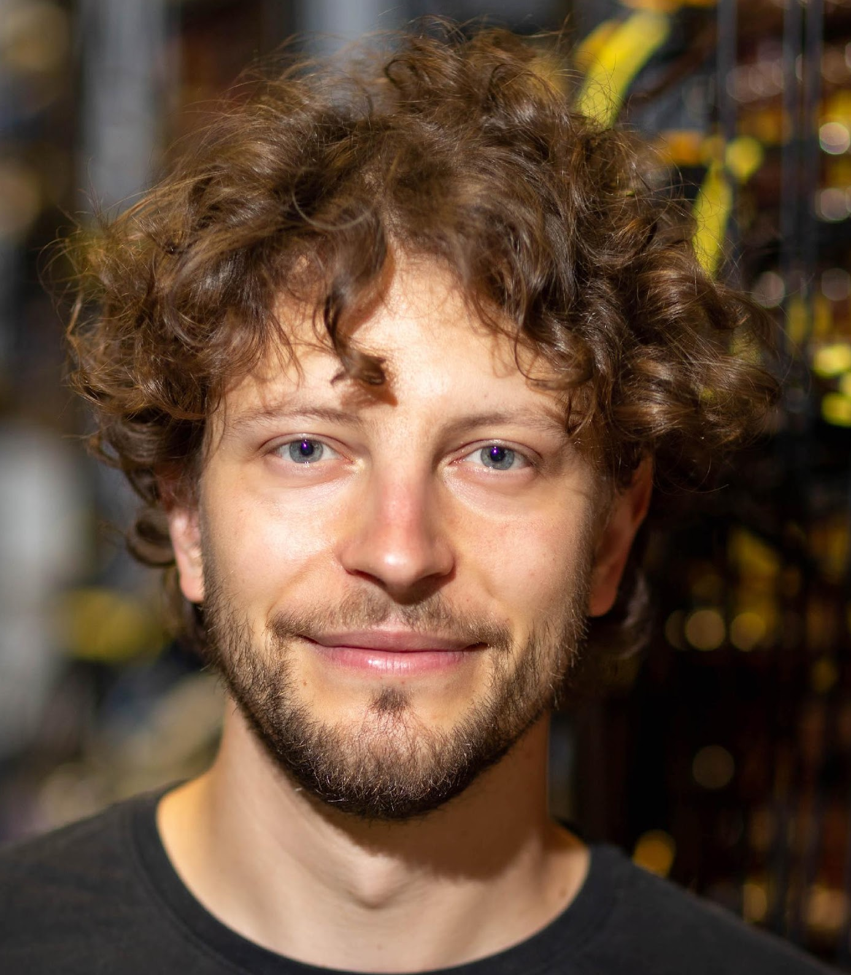
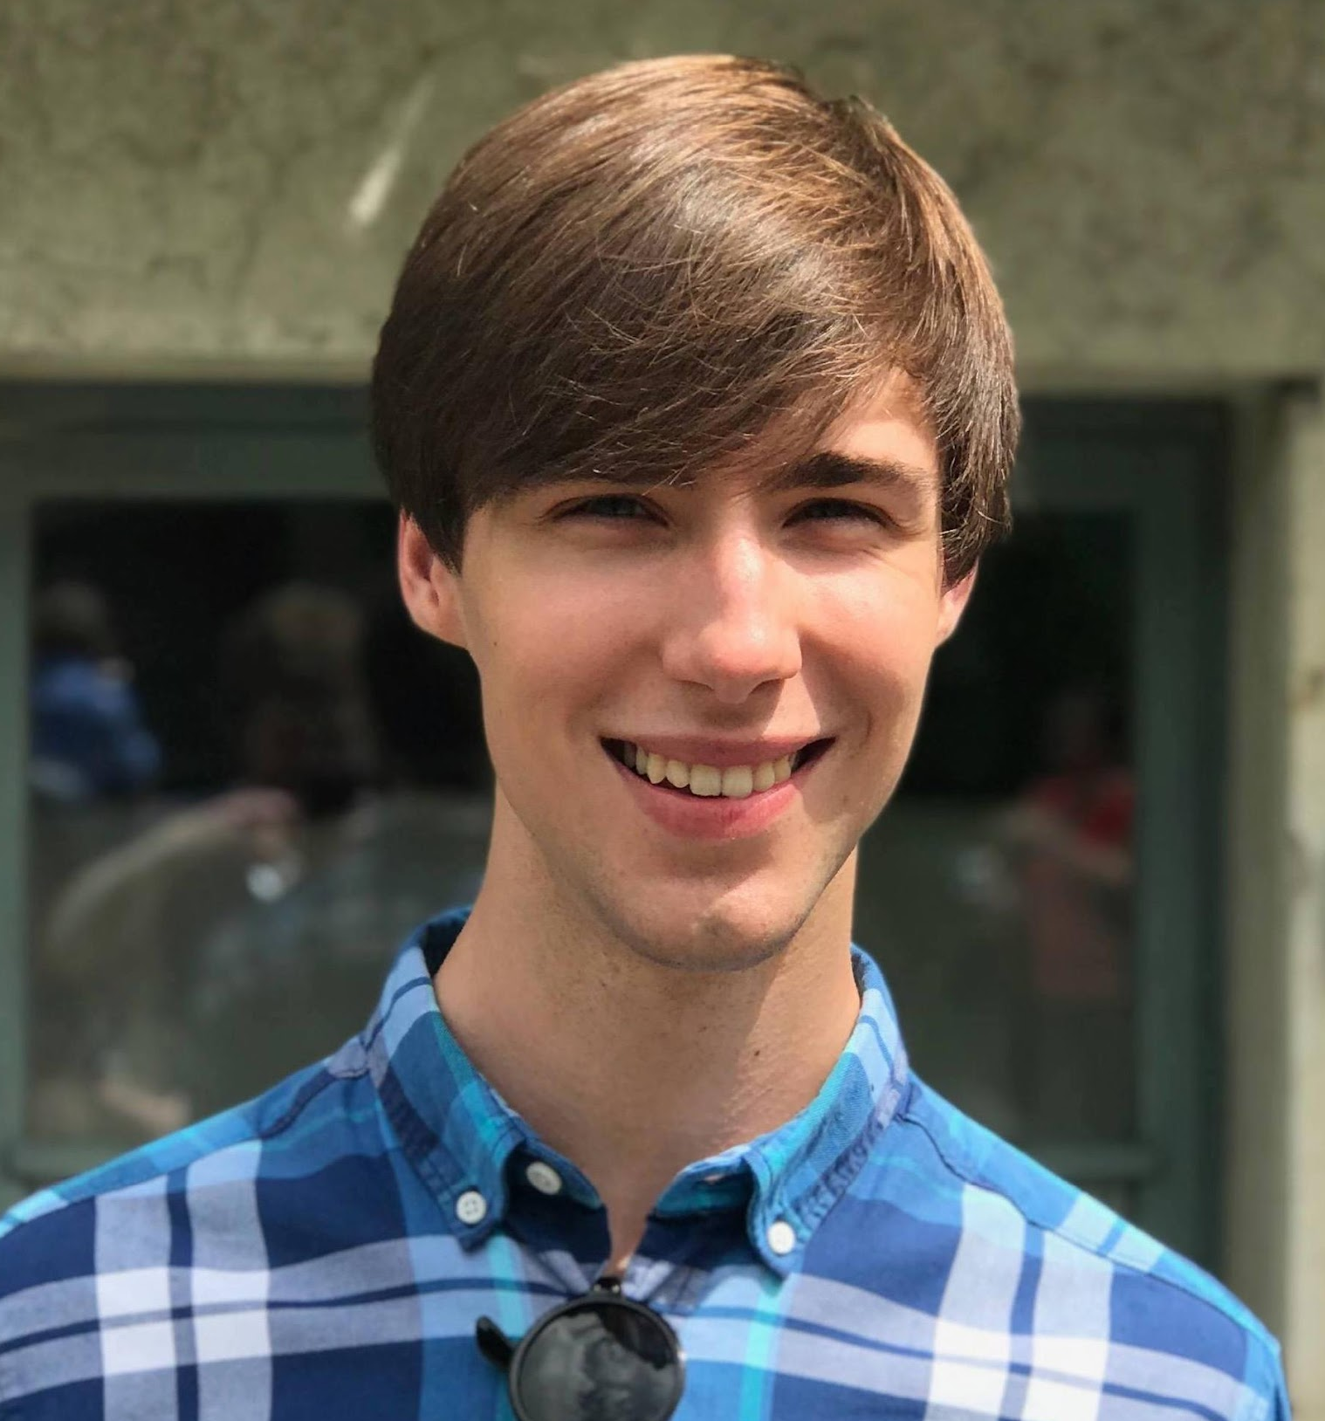

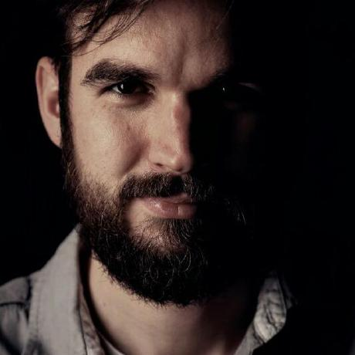
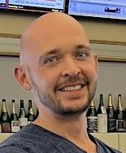
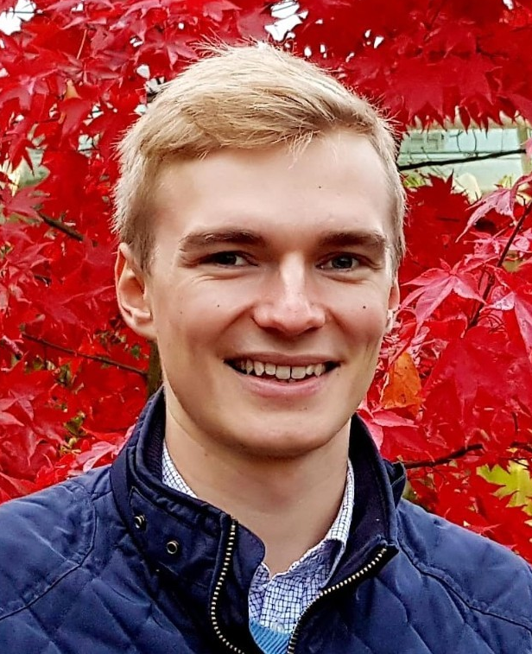
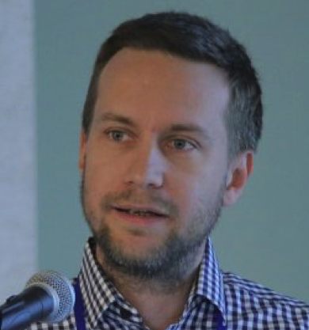

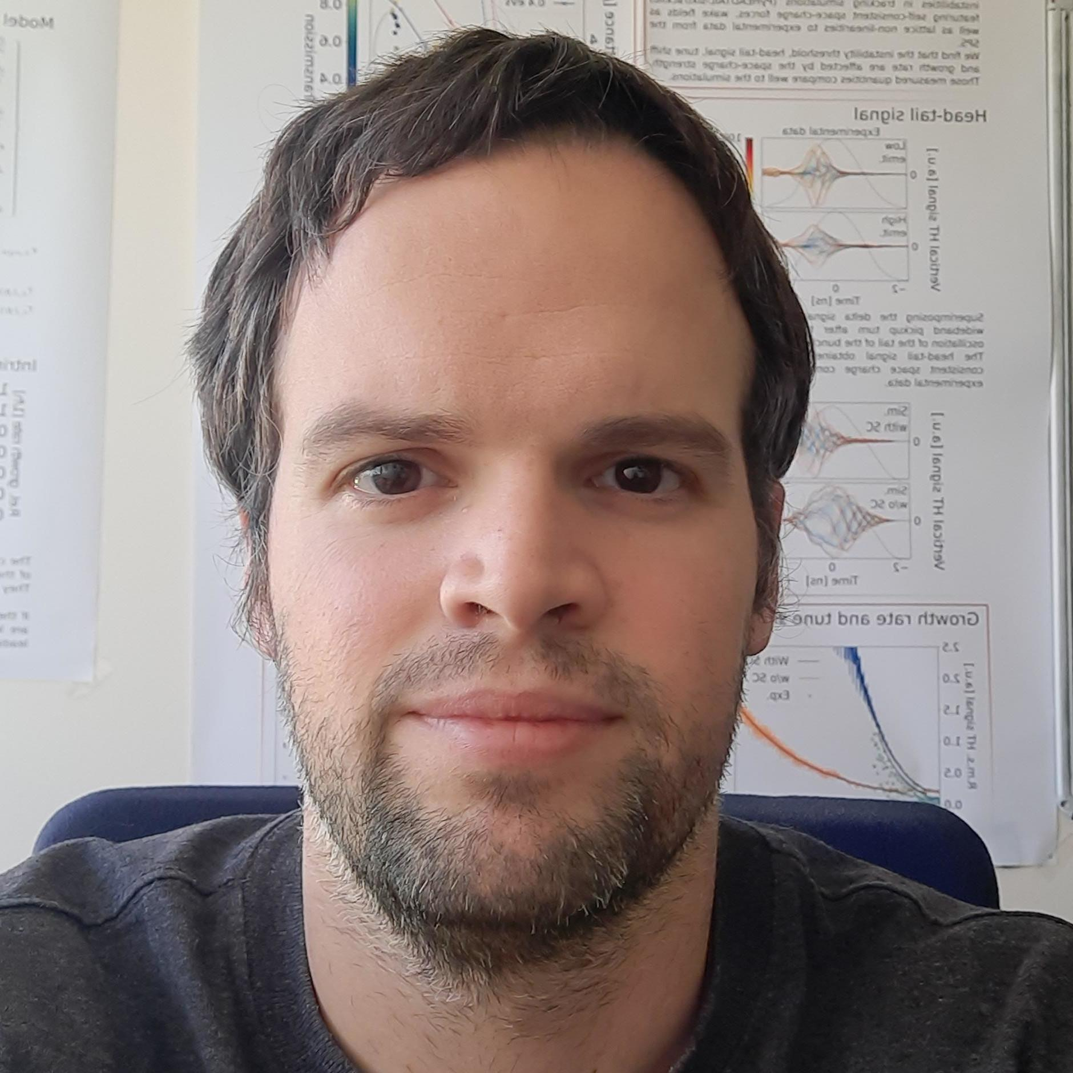




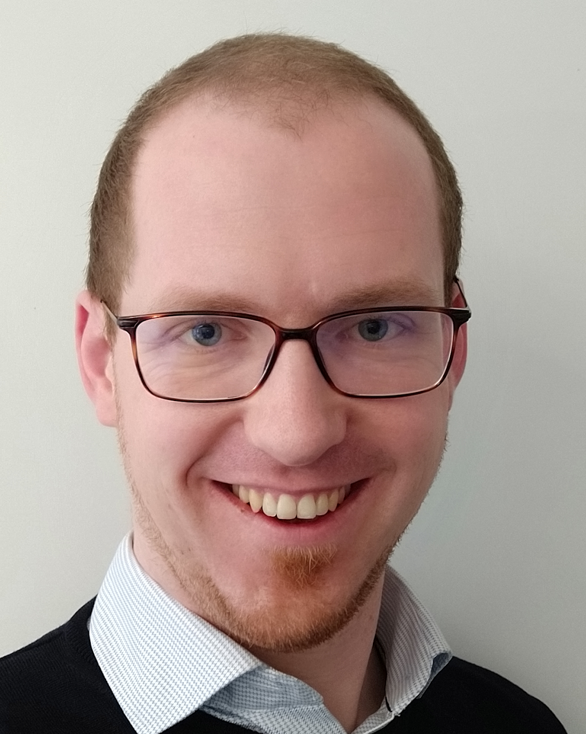

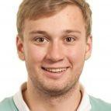
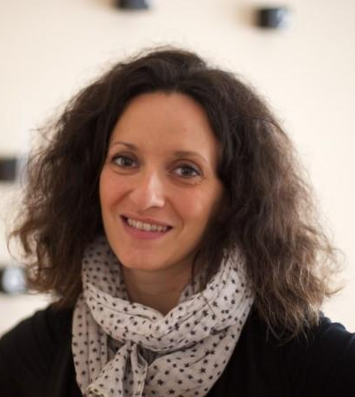

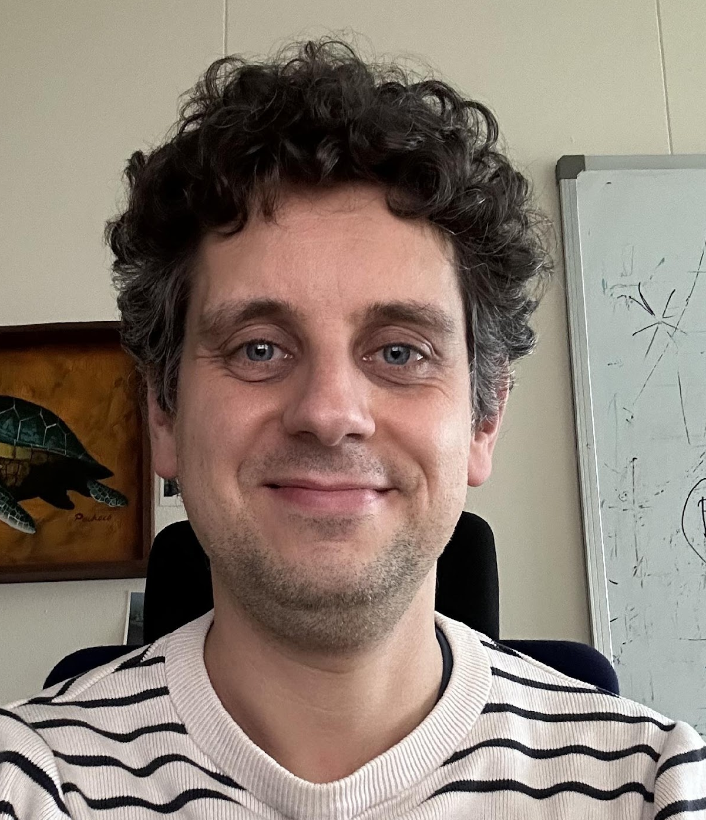

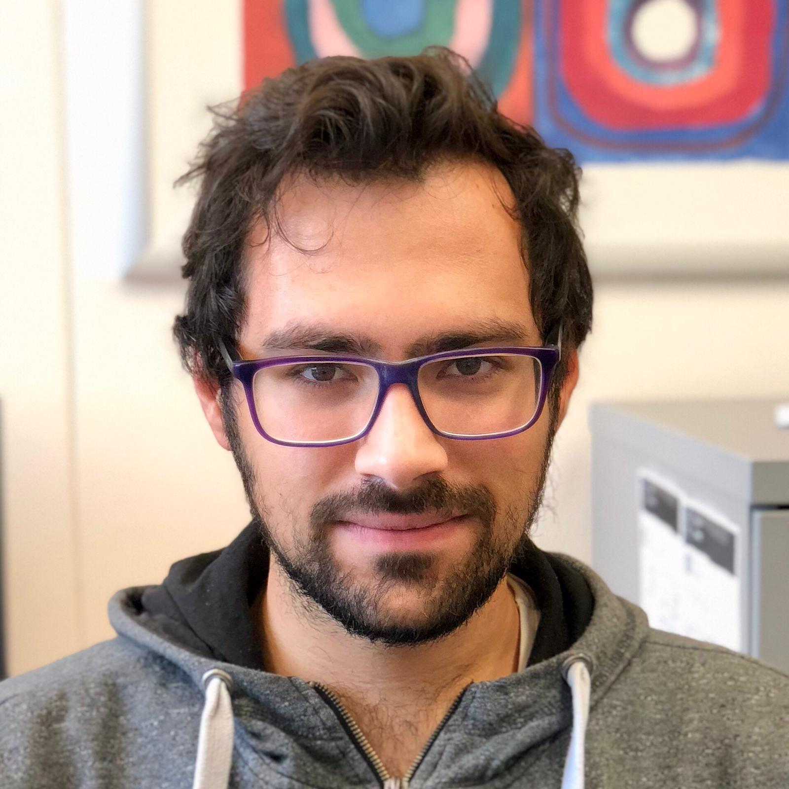

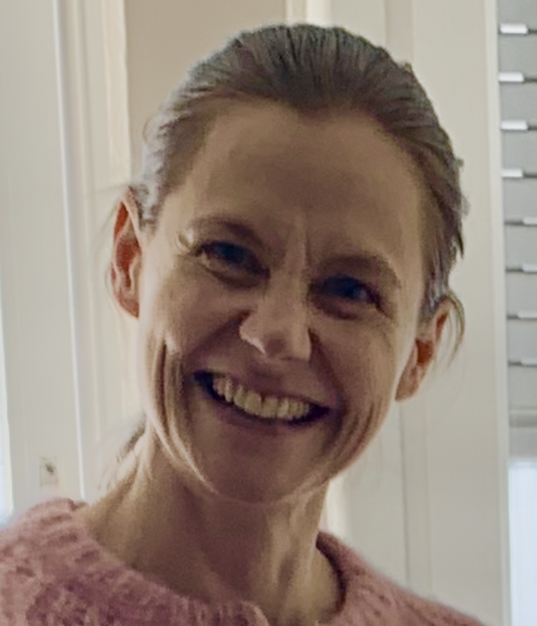
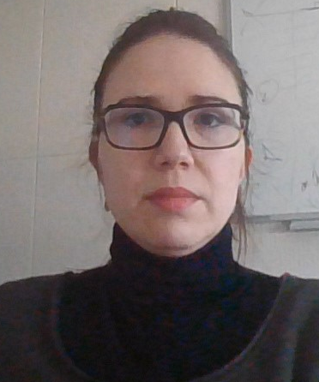
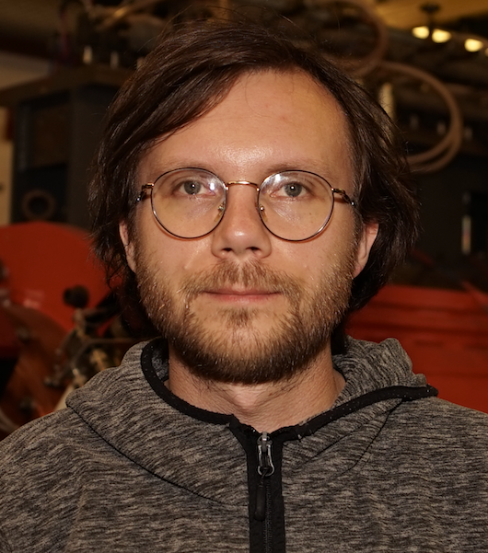




Final remarks
After almost four years the software has grown very rapidly, thanks to many people contributing code and expertise…
…
and more…

Slide 28
Final remarks
After three years the software has grown very rapidly, thanks to many people contributing code and expertise…
Response went well beyond our expectation:
>30 colleagues from CERN and other labs contributed by developing new features and debugging issues
          Leveraging their python skills and the short tool-specific learning curve
Xsuite was adopted by a large and diverse user community (>100 users!!!)
  Very lively community providing mutual support, advice, lots of feedback to developers (very precious!)
  For first time at CERN we are using the same software tool for optics, dynamic aperture studies, collimation, beam-beam, space-charge, instabilities, lepton machines, extraction and beam transfer studies and more…
    Already profited from lots of synergies and shared workflows
…
and more…

Slide 29
Final remarks
Xsuite simulations have been already used for studies covering a variety of rings:
CERN
ELENA
LEIR
PSB
PS
SPS, TI2, TI8
LHC
FCC-ee, FCC-hh
Muon collider
LEP
GSI
SIS-18
SIS-100
Medical facilities
HIT (Heidelberg)
MEDAUSTRON
PIMMS
NIMMS
BNL
RHIC
Booster
EIC
Fermilab
Main injector
Recycler
Booster
IOTA
Light sources and damping rings:
PETRA
DESY injector ring
ELETTRA
BESSY III
CLIC-DR
… and more
Each of these tought us something and contributed to extend and improve the software!

Slide 30
Final remarks
CERN Accelerator and Beam Physics group is committed to maintain Xsuite and support its users for the years to come
  For other legacy tools (e.g. MAD-X, PyHEADTAIL) we will keep present level of functionality and support for as long as needed, while focusing resources on the development of these new tools.
The code is publicly available on GitHub and can be installed through pip
  You are vey welcome to give it a try for your use case
  Installation instructions and many examples available in the documentation pages
  We are very interested in getting your feedback (don’t hesitate to contact us for issues, questions, suggestions)
Code is open-source and is open to developments from the community
  Get in touch if you are interested in contributing to the development

Slide 31
Thanks for your attention!
31

Slide 32

Discontinuation of legacy tools
In 2022-23 we have essentially discontinued the development and, to a very large extent, the usage of the following tools:
  Sixtrack
  Sixdesk
  Sixtracklib
  COMBI
  PySSD
  DistLib
This led to a massive simplification of our code base.
Lines of code
370k
75k
Written
(Xsuite)
Discontinued
(Legacy tools)

Slide 33
Twiss module
Computation of Twiss parameters based on the tracking has two main advantages:
Any physical model included in the tracking is automatically usable in Twiss
  Without additional development effort
Twiss becomes a powerful diagnostics tool on the built tracking model
  Allows measuring directly on the tracking model tunes, chromaticities, closed orbit, beta functions, etc.
  Can be done effortlessly and without exporting or manipulating the model.
  Used daily to for validating simulation models, catching mistakes, investigating issues
HL-LHC optics
Accuracy compared to MAD-X: Δβ / β << 10⁻⁴
Computation time is very similar
33
Example
33

Slide 34

Broader software architecture
Xsuite working as aggregation point of a wider Python ecosystem (under development)
acc-models
Optics and setting repository
Layout database
Optics and setting repository
ABP integrated simulation SW
RFTrack
Time-based tracking,
field maps,
Linac-specific physics
Xsuite
Xtrack
Fast tracking, lattice manipulation, optics calculation and matching, aperture analysis, radiation and tapering
MAD-NG
GTPSA tracking, parametric
normal forms, optimization
Wakis
Wakefield solver
Xfields
Beam-beam,
impendences, feedbacks, space charge, IBS
Xcoll
Particle-matter interaction
Collimation hierarchy config.
Loss map analysis
PyWIT
Impendence toolbox
GUINEA-PIG
IP physics and background
PyECLOUD
e- / ion cloud effects
FLUKA
BDSIM
GEANT4
BLOND

Slide 35

Dynamic control of beam line parameters
Simulation of a fast orbit bump used for the H⁻ injection into the CERN PS Booster
In accelerators often a single high-level parameter can be used to control groups of components with complex dependency relations. (e.g. circuits with multiple magnets, groups of RF cavities, etc.)
The Xdeps module provides the capability to include such dependencies in the simulation model (as done by MAD-X deferred expressions)
Example, LHC crossing angle knob:
  At any time, the user can set:
lhc.vars[’on_x1’] = 160 # murad
  which automatically changes the strength of 40 dipole correctors to get the required crossing angle
User can also use “Time functions”, i.e. time dependent knobs that are updated automatically during the simulation
35

