Slide 1
Applications possibles de Geant4 à la simulation de sources de particules
Atelier Calcul – GdR SCIPAC, 16 – 18 Octobre 2024
Marc Verderi, LLR, Ecole polytechnique

Slide 2
Introduction
Présentation fait suite au contact de Thomas Thuillier et Vincent Le Flanchec concernant la possible utilisation de Geant4 sur les sources de particules
« que pourrait apporter Geant4 pour l'interaction des électrons de basse énergies (>100 eV) avec les parois et s' il y a des possibilités/perspectives possibles pour l'interaction des ions (E > ... 10-50 eV) avec les parois ? »
J’ai pris l’avis des experts Geant4 en physique hadronique et électromagnétique…
Pour spoiler le reste de la présentation:
Pas simple, aujourd’hui, mais des aspects à essayer
Le problème : aux énergies O(10 eV), on est davantage dans des problématiques d’interaction particule – molécule que des interactions particule – atome/noyau
La paroi serait-elle alors vue comme un objet particulier du point de vue des interactions ?
Geant4 fait peu de particule – molécule
Il le fait en partie (ex: DNA et silicium à O(eV) en microdosimétrie)
Pas de limitation de principe, si besoin était, d’étendre Geant4 à ces questions
Et adjoindre des propriétés à des surfaces est fait par exemple en tracking de photons optiques
Mais pour cela, l’apport de nouvelles compétences –les vôtres– serait nécessaire
Cette présentation:
Un panorama rapide de Geant4, pour situer les choses
Puis des éléments de discussion

Slide 3
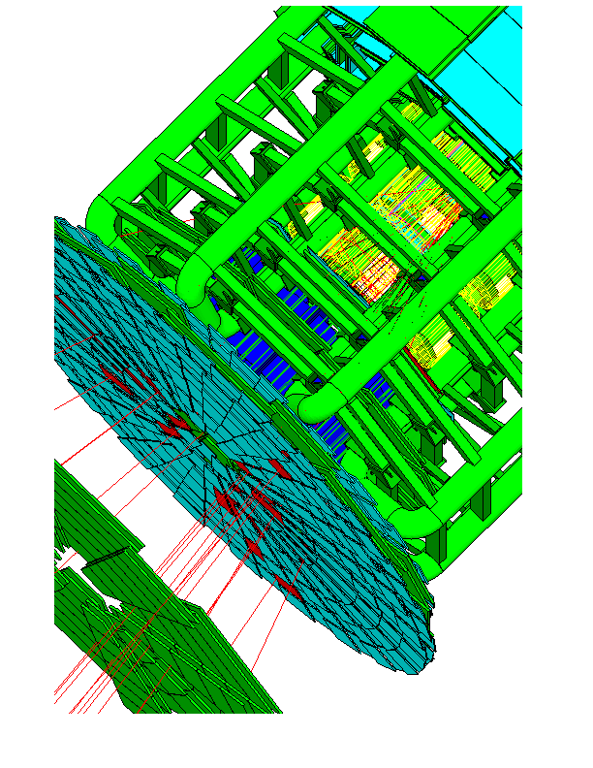
What is Geant4 ? Geant4 as a Software Toolkit
Geant4 is an Object Oriented (using C++17) Monte Carlo particle transport software toolkit for simulating the passage of elementary particles through matter and interacting with it.
It started in 1994 as the CERN RD44 project :
Goal of RD44 : assess the benefit of OO technologies for detector simulation for LHC era (LHC yet to come at that time !)
Medical and space domains requests included since the beginning !
Geant4 v1.0 released in Dec 1998
After alpha release in Apr 1997 and beta one in Jul 1998
Key functionalities:
Kernel → to animate the system
Geometry + navigation & materials → to describe the setup
Physics processes & tracking → to generate the series of physics interactions
EM (O(100 eV) – PeV), special extensions (O(eV) & O(mK)), hadronic (rest - multi-TeV)
Scoring → to collect data from the simulation
GUI and Visualization drivers → to pilot the application and visualize
“Toolkit” because users select components and build their application
Not an application like ROOT, or Powerpoint, etc.
Users can extend the toolkit !
The LHC ATLAS Detector

Slide 4
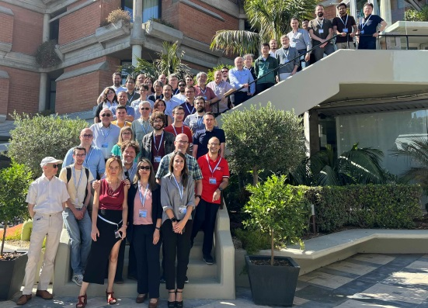
What is Geant4 ? Geant4 as a Collaboration
Distributed development model:
Based on GitLab (geant4-dev repo.)
Reserved to members & contributors
About 1000 Merge Requests / year
Distribution through:
Geant4 Web site
GitHub instance
GitLab mirror for public releases & patches
Open to public for Pull Requests
Special way, CVMFS, for LHC experiments (monthly tag)
One public release/year, in December
Latest release: Geant4 v11.2.2
Three general papers:
“Geant4: a simulation toolkit”, S. Agostinelli et al., NIM A, vol. 506, no. 3, pp. 250-303, 2003
“Geant4 Developments and Applications”, J. Allison et al., IEEE TNS, vol. 53, no. 1, pp. 270-278, 2006
“Recent Developments in Geant4”, J. Allison et al., NIM A, vol. 835, pp. 186-225, 2016
From last Collaboration Meeting
Geant4 is also the name of the Collaboration maintaining, developing and validating the software
~130 members + O(10) “contributors” = new light status
~30 FTE
~30 institutes, worldwide
(Map of collaborative institutes after)
16 working groups
Web site:
http://geant4.cern.ch/
Download area, documentation, news, announcement of releases, meetings (Technical Forum, etc.)

Slide 5
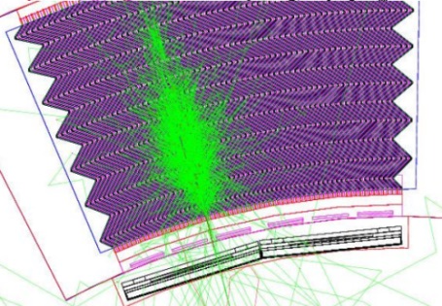
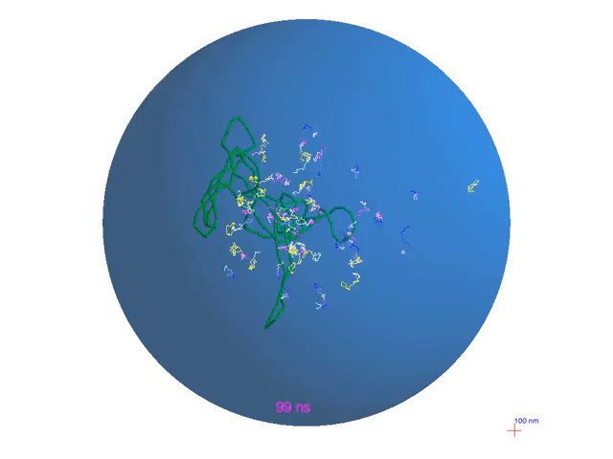
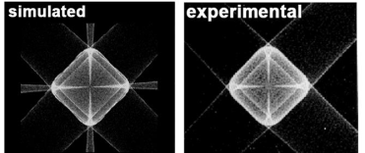
Electromagnetic Physics
“Standard” Electromagnetic:
Energy range 1 keV – O(100 TeV)
Processes for e-, e+, γ
Charged hadrons ionization up to 100 TeV
Muon, up to PeV
“Low energy” Electromagnetic:
More precise description:
PENELOPE 2008 reimplementation
LIVERMORE data for cross-sections and final states
Energy range down to ~250 eV / ~100 eV
Charged hadron ionization
ICRU’ 49 & 73 & 90, NIST
Material relaxation (PIXE, Auger e-, …)
DNA & MuElec:
For microdosimetry studies in DNA and Silicon
Processes down to a few eV
Chemistry stage for DNA
Water radical scattering
Optical photon: long wavelength γ (X-ray, UV, visible)
Reflection, refraction, absorption, wavelength shifts, Rayleigh
Phonons:
Suited for very low-temperature detectors (tens of mK)
Usable ?
EM shower in ATLAS calorimeter
Bragg peak for p in water
Cell nucleus (15 μm diameter) with 6×10⁹ base pairs of DNA
NIM B 306 (2013) 158-164
pBR322 plasmid irradiation, including radiolysis
Tracking is made down to zero kinetic energy. But threshold on secondary production is used (ionisation and brem.)
Very low energy, but very specific !
100 nm
e⁻/hole propagation with Luke phonon emission in Ge crystal
Phonon caustics in Ge

Slide 6
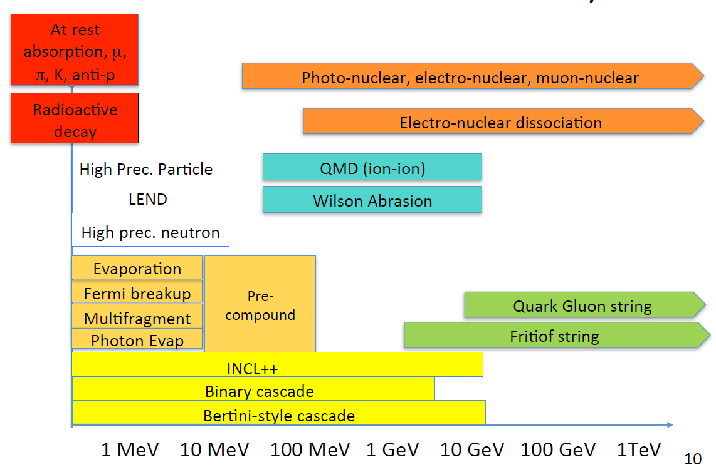
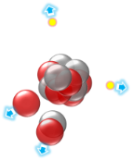
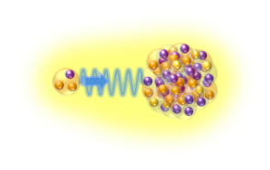
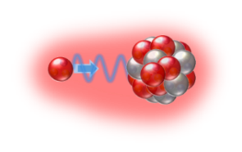
Hadronic Physics
Partial Model Inventory
Neutron tracking down to thermal energies is provided.
For the rest poor precision is expected.

Slide 7
What Geant4 can do today for sources simulation ?
Tracking is made down to zero kinetic energy
Fine for the primary ✔, but secondary production (ionization and brem.) is suppressed below threshold (O(100 eV)) ✘
Electromagnetic physics:
In vacuum, tracking in electromagnetic fields is easy, whatever energies are involved ✔
For interaction on surfaces:
The field map in the vicinity of the surface is needed. (?)
Note that some experiments shown that below (~25 eV) e- cannot enter/escape and be properly measured.
Above, Single Scattering physics describes tracking of charged particles well. Geant4 can do ✔
Any charged particle at a surface should go in or out due to elastic scattering.
Likely detailed surface field map, considering crystal structure, may have to be considered. (?)
Single Scattering must be used in limited areas (possible ✔), otherwise simulation will be very slow !
More complication may arise, with possibly special property of the surface that may play a role. (?)
To be learned & characterized by beam-surface test beam data. (?)
Geant4 does not have the knowledge/expertise for these phenomena. ✘
For hadronics physics:
Both energy range and projectile hadron type matter
Neutrons can be tracked down to thermal energies ✔
And there are several experts in Geant4 ✔
For other particles, it is difficult to say (?)
If the existing physics is not enough, then new expertise is needed ✘
In summary:
nothing can be expected out of the box ✘
likely some extension of Geant4 will be needed, but Geant4 does not have the expertise ✘

Slide 8
What Geant4 could do tomorrow for sources simulation ?
A priori no technical show-stoppers to extend Geant4 to the functionalities you need
Could a community-based (your community) effort provide these features in Geant4 ?
To make them available to the community ?
This happened several times in Geant4.
How ?
First stage could be to present these sources simulation needs at a Geant4 Technical Forum (TF) meeting:
https://geant4.web.cern.ch/collaboration/technical_forum
The TF is a users-developers forum
Where developers present the status of the Geant4 development
And where users present their needs or possible issues they found etc.
It is often an entry point for creating new functionalities
Then, depending on the amount of efforts this represents either:
One or a few persons join Geant4 as “contributors”
A sort of “light member” status
One or a few persons join Geant4 as “members”
More formal but more “robust” status
Requires contacting one of the Working Group coordinator, the one most appropriate
Proposing the topics of development, with expected FTE, etc.
The proposal is submitted to the Geant4 Steering Board (SB) by the Working Group coordinator
The SB gives is green light (in most of the cases)
In both cases, GitLab and the validation machinery are made available to the developers.

