Slide 1
Improvement of the sensitivity of a Michelson interferometer for the characterization of mechanical modes of a mirror
ARTEMIS, Observatoire de Nice
Stéphanie Grabielle
Jean-Pierre Coulon, Margherita Turconi, Walid Chaibi
Workshop « Développement des détecteurs (17th June 2024)

Slide 2
Outline
Goal: Monitoring evolution of Parametric instabilities’ (PIs)
Experimental setup and first results
Improvements
Conclusion and Perspectives

Slide 3
Outline
Goal: Monitoring evolution of Parametric instabilities’ (PIs)
Experimental setup and first results
Improvements
Conclusion and Perspectives
General context
What are PIs?
Our mitigation strategy

Slide 4
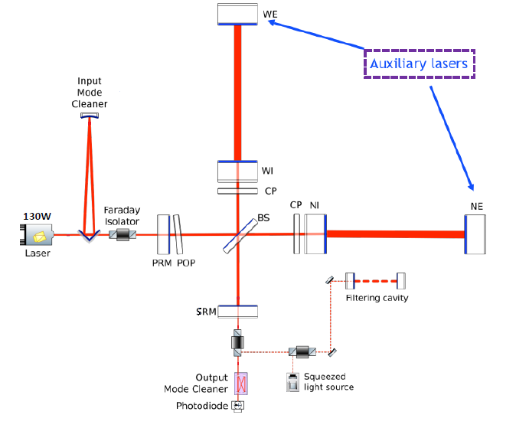
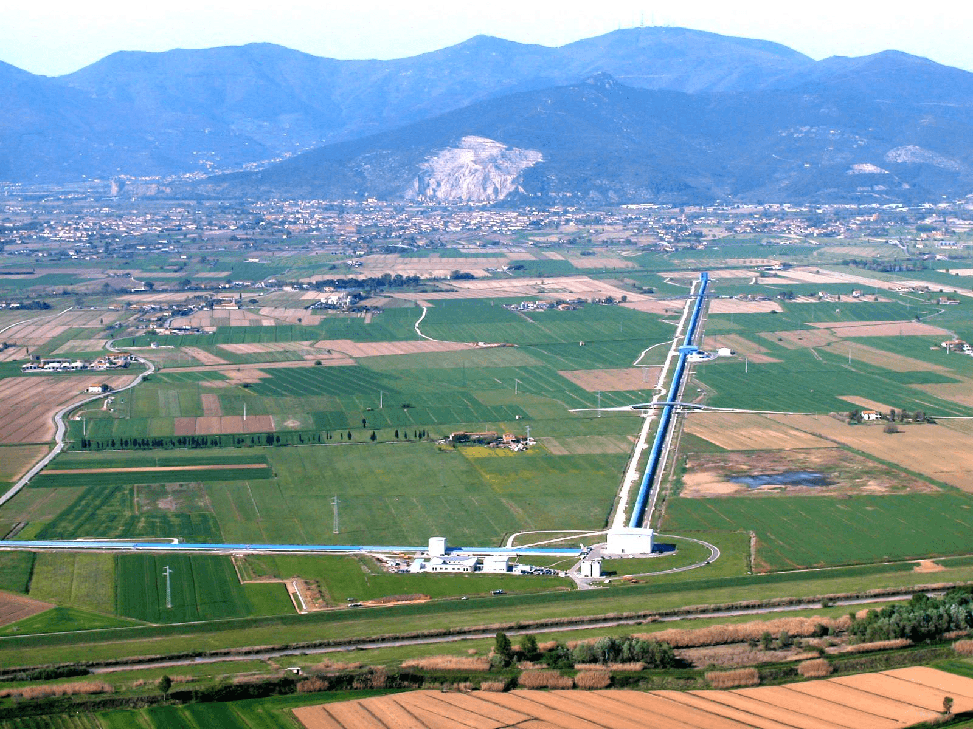
GW Detectors
300kW
300kW
40W
80W
High laser power
Post-O5 : 250W→ 1.5 MW
ET : 500W→ 3 MW
One limitation to the power increase : Parametric instabilities

Slide 5
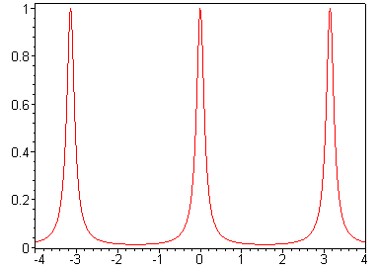
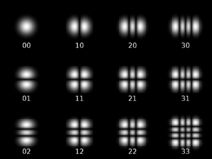
Linear optical cavity
q-1
q
q+1
2π
$$E_{in}$$
$$E_{t}$$
Normalized Transmittance
$$E_{r}$$
-2π
0
2π
Round-Trip phase
n
n+m
m
HG modes
Stable cavity : non degeneracy of HG modes’ resonance frequencies
Workshop « Développement des détecteurs » (17th June 2024)

Slide 6
Light scattering
$δx\left(t\right)=$ $δx_{0}\cos\left(Ωt\right)$
$$ℰ_{+}$$
Stokes process
$$Ω$$
$$ω$$
$$ℰ_{−}$$
$$t_{i}≃t_{f}−\frac{2}{c}\left[L+δx\left(t_{f}−\frac{L}{c}\right)\right]$$
$$ω−Ω$$
$ℰ_{−}\left(t_{f}\right)=ℰ_{+}\left(t_{i}\right)$= $ℰ_{0}e^{iωt_{i}}$= $ℰ_{0}e^{iω\left(t_{f}− \frac{2}{c}\left[L+δx\left(t_{f}− \frac{L}{c}\right)\right]\right)}$
Jacobi-Anger expansion (order 1)
Anti-stokes process
$$Ω$$
Signal
$$ω$$
$$ω$$
$$ω−Ω$$
$$ω+Ω$$
Stokes
Anti-stokes
$$ω+Ω$$
Workshop « Développement des détecteurs » (17th June 2024)

Slide 7
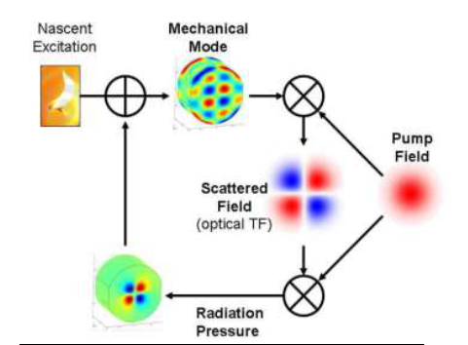
PI due to mirrors internal modes
Instability condition
Intracavity power
Mechanical quality factor
HOM optical quality factor
Parametric gain
Overlap
$$𝓡=\frac{P_{int}×Q_{m}×Q_{HOM}}{cL×mΩ_{m}^{2}}×\frac{B}{1+{\left(\frac{Δω_{HOM}}{ω_{p}}\right)}^{2}}>1$$
α mechanical mode energy
Cavity pole
HOM detuning
cavity
Evans et al, Phys. Lett. A, 374(4), 665-671 (2010)
[Braginsky et al, PLA 287 (2001)]

Slide 8
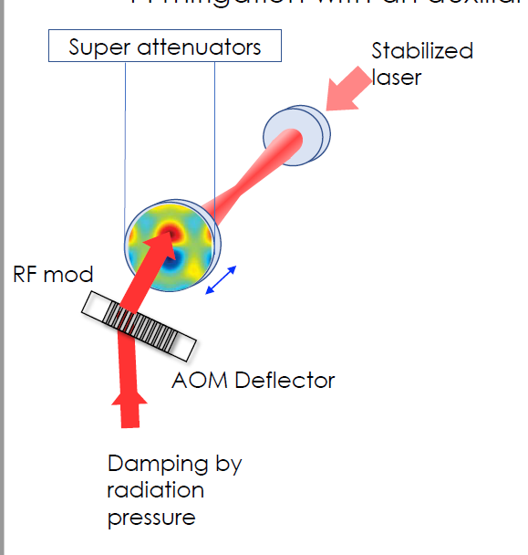
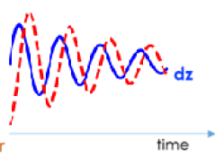
Mitigation based on Radiation Pressure
T. Harder et al. Optics Express Vol. 31, Issue 2, pp. 1486-1500 (2023)
35cm
$$π/2$$
Laser
AOM
AOM
Horizontal deflection
Vertical deflection
Damping by radiation pressure
Random access
Fast deflection
Mechanical damping
Light scattering → Optical damping
One way to monitor the parametric instabilities’ evolution is to characterize the mechanical modes of the mirror involved in the PIs

Slide 9
Outline
Goal: Monitoring evolution of Parametric instabilities’ (PIs)
Experimental setup and first results
Improvements
Conclusion and Perspectives

Slide 10
Requirements
Goal:
Monitoring thermally induced mechanical modes of a mirror with a quality factor $Q={10}^{6}$
Use of the parametric gain to assess if a mechanical mode is involved in PIs
Measuring small displacement with a required sensitivity: $<5×{10}^{−15} m/\sqrt{Hz}$ for frequencies > 30 kHz
Measurements cannot be done using a cavity
Michelson interferometer

Slide 11
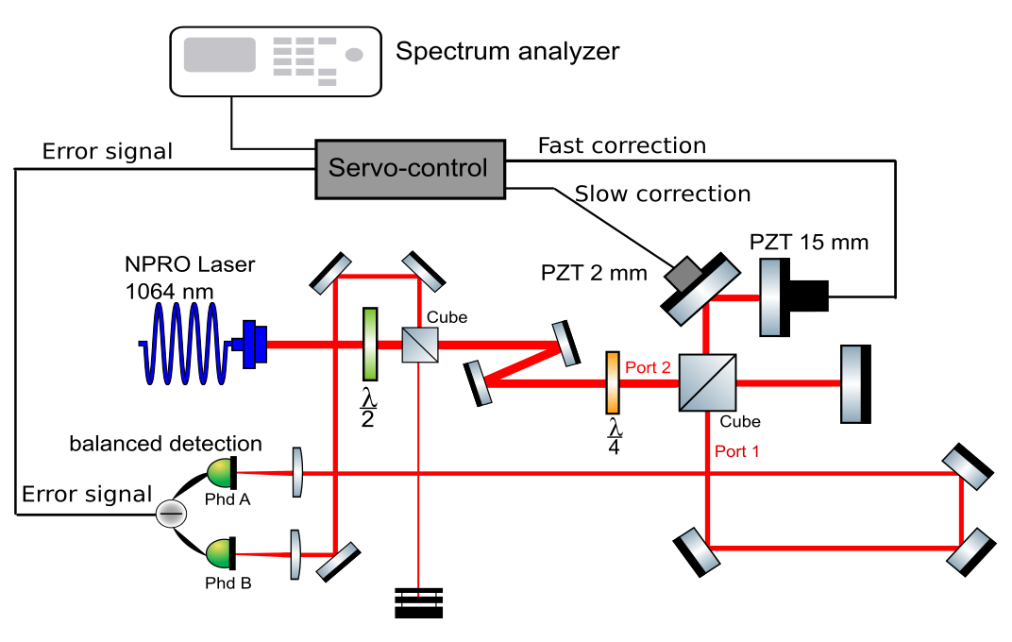
Experimental setup
Si Photodiode

Slide 12
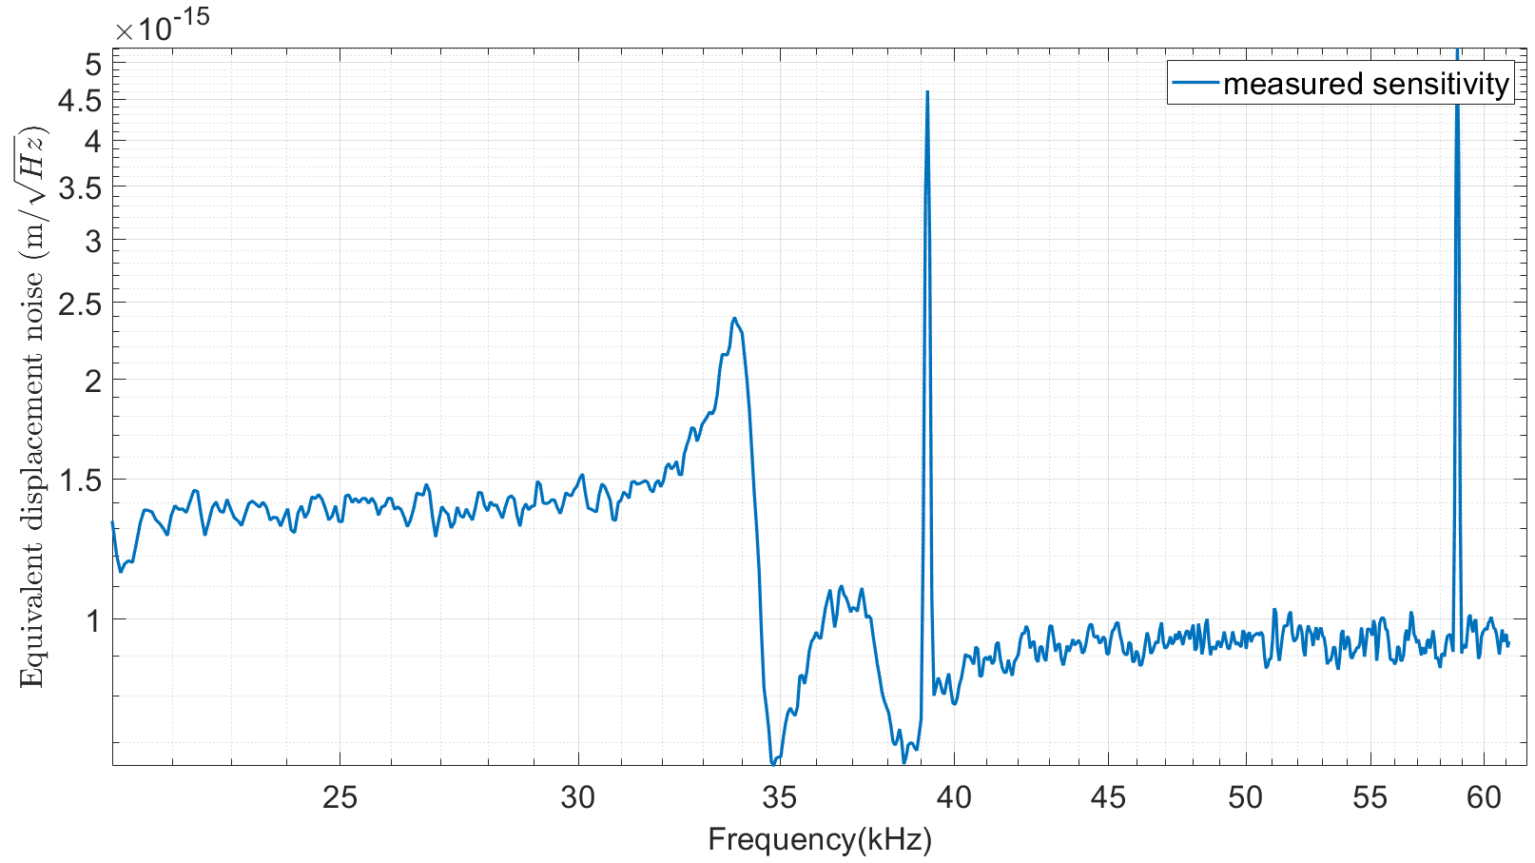
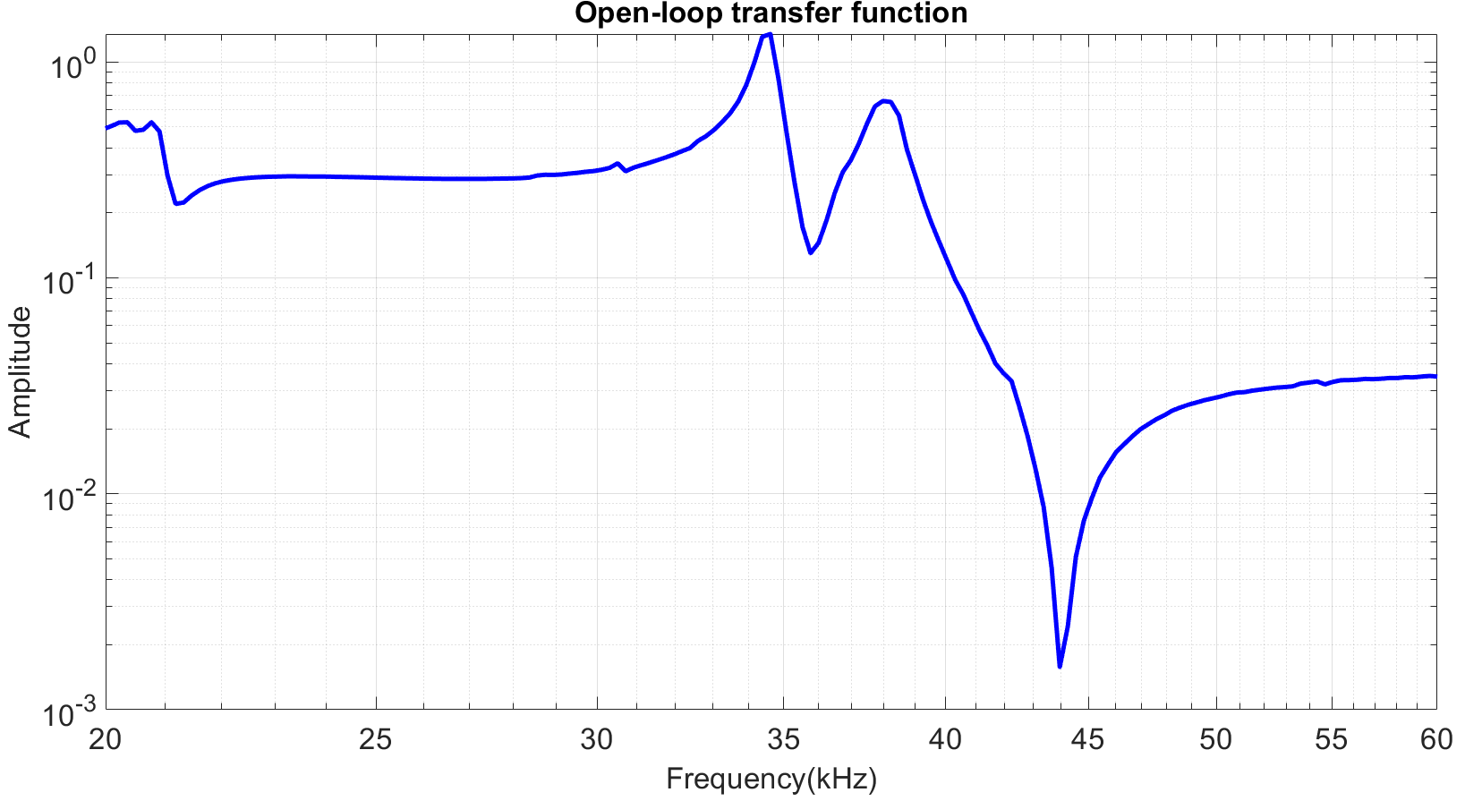
First results
Averaged power on each photodiode: 4.4 mW
Peaks already measured in the photodiode dark noise
PZT for the fast correction
Si Photodiode
Noise floor at $\sim 9.4×{10}^{−16}m/\sqrt{Hz}$
Shot-noise limited?

Slide 13
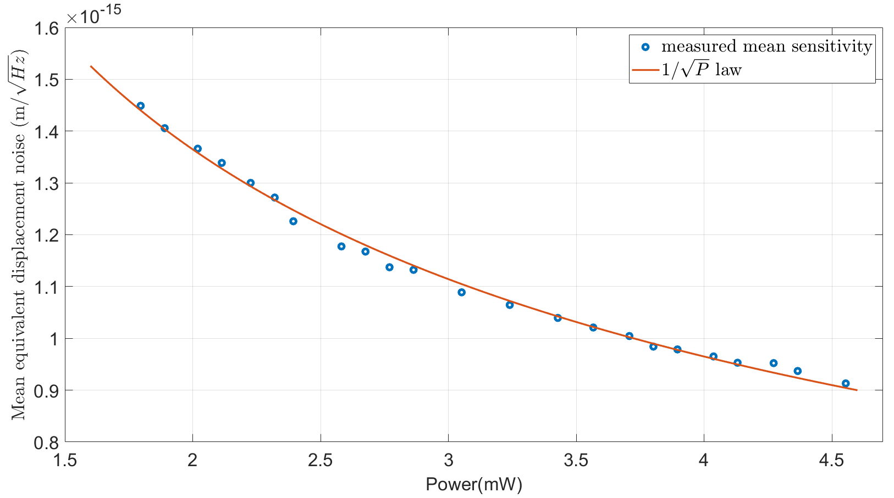
Shot-noise limited sensitivity
Sensitivity measurement as a function of optical power
Shot-noise limited if following a $1/\sqrt{P}$ law
Si Photodiode
Increasing the optical power measured by each photodiode improves the sensitivity

Slide 14
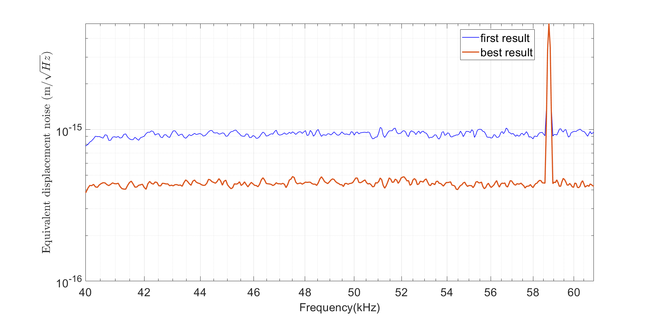
Best result with this experimental setup
Averaged power on each photodiode: 25 mW
Si Photodiode
Noise floor at $\sim 4.4×{10}^{−16}m/\sqrt{Hz}$
Sensitivity improved up to $4.4×{10}^{−16}m/\sqrt{Hz}$
But sensitivity and lock not stable in time due to thermal effects in the Si Photodiodes
Limitation on the averaged optical power to avoid thermal effects in the Si Photodiodes: 15 mW
Limitation on the sensitivity: $\sim 5×{10}^{−16}m/\sqrt{Hz}$

Slide 15
Outline
Goal: Monitoring evolution of Parametric instabilities’ (PIs)
Experimental setup and first results
Improvements
Conclusion and Perspectives

Slide 16
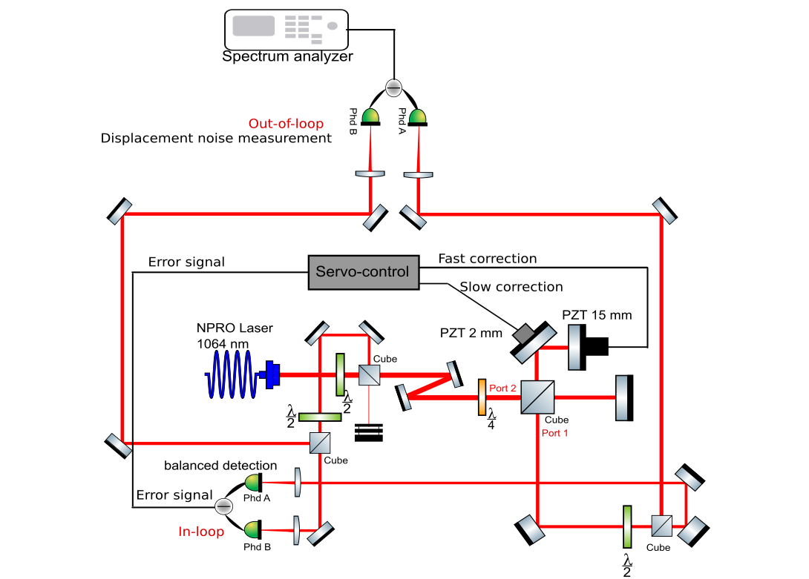
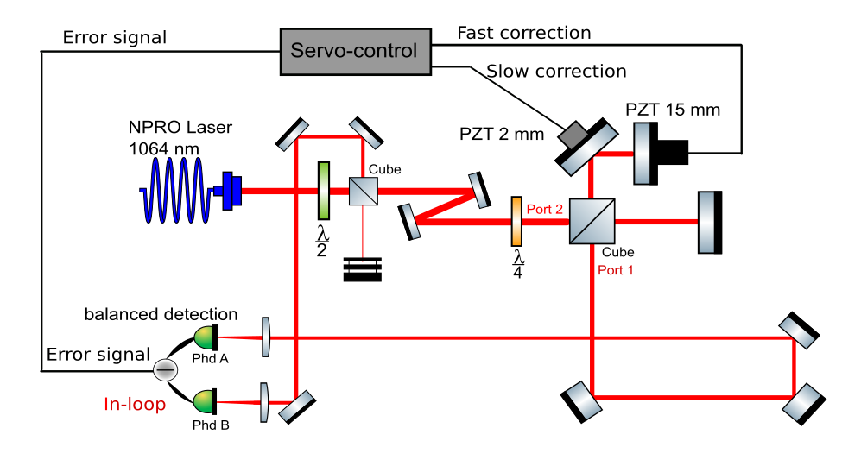
Improvements
Goal: Increasing the input optical power on the photodiode without degrading the sensitivity and the lock
New experimental setup
Lock using Si Photodiodes at low optical power $≤15 mW$
2. Out-of-loop displacement measurements with InGaAs Photodiodes at higher optical power
Balanced detection
InGaAs photodiodes
Si photodiodes
Si Photodiode

Slide 17
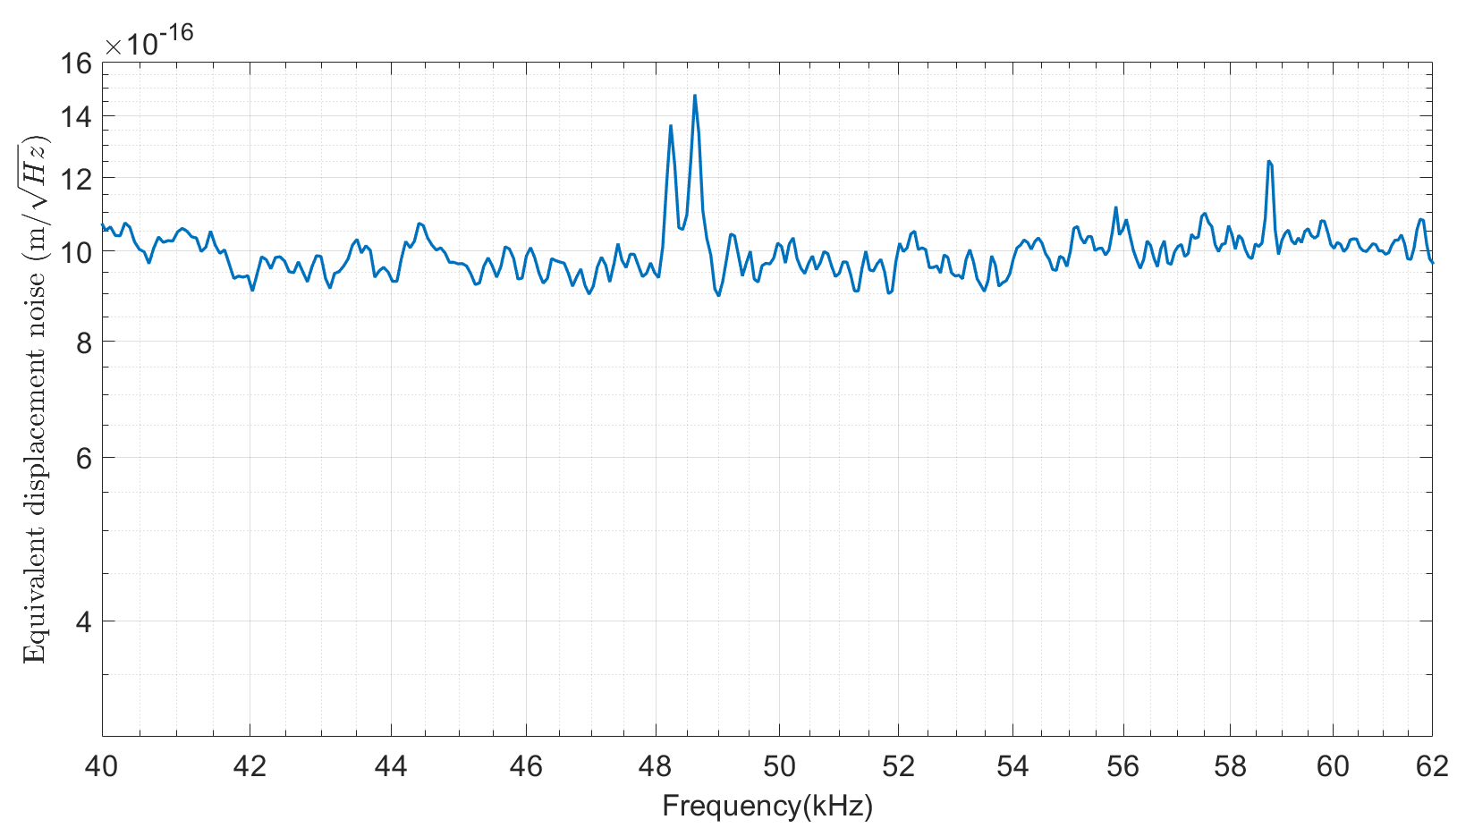
First results on the out-of-loop path
Averaged power on each photodiode: 2 mW
Peaks already measured in the photodiode dark noise
Noise floor at $\sim 9.5×{10}^{−16}m/\sqrt{Hz}$
Shot-noise limited?

Slide 18
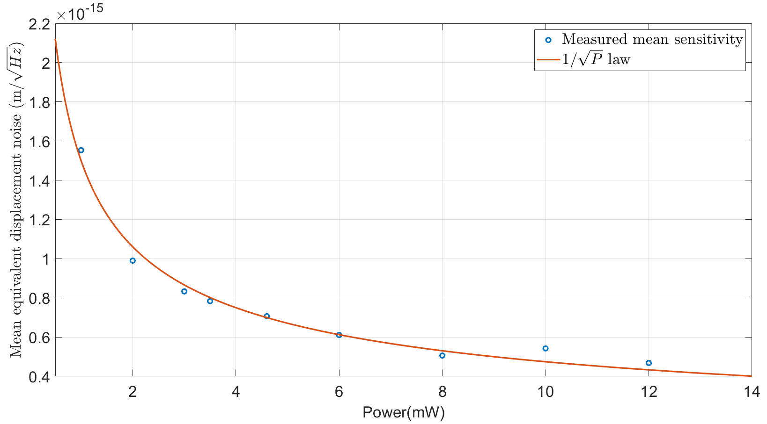
First results on the out-of-loop path
Sensitivity measurement as a function of optical power
Sensitivity limited by the shot-noise for low optical power ($<15 mW$)

Slide 19
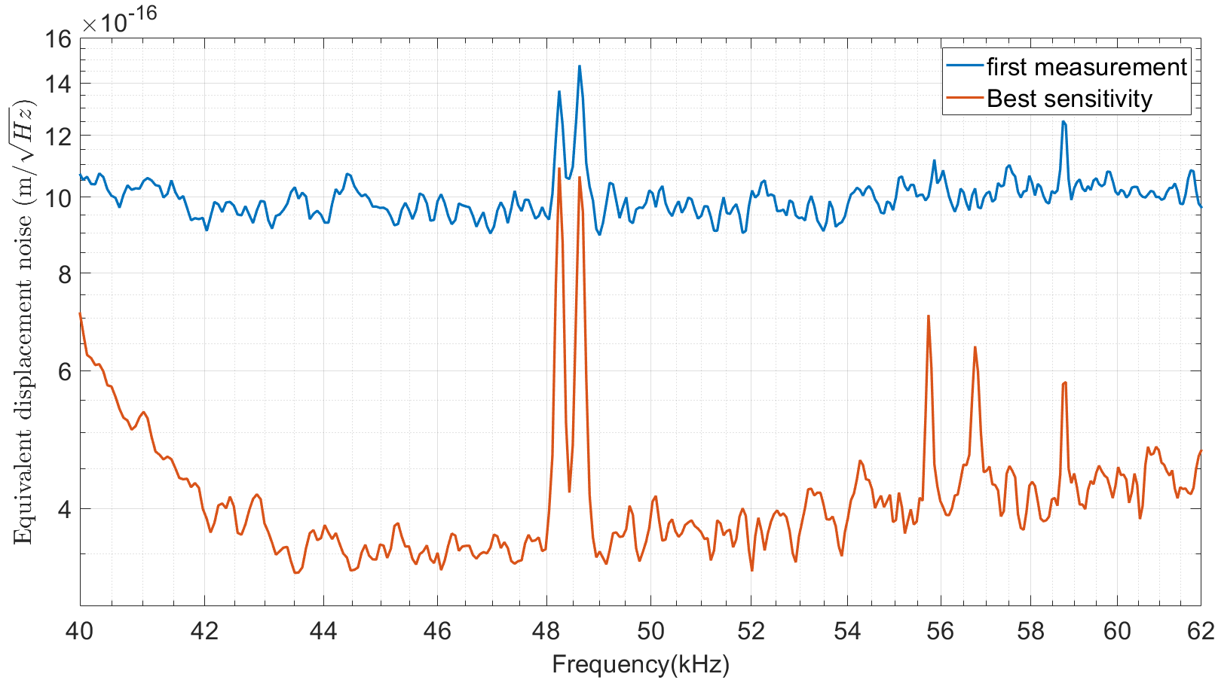
Best result on the out-of-loop path
Averaged power on each photodiode: 58 mW
Peaks already measured in the photodiode dark noise
Thermal peaks?
Noise floor at $\sim 3.5×{10}^{−16}m/\sqrt{Hz}$- not limited by the shot-noise ($2×{10}^{−16}m/\sqrt{Hz}$)

Slide 20
Conclusion and perspectives
To conclude
Measurement sensitivity Improvement up to $3.5×{10}^{−16}m/\sqrt{Hz}$
What’s next?
Investigation on the peaks measured around 56 kHz
Reaching the shot-noise limit at high optical power
Medium term Perspectives
Characterization of the mechanical modes of a suspended mirror under vacuum
Monitoring of the full surface of the mirror

Slide 21
Thank you for your attention

Slide 22
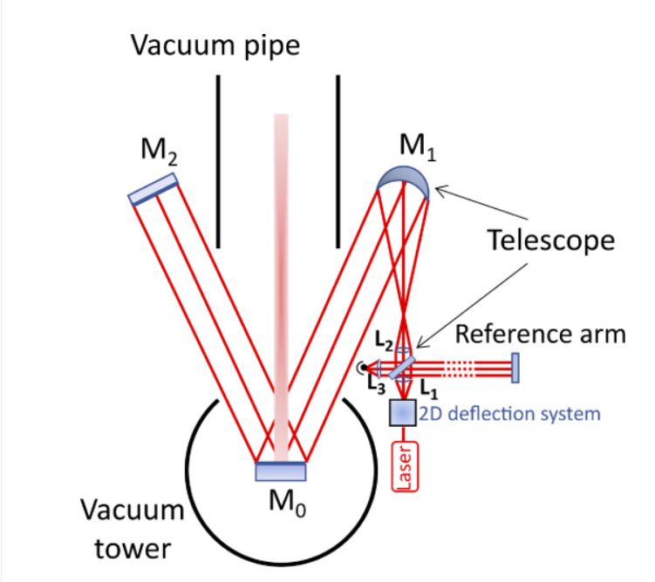
Perspectives towards implementation on a GW detector
T. Harder et al. Optics Express Vol. 31, Issue 2, pp. 1486-1500 (2023)

Slide 23
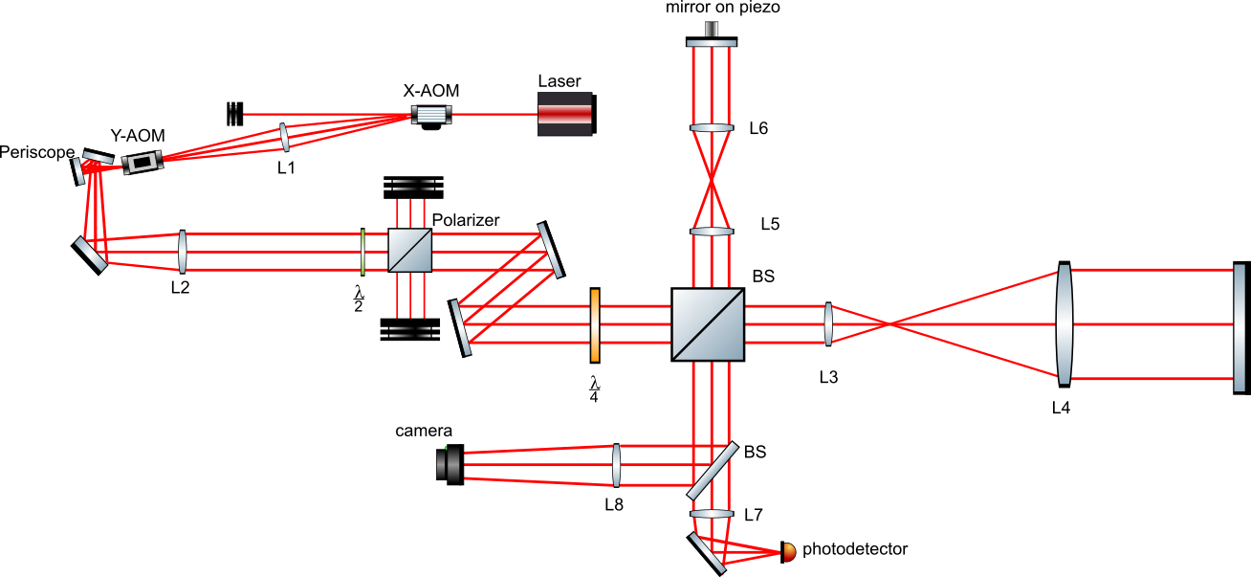
PIs observation and mitigation
Servo-control
USRP
RF-AMP
RF-AMP
L
L
vacuum
Electrostatic actuator
cavity

