Slide 1




Measurements below
the standard quantum limit
in atomic interferometry
Franck Pereira Dos Santos
SYRTE
Workshop « Développement des détecteurs"
Paris, June the 17th, 2024

Slide 2
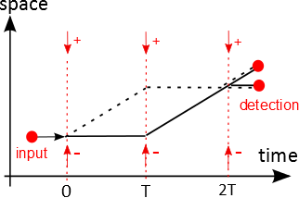
Principle of atom interferometry
Analogy with optical interferometry
Use atom-laser interaction to deflect matter waves
Interferometer based on a sequence of 3 laser pulses

Slide 3
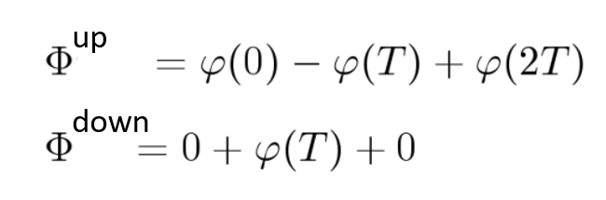
Phase difference between the two paths
Phase of the interferometer : $ΔΦ=Φ^{up}−Φ^{down}$
$Φ$: phase of the quantum wavepacket
upper arm
lower arm
$φ :$ laser phase : $φ\left(T\right)=kz\left(T\right)=\frac{4π}{λ}z\left(T\right)=4π\frac{z\left(T\right)}{λ}$
$$ΔΦ=φ\left(0\right)−2φ\left(T\right)+φ\left(2T\right)=k(z\left(0\right)−2z\left(T\right)+z\left(2T\right))$$
Sampling of the positions at the three pulses
For a constant acceleration a, $z\left(t\right)=\frac{1}{2}a t^{2} ⇒ ΔΦ=k a{ T}^{2}$
Key advantages
Scales as T² ⇒ Benefit of cold atoms
Depends on time (T) and frequency (k) ⇒ SI traceable, accurate, bias free

Slide 4
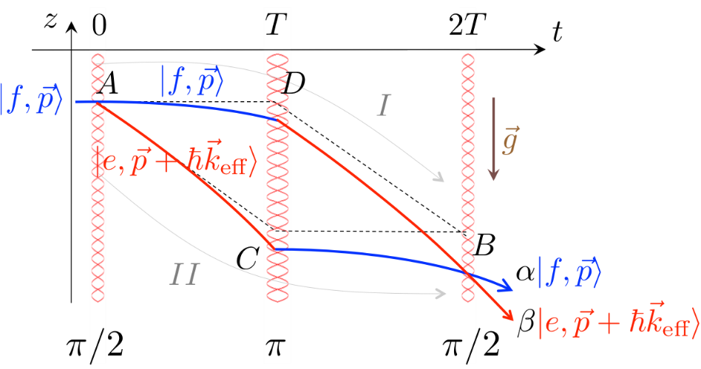

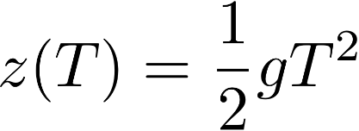

Gravimeter: a vertical accelerometer
Laser 1
3D-MOT
Bring the two lasers in a co-propagating way and retroreflect them on a mirror
Detection
Position of the equiphases
defined by the mirror position
Laser 2
Mirror
atomic measurement = measure of the relative displacement atoms/mirror

Slide 5
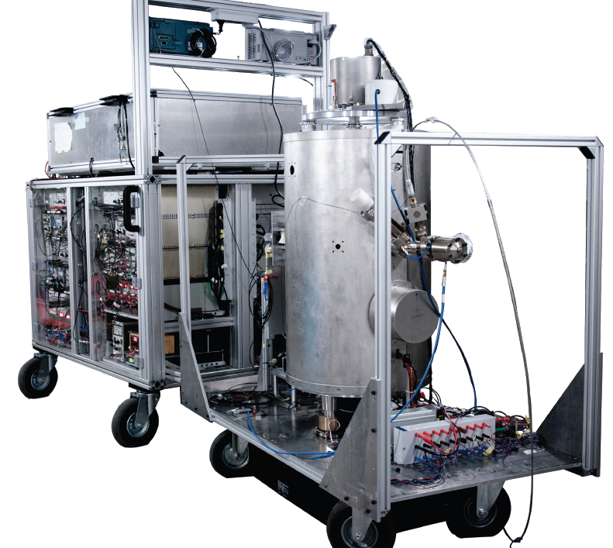
The SYRTE gravimeter
Laser system
Performances
Short term stability
57 nm/s2 @ 1s
Long term stability
< 1 nm/s2
Better than the reference “classical” instrument = corner-cube gravimeter
Accuracy
20 nm/s2
Drop chamber
130
140
Control electronics,
Power supplies
140
70

Slide 6
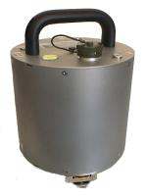
Sensitivity limits: vibrations
Typical noise in urban environnement
Without isolation platform: 2.9 · 10⁻⁶ g/Hz^{1/2}
With platform: 7.6 · 10⁻⁸ g/Hz^{1/2}
GAIN : factor 40
Post-correction
Seismometer
PC
k_{eff}gT²
v(t) → φ_{vib}^{S}
Interferometer
k_{eff}gT² + φ_{vib}^{S}
Provides additional gain from 2 to 10 depending on vibration noise conditions:
6 10⁻⁹ g/Hz^{1/2} (quiet, LUX) – 15 10⁻⁹ g/Hz^{1/2} (urban, WB lab, Trappes)

Slide 7
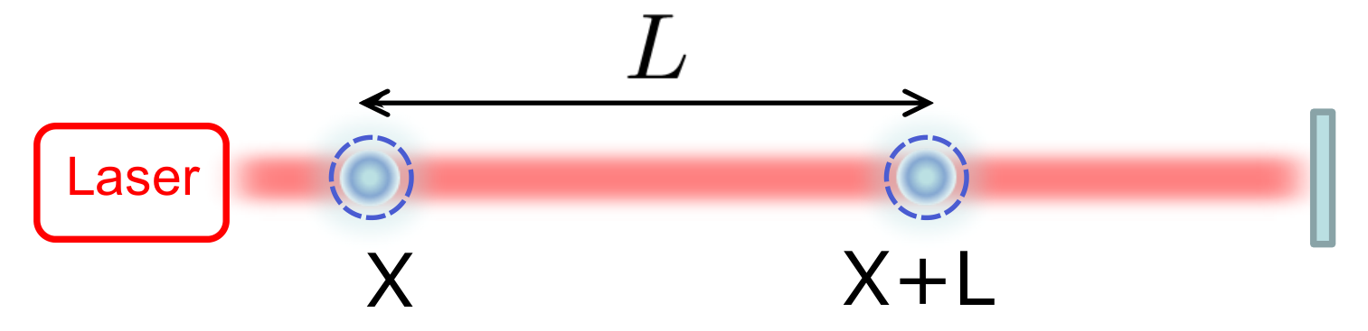
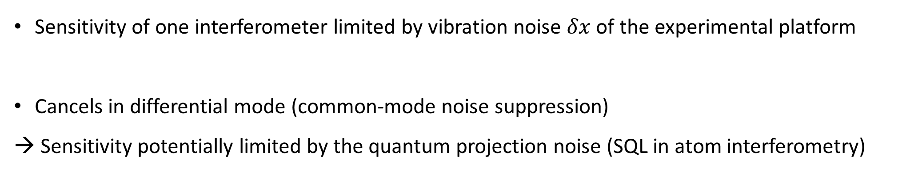

Differential measurements
$$δx$$
Sensitivity of one interferometer limited by vibration noise $δx$ of the experimental platform
Cancels in differential mode (common-mode noise suppression)
→ Sensitivity potentially limited by the quantum projection noise (SQL in atom interferometry)

Slide 8
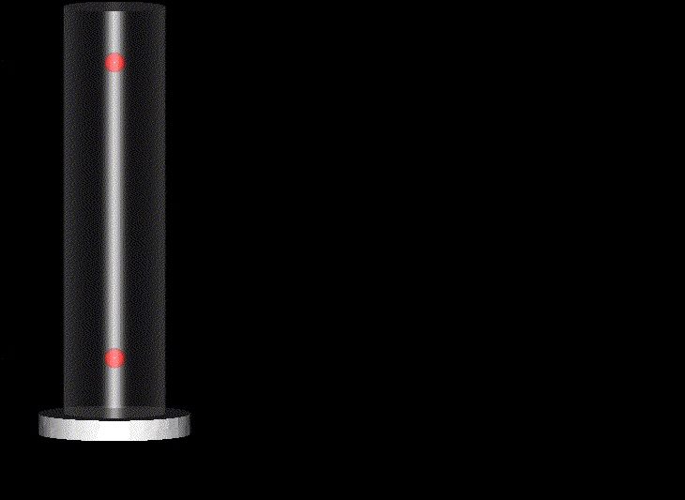
Differential interferometers
2 instrument configurations:
- Gradiometers
- Gyroscopes
Simultaneous interferometers
with two clouds of atoms and common lasers
Differential measurement gives access to acceleration difference
and therefore to the gravity gradient
Laser collimation
2 atomic beams
Simultaneous interferometers
with two conterpropagating beams
Differential measurement gives access to rotation
Cs oven
State preparation
Detection
Magnetic shields
Raman pulses
OPERATION AT THE SQL DEMONSTRATED IN THESE TWO CONFIGURATIONS

Slide 9
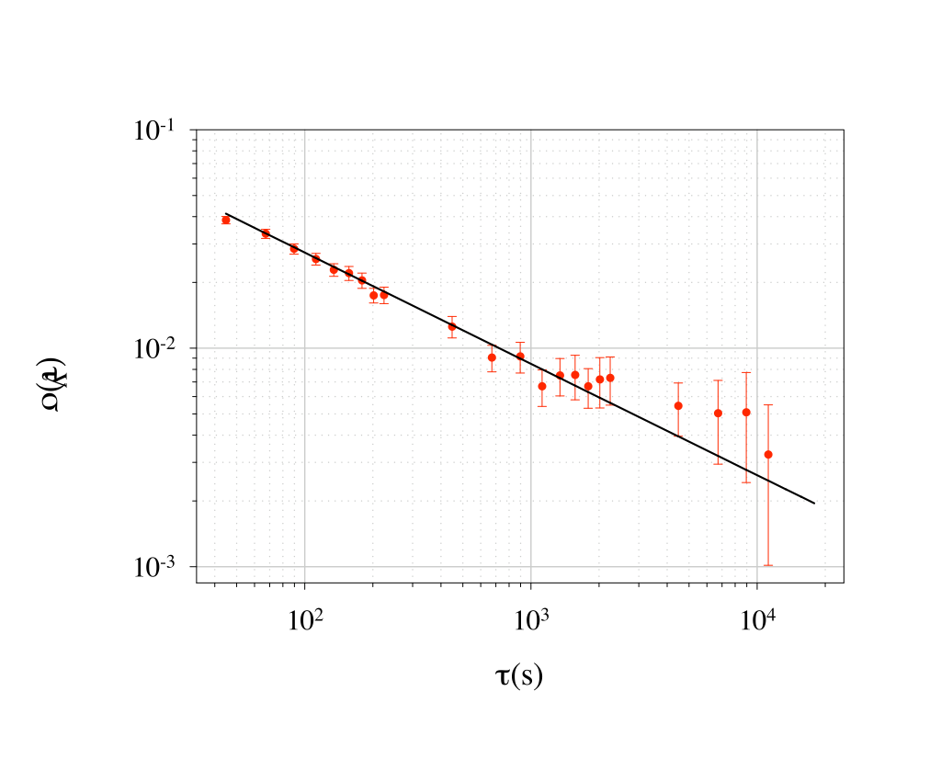
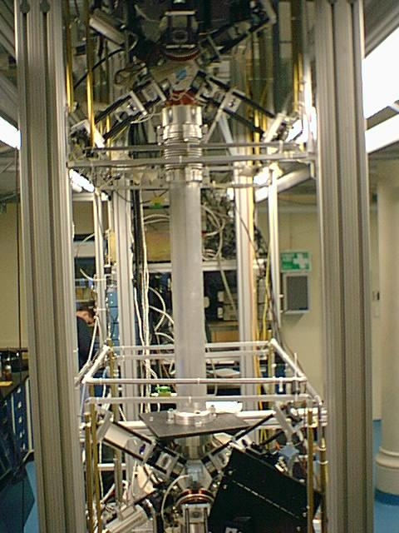
Differential interferometers
1.4 m
Demonstrated differential
acceleration sensitivity:
4x10⁻⁹ g/Hz^{1/2}
(2.8x10⁻⁹ g/Hz^{1/2} per accelerometer)

Slide 10
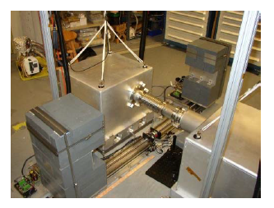
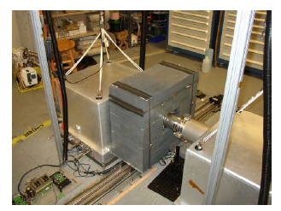
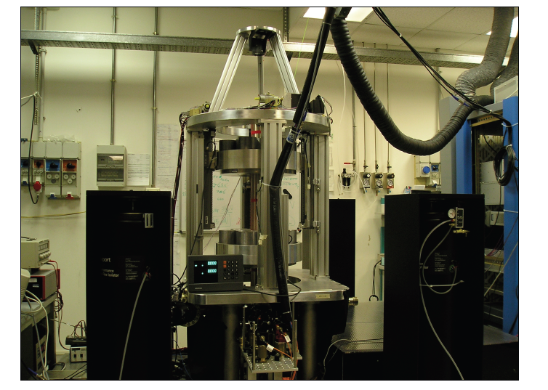
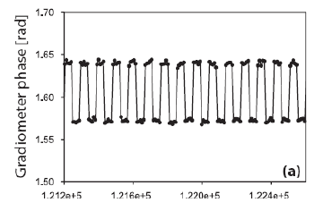
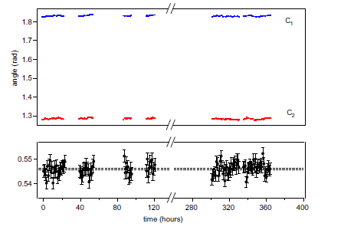
G measurements
Stanford, M. Kasevich
Florence, G. Tino
Differential acceleration stability : 10⁻¹¹ g
Statistical uncertainty : 2 10⁻⁴ on G
Statistical uncertainty:
3 10⁻⁴ on G

Slide 11
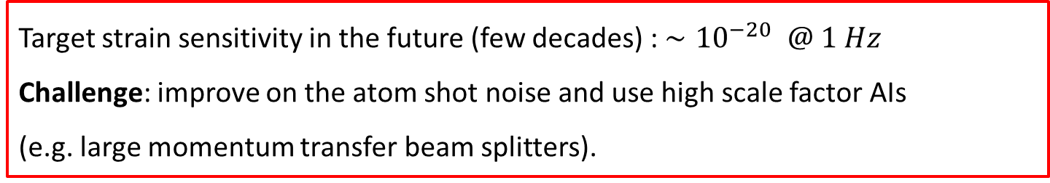
GW detection with atom interferometry
Motivation:
At low frequencies (<10 Hz), optical GW detectors are limited by motion noise
Residual seismic noise, thermodynamical noise in the mirror, etc.
Why not using "perfectly" free falling test masses to measure the laser phase?
→ Atom interferometry
Target strain sensitivity in the future (few decades) : ${∼10}^{−20} @ 1 Hz$
Challenge: improve on the atom shot noise and use high scale factor AIs
(e.g. large momentum transfer beam splitters).

Slide 12
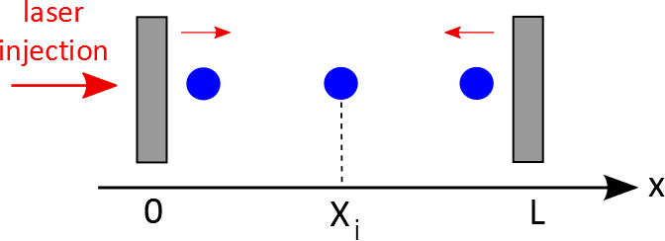
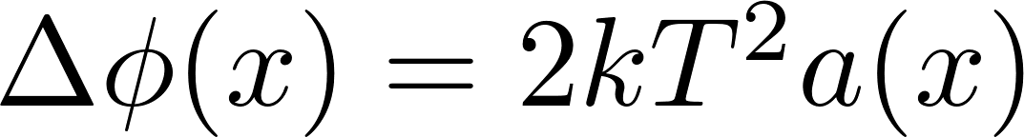
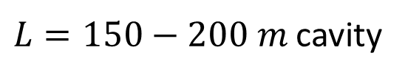
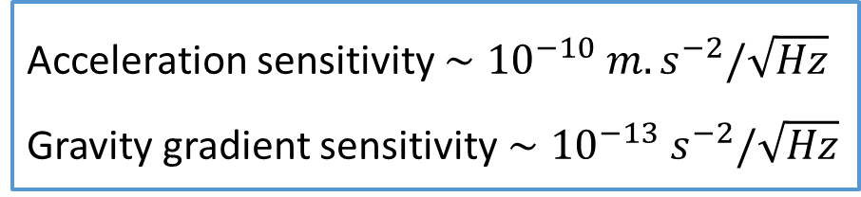
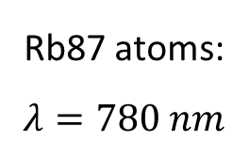
MIGA: towards large scale instrument
$L=150−200 m$ cavity
Rb87 atoms:
$$λ=780 nm$$
Interferometer phase shift at position x :
Interrogation time $2T≈0.5 s$ ; Phase sensitivity = 1/SNR ~ 1 mrad/shot
Acceleration sensitivity $∼{10}^{−10} m.s^{−2}/\sqrt{Hz}$
Gravity gradient sensitivity$∼{10}^{−13} s^{−2}/\sqrt{Hz}$

Slide 13
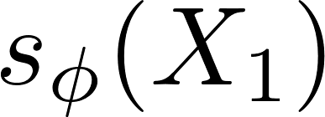
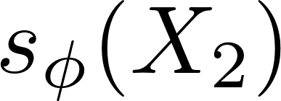
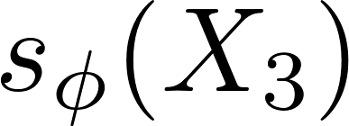
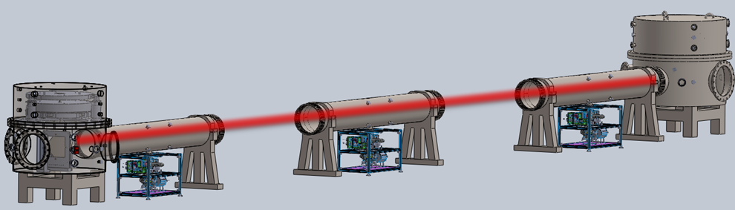
MIGA implementation
π
780 nm
π
Parameters
L = 200 m (=> 150 m)
Finesse = 150
2T = 500 ms
n=1
(two photon transition)
N=10⁶
Strain sensitivity
(detection noise limited)
2 10⁻¹³ @ 2Hz
30 cm
780 nm
π/2
Launch
Detection
150 m

Slide 14

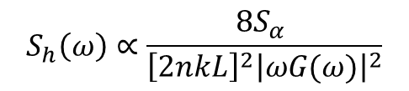
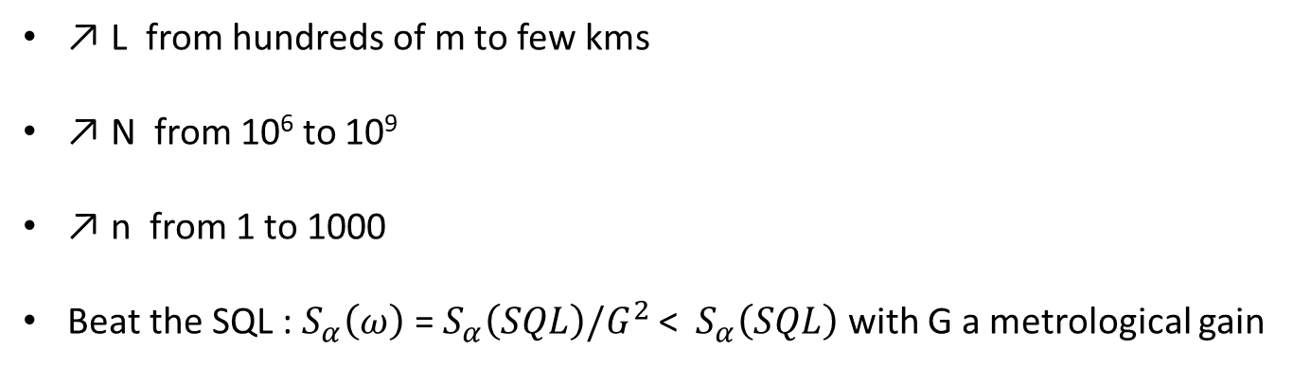
Strain sensitivity
How to improve ?
Contribution of the detection noise:
$$S_{h}\left(ω\right)∝\frac{{8S}_{α} }{{\left[2nkL\right]}^{2}{\left|ωG(ω)\right|}^{2}}$$
$S_{α}\text{(}\text{SQL}\text{)} \text{= 1/}\text{N}$ = 1(mrad)²/Hz for 10⁶ atoms
↗ L from hundreds of m to few kms
↗ N from 10⁶ to 10⁹
↗ n from 1 to 1000
Beat the SQL : $S_{α}\left(ω\right) \text{=}{ S}_{α}\left(SQL\right)/G^{2}$ < ${ S}_{α}\left(SQL\right)$ with G a metrological gain

Slide 15
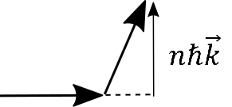

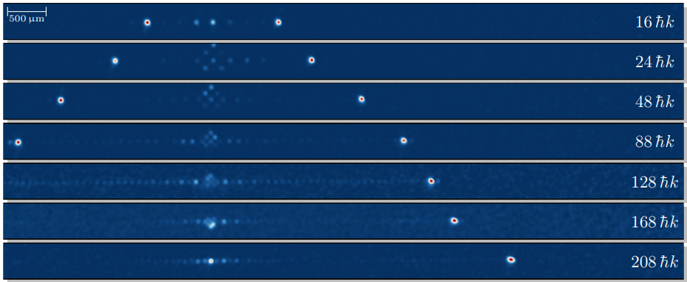

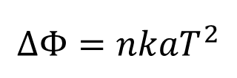
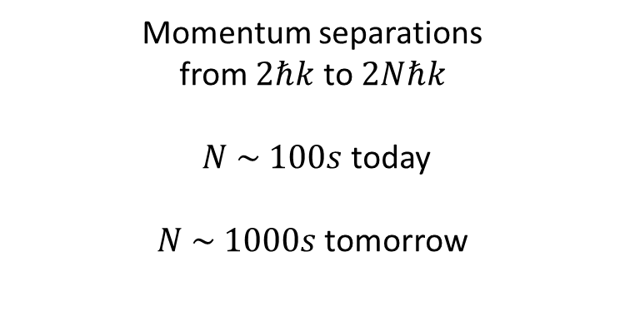
Large momentum transfer beamsplitters
$$ΔΦ=kaT^{2}$$
$$ΔΦ=nkaT^{2}$$
Example: Bragg diffraction in optical lattices
Momentum separations
from $2ℏk$ to $2Nℏk$
$N \sim 100s$ today
$N \sim 1000s$ tomorrow
Courtesy: S. Abend, LUH

Slide 16
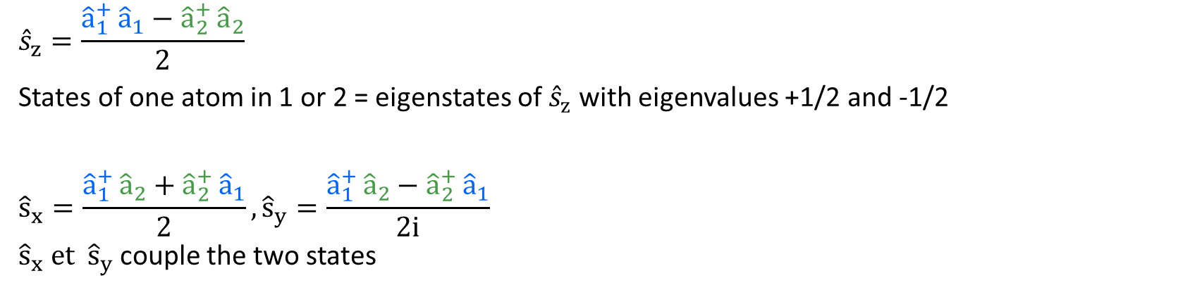
Pseudo-spin representation
A two level atom with states 1 and 2 can be represented by a pseudo-Spin ½
$${\hat{s}}_{z}=\frac{{\hat{a}}_{1}^{+ }{\hat{a}}_{1}−{\hat{a}}_{2}^{+ }{\hat{a}}_{2}}{2}$$
States of one atom in 1 or 2 = eigenstates of ${\hat{s}}_{z}$ with eigenvalues +1/2 and -1/2
$${\hat{s}}_{x}=\frac{{\hat{a}}_{1}^{+ }{\hat{a}}_{2}+{\hat{a}}_{2}^{+ }{\hat{a}}_{1}}{2}, {\hat{s}}_{y}=\frac{{\hat{a}}_{1}^{+ }{\hat{a}}_{2}−{\hat{a}}_{2}^{+ }{\hat{a}}_{1}}{2i}$$
${\hat{s}}_{x} et {\hat{s}}_{y}$ couple the two states
$${\hat{S}}_{z}$$
$${\hat{S}}_{y}$$
The state of the atom (and its dynamics)
can then be represented in the Bloch sphere
$${\hat{S}}_{x}$$

Slide 17
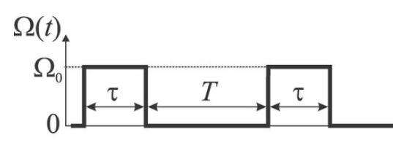










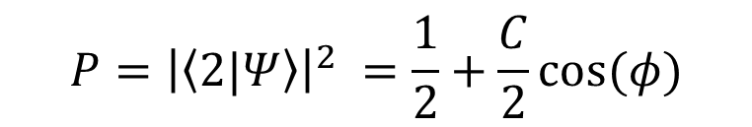





Atom-light interaction
2
Atom-light interaction = Coupling mode 1 and 2: ${\hat{a}}_{1}^{+ }{\hat{a}}_{2}$ & ${\hat{a}}_{2}^{+ }{\hat{a}}_{1}$
$$δω$$
$$\hat{H}\left(t\right)=ℏΩ_{R}(t) {[ \hat{s}}_{x} cos\left(φ_{L}\right)+{ \hat{s}}_{y} sin\left(φ_{L}\right)] + ℏδω(t) {\hat{s}}_{z} + ℏχ\left(t\right) {\hat{J}}_{z}^{2}$$
$$Ω_{R}$$
Ramsey sequence
$${\hat{s}}_{z}$$
1
$$|2〉$$
$${\hat{s}}_{z}$$
$$φ$$
$${\hat{s}}_{y}$$
$${\hat{s}}_{x}$$
$${\hat{s}}_{y}$$
$$φ$$
$${\hat{s}}_{x}$$
Superposition Evolution Recombinaison
$$|1〉$$
$φ=δω T$
$$P$$
Transition probability
At mid-fringe
$$P={\left|\left\langle 2|Ψ\right\rangle \right|}^{2} =\frac{1}{2}+\frac{C}{2}\cos{(φ)}$$
$$ΔP$$
$$ΔP=\frac{C}{2}Δφ$$
$$Δφ$$
$$φ$$
Phase

Slide 18





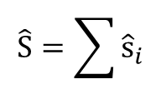








Pseudo-spin representation
$${\hat{S}}_{z}$$
Ensemble of N atoms represented by a macrospin
$$\hat{S}=\sum{{\hat{s}}_{i}}$$
Ramsey sequence
$${\hat{S}}_{y}$$
$$|2〉$$
$${\hat{s}}_{z}$$
$${\hat{s}}_{z}$$
$$〈{\hat{S}}_{x}〉= N/2$$
$${\hat{s}}_{y}$$
$$φ$$
$${\left(ΔS_{z}\right)}^{2}={\left(ΔS_{y}\right)}^{2}=N/4$$
$${\hat{s}}_{y}$$
$${\hat{s}}_{x}$$
$${\hat{s}}_{x}$$
$$φ$$
$${\hat{S}}_{x}$$
$$|1〉$$
Coherent atomic state
Superposition Evolution Recombinaison
$$P$$
$$Δφ_{SQL}=\frac{1}{\sqrt{N}}$$
$$ΔP$$
$$Δ{φ }_{SQL}=ΔS_{z}/〈{\hat{S}}_{x}〉$$
$$Δφ$$
$$φ$$
Phase

Slide 19
One-axis twisting
1) Coherent state 2) Squeezed state 3) Optimized for ${\hat{S}}_{z}$
$${\hat{S}}_{z}$$
$${\hat{S}}_{z}$$
$${\hat{S}}_{z}$$
Rotation around ${\hat{S}}_{y}$
→ Control of laser phase
$$ΔS_{z}$$
$${\hat{S}}_{y}$$
$${\hat{H}}_{int}∝{\hat{S}}_{z}^{2}$$
$${\hat{S}}_{y}$$
$${\hat{S}}_{y}$$
$$ΔS_{z}$$
$$ΔS_{z}$$
$$ΔS_{y}$$
« Rotation around $S_{z}$ with strength $∝{ S}_{z}$ »
$$Δφ_{SQL}=\frac{1}{\sqrt{N}}$$
$$Δφ_{squeezed}=\frac{Δφ_{SQL}}{G}$$
$$G∝\frac{ΔS_{z}}{ΔS_{z}}>1$$
$$Δφ_{SQL}=\frac{1}{\sqrt{N}}$$

Slide 20



Spin-squeezing with internal states
Two-body interactions in dense clouds (ex : BECs), with scattering lengths a₁₁, a₂₂, a₁₂
Mean field interaction
with
This rewrites as
with
Rb: 1 and 2 are the two hyperfine ground state F=1 and F=2
is negligible
Reduction of the ovelap between 1 and 2
is made negligible

Slide 21
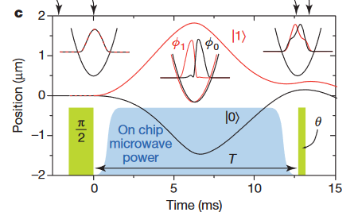
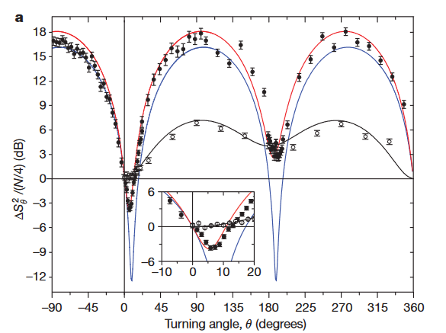
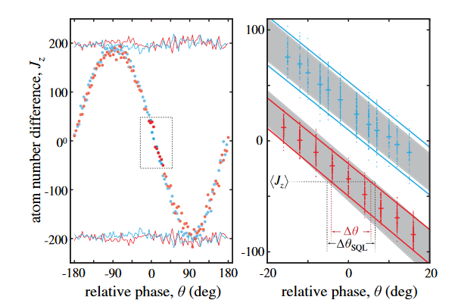
Spin-squeezing with internal states
Riedel, M., Böhi, P., Li, Y. et al. Nature 464, 1170–1173 (2010)
State-selective double well potential
-2.5(0.6) dB
metrologically useful squeezing
(Ramsey contrast of C = 88(3)%)
Gross, C., Zibold, T., Nicklas, E. et al. Nature 464, 1165–1169 (2010).
Exploit a Feshbach resonance to reduce U₁₂
Spin-noise tomography: inferred gain of −8.2 dB
-1.4 dB squeezing in a Ramsey interferometer

Slide 22
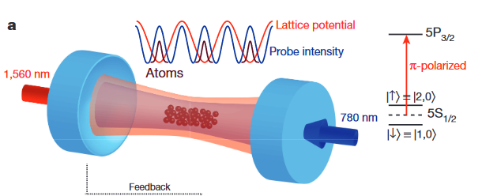
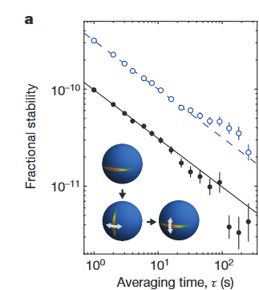
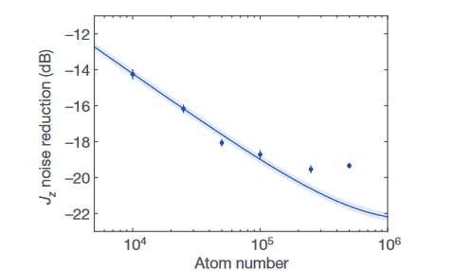
Spin-squeezing with internal states
Measurement enabled by a high-finesse optical cavity
|↓〉(|↑〉) atoms increase (decrease)
the index of refraction seen by the probe light.
⇒ Frequency shift of the cavity resonance is a direct predictor of Jz
Clock measurements
QND measurements:
Jz measurements prepare a state with reduced Jz noise.
A second measurement
is correlated with the first one.
10.5(3) dB metrological gain
Stability improved by a factor 3

Slide 23
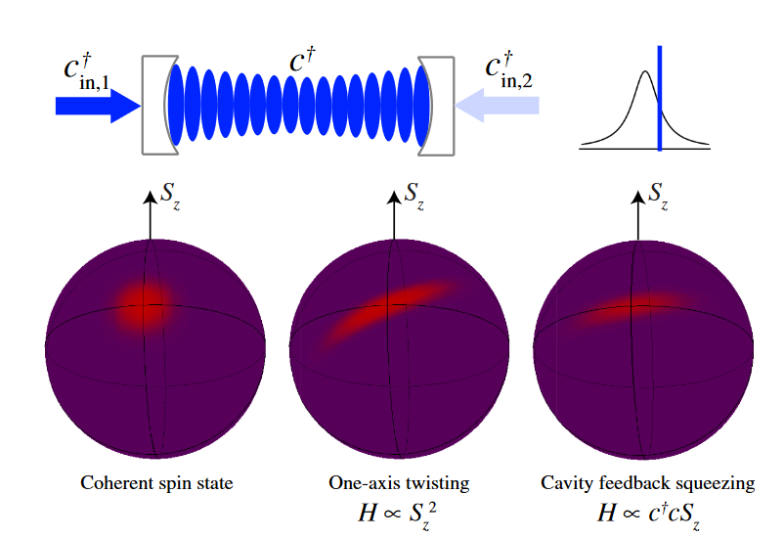

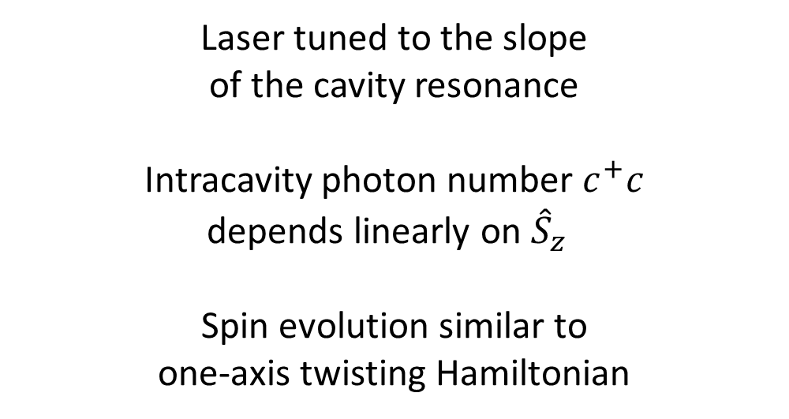
Cavity feedback squeezing
Atoms trapped in an intra-cavity standing wave
Probe laser (blue) produces a differential light shift between two atomic states
${\hat{H}}_{int}∝ c^{+}c{\hat{S}}_{z}^{}$
Laser tuned to the slope
of the cavity resonance
Intracavity photon number $c^{+}c$
depends linearly on ${\hat{S}}_{z}^{}$
Spin evolution similar to
one-axis twisting Hamiltonian
$${\hat{H}}_{int}∝{\hat{S}}_{z}^{2}$$

Slide 24
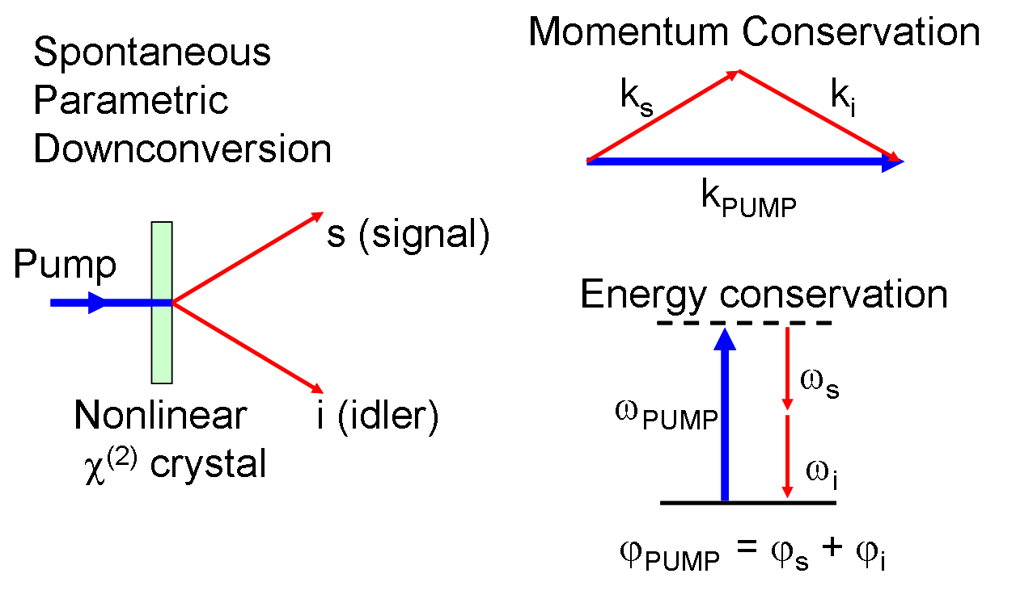
Generation of entanglement
Collisions allow production of correlated pairs of atoms with m_{F} = ±1
With atoms
With photons
F=2
mw dressing
m_{F}=+1
F=1
(Wikipedia: Spontaneous parametric down-conversion)
m_{F}=0
m_{F}=-1
signal
pump
idler

Slide 25
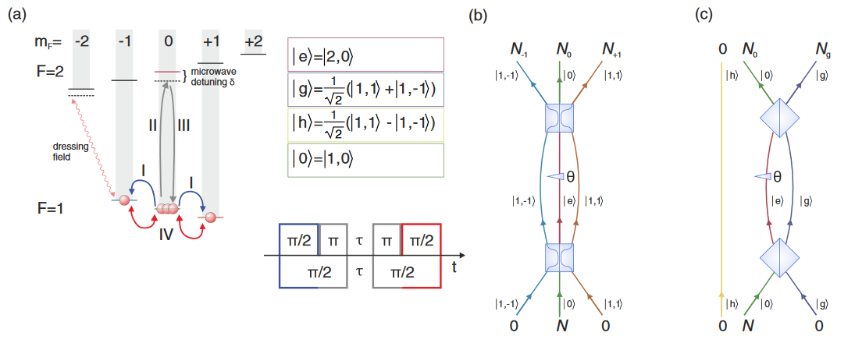
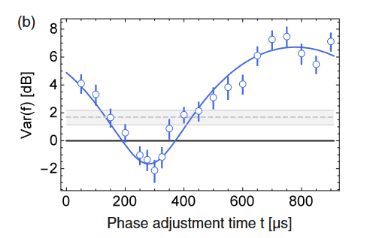
Squeezed vacuum in an interferometer
Realization
of a three mode
interferometer
Creation of a squeezed vacuum state
with spin dynamics in the BEC
prior to the interferometer sequence.
32 ms of spin dynamics
a mean number of 0.75 atoms
in the two states g and h is obtained
2 dB Gain

Slide 26
Atom interferometry (with separated paths)
z
Beamsplitter
Mirror
Beamsplitter
$$P_{1}$$
$$|{2,p}_{0}+2ℏk_{eff}〉$$
$$g$$
$${ΔP}_{1}$$
$$|1, p_{0}〉$$
$$|{1,p}_{0}〉$$
$$Δφ$$
t
$$φ$$
Phase
laser
laser
laser
$$\hat{H}\left(t\right)=ℏΩ_{R}(t) {[ \hat{S}}_{x} cos\left(φ_{L}\right)+{ \hat{S}}_{y} sin\left(φ_{L}\right)] + ℏδω(t) {\hat{S}}_{z}$$
Atom-light coupling
$Ω_{R}$ : Rabi frequency
Precession term
$$φ=\int{dt}δω(t)$$
Notes:
Dans le cadre de mon activité de recherche, les systèmes atomiques sont soit des horloges soit des capteurs inertiels dont le fonctionnement repose sur le principe des interféromètre à deux ondes.
Dans le cas des horloge, chaque atomes est mis dans un état de superposition cohérente d’énergie interne différentes alors que dans le cas des capteurs inertiel chaque atome est mis dans une superposition de deux état externes différentes. Dans ce cas les deux ondes partielles se séparent au cours du temps.
Dans les deux cas, l’état atomique est manipuler au travers de l’interaction atome-lumière.
Le principe d’une séquence est le suivant: l’ état de superposition évolue et accumule une phase qui est ensuite mesurer après avoir recombiner les deux chemins. La différence de phase accumulé est obtenue en évaluant la probabilité que l’état quantique soit projeté dans l’état fondamentale ou excite.
Ce que l’on appel la sensibilité, c’est la plus petite phase que l’on peut mesuré qui dans le cas de la limite quantique standard vaut 1/sqrt(N).
Typiquement dans le cas des horloges la phase est relié à la fréquence de la transition. En considérant 10^4 atomes interrogé pendant
une seconde ont atteins une mesure de la fréquence relative à quelque 10^-17.
Alors que dans le cas CI, on mesure une accélération relative de quelque 10-9 en considérant 10^6 atomes et un Tint de 100ms.

Slide 27
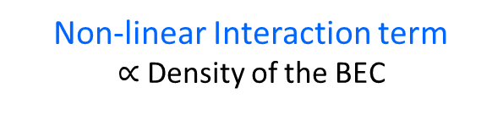
Atom interferometry (with separated paths and BECs)
z
Beamsplitter
Mirror
Beamsplitter
$$P_{1}$$
$$|{2,p}_{0}+2ℏk_{eff}〉$$
$$g$$
$${ΔP}_{1}$$
$$|1, p_{0}〉$$
$$|{1,p}_{0}〉$$
$$Δφ$$
t
$$φ$$
Phase
laser
laser
laser
$$\hat{H}\left(t\right)=ℏΩ_{R}(t) {[ \hat{S}}_{x} cos\left(φ_{L}\right)+{ \hat{S}}_{y} sin\left(φ_{L}\right)] + ℏδω(t) {\hat{S}}_{z} + ℏχ\left(t\right) {\hat{S}}_{z}^{2}$$
Atom-light coupling
$Ω_{R}$ : Rabi frequency
Precession term
$$φ=\int{dt}δω(t)$$
Non-linear Interaction term
$∝$ Density of the BEC
Challenge :
In free fall interferometers, the density drops quickly and thus the strength of the interactions
Notes:
Dans le cadre de mon activité de recherche, les systèmes atomiques sont soit des horloges soit des capteurs inertiels dont le fonctionnement repose sur le principe des interféromètre à deux ondes.
Dans le cas des horloge, chaque atomes est mis dans un état de superposition cohérente d’énergie interne différentes alors que dans le cas des capteurs inertiel chaque atome est mis dans une superposition de deux état externes différentes. Dans ce cas les deux ondes partielles se séparent au cours du temps.
Dans les deux cas, l’état atomique est manipuler au travers de l’interaction atome-lumière.
Le principe d’une séquence est le suivant: l’ état de superposition évolue et accumule une phase qui est ensuite mesurer après avoir recombiner les deux chemins. La différence de phase accumulé est obtenue en évaluant la probabilité que l’état quantique soit projeté dans l’état fondamentale ou excite.
Ce que l’on appel la sensibilité, c’est la plus petite phase que l’on peut mesuré qui dans le cas de la limite quantique standard vaut 1/sqrt(N).
Typiquement dans le cas des horloges la phase est relié à la fréquence de la transition. En considérant 10^4 atomes interrogé pendant
une seconde ont atteins une mesure de la fréquence relative à quelque 10^-17.
Alors que dans le cas CI, on mesure une accélération relative de quelque 10-9 en considérant 10^6 atomes et un Tint de 100ms.

Slide 28
Free fall interferometry
Position
Interferometer
$${\hat{S}}_{z}$$
$$φ$$
$${\hat{S}}_{y}$$
BEC dilution
t
$$Δr$$
$$t_{exp}$$
$$Δr_{0}$$
t

Slide 29
Quantum-enhanced free fall interferometry
Interferometer
$${\hat{S}}_{z}$$
Position
$$φ$$
$${\hat{S}}_{y}$$
State preparation
$${\hat{S}}_{z}$$
$${\hat{S}}_{z}$$
$${\hat{S}}_{y}$$
$${\hat{S}}_{y}$$
Interacting BEC
t
One-Axis Twisting (OAT)
$$Δr$$
Advantages:
  Spin-Squeezing dynamic
Disadvantages:
  Interacting ensemble during BS
  Shape deformation
  Limited amount of squeezing (G up to 7 dB)
$$t_{exp}$$
$$Δr_{0}$$
t
[1] S. S. Szigeti, et al., PRL 125, 100402 (2020).

Slide 30
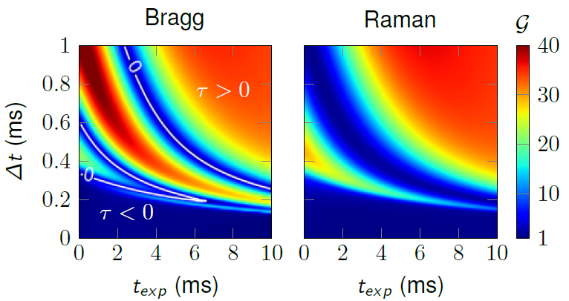
Quantum-enhanced free fall interferometry
Interferometer
$${\hat{S}}_{z}$$
Position
$$φ$$
$$S_{y}$$
State preparation
$${\hat{S}}_{z}$$
$${\hat{S}}_{z}$$
$${\hat{S}}_{y}$$
$${\hat{S}}_{y}$$
BEC dilution
t
One-Axis Twisting (OAT)
$$Δr$$
Advantages:
  Spin-Squeezing dynamic
  Non-Interacting ensemble during atom-light interaction
  Avoid Shape deformation
  Large Quantum Gain ( up to 20 dB )
$$Δt$$
$$t_{exp}$$
$$Δr_{0}$$
t
[2] R. Corgier, et al., Delta-kick Squeezing, PRL 127, 183401 (2021).

Slide 31

Quantum-enhanced free fall interferometry
Interferometer
Position
State preparation
Gain
1
(SQL)
$${\hat{S}}_{z}$$
Strength: $χ$
BEC dilution
t
One-Axis Twisting (OAT)
Linear AI $∝φ {\hat{S}}_{z}$
Non-linear AI $∝\tilde{φ} {\hat{S}}_{z}+\tilde{χ}\left(t\right) {\hat{S}}_{z}^{2}$
$${\hat{S}}_{z}$$
$${\hat{S}}_{z}$$
Key message:
Interactions during AI
are detrimental
$${\hat{S}}_{z}$$
$${\hat{S}}_{z}$$
$$Δ{\hat{S}}_{z}<\sqrt{N/4}$$
$$Δ{\hat{S}}_{z}>\sqrt{N/4}$$
$$φ$$
$$π/2$$
$$\tilde{φ}$$
$$π/2$$
[1] R.Corgier et al., PRA 103, L061301 (2021)

Slide 32


Quantum-enhanced free fall interferometry (in a cavity)
Injection of an entangled state
into a Mach–Zehnder light-pulse interferometer
QND measurements
+ cavity-mediated spin interactions
Sensitivity 3.4 dB and 2.5 dB below the SQL
Sensitivity 1.7 dB below the SQL
Greve, G.P., Luo, C., Wu, B. et al. Entanglement-enhanced matter-wave interferometry in a high-finesse cavity. Nature 610, 472–477 (2022). https://doi.org/10.1038/s41586-022-05197-9

Slide 33

An entangled-enhanced atomic gravimeter
https://arxiv.org/abs/2404.18668

Slide 34



Preparation of the input state
1. Generation of
two-mode squeezing
2. Transfer to clock state
10000 atoms
1st pulse (mw)
1 atom
2nd pulse (rf) → mag. insensitive clock state
3. Spin-state tomography
Gain of 5.4 dB

Slide 35


Realization of a gravimeter
π/2 microwave pulses for preparing and recombining coherent superpositions (more stable than Raman lasers)
4 Raman π-pulses to separate and recombine the spatial paths
A spin-echo will cancel residual microwave “atom clock” phase + common mode noise.
Blackman Raman pulses couple
$$|\left.1,p\right\rangle →|\left.2,p+2ℏk\right\rangle$$
with 98.2 % efficiency
But not
$$|\left.2,p\right\rangle →|\left.1,p−2ℏk\right\rangle$$
F=2
F=1
(|2,0> + 2hk)

Slide 36




Results
Gravimeter: Frequency chirp of Raman lasers
Change central T, find crossing point, find g
Repeat many times: noise in g due to δp
Scale factor “kT²” (-> sensitivity function)
‘’Δg error”
SQL
Measure g with -1.7dB below SQL or -3.9dB below unsqueezed state
Limited free fall durations (only 7-10ms available, including DKC, spin-dynamics etc)

Slide 37
Conclusion
Differential interferometers have reached the SQL (with state of the art performances)
Different protocols to beat the SQL implement in clocks and atom interfrometers
Squeezed clocks have been demonstrated, at the best level of performance (optical clocks)
State of the art squeezed (separated paths) atom interferometers still to be demonstrated

