Slide 1

Toward a first-principles description of transverse momentum dependent Drell-Yan production in proton-nucleus collisions
John Terry
Director’s Fellow Los Alamos National Lab
Based on work with Weiyao Ke and Ivan Vitev arXiv:2408.10310
REF 2024 Workshop

Slide 2


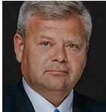
Outline of the talk
Overview
Motivation and background
Overview of Glauber SCET
Computation
Updated beam function
Phenomenology
Conclusion
And to Francesco Hautmann for the invitation
Special thanks to my collaborators
John Terry (Los Alamos National Lab)

Slide 3
Introduction
John Terry (Los Alamos National Lab)

Slide 4
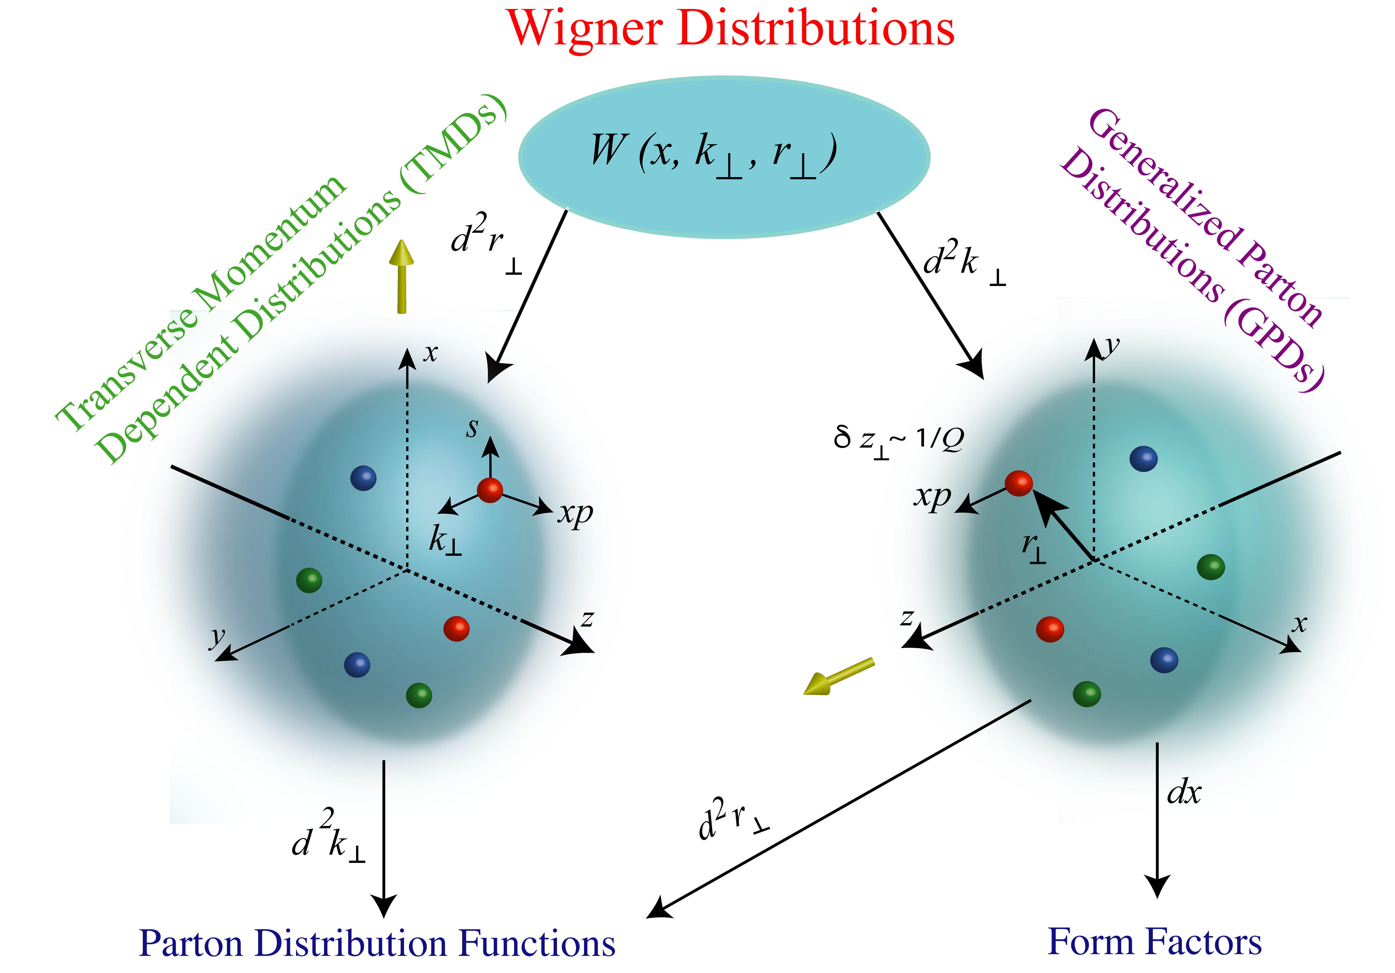
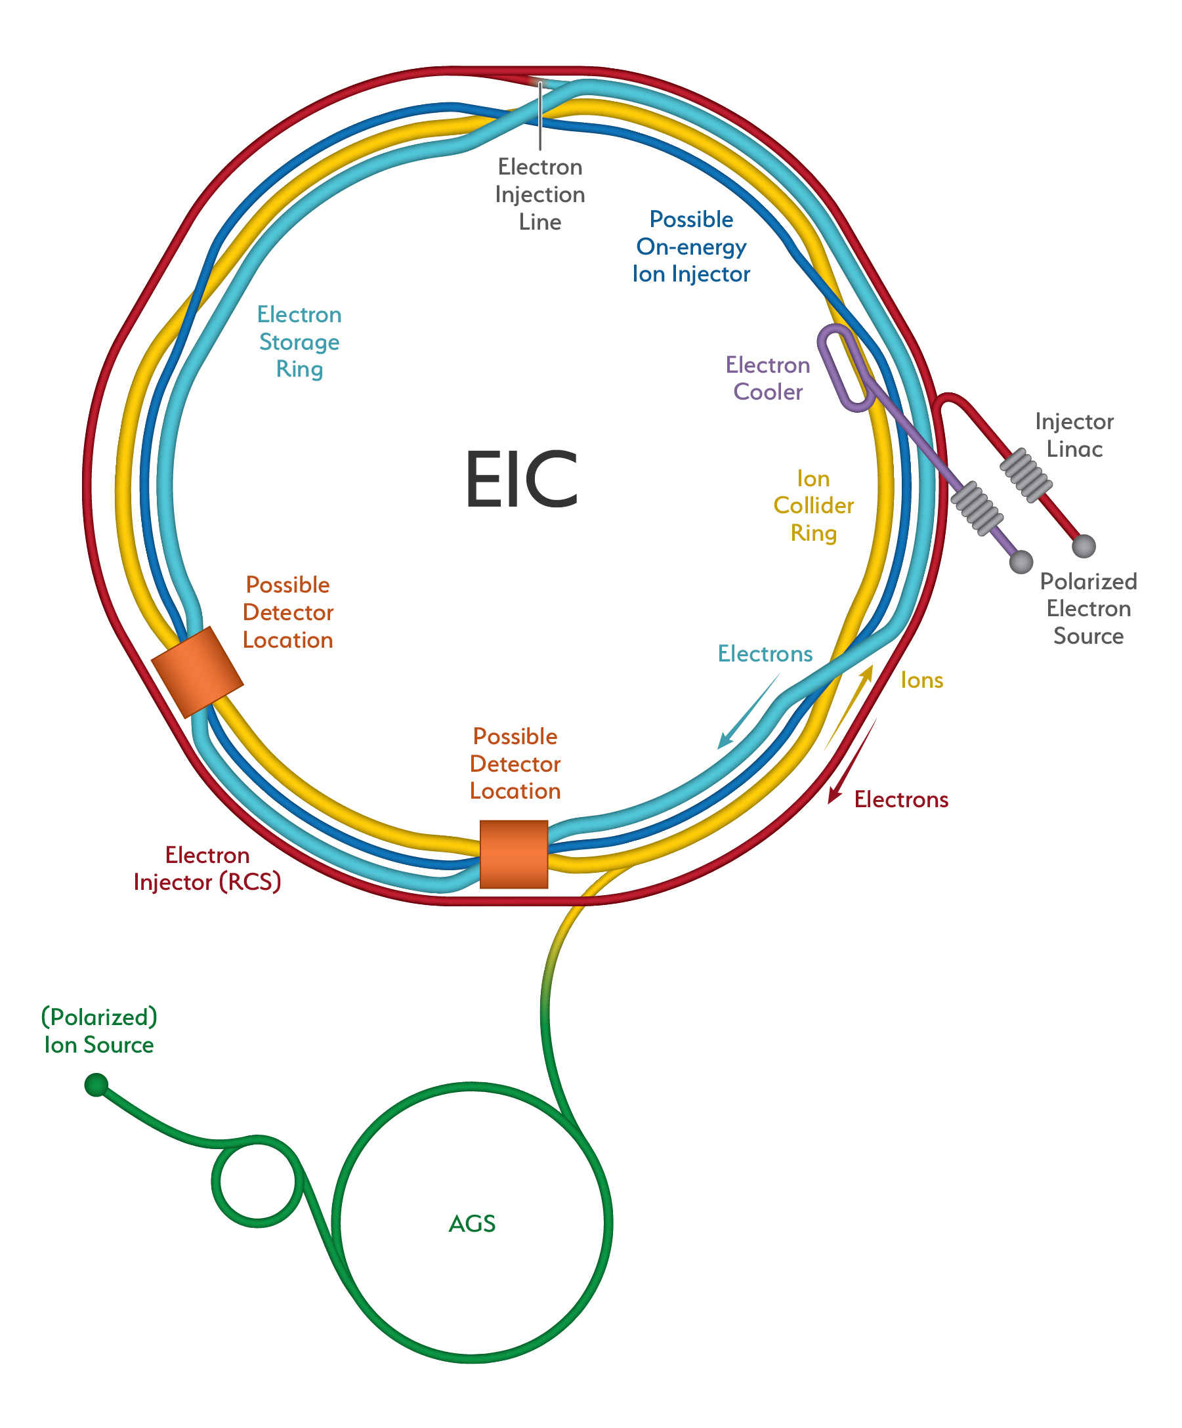
The structure of matter in the vacuum
Distributions of partons in hadrons
Highly differential distributions require high luminosity
John Terry (Los Alamos National Lab)

Slide 5
The structure of matter in the vacuum
Distributions of partons in hadrons
Highly differential distributions require high luminosity
The reach of EFTs
John Terry (Los Alamos National Lab)

Slide 6
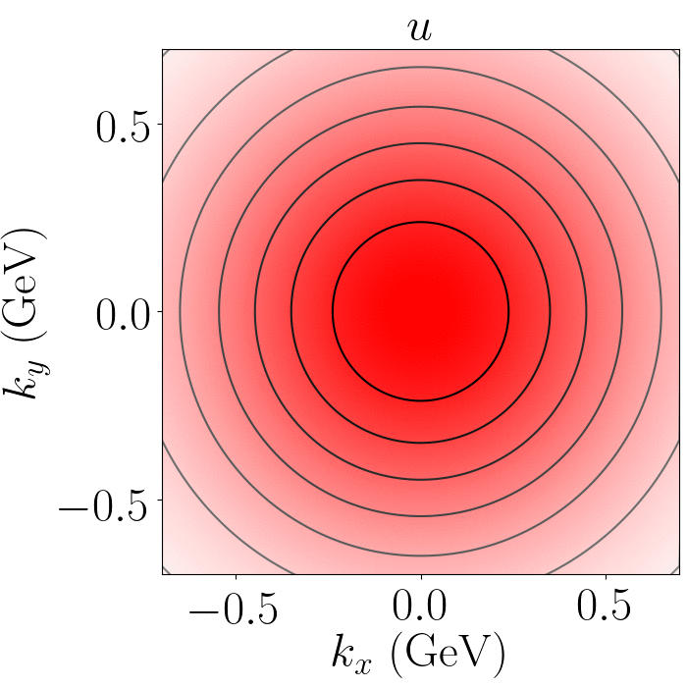
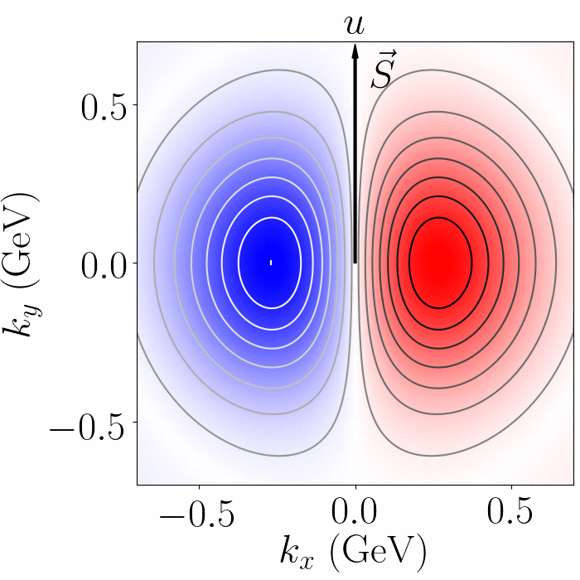
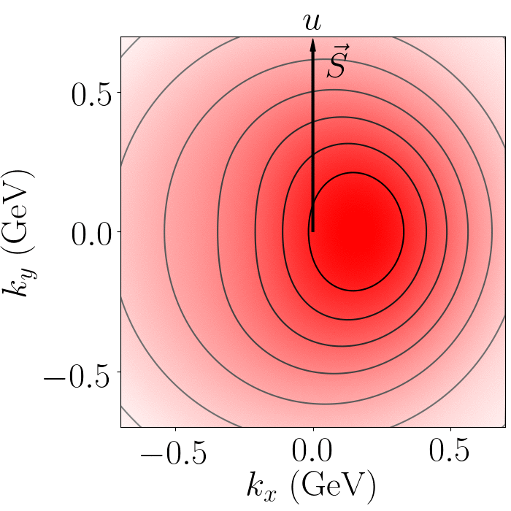

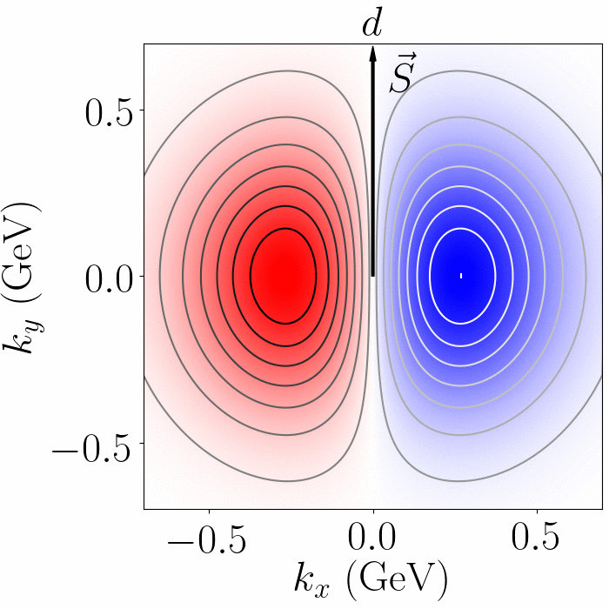
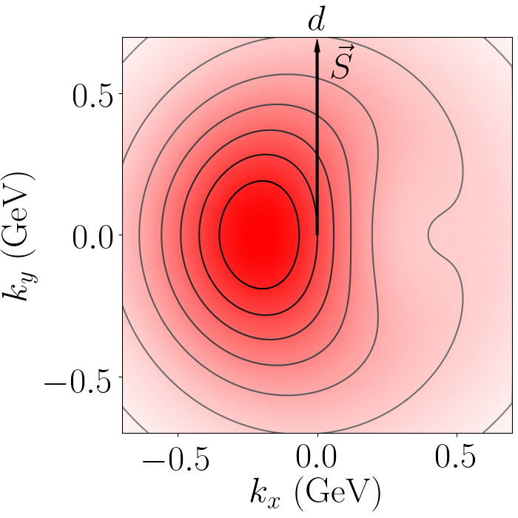
Images of proton structure
John Terry (Los Alamos National Lab)
Echevarria, Kang, JT (2020)
5/23

Slide 7
The structure of matter: The medium
Distributions of partons in hadrons
Highly differential distributions require high luminosity
The reach of EFTs
Additional degrees of freedom:
Geometry, correlations, binding energy, medium density
EMC effect still not understood from first principles
John Terry (Los Alamos National Lab)

Slide 8
The structure of matter: The medium
Distributions of partons in hadrons
Highly differential distributions require high luminosity
This work
The reach of EFTs
Additional degrees of freedom:
Geometry, correlations, binding energy, medium density
EMC effect still not understood from first principles
John Terry (Los Alamos National Lab)

Slide 9
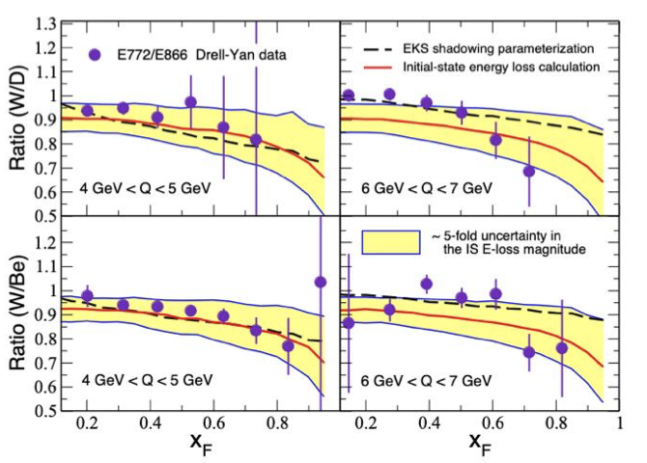
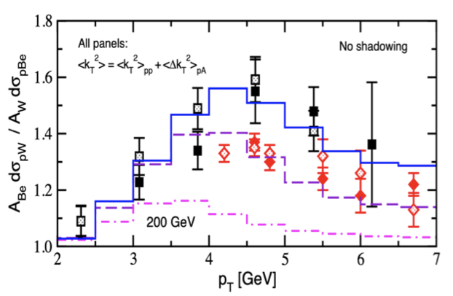
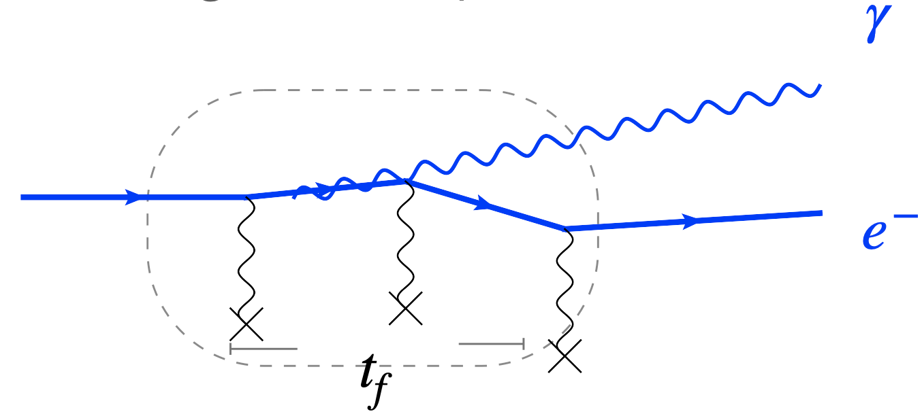
The structure of matter in the medium
Spectrum of energy and transverse momentum in matter is modified in a non-trivial way in QCD
Cross section can be written as an expansion in the opacity
is the average number of active partons that contribute
Gyulassy-Levai-Vitev (2000) Guo, Wang (2000)
Stimulated emissions in Drell-Yan result in energy loss
Careful treatment of energy loss requires the consideration of the LPM effect
John Terry (Los Alamos National Lab)

Slide 10
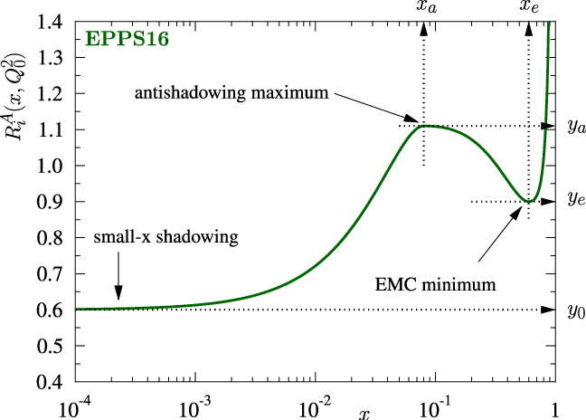
The structure of matter in the medium: an efficient approximation
nTMDs were originally defined using an approximate scheme by these two
Unmodified TMD PDF
Unmodified perturbative
Effective nuclear-modified PDF
Results from a purely collinear framework
Results from our TMD framework
Alrashed, JT et al (2022)
Alrashed, JT et al (2023)
John Terry (Los Alamos National Lab)

Slide 11
The structure of matter in the medium: modified beam function
Spectrum of energy and transverse momentum in matter is modified in a non-trivial way in QCD
Perturbatively modified
Unmodified perturbative
Effective nuclear-modified PDF
Modified proton PDF
Modified nucleon PDF
We consider the first-order opacity correction to the incoming beam function
The focus of this talk
John Terry (Los Alamos National Lab)

Slide 12
Methods
John Terry (Los Alamos National Lab)

Slide 13
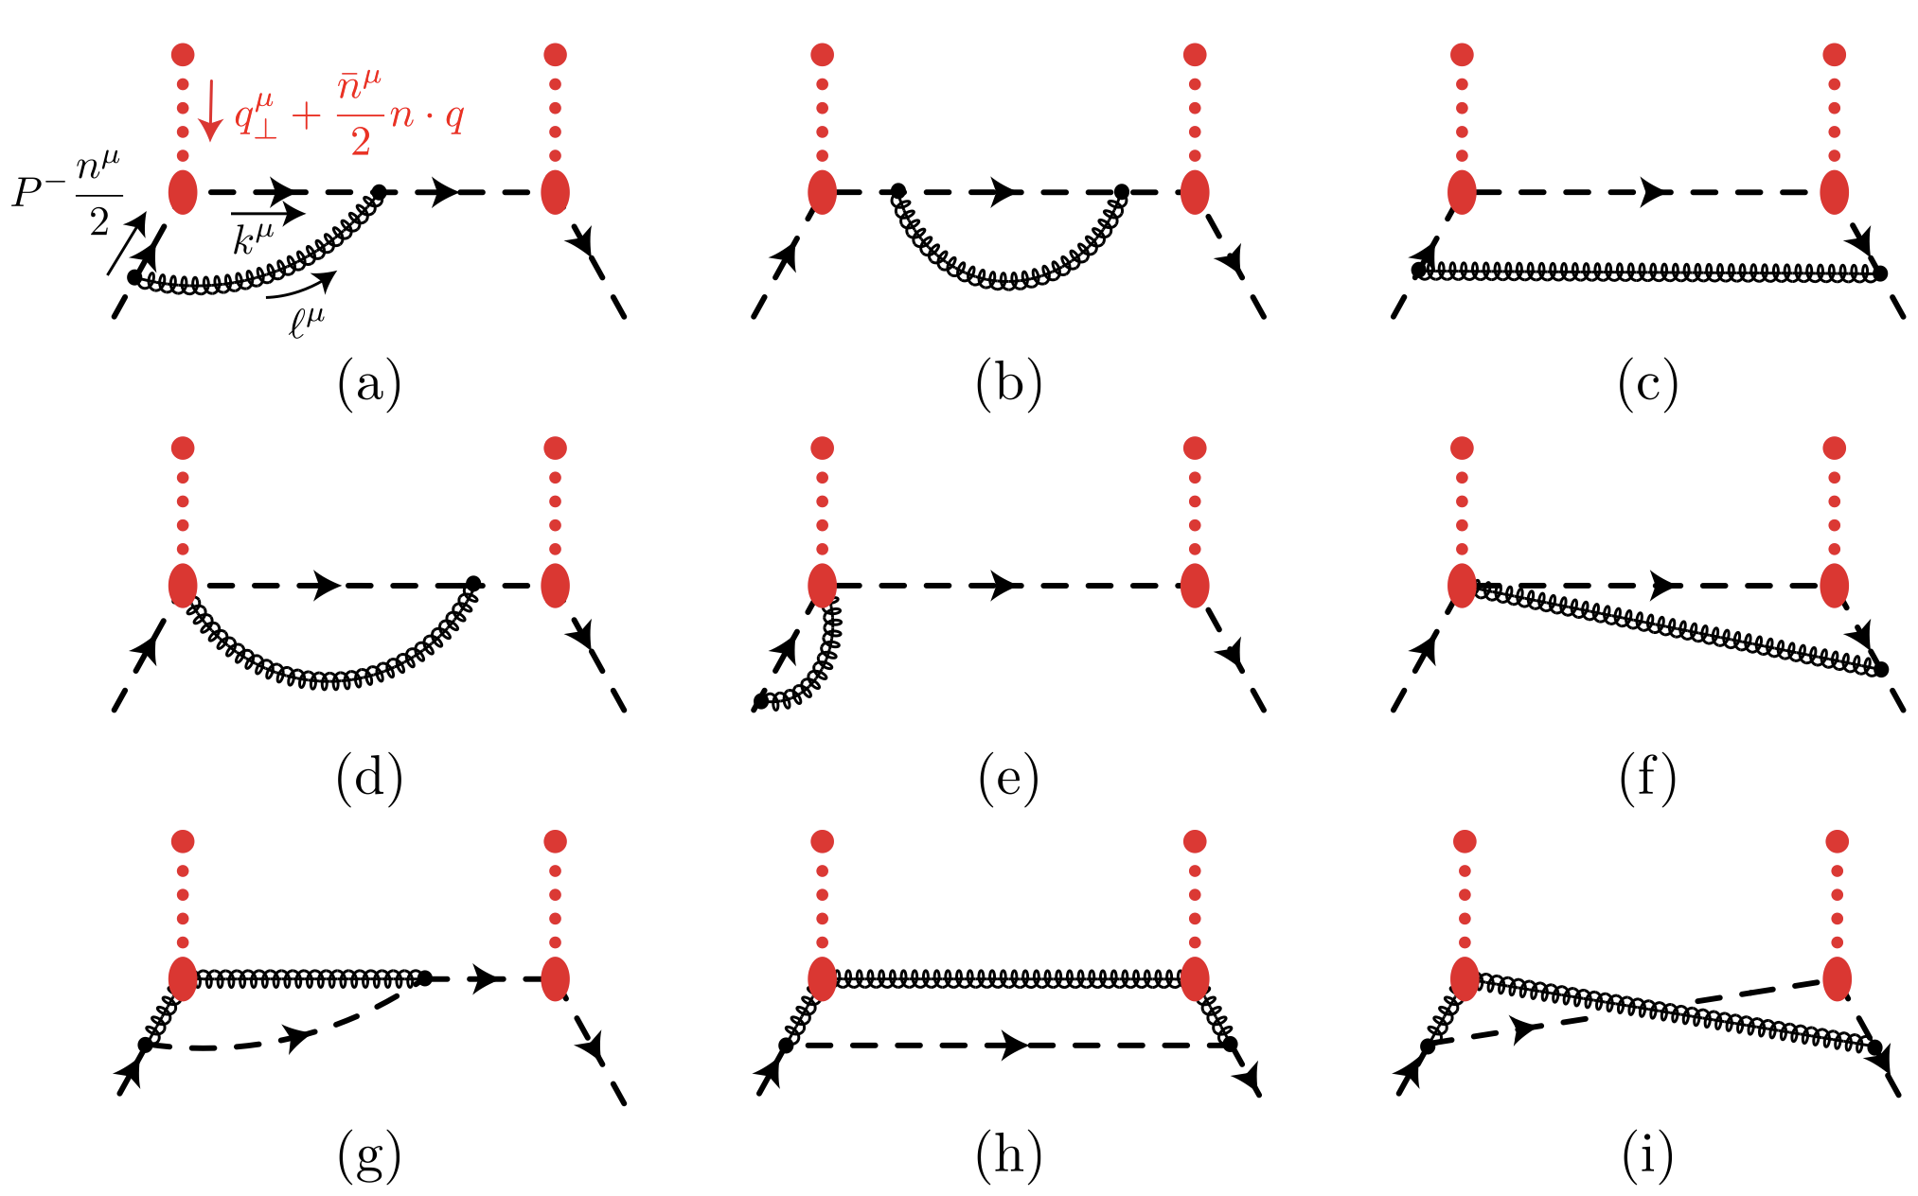
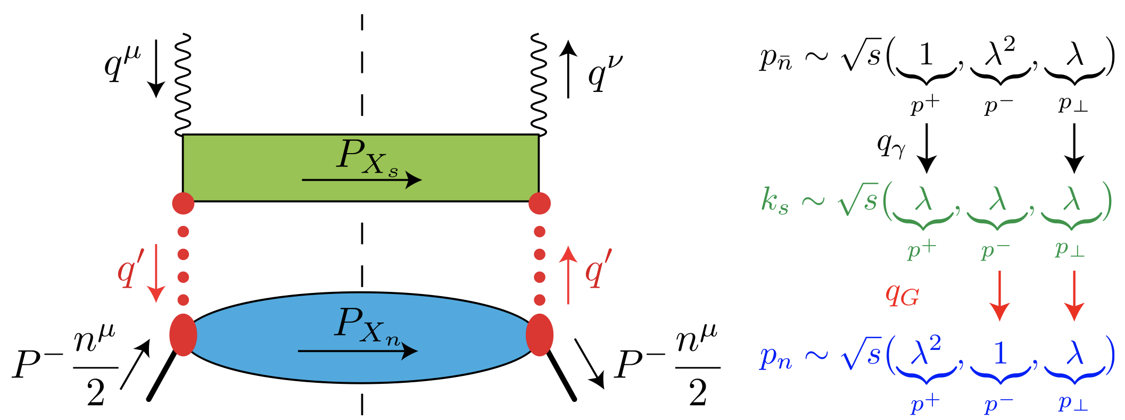
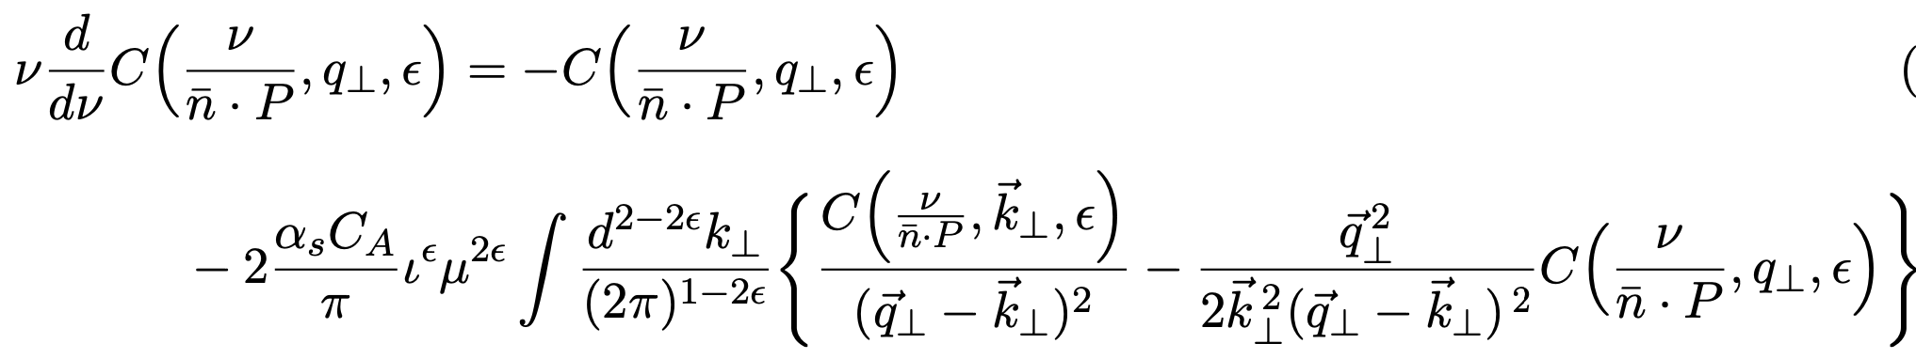
Soft-Collinear Effective Theory with Glaubers
SCET with Glauber gluons has been applied to pp and DIS
Was shown that rapidity divergences of the collinear function give rise to the BFKL evolution equation
Ovanesyan, Vitev (2011)
Rothstein, Stewart (2016)
Neill, Pathak, Stewart (2022)
John Terry (Los Alamos National Lab)

Slide 14
Overview of our computation
In this paper, we study the correlations between the incoming proton and the medium
Tree level terms
Collinear divergent terms
Rapidity divergent terms
Soft and anti-collinear divergent terms
Finite terms
Here we use the short-hand
John Terry (Los Alamos National Lab)

Slide 15
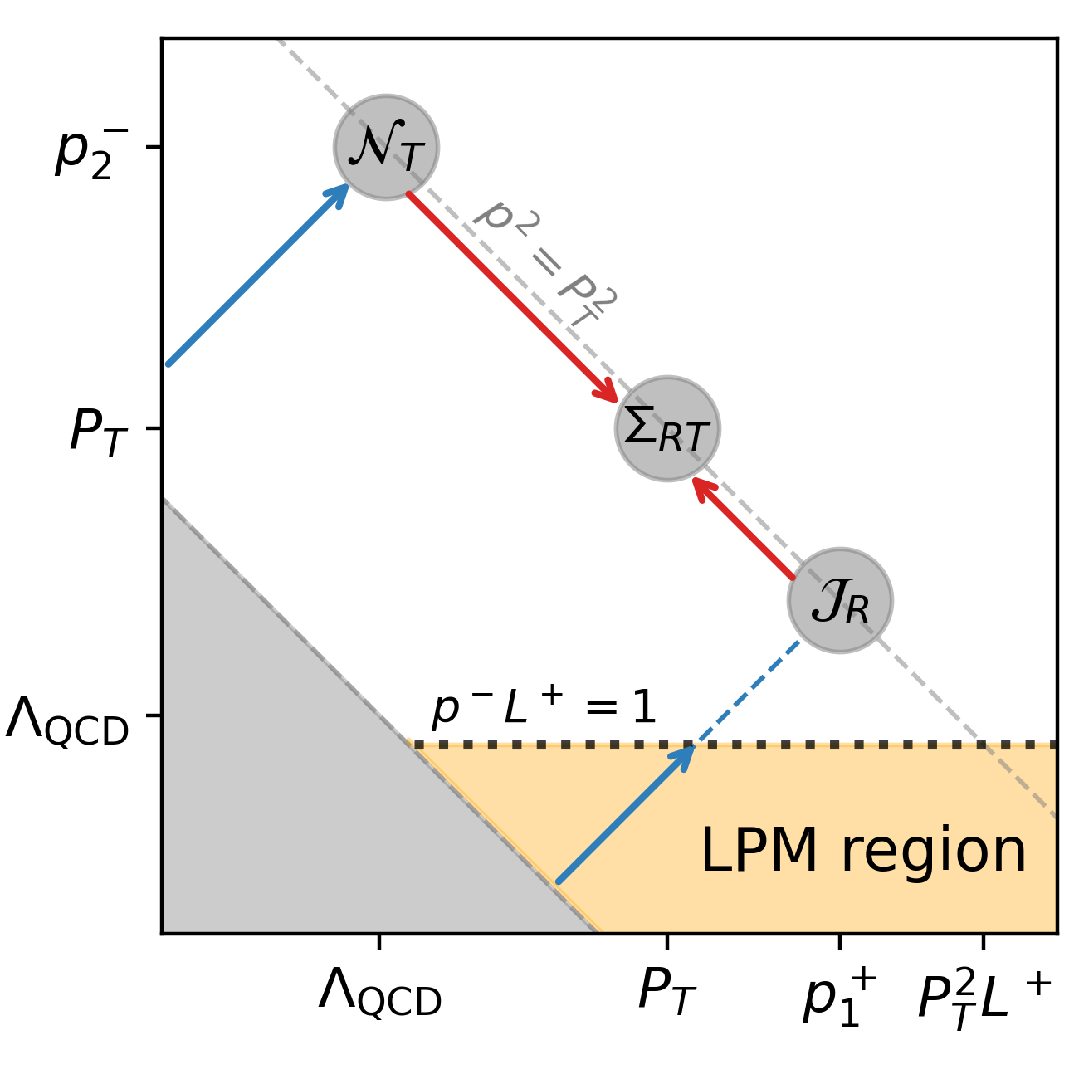
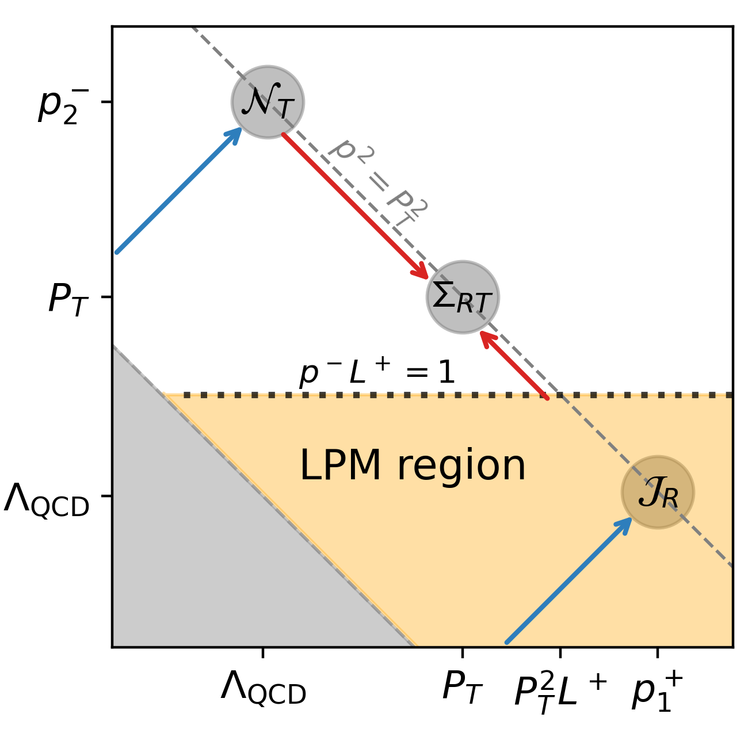
Power counting
There are two competing time-scales in the process
Time-scale for emission
Time-scale for traversing the medium
LPM phase
There are two regions with distinct power countings
Emissions break coherence (GB region)
Coherence is unbroken (LPM region)
John Terry (Los Alamos National Lab)

Slide 16
Graphs at one loop for the matching function
One loop graphs can be organized by the type of integration
Single Glauber, real emission
Single Glauber, virtual loop
Wave function
Double Glauber, virtual emission
John Terry (Los Alamos National Lab)
Double Glauber, real emission

Slide 17
Collinear matching function at one loop
The finite contributions to the collinear function can be organized based on the type of emission
We use the short-hand
The finite contributions to the collinear function can be organized based on the type of emission
Generate collinear divergences
Generate rapidity divergences
John Terry (Los Alamos National Lab)

Slide 18
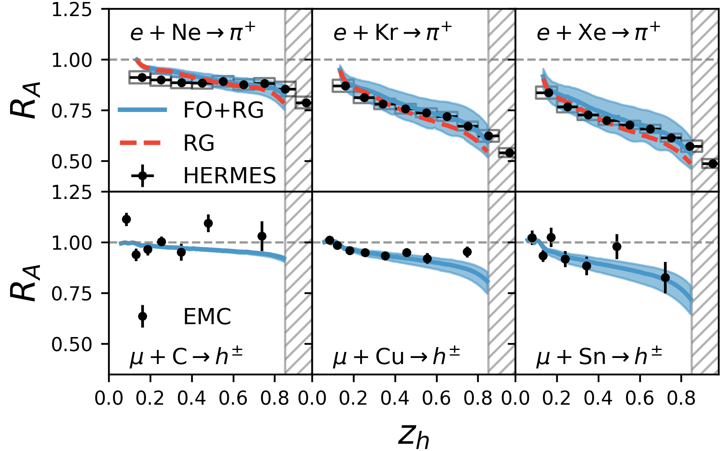
Medium induced collinear divergences
The one-loop computation yields a medium-induced collinear divergence
Medium-induced collinear divergence
Collinear divergences give rise to a medium modified DGLAP evolution equation
Flavor non-singlet
Flavor singlet
John Terry (Los Alamos National Lab)

Slide 19
Rapidity divergence in the collinear function
The one loop contribution to the collinear function takes on a simple form
The one loop contribution to the collinear function takes on a simple form
Different natural rapidity scale enters into the different regions
John Terry (Los Alamos National Lab)

Slide 20
Soft and anti-collinear contribution
Graphs from the soft sector
Graphs from the anti-collinear sector
Double Glauber exchange graphs are scaleless
Soft and collinear functions at one loop
John Terry (Los Alamos National Lab)

Slide 21
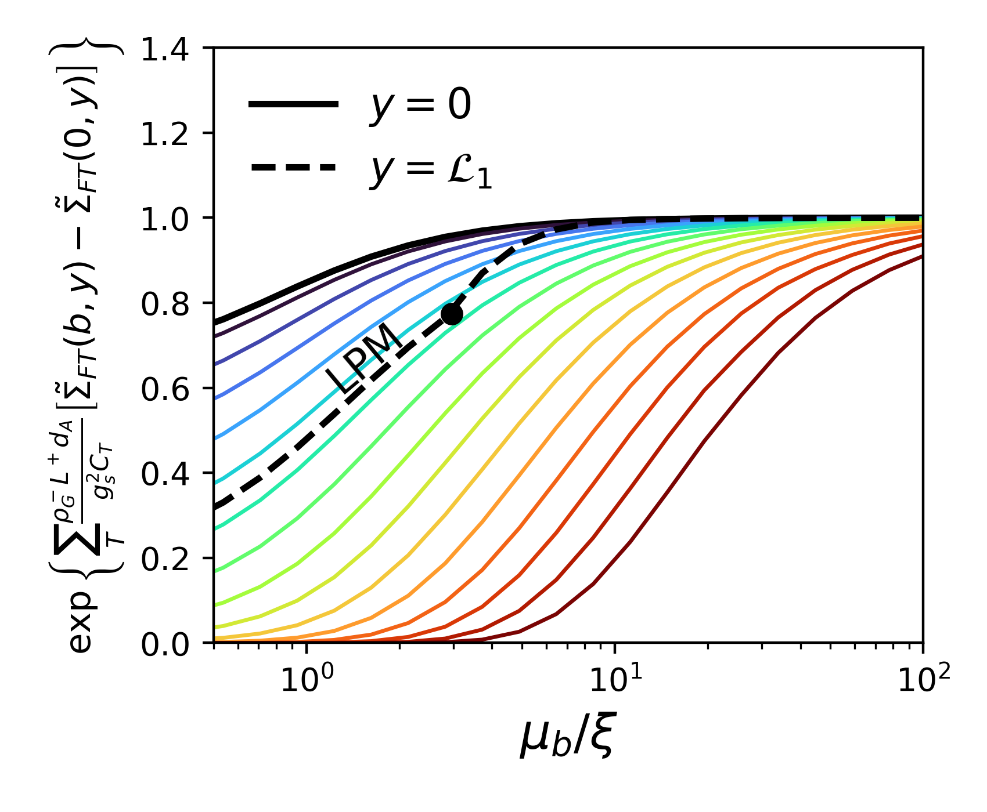
Anti-collinear contribution and the BFKL evolution equations
Each sector obeys a BFKL evolution equation
Each sector obeys a BFKL evolution equation
Broadening
John Terry (Los Alamos National Lab)

Slide 22
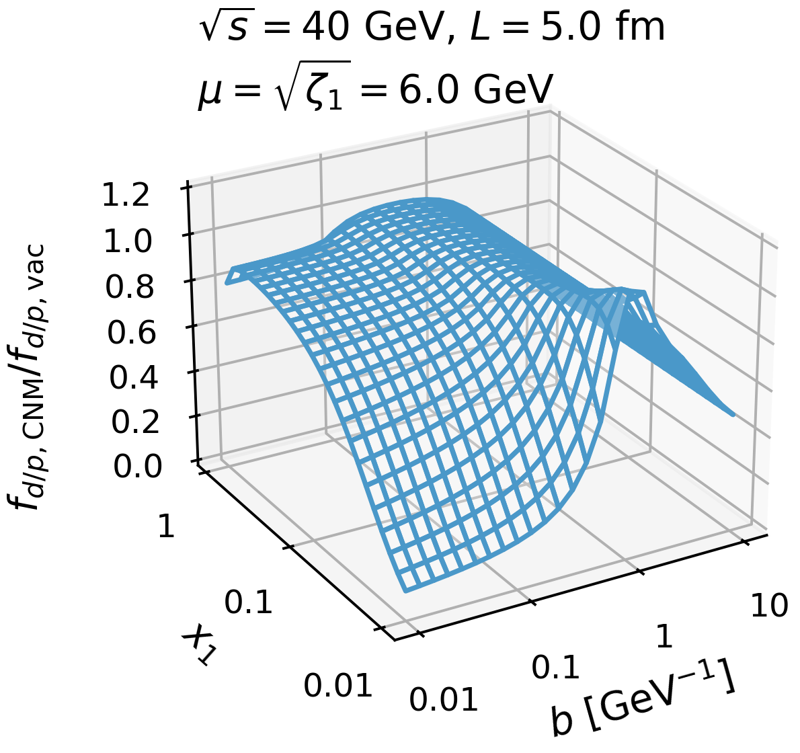
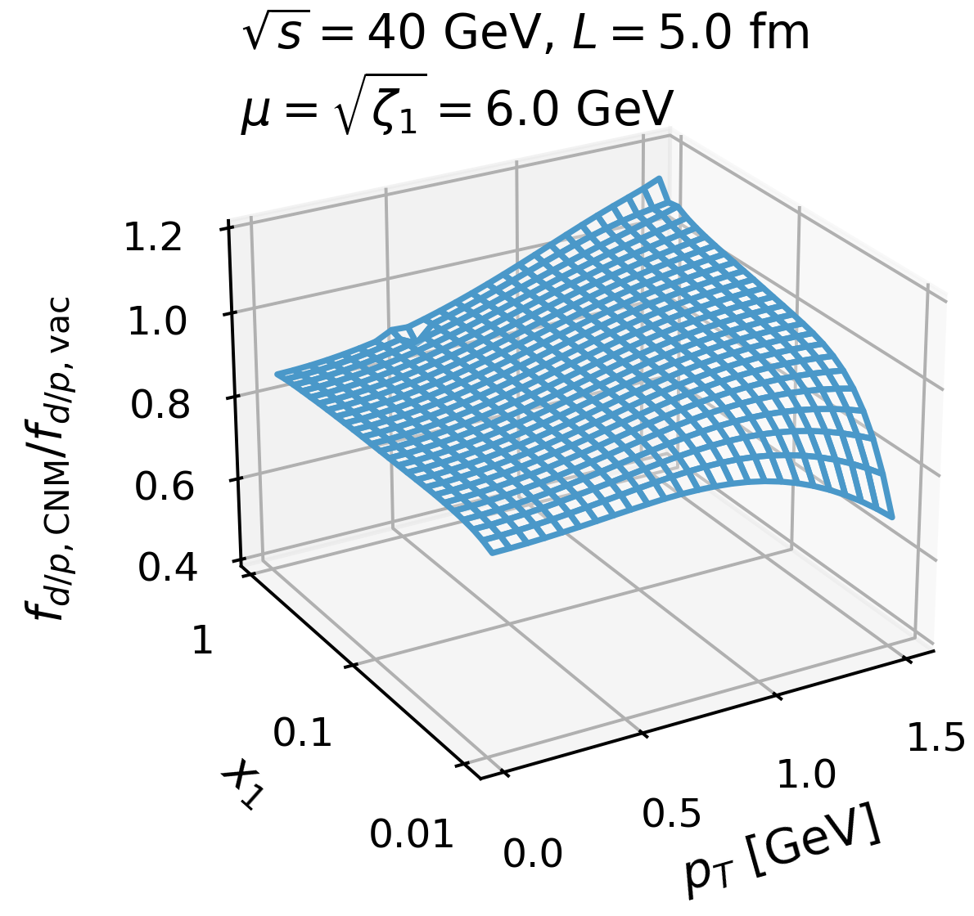
Three dimensional pictures
John Terry (Los Alamos National Lab)

Slide 23
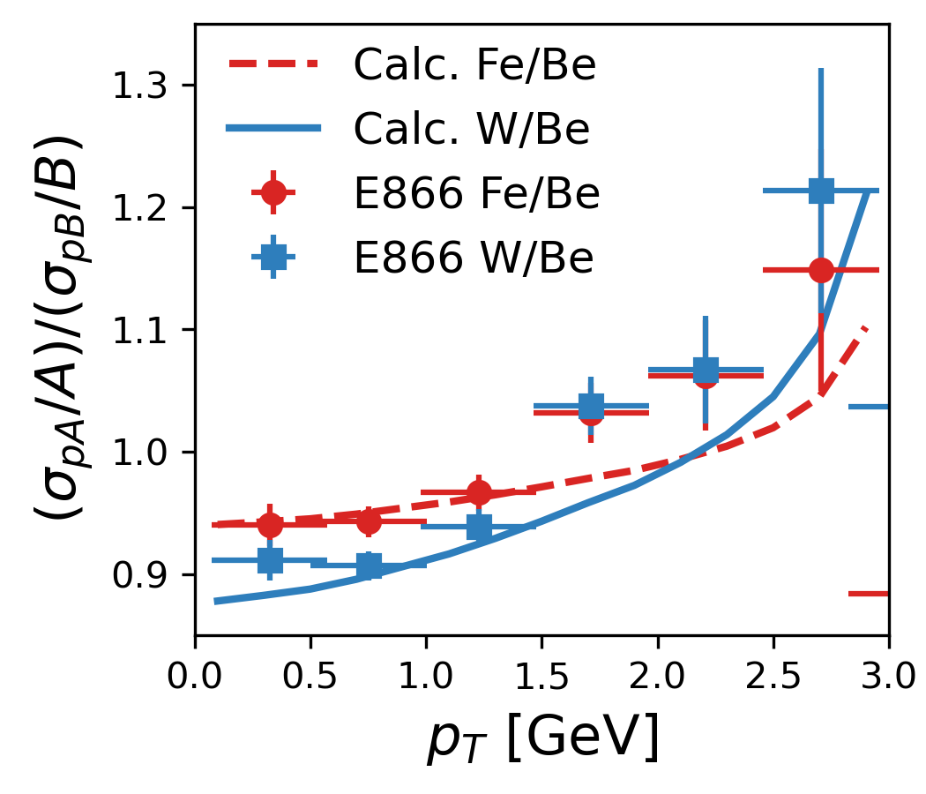
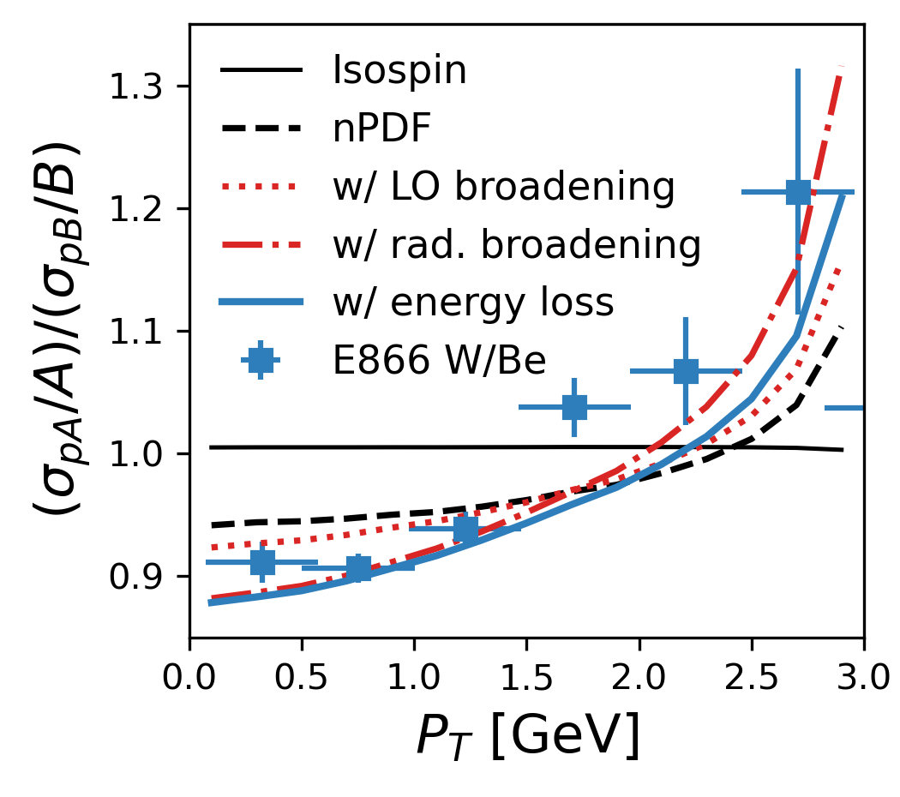
Example description of data
First principle description of data. Small improvements can be made by adding non-perturbative effects and investigating other perturbative effects
Nuclear size dependence
Various effects from RG
John Terry (Los Alamos National Lab)

Slide 24
Conclusion
We have made two strides in understanding nuclear matter effects.
We have used SCET with Glauber gluons to derive the one-loop expression for the proton beam function.
We have demonstrated that collinear and rapidity divergences give rise to the energy loss and transverse momentum broadening of the TMDs.
Demonstrated that the broadening effect is governed by a BFKL evolution equation.
John Terry (Los Alamos National Lab)
23/23

Slide 25
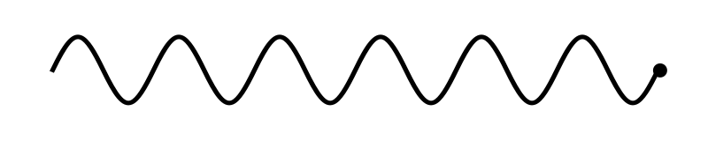
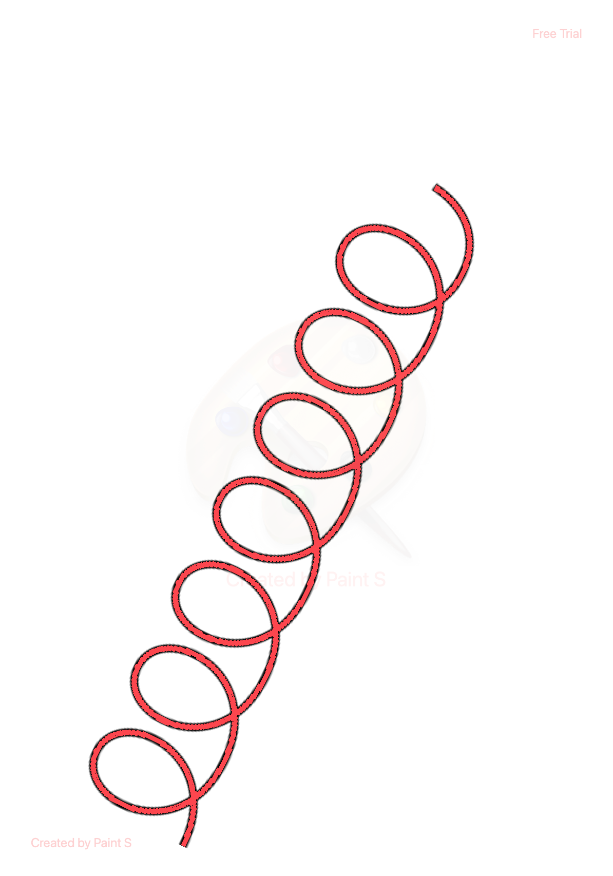
Perturbative background
Perturbative Sudakov: accounts for transverse momenta
generated from soft and collinear emissions
Experiments involve mixture of
Perturbative and non-perturbative
momentum
Perturbative momentum
Intrinsic/non-perturbative momentum
Anomalous dimensions
Obtain intrinsic momentum through a fit to data
John Terry (LANL)

Slide 26
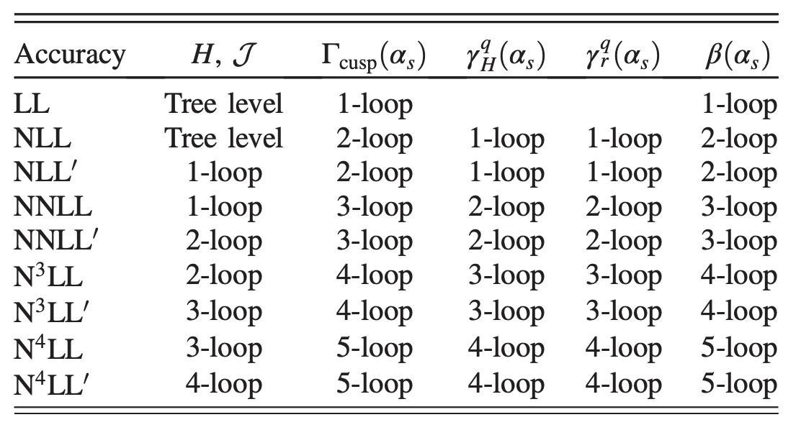
Available perturbative accuracy
Anomalous dimensions
Anomalous dimensions are almost known up to N⁴LL at this point (no 5-loop cusp)
Lee, Smirnov, and Smirnov (2010)
Gehrmann, Glover, Huber, Ikizlerli, and Studerus (2010)
Ebert, Mistlberger, Vita (2020)
Ebert, Mistlberger, Vita (2020)
Agarwal, von Manteuffel, Panzer, and Schabinger (2021)
Duhr, Mistlberger, Vita (2022)
Moult, Zhu, Zhu (2022)
Herzog, Moch, Ruijl, Ueda, Vermaseren, and Vogt (2019)
Baikov, Chetyrkin, and Kuhn (2017)
John Terry (LANL)

Slide 27
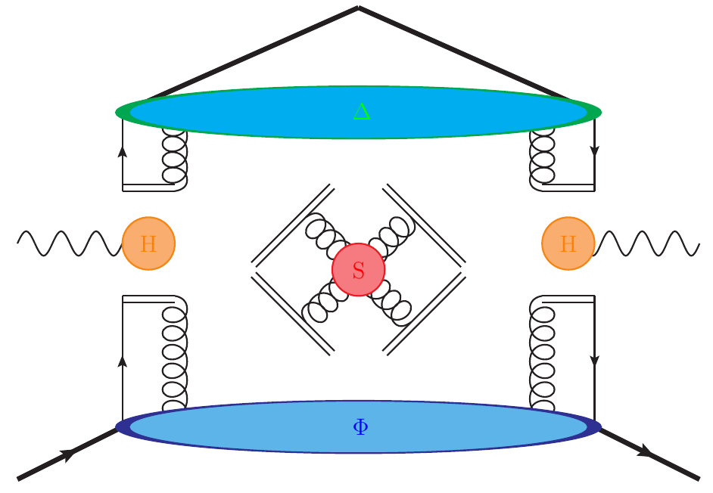
Factorization of physics at different scales
Factorization of the cross section in an OPE
TMD FF
Hard
Contains fixed order and large logs
Soft
Factorization of IR modes
TMD PDF
Matching coefficient contains fixed order and
large logs
Collinear PDF
John Terry

Slide 28
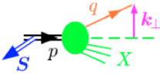
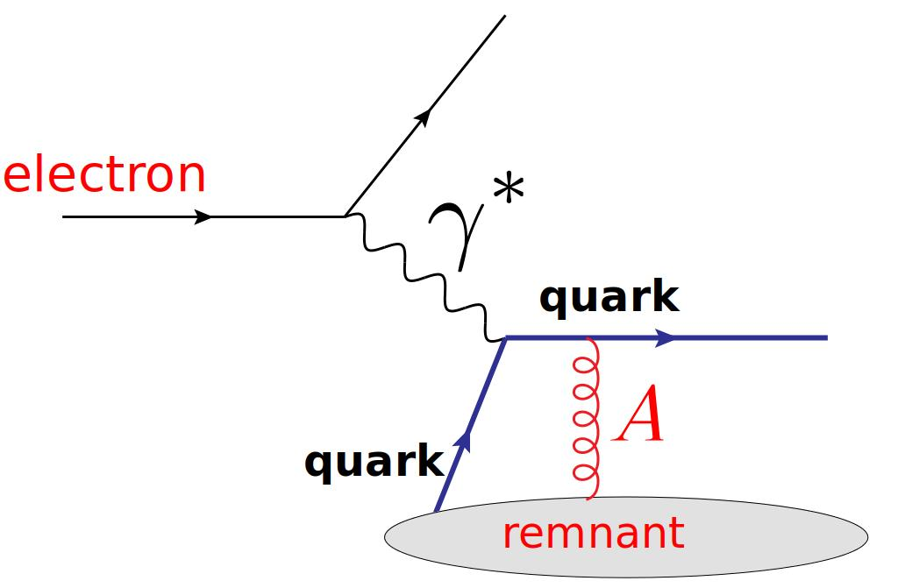
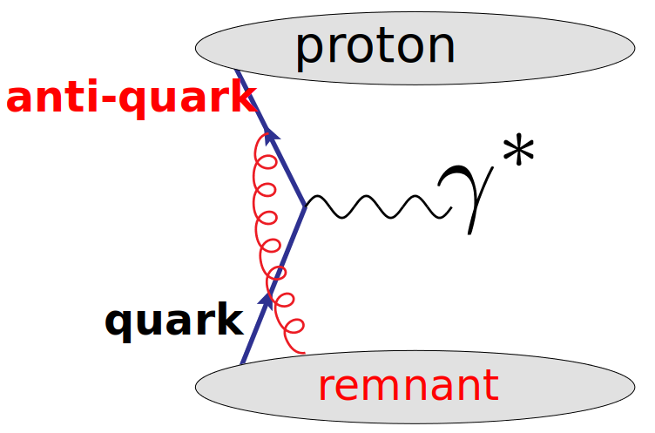
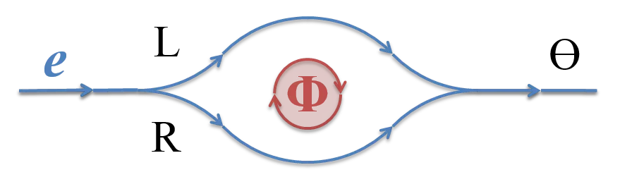
Intro to the Sivers effect
Anomalous dimensions
The Sivers function is process dependent
This long-range correlation is similar to the Aharanov-Bohm effect

Slide 29
Factorization and resummation
Differential cross section for Semi-Inclusive DIS is given by
Hard
TMD PDF
TMD FF
Hard
Sivers function
TMD FF
TMDs can be matched onto the collinear distributions
Perturbative
Non-perturbative
Large logarithms are are resumed to all orders in the perturbative Sudakov
John Terry
8/23

Slide 30
Matching of the Sivers function
Differential cross section for Semi-Inclusive DIS is given by
Hard
Sivers function
TMD FF
TMDs can be matched onto the collinear distributions
Same as the unpolarized
Transverse momentum dependence
Collinear dependence
11 params in total
John Terry
9/23

Slide 31
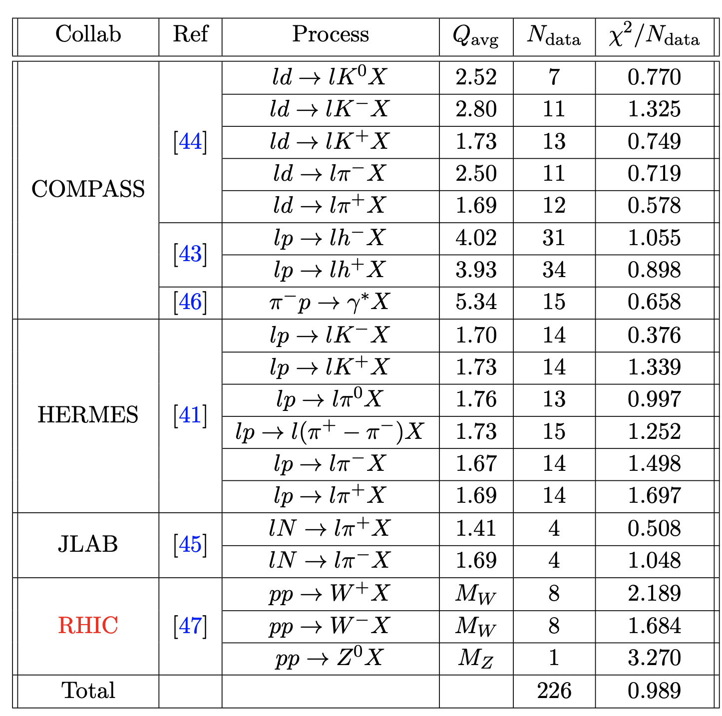
Data description
John Terry
10/23

Slide 32
Nuclear modifications to collinear PDFs
Nuclear medium modification via higher twist
Power suppressed by
Nuclear enhancement
LP TMD factorization cannot address how multiple partons are correlated with one another
Eskola, Kolhinen, Ruuskanen (1998)
Eskola, Paakkinen, Paukkunen, Salgado (2017)
John Terry

Slide 33
Method of treating nuclear modifications
Nuclear medium modification via higher twist
LP TMD factorization cannot address how multiple partons are correlated with one another
Eskola, Kolhinen, Ruuskanen (1998)
Eskola, Paakkinen, Paukkunen, Salgado (2017)
Nuclear modifications are absorbed into the non-perturbative parameterization.
John Terry

Slide 34
Effective treatment of medium modifications
Ejected quark undergoes multiple scattering in the nuclear medium, modifies the fragmentation functions
D. de Florian and R. Sassot (2004)
Zurita (2021)
Simultaneous extraction from hadroproduction in p-A collisions from PHENIX and STAR, and Semi-Inclusive DIS (collinear)
from HERMES
Abelev et al. (STAR) (2010)
Adams et al. (STAR) (2006)
Adare et al. (2013)
Airapetian et al. (HERMES) (2007)
John Terry

Slide 35
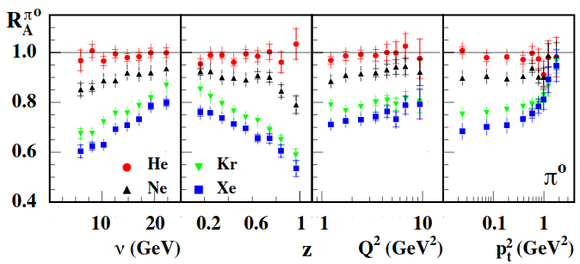
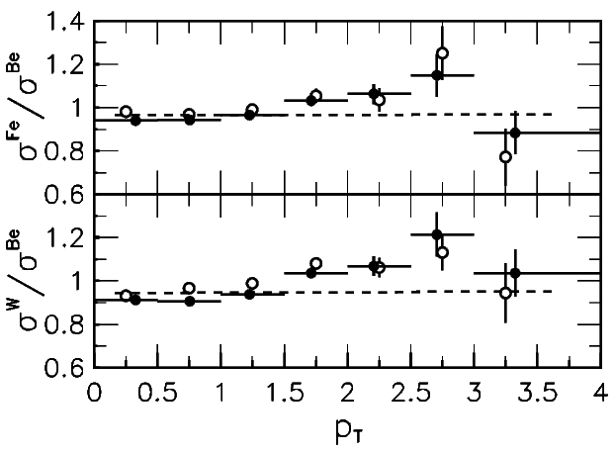
Effective treatment of the transverse momentum broadening
Interaction between partons and interact with the nuclear medium via Glauber exchange
Intrinsic
Medium
Perturbative
Effective intrinsic
John Terry
16/23

Slide 36
Available data
Semi-Inclusive DIS for e-A collisions
Drell-Yan production in p-A collusions
Kinematic coverage of the data
Multiplicity ratio
Cross section and cross section ratio
for p-A collisions
Airapetian et al. (HERMES), Nucl. Phys. B 780, 1 (2007)
Dudek et al., Eur. Phys. J. A 48, 187 (2012)
Burkert, in CLAS 12 RICH Detector Workshop (2008)
Alde et al., Phys. Rev. Lett. 64, 2479 (1990)
Vasilev et al. (NuSea), Phys. Rev. Lett. 83, 2304 (1999)
Leung (PHENIX), PoS HardProbes2018, 160 (2018)
Khachatryan et al. (CMS), Phys. Lett. B 759, 36 (2016)
Aad et al. (ATLAS), Phys. Rev. C 92, 044915 (2015)
SIDIS cross section
E772: A = C; B = D
DIS cross section
E866: A = Fe, W; B = Be
RHIC: A = Au; B = p
HERMES ratio for A = He, Ne, Kr, Xe
h =
ATLAS, CMS: distribution p-Pb
Jefferson Lab ratio for A = C, Fe, Pb
h =
John Terry
17/23

Slide 37
Available perturbative accuracy
Anomalous dimensions
Anomalous dimensions are almost known up to N⁴LL at this point (no 5-loop cusp)
Lee, Smirnov, and Smirnov (2010)
Gehrmann, Glover, Huber, Ikizlerli, and Studerus (2010)
Ebert, Mistlberger, Vita (2020)
Ebert, Mistlberger, Vita (2020)
Agarwal, von Manteuffel, Panzer, and Schabinger (2021)
Duhr, Mistlberger, Vita (2022)
Moult, Zhu, Zhu (2022)
Herzog, Moch, Ruijl, Ueda, Vermaseren, and Vogt (2019)
Baikov, Chetyrkin, and Kuhn (2017)
John Terry

Slide 38
Factorization and resummation in the medium
Differential cross section for Semi-Inclusive DIS is given by
Hard
nTMD PDF
nTMD FF
TMDs can be matched onto the collinear distributions
Perturbative
Non-perturbative
Large logarithms are are resumed to all orders in the perturbative Sudakov
John Terry
19/23

Slide 39
Non-perturbative treatment
Non-perturbative contributions given by
EPPS21
In house FF (new), previous analysis used LIKEn
Non-perturbative Sudakov given by
Parameterization for the medium modified fragmentation
John Terry
20/23

Slide 40
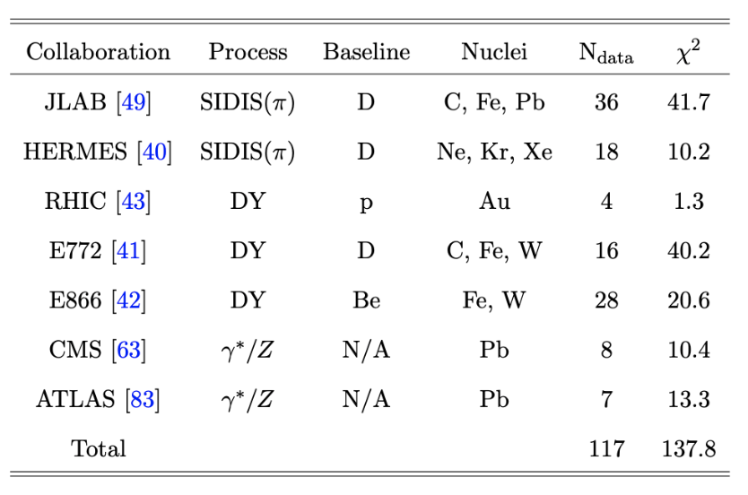
Description of the experimental data
HERMES
JLab
LHC
John Terry

Slide 41
Three-dimensional images
Ratios defined for nPDF and nFF
John Terry
22/23

Slide 42
Di-jet decorrelations in pp
Azimuthal angle decorrelations of di-jets measured at the CMS, are sensitive to nTMDs
Back-to-back region is sensitive to the 1+1 dimensional TMDs
CMS Measurements in pp and pA collisions
Phys.Rev.Lett.106:122003,2011
Eur. Phys. J. C 74 (2014) 2951
Phys. Rev. Lett. 121, 062002 (2018)
John Terry
23/23

Slide 43
Di-jet decorrelations in pp continued
Additional measurements of the integrated azimuthal angle decorrelation
Integration in region performed using a collinear approximation. However, there are issues with this approach
as due to large logarithms.
John Terry
24/23

Slide 44
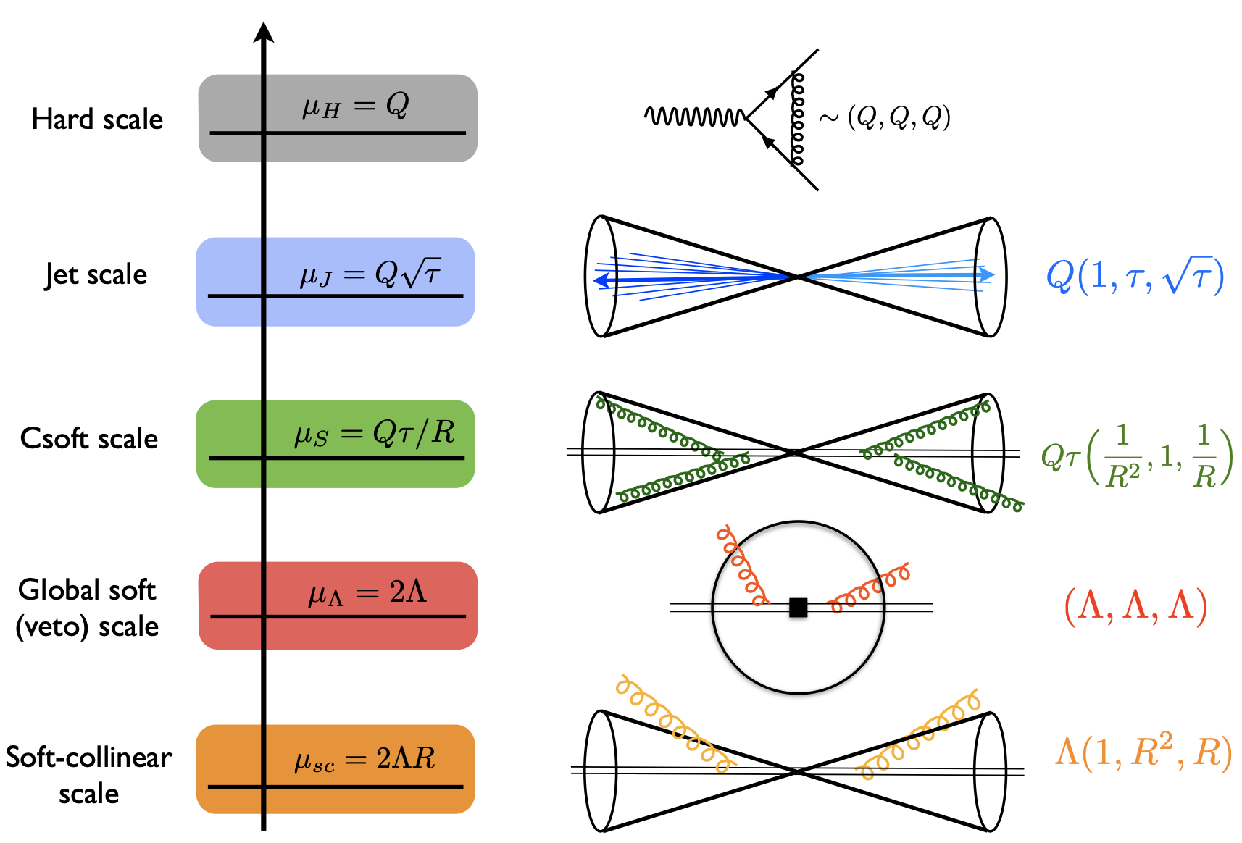
QCD modes in SCET
SCET is an EFT which captures soft and collinear emissions along the directions
Bauer, Fleming, Luke 2000
Bauer, Fleming, Pirjol, Stewart 2001
Bauer, Stewart 2001
Bauer, Pirjol, Stewart 2002
Beneke, Chapovsky, Diehl, Feldmann 2002
Beneke, Feldmann 2003
Hill, Neubert 2003
Echevarria, Idilbi, Scimemi 2011
Chien, Hornig, Lee 2015
John Terry

Slide 45
Factorization in SCET
Azimuthal angle decorrelations of di-jets measured at the CMS, are sensitive to nTMDs
Factorization and resummation derived in a SCET framework
John Terry
26/23

Slide 46
Factorization in SCET
Azimuthal angle decorrelations of di-jets measured at the CMS, are sensitive to nTMDs
Factorization and resummation derived in a SCET framework
John Terry
26/23

Slide 47
Factorization in SCET
Azimuthal angle decorrelations of di-jets measured at the CMS, are sensitive to nTMDs
Factorization and resummation derived in a SCET framework
John Terry
26/23

Slide 48
Factorization in SCET
Azimuthal angle decorrelations of di-jets measured at the CMS, are sensitive to nTMDs
Factorization and resummation derived in a SCET framework
John Terry
26/23

Slide 49
Factorization in SCET
Azimuthal angle decorrelations of di-jets measured at the CMS, are sensitive to nTMDs
Factorization and resummation derived in a SCET framework
John Terry
26/23

Slide 50
Factorization in SCET
Azimuthal angle decorrelations of di-jets measured at the CMS, are sensitive to nTMDs
Factorization and resummation derived in a SCET framework
Factorization and resummation at NLL:
John Terry
26/23

Slide 51
Do we observe factorization breaking effects?
Glauber mode note treated in our paper
Factorization breaking effects in dijet production studied in
Collins, Qiu Phys.Rev.D75:114014,2007
Collins (2007)
The experimental data is well-described by the experimental data in the back-to-back region, within the error bars
Phys.Rev.Lett.106:122003,2011
Phys. Rev. Lett. 121, 062002 (2018)
John Terry
27/23

Slide 52
Nuclear modifications to this process
Azimuthal angle decorrelations of di-jets measured at the CMS, are sensitive to nTMDs
nTMDs can be matched onto the collinear distributions
Perturbative
Non-perturbative: Contains all medium contributions
We ignore all final-state interactions between the jets and the medium.
High energy jets are not expected to be affected by the medium
Li, Vitev (2021)
John Terry
28/23

Slide 53
Factorization in pA
Azimuthal angle decorrelations of di-jets measured at the CMS, are sensitive to nTMDs
Factorization and resummation derived in a SCET framework
Factorization and resummation:
John Terry
29/23

Slide 54
Description of pA data
Strong consistency with the CMS measurements of the azimuthal angle decorrelation in pA and the ratio of the integrated
azimuthal angle decorrelation.
Eur. Phys. J. C 74 (2014) 2951
Phys. Rev. Lett. 121, 062002 (2018)
Red band is the uncertainty from the EPPS sets, small blue band from the uncertainty of the nTMDs and is very small for
high pT jet production.
John Terry
30/23

Slide 55
Predictions at ATLAS, ALICE, and sPHENIX
At the LHC, the collinear uncertainties are more dominant due to the large perturbative transverse momenta that are
generated. Uncertainty band of the broadening becomes larger at lower center of mass energies
John Terry
31/23

Slide 56
Fragmentation in the medium from first principles
Medium introduces three length scales to the problem
Thin medium: NP input only from medium properties
Large medium: requires additional NP input from hadronization
also require input from hadronic collisions
Number of collisions goes like
Dilute limit: Opacity expansion or higher twist
Dense limit: Opacity expansion or higher twist
Gyulassy-Levai-Vitev (2000)
Guo, Wang (2000)
Baier, Dokshitzer, Mueller, Peigné, Schiff (1996) Zakharov (1997)
Can be treated in Glauber SCET
Ovanesyan and Vitev (2011)
John Terry

Slide 57
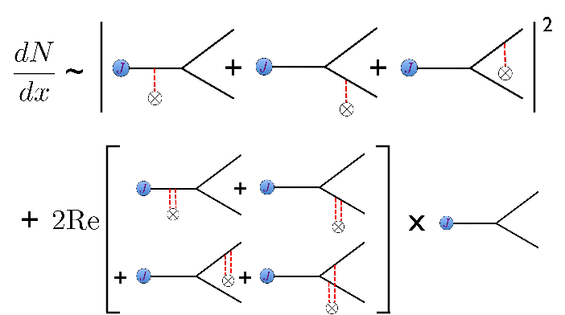
Medium modified DGLAP evolution
Previous work has been done in QCD and SCET to derive medium modified evolution equations
Ovanesyan, Vitev (2012)
Medium modification can be implemented into the fit, but introduces additional scales. Future work in this community
will involve including the medium modified DGLAP into the fit, as well as calculating the medium modifications to the
RG and Collins-evolution of the TMDs.
John Terry

Slide 58
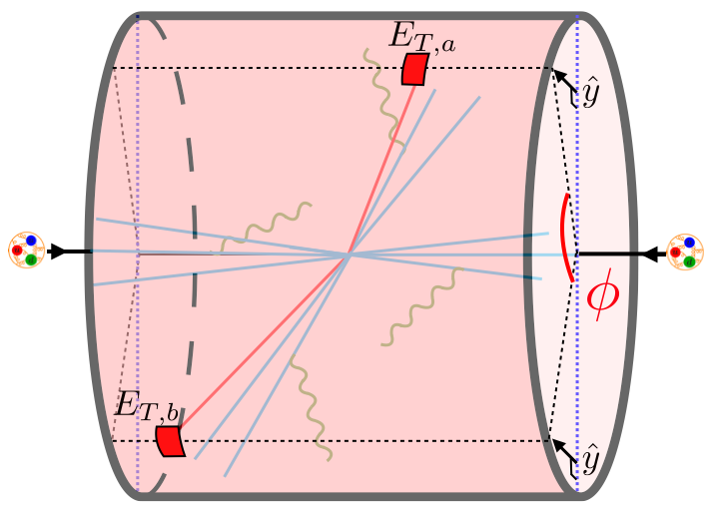
Future work
Graphs for medium modified evolution can be applied to final-state functions for TMD measurements (exclusive jet functions, EECs)
Medium modified DGLAP can be applied in a global analysis
Medium modified spin physics as a new probe of medium properties
John Terry
38/23

Slide 59
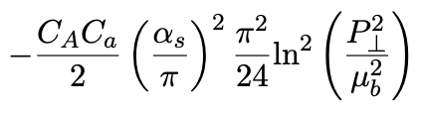
Non-global logs
Standard jets complicate resummation
Dasgupta, Salam (2001)
Larkoski, Moult, Neill (2016)
NGLs for jet at NLL is the same as jet mass in e+ e-
Becher, Neubert, Rothen and Shao (2016)
John Terry
24/23

Slide 60
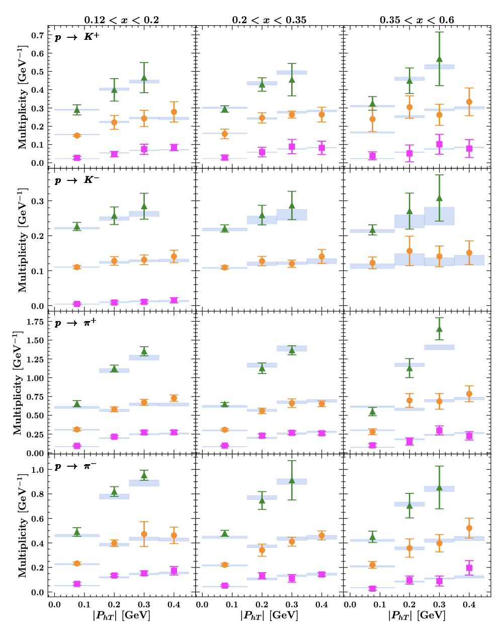
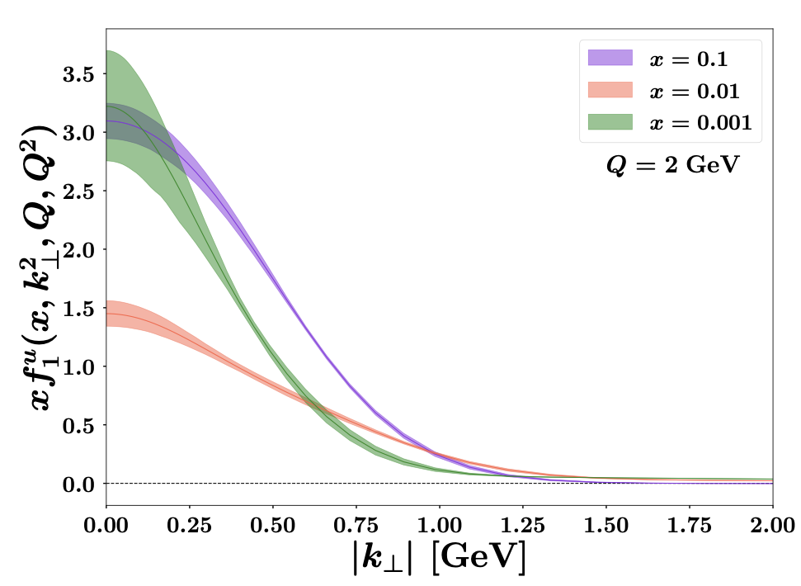
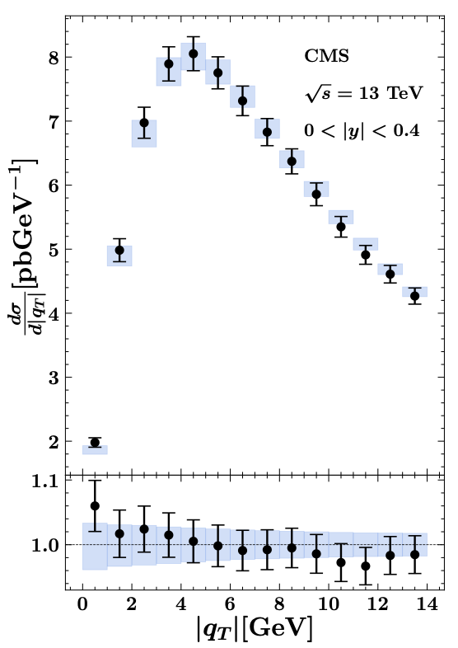
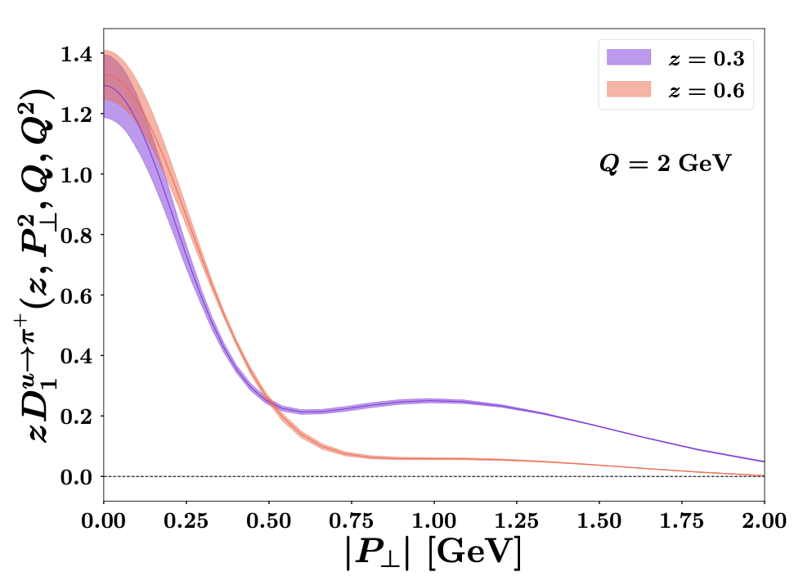
Map Collaboration
Extraction at NNLO+N³LL, SIDIS+DY
Hermes multiplicity data
CMS distribution
TMDs

Slide 61
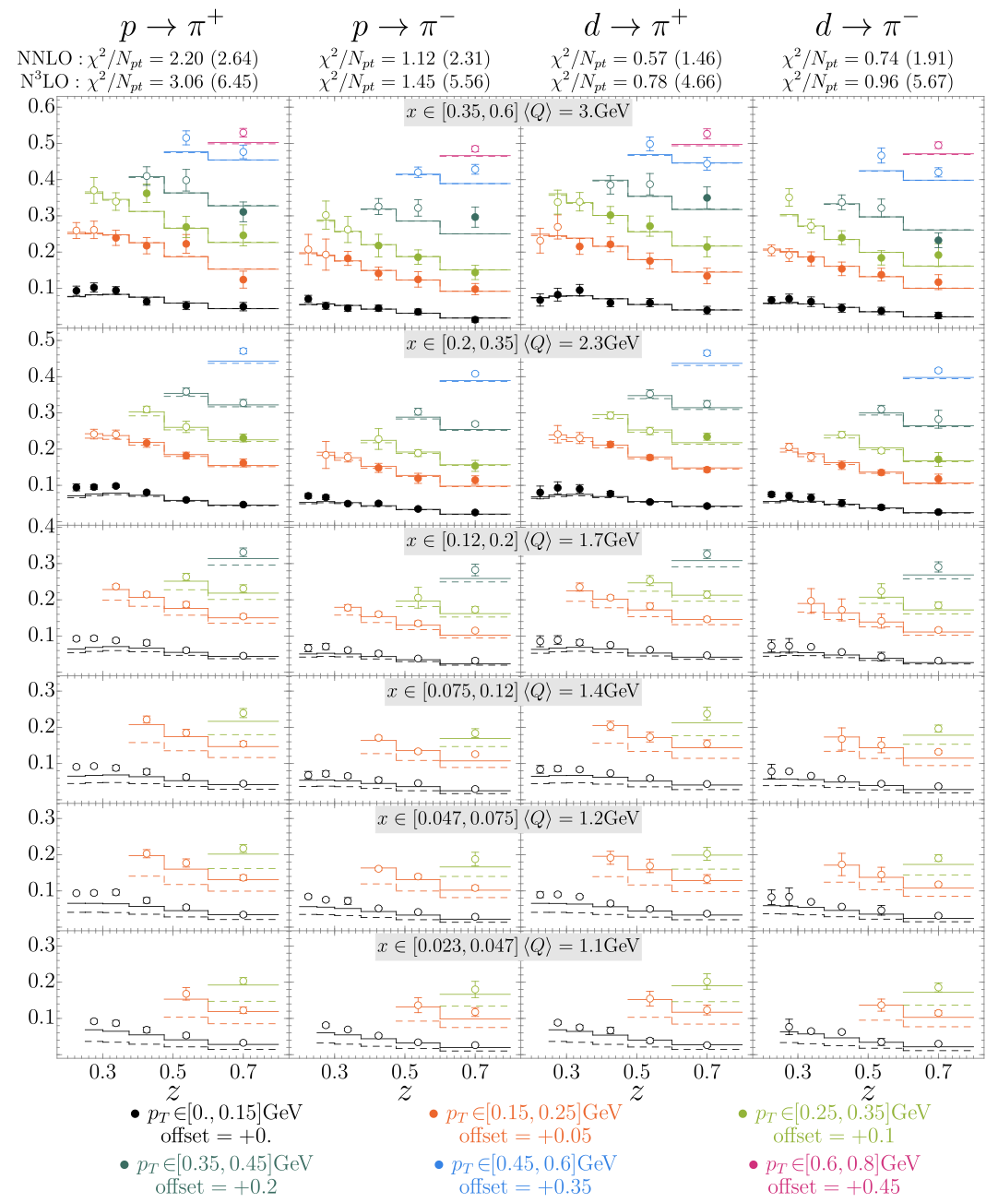
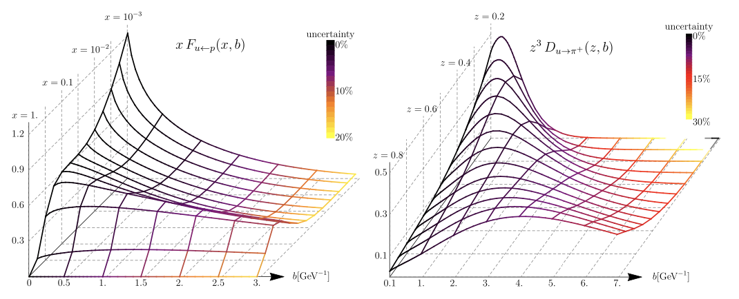
Artemides
Extraction obtained at NNLO+N³LL, SIDIS+DY
Hermes Multiplicity data
TMD PDF
TMD FF

Slide 62
Factorization of physics at different scales
Factorization of the cross section in an OPE
TMD FF
Hard
Contains fixed order and large logs
Soft
Factorization of IR modes
TMD PDF
Matching coefficient contains fixed order and
large logs
Collinear PDF
John Terry (Los Alamos National Lab)

Slide 63
Soft-Collinear Effective Theory
SCET is an EFT which captures soft and collinear emissions along the directions
Bauer, Fleming, Luke 2000
Bauer, Fleming, Pirjol, Stewart 2001
Bauer, Stewart 2001
Bauer, Pirjol, Stewart 2002
Beneke, Chapovsky, Diehl, Feldmann 2002
Beneke, Feldmann 2003
Hill, Neubert 2003
Echevarria, Idilbi, Scimemi 2011
John Terry (Los Alamos National Lab)

Slide 64
Back-to-back lepton-jet production
Process proposed by: Liu, Ringer,Vogelsang, Yuan (2019)
Less sensitive to non-perturbative physics
Lepton-jet transverse momentum imbalance
TMD region
Better than SIDIS in that there is no sensitivity to FFs
Worse due to the perturbative accuracy
Novel factorization using recoil-free jets
Hard:
Collinear:
Jet:
Global soft:
John Terry (Los Alamos National Lab)

Slide 65
Non-global logs
Standard jets complicate resummation
Dasgupta, Salam (2001)
Larkoski, Moult, Neill (2016)
NGLs for jet at NLL is the same as jet mass in e+ e-
Becher, Neubert, Rothen and Shao (2016)
John Terry
17/23

Slide 66
Winner take all jet axis
Direction of recoil-free jet is insensitive all soft emissions, jet points in direction of most energetic hadron. Thus no NGLS
Larkoski, Neill, and Thaler (2014)
Direction of jet and total jet momentum have a transverse momentum relative to one another, contains rapidity divergence
John Terry (Los Alamos National Lab)
18/23

Slide 67
Treatment of medium modifications to the jet
We want to take the jets to be energetic so that
Single gluon exchange
Infinite number of gluon exchanges
Modified jet function under this approximation
We consider an infinite chain of Glauber gluons
Jet
Collinear sources
Modification to the jet
John Terry (Los Alamos National Lab)
19/23

Slide 68
Predictions at the EIC
Comparison of our results with Pythia at NNLL
Perturbative ingredients are known to have N3LL accuracy.
Only missing the 3-loop jet function and the 5-loop
cusp anomalous dimension to reach N4LL
John Terry (Los Alamos National Lab)
20/23

Slide 69

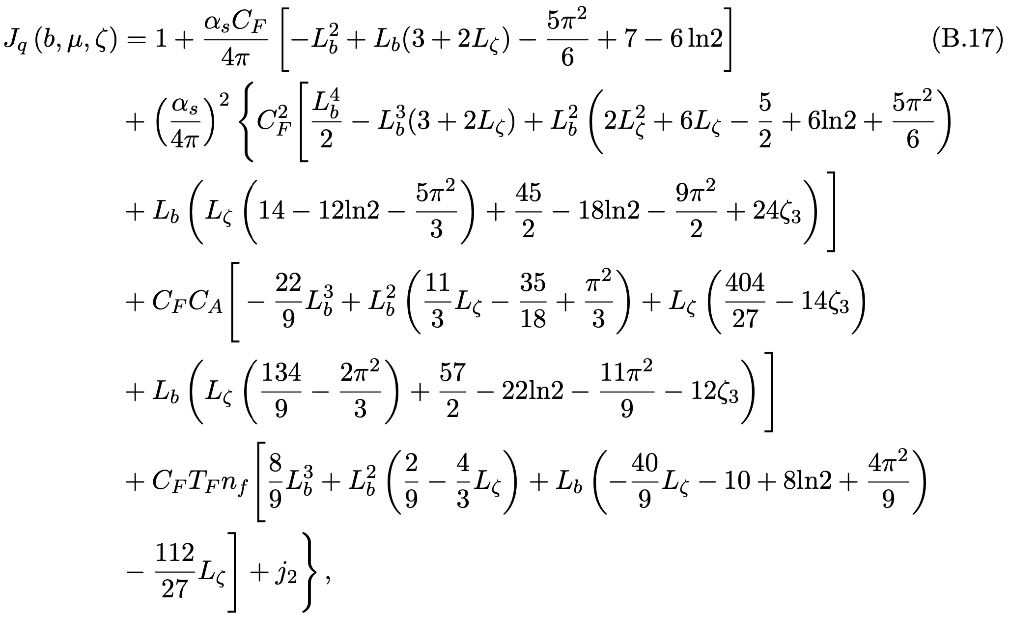
Higher order results
Results have been taken one step higher by
Fang, Gao, Li, Shao (2024)
Constant that was obtained numerically
John Terry (Los Alamos National Lab)
21/23

Slide 70


The structure of matter in the medium: an efficient approximation
nTMDs were originally defined using an approximate scheme by these two
Alrashed, Kang, JT, Xing et al (2022)
Alrashed, Kang, JT, Xing et al (2023)
Perturbative
Medium
Intrinsic
Effective nuclear modified PDF
John Terry (Los Alamos National Lab)

Slide 71
Power counting
Power counting the observable requires examining several scales
LPM phase rapidly oscillates
LPM phase contributes
Power counting the observable requires examining several scales. Collinear logs are different in these cases
John Terry (Los Alamos National Lab)

