Slide 1

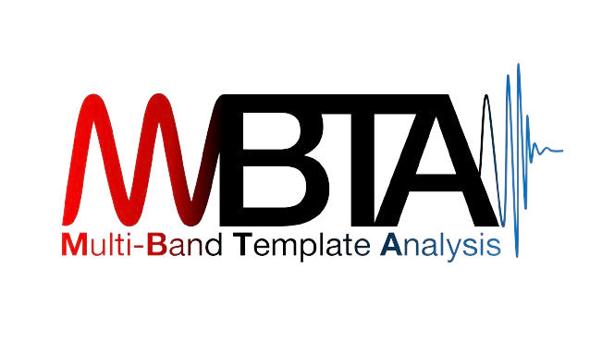

‘Detection of Compact Binary Coalescences by LIGO-Virgo-KAGRA Collaboration’ – PhD Days
Amazigh OUZRIAT
2st year PhD Candidate – Institut des 2 Infinis de Lyon
Supervisor: Dr. Viola SORDINI

Slide 2

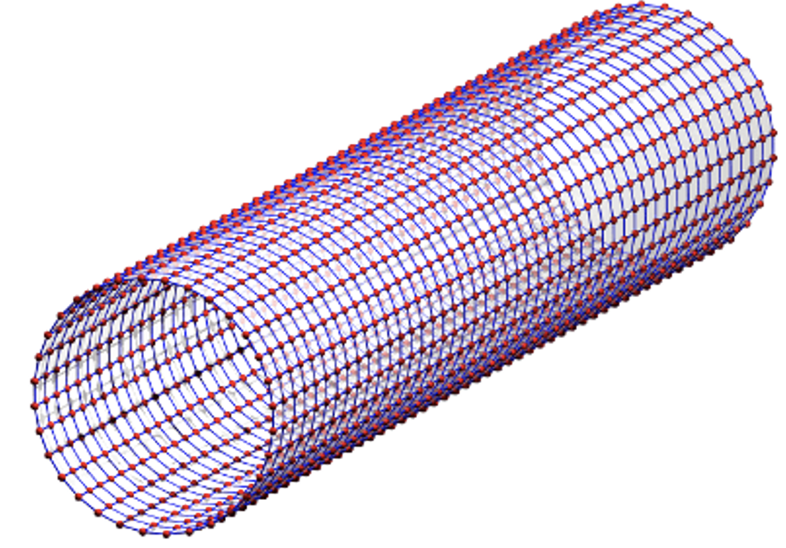
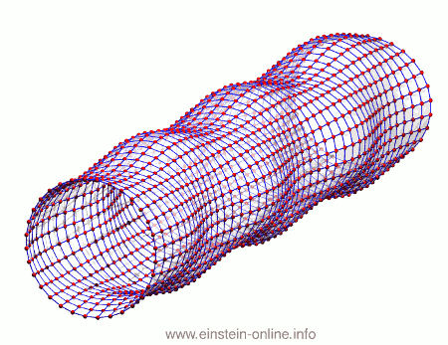
Gravitational waves: listen to the universe!
Ripples in space-time caused by mass acceleration
First predicted by Einstein’s General Relativity
1st direct measurement by LIGO (2015), merge of 2 black holes. Merge of 2 neutron stars (2017) by LIGO-Virgo.
Type of GW sources:
  Transient GWs:
    Compact Binary Coalescences (CBC) – modelled
    Bursts (ex. supernovae) – unmodelled
  Longer duration GWs: continuous emission from rotating neutron stars, stochastic GW background
Amazigh OUZRIAT – PhD Days 18/04/2024
Notes:
Add source

Slide 3
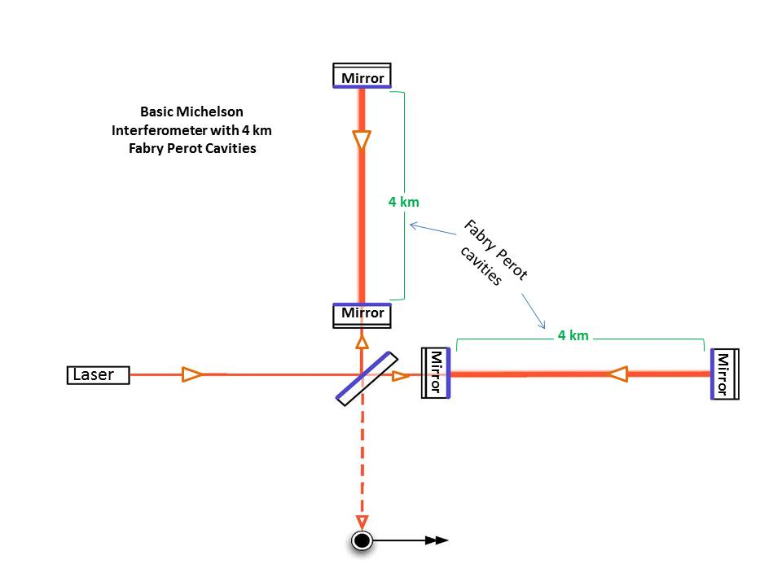
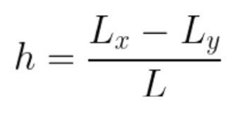
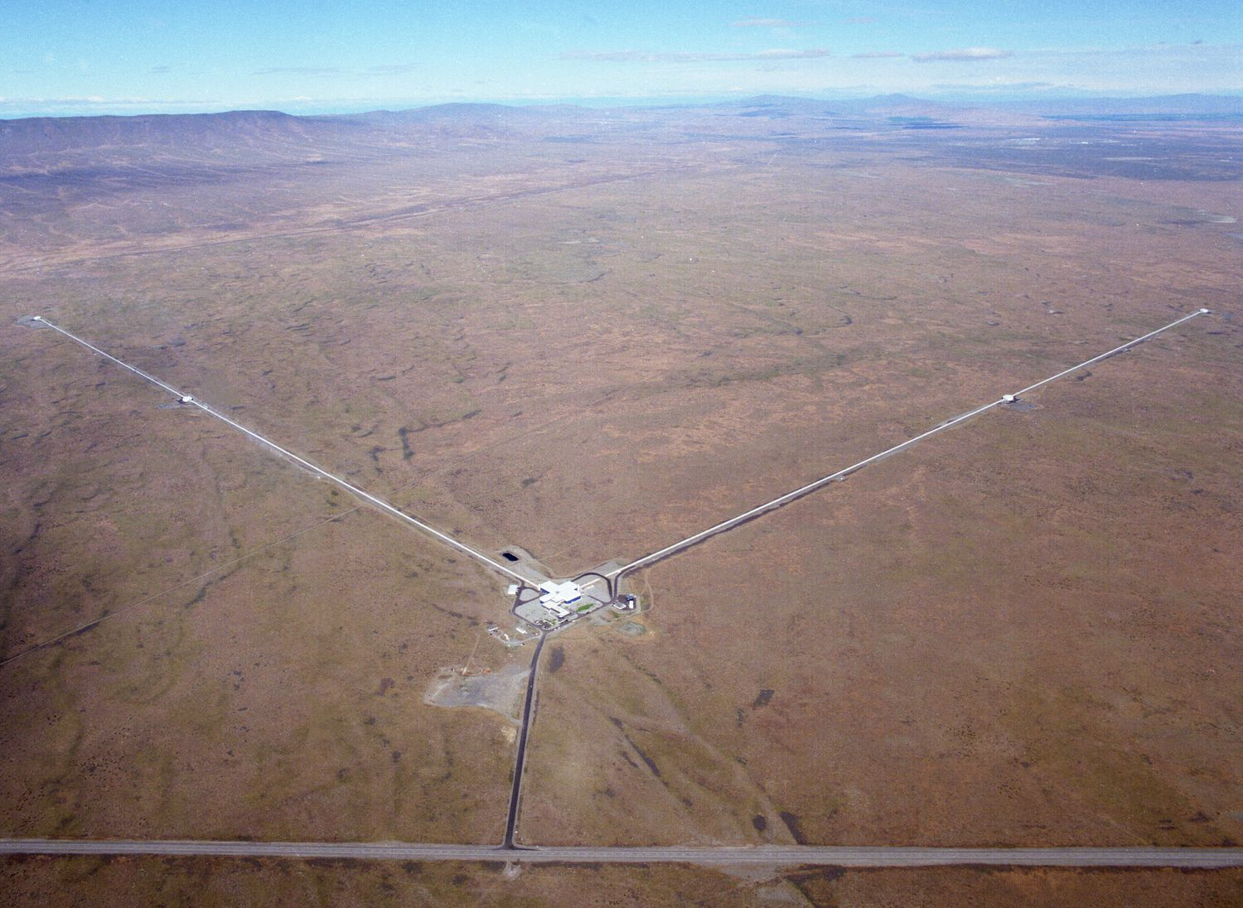
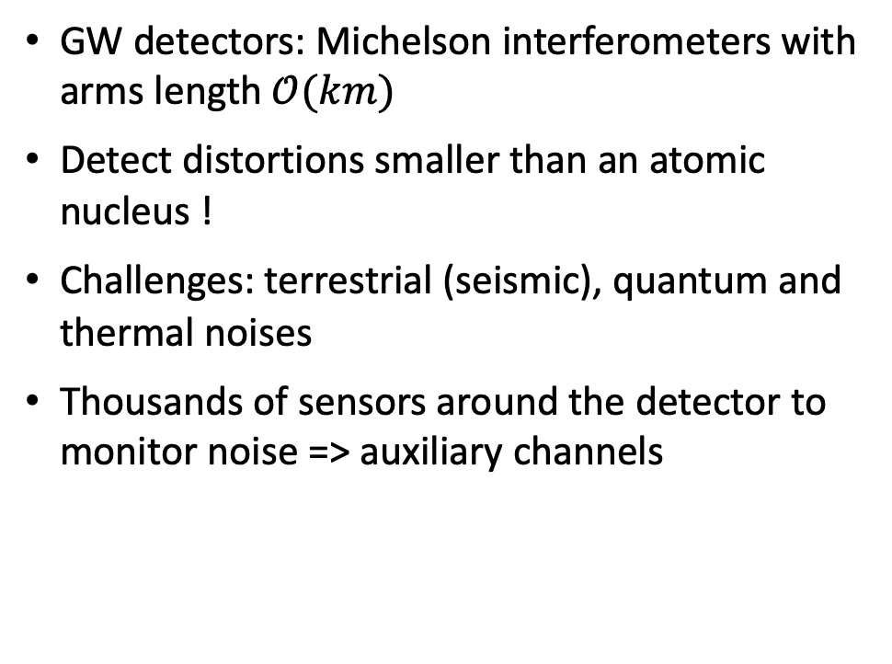
Detection of GWs
GW detectors: Michelson interferometers with arms length $𝒪(km)$
Detect distortions smaller than an atomic nucleus !
Challenges: terrestrial (seismic), quantum and thermal noises
Thousands of sensors around the detector to monitor noise => auxiliary channels
Amazigh OUZRIAT – PhD Days 18/04/2024
Notes:
Add source

Slide 4
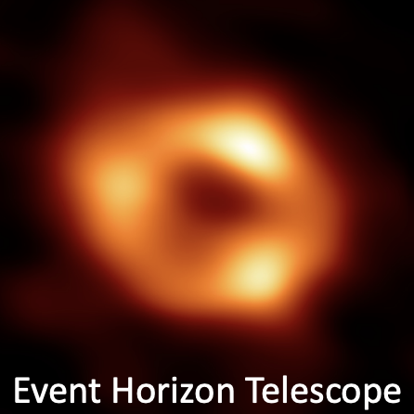
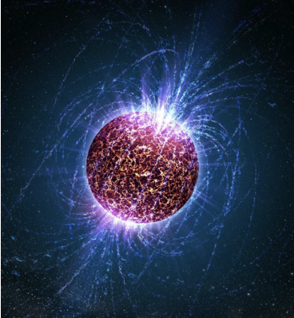
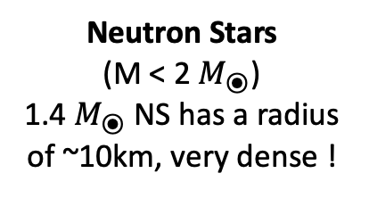
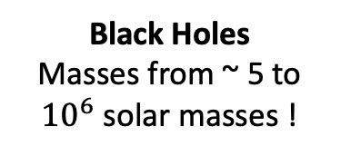
Compact Binary Coalescences (CBCs)
Mergers of 2 compact objects: black holes and/or neutron stars
Dense objects in the universe, with GW frequency within ~10Hz to ~kHz, where our detectors are most sensitive !
CBC detections open broad areas of research : GR tests, BH physics, dense matter physics, cosmology…
Neutron stars mergers: new era of multimessenger astronomy !
Black Holes
Masses from ~ 5 to ${10}^{6}$ solar masses !
Neutron Stars
(M < 2 $M_{⦿}$)
1.4 $M_{⦿}$NS has a radius of ~10km, very dense !
Amazigh OUZRIAT – PhD Days 18/04/2024
Notes:
Add source

Slide 5
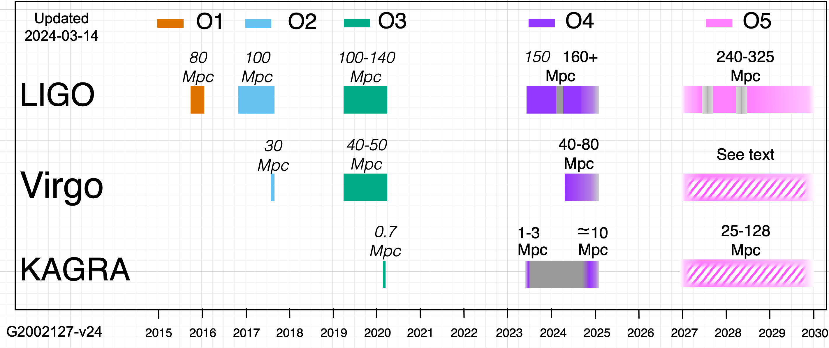
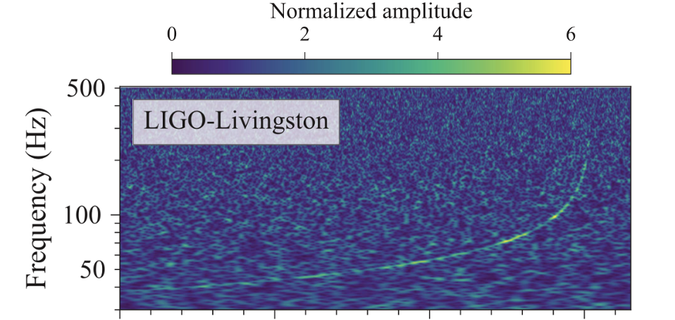

LIGO-Virgo-KAGRA (LVK) collaboration
Network of interferometers in USA (LIGO Hanford and Livingston), Italy (Virgo), Japan (KAGRA)
O1 to O3 observation runs: LIGO-Virgo
GWTC-3 catalog ~ 90 detections, mainly Binary Black Holes (BBH), few Binary Neutron Stars (BNS) and NS-BH coalescences
O4 run (18 months) started on 24th May 2023
O4 divided in 2 periods: O4a & O4b
~ 150-200 new events expected
IP2I GW team created in 2019, involved in data analysis since O3 observation run
GW170817
Amazigh OUZRIAT – PhD Days 18/04/2024
Notes:
Add source

Slide 6
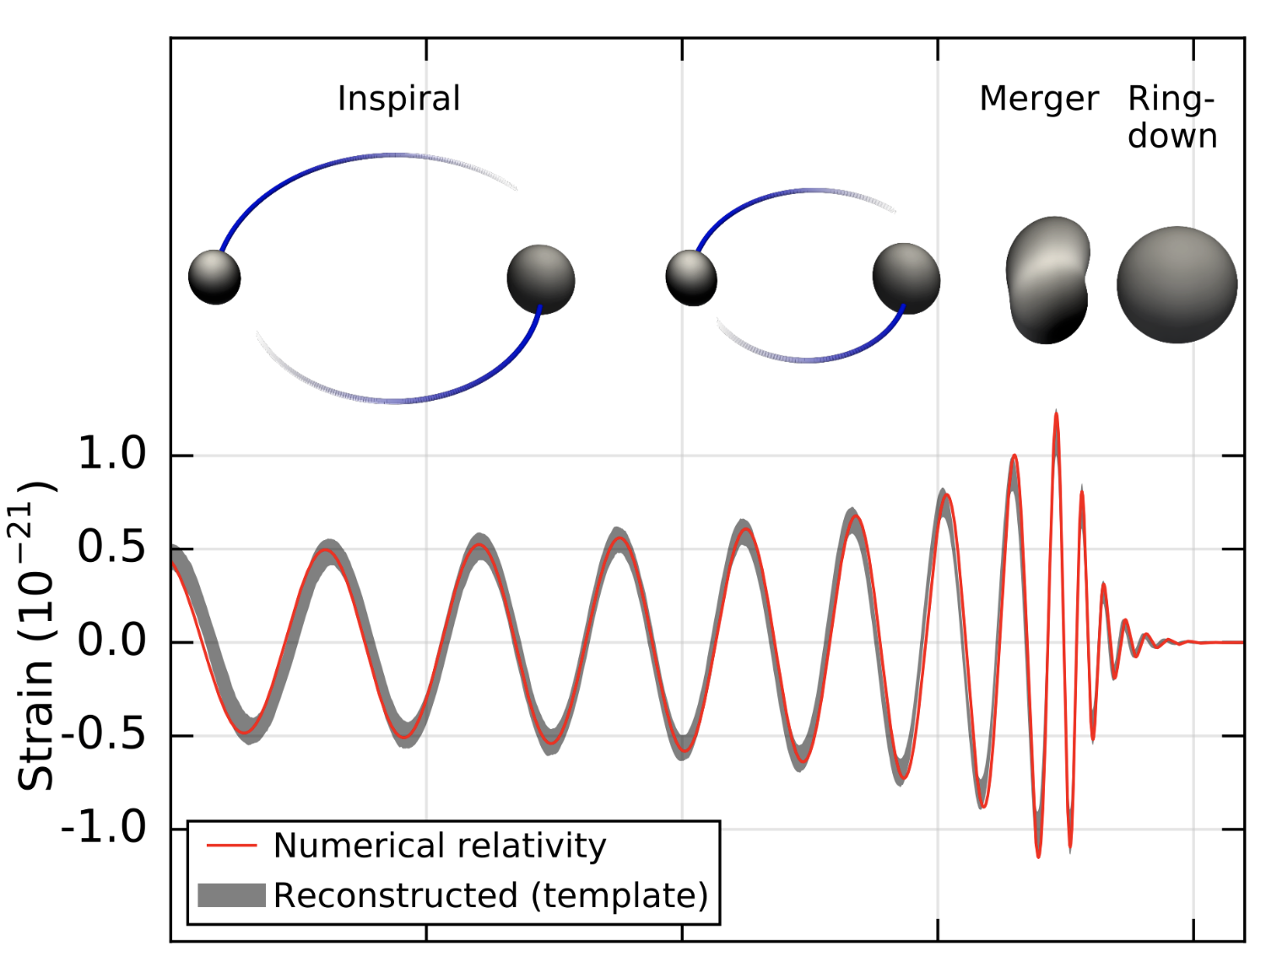
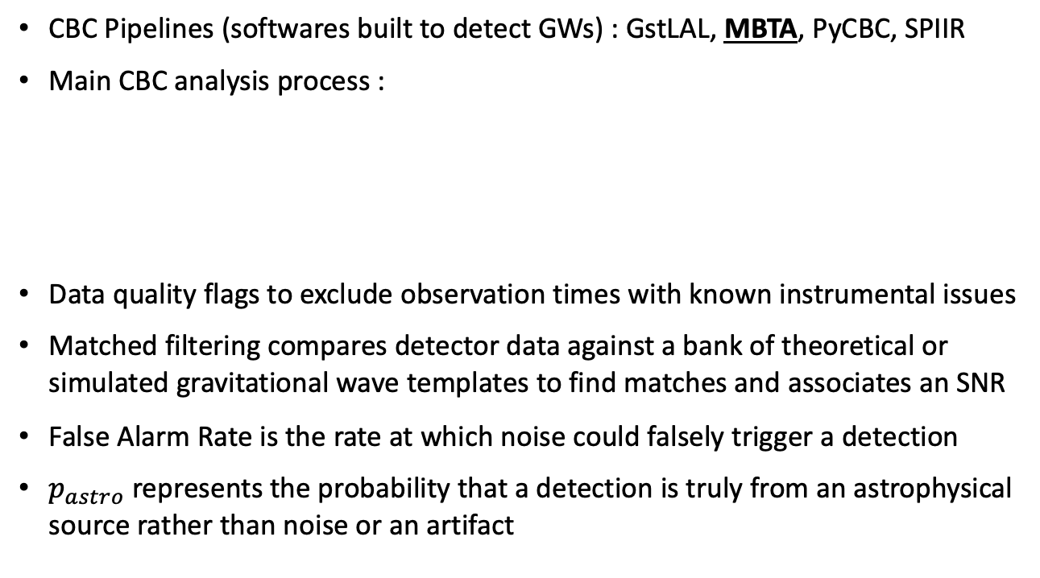
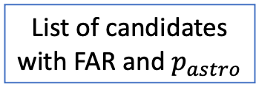
CBC search pipelines in LVK
CBC Pipelines (softwares built to detect GWs) : GstLAL, MBTA, PyCBC, SPIIR
Main CBC analysis process :
Data quality flags to exclude observation times with known instrumental issues
Matched filtering compares detector data against a bank of theoretical or simulated gravitational wave templates to find matches and associates an SNR
False Alarm Rate is the rate at which noise could falsely trigger a detection
$p_{astro}$ represents the probability that a detection is truly from an astrophysical source rather than noise or an artifact
Strain data h(t)
Matched filtering -> SNR
(CBC search pipelines)
List of candidates
with FAR and $p_{astro}$
Data quality
Amazigh OUZRIAT – PhD Days 18/04/2024
Notes:
Add source

Slide 7
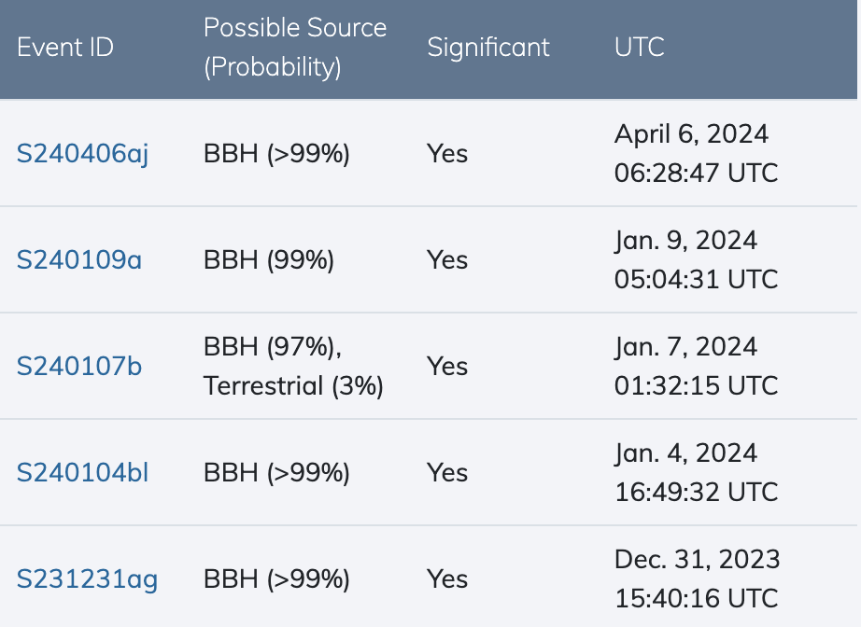
CBC search analysis : online vs offline
CBC search pipelines run in two different modes : online and offline
Online search:
  Real-time processing of incoming detector data
  Triggers with FAR < 2 per day are stored on “GraceDB” website
  Public alerts sent for significant events (FAR < 1 per 5 months)
  Crucial for enabling multimessenger astronomy !
Offline search:
  Benefits from increased computational ressources
  Elaborated handling of data quality, more sensitive analysis compared to online and enhanced noise rejection. Therefore relaxed selection criteria
  Crucial to confirm/retract online candidates, re-evaluation of marginal events
  Injection campaign in order to study search sensitivity and pipeline improvements
Amazigh OUZRIAT – PhD Days 18/04/2024
Notes:
Add source

Slide 8
My contribution to CBC search on O4a data
Amazigh OUZRIAT – PhD Days 18/04/2024
Notes:
Add source

Slide 9
MBTA search pipeline for CBC
Multi-Band Template Analysis, coded pipeline in C
MBTA team consists mainly of Virgo groups in France/Italy, IP2I group very active ! (Ines, Viola, Morgan)
Divide the bank of GWs templates in 2 frequency bands : low frequency part, high frequency part
Runs matched filtering in both bands (SNR for each band) then recombine SNR
O4 data divided in ‘chunks’, each chunk represents 2 week data.
2 runs on data for each chunk: with and without addition of simulated signals (12s spaced injections)
MBTA pipeline method paper on the way !
Amazigh OUZRIAT – PhD Days 18/04/2024

Slide 10
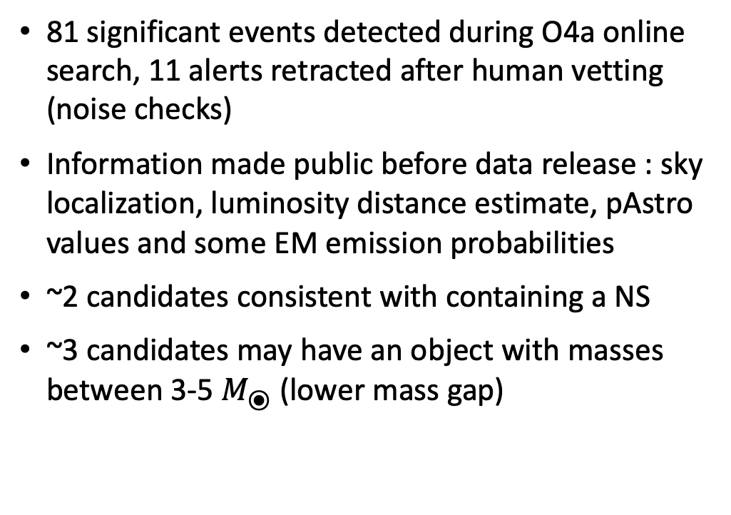
Online significant public alerts during O4a
81 significant events detected during O4a online search, 11 alerts retracted after human vetting (noise checks)
Information made public before data release : sky localization, luminosity distance estimate, pAstro values and some EM emission probabilities
~2 candidates consistent with containing a NS
~3 candidates may have an object with masses between 3-5 $M_{⦿}$ (lower mass gap)
Alert FAR thresholds for each candidate type:
 | Low Significance Alerts | High Significance Alerts
FAR threshold | 2 per day | 1 per 5 months
O4a alerts | 1624 | 81
After retractions
Amazigh OUZRIAT – PhD Days 18/04/2024

Slide 11
MBTA offline search results for O4a
Offline analysis running currently, search sensitivity studies on the way
Results are confidential, until data release on August 2025
Summarizing results for data taking for O4a run
64 significant detections (56 events already seen significant online online + 8 new ones)
10 significant alerts were not seen offline
These results will be included in the LVK GWTC-4 catalog paper
Amazigh OUZRIAT – PhD Days 18/04/2024

Slide 12
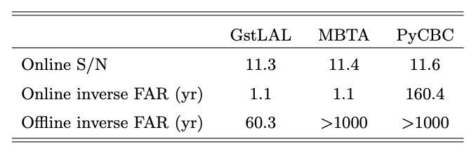
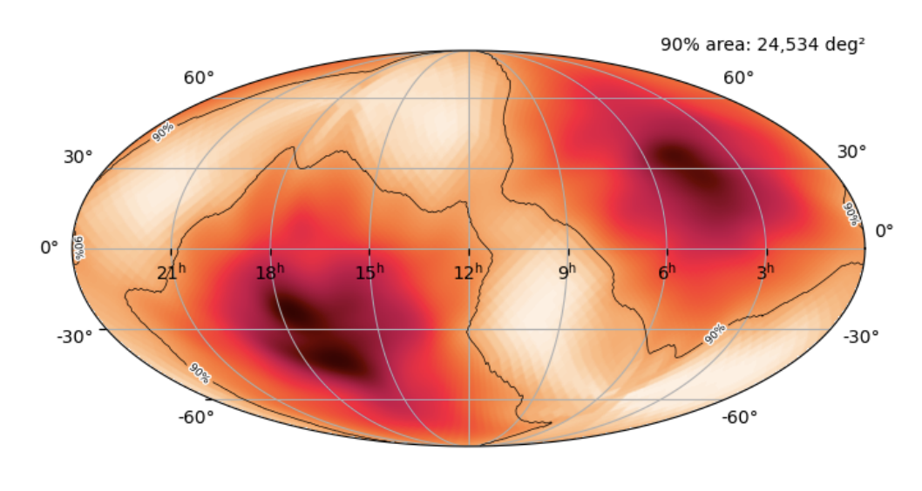
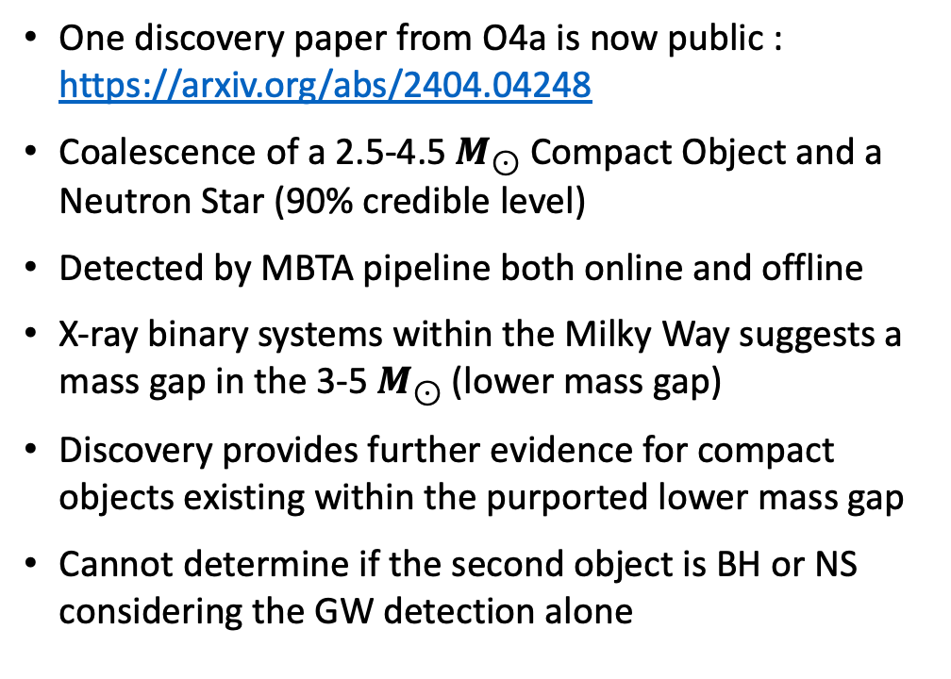
GW230529: A particular O4a event
One discovery paper from O4a is now public : https://arxiv.org/abs/2404.04248
Coalescence of a 2.5-4.5 $M_{⊙}$Compact Object and a Neutron Star (90% credible level)
Detected by MBTA pipeline both online and offline
X-ray binary systems within the Milky Way suggests a mass gap in the 3-5 $M_{⊙}$(lower mass gap)
Discovery provides further evidence for compact objects existing within the purported lower mass gap
Cannot determine if the second object is BH or NS considering the GW detection alone
Amazigh OUZRIAT – PhD Days 18/04/2024

Slide 13
My contribution to MBTA noise mitigation
Amazigh OUZRIAT – PhD Days 18/04/2024
Notes:
Add source

Slide 14
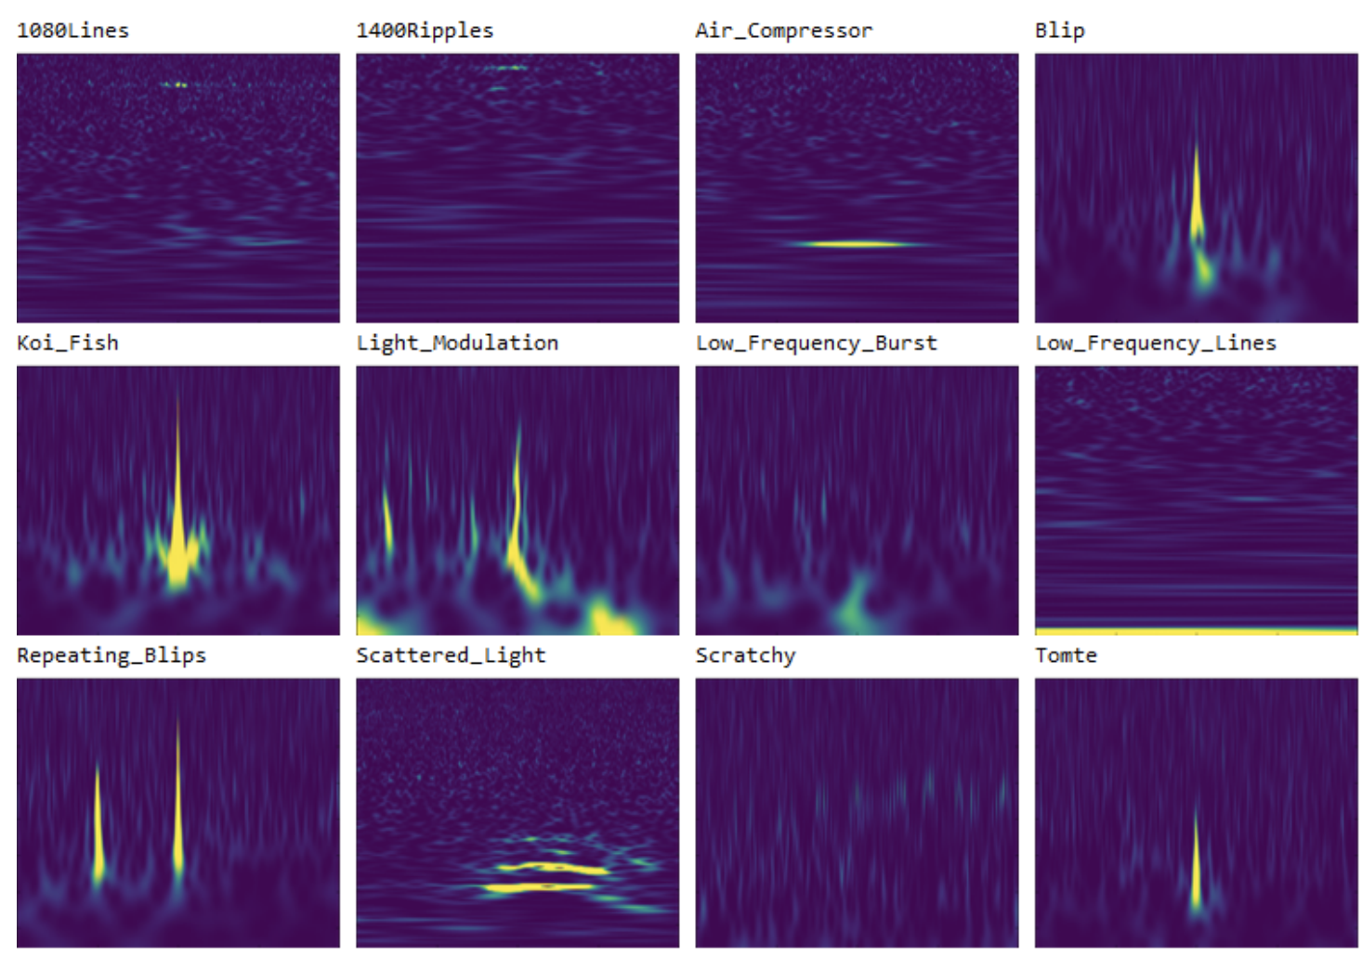
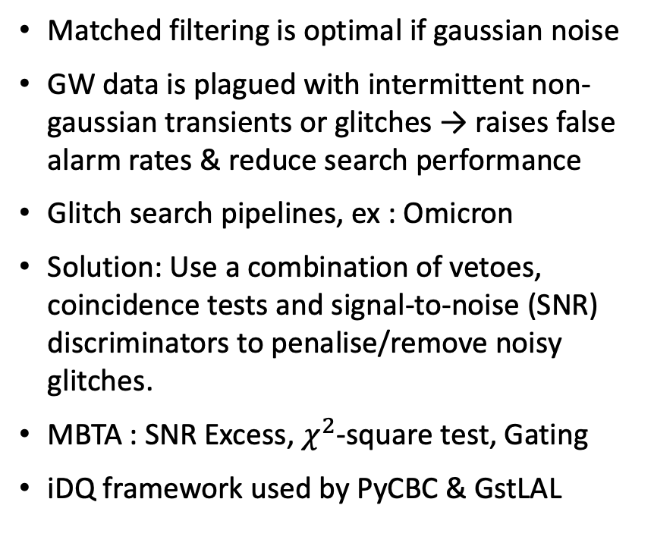
CBC search challenge: non-gaussian noise (glitches)
Matched filtering is optimal if gaussian noise
GW data is plagued with intermittent non-gaussian transients or glitches → raises false alarm rates & reduce search performance
Glitch search pipelines, ex : Omicron
Solution: Use a combination of vetoes, coincidence tests and signal-to-noise (SNR) discriminators to penalise/remove noisy glitches.
MBTA : SNR Excess, $χ^{2}$-square test, Gating
iDQ framework used by PyCBC & GstLAL
Some families of glitches, represented by Q scans (time-frequency spectrograms)
Amazigh OUZRIAT – PhD Days 18/04/2024
Notes:
Add source

Slide 15
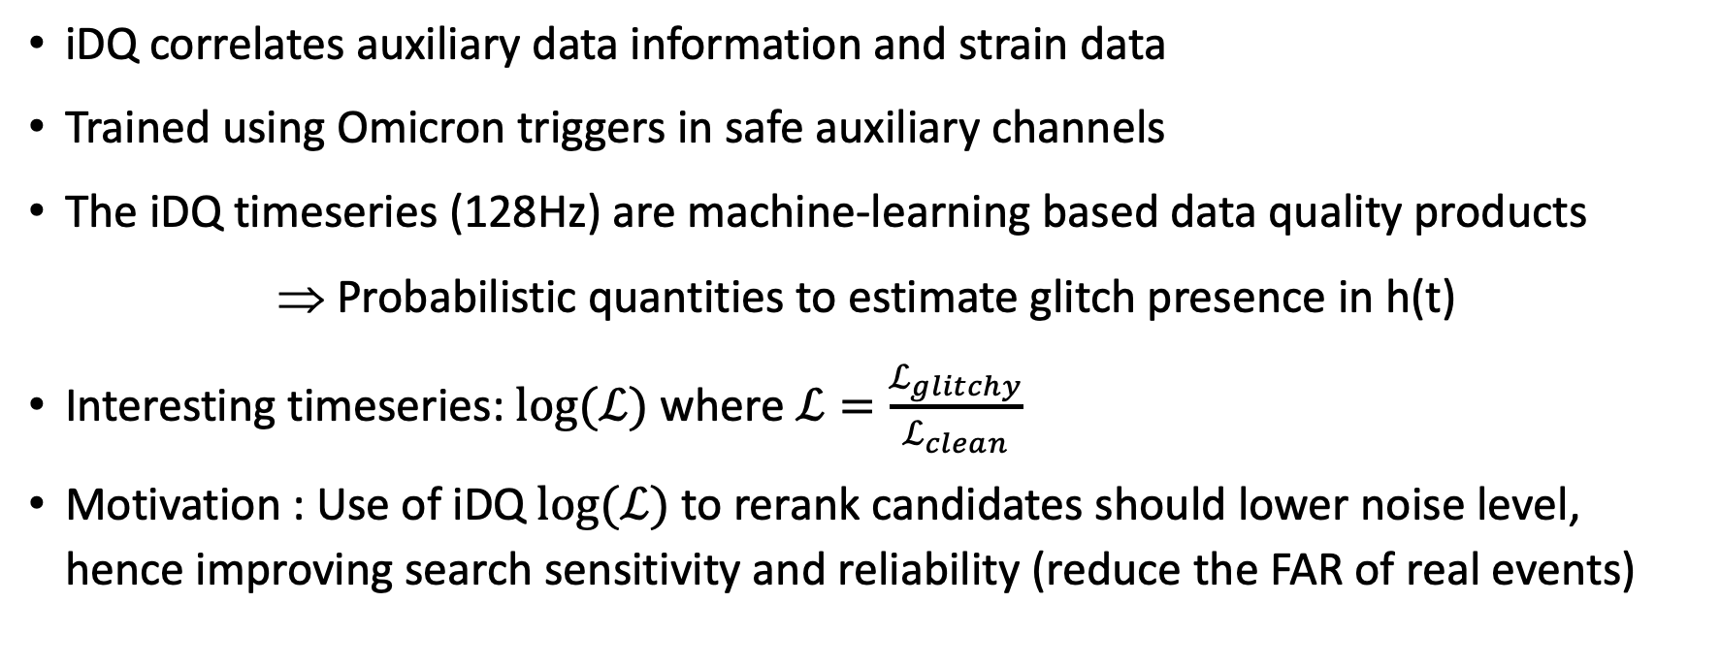
iDQ: Framework for statistical inference of glitches
iDQ correlates auxiliary data information and strain data
Trained using Omicron triggers in safe auxiliary channels
The iDQ timeseries (128Hz) are machine-learning based data quality products
Probabilistic quantities to estimate glitch presence in h(t)
Interesting timeseries: $log⁡(ℒ)$ where $ℒ=\frac{ℒ_{glitchy}}{ℒ_{clean}}$
Motivation : Use of iDQ $log⁡(ℒ)$ to rerank candidates should lower noise level, hence improving search sensitivity and reliability (reduce the FAR of real events)
Amazigh OUZRIAT – PhD Days 18/04/2024

Slide 16
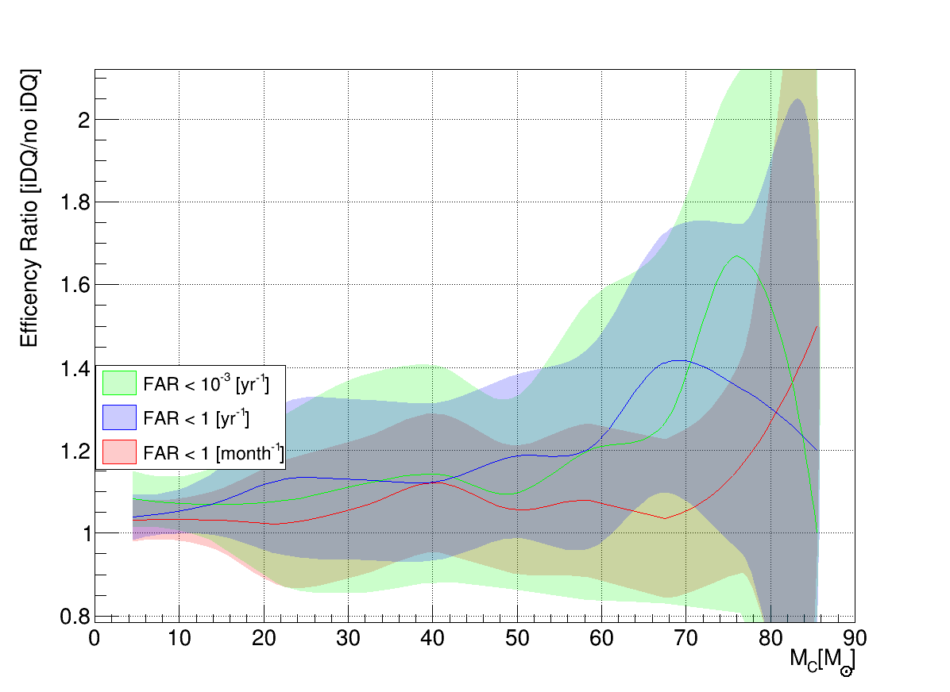
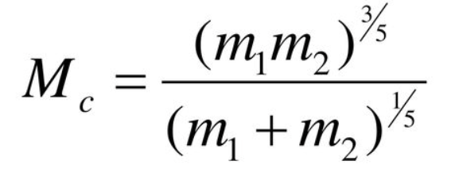
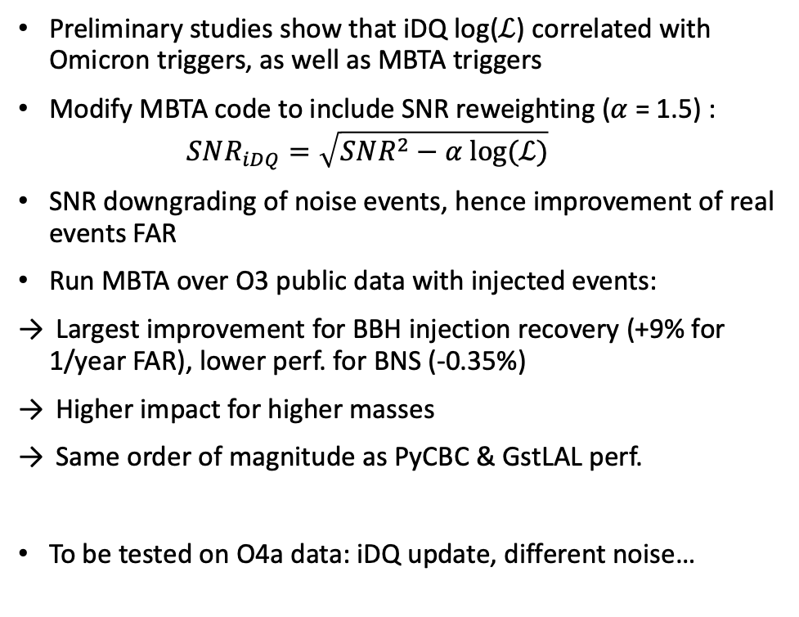
iDQ integration into MBTA on O3 public data
BBH detection efficency
Preliminary studies show that iDQ log($ℒ$) correlated with Omicron triggers, as well as MBTA triggers
Modify MBTA code to include SNR reweighting ($α$ = 1.5) :
  $$SNR_{iDQ}=\sqrt{SNR^{2}−α log⁡(ℒ)}$$
SNR downgrading of noise events, hence improvement of real events FAR
Run MBTA over O3 public data with injected events:
Largest improvement for BBH injection recovery (+9% for 1/year FAR), lower perf. for BNS (-0.35%)
Higher impact for higher masses
Same order of magnitude as PyCBC & GstLAL perf.
To be tested on O4a data: iDQ update, different noise…
Amazigh OUZRIAT – PhD Days 18/04/2024
Notes:
Add source

Slide 17
Conclusion
LIGO-Virgo-KAGRA O4a online analysis identified 81 significant CBC candidates (such as GW230529), detailed results still confidential.
Gravitational waves continue to improve our knowledge of the universe, from testing relativity to dense matter physics !
My contribution to LVK CBC search:
  MBTA offline analysis on-going, will participate to LVK catalog publication
  iDQ integration into MBTA for O3 data shows promising results, with a +9% detection efficiency increase for binary black holes.
  Transient noise remains a significant analysis challenge for CBC detection pipelines
  3rd year of thesis will explore GW potential to refine cosmological models
Amazigh OUZRIAT – PhD Days 18/04/2024
Notes:
Add source

Slide 18
Thank you !
Amazigh OUZRIAT – PhD Days 18/04/2024
Notes:
Add source

Slide 19
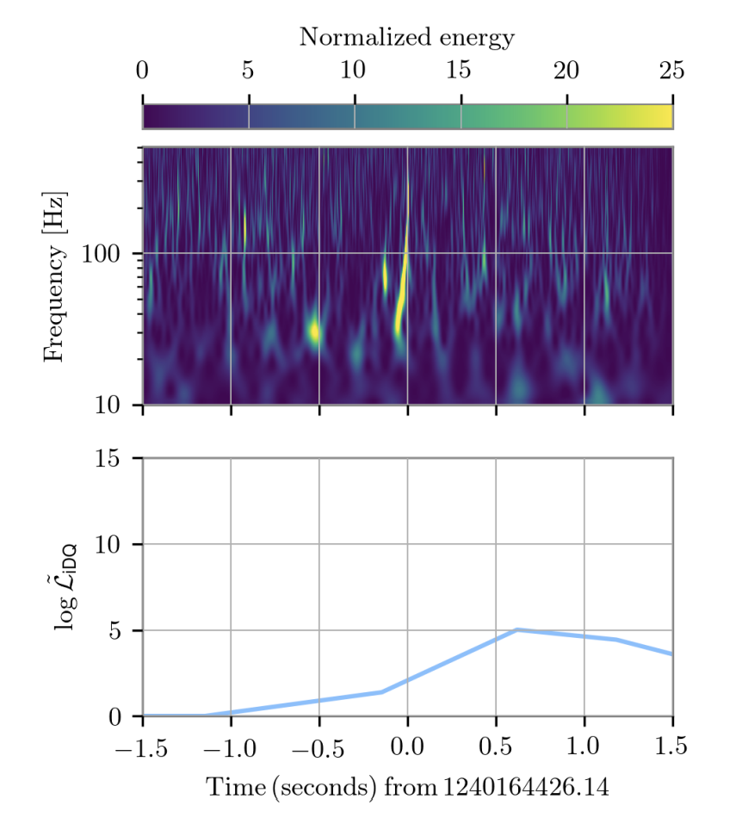
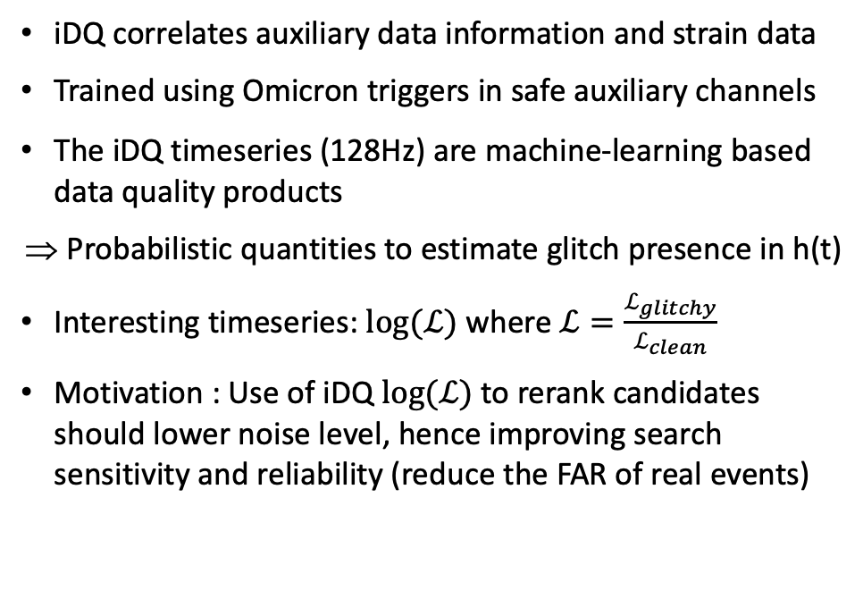
iDQ: Framework for statistical inference of glitches
iDQ correlates auxiliary data information and strain data
Trained using Omicron triggers in safe auxiliary channels
The iDQ timeseries (128Hz) are machine-learning based data quality products
Probabilistic quantities to estimate glitch presence in h(t)
Interesting timeseries: $log⁡(ℒ)$ where $ℒ=\frac{ℒ_{glitchy}}{ℒ_{clean}}$
Motivation : Use of iDQ $log⁡(ℒ)$ to rerank candidates should lower noise level, hence improving search sensitivity and reliability (reduce the FAR of real events)
Time surrounding GW190424A
Recovered after iDQ incorporation into GstLAL
Amazigh OUZRIAT – PhD Days 18/04/2024

Slide 20
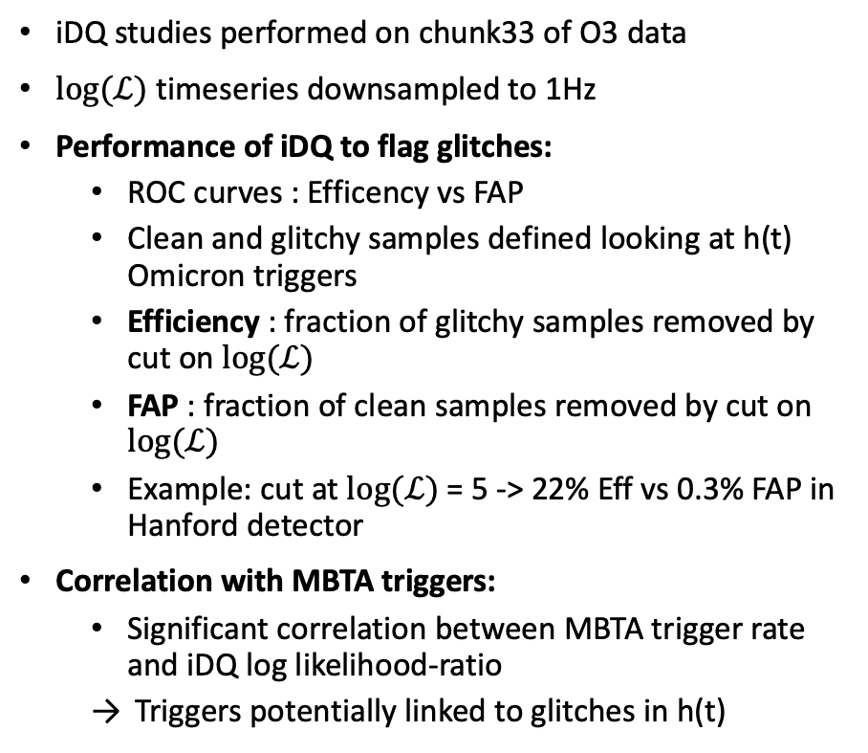
iDQ integration into MBTA – Preliminary study
iDQ studies performed on chunk33 of O3 data
$log⁡(ℒ)$ timeseries downsampled to 1Hz
Performance of iDQ to flag glitches:
  ROC curves : Efficency vs FAP
  Clean and glitchy samples defined looking at h(t) Omicron triggers
  Efficiency : fraction of glitchy samples removed by cut on $log⁡(ℒ)$
  FAP : fraction of clean samples removed by cut on $log⁡(ℒ)$
  Example: cut at $log⁡(ℒ)$= 5 -> 22% Eff vs 0.3% FAP in Hanford detector
Correlation with MBTA triggers:
  Significant correlation between MBTA trigger rate and iDQ log likelihood-ratio
  Triggers potentially linked to glitches in h(t)
Amazigh OUZRIAT – PhD Days 18/04/2024
Notes:
Add source

Slide 21
Omicron search pipeline for glitches
Omicron is a pipeline that detects transient noise (glitches) in gravitational wave data
Each trigger has an associated SNR (cut of 5 is a standard threshold)
Example: during chunk33 of O3 run, over 250k (400k) glitches in Hanford (Livingston) !
Sub-second glitches are dominant, representing brief and sharp disturbances in data
Some glitches families can be modelled and then suppressed from data !
Amazigh OUZRIAT – PhD Days 18/04/2024

