Slide 1
Optimisation and Deployment of an AI pipeline based on a Graph Neural Network (GNN) for Track Finding at LHCb
Anthony Correia, Fotis Giasemis, Nabil Garroum, Vava Gligorov, Bertrand Granado
22nd March 2024
Protection zone
In collaboration with

Slide 2
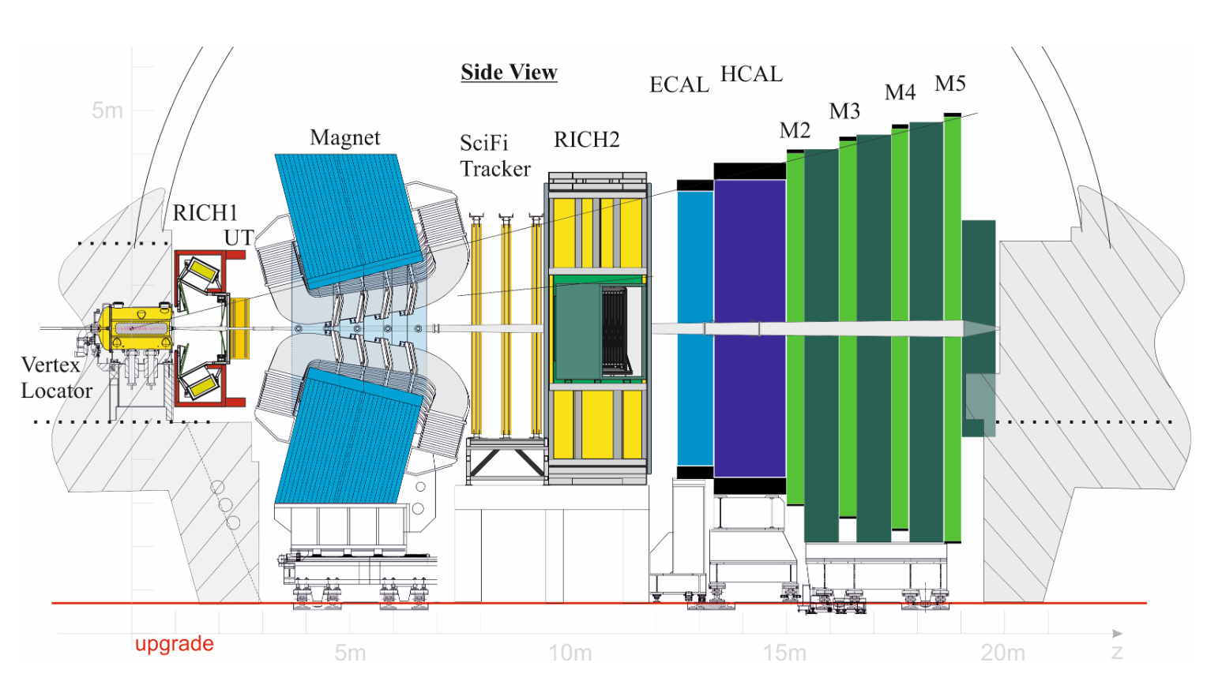
Problem Formulation
2 bunches of $∼{10}^{11}$ protons cross every $\sim$30 ns
$→$ $≈$ 30 MHz bunch crossing rate
$\sim$ 5 proton-proton collisions / bunch crossing
$$x$$
$$z$$
Magnet stations

Slide 3
Problem Formulation
2 bunches of $∼{10}^{11}$ protons cross every $\sim$30 ns
$→$ $≈$ 30 MHz bunch crossing rate
$\sim$ 5 proton-proton collisions / bunch crossing
$$x$$
Detector acceptance: 1°< |θ| <15°
$$z$$
Magnet stations

Slide 4
Problem Formulation
Velo
Vertex Locator
With silicon pixels
No magnetic field
UT
Upstream Tracker
With silicon strips
SciFi
With Scintillating Fibres
$$x$$
$$z$$
Magnet stations

Slide 5
Problem Formulation
Velo
Vertex Locator
With silicon pixels
UT
Upstream Tracker
With silicon strips
SciFi
With Scintillating Fibres
Magnet stations
$$x$$
Long track
Reconstructible in the Velo and SciFi
26 planes
$$z$$
Magnetic field $\vec{B}$
Velo track
Reconstructible in the Velo
No momentum measurement

Slide 6
Problem Formulation
Velo
Vertex Locator
With silicon pixels
UT
Upstream Tracker
With silicon strips
SciFi
With Scintillating Fibres
Magnet stations
$$x$$
Long track
Reconstructible in the Velo and SciFi
26 planes
$$z$$
Magnetic field $\vec{B}$
Velo track
Reconstructible in the Velo
No momentum measurement

Slide 7
Problem Formulation
Track finding: find tracks from hits
Notes:
Figure document approved needed

Slide 8
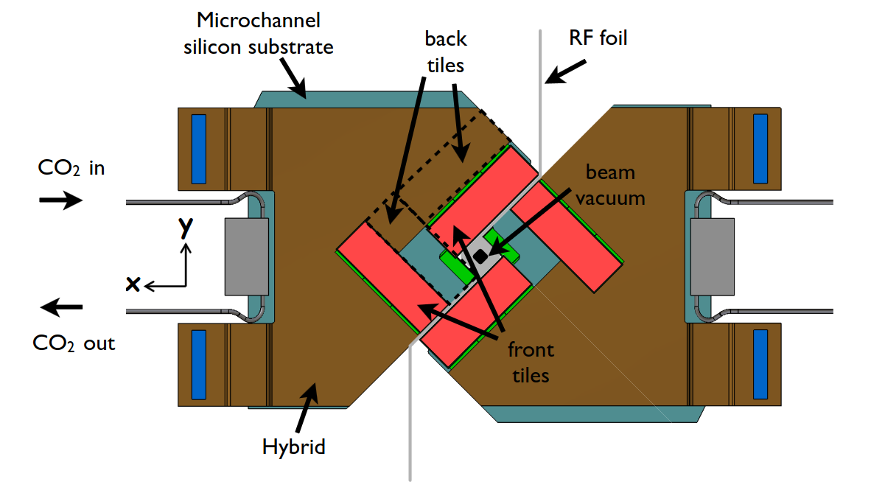
Problem Formulation
Track finding: find tracks from hits
Plane number
1
2
3
4
5
6
7
8
9
10
11
12
13
14
15
16
17
18
19
20
21
22
23
24
25
26
1 plane
4 sensor planes
1 plane $=$ 4 sensor planes
=
P. C. Tsopelas, ‘A Silicon Pixel Detector for LHCb’, PhD Thesis, Vrije U., Amsterdam, 2016.
Notes:
Figure document approved needed

Slide 9
Problem Formulation
Track finding: find tracks from hits
Plane number
1
2
3
4
5
6
7
8
9
10
11
12
13
14
15
16
17
18
19
20
21
22
23
24
25
26
Simplified example
Input: Velo Hits
Output: Velo tracks
Noise
Notes:
Figure document approved needed

Slide 10
Problem Formulation
Goal
Input: Velo Hits
Output: Velo tracks
9
18
18
13
9
13
Noise
3
6
14
3
6
1
10
10
14
4
15
1
4
15
2
7
11
16
19
2
7
16
19
11
5
8
12
20
5
8
12
20
17
17
Everything in GPU
$⇒$ needs to be as much parallelised as possible (NOT sequential)
Notes:
Figure document approved needed

Slide 11
Problem Formulation
Goal
Input: Velo Hits
Output: Velo tracks
9
18
18
13
9
13
Noise
3
6
14
3
6
1
10
10
14
4
15
1
4
15
2
7
11
16
19
2
7
16
19
11
5
8
12
20
5
8
12
20
17
17
$$X=\left(\begin{matrix}r_{1} & φ_{1} & z_{1} \\ r_{2} & φ_{2} & z_{2} \\ r_{3} & φ_{3} & z_{3} \\ ⋮ & ⋮ & ⋮ \\ r_{15} & φ_{15} & z_{15} \\ r_{16} & φ_{16} & z_{16}\end{matrix}\right)$$
List of connected components
{1, 4, 7, 11, 15, 16, 19}
{2, 6, 10, 13, 18}
{3}
{5, 8, 12, 17}
{9}
{14}
{20}
Hit coordinates
Everything in GPU
$⇒$ needs to be as much parallelised as possible (NOT sequential)
Notes:
Figure document approved needed

Slide 12
Problem Formulation
Goal
Noise
GNN-based pipeline is based on the work of Exa.Trkx (Eur. Phys. J. C 81, 876 (2021)).
With PyTorch
Notes:
Figure document approved needed

Slide 13
Problem Formulation
Goal
Noise
Build a rough graph
e.g., link every hits to hits on the next 2 planes.
1
0.3
0.2
2
Score every edge between 0 (fake) and 1 (genuine)
using a Graph Neural Network (GNN)
0.7
0.9
0.8
3
Discard fake edges by requiring edge score > $s_{edge,min}$ (for instance)
Notes:
Figure document approved needed

Slide 14
Problem Formulation
Build a rough graph
e.g., link every hits to hits on the next 2 planes.
1
0.3
0.2
2
Score every edge between 0 (fake) and 1 (genuine)
using a Graph Neural Network (GNN)
0.7
0.9
0.8
3
Discard fake edges by requiring edge score > $s_{edge,min}$
4
Find connected components using a weakly connected component algorithm
Use of cugraph (GPU) or SciPy (CPU)
Notes:
Figure document approved needed

Slide 15
Problem Formulation
Filter edges with GNN
Find connected components
Build graph
Build a rough graph
e.g., link every hits to hits on the next 2 planes.
1
0.3
0.2
2
Score every edge between 0 (fake) and 1 (genuine)
using a Graph Neural Network (GNN)
0.7
0.9
0.8
3
Discard fake edges by requiring edge score > $s_{edge,min}$
4
Find connected components using a weakly connected component algorithm
Use of cugraph (GPU) or SciPy (CPU)
Notes:
Figure document approved needed

Slide 16
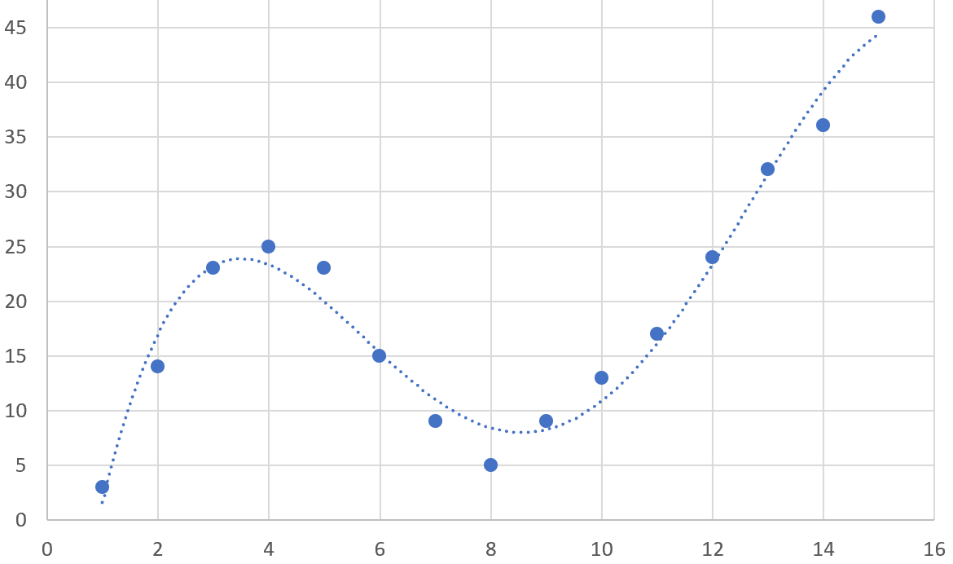
Interlude on Neural Network
Input $x$
Output $\hat{y}$
Predict $y$ from $x$?
Polynomial model
5 parameters
$$\hat{y}=ax^{4}+bx^{3}+cx^{2}+dx+e$$
$$y$$
$$x$$
Notes:
Figure document approved needed

Slide 17
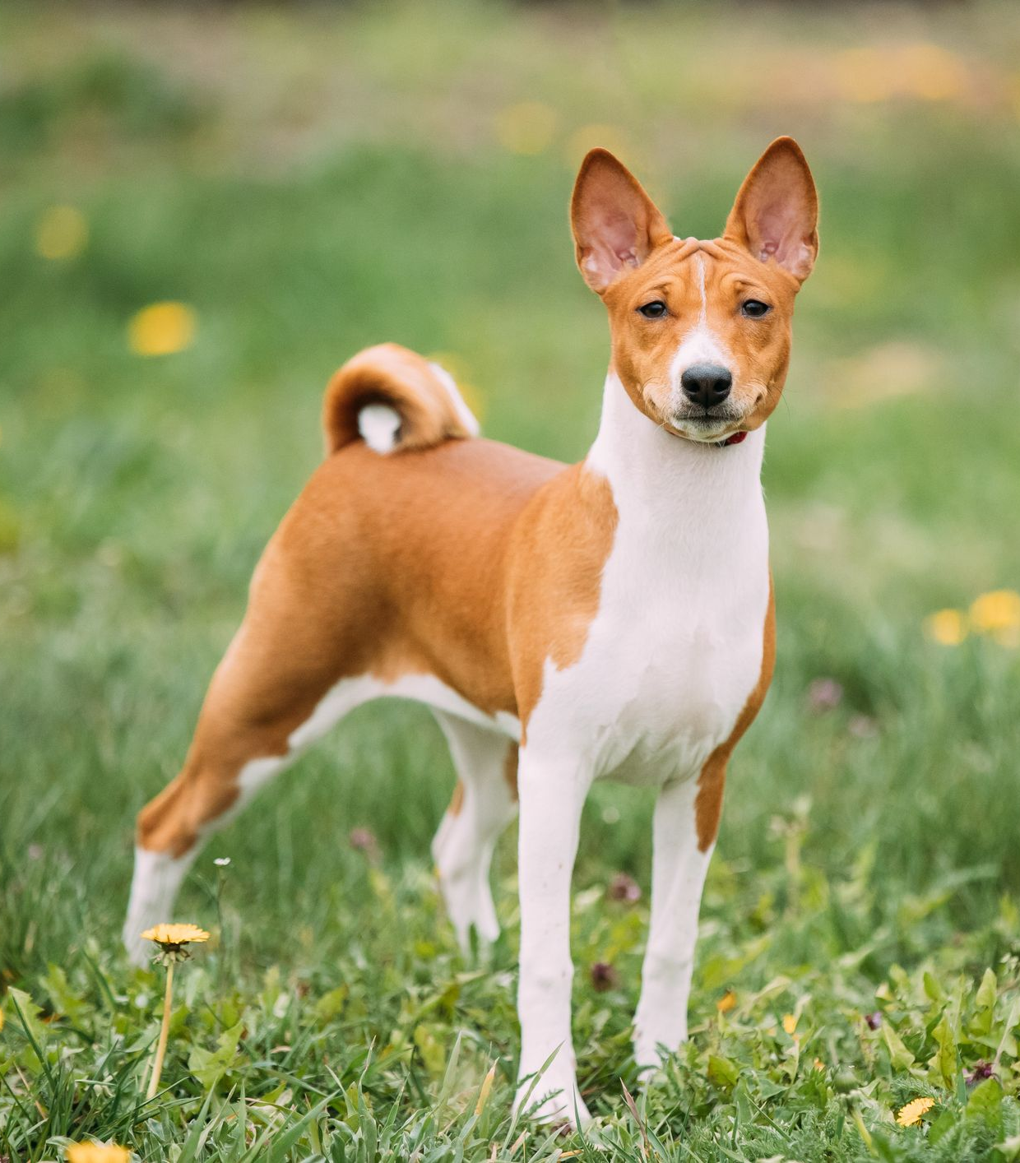
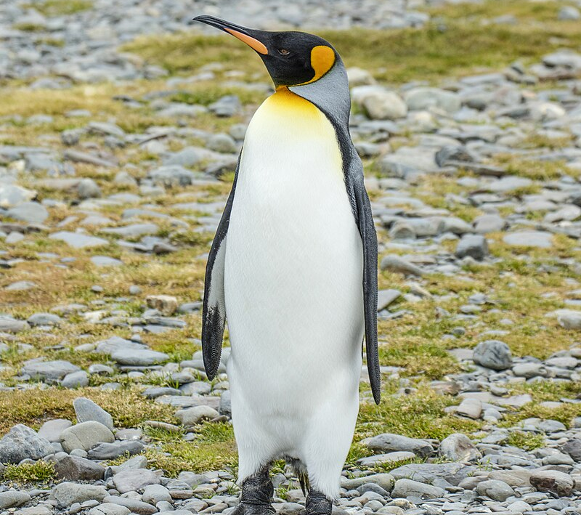
Interlude on Neural Network
Input $x$
Output $\hat{y}$
Predict $y$ from $x$?
Polynomial model
5 parameters
$$\hat{y}=ax^{4}+bx^{3}+cx^{2}+dx+e$$
$$y$$
$$x$$
Probability of being a cat?
0.4
Deep Learning model
Many parameters
$$\hat{y}=Model\left(x\right)$$
0.9
0.2
Notes:
Figure document approved needed

Slide 18
Interlude on Neural Network
Input $x$
Output $\hat{y}$
Predict $y$ from $x$?
Polynomial model
5 parameters
$$\hat{y}=ax^{4}+bx^{3}+cx^{2}+dx+e$$
$$y$$
$$x$$
Fit $a$, $b$, $c$, $d$, $e$ by minimising Mean Squared Distance Loss
$$ℒ_{MSE}=\sum_{i=1}^{N}{{\left(y_{i}−{\hat{y}}_{i}\right)}^{2}}$$
Probability of being a cat?
0.4
Deep Learning model
Many parameters
$$\hat{y}=Model\left(x\right)$$
0.9
Fit parameters by minimising Binary Cross Entropy Loss
$$ℒ=−\sum_{i=1}^{N}{{\left(y_{i}\log\left({\hat{y}}_{i}\right)−\left(1−y_{i}\right)\log\left(1−{\hat{y}}_{i}\right)\right)}^{2}}$$
0.2
Notes:
Figure document approved needed

Slide 19
Interlude on Neural Network
NB: For a picture, you should rather use a Convolutional Neural Network (CNN)
$N$ pixels
Probability of being a cat?
Multi-Layer Perceptron
(MLP)
Target
$$X=\left(\begin{matrix}x_{11} & ⋯ & x_{1N} \\ x_{21} & ⋯ & x_{2N} \\ x_{31} & ⋯ & x_{3N}\end{matrix}\right)$$
$$\hat{Y}=\left(\begin{aligned}0.4 \\ 0.9 \\ 0.2\end{aligned}\right)$$
$Y=$ $\left(\begin{aligned}0 \\ 1 \\ 0\end{aligned}\right)$
NB: Input features should be normalised.
Notes:
Figure document approved needed

Slide 20
Interlude on Neural Network
NB: For a picture, you should rather use a Convolutional Neural Network (CNN)
$N$ pixels
Probability of being a cat?
Multi-Layer Perceptron
(MLP)
Target
$$X=\left(\begin{matrix}x_{11} & ⋯ & x_{1N} \\ x_{21} & ⋯ & x_{2N} \\ x_{31} & ⋯ & x_{3N}\end{matrix}\right)$$
$$\hat{Y}=\left(\begin{aligned}0.4 \\ 0.9 \\ 0.2\end{aligned}\right)$$
$Y=$ $\left(\begin{aligned}0 \\ 1 \\ 0\end{aligned}\right)$
NB: Input features should be normalised.
1 layer
$$X_{0}=X$$
$$\hat{Y}=X_{1}$$
$$X_{1}=σ\left(X_{0}W_{1}+b_{1}\right)$$
Matrices $W_{1}$ and $b_{1}$ containing the parameters to fit
Sigmoid function so that result $∈\left[0,1\right]$
Notes:
Figure document approved needed

Slide 21
Interlude on Neural Network
NB: For a picture, you should rather use a Convolutional Neural Network (CNN)
$N$ pixels
Probability of being a cat?
Multi-Layer Perceptron
(MLP)
Target
$$X=\left(\begin{matrix}x_{11} & ⋯ & x_{1N} \\ x_{21} & ⋯ & x_{2N} \\ x_{31} & ⋯ & x_{3N}\end{matrix}\right)$$
$$\hat{Y}=\left(\begin{aligned}0.4 \\ 0.9 \\ 0.2\end{aligned}\right)$$
$Y=$ $\left(\begin{aligned}0 \\ 1 \\ 0\end{aligned}\right)$
3 layers
$$X_{0}=X$$
$$\hat{Y}=X_{3}$$
Activation function
(typically non-linear)
$$X_{1}=ReLU\left(X_{0}W_{1}+b_{1}\right)$$
$$X_{2}=ReLU\left(X_{1}W_{2}+b_{2}\right)$$
$$X_{3}=σ\left(X_{2}W_{3}+b_{3}\right)$$
Fit $W_{1}$, $b_{1}$, $W_{2}$, $b_{2}$, $W_{3}$ and $b_{3}$ by minimising binary cross entropy loss
$$ℒ=−\sum_{i=1}^{N}{{\left(y_{i}\log\left({\hat{y}}_{i}\right)−\left(1−y_{i}\right)\log\left(1−{\hat{y}}_{i}\right)\right)}^{2}}$$
Notes:
Figure document approved needed

Slide 22
Stage 1: Graph Building
Graph $𝓖$ is defined as :$\left(𝒱,ℰ\right)$
Set of nodes / vertices $𝓥=\left\{v_{1},v_{2}, v_{3},v_{4},v_{5},…,v_{N}\right\}$
Set of edges $𝓔$ $≡$ connection between nodes
Features / attributes:
Node features: node coordinates $X$
Edge features: concatenated node coordinates $F$
Notes:
Figure document approved needed

Slide 23
Stage 1: Graph Building
Graph $𝓖$ is defined as :$\left(𝒱,ℰ\right)$
Set of nodes / vertices $𝓥=\left\{v_{1},v_{2}, v_{3},v_{4},v_{5},…,v_{19},v_{20}\right\}$
Set of edges $𝓔$ $≡$ connection between nodes $I_{ℰ}=\left(\begin{matrix}1 & 2 & 4 & 5 & 6 & 7 & 8 & 10 & 11 & 11 & 12 & 13 & 15 & 16 \\ 4 & 6 & 7 & 8 & 10 & 11 & 12 & 13 & 15 & 16 & 17 & 18 & 19 & 19\end{matrix}\right)$
Features / attributes:
Node features: node coordinates $X$
Edge features: concatenated node coordinates $F$
18
9
13
3
6
14
1
4
10
15
19
2
7
11
16
5
8
12
20
17
$$X=\left(\begin{matrix}r_{1} & φ_{1} & z_{1} \\ r_{2} & φ_{2} & z_{2} \\ r_{3} & φ_{3} & z_{3} \\ ⋮ & ⋮ & ⋮ \\ r_{19} & φ_{19} & z_{19} \\ r_{20} & φ_{20} & z_{20}\end{matrix}\right)$$
$$X_{ℰ}=\left(\begin{matrix}r_{1} & φ_{1} & z_{1} & r_{4} & φ_{4} & z_{4} \\ r_{2} & φ_{2} & z_{2} & r_{6} & φ_{6} & z_{6} \\ r_{4} & φ_{4} & z_{4} & r_{7} & φ_{7} & z_{7} \\ ⋮ & ⋮ & ⋮ & ⋮ & ⋮ & ⋮ \\ r_{15} & φ_{15} & z_{15} & r_{19} & φ_{19} & z_{19} \\ r_{16} & φ_{16} & z_{16} & r_{20} & φ_{20} & z_{20}\end{matrix}\right)$$
Notes:
Figure document approved needed

Slide 24
Stage 1: Graph Building
Input: hits
Output: Edges of the rough graph
Hit coordinates
Goal
18
9
13
9
18
3
13
6
14
3
6
14
1
10
1
10
4
15
19
4
15
2
7
11
16
2
7
11
16
19
5
8
12
20
5
8
12
20
17
17
Filter edges with GNN
Find connected components
Build graph
Notes:
Figure document approved needed

Slide 25
Stage 1: Graph Building
Input: hits
Output: Edges of the rough graph
Hit coordinates
Goal
18
9
13
9
18
3
13
6
14
3
6
14
1
10
1
10
4
15
19
4
15
2
7
11
16
2
7
11
16
19
5
8
12
20
5
8
12
20
17
17
Formally….
Hit coordinates
Edge indices
$$X=\left(\begin{matrix}r_{1} & φ_{1} & z_{1} \\ r_{2} & φ_{2} & z_{2} \\ r_{3} & φ_{3} & z_{3} \\ ⋮ & ⋮ & ⋮ \\ r_{19} & φ_{19} & z_{19} \\ r_{20} & φ_{20} & z_{20}\end{matrix}\right)$$
$$I_{ℰ}=\left(\begin{matrix}1 & 1 & 1 & 1 & 1 & 1 & 2 & 2 & 2 & 2 & 2 & ⋯ & 17 & 17 \\ 3 & 4 & 5 & 6 & 7 & 8 & 4 & 5 & 6 & 7 & 8 & ⋯ & 19 & 20\end{matrix}\right)$$
Filter edges with GNN
Find connected components
Build graph
Notes:
Figure document approved needed

Slide 26
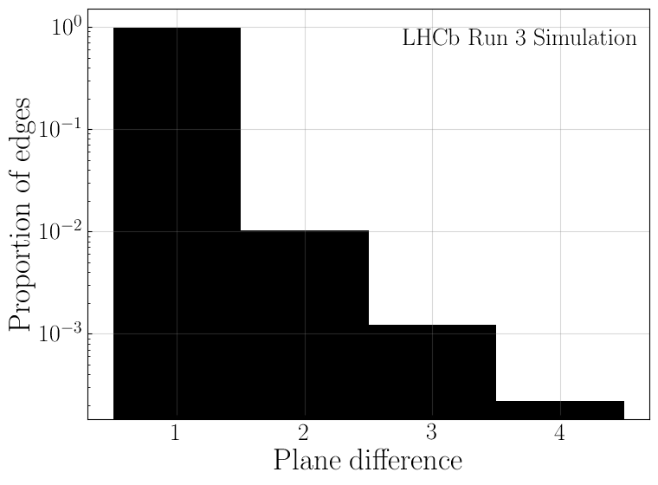
Stage 1: Graph Building
18
Hit coordinates
Goal
9
13
9
18
3
13
6
14
3
6
14
1
10
1
10
4
15
19
4
15
2
7
11
16
2
7
11
16
19
5
8
12
20
5
8
12
20
17
17
# | Idea | Observation
1 | Connect all the nodes together. | Too many edges. 😡 99.9% of edges are $≤$ 2 plane apart.
3
Notes:
Figure document approved needed

Slide 27
Stage 1: Graph Building
18
Hit coordinates
Goal
9
13
9
18
3
13
6
14
3
6
14
1
10
1
10
4
15
19
4
15
2
7
11
16
2
7
11
16
19
5
8
12
20
5
8
12
20
17
17
# | Idea | Observation
1 | Connect all the nodes together. | Too many edges. 😡 99.9% of edges are $≤$ 2 plane apart.
2 | Connect nodes in plane $k$ to all the nodes in plane $k+1$ and $k+2$ | Still too many edges 😠
3
Notes:
Figure document approved needed

Slide 28
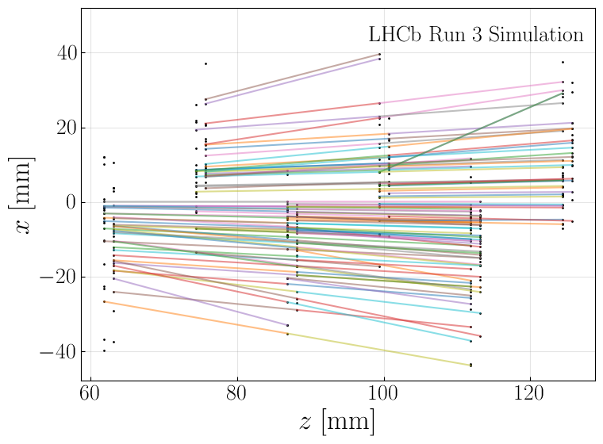
Stage 1: Graph Building
18
Hit coordinates
Goal
9
13
9
18
3
13
6
14
3
6
14
1
10
1
10
4
15
19
4
15
2
7
11
16
2
7
11
16
19
5
8
12
20
5
8
12
20
17
17
# | Idea | Observation
1 | Connect all the nodes together. | Too many edges. 😡 99.9% of edges are $≤$ 2 plane apart.
2 | Connect nodes in plane $k$ to all the nodes in plane $k+1$ and $k+2$ | Still too many edges 😠 Edges tend to be: Forward Away from $z$-axis $↔$ more tilted
3
$$p=10$$
$$p=11$$
$$p=12$$
Notes:
Figure document approved needed

Slide 29
Stage 1: Graph Building
18
Hit coordinates
Goal
9
13
9
18
3
13
6
14
3
6
14
1
10
1
10
4
15
19
4
15
2
7
11
16
2
7
11
16
19
5
8
12
20
5
8
12
20
17
17
# | Idea | Observation
1 | Connect all the nodes together. | Too many edges. 😡 99.9% of edges are $≤$ 2 plane apart.
2 | Connect nodes in plane $k$ to all the nodes in plane $k+1$ and $k+2$ | Still too many edges 😠 Edges tend to be: Forward Away from $z$-axis $↔$ more tilted
3 | Use a Neural Network to capture this trend. | 🤯
$$p=10$$
$$p=11$$
$$p=12$$
Notes:
Figure document approved needed

Slide 30
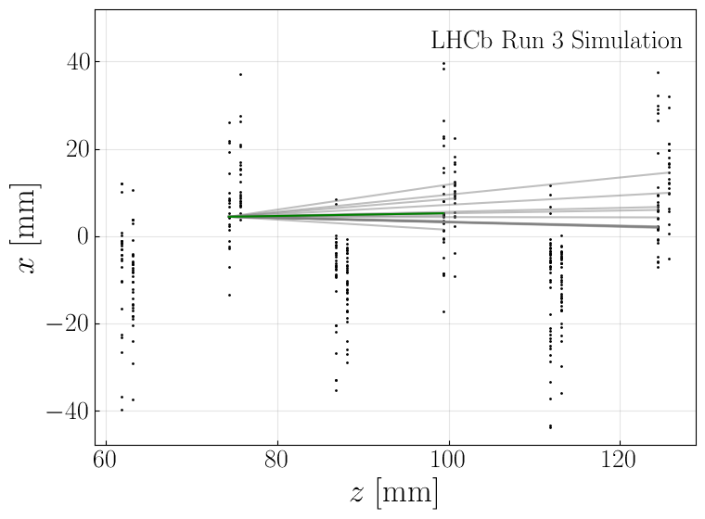
Stage 1: Graph Building
18
Hit coordinates
Goal
9
13
9
18
3
13
6
14
3
6
14
1
10
1
10
4
15
19
4
15
2
7
11
16
2
7
11
16
19
5
8
12
20
5
8
12
20
17
17
$$p=10$$
$$p=11$$
$$p=12$$
$$p=10$$
$$p=11$$
$$p=12$$
Example of edges drawn in the rough graph.
Only 1 true edge out of ~15 edges.
All the true edges
Notes:
Figure document approved needed

Slide 31
Stage 1: Graph Building
Let’s focus on connecting hits from plane $p$ to plane $p+1$ and $p+2$
Hit coordinates
Goal
4
7
4
7
1
5
8
1
5
8
2
2
3
3
6
6
9
9
Notes:
Figure document approved needed

Slide 32
Stage 1: Graph Building
Let’s focus on connecting hits from plane $p$ to plane $p+1$ and $p+2$
Hit coordinates
Goal
4
7
4
7
1
5
8
1
5
8
2
2
3
3
6
6
9
9
1
Embed each hit $\vec{x_{k}}→\vec{e_{k}}$ so that,
between nodes $v_{i}$ and $v_{j}$:
$d_{ij}^{2}= {\left\|\vec{e_{i}}−\vec{e_{j}}\right\|}^{2}<1$: edge is likely
$d_{ij}^{2}= {\left\|\vec{e_{i}}−e_{j}\right\|}^{2}>1$: edge is unlikely
7
4
7
1
4
2
5
2
5
8
1
8
3
6
3
6
9
9
Embedding space
1
MLP
251 parameters
$$\vec{x_{k}}=\left(\begin{aligned}r_{k} \\ φ_{k} \\ z_{k}\end{aligned}\right)$$
$$\vec{e_{k}}=\left(\begin{aligned}e_{k1} \\ e_{k2} \\ e_{k3}\end{aligned}\right)$$
Notes:
Figure document approved needed

Slide 33
Stage 1: Graph Building
Let’s focus on connecting hits from plane $p$ to plane $p+1$ and $p+2$
Hit coordinates
Goal
4
7
4
7
1
5
8
1
5
8
2
2
3
3
6
6
9
9
1
Embed each hit $\vec{x_{k}}→\vec{e_{k}}$ so that,
between nodes $v_{i}$ and $v_{j}$:
$d_{ij}^{2}= {\left\|\vec{e_{i}}−\vec{e_{j}}\right\|}^{2}<1$: edge is likely
$d_{ij}^{2}= {\left\|\vec{e_{i}}−e_{j}\right\|}^{2}>1$: edge is unlikely
1
For each node $v_{i}$ in plane $p$, find $k_{max}$ nearest nodes $\left\{v_{j}\right\}$ within sphere of radius $d_{max}^{2}$
4
7
2
4
7
4
7
2
2
5
1
5
2
5
8
1
8
8
3
6
3
6
3
6
9
9
Embedding space
9
1
MLP
251 parameters
$$\vec{x_{k}}=\left(\begin{aligned}r_{k} \\ φ_{k} \\ z_{k}\end{aligned}\right)$$
$$\vec{e_{k}}=\left(\begin{aligned}e_{k1} \\ e_{k2} \\ e_{k3}\end{aligned}\right)$$
Notes:
Figure document approved needed

Slide 34
Stage 1: Graph Building
Let’s focus on connecting hits from plane $p$ to plane $p+1$ and $p+2$
Hit coordinates
Goal
4
7
4
7
1
5
8
1
5
8
2
2
3
3
6
6
9
9
1
Embed each hit $\vec{x_{k}}→\vec{e_{k}}$ so that,
between nodes $v_{i}$ and $v_{j}$:
$d_{ij}^{2}= {\left\|\vec{e_{i}}−\vec{e_{j}}\right\|}^{2}<1$: edge is likely
$d_{ij}^{2}= {\left\|\vec{e_{i}}−e_{j}\right\|}^{2}>1$: edge is unlikely
1
For each node $v_{i}$ in plane $p$, find $k_{max}$ nearest nodes $\left\{v_{j}\right\}$ within sphere of radius $d_{max}^{2}$
4
7
2
4
7
4
7
2
2
5
1
5
2
5
8
1
8
8
3
6
3
6
3
6
9
9
Embedding space
9
2
Apply $k_{max}$-Nearest Neighbours (kNN) from plane $p$ to planes $\left\{p+1,p+2\right\}$
Only keep edges for which $d_{ij}^{2}<d_{max}^{2}$
1
MLP
251 parameters
$$\vec{x_{k}}=\left(\begin{aligned}r_{k} \\ φ_{k} \\ z_{k}\end{aligned}\right)$$
$$\vec{e_{k}}=\left(\begin{aligned}e_{k1} \\ e_{k2} \\ e_{k3}\end{aligned}\right)$$
$$I_{ℰ}=\left(\begin{matrix}1 & 1 & 2 & 2 & 2 & 3 & 3 \\ 4 & 7 & 4 & 5 & 8 & 6 & 9\end{matrix}\right)$$
Notes:
Figure document approved needed

Slide 35
Stage 1: Graph Building
Goal
18
Hit coordinates
9
13
9
18
3
13
6
14
3
6
14
1
10
1
10
4
15
19
4
15
2
7
11
16
2
7
11
16
19
5
8
12
20
5
8
12
20
17
17
Recap’
$$X=\left(\begin{matrix}r_{1} & φ_{1} & z_{1} \\ r_{2} & φ_{2} & z_{2} \\ r_{3} & φ_{3} & z_{3} \\ ⋮ & ⋮ & ⋮ \\ r_{19} & φ_{19} & z_{19} \\ r_{20} & φ_{20} & z_{20}\end{matrix}\right)$$
$$E=\left(\begin{matrix}e_{1,1} & e_{1,2} & e_{1,3} \\ e_{2,1} & e_{2,2} & e_{2,3} \\ e_{3,1} & e_{3,2} & e_{3,3} \\ ⋮ & ⋮ & ⋮ \\ e_{19,1} & e_{19,3} & e_{19,3} \\ e_{20,1} & e_{20,2} & e_{20,3}\end{matrix}\right)$$
1
Embedding Network
So that $d{\left(v_{i},v_{j}\right)}^{2}={\left\|\vec{e_{i}}−\vec{e_{j}}\right\|}^{2}<1$ if $\left(v_{i},v_{j}\right)$ likely to be an edge
MLP
Train with hinge embedding loss (see annexe)
Notes:
Figure document approved needed

Slide 36
Stage 1: Graph Building
Goal
18
Hit coordinates
9
13
9
18
3
13
6
14
3
6
14
1
10
1
10
4
15
19
4
15
2
7
11
16
2
7
11
16
19
5
8
12
20
5
8
12
20
17
17
Recap’
$$X=\left(\begin{matrix}r_{1} & φ_{1} & z_{1} \\ r_{2} & φ_{2} & z_{2} \\ r_{3} & φ_{3} & z_{3} \\ ⋮ & ⋮ & ⋮ \\ r_{19} & φ_{19} & z_{19} \\ r_{20} & φ_{20} & z_{20}\end{matrix}\right)$$
$$E=\left(\begin{matrix}e_{1,1} & e_{1,2} & e_{1,3} \\ e_{2,1} & e_{2,2} & e_{2,3} \\ e_{3,1} & e_{3,2} & e_{3,3} \\ ⋮ & ⋮ & ⋮ \\ e_{19,1} & e_{19,3} & e_{19,3} \\ e_{20,1} & e_{20,2} & e_{20,3}\end{matrix}\right)$$
1
Embedding Network
So that $d{\left(v_{i},v_{j}\right)}^{2}={\left\|\vec{e_{i}}−\vec{e_{j}}\right\|}^{2}<1$ if $\left(v_{i},v_{j}\right)$ likely to be an edge
MLP
Train with hinge embedding loss (see annexe)
2
kNNs plane by plane
Apply every plane $p∈\left\{1, …,n_{planes}−1\right\}$, apply $k_{max}$NN from plane $p$ to next 2 planes $p+1$ and $p+2$
Only keep edges for which $d\left(v_{i},v_{j}\right)<d_{max}^{2}$
Use faiss library
$⇒$ 2 parameters to choose for inference: $k_{max}$ and $d_{max}^{2}$ (in annexe)
Notes:
Figure document approved needed

Slide 37
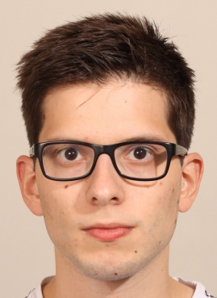
Stage 1: Graph Building
Siamese Network for One-Shot Face Recognition
Embedding network seen earlier can be used for face recognition
Convolutional Neural Network
Trained with hinge embedding loss
Embedding space
$⇒$ save only 1 picture / person in database
Paper (2015)
Notes:
Figure document approved needed

Slide 38
Stage 1: Graph Building
Notes:
Figure document approved needed

Slide 39
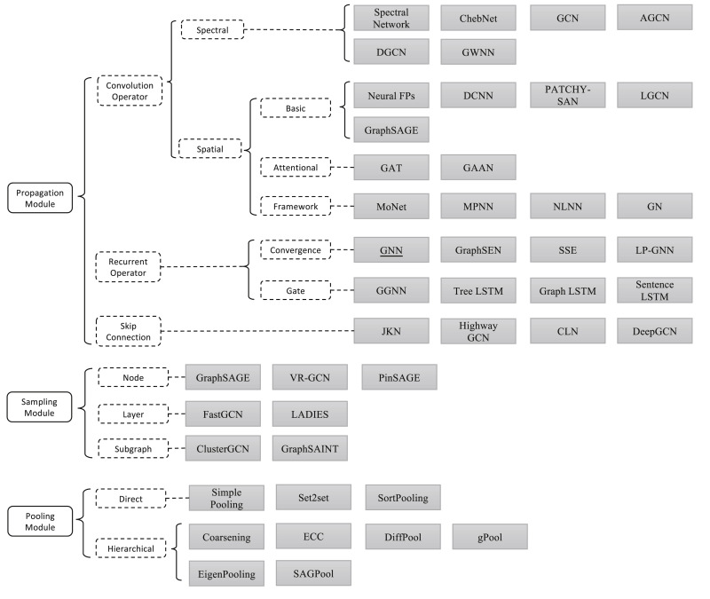
Stage 2: Graph Neural Networks
Graph Neural Network (GNN): Neural Network architecture that operates on graphs
$→$ Problem needs to be formulated with a graph.
MANY GNN architectures exist
List of GNNs implemented in PyTorch Geometric
Graph neural networks: A review of methods and applications (2020)
Notes:
Figure document approved needed

Slide 40
Stage 2: Graph Neural Networks
Graph Neural Network (GNN): Neural Network architecture that operates on graphs
$→$ Problem needs to be formulated with a graph.
MANY GNN architectures exist
List of GNNs implemented in PyTorch Geometric
GNN we used was described from this paper (2021)
Used by the Exa.TrkX collaboration
Follows the Interaction Network (IN) architecture
Can be described by the Message Passing Neural Network (MPNN) framework
Graph neural networks: A review of methods and applications (2020)
Notes:
Figure document approved needed

Slide 41
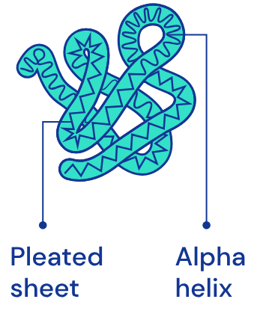
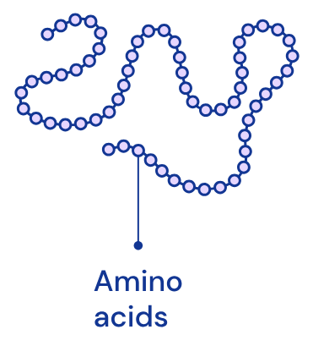
Stage 2: Graph Neural Networks
Task level | Example | Graph | Task
Node | AlphaFold 2 (2020) Input: protein = amino acid sequence Target: 3D structure of folded protein | Graph = proteine Node: amino acid Edge: if in proximity | Predict node coordinates.
Edge
Graph or subgraph
Description of these example cases are oversimplified.
Notes:
Figure document approved needed

Slide 42
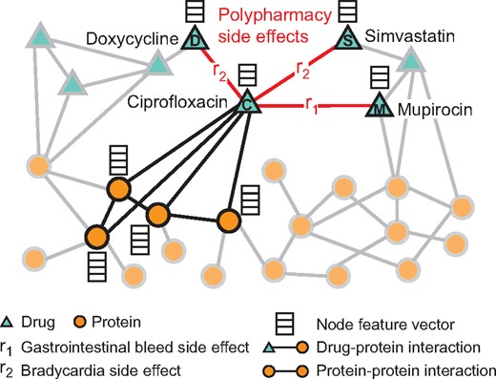
Stage 2: Graph Neural Networks
Task level | Example | Graph | Task
Node | AlphaFold 2 (2020) Input: protein = amino acid sequence Target: 3D structure of folded protein | Graph = proteine Node: amino acid Edge: if in proximity | Predict node coordinates.
Edge | Decagon (2018) Input: side effects between various drug combinations Target: (unknown) side effect between a 2 drug combinations | Graph of side effects Node: drug Edge: side effect | Predict probability that an edge corresponds to a given side effect.
Graph Or subgraph
Description of these example cases are oversimplified.
Notes:
Figure document approved needed

Slide 43
Stage 2: Graph Neural Networks
Task level | Example | Graph | Task
Node | AlphaFold 2 (2020) Input: protein = amino acid sequence Target: 3D structure of folded protein | Graph = proteine Node: amino acid Edge: if in proximity | Predict node coordinates.
Edge | Decagon (2018) Input: side effects between various drug combinations Target: (unknown) side effect between a 2 drug combinations | Graph of side effects Node: drug Edge: side effect | Predict probability that an edge corresponds to a given side effect.
Graph Or subgraph | Google Maps (2020) Input: road network Target: travel time of a chunk of road | Graph = road network Node: route segment Edge: if route segments are consecutive | Predict travel time of a supersegment = multiple adjacent segments.
Description of these example cases are oversimplified.
Notes:
Figure document approved needed

Slide 44
Stage 2: Graph Neural Networks
Task level | Example | Graph | Task
Node | AlphaFold 2 (2020) Input: protein = amino acid sequence Target: 3D structure of folded protein | Graph = proteine Node: amino acid Edge: if in proximity | Predict node coordinates.
Edge | Decagon (2018) Input: side effects between various drug combinations Target: (unknown) side effect between a 2 drug combinations | Graph of side effects Node: drug Edge: side effect | Predict probability that an edge corresponds to a given side effect.
Graph Or subgraph | Google Maps (2020) Input: road network Target: travel time of a chunk of road | Graph = road network Node: route segment Edge: if route segments are consecutive | Predict travel time of a supersegment = multiple adjacent segments.
Description of these example cases are oversimplified.
Notes:
Figure document approved needed

Slide 45
Stage 2: Graph Neural Networks
Task level | Example | Graph | Task
Node | AlphaFold 2 (2020) Input: protein = amino acid sequence Target: 3D structure of folded protein | Graph = proteine Node: amino acid Edge: if in proximity | Predict node coordinates.
Edge | Decagon (2018) Input: side effects between various drug combinations Target: (unknown) side effect between a 2 drug combinations | Graph of side effects Node: drug Edge: side effect | Predict probability that an edge corresponds to a given side effect.
Graph Or subgraph | Google Maps (2020) Input: road network Target: travel time of a chunk of road | Graph = road network Node: route segment Edge: if route segments are consecutive | Predict travel time of a supersegment = multiple adjacent segments.
Other applications: recommender system (e.g., PinSage (2018)), fraud detection, novel molecule generation with desirable properties, physics simulation with many particles, weather forecasting [2023], etc.
Notes:
Figure document approved needed

Slide 46
Stage 2: Graph Neural Networks
Input: rough graph
Hit coordinates
Goal
Output: edge scores
18
9
18
9
13
13
3
6
14
3
6
14
1
10
1
10
4
15
4
15
2
7
11
16
19
2
7
11
16
19
5
8
12
20
5
8
12
20
17
17
Input
$$S=\left(\begin{aligned}\begin{aligned}s_{1→3} \\ s_{1→4} \\ s_{1→5} \\ s_{1→6} \\ s_{1→7} \\ s_{1→8} \\ s_{2→4} \\ s_{2→5} \\ s_{2→6}\end{aligned} \\ s_{2→7} \\ s_{2→8} \\ ⋮ \\ s_{17→19} \\ s_{17→20}\end{aligned}\right)=\left(\begin{aligned}0 \\ 1 \\ 0 \\ 0 \\ 0 \\ 0 \\ 0 \\ 0 \\ 1 \\ 0 \\ 0 \\ ⋮ \\ 0 \\ 0\end{aligned}\right)$$
$$X=\left(\begin{matrix}r_{1} & φ_{1} & z_{1} \\ r_{2} & φ_{2} & z_{2} \\ r_{3} & φ_{3} & z_{3} \\ ⋮ & ⋮ & ⋮ \\ r_{19} & φ_{19} & z_{19} \\ r_{20} & φ_{20} & z_{20}\end{matrix}\right)$$
Hit coordinates
Edge scores
Edge indices
$$I_{ℰ}=\left(\begin{matrix}1 & 1 & 1 & 1 & 1 & 1 & 2 & 2 & 2 & 2 & 2 & ⋯ & 17 & 17 \\ 3 & 4 & 5 & 6 & 7 & 8 & 4 & 5 & 6 & 7 & 8 & ⋯ & 19 & 20\end{matrix}\right)$$
Filter edges with GNN
Find connected components
Build graph
Notes:
Figure document approved needed

Slide 47
Stage 2: Graph Neural Networks
Typical graph around edge $i→j$
$$v_{i}$$
$$s_{ij}$$
$$v_{j}$$
Notes:
Figure document approved needed

Slide 48
Stage 2: Graph Neural Networks
$$v_{A}$$
$$v_{H}$$
Typical graph around edge $i→j$
$$v_{B}$$
$$v_{I}$$
$$v_{i}$$
$$s_{ij}$$
$$v_{j}$$
$$v_{C}$$
$$v_{J}$$
Notes:
Figure document approved needed

Slide 49
Stage 2: Graph Neural Networks
$$v_{D}$$
$$v_{F}$$
$$v_{A}$$
$$v_{H}$$
Typical graph around edge $i→j$
$$v_{B}$$
$$v_{I}$$
$$v_{i}$$
$$s_{ij}$$
$$v_{j}$$
$$v_{C}$$
$$v_{J}$$
$$v_{E}$$
$$v_{G}$$
Notes:
Figure document approved needed

Slide 50
Stage 2: Graph Neural Networks
$$v_{D}$$
$$v_{F}$$
$$v_{A}$$
$$v_{H}$$
Typical graph around edge $i→j$
$$v_{B}$$
$$v_{I}$$
$$v_{i}$$
$$s_{ij}$$
$$v_{j}$$
$$v_{C}$$
$$v_{J}$$
$$v_{E}$$
$$v_{G}$$
Notes:
Figure document approved needed

Slide 51
Stage 2: Graph Neural Networks
$$v_{D}$$
$$v_{F}$$
$$v_{A}$$
$$v_{H}$$
$$v_{B}$$
Typical graph
$$v_{I}$$
$$v_{i}$$
$$\hat{y_{ij}}$$
$$v_{j}$$
$$v_{C}$$
$$v_{J}$$
$$v_{E}$$
$$v_{G}$$
GNN
Hit coordinates $X=\left(\begin{aligned}{\vec{x_{1}}}^{T} \\ ⋮ \\ {\vec{x_{N}}}^{T}\end{aligned}\right)$
Edge indices $I_{𝓔}$
Edge score $s_{ij}∈\left[0,1\right]$
Trained with binary cross entropy loss or sigmoid focal loss
Idea: work with intermediate « edge encoding »
Notes:
Figure document approved needed

Slide 52
Stage 2: Graph Neural Networks
$$v_{D}$$
$$v_{F}$$
$$v_{A}$$
$$v_{H}$$
$$v_{B}$$
Typical graph
$$v_{I}$$
$$v_{i}$$
$$s_{ij}$$
$$v_{j}$$
$$v_{C}$$
$$v_{J}$$
$$v_{E}$$
$$v_{G}$$
Edge features
$$\vec{f_{ij}}=\left\{\begin{aligned}\vec{x_{i}} \\ \vec{x_{j}}\end{aligned}\right\}=\left(\begin{aligned}r_{i} \\ φ_{i} \\ z_{i} \\ r_{j} \\ φ_{j} \\ z_{j}\end{aligned}\right)$$
Update
edge encodings
Updated edge encodings
$$\vec{e_{ij}^{final}}∈ℝ^{128}$$
Edge encodings
$$\vec{e_{ij}^{0}}∈ℝ^{128}$$
Edge score $s_{ij}∈\left[0,1\right]$
Edge encoder
Edge classifier
Concatenated node features
Intermediate 128-dimensional edge encoding representation
Notes:
Figure document approved needed

Slide 53
Stage 2: Graph Neural Networks
$$v_{D}$$
$$v_{F}$$
$$v_{A}$$
$$v_{H}$$
$$v_{B}$$
Typical graph
$$v_{I}$$
$$v_{i}$$
$$s_{ij}$$
$$v_{j}$$
$$v_{C}$$
$$v_{J}$$
$$v_{E}$$
$$v_{G}$$
Update
edge encodings
Updated edge encodings
$$\vec{e_{ij}^{final}}∈ℝ^{128}$$
Edge encodings
$$\vec{e_{ij}^{0}}∈ℝ^{128}$$
Goal: update edge encoding $\vec{e_{ij}^{0}}$ according to edge encodings of connected edges
Notes:
Figure document approved needed

Slide 54
Stage 2: Graph Neural Networks
$$v_{D}$$
$$v_{F}$$
$$v_{A}$$
$$v_{H}$$
$$v_{B}$$
$$v_{I}$$
$$v_{i}$$
$$s_{ij}$$
$$v_{j}$$
$$v_{C}$$
$$v_{J}$$
$$v_{E}$$
$$v_{G}$$
Build message for $v_{i}$: Aggregate neigbhour information
Node-ordering invariant
Separate incoming/outgoing nodes
$$\vec{m_{i}}=\left\{\begin{aligned}\vec{e_{A→i}^{0}}+\vec{e_{B→i}^{0}}++\vec{e_{C→i}^{0}} \\ \vec{e_{i→F}^{0}}+\vec{e_{i→j}}+\vec{e_{i→G}^{0}}\end{aligned}\right\}$$
incoming
outgoing
Notes:
Figure document approved needed

Slide 55
Stage 2: Graph Neural Networks
$$v_{D}$$
$$v_{F}$$
$$v_{A}$$
$$v_{H}$$
$$v_{B}$$
$$v_{I}$$
$$v_{i}$$
$$s_{ij}$$
$$v_{j}$$
$$v_{C}$$
$$v_{J}$$
$$v_{E}$$
$$v_{G}$$
Build message for $v_{i}$: Aggregate neigbhour information
Node-ordering invariant
Separate incoming/outgoing nodes
Build message for $v_{j}$: in a similar fashion
$$\vec{m_{i}}=\left\{\begin{aligned}\vec{e_{A→i}^{0}}+\vec{e_{B→i}^{0}}++\vec{e_{C→i}^{0}} \\ \vec{e_{i→F}^{0}}+\vec{e_{i→j}}+\vec{e_{i→G}^{0}}\end{aligned}\right\}$$
incoming
outgoing
$$\vec{m_{j}}=\left\{\begin{aligned}\vec{e_{D→j}^{0}}+\vec{e_{i→j}^{0}}++\vec{e_{E→j}^{0}} \\ \vec{e_{j→H}^{0}}+\vec{e_{j→I}}+\vec{e_{j→J}^{0}}\end{aligned}\right\}$$
incoming
outgoing
Notes:
Figure document approved needed

Slide 56
Stage 2: Graph Neural Networks
$$v_{D}$$
$$v_{F}$$
$$v_{A}$$
$$v_{H}$$
$$v_{B}$$
$$v_{I}$$
$$v_{i}$$
$$s_{ij}$$
$$v_{j}$$
$$v_{C}$$
$$v_{J}$$
$$v_{E}$$
$$v_{G}$$
Build message for $v_{i}$: Aggregate neigbhour information
Node-ordering invariant
Separate incoming/outgoing nodes
Build message for $v_{j}$: in a similar fashion
Infer $\vec{e_{i→j}^{final}}$ from $\vec{m_{i}}$, $\vec{m_{j}}$ and $\vec{e_{i→j}^{0}}$ using a MLP
$$\vec{m_{i}}=\left\{\begin{aligned}\vec{e_{A→i}^{0}}+\vec{e_{B→i}^{0}}++\vec{e_{C→i}^{0}} \\ \vec{e_{i→F}^{0}}+\vec{e_{i→j}}+\vec{e_{i→G}^{0}}\end{aligned}\right\}$$
incoming
outgoing
$$\vec{m_{j}}=\left\{\begin{aligned}\vec{e_{D→j}^{0}}+\vec{e_{i→j}^{0}}++\vec{e_{E→j}^{0}} \\ \vec{e_{j→H}^{0}}+\vec{e_{j→I}}+\vec{e_{j→J}^{0}}\end{aligned}\right\}$$
incoming
outgoing
$$\left\{\begin{aligned}\vec{m_{i}} \\ \vec{m_{j}} \\ \vec{e_{i→j}^{0}}\end{aligned}\right\}$$
$\vec{e_{i→j}^{final}}$
This is called message passing.
Edge network
Notes:
Figure document approved needed

Slide 57
Stage 2: Graph Neural Networks
$$v_{D}$$
$$v_{F}$$
$$v_{A}$$
$$v_{H}$$
$$v_{B}$$
Typical graph
$$v_{I}$$
$$v_{i}$$
$$s_{ij}$$
$$v_{j}$$
$$v_{C}$$
$$v_{J}$$
$$v_{E}$$
$$v_{G}$$
Update
edge encodings
Updated edge encodings
$$\vec{e_{ij}^{final}}∈ℝ^{128}$$
Edge encodings
$$\vec{e_{ij}^{0}}∈ℝ^{128}$$
Goal: update edge encoding $\vec{e_{ij}^{0}}$ according to edge encodings of connected edges
Notes:
Figure document approved needed

Slide 58
Stage 2: Graph Neural Networks
$$v_{D}$$
$$v_{F}$$
$$v_{A}$$
$$v_{H}$$
$$v_{B}$$
Typical graph
$$v_{I}$$
$$v_{i}$$
$$s_{ij}$$
$$v_{j}$$
$$v_{C}$$
$$v_{J}$$
$$v_{E}$$
$$v_{G}$$
Neigbour aggregation
Edge encodings
$$\vec{e_{ij}^{0}}∈ℝ^{128}$$
$$\left\{\begin{aligned}\vec{m_{i}} \\ \vec{m_{j}} \\ \vec{e_{i→j}^{0}}\end{aligned}\right\}$$
Updated edge encodings
$$\vec{e_{ij}^{final}}∈ℝ^{128}$$
Edge network
Goal: update edge encoding $\vec{e_{ij}^{0}}$ according to edge encodings of connected edges
Notes:
Figure document approved needed

Slide 59
Stage 2: Graph Neural Networks
$$v_{D}$$
$$v_{F}$$
$$v_{A}$$
$$v_{H}$$
$$v_{B}$$
Typical graph
$$v_{I}$$
$$v_{i}$$
$$s_{ij}$$
$$v_{j}$$
$$v_{C}$$
$$v_{J}$$
$$v_{E}$$
$$v_{G}$$
Edge features
Neigbour aggregation
$$\vec{f_{ij}}=\left\{\begin{aligned}\vec{x_{i}} \\ \vec{x_{j}}\end{aligned}\right\}=\left(\begin{aligned}r_{i} \\ φ_{i} \\ z_{i} \\ r_{j} \\ φ_{j} \\ z_{j}\end{aligned}\right)$$
$$\left\{\begin{aligned}\vec{m_{i}} \\ \vec{m_{j}} \\ \vec{e_{i→j}^{0}}\end{aligned}\right\}$$
Updated edge encodings
$$\vec{e_{ij}^{final}}∈ℝ^{128}$$
Edge encodings
$$\vec{e_{ij}^{0}}∈ℝ^{128}$$
Edge score $s_{ij}∈\left[0,1\right]$
Edge encoder
Edge network
Edge classifier
Concatenated node features
Notes:
Figure document approved needed

Slide 60
Stage 2: Graph Neural Networks
$$v_{D}$$
$$v_{F}$$
$$v_{A}$$
$$v_{H}$$
$$v_{B}$$
Typical graph
$$v_{I}$$
$$v_{i}$$
$$s_{ij}$$
$$v_{j}$$
$$v_{C}$$
$$v_{J}$$
$$v_{E}$$
$$v_{G}$$
Edge features
Neigbour aggregation
$$\vec{f_{ij}}=\left\{\begin{aligned}\vec{x_{i}} \\ \vec{x_{j}}\end{aligned}\right\}=\left(\begin{aligned}r_{i} \\ φ_{i} \\ z_{i} \\ r_{j} \\ φ_{j} \\ z_{j}\end{aligned}\right)$$
$$\left\{\begin{aligned}\vec{m_{i}} \\ \vec{m_{j}} \\ \vec{e_{i→j}^{0}}\end{aligned}\right\}$$
Updated edge encodings
$$\vec{e_{ij}^{final}}∈ℝ^{128}$$
Edge encodings
$$\vec{e_{ij}^{0}}∈ℝ^{128}$$
Edge score $s_{ij}∈\left[0,1\right]$
Concatenated node features
Edge network
Edge classifier
Edge encoder
message passing
Notes:
Figure document approved needed

Slide 61
Stage 2: Graph Neural Networks
$$v_{D}$$
$$v_{F}$$
$$v_{A}$$
$$v_{H}$$
$$v_{B}$$
Typical graph
$$v_{I}$$
$$v_{i}$$
$$s_{ij}$$
$$v_{j}$$
$$v_{C}$$
$$v_{J}$$
$$v_{E}$$
$$v_{G}$$
Edge features
Neigbour aggregation
$$\vec{f_{ij}}=\left\{\begin{aligned}\vec{x_{i}} \\ \vec{x_{j}}\end{aligned}\right\}=\left(\begin{aligned}r_{i} \\ φ_{i} \\ z_{i} \\ r_{j} \\ φ_{j} \\ z_{j}\end{aligned}\right)$$
$$\left\{\begin{aligned}\vec{m_{i}} \\ \vec{m_{j}} \\ \vec{e_{i→j}^{0}}\end{aligned}\right\}$$
Updated edge encodings
$$\vec{e_{ij}^{final}}∈ℝ^{128}$$
Edge encodings
$$\vec{e_{ij}^{0}}∈ℝ^{128}$$
Edge score $s_{ij}∈\left[0,1\right]$
Concatenated node features
Edge network
Edge classifier
Edge encoder
message passing
However, edge encoding only updated w.r.t. immediate neighbours.
$→$ How to update edge encoding as a function of indirect neighbours?
Just repeat message passing
Notes:
Figure document approved needed

Slide 62
Stage 2: Graph Neural Networks
$$v_{D}$$
$$v_{F}$$
$$v_{A}$$
$$v_{H}$$
$$v_{B}$$
Typical graph
$$v_{I}$$
$$v_{i}$$
$$s_{ij}$$
$$v_{j}$$
$$v_{C}$$
$$v_{J}$$
$$v_{E}$$
$$v_{G}$$
Edge features
Neigbour aggregation
$$\vec{f_{ij}}=\left\{\begin{aligned}\vec{x_{i}} \\ \vec{x_{j}}\end{aligned}\right\}=\left(\begin{aligned}r_{i} \\ φ_{i} \\ z_{i} \\ r_{j} \\ φ_{j} \\ z_{j}\end{aligned}\right)$$
$$\left\{\begin{aligned}\vec{m_{i}} \\ \vec{m_{j}} \\ \vec{e_{i→j}^{0}}\end{aligned}\right\}$$
Updated edge encodings
$$\vec{e_{ij}^{final}}∈ℝ^{128}$$
Edge encodings
$$\vec{e_{ij}^{0}}∈ℝ^{128}$$
Edge score $s_{ij}∈\left[0,1\right]$
Concatenated node features
Edge network
Edge classifier
Edge encoder
message passing
However, edge encoding only updated w.r.t. immediate neighbours.
$→$ How to update edge encoding as a function of indirect neighbours?
Just repeat message passing
Notes:
Figure document approved needed

Slide 63
Stage 2: Graph Neural Networks
$$v_{D}$$
$$v_{F}$$
$$v_{A}$$
$$v_{H}$$
$$v_{B}$$
Typical graph
$$v_{I}$$
$$v_{i}$$
$$s_{ij}$$
$$v_{j}$$
$$v_{C}$$
$$v_{J}$$
$$v_{E}$$
$$v_{G}$$
Edge features
Neigbour aggregation
$$\vec{f_{ij}}=\left\{\begin{aligned}\vec{x_{i}} \\ \vec{x_{j}}\end{aligned}\right\}=\left(\begin{aligned}r_{i} \\ φ_{i} \\ z_{i} \\ r_{j} \\ φ_{j} \\ z_{j}\end{aligned}\right)$$
$$\left\{\begin{aligned}\vec{m_{i}^{k−1}} \\ \vec{m_{j}^{k−1}} \\ \vec{e_{i→j}^{k−1}}\end{aligned}\right\}$$
Updated edge encodings
$$\vec{e_{ij}^{k}}∈ℝ^{128}$$
Edge encodings
$$\vec{e_{ij}^{k−1}}∈ℝ^{128}$$
Edge score $s_{ij}∈\left[0,1\right]$
Concatenated node features
Edge network
Edge classifier
Edge encoder
message passing, repeat for $k∈\left\{1,…,5\right\}$
However, edge encoding only updated w.r.t. immediate neighbours.
$→$ How to update edge encoding as a function of indirect neighbours?
Just repeat message passing
Notes:
Figure document approved needed

Slide 64
Stage 2: Graph Neural Networks
$$v_{D}$$
$$v_{F}$$
$$v_{A}$$
$$v_{H}$$
$$v_{B}$$
Typical graph
$$v_{I}$$
$$v_{i}$$
$$s_{ij}$$
$$v_{j}$$
$$v_{C}$$
$$v_{J}$$
$$v_{E}$$
$$v_{G}$$
Edge features
Neigbour aggregation
$$\vec{f_{ij}}=\left\{\begin{aligned}\vec{x_{i}} \\ \vec{x_{j}}\end{aligned}\right\}=\left(\begin{aligned}r_{i} \\ φ_{i} \\ z_{i} \\ r_{j} \\ φ_{j} \\ z_{j}\end{aligned}\right)$$
$$\left\{\begin{aligned}\vec{m_{i}^{k−1}} \\ \vec{m_{j}^{k−1}} \\ \vec{e_{i→j}^{k−1}}\end{aligned}\right\}$$
Updated edge encodings
$$\vec{e_{ij}^{k}}∈ℝ^{128}$$
Edge encodings
$$\vec{e_{ij}^{k−1}}∈ℝ^{128}$$
Concatenated node features
Edge network
Edge classifier
Edge encoder
message passing, repeat for $k∈\left\{1,…,5\right\}$
Message $\vec{m_{i}}$
Is node-related
Does not contain any node information!
Combine it with node encodings.
Notes:
Figure document approved needed

Slide 65
Stage 2: Graph Neural Networks
$$v_{D}$$
$$v_{F}$$
$$v_{A}$$
$$v_{H}$$
$$v_{B}$$
Typical graph
$$v_{I}$$
$$v_{i}$$
$$s_{ij}$$
$$v_{j}$$
$$v_{C}$$
$$v_{J}$$
$$v_{E}$$
$$v_{G}$$
$$\vec{x_{l}}=\left(\begin{aligned}r_{l} \\ φ_{l} \\ z_{l}\end{aligned}\right)$$
Node encodings
$$\vec{h_{l}^{k−1}}∈ℝ^{128}$$
$$\left\{\begin{aligned}\vec{m_{l}^{k}} \\ \vec{h_{l}^{k−1}}\end{aligned}\right\}$$
Updated node encodings
$$\vec{h_{l}^{k}}∈ℝ^{128}$$
Neigbour aggregation
Node encoder
Edge encodings
$$\vec{e_{ij}^{k−1}}∈ℝ^{128}$$
$$\left\{\begin{aligned}\vec{h_{i}^{k}} \\ \vec{h_{j}^{k}} \\ \vec{e_{i→j}^{0}}\end{aligned}\right\}$$
Updated edge encodings
$$\vec{e_{ij}^{k}}∈ℝ^{128}$$
Edge score $s_{ij}∈\left[0,1\right]$
$$\vec{f_{ij}}=\left\{\begin{aligned}\vec{x_{i}} \\ \vec{x_{j}}\end{aligned}\right\}$$
Edge network
Edge classifier
Edge encoder
message passing, repeat for $k∈\left\{1,…,5\right\}$
Notes:
Figure document approved needed

Slide 66
Stage 2: Graph Neural Networks
$$v_{D}$$
$$v_{F}$$
$$v_{A}$$
$$v_{H}$$
$$v_{B}$$
Typical graph
$$v_{I}$$
$$v_{i}$$
$$s_{ij}$$
$$v_{j}$$
$$v_{C}$$
$$v_{J}$$
$$v_{E}$$
$$v_{G}$$
$$\vec{x_{l}}=\left(\begin{aligned}r_{l} \\ φ_{l} \\ z_{l}\end{aligned}\right)$$
Node encodings
$$\vec{h_{l}^{k−1}}∈ℝ^{128}$$
$$\left\{\begin{aligned}\vec{m_{l}^{k}} \\ \vec{h_{l}^{k−1}}\end{aligned}\right\}$$
Updated node encodings
$$\vec{h_{l}^{k}}∈ℝ^{128}$$
Neigbour aggregation
Node encoder
Node encoder
Edge encodings
$$\vec{e_{ij}^{k−1}}∈ℝ^{128}$$
$$\left\{\begin{aligned}\vec{h_{i}^{k}} \\ \vec{h_{j}^{k}} \\ \vec{e_{i→j}^{0}}\end{aligned}\right\}$$
Updated edge encodings
$$\vec{e_{ij}^{k}}∈ℝ^{128}$$
Edge score $s_{ij}∈\left[0,1\right]$
$$\vec{f_{ij}}=\left\{\begin{aligned}\vec{h_{i}^{0}} \\ \vec{h_{j}^{0}}\end{aligned}\right\}$$
Concatenated node encodings
Edge network
Edge classifier
Edge encoder
message passing, repeat for $k∈\left\{1,…,5\right\}$
Notes:
Figure document approved needed

Slide 67
Shared hits
GNN to filter edges
Build tracks from graph
Graph Building
But if you do this… track efficiency on long electrons is terrible!
🤮
Metric | Default GPU algorithm | ETX4VELO
Efficiency | 98.17% | 46.23%
(evaluated on 1000 events)

Slide 68
Shared hits
Observations
$∼$ 55 % electrons share hits with another electron
The 2 electrons share $≥1$ hit(s) before splitting up
Example 1: share the first hit only
Example 2: share several hits before splitting up
$⇒$ the connected component algorithm consider the 2 electron tracks as a single track

Slide 69
Shared hits
Tracks crossing (> 524 in 1000 events)
Track starts on a shared hit
The last hit of a track is the first hit of another track (>141 in 1000 events)
Track ends on a shared hit

Slide 70
Shared hits
In this case, one cannot even guess that there are possibly 2 tracks!
Hit-hit connection is not enough
$⇒$ need edge-edge connections

Slide 71
Shared hits
3 kind of edge-edge connections (or triplets) are possible
A
C
Articulation
B
Could be a shared hit
Left elbow
Right elbow

Slide 72
Shared hits
New simplified example to take into account shared hits
Goal
Track Finding
First 2 steps are the same as before

Slide 73
Shared hits
New simplified example to take into account shared hits
Goal
Track Finding
First 2 steps are the same as before
1
Build a “rough” graph
Embedding Network + kNN
2
Classify the edges as genuine or fake
Graph Neural Network

Slide 74
Shared hits
Goal
Handle Shared Hits

Slide 75
Shared hits
Goal
Handle Shared Hits
3
Build edge-edge connections
(or triplets)
Use dataframes with Pandas (CPU) or cudf (GPU)
Articulation
Elbow

Slide 76
Shared hits
Goal
Handle Shared Hits
3
Build edge-edge connections
(or triplets)
Use dataframes with Pandas (CPU) or cudf (GPU)
Articulation
Elbow
4
Classify the triplets with the GNN
Filter out the fake triplets

Slide 77
Shared hits
Goal
Handle Shared Hits
3
Build edge-edge connections
(or triplets)
Use dataframes with Pandas (CPU) or cudf (GPU)
Articulation
Elbow
4
Classify the triplets with the GNN
Filter out the fake triplets
5
Build tracks from triplets

Slide 78
ETX4VELO
Pipeline has become
Embedding Network
kNN
$$k_{max}, d_{max}^{2}$$
kNN
𝒌_𝐦𝐚𝐱, 𝒅_𝐦𝐚𝐱^𝟐
GNN edge classifier
Filter edges $s_{edge,min}$
Filter edges 𝒔_(𝐞𝐝𝐠𝐞,𝐦𝐢𝐧)
Build triplets
Filter triplets $s_{triplet,min}$
Filter triplets 𝒔_(𝐭𝐫𝐢𝐩𝐥𝐞𝐭,𝐦𝐢𝐧)
Build tracks
Triplet classifier
Build rough graph
Filter out fake edges
Filter out fake triplets

Slide 79
ETX4VELO
Embedding Network
kNN
$$k_{max}, d_{max}^{2}$$
kNN
𝒌_𝐦𝐚𝐱, 𝒅_𝐦𝐚𝐱^𝟐
GNN edge classifier
Filter edges $s_{edge,min}$
Filter edges 𝒔_(𝐞𝐝𝐠𝐞,𝐦𝐢𝐧)
Build triplets
Filter triplets $s_{triplet,min}$
Filter triplets 𝒔_(𝐭𝐫𝐢𝐩𝐥𝐞𝐭,𝐦𝐢𝐧)
Build tracks
Triplet classifier
Last step of the GNN edge classifier was
Updated edge encoding
Edge score $s_{ij}∈\left[0,1\right]$
$$\vec{e_{ij}^{n}}$$
Edge classifier

Slide 80
ETX4VELO
Embedding Network
kNN
$$k_{max}, d_{max}^{2}$$
kNN
𝒌_𝐦𝐚𝐱, 𝒅_𝐦𝐚𝐱^𝟐
GNN edge classifier
Filter edges $s_{edge,min}$
Filter edges 𝒔_(𝐞𝐝𝐠𝐞,𝐦𝐢𝐧)
Build triplets
Filter triplets $s_{triplet,min}$
Filter triplets 𝒔_(𝐭𝐫𝐢𝐩𝐥𝐞𝐭,𝐦𝐢𝐧)
Build tracks
Triplet classifier
Last step of the GNN edge classifier was
DO NOT REPEAT THE GNN
Instead, re-use directly the very same edge encodings!
Training with sum of edge and triplet classification losses:
$$ℒ_{tot}=ℒ_{edges}+ℒ_{triplets}$$
Updated edge encoding
Edge score $s_{ij}∈\left[0,1\right]$
$$\vec{e_{ij}^{n}}$$
Edge classifier
Concatenated edge encodings
$$\left\{\begin{aligned}\vec{e_{AC}^{n}} \\ \vec{e_{CB}^{n}}\end{aligned}\right\}$$
Triplet score $s_{A→C→B}∈\left[0,1\right]$
Triplet classifier

Slide 81
Shared hits
Embedding Network
kNN
$$k_{max}, d_{max}^{2}$$
kNN
𝒌_𝐦𝐚𝐱, 𝒅_𝐦𝐚𝐱^𝟐
GNN edge classifier
Filter edges $s_{edge,min}$
Filter edges 𝒔_(𝐞𝐝𝐠𝐞,𝐦𝐢𝐧)
Build triplets
Filter triplets $s_{triplet,min}$
Filter triplets 𝒔_(𝐭𝐫𝐢𝐩𝐥𝐞𝐭,𝐦𝐢𝐧)
Build tracks
Triplet classifier
Goal
In annexe.

Slide 82
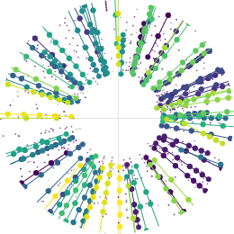
Performance
Embedding Network
kNN
$$k_{max}, d_{max}^{2}$$
kNN
𝒌_𝐦𝐚𝐱, 𝒅_𝐦𝐚𝐱^𝟐
GNN edge classifier
Filter edges $s_{edge,min}$
Filter edges 𝒔_(𝐞𝐝𝐠𝐞,𝐦𝐢𝐧)
Build triplets
Filter triplets $s_{triplet,min}$
Filter triplets 𝒔_(𝐭𝐫𝐢𝐩𝐥𝐞𝐭,𝐦𝐢𝐧)
Build tracks
Triplet classifier
$⇒$ can reach better physics performance than default algorithm at LHCb.
However, need to consider throughput $≡$ # bunch crossings processed / s
Choice of $s_{edge,min}$ and $s_{triplet,min}$ : vary them and choose the one leading to best performance.
Proportion of… | Default GPU algorithm | ETX4VELO
Reconstructed particles | 99.08% | 99.33%
Duplicate tracks | 2.65% | 1.09%
Fake tracks | 2.51% | 0.71%
For particles reconstructible in the VELO and the SciFi.
Notes:
Figure document approved needed

Slide 83
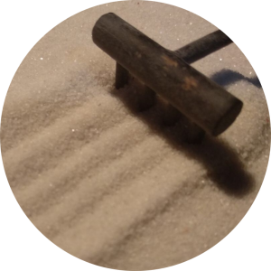
Performance
Goal: implement GNN-based pipeline on C++/CUDA inside Allen .
Optimization: To optimize throughput (PyTorch slower than C++/CUDA implementation)
Integration: can be used with other reconstruction algorithms.
Notes:
Figure document approved needed

Slide 84
Performance
Goal: implement GNN-based pipeline on C++/CUDA inside Allen .
Optimization: To optimize throughput (PyTorch slower than C++/CUDA implementation)
Integration: can be used with other reconstruction algorithms.
Pipeline: no triplet for the moment
Detailed view:
GNN to filter edges
Build tracks
Graph Building
Embedding Neural Network
kNN
GNN edge classifier
Filter edges
Weakly connected component algorithm
Notes:
Figure document approved needed

Slide 85
Performance
Goal: implement GNN-based pipeline on C++/CUDA inside Allen .
Optimization: To optimize throughput (PyTorch slower than C++/CUDA implementation)
Integration: can be used with other reconstruction algorithms.
Pipeline: no triplet for the moment
Detailed view:
There are deep learning model to export and algorithms to implement in C++/CUDA.
Deep learning model inference in C++:
Export model in ONNX open-source format.
Inference in C++ using either ONNXRuntime or NVIDIA TensorRT libraries.
GNN to filter edges
Build tracks
Graph Building
Embedding Neural Network
kNN
GNN edge classifier
Filter edges
Weakly connected component algorithm
Notes:
Figure document approved needed

Slide 86
Performance
 | Throughput: # bunch crossings processed / s
ETX4VELO with ONNXRuntime | 310
ETX4VELO with TensorRT | 730
Allen (default) | 540k
So far
But we still have ideas to increase the throughput.
Notes:
Figure document approved needed

Slide 87
Conclusion
First-level trigger at LHCb on GPU
ETX4VELO:
New GNN-based pipeline for track-finding in the Velo at LHCb.
Repository and documentation.
Can meet Allen physics performance.
Ongoing work:
Run the full ETX4VELO pipeline in C++/CUDA inside Allen.
Optimise ETX4VELO throughput.
Adapt the pipeline to other LHCb tracking detectors (e.g., SciFi detector).
Notes:
Figure document approved needed

Slide 88
Thank you!

Slide 89
Track Finding in the Velo
arXiv:2207.03936
Goal
Noise
In Allen : search by triplet algorithm
Notes:
Figure document approved needed

Slide 90
Track Finding in the Velo
arXiv:2207.03936
Goal
Noise
In Allen : search by triplet algorithm
1
Iterate from the last to the first plane:
a
Seeding: Find compatible triplets of hits
b
Following:
a.1. Extrapolate the track
a.2. Find compatible hits
Notes:
Figure document approved needed

Slide 91
Track Finding in the Velo
arXiv:2207.03936
Goal
Noise
In Allen : search by triplet algorithm
1
Iterate from the last to the first plane:
a
Seeding: Find compatible triplets of hits
b
Following:
a.1. Extrapolate the track
a.2. Find compatible hits
Notes:
Figure document approved needed

Slide 92
Track Finding in the Velo
arXiv:2207.03936
Goal
Noise
In Allen : search by triplet algorithm
1
Iterate from the last to the first plane:
a
Seeding: Find compatible triplets of hits
b
Following:
a.1. Extrapolate the track
a.2. Find compatible hits
Notes:
Figure document approved needed

Slide 93
Track Finding in the Velo
arXiv:2207.03936
Goal
Noise
In Allen : search by triplet algorithm
1
Iterate from the last to the first plane:
a
Seeding: Find compatible triplets of hits
b
Following:
a.1. Extrapolate the track
a.2. Find compatible hits
Notes:
Figure document approved needed

Slide 94
Track Finding in the Velo
arXiv:2207.03936
Goal
Noise
In Allen : search by triplet algorithm
1
Iterate from the last to the first plane:
a
Seeding: Find compatible triplets of hits
b
Following:
a.1. Extrapolate the track
a.2. Find compatible hits
Notes:
Figure document approved needed

Slide 95
Track Finding in the Velo
arXiv:2207.03936
Goal
Noise
In Allen : search by triplet algorithm
1
Iterate from the last to the first plane:
a
Seeding: Find compatible triplets of hits
b
Following:
a.1. Extrapolate the track
a.2. Find compatible hits
Notes:
Figure document approved needed

Slide 96
Track Finding in the Velo
arXiv:2207.03936
Goal
Noise
In Allen : search by triplet algorithm
1
Iterate from the last to the first plane:
a
Seeding: Find compatible triplets of hits
b
Following:
a.1. Extrapolate the track
a.2. Find compatible hits
Notes:
Figure document approved needed

Slide 97
Track Finding in the Velo
arXiv:2207.03936
Goal
Noise
In Allen : search by triplet algorithm
1
Iterate from the last to the first plane:
a
Seeding: Find compatible triplets of hits
b
Following:
a.1. Extrapolate the track
a.2. Find compatible hits
2
Filter triplets
Notes:
Figure document approved needed

Slide 98
Stage 1: Graph Building
GNN to filter edges
Build tracks from graph
Graph Building
1
$$\left(r, φ, z, \text{plane}\right)$$
DNN
$$\vec{e}=\left(e_{1}, e_{2}, e_{3}, {\text{e}}_{4}\right)$$
Embed all the hits using the network
For a random given set of hits, build a dataset of genuine edges and fake edges. Compute the distances between their hits in the embedding space:
$\left\{d_{genuine,i}^{2},∀i\right\}$ and $\left\{d_{fake,j}^{2},∀j\right\}$
2
Training step
hyperparameter
3
Minimise hinge loss $ℒ_{total}=8ℒ_{genuine}+ℒ_{fake}$ where
hyperparameter
$$ℒ_{genuine}=\frac{1}{n_{genuine}}\sum_{i}{d_{genuine,i}^{2}}$$
$$ℒ_{fake}=\frac{1}{n_{fake}}\sum_{j}{\max\left(1−d_{fake,j}^{2},0\right)}$$
Minimise $d_{genuine,i}$
Maximise $d_{fake,j}$
Training dataset
Hard Negative Mining: edges built by a kNN ($→$ “hard” negatives)
True edges
Random edges

Slide 99
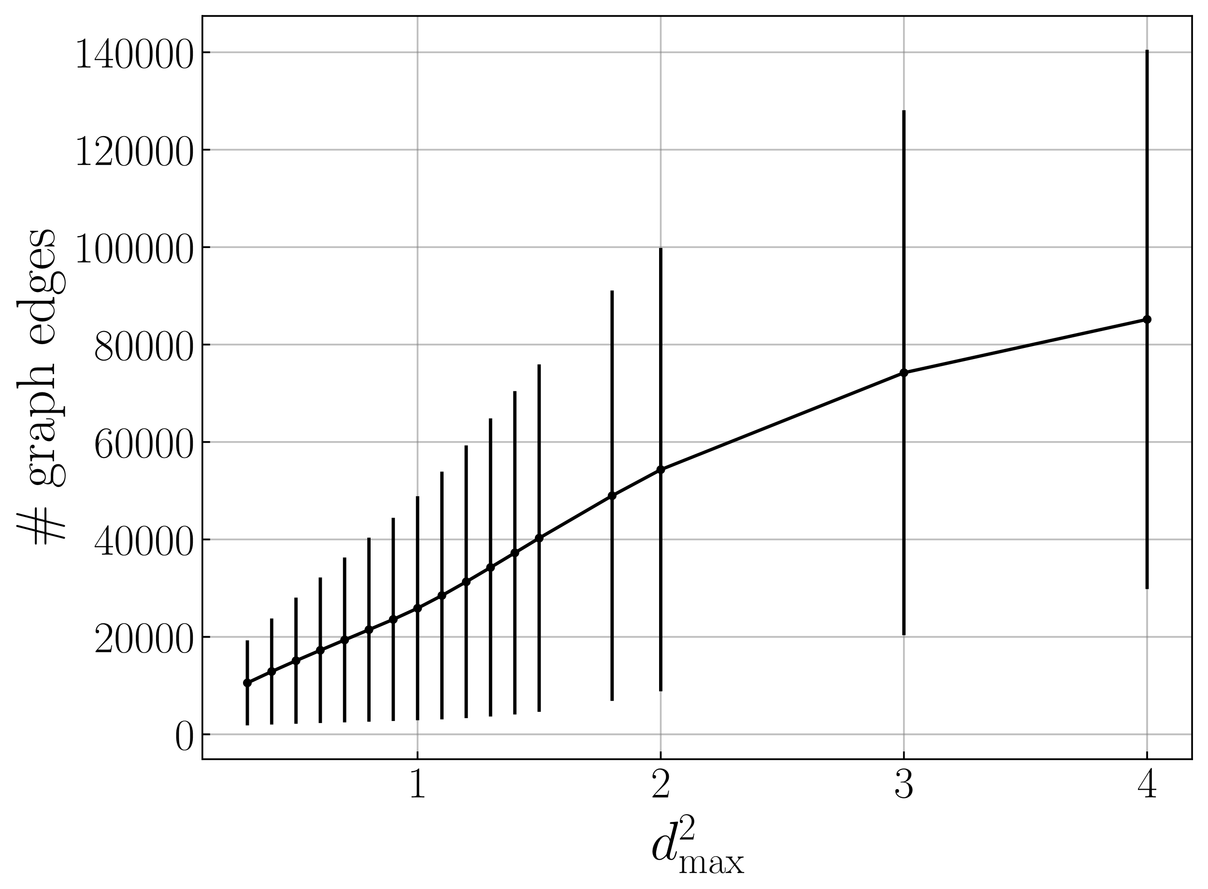
Stage 1: Graph Building
GNN to filter edges
Build tracks from graph
Graph Building
After training, we choose maximal number of neighbours $k_{max}=50$ (not optimised)
To choose maximal squared distance $d_{max}^{2}$, for various values for $d_{max}^{2}$:
Build the rough graph using $d_{max}^{2}$
Remove all fake edges in the rough graph and build the tracks from this purified graph
Compute track-finding performance $⇒$ correspond to the best performance given $d_{max}^{2}$
Performance if all the fake edges are discarded($≡$ best performance)
$⇒$ Choose $d_{max}^{2}=0.9$
(evaluated on 200 events)

Slide 100
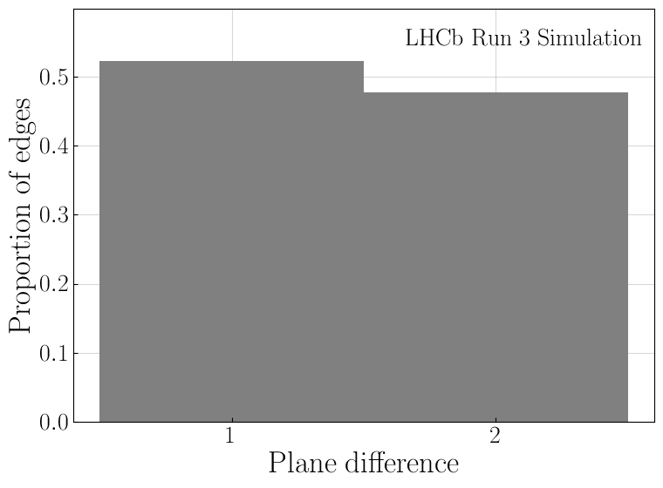
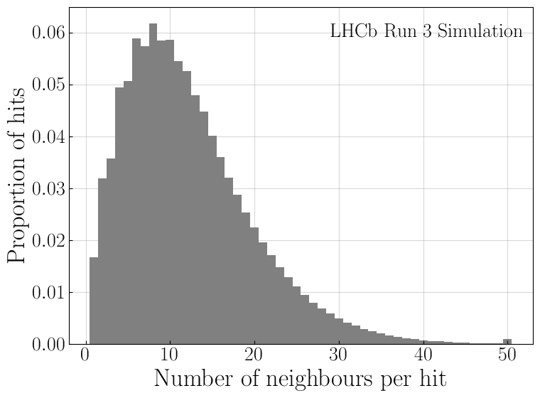
Stage 1: Graph Building
Rough graph with $k_{max}=50$ and $d_{max}^{2}=0.010$
Even though $1\%$ of genuine edges are 2-plane apart, the rough graph needs to contain almost $50\%$ of such edges
$⇒$ $k_{max}$ could probably be reduced to increase throughput

Slide 101
Interlude on Graph Neural Networks
Graph Neural Network (GNN): Neural Network architecture that operates on graphs
$→$ Problem needs to be formulated with a graph.
Resource | Description | Opinion
Stanford online videos | Series of lectures recorded in Youtube. | Clear explanations Quite complete Notebooks without solution
Introduction to Graph Neural Networks Zhiyuan Liu, Lie Zhou | Book | Clear, quite complete Succinct
PyTorch Geometric Tutorials | Videos & notebooks | Notebooks Use of PyTorch Geometric Not very clear Self-advertisement
Graph Neural Networks: Foundations, Frontiers, and Applications Lingfei Wu, Peng Cui, Jian Pei, Liang Zhao | Book | Extremely complete Not so good for just learning
Probably other learning resources out there!
Notes:
Figure document approved needed

Slide 102
Shared hits
Embedding Network
kNN
$$k_{max}, d_{max}^{2}$$
kNN
𝒌_𝐦𝐚𝐱, 𝒅_𝐦𝐚𝐱^𝟐
GNN edge classifier
Filter edges $s_{edge,min}$
Filter edges 𝒔_(𝐞𝐝𝐠𝐞,𝐦𝐢𝐧)
Build triplets
Filter triplets $s_{triplet,min}$
Filter triplets 𝒔_(𝐭𝐫𝐢𝐩𝐥𝐞𝐭,𝐦𝐢𝐧)
Build tracks
Triplet classifier
Goal
1
Connect left and right elbows and remove duplicate edge-edge connections
2
Apply connected components, excluding splitting edge-edge connections
3
Each remaining link correspond to a new track

