Slide 1
Towards a new measurement of
the neutron electric dipole moment
The n2EDM experiment

Slide 2
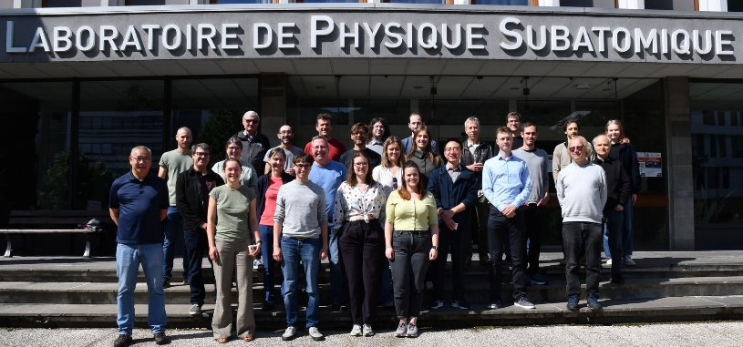
Sensitivity goal: 10⁻²⁷ e cm
Collaboration of 12 institutes (mainly European)
(25 permanents, 15 doc + post-doc)

Slide 3
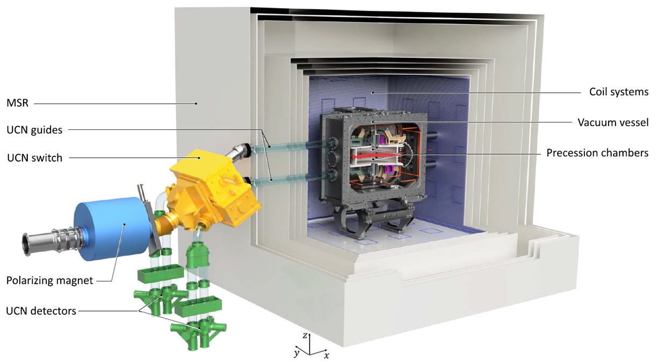
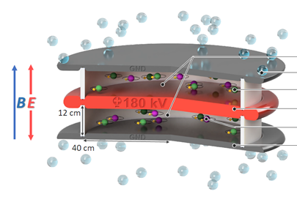
The design of the n2EDM experiment
From the measurement of two frequencies (parallel and antiparallel fields configurations)
→ Ramsey’s method: required polarized neutrons
UCN
Storage chambers where neutron frequency measurement is performed
Two main challenges
neutron statistic & magnetic field uniformity and stability

Slide 4
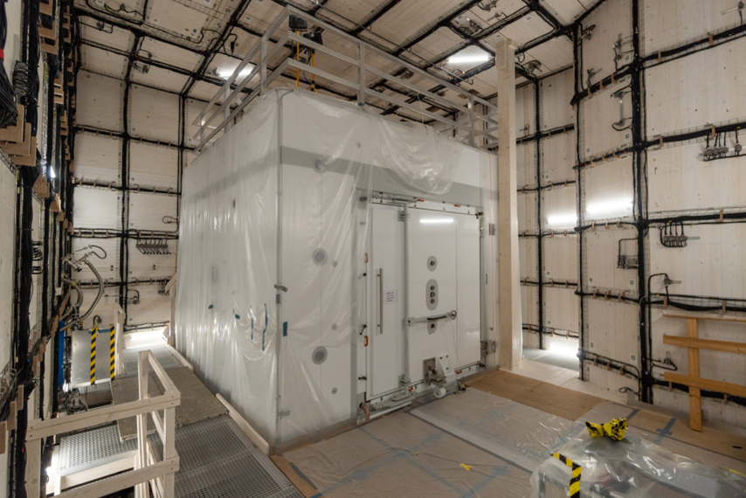
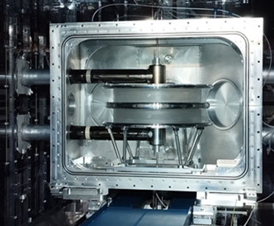
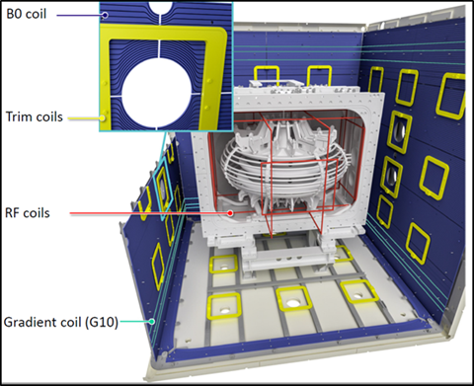
Control of the magnetic field
Magnetically shielded Room (MSR): 6-layers mu-metal shield (suppression factor of 10⁵ for quasistatic field)
MSR in the thermo-house
Storage chambers in the VT
Magnetic field generation: internal coils system (64)
- 1 main B₀ coil + 63 correcting coils
Online measurements of the magnetic field:
- Hg comagnetometer (in situ): mag. field drift
- 112 Cs magnetometers : field non uniformities

Slide 5
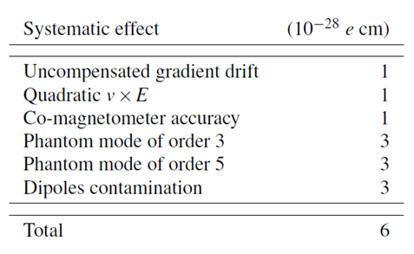
Expected sensitivity
Gain with respect to the nEDM experiment:
T: storage time
E: electric field intensity
α: UCN polarization
N: number of UCN
Based on 2016 UCN source performances
Sensitivity improvements:
Number of UCN (x8): storage volume (x3) + optimized* connection source - apparatus
Electric field intensity (+35 %): HV electrode better insulated /nEDM
Final sensitivity of 10⁻²⁷ e cm → 500 days of data taking (4 years)
Systematics: mostly induced by the magnetic field non uniformities
Highly uniform and stable magnetic field (1 µT) required
Field uniformity: $σ\left(B_{z}\right)<170 pT$ in the chambers
Field stability : 30 fT/min
*G. Zsigmond et al, Eur. Phys. J.A 56, 33 (2020).

Slide 6
French contributions to the n2EDM experiment

Slide 7
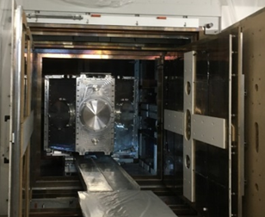
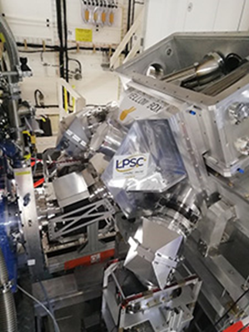
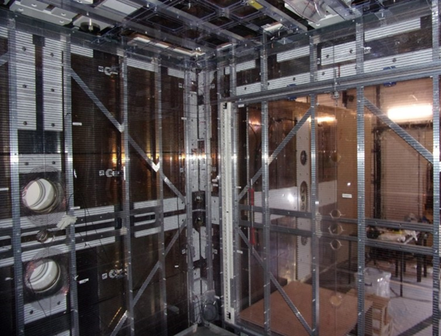
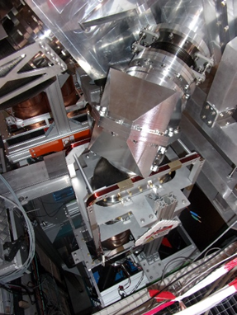
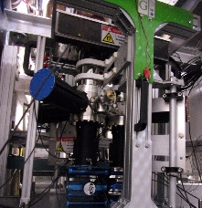
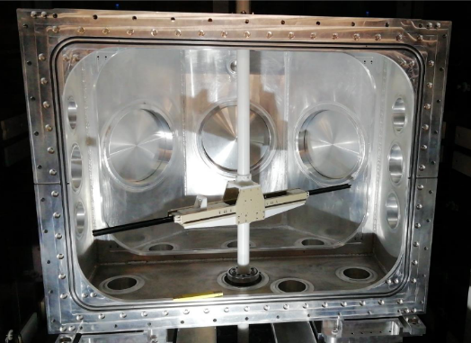
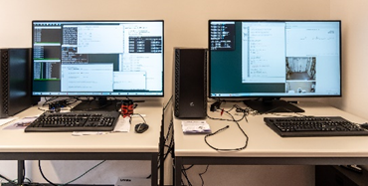
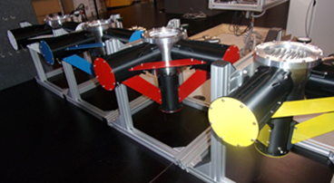
In2p3 hardware contributions
Hg polarization cell (LPSC)
Vacuum vessel (LPC)
Switch box (LPSC)
Internal coils system (LPC)
Spin analyser (LPC)
Neutron detectors + FASTER (LPC)
Data monitoring interface (LPSC)
Mapping robot (LPSC)

Slide 8
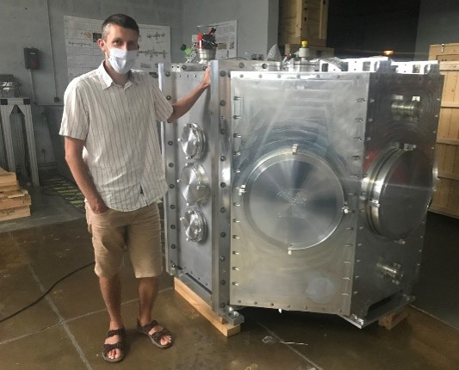
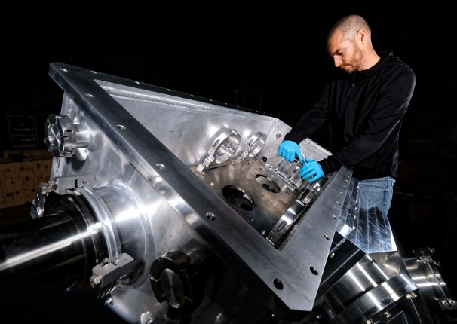
In2p3 hardware contributions
ANR (570 k€, 2014-2019) + ERC (200 k€, 2016-2021):
- strong implication of the technical services (4 FTE / year between 2015 and 2022)
+ data management (CCin2p3), data analysis, data blinding, systematic effects, strategy board ….

Slide 9
Commissioning results

Slide 10
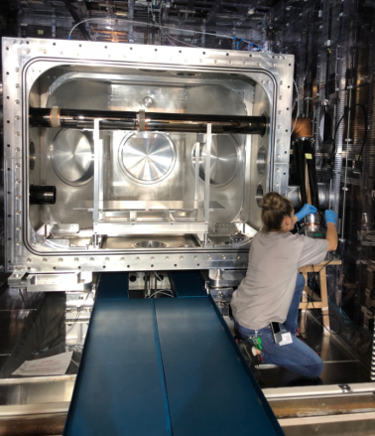
UCN commissioning (2023)
First UCN in the apparatus in July 2023: number of neutrons too low by a factor 20 !!
Number of stored UCN end of 2023 (180 s): 24,000
(still a factor 5 missing / design goal)
Many tests performed during Fall 2023:
UCN transport: up to the chambers: OK !
during emptying phase: factor 2 too low / simulations
Storage capacity of the chambers:
- Insulator rings: redo the DPS coating → increase of UCN statistic
nEDM insulator ring → increase of UCN statistic
- Electrodes : dummy copper electrodes → increase of UCN statistic
visual inspection : small spots peeled off
Electrode coating (DLC) and insulator coating (DPS): underperforming
Two culprits: coating technique and surface roughness
Test chambers under construction (coating investigation during Fall 2024)
- new insulator ring (quartz instead of PS)
- new electrodes with exchangeable parts (test of coating procedures)

Slide 11
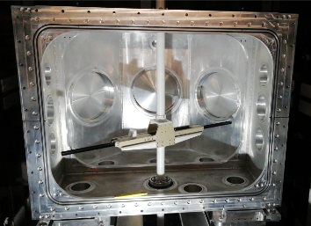
Magnetic field commissioning
Magnetic field characterization (2021-2022): close collaboration between LPC and LPSC
- internal coils system simulated, built and installed by LPC
- field characterization performed by LPSC
$$σ\left(B_{z}\right)=900 pT$$
$$σ\left(B_{z}\right)=50 pT$$
Performances are excellent
Part of the systematics already below requirements
T. Bouillaud, P. Flaux, “An exceptionally uniform magnetic field for the n2EDM experiment” (LPC-LPSC); internal review.

Slide 12
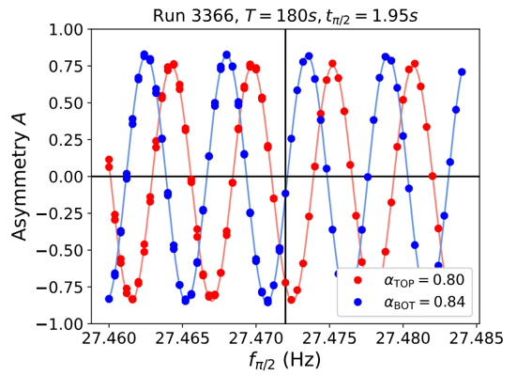
Apparatus commissioning
Neutron frequency measurement:
Ramsey oscillating field method: operational !
neutron polarization, transport, storage and detection: 0K !
Final polarization larger than in design goal (> 0.8) !!
Components | Operational | Performances
Neutrons statistic |  | 24,000
Magnetic field |  | $σ\left(B_{z}\right)=35 pT$ ; systematics
High Voltage |  | +15 KV/cm
Ramsey meas. |  | α > 0.8
Hg Comagnetometer |  | T₂ = 35 s → 100 s
Cs magnetometers
$$√$$
$$√$$
$$√$$
$$√$$
2024 goal: first nEDM data
$$√$$
Current performances:
Sensitivity already better than in nEDM (1.9)
15 kV/cm last Wednesday !

Slide 13
Perspectives and conclusions

Slide 14
Perspectives and conclusions
Towards a final sensitivity of 10⁻²⁷ e cm: two steps approach
First phase (2024-2026):
Sensitivity already improved / nEDM (x1.9): new result is guaranteed
final sensitivity will depend on new chambers storage properties
Systematics : part of the systematics already under control (magnetic commissioning)
UCN source (PSI)
Second phase (2028-2030):
UCN source repair/upgrade (x3): D₂ container and UCN shutter exchanged, proton beam intensity, D₂ solid prod.
final sensitivity will depend on UCN source performances (missing 2.2)
New operation mode: suppress the main systematic effect (false motional EDM) with magic B0 field (10 µT)
Beyond 2030: nEDM measurement in superfluid Helium (SNS prototype move to Europe) ?
G. Pignol, A magic magnetic field to measure the neutron electric dipole moment, Phys. Lett. B, 793, 440 (2019)

Slide 15
Summary and requests
Summary of our involvement since 2004:
There was always a French co-spoke (LPC or LPSC) person since 2004 (beside 2008-2012)
French involvement in the n2EDM experiment:
Budget : ≈ 20 %
Staff : ≈ 20 - 25 %
n2EDM experiment is the worldwide leader: UCN source operational + preliminary measurements ongoing
- sensitivity already better than for nEDM: any improvements bring us towards 10⁻²⁷ e cm
Strong involvement of the French teams in n2EDM ?
- The only CNRS staff is going to retire (LPSC) → CR recruitment (LPC or LPSC)
- Keep on implying PhD & post-doc in the project
- Collaboration agreement (common funds) up to 2026: to be secured till 2030
- Support the mission to PSI for shift duty (3.5 weeks /year/person)
- L4M @ LPSC: magnetometry developments → in2p3 support
- Maintenance of all French components (technical services: 1-2 FTE/year)

Slide 16
Collaboration nEDM
Merci

Slide 17
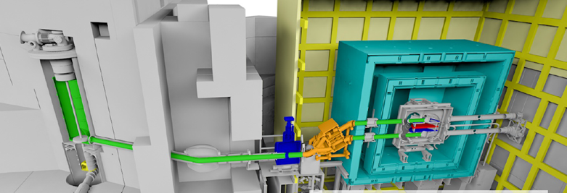
Design of the n2EDM experiment
PSI UCN source: pulsed proton beam on a Deuterium crystal (5 K)
Production of ultracold neutrons (T < 300 neV)
Can be stored in chambers for a few minutes
Pulsed UCN source
measurement performed every cycle (7 min)
UCN source improvements since 2016:
Solid D2 improvements: x1.5
UCN source improvements in 2027:
Flap repair: x1.3
D2 container lid: x1.8
Proton beam current intensity: x1.2
Source conditioning: x1.2
D2 crystal
(30 L @ 5 K, 4.5 kg)
Heavy water (300 K)
n2EDM experiment
Pulsed proton beam
(650 MeV, 2.2 mA)
Pb spallation target
Built at PSI for the nEDM project
(start in 2011)
17

Slide 18
Control of the magnetic field
Magnetically shielded Room (MSR): 6-layers mu-metal shield (suppression factor of 10⁵ for quasistatic field)
Active Magnetic Shield (AMS): suppress the ambient field variations around the MSR (a few µT)
Thermo-house: controlled environment (temperature, humidity)
MSR in the thermo-house
Storage chambers in the VT
Stringent magnetic requirements in the MSR:
- at the vacuum tank level: < nT @ 5 cm
- close to the precession chambers: < 20 pT @ 5 cm
Magnetic properties of every pieces installed are checked:
- small components : specific device (gradiometer developed at PSI)
- large pieces: at PTB Berlin (electrodes, vacuum tank …)
Any magnetic dipole on the chambers walls must be removed (cleaning procedure)
Gradiometer
A very large magnetically shielded room with an exceptional performance for fundamental physics measurements
A large 'Active Magnetic Shield' for a high–precision experiment. Eur.Phys.J.C, 2023, 83 (11), pp.1061

Slide 19
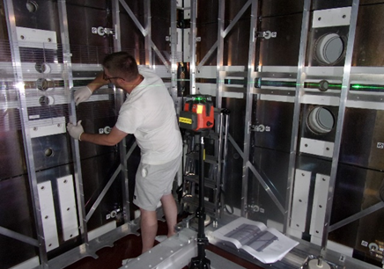
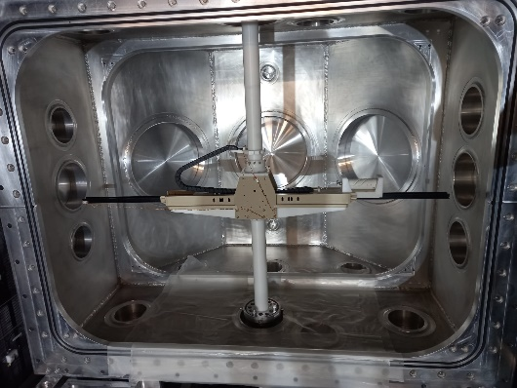
Control of the magnetic field
Magnetic field generation: internal coils system (64)
- 1 main B₀ coil (optimized vertical solenoid)
- 56 squared correcting coils
- 7 gradients coils (G₁₀ , G₂₀ , G₃₀ , G₁₁ , G₁₋₁ …)
Online measurements of the magnetic field:
- Hg comagnetometer (in situ)
→ magnetic field drift + ${∂B_{z}}/{∂z}$ (G₁₀)
- 112 Cs magnetometers surrounding the chambers
→ field non uniformities (G₃₀,G₅₀)
Offline measurements:
- magnetic field mapping (field non uniformities: G₃₀ , G₅₀ , G₇₀)
- field mapping before and after the data taking
- offline corrections of some systematic effects (reproducibility)

