Slide 1




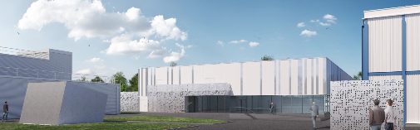
Status of DESIR
Bertram Blank, LP2i Bordeaux
CSI of IN2P3, Strasbourg, June 24, 2024
DESIR : Désintégration, Excitation et Stockage d’Ions Radioactifs - EQUIPEX (2012-2024)

Slide 2


DESIR scientific objectives

Slide 3

« Decay, Excitation and Storage of Radioactive Ions »
Masses
Trap-assisted spectroscopy
Correlation measurements
Exotic decay modes
High-precision β-decay studies
Magnetic and quadrupole moments
Mean-square charge radii
Spins
BESTIOL
DETRAP
LUMIERE
Fundamental properties of nuclei in their ground and long-lived isomeric states
Ultra-pure samples for high-precision measurements
Ion manipulation using traps and laser manipulation
Complementarity with S³-LEB and other GANIL/SPIRAL2 facilities

Slide 4
DESIR infrastructure

Slide 5
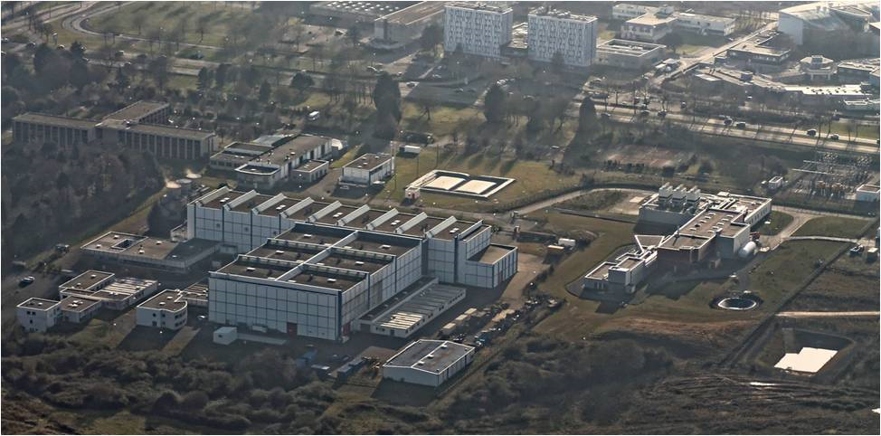
DESIR @ GANIL
Operation: Construction of the DESIR facility within INB 113
Basic Nuclear Installation
INB 113
DESIR faciliy
GANIL facility
SPIRAL2 facility

Slide 6
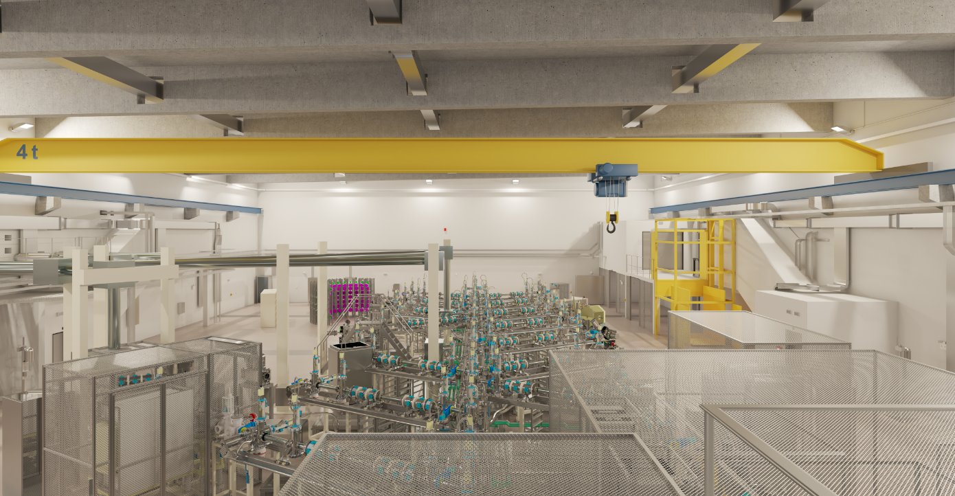
…..the projet
Projected investment cost: €33M (2/3 building and infrastructure - 1/3 scientific process)
Human resources: 250 FTE / 8 years
INB modification authorization process
Building delivery: T3-2025
Experiments: 1. half of 2027 (stable) / end of 2027 (radioactive)
Building :
4500 m³ concrete / 2700 m² of floor space
95% under nuclear ventilation
Process :
180 m of beam lines
5 beam preparation devices
Up to 18 experimental spots
5 safety classified systems

Slide 7
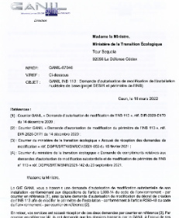
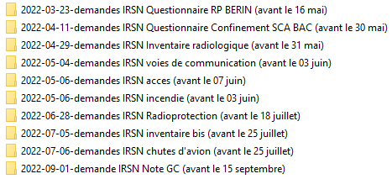

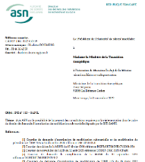
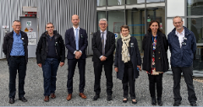
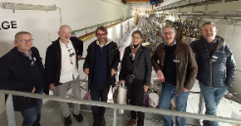
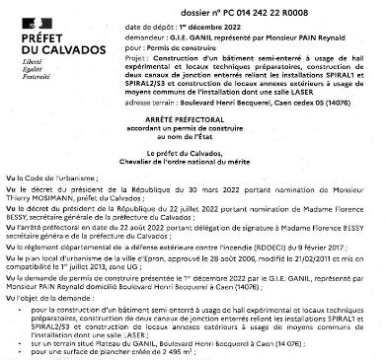

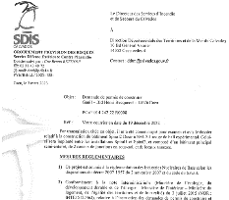


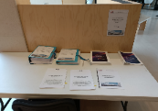

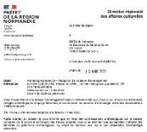



… administrative requirements
March 2022: construction licence submission to the Ministry of Ecological Transition
Sept. / Nov. 2022: green light from the safety authority -> Ministry of Ecological Transition
Discussion with local government representatives
Instruction
(many Q/A with the safety authority)
…with the Environmental authority
Next: same procedure for the operation licencing
June 2023: Construction permit
March 2023: Green light -> Ministry of Ecological Transition
April-May 2023: Public Enquiry
Public Enquiry preparation
… numerous comments

Slide 8
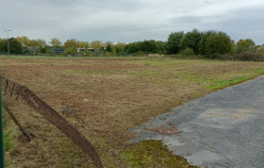
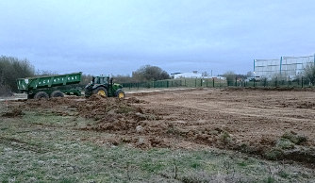
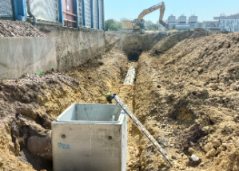
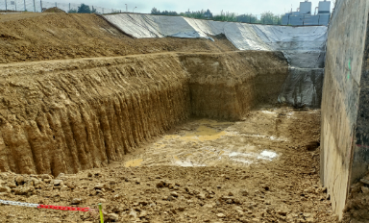
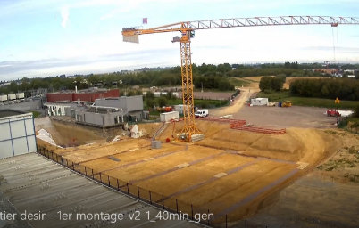
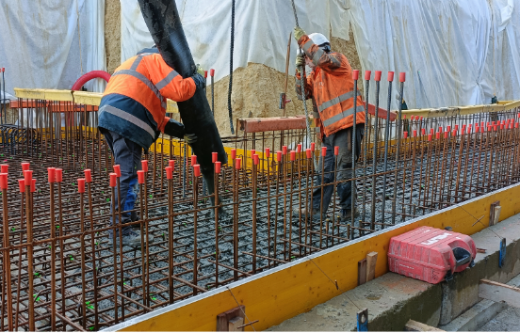
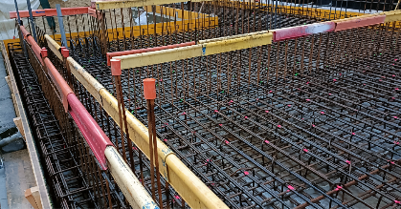
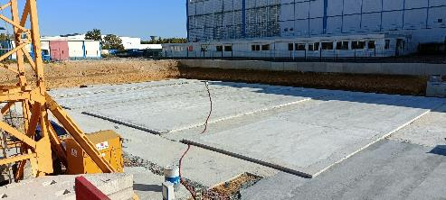
… then the real thing
October 2022: Clearing/releasing of construction areas
April 2023 : surface levelling
June 2023 : reorganization of site utilities
July 2023 : general earthworks
September 2023 : site preparation
31 October 2023 : first concrete!
October 2023 : steel reinforcement level -3
October 2023 : surface preparation

Slide 9
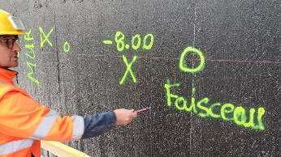
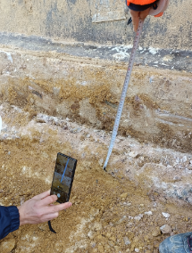
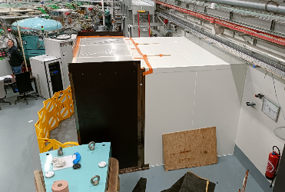
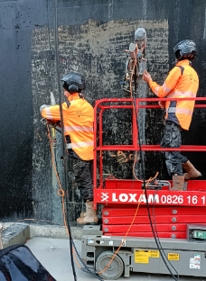
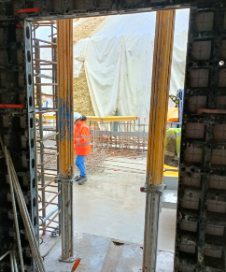
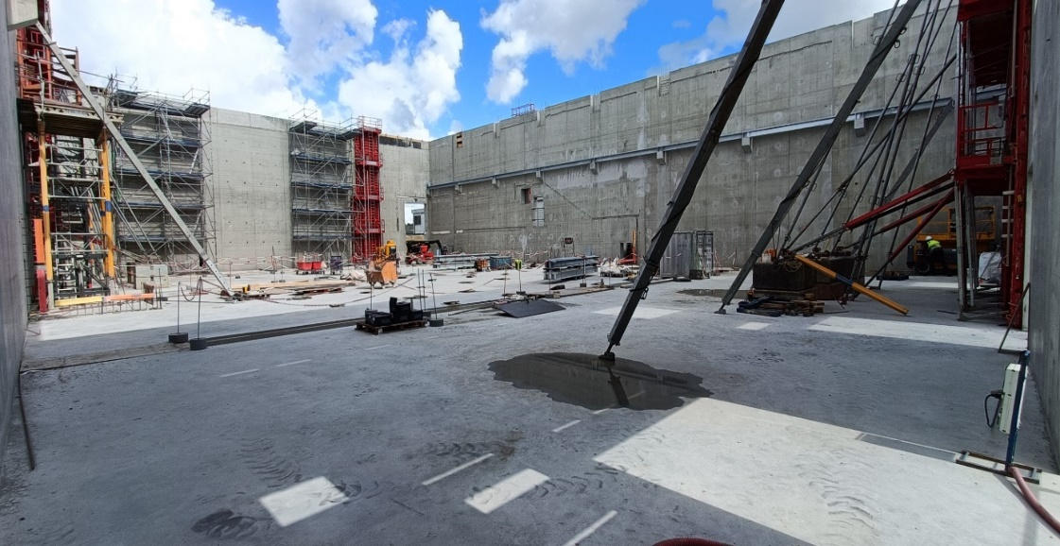
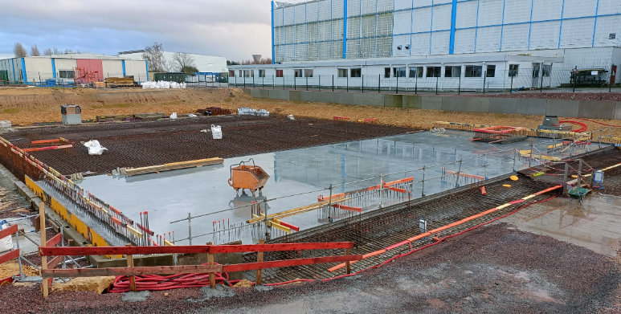
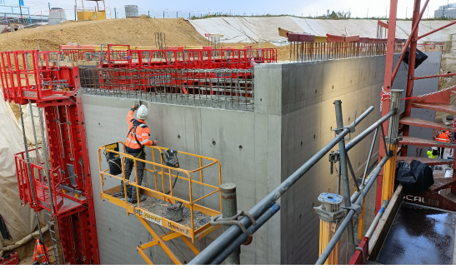
… few pictures
Dec. 2023… A number of questions!
Actually nothing to worry about
Drilling of existing walls, elevation of walls to level -3 and preparation of hall floor slab
May 2024: DESIR has its four walls
January 2024: Finishing of level -3 wall

Slide 10
DESIR beam lines

Slide 11
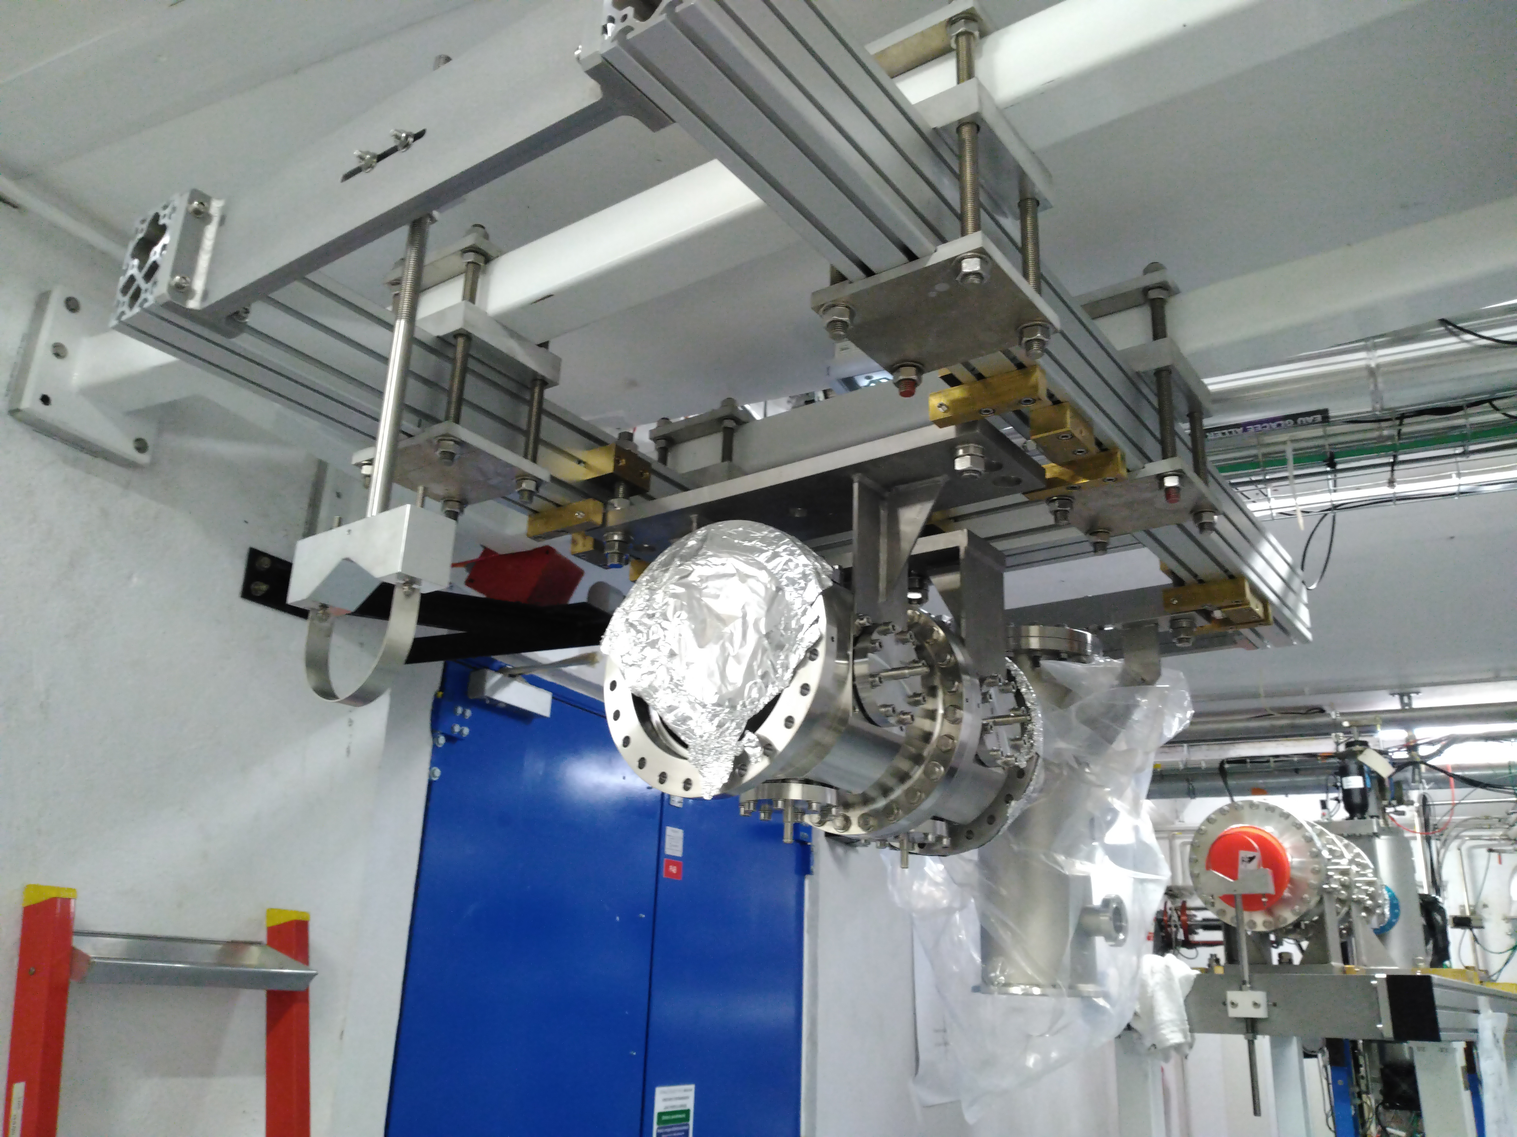
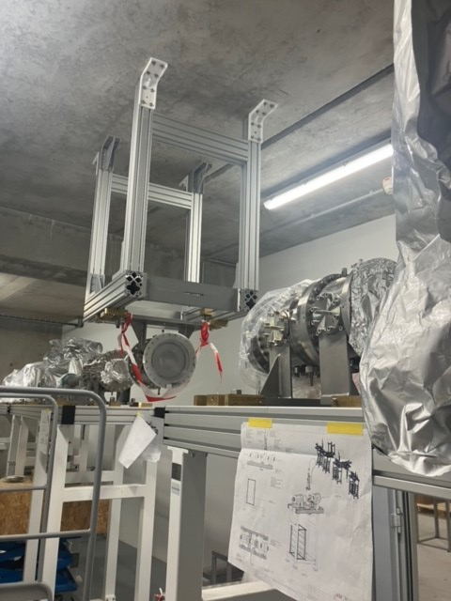
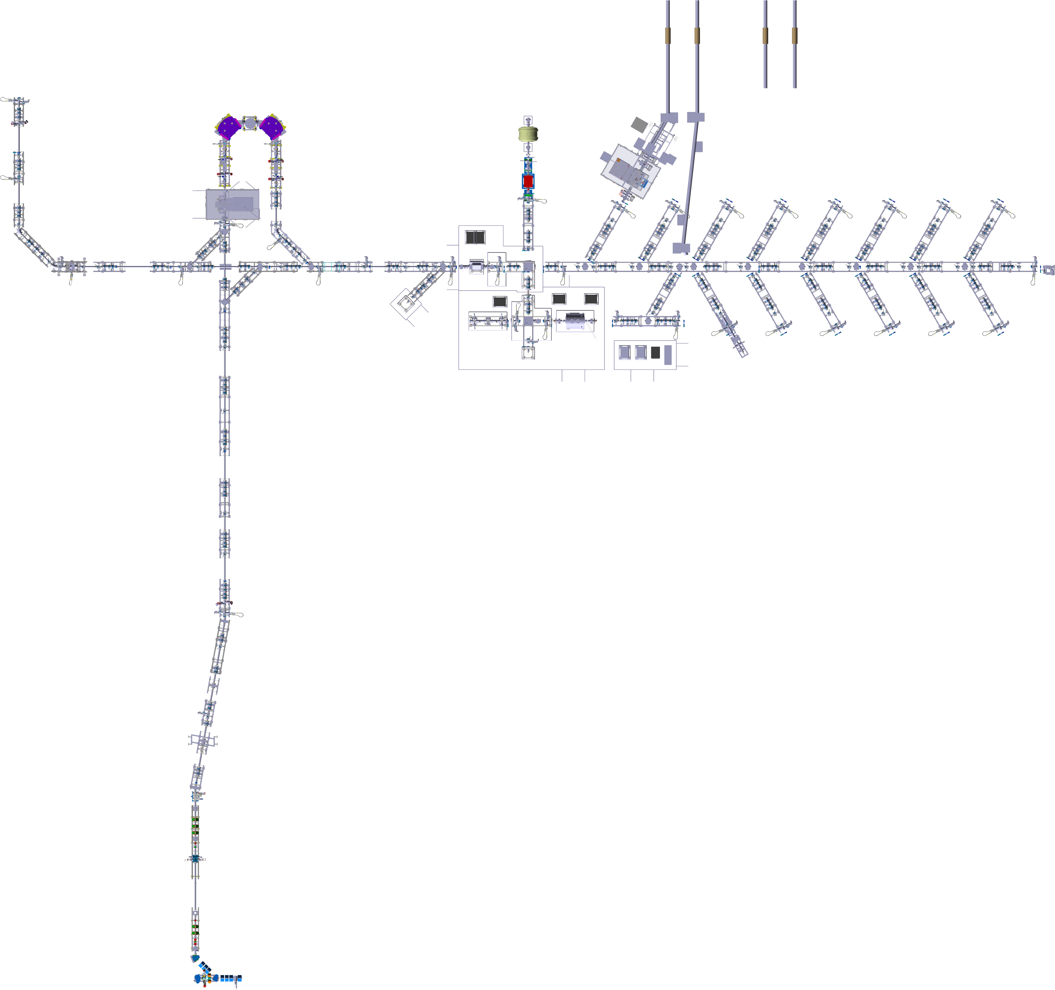
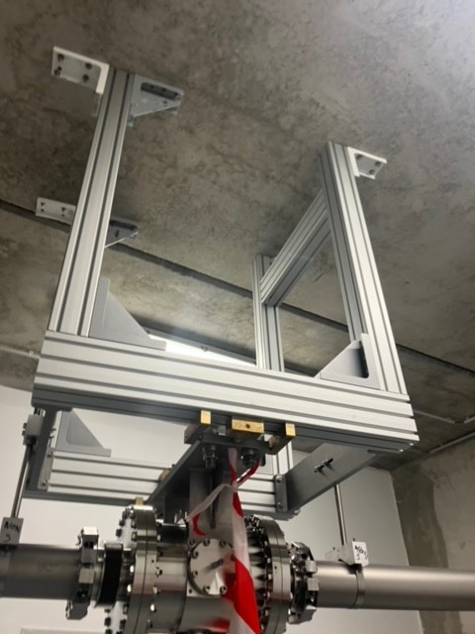
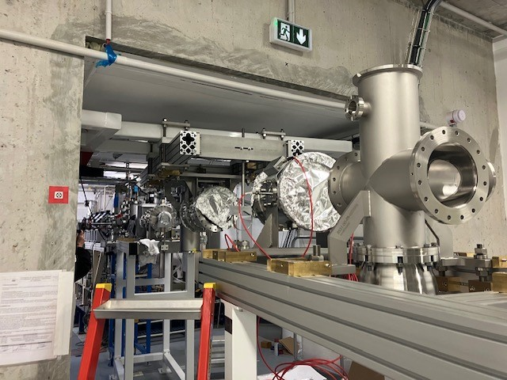
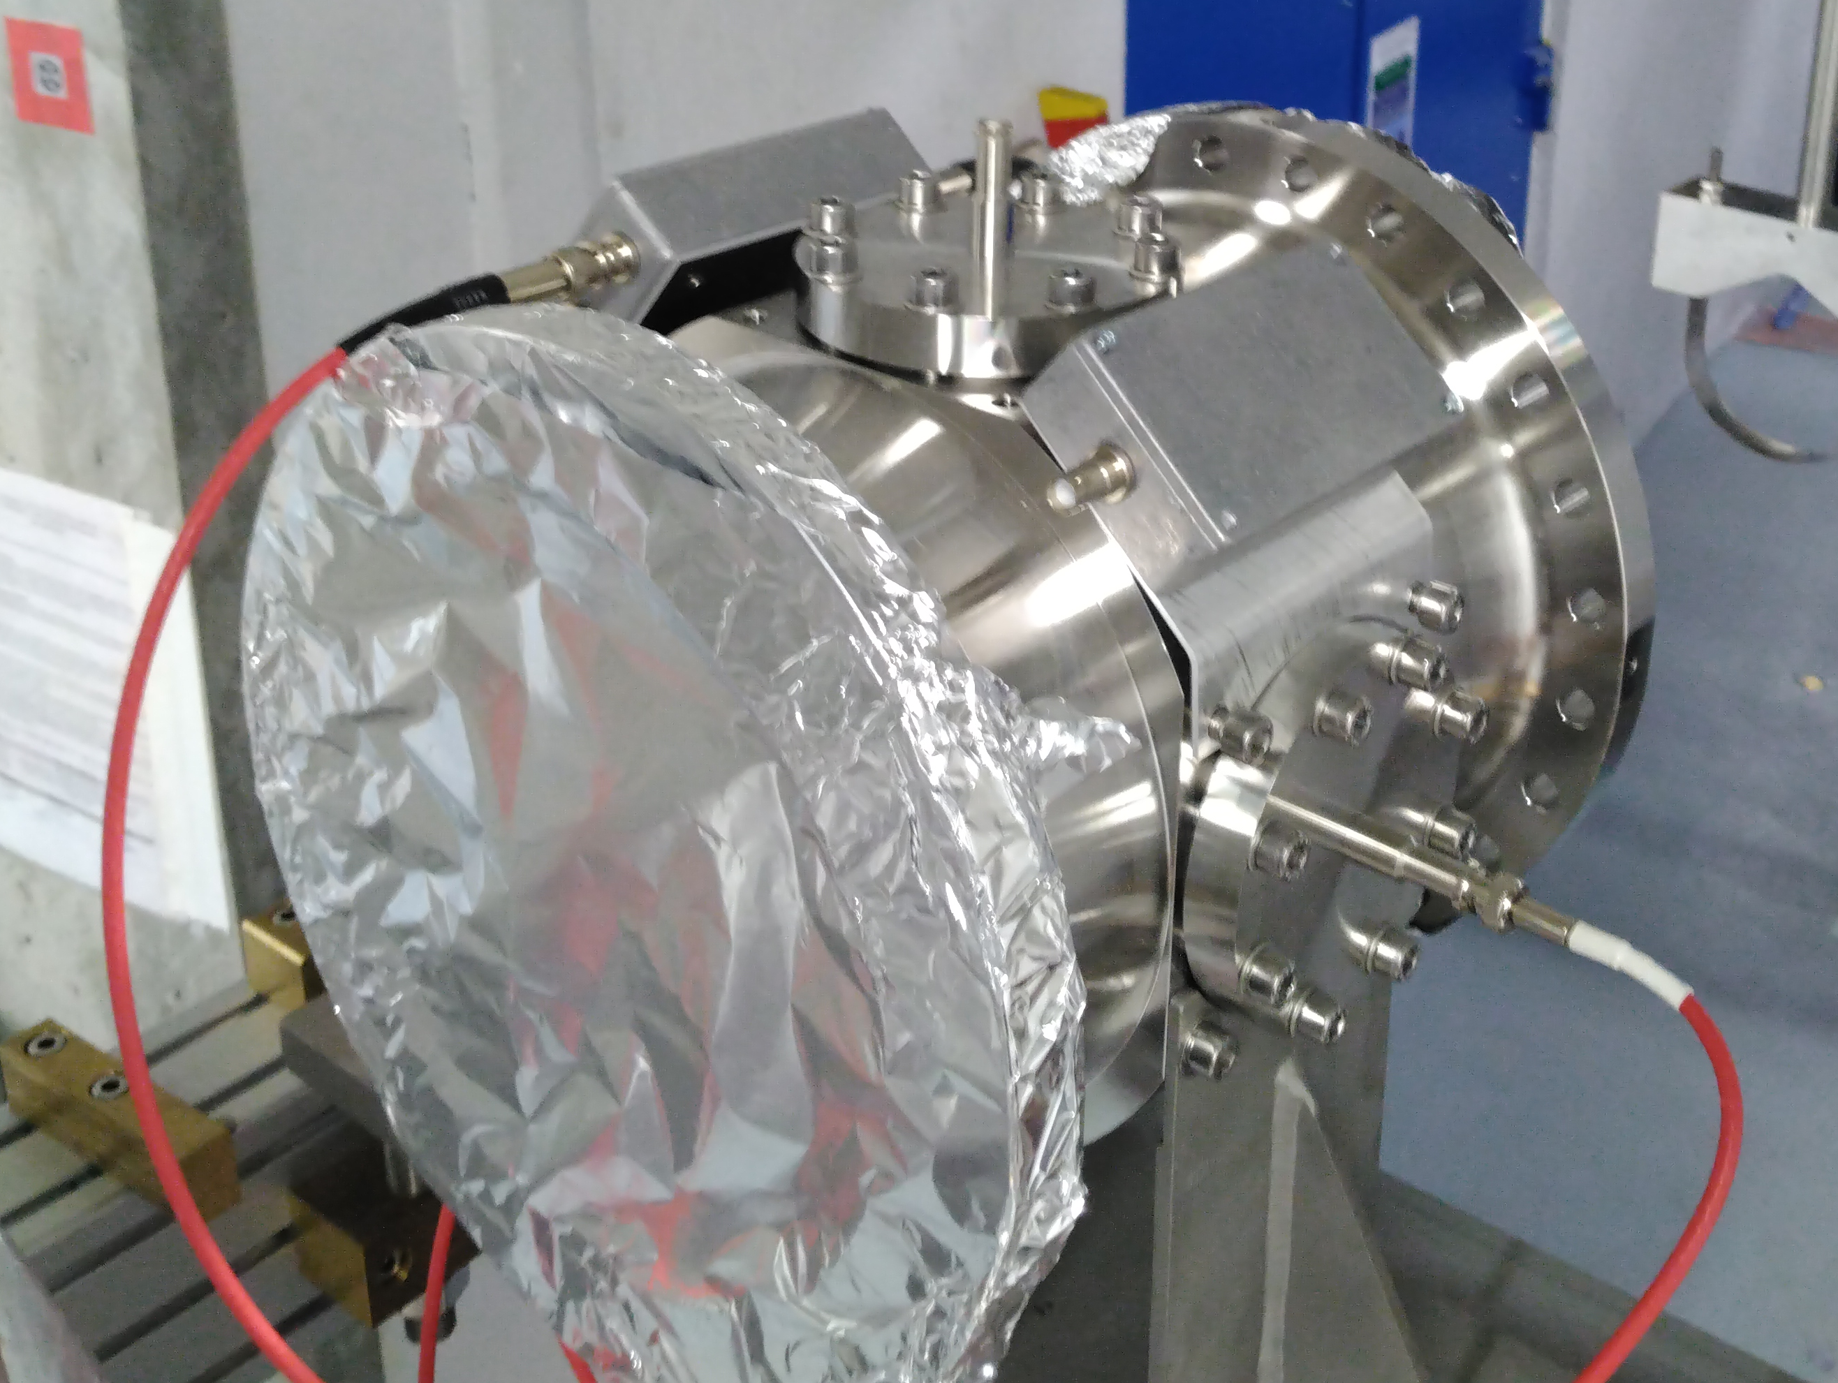
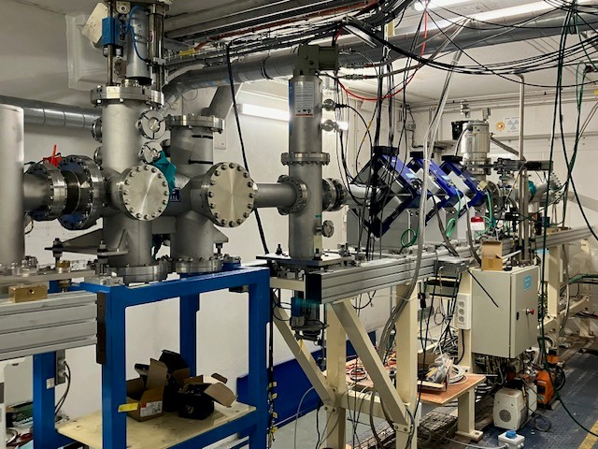
DESIR beam lines (IJC Lab)
RFQ1P (LPC)
HRS (LP2IB)
MLLTRAP (IJCLab)
MORA (LPC)
Junction S3-LEB / DESIR
GPIB
(LP2IB)
Laser
180 m of beam lines
Stable source
PIPERADE (LP2IB)
Distribution lines
LT section 2
current installation
SPIRAL1

Slide 12
DESIR beam purification and sampling

Slide 13

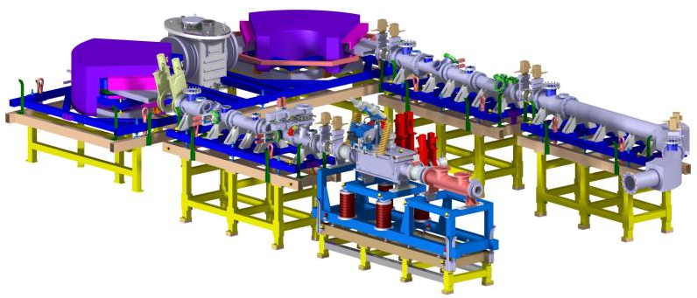
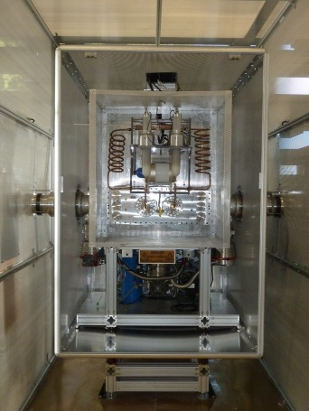

DESIR beam purification: SHIRaC + HRS (LPCC, LP2iB)
HRS
J. Michaud et al., NIM B 541 (2023) 161
Commissioning of the DESIR high-resolution mass separator”
HRS
Conception: QQSQD-M-DQSQQ
Specification:
M/ΔM =20,000 @ 3π mm.mrad @ 60keV
Achievement;
M/ΔM =25,000 @ 1-2π mm.mrad @ 25 keV
~8 m
~3.5m
Commissioning at LP2iB
SHIRaC RFQ
SHIRaC
Emittance reduction of high intensity beams
Transmission ~70 % @ 1µA
Refurbishing at LPC Caen
R. Boussaid et al., JINST 9 (2014) P07009
“Simulations of high intensity ion beam RFQ cooler for DESIR/SPIRAL 2: SHIRaC”

Slide 14

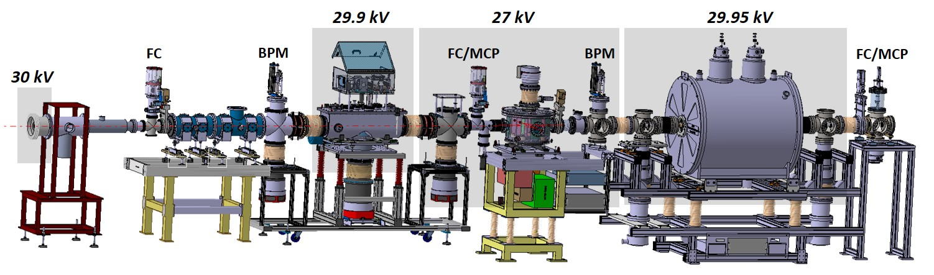






DESIR beam purification: GPIB + PIPERADE (LP2iB)
General Purpose Ion Buncher and cooler (GPIB)
  10⁶-10⁷ ions/bunch, < 100 Hz
  emittance reduction
Stable ion source
Injection optics
90° deflector
S³-LEB – DESIR
Double Penning trap
  10⁵ ions/bunch, 2-20 Hz
  M/ΔM = 10⁵
M. Gerbaux et al., NIM A 1046 (2023) 167631
“The General Purpose Ion Buncher: A radiofrequency quadrupole cooler-buncher for DESIR at SPIRAL2”
P. Ascher et al., NIM A 1019 (2021) 165857
“PIPERADE: A double Penning trap for mass separation and mass spectrometry at DESIR/SPIRAL2”
Commissioning at LP2iB

Slide 15
DESIR experimental equipment

Slide 16
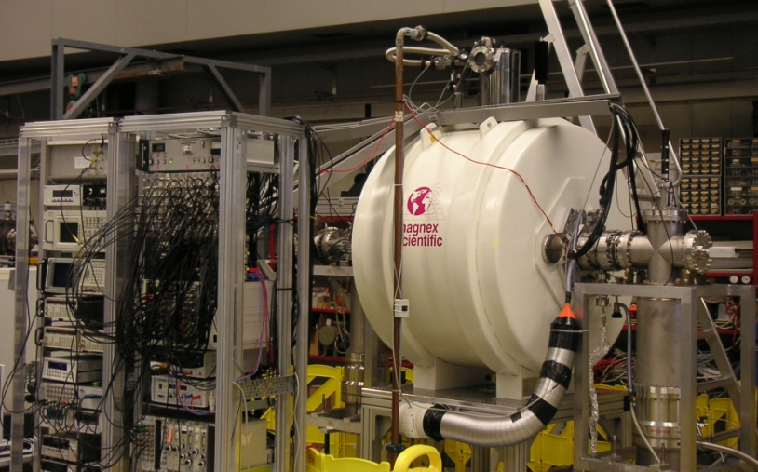
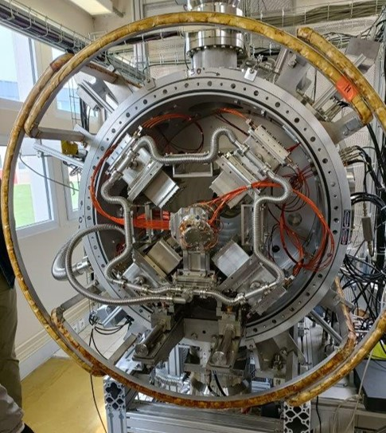


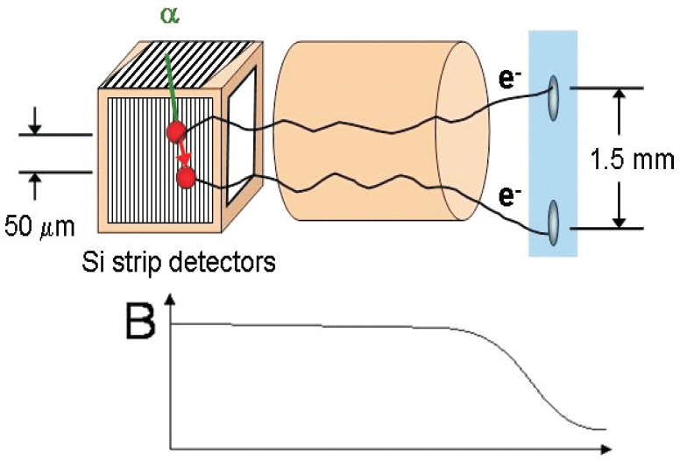
The DEsirTRAPping facility
MORA
MLLTrap
P. Delahaye, GANIL, L. Hayen, LPC Caen
P. Thirolf, LMU Munich – E. Minaya Ramires, IJClab
RFQ-CB associated with a Paul trap
-> β-ν angular correlation coefficient
-> D correlation with laser polarized beams
7T double Penning trap
-> mass measurements (ΔM/M~10⁻⁸) of pure samples
-> in-trap e- and α spectroscopy
e⁻ pixel
detector
E. Minaya-Ramires et al., NIM B 463 (2020) 315
P. Chauveau et al., NIMB 463 (2020) 371
Nuclear structure & decay properties
  shell evolution, deformation
  (super-) heavy nuclei decay spectroscopy
Commissioning at ALTO (IJCLab)
P. Delahaye et al., Hyperfine Interaction 240 (2019) 63
Commissioning at JYFL

Slide 17
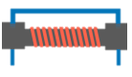
The LUMIERE facility
Laser Utilization for Measurement and Ionization of Exotic Radioactive Elements
Collinear laser spectroscopy (CRIS like, ISOLDE)
  -> hyperfine structure (magnetic and quadrupole moments, mean square charge radii, spins)
Charge exchange cell
Field ionization unit
Quadrupole triplet
Differential pumping
Quadrupole triplet
Voltage scanning device
RF electrode
90°
bender
Quadrupole triplet
Optical detection
Interaction region 10⁻¹⁰ mbar
RFQ
Ion detector
→
RIB →
Purified beam to decay/traps
Ion source
LUMIERE Workshop: July 2, 2024

Slide 18
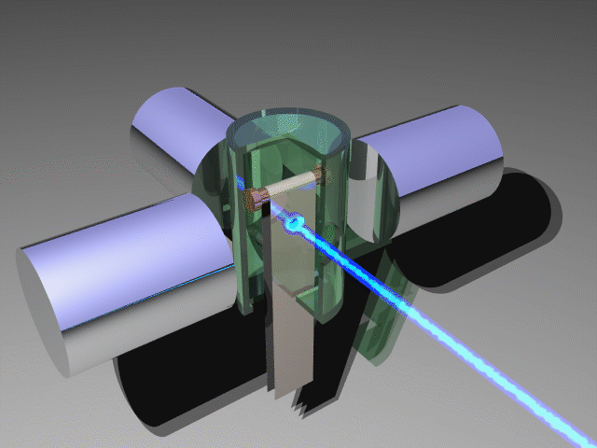
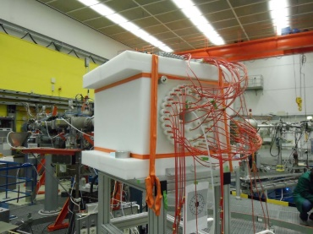
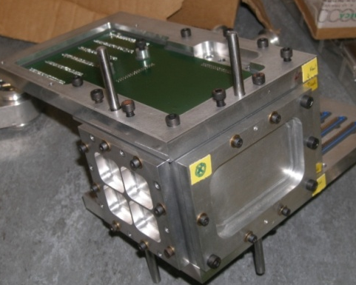
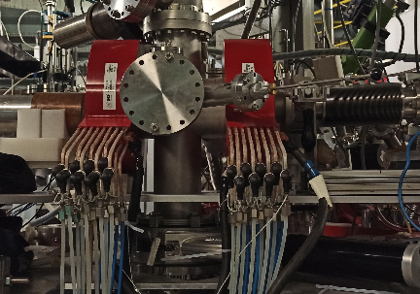
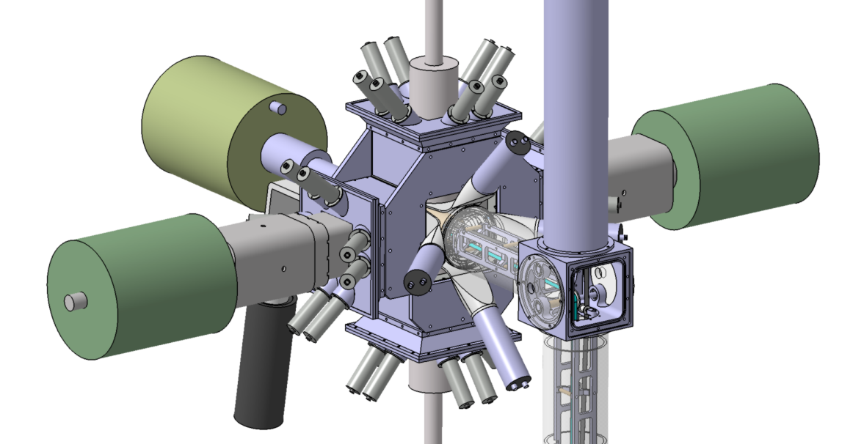
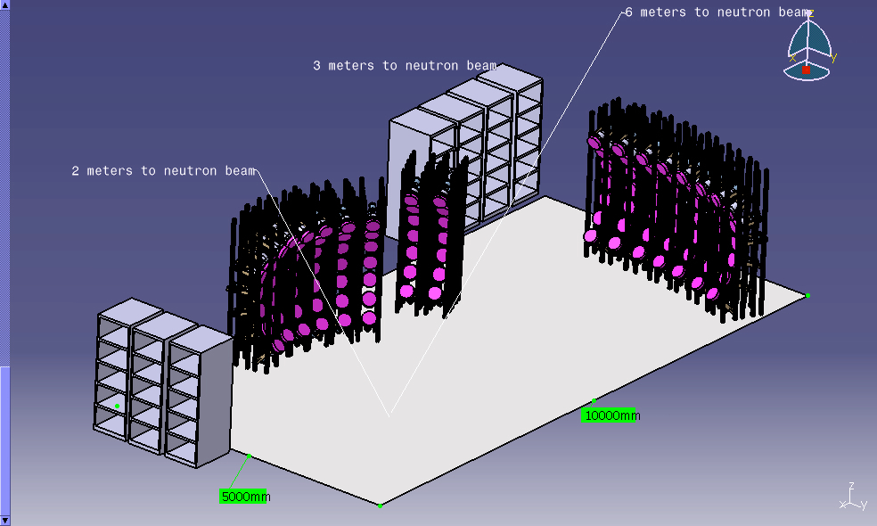
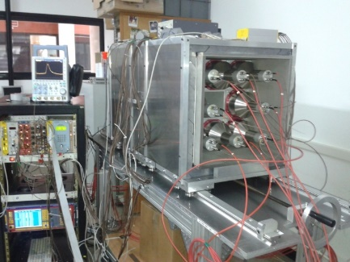
The BESTIOL facility
BEta decay STudies at the SPIRAL2 IsOL facilty
Beam cooling and purification using PIPERADE for (trap-assisted) decay spectroscopy
-> High-precision measurements with ultra-pure samples using:
β-γ decay stations (BEDO, …)
full absorption spectrometers (DTAS)
neutron detection arrays (BELEN, MONSTER, …)
Fundamental interaction, nuclear structure, decay properties
CVC, V_{ud}
lifetimes, P_{(2)n}
exotic decays (β-2p, cluster emission)
Gamow-Teller strength
BELEN
SiCube
COeCO
BEDO
MONSTER
DTAS

Slide 19
DESIR time line

Slide 20
DESIR time line
Building delivery : September 2025
October 2025 to September 2026 : Beam line & experiment installation
October 2026 to June 2027 : Technical commissioning
March to October 2027 : Stable beam commissioning
November 2027 : Facility ready for radioactive beams

Slide 21
DESIR time line
Building delivery : September 2025
October 2025 to September 2026 : Beam line & experiment installation
October 2026 to June 2027 : Technical commissioning
March to October 2027 : Stable beam commissioning
November 2027 : Facility ready for radioactive beams
➔➔ but for all this we need wo/man power at GANIL…

Slide 22
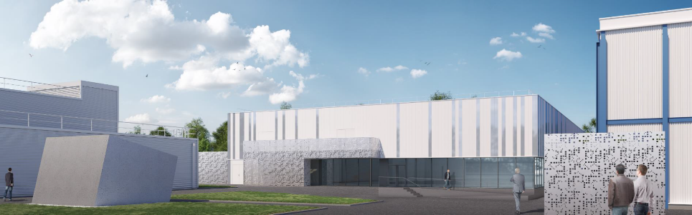
DESIR
Thank you for your attention

