Slide 1
Hydrodynamic fluctuations and related observables in dynamical models
Koichi Murase Tokyo Metropolitan Univ.
Hydrodynamics and related observables in heavy-ion collisions,
2024/10/29, Subatech, Nantes, France

Slide 2
Introduction

Slide 3
Fluctuations in heavy-ion collisions
Final observables
flow coefficients v_{n}, etc.
Initial state fluctuation
nucleon distribution,
gluon/color fluctuations, etc.
time
Matter response
EoS, η, ζ, τ_{R}, etc.
Additional fluctuations
+ hydro fluctuations
+ jets/mini-jets, etc
Relativistic hydrodynamics
(～QGP)
collision axis
0
Notes:
Hydrodynamic fluctuations are one of the various fluctuations in relativistic nuclear collisions.
The event by event fluctuations are observed in experimental observables such as flow coefficients, and other correlations.
The major origin of the fluctuations come from the initial distribution of wounded nucleons.
This initial spatial anisotropy is converted to final momentum anisotropy by the response of matter.
So by comparing these fluctuations using dynamical models,
we can extract the properties of matter such as EoS, shear viscosity, bulk viscosity, and so on.
However there are other sources of fluctuations.
For example there are fluctuations from sub-nucleonic structures.
And also the interaction of the matter with jets and minijets,
and hydrodynamic fluctuations.
Hydrodynamic fluctuations are the thermal fluctuations
in the hydrodynamic stage of the collision reaction.
In order to precisely determine the properties of the matter,
we need to quantify the effects from such additional fluctuations.
And in this talk we focus on HF.

Slide 4
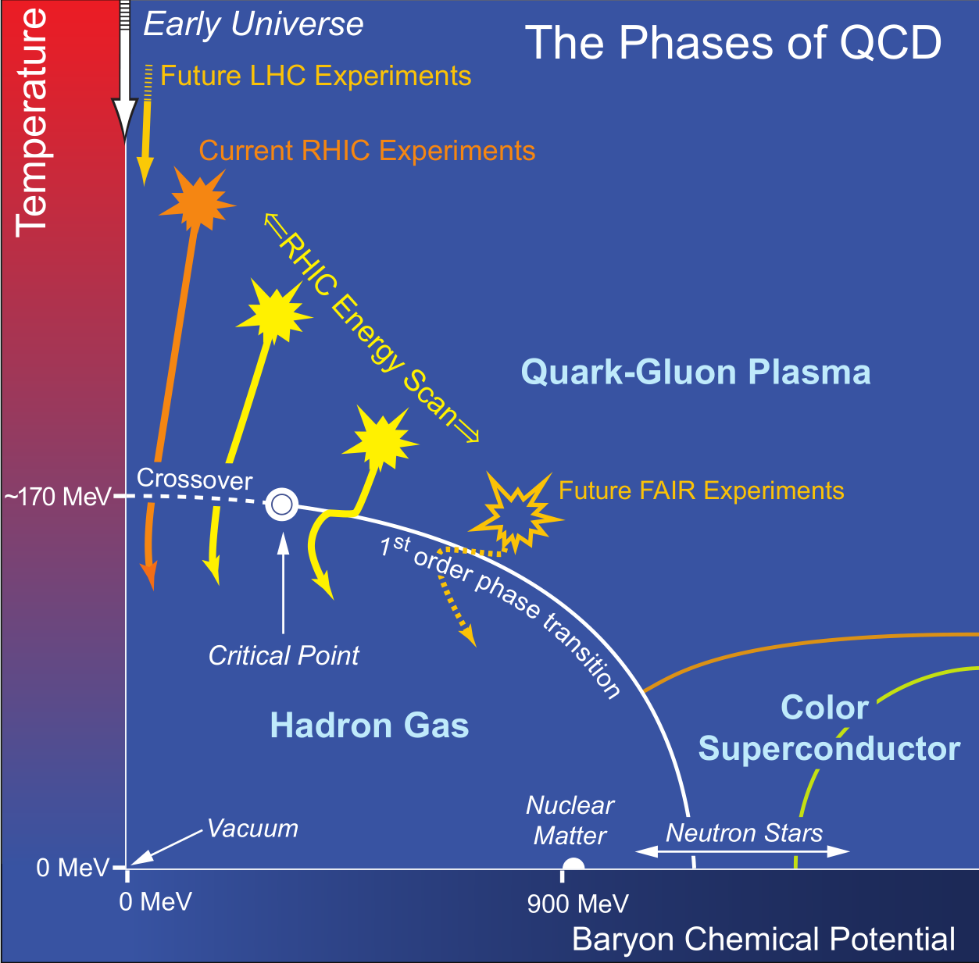
Fluctuations in critical point search
Search of QCD critical point
and 1st order phase transition
Dynamical models for high-energy collisions
(Hydro + cascade + …)
Needed extensions
EoS modeling
critical fluctuations
dynamical initialization
dynamical core-corona separation
Schematic phase diagram of QCD
[taken from the 2007 NSAC Long Range Plan]
Dynamical models for lower-energy collisions?
Notes:
Hydrodynamic fluctuations are also becoming important in the era of the search of QCD crit pt and 1st order phase transition.
Existing dynamical models based on hydorynamics combined with hadronic transport model and sophisticated IC
have been developed for the high-energy collisions corresponding to this region of phase diagram.
While, recently to explore the high baryon density region here RHIC BES program
are on going and also many other experiments are planned.
But existing models cannot be simply applied to this region.
We need additional modeling to describe the dynamics in this region.
For example, the equation of state. Th eos on the temperature axis is already known from the 1stprinciples calculation, lattice QCD. But we don’t know the QCD EoS for high density due to the sign problem. We need to model phenomenological EoS.
Also in the lower energy collisions the Lorentz contraction of colliding nuclei is not enough so that
the initial interaction is no longer instantaneous. We need to explicitly describe the dynamics of initial states.
Another thing is core-corona separation. In lower energy collisions, the fraction of thermalized part
is smaller compared to the higher energy collisions,
and we should describe both of thermalized part and non-thermalized part dynamically
by hydrodynamics and transport models dynamically coupled to each other.
And the most important physics is the critical fluctutuations.
To describe the phase transition we have to consider appropriate slow hydrodynamic modes and its thermal fluctuations.
In this sense hydrodynamic fluctuations are now more and more important.

Slide 5
Hydrodynamic fluctuations
Thermal fluctuations of fluid fields
spontaneous field fluctuations
of fluid fields such as π^{μν}, Π, etc.
at each t and each x
π^{μν}, Π
x
c.f. L. D. Landau and E. M. Lifshitz,
Fluid Mechanics (1959)
Fluctuation-dissipation relation (FDR)
Magnitude of fluctuations δπ, etc.
is determined by dissipation η, etc. (and temperature T)
η ≠ 0
δπ ≠ 0
Notes:
As already mentioned, hydrodynamic fluctuations are th fluc of hydrodynamics.
It is the spontaneous field fluctuations of fliud fields such as shear stress, bulk pressure and so on.
They arise independently at each time t, and each space position x, and fields becomes inhomogeneous like this.
The statistics of HF is determined by FDR. This is an example for the shear stress. By this relation
the mag of fluctuations such as delta pi is related to the dissipation such as shear viscosity.
This means that if there are non-zero viscosity, the thermal fluctuations always comes with it with non-zero magnitude.
But usually we do not care about the thermal fluctuations in our daily life.
For example the water has non-zero viscosity but looking at we cannot see any fluctuations of water.
Why do they important in heavy ion collisions. Here let us make an easy order estimation

Slide 6
Hydrodynamic fluctuations
FDR: 〈δπ²〉 ≃ 4Tη / Δt Δx³
(Δt, Δx: typical length/time scale)
Water in a glass
QGP in heavy-ion collisions
η ≃ 10⁻³ [Pa sec] (≃ 50 s)
T ≃ 300 [K] (≃ 3×10⁻⁹ [MeV])
Δx ≃ 10⁻³ [m]
Δt ≃ 10⁻¹ [sec]
δπ ≃ 4×10⁻⁸ [Pa]
P ≃ 10⁵ [Pa]
δπ / P = 4×10⁻¹³
η ≃ 0.1 s ≃ 0.2 [fm⁻³]
T ≃ 300 [MeV]
Δx ≃ 1 [fm]
Δt ≃ 1 [fm]
δπ ≃ 2×10² [MeV/fm³]
P ≃ 4×10³ [MeV/fm³]
δπ / P = 0.05
Hydrodynamic fluctuations are not negligible in QGP
Notes:
FDR can be simply written in this form.
Here delta t and delta x are typi len/time scales of our interest respectively.
So let’s evaluate this for water, and QGP.
First water. the viscosity of water is around

Slide 7
Simulating hydrodynamic fluctuations
Solve Stochastic Partial Differential Eqs (SPDE) directly
[This talk]
Solve the Langevin eqs. with noise terms numerically
(event-by-event calculations)
Explicit cutoff for the noise wave length
M. Nahrgang, C. Herold, S. Leupold, I. Mishustin, M. Bleicher, J. Phys. G 40, 055108 (2013)
K. Murase, T. Hirano, NPA 956, 276 (2016)
K. Murase, A. Sakai, T. Hirano, PLB 829, 137053 (2022)
M. Bluhm, M. Nahrgang, T. Schafer, S.A. Bass, EPJ Web Conf. 171, 16004 (2018)
M. Singh, C. Shen, S. McDonald, S. Jeon, C. Gale, NPA 982, 319 (2019)
Solve moments/correlations (deterministic)
Fokker-Planck-type idea … solve “distribution”
→ Solve moments/correlations instead of the distributions
Hydro-kinetic theory, Hydro+, etc.,
Y. Akamatsu et al, PRC 95 014909 (2017)
M. Stephanov and Y. Yin, PRD98 036006 (2018), L. Du, et al., PRC102, 054911 (2020)
X. An, G. Basar, M. Stephanov, H.-U. Yee, PRC 100 024910 (2019), PRC 102, 034901 (2020)
K. Rajagopal, G. Ridgway, R. Weller, Y. Yin, PRD 102 094275 (2020)
L. Jiang, F. Gao, Y.-X. Liu, 2310.15770 (2023)
Higher correlations, instability, etc.

Slide 8
Models and observables

Slide 9
Dynamical model with hydro fluctuations
4. Hadronic cascade (JAM)
time
3. Particlization at T_{sw} = 155 MeV Cooper-Frye formula: f₀ + δf
Negative f ignored: f = max(0, f₀ + δf)
D. Teany, PRC 68, 034913 (2013), etc
2. (3+1)-dim. relativistic fluctuating hydrodynamics (rfh) EoS: s95p-v1.1, η/s = 1/4π
collision axis
0
1. Initial state model MC-KLN, MC-Glauber/modified BGK, MC-Glauber/PYTHIA, etc.
KM, T. Hirano, Nucl. Phys. A956 (2016) 276
KM, A. Sakai, T. Hirano, PLB 829, 137053 (2022)

Slide 10
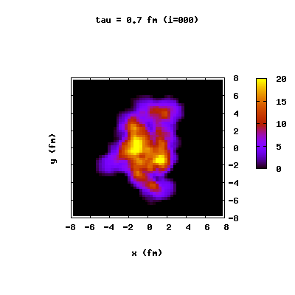
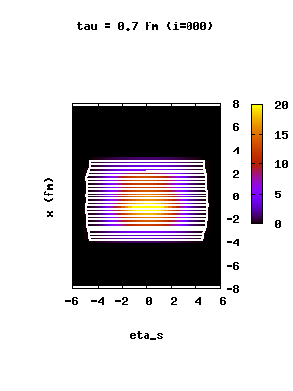
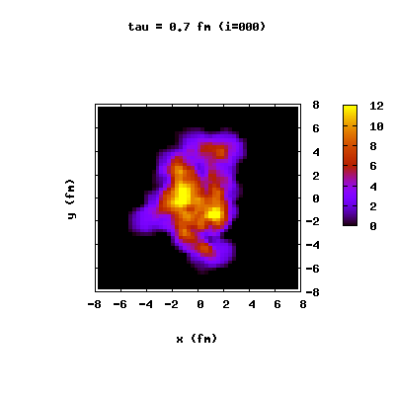
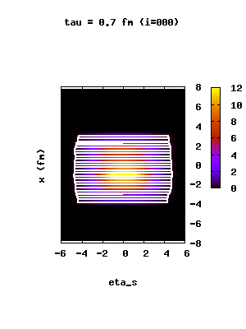
Hydrodynamic evolutions
without HF
τT ^{ττ}
conventional 2nd-order
viscous hydro
y [fm]
x [fm]
x [fm]
η_{s}
with HF
2nd-order fluctuating hydro
y [fm]
x [fm]
x [fm]
η_{s}

Slide 11
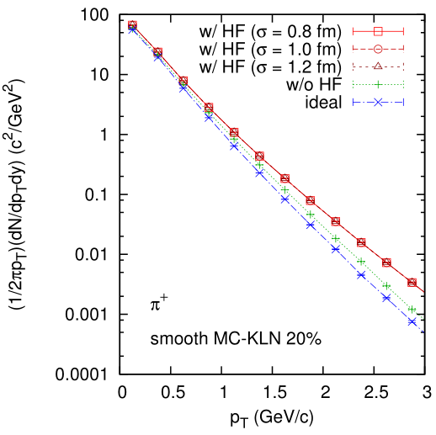
p_{T}-spectra (pions)
K. Murase, T. Hirano, QM 2015 NPA 956, 276 (2016)
local flows by hydro fluctuations
AuAu 200 GeV
For fixed I.C.
High-pt particles increase with HF ← accelerated by local flows
Need renormalization of f(x, p) in Cooper-Frye formula?

Slide 12
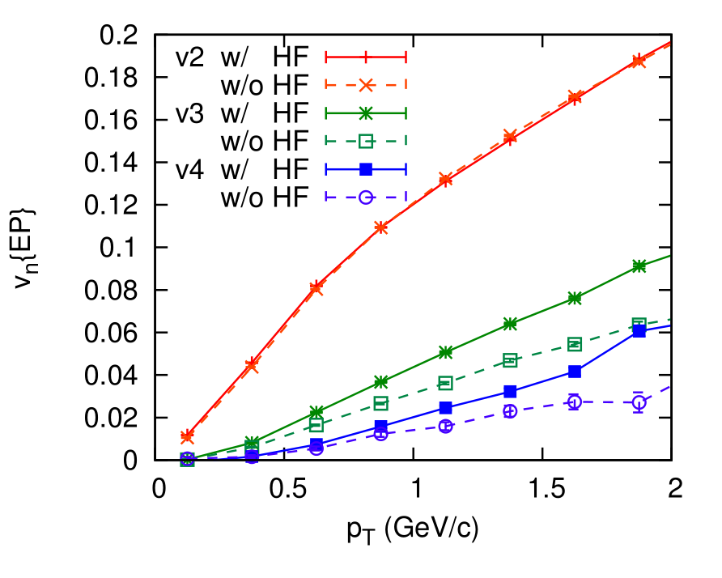
v_{n}{EP} vs p_{T}
K. Murase, T. Hirano, QM 2015 NPA 956, 276 (2016)
EP: η-sub,
|η| = 1.0-2.8
AuAu 200 GeV, MC-KLN
20-30%
v₂: (IS Fluct.) + (HF) + (Collision geometry)
v₃, v₄: (IS Fluct.) + (HF)

Slide 13
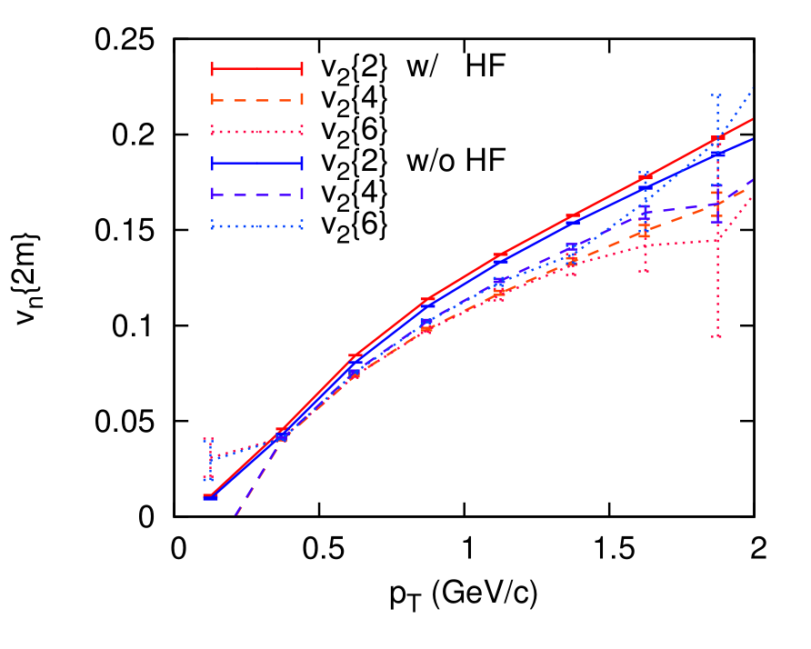
v_{n}{2m} vs p_{T}
K. Murase, T. Hirano, QM 2015 NPA 956, 276 (2016)
v{2}² ＝ v² ＋ σ²,
v{4}² , v{6}² ～ v² － σ²,
～ flow fluct.
AuAu 200 GeV, MC-KLN
20-30%
v{4}² ＝ v{6}² ＜ v{2}²
flow fluctuations σ: larger with HF

Slide 14
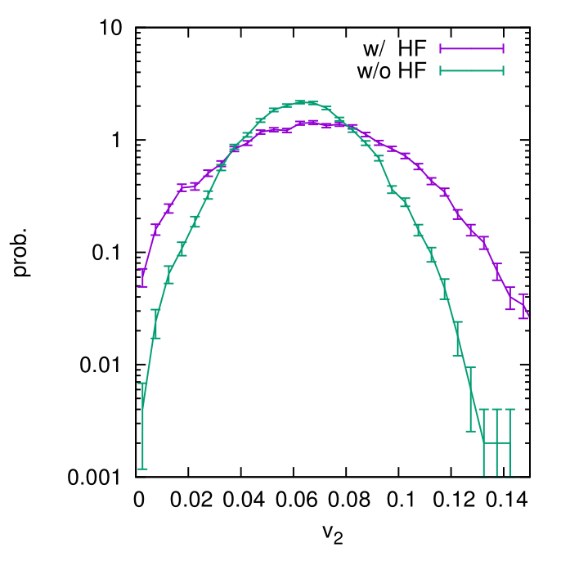
E-by-E distribution of v₂
K. Murase, T. Hirano, QM 2015 NPA 956, 276 (2016)
v{2}² ＝ v² ＋ σ²,
v{4}² , v{6}² ～ v² － σ²,
AuAu 200 GeV, MC-KLN
20-30%
Broader distribution of v₂

Slide 15
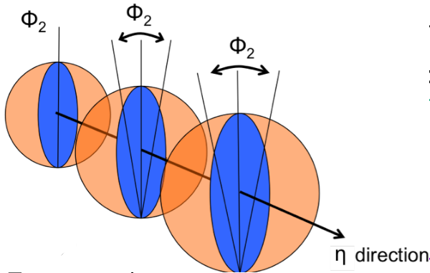
Longitudinal decorrelation
Flow decorrelations in rapidity direction
J. Jia, and P. Huo,
Phys. Rev. C 90, 034905 (2014),
〜 cos[n(Φ_{a}-Φ_{b})]
CMS, Phys. Rev. C92, 034911 (2015)
If there is no rapidity dependence of flow → r_{n}(ηª, η^{b}) = 1
Longitudinal fluctuations
Event-plane decorrelation (twist)
Flow magnitude decorrelation (asymmetric flow)
→ r_{n}(ηª, η^{b}) < 1

Slide 16
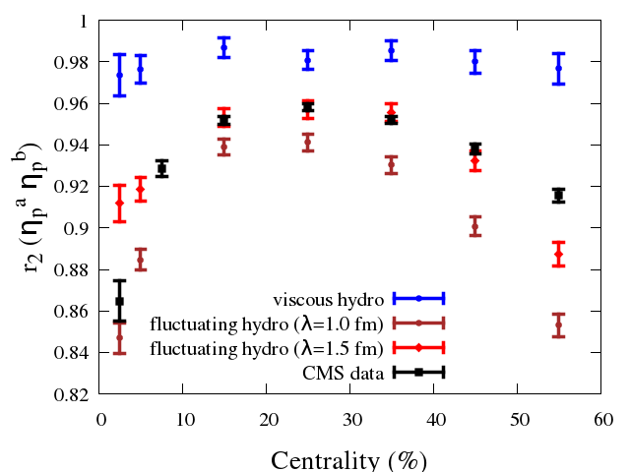
Factorization ratio $r_{2}\left(η_{p}^{a},η_{p}^{b}\right)$
K. Murase, A. Sakai, T. Hirano, PLB 829, 137053 (2022)
Hydrodynamic fluctuations
Longitudinal decorrelation
Pb+Pb 2.76 TeV MC-Glauber
0-10%: cutoff λ = 1.0
10-50%: cutoff λ = 1.5
Centrality dependence cannot be reproduced
only by hydro fluctuations
$2.0<η_{p}^{a}<2.5$,$3.0<η_{p}^{b}<4.0$

Slide 17
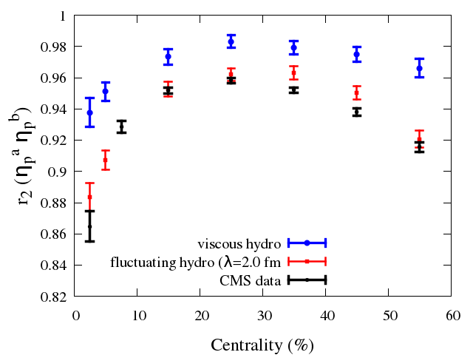
Factorization ratio $r_{2}\left(η_{p}^{a},η_{p}^{b}\right)$
A. Sakai, K. Murase, T. Hirano, PLB 829, 137053 (2022)
Hydrodynamic fluctuations
+
Initial longitudinal fluctuations
(PYTHIA×Modified BGK model)
Pb+Pb 2.76 TeV MC-Glauber
Reproduce centrality dependence of data
Both fluctuations are important to understand
factorization ratio
$2.0<η_{p}^{a}<2.5$,$3.0<η_{p}^{b}<4.0$

Slide 18
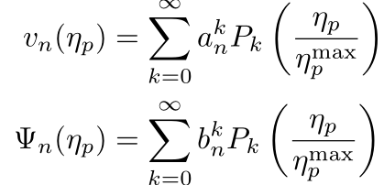
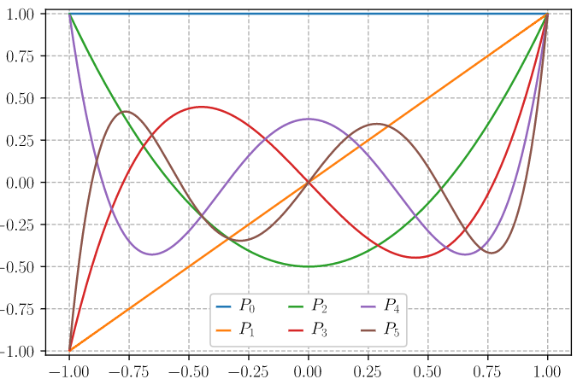
Legendre coefficient of flow
Sakai, KM, Hirano, PRC102, 064903 (2020)
Fourier expansion for φ dependence
→ Flow coefficients
Expansion in η_{p} direction
P_{k}: Legendre polynomials
Mixed correlation in rapidity direction?
Notes:
Pk ルジャンドル多項式

Slide 19
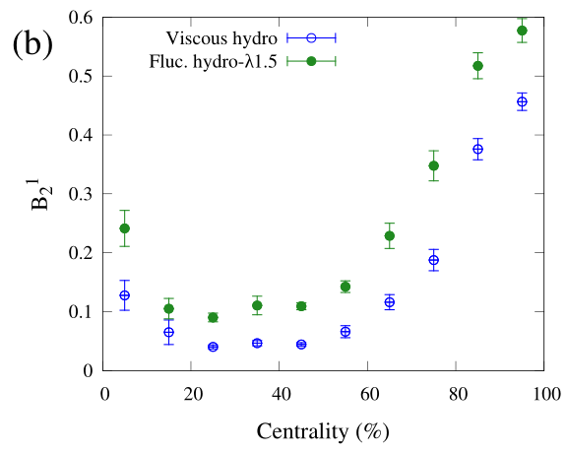
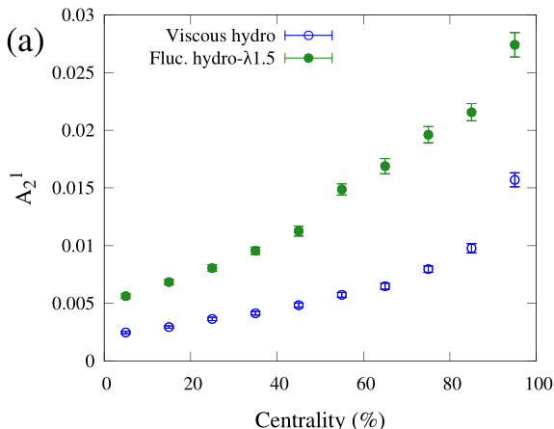
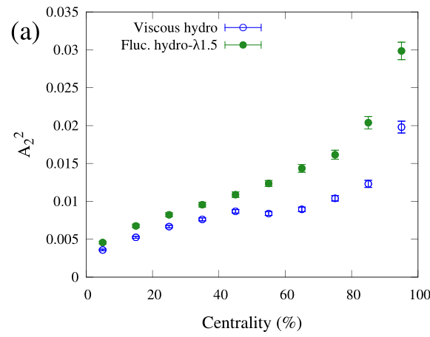
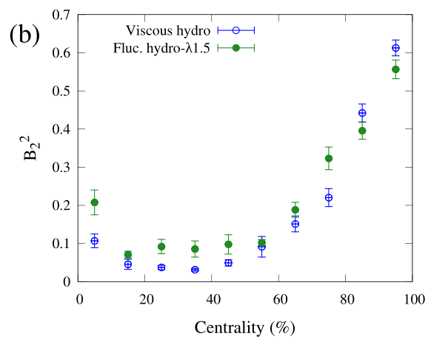
Legendre coefficients of flow
Sakai, KM, Hirano, PRC102, 064903 (2020)
A¹
B¹
P₁(z) Magnitude fluctuations
P₁(z) Twist
A²
P₂(z) Magnitude fluctuations
B²
P₂(z) Twist

Slide 20
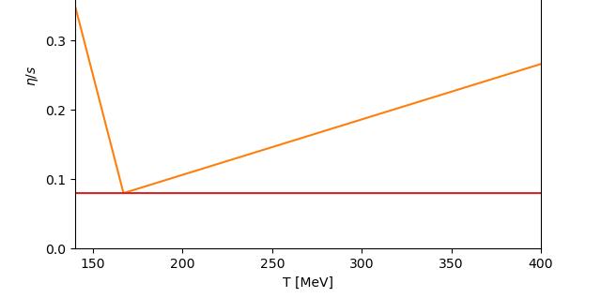
Dynamical model with hydro fluctuations
K. Oshima, K. Murase, A. Sakai, C. Nonaka
4. Hadronic cascade (UrQMD)
time
3. Particlization by frzout
S. Pratt and G. Torrieri, PRC 82 044901 (2010)
2. (3+1)-dim. relativistic fluctuating hydrodynamics (rfh) EoS: η/s:
M. Bluhm, P. Alba, W. Alberico, A. Beraudo and C. Ratti, Nucl. Phys. A 929 (2014) 157
temperature-dependent
collision axis
0
1. Initial state model TRENTo (p = 0)

Slide 21
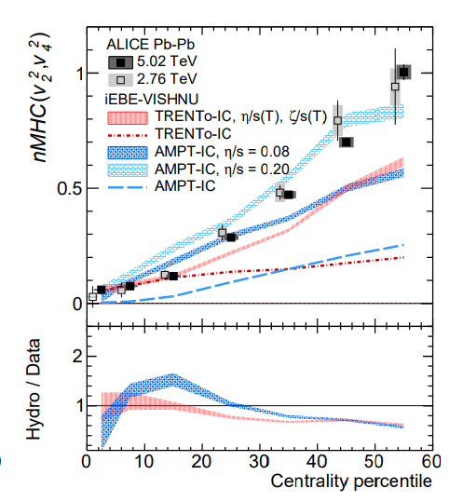
Mixed harmonic cumulants (MHC)
MHC Examples
$$MHC\left(v_{2}^{2},v_{3}^{2}\right)=⟨v_{2}^{2}v_{3}^{2}⟩−⟨v_{2}^{2}⟩⟨v_{3}^{2}⟩$$
$$MHC\left(v_{2}^{2},v_{4}^{2}\right)=⟨v_{2}^{2}v_{4}^{2}⟩−⟨v_{2}^{2}⟩⟨v_{4}^{2}⟩$$
$$MHC\left(v_{2}^{4},v_{3}^{2}\right)=⟨v_{2}^{4}v_{3}^{2}⟩−4⟨v_{2}^{2}v_{3}^{2}⟩⟨v_{2}^{2}⟩−⟨v_{2}^{4}⟩⟨v_{3}^{2}⟩+4{⟨v_{2}^{2}⟩}^{2}⟨v_{3}^{2}⟩$$
Existing studies (w/o hydro fluctuations)
$$η/s=0.20$$
etc.
$$nMHC\left(v_{m}^{k},v_{n}^{l}\right)=\frac{MHC\left(v_{m}^{k},v_{n}^{l}\right)}{⟨v_{m}^{k}⟩⟨v_{n}^{l}⟩}$$
Normalized MHC Examples
$$η/s=0.08$$
etc.
MHC may be used for more detailed constraints of the models
ALICE Collaboration, Phys. Lett. B 818, (2021) 136354
Ming Li, You Zhou, Wenbin Zhao, Baochi Fu, Yawen Mou, and Huichao Song, Pays. Rev. C 104, (2021) 024903
Notes:
etc

Slide 22
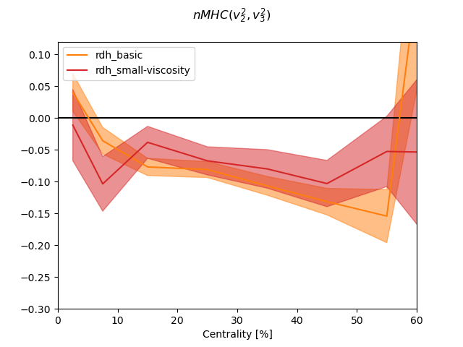
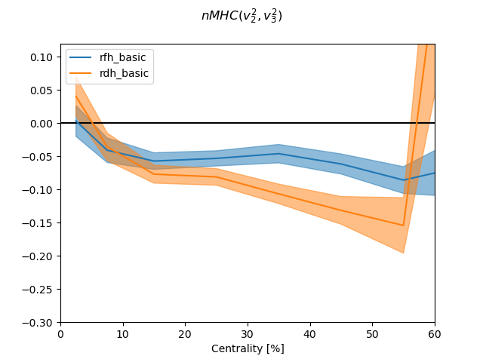
$$nMHC\left(v_{2}^{2},v_{3}^{2}\right)$$
$$v_{3}$$
$$v_{2}$$
K. Oshima, K. Murase, A. Sakai, C. Nonaka (Preliminary)
Effect of viscosity
Effect of hydro fluctuations
rdh： η/s = KSS bound
rfh：hydro fluctuations
rdh：no fluctuations
rdh： temperature dependent η/s
No dependence on viscosity Sensitive to hydrodynamic fluctuations
*Note: does not reproduce data with the current parameter set

Slide 23
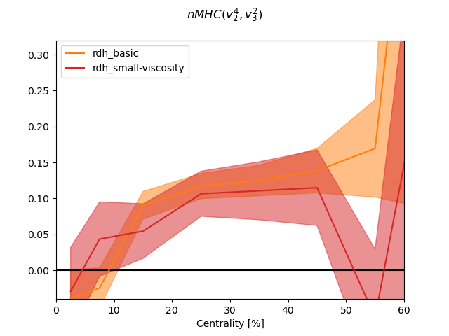
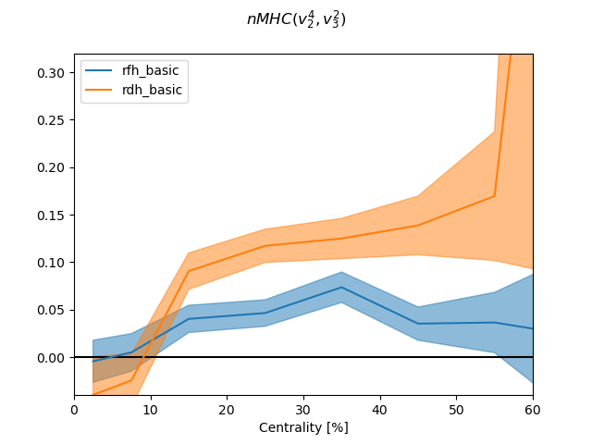
$$nMHC\left(v_{2}^{4},v_{3}^{2}\right)$$
$$v_{3}$$
$$v_{2}$$
K. Oshima, K. Murase, A. Sakai, C. Nonaka (Preliminary)
Effect of viscosity
Effect of hydro fluctuations
rdh： η/s = KSS bound
rdh：no fluctuations
rdh： temperature dependent η/s
rfh：hydro fluctuations
No dependence on viscosity Sensitive to hydrodynamic fluctuations
*Note: does not reproduce data with the current parameter set

Slide 24
Discussion

Slide 25
Hydrodynamic fluctuations and observables
Q. Any observables sensitive to only hydro fluctuations?
A. Currently, it is hard to find such observables
Randomness in the model
Initial Impact param (～centrality), Nucleon dist, internal structure, Many other random processes
All the fluctuations are accumulated in the final-state hadron spectra
Time evolution
Hydro Hydrodynamic fluctuations, hydro-jet interaction, etc.
Hadron gas Particlization (MC sampling based on Cooper-Frye formula), decay, rescattering, etc.

Slide 26
Hydrodynamic fluctuations and observables
Q. Any observables sensitive to only hydro fluctuations?
A. Currently, it is hard to find such observables
Randomness in the model
Initial Impact param (～centrality), Nucleon dist, internal structure, Many other random processes
All the fluctuations are accumulated in the final-state hadron spectra
Time evolution
Hydro Hydrodynamic fluctuations, hydro-jet interaction, etc.
Hadron gas Particlization (MC sampling based on Cooper-Frye formula), decay, rescattering, etc.
～ related to thermal fluctuations

Slide 27
Thermal fluctuations
= Uncertainty due to reduction of degrees of freedom (dof)
System that we are interested in (macroscopic dof)
Thermal bath (the rest microscopic dof)
Relevant dof, slow, long wavelength
Integrated dof, fast, short wavelength
Thermal fluctuations depend on the dof that we explicitly consider in the description … “cutoff” dependence
Hydrodynamic fluctuations … error associated with “hydro description” of a real system
Are hydrodynamic fluctuations “observable quantity” in the sense that it is model-independently well-defined? … (No, but still important within the model descriptions)
Notes:
平衡からのずれとしての熱揺らぎ

Slide 28
Summary

Slide 29
Summary
Observables with stochastic hydrodynamics for HIC
Hydrodynamic fluctuations (HF) affect various observables
Longitudinal factorization ratio and mixed harmonic cumulants may be important observables for HF
Hard to find observables that is sensitive to only HF?
Is HF well-defined independently of the model?
Future modeling
There are still many parts to improve/fix dynamical modeling with HF
Renormalization of transport coefficients/EoS
Renormalization of distribution func f(x, p) in Cooper-Frye formula
Renormalization of initial condition
Stable, efficient, and accurate numerical scheme
…
[talk by N. Touroux (Thu)]

Slide 30
Backup: Modeling

Slide 31
Ito/Stratonovich integral
Structure of 2nd order hydro:
noise
τ: proper time
→ No difference between Ito/Stratonovich integral
Stratonovich product
dτ
0
Ito product
With relaxation time, the noise is essentially colored
K. Murase, Ph.D. Thesis (The University of Tokyo), Sec. 6.4 (2015)

Slide 32
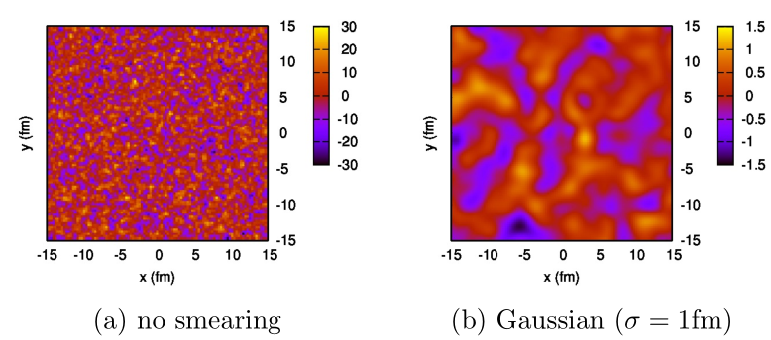
Cutoff of fluctuating hydrodynamics
Noise autocorrelation ～ δ⁽⁴⁾(x-x’)
Hydrodynamics is non-linear eq system
→ Non-trivial continuum limit of fluct hydro
Regularization: cutoff length λ (or cutoff momentum Λ=1/λ)
～ coarse graining scale > microscopic scale
Noise term w(x) is smeared by Gaussian distr. with finite width
→ Renormalization of transport coeff and EoS to cancel the cutoff dependence of the bulk property

Slide 33
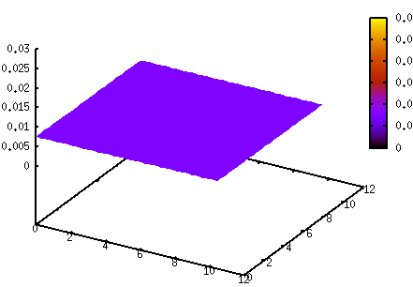
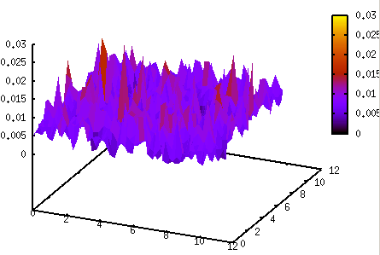
Renormalization of EoS/viscosity
λ-dependence of EoS and transport coefficients
e.g. Decomposition of energy density in equilibrium
〈T⁰⁰〉 = e = 〈e_{λ}〉 + 〈(e_{λ}+P_{λ})u_{λ}² + π_{λ}⁰⁰〉
internal energy
in ordinary sense
“internal” energy
“kinetic” energy
Global equilibrium in Conventional hydrodynamics
Global equilibrium in Fluctuating hydrodynamics
Notes:
Finally I would like to mention the cutoff length scale of the hydrodynamic fluctuations.
In order to calculate the non-linear dynamics of the hydrodynamic fluctuations,
we have to introduce the cutoff length scale or the coarse-graining scale of the hydrodynamic fluctuations
where shorter wavelength of the fluctuations are not considered.
At the same time, we have to consider the modification
of the EoS and transport coefficients by the hydrodynamic fluctuations.
As an example. let’s consider the decomposition of energy density in global equilibrium.
For the case of the global equilibrium, the solution of the conventional hydrodynamics becomes constant static one.
However, in the actual system, there are locally thermal fluctuations as in the fluctuating hydrodynamics.
In two cases the energy density T00 are decomposed differently.
The energy density in the conventional calculations
are seperated into two different parts: apparent internal energy and apparent kinetic energy.
This means that in fluctuating hydrodynamics, some part of
the internal degrees of freedom are desribed dynamically,
so a part of the internal energy is changed to kinetic energy.

Slide 34
Renormalization of EoS/viscosity
λ-dependence of EoS and transport coefficients
e.g. Decomposition of energy density in equilibrium
〈T⁰⁰〉 = e = 〈e_{λ}〉 + 〈(e_{λ}+P_{λ})u_{λ}² + π_{λ}⁰⁰〉
internal energy
in ordinary sense
“internal” energy
“kinetic” energy
Every “macroscopic” quantities (e_{λ}, u_{λ}, etc.) are redefined for each cutoff λ.
Macroscopic relations such as viscosity, EoS, etc. should be renormalized not to change the bulk properties (k→0, ω→0)
Additional terms in hydrodynamic eqs: “long-time tail”
P. Kovtun, et al., Phys. Rev. D68, 025007 (2003); P. Kovtun, et al., Phys. Rev. D84, 025006 (2011); P. Kovtun, J. Phys. A45, 473001 (2012); Y. Akamatsu, et al., Phys. Rev. C95, 014909 (2017); Y. Akamatsu, et al., Phys. Rev. C97, 024902 (2018)
Notes:
Finally I would like to mention the cutoff length scale of the hydrodynamic fluctuations.
In order to calculate the non-linear dynamics of the hydrodynamic fluctuations,
we have to introduce the cutoff length scale or the coarse-graining scale of the hydrodynamic fluctuations
where shorter wavelength of the fluctuations are not considered.
At the same time, we have to consider the modification
of the EoS and transport coefficients by the hydrodynamic fluctuations.
As an example. let’s consider the decomposition of energy density in global equilibrium.
For the case of the global equilibrium, the solution of the conventional hydrodynamics becomes constant static one.
However, in the actual system, there are locally thermal fluctuations as in the fluctuating hydrodynamics.
In two cases the energy density T00 are decomposed differently.
The energy density in the conventional calculations
are seperated into two different parts: apparent internal energy and apparent kinetic energy.
This means that in fluctuating hydrodynamics, some part of
the internal degrees of freedom are desribed dynamically,
so a part of the internal energy is changed to kinetic energy.

Slide 35
Other renormalization
Cooper-Frye formula: How to sample hadrons from (e_{λ}, u_{λ}^{μ}, π_{λ}^{μν}, Π_{λ})?
Initialization model (from partons, etc.): Width and shape of smearing kernel should match with those in fluctuating hydrodynamics?
?
(e_{λ}, u_{λ})
Larger λ
Smaller λ
Renormalization?
larger internal energy e_{λ}
smaller initial flow u_{λ}
smaller internal energy e_{λ}
larger initial flow u_{λ}

Slide 36
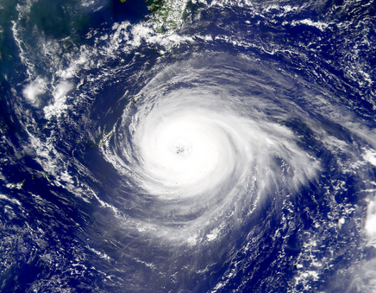
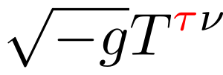
Conservation in curved coordinate
Conservation
Conservation in curved coordinate T^{μν}=A^{μ}_{α}A^{ν}_{β}T^{αβ}
Conservation for “mixed” tensor T^{μν}=A^{μ}_{α}T^{αν}
is conserved

Slide 37
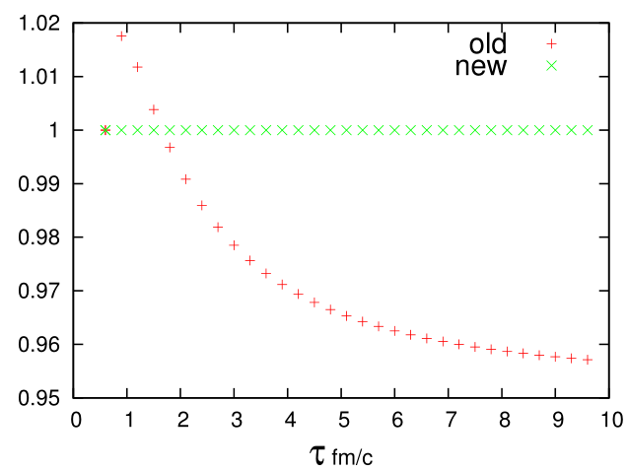
Conservation in curved coordinate
time evolution with √(-g)T^{τν}
⇔ time evolution with √(-g)T^{τν} with discretized Γ^{μ}_{αβ}
In a conservative scheme , Γ^{μ}_{αβ} should be discretized along with other derivatives of fields
discretized version of Γ
analytic expression of Γ
Yasuki Tachibana, KM

Slide 38
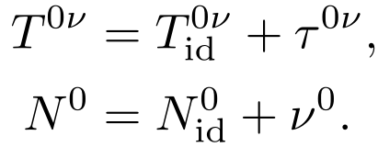
Conservation and dynamical variables
Conserved quantity Dynamical variables (representation of fields)
.
.
. ← This LRF: dissipative currents in local rest frame

Slide 39
Constitutive equation in LRF
In ordinary coordinate
In the local rest frame Rotation

Slide 40
Backup: observables

Slide 41
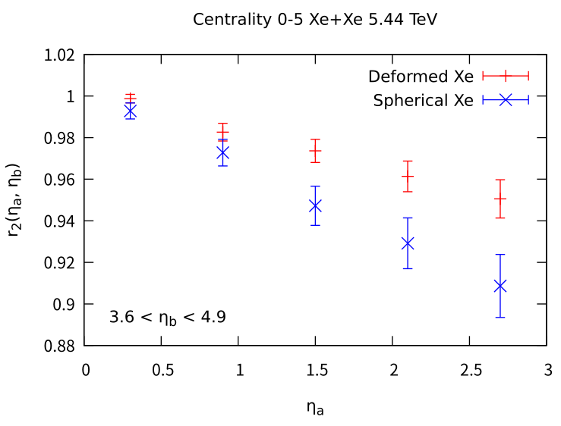
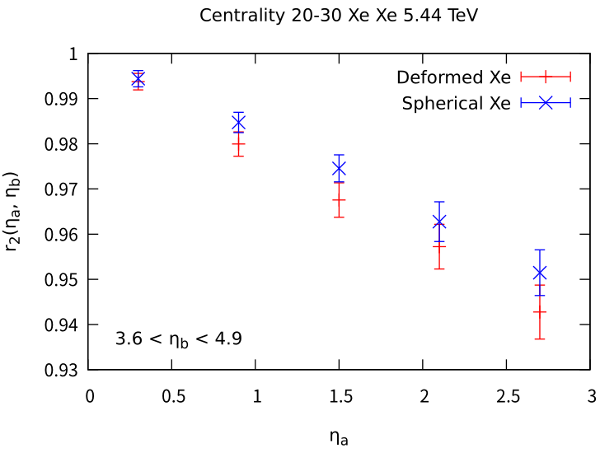
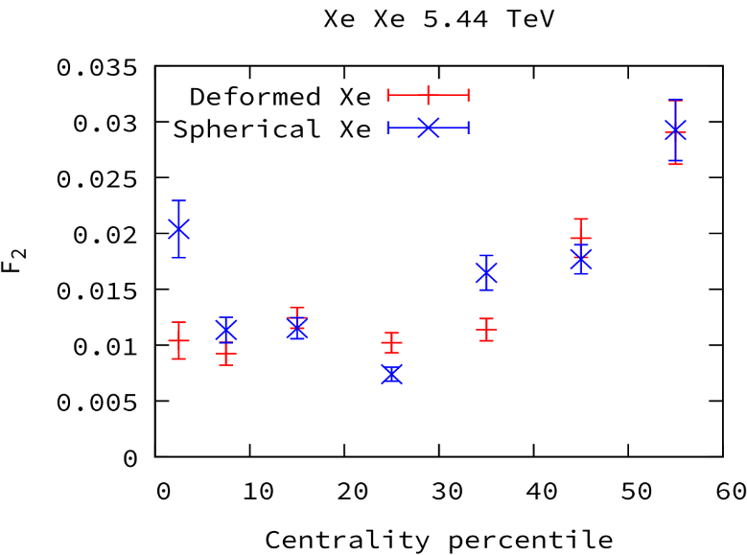
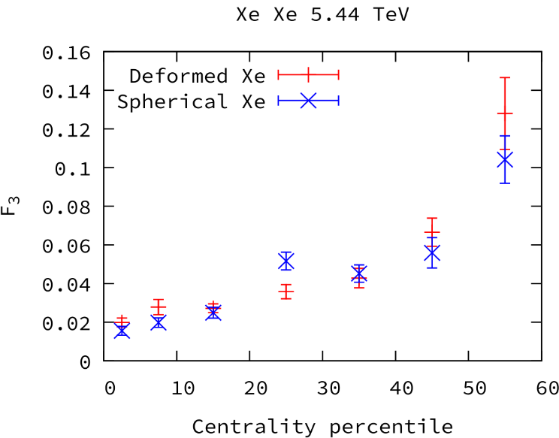
r_{n}(η_{p}ª,η_{p}^{b}) for deformed vs spherical Xe
KM, Sakai (Preliminary)
Xe+Xe 5.44 TeV
β₂ = 0.162,
β₄ = -0.003.
n = 2
n = 2
0-5%
20-30%
less decorrelate
← stronger
geometry
more decorrelate
Decorrelation by HF is affected by the deformation in central collisions
No clear difference in non-central collisions
Slope parameter F_{n}: r_{n}(η_{a}) = 1- 2 F_{n} η_{a}
… magnitude of decorrelation
Centrality dependence
Elliptic-flow decorr. in central collision is suppressed
n = 2
n = 3
Higher-order (n=4, 5) do not receive clear effects

Slide 42
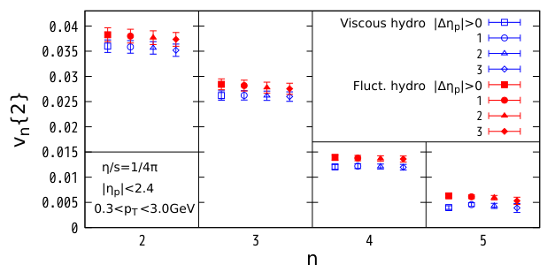
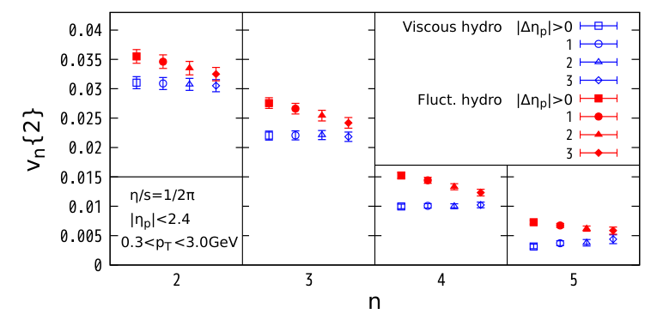
Effect of rapidity gap (ultra central PbPb)
Kuroki, Sakai, KM, Hirano, PLB 842 137958 (2023)
η/s = 1/4π
η/s = 1/2π

Slide 43
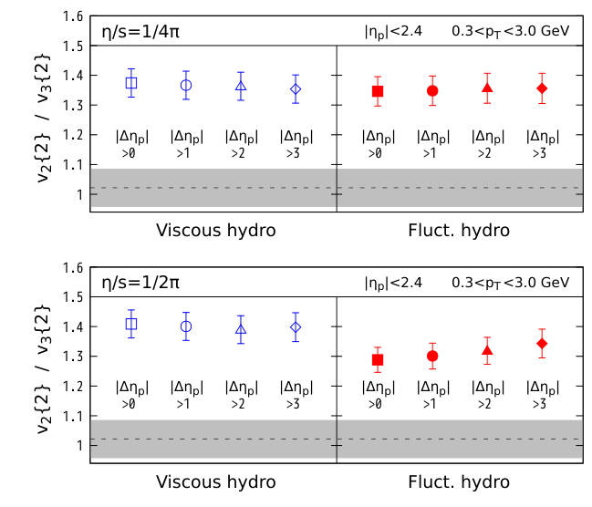
v2{2}/v3{2} for of ultra-central flow puzzle
Kuroki, Sakai, KM, Hirano, PLB 842 137958 (2023)
η/s = 1/4π
η/s = 1/2π

Slide 44
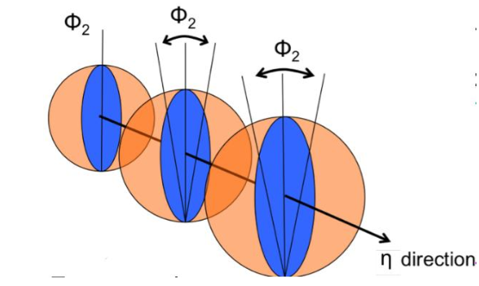
Longitudinal fluctuations
Observables for hydrodynamic fluctuations
= Observables in which other fluctuations have less effect?
Transverse dynamics … event-by-event fluctuations coming from the initial nucleon distribution
Longitudinal dynamics … less fluctuations from the nucleon distribution
Flow correlation between different rapidities
Jia and Huo, PRC90 034905 (2014)
〜 cos[n(Φ_{a}-Φ_{b})]

Slide 45
Hydrodynamic fluctuations in HIC
A
Ideally S(r) should be given by dynamical models of high-energy nuclear collision reactions
S. Pratt, PRL 102 (2009), P. Batyuk, I. Karpenko et al, PRC 96 (2017), P. Chakraborty, A.K. Pandey, S. Dash, EPJA 57 (2020), V.M. Shapoval, Y.M. Sinyukov, NPA 1016 (2021), D. Kincses, M. Stefaniak, M. Csanad, Entropy 24 (2022), K. Kuroki (2024), etc.
Modern dynamical model for HIC ~
Initial-state model
+
Relativistic hydrodynamics
+
Hadronic transport
IPGlasma, TRENTO, MCKLN, Glauber, …
VISH, MUSIC, CLVisc, vHLLE, rfh, (many)…
JAM, UrQMD, SMASH, …
QGP
Hadron gas
What is “emission” in this more realistic picture?
(1) End of hydro: many hadrons still interact
(2) End of hadronic transport: no interaction anymore
Should emission be somewhere between (1) and (2)?
+ Realistic modeling of hadron production?

