Slide 1
Causal hydrodynamic fluctuations in a one-dimensional expanding system
Workshop on Hydrodynamics and related observables in heavy-ion collisions @ Subatech/IMT-Atlantique, Nantes, France
S. Fujii and T. Hirano, Phys. Rev. C 109, 024916 (2024)
Shin-ei Fujii
Sophia University

Slide 2
OUTLINE
▸Introduction
▸Model
▸Results & Discussions
▸Summary

Slide 3
OUTLINE
▸Introduction
▸Model
▸Results & Discussions
▸Summary

Slide 4
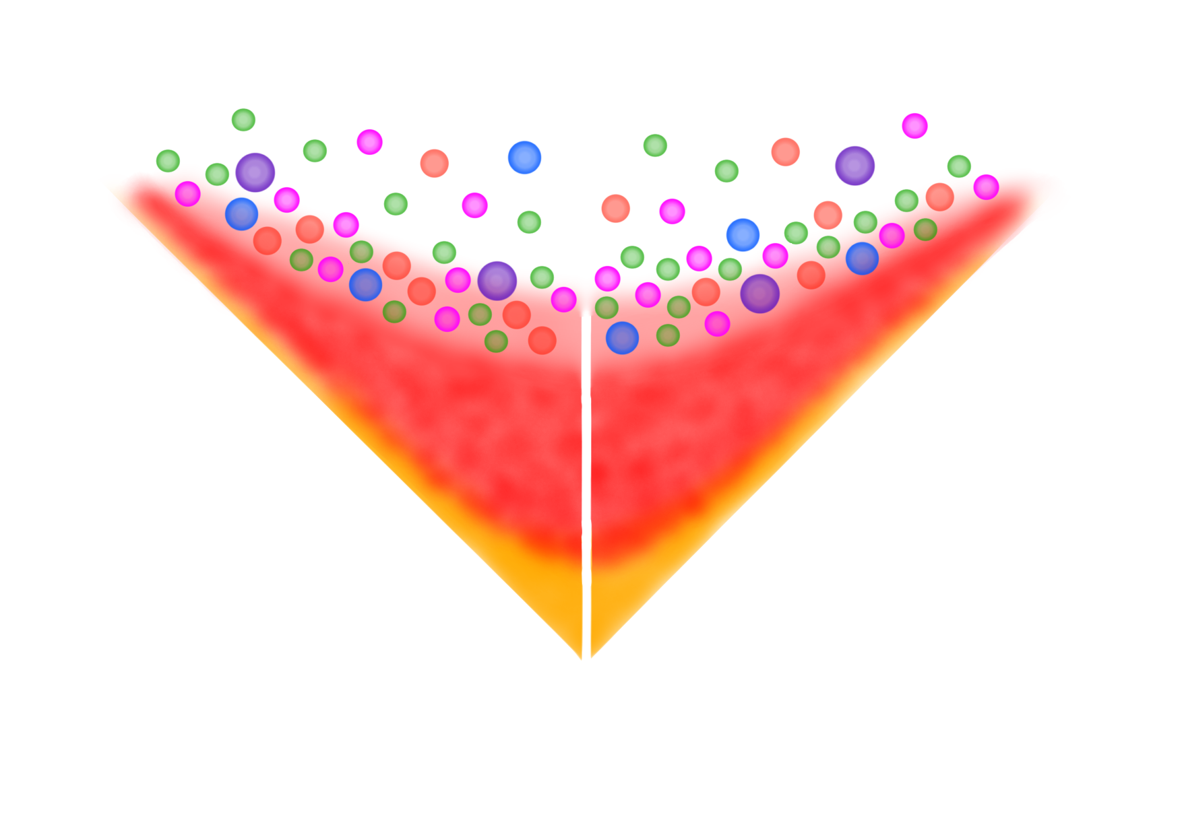



Event-by-event fluctuations in HIC
$$t$$
Finite number of particles
Hadrons
Critical fluctuation
Jets
Propagation of jets
QGP
Hydrodynamic fluctuation
Non-equilibrated
matter
Initial fluctuation
$$z$$
Nuclei
Effects of each fluctuation
on observables?
Space-time evolution of HIC reaction

Slide 5
Event-by-event fluctuations in HIC
$$t$$
Finite number of particles
Hadrons
Critical fluctuation
Jets
Propagation of jets
QGP
☛
Hydrodynamic fluctuation
Non-equilibrated
matter
Initial fluctuation
$$z$$
Nuclei
Effects of each fluctuation
on observables?
Space-time evolution of HIC reaction

Slide 6
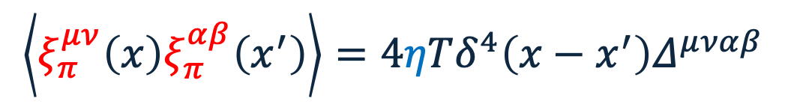
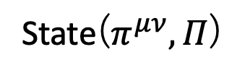

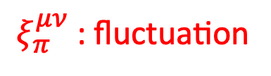
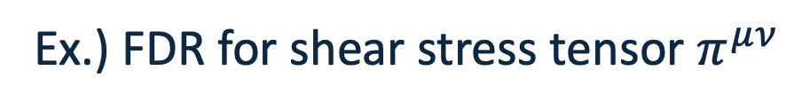
Fluctuation dissipation relation
Entropy
▪︎Dissipation (viscosity) and fluctuations
are always accompanied
Dissipation
▪︎Thermal equilibrium state is stable due to
the balance between them
Fluctuation
Dissipation
balance
Fluctuations
State($π^{μν}, Π$)
Ex.) FDR for shear stress tensor $π^{μν}$
Hydrodynamic fluctuations
should be incorporated
in the sophistication stage!
$$\left\langle ξ_{π}^{μν}\left(x\right)ξ_{π}^{αβ}\left(x^{′}\right)\right\rangle =4ηTδ^{4}\left(x−x^{′}\right)Δ^{μναβ}$$
$ξ_{π}^{μν}$: fluctuation
$η$: viscosity

Slide 7
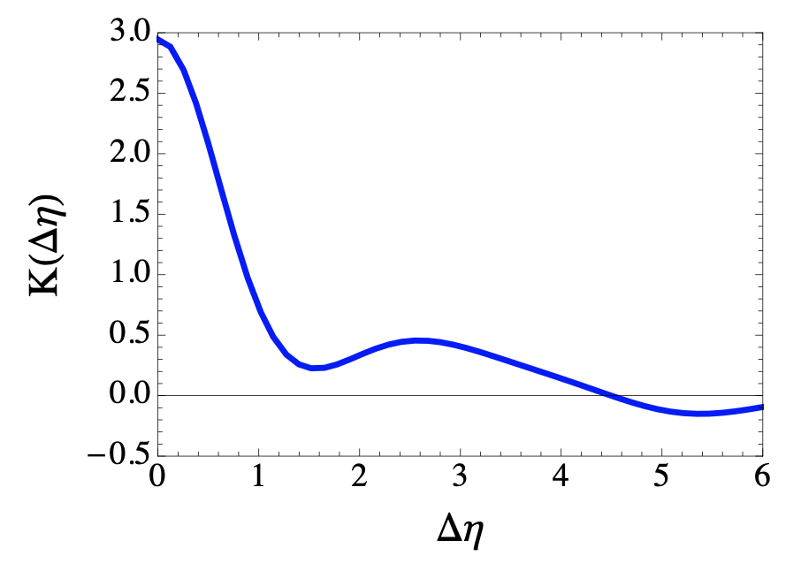

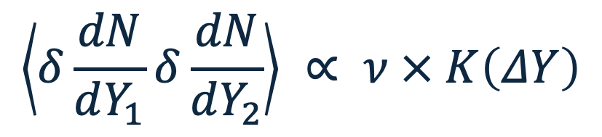





A study based on hydrodynamic fluctuations
J. I. Kapusta et al., Phys. Rev. C 85, 054906 (2012)
correlation function of pions
Correlation function of
particle number fluctuations
Autocorrelation
$$\left\langle δ\frac{dN}{dY_{1}}δ\frac{dN}{dY_{2}}\right\rangle ∝ ν × K\left(ΔY\right)$$
Sound front
Intensity
$$K\left(ΔY\right)$$
Sound velocity
$ν≡{\left({4η}/3+ζ\right)}/s$
$η$: shear viscosity
$ζ$: bulk viscosity
$K\left(ΔY\right)$: rapidity dependent part
$$ΔY$$
The correlation function depends on the properties of the medium
Constrain them from
experimental data!

Slide 8
OUTLINE
▸Introduction
▸Model
▸Results & Discussions
▸Summary

Slide 9
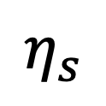
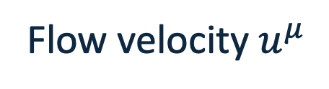
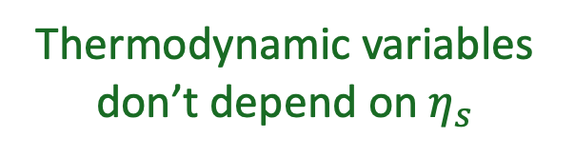

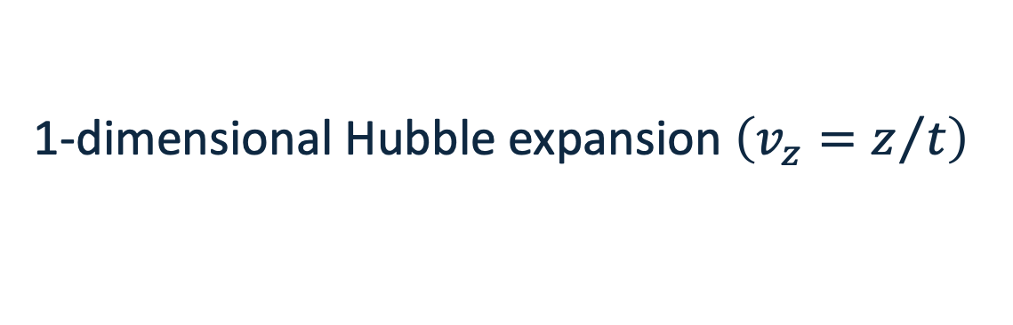

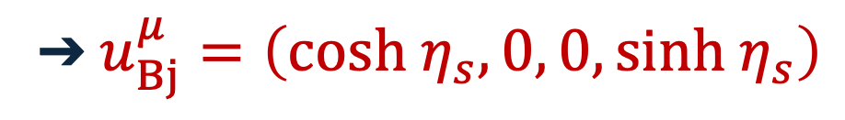
Bjorken’s scaling solution
J. D. Bjorken, Phys. Rev. D 27, 140-151 (1983)
Flow velocity $u^{μ}$
➔ $u_{Bj}^{μ}=\left(cosh η_{s}, 0, 0, sinh{ η}_{s}\right)$
$η_{s}=\frac{1}{2}ln\left(\frac{t+z}{t−z}\right)$: coordinate rapidity
1-dimensional Hubble expansion $\left(v_{z}=z/t\right)$
$τ=\sqrt{t^{2}−z^{2}}$: proper time
Boost invariant
Thermodynamic variables don’t depend on $η_{s}$
Good approximation
in heavy ion collision!
$$η_{s}$$

Slide 10

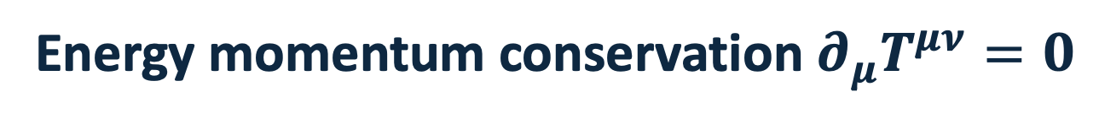
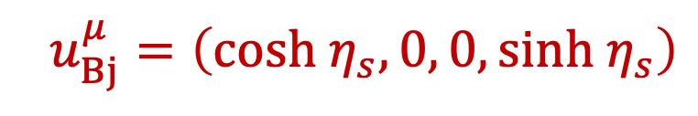

Perturbative expansion
J. I. Kapusta et al., Phys. Rev. C 85, 054906 (2012)
C. Chattopadhyay et al., Phys. Rev. C 97, 054902 (2018)
Bjorken’s solution
$u_{Bj}^{μ}=\left(cosh η_{s}, 0, 0, sinh{ η}_{s}\right)$
Small deviations
$$u^{μ}→\left(cosh\left(η_{s}+δy\left(τ,η_{s}\right)\right), 0, 0, sinh\left(η_{s}+δy\left(τ,η_{s}\right)\right)\right)$$
$$e→e_{0}\left(τ\right)+δe\left(τ,η_{s}\right)$$
etc.
etc.
$e$: energy density
Energy momentum conservation $∂_{μ}T^{μν}=0$
Balance equation for background (0th order perturbation)
Balance equation for fluctuation (1st order perturbation)

Slide 11



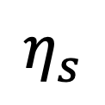

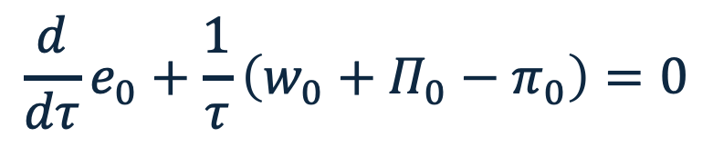

Balance equations
$$e$$
Total
Background
Background
$$\frac{d}{dτ}e_{0}+\frac{1}{τ}\left(w_{0}+Π_{0}−π_{0}\right)=0$$
Fluctuation
$$η_{s}$$
Any constitutive equation can be employed
Fluctuation
$$\frac{∂}{∂τ}\left(\begin{aligned}δe \\ δy\left(w_{0}+Π_{0}−π_{0}\right)\end{aligned}\right)+\frac{1}{τ}\frac{∂}{∂η_{s}}\left(\begin{aligned}δy\left(w_{0}+Π_{0}−π_{0}\right) \\ δp+δΠ−δπ\end{aligned}\right)+\frac{1}{τ}\left(\begin{aligned}δw+δΠ−δπ \\ 2δy\left(w_{0}+Π_{0}−π_{0}\right)\end{aligned}\right)=0$$
➔ No longer boost invariant
$w=e+p$: enthalpy density,
$p$: hydrostatic pressure,
$Π$: bulk pressure,
$π≡π^{00}−π^{33}$: shear pressure

Slide 12
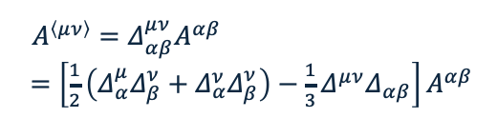

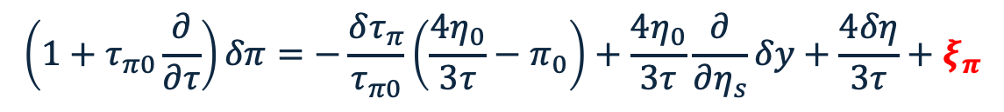
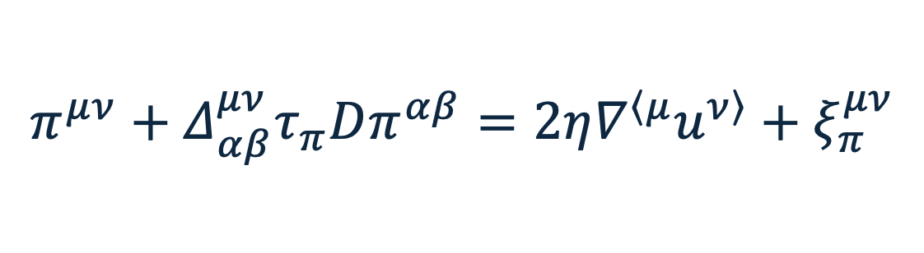
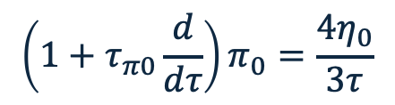


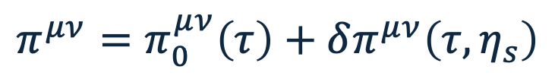




Constitutive equations
W. Israel and J. M. Stewart, Annals Phys. 118, 341 (1979)
$$D=u^{μ}∂_{μ}$$
Israel-Stewart equation + noise
$ξ_{π}^{μν}$: noise
$$π^{μν}+Δ_{αβ}^{μν}τ_{π}Dπ^{αβ}=2η∇^{\left\langle μ\right.}u^{\left.ν\right\rangle }+ξ_{π}^{μν}$$
$τ_{π}$: relaxation time
$$Δ^{μν}=g^{μν}−u^{μ}u^{ν}$$
relaxation term
➔ causal hydro
noise
➔ fluctuations
$$g^{μν}=diag\left(1, −1, −1, −1\right)$$
$A^{\left\langle μν\right\rangle }=Δ_{αβ}^{μν}A^{αβ}$
$=\left[\frac{1}{2}\left(Δ_{α}^{μ}Δ_{β}^{ν}+Δ_{α}^{ν}Δ_{β}^{ν}\right)−\frac{1}{3}Δ^{μν}Δ_{αβ}\right]A^{αβ}$
Perturbative expansion (around Bjorken’s solution)
$$π^{μν}=π_{0}^{μν}\left(τ\right)+δπ^{μν}\left(τ,η_{s}\right)$$
etc.
Background
Fluctuation
$$\left(1+τ_{π0}\frac{d}{dτ}\right)π_{0}=\frac{4η_{0}}{3τ}$$
$$\left(1+τ_{π0}\frac{∂}{∂τ}\right)δπ=−\frac{δτ_{π}}{τ_{π0}}\left(\frac{4η_{0}}{3τ}−π_{0}\right)+\frac{4η_{0}}{3τ}\frac{∂}{∂η_{s}}δy+\frac{4δη}{3τ}+ξ_{π}$$
$π≡π^{00}−π^{33}$,
$$ξ_{π}≡ξ_{π}^{00}−ξ_{π}^{33}$$

Slide 13
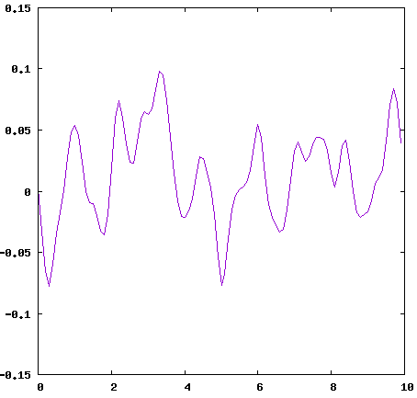


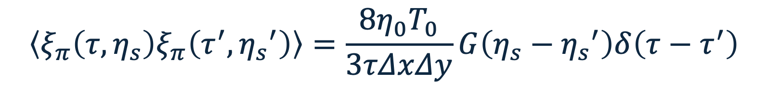






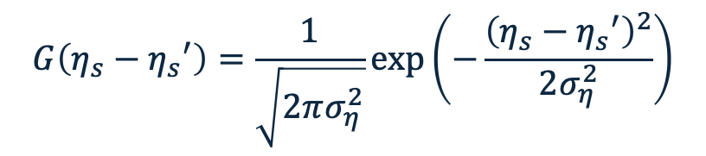
Fluctuation dissipation relation
FDR for shear pressure
$$\left\langle ξ_{π}\left(τ,η_{s}\right)ξ_{π}\left(τ^{′},{η_{s}}^{′}\right)\right\rangle =\frac{8η_{0}T_{0}}{3τΔxΔy}G\left(η_{s}−{η_{s}}^{′}\right)δ\left(τ−τ^{′}\right)$$
correlation in $η_{s}$
No correlation in $τ$
$$\left\langle ξ_{π}\left(τ,η_{s}\right)\right\rangle =0$$
$$G\left(η_{s}−{η_{s}}^{′}\right)=\frac{1}{\sqrt{2πσ_{η}^{2}}}exp\left(−\frac{{\left(η_{s}−{η_{s}}^{′}\right)}^{2}}{2σ_{η}^{2}}\right)$$
Fluctuation
$η_{0}$: shear viscosity of background
$$Δx=Δy=2 fm$$
$T_{0}$: temperature of background
$$σ_{η}=0.1$$
$$η_{s}$$

Slide 14
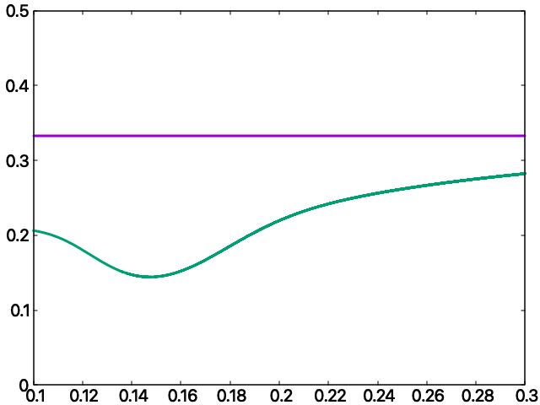

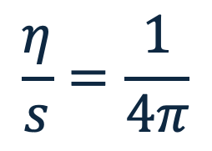


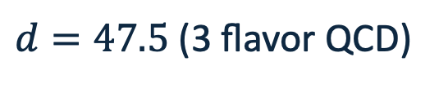

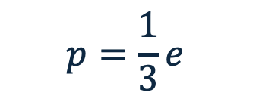

EoS and transport coefficients
Conformal EoS
Shear viscosity
$$p=\frac{1}{3}e$$
$$\frac{η}{s}=\frac{1}{4π}$$
$d=47.5$ (3 flavor QCD)
or
Lattice EoS
$$\frac{p_{id}+{a_{n}}/{\overline{t}}+{b_{n}}/{{\overline{t}}^{2}}+{c_{n}}/{{\overline{t}}^{3}}+{d_{n}}/{{\overline{t}}^{4}}}{1+{a_{d}}/{\overline{t}}+{b_{d}}/{{\overline{t}}^{2}}+{c_{d}}/{{\overline{t}}^{3}}+{d_{d}}/{{\overline{t}}^{4}}}$$
P. Kovtun et al., Phys. Rev. Lett. 94, 111601 (2005)
$$\frac{p}{T^{4}}=\left(1+tanh\left(c_{t}\left(\overline{t}−t_{0}\right)\right)\right)$$
Relaxation time
A. Bazavov et al., Phys. Rev. D 90, 094503 (2014)
Speed of sound in both EoSs
$$τ_{R}=\frac{2−ln⁡2}{2πT}$$
Conformal EoS:
Always constant (=1/3)
Conformal EoS
Lattice EoS:
Always smaller than that
of conformal EoS and non- monotonic behaviour
S. Bhattacharyya et al., JHEP 02, 045 (2008)
$$c_{s}^{2}$$
R. Baier et al., JHEP 04, 100 (2008)
Lattice EoS
※ Neglect bulk pressure in this study
for simplicity
$$T GeV$$

Slide 15
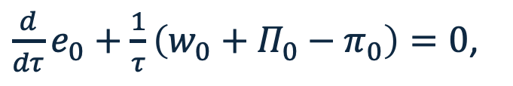
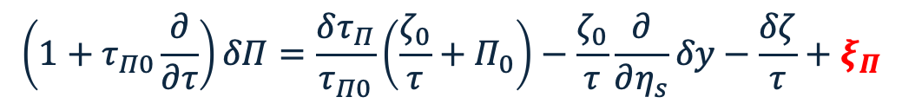
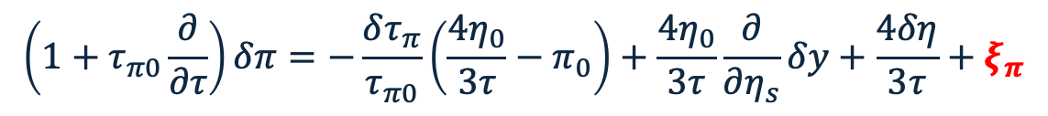
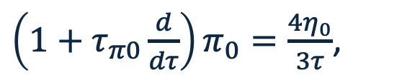
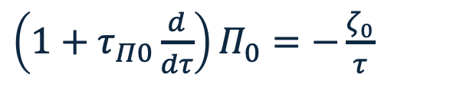
Summary of equations
Background (0th order perturbation)
$\frac{d}{dτ}e_{0}+\frac{1}{τ}\left(w_{0}+Π_{0}−π_{0}\right)=0$,
$\left(1+τ_{π0}\frac{d}{dτ}\right)π_{0}=\frac{4η_{0}}{3τ}$,
$\left(1+τ_{Π0}\frac{d}{dτ}\right)Π_{0}=−\frac{ζ_{0}}{τ}$
Fluctuation (1st order perturbation)
$$\frac{∂}{∂τ}\left(\begin{aligned}δe \\ δy\left(w_{0}+Π_{0}−π_{0}\right)\end{aligned}\right)+\frac{1}{τ}\frac{∂}{∂η_{s}}\left(\begin{aligned}δy\left(w_{0}+Π_{0}−π_{0}\right) \\ δp+δΠ−δπ\end{aligned}\right)+\frac{1}{τ}\left(\begin{aligned}δw+δΠ−δπ \\ 2δy\left(w_{0}+Π_{0}−π_{0}\right)\end{aligned}\right)=0$$
$$\left(1+τ_{π0}\frac{∂}{∂τ}\right)δπ=−\frac{δτ_{π}}{τ_{π0}}\left(\frac{4η_{0}}{3τ}−π_{0}\right)+\frac{4η_{0}}{3τ}\frac{∂}{∂η_{s}}δy+\frac{4δη}{3τ}+ξ_{π}$$
FDR
EoS
Transport coefficients
+
$$\left(1+τ_{Π0}\frac{∂}{∂τ}\right)δΠ=\frac{δτ_{Π}}{τ_{Π0}}\left(\frac{ζ_{0}}{τ}+Π_{0}\right)−\frac{ζ_{0}}{τ}\frac{∂}{∂η_{s}}δy−\frac{δζ}{τ}+ξ_{Π}$$
Solve these Simultaneous Stochastic Differential Equations
➔ event-by-event/event-averaged analysis of hydrodynamic fluctuations

Slide 16
OUTLINE
▸Introduction
▸Model
▸Results & Discussions
▸Summary

Slide 17
Results & Discussions
event-by-event analysis

Slide 18
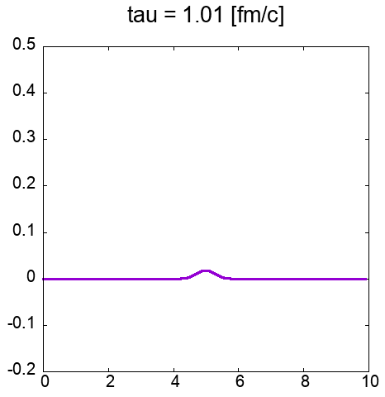
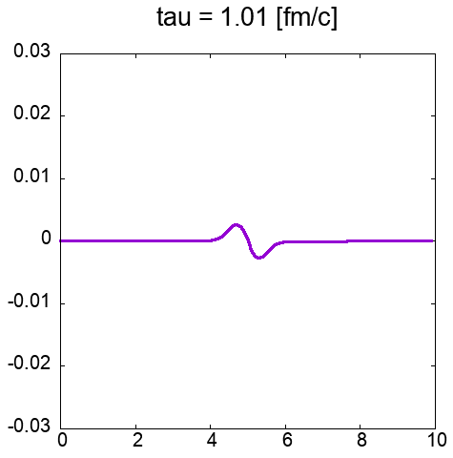
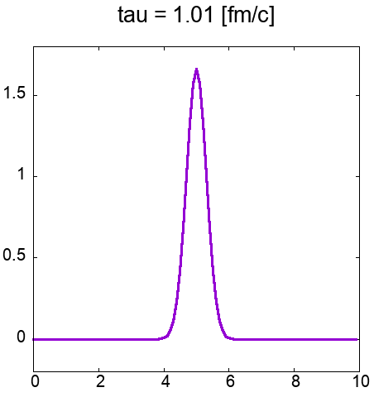










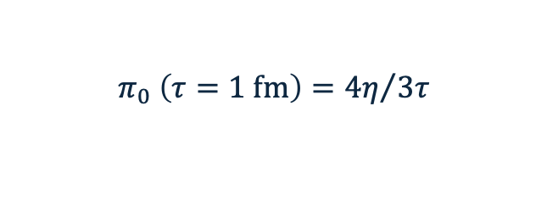
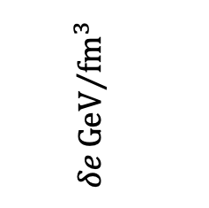



Behaviours of solutions (test calculations)
Initial conditions: $e_{0}\left(τ=1 fm\right)=10 GeV/{fm}^{3}$,
$$π_{0} \left(τ=1 fm\right)={4η}/{3τ}$$
$δe\left(τ=1 fm\right)=0$,
$δy\left(τ=1 fm\right)=0$,
$δπ\left(τ=1 fm\right)=Gaussian$ $(@ η_{s}=5)$
Energy density
Flow velocity
Shear pressure
$τ$
$$fm$$
$τ$
$$fm$$
$τ$
$$fm$$
$$δe{GeV}/{{fm}^{3}}$$
$$δy$$
$$δπ{GeV}/{{fm}^{3}}$$
$$η_{s}$$
$$η_{s}$$
$$η_{s}$$

Slide 19
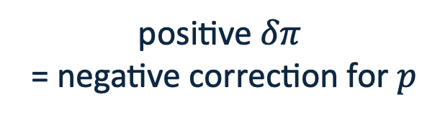

Behaviours of solutions (test calculations)
Initial conditions: $e_{0}\left(τ=1 fm\right)=10 GeV/{fm}^{3}$,
$$π_{0} \left(τ=1 fm\right)={4η}/{3τ}$$
$δe\left(τ=1 fm\right)=0$,
$δy\left(τ=1 fm\right)=0$,
$δπ\left(τ=1 fm\right)=Gaussian$ $(@ η_{s}=5)$
Energy density
Flow velocity
Shear pressure
$τ$
$$fm$$
$τ$
$$fm$$
$τ$
$$fm$$
$$δe{GeV}/{{fm}^{3}}$$
$$δy$$
$$δπ{GeV}/{{fm}^{3}}$$
$$η_{s}$$
$$η_{s}$$
$$η_{s}$$
positive $δπ$
= negative correction for $p$

Slide 20

Behaviours of solutions (test calculations)
Initial conditions: $e_{0}\left(τ=1 fm\right)=10 GeV/{fm}^{3}$,
$$π_{0} \left(τ=1 fm\right)={4η}/{3τ}$$
$δe\left(τ=1 fm\right)=0$,
$δy\left(τ=1 fm\right)=0$,
$δπ\left(τ=1 fm\right)=Gaussian$ $(@ η_{s}=5)$
Energy density
Flow velocity
Shear pressure
$τ$
$$fm$$
$τ$
$$fm$$
$τ$
$$fm$$
$$δe{GeV}/{{fm}^{3}}$$
$$δy$$
$$δπ{GeV}/{{fm}^{3}}$$
$$η_{s}$$
$$η_{s}$$
$$η_{s}$$
inward
flow velocity
positive $δπ$
= negative correction for $p$

Slide 21
Behaviours of solutions (test calculations)
Initial conditions: $e_{0}\left(τ=1 fm\right)=10 GeV/{fm}^{3}$,
$$π_{0} \left(τ=1 fm\right)={4η}/{3τ}$$
$δe\left(τ=1 fm\right)=0$,
$δy\left(τ=1 fm\right)=0$,
$δπ\left(τ=1 fm\right)=Gaussian$ $(@ η_{s}=5)$
Energy density
Flow velocity
Shear pressure
$τ$
$$fm$$
$τ$
$$fm$$
$τ$
$$fm$$
$$δe{GeV}/{{fm}^{3}}$$
$$δy$$
$$δπ{GeV}/{{fm}^{3}}$$
$$η_{s}$$
$$η_{s}$$
$$η_{s}$$
Surrounding energy density
is scooped up (dips appear)
inward
flow velocity
positive $δπ$
= negative correction for $p$

Slide 22
Behaviours of solutions (test calculations)
Initial conditions: $e_{0}\left(τ=1 fm\right)=10 GeV/{fm}^{3}$,
$$π_{0} \left(τ=1 fm\right)={4η}/{3τ}$$
$δe\left(τ=1 fm\right)=0$,
$δy\left(τ=1 fm\right)=0$,
$δπ\left(τ=1 fm\right)=Gaussian$ $(@ η_{s}=5)$
Energy density
Flow velocity
Shear pressure
$τ$
$$fm$$
$τ$
$$fm$$
$τ$
$$fm$$
$$δe{GeV}/{{fm}^{3}}$$
$$δy$$
$$δπ{GeV}/{{fm}^{3}}$$
$$η_{s}$$
$$η_{s}$$
$$η_{s}$$
outward
flow velocity
as a response
Surrounding energy density
is scooped up (dips appear)

Slide 23
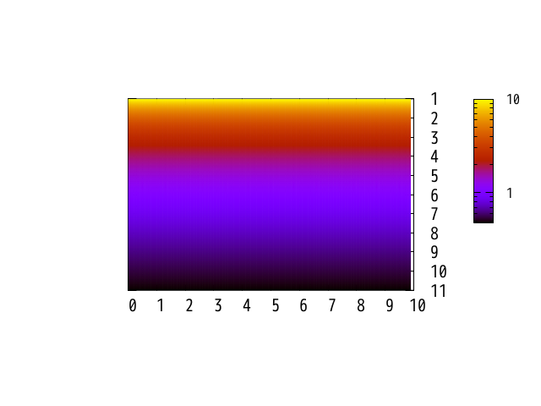
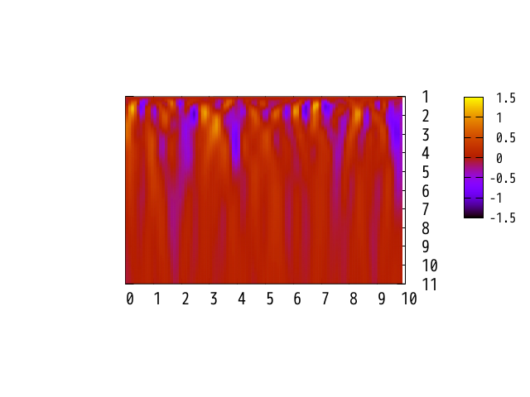




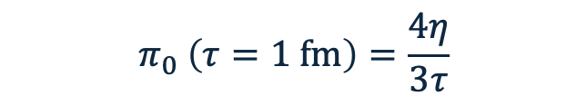



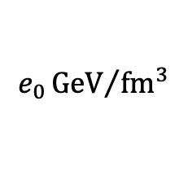
Evolution of energy density
$$π_{0} \left(τ=1 fm\right)=\frac{4η}{3τ}$$
Initial conditions: $e_{0}\left(τ=1 fm\right)=10 GeV/{fm}^{3}$,
$δe\left(τ=1 fm\right)=0$,
Background
Fluctuation
$$e_{0}{GeV}/{{fm}^{3}}$$
$$δe{GeV}/{{fm}^{3}}$$
$$τ fm$$
$$τ fm$$
$$η_{s}$$
$$η_{s}$$
Boost invariant
Non-boost invariant

Slide 24
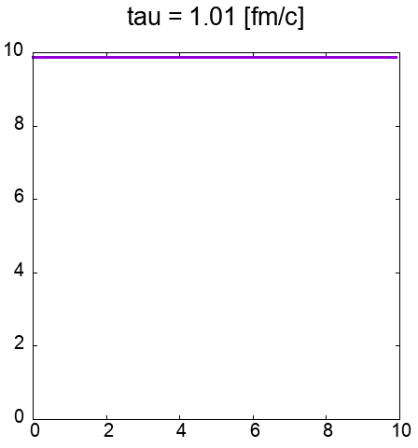
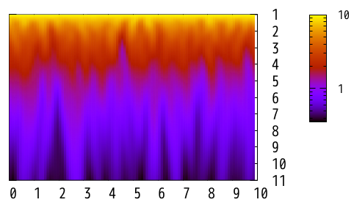







Evolution of energy density
Total
$τ$
$fm$
$$e_{0}+δe{GeV}/{{fm}^{3}}$$
$$τ fm$$
$$e_{0}+δe{GeV}/{{fm}^{3}}$$
Freeze!
$$η_{s}$$
$$η_{s}$$
Streak-like structure appears
New
Frozen distribution of energy density
➔ carry the information of the early stage?

Slide 25







Evolution of flow velocity and shear pressure
Flow velocity
Shear pressure
$$δy$$
$$π_{0}+δπ{GeV}/{{fm}^{3}}$$
$$τ fm$$
$$τ fm$$
$$η_{s}$$
$$η_{s}$$
New
New
Streak-like structure
No such structure
Common behaviour with energy density
as a slow variable (conservation law)
▪︎Fast variable (no conservation law)
▪︎Disturbed by fluctuations

Slide 26
Results & Discussions
event-averaged analysis

Slide 27





Correlations of energy density
$$δ\tilde{e}\left(τ,η_{s}\right)≡{δe\left(τ,η_{s}\right)}/{e_{0}\left(τ\right)}$$
Relaxation time dependence
EoS (sound velocity) dependence
$$\left\langle δ\tilde{e}\left(τ,η_{s}\right)δ\tilde{e}\left(τ,η_{s}^{′} \right)\right\rangle$$
$$\left\langle δ\tilde{e}\left(τ,η_{s}\right)δ\tilde{e}\left(τ,η_{s}^{′} \right)\right\rangle$$
10,000 events ave.
10,000 events ave.
$${Δη}_{s}$$
$${Δη}_{s}$$
New
Visible effects of bulk and transport properties
of the medium on energy density correlations
How are these correlations
inherited by observables?

Slide 28










Hadronisation
So far, results are not observables… Hadronisation!
Cooper-Frye formula
$f\left(p^{μ}u_{μ},T\right)$: distribution function
$dσ^{μ}$: 4-normal vector of hypersurface element
$$E\frac{dN}{d^{3}p}=\frac{d}{{\left(2π\right)}^{3}}\int{f\left(p^{μ}u_{μ},T\right) p_{μ}dσ^{μ}}$$
$p_{μ}$: 4-momentum
$d$: degrees of freedom
F. Cooper and G. Frye, Phys. Rev. D 10, 186 (1974)
Variable transformation, Integration, …
$Y≡\tanh^{−1}\left(\frac{p_{z}}{E}\right)$: rapidity
Rapidity distribution
$A$: transverse area
$m_{T}≡\sqrt{p_{T}^{2}+m^{2}}$: transverse mass
$$\frac{dN}{dY}=\frac{dτA}{{\left(2π\right)}^{2}}\int_{−∞}^{∞}{dη_{s}}\int_{m}^{∞}{dm_{T}} m_{T}^{2}cosh\left(Y−η_{s}\right)f$$
$p_{T}≡\sqrt{p_{x}^{2}+p_{y}^{2}}$: transverse momentum

Slide 29



Distribution function
Boltzmann distribution (with fluctuations)
$$f_{ideal}\left(p^{μ}u_{μ},T\right)=exp\left(−\frac{p^{μ}u_{μ}}{T}\right)=exp\left(−\frac{m_{T}cosh\left(Y−η_{s}−δy\right)}{T_{0}+δT}\right)$$
Viscous correction
$$f=f_{ideal}+f_{vis}$$
$$f_{vis}=\frac{1}{2\left(s_{0}+δs\right){\left(T_{0}+δT\right)}^{3}}f_{ideal}\left[\frac{1}{2}p_{T}^{2}−m_{T}^{2}\sinh^{2}\left(Y−η_{s}−δy\right)\right]\left(π_{0}+δπ\right)$$
1st vis.
A. Monnai and T. Hirano, Phys. Rev. C 80, 054906 (2009)
Perturbative expansion
$$f=f_{0,ideal}+f_{0,vis}+δf_{ideal}+δf_{vis}$$
1st vis.
1st per.
1st vis./per.

Slide 30




2-particle correlations
Mass dependence
EoS (sound velocity) dependence
Lattice EoS
Enhance
Enhance
$${\left\langle \frac{dN}{dY_{1}}\frac{dN}{dY_{2}}\right\rangle }/{\left\langle \frac{dN}{dY_{1}}\right\rangle \left\langle \frac{dN}{dY_{2}}\right\rangle }$$
$${\left\langle \frac{dN}{dY_{1}}\frac{dN}{dY_{2}}\right\rangle }/{\left\langle \frac{dN}{dY_{1}}\right\rangle \left\langle \frac{dN}{dY_{2}}\right\rangle }$$
Narrow
Broaden
New
▪︎Heavier hadrons as better probes of 2-particle correlations
▪︎Sound velocity enhance/broaden the 2-particle correlations

Slide 31












Why heavier hadrons are good probes?
$$\frac{dN}{dY}$$
fluid cell
$$y_{f}$$
$$\frac{m}{T_{0}}≪1$$
$$y_{f}$$
$$Y$$
Large effects from
thermal fluctuations
$$y_{f}$$
Rapidity
dist.
Sampling
$$\frac{dN}{dY}$$
fluid cell
Enhance
$$y_{f}$$
$$\frac{m}{T_{0}}≫1$$
$$y_{f}$$
Narrow
Small effects from
thermal fluctuations
$$Y$$
$$y_{f}$$
Heavier particles reflect
the fluid rapidity better!
$y_{f}$: fluid rapidity
: momentum

Slide 32







Why does sound velocity enhance/broaden?
Temperature in Bjorken expansion
Sound velocity in Bjorken expansion
$$e_{0}\left(τ=1 fm\right)=10 GeV/{fm}^{3}$$
Conformal EoS
Lattice EoS
$$T GeV$$
$$c_{s}^{2}$$
freezeout!
Lattice EoS
Conformal EoS
$$τ fm$$
$$τ fm$$
▪︎Conformal EoS picks up earlier time
strong correlations
▪︎Always Information is likely to
propagate further in conformal EoS
Enhance
Broaden

Slide 33




2-particle correlations
Shear viscosity dependence
Relaxation time dependence
Lattice EoS
Lattice EoS
Enhance
Suppress
$${\left\langle \frac{dN}{dY_{1}}\frac{dN}{dY_{2}}\right\rangle }/{\left\langle \frac{dN}{dY_{1}}\right\rangle \left\langle \frac{dN}{dY_{2}}\right\rangle }$$
$${\left\langle \frac{dN}{dY_{1}}\frac{dN}{dY_{2}}\right\rangle }/{\left\langle \frac{dN}{dY_{1}}\right\rangle \left\langle \frac{dN}{dY_{2}}\right\rangle }$$
New
Viscosity ➔ Enhance
Relaxation time ➔ Suppress

Slide 34






Why enhancement/suppression?
Constitutive equation for $π^{μν}$ (integral form)
$$π^{μν}\left(x\right)=\int{d^{4}x^{′}}G_{αβ}^{μν}\left(x,x^{′}\right)X^{αβ}\left(x^{′}\right)+{δπ}^{μν}\left(x\right)$$
$$⟺$$
Israel-Stewart equation
+ noise (differential form)
Green’s func.
thermodynamic
force
noise
$$G_{αβ}^{μν}\left(x,x^{′}\right)=\frac{2η\left(τ^{′}\right)}{τ_{π}\left(τ^{′}\right)}exp\left(−\int_{τ^{′}}^{τ}{\frac{dτ^{′′}}{τ_{π}\left(τ^{′′}\right)}}\right)∆_{αβ}^{μν}\left(τ;τ^{′}\right)Θ^{4}\left(τ,τ^{′}\right)$$
K. Murase, Annals Phys. 411, 167969 (2019)
FDR for ${δπ}^{μν}$
$$\left\langle {δπ}^{μν}\left(x\right){δπ}^{αβ}\left(x^{′}\right)\right\rangle ∝T_{0}G^{μναβ}\left(x,x^{′}\right)$$
Viscosity ➔ Enhance
$$\left|{δπ}^{μν}\right|∝\sqrt{η/{τ_{π}}}$$
Relaxation time ➔ Suppress

Slide 35
OUTLINE
▸Introduction
▸Model
▸Results & Discussions
▸Summary

Slide 36
Summary
▪︎Frozen structure of distribution of slow variables
➔ Carry the information of the early stage?
▪︎Significant effects of bulk and transport properties of the medium
on 2-particle correlations induced by hydrodynamic fluctuations
➔ Extract the properties of the medium from 2-particle correlations!
▪︎Hydrodynamic fluctuations provide a multidimensional analysis

Slide 37
Backup(Formalism)

Slide 38







2-particle correlation function in Bjorken expansion
Cooper-Frye formula
$p_{T}≡\sqrt{p_{x}^{2}+p_{y}^{2}}$: transverse momentum
$$E\frac{dN}{d^{3}p}=\frac{d}{{\left(2π\right)}^{3}}\int{f\left(p^{μ}u_{μ},T\right) p_{μ}dσ^{μ}}$$
$Y≡\tanh^{−1}\left(\frac{p_{z}}{E}\right)$: rapidity
$m_{T}≡\sqrt{p_{T}^{2}+m^{2}}$: transverse mass
$φ$: azimuthal angle
① $\frac{d^{3}p}{E}=d^{2}p_{T} dY=m_{T}dm_{T} dφ dY \left(∵\frac{dY}{dp_{z}}=E, { p}_{T}dp_{T}=m_{T}dm_{T}\right)$
$A$: transverse area
② ${ p}_{μ}dσ^{μ}=\left(E, 0, 0, 0\right)∙\left(dV, 0, 0, 0\right)=\left(m_{T}\cosh\left(Y−η_{s}\right),0, 0, 0\right)∙\left(τAdη_{s},0, 0, 0\right)$
$=τAdη_{s}m_{T}cosh\left(Y−η_{s}\right)$
③ Assumption: Boltzmann dist. with fluctuation
$f\left(p^{μ}u_{μ},T\right)=exp\left(−\frac{p^{μ}u_{μ}}{T}\right)=exp\left(−\frac{m_{T}cosh\left(Y−η_{s}−δy\right)}{T_{0}+δT}\right)$
$≈exp\left(−\frac{m_{T}cosh\left(Y−η_{s}\right)}{T_{0}}\right)+exp\left(−\frac{m_{T}cosh\left(Y−η_{s}\right)}{T_{0}}\right)\left\{\frac{m_{T}cosh\left(Y−η_{s}\right)}{T_{0}}δT+\frac{m_{T}sinh\left(Y−η_{s}\right)}{T_{0}}δy\right\}$
$≡f_{0}+δf$

Slide 39







2-particle correlation function in Bjorken expansion
Cooper-Frye formula
NOTE: incomplete Gamma function
$$E\frac{dN}{d^{3}p}=\frac{d}{{\left(2π\right)}^{3}}\int{f\left(p^{μ}u_{μ},T\right) p_{μ}dσ^{μ}}$$
$$Γ\left(a\right)=\int_{0}^{∞}{dt} t^{a−1}e^{−t}=\int_{0}^{x}{dt} t^{a−1}e^{−t}+\int_{x}^{∞}{dt} t^{a−1}e^{−t}$$
Lower incomplete
Gamma function
Upper incomplete
Gamma function
ex.)
$$\int_{m}^{∞}{dm} m^{2}e^{−mA}=\left(\frac{m^{2}}{A}+\frac{2m}{A^{2}}+\frac{2}{A^{3}}\right)e^{−mA}$$
Rapidity dist. in Bjorken expansion
$$E\frac{dN}{dY}=\frac{dτA}{{\left(2π\right)}^{2}}\int_{−∞}^{∞}{dη_{s}}\int_{m}^{∞}{dm_{T}} m_{T}^{2}cosh\left(Y−η_{s}\right)\left\{f_{0}+δf\right\}$$
Upper incomplete Gamma function
$m_{T}$ integral, event average, $Y$ average
$$\left\langle \frac{dN}{dY}\right\rangle =\left\langle \frac{dτA}{{\left(2π\right)}^{2}}\int_{−∞}^{∞}{dη_{s}}cosh\left(Y−η_{s}\right)\left\{\frac{T_{0}m^{2}}{cosh (Y−η_{s})}+\frac{2T_{0}^{2}m}{\cosh^{2}(Y−η_{s})}+\frac{2T_{0}^{3}}{\cosh^{3}(Y−η_{s})}\right\}f_{0}\right\rangle$$

Slide 40


Transport coefficients
S. Fujii and T. Hirano, Phys. Rev. C 109, 024916 (2024)

Slide 41
Backup(Results)

Slide 42







Correlations of energy density
$τ$
$δ\tilde{e}\left(τ,η_{s}\right)≡δe\left(τ,η_{s}\right)/e_{0}\left(τ\right)$
➔ normalised energy density
Acausal hydro($τ_{π}=0$)
▪︎Autocorrelation grows up
faster in acausal hydro.
Causal hydro(default)
Causal hydro($5×τ_{π}$)
▪︎Propagation of sound front
is faster in acausal hydro.
$$\left\langle δ\tilde{e}\left(τ,η_{s}\right)δ\tilde{e}\left(τ,η_{s}^{′} \right)\right\rangle$$
New
Correlations are closely related
with the transport coefficients
particularly in early stage.
$${∆η}_{s}$$

Slide 43





Correlations of energy density
$τ$
$fm$
▪︎Autocorrelation is more likely
to remain in Lattice EoS.
Conformal EoS
Lattice EoS
▪︎Propagation of sound front
is slightly faster in conformal EoS.
$$\left\langle δ\tilde{e}\left(τ,η_{s}\right)δ\tilde{e}\left(τ,η_{s}^{′} \right)\right\rangle$$
New
Correlations include
information of EoS, but
differences are small.
$${∆η}_{s}$$

Slide 44


Power of noise
$$\frac{1}{N_{event}}\sum_{i=1}^{N}{{\left[Fluctuation\right]}^{2}}$$
expectation value

Slide 45









Large smearing
$$σ_{η}=0.1→0.5$$
$$δe {GeV}/{{fm}^{3}}$$
$$δe{GeV}/{{fm}^{3}}$$
$$τ fm$$
$$η_{s}$$
$$τ fm$$
$$η_{s}$$

Slide 46








Large smearing
$$σ_{η}=0.1→0.5$$
$$e_{0}+δe{GeV}/{{fm}^{3}}$$
$$e_{0}+δe{GeV}/{{fm}^{3}}$$
$$τ fm$$
$$η_{s}$$
$$τ fm$$
$$η_{s}$$

Slide 47






Correlations of flow velocity and shear pressure
Causal hydro
Causal hydro
Acausal hydro
$$\left\langle δy\left(τ,η_{s}\right)δy\left(τ,η_{s}^{′} \right)\right\rangle$$
$$\left\langle δ\tilde{π}\left(τ,η_{s}\right)δ\tilde{π}\left(τ,η_{s}^{′} \right)\right\rangle$$
$${Δη}_{s}$$
$${Δη}_{s}$$

Slide 48


Validity of perturbation

Slide 49





Validity of perturbation
Within simple settings

Slide 50

Correlations of energy density

Slide 51

Correlations of energy density

Slide 52

Correlations of energy density

