Slide 1


New insights on properties of matter produced in few-GeV collisions
Szymon Harabasz (TU Darmstadt) for the HADES collaboration
Hydrodynamics and related observables in heavy-ion collisions, Nantes
October 28-31, 2024
Delta resonance mass distribution in AA collisions

Slide 2
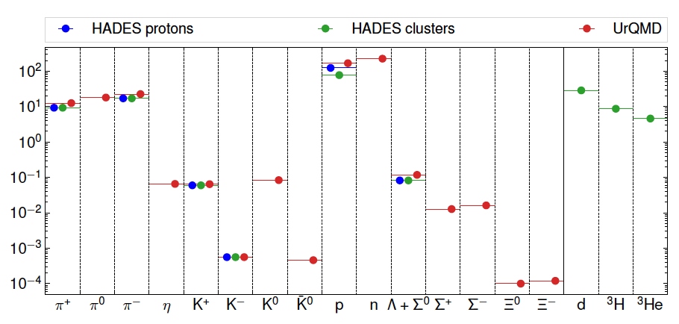

LOW Energy edge
UrQMD
90
80
70
60
50
40
T
ρ
3
Au-Au $\sqrt{s_{NN}}$=2.42 GeV, 0-10% centrality
eff
A. Motornenko et al., PLB 822 (2021) 136703
μ_{π}
2.5
T and μ_{π} [MeV]
2
eff 0
ρ / ρ
1.5
30
1
20
0.5
10
0
10
20
time τ [fm/c]
30
Not so strong Lorentz contraction but low transparency
We detect mostly nucleons:
  Incoming nuclei
  Decays of baryonic resonances
  Baryon-dominated matter

Slide 3
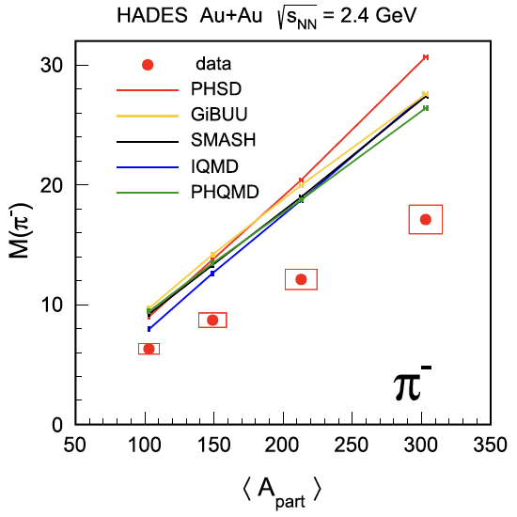
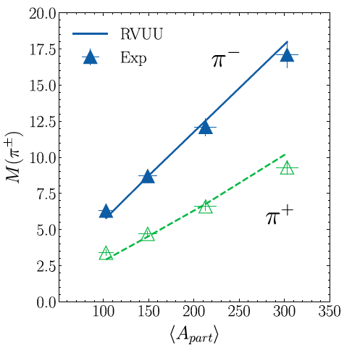
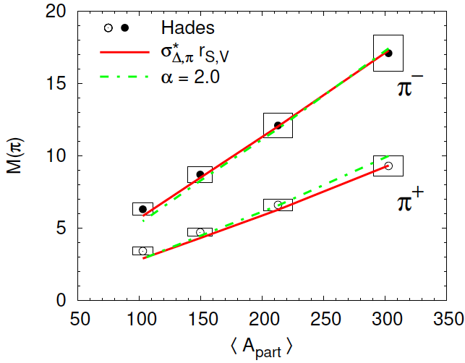
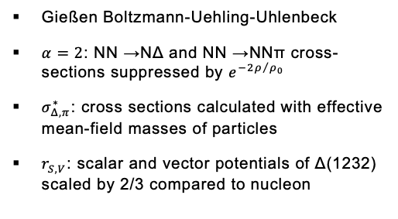
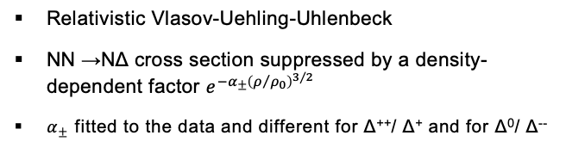
Pion production
HADES, EPJA 56 (2020) 259
K. Godbey et al., PLB 829 (2022) 137134
C. Kummer et al., PRC 109 5, 054901
Relativistic Vlasov-Uehling-Uhlenbeck
NN →NΔ cross section suppressed by a density-dependent factor $e^{−α_{±}{\left(ρ/{ρ_{0}}\right)}^{3/2}}$
$α_{±}$ fitted to the data and different for Δ⁺⁺/ Δ⁺ and for Δ⁰/ Δ⁻⁻
Gießen Boltzmann-Uehling-Uhlenbeck
$α=2$: NN →NΔ and NN →NNπ cross-sections suppressed by $e^{−2ρ/{ρ_{0}}}$
$σ_{Δ,π}^{∗}$: cross sections calculated with effective mean-field masses of particles
$r_{S,V}$: scalar and vector potentials of Δ(1232) scaled by 2/3 compared to nucleon
Simular situation for π⁺
Common kinetic transport models fail to reproduce pion yields measured by HADES

Slide 4
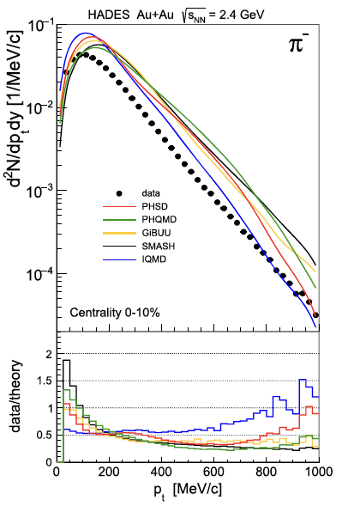
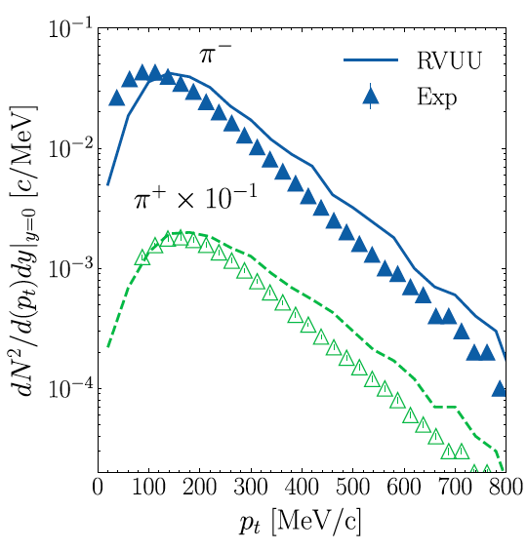
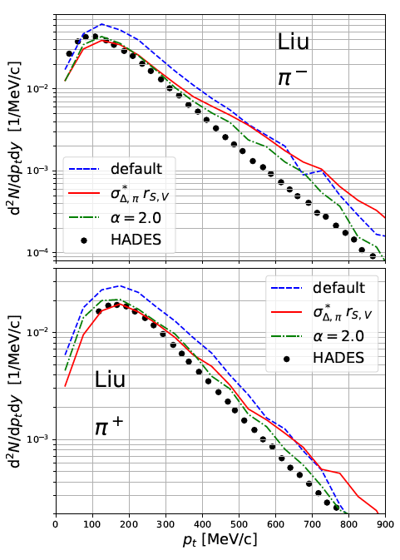
We Are On A GOOD Way…
HADES, EPJA 56 (2020) 259
K. Godbey et al., PLB 829 (2022) 137134
C. Kummer et al., PRC 109 5, 054901
Proper treatment of Δ in medium is crucial for describing hadron spectra but current approaches are still too schematic

Slide 5
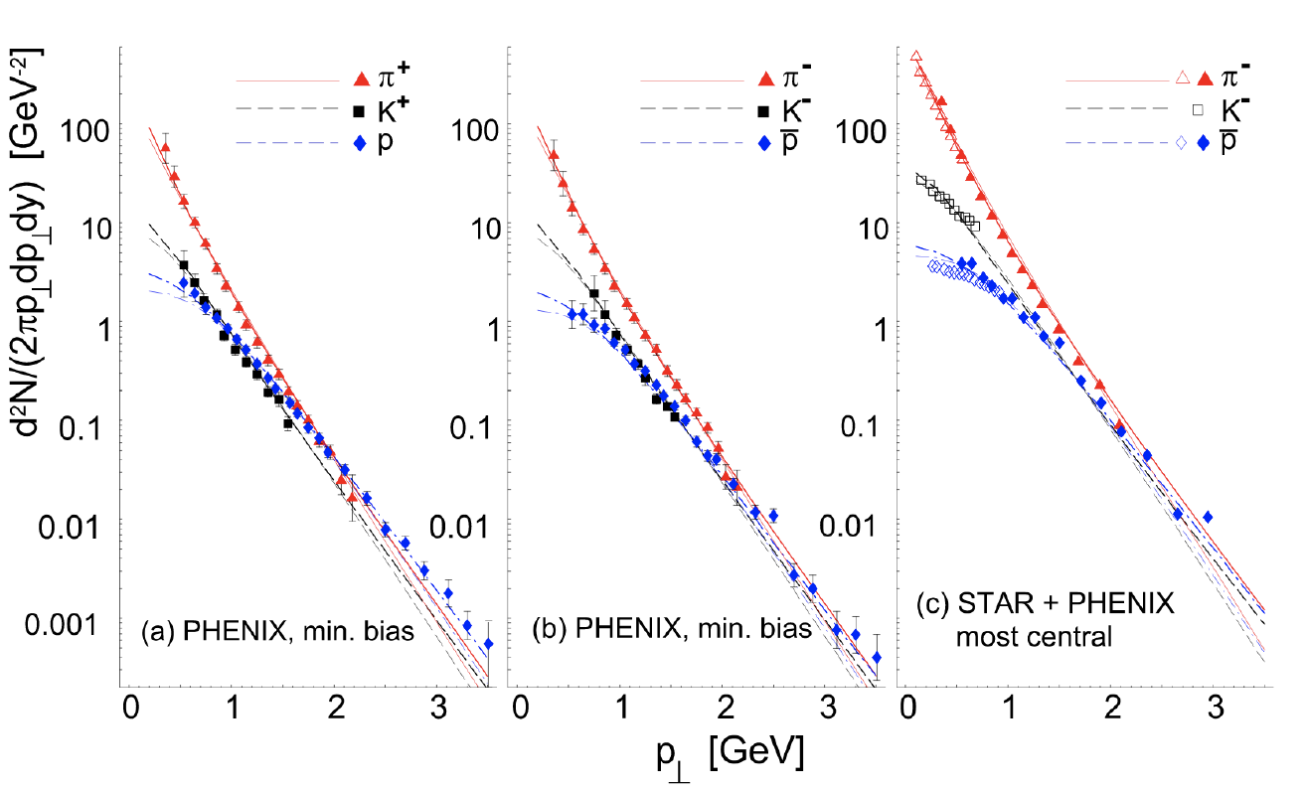
Single freeze-out scenario at RHIC energies
W. Broniowski and W. Florkowski, PRL 87 (2001) 272302
Chemical (= particle abundances fixed) and kinetic
(= particle momenta fixed) freeze-outs coincide
Hadron yields are given by the integrals of hadron spectra
Feed-down from resonance decays included
Implemented in the event generator Therminator 2
Successful at RHIC, does it work at SIS18 energies?
30.10.24
5

Slide 6
Thermal Event Generator
(Therminator 2)
M. Chojnacki et al., Comput. Phys. Comm. 103 (2012) 746-773
SH, W. Florkowski, T. Galatyuk et al., PRC 102 (2020) 5, 054903
SH, W. Florkowski, T. Galatyuk et al., PRC 107 (2023) 3, 034917
Ingredients of the method:
Fix parameters with particle multiplicity ratios:
  Six equations for six parameters:
protons (incl. those bound in light nuclei): 124.1
π⁺: 9.3
π⁻: 17.1
K⁺: 0.0598
K⁻: 0.00056
Λ: 0.0822
HADES data:
M. Szala, Proc. of SQM 2019
EPJA 56 (2020) 10, 259
PLB 778 (2018) 403-407
PLB 793 (2019) 457-463
T μ_{B} μ_{I3} μ_{S} γ_{S} R
H in Hubble-like expansion v = tanh(Hr)
δ - eccentricity parameter for the spheroid
in the momentum space
m_{t} spectra of p and π in five rapidity bins
Femtoscopic radii
ε - eccentricity parameter for the spheroid
in the position space
30.10.24
6

Slide 7
Hadron spectra
HADES data:
M. Szala, Springer Proc.Phys. 250 (2020) 297-301
EPJA 56 (2020) 10, 259
PLB 778 (2018) 403-407
PLB 793 (2019) 457-463
π⁺
proton
SH et al., PRC 102 (2020) 5, 054903, PRC 107 (2023) 3, 034917
Parameter | Value
T (MeV) | 70.3
R (fm) | 6.06
μ_{B} (MeV) | 876
H (GeV) | 0.0225
δ | 0.4
Good agreement for such a simple model
Extracting prolateness of the fireball (in momentum space)
30.10.24
7

Slide 8
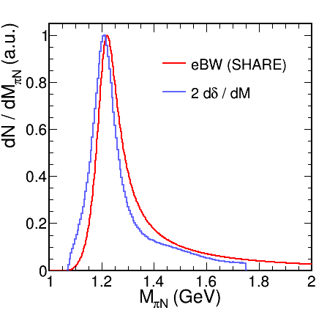
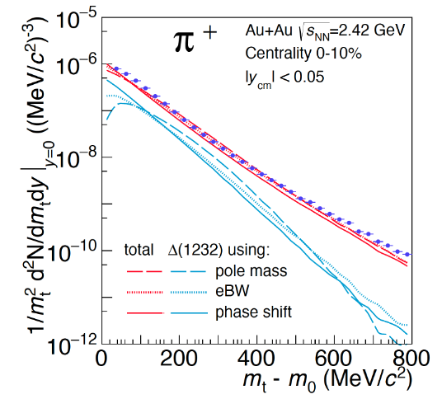

Resonance treatment
R. Dashen, S. K. Ma and H. J. Bernstein, Phys. Rev. 187 (1969) 345 (1969)
R.Venugopalan, and M. Prakash, NPA 546 (1992) 718
W. Weinhold, and B. Friman, PLB 433 (1998) 236
Pok Man Lo, EPJC 77 (2017) no.8, 533
πN phase shift in the P₃₃ channel
Spectral function: $B_{l}\left(M\right)=2\frac{d}{dM}δ_{l}$
Sensitivity of hadron spectra
Pok Man Lo et al., PRC 96, 015207
GW WI08: R.L. Workman et al. PRC 86, 035202
30.10.24
8

Slide 9
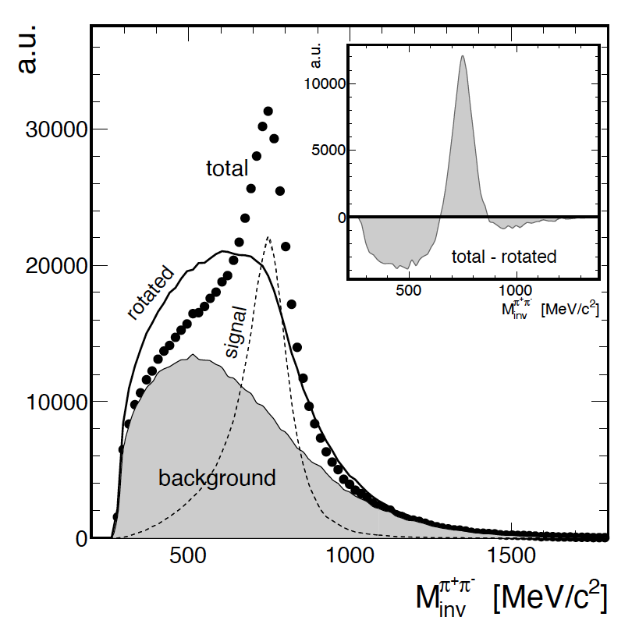
Extracting BROAD Signals From Very HIGH Backgrounds
G. Kornakov, T. Galatyuk., EPJA 55 (2019) 11, 204
U - some particle decorrelating operation
  Event mixing
  Position swapping
  Momentum rotation
It is non-linear
Total yield = signal + combinatorial background
T = S + B
Inset: T – U(T)
Peak contains only signal, even if underestimated
  First approximation S⁰ = max[T – U(T), 0]
Next steps: S^{k+1} = max{T – [U(T)– U(S^{k})], 0}
(The negative part is always ignored)
Convergence when S^{k+1} = S^{k}
30.10.24
9

Slide 10
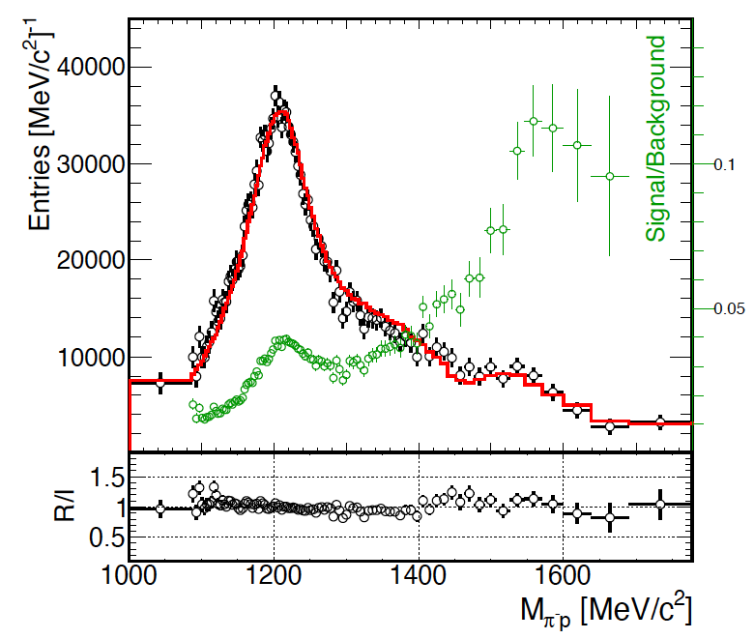
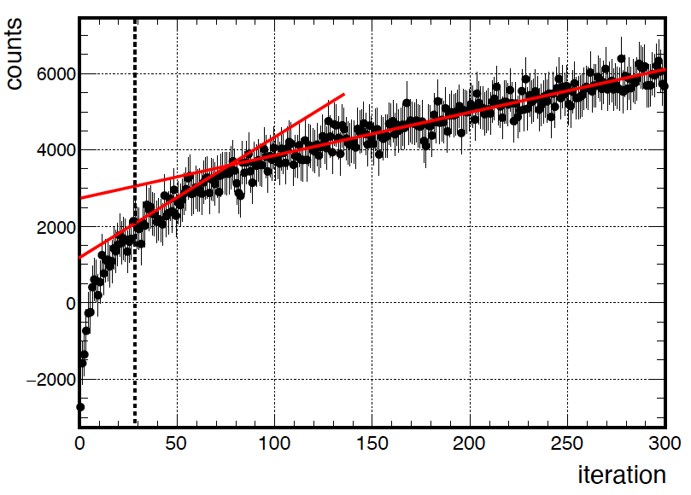
TESTING with Monte Carlo
SIMULATION
G. Kornakov, T. Galatyuk., EPJA 55 (2019) 11, 204
Final comparison
  Points: reconstructed signal
  Line: original signal
Background not shown, but note the S/B ratio
Thermal source of protons (~80%), pions (~10%), most abundant Deltas and N*s (~10%)
We keep increasing signal in max{…} due to fluctuations
  Real convergence impossible
  But the growth rate changes trend
30.10.24
10

Slide 11
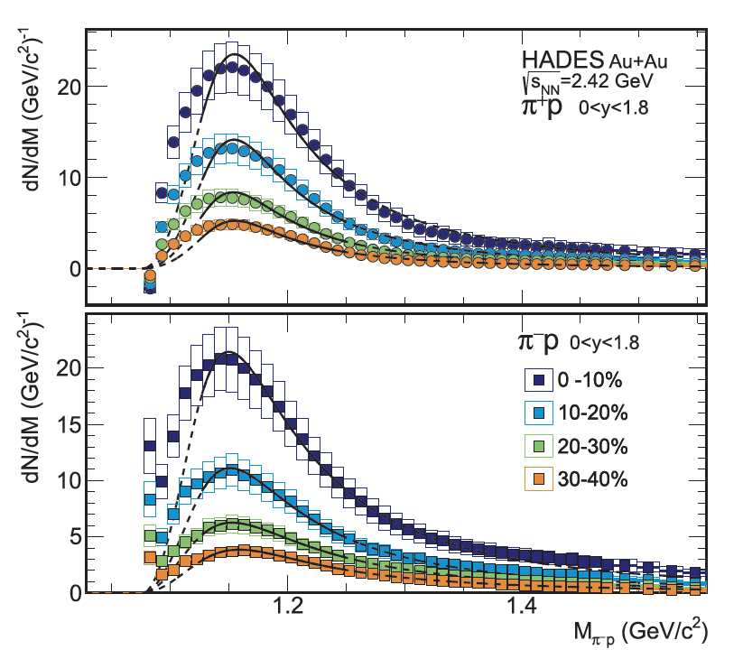
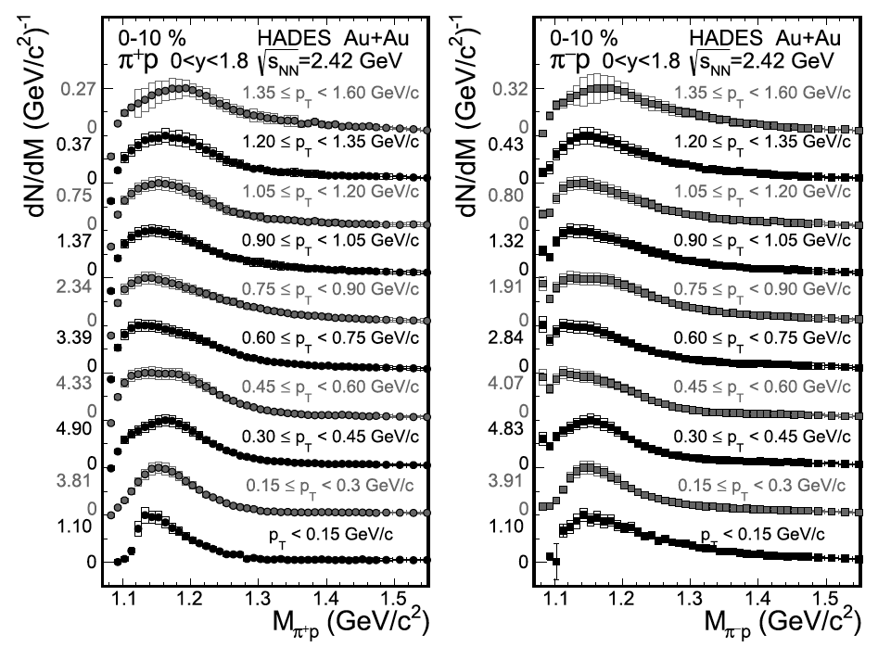
Extracting signal in Experimental Data
HADES, PLB 819 (2021) 136421
Unprecedented statistical and systematic precision, allowing for multi-differential analysis
30.10.24
11

Slide 12
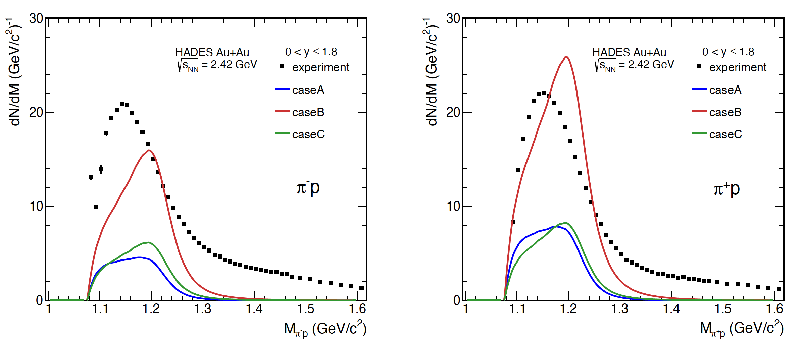
Comparison to thermal model
M. Kurach, Master’s thesis, Warsaw University of Technology (in preparation)
Interplay of freeze-out parameters:
  caseA: low T, low μ_{B}, large volume (clusters produced by coalescence, first minimum)
  caseB: high T, high μ_{B}, small volume (clusters produced by coalescence, other minimum)
  caseC: medium T, low μ_{B}, medium volume (clusters produced thermally, unique, but bad, minimum)
Phase shift corresponds to vacuum spectral function
Particle production at the freeze-out only
30.10.24
12

Slide 13
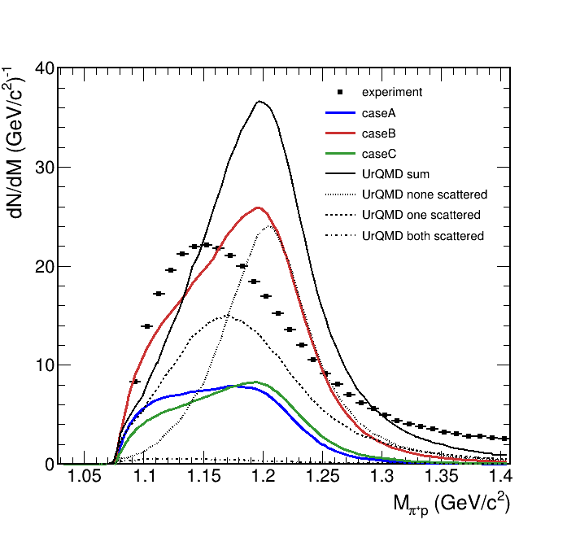
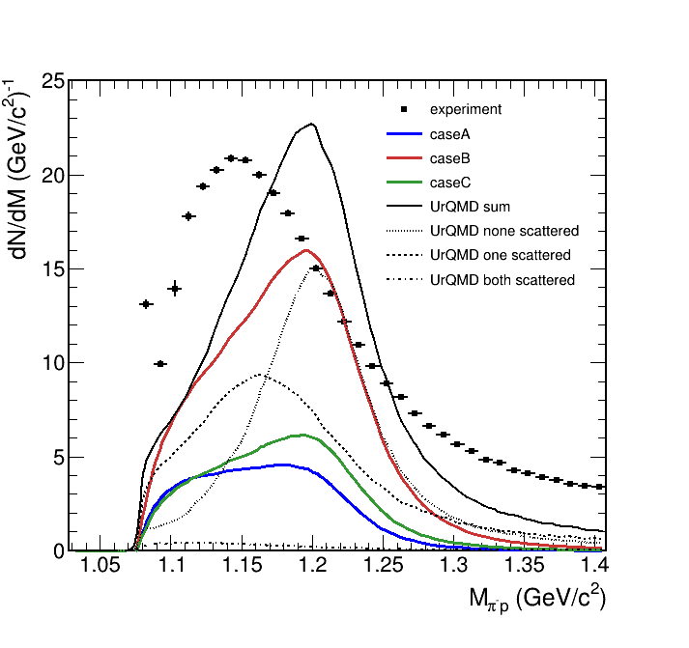
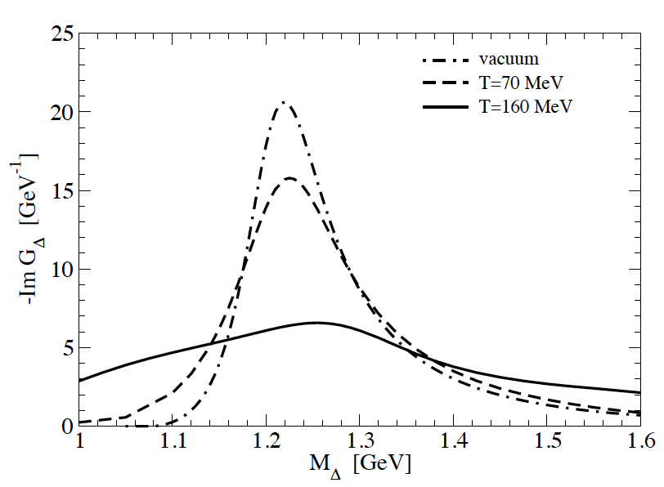
Adding Kinetic transport model
HADES data: PLB 819 (2021) 136421
Thermal model: M. Kurach, Master’s thesis, Warsaw University of Technology (in preparation)
UrQMD: T. Reichert et al., J. Phys G 46 (2019) 105107
Calculation with public UrQMD version 3.4
If one of the daughter particles rescatters, the shape starts to resemble experimental data
  Dashed line
  Effect still too weak
  In most cases, none of the daughters rescatter
Shape without scattering is similar to the thermal model
  Enhancement of thermal model at low mass
  Role of the thermal factor?
  Non-resonant part of the phase shift?
In-medium effects are too small in the transport model.
Perspective: using an in-medium spectral function
H. van Hees and R. Rapp, PLB 606 (2005) 59-66
30.10.24
13

Slide 14
Contributng to the QCD Equation-Of-State

Slide 15


Multi-differential Nucleon Flow Analysis
EPJA 59 (2023) 80
High-precision experimental data
Participant scaling well fulfilled:
  Here example of v₄, works all the more for v₂
Indication of coalescence as a dominating production mechanism of light nuclei
Valid only at mid-rapidity
30.10.24
15

Slide 16












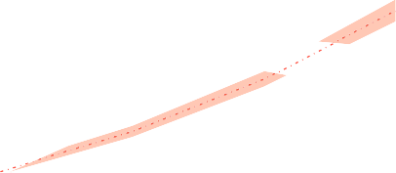
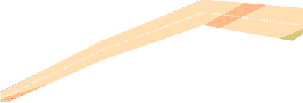
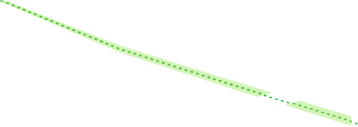
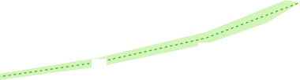



INPUT FOR the EOS DETERMINATION
EPJA 59 (2023) 80
Different density-dependent potentials:
  JAM NS3: ”hard”, momentum independent
  JAM MD1: “hard” momentum dependent
  JAM MD4: “soft” momentum dependent
  UrQMD: run with “hard” EoS
  GiBUU: run with “soft” EoS
Models qualitatively reproduce trends in the data
Quantitative description of multi-differential dependences requires detailed knowledge
of the EoS
  HADES data can be included in a Bayesian analyses
Comparison with light nuclei is also possible
  Models need a coalescence implementation
30.10.24
16

Slide 17
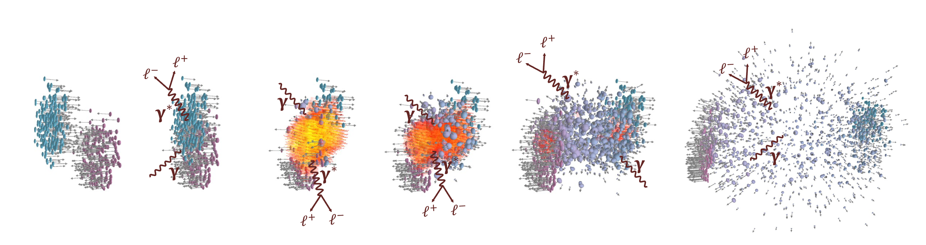
Electromagnetic probes
Photons (virtual and real):
Do not undergo strong interaction
Probe all the stages of heavy-ion collisions

Slide 18




Thermal Dileptons From Baryon-Rich Matter
HADES, Nature Phys. 15 (2019) 1040
Thermal dilepton production rates
L. D. McLerran, T. Toimela, PRD 31 545 (1985)
Properly described by in-medium spectral function from many-body calculation
Rapp and Wambach, Adv. Nucl. Phys 25 (2000) 1
  Successful at all collision energies
  At low ones: local thermal equilibrium – coarse graining Galatyuk et al., EPJA, 52 5 131 (2016)
Crucial role of coupling to baryonic resonances
Thermal factor
(“Planck-like” radiation)
$$\frac{dN_{ll}}{d^{4}qd^{4}x}=−\frac{α_{em}^{2}}{π^{3}}\frac{L\left(M^{2}\right)}{M^{2}}f^{B}\left(q_{0},T\right)ImΠ_{em}(M,q,T,μ_{B})$$
In-medium ρ spectral function
$$R=Δ, N\left(1520\right), a_{1}, …$$
$$ρ$$
>
>
$$h=N, π, K, …$$

Slide 19
Decoding QCD phase structure from dileptons
F. Seck et al., PRC 106 (2022), 014904
Calculations with kinetic transport and hydro
Hydro with CMF EoS, parameters set to have or not have a 1st order phase transiton
Phase transition causes a clear increase in dilepton yield
Higher statistics of experimental data would be needed

Slide 20
Discovering the QCD “caloric curve”
Rapp and v. Hess, PLB 753 (2016) 586
Galatyuk et al., EPJA 52 (2016) 131
https://github.com/tgalatyuk/QCD_caloric_curve
  T. Galatyuk, JPS Conf.Proc. 32 010079 (2020)
Temperature or integral of the spectrum vs. energy density (collision energy as a proxy)
Phase transition may manifest itself as a plateau in T and/or peak in integrated yield
Important to perform experiments at various energies
30.10.24
20

Slide 21
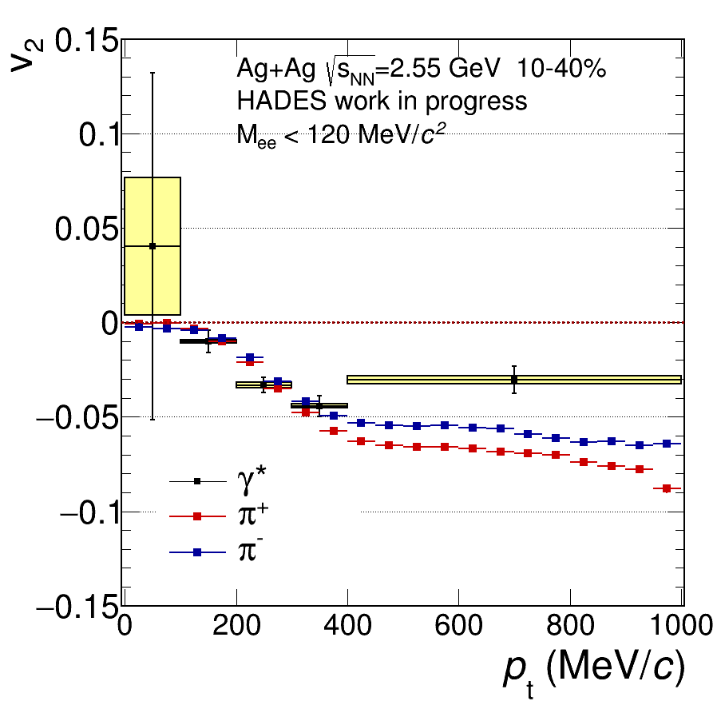
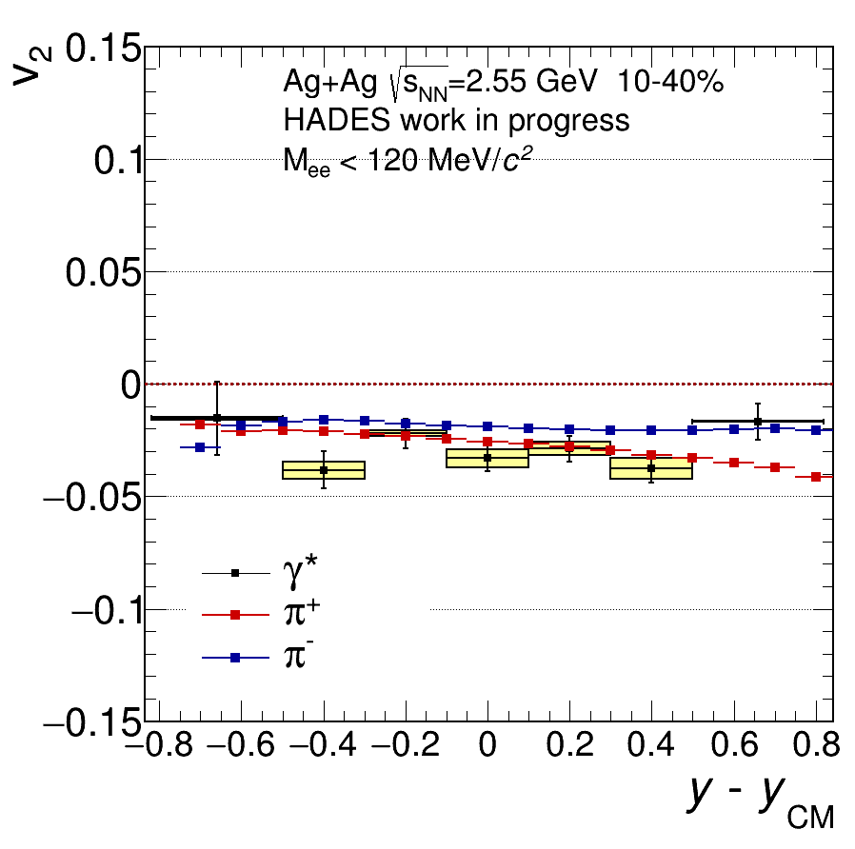
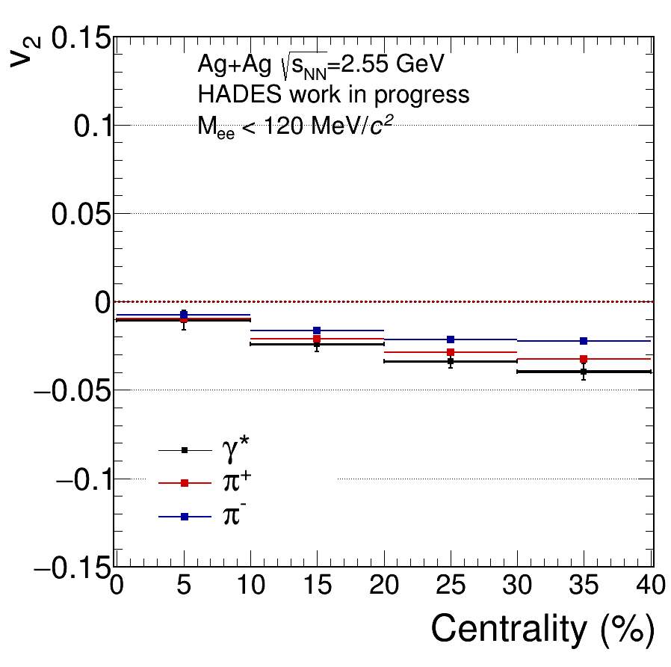
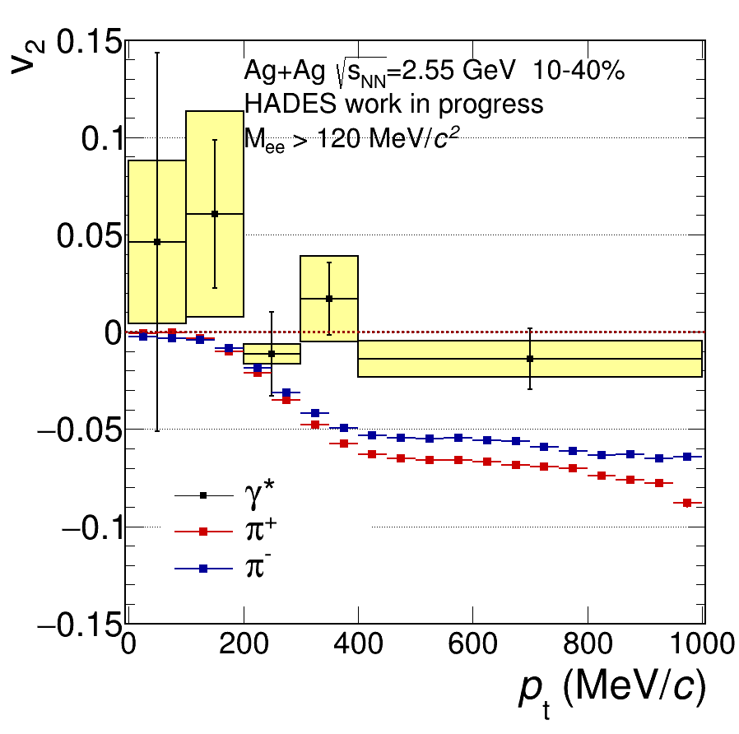
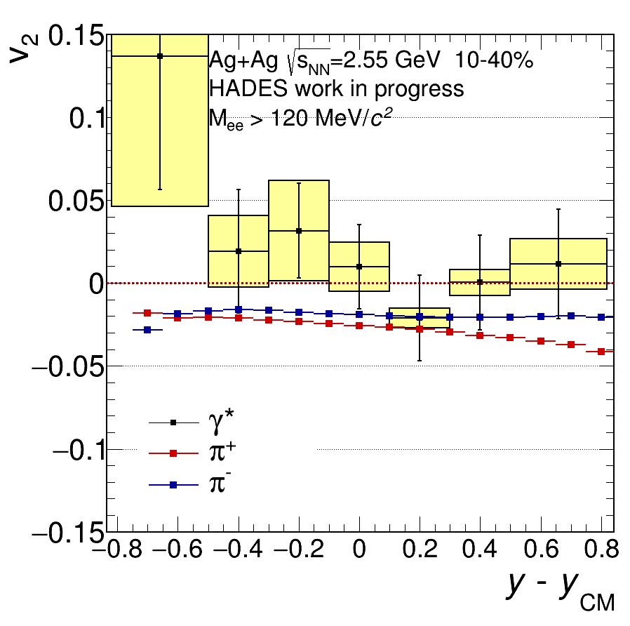
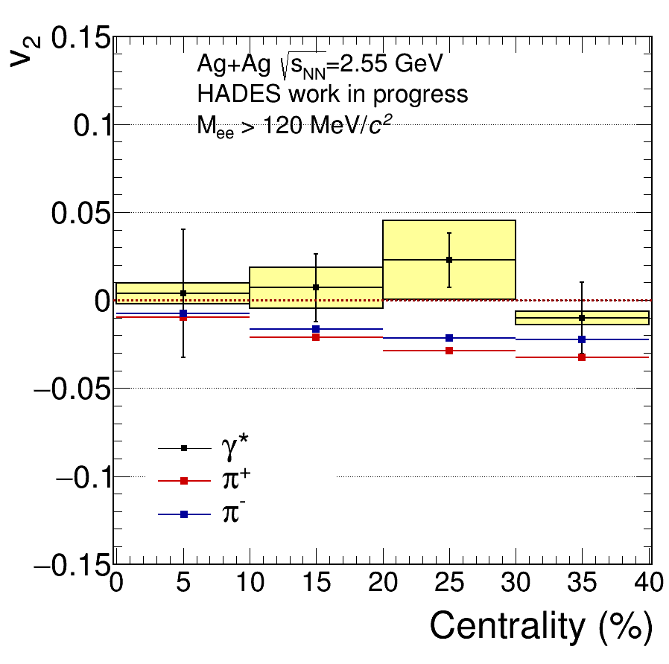
Elliptic flow of dileptons
M_{ee} below 0.12 GeV/c²
Low invariant mass dominated by π⁰ Dalitz decays
  Elliptic flow comparable to charged pion results
  Attenuation due to missing momentum of the real photon (?)
At higher invariant mass, v₂ closer to 0
  Dilepton sources didn’t have time to “feel” the squeeze-out
  Early emission
M_{ee} above 0.12 GeV/c²

Slide 22
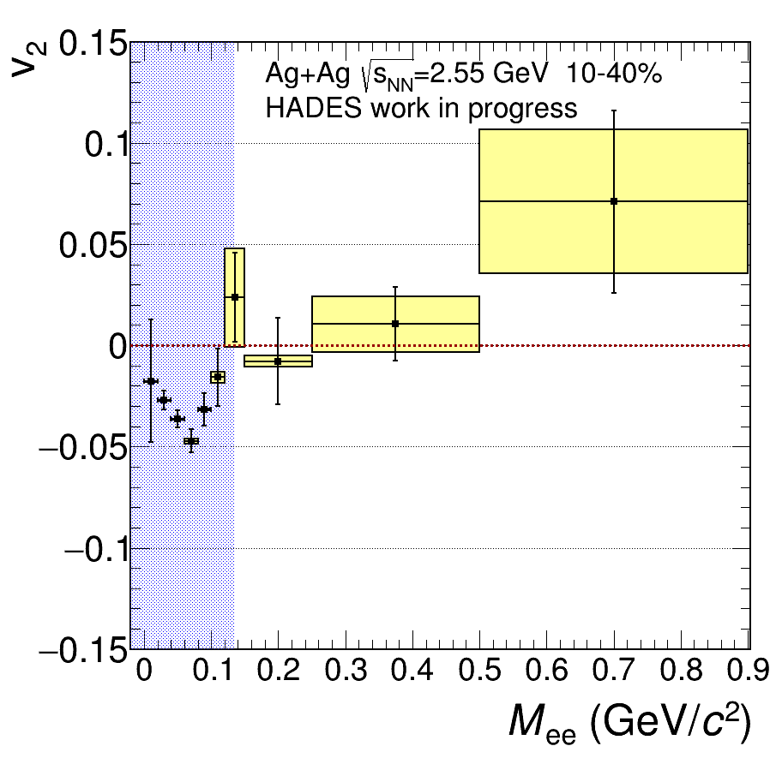
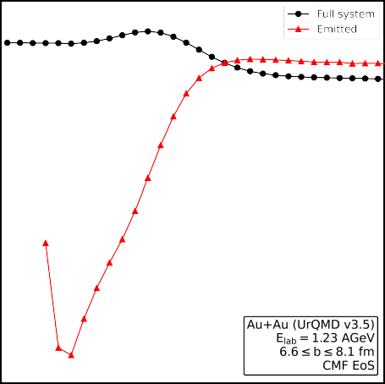


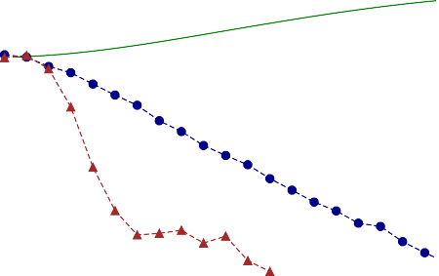

Dilepton Sensitivity to the Equation Of State
T. Reichert et al., PLB 841 (2023) 137947
At early stages, pressure gradient is generated
– positive v₂ of the whole system
Only nucleons not hindered by spectator matter can decouple – negative v₂ of emitted particles
Dileptons decouple when they are produces and they see the positive v²!

Slide 23
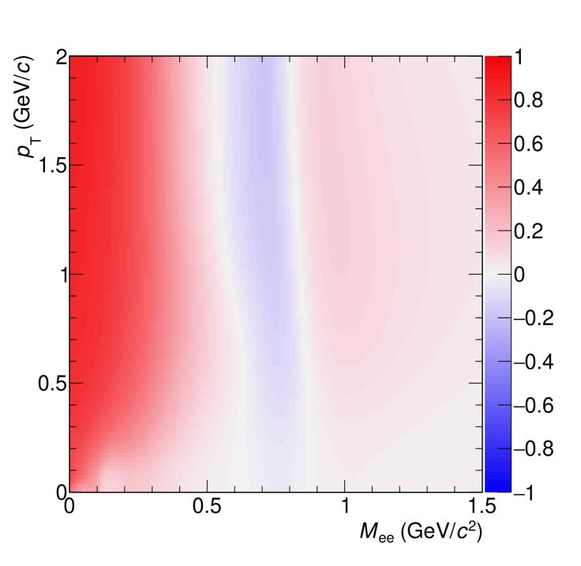
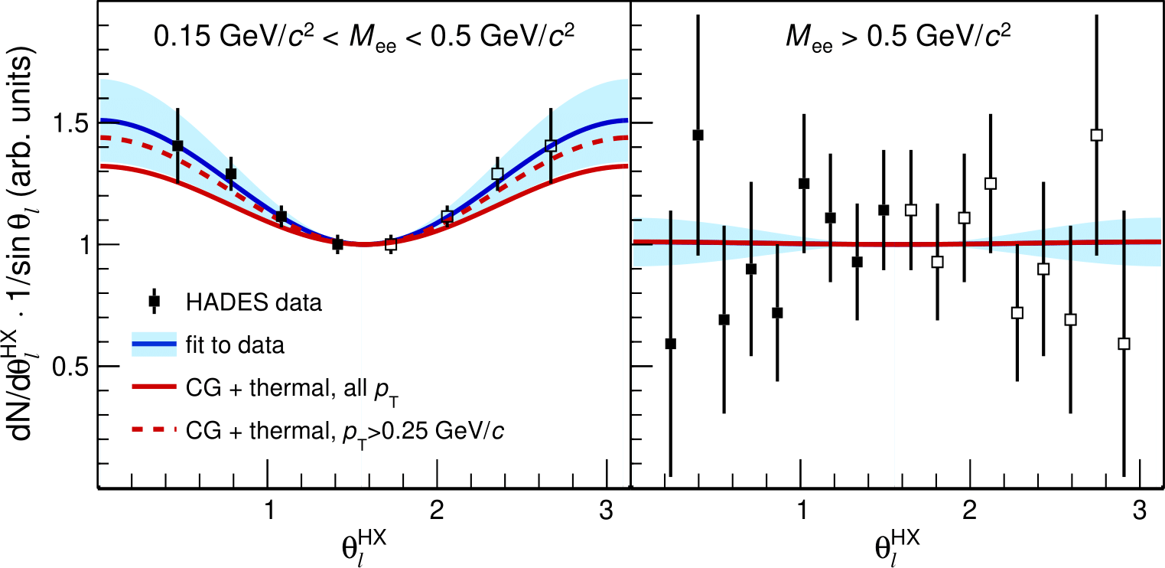

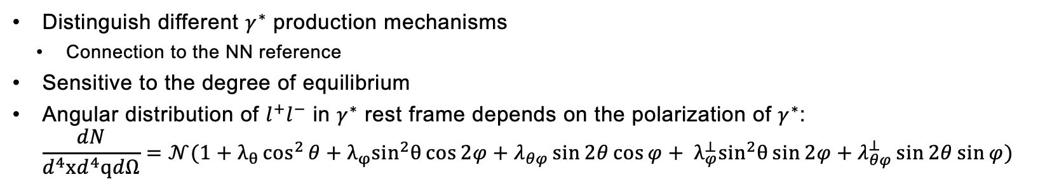
OUTLOOK: DILEPTON POLARIZATION
  Distinguish different $γ^{∗}$ production mechanisms
    Connection to the NN reference
  Sensitive to the degree of equilibrium
  Angular distribution of $l^{+}l^{−}$ in $γ^{∗}$ rest frame depends on the polarization of $γ^{∗}$:
  $\frac{dN}{d^{4}xd^{4}qdΩ}=𝒩(1+λ_{θ}\cos^{2}{θ}+λ_{φ}\sin^{2}θ\cos{2φ}+λ_{θφ}\sin{2θ}\cos{φ+ λ_{φ}^{⊥}\sin^{2}θ\sin{2φ}+λ_{θφ}^{⊥}\sin{2θ}\sin{φ})}$
HADES, Phys. Rev. C 84 (2011) 014902
F. Seck et al., arXiv: 2309.03189
Ar-KCl $\sqrt{s_{NN}}$ = 2.61 GeV

Slide 24
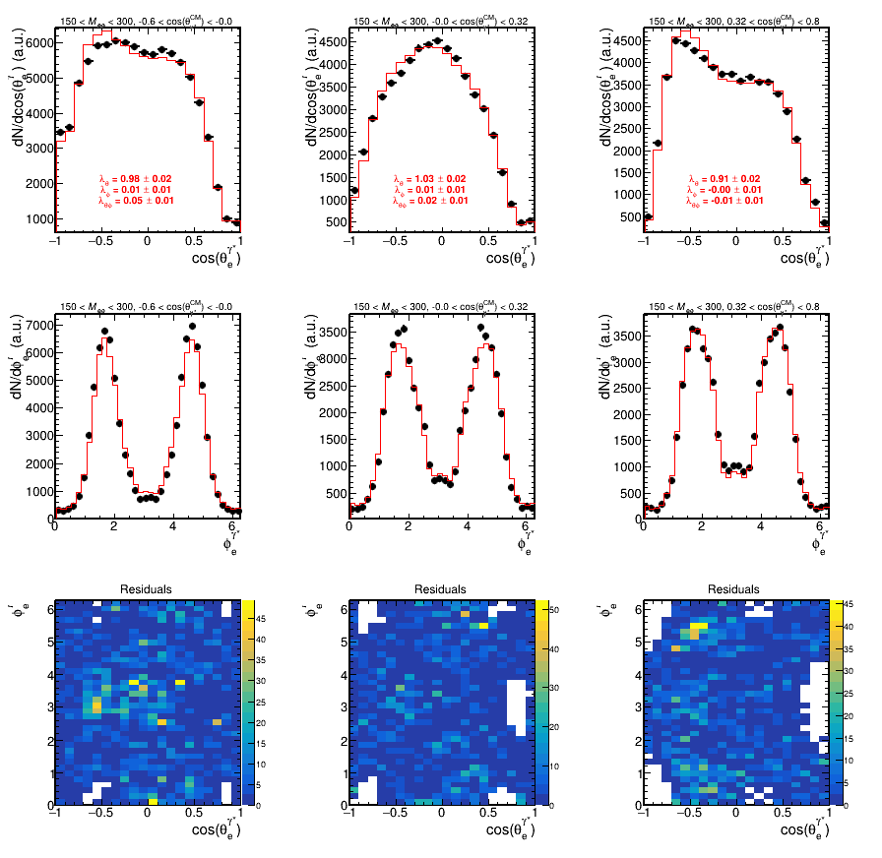
OUTLOOK: DILEPTON POLARIZATION
  A new method of extracting true parameters from “raw” spectra
  On-going: understanding of combinatorial background effects
    Now, e.g., negative counts after subtracting like-sign background for some values of the angles.

Slide 25
Summary AND OUTLOOK
At relatively low energy, the system is dominated by baryons
Baryonic resonances and their interactions play an important role in the dynamics
  Their understanding is essential even for most common observables
  Current models are not sufficient to explain the data
HADES offers a variety of data useful to constrain QCD Equation-Of-State:
  Large, multiple differential data on azimuthal anisotropy of hadrons
  Phase-space distributions of dileptons
  Dilepton flow
30.10.24
25

Slide 26
Thank you for youR attention

Slide 27
BACKUP

Slide 28
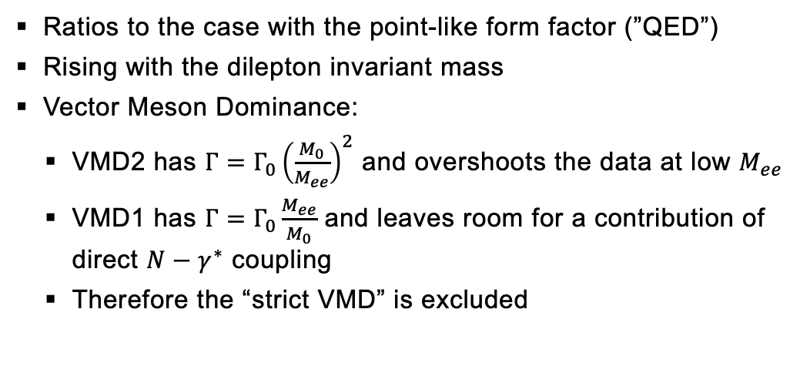
Baryons as extended objects
Exclusive analysis of π⁻p → n e⁺e⁻ at $\sqrt{s}$ = 1.49 GeV
Ratios to the case with the point-like form factor (”QED”)
Rising with the dilepton invariant mass
Vector Meson Dominance:
  VMD2 has $Γ=Γ_{0}{\left(\frac{M_{0}}{M_{ee}}\right)}^{2}$ and overshoots the data at low $M_{ee}$
  VMD1 has $Γ=Γ_{0}\frac{M_{ee}}{M_{0}}$ and leaves room for a contribution of direct $N−γ^{∗}$ coupling
  Therefore the “strict VMD” is excluded
Data: arXiv:2205.15914 [nucl-ex]
Zétényi: PRC 104, 015201 (2021)
Ramalho: PRD 95, 014003 (2017), PRD 101, 114008 (2020)
28

