Slide 1
Linear Polarization Analysis With Fast Beam Data
Peter Farris
4th AGATA-GRETINA/GRETA Tracking Arrays Collaboration Meeting

Slide 2
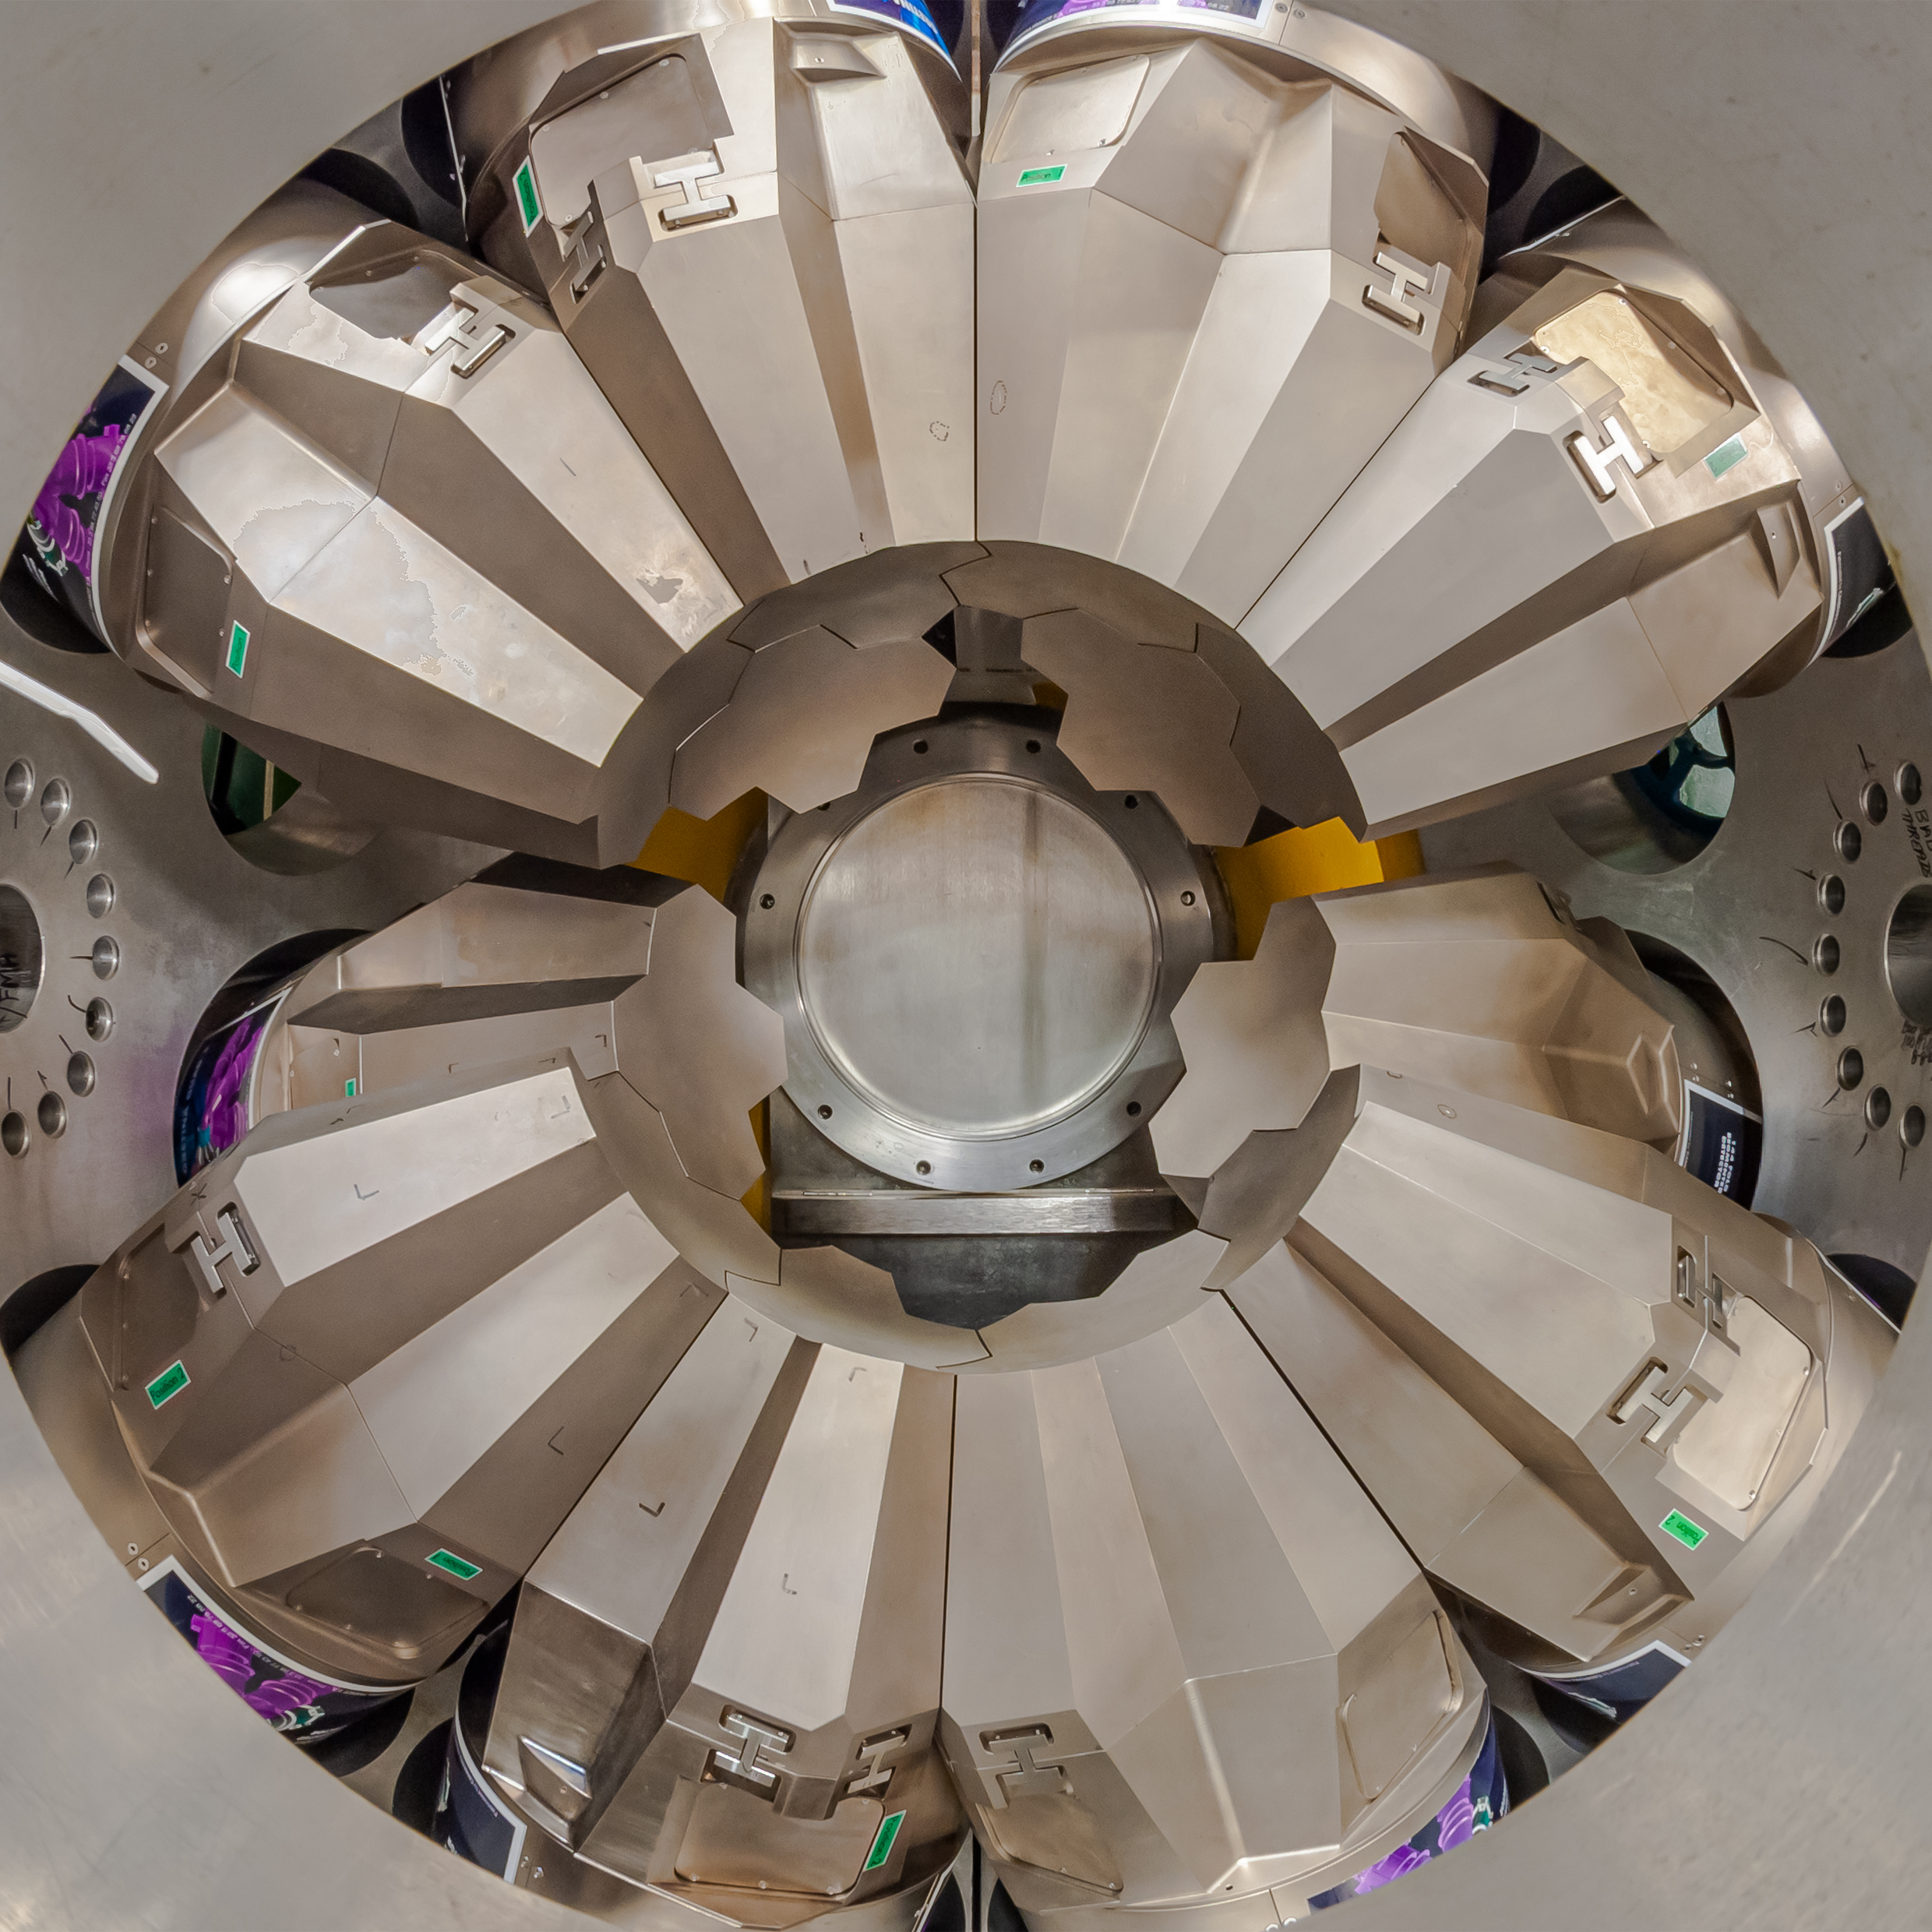
Outline
12 GRETINA Quads
Using Tracking Arrays as Compton Polarimeters
Attempting Linear Polarization Analysis With Fast Beam Data
A Confounding Correlation from Fast Beam Data
Accounting for the Correlation
Summary & Outlook
Courtesy of Shumpei Noji (FRIB)

Slide 3
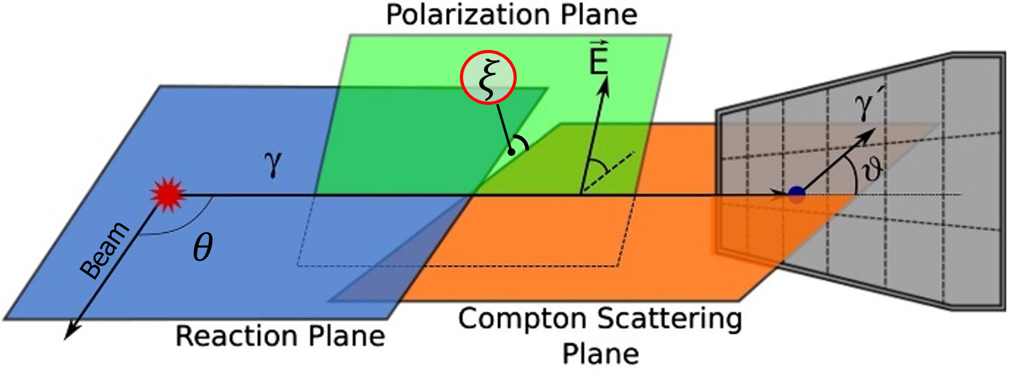
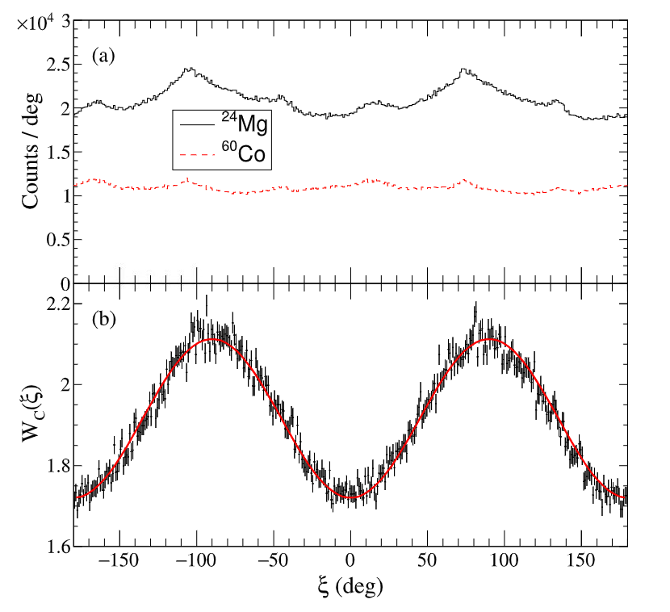
Tracking Arrays are Powerful Compton Polarimeters
$$β_{recoil}<0.005$$
2
1
The first two interaction points determine the Compton scattering plane
The distribution of the Compton scattering plane orientations probes the asymmetry from linearly polarized gamma rays
Asymmetry $A_{0}$ is proportional to the amplitude in the azimuthal scattering angle distribution
$$2A_{0}$$
$$A_{0}=\frac{1}{2}QP$$
$$W_{c}\left(ξ\right)=b(1−A_{0}\cos{2ξ})$$
[1] Adapted from B. Alikhani, et al. Compton polarimetry with a 36-fold segmented HPGe-detector of the AGATA-type. Nucl. Instrum. Methods in Phys. Res. A, Volume 675 (2012)
[2] C. Morse, et al. The polarization sensitivity of GRETINA. Nucl. Instrum. Methods in Phys. Res. A, Volume 1025 (2022)
Notes:
Also using GRETINA’s segmentation, for every gamma ray event it gives us a collection of interaction point energies and positions as it scatters through the crystal
This makes GRETINA capable of polarimetry
This is because Compton scattering is sensitive to gamma ray polarization as we know from the klein-nishina formula
Specifically Linear Polarized gamma rays prefer to scatter perpendicularly to the polarization plane, resulting in an asymmetry in the azimuthal Compton scattering angle
And we can measure this asymmetry by finding the angle between the Compton scattering plane and a reference plane
That’s what this angle xi is here, it’s there difference between our two planes
The reference plane we use is the reaction plane which is defined by the beam direction and outgoing gamma ray
From Klein-Nishina, we know that the distribution of xi will follow a cosine for polarized gamma rays and we can see this here
These are results from a paper by Chris Morse from an p p’ experiment on Mg24 done at Argonne National Lab
The bottom panel is showing that ratio of these two curves here at the top, this one is a xi distribution for a magnesium transition, and this is from an unpolarized source
The key observable then is the amplitude of this distribution A0 which tells you the asymmetry
It tells you how much more scattering you see between your parallel and perpendicular scattering directions
here we’re seeing more in the perpendicular scattering than parallel scattering relative to the reaction plane
The magnitude of the asymmetry is proportional the amount of polarization you have while
The sign of the asymmetry distinguishes between E and M type radiation, so since this is an E type for M we would expect the inverse distribution

Slide 4
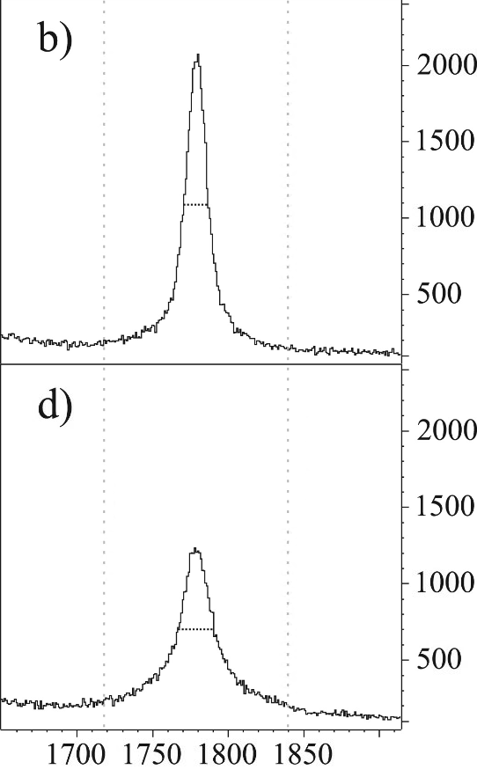
Our Approach to Choosing Interaction Point Order
Events where Main Int. and Tracking differ
The Main Interaction assumption takes the highest energy deposition interaction point as the first
This assumption does well identifying the first interaction point, performing better than some conventional tracking algorithms
We extend this idea and choose the second highest energy deposition as our second interaction point
We only consider interaction points within a single crystal
Main Interaction
Tracking
Counts / 1keV
Energy [keV]
[3] D. Weisshaar, et al. The performance of the γ-ray tracking array GRETINA for γ-ray spectroscopy with fast beams of rare isotopes, Nucl. Instrum. Methods in Phys. Res. A, Volume 847, (2017)

Slide 5
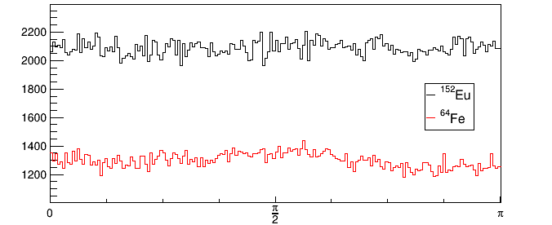
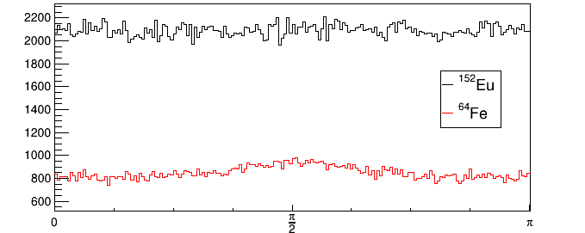
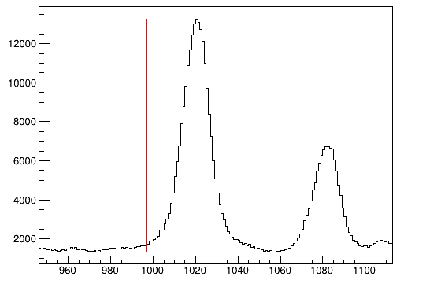
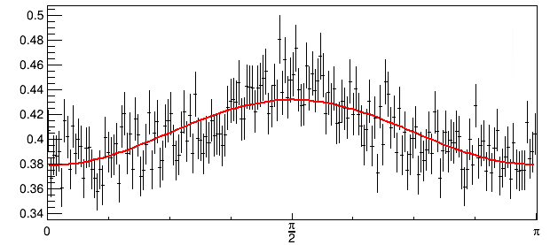
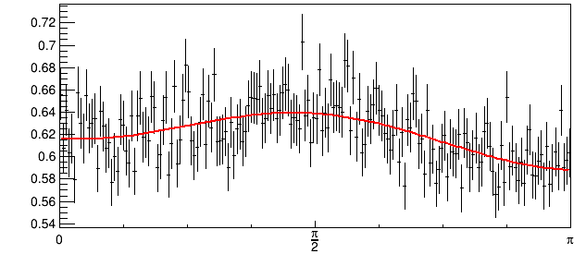
Polarization With Fast Beams
$$β_{recoil}<0.005$$
keV / bin
⁶⁴Fe
$β=0.44$
Counts / deg
Counts / deg
3 FWHM
3 FWHM gate
1 FWHM gate
Normalized Counts / deg
Normalized Counts / deg
Energy [keV]
$$ξ [rad]$$
[2] C. Morse, et al. The polarization sensitivity of GRETINA. Nucl. Instrum. Methods in Phys. Res. A, Volume 1025 (2022)

Slide 6
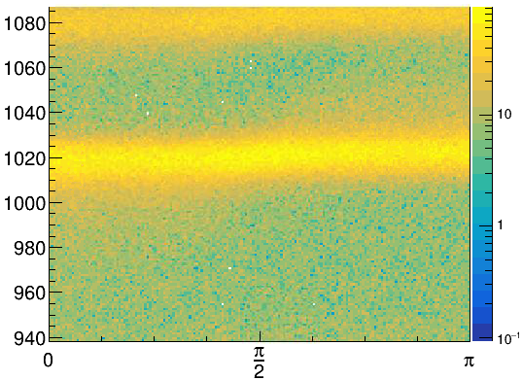
Azimuthal Scattering Angle and Doppler Corrected Energy Correlation
From the last slide, we saw fast beams we obtain a $ξ$ distribution that looks like there’s an asymmetry
⁶⁴Fe
$β=0.44$
Energy [keV]
Gamma rays emitted from fast beams show a correlation between $E$ and $ξ$
Gate
Normalized Counts / deg
$ξ$ [rad]
$ξ$ [rad]
Notes:
Now lets do polarization with fast beams
On the right here, the Berkley group did a p p’ experiment so their gammas were coming from the target, but we’re looking at gamma rays from the beam
You can see that the resulting xi distribution that we get from fast beams look a lot like this one
If we look closer however, this has nothing to do with polarization but a correlation between Doppler reconstructed energy, plotted here on the y axis, and xi plotted here on the x axis
You can see a clear correlation between the reconstructed energy and xi in these halos that are most prominent in the parallel angles
So if I do an energy gate to look at events in the full energy peak, we cut out more events around the parallel directions than the perpendicular
Creating a bias in our xi distribution that mimics the distribution we’re looking for
This correlation is comes from the fact that we need the first interaction point to do both the Doppler reconstruction and calculate xi
So if we get the first interaction point wrong, there is going to be an unphysical correlation between them

Slide 7
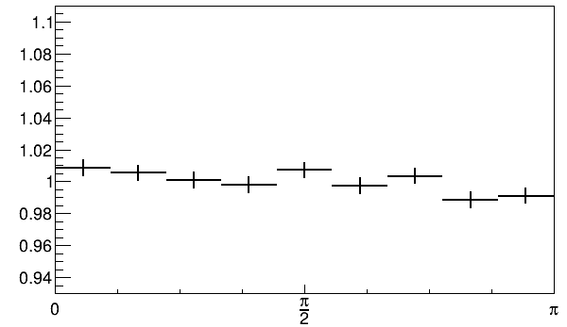
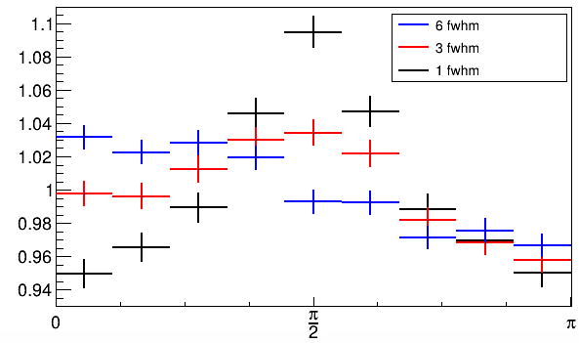
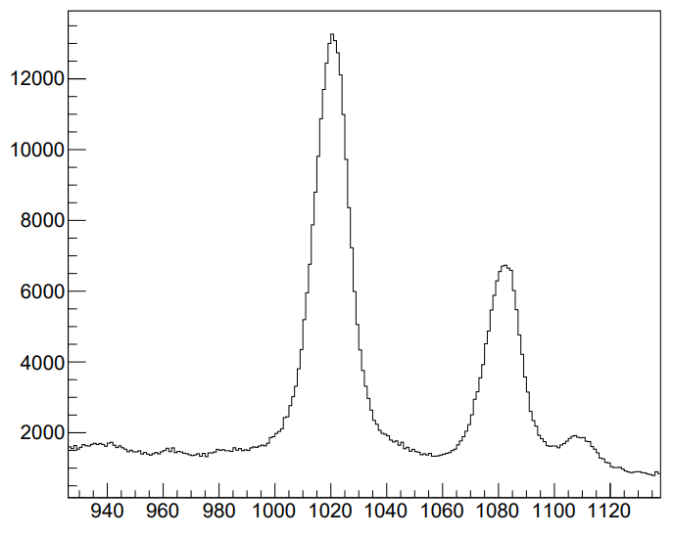
Energy Gate Widths Affect $ξ$ Distribution
Simulated FEP events
Unpolarized
Perfect tracking
$$β=0.43$$
⁶⁴Fe
$β=0.44$
Normalized Counts / 20 deg
Normalized Counts / 20 deg
keV / bin
$ξ$ [rad]
$ξ$ [rad]
Energy [keV]

Slide 8
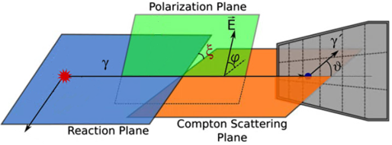
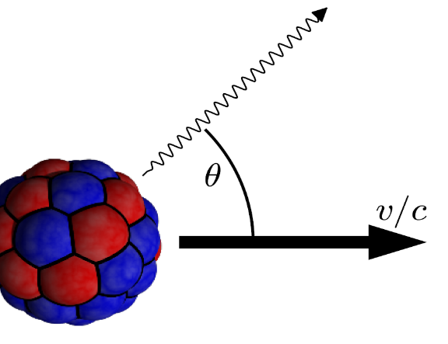
Fast Beams Remove Independence Between $E$ and $ξ$
A good $ξ$ calculation requires identifying the first two interaction points
A good determination of $θ$ (for Doppler reconstructed energy $E$) requires correctly identifying the first interaction point
Thus, in fast beam data the two observables $θ$ and $ξ$ are no longer necessarily independent
2
1
Depends on correct first two interaction points
1
Depends on correct first interaction point
[1] Adapted from B. Alikhani, et al. Compton polarimetry with a 36-fold segmented HPGe-detector of the AGATA-type. Nucl. Instrum. Methods in Phys. Res. A, Volume 675 (2012)
[4] Adapted from S. Paschalis, et al. The performance of the Gamma-Ray Energy Tracking In-beam Nuclear Array GRETINA, Nucl. Instrum. Methods in Phys. Res. A, Volume 709, (2013)

Slide 9
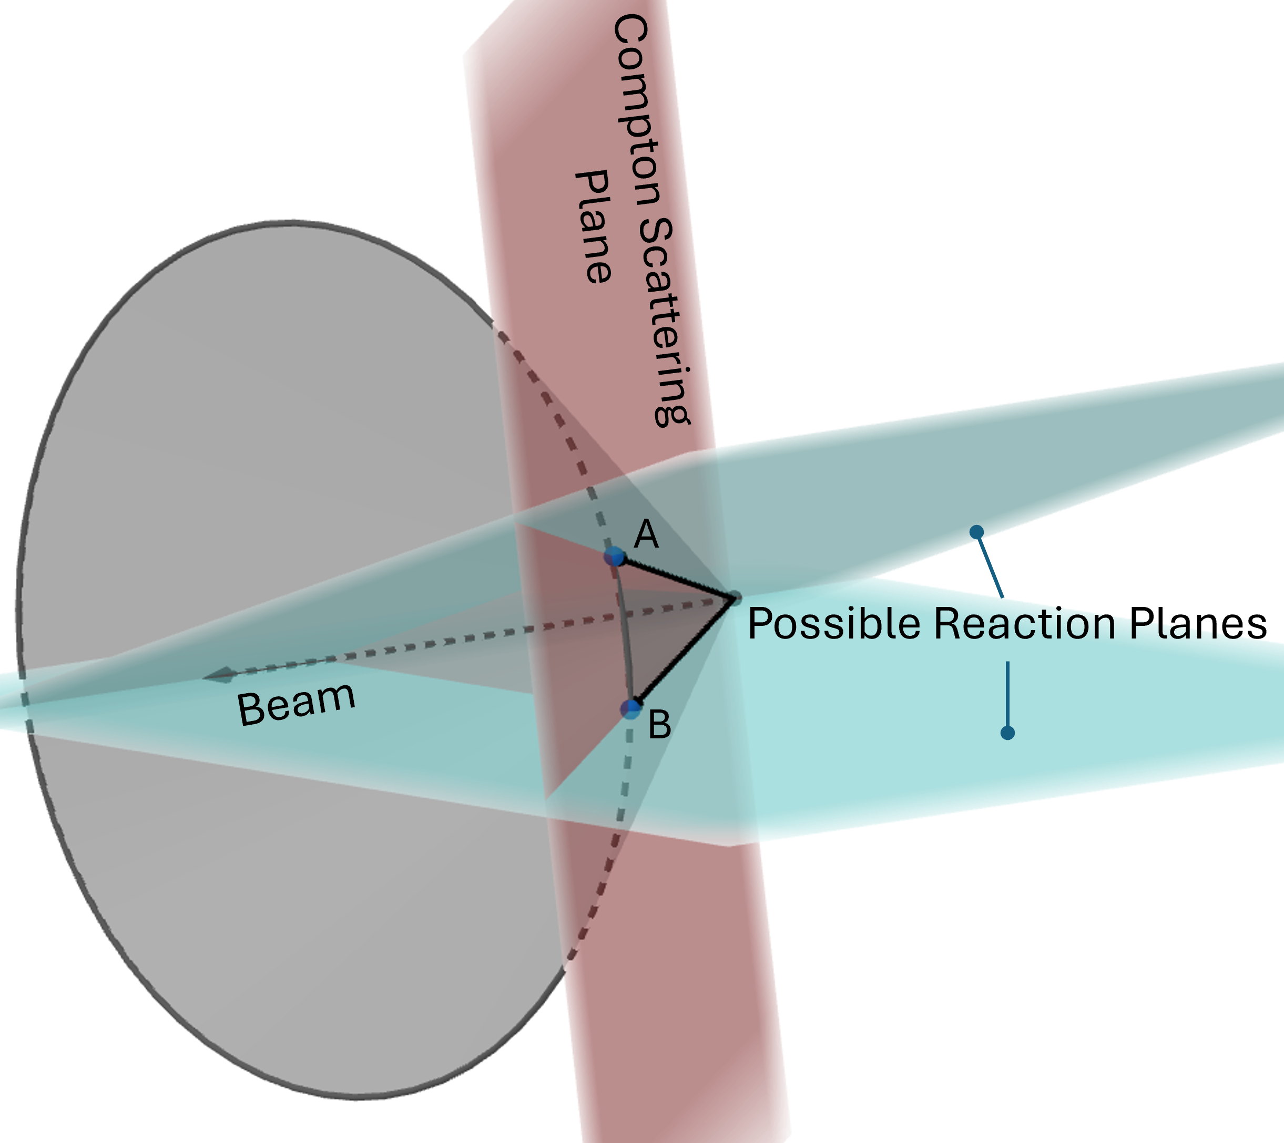
Induced Correlation: Perpendicular Case
Consider the simple case of two interaction points A and B
The cone shows all points that give the same emission angle $θ$ and therefore Doppler reconstruct to same energy
When points A and B give the same $θ$, the Compton scattering plane by construction is perpendicular to both possible reaction planes
Even if first point misidentified, perpendicular scattering events tend toward photopeak center
No Doppler penalty for choosing bad first point
$$E_{dop}\left(A\right)=E_{dop}(B)$$

Slide 10
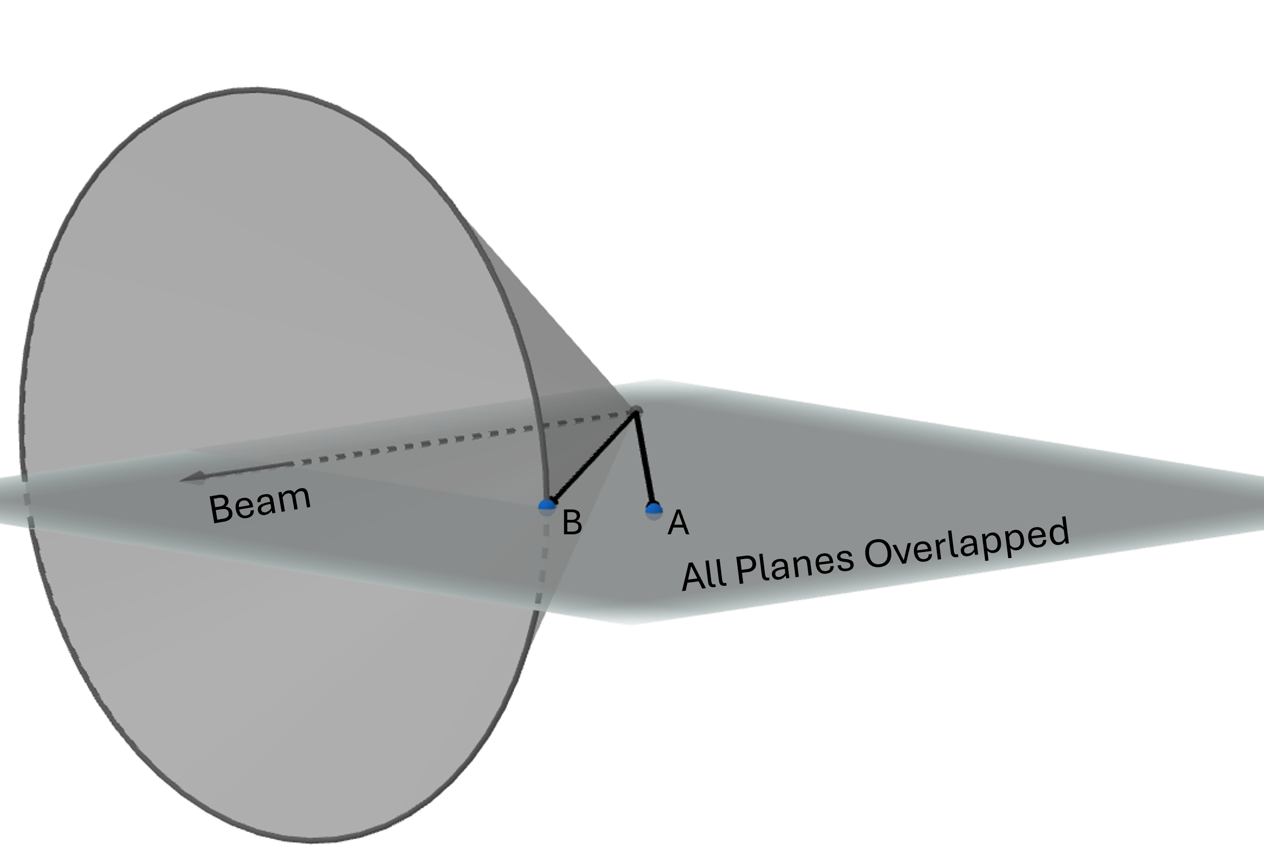
Induced Correlation: Parallel Case
Consider the simple case of two interaction points A and B
The cone shows all points that give the same emission angle $θ$ and therefore Doppler reconstruct to same energy
When points A and B give the maximum difference in $θ$, the Compton scattering plane by construction is parallel with the reaction plane
If first point misidentified, parallel scattering events tend toward the photopeak tails
Max Doppler penalty for choosing bad first point
$$E_{dop}\left(A\right)>E_{dop}\left(B\right)$$

Slide 11
Improving the Main Interaction Assumption
Use interaction point energies and positions to find the pair of points that minimize $f_{min}$
1st Point Candidate
2nd Point Candidate
Int. Pts.
$$f_{min}\left({\{E}_{i},\vec{x_{i}}\},{\{E}_{j},\vec{x_{j}} \}\right)={\left(\frac{E }{E_{i}}\right)}^{3} ∗{\left(\frac{E}{E_{j}}\right)}^{2}∗Compt\left(E_{i},θ_{ij}\right)∗z_{i}∗z_{j}∗α_{ij} ∗Klein\left(E_{i},θ_{ij}\right)∗LP\left(E_{i}\right)∗LP(E_{j})$$
$$\left\{E_{1},\vec{x_{1}}\right\}$$
$$\left\{E_{2},\vec{x_{2}}\right\}$$
Main Interaction
$$\left\{E_{3},\vec{x_{3}}\right\}$$
$$\left\{E_{4},\vec{x_{4}}\right\}$$
Compton formula (difference squared between Energy term and scatter angle term)
Klein-Nishina formula
…
Crystal depth coordinates
$γ$ event
Last point penalties
Angle between two points in the global basis

Slide 12
New Algorithm Performance in Simulation
Simulated 1329 keV Full Energy Peak Events Only
Interaction Point Order
Right 1st
Right 2nd
Right 1st
Wrong 2nd
Wrong 1st
Right 2nd
Wrong 1st
Wrong 2nd
Fairly equal performance between the New Algorithm and Main Interaction with two interaction points
Over all interaction points, the New Algorithm performs noticeably better than the Main Interaction

Slide 13
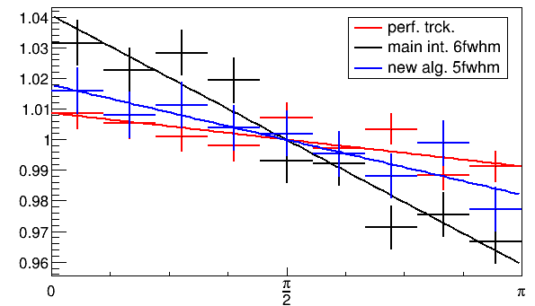
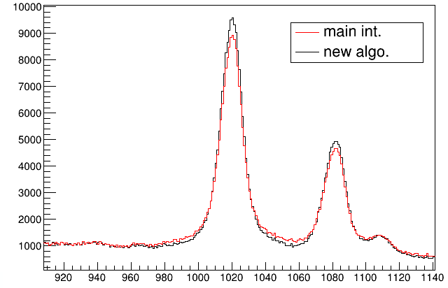
New Algorithm Performance in Real Data
# of interactions > 1
⁶⁴Fe
$β=0.44$
keV / bin
Normalized Counts / 20 deg
$ξ$ [rad]
Energy [keV]

Slide 14
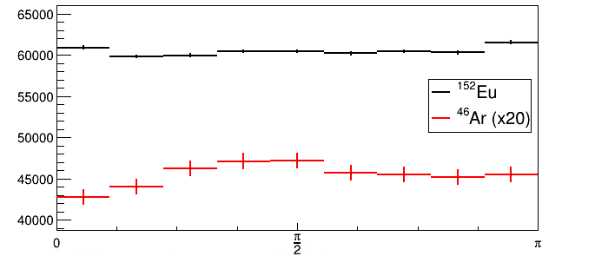
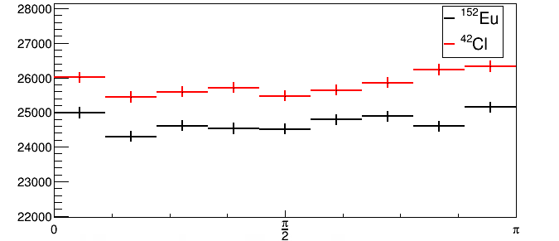
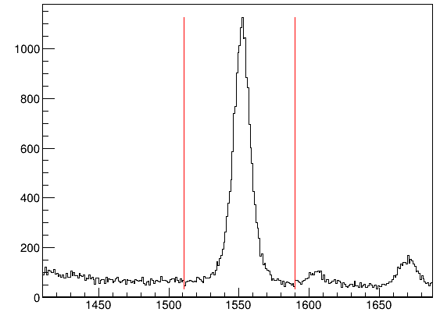
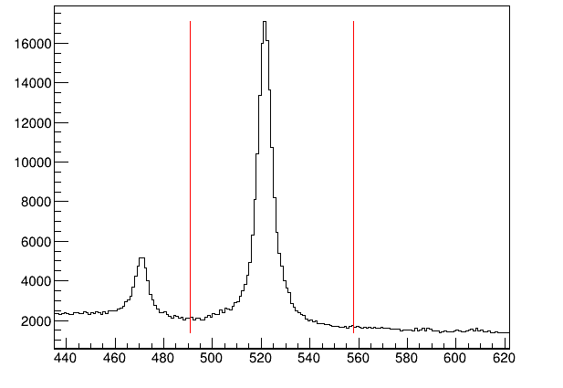
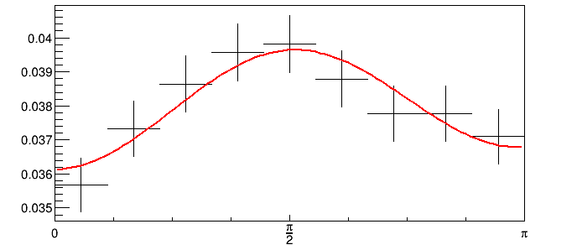
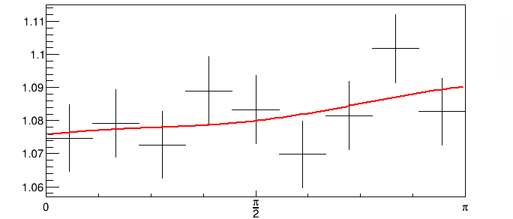
Promising Polarization Results
⁴⁶Ar (1p pickup)
$$β=0.334$$
⁴²Cl (3n knockout)
$$β=0.338$$
Counts \ 20 Deg
Counts \ 20 Deg
keV / bin
$$A_{0}=−0.0025±0.0044$$
Normalized Counts / 20 deg
Normalized Counts / 20 deg
$$A_{0}=0.044±0.012$$
Energy [keV]
Energy [keV]
$ξ$ [rad]
$ξ$ [rad]

Slide 15
Summary & Outlook
In fast beam data, there is an induced correlation between $E$ and $ξ$ when the gamma ray interaction point order is incorrectly determined
It’s all about including the tails! Too narrow of an energy gate will bias your data toward the perpendicular azimuthal scattering directions
Linear polarization analysis with fast beams looks feasible, but has limitations
Transitions must be isolated
Transitions must be intense and have good signal to background ratios
Multiplicity gates on interaction point numbers can also help reduce the correlation at the cost of losing statistics
Let the tail wag the dog?

Slide 16
Acknowledgment
Thanks to the Gamma Group
Alexandra Gade
Ava Hill
Dirk Weisshaar
Gabriel Grauvogel
Marshall Basson
Joseph Chung-Jung
Stephen Gillespie
Tom Parry
And former Gamma Group members
Brandon Elman
Brenden Longfellow
Daniel Rhodes
Elizabeth Rubino
Jing Li
Mark Spieker
Sayani Biswas
Tobias Beck
This work was supported by the U.S. Department of Energy, Office of Science, Office of Nuclear Physics under Contracts No. DE-SC0020451, DE-SC0019034, and DE-SC0023633

Slide 17
Thank you!
Questions?

Slide 18
Backup Slides

Slide 19
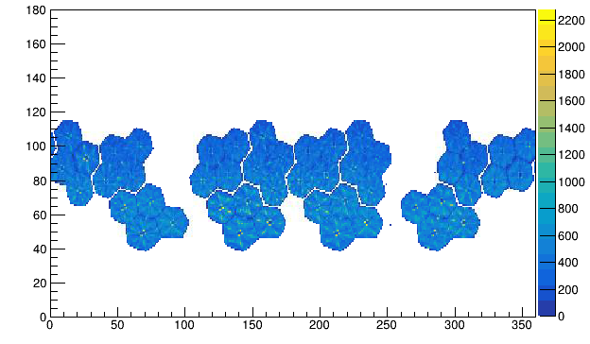
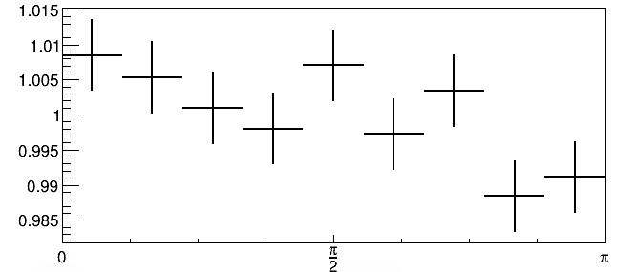
Lorentz Focusing Effects Overall $ξ$ Distribution in GRETINA
Events that scatter along increasing/decreasing theta must be more parallel to the reaction plane
Crystals have slightly more hit intensity on the forward edge than the backward edge due to Lorentz focusing
This creates a preferred scattering direction between the two parallel angles
$θ$ [deg]
$φ$ [deg]
$$θ$$
Intensity
$$γ$$

Slide 20
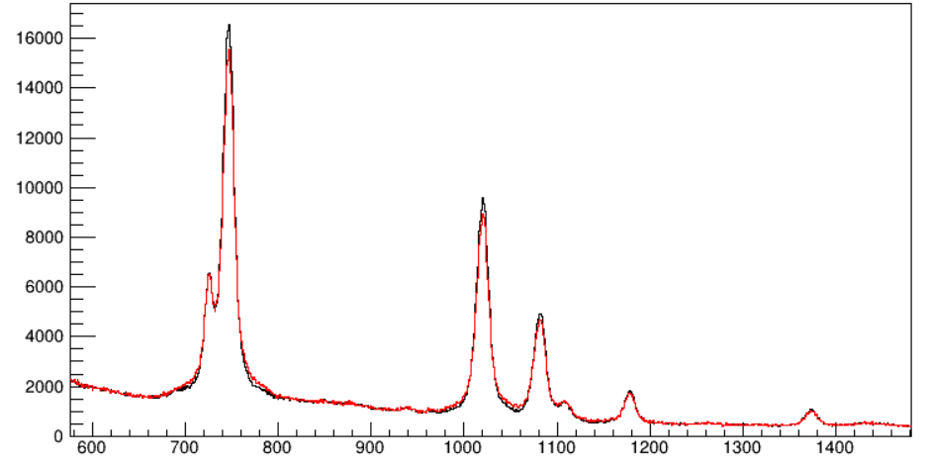
New Algorithm vs Main Interaction
⁶⁴Fe

Slide 21
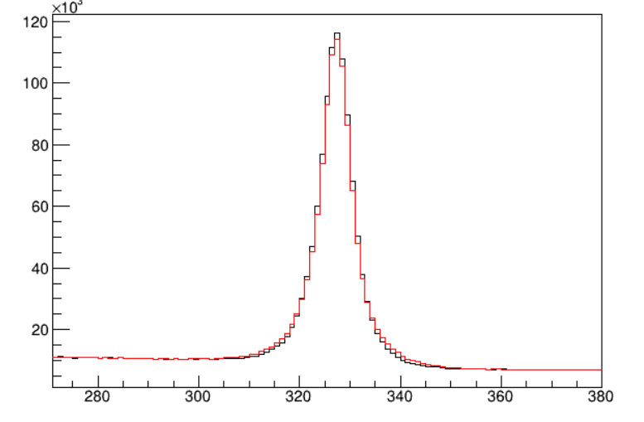
New Algorithm vs Main Interaction
⁴³Cl

