Slide 1
Development of a self-calibration technique for gamma-ray tracking arrays
Sidong Chen and Stefanos Paschalis
University of York
4th AGATA-GRETINA/GRETA Workshop, 20-22 Nov 2024

Slide 2
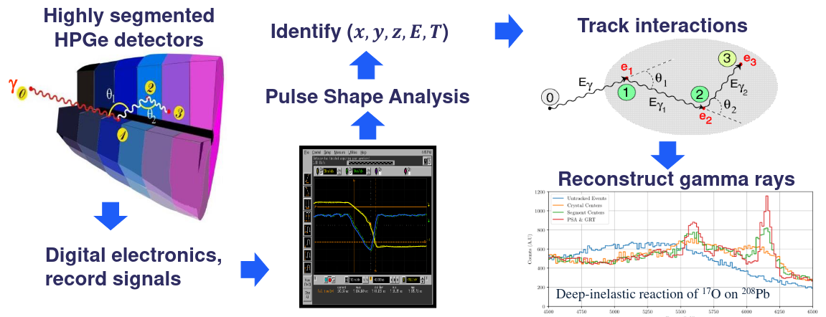
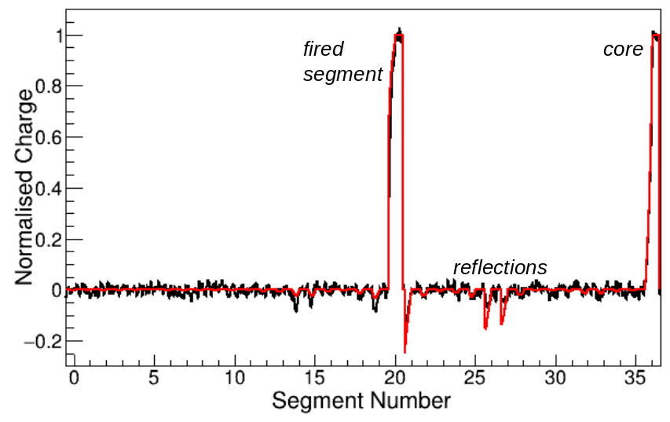
Gamma-ray tracking array
Energy (keV)
PSA:
Gamma-ray tracking array: highly segmented HPGe (36 segments)
Pulse Shape Analysis (PSA) => interaction position
PSA performed by comparing with signal basis for every detector

Slide 3
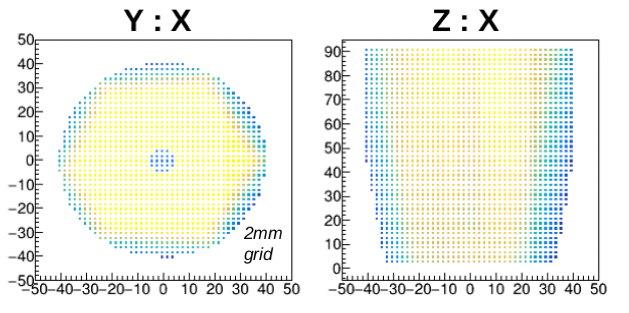
Current challenges
signal basis generation
Experimental (scanning)
long acquisition times
different conditions between scanning and experiment, e.g. noise, radiation damage
mechanical alignment
Analytical (calculated)
intrinsic space-charge density
the electron/hole mobility
crystal temperature and
crystal orientation
passivated and contact thickness
shape of charge cloud

Slide 4
Self-calibration concept
Generate signal basis experimentally & in situ
Det1
Det2
S. Heil, S. Paschalis, and M. Petri, Eur. Phys. J. A (2018) 54: 172
Det3
HC2
Group interaction points from different gamma-rays into hit collections
HC3
HC1
path2
Optimise coordinates of hit collection using the tracks that link their constituent points and Compton formula
path1
Use Compton formula to order interaction points
Define tracks between interaction points that also link the hit collections with each other
source
Produce pulse shape basis for all detectors
Strong gamma source illuminate the whole array
Compton formula optimize scattering events

Slide 5
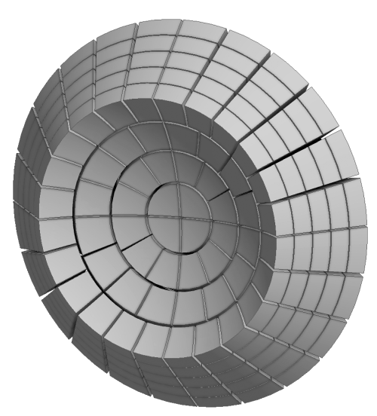
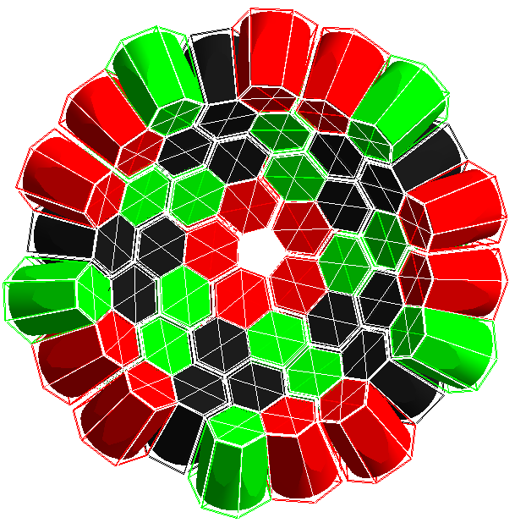
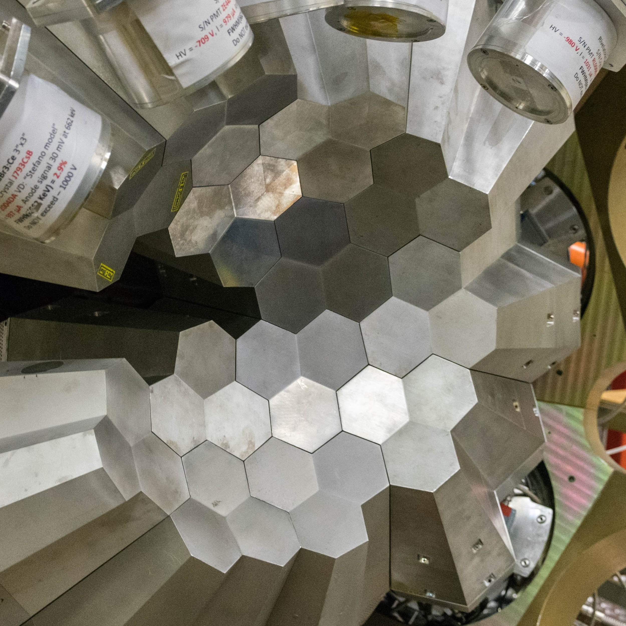
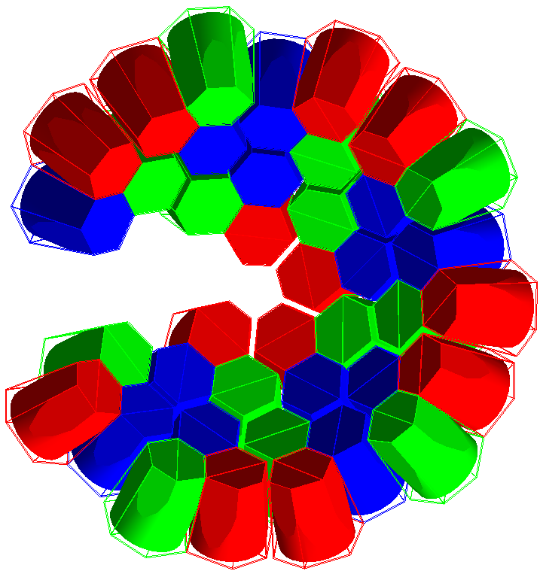
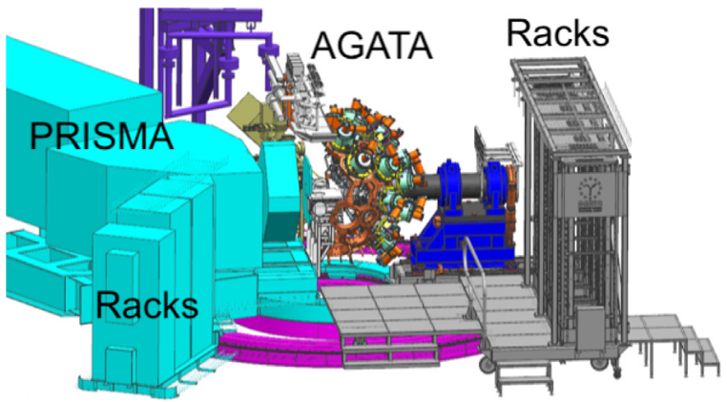
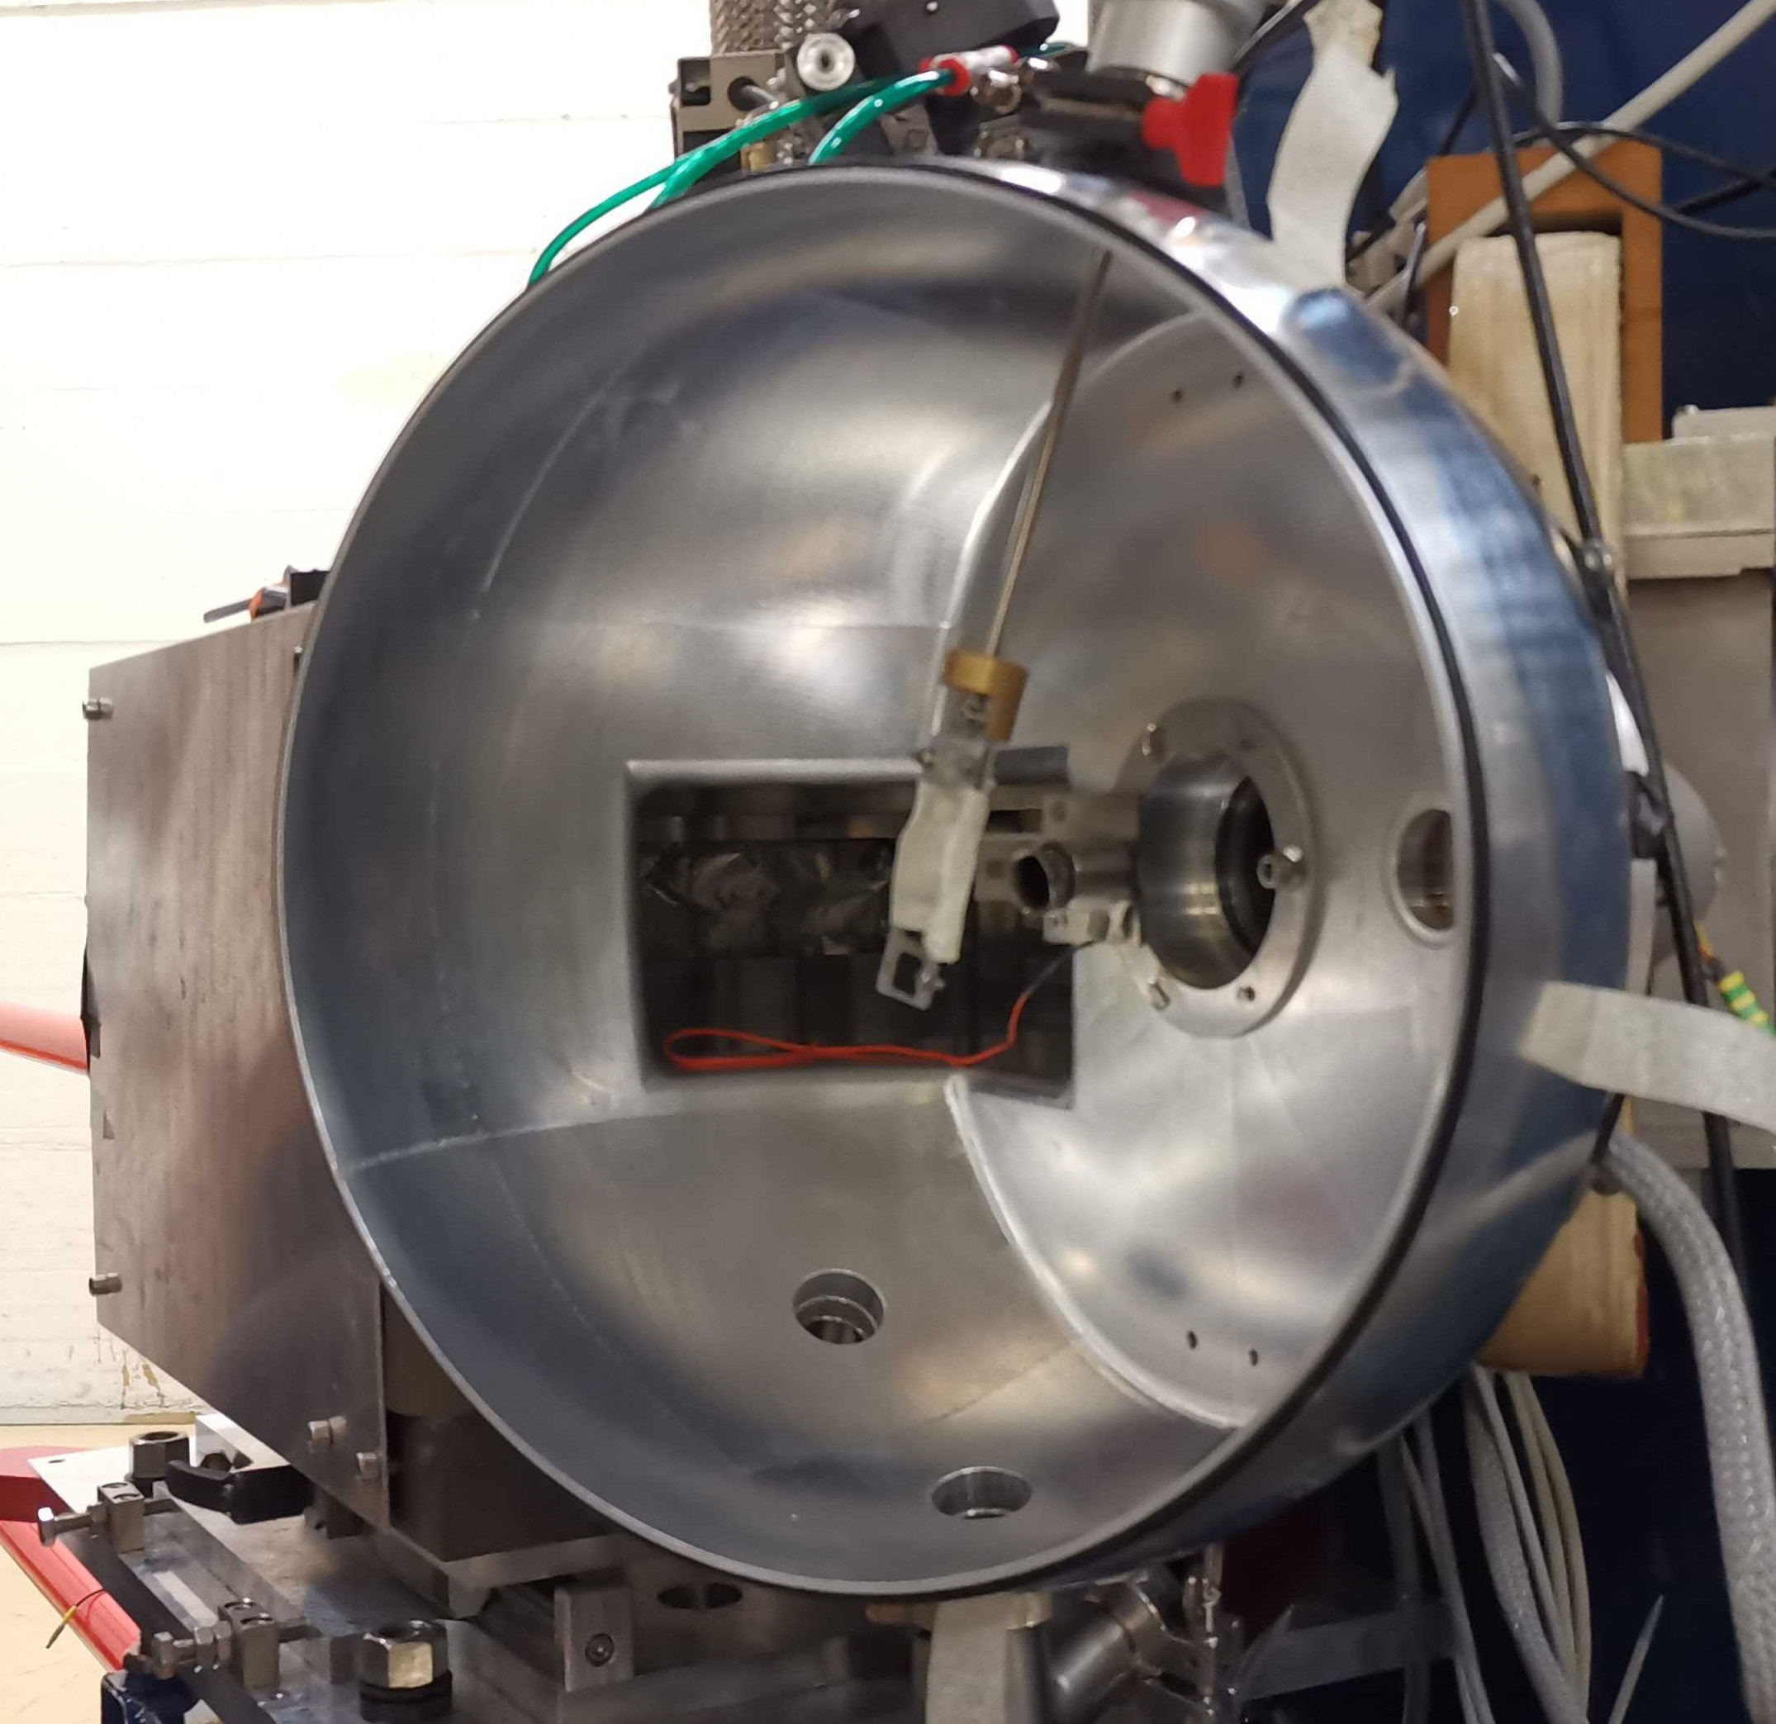
Method validation timeline
simulation of realistic geometry of AGATA (even with 1Pi)
end-to-end simulation including pulse shape analysis
validation using experimental data (source and in-beam)
forthcoming, dedicated in-beam LNL experiment Dec 2024
2018: proof of principle with a simple simulation
2022: test with AGATA simulation with pulse shape
2023: test with real gamma source data at LNL
2024: produce optimized basis and validating with in-beam experiments
2018
2019
2020
2021
2022
2023
2024
2025

Slide 6
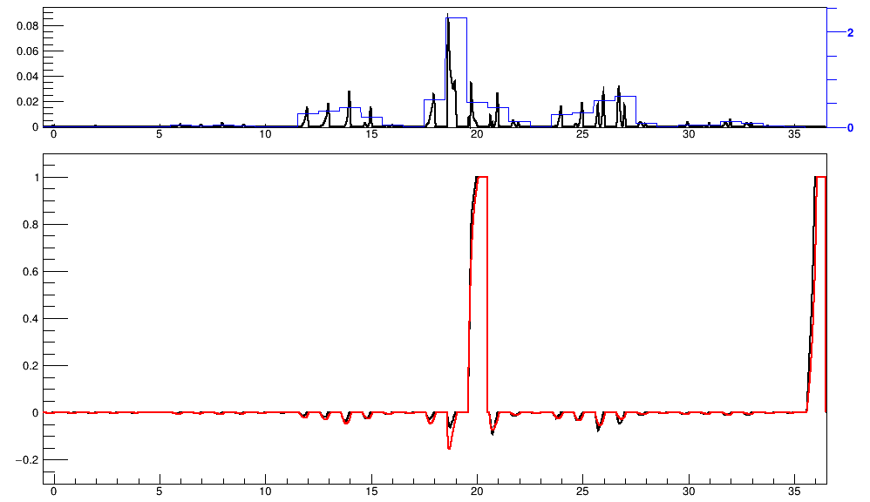
Simulation with Pulse Shape
Geant4 simulation:
Group pulse shape:
Normalised Charge
segments
Geant4 simulate AGATA-1Pi array, save Compton scattering events
Pulse shape basis linear interpolation → simulation pulse data
Group pulse shape according to similarity

Slide 7
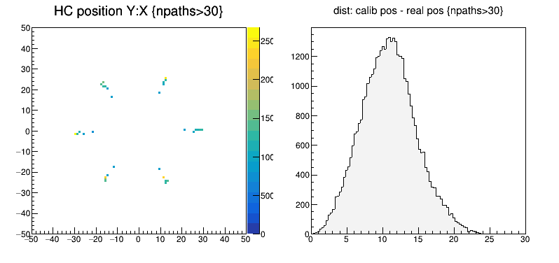
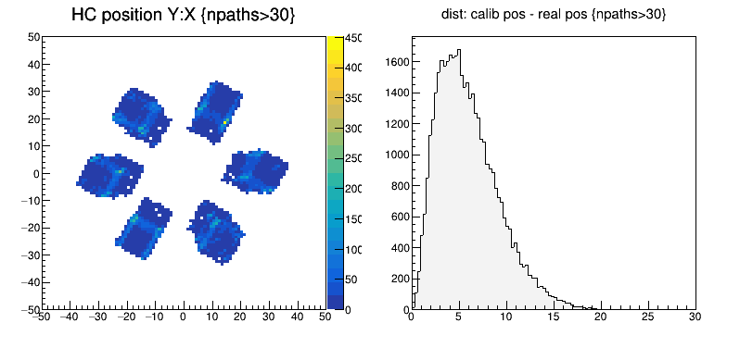
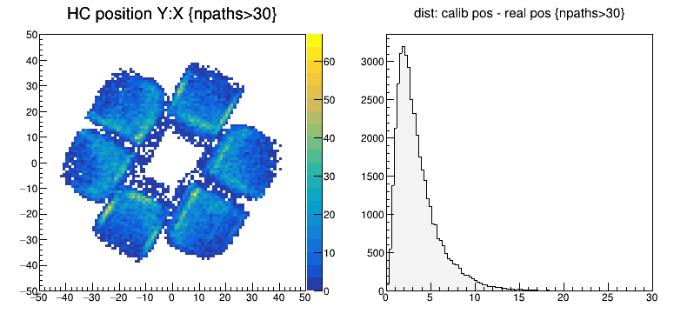
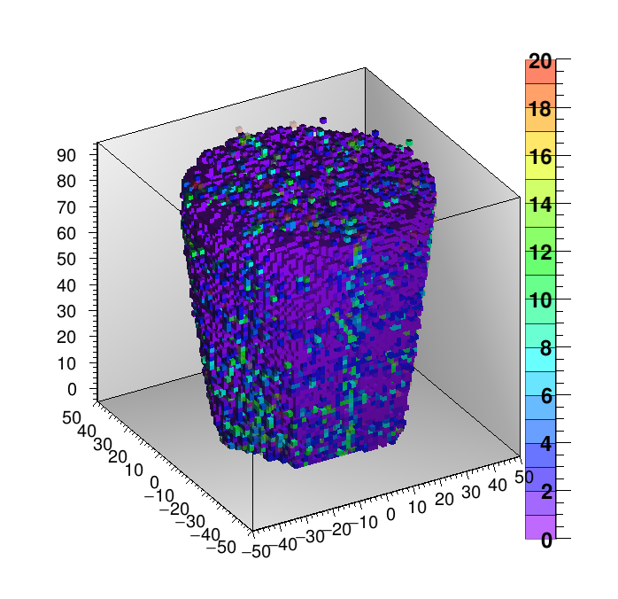
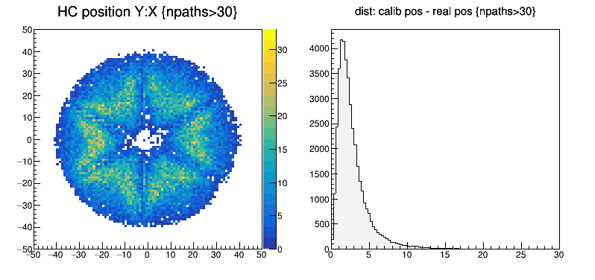
Position optimization
Self-calibration using a full Simulation (with PSA)
HC position Y:X
dist: calib pos – real pos
initial
Y / mm
Det1
Det2
Det3
HC2
Y / mm
1st iter.
HC3
HC1
path2
path1
2nd iter.
Y / mm
Y / mm
5th iter.
source
Simulate 2MeV gamma 2e10 events
X / mm
distance / mm

Slide 8
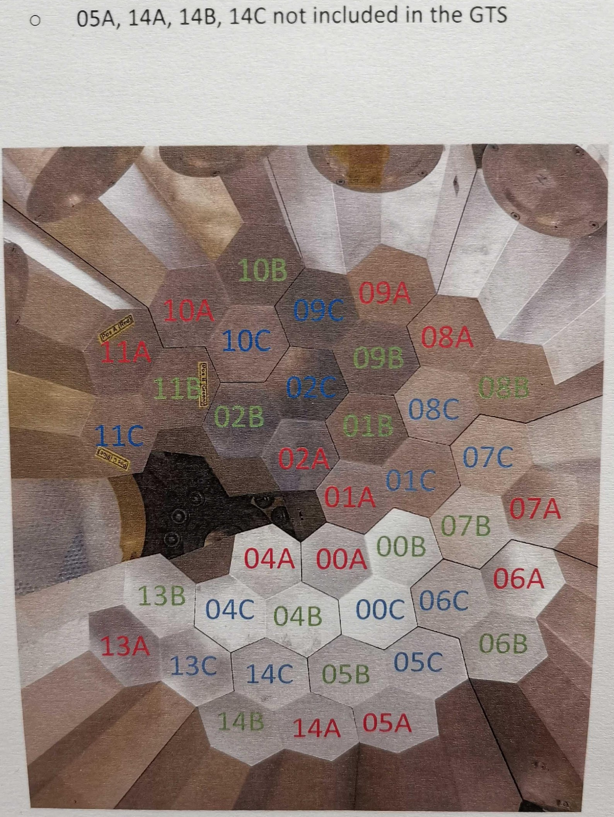
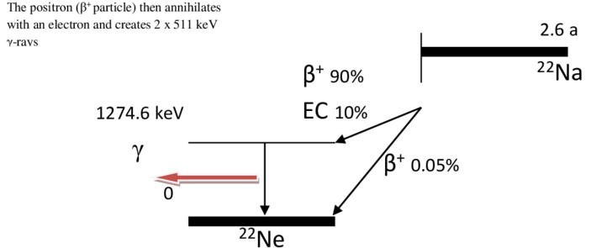
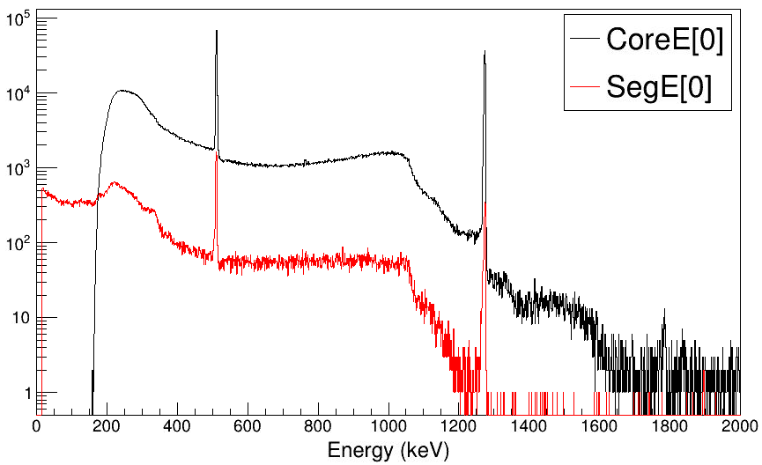
Experiment: source data
²²Na source, 130kBq
source at target position
13 ATC at LNL
²²Na 130kBq source at center of array
Large signals, CoreE>200keV (CoreE>300keV data is used for self-calibration)
Compton scattering events (fold 2 trigger)

Slide 9
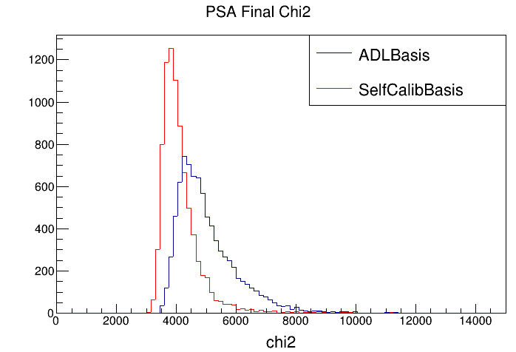
Pulse Shape Analysis (PSA)
PSA:
ADL (AGATA Detector Library): theoretical calculated basis on 2 mm grid
Chi2: the difference between experimental signal and the signal basis fitting
The PSA final chi2 with self-calibration basis is smaller than that with ADL basis
⇒ self-calibration basis better describe experimental signal

Slide 10
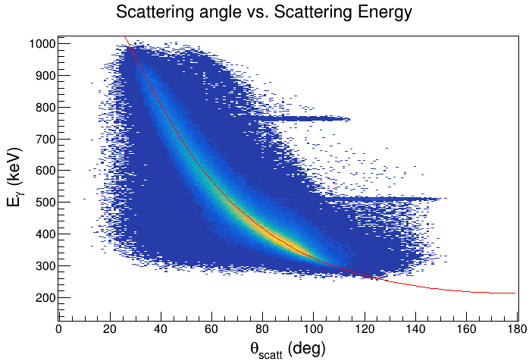
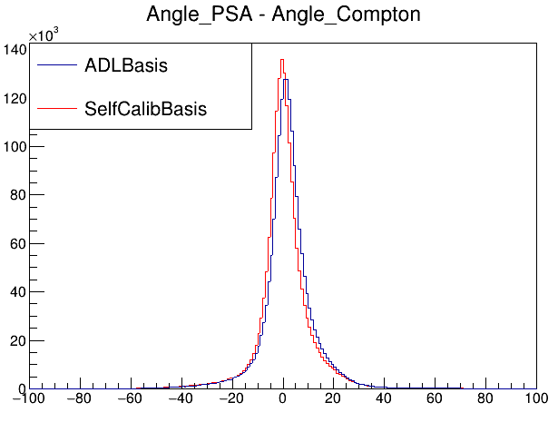
Compton Scattering Angle
Compton scattering of 1274keV gamma
Interaction position from PSA with ADL basis and SelfCalib basis
Comparing scattering angle from PSA and the Compton angle from energy deposit
E2
E1 + E2 = 1274keV
1274keV
theta
E1

Slide 11
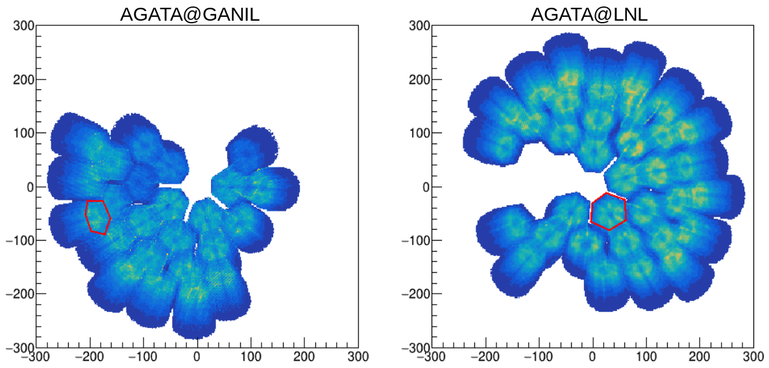
GANIL benchmark data
(in beam)
A006
11A (DetId=33)
00A (DetId=0)
E680 fission data of ⁹⁸Zr from 2015
Crystal A006 commonly used in GANIL setup and LNL setup
Electronics following the crystal can be different between two setups

Slide 12
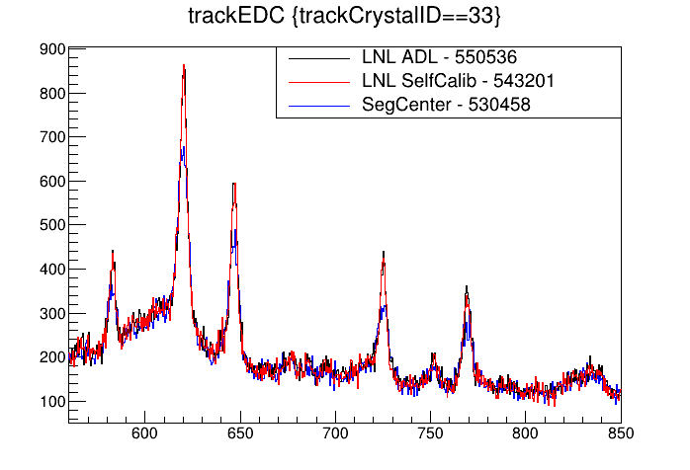
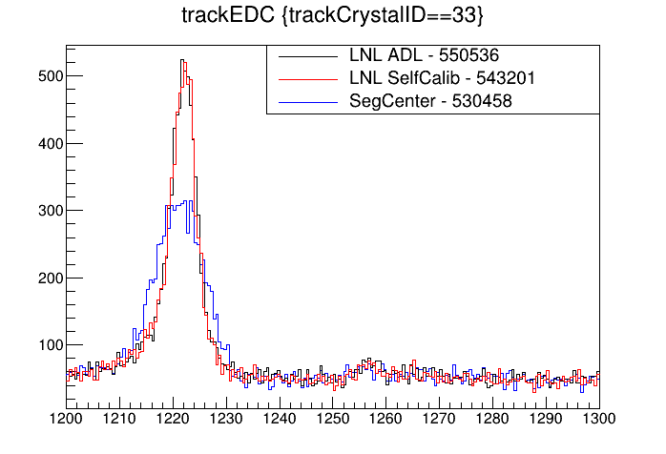
GANIL benchmark data
A006 spectra with ADL basis, self-calib basis and segment center

Slide 13
A006 Signal basis
ADL basis
Self-calib basis

Slide 14
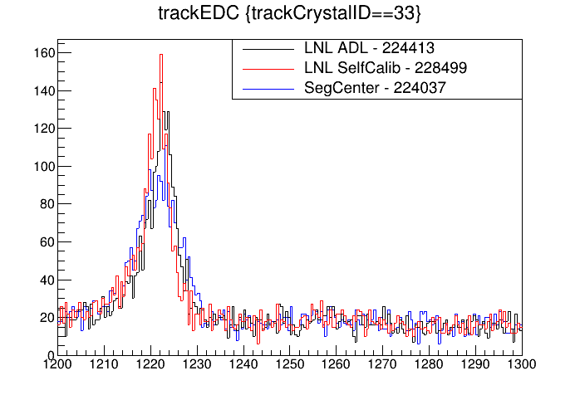
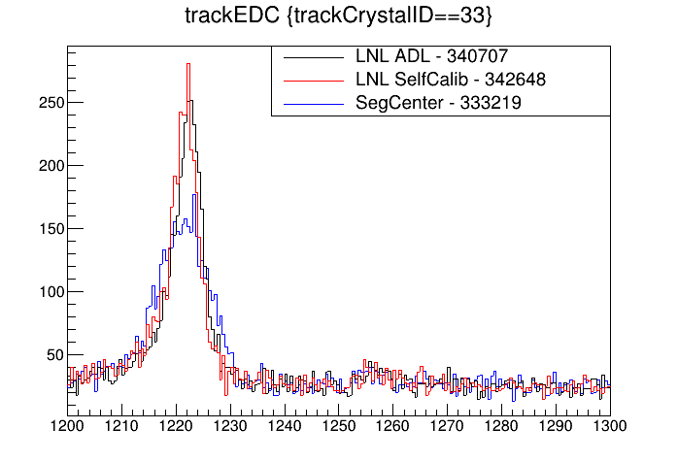
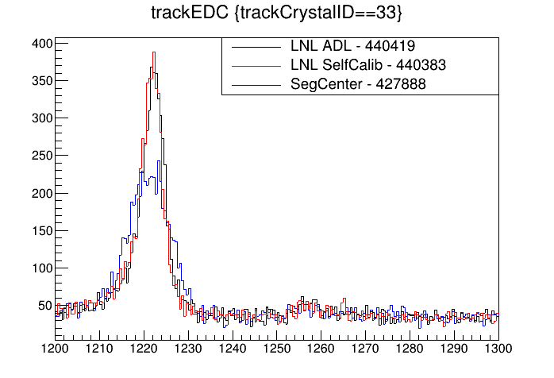
GANIL benchmark data
Self-calib basis
slice<1
slice<2
slice<3

Slide 15
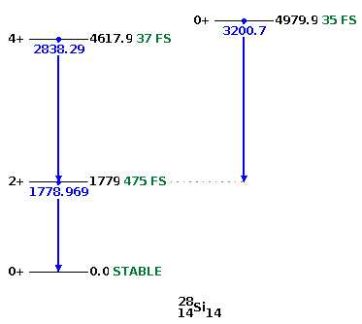
Forthcoming, dedicated experiment at LNL (Dec 2024)
AGATA
²⁸Si@175MeV
²⁸Si@160MeV
¹⁹⁷Au
1mg/cm²
PRISMA
PRISMA at 45°
¹⁹⁷Au target 1mg/cm² (0.52um)
²⁸Si scattered to 45°, 160MeV (β=0.11)
²⁸Si 2⁺ t_{1/2} = 0.475ps
Scheduled in December 2024

Slide 16
Summary
Technique validated with simulation data using realistic AGATA 1PI geometry and PSA
Applied to experimental data (²²Na source at LNL) obtaining results consistent with simulations
Self-calibration basis (from LNL) applied to the GANIL in-beam data yielding reasonable results despite different setups
PSA performance using self-calibration basis and original basis shows improvement
A dedicated in-beam experiment at LNL (²⁸Si Coulex) accompanied by a dedicated ⁸⁸Y source calibration are scheduled for December 2024, stay tuned!
2018: proof of principle with a simple simulation
2022: test with AGATA simulation with pulse shape
2023: test with real gamma source data at LNL
2024: produce optimized basis and validating with in-beam experiments
2018
2019
2020
2021
2022
2023
2024
2025

Slide 17
Collaboration of LNL experiment Q24.001 scheduled for Dec 2024
S. Chen¹, S. Paschalis¹, M. Bentley¹, M. Petri¹, M. Labiche², F. Holloway³, L. Harkness-Brennan³, A.J. Boston³, J.J. Valiente Dobón⁴, M. Rocchini⁵, A. Goasduff^{4,6,7}, R.M. Pérez-Vidal⁴, D. Kalaydjieva⁸, K. Stoychev⁸, N. Marchini⁹, M. Zielińska¹⁰, A.O. Macchiavelli¹¹, I.Y. Lee¹², J. Dudouet¹³
¹ University of York, York, UK. ² STFC Daresbury Laboratory, Daresbury, UK. ³ University of Liverpool, Liverpool, UK. ⁴ INFN, Laboratori Nazionali di Legnaro, Legnaro, Italy. ⁵ Università degli Studi and INFN Sezione di Firenze, Florence, Italy. ⁶ Dipartimento di Fisica dell’Università di Padova, Padova, Italy. ⁷ INFN, Sezione di Padova, Padova, Italy. ⁸ University of Guelph, Canada. ⁹ INFN Firenze, Italy. ¹⁰ Irfu, CEA, Université Paris-Saclay, France. ¹¹ Oak Ridge National Laboratory, USA. ¹² Lawrence Berkeley National Laboratory, USA. ¹³ Université de Lyon, CNRS/IN2P3, Villeurbanne Cedex, France
Thank you for your attention

Slide 18
Backup

Slide 19
TAC comments
The PRISMA MWPPAC focal plane detector is known to have quite low efficiency for Z<20 ions. Please consider about 50-60% intrinsic efficiency for Z=14 ions.
If the statistics are lower than expect, we can combine data from several detectors.
Could the target (Au) excitation be a problem for you? You will have many gamma-ray transitions around 200-500 keV which may be problematic for your event selection. Have you considered the possibility to use instead Nb, Pt, Pb targets?
We don’t think the Au excitation will make serious problem. If it does, we can use Pb target instead.
Beam: The required energy from Tandem is high: in this configuration (double stripper in the Tandem) the required beam current is at the very limit: it could be that the maximum current achievable is lower, around 1pnA.
We will use 1-mg/cm² Au target and 1pnA ²⁸Si beam.

Slide 20
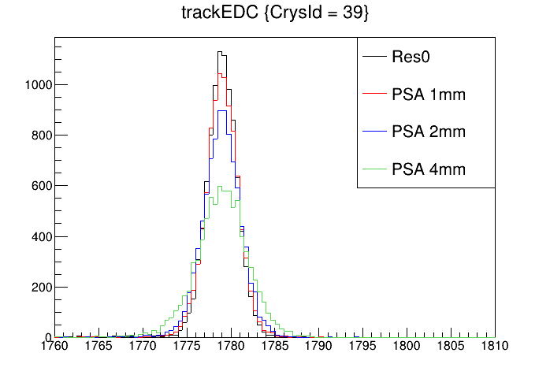
Experimental Estimates
Beam intensity: ²⁸Si 1-pnA
Target thickness: ¹⁹⁷Au 1-mg/cm²
GOSIA estimated yield 400,000 gamma-particle coincidences per day
PRISMA rate 3kHz
PRISMA energy resolution 1/1000
MCP entrance detector position resolution 1mm

Slide 21
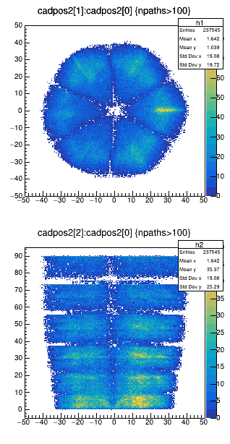
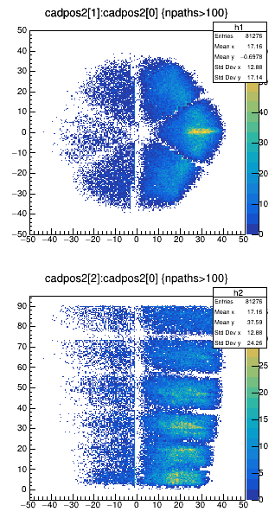
Source calibration
Strong ⁸⁸Y source, ~500kBq x2
source at some positions (target position, close to some detectors, ...)
Flod 2 trigger with core energy threshold 300keV or higher
Save trace data, validation rates below 1kHz per crystal
Data taking for 7 days
AGATA
Det 00
Det 39
source
Selfcalib basis from simulation data, ⁸⁸Y source at target position, 1e11 decays

Slide 22
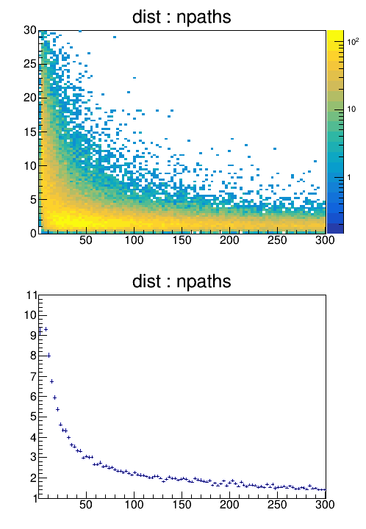
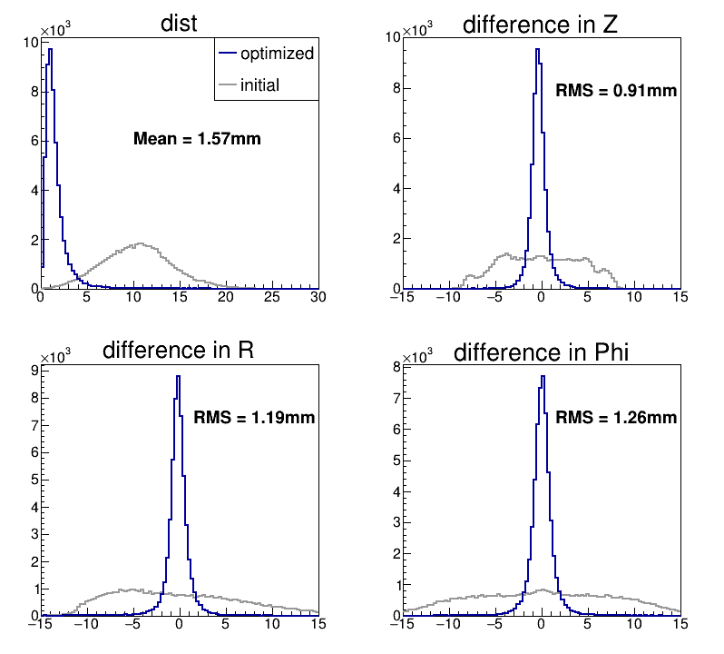
Simulation: Position fidelity
distance / mm
distance / mm
select HCs
Select HC linked with large number of paths
Converged HC position reach ~1mm (RMS) fidelity
Slightly worse resolution in phi direction
Number of paths
Simulate 2MeV gamma 2e10 events

Slide 23
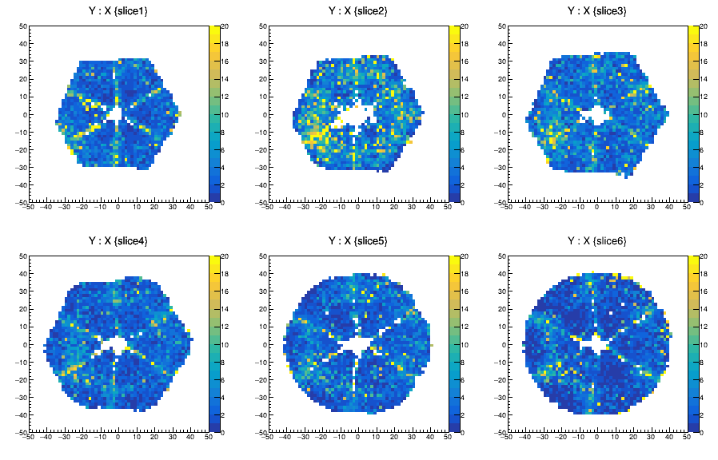
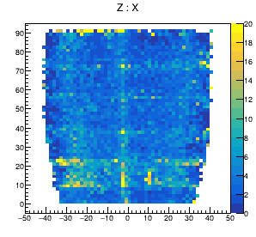
Self-calibration basis (simulation)
Chi2 difference: self-calib pulse vs. real pulse
Large Chi2 observed around segment boundary
Simulate 2MeV gamma 2e10 events

Slide 24
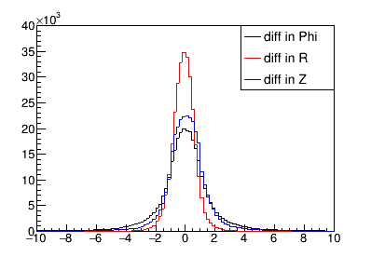
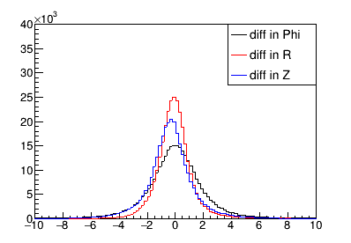
PSA position resolution (simulation)
Using the calculated
Basis on a 2mm grid
Using the self-calibrated
basis
difference / mm
difference / mm

Slide 25
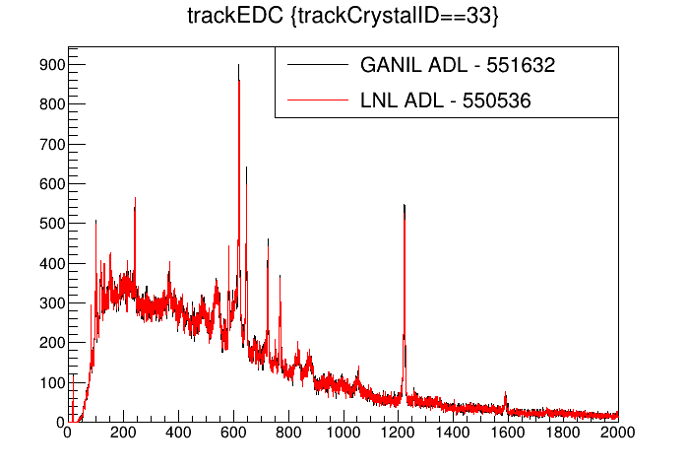
GANIL benchmark data
A006 spectra with GANIL cross-talk parameters and LNL cross-talk parameters

Slide 26
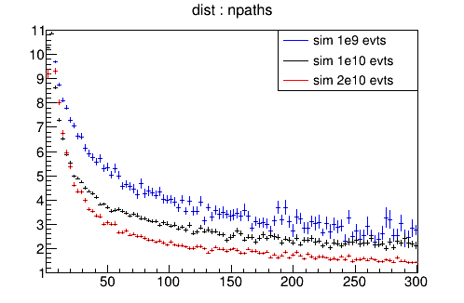
Position resolution
distance / mm
Number of paths
Simulation data size influence to position resolution

Slide 27
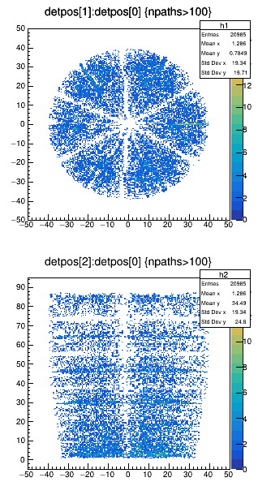
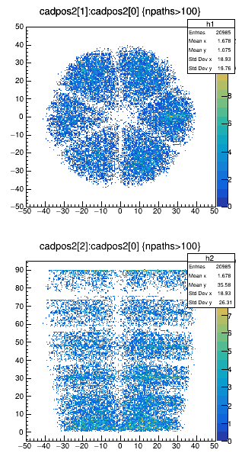
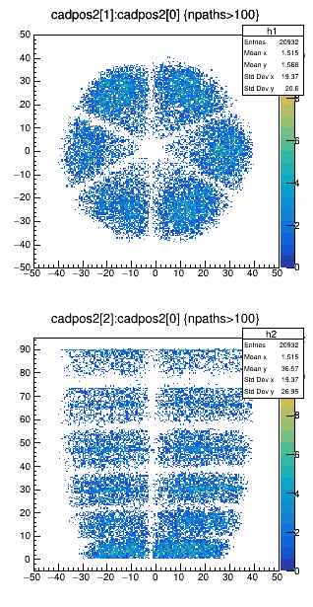
Self-calibration result
Simulation data (same size as source data)
source data
Real HitCollection Position
Calib HitCollection Position
Calib HitCollection Position
Identify incoming gamma energy by OFTtracking
consistent results between simulation and source calibration

Slide 28
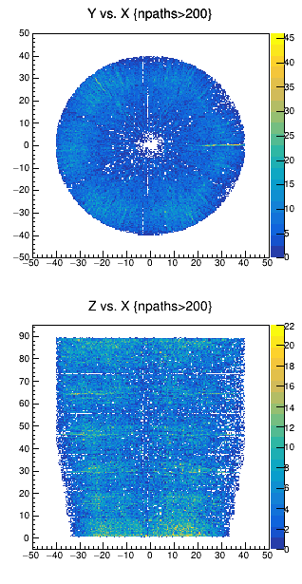
Simulation: Position fidelity
2MeV gamma 2e11 events
Distance between self-calib position and “real” position
without electrical noise
distance / mm
Better than 1mm
with electrical noise
distance / mm
1-2 mm
Number of paths

Slide 29
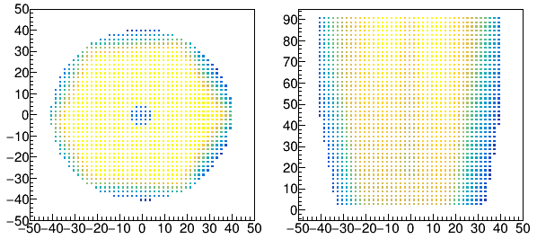
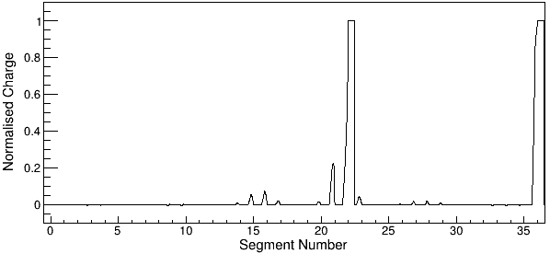
Simulation with Pulse Shape
Geant4:
Signal Basis:
Y : X
Z : X
2mm
grid
Pulse shape signal basis
AGATA Detector Library (ADL)
AGATA-1Pi array: 45 detectors
Geant4: Compton events information
Linear interpolation ADL pulse shape basis

Slide 30
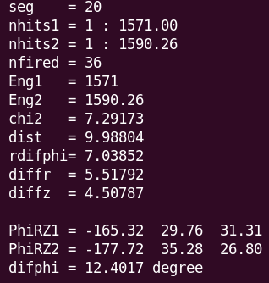
Group Pulse Shape
Chi2s[0]: seg20, core
neighbour sectors:
Chi2s[1]: seg14, seg26
neighbour slices:
Chi2s[2]: seg19, seg21

Slide 31
Group Pulse Shape

Slide 32
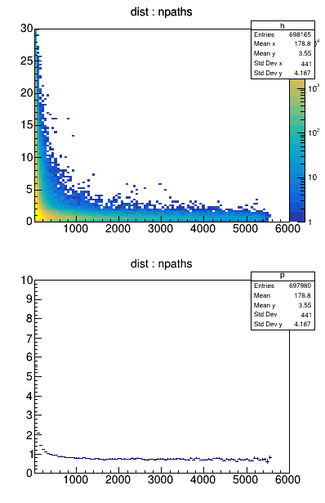
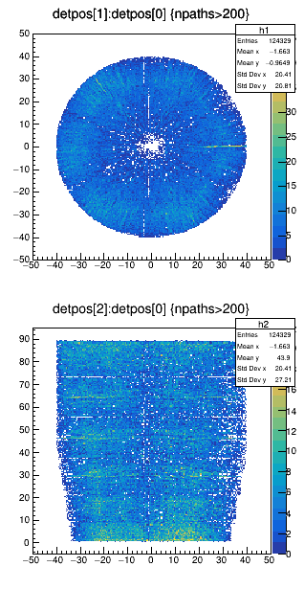
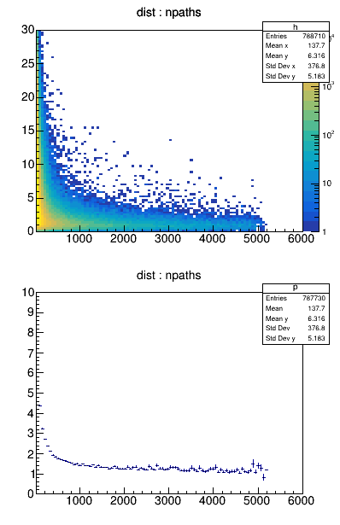
Simulation: Position resolution
Simulate 2MeV gamma 1e11 events
without noise
with noise

Slide 33
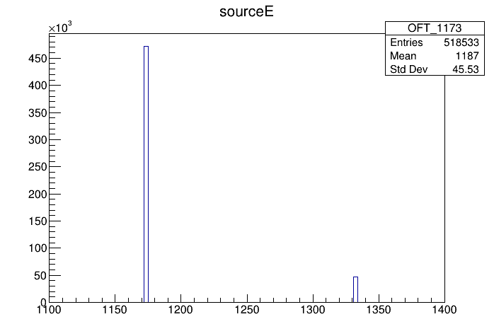
Gamma source
Identify incoming energy according to figure of merit from OFT
⁶⁰Co source
⁸⁸Y source
Simulate 1173keV
Simulate 898keV
correctness 91%
correctness 99%
Simulate 1332keV
Simulate 1836keV
correctness 73%
correctness 96%

Slide 34
⁶⁰Co source
Identify incoming energy according to total energy deposit in array
Select events with total Energy of 1173±10keV and 1332±10keV
correctness 99%

Slide 35
⁶⁰Co source
Simulate ⁶⁰Co source 2e10 evts (energy gate ±10keV, ~2e8 good evts)
accurate source position
10mm mistake

Slide 36
Source position
Source at (0,0,-400)
Source at (0,0,-160)
(0,0,0)
(0,0,-160)
(0,0,-400)

Slide 37
Calibration data
multi segments hit
small signal
small Compton signal
accepted

