Slide 1
GRETINA@FRIB Status
Stephen Gillespie
4th AGATA-GRETINA Collaboration meeting
gillespi@frib.msu.edu
20-22 November 2024

Slide 2
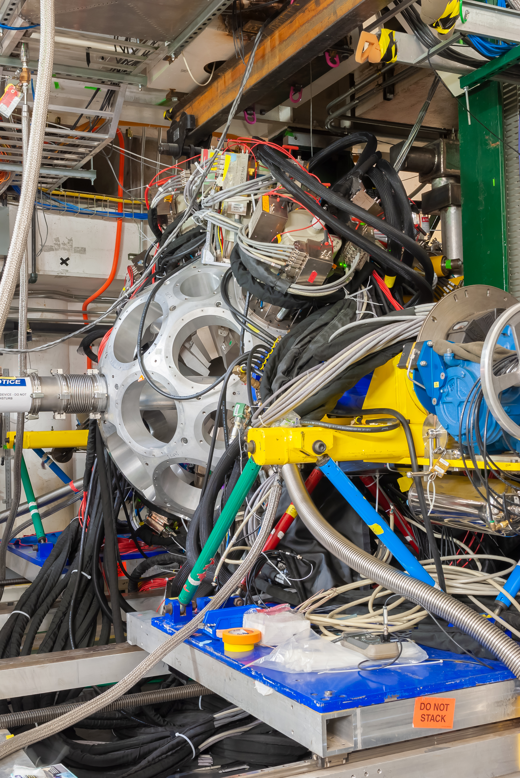
GRETINA 2022-2024 Campaign Summary
All GRETINA components shipped from Argonne May-June 2022, array is assembled ready for experiments at FRIB ready beginning 12th July.
14 fast beam (v/c ~ 0.4) experiments performed during the campaign, all using the S800 Spectrograph.
Typically, several experiments were performed with 1-3 weeks between beam times, followed by shutdowns which last 2-4 months.
During shorter shutdowns, detectors were left under bias and checked once per week to monitor performance. During the longer shutdowns (holidays), detectors and digitizers were left off.
https://people.frib.msu.edu/~noji/photo/gretina/20220715/full/5.jpg

Slide 3
Core FET reliability
During previous campaigns after the detectors are moved between ANL-NSCL it was found that core FETs would need to be replaced after a few months of operation (11 in 2017).
To mitigate this in a new procedure was implemented for warming detectors after long term use (e.g. at end of campaigns)
Allow the quad to warm up unassisted to room temperature and then heat at 80C for 36 hours.
Turn off the heating, let the quad detector cool down unassisted while still pumping it and close at room temperature.
Along with careful conditioning, the procedure has significantly reduced the number of failing Core FETs (0 failed during FRIB campaign).

Slide 4
Detector Testing Procedure
All detectors are tested in the lab, before being mounted in the array.
Detectors are biased to 50 V and all signals are checked.
Detector bias raised to 3500 V and core resolutions are checked with ^{57,60}Co sources.
Take quick segments spectra to verify gains.
Check all 50 Ω return lines for are present.

Slide 5
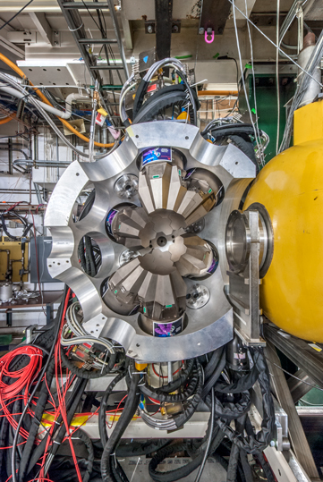
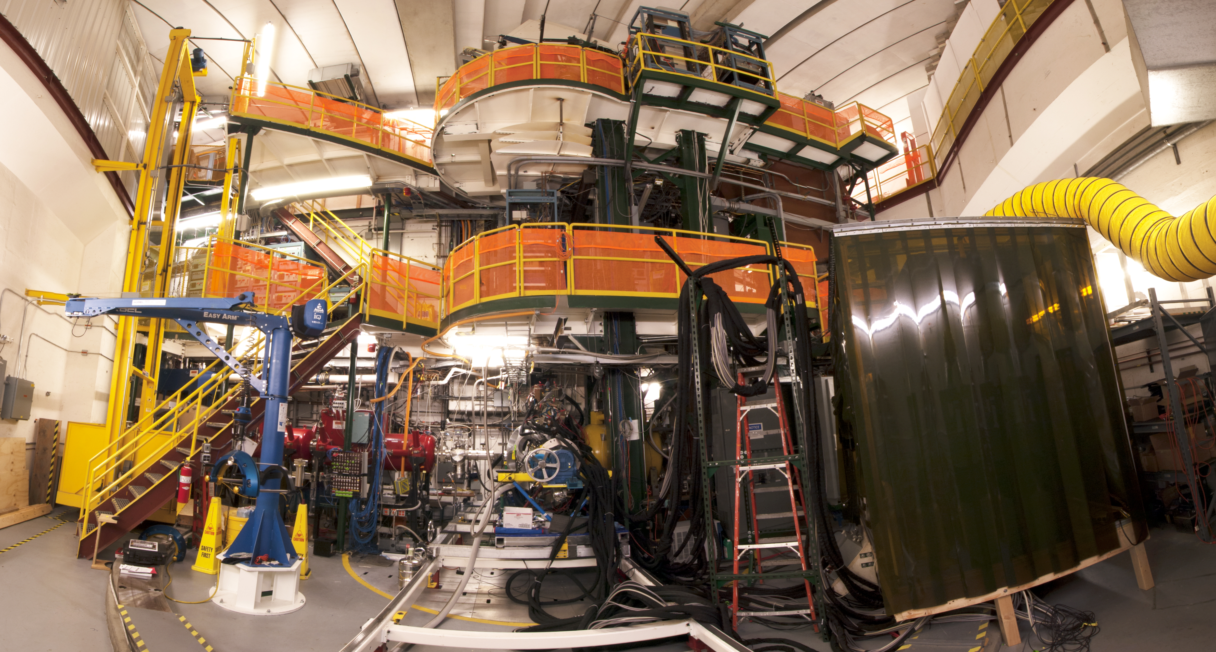
Detector Mounting and Conditioning
Detector mounting is performed with a minimum of two people, one person using an arm crane installs the detector, with the other person looking for conflicts with other detectors using a multimeter.
https://people.frib.msu.edu/~gretina/photo/20130605/full/1.jpg
https://people.frib.msu.edu/~noji/photo/gretina/20170613/full/1.jpg

Slide 6
Detector Mounting and Conditioning
Detector mounting is performed with a minimum of two people, one person using an arm crane installs the detector, with the other person looking for conflicts with other detectors using a multimeter.
After installation, radial boxes are mounted on the detectors and the detectors are biased to 3500 V and data are taken with the DAQ and all core and segment spectra are checked.
If everything is good the array is rotated back into position and all channels are checked again in the DAQ.
If good the biased is raised to 4000 V and left overnight. In the morning signals are checked again and if there are no problems the bias is increased to 4500 V and the detector is left to condition for as long as possible.
Detectors are brought to 5000 V just before the beam time or before a new superpulse measurement.

Slide 7
Noisy Segments
In multiple crystals we have observed segments started to become very noisy (x5 baseline noise) which is degrading their resolution, ~10 KeV FWHM.
No effect on the core performance.
Noise cannot be attributed to leakage current.
Normal
5x Baseline
Feedthrough

Slide 8
Noisy Segments
In multiple crystals we have observed segments started to become very noisy (x5 baseline noise) which is degrading their resolution, ~10 KeV FWHM.
No effect on the core performance.
Noise cannot be attributed to leakage current.
Swap the electronic chain at the feedthrough, segment is still noisy. Note this was done at low HV (<100 V).
5x Baseline
Normal
Feedthrough

Slide 9
Noisy Segments
In multiple crystals we have observed segments started to become very noisy (x5 baseline noise) which is degrading their resolution, ~10 KeV FWHM.
No effect on the core performance.
Noise cannot be attributed to leakage current.
Swap the electronic chain at the feedthrough, segment is still noisy. Note this was done at low HV (<100 V).
If the neighbouring segment is disconnected and left floating the segment baseline is normal.
Normal
Feedthrough

Slide 10
Noisy Segments
In multiple crystals we have observed segments started to become very noisy (x5 baseline noise) which is degrading their resolution, ~10 KeV FWHM.
No effect on the core performance.
Noise cannot be attributed to leakage current.
Swap the electronic chain at the feedthrough, segment is still noisy. Note this was done at low HV (<100 V).
If the neighbouring segment is disconnected and left floating the segment baseline is normal.
Problem appears to be with the crystals
Normal
Feedthrough

Slide 11
Q2 vacuum leak and crystal swaps
A year into operations, Q2 temperature began to rapidly rise; after removing from the array a leak was found near the pumping port.
The leak could not be repaired so we decided to switch the working crystals in Q2 with bad crystals from other detectors.
Once GRETA manufacturing is complete, detector with 4 bad crystals will be returned to Mirion for repair.

Slide 12
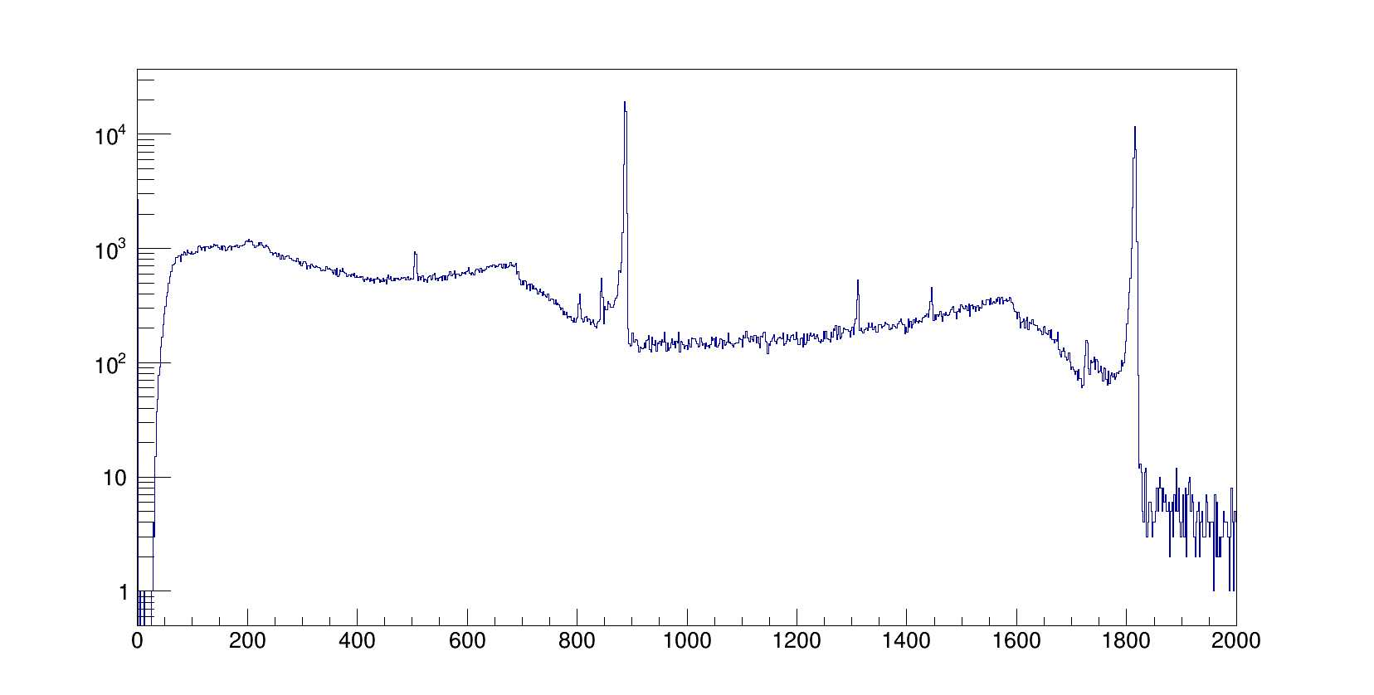
Shorted Segments
2 (out of 1872) segments crystals are shorted internally. This does not affect the core, but the neighbouring segments have poorer resolution.
Q4P1 ε1 shorted after annealing.
Q9P2 γ1 short developed after swapping another crystal in quad.
1 segment is position sensitive, everything is OK when measured in the lab, but when placed in the array the segment is poorly terminated leading to feet in core spectra.

Slide 13
Q7 Baseline instability
P3 Crystal baseline was unstable during the campaign even at very low bias (< 50 V), this did not affect the core resolution.
Near the end of the campaign, we started to see large noise bursts from this crystal, DAQ trigger rate increase from 15000 – 60000 events/s.
The core FET board was swapped with a neighbouring crystal and the baseline instability followed the board.
Replacing all the components on the board (FET, resistor, capacitor) fixed the baseline instability issues.

Slide 14
Q9 Oscillations
In previous campaigns large 10 MHz oscillations were observed when all 4 crystals were under LV power. If any 3 crystals are under LV power no oscillations are observed.
Oscillations could not be reproduced in the gamma lab and the detector was used in the array for over a year before it resumed oscillated.
After some investigations we found we could stop the oscillations by adjusting the LN2 injector but would eventually return to oscillating after 2-3 days. A fan was used to prevent ice build-up which extended this time to the point we could run a complete experiment without the detector oscillating.
After discussions with Mirion, it was suggested to slow all of the segment preamps by adjusting the input stage of the preamplifier. After doing so the oscillation in Q9 has no longer been observed.

Slide 15
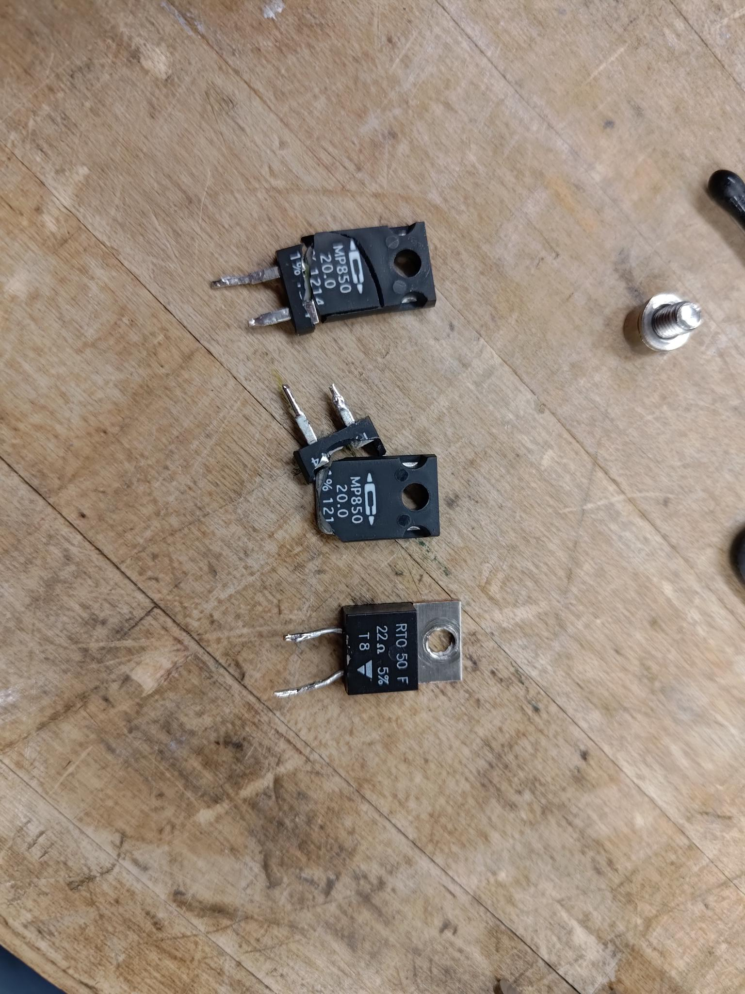
Heating Resistors
Only one of the 2 heating elements on Q10 was able to provide current to warm detector.
While swapping a bad crystal with Q2 noticed that the resistors had become disconnected.
While attempting the repair the resistors themselves broke and were swapped with the resistors from Q2.
Newer GRETINA/GRETA quad appear to have different heating resistor components, possibly not as robust.

Slide 16
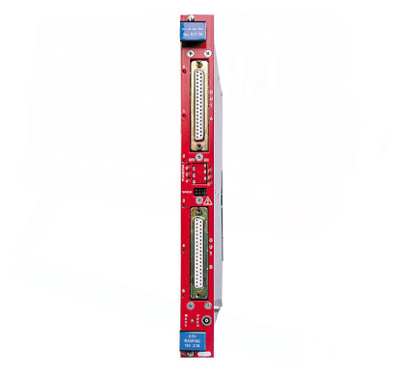
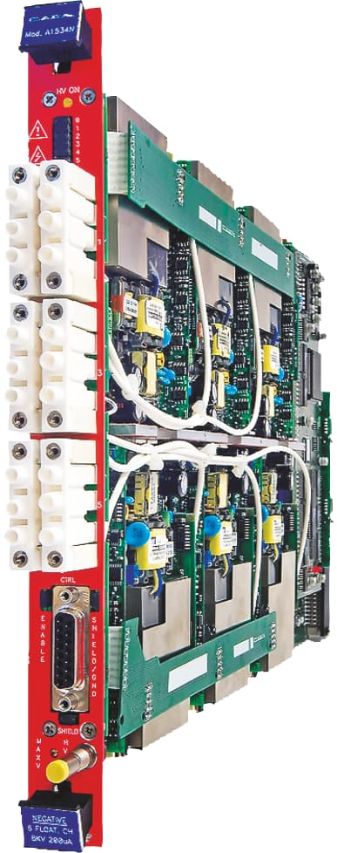
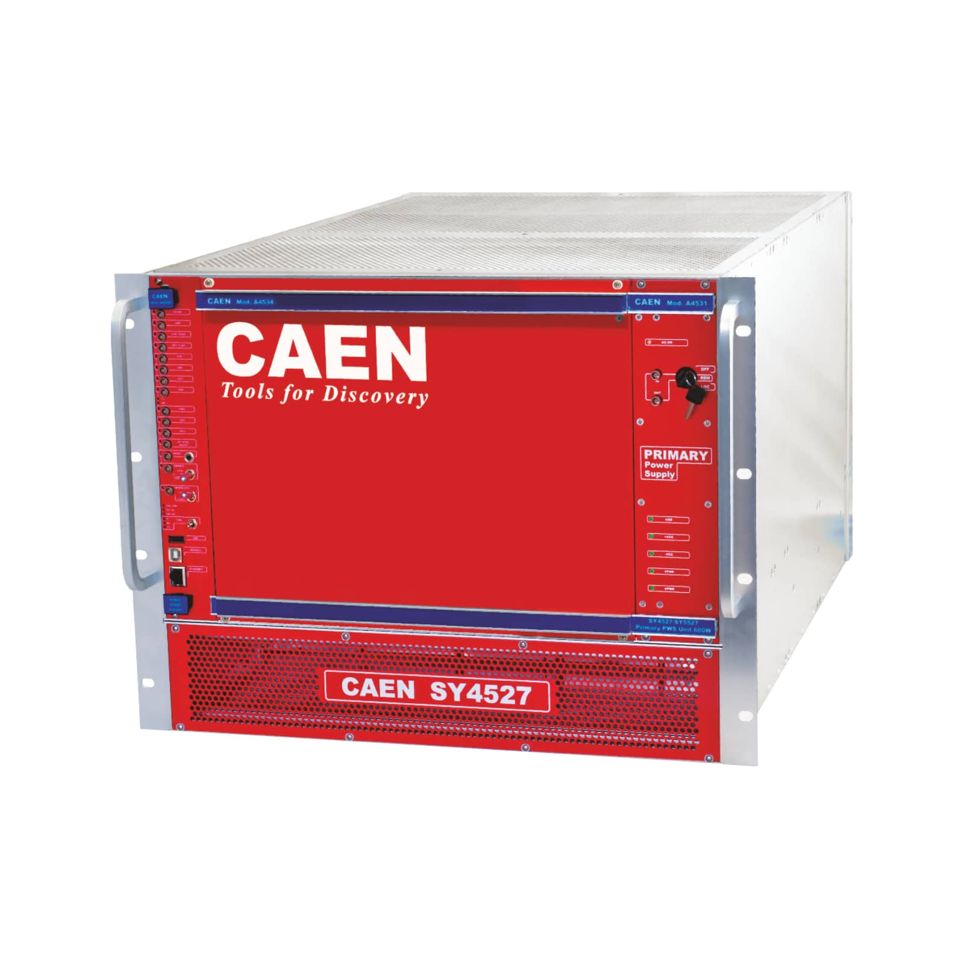
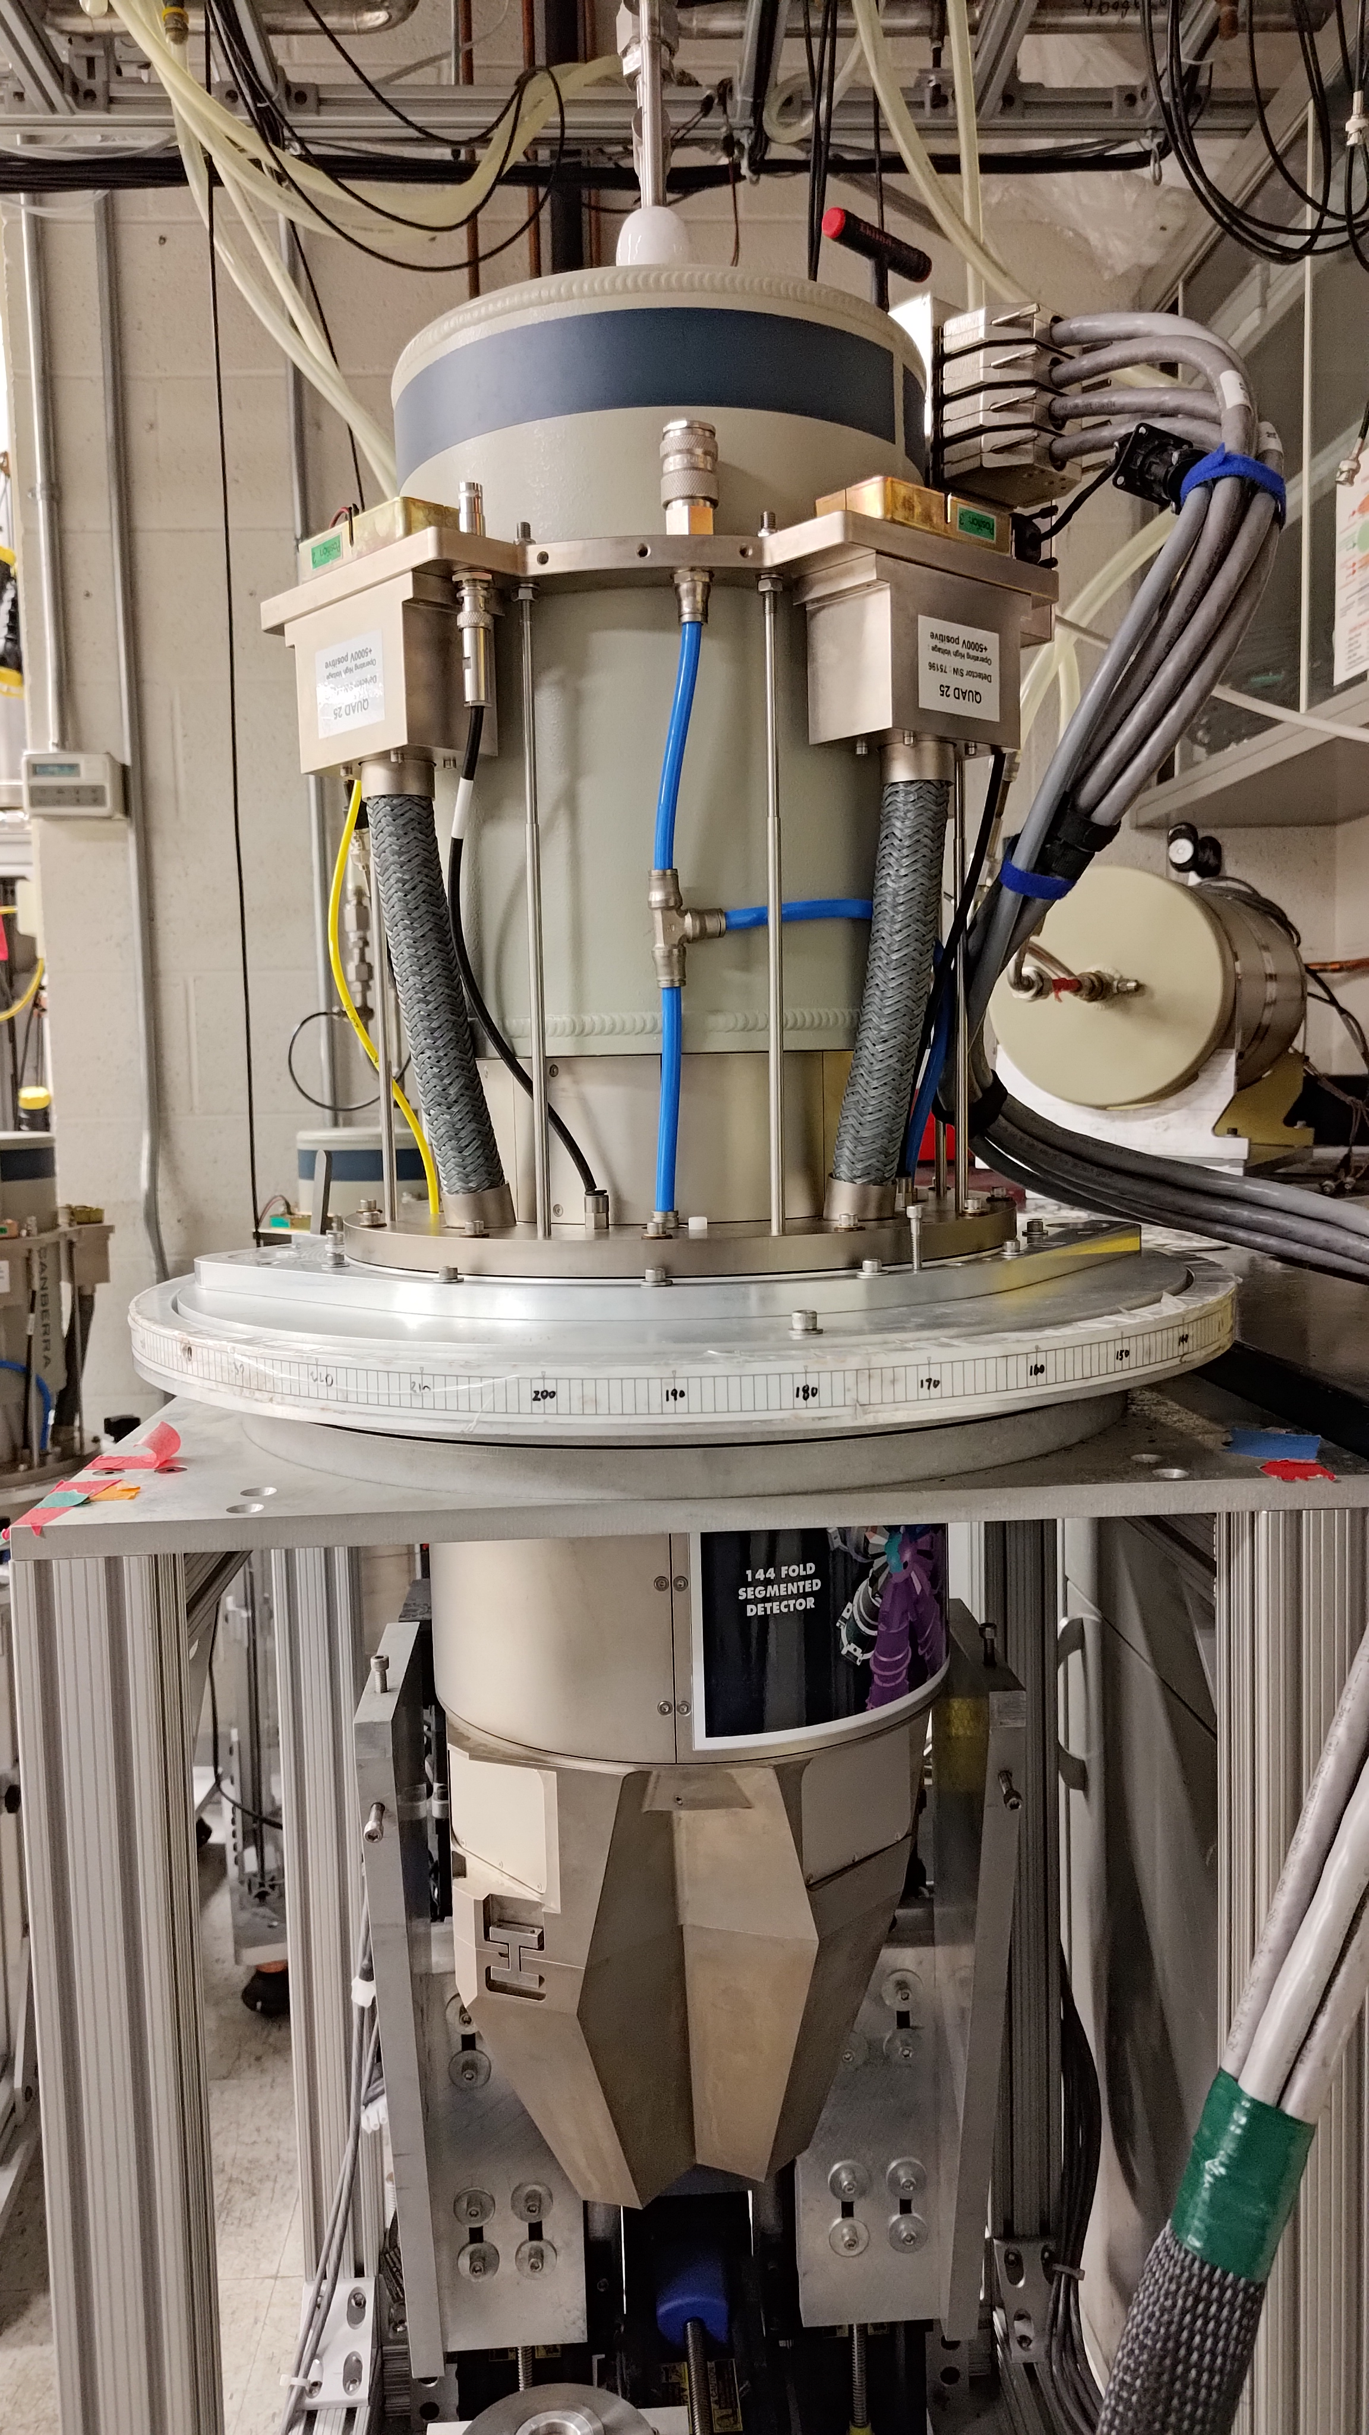
LV/HV summary
±13V
±13V
LV Breakout box
Alarm
Card
HV enable
HV
HV enable signal generated when;
- Good reading from Alarm Card (short to ground).
- LV power applied.

Slide 17
HV enable problems
LV breakout boxes supply provide +5 V DC to enable HV. This voltage is generated when;
Good reading from Alarm Card (short to ground).
LV supply turned on.
Some alarm cards are showing a false high temperature reading which prevents HV from being applied to full quads.
At the crystal level the +5 V DC is suspected to be intermittent
On the CAEN interface, the HV is found to be turned off, no alarms are present and HV can be turned on again.
Hard to directly observe, only once we were able to see the HV channels become temporarily inhibited.
For these channels, the HV enable needs to be bypassed, to turn on and keep HV on.
Problem is getting worse, more detectors had to be bypassed as the campaign progressed.

Slide 18
Low Voltage Supply reliability
CAEN A1516B 6 Ch boards used to provide low voltage supply to pre-amps.
Over the course of GRETINA operations, many modules have started to develop problems including
Inability to provide required ±13 V supply to pre-amplifiers.
Channels unable to provide any power.
Board temperature readout failure, cannot turn any channels on.
One module will make CAEN Mainframe inoperable.
Found certain combinations of LV supplies and radial boxes work well together.
Many boards returned to CAEN for repairs, during repair use “dumb” power supplies for low voltage power.
See deterioration of CAEN LV modules during the campaign.
Note this is only a problem with LV, HV supplies were reliable.

Slide 19
CAEN Mainframe Power Supply failure
Several detector temperatures found to be lower in the morning, logged into HV mainframe and found all LV and HV channels off reporting current trips. Rebooting the crate did not clear errors.
Due to the spares not being readily available and the proximity to the start of an experiment, all low voltage power cables were rerouted to the spare low voltage supplies and the remaining mainframe was used for HV supplies only.
After biasing one detector was found to have developed problems with two segments requiring removal from array at the end of the experiment.
Post experiment one of the expanded power supply found to have failed, after replacing mainframe worked again.
Spare crate was not configured for network access and required software updates.

Slide 20
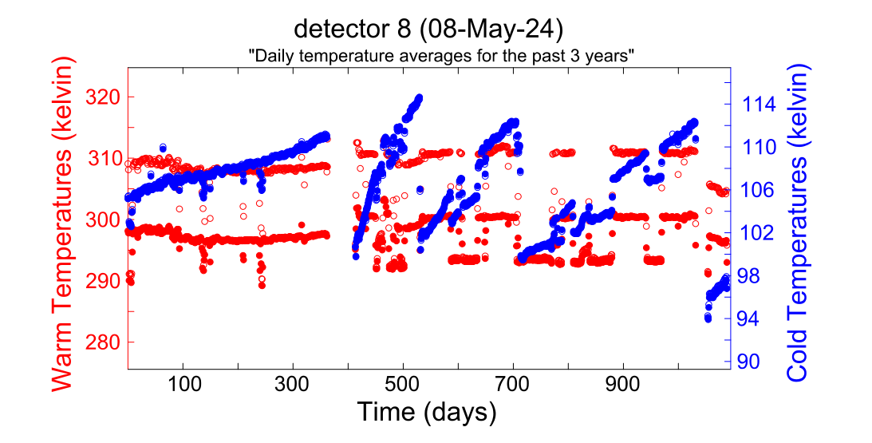
Cold pumping
Elevated Helium levels in S3 vault from the S800, which leaks into GRETINA quads causing temperatures to increase more rapidly than at ANL.
Every 9-12 months we need to cold pump the detectors within the array.

Slide 21
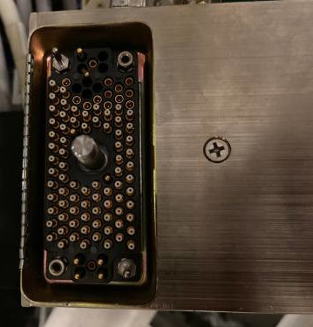
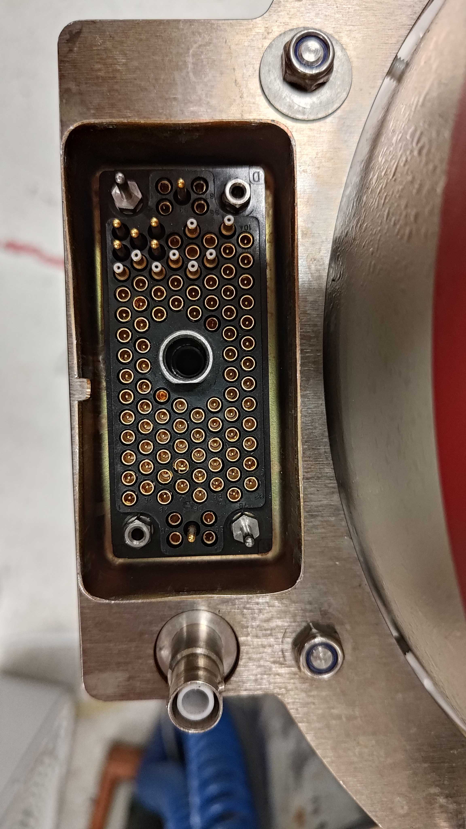
Radial Connectors
Radial connectors on the detectors and radial boxes have some “wear and tear” due to repeated removal of radial boxes.
Must common problems are bent inner pins or damaged cable shielding, in worst cases entire pins are destroyed requiring re-crimping on both ends.
Installation of radial boxes without cables attached is less likely to damage either detector or radial box.

Slide 22
DAQ reliability
Aside from calibration runs DAQ runs in conjunction with S800 DAQ. Both DAQs must report ready or else problems emerge when starting runs
Initially DAQ might crash immediately after starting consistent with DAQs not being ready, a bug was found were not all nodes were being checked when reporting DAQ ready status.
Long term reliability, IOCs would not always boot correctly after extended shutdowns due to bootline corruptions.

Slide 23
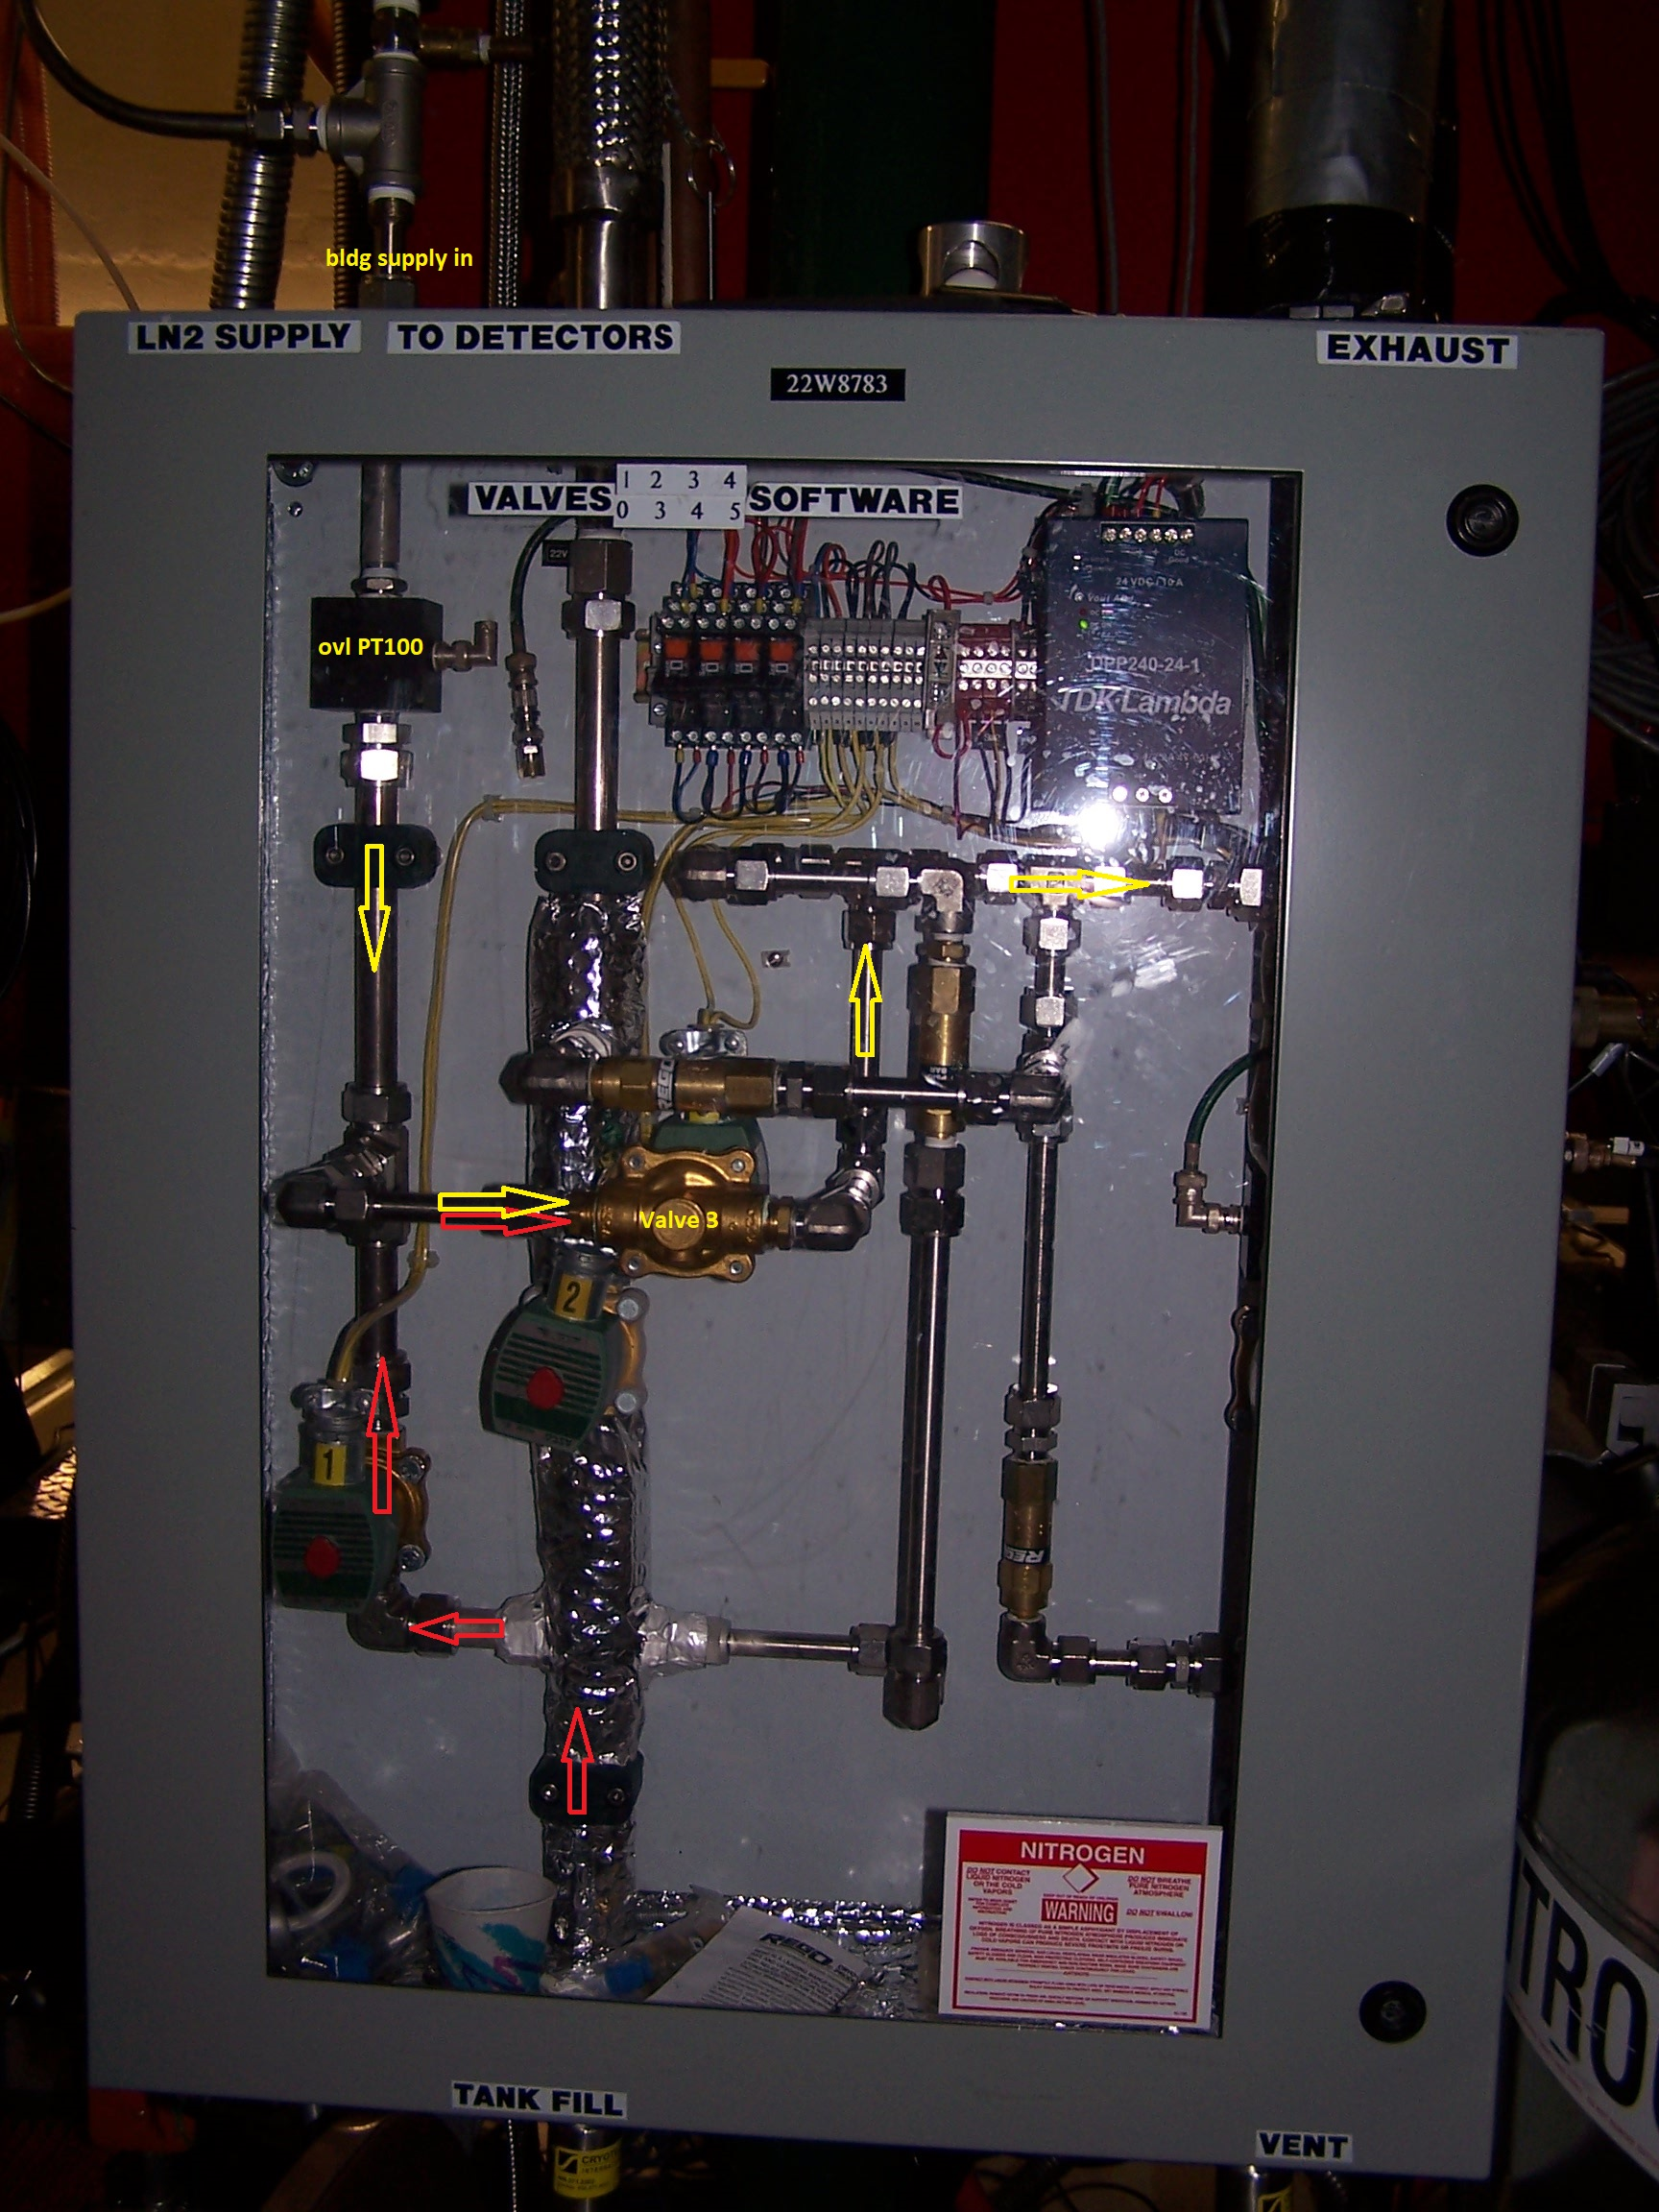
LN2 Problems
Failure of master valve due to broken gasket which was replaced with a spare, occurred during experiment, resulted in 2 hours loss of beam time.
LN2 overflow sensors (PT100s) have a fail rate of 2-3 per year.
Detectors in topmost positions initially had problems with premature filling. The overflow sensor is located at the end of the exhaust hose and extending this mitigated the problem somewhat, but only after replacing injectors with larger fill holes fixed the problem.

Slide 24
Summary
A very successful experimental campaign at FRIB.
Segment noise issues and short connects are becoming more common, and we do not yet understand how to fix this.
We are seeing some long-term performance issues with the electronics, but these will all be replaced for GRETA.

