Slide 1

AGATA Project Status
Emmanuel Clément (GANIL)
on behalf of the AMB, LNL and Padova local team
2024 AGATA GRETINA WKS

Slide 2
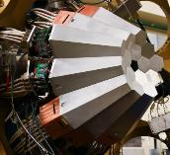
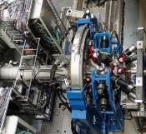
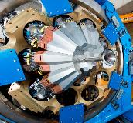
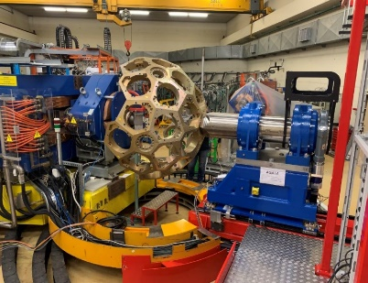
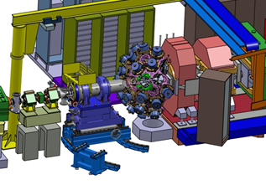
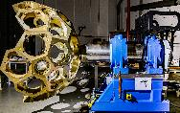
The AGATA project : THE ultimate spectrometer
1st AGATA Steering Committee and Management Board (2002)
March 2022
MoU Phase 1 + Addendum
MoU Phase 2
2010-2012
Legnaro, Italy
Intense stable beams
15 detectors
AGATA Demonstrator + PRISMA at LNL
2012-2014
GSI, Germany
Fast fragmentation beams
25 detectors
AGATA at GSI
2014- 2021
GANIL, France
ISOL and stable beams
approaching 1π (45)
AGATA at GANIL
2021- 2028
LNL, Italy
Stable beams
EXOTIC beams
AGATA at LNL
LNL 2.0
2028- 2030(+1 ?)
GANIL, France
ISOL beams from
SPIRAL1
GANIL 2.0
2031 –
LNL, SPES, Italy
FAIR, Germany
ISOLDE, CERN

Slide 3
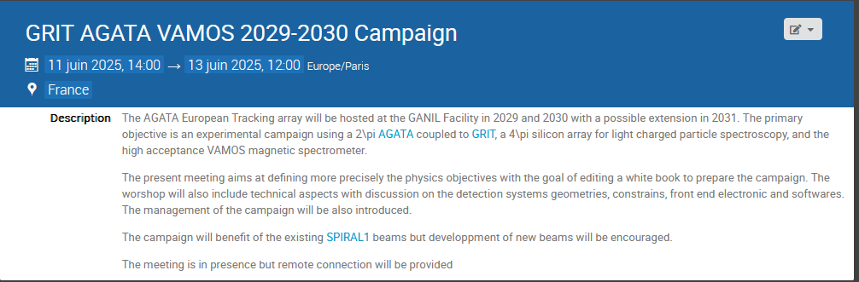
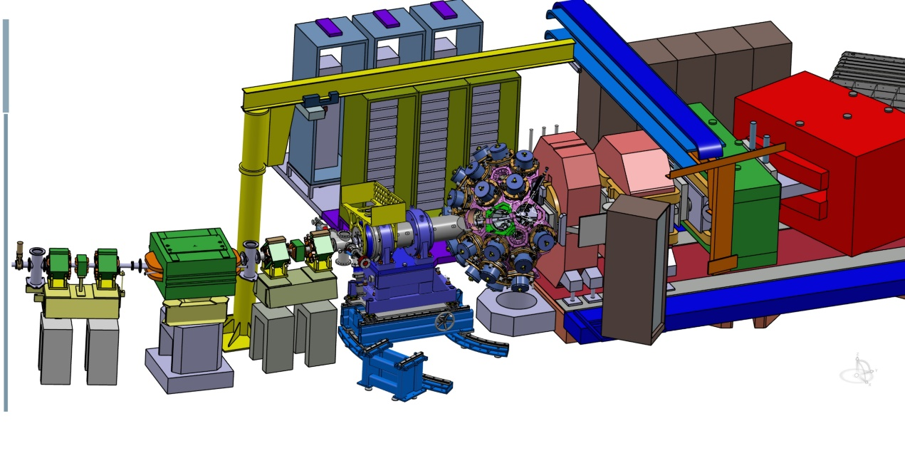
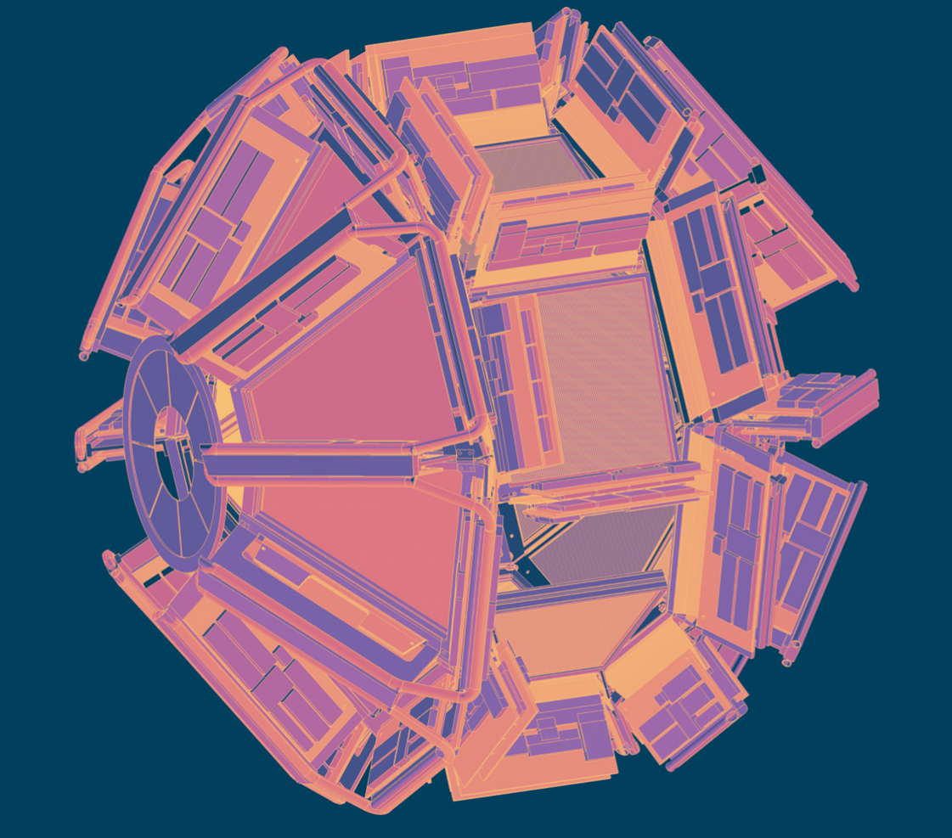

Next is AGATA@GANIL.2 from mid-2028
www.agata.org
https://grit.in2p3.fr/
https://indico.in2p3.fr/event/34661/

Slide 4
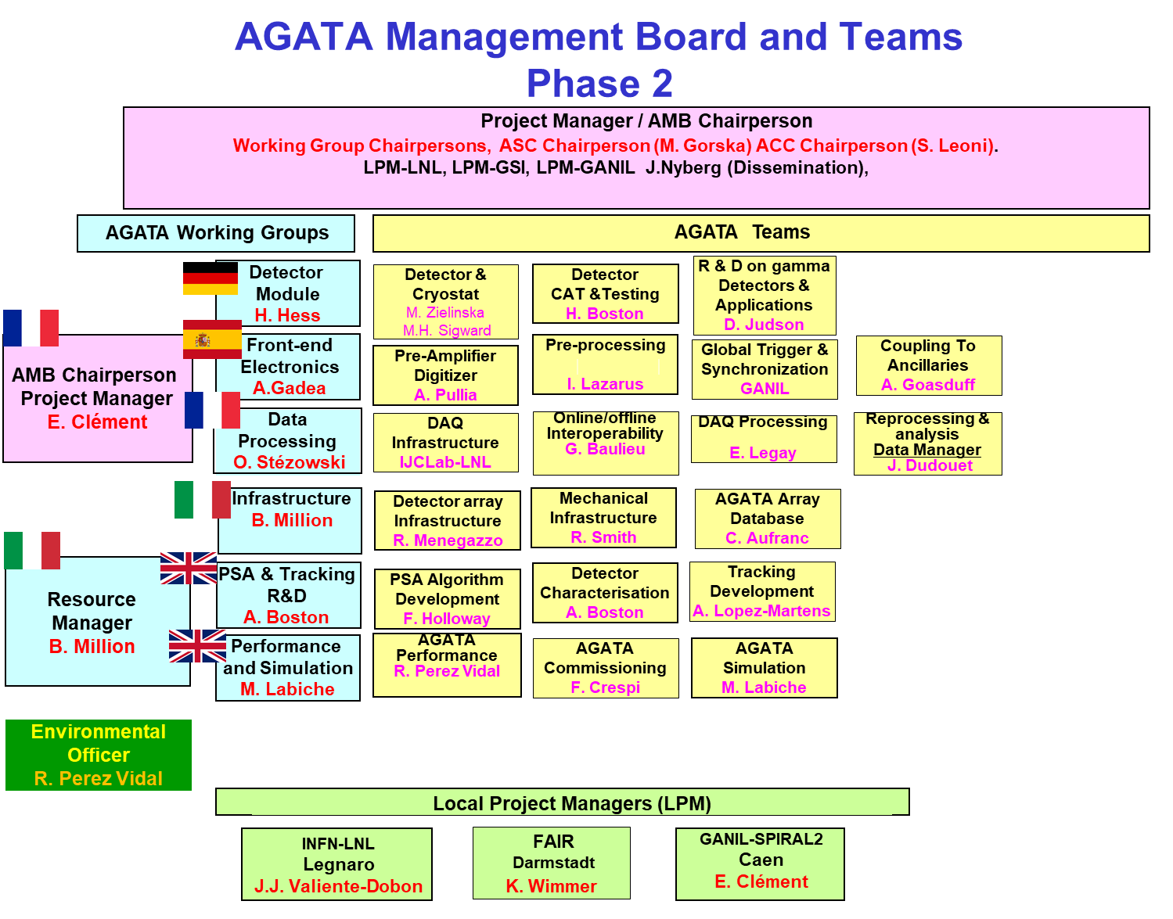
The AMB meets every month by zoom
The February AMB meeting was in presence in Paris, first one since Covid
The June AMB meeting included all team leaders. We will repeat this format ~3 times per year
  → Next one will be the December meeting

Slide 5

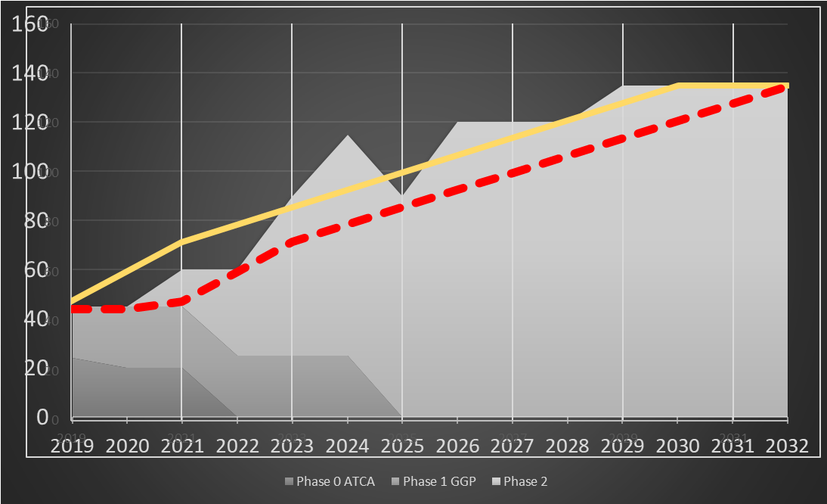
Project Plan Phase 2
The detailed Project Plan : ATRIUM-563607, ATRIUM-563609
MoU funding scheme (section 3.6)
The present project plan, conceived technically for a 4π array,
foresees the construction of a 3π array with capital investment from 2021 to 2030, consistent with the MoU,
The production of the Triple Clusters constrains the project
The project plan is based on an annual production of 2-3 Triple Clusters (ordered, produced, assembled and tested)
→ A 2π system available by the end of the LNL campaign ( >2026) and for the start of the next campaign (SPES, FAIR, GANIL, ISOLDE …)
In 2025, the project will be reviewed by the funding agency to allow the signature of the Phase 2 MoU [2026-2030]
Project progresses, budgets, timeline (AMB resp.) and scientific output will be considered
89
92
82
86
75
80
73
67
62
Capsules order placed
Main milestone
Clusters in operation
92
Capsules order - visibility
Electronic channels ordered

Slide 6
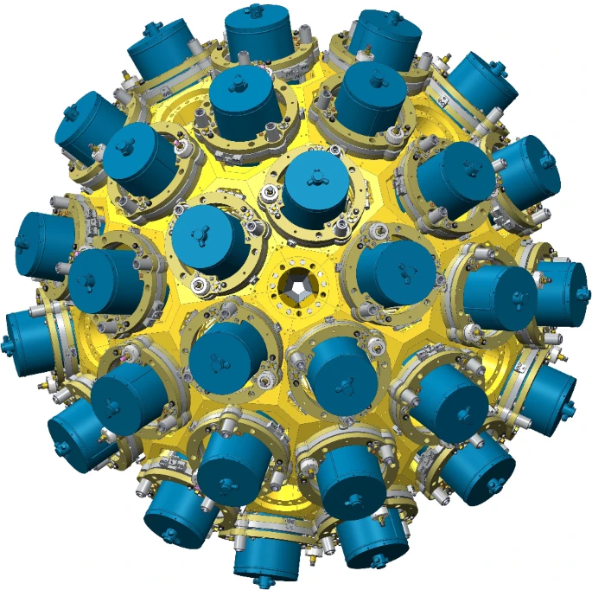
Topical Issue EPJA : https://epja.epj.org/component/toc/?task=topic&id=1878
The European Physical Journal A
AGATA: Advancements in Science and Technology
Editors : Nicolas Alamanos, Maria Jose Garcia Borge, Angela Bracco, Emmanuel Clement, Andres Gadea, Wolfram Korten, Silvia Leoni and John Simpson
Description of all achievement, progresses in hardware, software, performances since the reference NIMA of the collaboration.
For scientific publications making references to the FEBEE and detectors used, PSA/ Tracking/ Monitoring/ Replay/data management used to process the data, simulations and performances,
these publications must be cited to showcase the daily work of AGATA team/WG members, including the local teams.
Mak

Slide 7
Detector status (Nov 2024)
The total number of delivered AGATA capsules is 68, 7 more in the production line
The Detector task is budget driven

Slide 8
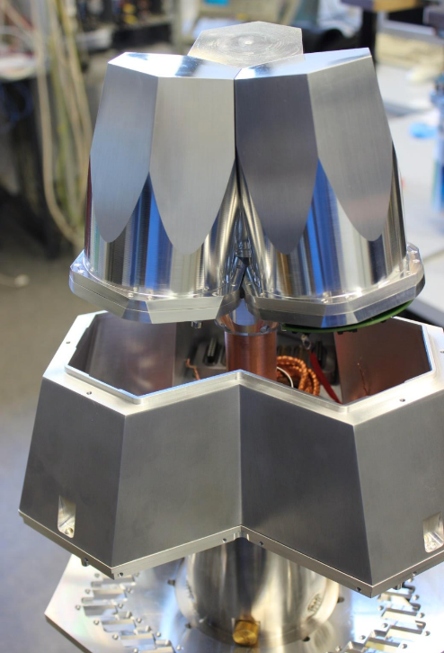
Detector status (Nov 2024)
The total number of delivered AGATA capsules is 68
8 new orders to be placed in 2024 !
Capsules location – July 2024 (IRFU – IPHC – IKP - LNL)
57 capsules assembled in ATC located in LNL
A005 in IPHC→ GSI
B003 in Salamanca
severals capsules on the shelf in IKP
3 symmetric in IKP
ATC22 and ATC23 completed in LNL
A DEGAS ATC completed in IKP
Open Orders: 8 detectors
2 x Owner (Italy)
3 x Owner (France CEA) delivery expected 2024 (2nd priority)
2 x Owner (GSI) must be delivered within 24 (1st priority)
Personnel
The BMBF budget cut on the AGATA grant is introducing a strong thread on the detector activity at IKP and finally for the AGATA detector working group
A re-organization is needed at some point
Cluster Assembly and Maintenance
ATC25 order placed by GANIL. One more by GSI (ATC24)
ATC16 (conversion of ADC03 - GANIL): hardware and electronics delivered to Cologne last February
Test cryostats refurbishment
3 capsules to be sent to MIRION for repair (A008 and C017) + one more broken, on its way to MIRION
A006, A008, B005, B009, C001, C014 returned from Mirion for annealing. 12 more in the 2nd half of 2024
Under preparation : a 4 years contract (1.6 M€) between GANIL and MIRION for new orders/ annealing / repairs

Slide 9
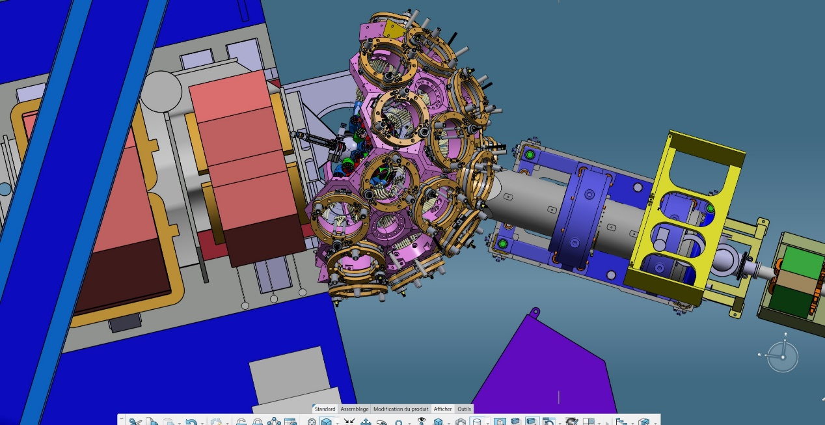
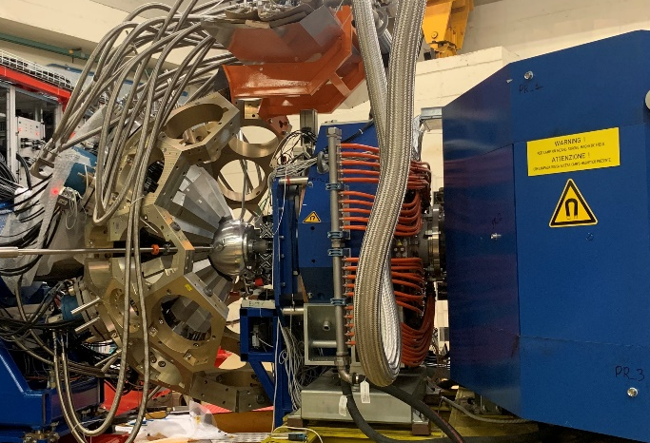
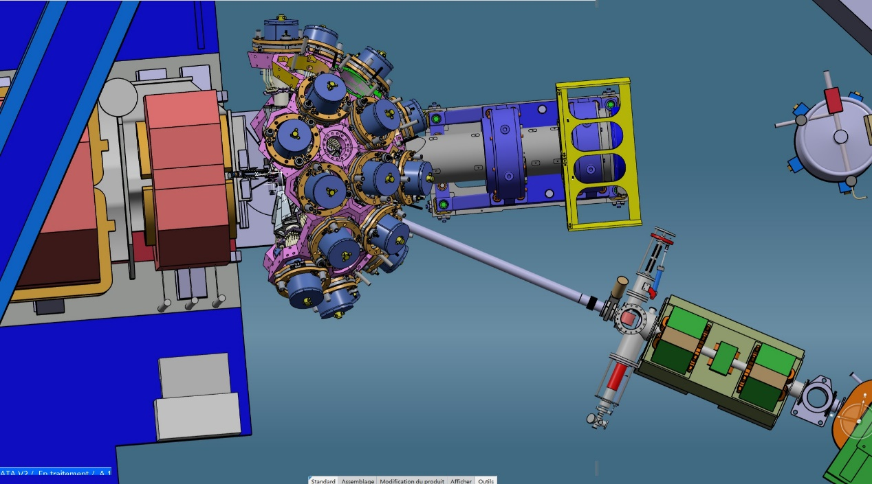
Infrastructures
GANIL - STFC
Mechanics :
Involved in the 0° degree change (STFC- LNL – PD)
Involved in the next Host Lab discussion
Joined discussion on the EMC (N. Karkour)
Detector Support System (IRFU)
Large activity of maintenance and get the array prepared for the increase of solid angle
Delivery of the 2nd batch of LVPS
2π is covered
→ 2024 highlight : investment in a “movable/travelling” detector lab’ (pump, baking, etc ..) on top of the mobile test bench ACQ
Open issue : final design of GRIT and CryoTarget

Slide 10
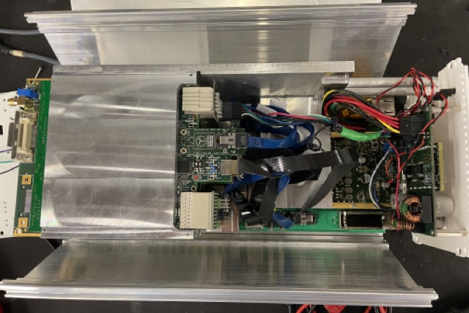
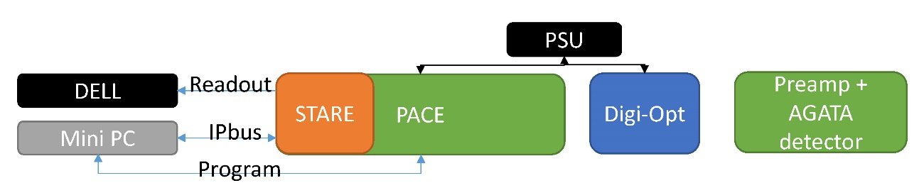
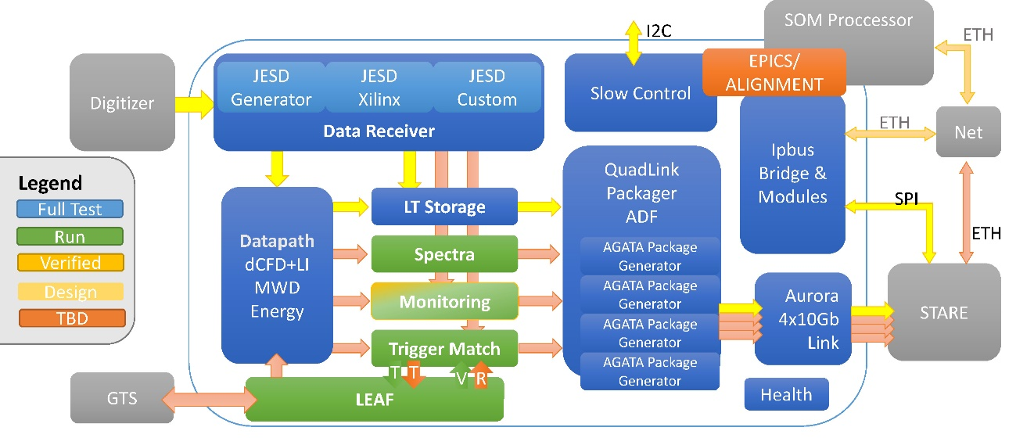
Phase 2 FEBEE status
Status of the test bench@LNL
Full data path using an AGATA detector
+ DIGOPT12 (INFN, IFIC)
+ PACE and its firmware (IFIC, GANIL, IPHC)
+STARE (IJCLab)
+readout (IJClab-IP2I)

Slide 11
Phase 2 FEBEE status
Status :
Full data path using an AGATA detector
+ DIGOPT12 (INFN, IFIC)
+ PACE and its firmware (IFIC, GANIL, IPHC)
+STARE (IJCLab)
+readout (IJClab-IP2I) running at LNL – Data integrity stress by IP2i
On 5th of March we agreed to proceed with the production of STARE.
On 16th of May, we agreed on the production of the PACE board.
DIGOPT12 are currently delivered
Completion of the final firmware (2025)→ the present bottleneck.
The FEBEE task is HR driven
→ The equivalent of ~30 clusters electronic chains are in the production line

Slide 12
Data flow and Acquisition
Mini daq box for data flow R&D setup in Orsay for prototyping our new architectures
Preparing the increase of Tb production from the 0° campaign
Maintaining the present system with upgrades of the CEPH (1 Po), switches, Analysis machine, anodes, DCOD etc ….
Most of the V2 pipe line is ready
Both using an V2 emulator and real data taken in LNL, stress of the data pipeline
The data analysis process is part of the WG activities. Steps forward in continues integration, gitlab, updates, FAIRNESS, metadata, catalogues, benchmarks,…. Goals are a reliability, easy access to code and data (GRID)
Data monitoring : “graphana”, Spy, integrity, “big data” management
Data processing eco-system became a major activity in the WG with respect to phase 1
Improvements in accessing the data from GRID
Full document ATRIUM-902780

Slide 13
Data flow and Acquisition
Longer term view:
FAIRifaction process to be continued
  Data Management and Meta Data Production
  Catalog
  GSI/FAIR, GANIL or other host labs specificities with strong Data Management Plan
Get use of remote processing for offline (GRID, iRod, clouds, data lakes etc …)
AGATA should collect the result of the final data processing
How to include AGATA into EOSC is not yet fully clear, either from CCIN2P3 or CNAF via clouds / data lakes …

Slide 14
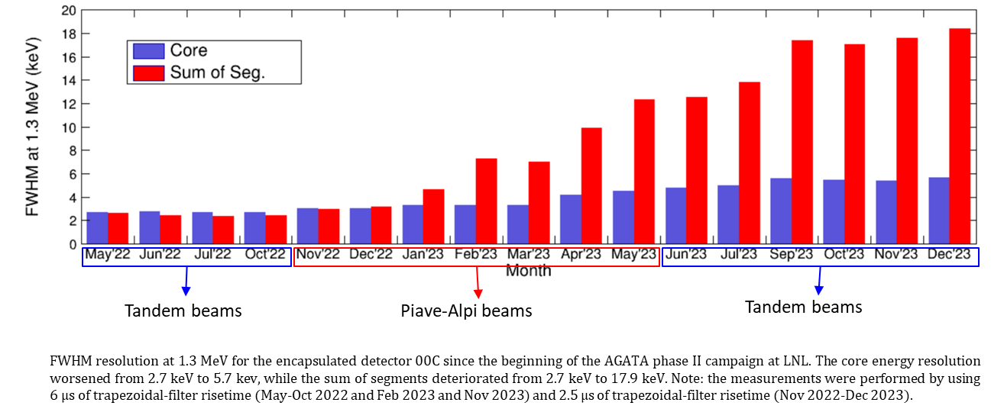
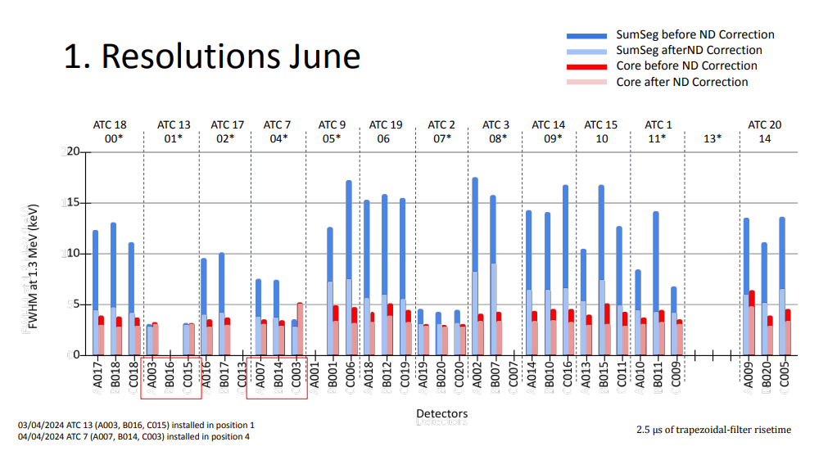
Performances and Simulations
Neutron damage : the report given by the Performance team during the 2023 AGATA week warned the AMB on the present resolution of the array even after the neutron damage correction is applied. The AMB follows carefully the situation.
UK work with un-purpose neutron irradiation; New Post-PSA algo.
18 capsules are already being annealed by MIRION in 2024 (6 done, 6 ready to, 6 to be scheduled).
Operation Cost are fundamental for this operation.
There is no feedback presently for an AGATA or GRETINA like capsule after several annealing in term of loss of performances.
The AMB is in particular investigating a possible strict criterion to help in the decision.
Perf. Report (ie resolution) at each AMB now.
Please note that offline PostPSA has better results so it worth to do it extensively at home
High energy gamma ray benchmark

Slide 15



PSA-Tracking R&D
Visit to the University of Birmingham Neutron facility took place on Friday 9th Feb. A plan for neutron damaged measurements is now being finalised with A601. (See Christopher’s talk). New scanning table commissionning
Strasbourg Scanning table On the request of AGATA's Performances and PSA Teams, scan of the A005 detector to determine for the first time in 3D various properties of large-volume segmented Ge crystals; strong French involvement in data analysis (IPHC, IJCLab, GANIL, Lyon). Full 2x2mm scans have been performed and analysed on NN approach. Reprocessing of the PSA based on NN basis, AGATAGeFEM, ADL. Tomography reports. A step is made with this approach (ie using the scanning table). Much more to come
(see talks by Gilbert and Jérémie).
Salamanca Scanning of B003 has been delayed by a problem with the data acquisition losing events, possibly due to the network connection.

Slide 16
J. Dudouet et al (IP2i)

Slide 17
PSA-Tracking R&D
Implementation of the multi-interaction PSA grid search using the GRETINA approach : This has been fully implemented in AGAPRO and works.
Implementation of the multi-interaction PSA grid search using SIMPLEX
A secondary algorithm was developed in response to this bias that determines the best optimum linear interpolation of signals rather than their combination. The algorithm, provisionally named SIMPLEX, utilises a similar grid search procedure as used in the GRETINA algorithm but works in an L2 feature space. -- Also here a breakthrough – See Fraser’s talk on Tuesday
Other future proposed work
T0 sensitivity of the PSA and how it affects the predictions. PSA could be modified to include the time shift in its search more appropriately, ideally the PSA would search over the full (x,y,z,t) space but that has ramifications on both the execution rate and memory footprint of the PSA:
workshops
OASIS AGATA AI workshop 2024, 13th of May
AGATA – GRETINA in ANL (Nov. 2024)
Tracking report
Investigation into how tracking behaves when the proper position & energy dependent uncertainties are used to estimate the error on the Compton scattered energies

Slide 18

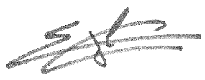
PSA-Tracking R&D
a full ML/NN PSA ←→ Tracking flow trained from in-beam data
should

Slide 19
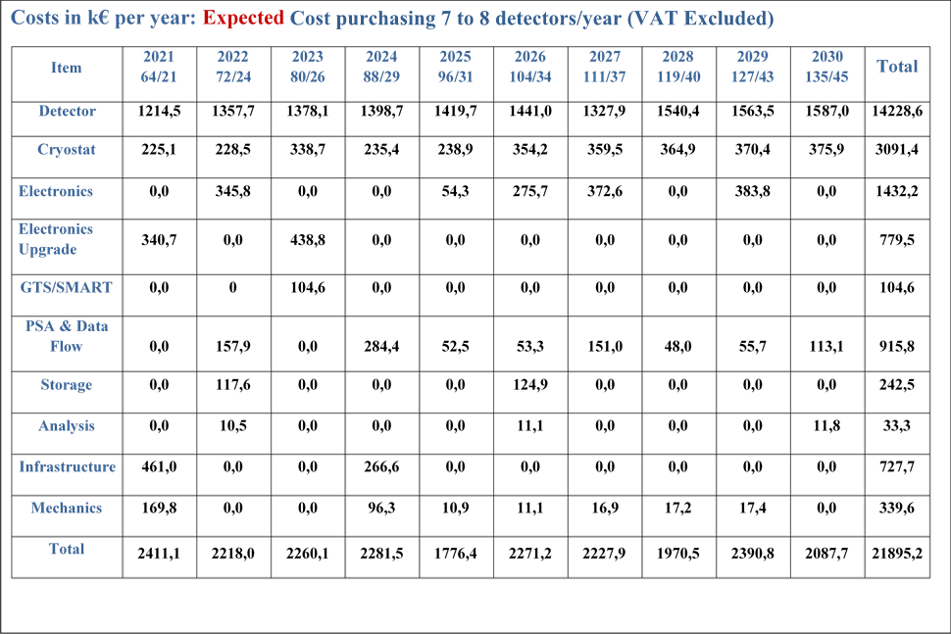
Capital Ressources
Estimates from MoU: inflation 1,5% + 7/8 capsule/year
Detectors procurement represents
~80% of the AGATA Core budget
Discount agreement with Mirion (capsules) :
With an inflation of 2,5%
2022: 6 capsules
215k€/caps → 183k€/caps
2023: 7 capsules
220k€/caps → 181k€/caps
2024: 8 capsules
226k€/caps → 178,6k€/caps
Total estimated cost in 2021: 22 M€

Slide 20
Capital Ressources
GSI
UK, France and Italy are in-advanced with respect to the 2025 milestone

Slide 21
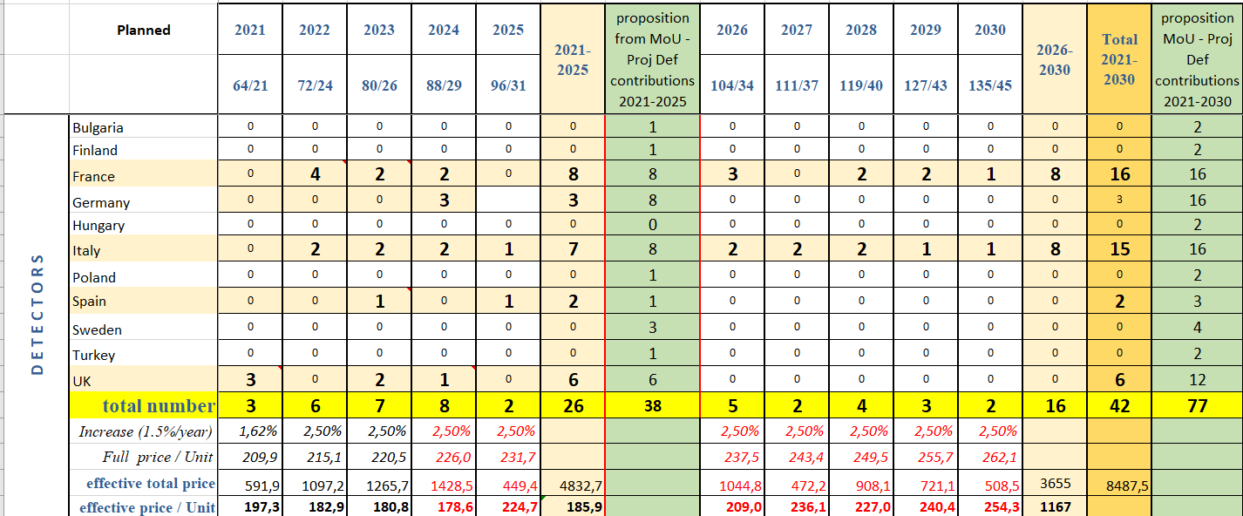
It was an open question to ARRB to delay these 2 orders to save money, ie no orders in 2025 but the production line is full;
AMB hypothesis, 2025 = maintenance with MIRION

Slide 22
Capital Resources
Standardisation of specifications for calls for tender
Capsules : ATRIUM-623168
Cryostats: ATRIUM-681055
Soon for Annealing and repairs
Presently very good collaboration with MIRION
Great effort to optimise the
discount on capsule purchase
…
14 capsules not yet planned
1 extra cryostat planned
The second phase of the MoU will be reviewed in 2025
It is anticipated a copy/paste in the funding ~100 capsules in 2030

Slide 23
Re-evaluation of the AVERAGE COST OF 1 FULL ATC in Phase 2
No discounts with 1.5% inflation
discounts with 1.5% inflation
discounts with 2.5% inflation
No discount
With discount

Slide 24
Thanks to all AGATA contributors
++ The local team LNL/PD

