Slide 1
Recent developments with OFT
A. Lopez-Martens
(IJClab, Orsay)
J. Dudouet
(IP2I, Lyon)
D. Kalaydjieva* and K. Stoychev*
(IJCLab, Orsay)
J. Ljungvall
(IPHC, Strasbourg)
4th AGATA-GRETINA Workshop, 2024
*present affiliation: U. of Guelph, Canada

Slide 2
Recent OFT upgrades
Latest version gives information on tracked type (single, Compton, pair production) and can take up to 4 parameters:
OftMinProbTrack 0.05 (default: 0.05) ⇦ FoM threshold
OftSigmaThetha 0.8 (default: 0.8) ⇦ Position uncertainty (cm)
OftClustRedFact 1 (default: 1-> no reduction)
OftFixedAngle 0 (default: 0 -> variable opening angle) ⇦ in rad
If OftFixedAngle =0, compute the maximum angular separation α_{max} between points in a cluster = f(n_{int})
Loop on α_{min}(=0.15) < α < α_{max} with δα=0.1 rad and find n different clusters with total energy e_{clust}
Can reduce α_{max}=α_{max}/OftClusterRedFact

Slide 3
Recent OFT upgrades
OftSigmaThetha varies from 0.4, 0.6, 0.8, 1, 1.3, 1.6 to 2
OftFixedAngle=0.35 rad
Variable clustering angle
1172 keV (⁶⁰Co source data, 2016)

Slide 4
Recent OFT upgrades
OftSigmaThetha varies from 0.4, 0.6, 0.8, 1, 1.3, 1.6 to 2
OftFixedAngle=0.35 rad
Variable clustering angle
1172 keV (⁶⁰Co source data, 2016)

Slide 5
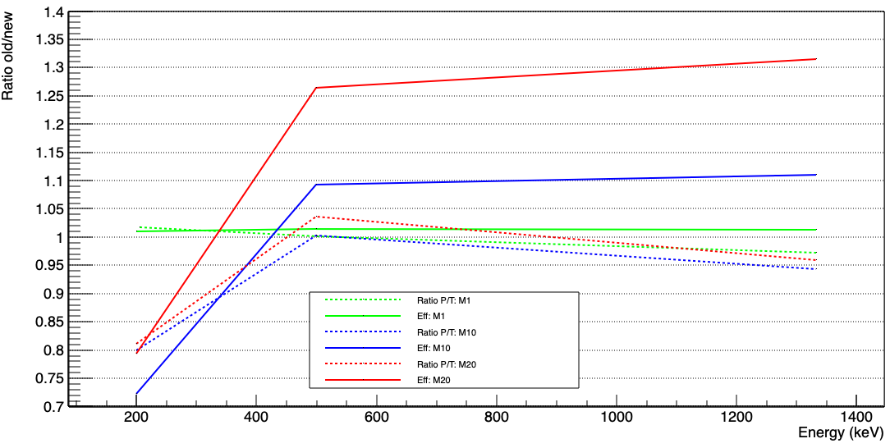
Fixed angle vs variable angle
OftSigmaThetha =0.8
Agata simulated data
Courtesy of J. Dudouet

Slide 6
Why does OFT have the parameter OftSigmaThetha ?

Slide 7
Compton vertex evaluation
e_{i}
θ_{i}
E_{i-1}
i
E_{i}
i-1
i+1

Slide 8
Compton vertex evaluation
e_{i}
θ_{i}
E_{i-1}
i
E_{i}
i-1
i+1
mgt:
Gretina:
OFT:

Slide 9
Compton vertex evaluation
e_{i}
θ_{i}
E_{i-1}
i
E_{i}
i-1
i+1
mgt:
Gretina:
OFT:

Slide 10
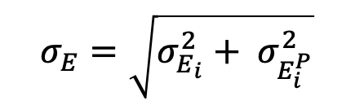
Compton vertex evaluation
e_{i}
θ_{i}
E_{i-1}
i
E_{i}
i-1
i+1
mgt:
Gretina:
OFT:
$$σ_{E}=\sqrt{σ_{E_{i}}^{2}+ σ_{E_{i}^{P}}^{2}}$$

Slide 11
Scattering angle uncertainty in OFT
$$\cos{θ_{1}=\frac{\vec{01}∙\vec{12}}{\left\|\vec{01}\right\|\left\|\vec{12}\right\|}}$$
e₁,x₁,y₁,z₁
θ₁
e₂,x₂,y₂,z₂
Compton vertex
e₀,x₀,y₀,z₀

Slide 12

Scattering angle uncertainty in OFT
$$\cos{θ_{1}=\frac{\vec{01}∙\vec{12}}{\left\|\vec{01}\right\|\left\|\vec{12}\right\|}}$$
e₁,x₁,y₁,z₁
θ₁
e₂,x₂,y₂,z₂
Compton vertex
e₀,x₀,y₀,z₀
$∂\cos{θ_{1}= }σ_{x,y,z}\sqrt{{\left(\frac{∂\cos{θ_{1}}}{∂x_{0}}\right)}^{2}+{\left(\frac{∂\cos{θ_{1}}}{∂y_{0}}\right)}^{2}\text{+} {\left(\frac{∂\cos{θ_{1}}}{∂z_{0}}\right)}^{2}\text{+} {\left(\frac{∂\cos{θ_{1}}}{∂x_{1}}\right)}^{2}\text{+} {\left(\frac{∂\cos{θ_{1}}}{∂y_{1}}\right)}^{2}\text{+} {\left(\frac{∂\cos{θ_{1}}}{∂z_{1}}\right)}^{2}\text{+} {\left(\frac{∂\cos{θ_{1}}}{∂x_{2}}\right)}^{2}\text{+} {\left(\frac{∂\cos{θ_{1}}}{∂y_{2}}\right)}^{2}\text{+} {\left(\frac{∂\cos{θ_{1}}}{∂z_{2}}\right)}^{2}}$
σ_{x}=σ_{y}=σ$z$= constant = σ_{θ} = CONSTANT

Slide 13
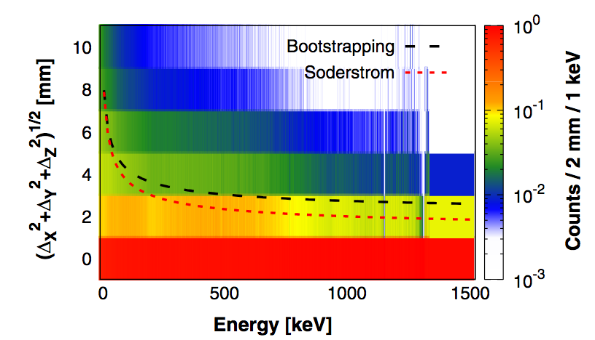
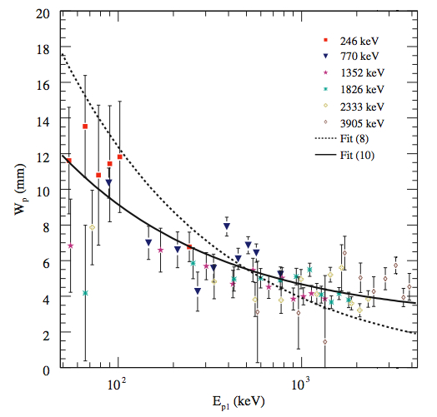
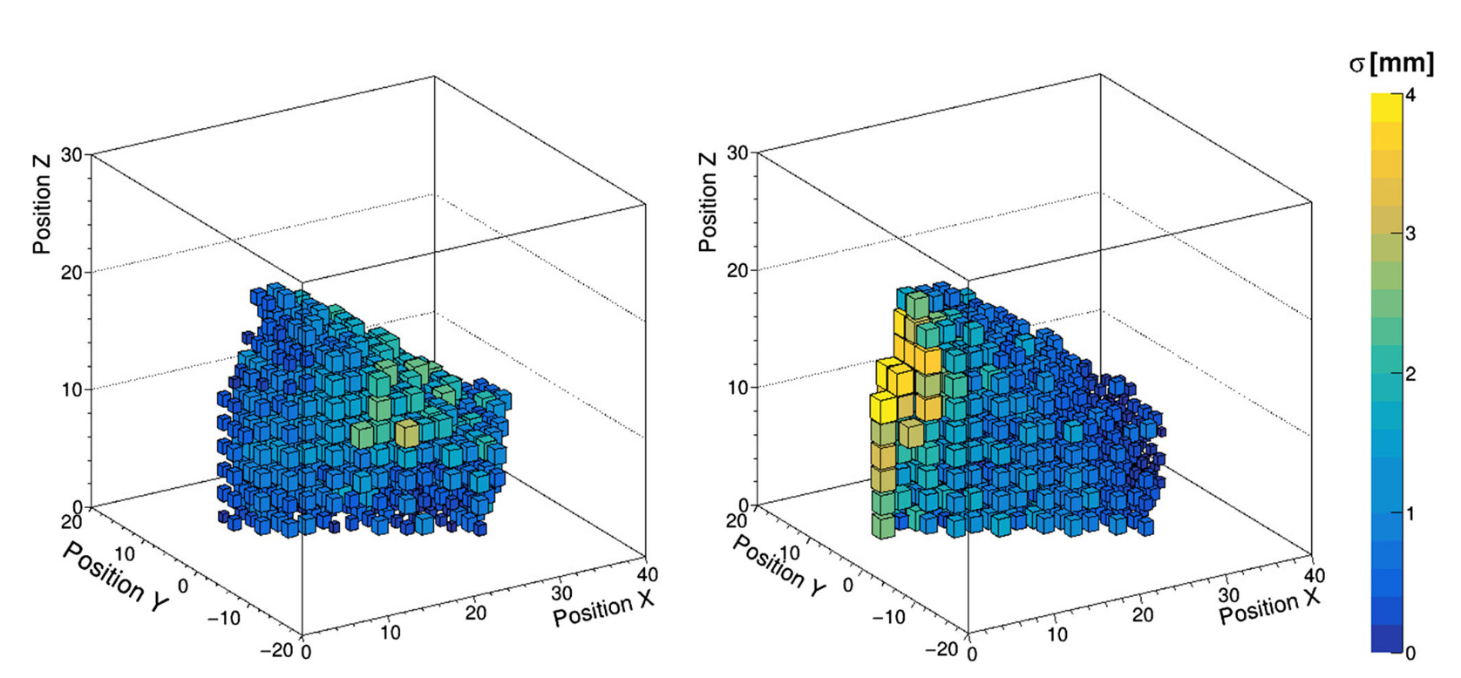
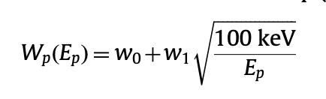
Reality is different
M. Siciliano et al., Eur. Phys. J. A (2021) 57:64
P.-A. Söderström et al., Nucl. Instr. Meth. A 638 (2011) 96
-σ_{x}(64 keV – 128 keV)
+σ_{x}(64 keV – 128 keV)
FWHM =
w1=2.7
w2=6.2

Slide 14
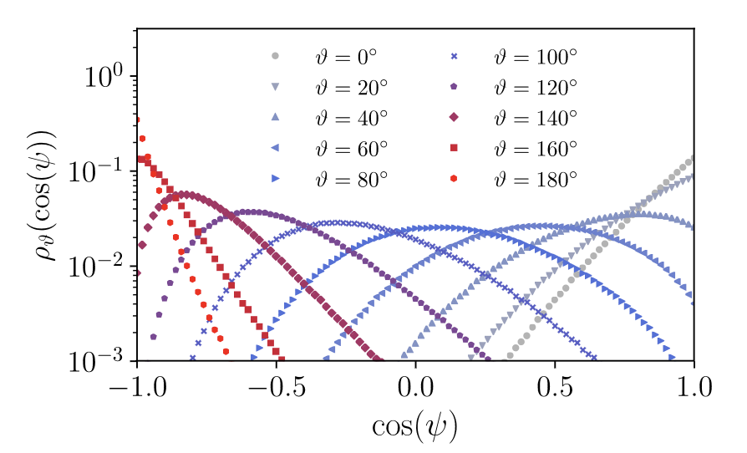
Non-gaussian behaviour of θ
e₁,x₁,y₁,z₁
θ
e₂,x₂,y₂,z₂
Compton vertex
e₀,x₀,y₀,z₀
r₁₀=r₁₂=12 mm
σ=2.12 mm
P. Napiralla et al., Nucl. Instr. Meth. A 955 (2020) 163337

Slide 15
Can position- & energy-dependent position uncertainties improve the tracking performance of OFT ?

Slide 16
Two position-dependent position resolution data bases
1) M. Siciliano (Bootstrapping method) – asymmetric uncertainties, 3 LUTs for crystals A,B & C and for different deposited energy ranges, cartesian coordinates
(MS)
2) M. Labiche & S. Chong – symmetric uncertainties, 3 LUTs for crystals A,B & C scaled by Söderström energy dependence, cylindrical coordinates (data base pipeline: GEANT4 simulations -> signal generation via ADL -> PSA -> comparison between extracted positions from PSA and real positions)
(ML)
M. Siciliano et al., Eur. Phys. J. A (2021) 57:64

Slide 17
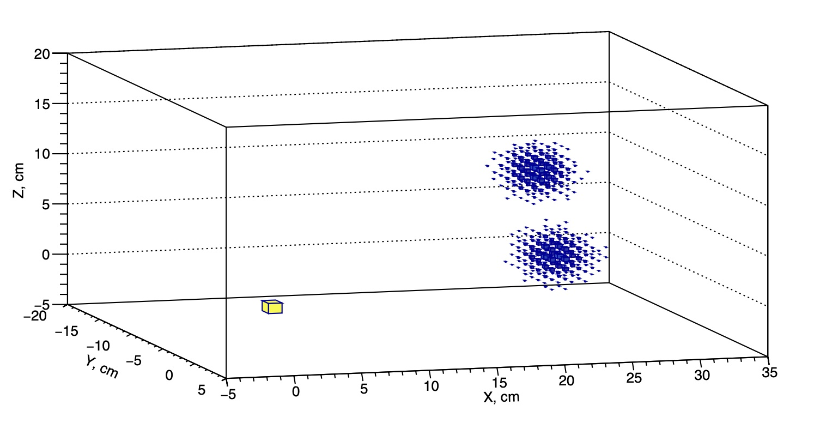
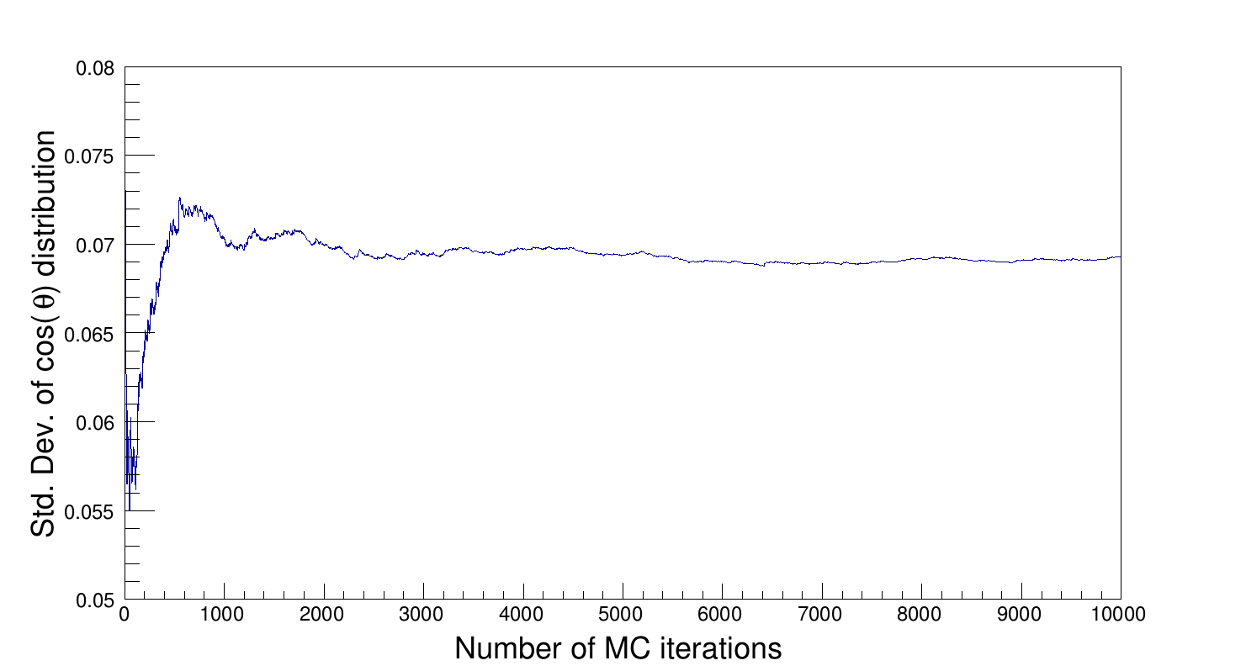
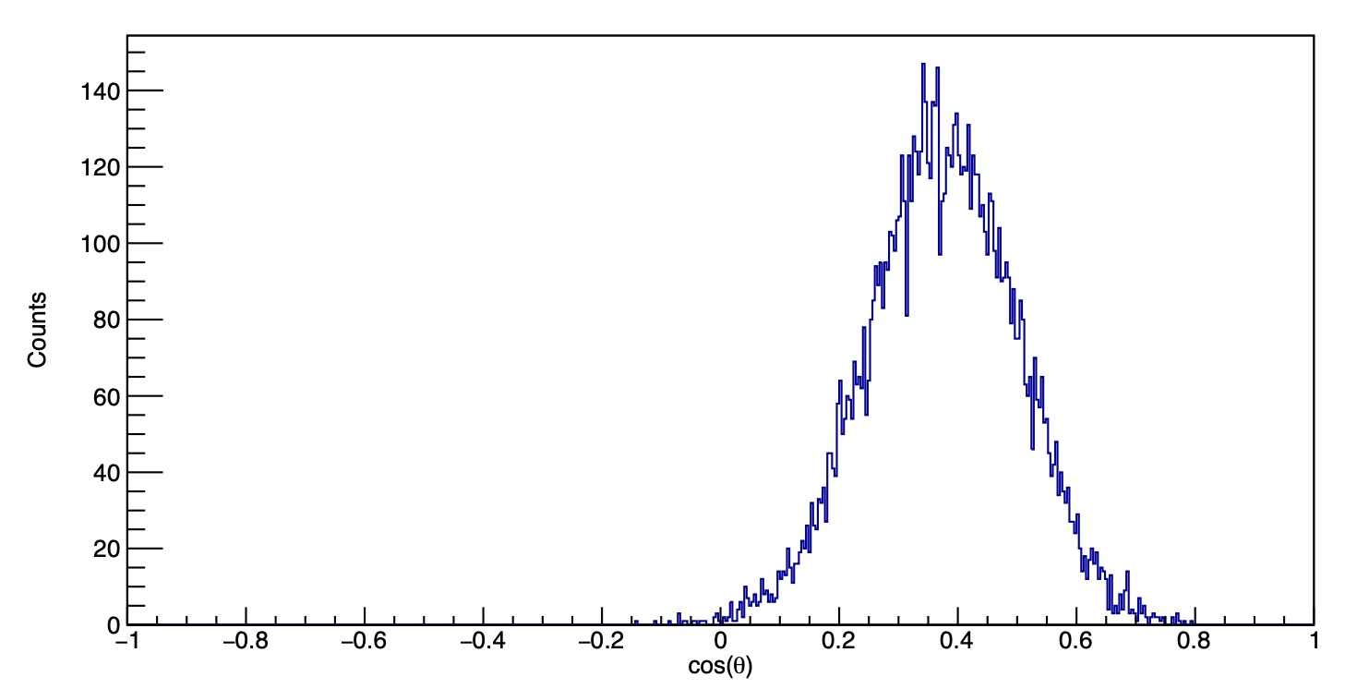
Computing ∂cosθ when σ_{x}, σ_{y} and σ_{x} are different
Monte Carlo sampling of positions @ every Compton vertex from a normal (symmetric case) or split normal distribution
(asymmetric case)
θ
Fit of cosθ distribution to extract Δcosθ @ vertex

Slide 18
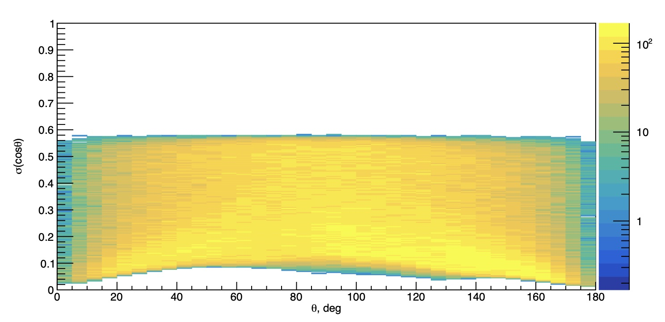
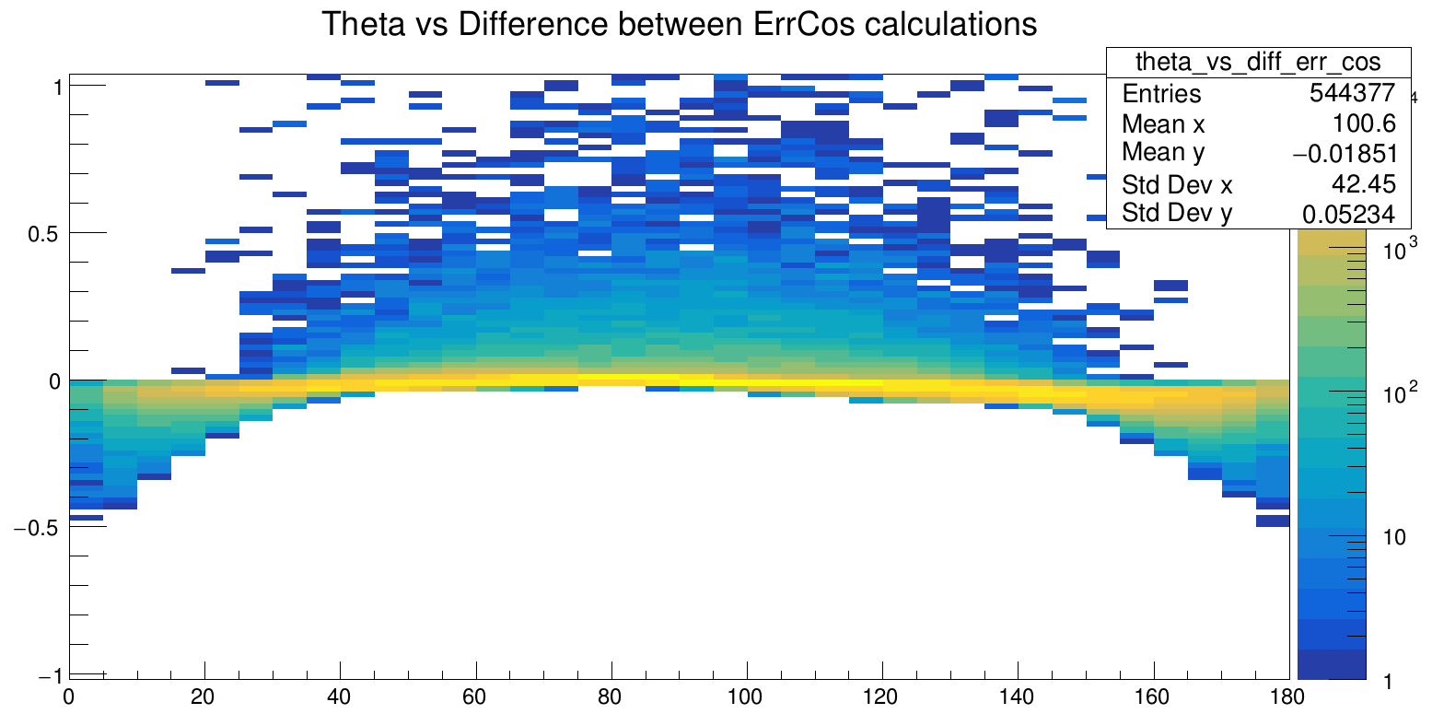
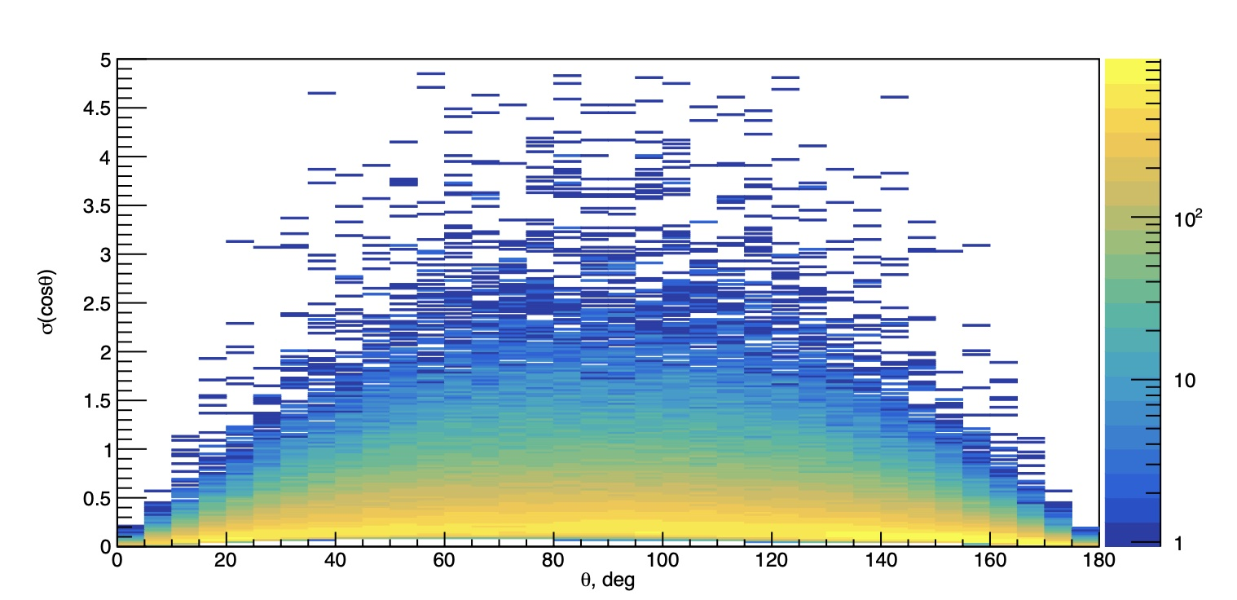
Monte Carlo cosine uncertainties
(constant position uncertainty)
OFT analytical cosine uncertainties
(constant position uncertainty)

Slide 19
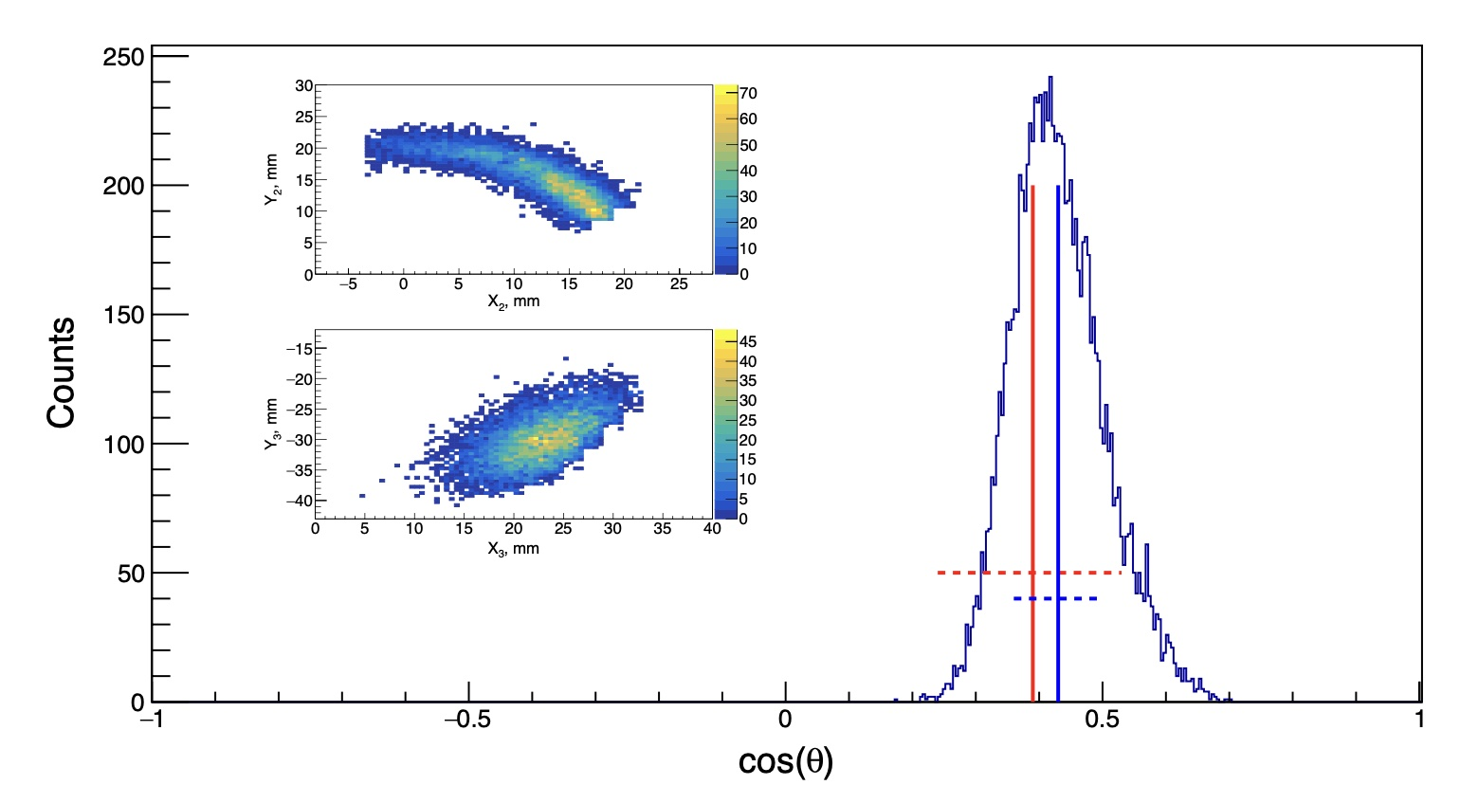
Effect of segment borders & asymmetric errors
Analytical mean and variance
(with σ_{θ}=0.8))
Monte Carlo mean & variance (ML)

Slide 20
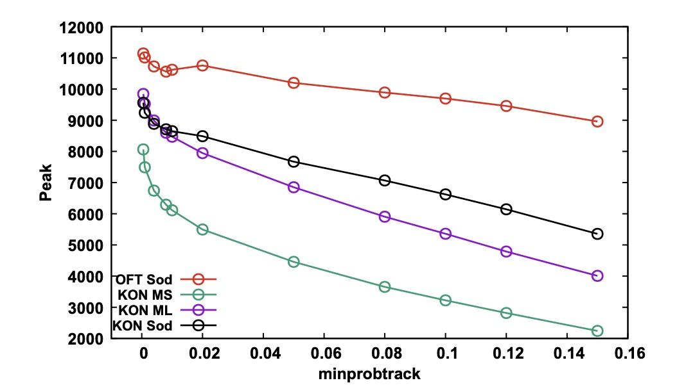
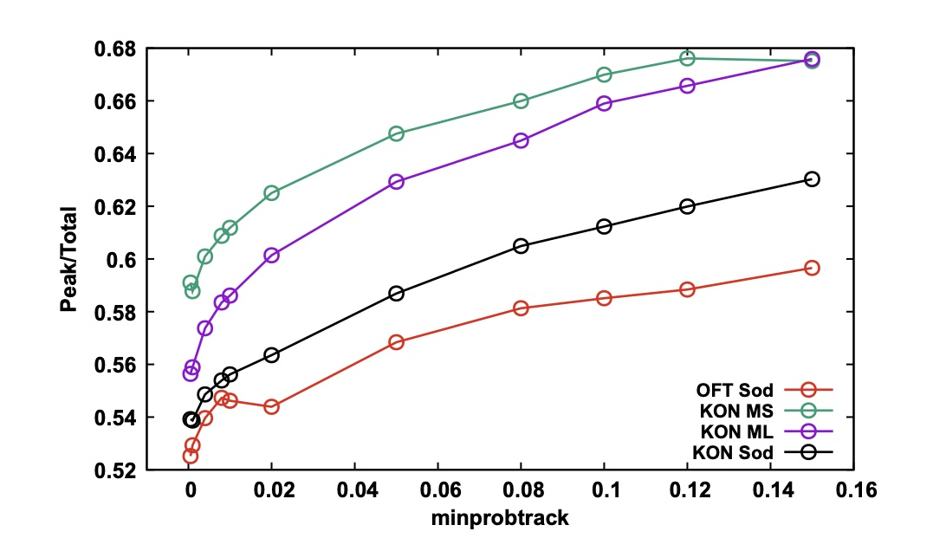
Ganil ⁶⁰Co source run
29 detectors – 1332 keV-gated data, No single-point interactions, Fixed clustering angle
Standard OFT = analytical calculation of ∂cosθ & σ_{θ}=0.8
OFT modified by Konstantin = Monte Carlo extraction of Δcosθ & σ_{θ}=0.8
Monte Carlo extraction of Δcosθ & σ(e,x,y,z) read from data base of Marco Siciliano or Marc Labiche

Slide 21
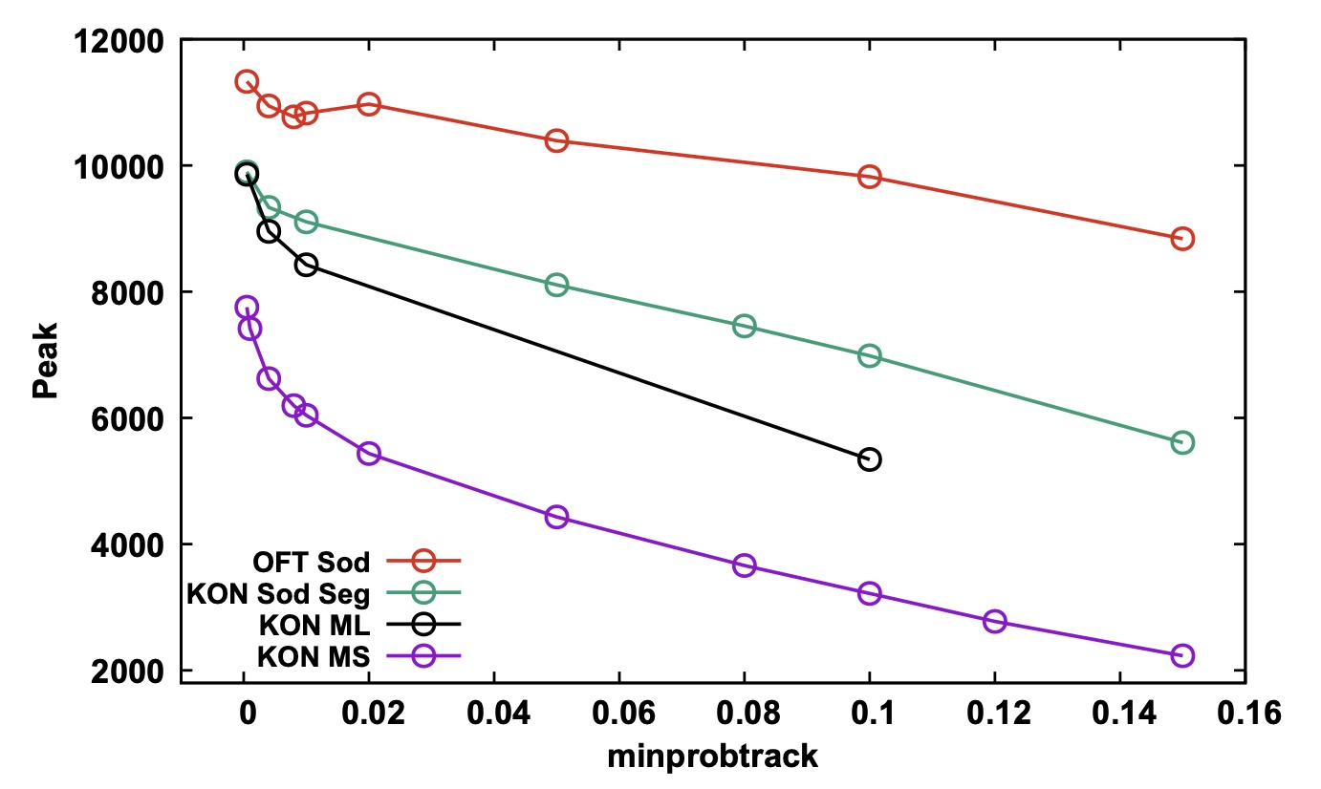
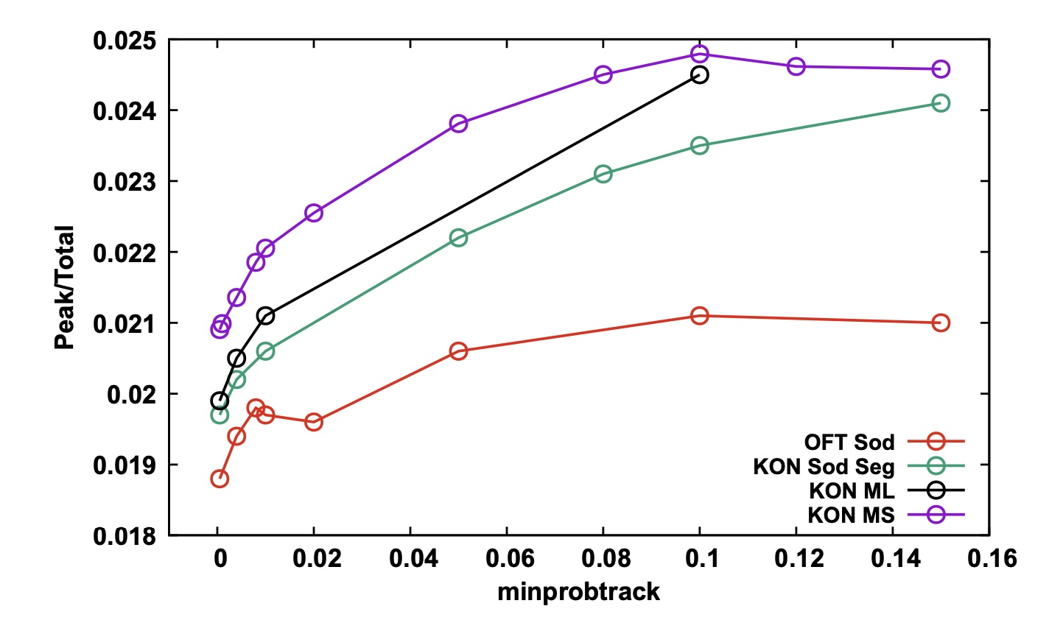
In-beam ⁹⁸Zr PSA test-bench data
Peak of interest: 1222.9 keV (2₁⁺ → 0₁⁺ )
No single-point interactions
Fixed clustering angle
(NB:color code not the same as previous slide)

Slide 22
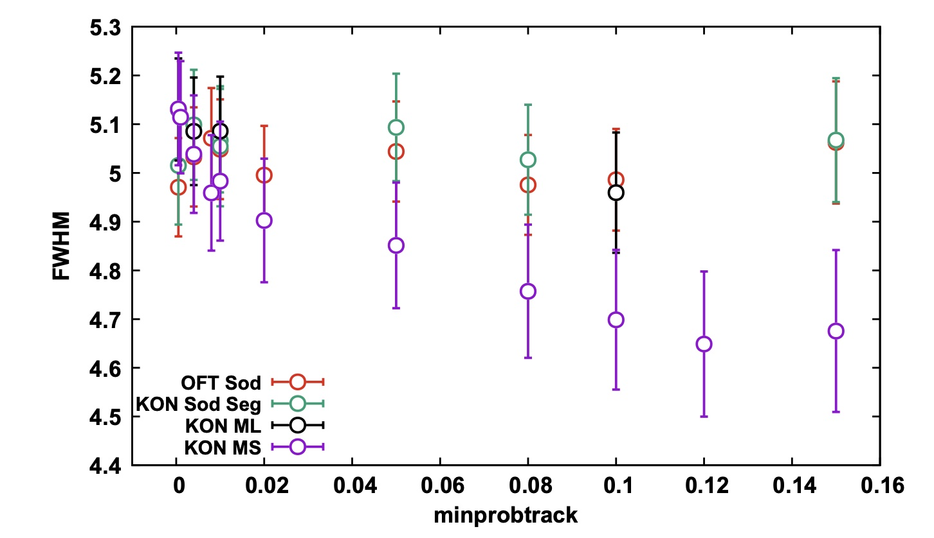
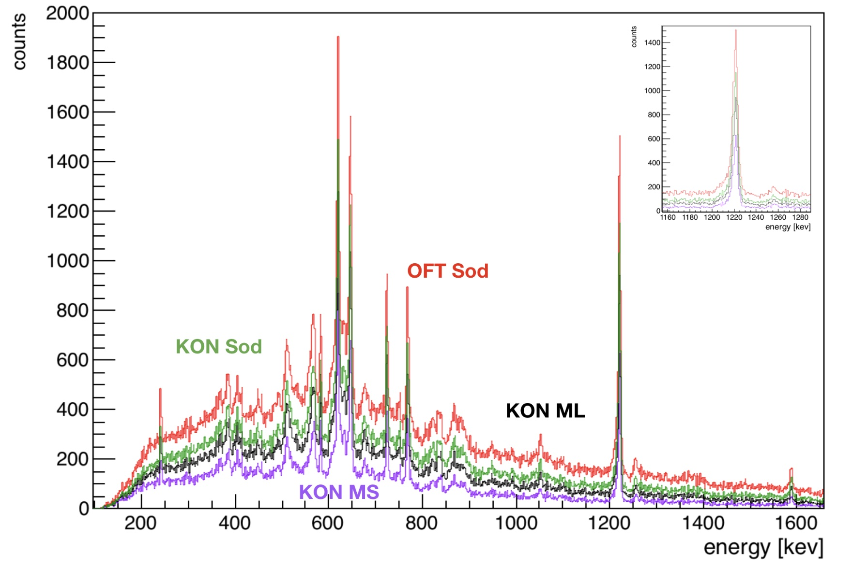
In-beam ⁹⁸Zr data
minprobtrack=0.08
Peak fits performed with gaussian + skewed gaussian + step function

Slide 23
Conclusions
The uncertainty in cosθ is overestimated in OFT (except at small and large angles, where it is underestimated)
The vertex evaluator of OFT performs better (albeit with a worse P/T) with an average uncertainty on all points than with the available position uncertainty maps (effect of evaluator or non fidelity of uncertainty data base ?)
Some things to investigate:
Scale OFT cosine uncertainties for forward and backscattered events to recuperate the forward and backward scattered events which are rejected due to the “close-to-0” cosθ uncertainties
Extract more realistic position uncertainty data base from scanning tables (difference in positions given by PSA using ADL vs positions given by PSA using experimental data base)
Investigate other types of evaluators

Slide 24
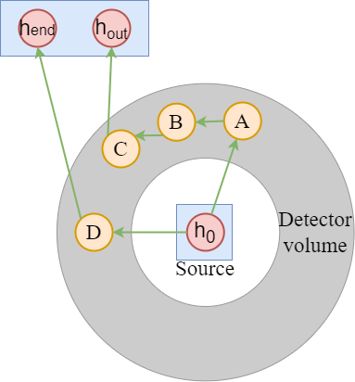
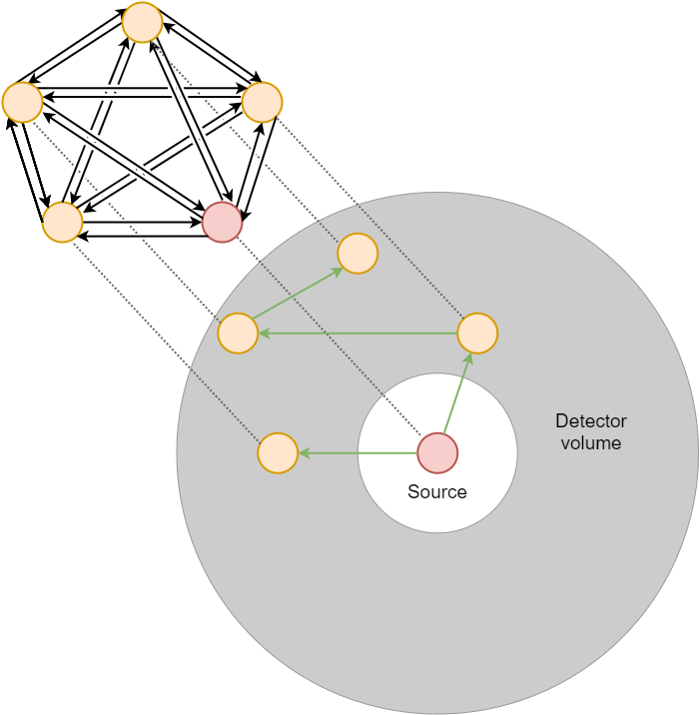
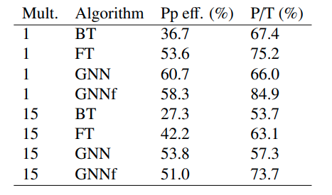
Perspectives
From KTH: Promising preliminary results on tracking with Graph Neural Networks to evaluate the connectivity between energy deposits
1332 keV
Simulated data (Ge sphere)
5mm packing & smearing
Mikael Andersson & Torbjörn Bäck, Nucl. Instr. Meth. A 1048 (2023) 168000

