Slide 1
PSA R&D with AGATA
Dr. Fraser Holloway

Slide 2
Presentation Overview
Single-interaction PSA:
Conventional AGATA PSA
Novel Techniques
Multi-interaction PSA:
Existing Methods
Novel Techniques
Machine Learning in Instrumentation:
Current Methods, challenges
Future Perspectives
“Machine Learning in Nuclear Physics” - Made with DALL.E3

Slide 3
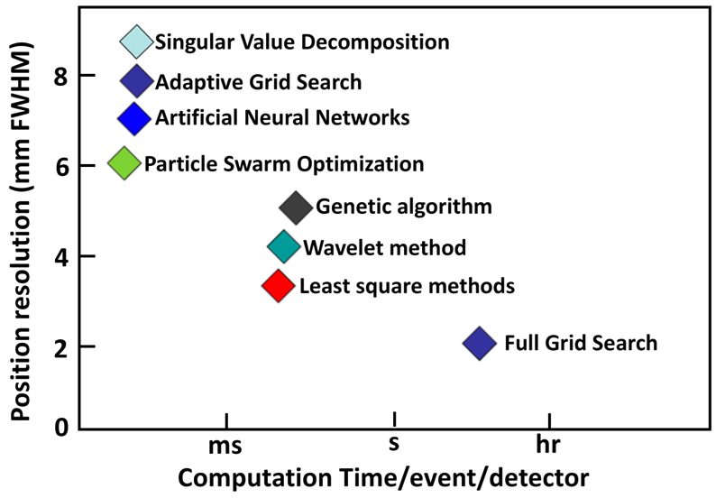
PSA in AGATA
Most PSA algorithms are optimization based:
$$Figure of Merit= \sum_{j}{\sum_{t_{i}}{{\left|A_{m}^{j} \left[t_{i}\right]−A_{s}^{j}\left[t_{i}\right]\right|}^{p} }}$$
For signals of segment $j$ at time step $t_{i}$ with $p$ typically =2
Full grid searches are accurate but too slow.
Adaptive grid search is most widely used but is not sufficient for online interaction localization.

Slide 4
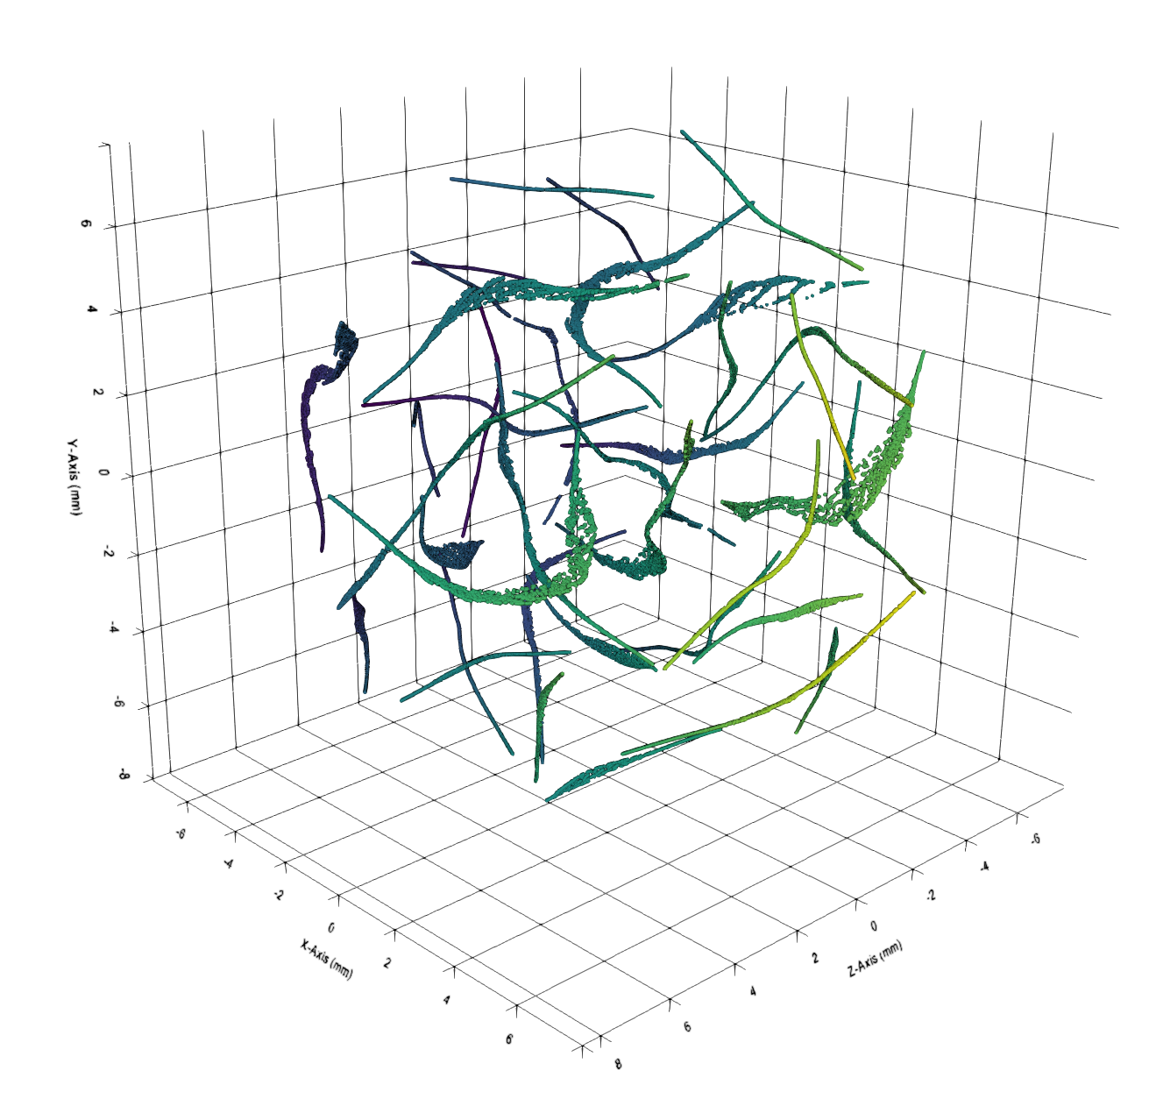
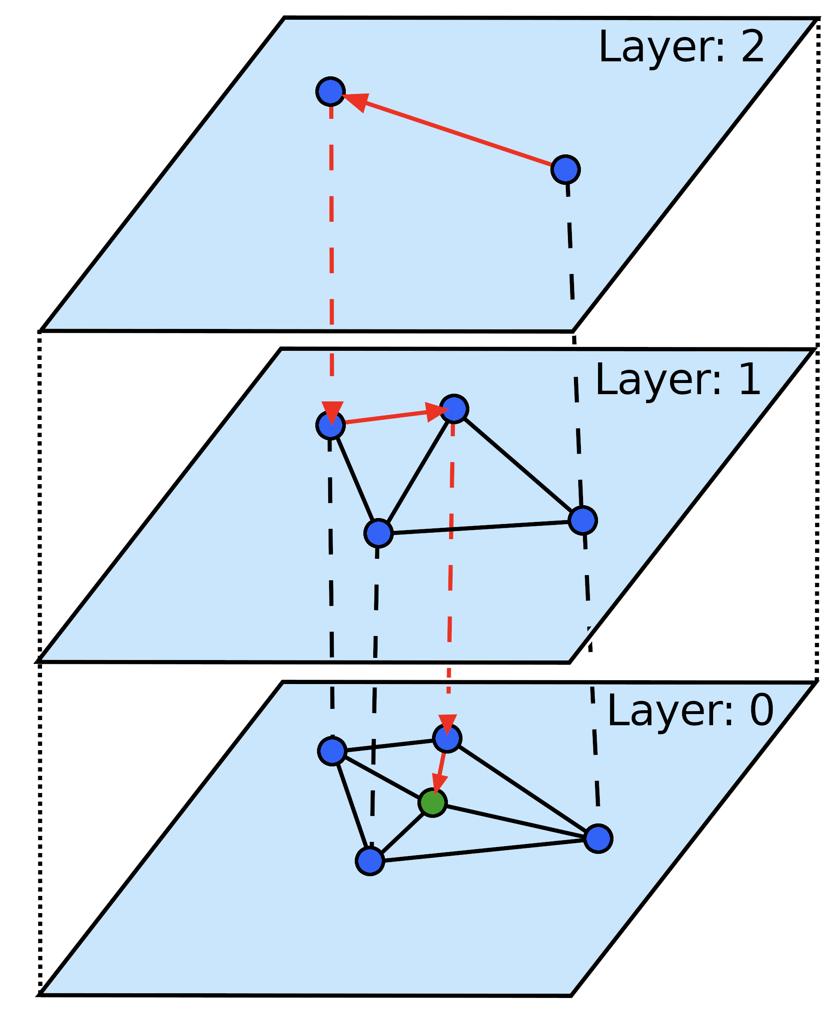
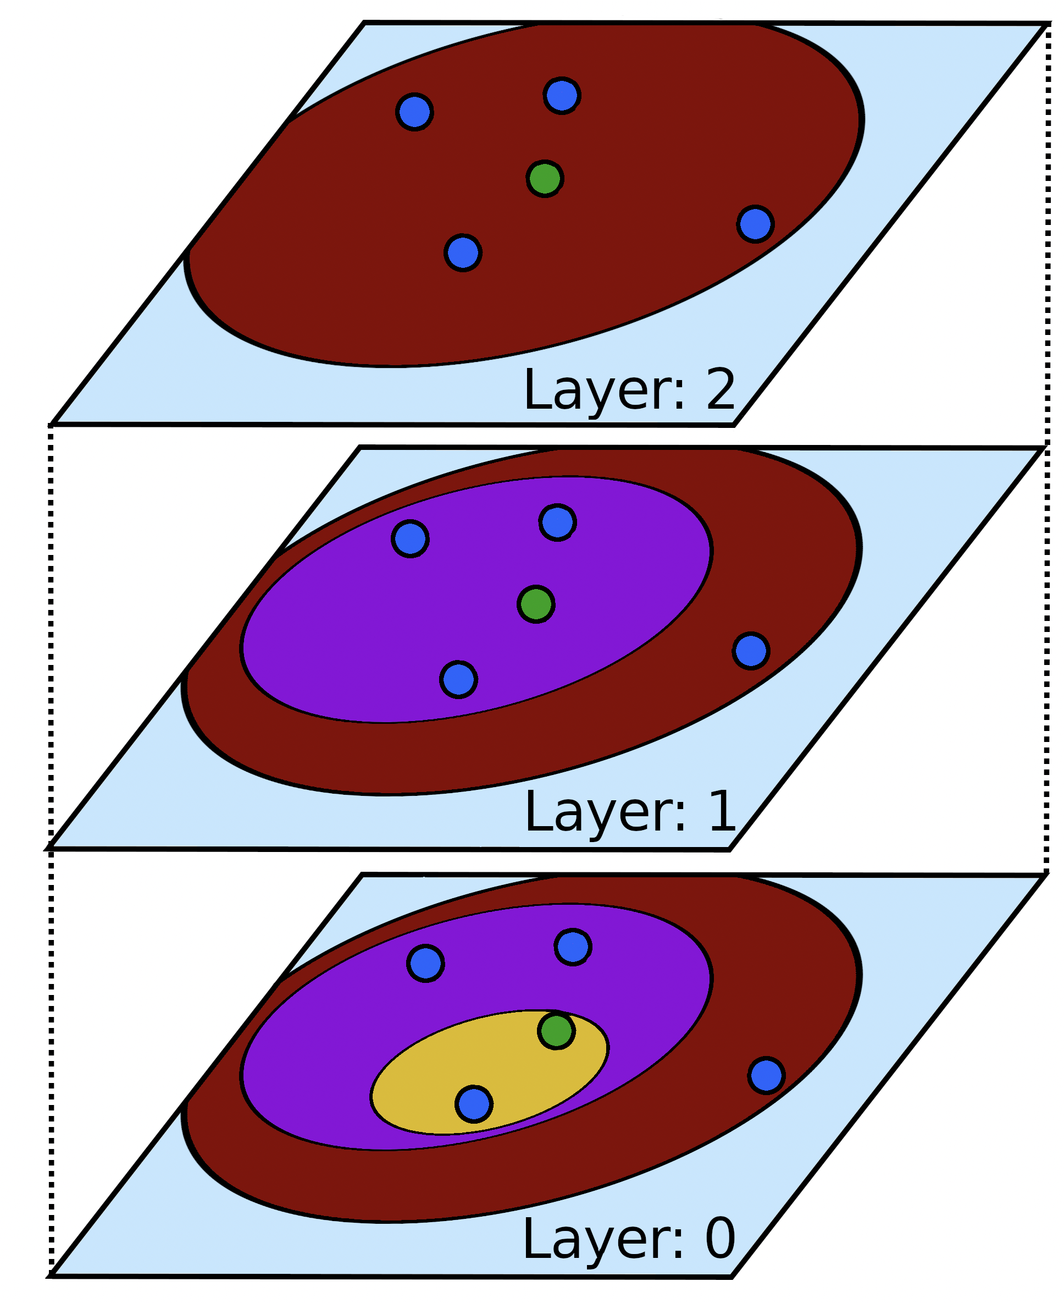
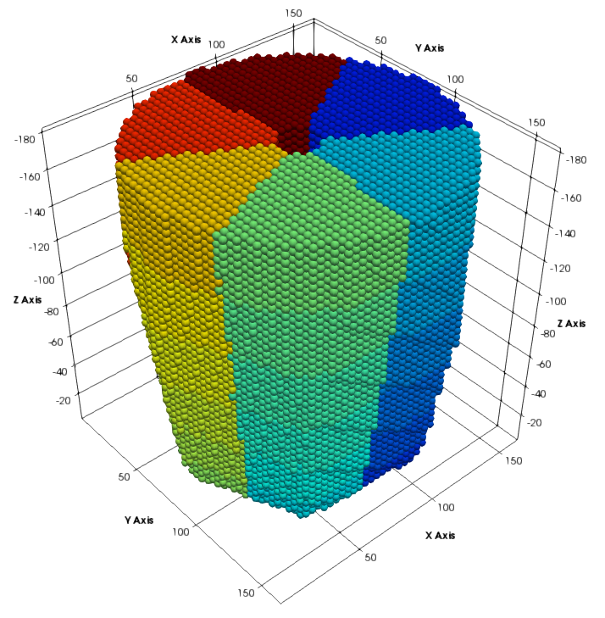
Graph Structures & Accelerated PSA
As part of my work, I investigated the use of graph structures to accelerate PSA, they have several marked benefits:
Data-driven ∴ no parametric methods (e.g. T₉₀) needed.
Self-organised ∴ no rigid grid structure required.
Hierarchical ∴ adaptive resolution.
In my work I profiled several methods for accelerated PSA:
Space Partitioning (exact $k$NN): $k$D-Tree, $M$-Trees, etc.
Coarse Indexing (approximate $k$NN): HNSWLib, FAISS.
These methods look promising for single-interaction PSA but have caveats:
Dynamic windowing is a complex thing.
$M$-Tree Structure
$HNSW$Structure
Signal (UMAP) Representation
Euclidean Representation

Slide 5
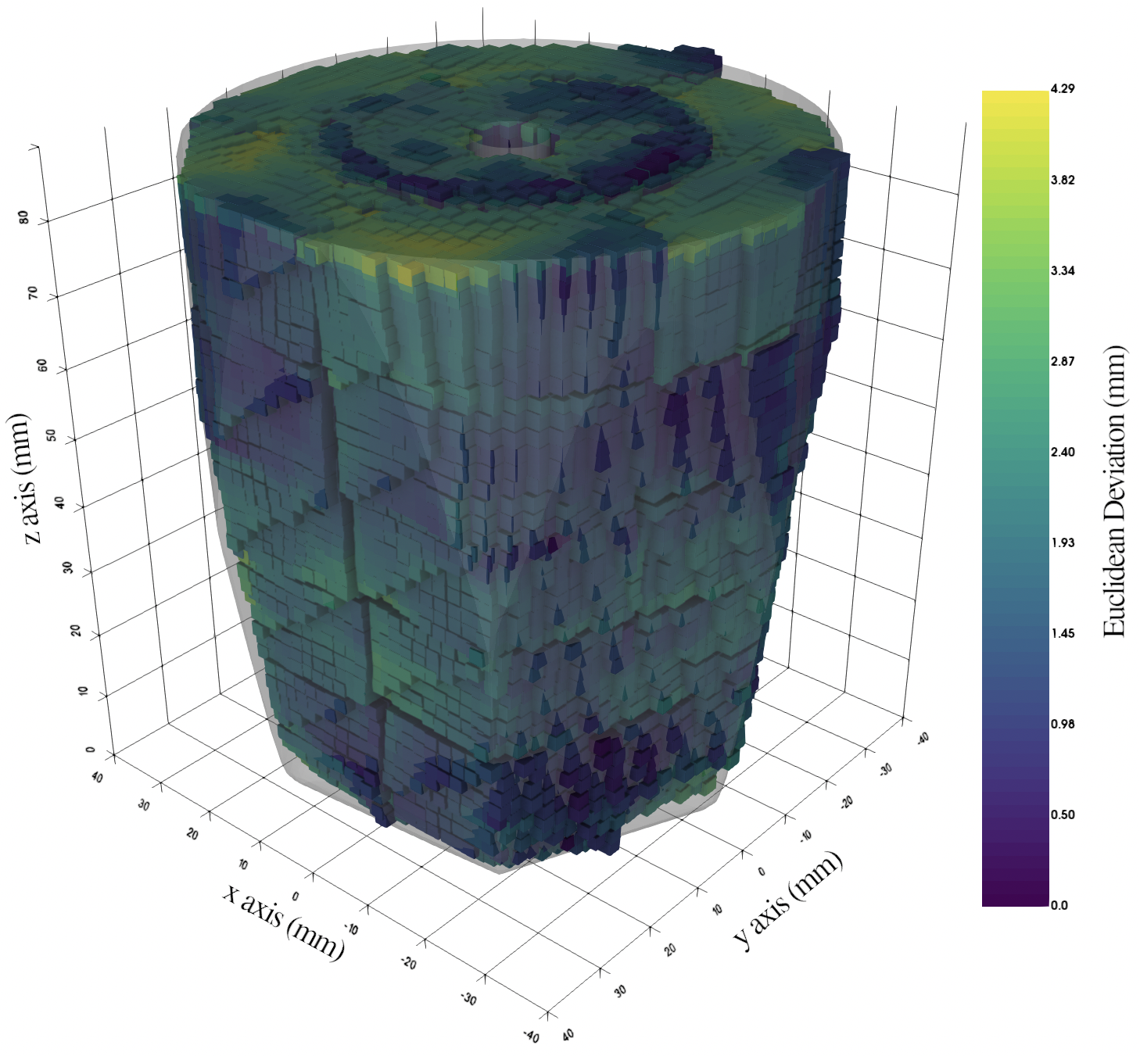
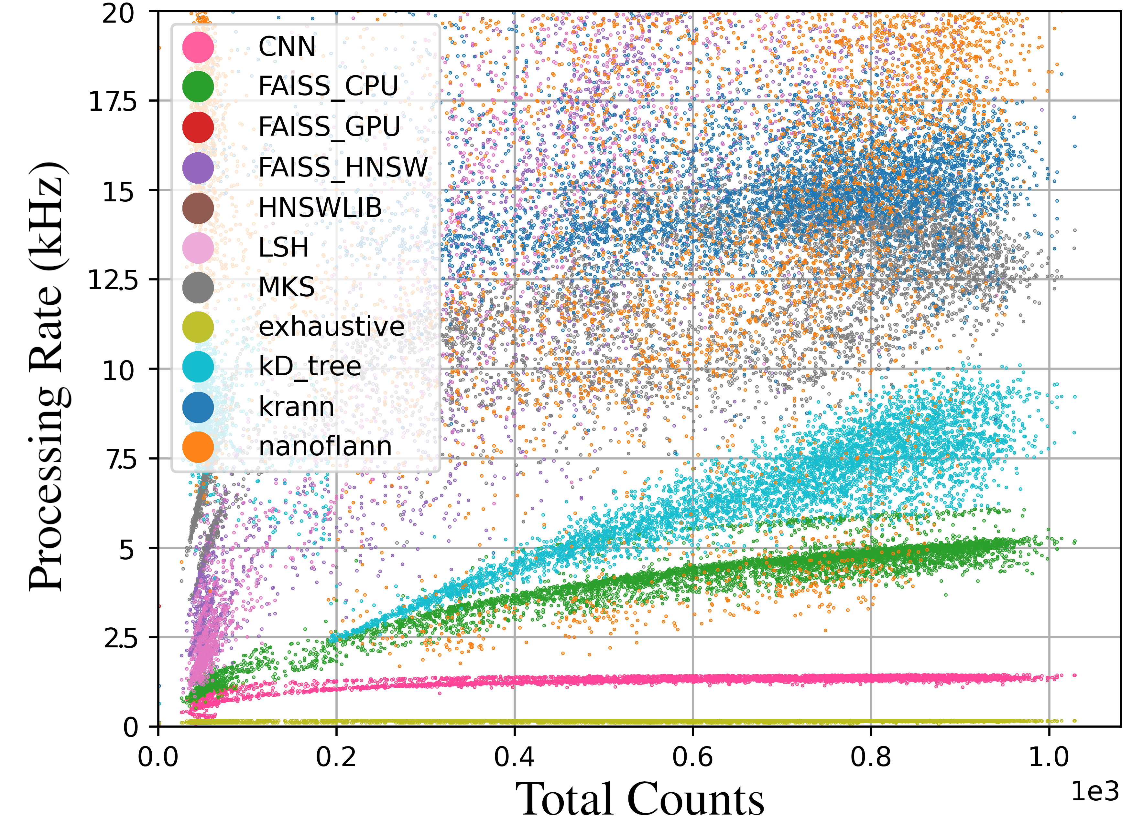
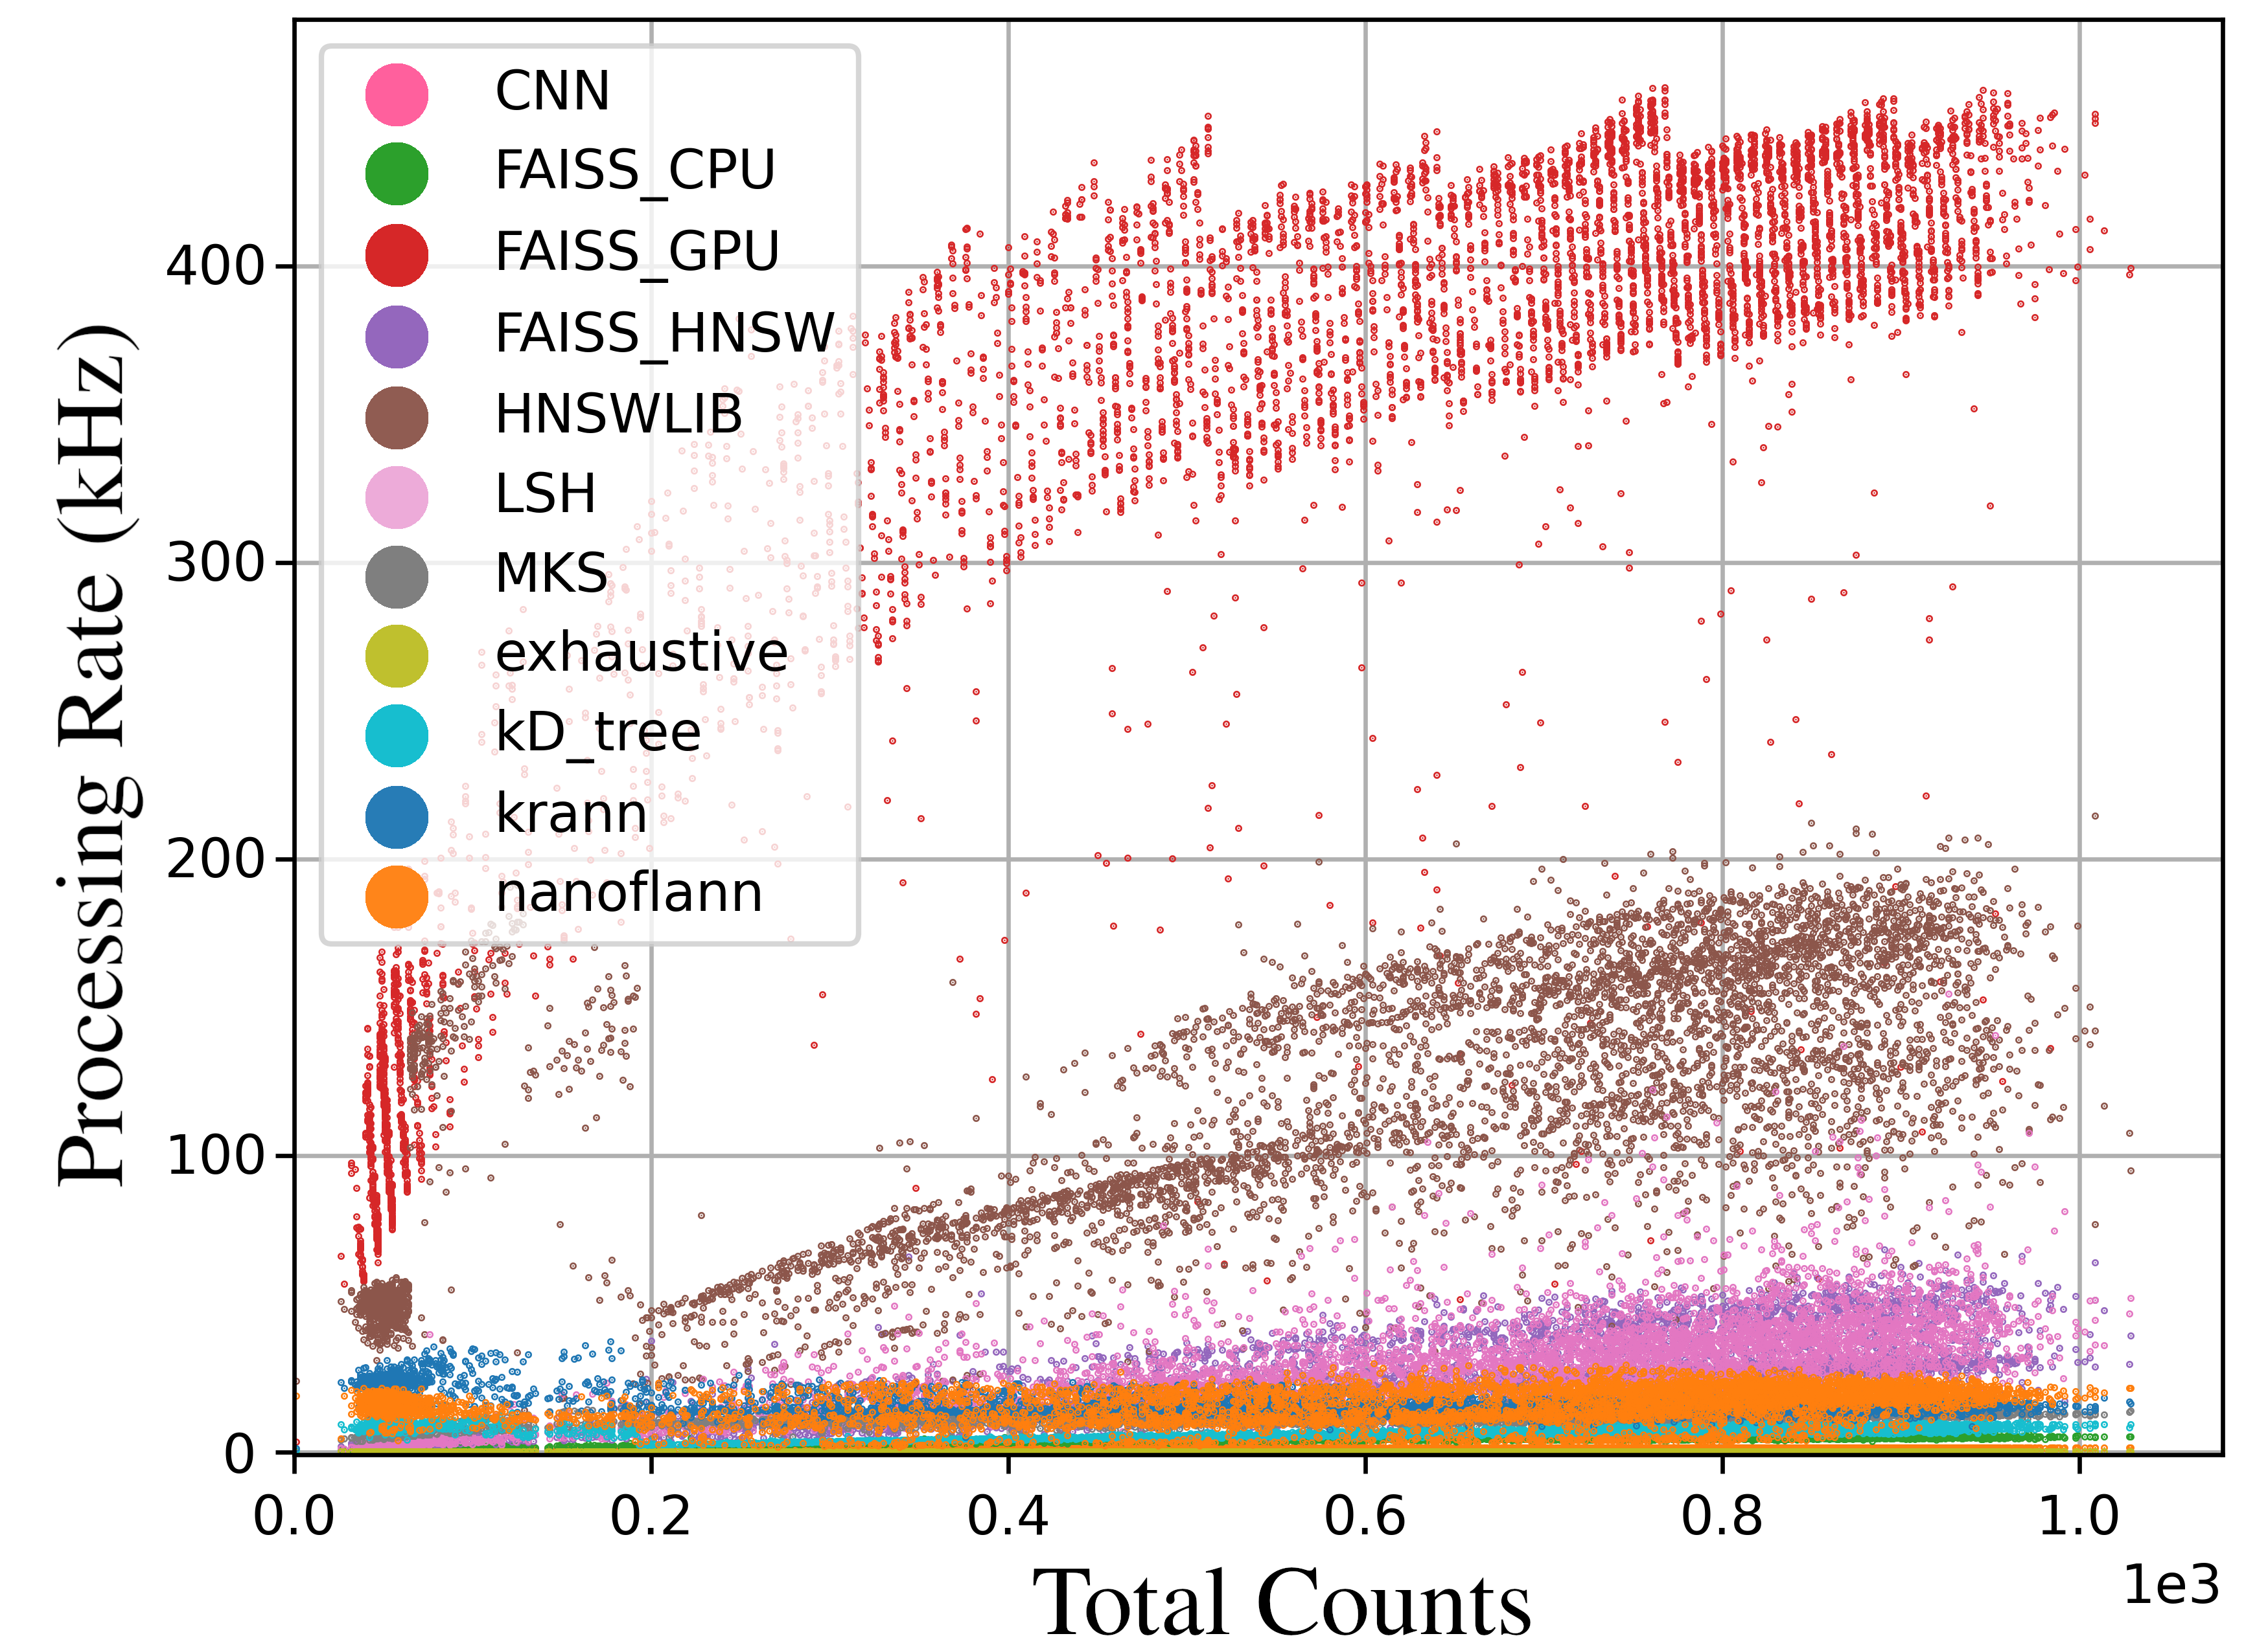
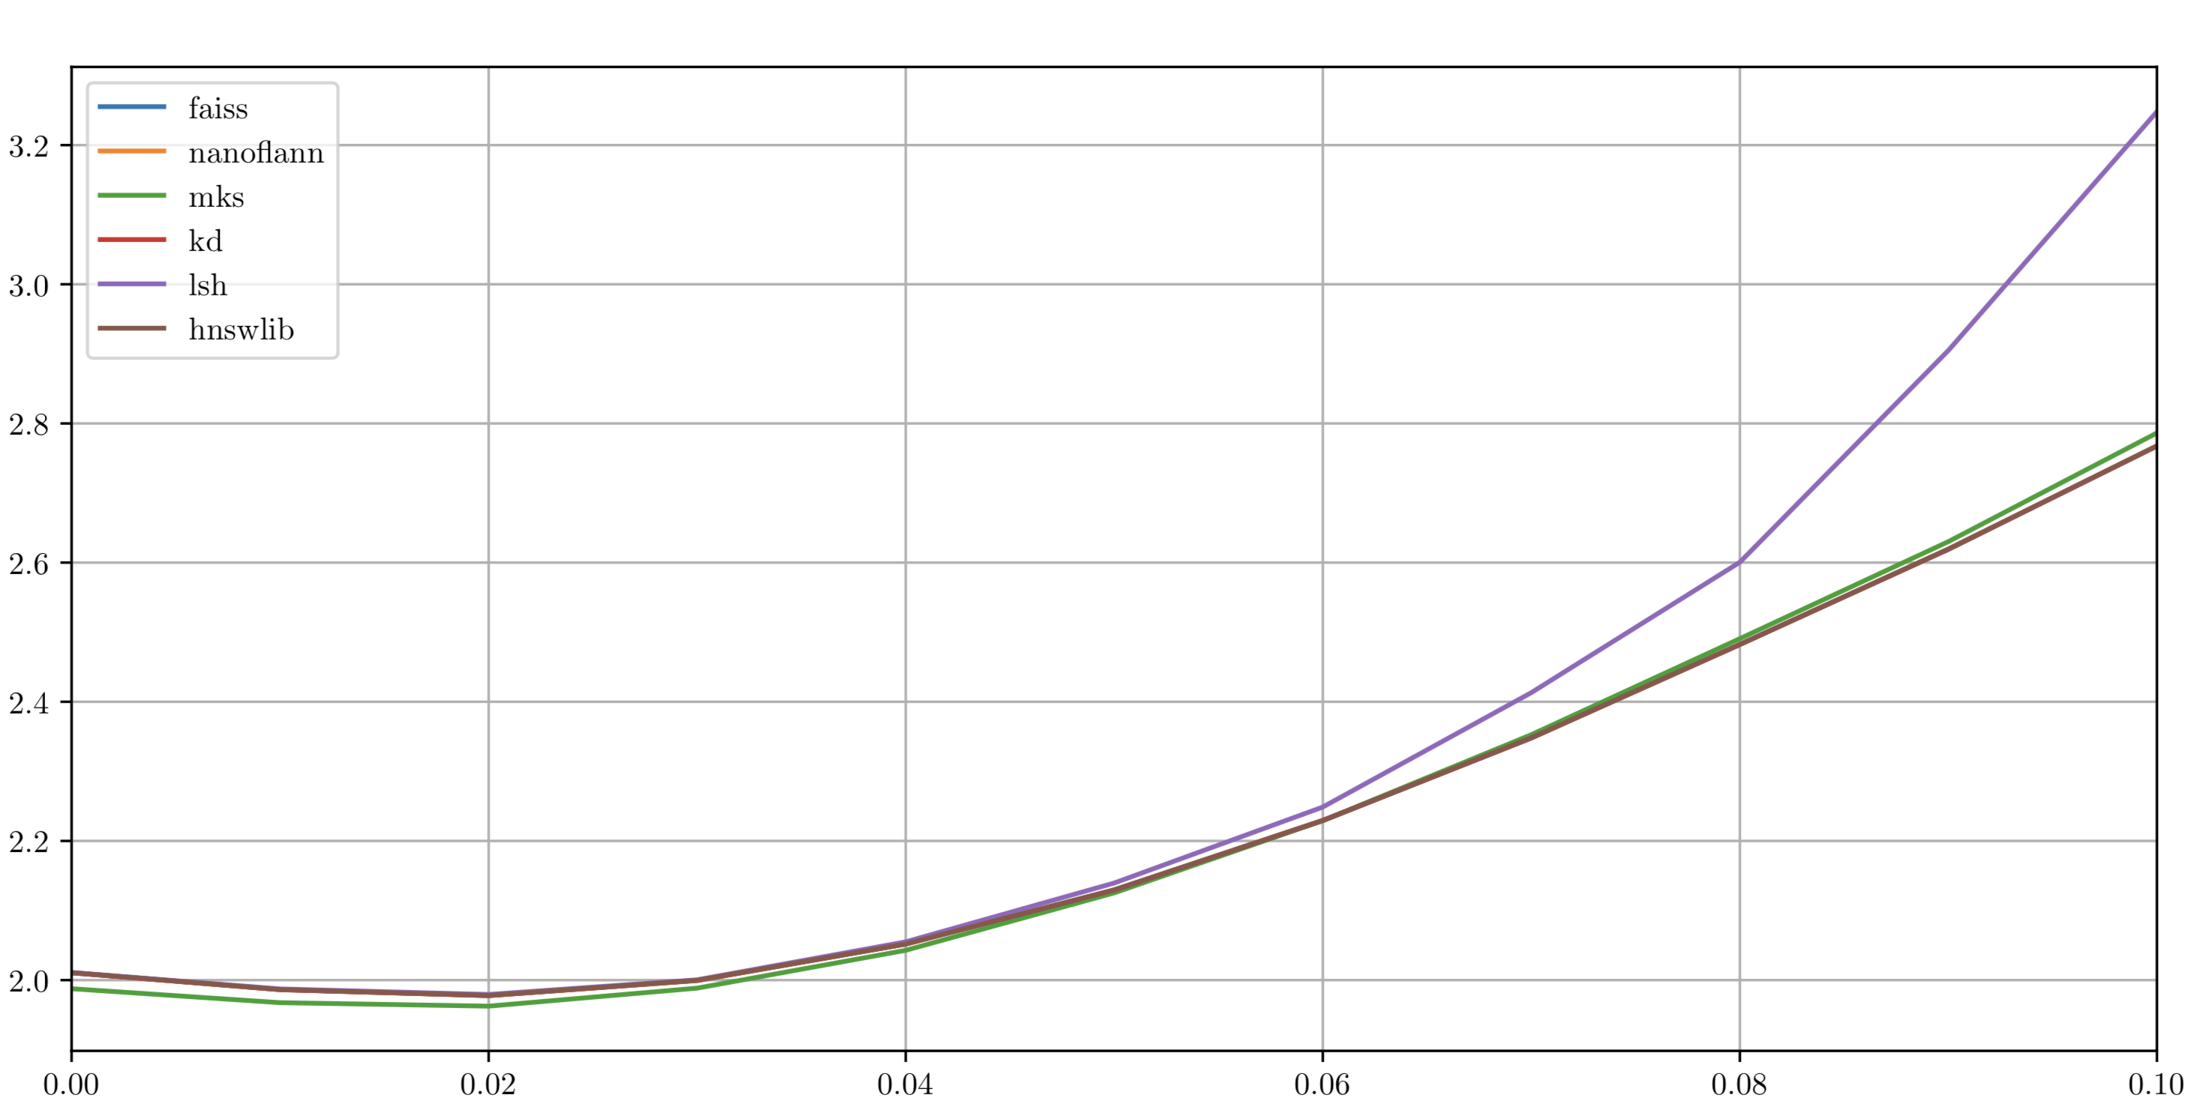
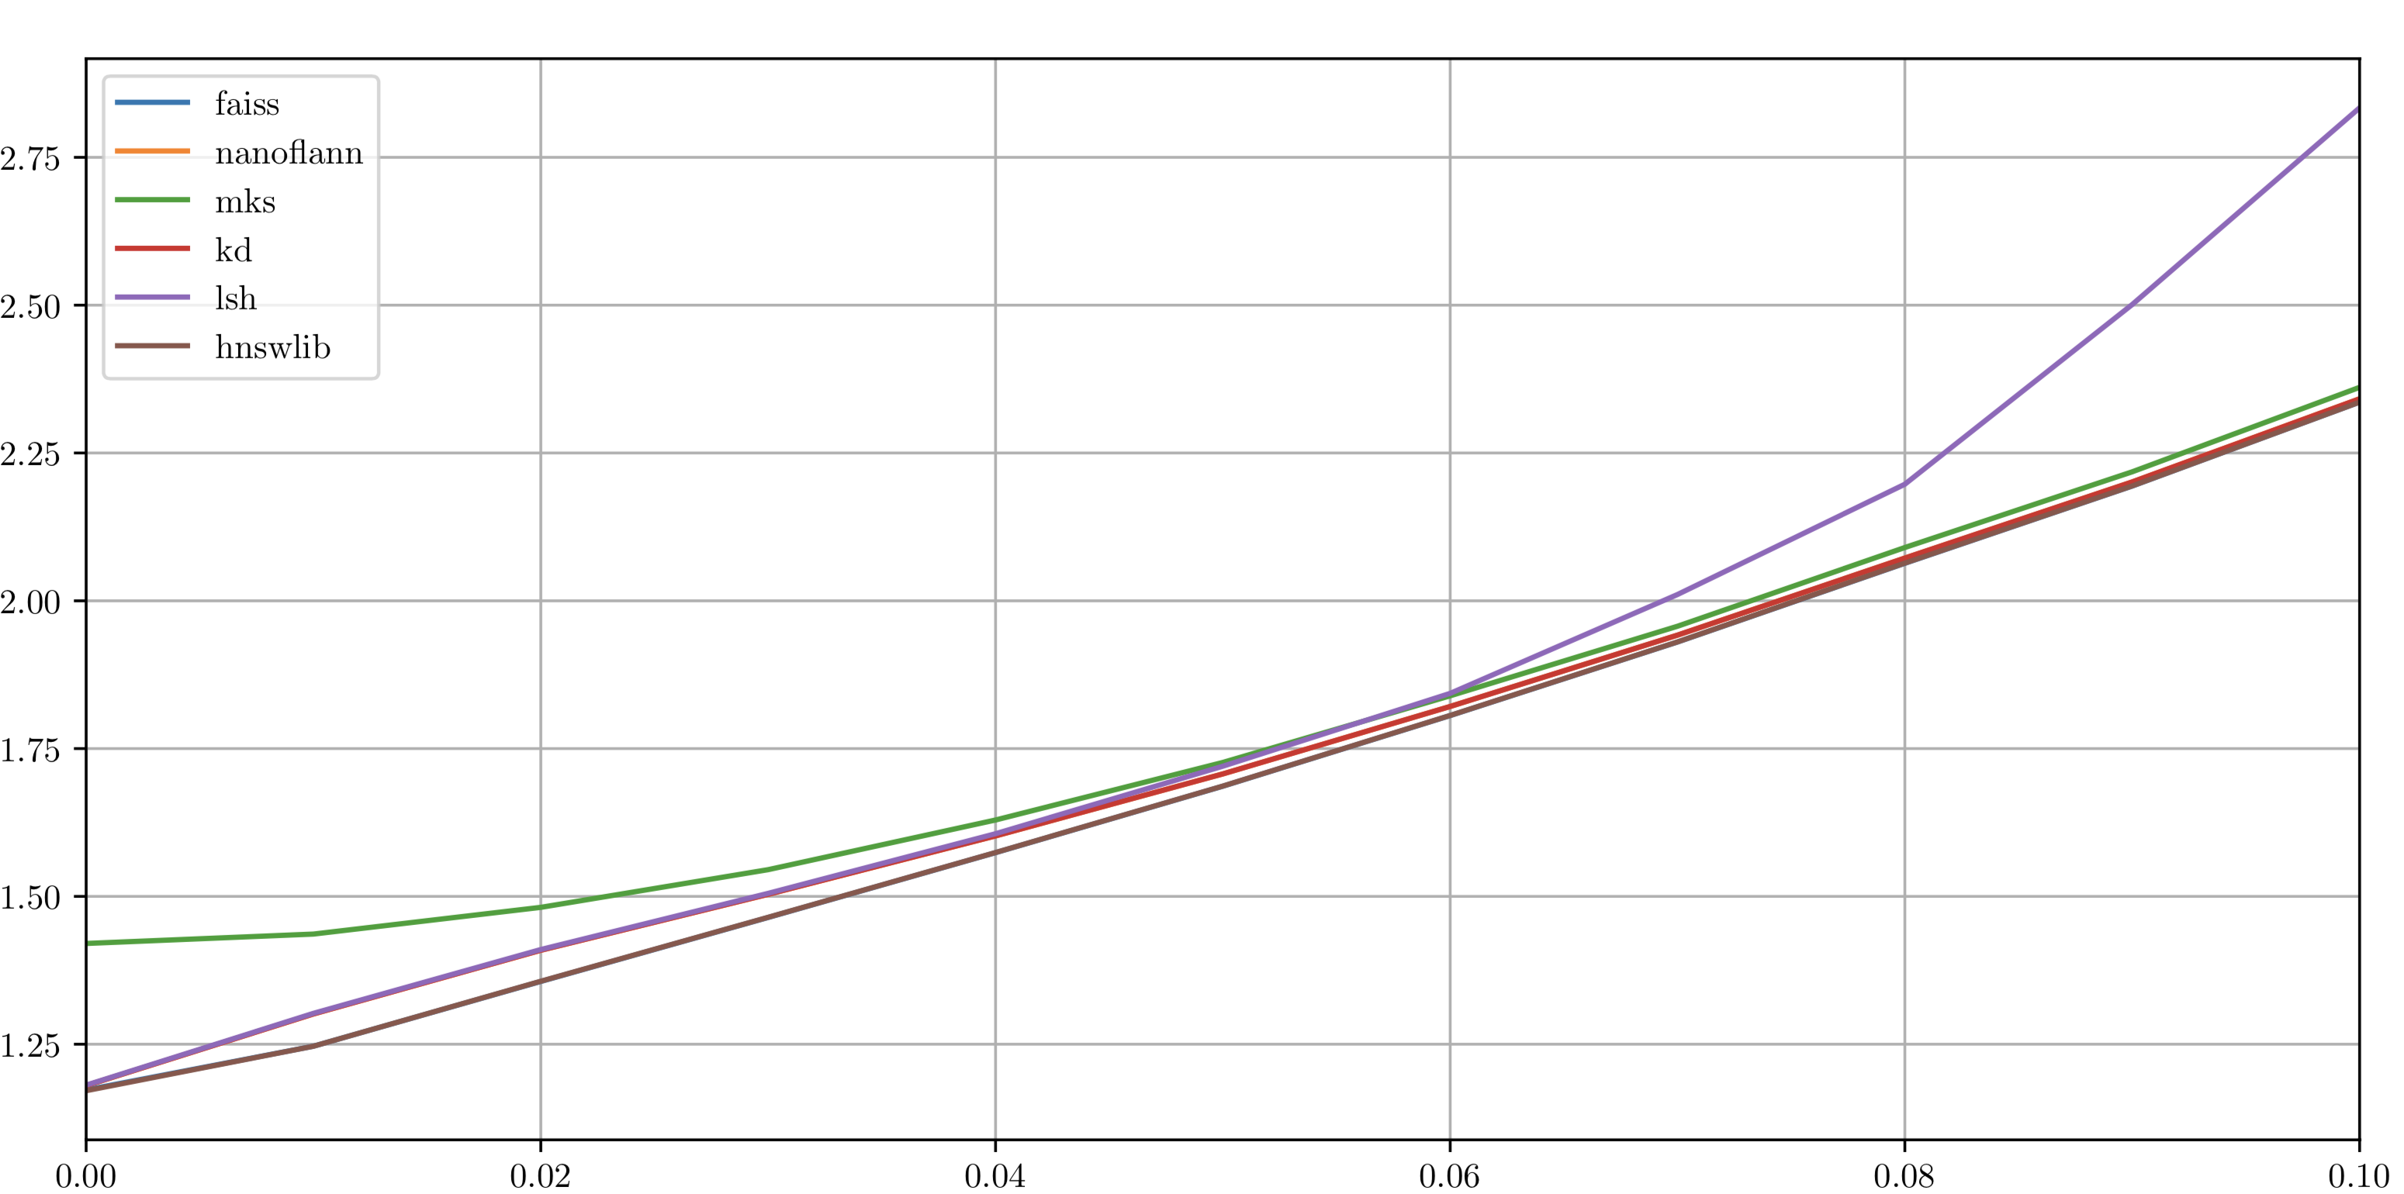
Single-Interaction PSA Results
Approximate $k$NN methods offer a significant speedup over the existing (AGS) method.
GPU-Acceleration increases this further.
PCA embedding offers a tuneable performance.
Using IDW regression, mean deviation is improved.
Method | Execution Rate | 1-recall at $σ$ = 0.05
AGS | 1.5kHz | 76.2%
True Exhaustive | 1.5Hz | 88.5%
100D Exhaustive | 200Hz | 84.7%
CNN | 1.5kHz | N/A
$k$D-Tree | 8.0kHz | 82.2%
LSH | 25kHz | 79.6%
MKS | 12.5kHz | 79.6%
HNSWLIB | 180kHz | 80.1%
NanoFLANN | 20kHz | 80.2%
FAISS (CPU) | 5.0kHz | 80.4%
FAISS (GPU) | 430kHz | 80.4%
Mean Absolute Deviation (mm)
Mean Absolute Deviation (mm)
$k$=3 IDW Regression
$k$=1 NN
Applied Gaussian Noise
Applied Gaussian Noise

Slide 6
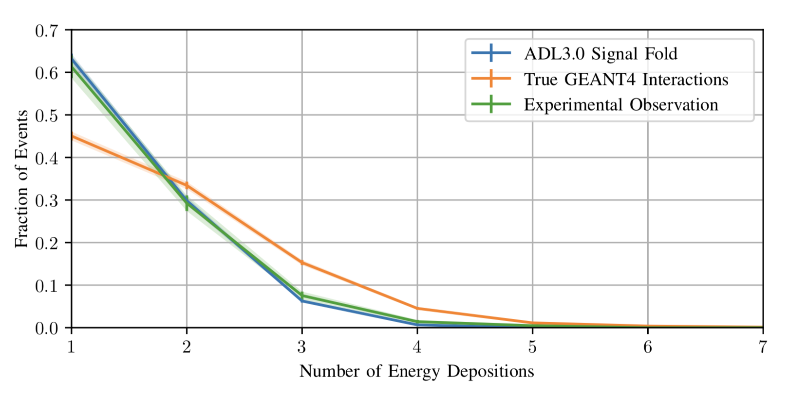
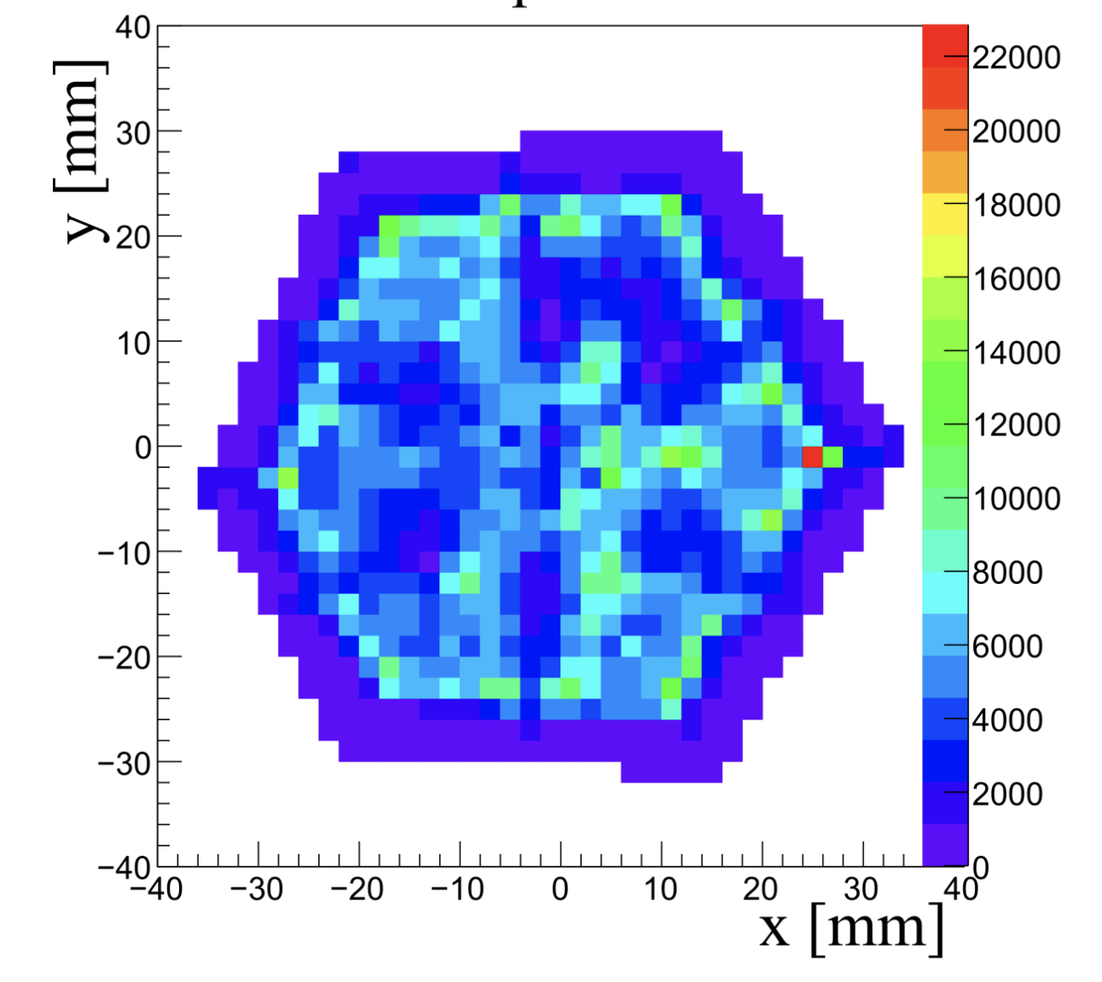
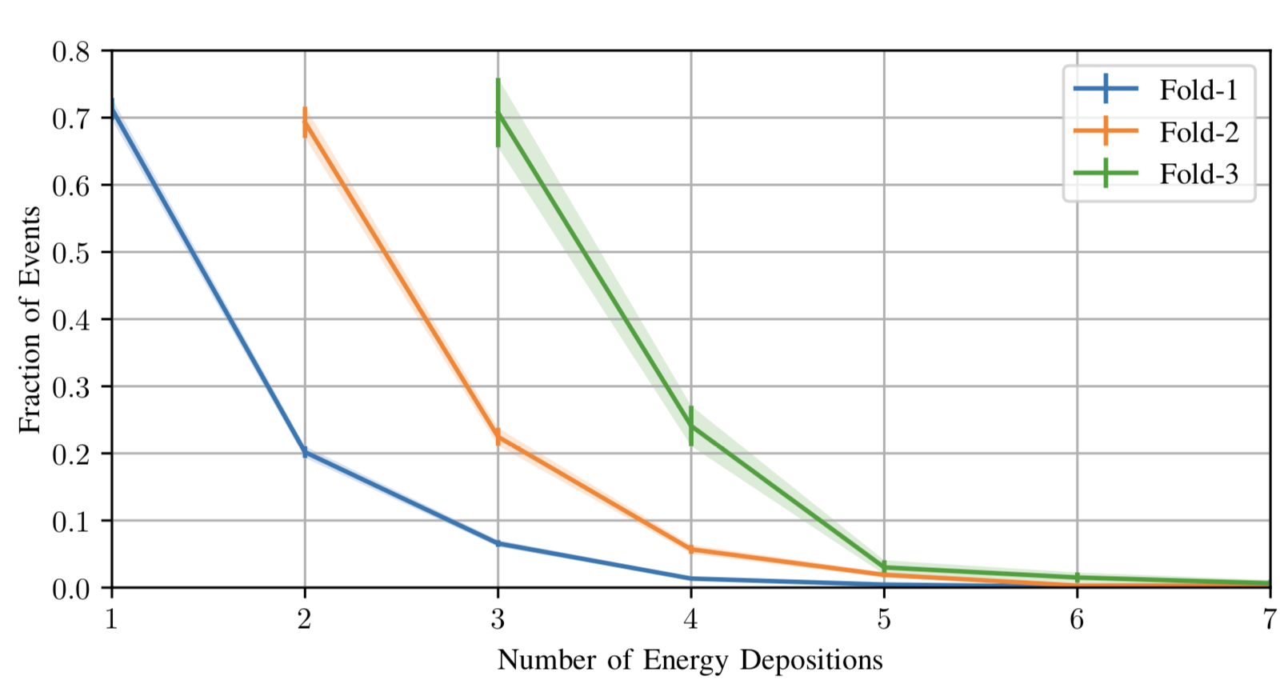
Multiple-Interaction PSA
Multiple interaction events make up a significant fraction of the data collected by AGATA.
Around 30% of events in AGATA are comprised of events where multiple interactions occur in the same segment.
This will vary as a function of $γ$-ray energy
In these cases the PSA tends to fit a weighted average of the positions.
Preference to predict barycentre at segment centres.
Evaluation of multi-interaction events using conventional PSA is not feasible.
Characteristic Clustering of PSA

Slide 7
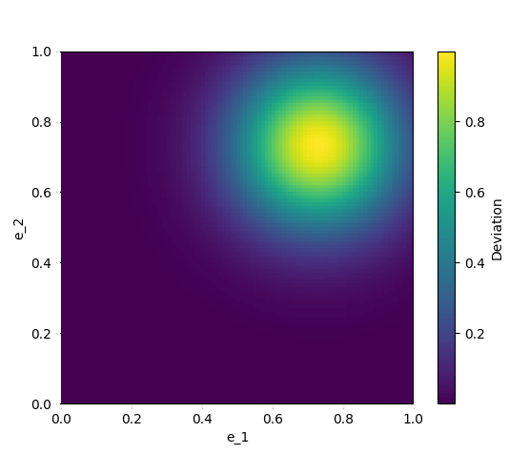
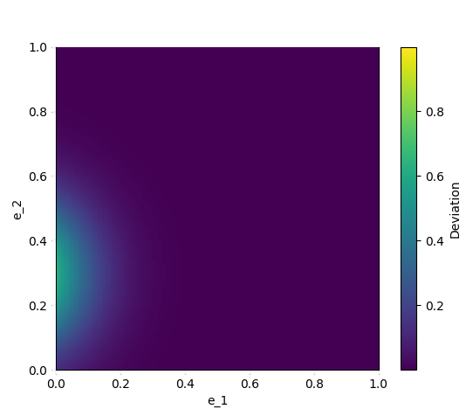
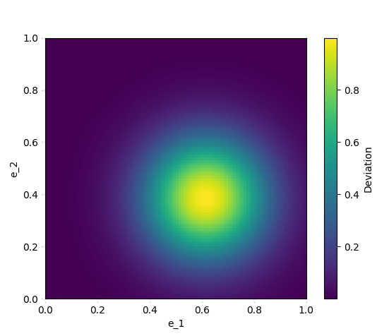
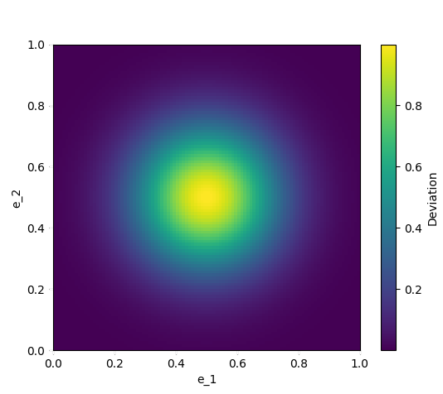
GRETA Approach: ${∂χ}^{2}$ Optimisation
GRETA infers the best match for a signal $O$ is the minimum of the $χ^{2}$ of a combined signal $C$.
It assumes that: $C={e_{i}C}_{i}+{e_{j}C}_{j}$
It determines where: $\frac{∂χ^{2}}{∂e_{i}}=\frac{∂χ^{2}}{∂e_{j}}=0$
This is assumed to be the optimum of the space
Some parameters are well known before PSA:
Only two parameters need to be calculated online:
$$χ^{2}=\sum_{s,t}{\frac{{\left(O_{s,t}−C_{s,t}\right)}^{2}}{σ_{s,t}^{2}}}=\sum_{s,t}{\frac{{\left(O_{s,t}−\left(e_{i}{C_{i}}_{s,t}+{e_{j}C_{j}}_{s,t}\right) \right)}^{2}}{σ_{s,t}^{2}}}$$
$$\frac{∂χ^{2}}{∂e_{i}}=\frac{∂χ^{2}}{∂e_{j}}= \frac{2⋅\sum_{s,t }{\left(O_{s,t}{C_{i}}_{s,t}−e_{i}{C_{i}}_{s,t}^{2}−e_{j}{C_{i}}_{s,t}{C_{j}}_{s,t}\right)} }{σ_{s,t}^{2}}=0$$
$$\sum_{s,t}{(}{C_{i}}_{s,t}^{2}) \sum_{s,t}{(}{C_{j}}_{s,t}^{2}) \sum_{s,t}{(}{C_{i}}_{s,t}{C_{j}}_{s,t})$$
$$\sum_{s,t}{\left(O_{s,t}{C_{i}}_{s,t}−e_{i}{C_{i}}_{s,t}^{2}−e_{j}{C_{i}}_{s,t} {C_{j}}_{s,t} \right)}=0$$
$$\sum_{s,t}{\left(O_{s,t}{C_{j}}_{s,t}−e_{j}{C_{j}}_{s,t}^{2}−e_{i}{C_{i}}_{s,t} {C_{j}}_{s,t} \right)}=0$$
$$\sum_{s,t}{(}O_{s,t}{C_{i}}_{s,t}) \sum_{s,t}{(}O_{s,t}{C_{j}}_{s,t})$$
Interestingly it doesn’t assume: $e_{i}+e_{j}≡1$
It doesn’t assume: $0≤e_{i} , e_{j}≤1$either.

Slide 8
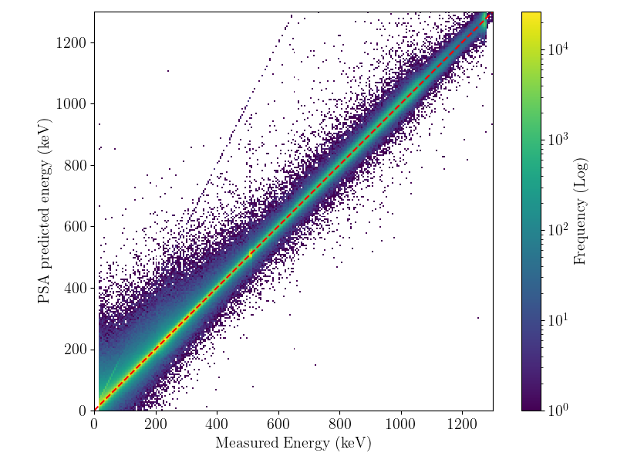
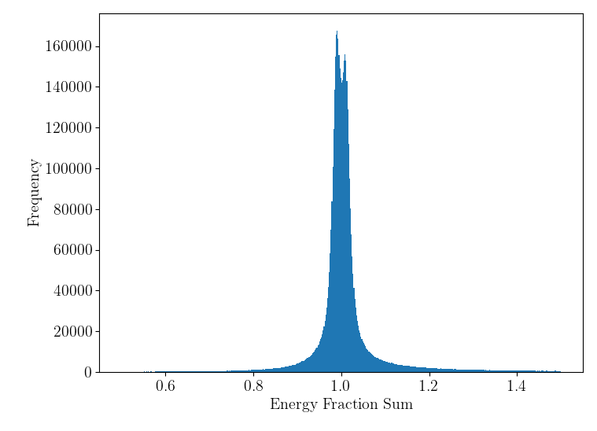
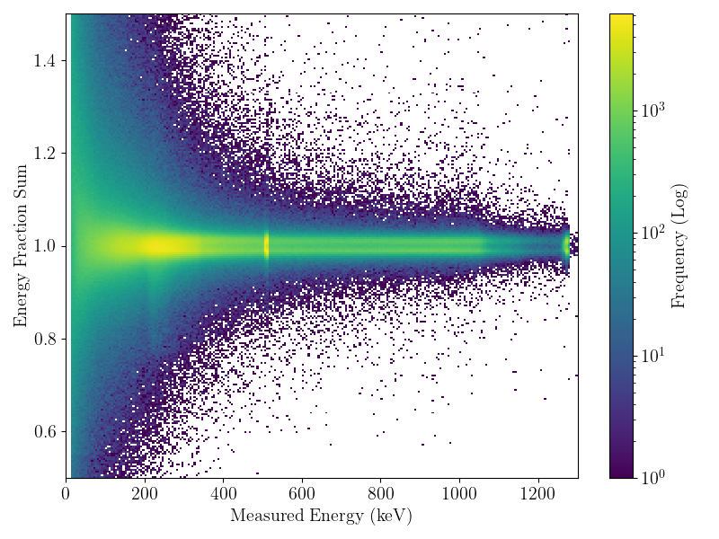
Ramifications for Spectra
When taking the predicted energies interesting effects are seen, the sum of $e_{i}+e_{j}$ has two peaks around 1 and significant tails.
The effect is more pronounced at lower energies, with some predictions varying by 50%
Additional features and structure are present in the predictions.
GRETA’s Grid Search algorithm picks up features that deviate from a 2-interaction signal

Slide 9
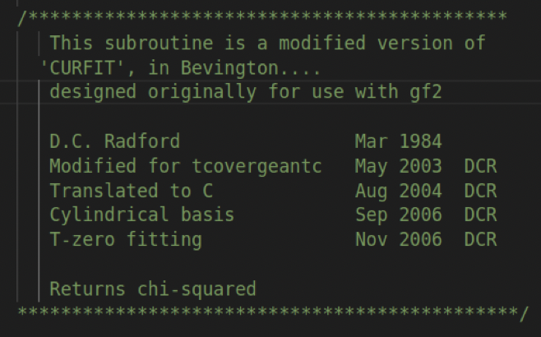
GRETA’S Approach: Part 2 (NLLS Fitting)
GRETA uses a secondary optimisation (NLLS) to mediate this issue.
It also tries to optimise $t_{0}$ amongst other things
Does a very good job but is still reliant on the ‘optimum’ AGS indices $i \& j$ which are fixed.
The optimum is then moved to a more physical combination with a worse $χ^{2}$
As a result the ‘optimal match’ is non-physical and the ‘physically-possible’ match is non-optimal.
The energy is now physical, but $i \& j$ don’t change.
Because $i \& j$ are static how correct is the fit?
Maybe running NLLS for each combination?
Likely too expensive?
Line of Interpolation
$$O$$
$$S$$
Originally written in FORTRAN in 1984 By D. Radford
Nonlinear fitter for correction, iterative.

Slide 10
An Alternative Approach: SIMPLEX Deconvolution
Realistically we don’t want non-physical optima.
We also don’t want an iterative method.
Only valid solutions lie upon a line of interpolation.
Can we constrain the optimisation to just this space?
Not with GRETA’s approach.
$\frac{∂χ^{2}}{∂e_{i}}≠\frac{∂χ^{2}}{∂e_{j}}≠0$
No way to fix the optimum and constrain it.
We need a different constraint to work with.
How about orthogonality?
$\vec{SC_{1}}⋅\vec{SO}=\vec{SC_{2}}⋅\vec{SO}=\vec{C_{1}C_{2}}⋅\vec{SO}=0$
We also want convexness:
$0<\left[e_{1}, e_{2}\right]<1$
$∠OC_{1}C_{2} \& ∠OC_{2}C_{1}<90°$
$$C_{2}$$
Line of Interpolation
$$O$$
$$S$$
$$C_{1}$$

Slide 11
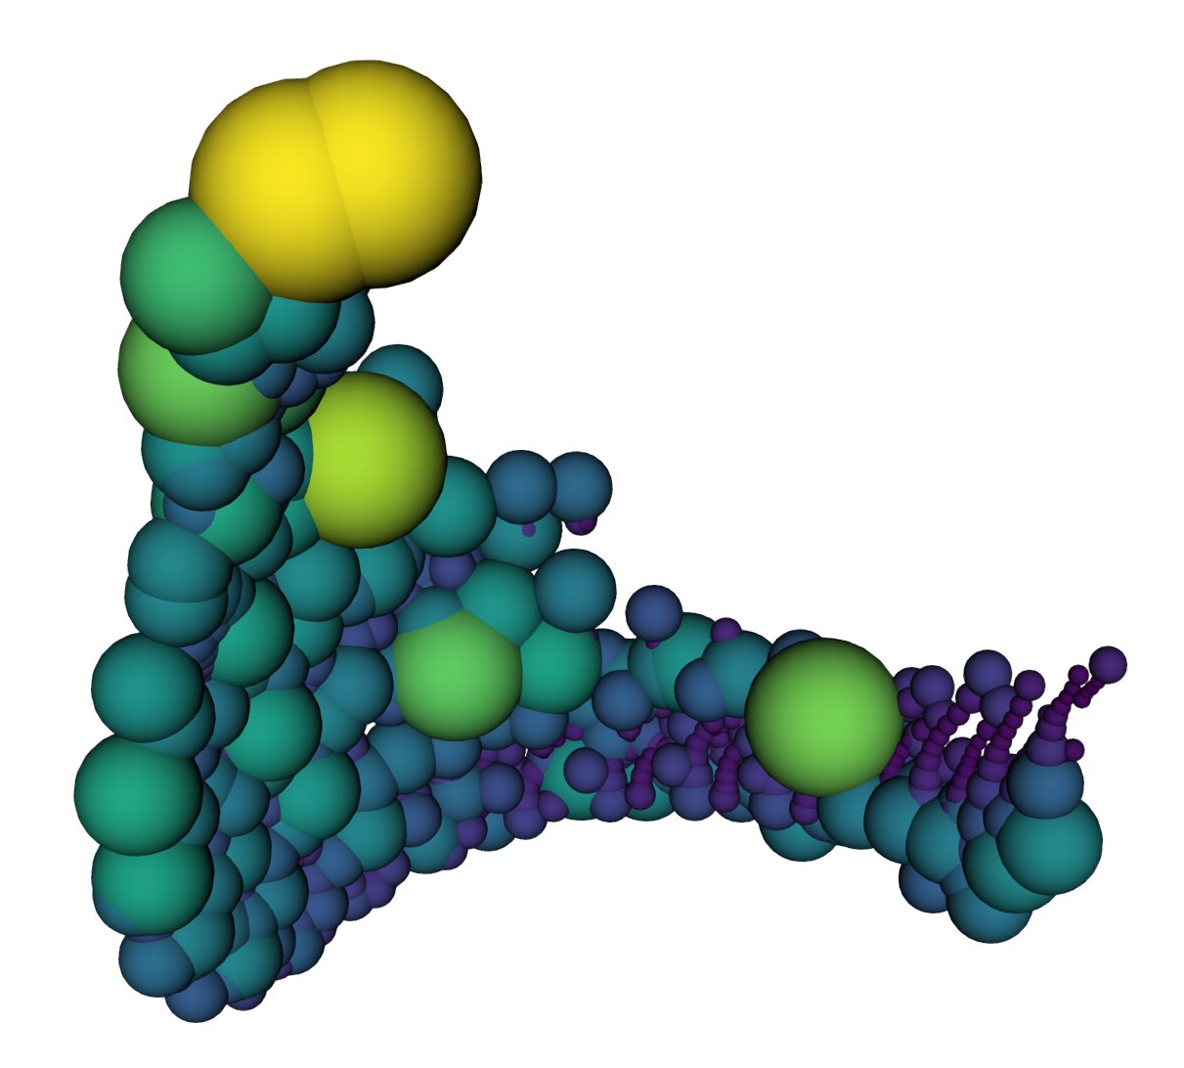
Simplex De-mixing in High Dimensions
Signals exist in a high-dimensional space $\left(ℛ_{4377D}\right)$
Maths gets a little complex so we’ll use distances
${\left(L2\right)}^{2}$ distances specifically
Like in GRETA’s method we infer the optimum for every combination of pairs in the basis directly.
One set of distances can be precomputed:
${\left|C_{1},C_{2}\right|}^{2}$
Two distances are novel but get re-used:
${\left|O,C_{1}\right|}^{2}$, ${\left|O,C_{2}\right|}^{2}$
$e_{i}+e_{j}≡1$ by definition
Only solutions where $0≤e_{i}, e_{j}≤1$ are valid:
Way easier to check and constrain
We can also account for $σ_{i,j}$ using radii constraints.
1-Simplex
2-Simplex
Response Space

Slide 12
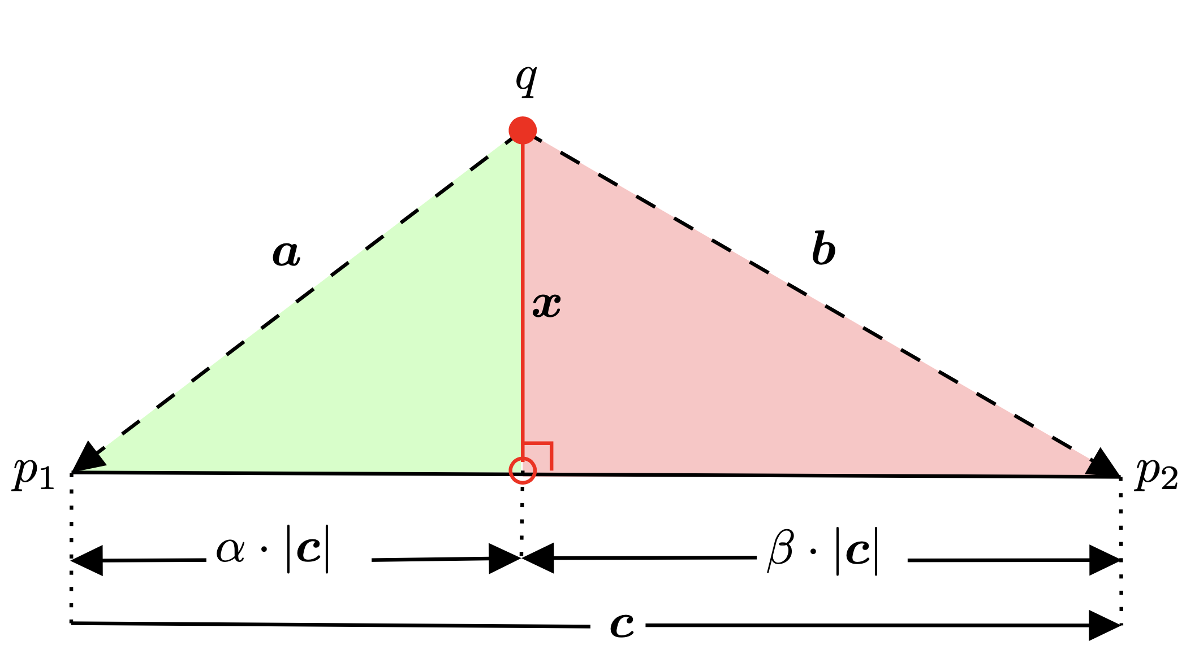
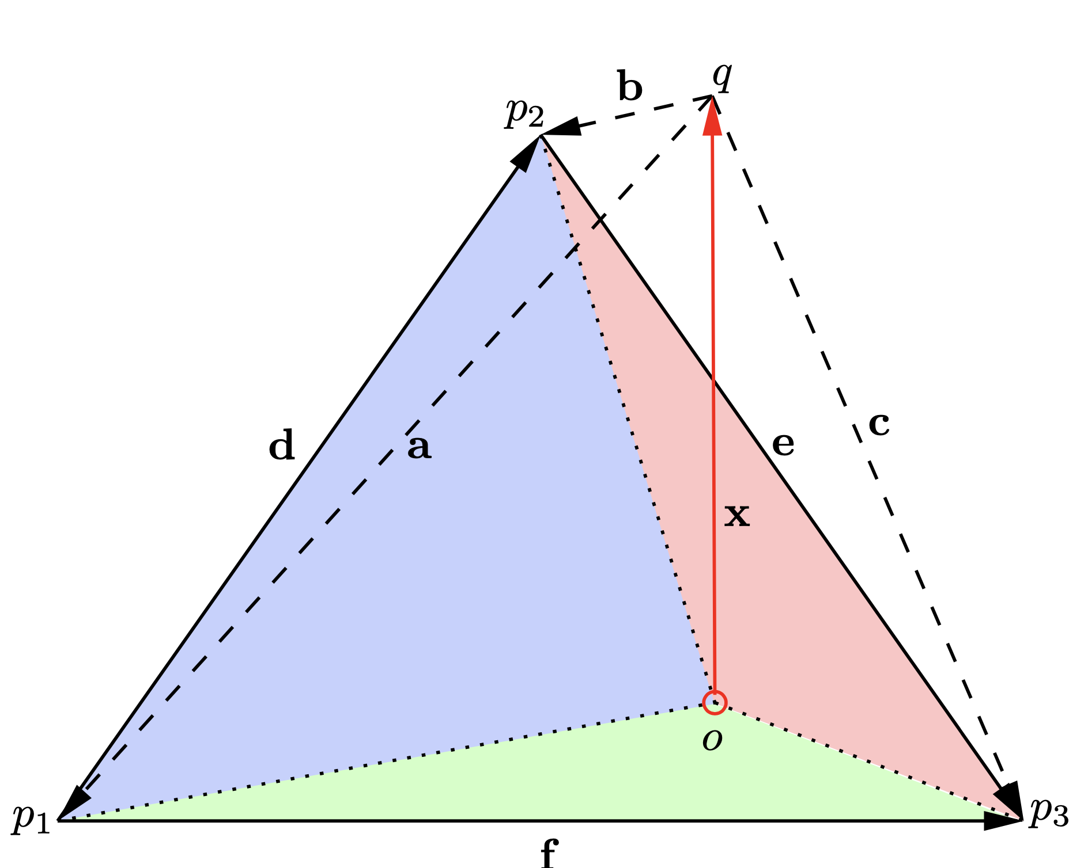
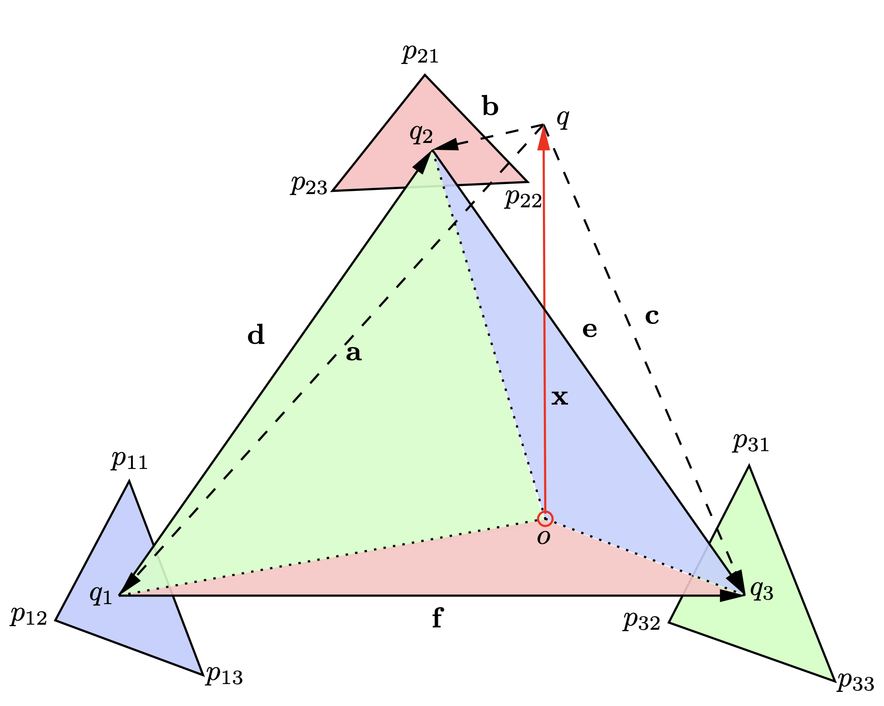
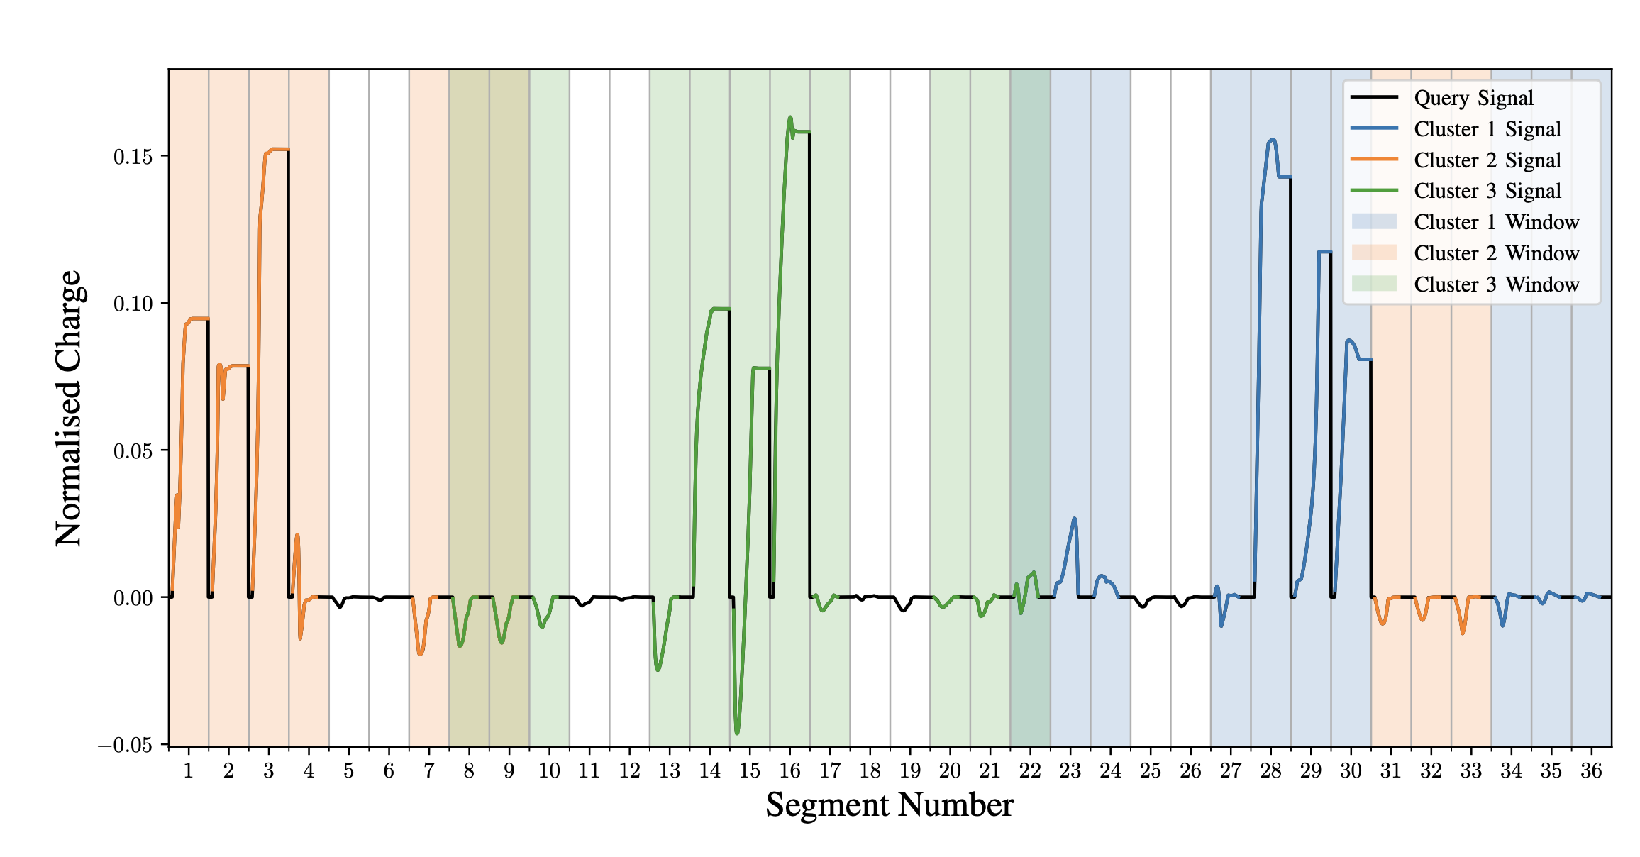
Simplex De-mixing in High Dimensions
A new convention was developed to evaluate multi-interaction signals using distance geometry and simplex de-mixing.
$\vec{Op_{1}}⋅\vec{qO}=\vec{Op_{2}}⋅\vec{qO}=\vec{p_{1}p_{2}}⋅\vec{qO}=0$
$∠Op_{1}p_{2} \& ∠Op_{2}p_{1}<90°$
This convention allows for direct fitting of multi-interaction signals.
Also works recursively, allowing for 9-interaction fits.
Can apply to arbitrary $n$-combinations.
Exhaustive combinations are required to find the best solution:
~1,100,000 combinations for 2 interactions.
~550,000,000 combinations for 3 interactions.
~10³⁰ combinations for 9 interactions.
Not feasible to do on a CPU exhaustively real-time.
Somewhat possible on a GPU.
How about using graph acceleration?

Slide 13
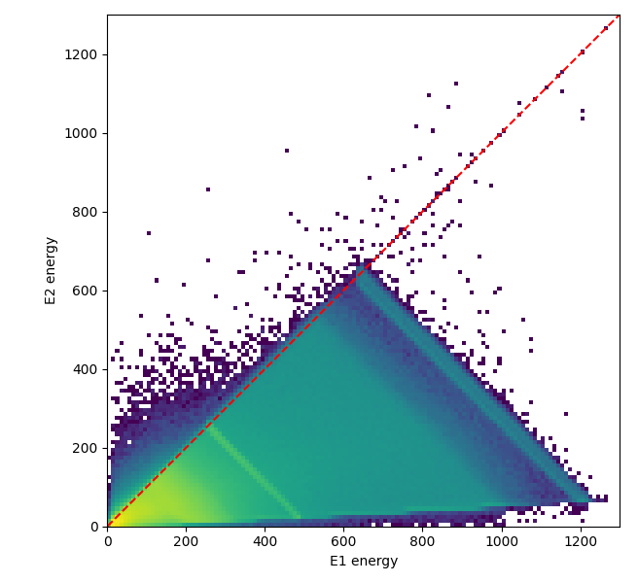
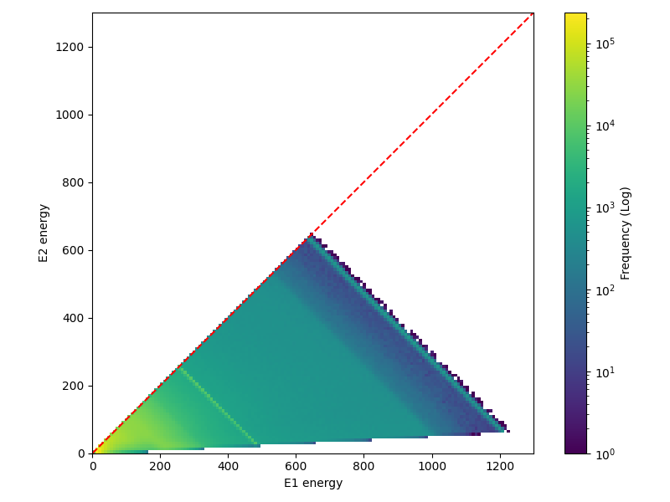
AGATA-GRETA $\left(γ_{1},γ_{2}\right)$ Matrices
GRETA
AGATA

Slide 14
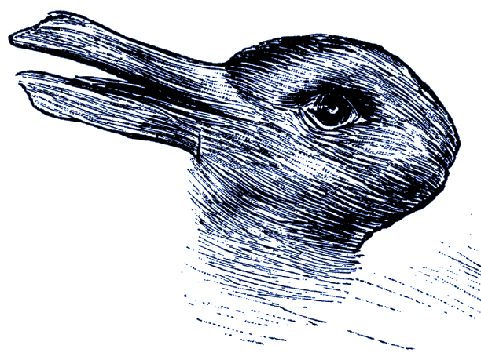
AGATA-GRETA Cross-Validation
AGATA & GRETA algorithms were run on identical datasets, predicted indices & energies were compared.
They agree on the high energy event 41% of the time.
They agree around 27% for the low energy event.
They agree 23% for both events.
If they agree on the high energy the low energy is 56%.
If they agree on the low energy the high energy is 86%.
Both algorithms saturate at ~7kHz using an adaptive grid
Both algorithms saturate at ~3kHz using an exhaustive grid
Rabbit or Duck?

Slide 15
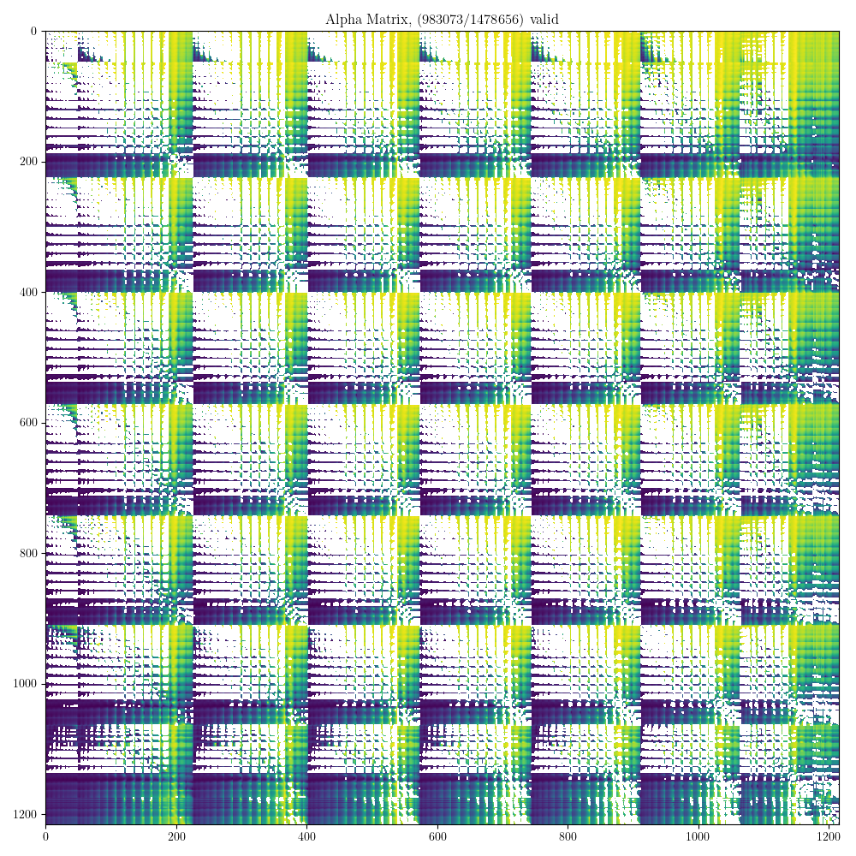
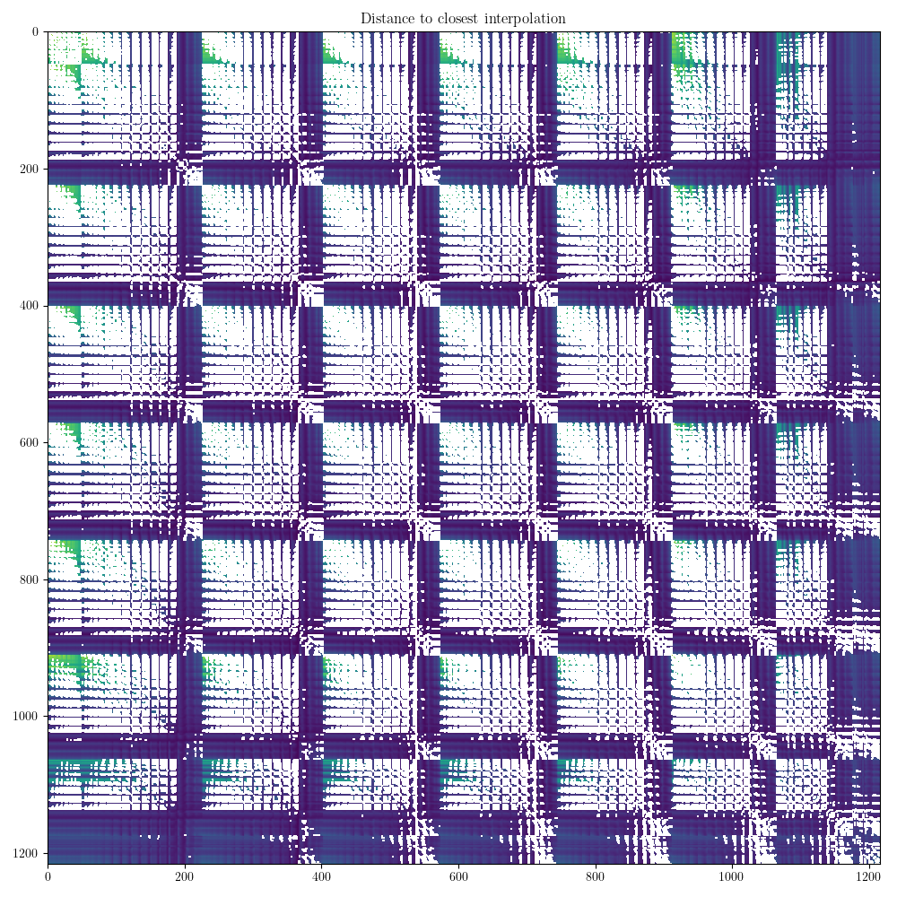
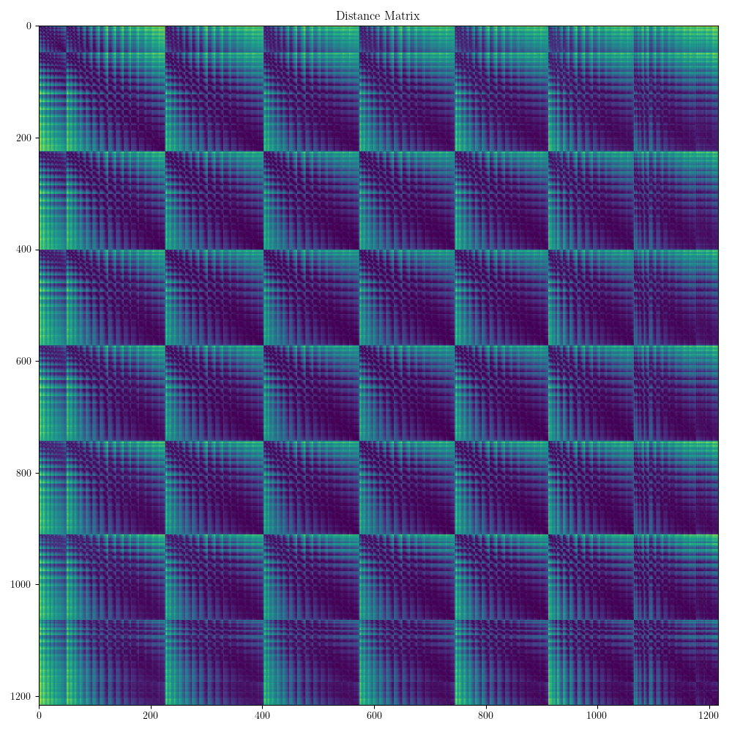
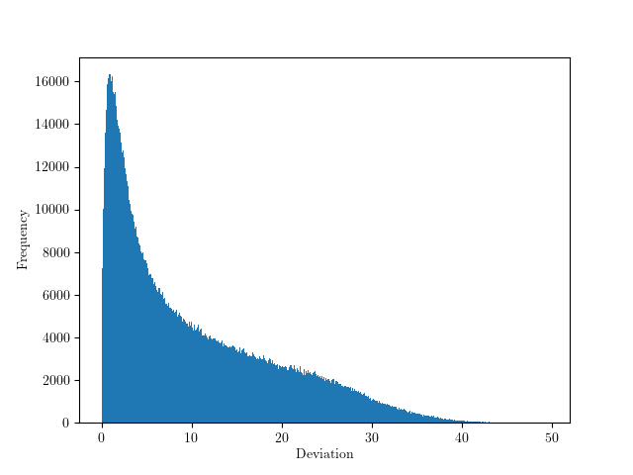
What about GPUs?
GPUs allow for “massively parallel” operations…
Data must be transferred from system to the GPU
Computationally expensive
GPUDirect hardware interface possible?
Computation must be predictable.
For Fold-1with 1200 reference pulses:
1kB/query ∴ ~2,000,000 pulses simultaneously
~21kHz effective rate
Direct benefit from Dimensionality reduction.
For Fold-2₁ with 1200 reference pulses:
5MB/query ∴ ~8000 pulses simultaneously
~3 kHz effective rate
For Fold-2₂ with 2x1200 reference pulses:
20MB/query ∴ ~2000 pulses simultaneously
~2 kHz effective rate
For Fold-3₂ with 2x800 reference pulses: 0.2 Hz

Slide 16
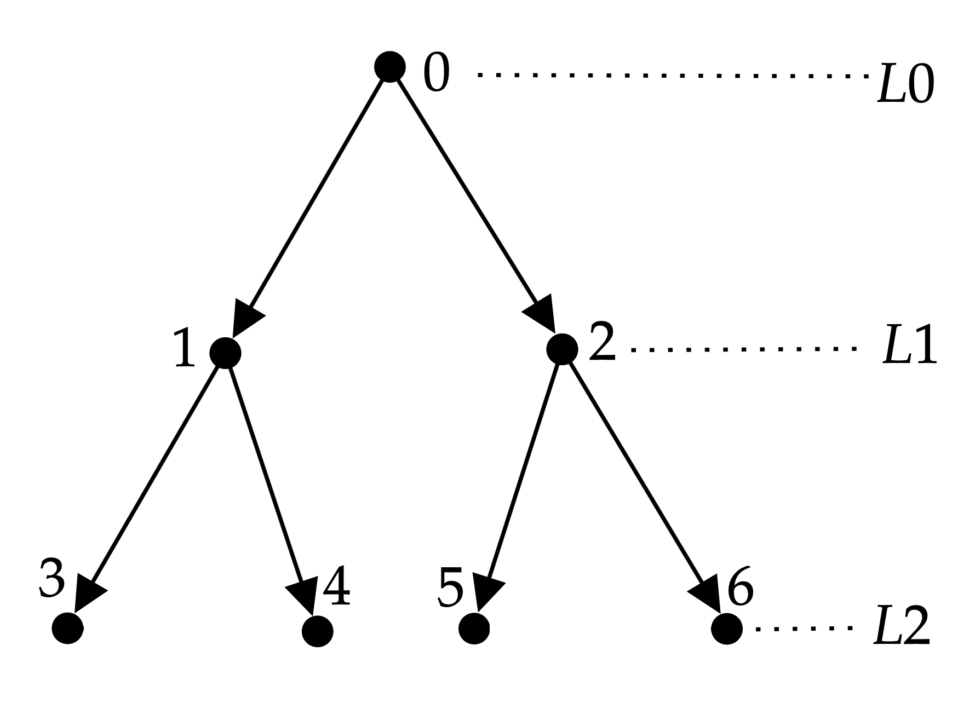
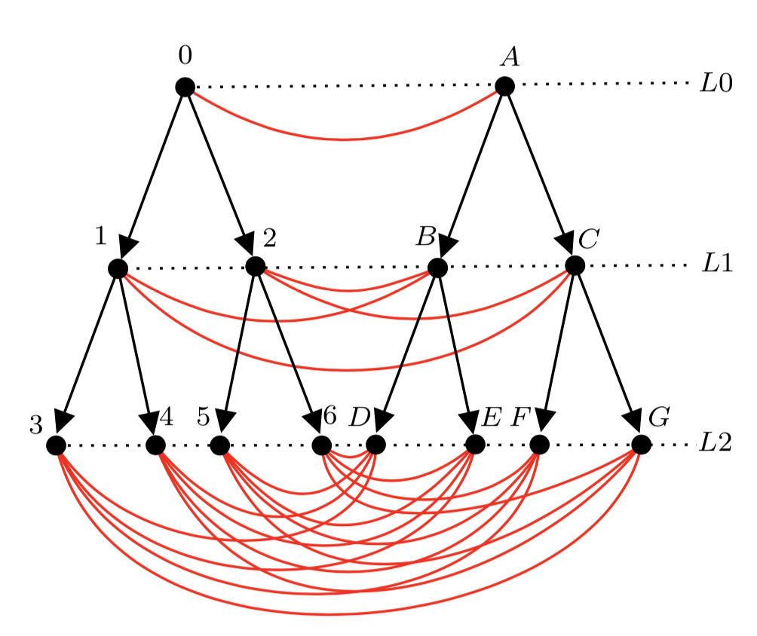
Hypergraph-accelerated PSA
Physical Representation
2-interaction solutions exist as edges that connect between nodes of two orthogonal trees.
Lower levels have more nodes ∴ more edges.
Just like how nodes can have child nodes edges can have child edges.
The validity of an edge applies recursively.
If an edge is invalid, all child edges are also invalid.
This allows for us to cull large sections of the graph.
$M$-Tree Representation

Slide 17
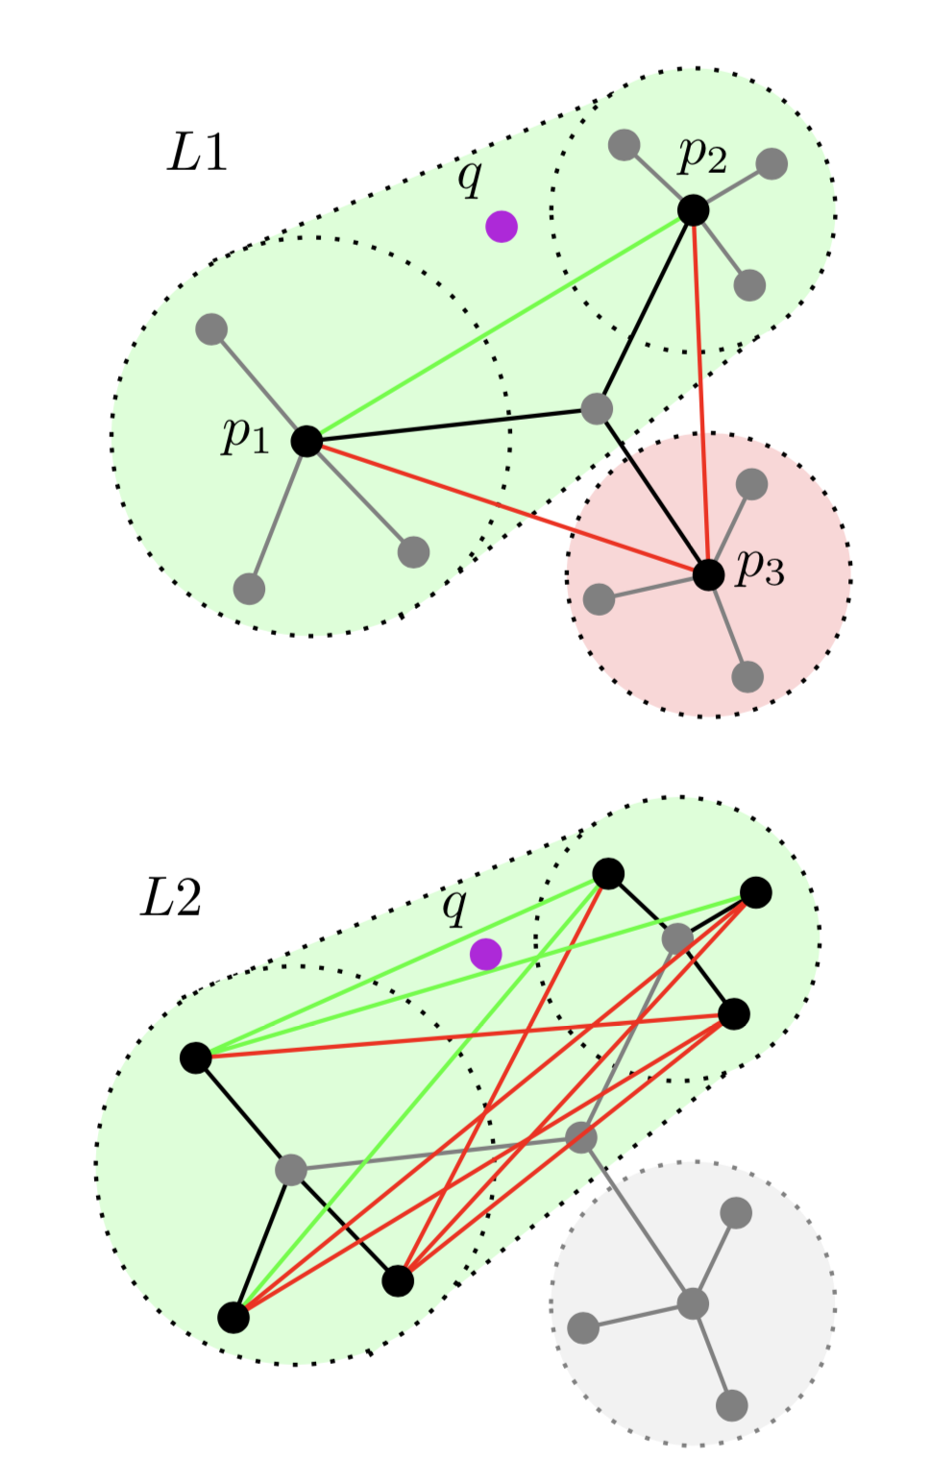
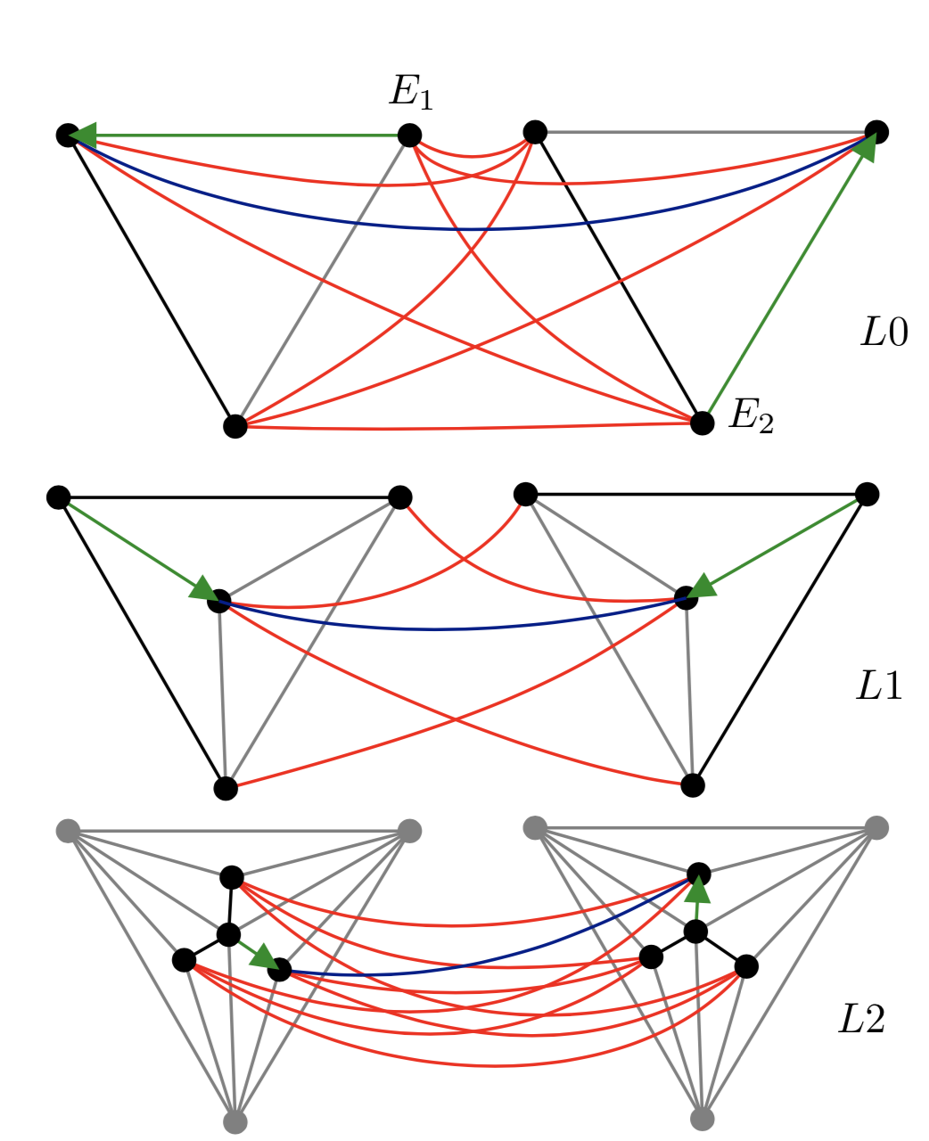
Hypergraph-accelerated PSA
Two hypergraph-accelerated methods have been developed:
Hyper-$M$-Tree
Recursive covering (Exact $k$NS search).
Hyper-Hierarchical New Small World Graphs.
Greedy simplex traversal (Approximate $k$NS search).
These overcome conventional limitations of the existing method:
Native support for PSA uncertainty
Self-learned hierarchy.
Support for dynamic resolution (FEM) bases.
Coverage pruning
Greedy Traversal

Slide 18
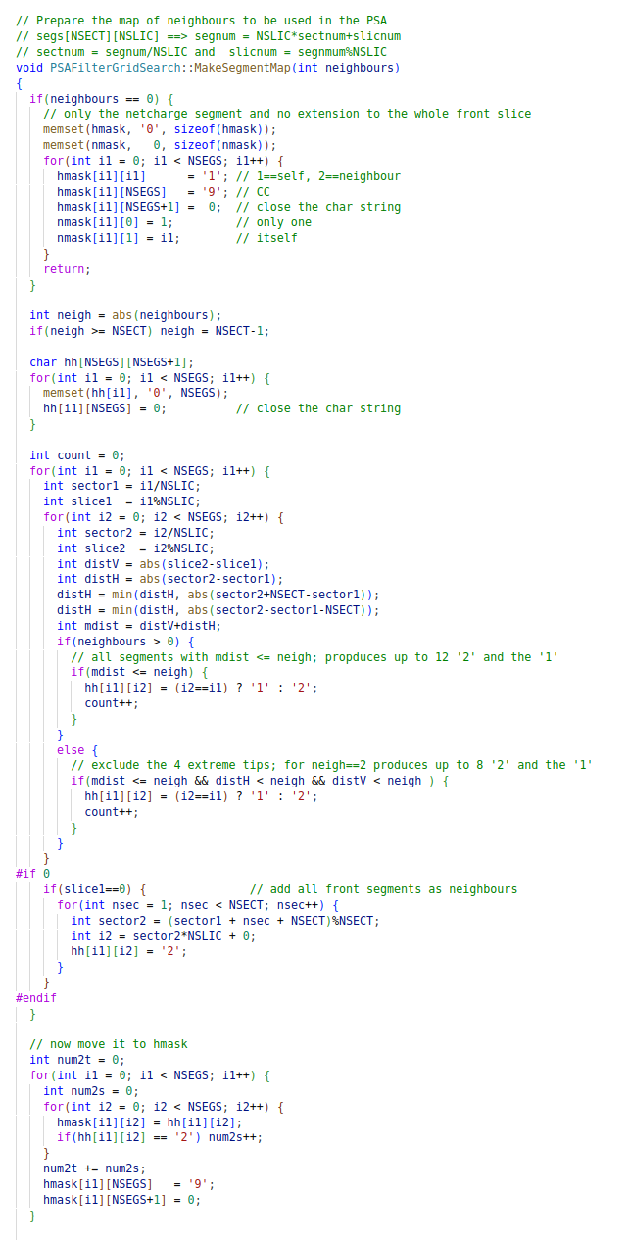
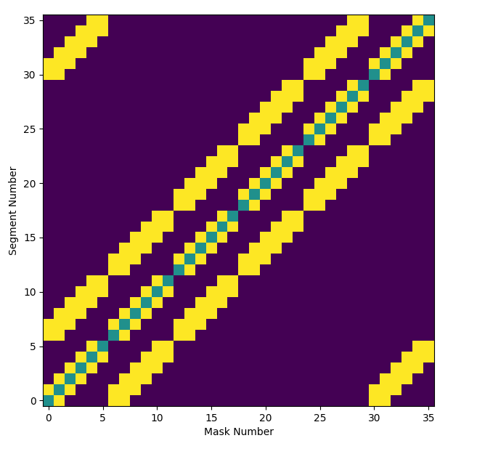
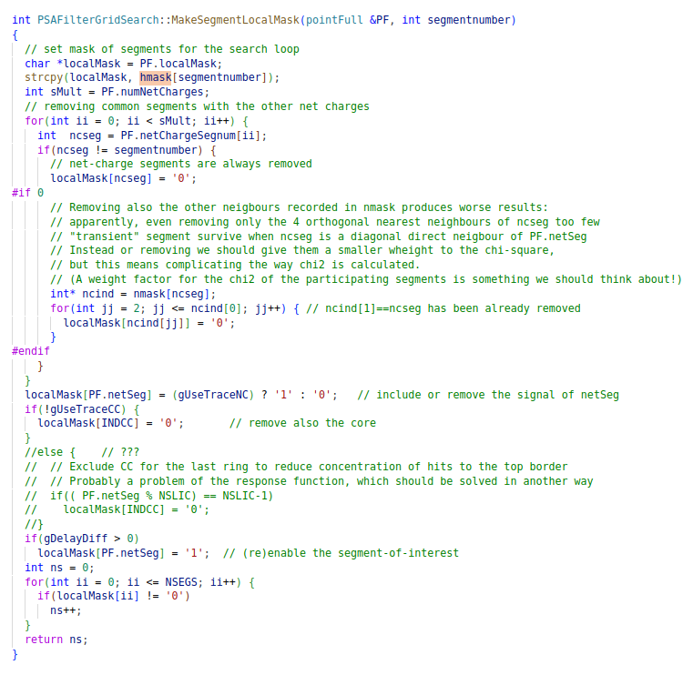
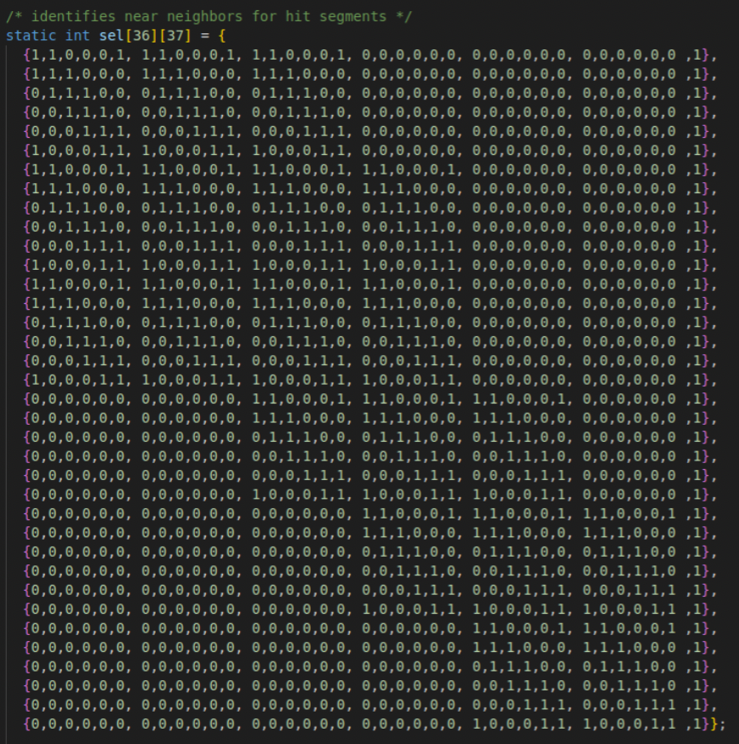
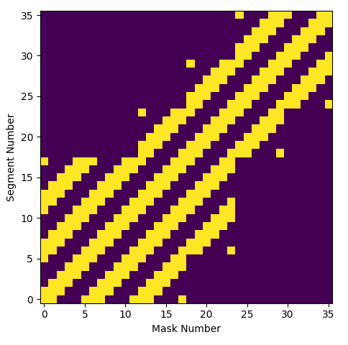
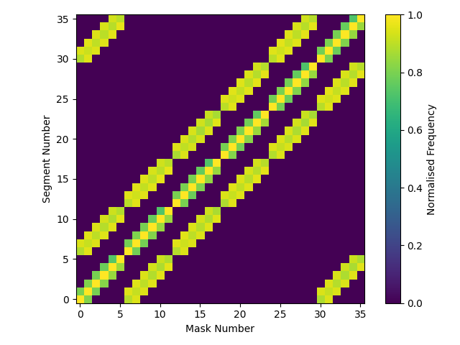
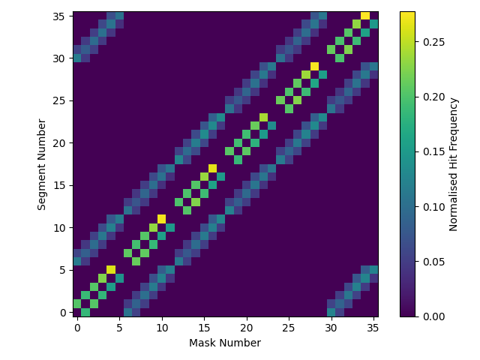
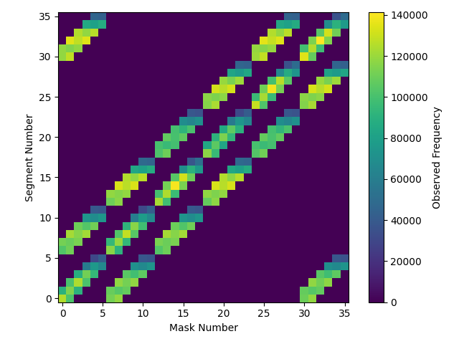
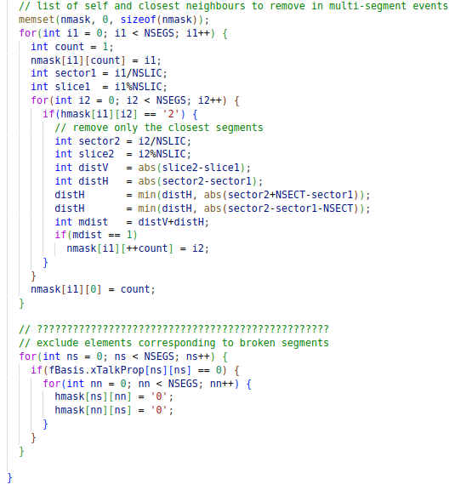
Dynamic Masking in AGAPRO
Whenever a signal is processed in AGAPRO a window is created to allow PSA to process events independently.
This occurs roughly 2/3 of the time.
Comes in two forms hmask & lmask(& nmask):
hmask is pre-event, depends on the hit segment.
neighbours = -2
36 static masks that are well-known.
lmask is novel, depends on the other events in the crystal.
Removes other net charge signals.
Could remove neighbour transients, currently disabled.
Around 3500 unique masks
Because lmask changes for each event the precomputed distances are directly affected.
This is problematic, there are 35 million of them.
Front?
Mistake?
lmask calculation
GRETA’s mask generation code
Observed hmask
GRETA’s mask
lmask Frequency (normalised)
Neighbour hit frequency
lmask Frequency
hmask calculation
hmask calculation

Slide 19
Assessing PSA performance
A dataset was extracted from E680 at GANIL, fission ⁹⁸Zr nucleus with a strong $γ$-ray transition at 1.2 MeV.
Fragments were emitted with velocities of $β≈$10, making the resolution of such transition strongly dependant on the quality of the Doppler correction.
Doppler correction only applies to first interaction.
PSA also will heavily influence tracking accuracy.
Should influence peak prominence.
Important note:
The spectral performance of AGATA is the combined effect of PSA, GRT & simulated bases accuracy.
GRT has yet to be tuned for the new PSA.
Bases are being recalculated at higher fidelity.
This is all with the current flaws, I am working on fixes.
Performance will likely change in the future.

Slide 20
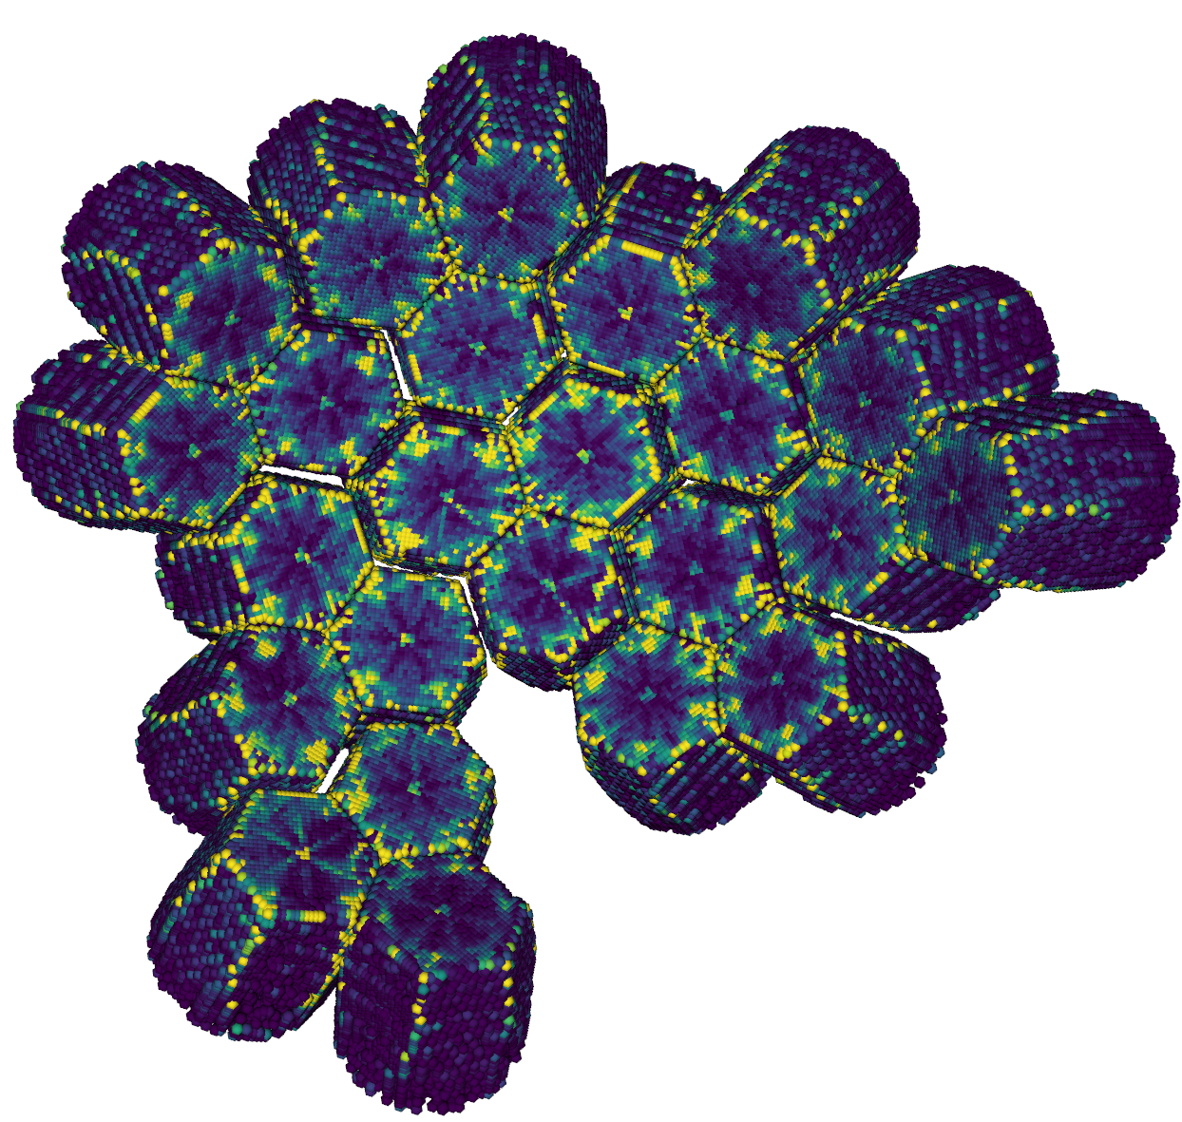
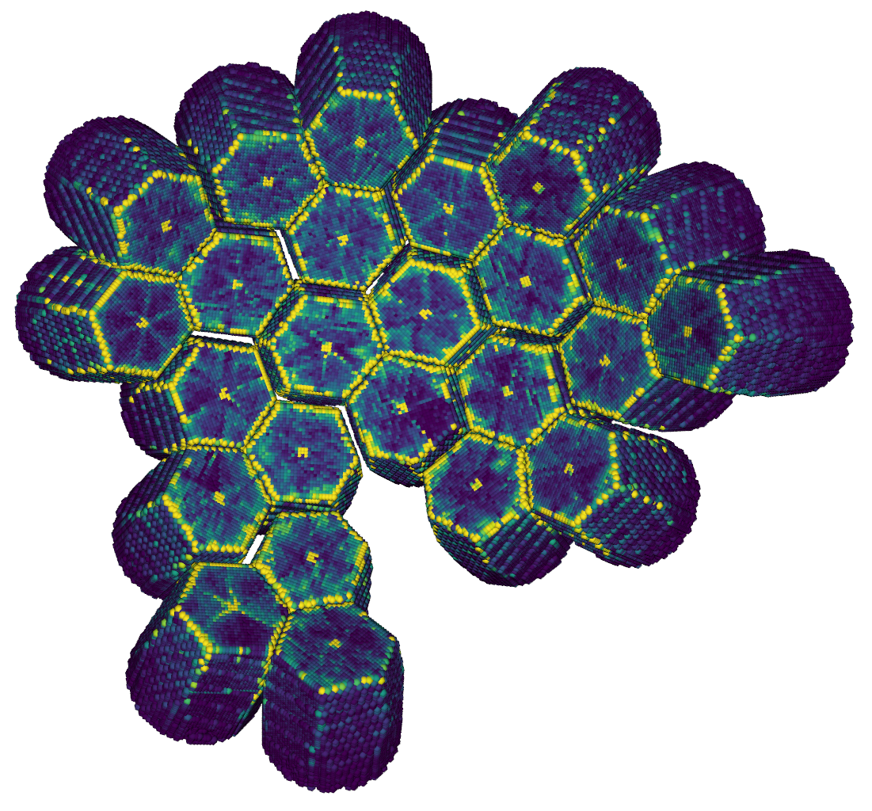
First Hit Predictions – Front Faces
Current PSA
Predictions
New PSA
Predictions

Slide 21
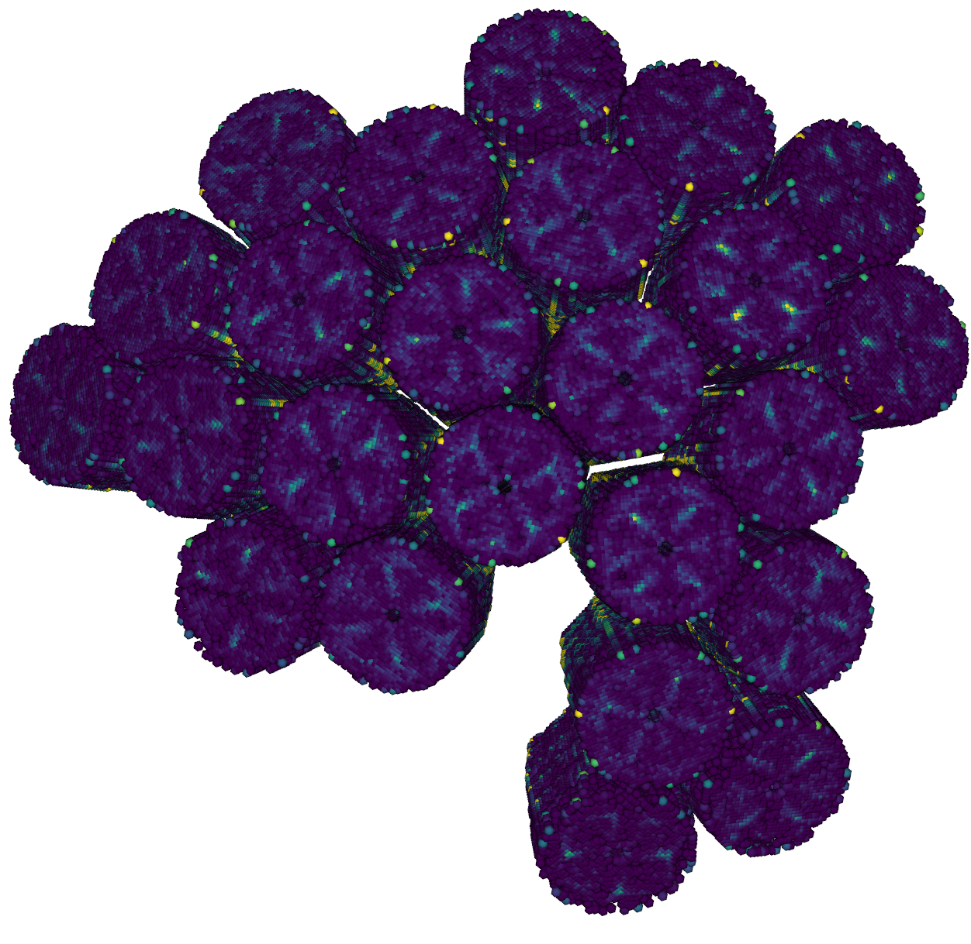
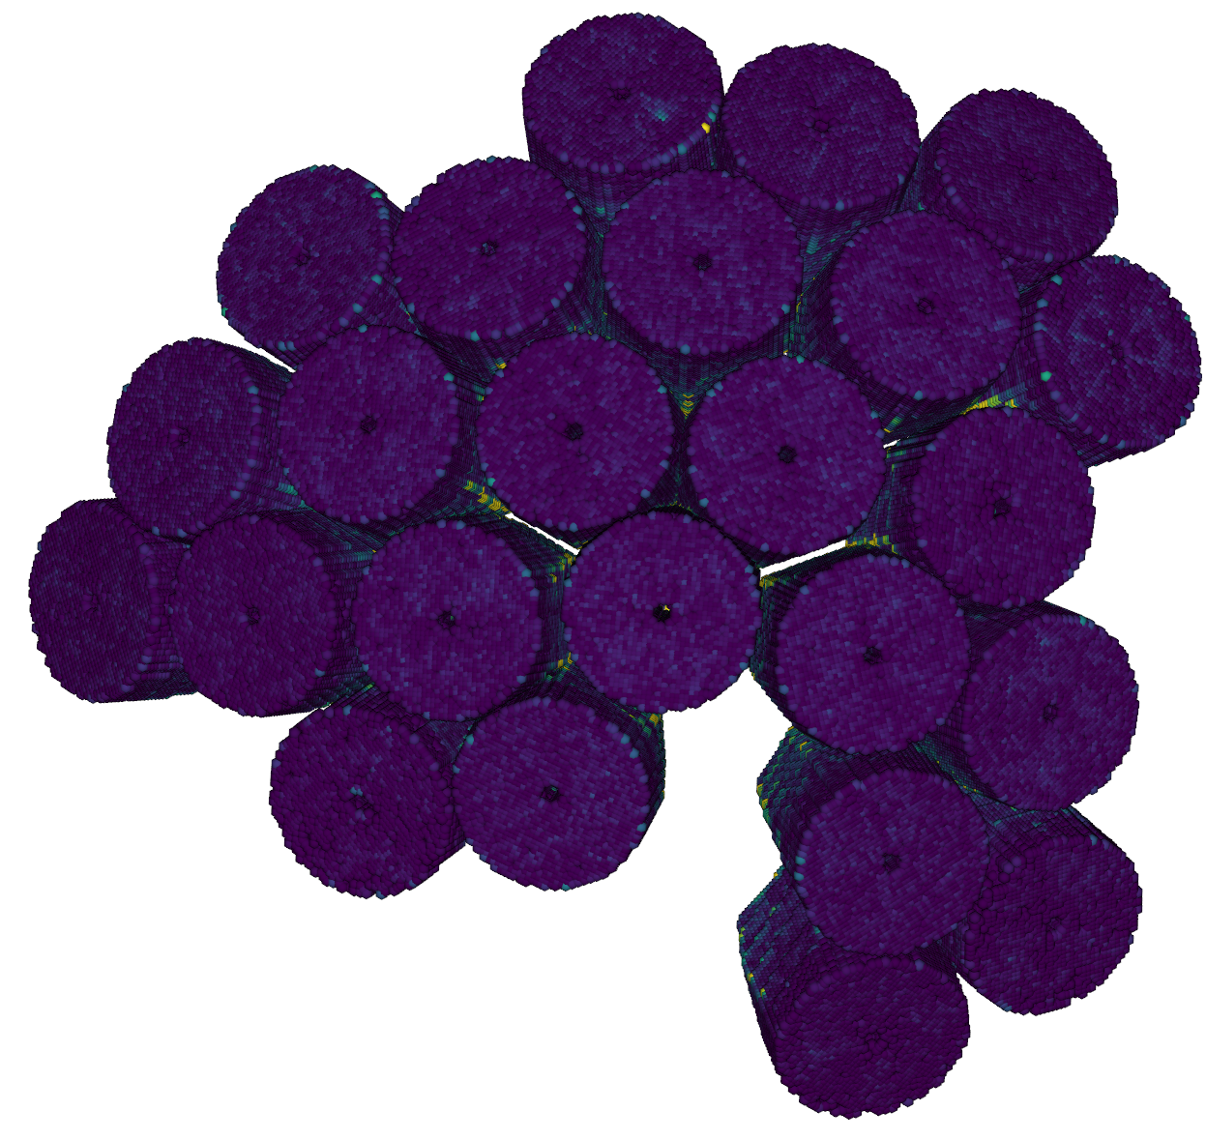
First Hit Predictions – Back Faces
Existing PSA
Predictions
New PSA
Predictions

Slide 22
Interaction Multiplicity
Observed number of interactions changes drastically with the new algorithm
Prevalence of single-interaction signals is reduced significantly, average track length increased.
Previously 44% of tracks were P.E single-site
Now only 21% are P.E single-site
Existing Method
New Algorithm

Slide 23
ML-Assisted Simulation & Detector Design
Electrode design has a huge impact on signal response
Driven by fabrication limitations & cost.
More advanced lithography gives a lot of creative freedom.
Can additional information be encoded into the electrodes?
Can we achieve effective GRT with fewer electrodes?
Can we use FEM approaches to improve accuracy?
What positions make the most sense to simulate?
Charge clouds are complex to simulate, can we approximate?
Eur. Phys. J. C (2021) 81:76
https://doi.org/10.1140/epjc/s10052-021-08889-0
Python-Adaptive, B. Nijholt, (2019)
doi:10.5281/zenodo.1182437
AGATAGeFEM, J. Ljungvall, Eur. Phys. J. A (2021) 57:198 https://doi.org/10.1140/epja/s10050-021-00512-w
SolidStateDetectors.jl
(doi:https://doi.org/10.1088/1748-0221/16/08/p08007)
Cheng, L., & Illarramendi, E.A. (2021) PlasmaNet

Slide 24
Experimentally Trained Algorithms
Using specific experimental setups, it is possible to train ML.
Identify multiple interactions.
Determine $t0$offset, radial position.
Perform single-interaction PSA.
Generate simulated signals for given ($x,y,z$) positions.
Generate experimentally derived bases in-situ.
Graph Neural Networks for GRT (using ASC & GEANT4).
B. De Canditiis, Eur. Phys. J. A (2021) 57:223
https://doi.org/10.1140/epja/s10050-021-00537-1
J. Dudouet, AGATA Week (2022)
S. Heil, Eur. Phys. J. A (2018) 54: 172
https://doi.org/10.1140/epja/i2018-12609-0
M. Andersson (2023)
(doi:https://doi.org/10.1016/j.nima.2022.168000)
R.W. Gladen (2020), (doi: https://doi.org/10.1016/j.nima.2020.164505)

Slide 25
Intelligent PSA Preprocessing
Multi-interaction PSA is a time-consuming process.
Assessment of 1 vs 2 interactions is performed after PSA search via fallback vetoes:
Interaction separation.
Energy fraction & absolute energy.
$χ^{2}$ reduction.
Can we infer what the expected $χ^{2}$, energy fractions & separation are before PSA?
If so, then can we only run 2-interaction on events that will show an improvement?
Can this information provide a better starting guess for PSA?

Slide 26
Non-parametric Responses – Coax Detectors
HPGe detectors show some signal variation with position, most signals form a continuous response manifold in $ℛ^{d}$.
This can be observed with covariance matrices.
Alternatively, we can use manifold learning.
Uniform Manifold Approximation Projection (UMAP).
Hit Segment Response
B.Bruyneel – Eur. Phys. J. A (2016)
Bulletized Coaxial Detector

Slide 27
Self-Organising Maps
Self-Organising Maps are a graph-ANN that use competitive learning to fit maps to an underlying manifold of data. Generally used for classification.
The map is initialised in $ℝ^{d}$ space and slowly iterates to form a topologically constrained approximation of the data.
Learning constrained by $σ$ & $η$, used to form vectors $\overline{G}$:
$$\overline{G}={η⋅\left(\overline{x−n}\right)⋅e}^{\frac{{\min\left(d\left(x,n\right)\right)}^{2}}{σ^{2}}}$$
Distance applied across graph edges.
Nodes in the graph then learn from their immediate surroundings via distance weighted inference.
Support a variety of cardinalities & hierarchies.
Cardinality-1 SOM
Cardinality-2 SOM
Graph SOM

Slide 28
Simplicial Approximation
From [4]:
Any PL-manifold is directly triangulable.
$f:X →𝒢_{d}\left(ℝ^{n}\right)$
$f^{∗}:H^{∗}\left(X\right)←H^{∗}\left(𝒢_{d}\left(ℝ^{n}\right)\right)$
Any topological manifold is Homotopy-equivalent to a simplicial complex.
SOM algorithm was modified to produce a simplicial complex.
Force-directed layout, exclusivity, dynamic topology.
Linear interpolations of signals can be approximated to linear interpolations of simplices.
Rather than evaluating 100,000 points we could evaluate ~100 simplices.
Can evaluate best single-interaction solution.
Also provides multi-interaction predictions.
Signal Manifold
SOM Nodes
Experimental Query
1-int Approximation
2-int Approximation
[4] Kirby, R.C. and Siebenmann, L.C., 1969. On the triangulation of manifolds and the Hauptvermutung. Bull. Amer. Math. Soc, 75(4), pp.742-749.

Slide 29
Performance on AGATA
Radial position was predicted using experimental data.
1 GBq ¹³⁷Cs source, Collimated to 1 mm beam.
Coincidence with collimated BGO ancillary array.
Energy gated to 90° Compton scatter.
SOM guesses are relatively poor.
Due to signal complexity in front face.
Can be used to determine if further PSA is necessary.
Can build informed topologies for $k$NN & $k$NS search.
Core
Method | Mean Deviation (mm) | $σ$ (mm) | Rate (kHz)
$k$NN | -0.04 | 1.5 | ~4
SOM | -0.06 | 3.2 | ~850

Slide 30
Multi-Interaction Veto for Point Contact Detectors
Multi-interaction events were generated from a GEANT4 simulation of SIGMA.
Converted to signals using precomputed basis.
Realistic experimental noise added.
When given single-interaction data the PSA solutions are roughly equivalent.
When given multi-interaction data the 2-interaction PSA solutions are closer than single-interaction PSA solutions.
Ratio of distances can be used as veto;
Also energy ratio, $δt$, position (in SIGMA).
Will be incorporated into a Bayesian Inference pipeline.
1-interaction
2-interactions

Slide 31
Thanks for Listening
Any Questions?
Dr. Fraser Holloway

