Slide 1
RNA profiling of molecule-crowded nuclear micro-environments
Nathan Lecouvreur
Thierry Forné’s team
IGMM, Montpellier
Notes:
Hello everyone and thank you for having me here today, I am nathan Lecourveuvreur, a second year PhD student in Thierry Forné’s team and today I will present par of my PhD project, which revolves around the RD-HRS method, which allows us to obtain new insights on the relationship between phase seperation, DNA and RNA.

Slide 2
Introduction
Genome organization and molecular crowding
The HRS technique
Notes:
First of all I will introduce the main topics of my PhD, nuclear bodies andp hase separation and the HRS technique

Slide 3
Genome organization and molecular crowding
~10kb
Nucleosomal scale
Supranucleosomal
scale
Nuclear
scale
1 pb - ~10 kb
~10kb
~3Mb
~100Mb - ~3000Mb
EPIGENETIC MODIFICATIONS
INTRA-TAD
DYNAMICS
INTER-TAD
DYNAMICS
NUCLEAR
POSITIONING
NUCLEOSOMES
TOPOLOGICALLY
ASSOCIATING
DOMAINS = TADs
CHROMATIN
INTERACTIONS WITH NUCLEAR BODIES
NUCLEAR BODY
A
A
NUCLEAR BODY
B
CHROMATIN
LOOPS
NUCLEAR BODY
A
NUCLEUS
NUCLEAR BODY
B
A/B CHROMOSOMAL
COMPARTMENTS
CHROMOSOME TERRITORIES
Adapted from Ea et al. 2015
Notes:
Inter tad interaction happen in nuclear micro environements throught high molecular crowding

Slide 4
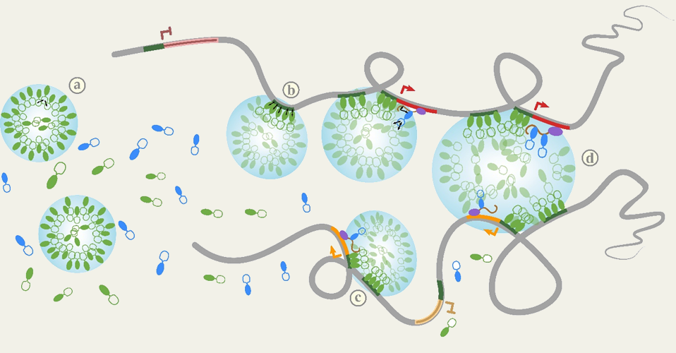
Genome organization and molecular crowding
Nuclear bodies are formed by phase separation,
Due to local concentrations of proteins
Lesne et al. Genes 10:E1049, 2019.
Notes:
As I said the nuclear bodies are formed by phase seperation, which happens when a protein has a more affinty with itself than its solvant. This will make aggregates of the protein that will end as droplets of high concentration of the protein of interest. But other proteins can locate to these droplets but also DNA can be dragged within DNA binding proteins are contained insidet he droplets. Even RNA can be found within these droplets and even give a higher level of organization.

Slide 5
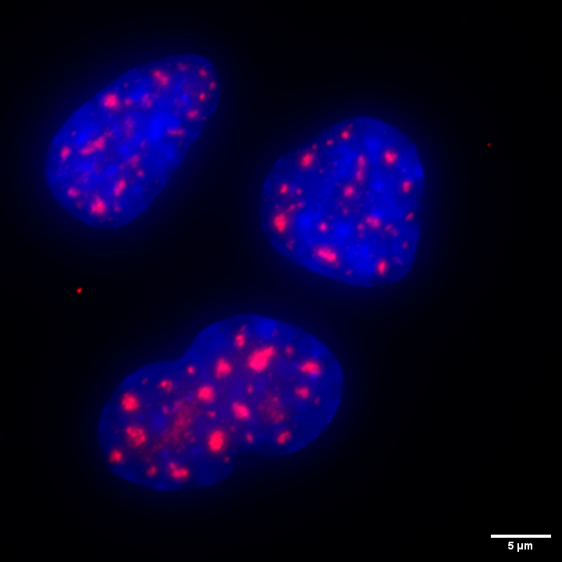
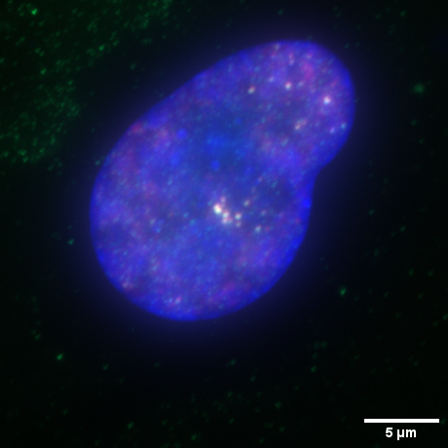
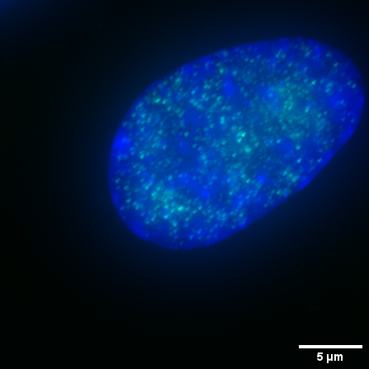
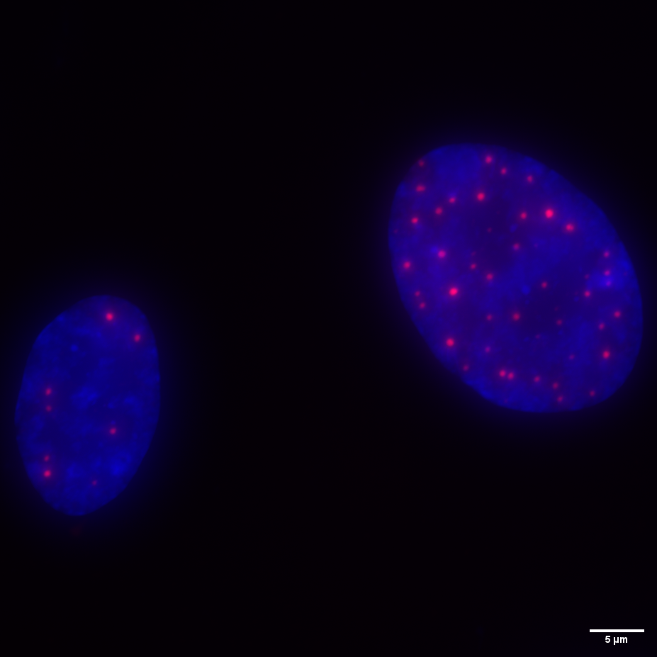
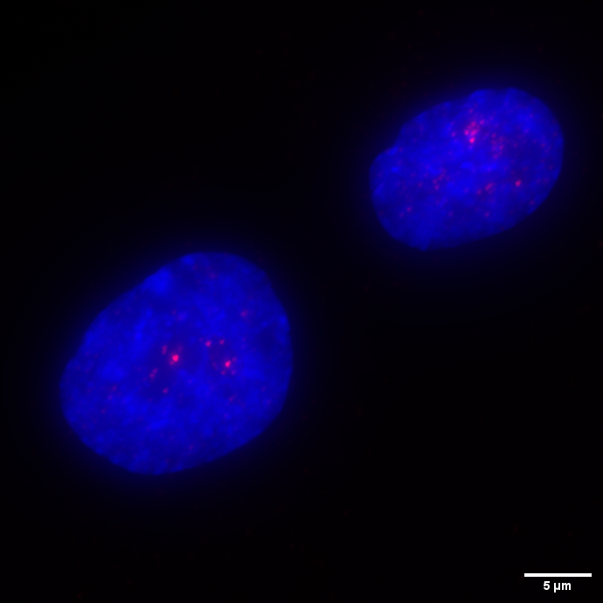
Genome organization and molecular crowding
Membraneless organels : (MLO)
Formed by phase separation
Distinguishable by specific proteins
Various role, most often on gene expression
Nuclear Speckles
SC35
Paraspeckles
NONO
PSPC1
Transcriptional condensates
Pol2 CTD pS2
PML Bodies
PML
Polycomb Bodies
Bmi1
Notes:
So one of the topics from my PhD will be the nuclear bodies. They are membraneless organels within the nucleus and are formed by phase seperation. There is ahuge variety of nuclear bodies and they are distiguishable by the proteins that compose them. They can have various roles, but most of them are based around the regulation of gene expression and RNA processing.

Slide 6
Introduction
Genome organization and molecular crowding
The HRS technique
Notes:
First of all I will introduce the main topics of my PhD, nuclear bodies andp hase separation and the HRS technique

Slide 7
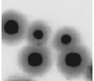
The RD-HRS allows the study of DNA and RNA associated to nuclear bodies
Cells (tissues, cultures)
Isolation of nuclei
PBS Wash
Permeabilization
2M NaCl treatment
Nuclear halos
Washes
Restriction enzyme digestion
Ultrafiltration
Ultrafiltration unit
Soluble
Insoluble
Notes:
RD-HRS since from the same sample we get the RNA and DNA
Filtre pour loops
Dessin du filtre

Slide 8
The RD-HRS allows the study of DNA and RNA associated to nuclear bodies
Cells (tissues, cultures)
Isolation of nuclei
qPCR
DNAseq
PBS Wash
Permeabilization
2M NaCl treatment
Nuclear halos
Washes
Insoluble DNA
Soluble DNA
Restriction enzyme digestion
Ultrafiltration
Soluble
Insoluble
Notes:
RD-HRS since from the same sample we get the RNA and DNA
Filtre pour loops
Dessin du filtre

Slide 9
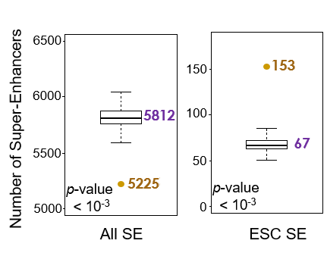
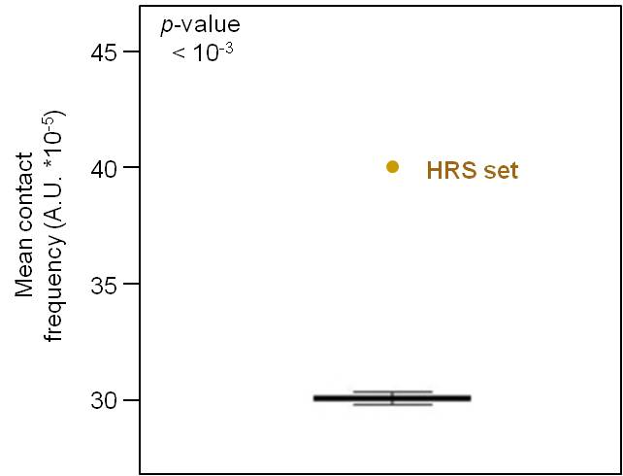
Characterizing the HRS sequences in mouse ES cells
HRS are DNA sequences enriched in the Insoluble fraction relative to the soluble fraction:
have a preferential spacial proximity (HiC data, Ren et al. 2009)
are associated with the active A compartment
are enriched in active transcriptional start sites (TSS)
are enriched in active super-enhancers
Include nuclear body associated sequences (Histone genes, tRNA genes, …)
Marie-Odile Baudement
HRS display preferential spacial proximity
Active super enhancers are over represented in HRS
Baudement et al. Genome Research 28:1733-1746, 2018
HRS set / random sequences
Notes:
To characterise these HRS Marie Odile the phd student that developed the HRSseq performed experiments on mouse ES cells and she showed that the HRS display a high spacial proximity when compared to mESC HiC data. She also showed that they were associated with the A compartment. She then tried to look at the TSS content inside the HRS, and she found a high correlation but only with active TSS. Then she chose to look at the super enhancers since when active they are supposed to localise a type of nuclear body, the transcriptional condensates. And she didn’t find a correlation between the HRS and the whole pool of super enhancers, but only with the ones that are active in mESCs. She also found sequences that are very well known to associate to nuclear bodies, such as histone genes, tRNA genes and much more.
These results show us that the HRS is a good method to study the global association of DNA to nuclear bodies.

Slide 10
Characterization of the RNA content in the HRS fractions in IMR90 cells
HRS : High-salt Recovered Sequence Assay
IMR90 cells
Human Fetal Lung Fibroblasts
(Female)
Cells (tissues, cultures)
Isolation of nuclei
PBS Wash
PBS Wash
Permeabilization
Permeabilization fraction
2M NaCl treatment
High salt fraction
Nuclear halos
Washes
Washing fraction
Restriction enzyme digestion
Ultrafiltration
Soluble
Insoluble
Insoluble fraction
Soluble fraction
Notes:
So I analysed the fractions from an HRS experiment on IMR90 cells, which are human fœtal lung fibroblasts, and analysed it using RT-qPCR I checked each fraction for the presence of 3 RNA, the 18S ribosomic RNA, the GAPDH mRNA and the long non coding Neat1 RNA. So we can see for each fraction the % of RNA that is recovered at each fraction. We can see that in the permeabilization fraction we have most of the ribosomic RNA and 30% of the mRNA can be found in this fraction, but we barely find any Neat1 in this fraction. In the next step we find more than 10 times less RNA, and even less in the washes. In the soluble fraction we can’t even detect any RNA. BUT in the Insluble fraction we can find RNA, but very little 18S RNA. But we find most Neat1 RNA in this fraction. But according to the litterature the Neat1 RNA is known to be located in a nuclear body.

Slide 11
Characterization of the RNA content in the HRS fractions in IMR90 cells
HRS : High-salt Recovered Sequence Assay
Performed on IMR90 cells
human fœtal lung fibroblasts
Cells (tissues, cultures)
Insoluble RNA/DNA
Isolation of nuclei
95.7
PBS Wash
Permeabilization
Nucleoplasmic
RNA
2M NaCl treatment
Nuclear halos
RNA recovery (% of total)
37.8
32.6
Washes
35.1
38
24.5
Restriction enzyme digestion
18.3
Ultrafiltration
7.4
3.9
0
1.6
1.4
0.4
0.3
0
0.9
0.7
1.2
Soluble
Insoluble
Permabilization
HRS-RT-qPCR STEPS
Notes:
So I analysed the fractions from an HRS experiment on IMR90 cells, which are human fœtal lung fibroblasts, and analysed it using RT-qPCR I checked each fraction for the presence of 3 RNA, the 18S ribosomic RNA, the GAPDH mRNA and the long non coding Neat1 RNA. So we can see for each fraction the % of RNA that is recovered at each fraction. We can see that in the permeabilization fraction we have most of the ribosomic RNA and 30% of the mRNA can be found in this fraction, but we barely find any Neat1 in this fraction. In the next step we find more than 10 times less RNA, and even less in the washes. In the soluble fraction we can’t even detect any RNA. BUT in the Insluble fraction we can find RNA, but very little 18S RNA. But we find most Neat1 RNA in this fraction. But according to the litterature the Neat1 RNA is known to be located in a nuclear body.

Slide 12
Characterization of the RNA content in the HRS fractions in IMR90 cells
RD-HRS : RNA/DNA High-salt Recovered Sequence Assay
Performed on IMR90 cells
Cells (tissues, cultures)
Isolation of nuclei
PBS Wash
Permeabilization
2M NaCl treatment
The Permeabilization fraction contains the Soluble nucleoplasmic RNA
And is the best suited to calculate the RNA enrichment in the Insoluble fraction
Nuclear halos
Washes
Restriction enzyme digestion
Ultrafiltration
Soluble
Insoluble

Slide 13
The RD-HRS allows the study of DNA and RNA associated to nuclear bodies
Cells (tissues, cultures)
Isolation of nuclei
PBS Wash
RT-qPCR
RNAseq
Permeabilization
2M NaCl treatment
Nuclear halos
Washes
Soluble RNA
Insoluble RNA
Restriction enzyme digestion
Ultrafiltration
Soluble
Insoluble
RNA
Notes:
RD-HRS since from the same sample we get the RNA and DNA

Slide 14
Results
HRS RNAseq
Notes:
First of all I will introduce the main topics of my PhD, nuclear bodies andp hase separation and the HRS technique

Slide 15
The Insoluble fractions RNAseq reads map predominantly in introns
Qualimap analysis the genomic location of aligned reads
Soluble RNA
Insoluble RNA
Intergenic
1.2+/-0,1%
Intergenic
2.6+/-0.1%
Intronic
21.7+/-4.2%
Exonic
33.1+/-11.2%
Intronic
65.0+/-11.3%
Exonic
76.3+/-4.2%

Slide 16
The Insoluble fractions RNAseq reads map predominantly in introns
Qualimap analysis the genomic location of aligned reads
Soluble RNA
Insoluble RNA
Intergenic
1.2+/-0,1%
Intergenic
2.6+/-0.1%
Most reads in the Insoluble fraction align to Intronic regions
Probably meaning that pre-mRNA transcripts are detected in the Insoluble fraction
Intronic
21.7+/-4.2%
Exonic
33.1+/-11.2%
Intronic
65.0+/-11.3%
Exonic
76.3+/-4.2%

Slide 17
More than 5500 genes are differentially retained in the Soluble and Insoluble RNA
Differential analysis of genebody reads
between the Soluble and Insoluble RNA
2531
37733
3137

Slide 18
Histone mRNA are enriched in the Soluble RNA
HIST1 locus
H1-5 : FC=0.0647
adj. p-value=1.2 10⁻⁹²
Soluble Fraction
RNAseq
Replicates
Soluble
RNAseq
Replicates
0-10000
Insoluble Fraction
RNAseq
Replicates
Insoluble
RNAseq
Replicates
0-10000

Slide 19
Histone mRNA are enriched in the Soluble RNA
10X zoom on the Insoluble track
HIST1 locus
H1-5 : FC=0.0647
adj. p-value=1.2 10⁻⁹²
Soluble Fraction
RNAseq
Replicates
Soluble
RNAseq
Replicates
0-10000
Insoluble Fraction
RNAseq
Replicates
Insoluble
RNAseq
Replicates
0-1000

Slide 20
Histone mRNA are enriched in the Soluble RNA
10X zoom on the Insoluble track
HIST1 locus
H1-5 : FC=0.0647
adj. p-value=1.2 10⁻⁹²
Soluble Fraction
RNAseq
Replicates
Soluble
RNAseq
Replicates
0-10000
Insoluble Fraction
RNAseq
Replicates
Insoluble
RNAseq
Replicates
0-1000
Highly enriched in the soluble fraction
But still detected in the Insoluble fraction
Histone mRNA seem to be released very fast from the Histone locus bodies

Slide 21
Histone mRNA are enriched in the Soluble RNA
H2AZ1 locus
FC=0.0839
adj. p-value= 1.8 10⁻⁷⁶
Soluble Fraction
RNAseq
Replicates
Soluble
RNAseq
Replicates
0-10000
Insoluble Fraction
RNAseq
Replicates
Insoluble
RNAseq
Replicates
0-10000
Highly enriched in the soluble fraction
But still detected in the Insoluble fraction
Histone mRNA seem to be released very fast from the Histone locus bodies

Slide 22
Histone pre-mRNA are detected only in the Insoluble RNA
100X zoom
H2AZ1 locus
FC=0.0839
adj. p-value= 1.8 10⁻⁷⁶
Soluble Fraction
RNAseq
Replicates
0-100
Soluble
RNAseq
Replicates
Insoluble Fraction
RNAseq
Replicates
0-100
Insoluble
RNAseq
Replicates
Highly enriched in the soluble fraction
But still detected in the Insoluble fraction
The unspliced version of histones are enriched
Histone mRNA seem to be released very fast from the Histone locus bodies
Notes:
Ajouter accumulation dans la fraction soluble

Slide 23
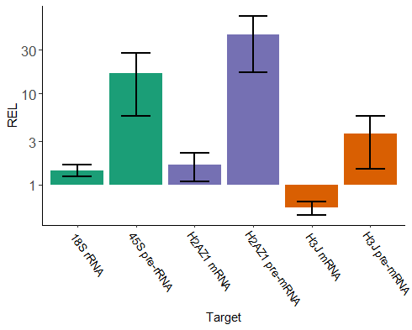
HRS RT-qPCR validates the enrichment of precursor RNAs
RT-qPCR relative enrichments level (REL)
in the Insoluble vs Soluble fractions of mature and precursor RNAs
FC (RNA seq)
X
0.08
0.06
REL (RT-qPCR)
1.4
16.7
1.7
44.1
0.6
3.6
Relative Enrichment Level
Notes:
Faire figure avec méthode de calcul d’isabelle et flavio

Slide 24
Nuclear body associated RNAs are found in the Insoluble RNA
NEAT1 locus
FC=9.7852
adj. p-value=0.0107
Soluble Fraction
RNAseq
Replicates
Soluble
RNAseq
Replicates
0-12000
Insoluble Fraction
RNAseq
Replicates
Insoluble
RNAseq
Replicates
0-12000
0-1250
FC=9.7852
adj. p-value=0.0107
Factory-seq
(Zirkel et al., 2018)
NEAT1_2
Well known nuclear body associated lncRNAs are found enriched in the Insoluble fraction
Notes:
Neat et Xist

Slide 25
Nuclear body associated RNAs are found in the Insoluble RNA
XIST locus
FC=4.5419
adj. p-value=3.6.10⁻¹⁵
Soluble Fraction
RNAseq
Replicates
Soluble
RNAseq
Replicates
0-2000
Insoluble Fraction
RNAseq
Replicates
Insoluble
RNAseq
Replicates
0-2000
Gene
TSIX
XIST
Well known nuclear body associated lncRNAs are found enriched in the Insoluble fraction
In their spliced Isoform
And from heterochromatin associated structures
Notes:
xist

Slide 26
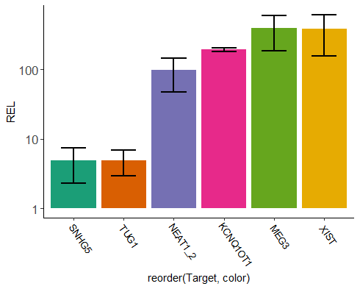
HRS RT-qPCR validates the enrichment of some lncRNAs
RT-qPCR relative enrichments (REL) in the Insoluble vs Soluble fractions of target RNAs
FC (RNA seq)
0.7
0.3
9.8
16.5
14.8
4.5
REL (RT-qPCR)
4.9
4.9
97.1
192
394
385
Relative Enrichment Level

Slide 27
Splicing events are detected in the Insoluble RNA
LENG8 locus
FC=13.0514
adj. p-value=10⁻¹¹⁷
Soluble Fraction
RNAseq
Replicates
Soluble
RNAseq
Replicates
0-2500
Insoluble Fraction
RNAseq
Replicates
Insoluble
RNAseq
Replicates
0-2500
LENG8-AS1
LENG8
LENG9
LENG8 RNA is retained in the Insoluble fraction
Intron 15

Slide 28
Splicing events are detected in the Insoluble RNA
10X zoom on the Soluble track
LENG8 locus
FC=13.0514
adj. p-value=10⁻¹¹⁷
Soluble Fraction
RNAseq
Replicates
Soluble
RNAseq
Replicates
0-200
Insoluble Fraction
RNAseq
Replicates
Insoluble
RNAseq
Replicates
0-2500
LENG8-AS1
LENG8
LENG9
LENG8 seems to be retained in the Insoluble fraction
Intron 15
But only when the intron 15 is not spliced
When it is spliced it is released

Slide 29
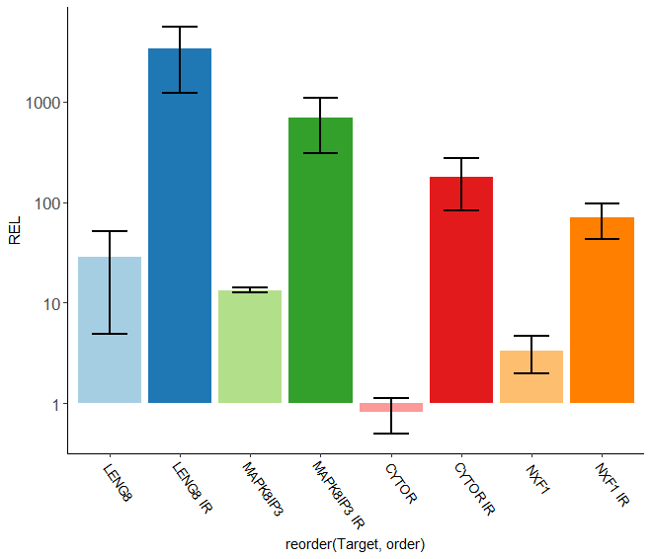
HRS RT-qPCR allows the detection of transcripts containing intron retention
RT-qPCR relative enrichments (REL) in the Insoluble vs Soluble fractions of mature and retained introns RNAs
FC (RNA seq)
13
16.3
3.6
1.4
REL (RT-qPCR)
28.4
3354
13.3
698
0.82
177
3.3
68.9
Relative Enrichment Level

Slide 30
Is there global link between intron retention and RNA-HRS enrichment ?
IR Finder computes an Intron Retention score (IRratio) representing the splicing frequency of an intron from 0 to 1
0 meaning the intron is always spliced
1 meaning it is never spliced
Middleton et al. 2017
Notes:
Known exon = alternative splicing of a known exon

Slide 31
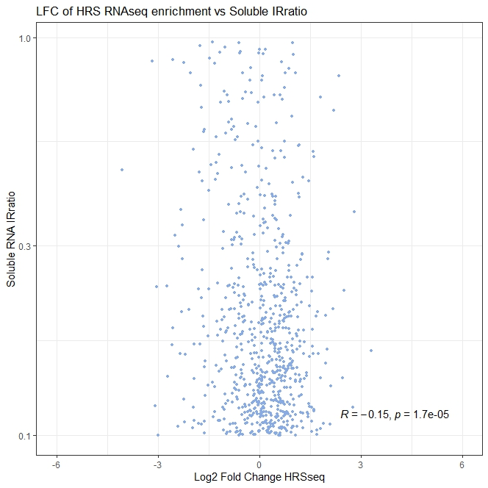
Is there global link between intron retention and RNA-HRS enrichment ?
IR Finder computes an Intron Retention score (IRratio) representing the splicing frequency of an intron from 0 to 1
0 meaning the intron is always spliced
1 meaning it is never spliced
Middleton et al. 2017
Notes:
Known exon = alternative splicing of a known exon

Slide 32
Is there global link between intron retention and RNA-HRS enrichment ?
IR Finder computes an Intron Retention score (IRratio) representing the splicing frequency of an intron from 0 to 1
0 meaning the intron is always spliced
1 meaning it is never spliced
Middleton et al. 2017
There is no correlation between intron retention in the Soluble RNA and enrichment in RNA-HRS experiment
Notes:
Known exon = alternative splicing of a known exon

Slide 33
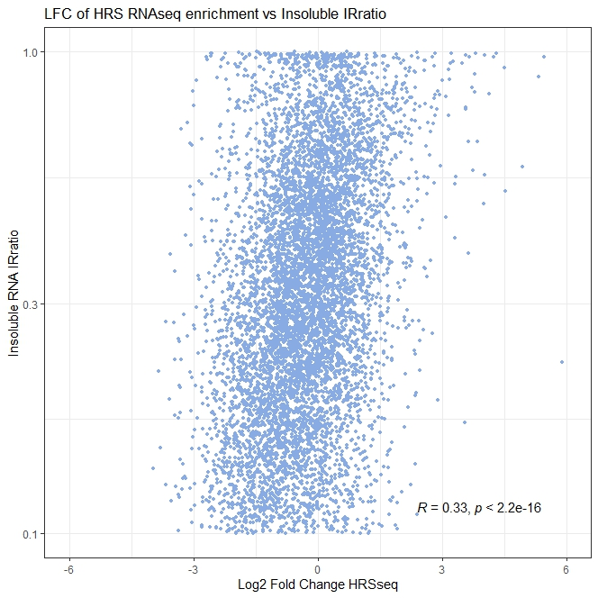
Is there global link between intron retention and RNA-HRS enrichment ?
IR Finder computes an Intron Retention score (IRratio) representing the splicing frequency of an intron from 0 to 1
0 meaning the intron is always spliced
1 meaning it is never spliced
Middleton et al. 2017
Notes:
Known exon = alternative splicing of a known exon

Slide 34
Is there global link between intron retention and RNA-HRS enrichment ?
IR Finder computes an Intron Retention score (IRratio) representing the splicing frequency of an intron from 0 to 1
0 meaning the intron is always spliced
1 meaning it is never spliced
Middleton et al. 2017
There is a weak but significant correlation between intron retention in the Insoluble RNA and enrichment in RNA-HRS experiement
Notes:
Known exon = alternative splicing of a known exon

Slide 35
Is there global link between intron retention and RNA-HRS enrichment ?
LFC of HRS RNAseq experiment vs
Insoluble RNA IRratio of "clean" introns
Median lnFC +/- 10 median FC
1
There is a weak but significant correlation between intron retention in the Insoluble RNA and enrichment in RNA-HRS experiement
Insoluble RNA IRratio
Many transcripts with an intron retention are enriched in Insoluble RNA but not in Soluble RNA
Log2(FC)
Notes:
Threshold at 10 FC -> finding outlisers

Slide 36
Results :
In progress : Targeting the paraspeckles
Notes:
First of all I will introduce the main topics of my PhD, nuclear bodies andp hase separation and the HRS technique

Slide 37
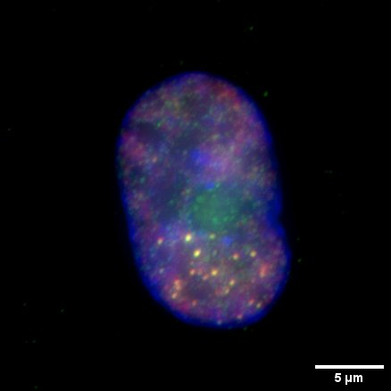
Paraspeckles
The paraspeckles :
Small Nuclear bodies formed by phase separation based around the
Neat1 RNA long isoform
Paraspeckles
NONO
PSPC1
Fox A. H. et al 2002
Hennig S. et al. 2015
Torres M. et al. 2016
Jang Li. et al. 2017
Zhang Q. et al 2013
Nishimoto Y. et al. 2013
Notes:
Fiare transi

Slide 38
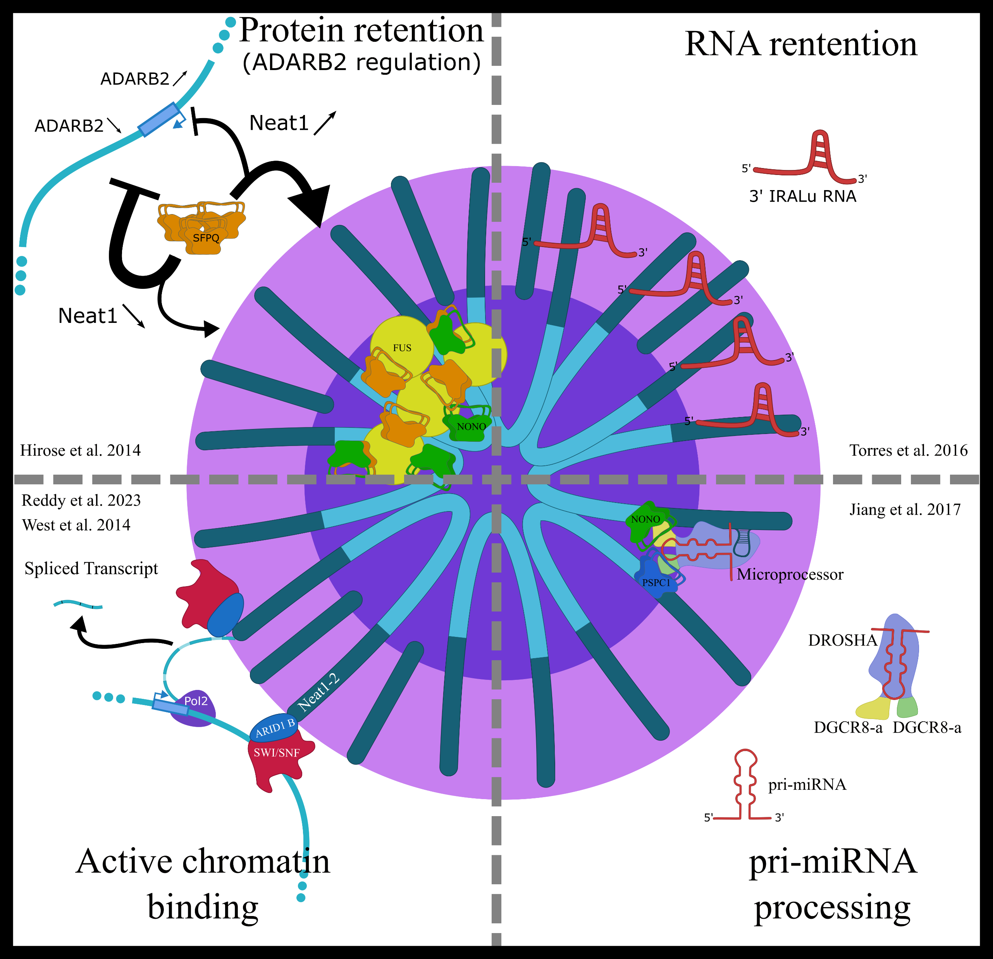
Paraspeckles
The paraspeckles :
Small Nuclear bodies formed by phase separation based around the
Neat1 RNA long isoform
Involved in multiple processes
(Post-transcriptionnal regulation, pri-miRNA processing, …)
Involved in several diseases
Viral Infection, Acute Lateral Sclerosis (ALS),
Acute Myeloid Leukemia (AML), and other cancers
Fox A. H. et al 2002
Hennig S. et al. 2015
Torres M. et al. 2016
Jang Li. et al. 2017
Zhang Q. et al 2013
Nishimoto Y. et al. 2013
Notes:
Since I don’t have enough time to target all the nuclear bodies one by one, I chose to focus on one, the paraspeckles, which are a small nuclear body, 400 nm in diameter. They are known to be formed by phase seperation and very interestingly they are organised by the Neat1 RNA. They are involved in a wide range of processes in the nucleus which makes them involved in numerous deseases such as viral infection, amyotrofic lateral sclerosis, and multiple cancers

Slide 39
Paraspeckles
Notes:
And now the active chromatin binding. In 2014 West has shown that Neat1 attaches to active promoters using RNA/DNA interaction detection, but without beeing able to identify the isoform that is bound due to the lack of sequencing depth. But very recently in 2023 Reddy showed that Neat1_2 binds the SWI-SNF complex throught its ARID1 B subunit. So the binding at active promoters might be mediated by this interaction since SWI/SNF is linked to active chromatin remodeling. This is the aspect that interests us the most since it involves DNA/RNA/nuclearbody interactions.

Slide 40
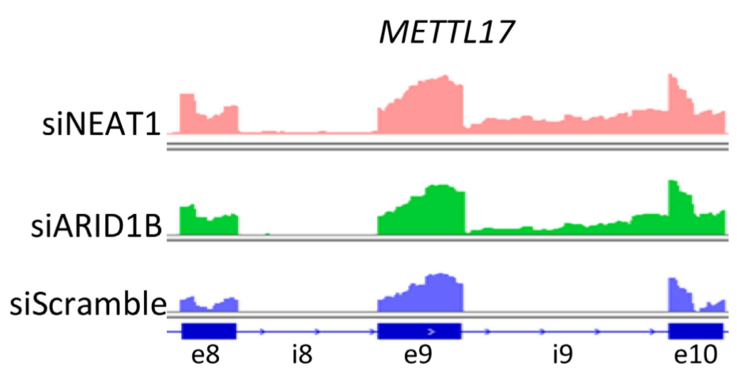
Known Intron retention associated to paraspeckles …
Reddy et al 2023
Reddy et al. Observed that when either ARID1B or Neat1 are disrupted some introns are retained

Slide 41
… are observed in HRS RNAseq
Reddy et al. 2023
METTL17
Soluble Fraction
RNAseq
Replicates
Soluble
RNAseq
Replicates
Insoluble Fraction
RNAseq
Replicates
Insoluble
RNAseq
Replicates
Intron 9
Reddy et al. Observed that when either ARID1B or Neat1 are disrupted some introns are retained

Slide 42
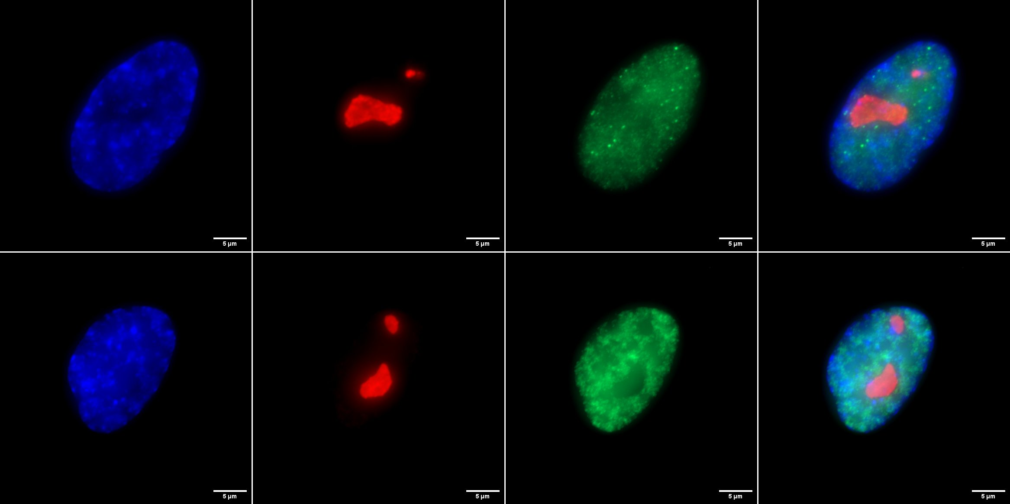
In Progress :
Destroying the paraspeckles to characterize their RNA content by targeting NONO
DAPI
Nucleoline
PSPC1
Merge
si HPRT1 72h
(si T+)
si NONO 72h

Slide 43
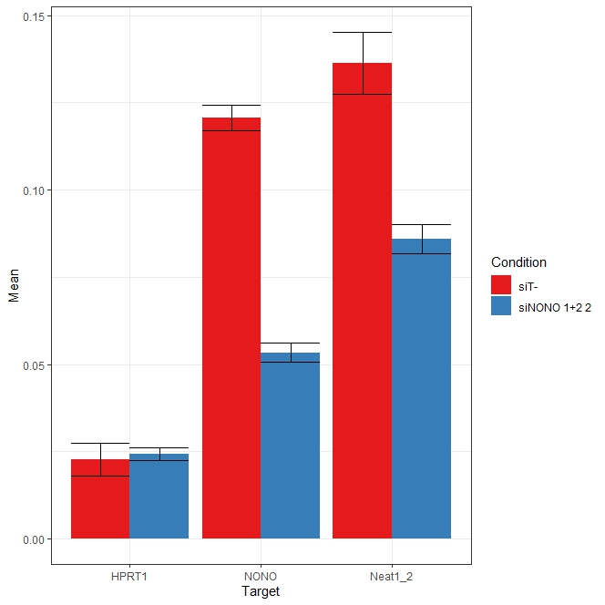
In Progress :
Destroying the paraspeckles to characterize their RNA content by targeting NONO
RT-qPCR quantification of RNA in siRNA treated cells
Merge
Relative Expression to GAPDH
Image from NONO 1+2 2
Notes:
Enlever réplicat 1
Mettre T- en premier

Slide 44
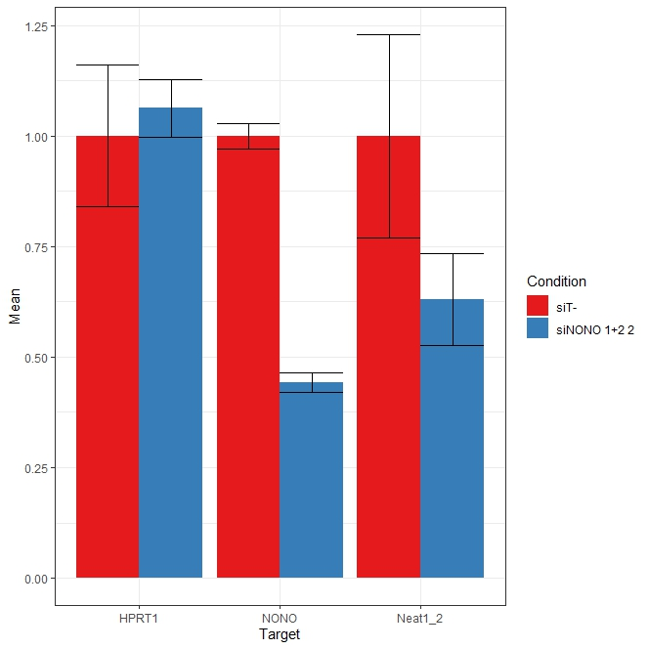
In Progress :
Destroying the paraspeckles to characterize their RNA content by targeting NONO
RT-qPCR quantification of RNA in siRNA treated cells
Merge
Relative Expression to GAPDH
Image from NONO 1+2 2
Notes:
Enlever réplicat 1
Mettre T- en premier

Slide 45
Specific RD-HRS study of the paraspeckles
In progress …
Paraspeckles associated RNA/DNA Identification
RD-HRS on the siRNA treated cells
Notes:
Target sharing betwee

Slide 46
Specific RD-HRS study of the paraspeckles
In progress …
Paraspeckles associated RNA/DNA Identification
RD-HRS on the siRNA treated cells
Confirming the hits
RNA/DNA FISH against the RNAs found
Notes:
Target sharing betwee

Slide 47
Specific RD-HRS study of the paraspeckles
In progress …
Paraspeckles associated RNA/DNA Identification
RD-HRS on the siRNA treated cells
Confirming the hits
RNA/DNA FISH against the RNAs found
Using splicing inhibiting drugs to better understand the role of nuclear bodies in splicing
(Auranofin, Pladienolide B)
RD-HRS RT-qPCR on the treated cells
Notes:
Target sharing betwee

Slide 48
Thank you for your attention
The TFL team :
Collaborators :
Jean-Marc Victor (LPTMC)
Cosette REBOUISSOU
Thierry
FORNE
Annick
LESNE
Audrey
FRAT
Irina
LASSOT
Stephan
MORA
Samy
AMIRI

