Slide 1
TPCs for High Energy Physics
Paul Colas, CEA/Irfu U. Paris Saclay

Slide 2
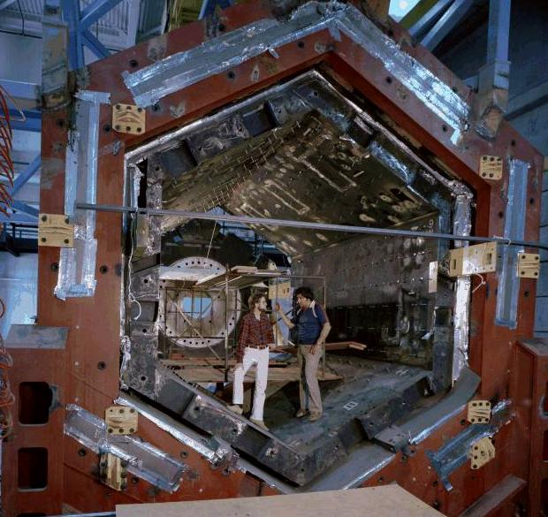
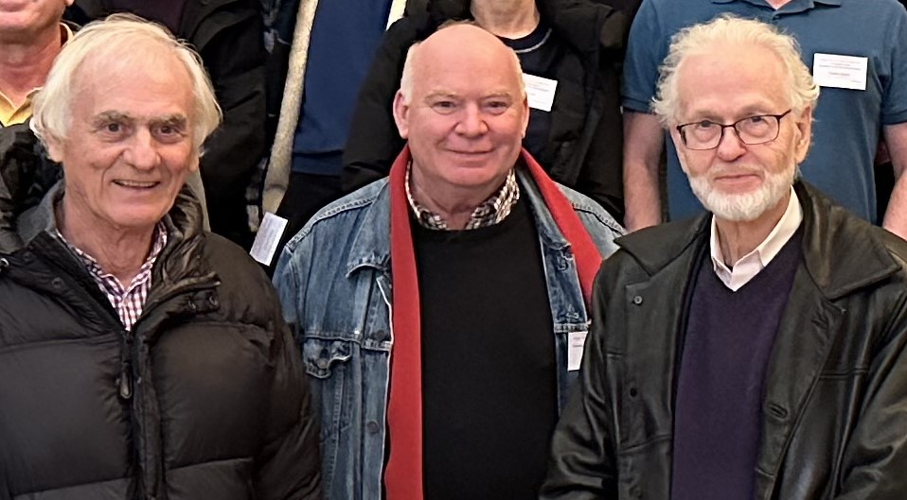
History : 50 years of TPCs
Time Projection Chamber : a drift chamber, with a long drift length O(m) and usually embedded in a strong magnetic field parallel to the drift electric field, to reduce transverse diffusion.
Invented in 1974 by David Nygren. First TPC at PEP4, SLAC. Then large TPCs at LEP e+e- collider (ALEPH and DELPHI) and at LHC (ALICE)
Initially readout by multiwire proportional chamber, now trend to use MPGDs instead: Micromegas for T2K/ND280 and GEMs for ALICE
I. Giomataris, PC and David Nygren at TPC for Low-Energy Rare events, Paris, December 2023

Slide 3
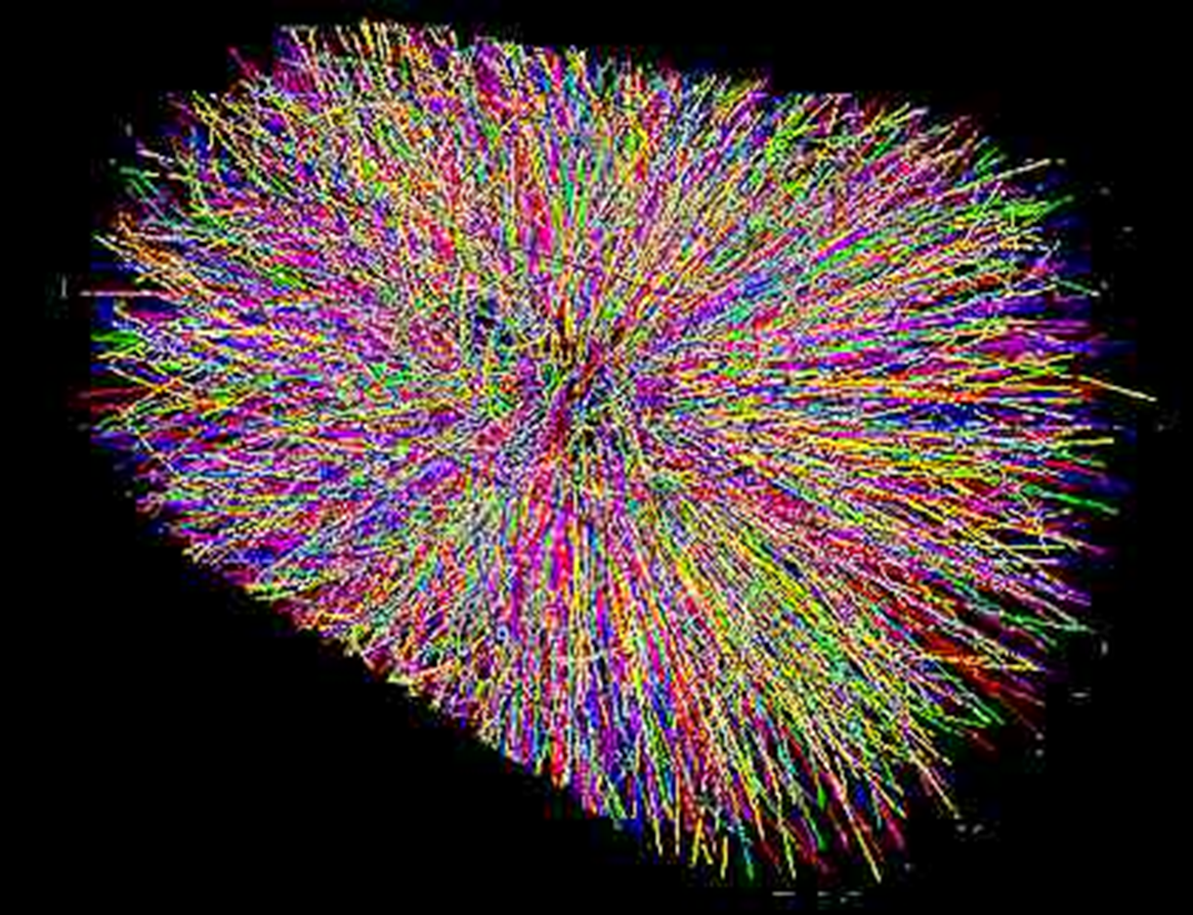
A TPC allows 3D reconstruction of high density events
And Particle identification with dE/dx
STAR TPC at RHIC
3000 tracks
Ion-ion collision

Slide 4
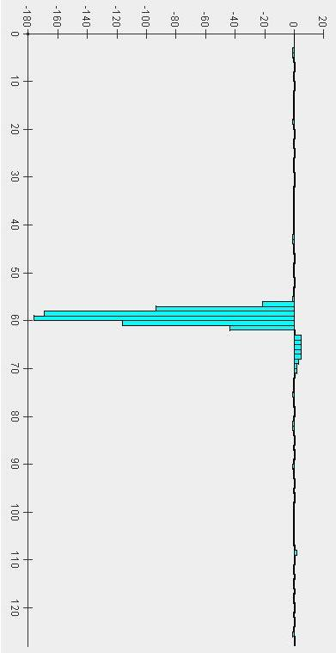
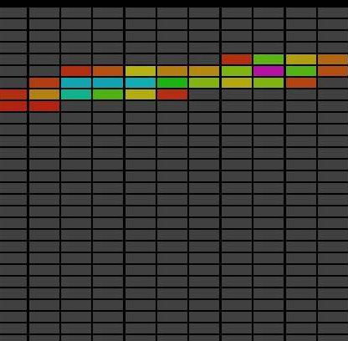
TPC : Time projection chamber
electrons diffuse and drift under electric field
t
ionizing particle
electrons are separated from ions
B
E
A magnetic field reduces electron diffusion
y
x
Micromegas TPC : the amplification is made by a Micromegas
Localized in time and x-y

Slide 5
Longitudinal diffusion limits z resolution (along the drift direction) to typically 200-500 μ/√cm
B strongly reduces the electron transverse diffusion
ω=eB/m_{e}, τ = time between collisions
ωτ = from ~1 to 15-20 (noter: ωτ ∼V_{drift} B/E)

Slide 6


Drift
Langevin equation :
With τ = m/K, for t >> τ
and ω = eB/m (cyclotron pulsation)
“ExB” effect : distortions if E not parallel to B

Slide 7
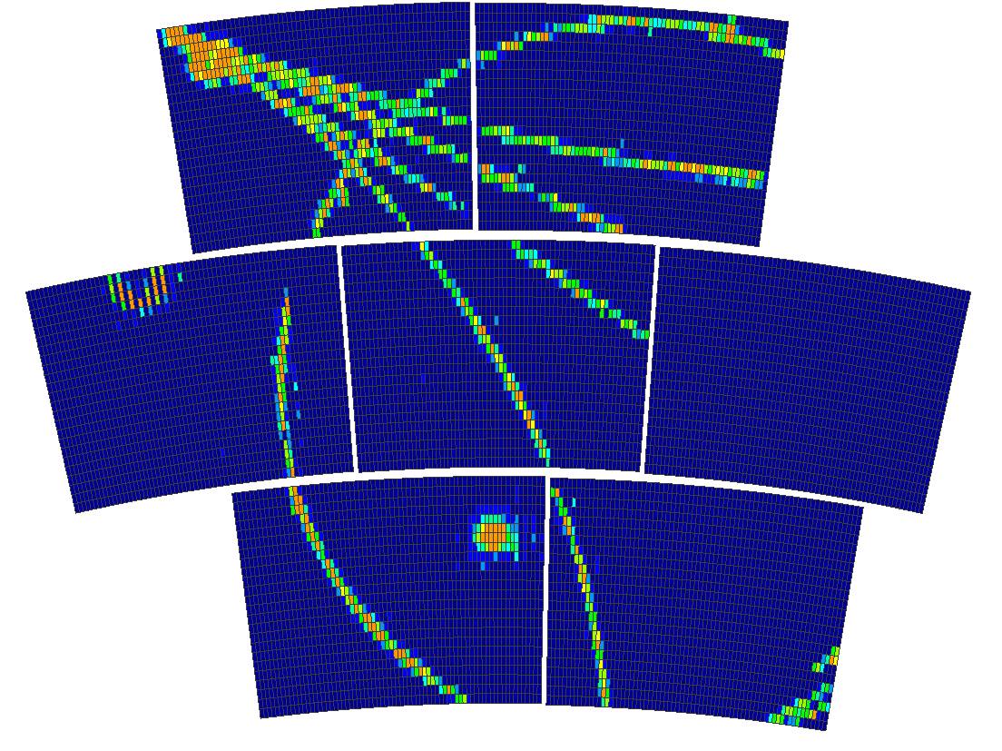
New trends
Endplates : wire chambers replaced by Micropattern Gaseous Detectors (MPGD) :
  GEM (Alice)
  Micromegas (T2K/ND280)
Minimizes ExB effect near the wires, which
limits the spatial resolution
Easier to manufacture and more robust
Reduced ion backflow with respect to wires

Slide 8
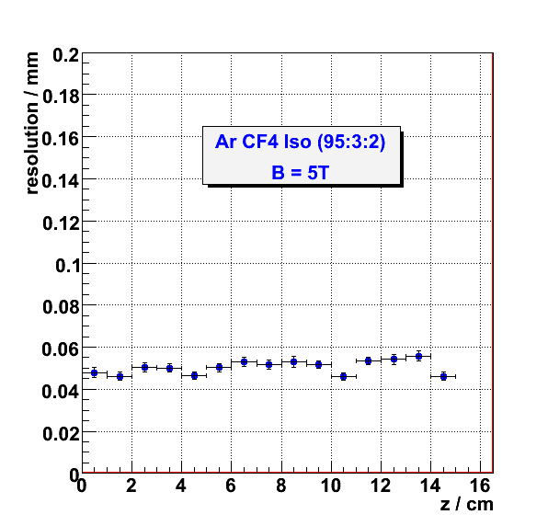
The spatial resolution improves greatly in a strong magnetic field, as the diffusion is strongly reduced
(here with 2mm pads, 50 µm)

Slide 9
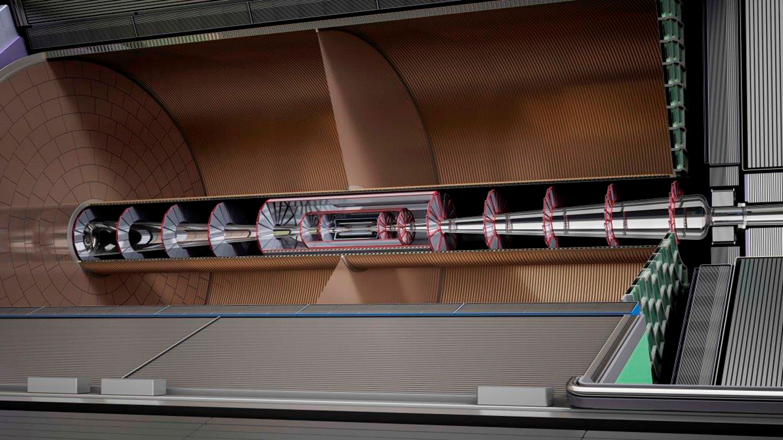
The ILD TPC

Slide 10
2 kinds of improved Micromegas
Standard pads : charge spreading. In Micromegas the avalanche is very localized (O(20-30 µm)). Need to share the charge between at least 2 neighbouring pads. This is done by a continuous RC circuit built on top of the anode pads. In addition, the resistive coating quenches the sparks and protects the electronics
This technique is applied to the new T2K/ND280 TPCs in Tokai
Pixels : there all single electrons are detected : ultimate detector. In practice, this is done by using a chip with 55x55µm² pixels with time information (Timepix, followed by Timepix 3 and Timepix 4)
This technique is chosen for the reference detector of CEPC

Slide 11
Encapsulated Resistive Anode Micromegas
With encapsulation
New scheme, to reduce distortions at the edges
of the modules : mesh at the same potential as the
frame, and resistive anode at the +ve HV.
Also encapsulation reduces the EMI.
Another advantage: the amplification field can be
tuned independently of the drift field, providing
flexibility.
The gains can be equalized while keeping the drift field very uniform.
Without encapsulation

Slide 12
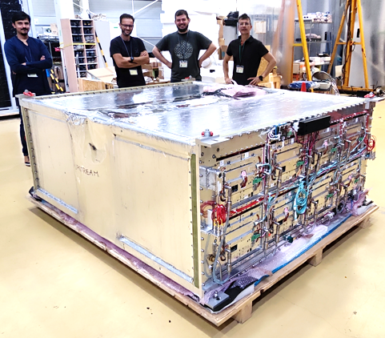
T2K/ND280 upgrade
+2 new TPCs above and below instrum target installed Sept 2023 and April 2024
3 Micromegas TPCs built in 2009

Slide 13
T2K/ND280 upgrade
+2 new TPCs above and below instrum target installed Sept 2023 and April 2024
3 Micromegas TPCs built in 2009

Slide 14
Charge spreading
By adding a resistive layer and dielectric layer on top of the anodes, we obtain a resistive-capacitive continuous network that spreads evenly the charge between the hit pad and its neighbours.
This allows a barycentre to be determined, which greatly improves the resolution.
Resolutions as good as 1/50 times the pad size can be obtained.
For an e+e- TPC, with 3mm pads, resolutions of 60 µm have been obtained in beam tests.
By fitting the wave forms of a leading pad and the subleading pad next to it, the RC parameter can be mapped:
And this matches the resistivity direct measurement (C is very well constrained by the thickness of insulator
R inhomogenities in the sputtering are clearly visible in the direction perpendicular to the drum rotation axis.

Slide 15
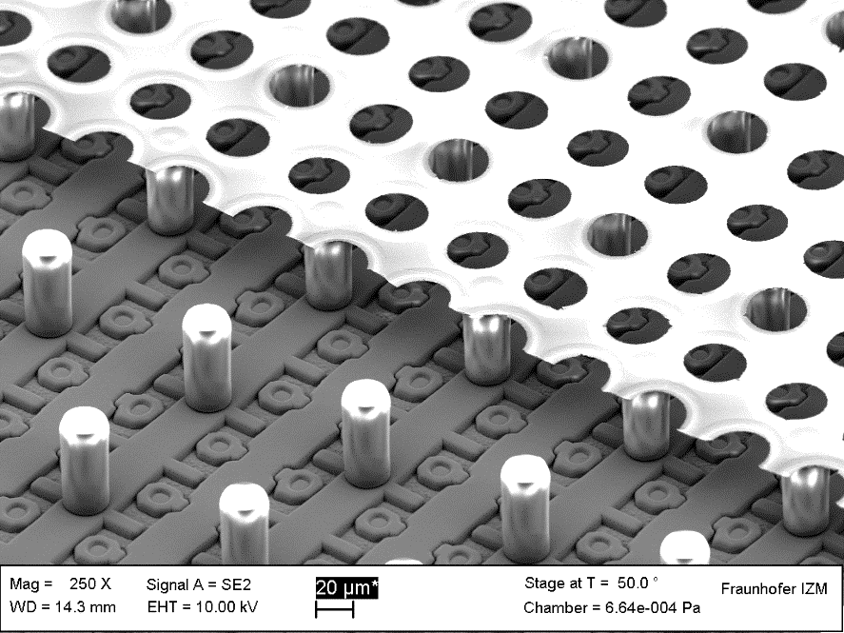
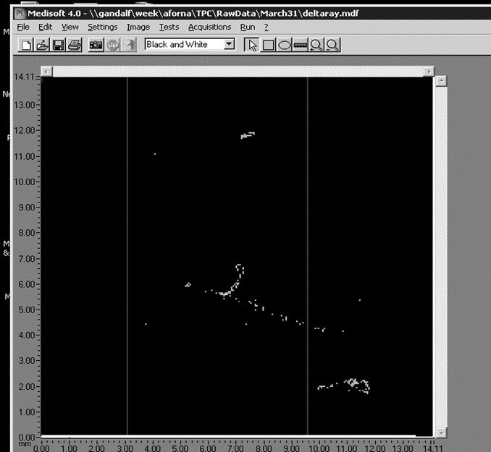
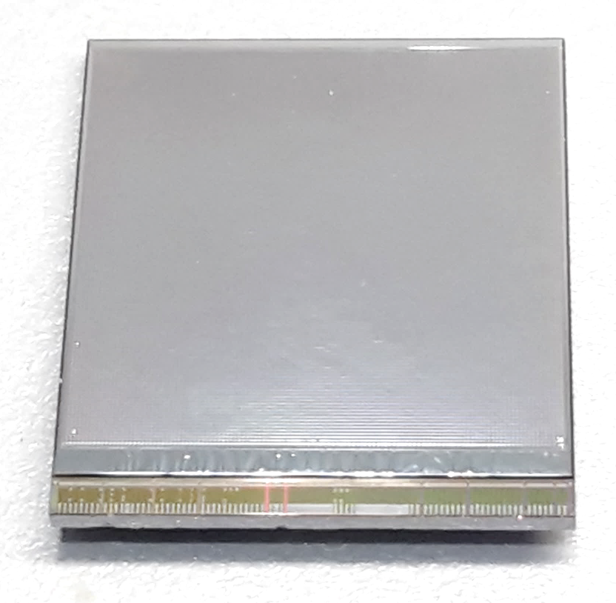
The integrated grid
By deposition of an Al layer (0.8 µm) on SU8, followed by etching, one can make a micromesh directly integrated on a Si layer, or even on a readout chip with Pixels.
50 µm

Slide 16
The Digital TPC, TimePix
By adding a clock distributed in all the pixels of a Medipix 2 chip, the ‘grey level’ for photon counting is changed into a time measurement on all pixels, changing the imaging chip into a TPC (digital) readout.
The chip, however was very sensitive to sparks. A 15 µm resistive layer is necessary to protect the chip.
TimePix4
2x2 times larger than previous TimePix. Uses 65 nm TSMC technology, with thru-silicon vias. 4-side buttable, allowing covering large surfaces with almost no dead area. 6000 transistors per 55µ pixel!

Slide 17
Timepix4 arrangement
256 x 256
55 µm²
(65 Kpixels)
Timepix3
512 x 448 of 55 x 55 µm pixels
  2 Matrices (TOP and BOTTOM)
3 peripheries with TSV (Through-Silicon-Vias):
  TOP, BOTTOM (TSV, WB): Data Readout (16x 10.24 Gbps Serializers)
  CENTER (TSV): Analog Blocks (DACs, ADC, Band-Gap…)
On-chip bump to pixel redistribution layer (RDL):
  Pixel matrix pixels are shorter (51.4 µm) than sensor pixels (55 µm)
  Equalized Cin for all pixels → ~46 fF increase for a 460 µm periphery
Edge peripheries include 1mm Wire Bond Extender
Dicing options:
  With WB (Wire-Bonds Extenders): 29.96 mm x 24.7 mm
    >93.7% active area (28.16mm x 24.64mm)
  Without WB (TSV Only) : 28.22 mm x 24.7 mm
    >99.5% active area (28.16mm x 24.64mm)
    Through Silicon Vias (TSV) requires post processing at wafer level to create TSV and on the ASIC back sides RDL + BGA pads
Periphery
24.64 mm
WB Extender
TOP Periphery + TSVs
TOP Matrix
256 x 448
55 µm²
28.16 mm
CENTER Periphery + TSVs
BOTTOM Matrix
256 x 448
55 µm²
Timepix4
BOTTOM Periphery + TSVs
WB Extender

Slide 18
Lessons learned about field cages
Electrostatic charge deposition on insulators create very bad field distortions (this happened to STAR and Alice TPCs)
Appart from the resistor chain of the potential degrader, no other path must exist for the cage current (in T2K at the beginning a cage had its resistance lowered to a few 100 GOhm due to the application of an antistatic spray all around the field cage. The HV could not be raised to its nominal value.

Slide 19
Distortions from positive ions
Ions drifting in the gas are very slow (typically a few m/s)
Primary ions from ionization in the gas (from event tracks of from machine background) or secondary ions created during amplification and back-flowing in the drift region, drift very slowly, producing space charge which distorts the trajectories of the electrons drifting from the tracks by creating a component transverse to the drift field

Slide 20
Positive ion density at the Z peak
From hadronic Z decays (Toy MC by K.Fujii, full simulation by Daniel Jeans)
60 KHz of Z decays : 26 000 ion disks created in the amplification pile-up in the 0.44 s of flushing time of the ions (assuming 5 m/s ion drift velocity)

Slide 21
D. Jeans

Slide 22
Similar situation in ALICE at LHC Run3. IBF~1%, gain=2000.
200 ms ion drift
50 kHz lead-lead collisions.
-> the ions of 10 000 collisions pile-up in a TPC length.
Space-charge density cause distortions up to several cm, varying with instantaneous luminosity and fluctuating.
Measurement of the space charge (from integrated currents) necessary.
Can this be corrected for?
R&D and analysis in progress
ALICE, Jens Wiechula, LCTPC collaboration meeting, Jan 18, 2023.

Slide 23
TPCs for Rare Events
Liquid TPC : DUNE as a long baseline neutrino oscillation experiment.
Also a large sensitivity to nucleon decay, even in very difficult modes.

Slide 24
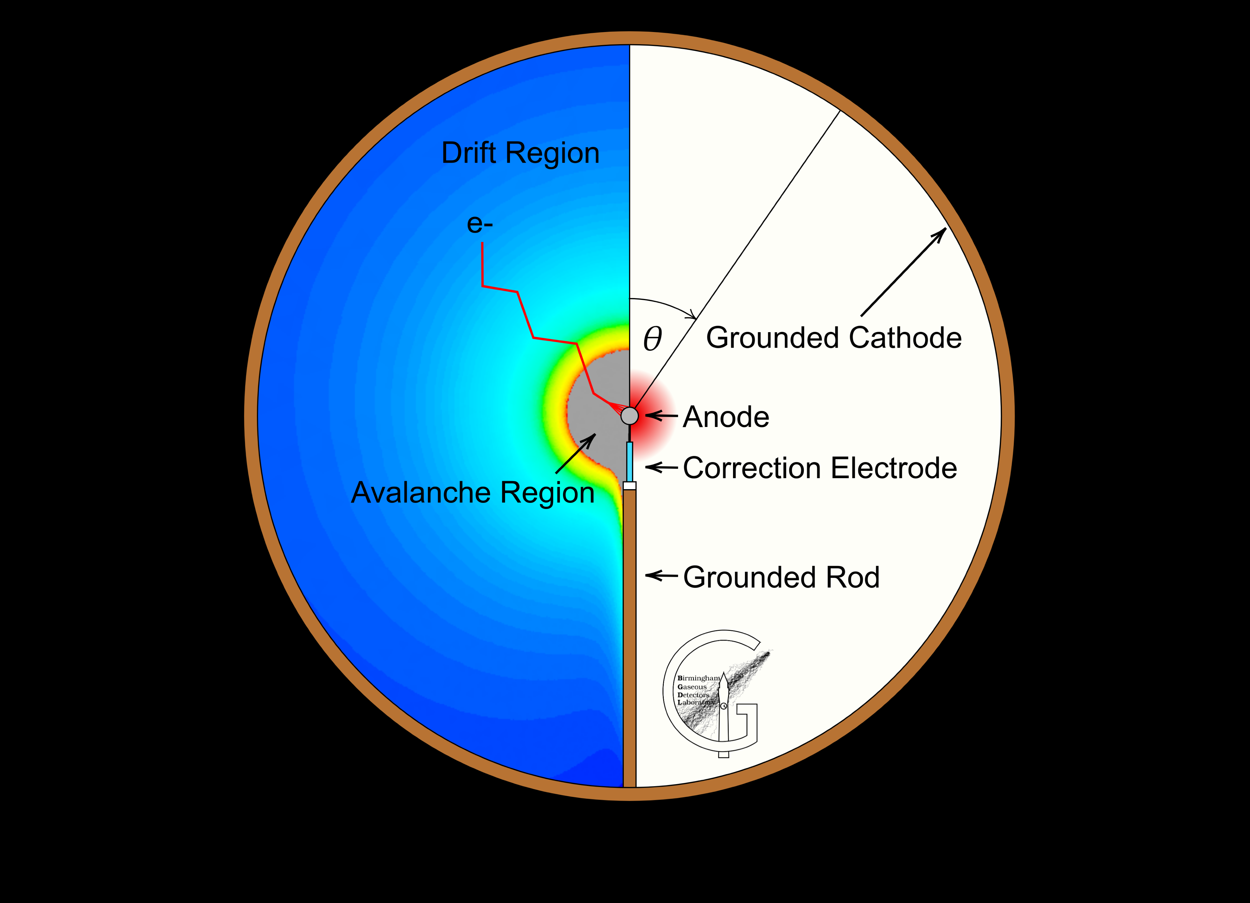
Spherical TPC
Spherical drift region : drift field ~1/r². Avalanche takes place on the small central ball.
To decouple drift from amplification, and uniformize the field, replace the central ball by ‘Achinos’ =‘sea urchin’.
It also allows segmentation
Used for dark matter search, especially low mass.

Slide 25
Summary
Invented 50 year ago, TPC still diversifies
Charge spreading or pixel readout, gaseous or liquid, cylindrical or spherical… one choice for every application
Still the smaller amount of matter for a continuous 3D detection.
R&D continues in the framework of DRD1. Work packages 4 (collider TPCs) and 8 (Active target TPCs and non-accelerator TPCs)

Slide 26
BACKUP

Slide 27
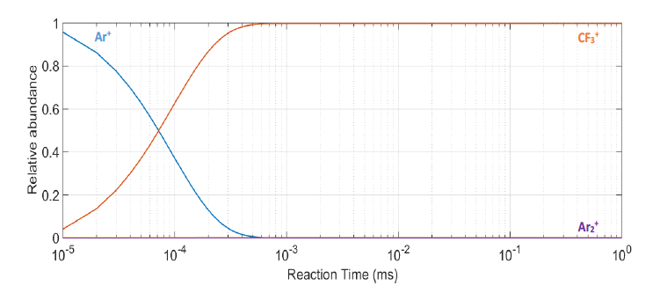
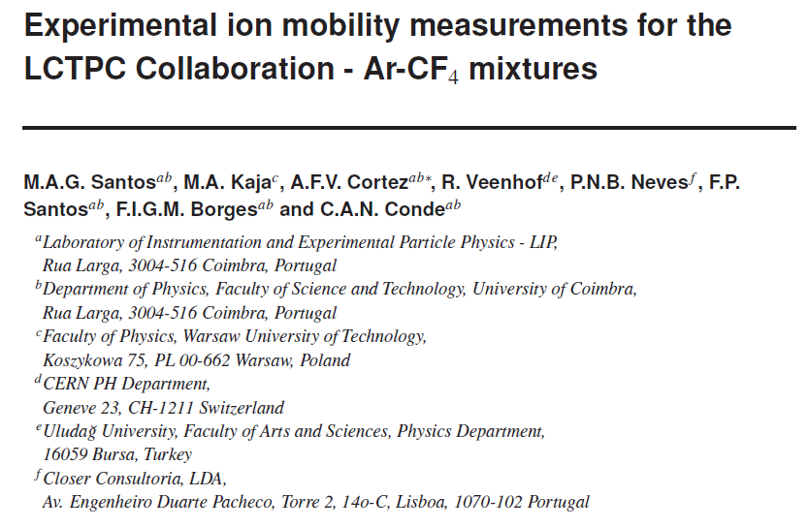
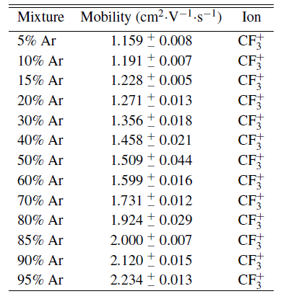
Structure of the ion disk
Useful to dimension the gap between ion gate and amplification device.
Measurement of the mobility of various ion species (A. Cortez, Coimbra) in T2K gas mixture :
Ar⁺, CF₃⁺, (Ar₂)⁺
Study of evolution of ion disk composition (ionization exchange between species)

