Slide 1
Time Projection Chambers for Nuclear Fission Experiments
Malia Mehdi – 1st year PhD Student
Supervised by Matthieu Lebois & Gabriel Charles
Nuclear Pole - IJCLab

Slide 2
Content
Introduction to the Physics Case and Experimental Features
Fission Event Reconstruction Arsenal
Ongoing Project: ICETEA
Outlook and Perspectives

Slide 3
Content
Introduction to the Physics Case and Experimental Features
Fission Event Reconstruction Arsenal
Ongoing Project: ICETEA
Outlook and Perspectives

Slide 4
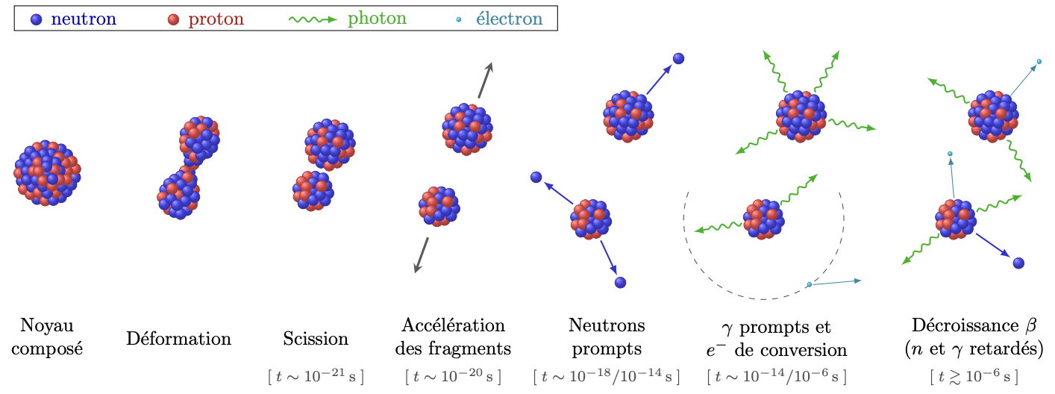
Nuclear Fission
V.Piau, PhD thesis 2022
~160-180MeV kinetic energy shared between the 2 fragments
Mass 90 < A < 160 amu , High charge Z+, 28 < Z < 64

Slide 5
Experimental Features
Tagging the fission events/ Kinematics of the fission fragments
Ionization chamber: Twin Frisch-Grid ionization chamber
Measuring 𝛾 rays
Spectroscopy/Counting with scintillators: HPGe, La(Ce)Br₃,PARIS arrays (LaBr₃+NaI phoswiches)
Measuring neutrons
Counting ( neutron counters), spectroscopy with liquid scintillators

Slide 6
Experimental Features
Tagging the fission events/ Kinematics of the fission fragments
Mass identification from total kinetic energy-> Energy resolution (675keV<-> ~0.54 amu)
Angle of emission
Charge identification Z (ideally 1 charge unit)
Timing resolution <1ns to establish correlations with gamma-ray measurements
Z⁺
Z’⁺

Slide 7
Content
Introduction to the Physics Case and Experimental Features
Fission Event Reconstruction Arsenal
Ongoing Project: ICETEA
Outlook and Perspectives

Slide 8
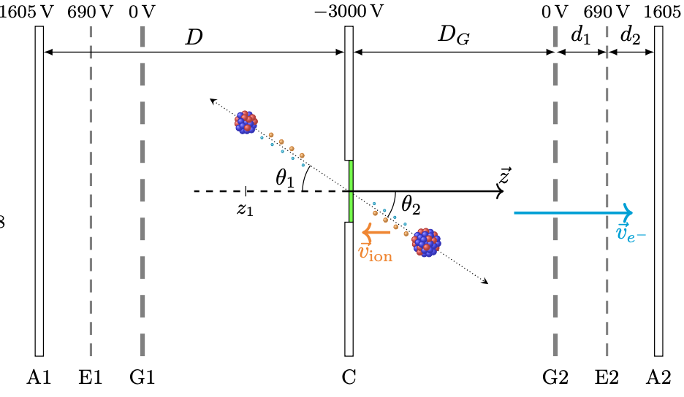
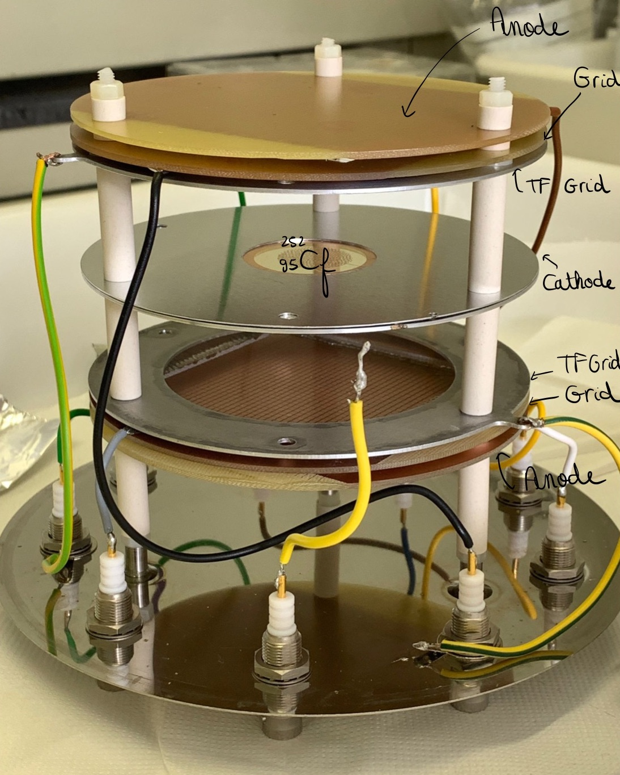
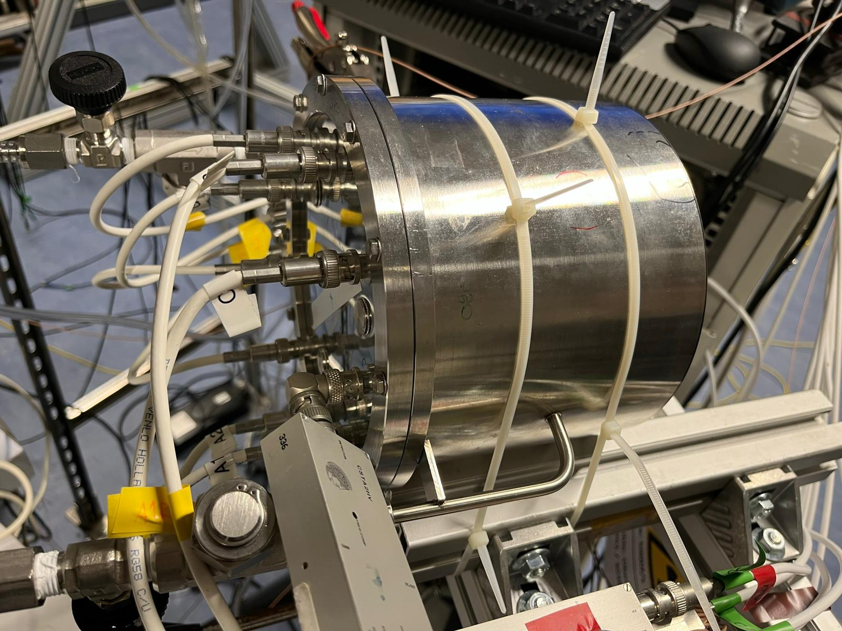
Twin Frisch-Grid ionization Chamber
Tagging the fission events/ Kinematics of the fission fragments
Position sensitive Ionization Chamber:
Fission tag ~ 3ns
Mass identification of the fragments ~ 3amu
CH₄ timing resolution < 1ns (electrons)
Kinematics
$$\vec{E}$$
$$\vec{E}$$
JRC Geel
V.Piau, PhD thesis 2022

Slide 9
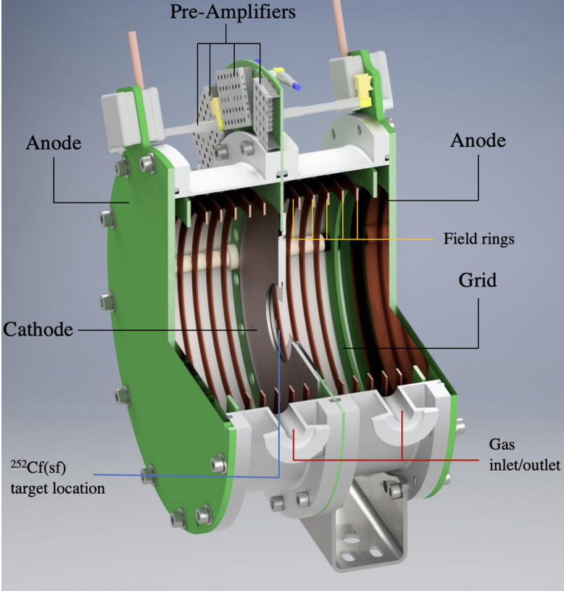
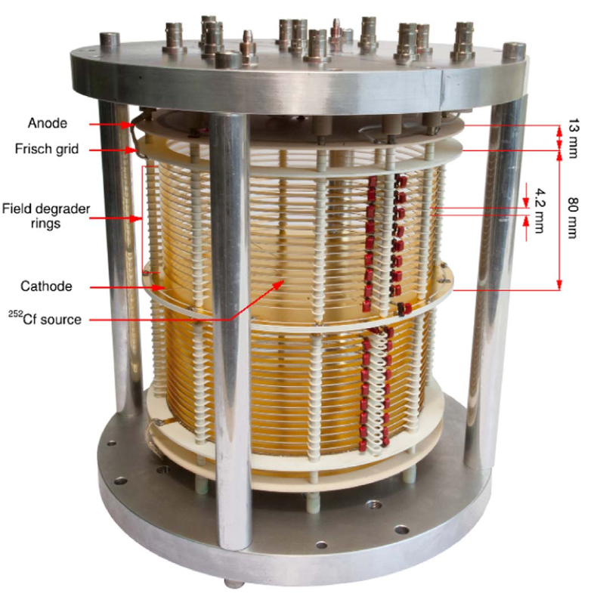
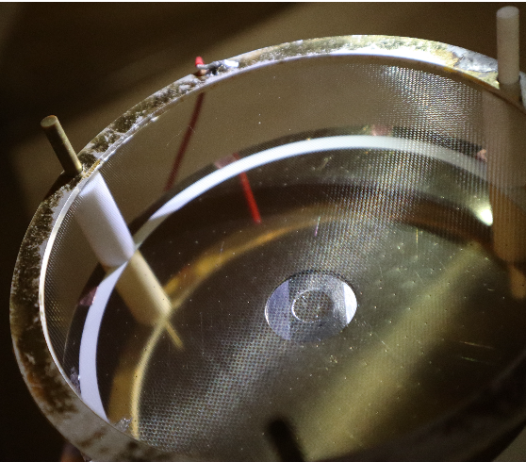
Twin Frisch-Grid ionization Chamber
L.Gaudefroy et al. (2017)
CEA DAM
S.Marin et al. (2022)
A.Francheteau, PhD thesis (2023)

Slide 10
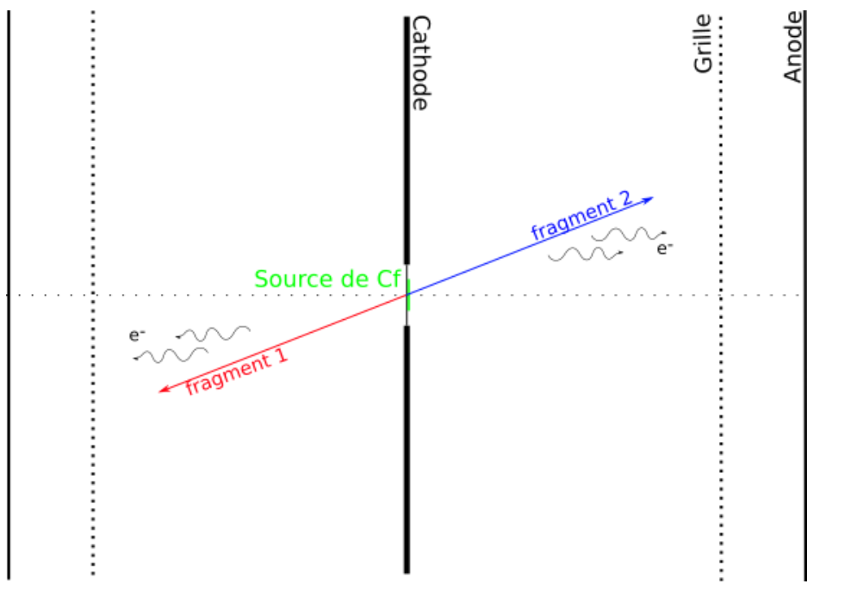
Twin Frisch-Grid ionization Chamber
Tagging the fission events/ Kinematics of the fission fragments
Position sensitive Ionization Chamber:
Fission tag ~ ?ns
Energy resolution ~675keV
Mass identification of the fragments ~ 0.54amu
Ar+CH₄ P =0.5bar, timing resolution~ 1ns
Kinematics
L.Gaudefroy et al. (2017)
A.Francheteau, PhD thesis 2023

Slide 11
Required Performances
Existing chamber
Fission tag ~ 4ns (ionic signal)
Mass identification of the fragments ~ 3amu
Poor angular reconstruction
What we need
Fission tag <1ns
Mass identification of the fragments <1amu⬄<600keV
Proper angular reconstruction
Deduce the charge of the fission fragment
Compactness
New technology?

Slide 12
Content
Introduction to the Physics Case and Experimental Features
Fission Event Reconstruction Arsenal
Ongoing Project: ICETEA
Outlook and Perspectives

Slide 13
ICETEA - Ionization Chamber with Enhanced Timing and Energy resolution without Amplification
Our alternative solution!
CH4
Gaseous ionisation chamber with included wire chamber
Tracking and calorimetery for charged particles
Expected timing resolution < 1ns
Expected Energy resolution < 600keV
Prototype to be built in 2024 – Launching mid-September
Tests with 3-⍺ source
Frisch-Grid
CH4
CH4
Energy plane: total charge collection anode plane
Source/Target
Wire chamber
Readout/Electronics
?
CH4
M. Lebois, G. Charles, K. Pressard, M. Mehdi

Slide 14
Content
Introduction to the Physics Case and Experimental Features
Fission Event Reconstruction Arsenal
Ongoing Project: ICETEA
Outlook and Perspectives

Slide 15
Next Step
Development of a prototype of ICETEA by December 2024-January 2025
Commissioning of the prototype and performing new measurements on different fissionning systems (²⁵²Cf, ²⁴⁸Cm etc…)~Early 2025
Can we do better?

