Slide 1
Radiation tolerance of diamond detector : flux and fluence studies
( )
Robin Molle
Marie-Laure Gallin-Martel, Pierre Everaere, Charbel Koumeir
molle@lpsc.in2p3.fr
Notes:
I will talk about diamond radiation detector and their hardness. (clic) I will focus mainly on fluence studies, but I also worked on flux.

Slide 2
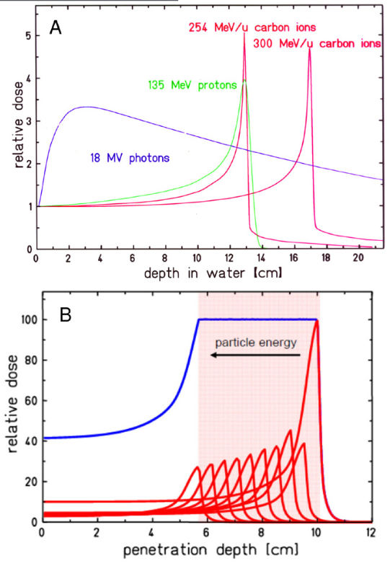
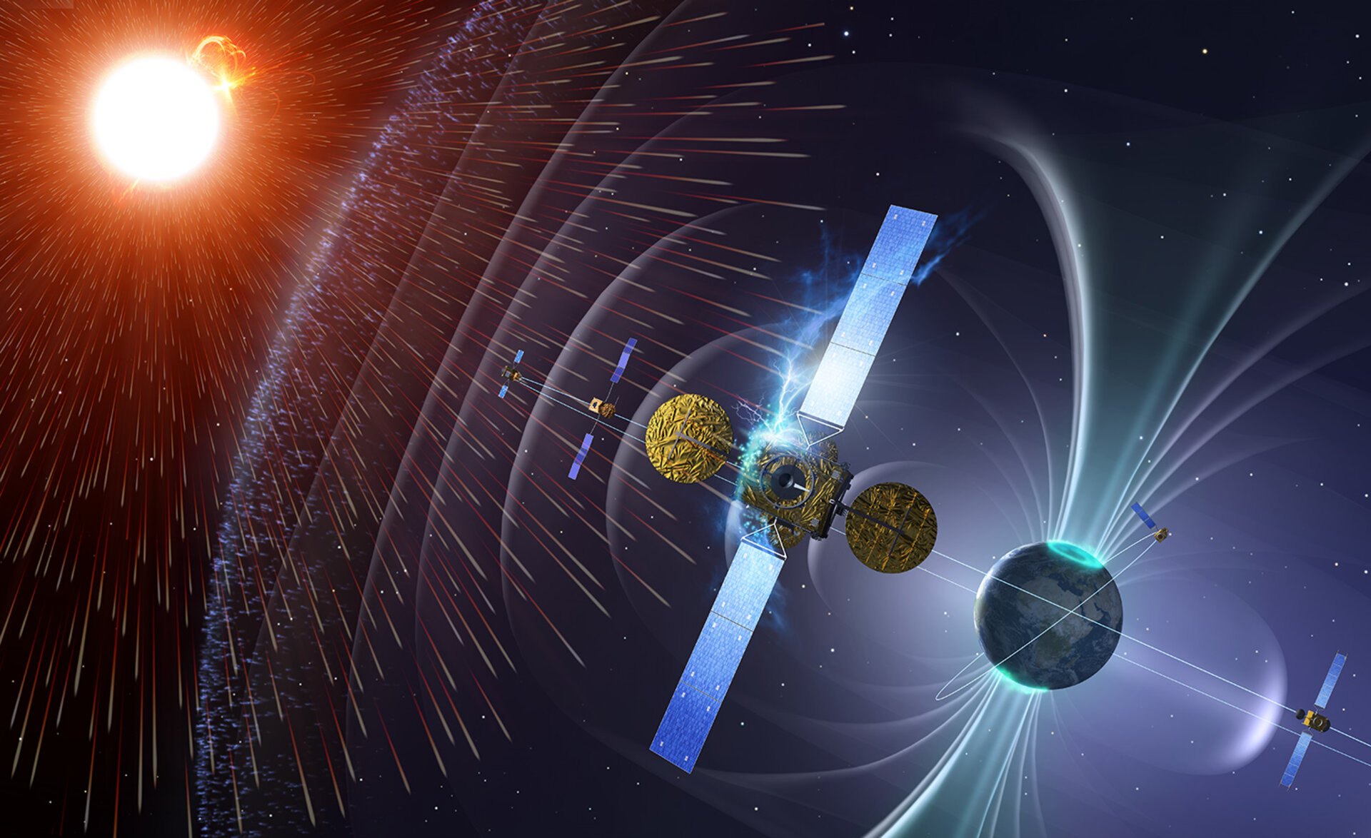
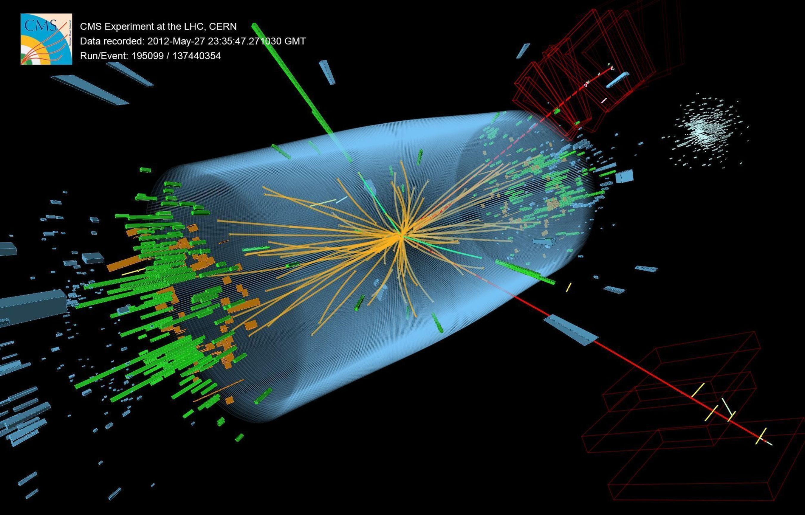
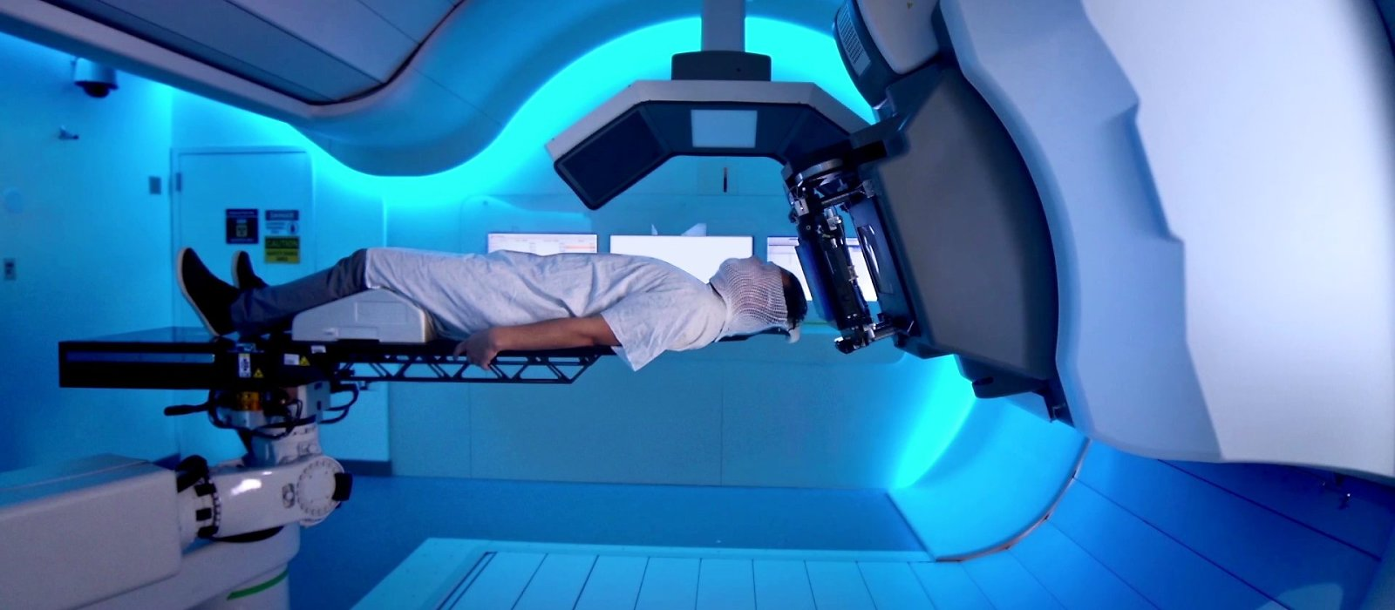
Why radiation tolerance ? (1/2)
Study of detector behavior in extreme conditions
Spatial
High Energy Physics
Medical applications
Durante, M., & Paganetti, H. (2016). Nuclear physics in particle therapy: a review. Reports on Progress in Physics, 79(9), 096702.
Notes:
Why radiation tolerance ? (clic)
Multiple fields where radations are important to take into account or even are the targetted physics : spatial, high energy physics, or medical applications. I participate to a detector development for beam monitoring, particularly for high flux of light ions for radiation therapy (clic). In conventinal radiotherapy, X rays are used. They irradiate healthy tissues before and after targetted tissues, the tumor. Light ions got a peaked dose deposition that helps to not preserve healthy tissues.

Slide 3
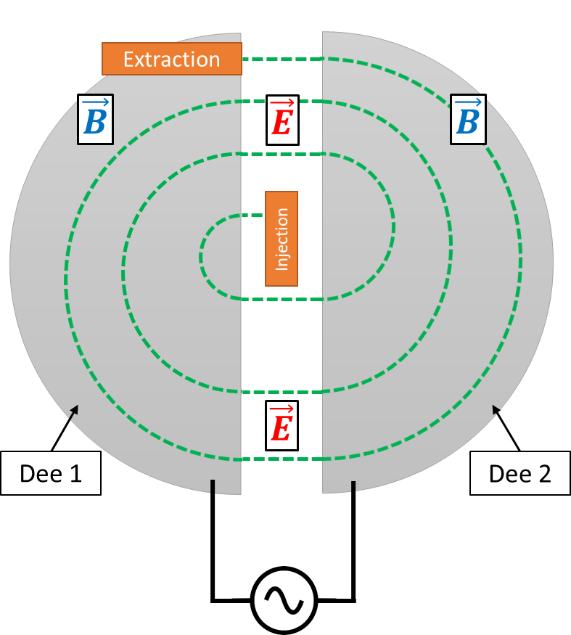
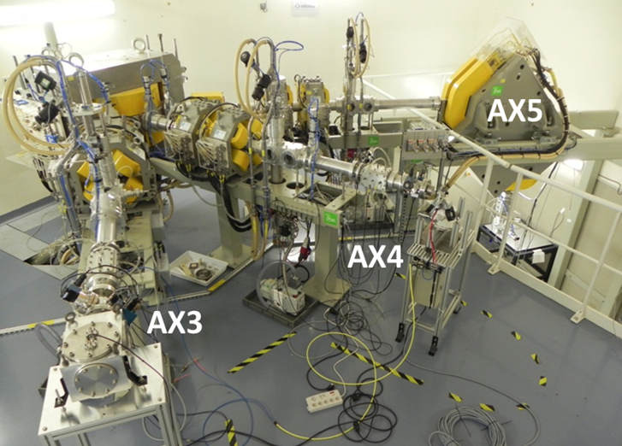
Why radiation tolerance ? (2/2)
DIAMMONI detector : a radiation detector for light ion beams at high flux and fluences (40→ 250 MeV)
$1^{st}$ prototype for ARRONAX cyclotron
ARRONAX cyclotron :
Particle energy : 70 MeV (H-D-He)
Beam intensity $⇒30 µA$
ARRONAX beam
ARRONAX AX casemate
Cyclotron principle
Notes:
DIAMMONI detector is developped for light ion beam accelerators, such as cyclotron. The first prototype is integrated at arronax since april. Arronax is a cyclotron accelerating protons alpha and deuteriums to 70 MeV.

Slide 4
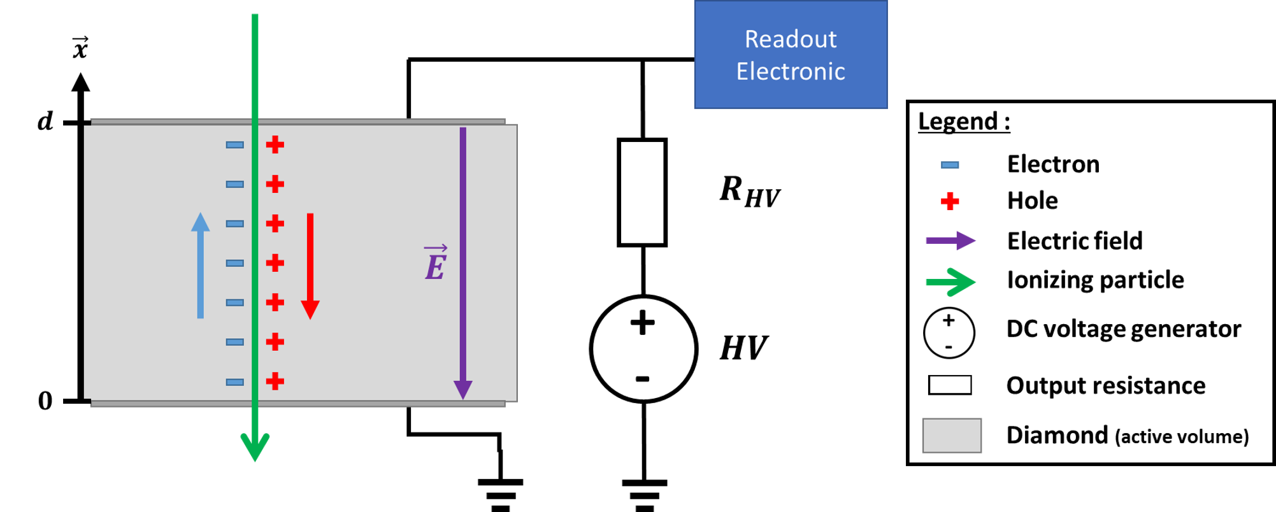
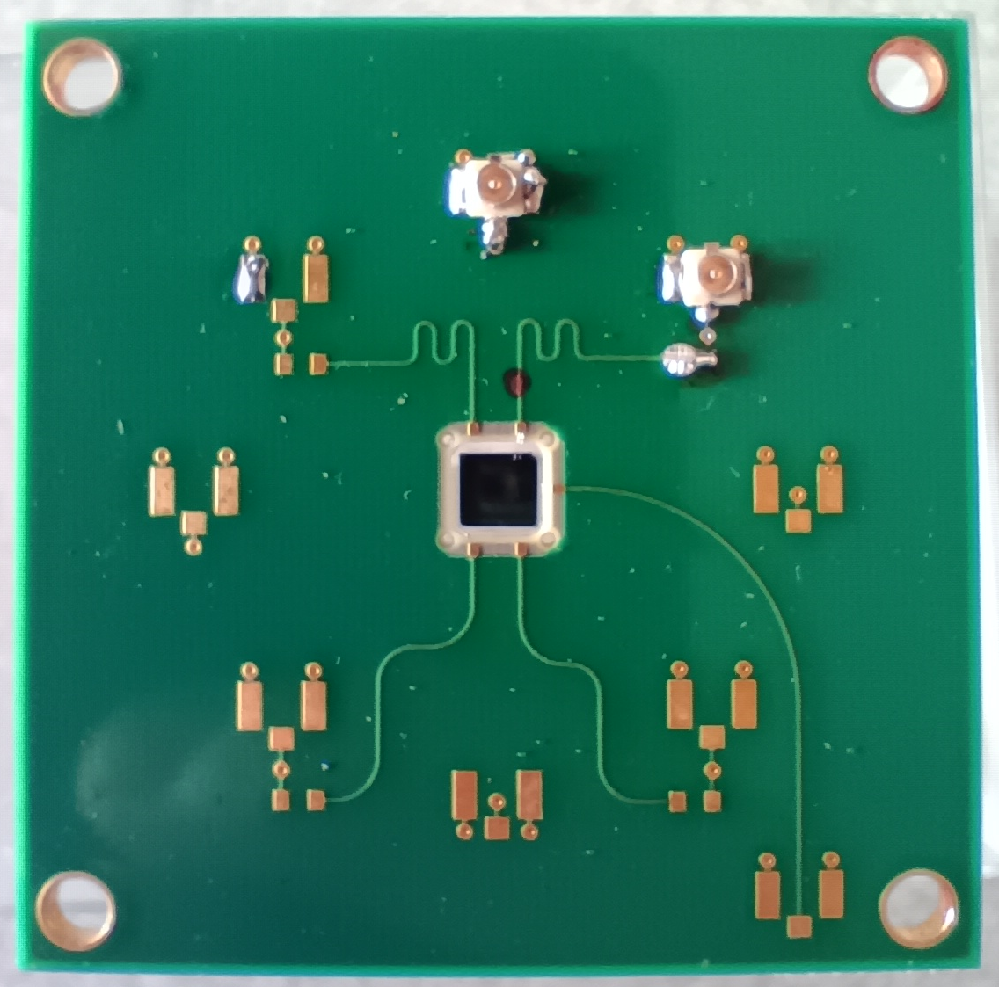
Diamond radiation detector for beam monitoring
Diamond is used as a solid-state ionization chamber
Notes:
Where is the diamond you ‘ll tell me !
It is the radiation detector that we use. We use it as a solid state ionization chamber. Electrons and holes are created along the particle path. Thanks to a strong electric field, theses charge carriers drift. This signal is read by specific readout electronic.
Our samples are metallized on each side with a thin layer of aluminium, and integrated to a PCB.

Slide 5
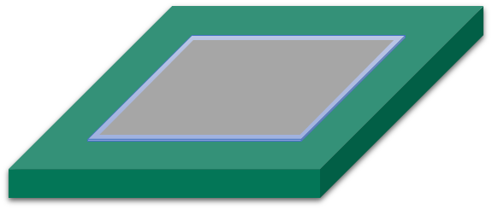
What is flux and fluence ?
Flux relate to the speed of delivery
Supposing
$$S=1 cm²$$
Fluence relate to the history of the device
 | Units | Value
Flux | particle/cm²/s | 0
Fluence | particle/cm² | 0
8
4
16
8 + 16 + 4
8 + 16
28
8
Notes:
I must explain what is flux and fluence first.
If we imagine a diamond sample under radiations. I will represent some particles crossing the detector. First 8 particles are crossing, flux is the number par cm² per second. Lets consider 1 sec irradiation. So it’s a flux of 8. fluence is the cumulated number of particles, so 8 also. After the irradiation, flux coming back to 0, not fluence. And so on and so far, fluence is always increasing and the flux show the speed of delivery.

Slide 6
Experimental setup
68 MeV proton range in diamond : $12.23 mm$
64 MeV alpha range in diamond : $0.90 mm$
$∅ 3 mm$
Al collimator
$∅ 1 mm$
W collimator
Diamond detector
68 MeV proton beam
or
64 MeV
alpha beam
Scattered particles
Notes:
In the future experiments i will discuss, we used a proton beam of 68 MeV or 64 MeV alpha. A wide beam arrives on a first collimator selecting a part of the beam. A second one made of tungsten is selecting more particles so as to reach a small diameter, so as to irradiate on multiple points one single diamond. However, scattered protons are generated by the last collimator, and it has its importance.

Slide 7
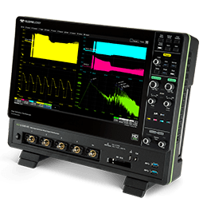
Experimental setup
68 MeV proton range in diamond : $12.23 mm$
64 MeV alpha range in diamond : $0.90 mm$
$∅ 3 mm$
Al collimator
$∅ 1 mm$
W collimator
Diamond detector
68 MeV proton beam
or
64 MeV
alpha beam
$$C_{tank}$$
HV
Acquisition of all waveforms possible
Irradiations with $50 µs$trains of particles
Fast oscilloscope
Notes:
Detector is connected on one side to an oscilloscope for current induced measurement. On the other side, a capacitor and high voltage allow the conservation of the strong electric field with time.

Slide 8
Fluence studies
Gafchromic© film
Target
sCVD Diamond
$$4.6×4.6×0.55 mm^{3}$$
Al metallization
100 nm thick
64 MeV alpha particle
Notes:
First experiment : we used 64 MeV alpha particle. A really pure sCVD diamond of 550 µm thickness was used, nd targetted on 5 different points, at different flux, and approximately same fluence

Slide 9
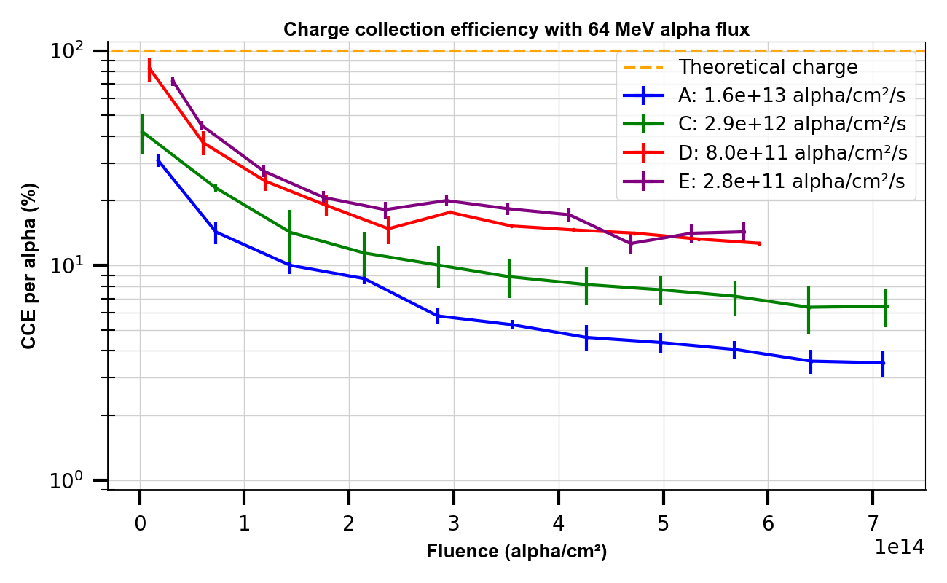
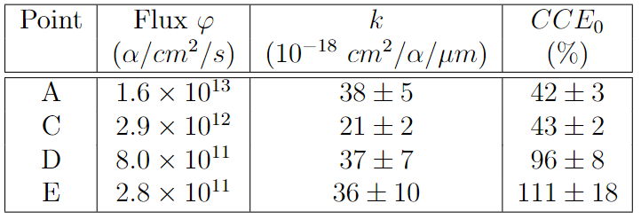
Fluence studies
Hartjes, F., Adam, W., Bauer, C., Berdermann, E., Bergonzo, P., Bogani, F., ... & RD42 Collaboration. (1999). Parameterisation of radiation effects on CVD diamond for proton irradiation. Nuclear Physics B-Proceedings Supplements, 78(1-3), 675-682.
Charge Collection Efficiency
Model with fluence
$$CCE=\frac{CCE_{0}}{1+k d φ }$$
To be published *
$d :thickness$ $φ :fluence$
Damage constant :$64 MeV α$
* PhD thesis R. Molle (2024)
Notes:
Here are the result of charge collection efficiency per particle with the fluence. We see a strong decrease of the CCE with fluence. Also, a behavior with flux : the higher the flux is, the lower is the CCE. A CCE model has been developed by RD42 Collaboration. We observe damge constant k was constant with flux. This paramater is known to depend with the particle energy and type
Paramètre k

Slide 10
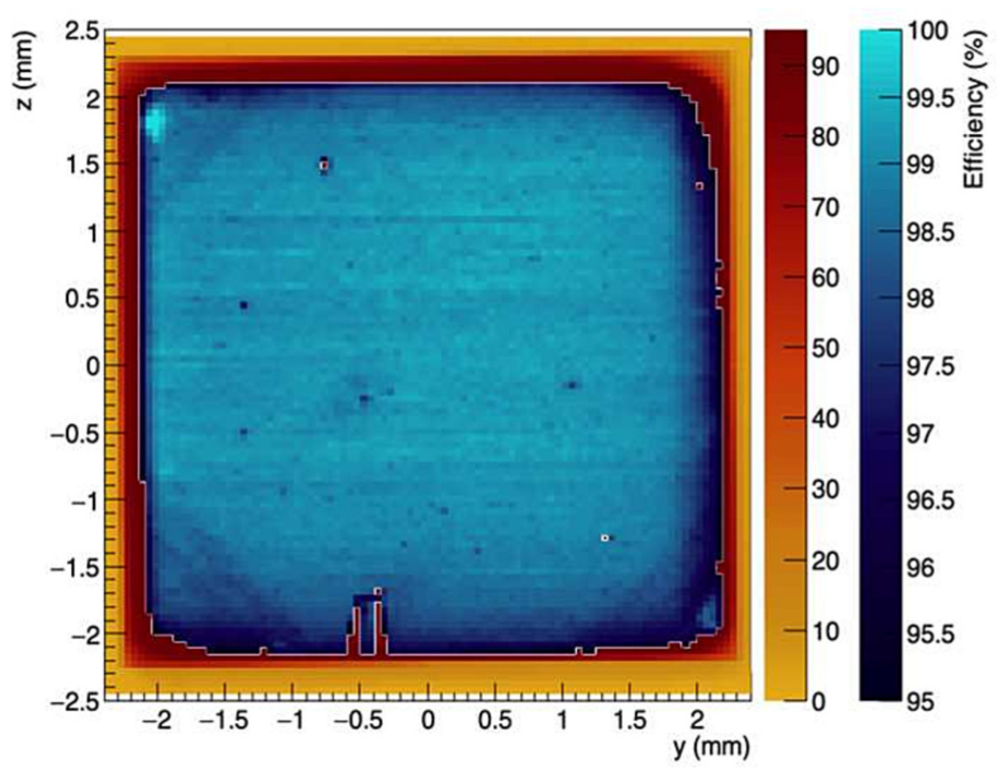
Fluence studies
XBIC map before irradiation
XBIC map after irradiation
XBIC map after irradiation and annealing
$$T=1000°C −6h$$
Diamond after irradiation
Homogeneous
Around $99 \%$ of CCE
5 spots visible ($15 \%$ CCE)
Scattered particles around the spots
Enhanced CCE everywhere
Structure in the spots
Notes:
We characterized our sample with ESRF XBIC technique (cf tallk pierre). As Pierre presented on Monday, the diamond we used was really homogeneous, because it was an electronic grade. After irradiation, we were able to see the 5 spots because of a light blue/green colo, sign of a color center. XBIC technique shows a strong decrease of charge collection efficiency. Scattered protons can be seen around theses spots, with the gradient of CCE.
The last figure shows the same diamond after annealing and XBIC map. We see an enhanced charge collection efficiency thanks to this technique.

Slide 11
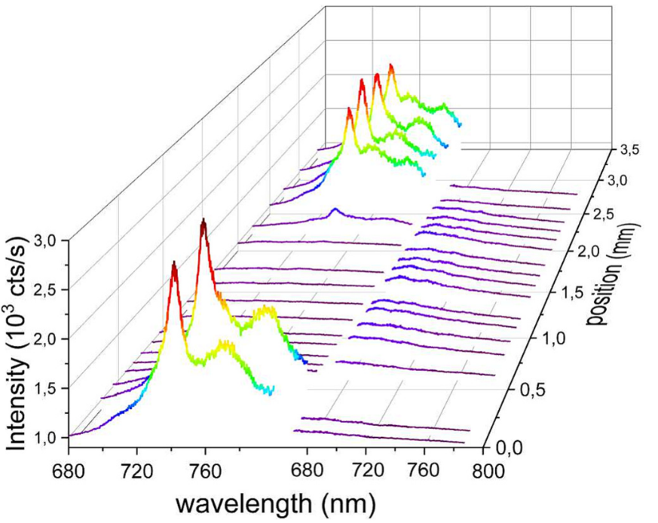
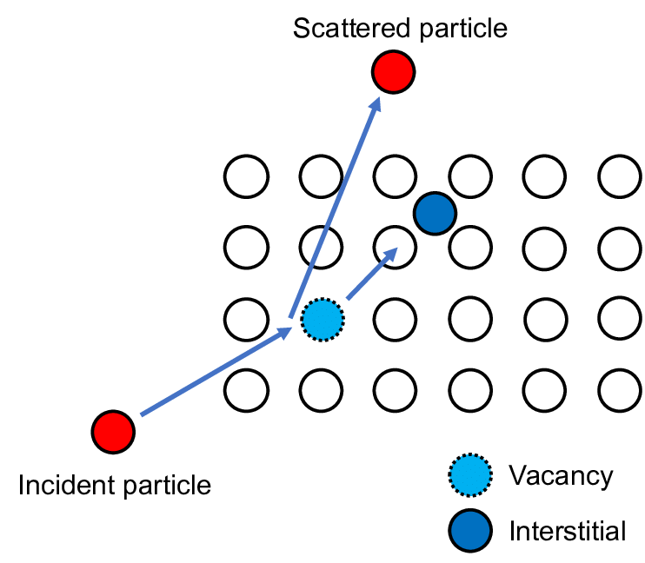
Fluence studies
XBIC map after irradiation
$$10^{15} α/cm²$$
Raman-PL
XBIC map after irradiation and annealing
$$T=1000°C −6h$$
GR1 centers created (Vacancies)
After annealing : NV centers apparent
F. Lafont 2023
Notes:
we did some raman photoluminescence measurements before and after annealing. We published that in an article of Fabien, and thanks to Diamfab we determined GR1 centers creations with the irradiation, and no more after annealing. Some of theses vacancies combined with nitrogen to create NV centers. We did that with alpha particle but we wanted to study particularly for protons

Slide 12
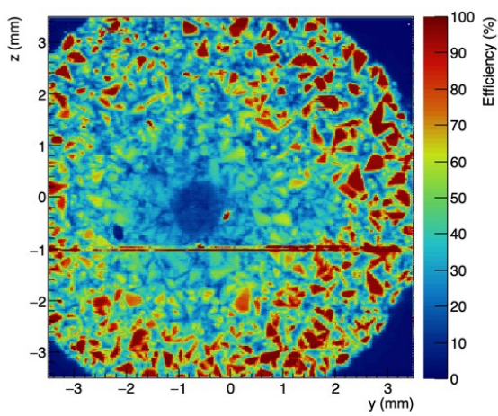
Fluence studies
XBIC maps
sCVD Diamond
$$4.6×4.6×0.55 mm^{3}$$
pCVD Diamond
$$4.6×4.6×0.30 mm^{3}$$
68 MeV proton
Notes:
So we did a close experiment with 68 MeV protons. However, we used a sCVD diamond and a pCVD diamond. And we irradiate them with vairuous flux and fluence. We irradiate from the lowest fluence to the highest to avoid fluence effects. You have the XBIC maps of theses diamonds. You can see the effect of scattered protons here.

Slide 13
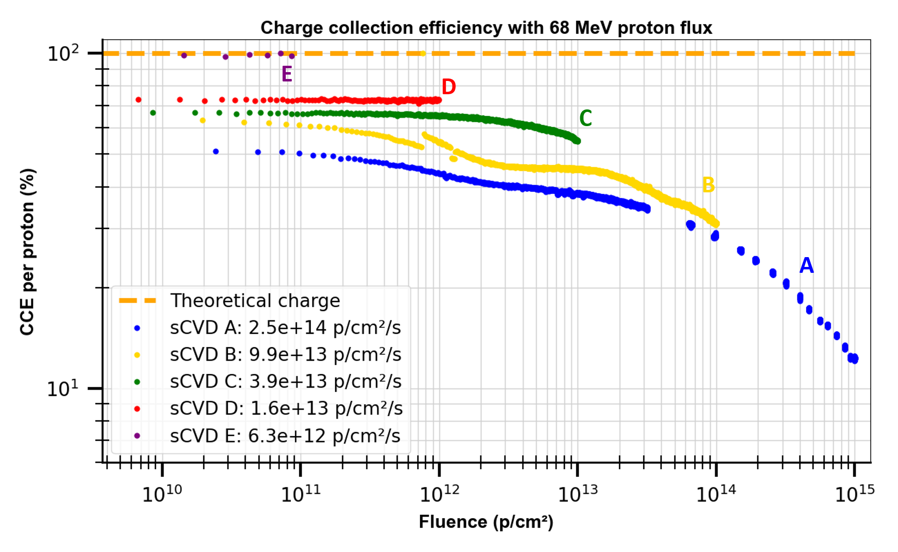
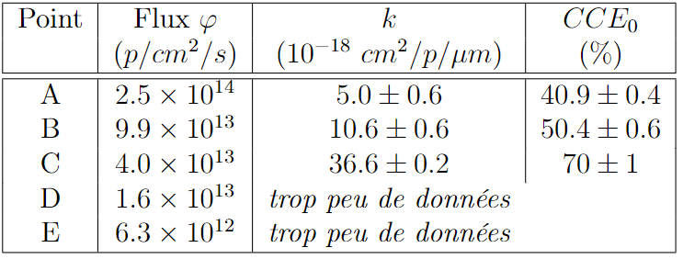
Fluence studies
Charge Collection Efficiency
Model with fluence
$$CCE=\frac{CCE_{0}}{1+k d φ }$$
$d :thickness$ $φ :fluence$
Damage constant :$68 MeV p$ sCVD
To be published *
Not enough data
sCVD
* PhD thesis R. Molle (2024)
Notes:
Here is the charge collection efficiency with fluence. We see the same behavior with flux : a decrease of CCE without any fluence with flux. It is due to Electric field variations inside the substrate. We matched also with the same model than previously. Here we saww a decrease of the k parameter with flux. In fact, we see also an issue with highest flux, because a second contribution seems to be visible.

Slide 14
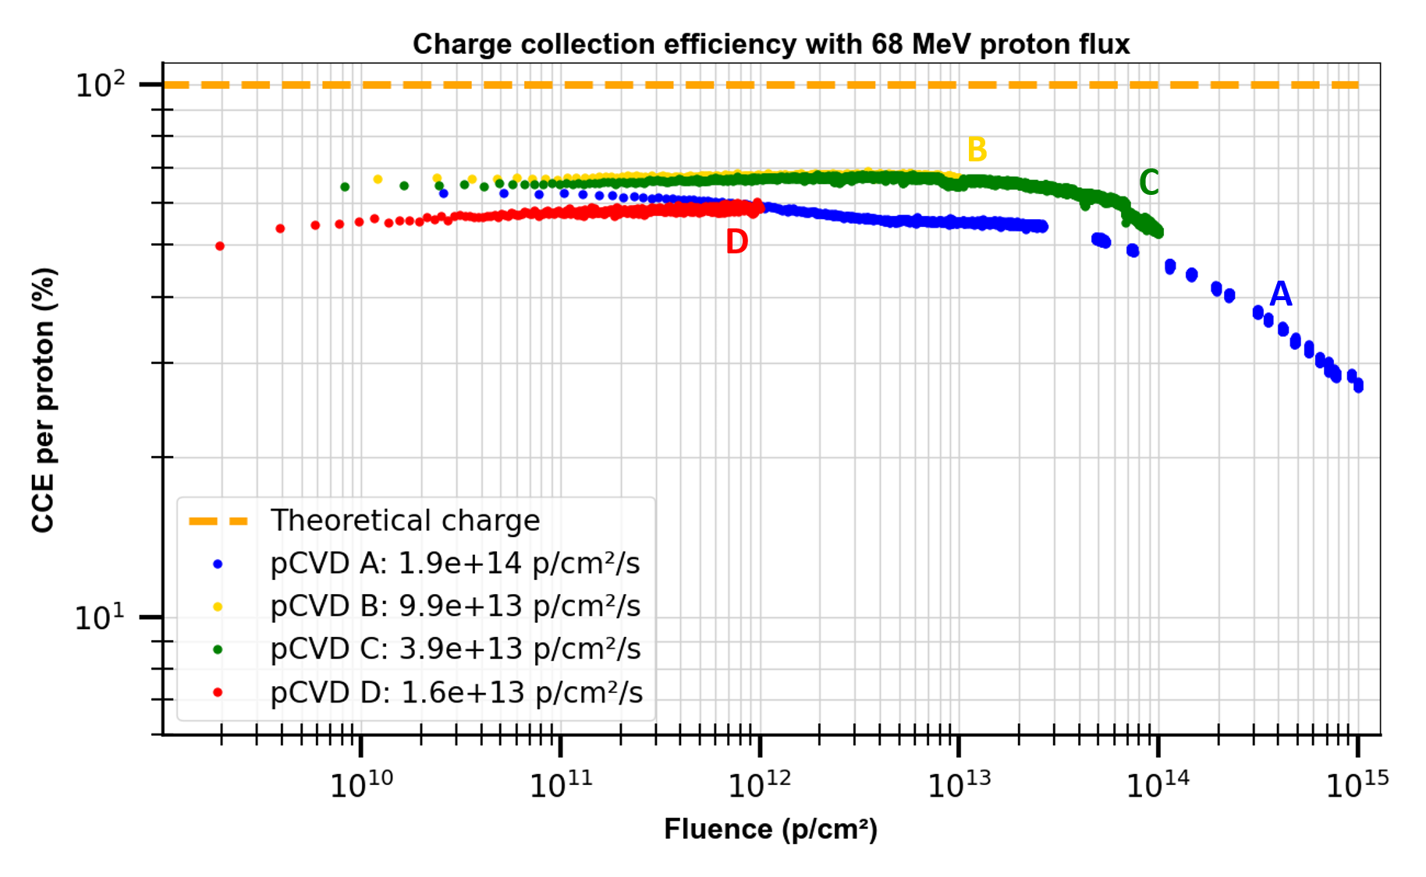
Fluence studies
Charge Collection Efficiency
Model with fluence
$$CCE=\frac{CCE_{0}}{1+k d φ }$$
$d :thickness$ $φ :fluence$
To be published *
Damage constant :$68 MeV p$ pCVD
Not enough data
pCVD
Not enough data
* PhD thesis R. Molle (2024)
Notes:
For pCVD diamond, we have the same global behavior. We see here a constant k with flux. Again, a contribution seems visible at high flux. Moreover, we see D point got an increasing CCE with fluence

Slide 15
Fluence studies
Diamond | Flux (p/cm²/s) | Fluence (p/cm²)
D1 | $$8.2×{10}^{13}$$ | $$1.96×{10}^{15}$$
D2 | $$1.3×{10}^{12}$$ | $$0.78×{10}^{15}$$
D3 | $$1.9×{10}^{12}$$ | $$1.21×{10}^{14}$$
D4 | $$1.9×{10}^{12}$$ | $$1.21×{10}^{13}$$
68 MeV proton
Notes:
The next experiment was design to avoid this effect. One single diamond was cut in two, and one of these two was cut in 4 to make 4 different detectors. There were irradiated separetely with various fluence, but 3 of them got same flux.

Slide 16
Experimental setup
68 MeV proton range in diamond : $12.23 mm$
64 MeV alpha range in diamond : $0.90 mm$
$∅ 3 mm$
Al collimator
$∅ 1 mm$
W collimator
Diamond detector
68 MeV proton beam
Scattered particules
Notes:
To avoid scattered protons, we removed collimators so as to irradiate the more homogeously the sample.

Slide 17
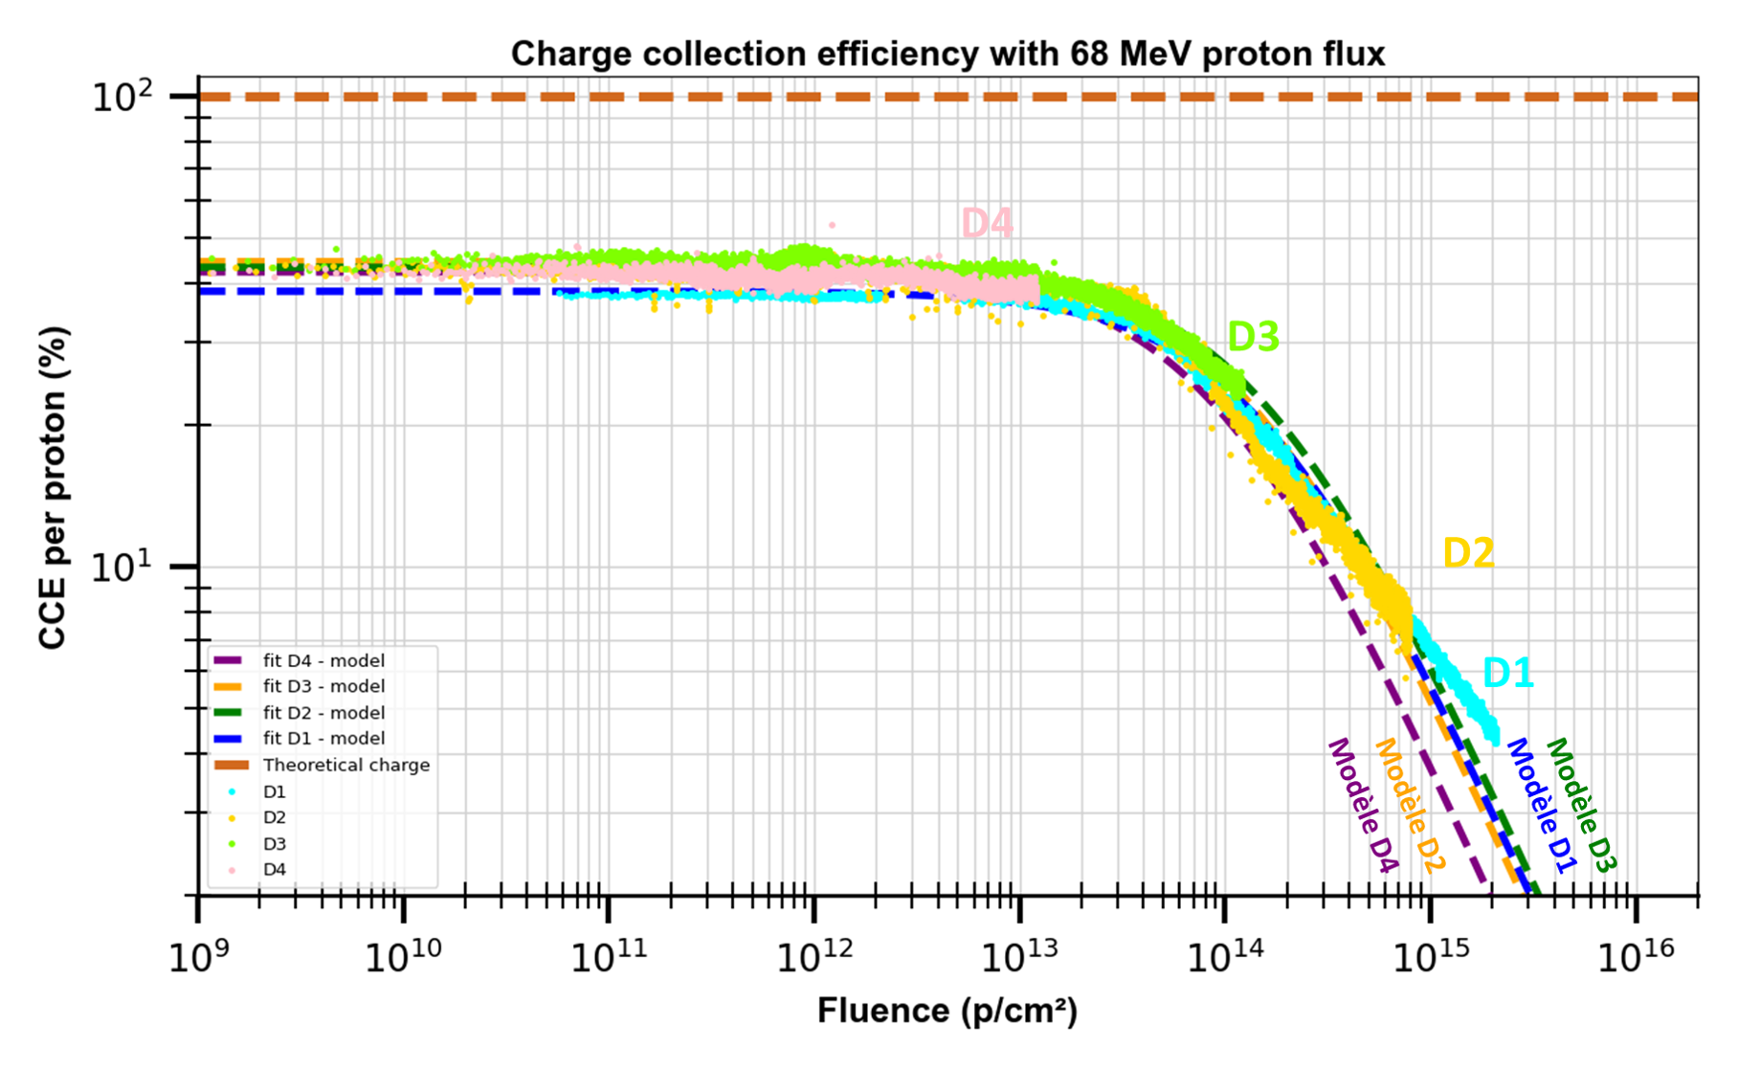
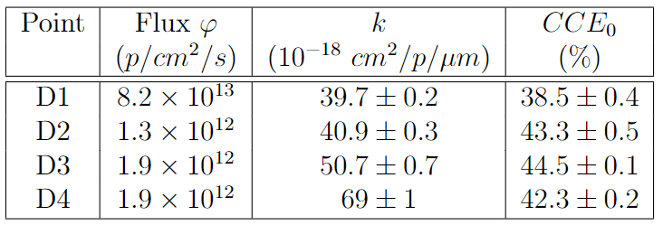
Fluence studies
Charge Collection Efficiency
Model with fluence
$$CCE=\frac{CCE_{0}}{1+k d φ }$$
$d :thickness$ $φ :fluence$
Damage constant :$68 MeV p$ sCVD
To be published *
An incomplete model?
* PhD thesis R. Molle (2024)
Notes:
In that case, we saw more regular data withthe same behavior. I represent also the model of single velocity. In that cas we see k is increasing with flux. We have to understand more what is happening with this k parameter with flux. One of the drawbacks is the precision on fluence delivered.

Slide 18
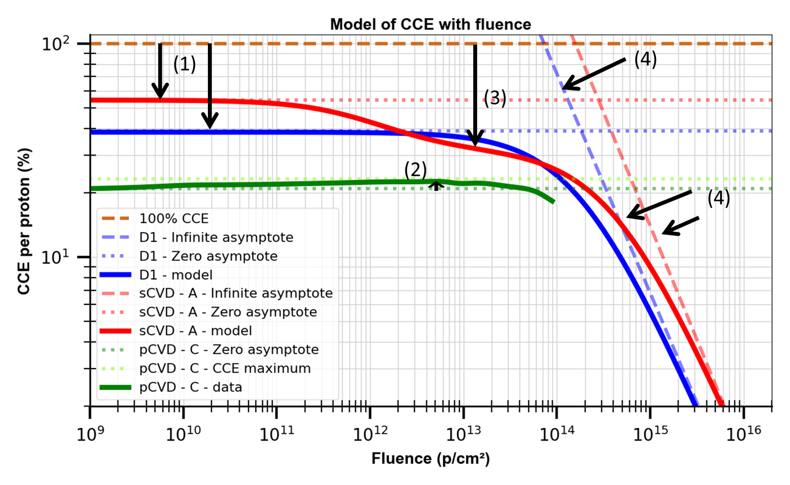
Fluence studies
(1) Crystal intrinsic quality + Flux
(2) Traps filling
(for pCVD mainly)
(3) Inhomogeneity of defects ➔ scattered particle
(4) Cumulated defects with fluence
Notes:
A global behavior can be extracted from our studies. 4 different contributions can be identified : (1) the impact of crystal intrinsic quality, that lower the Global CCE without fluence. In the case of pCVD mainly, some traps can be filled, and create an increase of the CCE even if we accumulate defects. (3) inhomogeneity of defects in the crystal can lead to a second plateau as seen on the red curve. (4) at really high fluence, diamond is dominated by defects created in the crystal due to radiations.

Slide 19
Conclusion
Development of a specific detector for extreme radiations conditions
DIAMMONI detector
Studies were done about flux (PhD thesis R. Molle (2024))
Studies about fluence :
Model observation function of crystal quality and defects created
Understudies : annealing process to enhance detector lifetime

Slide 20
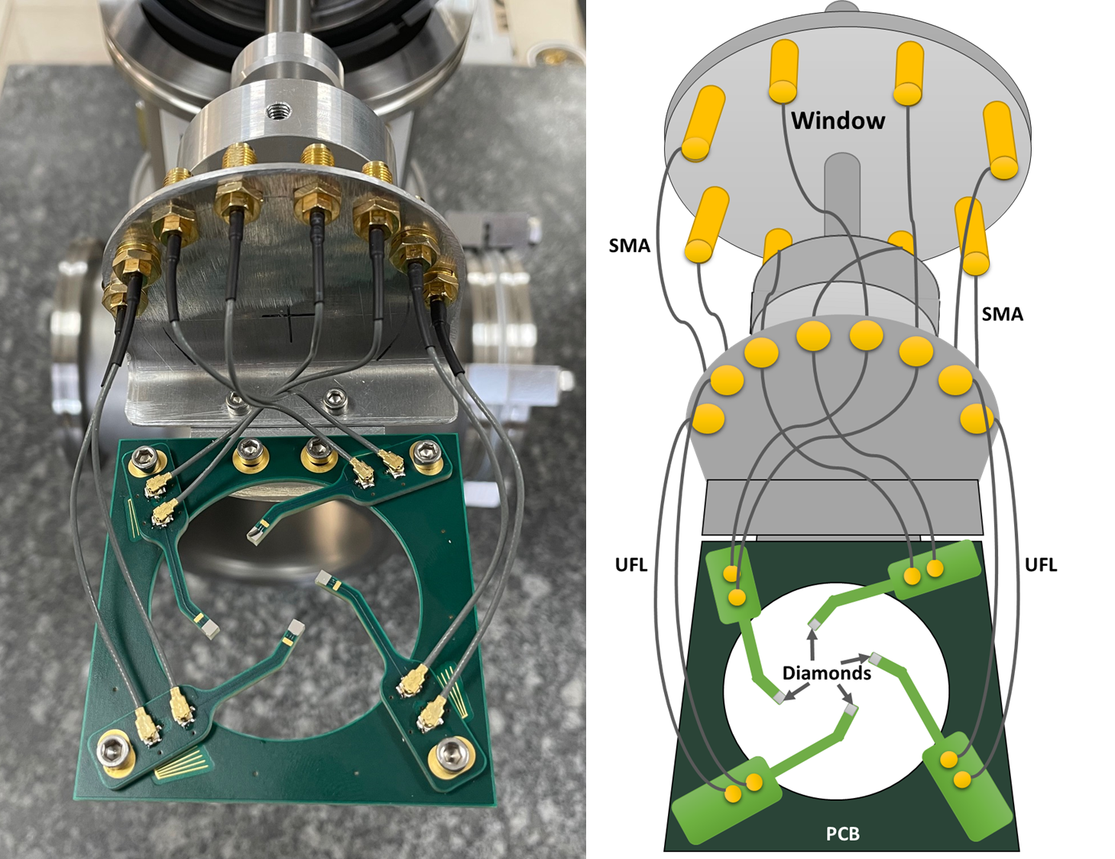
DIAMMONI detector
A detector integrated to AX beam line at ARRONAX
Online control of dose and beam monitoring
DIAMMONI detector – Train Counting

Slide 21
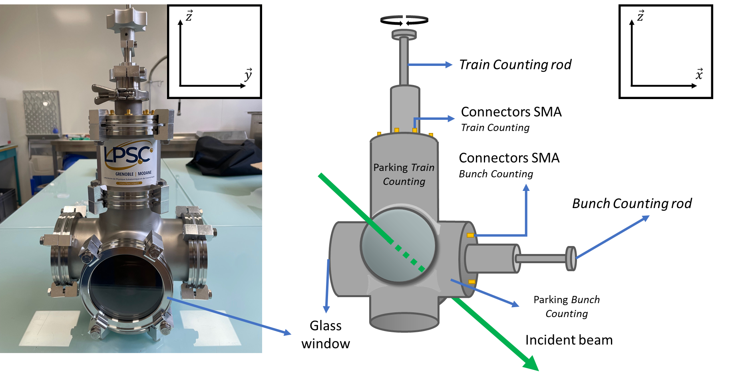
DIAMMONI detector
DIAMMONI detector

Slide 22
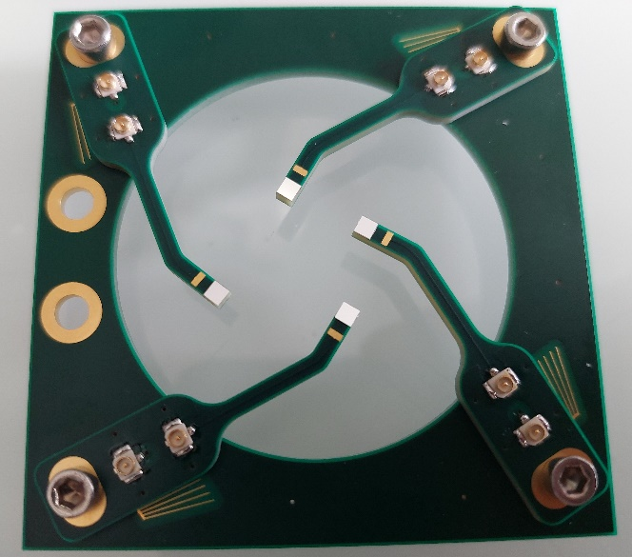
Thank you for your attention !
R. Molle, N. André, Y. Arnoud, A. Bes,
J-L Bouly, J. Collot, D. Dauvergne,
L. Gallin-Martel, M-L Gallin-Martel,
O. Guillaudin, C. Hoarau, A. Lacoste, F. Lafont,
E. Lagorio, J. Livingstone, S. Marcatili, M. Marton, A. Mohammed-Matallah, J-F Muraz, N. Ponchant, F. Rarbi, M. Reynaud, O. Rossetto, J. Waquet
M. Evin, A. Guertin, F. Haddad,
C. Koumeir, V. Métivier, R. Molle,
Q. Mouchard, F. Poirier, N. Servagent
J. Bassaler, J. Bousquet, J. Letellier, D. Nusimovici
P. Everaere, F. Laffont, T-N. Tran-Caliste

Slide 23
Back up slides

Slide 24
Why radiation tolerance ?
FLASH Therapies
Carbontherapy
Protontherapy
Hadrontherapies
External radiotherapies
Radiotherapies

Slide 25
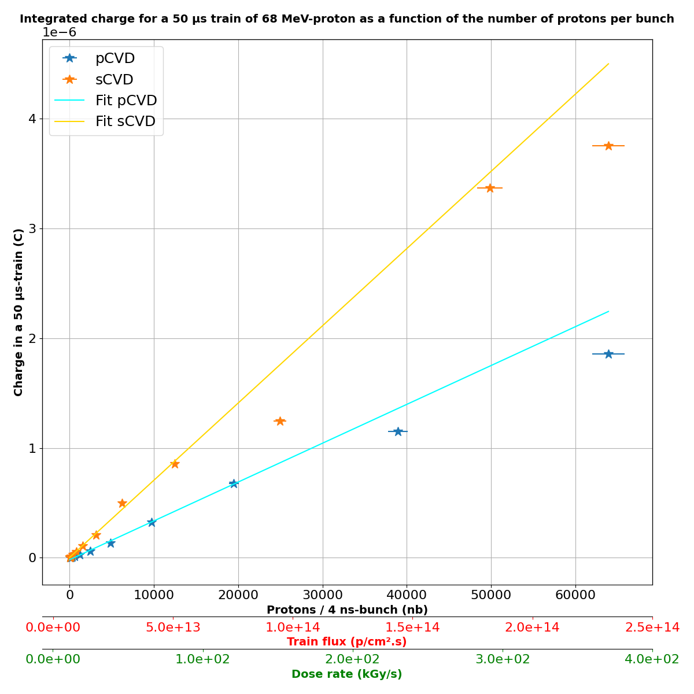
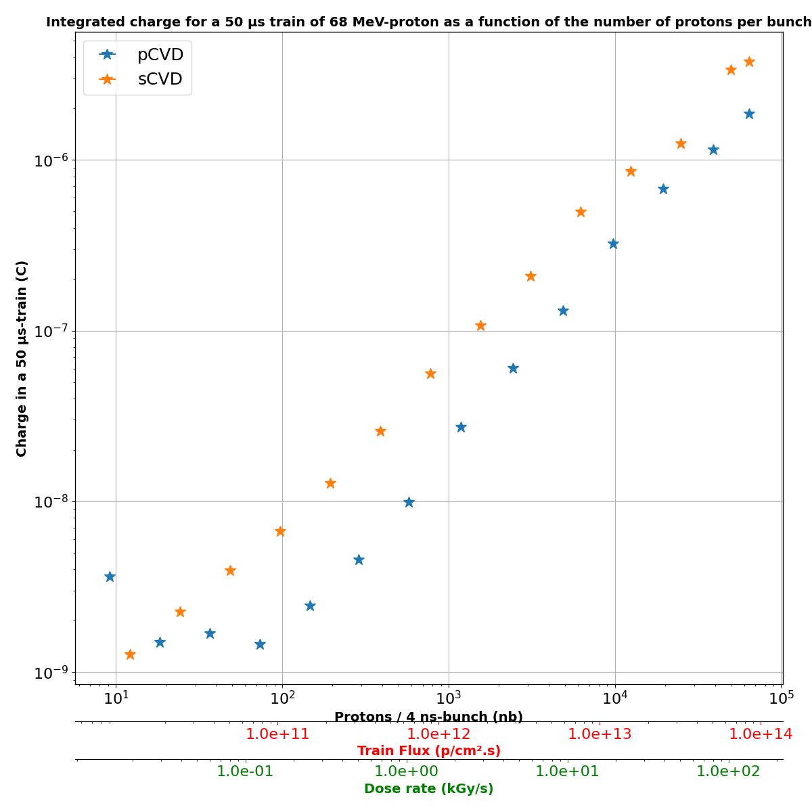
Not published yet
Not published yet

Slide 26
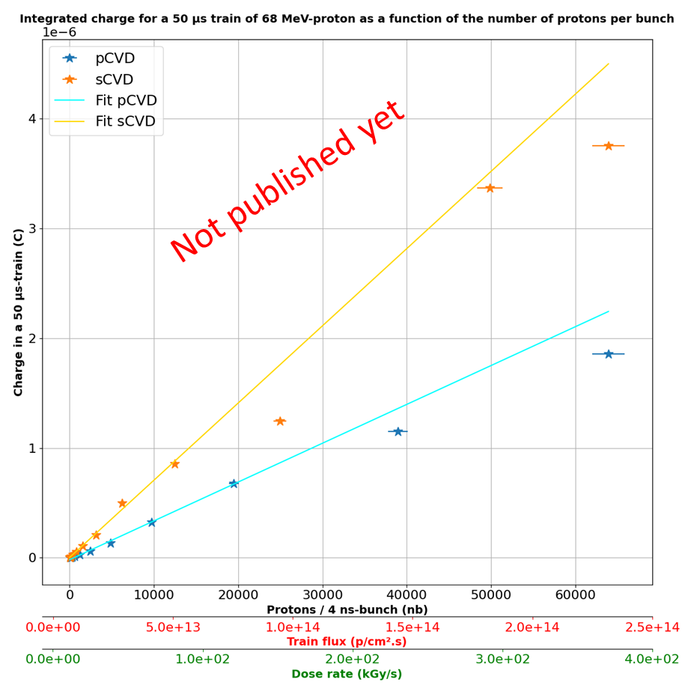
Flux studies
Each point corresponds to one train
50 µs train for low cumulated fluence
Study with sCVD 550 µm and pCVD 300µm
Some points apart the linearity :
Sign of saturation of CCE (no!)
Scattered protons (no!)
Fluctuation of the beam (certainly)

Slide 27
Fluence studies
Irradiation sequence : E➔D➔C➔B➔A
Intrinsic defects in diamond
Additionnal defects from irradiation
Charge Collection Efficiency
Model with fluence
CVD diamond
$$CCE=\frac{CCE_{s}}{1+k_{s} d φ }+\frac{CCE_{f}}{1+k_{f} d φ }$$
Defect density
BEFORE
1 a.u.
5 a.u.
$$×5$$
Decreased CCE with defects already created
Defect density
AFTER
7 a.u.
11 a.u.
$$×1.6$$
Need to avoir scattered particules
Bhattacharya, A., Grotjohn, T. A., & Stolz, A. (2016). Degradation of single crystal diamond detectors in swift heavy ion beams. Diamond and Related Materials, 70, 124-131.
Notes:
the second contribution was explained in some papers that has seen this effect, with an inhogeneous densities of defects in one sample. For example, i took on diamond. I take two differents zones. We see various intrinsic defects numbers between the two zones. So the variation of CCE in theses two cases will be really important. If we irradiate, we cumulate the same amount of number in each zone theorically. This leads to an homogenisation of the density of defects, because de variation of density will be low. As a matter of fact, CCE will be less variant between the two irraidated zones. This effect was modelized by this formula, with a fast component and a slow component.
In our case, we understood that CCE has been affected by scattered particules, because of the procimity of the irradiated spots.

