Slide 1


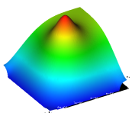
ECORCE
Finite volume software
http://www.ecorce.eu
Overview of TCAD modeling of components
Capabilities of ECORCE
Alain Michez
Delphea, University of Montpellier – IES laboratory, Montpellier, France
25/06/2024 GDR IN2P3
Notes:
Good morning,
I am Alain Michez from the University of Montpellier.
I will present an overview of TCAD modeling for components under radiation.
The goal of this presentation is to present the physical models ECORCE is able to simulate and to see how it can help you in your research project.
L’objectif de cette présentation est de vous montrer les possibilités offerte par le logiciel ECORCE et de voir s’il pourrait être utile pour vos travaux de recherche.

Slide 2
ECORCE
Finite volume software
https://www.delphea.eu
ECORCE?
Etude du COmportement sous Radiation des Composants Electroniques
Similar to SENTAURUS and ATLAS
Designed to ease TCAD implementation
Special features
Full graphical interface
Control of model definition
Dynamic mesh
Optimizer (equivalent to DOE)
Radiation effect modeling
Single event, dose and dose rate effects
Multiple trapping-detrapping model in insulator volume and at interfaces
Lacks
Process modeling
3D
suitable for teaching (11 years effects of radiation,13 years finite element method)
125000 lines of code, 34 years of development, university of Montpellier
Commercial distribution by the SAS Delphea

Slide 3
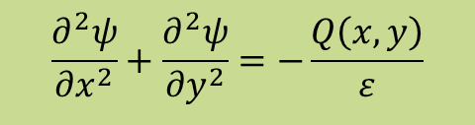
ECORCE
Finite volume software
http://www.ecorce.eu
Mesh design
TCAD → Technological Computer Aided Design
Modeling of component based on semiconductors and insulators,
by solving differential equations: Poisson, Transport, Heat, Trapping, …
No analytical solution, solving method:
Discretisation of differential equations: Variation of DF linear in each element
Approximate solution: mesh adjusted to control the error
$$\frac{∂^{2}ψ}{{∂x}^{2}}+\frac{∂^{2}ψ}{{∂y}^{2}}=−\frac{Q\left(x,y\right)}{ε}$$
Notes:
Firstly I will discuss of a general problem: the mesh quality.
Since electronics components are made with semiconductors and insulators, TCAD modeling modelise the behavior of these devices
By solving the differential equations in these materials, using parameters like permitivity, mobility and so on.?

Slide 4
ECORCE
Finite volume software
http://www.ecorce.eu
Mesh design
Potential
V₁
V₄
Finer mesh on high gradient area
→ improves precision of results
V₂
V₃
Potential
Node 1
x₁
Node 2
x₂
Node 3
x₃
Node 4
x₄
x
V₄
High gradient area, need to add nodes
V₃
V₂
Coarse mesh on low gradient area
→ reduces computation time
V₁
Node 1
x₁
Node 2
x₂
Node 3
x₃
Node 4
x₄
“Dynamic mesh for TCAD modeling with ECORCE”, A Michez et al 2016 J. Phys.: Conf. Ser. 738 012128
x
Low gradient area, need to remove node
Complicated task → difficult to design an optimized mesh by hand
Should be automatically handled by the TCAD tool.
ECORCE provides a dynamic mesh generator that add and remove nodes at each step of the modeling
With ECORCE, no more convergence problem induced by the mesh
Is it really so important for results precision?
Notes:
Firstly I will discuss of a general problem: the mesh quality.
Since electronics components are made with semiconductors and insulators, TCAD modeling modelise the behavior of these devices
By solving the differential equations in these materials, using parameters like permitivity, mobility and so on.?

Slide 5
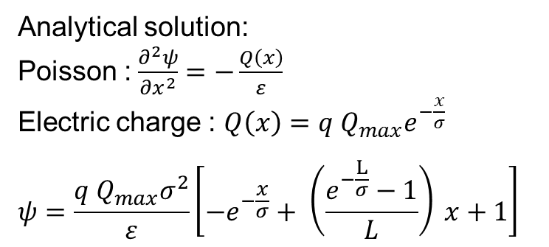
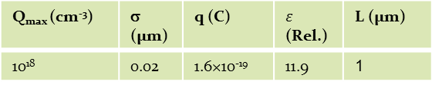
ECORCE
Finite volume software
http://www.ecorce.eu
Mesh Design
Q_{max} (cm⁻³) | σ (µm) | q (C) | $ε$ (Rel.) | L (µm)
10¹⁸ | 0.02 | 1.6×10⁻¹⁹ | 11.9 | 1
Analytical solution:
Poisson : $\frac{∂^{2}ψ}{{∂x}^{2}}=−\frac{Q\left(x\right)}{ε}$
Electric charge : $Q\left(x\right)={q Q}_{max}e^{−\frac{x}{σ}}$
$$ψ=\frac{{q Q}_{max}σ^{2}}{ε}\left[−e^{−\frac{x}{σ}}+ \left(\frac{e^{−\frac{L}{σ}}−1}{L}\right) x+1\right]$$
Potential induced by Q(x) for a 1um wide device
(Analytical solution)
Error:
70% → 62.5 nm mesh size (17 nodes)
0.3% → 3.9 nm mesh size (257 nodes)
0.16% → variable mesh size (77 nodes)
Mesh quality is critical for results reliability.
Adding complex models useless if mesh badly designed
Relative error compared to the analytical solution
as a function of the mesh size (markers: nodes of the mesh)
Notes:
Most often we are not able to calculate analytical solution for differential equations, especially for 2D and 3D.
Here, in 1D we are able to find an analytical solution for the equation of Poisson.
Considering this electrical charge distributed as a decreasing exponential over the device,
We can find this exact solution you can see here:
the potential along the y axis as a function of the position in the device along the x axis.
Now let us calculate the relative error between this analytical solution and the solution given by a TCAD tool for various meshes.
This chart gives this error as a function of the position for:
Constant mesh size of 62 nm. The relative error is closed to 100%. This means we have an error of a factor 2.
This is surprising since the mesh size does not seem so coarse.
Reducing the mesh size we see a reduction of the error and the best result is for a constant mesh size of 3.9 nm
That need 257 nodes for the 1µm device and give an error of 0.3 %
Now, with a variable mesh size calculated by the TCAD tool, we need only 77 nodes for the best precision of 0.16%

Slide 6
ECORCE
Finite volume software
http://www.ecorce.eu
TID
Total Ionizing dose -> electron/hole pairs generated
in the whole structure
Silicon → charges quickly recombined/collected at the contact
Oxide → positive charge trapped on defects.
Many oxides used in all components: MOSFET, Bipolar, ...
3 models available: → Fixed charge (available with all TCAD tools)
→ Srour model (available with ECORCE and ???)
→ Precursor model (available only with ECORCE))
Gate
Drain
Source
STI
N +
N +
STI
P substrate
Buried Oxide
Handle Wafer
Substrate
Oxides in a PDSOI structure
Notes:
This is a schematic view of a n MOS transistor.
I will use this structure to illustrate my comments.
So transistors are mainly composed of silicon and oxide.
Applying a Total Ionizing Dose will generate electron hole pairs in the components.
This charge will be quickly collected at the contact in silicon and others conductive materials.
In insulators, the generated electron are also collected at the contact or at the interface,
but holes are trapped on defects.
Over time a high positive charge appears in oxides, depending on the dose rate, the electric field and the temperature.
This charge will change the characteristic of the transistor, whatever the oxide it is deposited: Gate oxide, Shallow Trench Insulator or Buried Oxide.
For this presentation, I will focus on the gate oxide since the degradation is easy to quantify with the threshold voltage shift,
Of course, it is well known that, because of the very low thickness of this oxide in recent technology, the threshold voltage shift can be neglected today for most transistor.

Slide 7
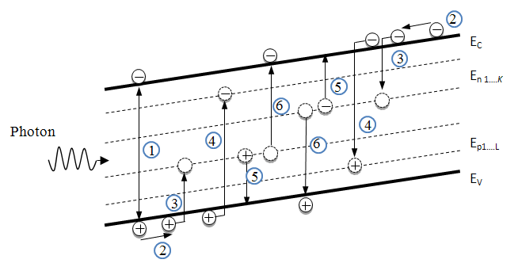
ECORCE
Finite volume software
http://www.ecorce.eu
TID: Srour Model
O. L. Curtis Jr and J. R. Srour, “The multiple‐trapping model and hole transport in SiO2”, J. Appl. Phys., vol. 48, no. 9, pp. 3819–3828, 1977
Oxide → wide band gap semiconductor
→ defects inside the gap, trap charges
Traps defined by → activation energy
→ density
Semiconductor → displacement damages
Oxide/semiconductor interface -> interface trap
Phenomena taken into account
electron-hole pairs generated by radiation
drift-diffusion of carriers in their respective allowed band
trapping of free carriers
recombination of trapped carriers by free carriers of the opposite type
thermal reemission of trapped carriers to their respective allowed band
⑥ thermal reemission of a free electron or hole from an empty trap
Trapping-detrapping on defects inside the band gap during irradiation.
Srour model → Traps are considered to be pre-existing in the oxide
ECORCE also provides an improved model (traps are created during irradiation)

Slide 8
ECORCE
Finite volume software
http://www.ecorce.eu
Wide gap semiconductors
 | Activation Energy (eV) | Traps density (cm⁻²) | Capture cross section (cm²) | Recombinaison cross section (cm²)
Hole traps Level 0 | 2.77 | 4.39 x 10¹¹ | 1.5 x 10⁻¹³ | 1.6 x 10⁻¹²
Hole traps Level 1 | 2.88 | 6 x 10¹¹ | 1.5 x 10⁻¹³ | 1.6 x 10⁻¹²
Hole traps Level 2 | 2.94 | 3.49 x 10¹¹ | 1.5 x 10⁻¹³ | 1.6 x 10⁻¹²
Electron traps Level 0 | 1.2 High enough to remove thermal reemission | 1.7 x 10¹¹ | 8 x 10⁻²² | 4.8 x 10⁻¹²
 | Activation Energy (eV) | Traps density (cm⁻²) | Capture cross section (cm²) | Recombinaison cross section (cm²)
Hole traps Level 0 | 2.77 Curve @ | 4.39 x 10¹¹ | 1.5 x 10⁻¹³ | 1.6 x 10⁻¹²
Hole traps Level 1 | 2.88 | 6 x 10¹¹ | 1.5 x 10⁻¹³ | 1.6 x 10⁻¹²
Hole traps Level 2 | 2.94 | 3.49 x 10¹¹ | 1.5 x 10⁻¹³ | 1.6 x 10⁻¹²
Electron traps Level 0 | 1.2 High enough to remove thermal reemission | 1.7 x 10¹¹ | 8 x 10⁻²² | 4.8 x 10⁻¹²
 | Activation Energy (eV) | Traps density (cm⁻²) | Capture cross section (cm²) | Recombinaison cross section (cm²)
Hole traps Level 0 | 2.77 | 4.39 x 10¹¹ | 1.5 x 10⁻¹³ | 1.6 x 10⁻¹²
Hole traps Level 1 | 2.88 | 6 x 10¹¹ | 1.5 x 10⁻¹³ | 1.6 x 10⁻¹²
Hole traps Level 2 | 2.94 | 3.49 x 10¹¹ | 1.5 x 10⁻¹³ | 1.6 x 10⁻¹²
Electron traps Level 0 | 1.2 | 1.7 x 10¹¹ | 8 x 10⁻²² | 4.8 x 10⁻¹²
 | Activation Energy (eV) | Traps density (cm⁻²) | Capture cross section (cm²) | Recombinaison cross section (cm²)
Hole traps Level 0 | 2.77 Curve @ | 4.39 x 10¹¹ | 1.5 x 10⁻¹³ | 1.6 x 10⁻¹²
Hole traps Level 1 | 2.88 Curve @ | 6 x 10¹¹ | 1.5 x 10⁻¹³ | 1.6 x 10⁻¹²
Hole traps Level 2 | 2.94 | 3.49 x 10¹¹ | 1.5 x 10⁻¹³ | 1.6 x 10⁻¹²
Electron traps Level 0 | 1.2 High enough to remove thermal reemission | 1.7 x 10¹¹ | 8 x 10⁻²² | 4.8 x 10⁻¹²
 | Activation Energy (eV) | Traps density (cm⁻²) | Capture cross section (cm²) | Recombinaison cross section (cm²)
Hole traps Level 0 | 2.77 Curve @ | 4.39 x 10¹¹ | 1.5 x 10⁻¹³ | 1.6 x 10⁻¹²
Hole traps Level 1 | 2.88 Curve @ | 6 x 10¹¹ | 1.5 x 10⁻¹³ | 1.6 x 10⁻¹²
Hole traps Level 2 | 2.94 Curve @ | 3.49 x 10¹¹ | 1.5 x 10⁻¹³ | 1.6 x 10⁻¹²
Electron traps Level 0 | 1.2 High enough to remove thermal reemission | 1.7 x 10¹¹ | 8 x 10⁻²² | 4.8 x 10⁻¹²
 | Activation Energy (eV) | Traps density (cm⁻²) | Capture cross section (cm²) | Recombinaison cross section (cm²)
Hole traps Level 0 | 2.77 Curve @ | 4.39 x 10¹¹ | 1.5 x 10⁻¹³ | 1.6 x 10⁻¹²
Hole traps Level 1 | 2.88 Curve @ | 6 x 10¹¹ | 1.5 x 10⁻¹³ | 1.6 x 10⁻¹²
Hole traps Level 2 | 2.94 Curve @ | 3.49 x 10¹¹ | 1.5 x 10⁻¹³ | 1.6 x 10⁻¹²
Electron traps Level 0 | 1.2 High enough to remove thermal reemission | 1.7 x 10¹¹ | 8 x 10⁻²² Shift → | 4.8 x 10⁻¹²
SiC power NMOSFET → interface states
Adjusting the experimental characteristic
4 seconds between Id=f(Vgs) measures
Vth value
Curvature
Vth shift
Useless

Slide 9
ECORCE
Finite volume software
http://www.ecorce.eu
TID: Precursor Model
Gate
Source
Source
Experimental results
N MOSFET, IRF130 batch, same datecode
70krad, 100rad/s, X-ray
3 biases Vgs : -5V, +5V et +12V
8 temperatures during irradiation:
30°C, 55°C, 70°C, 85°C, 93°C, 100°C, 130°C and 160°C
N +
N +
P substrate
Drain
Only 2 precursors energy levels
→ 5 parameters fitted using 5 experimental results
(2 energy levels and 3 spatial distribution parameters)
Threshold voltage shifts for positive and negative biases consistent with experiments
No fitting with Srour model
Gate
Interface
Notes:
Mon objectif principal lorsque j’ai développé ECORCE était de faciliter la mise en oeuvre de la TCAD.
Tous ceux qui ont utilisé un logiciel TCAD ont été confrontés à l’écriture de commandes texte avec la lecture d’une documentation de plusieurs centaines de pages.

Slide 10
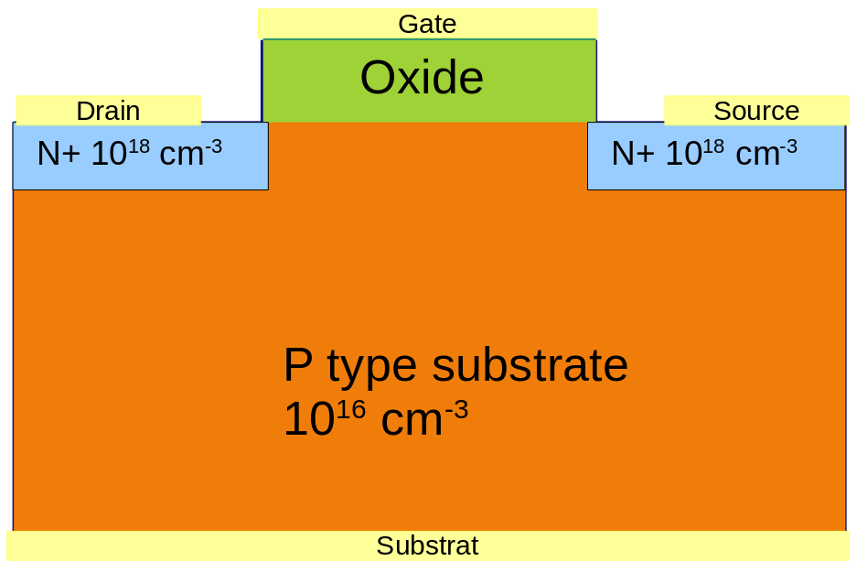
ECORCE
Finite volume software
http://www.ecorce.eu
Single Event Effects
SEE: Effects induced by a single particle (ions, protons, neutrons, …)
Generation of electron hole pairs along the track
Creation of displacement damages along the track
: vacancies
: interstitial atoms
- + + -
- + + -
- + + -
- + + -
Reported effects
Transient currents
Latchup of parasitic thyristor PNPN structure
Burnout of power devices
MOSFET gate rupture
Upset of one or multiple bits of memory
Stuck bit of memory
…
- + + -
- + + -
- + + -
- + + -
- + + -
- + + -
- + + -
- + + -
- + + -
- + + -
- + + -

Slide 11
ECORCE
Finite volume software
http://www.ecorce.eu
Mesh Design
Usually mesh adapted only on doping profile → high changes of potential and carriers distribution not taken into account.
ECORCE → mesh corrected according to all variables, for all steps including transient modeling
→ Essential for Single Event Effect (Example: ion effect on a negatively biased PN junction)
P+
N substrate
Before Ion, 678 nodes
Ion impact, 11904 nodes
10⁻¹⁰ s after impact, 11253 nodes
10⁻⁹ s after impact, 4009 nodes
As expected: 2 peaks of current (blue curve)
Number of nodes ranging from 678 to 19549 (red curve)

Slide 12
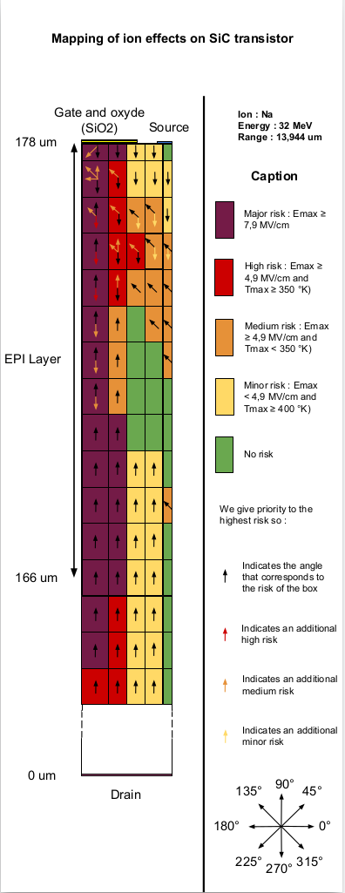
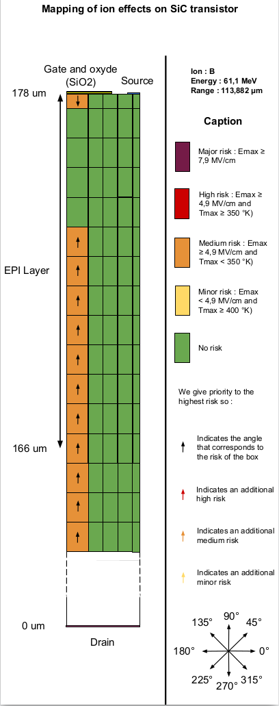
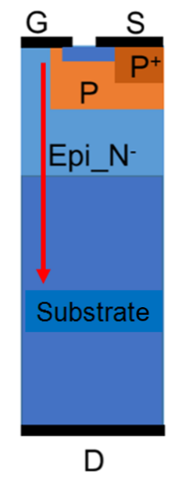
ECORCE
Finite volume software
http://www.ecorce.eu
SEE: Neutron effect on SiC power MOSFET
6 secondary ions tested:
→ Si 26 and 100 MeV
→ Al 27.6 MeV
→ Mg 30.7 MeV
→ Na 32 MeV
→ B 61.1 MeV
For each ion:
80 positions
8 directions
All calculations:
→ 3600 simulations
12000 calculation hours on one processor
7 days with 72 processors
Burnout strongly rely on initial LET
No burnout for low Z ions

Slide 13
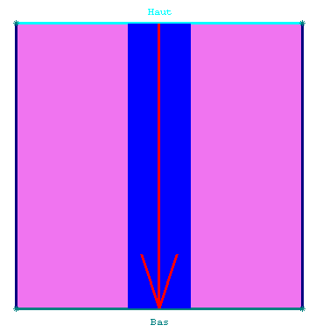
ECORCE
Finite volume software
http://www.ecorce.eu
Flux of particles
450 µm
Effects induced by a flux of particles (ions, protons, …)
Generation of electron hole pairs along the track
Creation of displacement damages along the track
450 µm
IN2P3 Grenoble
Robin Molle, Marie Laure Gallin Martel
Effect of proton flux on Diamond detectors
Proton Flux focused on a 50 µm radius area (blue rectangle)

Slide 14
ECORCE
Finite volume software
http://www.ecorce.eu
Wide gap semiconductors
Silicon carbide (SiC): at the state of art (developed in collaboration with JAXA)
Specific heat and thermal conductivity function of temperature
Gap reduction function of doping and temperature
Band to band tunneling function of electric field and gap
Impact ionization function of temperature
Mobility function of doping, temperature, carrier-carrier scattering, parallel and perpendicular electric field
Recombination SRH and Auger
Gallium nitride (GaN): ready to use, improvement on the way (collaboration with LETI)
Specific heat and thermal conductivity function of temperature
Gap reduction function of doping and temperature
Impact ionization (not function of temperature)
Recombination SRH (Auger not yet available)
Band to band tunneling and mobility not yet available
Diamond (C): all known laws implemented
Incomplete doping ionization
Impact ionization function of temperature
Mobility function of temperature and P doping only
Recombination SRH (Auger not yet available)
Specific heat, thermal conductivity, gap reduction and band to band tunneling not yet available

Slide 15
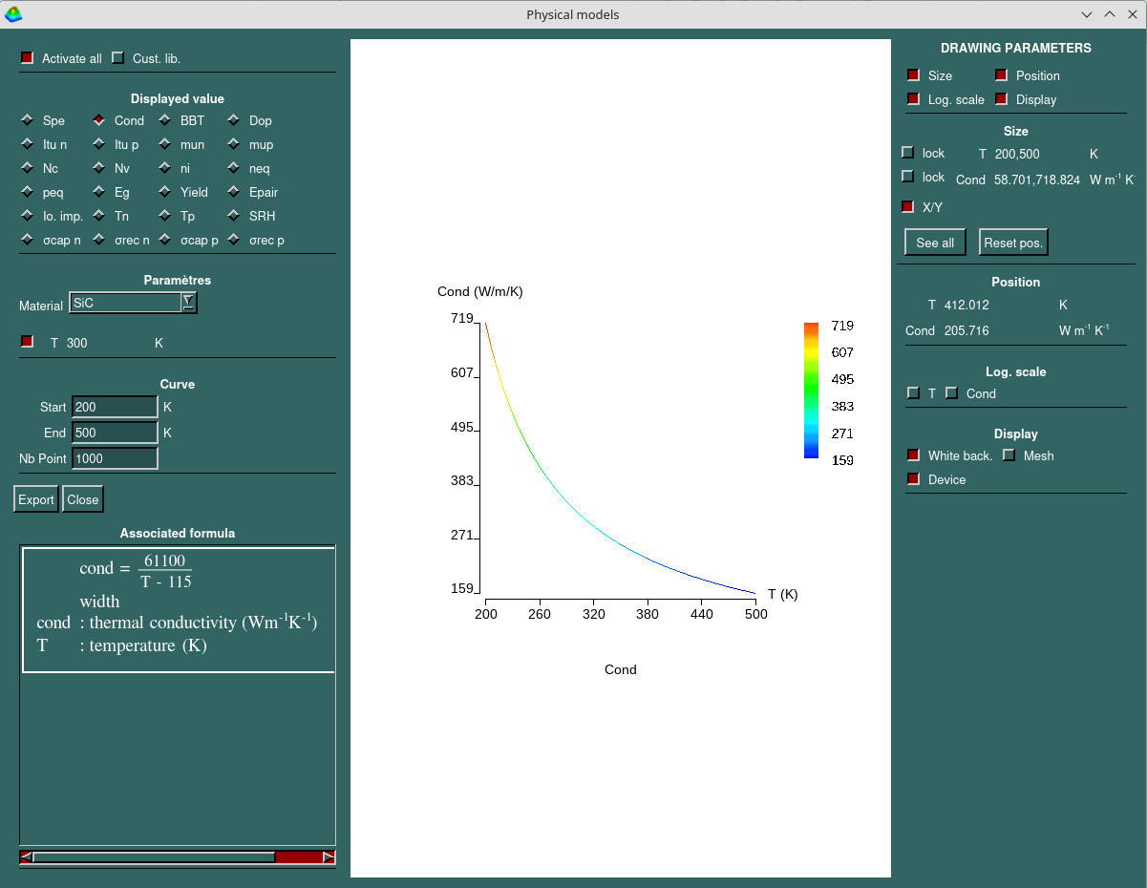
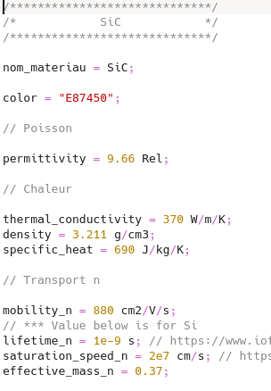
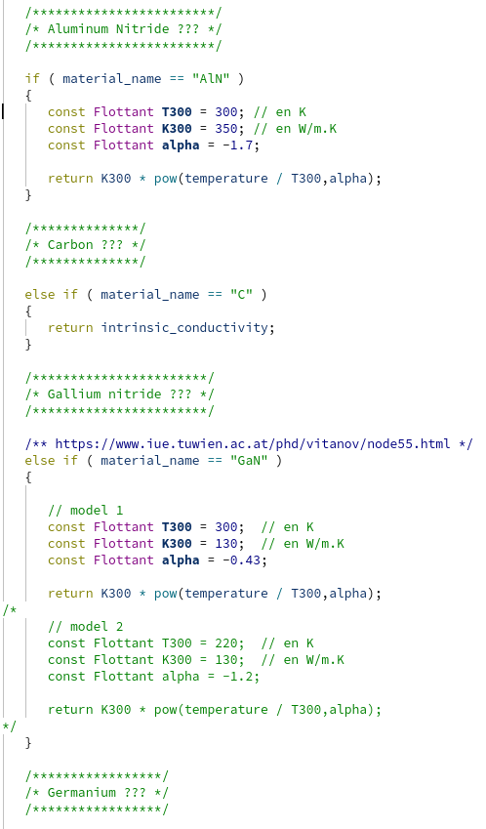
ECORCE
Finite volume software
http://www.ecorce.eu
Customized material and library
Add new material
Customize defined materials
→ Source code available for many laws:
Specific heat,
Thermal conductivity,
Mobility function of temperature, electric field, …
Gap function of doping and temperature,
Density of states,
Impact ionization,
Band to Band Tunneling,
Incomplete doping ionizing,
Lifetime function of doping density,
SRH and Auger recombination
Easy to use: auto-compilation of ECORCE
Example of customizable source code:
thermal conductivity of several materials

Slide 16
ECORCE
Finite volume software
http://www.ecorce.eu
Conclusion
Mesh design
essential for results precision and realistic modeling
dynamic mesh reduces TCAD implementation time
Wide bandgap materials available
Customizable source code: mobility, impact ionization, … (C++ programming)
Radiation effects
→ Total Ionizing Dose: space, medical and power plant applications
→ Single Event Effect: occurs everywhere (neutron at ground level)
Live demonstration at coffee break/lunch
Notes:
To sum up:
The mesh design is essential. This is already well known but it is so important that we must repeat as often as possible.
The dynamic mesh is helpfull for TCAD users. It reduces the time needed to create a realistic model.
For Single Event Effects a complete model is mandatory to reproduce real phenomena.
If the model is correct it can physically explain what can not be understood by experiments.
The burnout of SiC Schottky diode is a good example of information given by TCAD.
3 models are available for Total Ionizing Dose modeling.
The choice of a model is a balance between the relevance of the results and the calculation effort
With the most complete model, it is possible to predict the Threshold Voltage Shift for a full range of biases and temperature.
We must check this capability for various doses and dose rates.

Slide 17
ECORCE
Finite volume software
http://www.ecorce.eu
Thank you for your attention.
Questions ?
Notes:
To sum up:
The mesh design is essential. This is already well known but it is so important that we must repeat as often as possible.
The dynamic mesh is helpfull for TCAD users. It reduces the time needed to create a realistic model.
For Single Event Effects a complete model is mandatory to reproduce real phenomena.
If the model is correct it can physically explain what can not be understood by experiments.
The burnout of SiC Schottky diode is a good example of information given by TCAD.
3 models are available for Total Ionizing Dose modeling.
The choice of a model is a balance between the relevance of the results and the calculation effort
With the most complete model, it is possible to predict the Threshold Voltage Shift for a full range of biases and temperature.
We must check this capability for various doses and dose rates.

Slide 18
ECORCE
Finite volume software
http://www.ecorce.eu
Notes:
To sum up:
The mesh design is essential. This is already well known but it is so important that we must repeat as often as possible.
The dynamic mesh is helpfull for TCAD users. It reduces the time needed to create a realistic model.
For Single Event Effects a complete model is mandatory to reproduce real phenomena.
If the model is correct it can physically explain what can not be understood by experiments.
The burnout of SiC Schottky diode is a good example of information given by TCAD.
3 models are available for Total Ionizing Dose modeling.
The choice of a model is a balance between the relevance of the results and the calculation effort
With the most complete model, it is possible to predict the Threshold Voltage Shift for a full range of biases and temperature.
We must check this capability for various doses and dose rates.

Slide 19
ECORCE
Finite volume software
http://www.ecorce.eu
Notes:
To sum up:
The mesh design is essential. This is already well known but it is so important that we must repeat as often as possible.
The dynamic mesh is helpfull for TCAD users. It reduces the time needed to create a realistic model.
For Single Event Effects a complete model is mandatory to reproduce real phenomena.
If the model is correct it can physically explain what can not be understood by experiments.
The burnout of SiC Schottky diode is a good example of information given by TCAD.
3 models are available for Total Ionizing Dose modeling.
The choice of a model is a balance between the relevance of the results and the calculation effort
With the most complete model, it is possible to predict the Threshold Voltage Shift for a full range of biases and temperature.
We must check this capability for various doses and dose rates.

Slide 20
ECORCE
Finite volume software
http://www.ecorce.eu
5. Conclusion
Mesh design
essential for results precision and realistic modeling
dynamic mesh reduces TCAD implementation time
TID
3 models available
choice based on the results relevance needed and computation effort accepted
fit quantitatively experimental results
Model of interface state creation available (experimental)
SEE
Take into account the LET distribution along the ion track
All ion energies and type available for all materials
Notes:
To sum up:
The mesh design is essential. This is already well known but it is so important that we must repeat as often as possible.
The dynamic mesh is helpfull for TCAD users. It reduces the time needed to create a realistic model.
For Single Event Effects a complete model is mandatory to reproduce real phenomena.
If the model is correct it can physically explain what can not be understood by experiments.
The burnout of SiC Schottky diode is a good example of information given by TCAD.
3 models are available for Total Ionizing Dose modeling.
The choice of a model is a balance between the relevance of the results and the calculation effort
With the most complete model, it is possible to predict the Threshold Voltage Shift for a full range of biases and temperature.
We must check this capability for various doses and dose rates.

Slide 21
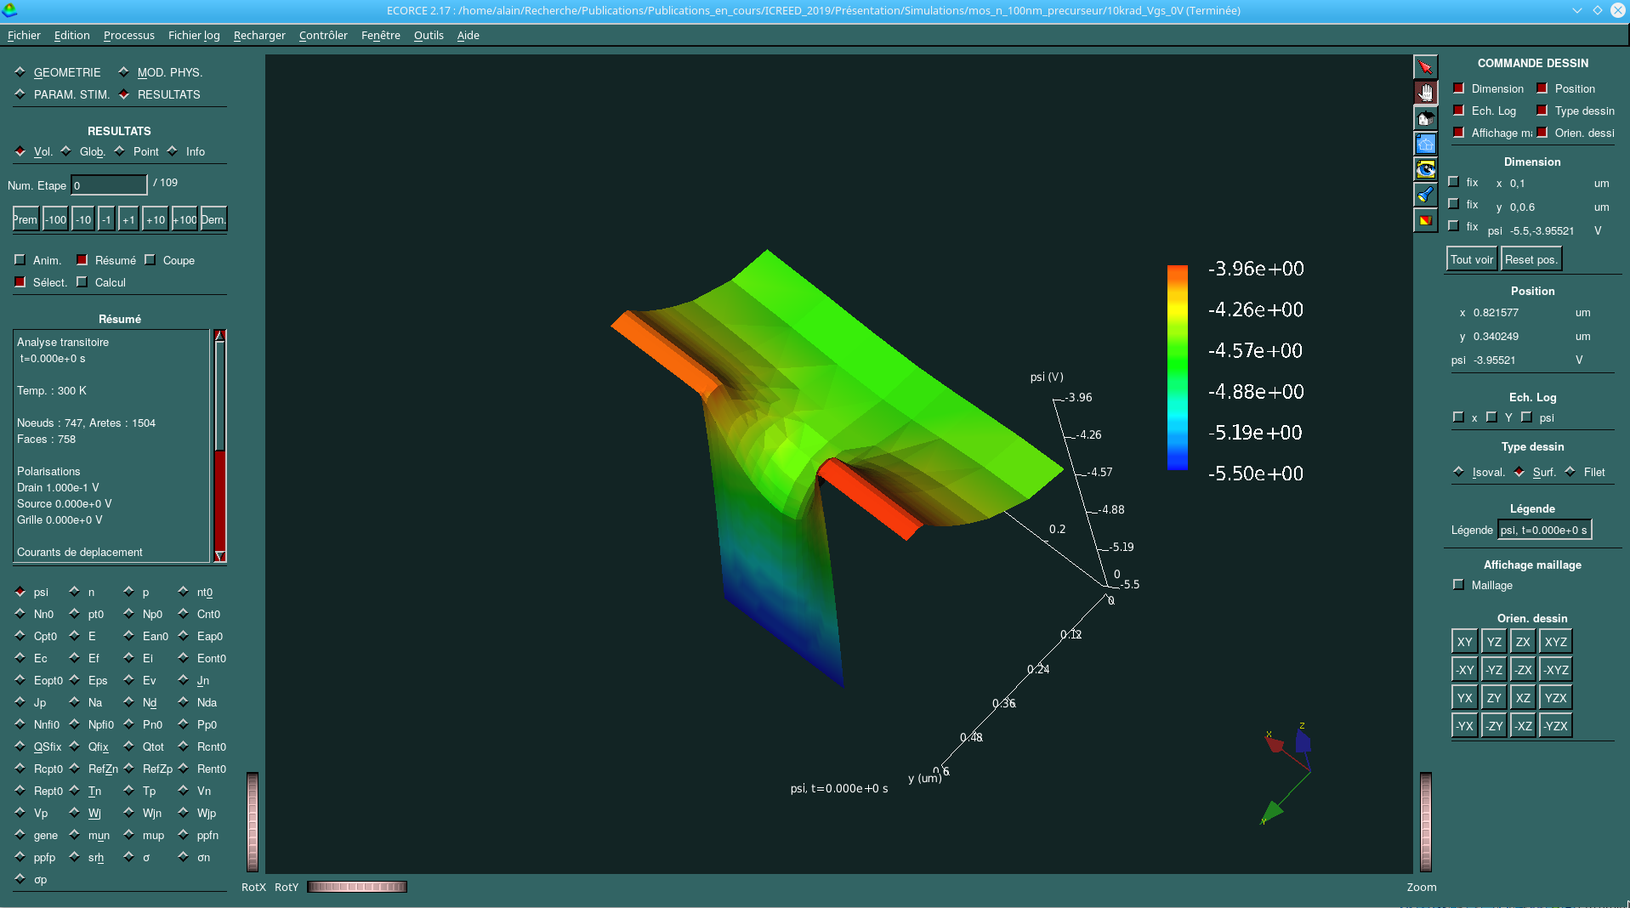
ECORCE
Finite volume software
http://www.ecorce.eu
1. TCAD tools
Many TCAD software are available
PISCES, Fielday, Sentaurus, Atlas, Genius, NanoTCAD, Lumerical, FLOODS, …
(see www.tcad.com for a more exhaustive list)
Commercial or Open Source, general or dedicated to a specific domain
→ Dimensions: 1D, 2D, Axisymmetric, 3D
→ Materials: Si/SiO2, SiC, GaN, Graphene, …
→ Applications: Radiation effects, Solar cells, nano devices, optoelectronic, …
This presentation
→ Examples of the influence of mesh design and model choice for SEE and TID modeling
→ Highlight the advantages of the dynamic mesh
of ECORCE
“ECORCE: A TCAD Tool for Total Ionizing Dose and Single Event Effect Modeling”. IEEE Transactions on Nuclear Science, 2015, 62 (4), pp.1516 - 1527.

Slide 22
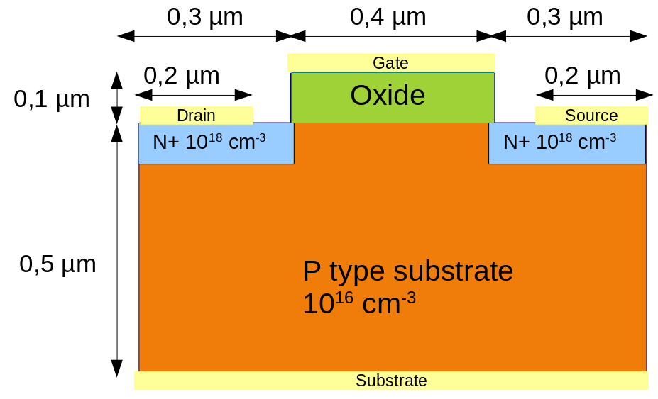
ECORCE
Finite volume software
http://www.ecorce.eu
Example: academic MOSFET design
Within ECORCE modeling executed in 5 steps:
Geometry design
Definition of physical model
equations, doping, …
Definition of stimuli
bias, temperature, irradiation, …
Calculation of solution
Analysis of results
Live demonstration at the break

Slide 23
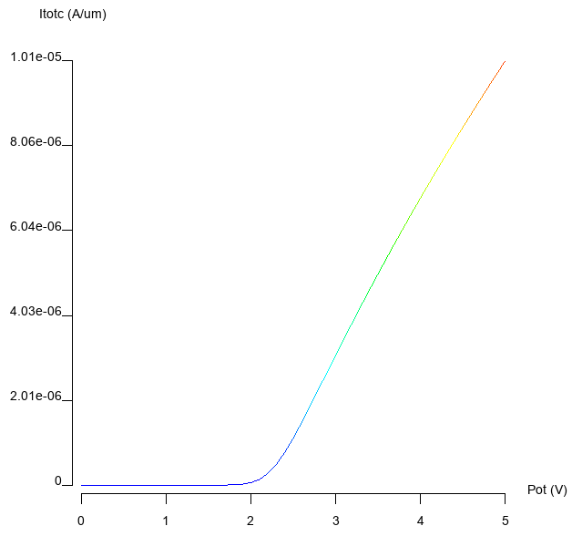
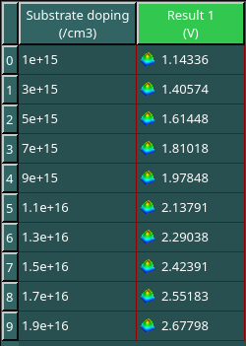
ECORCE
Finite volume software
http://www.ecorce.eu
Adjusting the device parameters
TCAD model must be adjusted to fit experimental results.
Considering the Id=f(Vgs) characteristic.
What is the effect of the P substrate density on the threshold voltage?
The optimizer automatically calculates
Vth for several dopings
Live demonstration
V_{th} = 2.23 V for Na = 10¹⁶ cm⁻³

Slide 24
ECORCE
Finite volume software
http://www.ecorce.eu
TID: Fixed Charge
Gate
Example: 10 krad Co60, Vgs = 12 V
Density generated in the gate oxide: 7.6 10¹⁶ cm⁻³
Electric field: 1.2 MV/cm
Initial separation of generated pairs: 0.92
    Fixed charge density applied: 7 10¹⁶ cm⁻³, full oxide volume
    Or 1.4 10¹⁷ cm⁻³ half oxide volume, close to the gate
    Threshold Voltage Shift: -2.65 V
Drain
Source
N +
N +
P substrate
Substrate
Easy to implement
Low calculation time
Does not take into account
→ change of the electric field during irradiation
Real displacement of charges in the oxide
Temperature
Recombination of trapped holes with electrons
→ Thermal reemission of trapped hole
Thick oxide: 100nm
Similar to power MOSFETS
Vt shift
Fast but weak method.
Many phenomena are not taken into account
Notes:
This is a schematic view of a n MOS transistor.
I will use this structure to illustrate my comments.
So transistors are mainly composed of silicon and oxide.
Applying a Total Ionizing Dose will generate electron hole pairs in the components.
This charge will be quickly collected at the contact in silicon and others conductive materials.
In insulators, the generated electron are also collected at the contact or at the interface,
but holes are trapped on defects.
Over time a high positive charge appears in oxides, depending on the dose rate, the electric field and the temperature.
This charge will change the characteristic of the transistor, whatever the oxide it is deposited: Gate oxide, Shallow Trench Insulator or Buried Oxide.
For this presentation, I will focus on the gate oxide since the degradation is easy to quantify with the threshold voltage shift,
Of course, it is well known that, because of the very low thickness of this oxide in recent technology, the threshold voltage shift can be neglected today for most transistor.

Slide 25
ECORCE
Finite volume software
http://www.ecorce.eu
Outline
Goal of TCAD for component under radiation
Importance of the mesh quality
Single Event Effects modeling
Total Ionizing Dose modeling
Conclusion

Slide 26
ECORCE
Finite volume software
http://www.ecorce.eu
1. TCAD goal
Goal: understand phenomena induced by radiation on components
Single Event Effects (SEE)
Total Ionizing and Non Ionizing Dose (TID) (TNID)
ElectroStatic Discharge (ESD)
Combined effects:TID, TNID, SEE, ESD
Advantages over experiments:
→ model in a reduce time long duration
phenomena.
→ fast and easy(?) results
→ insight of the mechanisms at play
Drawbacks:
→ not a qualification tool
→ reduce set of components
→ results reliability?
→ keep in mind: « Garbage In, Garbage Out » (GIGO)
It is essential to carefully check inputs and correlate modeling with experiments
Notes:
I will focus on SEE and TID during this speech
Tcad can modelize long term effects in a reduce time and at lower cost than experiments
When it works, results are easily obtained
And of course it allows an overview of the physical mechanisms at play inside the device.
But TCAD is not a qualification tool,
It always gives results but how can we be sure they are significant
And it is vey easy to make an error when defining inputs, so keep in mind : Garbage In, Garbage Out
For all these reasons, it is essential to carefully chek inputs and correlate modeling with experiments.

Slide 27
ECORCE
Finite volume software
http://www.ecorce.eu
3. SEE case study
Case Study: SiC Schottky diode used in satellite power supply
1.3 GeV Xe
Range : 64.39 µm
Burnout
Critical temperature
Nd=2 10¹⁸ cm⁻³
SiC
EPI layer
Nd=10¹⁶ cm⁻³
SiC
Cathode, 0 V
Ohmic contact
Anode, -200 V
Schottky contact
3 TCAD model, same results:
A. Javanainen (2017),
A. F. Witulski (2018),
S. Kuboyama (2019)
Ion experiments (2006)
→ Unexpected failure for low reverse bias.
→ No sensitivity for Si Schottky diode. Why?
TCAD model including heat equation and Impact Ionization (all models proposed)
Axisymmetric modeling→ same results as 3D.
Dynamic mesh, lowest edge size: 0.02 µm
Critical temperature (reached very close to Schottky contact) exceeds SiC melting point (3100K)
What are the mechanisms at play?

Slide 28
ECORCE
Finite volume software
http://www.ecorce.eu
3. SEE case study
Mechanism located in the low conductivity area, between 110 and 120 µm (EPI layer)
Electric field: 0.2 MV/cm because of -200V applied on Anode
Impact Ionisation triggered
→ Additionnal pairs generation (yellow)
→ ceiling of the electric field when the generation rate is high enough.
Generation and separation of charges
High positive charge appears at the contact
→ increase the electric field
→ speed up the pairs separation.
Critical electric field, Si : 0.3 MV/cm, SiC : 3 MV/cm
Power heat density (W/µm³) ≈ E², x 100 in SiC than in Si
Notes:
Mon objectif principal lorsque j’ai développé ECORCE était de faciliter la mise en oeuvre de la TCAD.
Tous ceux qui ont utilisé un logiciel TCAD ont été confrontés à l’écriture de commandes texte avec la lecture d’une documentation de plusieurs centaines de pages.

Slide 29
ECORCE
Finite volume software
http://www.ecorce.eu
3. SEE Issue on mesh design
Thermal runaway mechanism, very sensitive to parameters variation. (mobility laws, Impact ionization, …)
What about mesh sensitivity?
New modeling, dynamic mesh → lowest edge size from 0.02 to 0.1 µm
Highest temperature: 1700 K
Thermal runaway disappears → unrealistic modeling, badly designed mesh
Electric field for finest mesh is high (blue curve) → Impact Ionization triggered
Electric field for large mesh is low (red curve) → Impact Ionization not triggered
Two large edges at the anode do not take into account this localized effect
According to user parameters, the dynamic mesh automatically compute the right solution
Notes:
Mon objectif principal lorsque j’ai développé ECORCE était de faciliter la mise en oeuvre de la TCAD.
Tous ceux qui ont utilisé un logiciel TCAD ont été confrontés à l’écriture de commandes texte avec la lecture d’une documentation de plusieurs centaines de pages.

Slide 30
ECORCE
Finite volume software
http://www.ecorce.eu
4. TID: Srour model
Experimental results
N MOSFET, IRF130 batch, same datecode
70krad, 100rad/s, X-ray
3 biases Vgs : -5V, +5V et +12V
8 temperatures during irradiation:
30°C, 55°C, 70°C, 85°C, 93°C, 100°C, 130°C and 160°C
Best model
3 traps levels: density and activation energy fitted
→ 6 parameters fitted using 6 experimental results.
Traps are close to the interface
Threshold voltage shifts for others experimental points?
100 nm
Oxide
Silicon
Srour model
Impossible to fit positive and negative biases with the same trap distribution
Positive biases: traps close to the interface
Negative biases: traps close to the gate
Interface

