Slide 1
EICROC : an ASIC to read-out AC-LGAD sensors for the Electron-Ion Collider (EIC)
24/06/2024
F. Bouyjou, S. Conforti, E. Delagnes, A.-S. Torrento , F. Dulucq, M. Idzik, B.-Y. Ki,
C. de La Taille, J. Moron, D. Marchand, C. Munoz, M. Nguyen, N. Seguin-Moreau,
L. Serin, S. Extier, D. Thienpont, A. Verplancke

Slide 2
Summary
ePIC experiment @ EIC, roman pots
AC-LGAD sensors
EICROC, an AC-LGAD read-out ASIC
EICROC0 measurement results
Status & perspectives

Slide 3
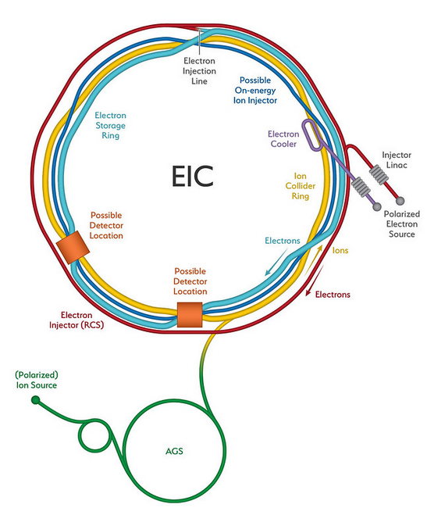
ePIC Experiment @ EIC - Overview
Electron-Ion Collider (EIC)
International collaboration
Particle accelerator will be built in Brookhaven, NY
Based on RHIC
Roman
Pots

Slide 4
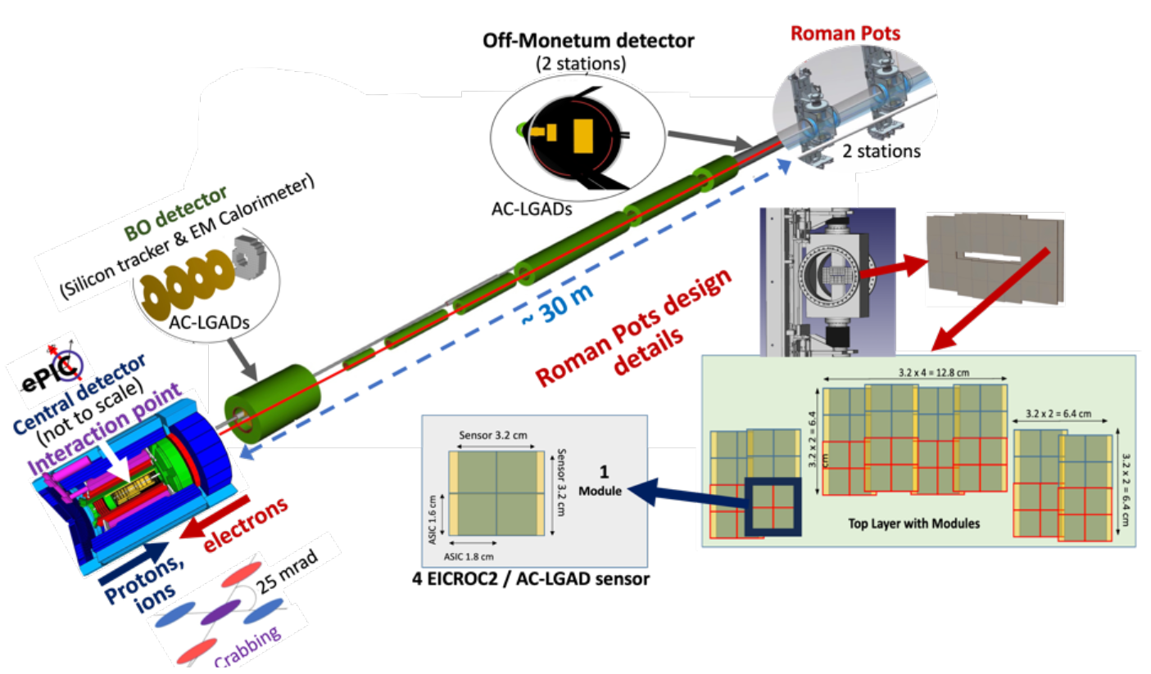
ePIC Experiment – Roman Pots
Roman Pots for ePIC experiment:
Used in the far forward tracking of particle collisions, mandatory for exclusive reactions (detection of protons and ions)
2 stations ~2m apart
2-3 layers of sensors per station
Squared pixels
Stringent technological requirements
AC-LGAD sensors will be used because of their capability to provide excellent resolution in timing and spatial resolution (charge sharing).
EIC Conceptual Design Report, 2021

Slide 5
AC-LGAD detectors
AC-LGAD P2IO
Dominique Marchand
AC-LGAD sensors fulfill both time and spatial resolution requirements :
Timing resolution: ~25 ps per hit
Position resolution: ~30 μm with 500 x 500 μm² pixel (exploiting charge sharing among neighboring pixels, barycenter comutation)
100% fill factor is achieved along with good resolution
DC-LGADs present good timing resolution (~25 ps per hit) but dead volume is present by construction, which makes 4D detection impossible
Use of a novel detector is needed to have 100% fill factor on the roman pot sensor layers
ALTIROC
EICROC

Slide 6
ALTIROC : a DC-LGAD read-out chip
ALTIROC : a DC-LGAD read-out ASIC for HGTD
First 225 channels full matrix LGAD readout chip with 1 GHz preamplifier with 4 pF detector capacitance
Analog 30% and Digital 70 % (Digital on Top)
Electronics jitter ~25 ps for MIP=10 fC
4 mW/ch
Minimum detectable charge ~ 3 fC
ALTIROC3 block diagram

Slide 7
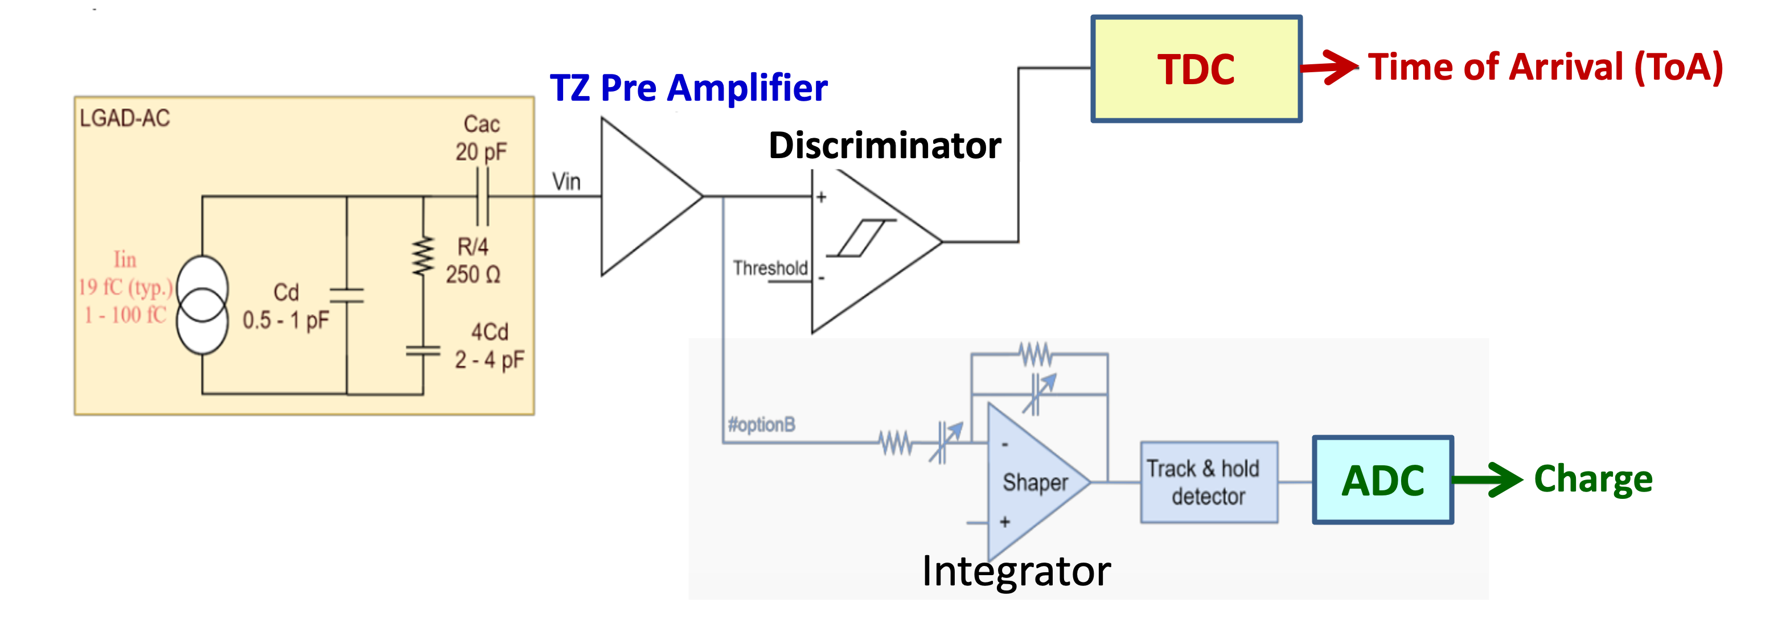
EICROC : Overview
EICROC : an AC-LGAD read-out ASIC
First prototype EICROC0 to test perfomance with and without sensor
4x4 pixels / ASIC
~2mW/channel + 4*20mW « analog probe preamp »
Final version specifications :
32x32 pixels / ASIC
<1mW/channel
Charge det. Range 1-50 fC
Timing jitter 15-20 ps
Input capacitance : C_{D} = 1-5 pF
EICROC0 Layout

Slide 8
EICROC0 measurement results @ IJCLab : preamplifier output
Preamp nonlinearities start around ~10 fC

Slide 9
EICROC0 measurement results @ IJCLab : preamplifier output
Preamp max amplitude reduces from top to bottom of column

Slide 10
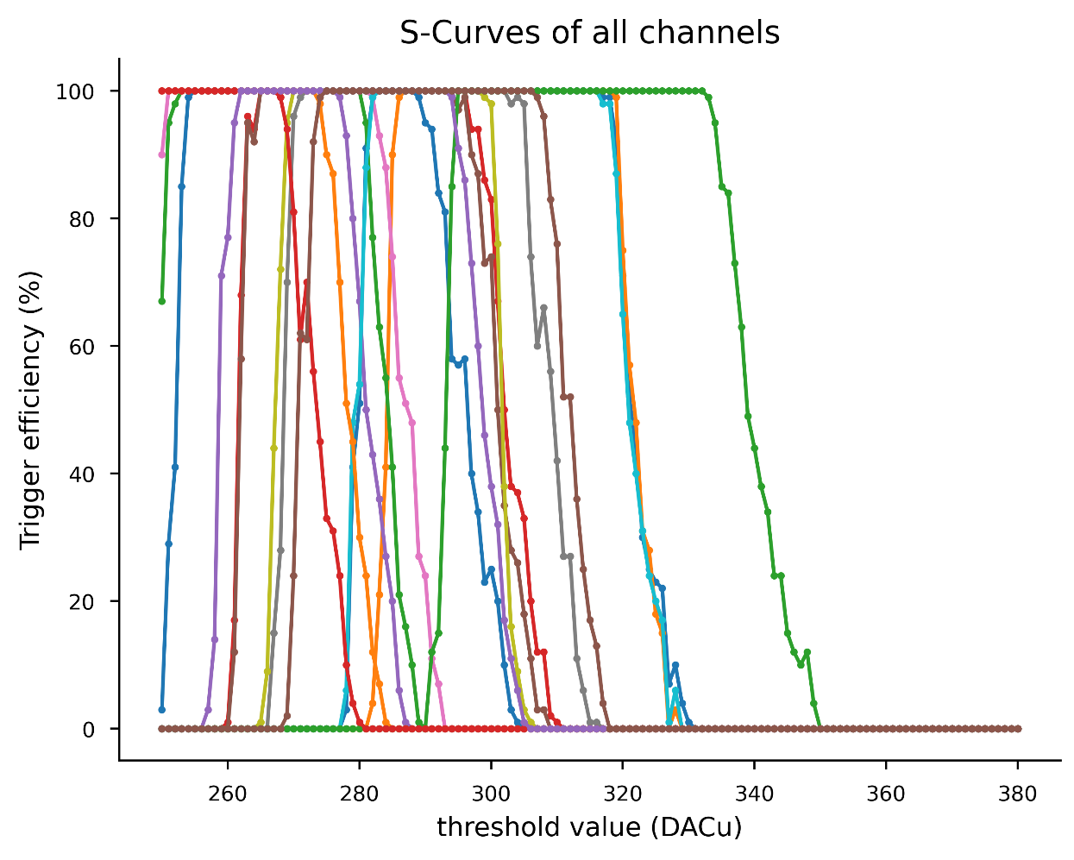
EICROC0 measurement results @ Omega : discriminator threshold sweep
S-Curve 50% spread reduced from 70 DACu to 12 DACu
S-Curve alignment with pixel correction DACs
Alignment done for an injected charge of 2,5 fC (~ lowest charge detectable)
Noise from pedestal S-Curves ~0.2 fC

Slide 11
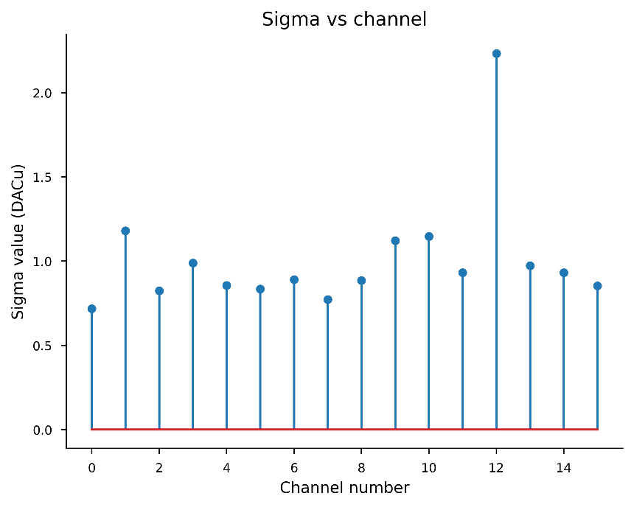
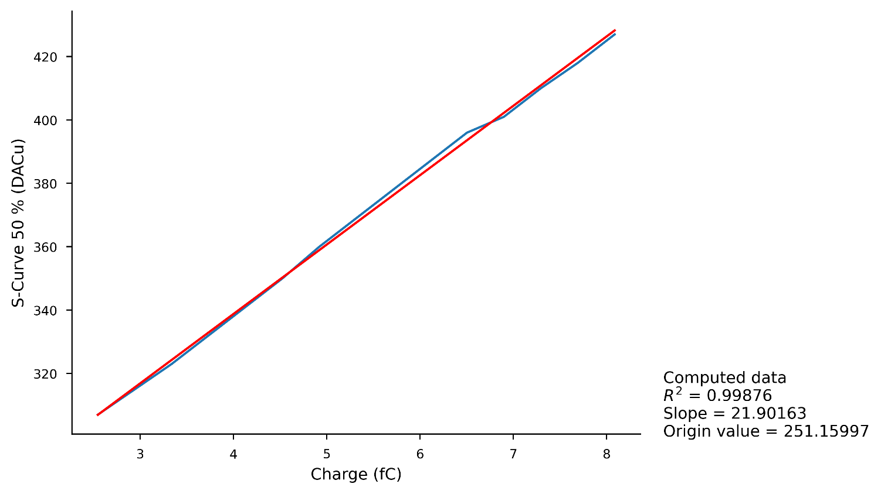
EICROC0 measurement results @ Omega : min. charge & noise per channel
Minimum detected charge ~2.5 fC
(slow control C_{D} = 00 & C_{P} = 1)
Similar performance on all channels
Noise per chan ~0.2 fC
(~0,1 fC/DACu)

Slide 12
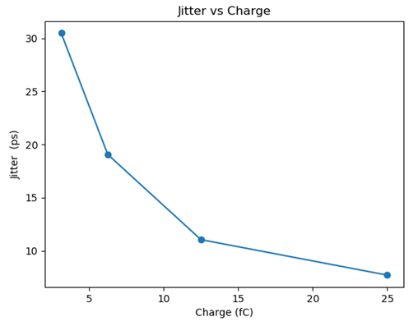
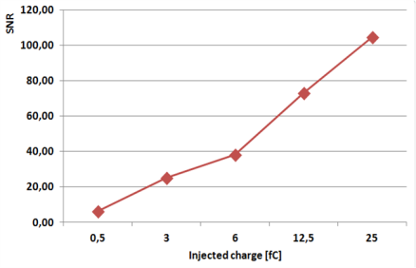
EICROC0 measurement results @ IJCLab : preamplifier output
Probe PA Signal-to-Noise Ratio
vs injected charge
Probe PA jitter vs injected charge
TZ Pre Amplifier output signals
- Jitter evaluation: < 20 ps ( ≥ 6 fC) ; 8 ps (25 fC)
- SNR > 70 for 12.5 fC input ; SNR > 6 for 1 fC input)

Slide 13
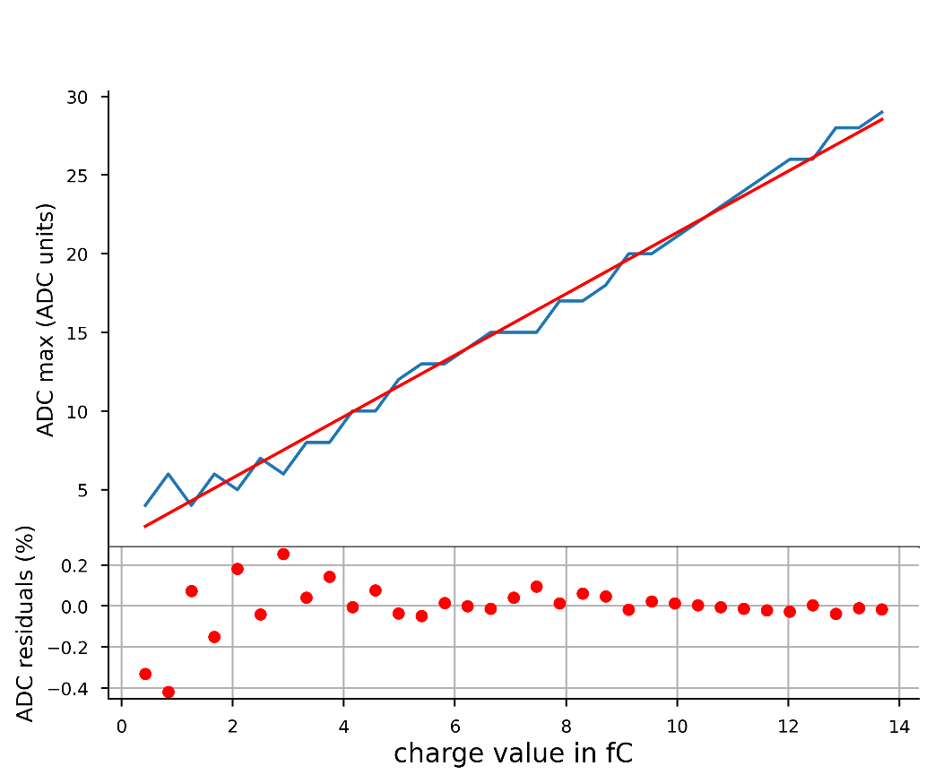
EICROC0 measurement results @ Omega : TDC jitter & ADC linearity
Scope measurement from discriminator output : 15 ps @ 10 fC
TDC measurements ~50 ps
Still large correlated noise under investigation
ADC : ~0,4% linearity
Similar performance on all channels

Slide 14
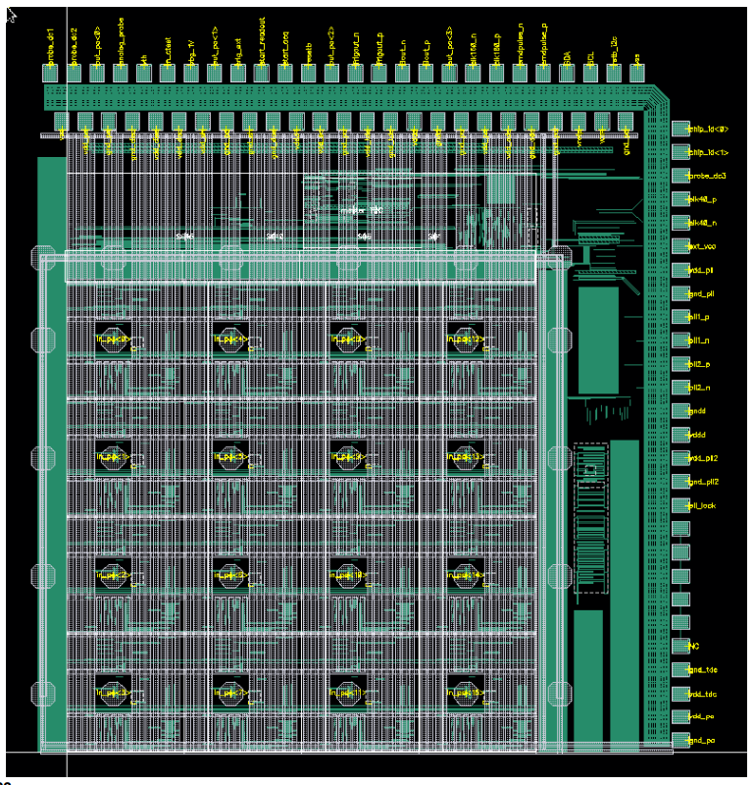
EICROC : Status & perspectives
EICROC0 is a testbeam prototype => sensor characterization
Triggered readout, all data shipped out : 16 ch * 8 samples ADC + TDC
Present power ~2 mW/ch + 4*20 mW « analog probe preamp »
Status : measurements in progress
ADC power + shaper/driver to be reduced from ~1 mW to 100 µW/ch => EICROC0A
EICROC0A : simulations in progress
EICROC1 will address larger dimensions 4x16 or 8x16 or 4x32 or 8x32
Address floor planning and power distribution
Selective readout : hit + 8 neighbouring channels
Status : layout started based on EICROC0, adding more testability
Still EICROC0-like readout
EICROC2 final size : 32x32

Slide 15
Thank you for your attention!

