Slide 1




Développement d'ASICs de lecture des pixels dans les futurs collisionneurs
Marlon Barbero, Roua Boudagga, Denis Fougeron, Eva Joly, Mohsine Menouni
CPPM - Aix-Marseille Univ, France
MI2I – Micro-électronique des 2 infinis
Réunion du GDR DI2I
IJCLab – Orsay - France, du 24 Juin au 26 Juin

Slide 2
  MI2I – Microélectronique des 2 infinis

Slide 3
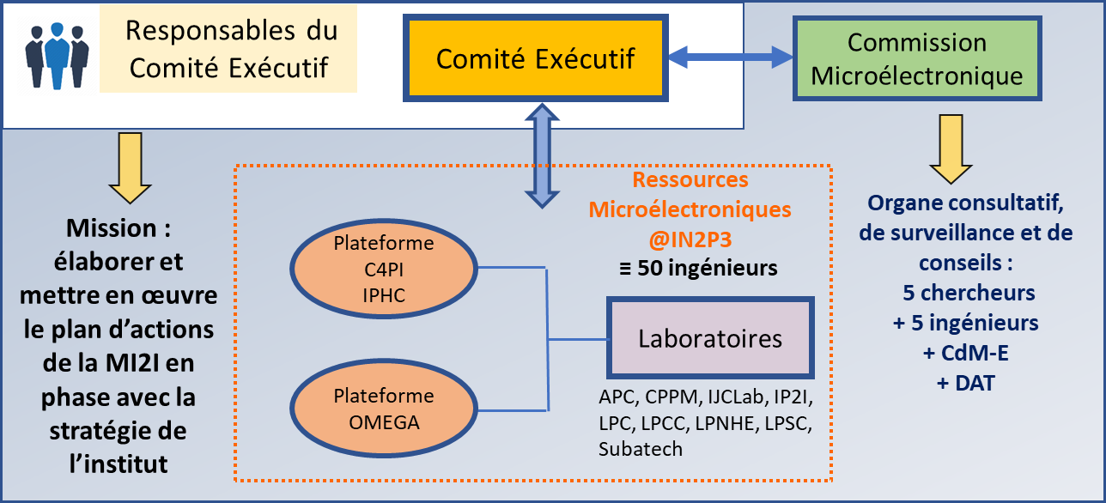
Structuration de la MI2I
Réseau MI2I :
  Fédérer les micro-électroniciens de l’IN2P3 (labo + plateformes)
  Recenser et répondre aux besoins de l'institut
  Faire face à la complexité des designs et à l’augmentation des coûts des fonderies
  Formation continue et permanente
Organisation articulée autour :
  Comité Exécutif (Com’Ex), organe en charge d’élaborer le plan d’actions de la MI2I
  Commission Microélectronique (Com’Mic) qui est l’organe consultatif de surveillance et de conseils
Le Com’Ex rend compte à la Com’Mic de l’ensemble de ses travaux et prend en compte ses avis et recommandations lors de revues organisées deux fois par an
Site web : https://caemi2i.in2p3.fr/

Slide 4
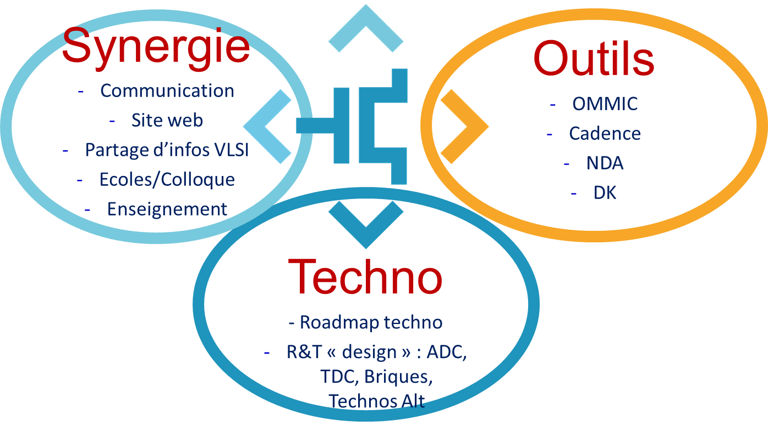
Axes de travail pour le mandat 2023-2025
Meeting le 11 et 12/05/2023 à Lyon :
  Meeting MI2I@Lyon
  Structurer le second mandat (sur 2 ans)
  Resserrer les activités sous trois axes principaux
Synergie
  Fédérer la communauté
Outils
  Mutualiser les logiciels, les serveurs, les licences, les méthodes et les designs
Techno
  Veille techno et roadmap, Fonderies/technos, R&T et Projet moyen terme,
  Mesure de temps, TDC, ADC

Slide 5
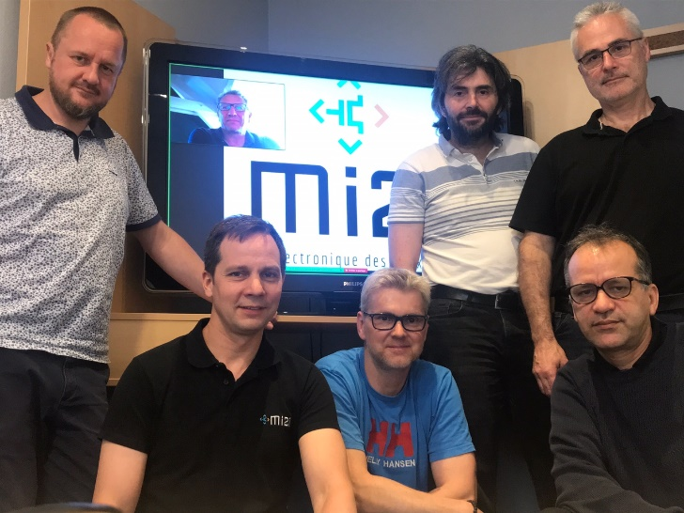
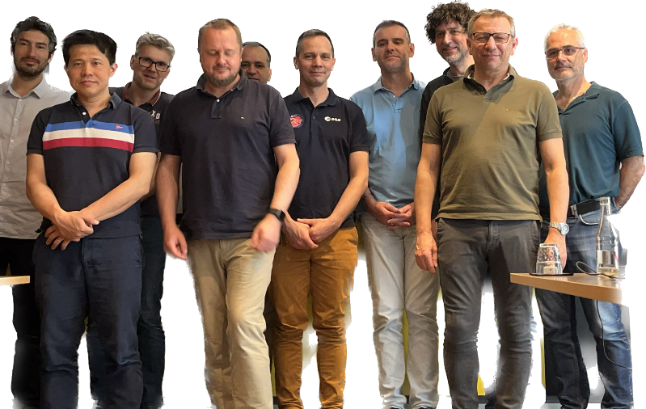
Les actions du Com’Ex pour le mandat 2023-2025
Meeting le 14 et 15/05/2024 à Marseille pour définir les actions du second mandat
  Meeting MI2I@Marseille
Poursuivre les échanges réguliers entre micro-électroniciens de la communauté
  Colloque de fin d’année à Meudon 12 et 13/12 2024
  Organisation ANF Nanoelec Roscoff → 21-26/09 2025
  Appel fait à la communauté pour participer aux différents axes de travail
  Intensifier la relation avec le GDR DI2I, le réseau DAQ et la EL2I
  Meeting mensuel du COMEX + meetings spécifiques pour chaque axe de travail
Réactualiser l’inventaire sur les ressources Microélec à l’IN2P3
Progresser sur OMMIC, outils communs microélectroniques au CCIN2P3
Adapter les axes de travail aux DRD identifiés par le CERN (essentiellement DRD7) en accord avec l’IN2P3 pour les HEP
8 personnes constituent le Com’Ex version 2023-2025
  Grégory Bertolone, C4PI
  L. Leterrier, LPC Caen
  H. Mathez, IP2I
  M. Menouni, CPPM
  F. Morel, C4PI
  P. Vallerand, IJCLab
  D. Prêle, APC (responsable adjoint)
  S. Manen, LPC Clermont (responsable)

Slide 6
Développement d'ASICs de lecture des pixels dans les futurs collisionneurs

Slide 7
Outline
Introduction
  DEPHY R&T project
Hybrid pixels for future experiments
  Timing effect
  4D tracking in the future experiments
  Electronics and sensor requirements for 4D tracking
R&D activities at CPPM
  28 nm chip design
  Preliminary test results
Conclusion and perspectives

Slide 8
DEPHY Project
DEveloppements de Pixels HYbrides et monolithiques radio-tolérant
  Supported by CPPM and IPHC (M. Barbero / CPPM and J. Baudot / IPHC)
General items
  Pixels detectors for trackers in relevant technologies to future projects requiring:
    High count rates / occupancy rates
    Medium to very high radiation tolerance
2 Work Packages
  Monolithic Pixels with the exploration of Depleted MAPS technology in two main directions :
    Exploiting current developments TJ-180 nm OBELIX sensor for BELLE II Experiment)
    Potential of new technologies (TJ-65nm prototype design)
  Hybrid Pixels with the exploration of technologies implementing advanced process nodes (CMOS 28 nm) and new hybridization techniques for small pixel size

Slide 9
  Hybrid pixels for future experiments

Slide 10
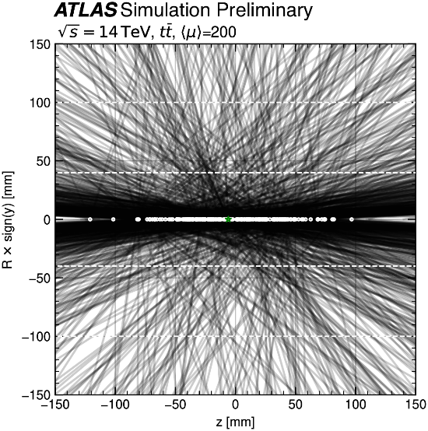
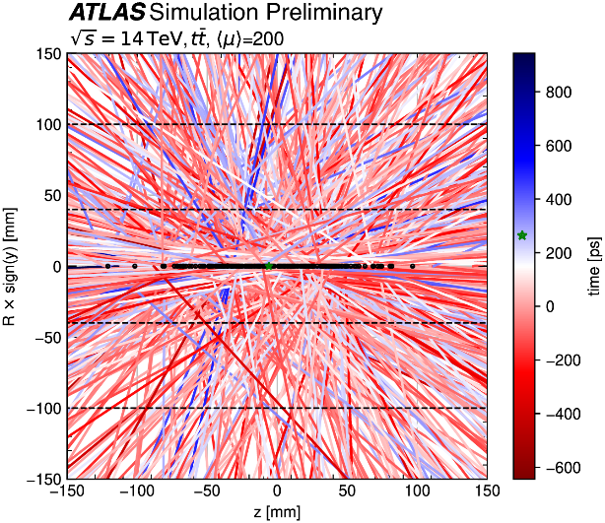
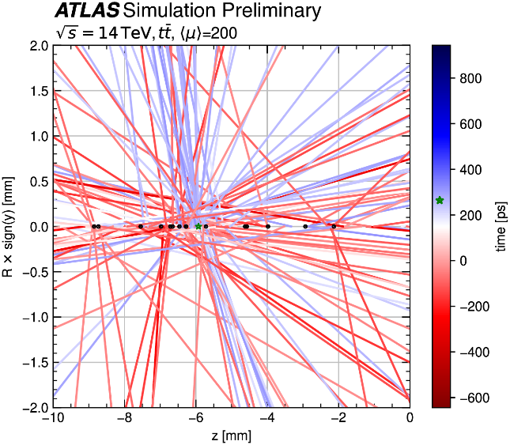
The effects of timing
Without track-timing
With track-timing
Zoom in the spatial coordinate
timing
Pile-Up (PU) level increase for the HL-LHC
  PU average of 200 during HL-LHC (5-10 × LHC)
  PU adds a new level of ambiguity to the reconstruction process
  When timing information is available for the tracks, the association of track to vertices becomes less ambiguous
4D tracking
  Using timing at each layer along the tracks
  For the rate of 200 PU events/BC
    Timing resolutions of 30 ps is expected to reduce by a factor of 5 the number of pileup tracks per primary vertex
Investigating the impact of 4D Tracking in ATLAS Beyond Run 4,
Tech. rep., CERN, Geneva (2023), ttps://cds.cern.ch/record/2870326
Timing information will be more important at future high-energy, high-luminosity hadron colliders with much higher levels of pileup

Slide 11
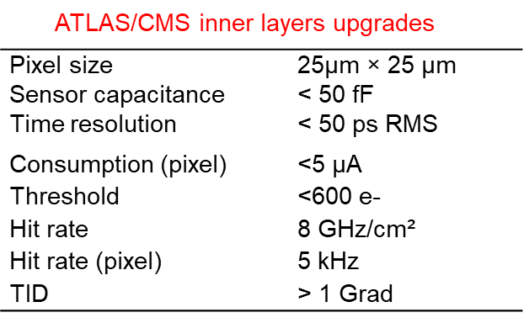
Pixel design for 4D tracking
For the next upgrades or the next generation of hadron collider :
  ATLAS, CMS and LHCb trackers upgrades (Run5),
  or for FCC–hh -> Very long-term
  High spatial resolution and high time precision
  Very high radiation tolerance
  Hybrid pixels with a dedicated ASIC bonded to the sensor is
  the best suited to these applications
Front end electronics
  Need of higher density and higher speed regarding the RD53 chip designed with the 65 nm process
  28nm CMOS technology is considered as the next node for highly integrated chips such as pixel readout chips
Sensor candidates currently being considered for 4D tracking
  LGAD sensors with modification of the gain implant profile
    Not yet satisfying a fluence > 2-3 × 10¹⁵ MeV neq/cm²
  3D-trench sensors developed and tested within the TimeSPOT
  project
    No performance loss up to fluences of
    2.5 × 10¹⁶ MeV neq/cm²
M. Ferrero et. Al : Nuclear Inst. and Methods
in Physics Research, A 919 (2019) 16–26
Doug Berry:FERMILAB-CONF-22-284-PPD1

Slide 12
  CPPM activities

Slide 13
R&D activities at CPPM
R&D around hybrid pixels for future upgrades and future colliders with the 28nm CMOS technology
  The radiation tolerance of the 28nm process up to 1-2 Grad
  Time measurement with a resolution better than 50ps
  Small pixel size -> 25µm × 25µm
Context
  RD53 collaboration shows a strong interest in these developments for the future upgrades of ATLAS and CMS trackers
  AIDAinnova project
  The project is part of the R&D project DEPHY and can be extended to the other IN2P3 labs interested in the 28 nm process
  This work is done with the CERN R&D Program on technologies for Future Experiments
  CPPM is a member of two working groups within the DRD (ECFA) projects
    WG 7.3a (4D and 5D techniques) to develop front ends with high temporal resolution
    WG 7.4b (Advanced and hardened CMOS nodes) to study the effects of radiation on highly advanced processes

Slide 14
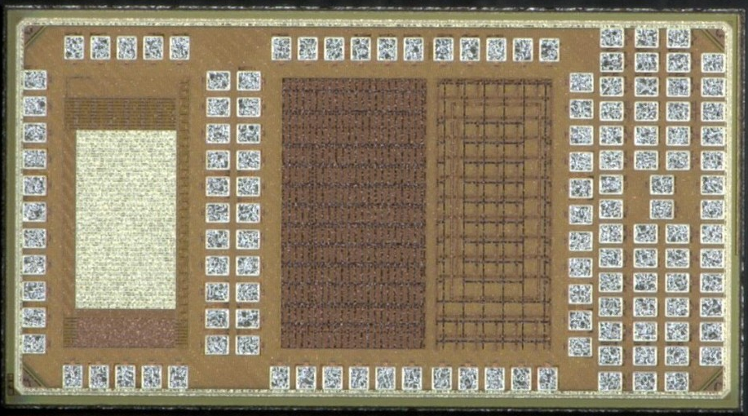
28 nm chip design
R&D on hybrid pixels
  Process qualification in terms of performance for analog, low-power and low-noise circuits
  Architecture studies
  Fast charge amplifier array
Study of Single Event Effects (SEE)
  Measure the SET cross-section
  Measure the SET pulse width with a good
  resolution < 20 ps
  Measure the effect of the std cell size
TID tests and qualification
  Compatibility with typical dose levels for future projects
  28 nm process device qualification
  Gate delay evolution with TID and the effect of the std cell size
  TID Effects modeling → Analog and digital simulations with TID effects
Single
devices
Pixel array
SET
RO - TID
Mini@sics of 2×1 mm2 received June 2023, consisting of 4 main blocks
  Analog pixel array (25×25 µm2) with Fast charge amplifiers for high time resolution
  SET test structures
  Ring Oscillators for TID tests on digital standard cells
  Test structures for TID tolerance studies

Slide 15
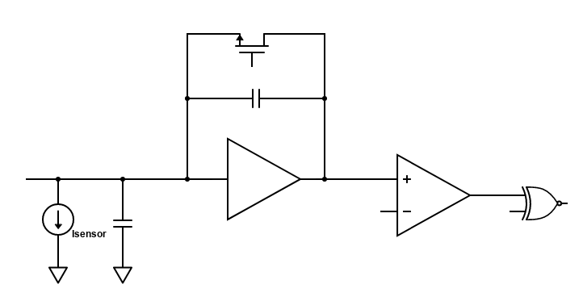
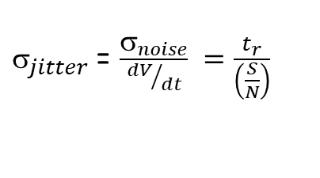
Fast amplifier design
Study the limits to time resolution in the analog front- end designed with the 28 nm CMOS process
  Effects of the Current bias, power supply, Bandwidth, Noise …
Design and test a pixel array of 36 × 12 cells where only the analog part is considered and implemented
The time resolution of the pixel:
Minimizing the front-end jitter corresponds to :
  Low RMS noise of the charge amplifier (CSA)
  High output voltage
  Small rise time → High bandwidth
Cf
HitOr
Cs
CSA
Comp
$_{total}^{2} ={_{jitter}^{2}+ }_{timewalk}^{2}$ $+ _{Landau}^{2}+_{TDC}^{2}$
Analog FE pixel design
$_{jitter}$= $\frac{σ_{noise}}{{dV}/{dt}} =\frac{t_{r}}{\left(\frac{S}{N}\right)}$

Slide 16
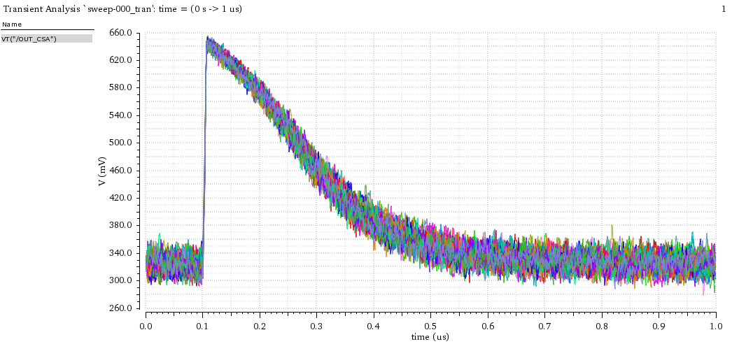
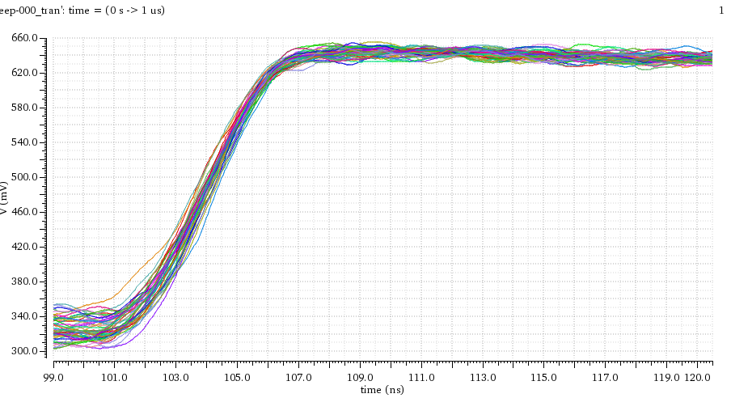
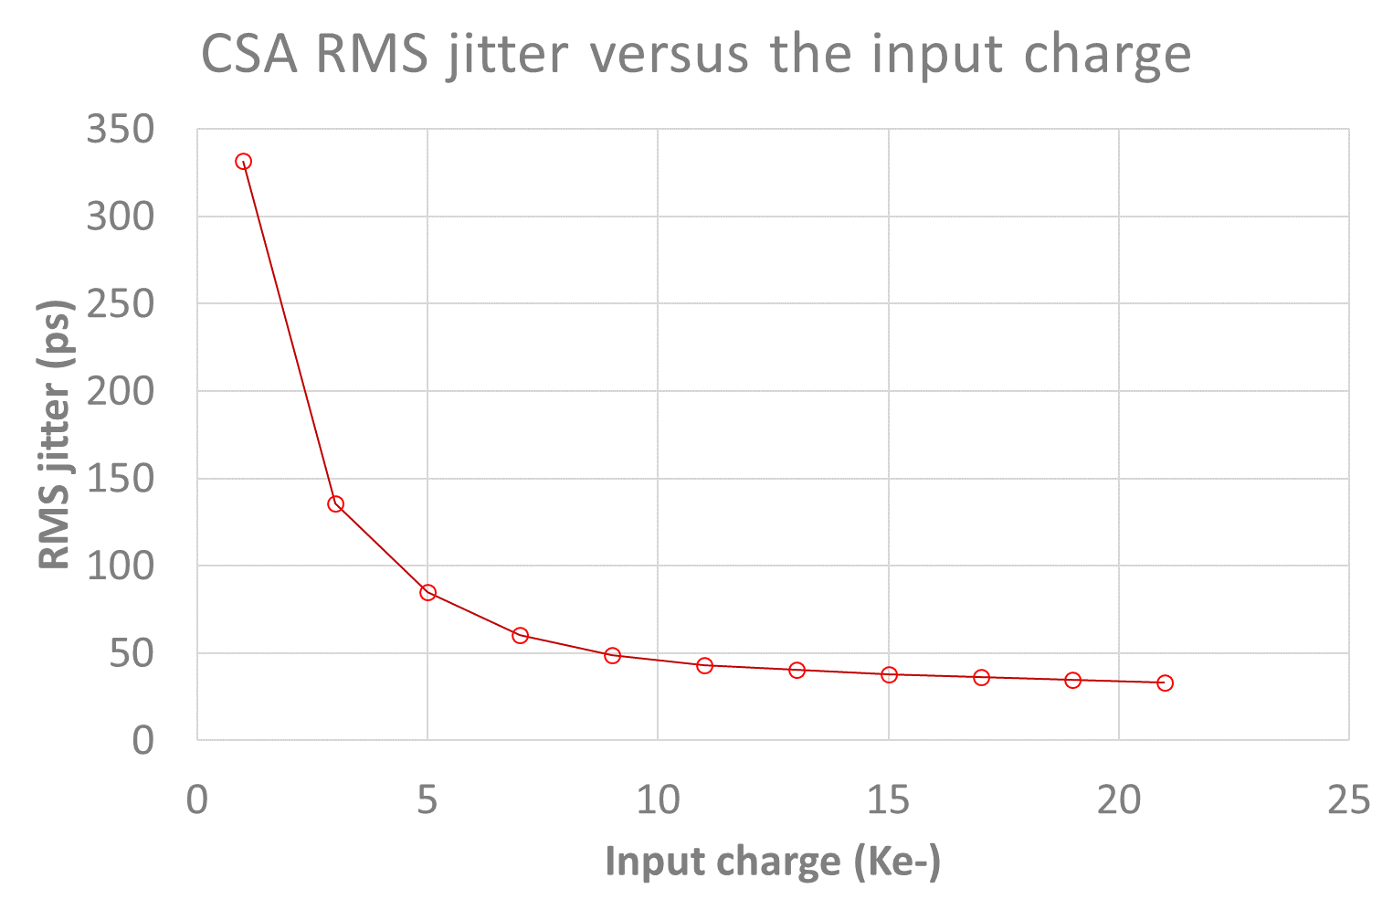
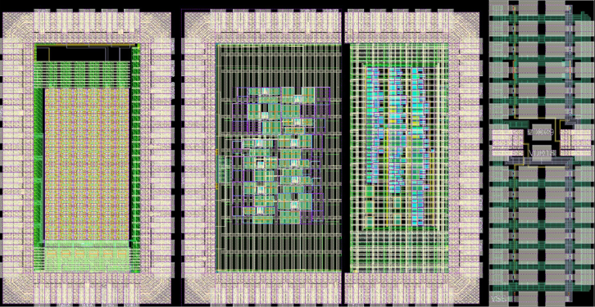
Analog FE pixel prototype
For each pixel :
  The charge amplifier current bias can be set in the range of 2µA-20µA
  MOM capacitance connected to each preamplifier input -> test for different input capacitance values
Large bandwidth buffers (> 1GHz) implemented and connected for a few pixels for direct jitter measurement
Simulations for I_{CSA} = 5 µA
  dV/dt = 100 mV/ns
  RMS noise = 97 e- RMS for Cin = 100fF
  Jitter < 100 ps RMS for input charge > 4 ke-
  Jitter < 40 ps RMS for charge > 10 ke-
Each pixel contains : CSA + Discriminator + 6 bit DAC
  Size : 20 µm × 12 µm
50 superimposed transient noise simulations
Jitter simulations
Pixel array of 36 × 12 pixels

Slide 17
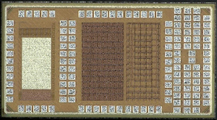
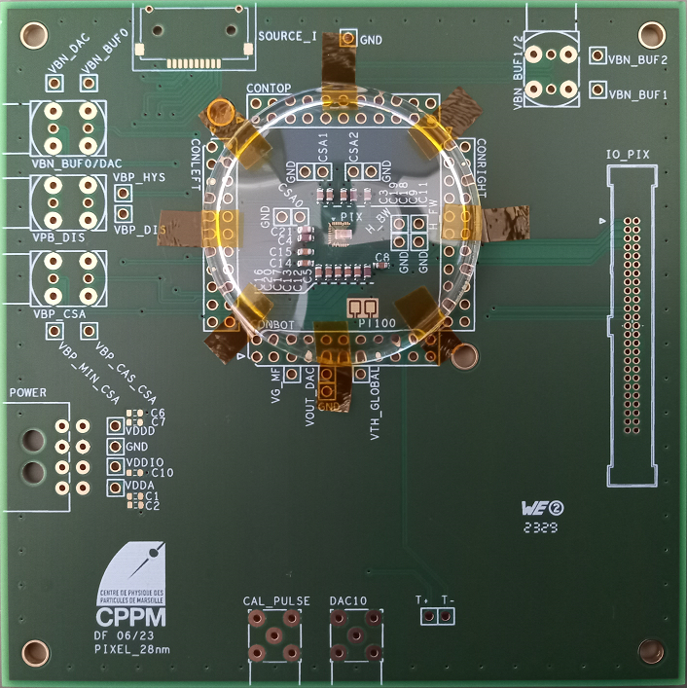
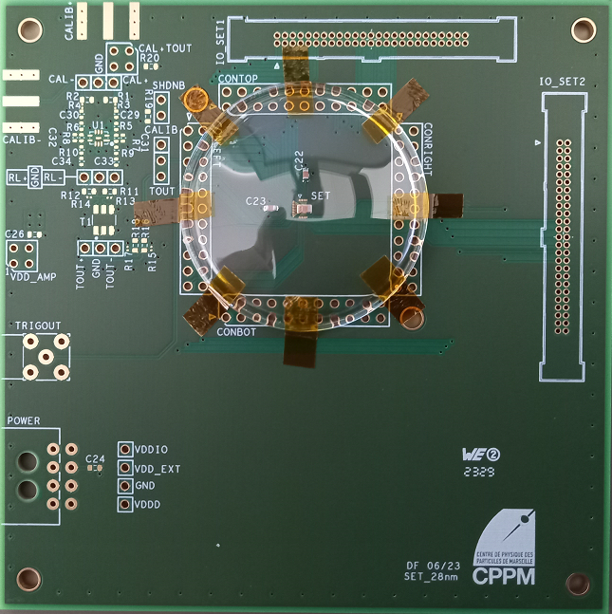
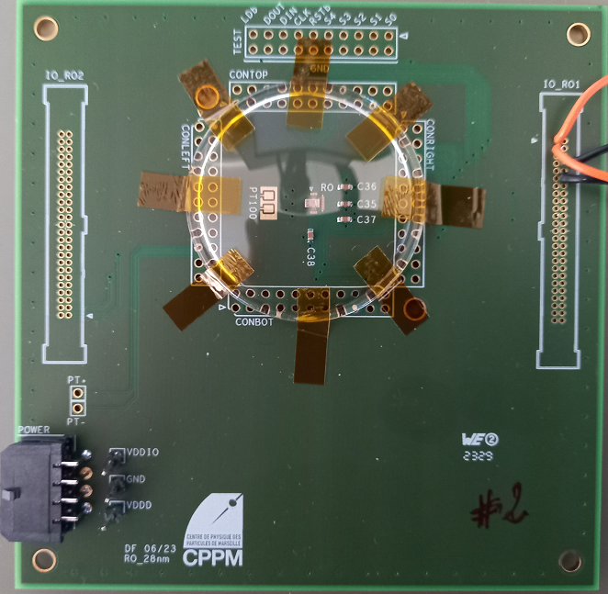
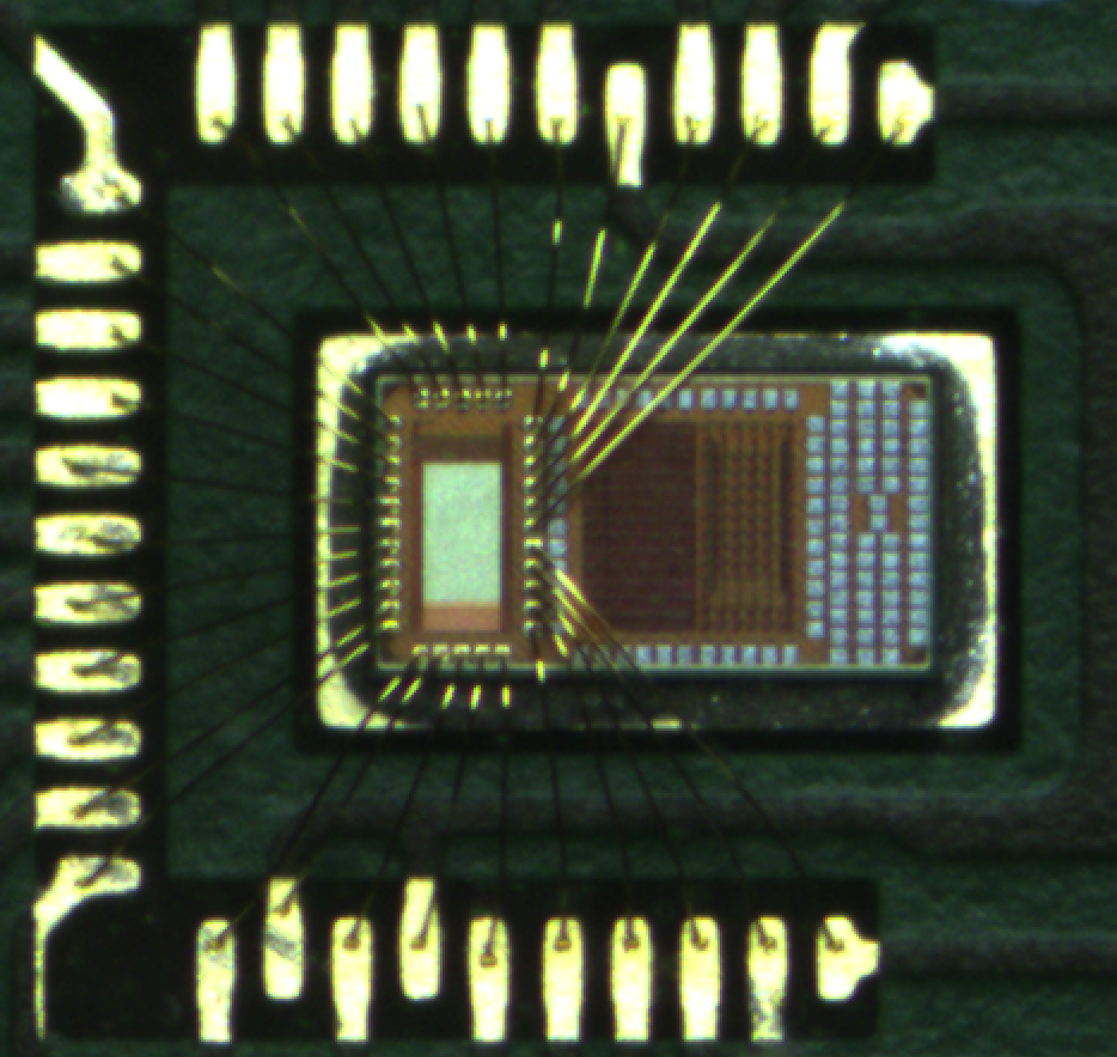
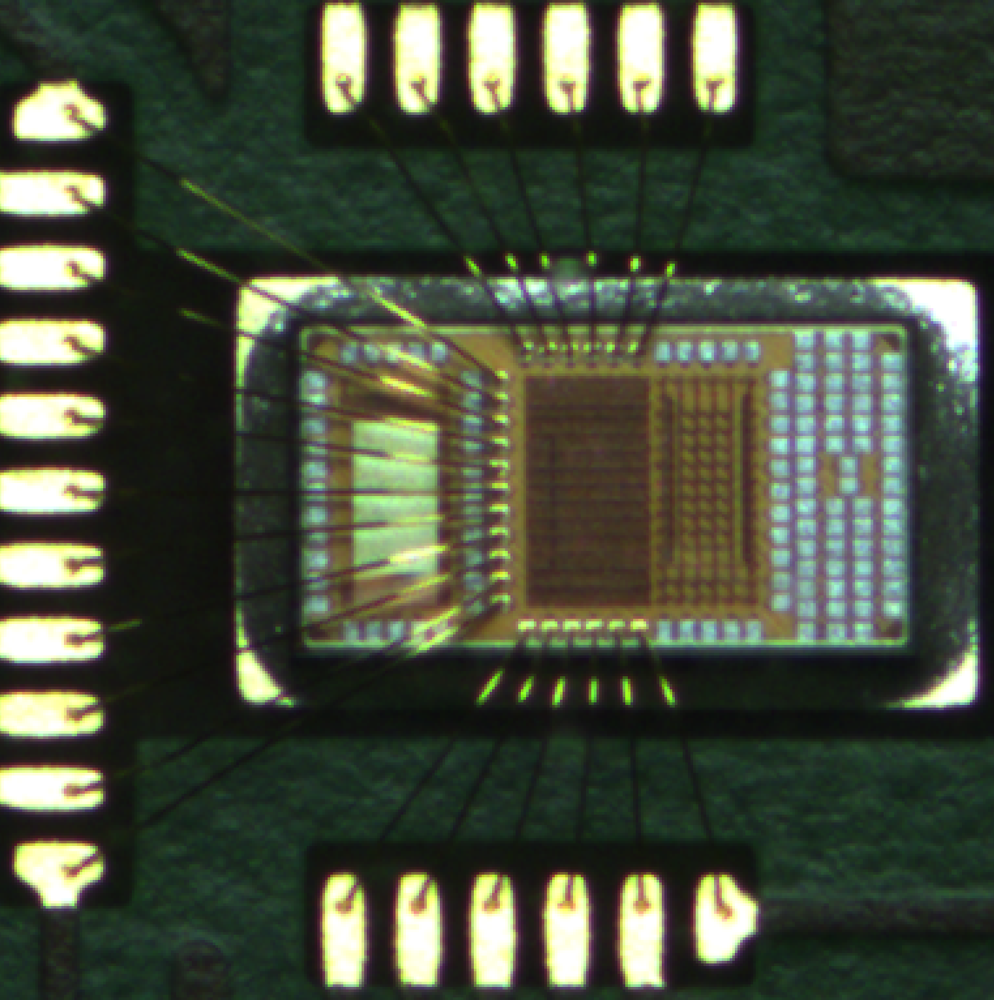
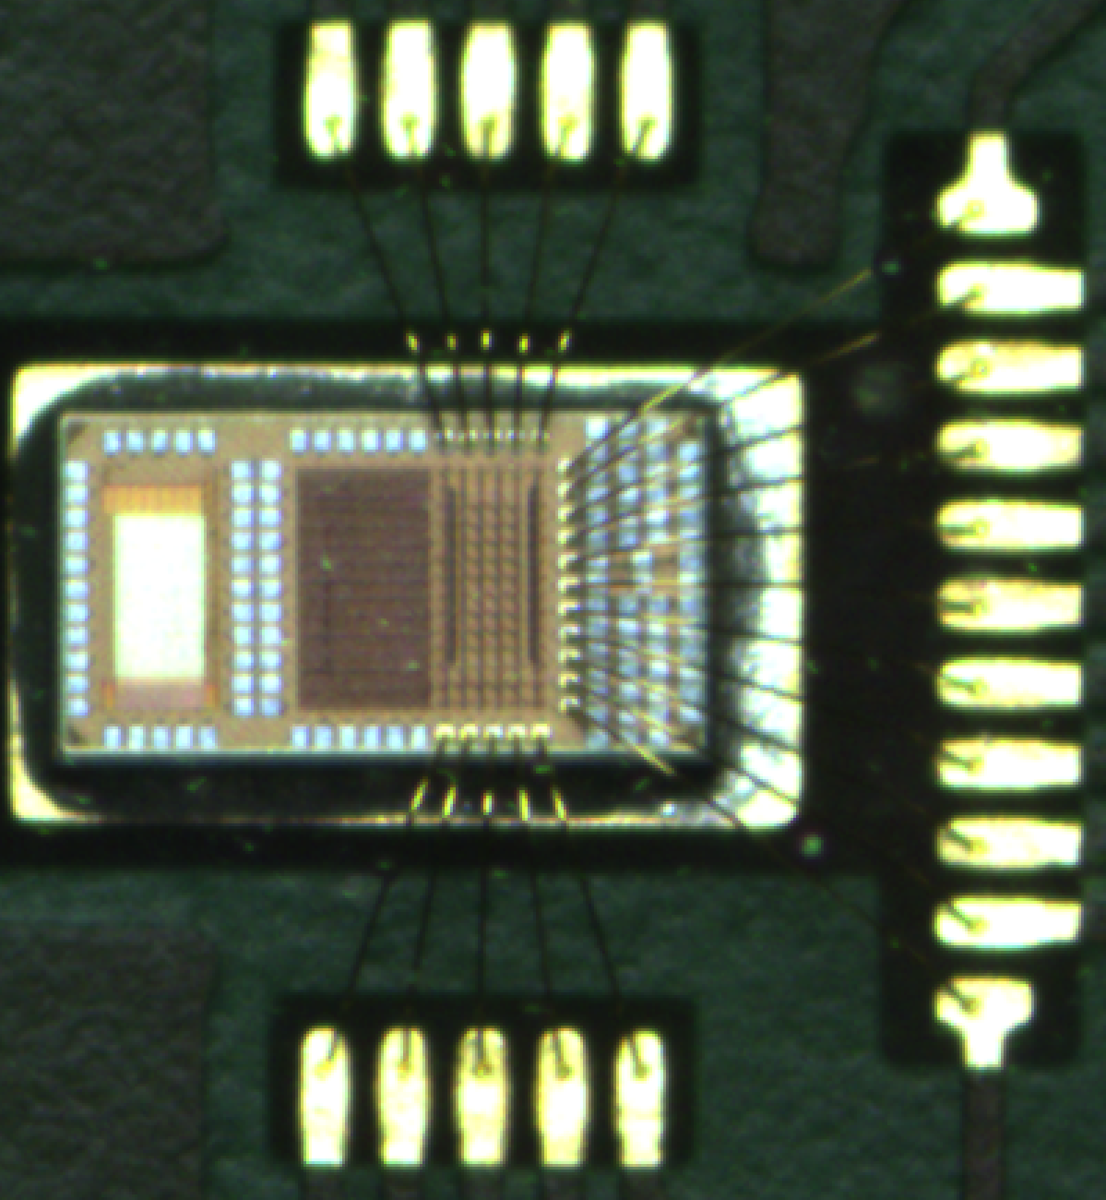
Prototypes 28nm sur PCB
Pixel_28nm
SET_28nm
RO_28nm

Slide 18
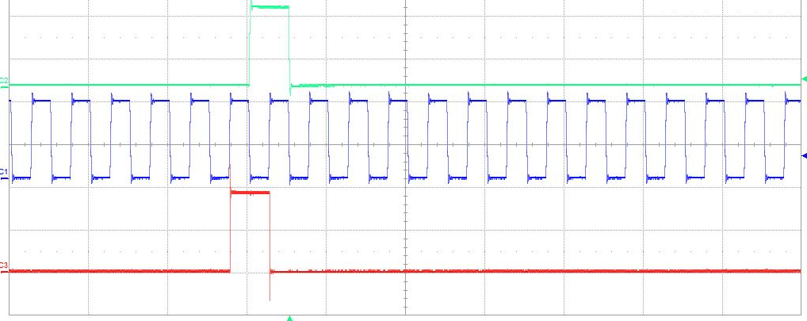
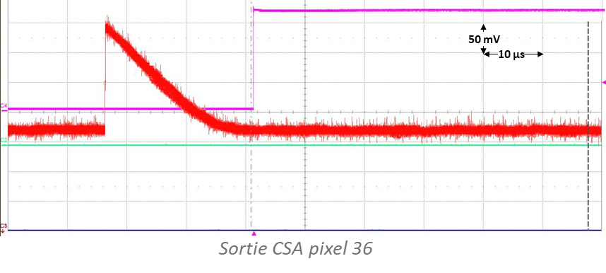
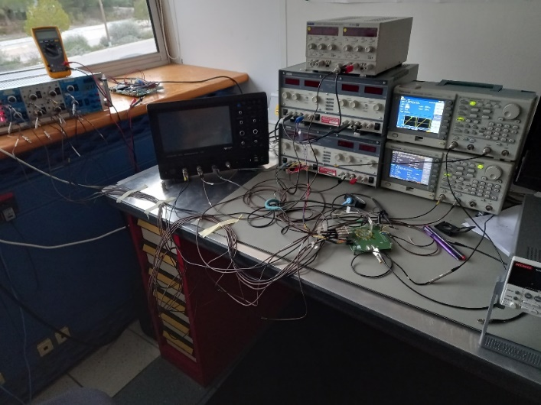
Preliminary results
The pixel array prototype is working properly
  The 3456 registers can be configured correctly
  The output signal of the test pixel is consistent with simulations
  intensive testing under way
DIN
1 V
2 µs
CK
DOUT
Configuration SR chip Pixel_28nm (EN_INJ = ‘1’ pixel 36)

Slide 19
Conclusion and perspectives
28nm prototype test boards received the beginning of 2024
  Testing has started and first results are quite promising
  4 different design to be tested and characterized
  Existing test-setup based on a beagle-bone board to be used
Continuation of the project
  The project is part of the IN2P3 R&D DEPHY project
  Functional tests to be completed in Q3 2024
  Irradiation tests (TID and SEE) in Q4 2024
  A new 28 nm design focused on larger size pixel array
    Implementation of TDC related to ToA and ToT
    The possibility to bump bond the FE array with sensor array
  Use of CERN PDK makes the design more manageable
  Prototype submission scheduled for Q4 2024

Slide 20
Thank you for your attention

Slide 21
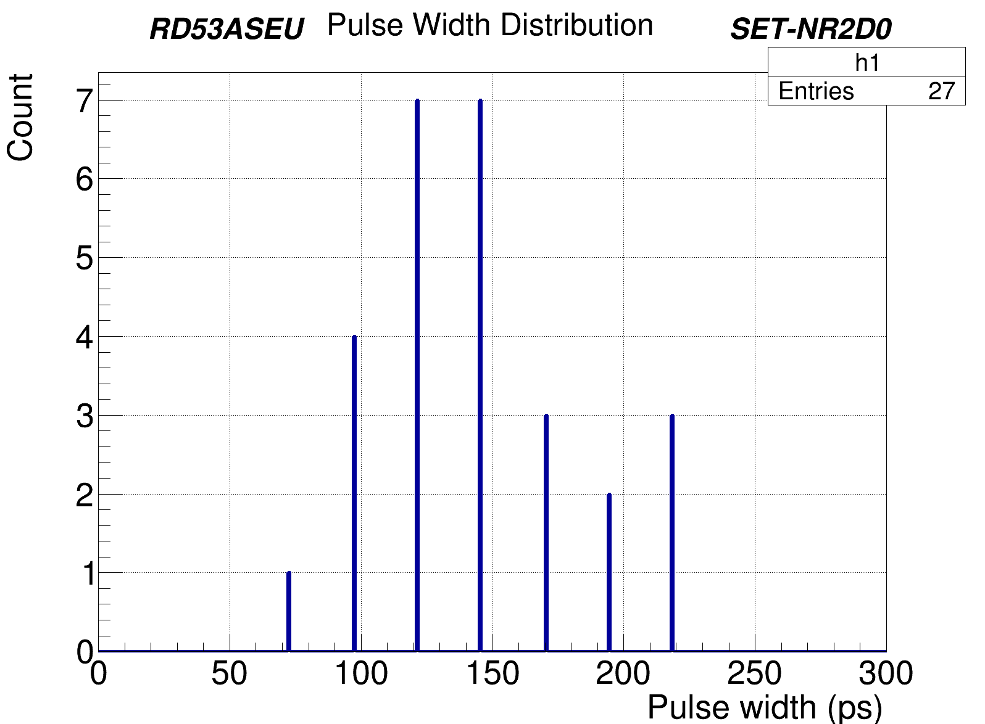
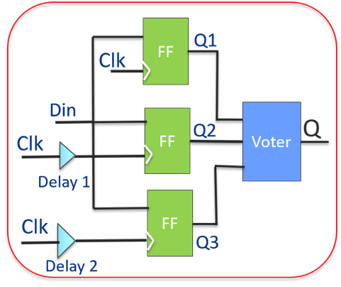
SEE/SET Testing
Single Event Transient (SET) sensitivity increases with process advance
  Propagation through combinatorial logic and generate SEU in memories
  Sensitivity to SET increases with speed
Implementation of test structures to characterize the 28 nm process for SET tolerance
Objectives :
  Measure the SET cross-section
  Measure the SET pulse with a good
  resolution < 20 ps
Allows as an example to define the delay to be used for the triplication with time delay mitigation
SEU tolerant design with
temporal Mitigation

Slide 22
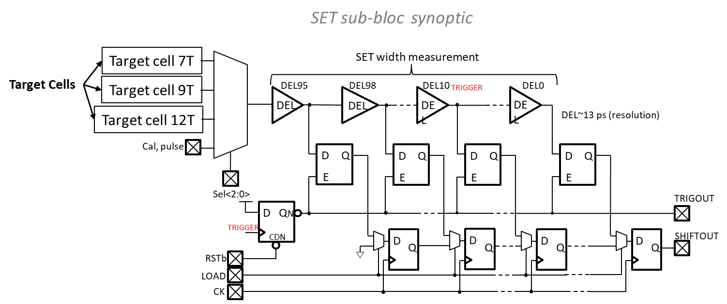
SET chip design
Each sub-bloc contains
  3 target cells made up of thousands of basic cells + 1 calibration input
  Circuit for SET width measurement 96 delay cells (13ps/cell) → from a few ps to 1ns
  Shift register to send the data to the output when a trigger signal occurs
31 SET sub blocs
  24 uses SVT target cells (7T, 9T, 12T) -> Effect of the cell size
  7 uses LVT or HVT target cells -> Effect of the device options
The whole bloc contains 6 inputs / 13 outputs
In addition to SET testing, this constitutes a sub-block of the TDC required in the pixel front end design

Slide 23
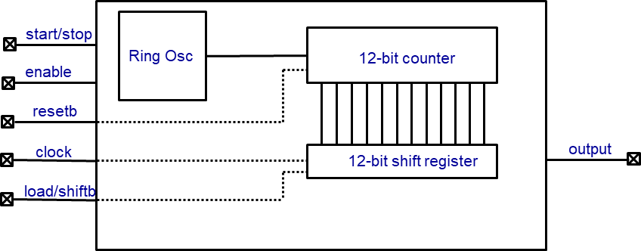
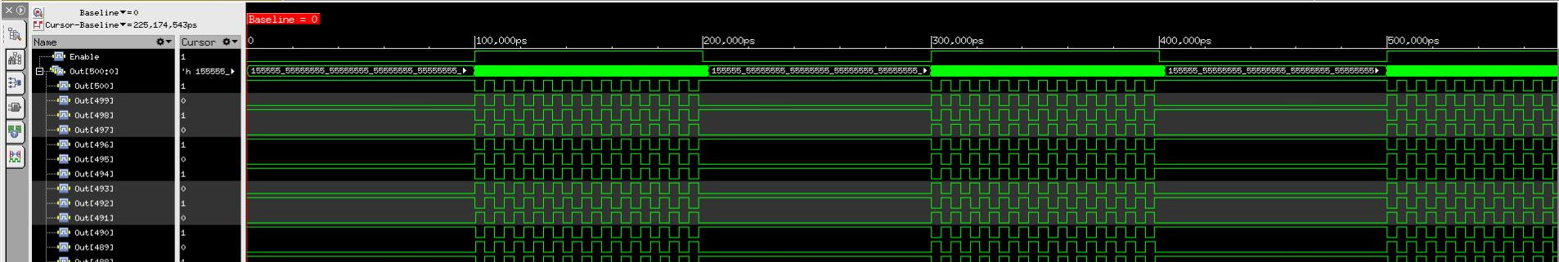
Ring Oscillator chip design
Study of the effect of TID on the performance of digital standard cells
Timing of combinatorial or sequential cells
Leakage currents and static power
Effects of device size on TID tolerance
Design based on the digital flow
96 Rosc sub-bloc
  Cell size (7T, 9T,12T)
  Driving (D0, D2, D4)
  SVT, LVT, HVT
ROsc sub-bloc synoptic
Basic cells | Frequency (MHz)
INVD0 | 154
INVD2 | 222
NAND0 | 118
NAND2 | 143
NOR0 | 111
NOR2 | 139
Simulation

Slide 24
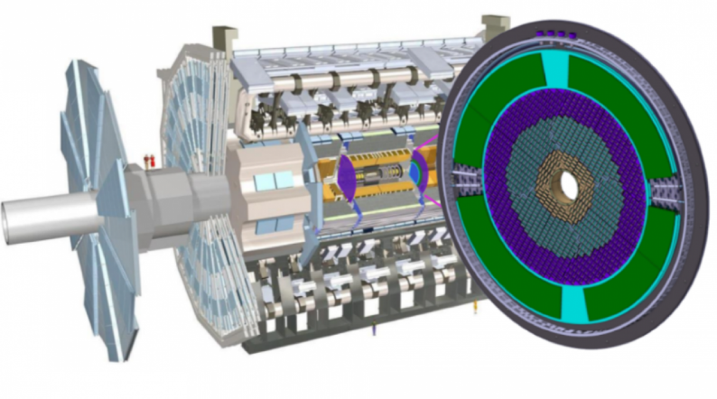
4D tracking in future experiments
Hadron colliders
Timing layers (HL-LHC) Run 4
  CMS and ATLAS are building silicon-based timing detector layers that will timestamp each track with a precision of
  30 ps
  ATLAS High Granularity Timing Detector (HGTD) and the CMS Timing Detector (MTD) placed in the forward regions (2.4<|η|<4.0)
  Based on novel Low Gain Avalanche Detectors (LGADs)
  The readout chip HGTD is an array of 15×15 channels
  of 1.3 × 1.3 mm²
The ATLAS and CMS tracker Run 5
  The two innermost pixel layers will need to be replaced after 5 years (LS4)
  Pixel time resolution of 50 ps is needed to boost the tracking performances
Future Circular Collider tracker (FCC-hh)
  Efficient reconstruction of charged particle tracks in an environment of high pileup density (1000 pileup)
  Position < 10 μm, Time resolution < 10 ps
  Radiation levels: 40 Grad and 6×10¹⁷neq/cm²
  (40 × HL-LHC)
  A big challenge in sensor and ASIC design
Electron colliders
Linear colliders ( ILC, CLIC) and Circular colliders
(FCPC, FCC-ee)
  High spatial precision is required for physics measurements -> Pixel size < 25 µm x 25 µm
  Time resolution at the ns level is sufficient
  Potential applications of timing at the ps level
Electron Ion Collider (EIC)
  4D detectors based on AC-LGADs are planned to provide timing capability
  Time resolution of 30 ps is required
  Spatial resolutions of 15 μm to 150 μm depending on the location.
Muon Collider
  Initial studies indicate that single hit resolutions of 20-30 ps are sufficient to reduce the Beam-Induced Background (BIB) to a manageable level
ATLAS High Granularity Timing Detector (HGTD)

