Slide 1
Signal formation in Vertical Drift
DUNE France - Analysis workshop
Supervisors :
J. COLLOT – LPSC Grenoble
L. ZAMBELLI – LAPP Annecy
D. DUCHESNEAU – LAPP Annecy

Slide 2
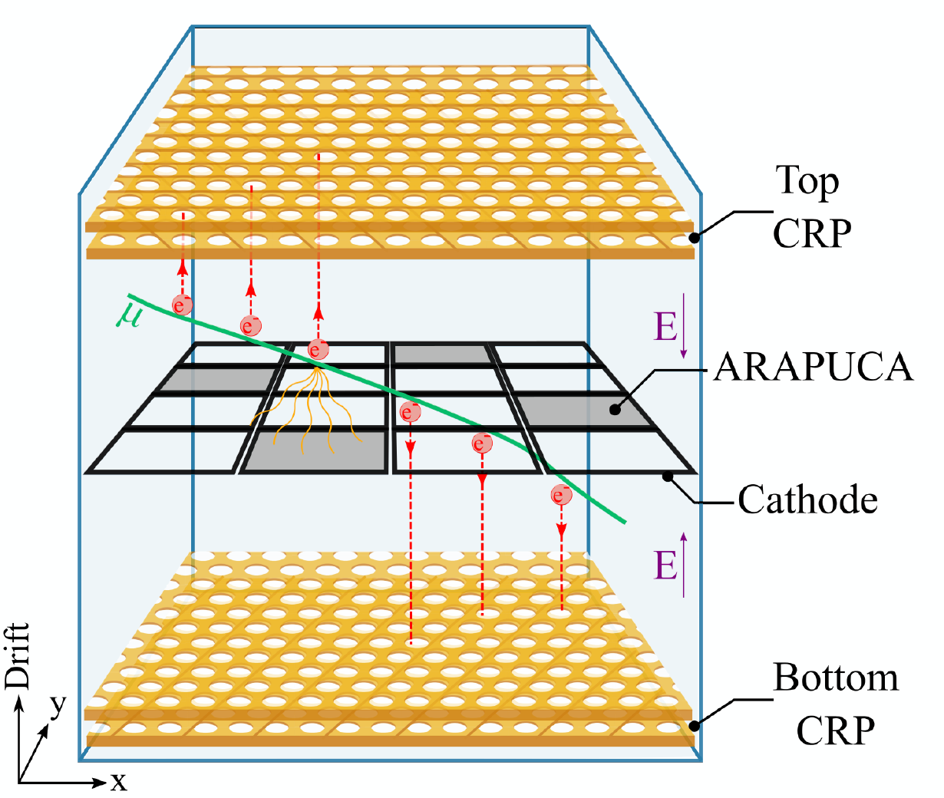
Vertical drift design
2 volumes split by a cathode
Electric drift field: $\left|\vec{E}\right|=0.5 kV/cm$
X-ARAPUCA* for light detection on the cathode
The new perforated anode technology
Stack of 2 perforated Printed Circuit Boards (PCB)
Etched copper electrode strips on each PCB face
A sub-centimeter spatial resolution
Module called Charge-Readout Planes (CRP) ~ 3x3 m
DUNE Far detector at SURF:
80 module CRPs for each top and bottom TPC
Half will be produced at Grenoble
Diagram by L. Zambelli
* Light detector device
Notes:
I don’t think is necessary to go into detail on this slide here but just as a reminder

Slide 3
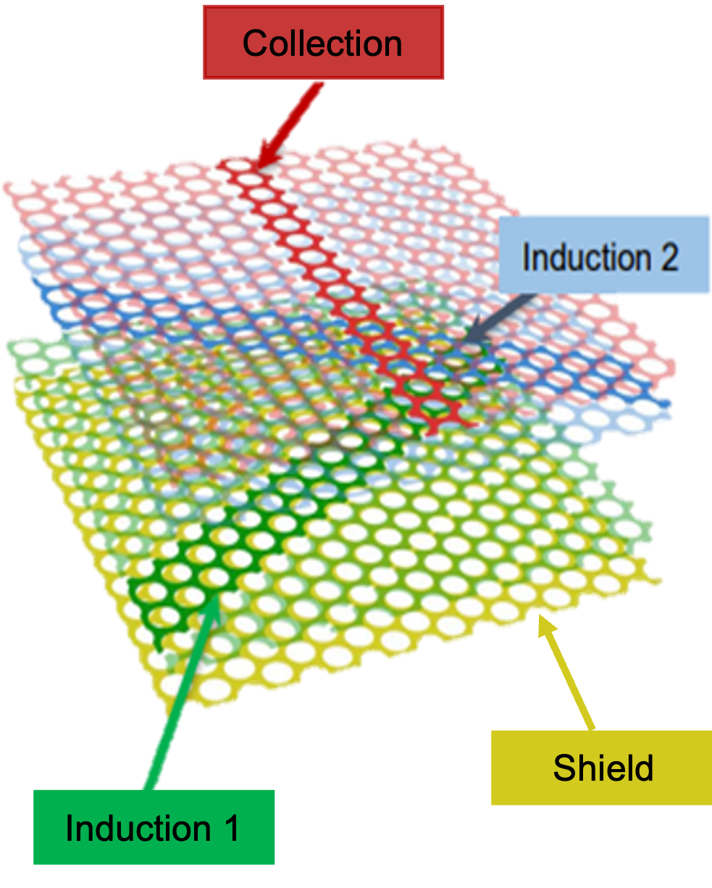
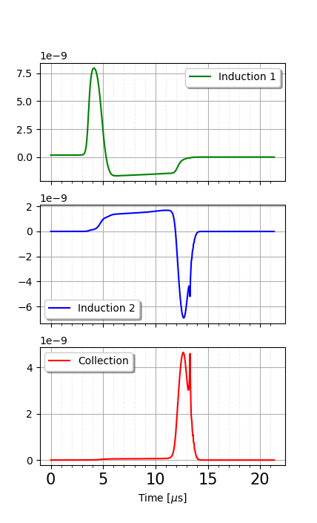
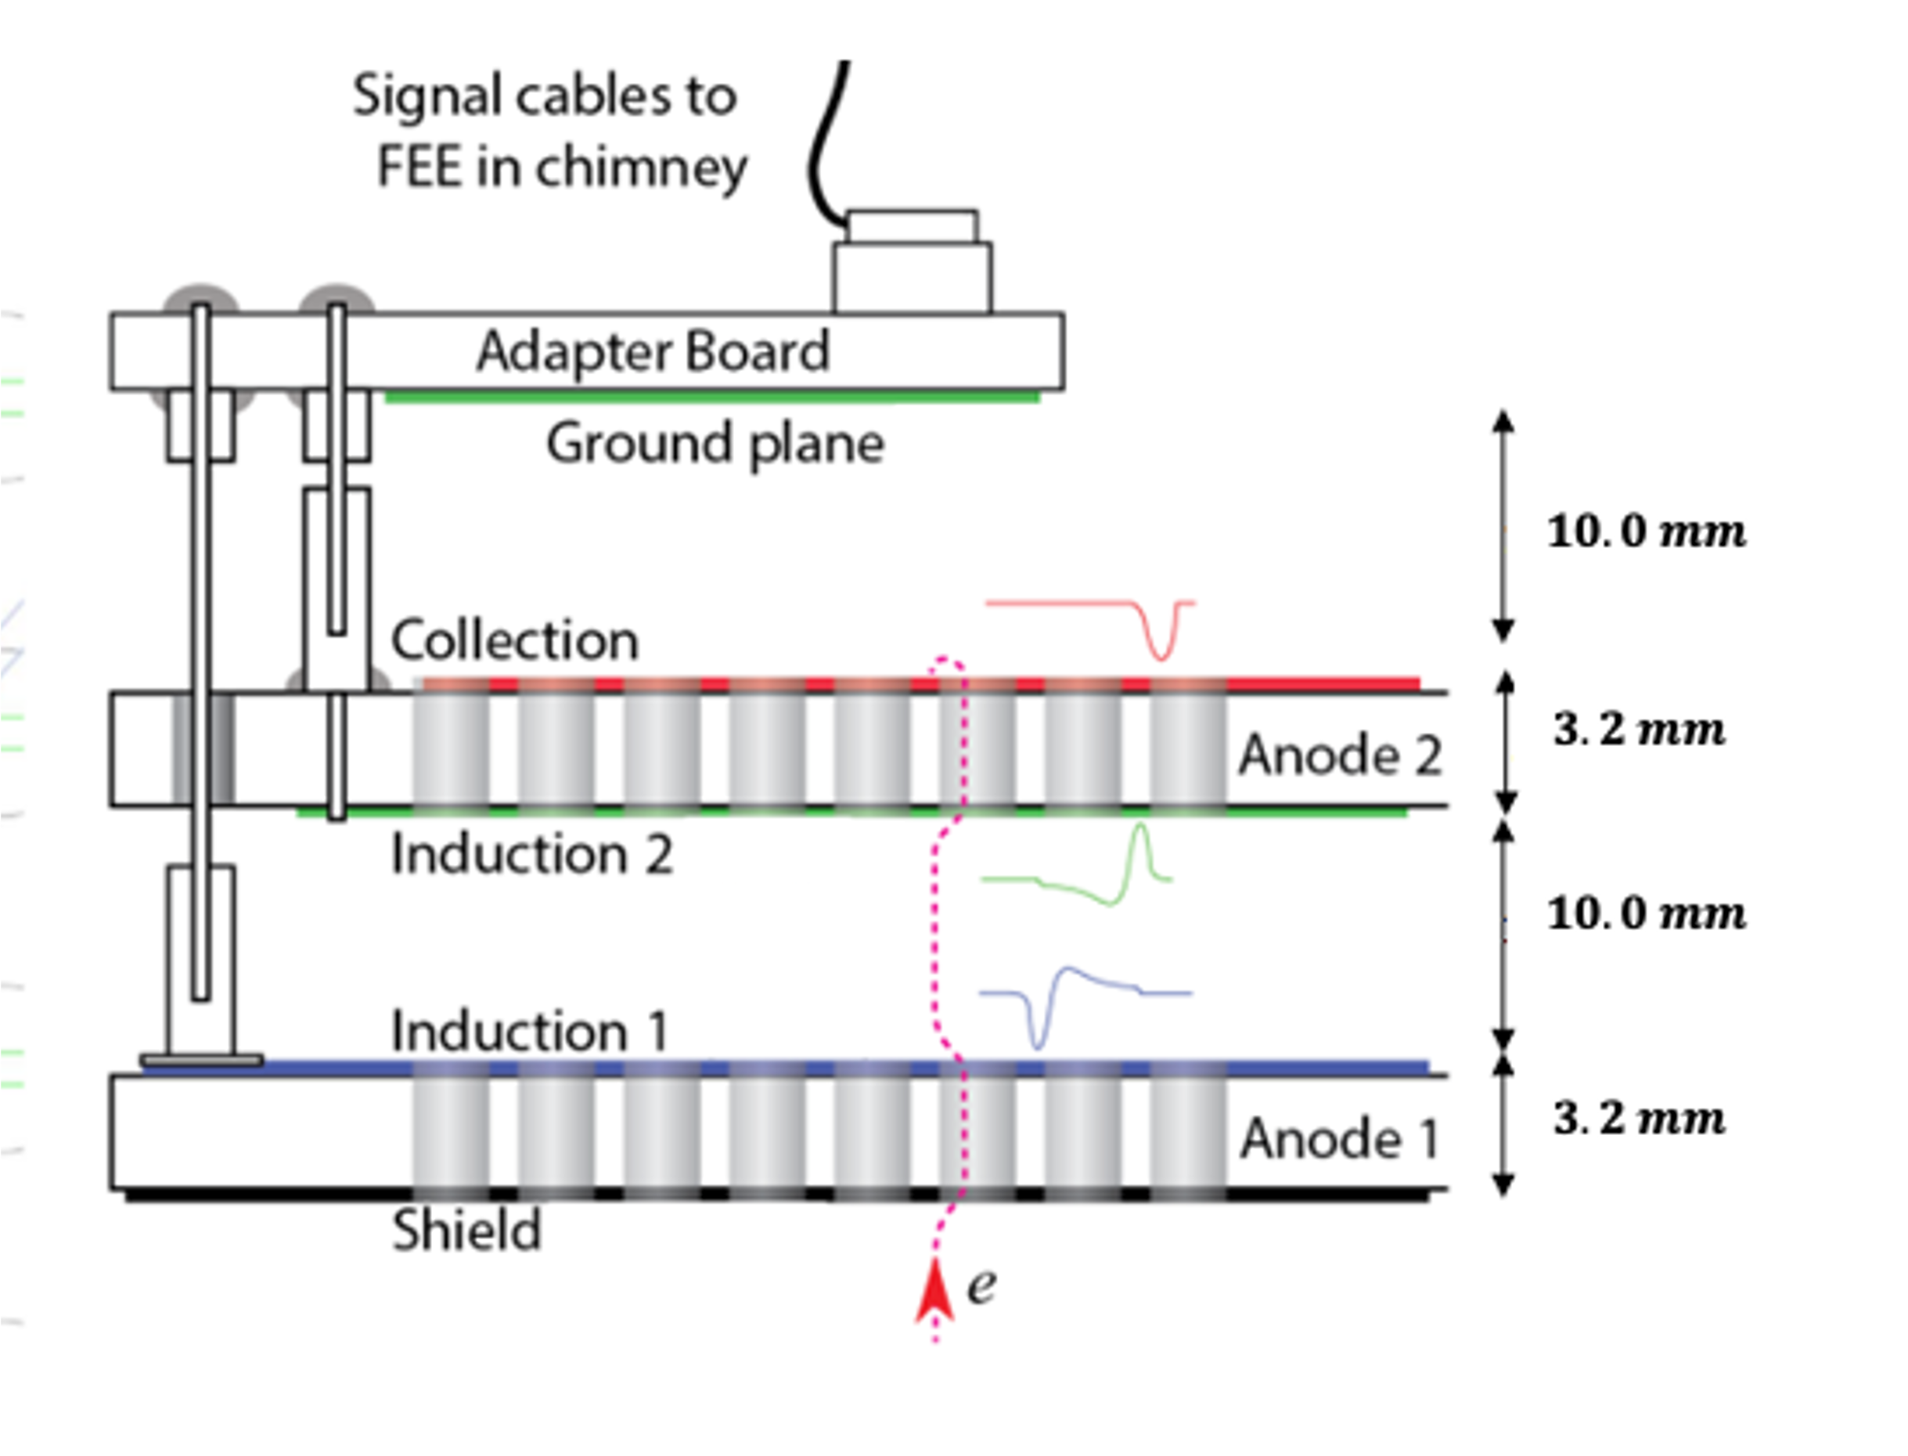
The perforated anode technology
Shield + 3 different charge readout layers:
Induction 1 (view 0) – strip orientation -30° wrt beam axis
Induction 2 (view 1) – strip orientation +30° wrt beam axis
Collection (view 2) – strip orientation 90° wrt beam axis
Signal before convolution
$$Q_{i}=∫S\left(t\right)dt=0$$
$$Q_{i}=∫S\left(t\right)dt=0$$
Induction views: Bipolar signals
Collection view: Unipolar signal
Collection : +1000V
Induction2 : 0V
Induction1 : -500V
$$Q_{coll}=∫S\left(t\right)dt=N_{e}×e$$
Shield : -1500V
Notes:
As a reminder we have 3 different charge readout layers called :
Each layer has its own strips with different orientation which are necessary to know the position of the deposited energy on the detector
We can see on the right, a spoiler of my result from my simulation for the three views. We can see 2 bipolar signals for the induction because the collected charge is equal to 0 and an unipolar signal on the collection view.

Slide 4
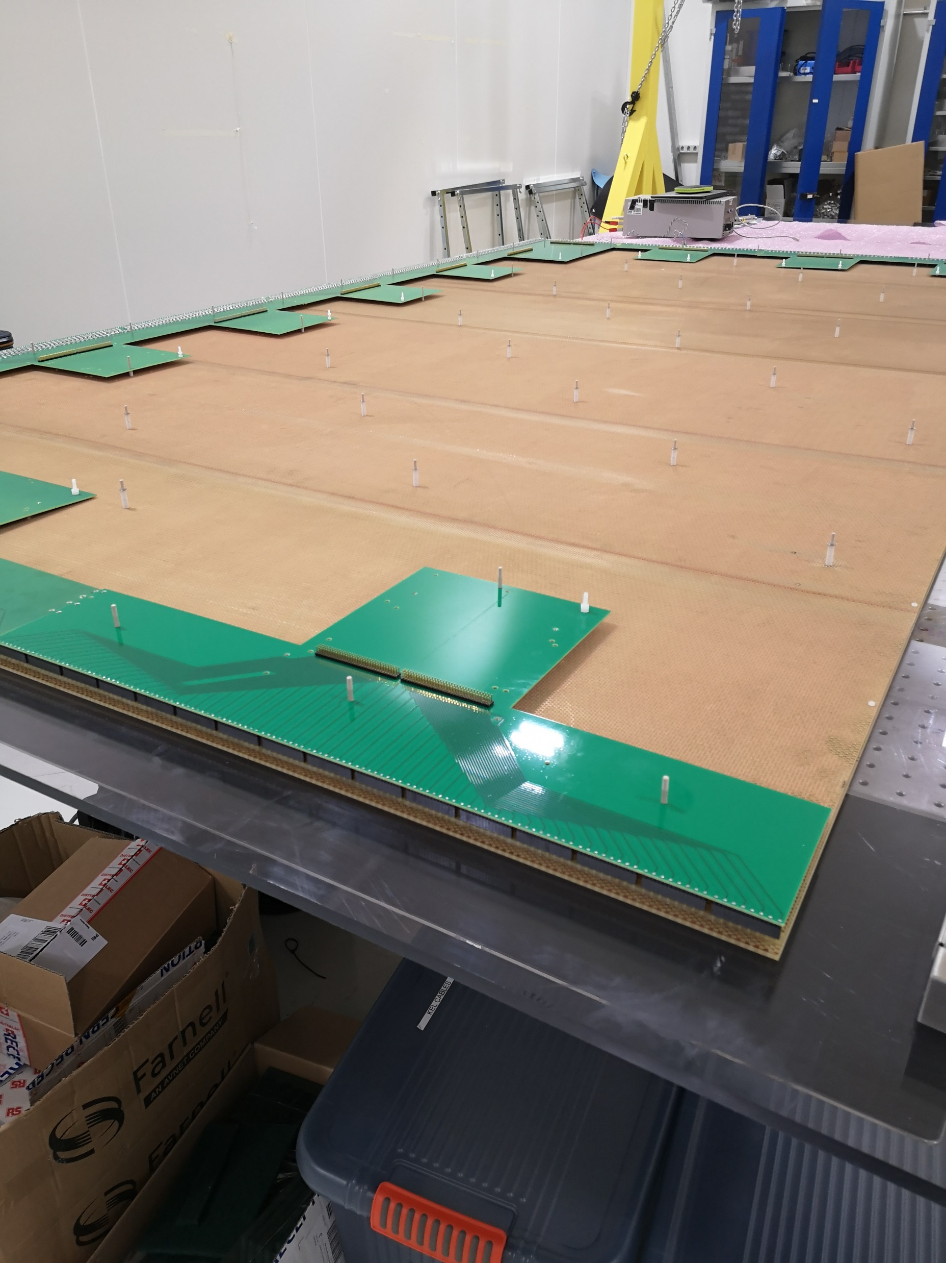
Signal formation study on anodes
Problematic:
Use of new anode technology
Important to know the deposited energy in the detector to measure the neutrino oscillation parameters
Important to reconstruct the particle tracks from collected charge
My work:
Understanding the waveforms based on energy, track angle and position
Understanding the charge lost in the anodes
Estimate the different systematics
CRP assembly at CERN
Study of induced signal formation on the anode
Notes:
To solve these problems,

Slide 5
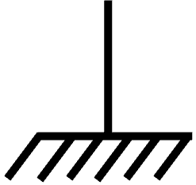
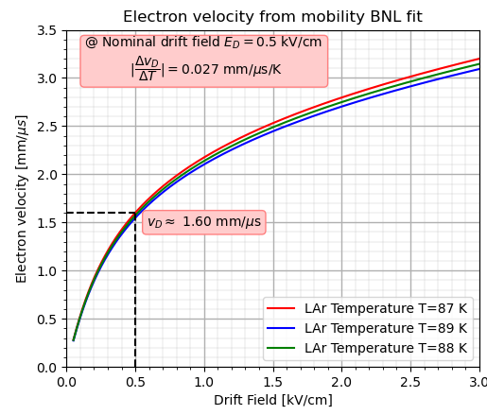
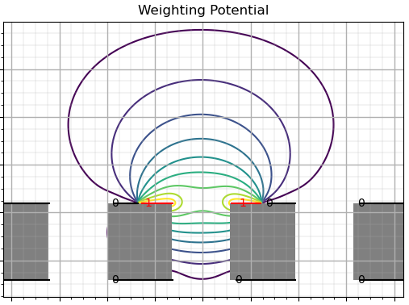
Modeling signal formation
Superposition principle
$$V_{1}$$
$$V_{2}$$
$$V_{1}$$
$$V_{2}$$
$$Q_{i}=ε\oint{\vec{E}. \vec{dS_{i}}}=ε\left[\oint{\vec{E_{0}}. \vec{dS_{i}}+\oint{\vec{E_{1}}. \vec{dS_{i}}}}\right]$$
$$\vec{v}$$
$$\vec{v}$$
$$q$$
$$q$$
$$V_{4}$$
$$\vec{E}$$
$$V_{3}$$
$$V_{4}$$
$$\vec{E_{0}}$$
$$V_{3}$$
$$\vec{E_{1}}$$
$$V_{k}$$
$$V_{k}$$
Drift velocity:
$\vec{v_{D}}≡\vec{v_{D}} (\vec{E_{D}},T)$
Shockley-Ramo theorem:
$$i\left(t\right)=q {\vec{E}}_{w} .{\vec{v}}_{D}$$
Weighting Field $\vec{E_{w}}$ is virtual field defined when the reading strip equal 1 V and all others fixed to 0 V
$\vec{E_{w}}$: geometry factor
$\vec{v_{D}}$: physics factor
The instantaneous current is induced by charge motion only
Need simulation for complex geometry
$$0$$
$$0$$
$$1$$
$$1$$
$$0$$
$$0$$
$$0$$
$$0$$
$$0$$
$$0$$
$$0$$
$$0$$
https://lar.bnl.gov/properties/trans.html
Notes:
To simulate the signal formation on the strips, we usually use the famous Shockley-Ramo theorem. This theorem become directly from the Maxwell equation

Slide 6
Induced signal simulation
Design of a simulation on Python
Hexagonal pattern
CRP geometry
Strip dimensions

Slide 7
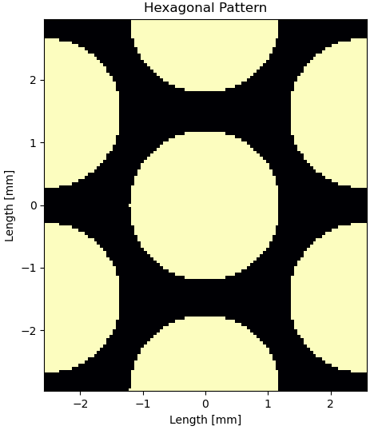
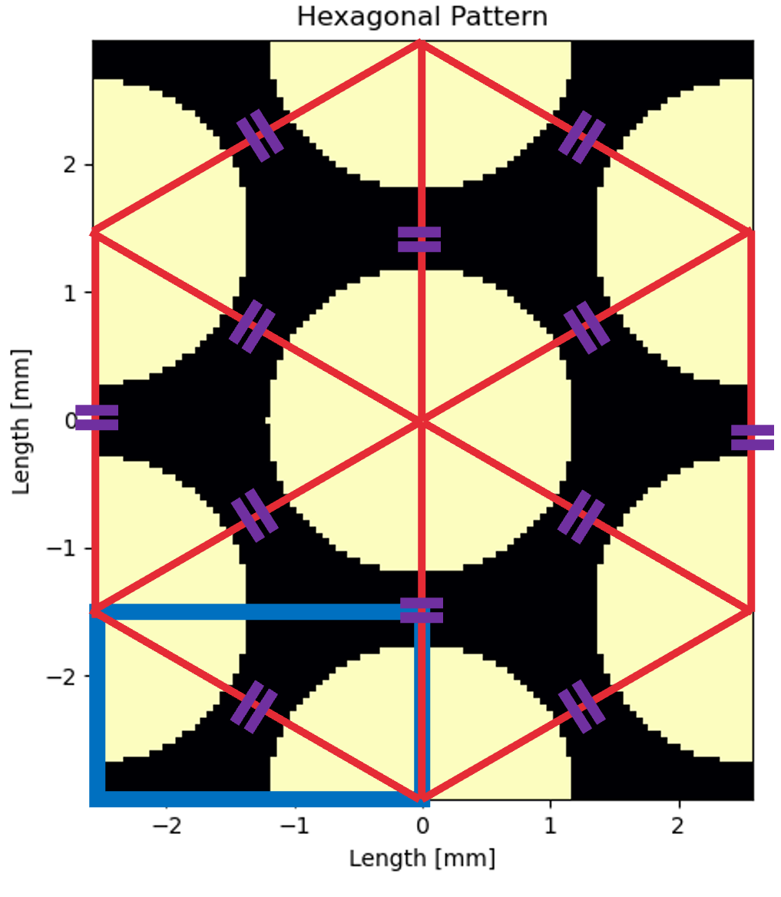
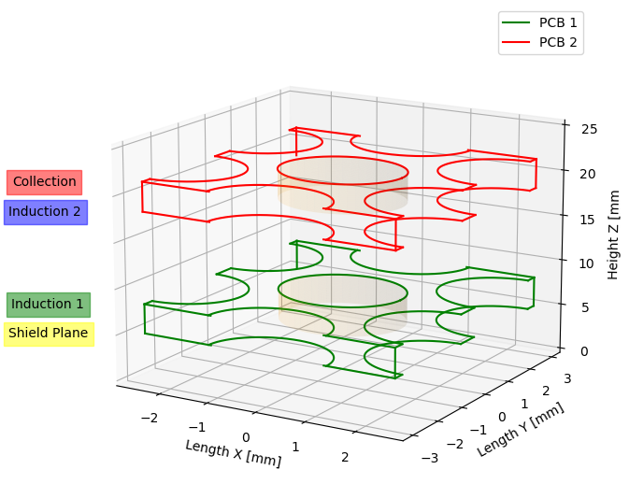
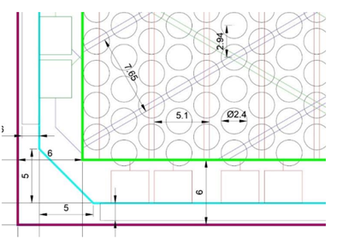
Induced signal simulation
Shield: -1 500 V
Induction 1: -500 V
Induction 2: 0 V
Collection: 1 000 V
Numerical simulation on Python
Implement CRP geometry hexagonal pattern, width strips, 2 Printed Circuit Boards, 4 equipotential planes
Hexagonal pattern
CRP geometry
Strip dimensions
Induction strip
Step used: $50 μm$
Induction strip
Collection Strip

Slide 8
Induced signal simulation
Design of a simulation on Python
Induced signal on the readout strips:
Run Time: ~ 30 mins
$$i\left(t\right)=q \vec{E_{W}}. \vec{v_{D}}$$
Hexagonal pattern
Drift Field
Weighting field $\vec{E_{W}}$
Drift Velocity Field: $\vec{v_{D}}=μ\left( \left|\vec{E_{D}}\right|,T\right) ×\vec{E_{D}}$
CRP geometry
Field calculation
Step used: $50 μm$
Bin files generation
Solving Laplace’s equation in 3D: $Δφ\left(x,y,z\right)=0$
3D Finite element method (FEM):
Strip dimensions
Weighting Field
Induction 1
Collection
Induction 2
Specific geometry setting up
$$φ_{i,j,k}= \frac{φ_{i±1,j,k}+φ_{i,j±1,k}+φ_{i,j,k±1}}{6}$$
Run Time: ~ 2h30
Iterative method, step by step

Slide 9
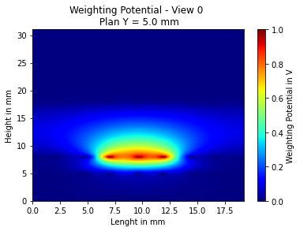
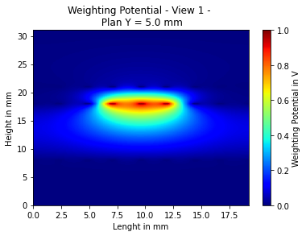
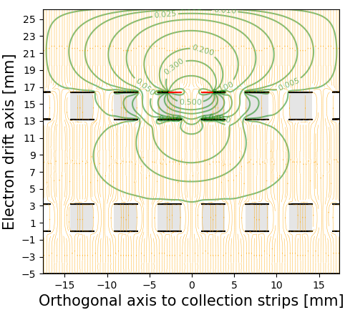
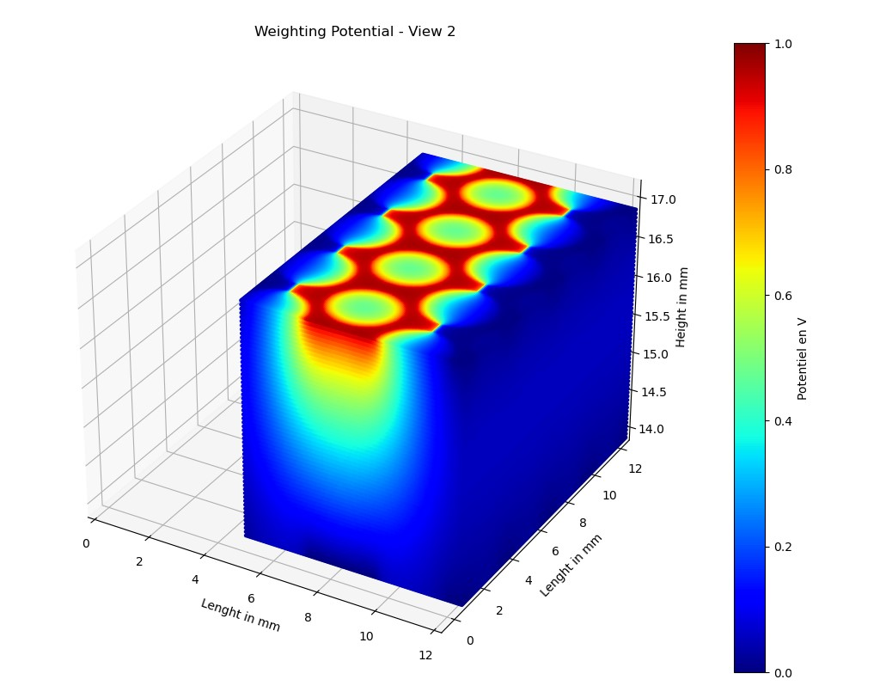
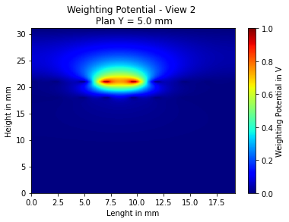
Field results
Weighting Potential
2D projection of drift field lines and weighting equipotential
Collection
FR4
Induction 2
Ar
Induction 1
Shield
Induced signal in the nearby strips

Slide 10
Induced signal simulation
Design of a simulation on Python
$\left|\vec{E_{D}}\right|∈\left[0.5 ;4 \right]$ kV/cm
Hexagonal pattern
$$v_{D}≡v_{D}(\left|\vec{E_{D}}\right|,T)$$
Drift field
Drift velocity
CRP geometry
Field calculation
Bin files generation
Ionization electron
Induced signal
Strip dimensions
Weighting field
Trajectory simulation
Induction 1
Collection
Induction 2
Specific geometry setting up
Field generation with CRP geometry

Slide 11
Ionization electron generation
Electron trajectories passing through a CRP’s hole
Thermal electron
Trajectory follow drift field lines
Collection
The electron trajectory is perfectly defined
Induction 2
Runge Kunta like simulation
$$\left(x_{i+1},y_{i+1}\right)$$
$$x_{i+1}=x_{i }+\frac{E_{x}^{interp}(x_{i},y_{i})}{\left|E(x_{i},y_{i})\right|}×S$$
$$y_{i+1}=y_{i}+\frac{E_{y}^{interp}(x_{i},y_{i})}{\left|E(x_{i},y_{i})\right|}×S$$
$$(E_{i};E_{j+1})$$
$$S$$
$$(E_{i+1};E_{j+1})$$
$$\left(x_{i},y_{i}\right)$$
$$\left(E_{i};E_{j}\right)$$
$$(E_{i+1};E_{j})$$
Induction 1
$$e^{−}$$
Shield
$E^{interp}:$ 3D linear interp
$$step=50 μm$$
$$i−1$$
$$i$$
e
Drift simulation 5 mm
Grid of the mesh used for the field calculation
Drift

Slide 12
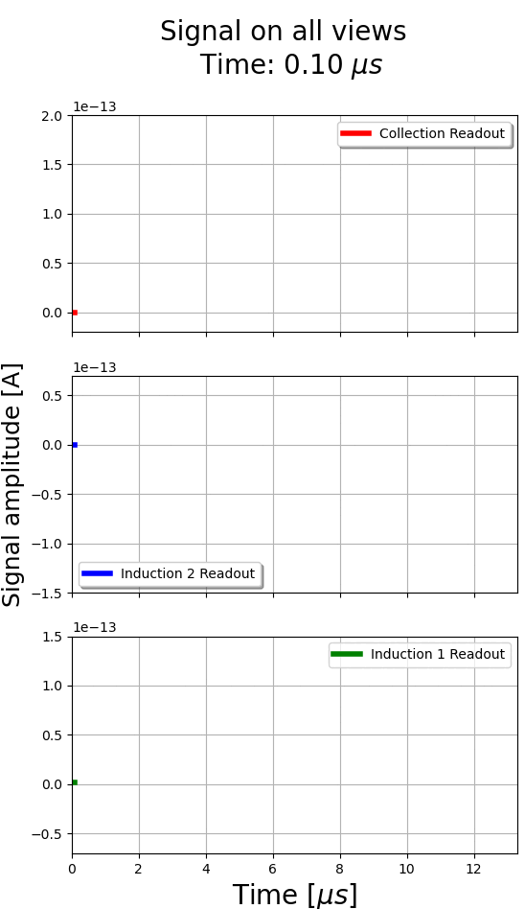
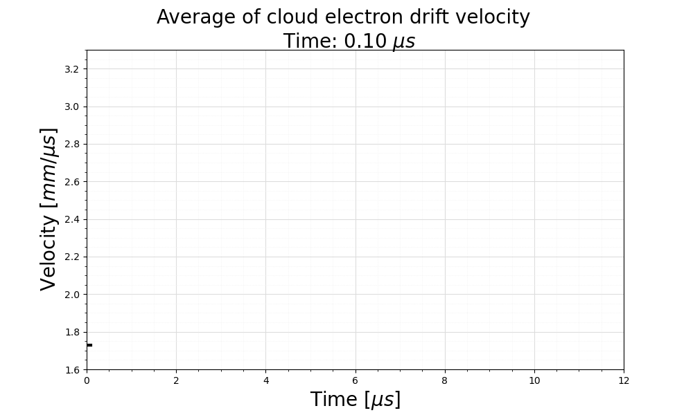
Electron cloud simulation
$$+1 000 V$$
Collection
Induction 2
$$0 V$$
Induction 1
$$− 500 V$$
Shield
$$−1 500 V$$

Slide 13
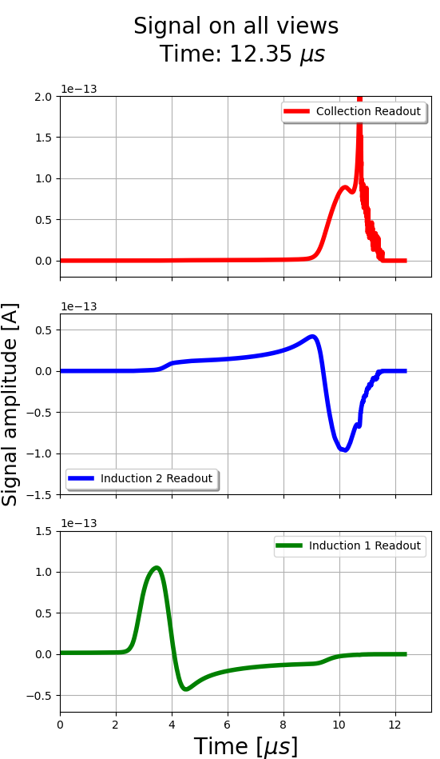
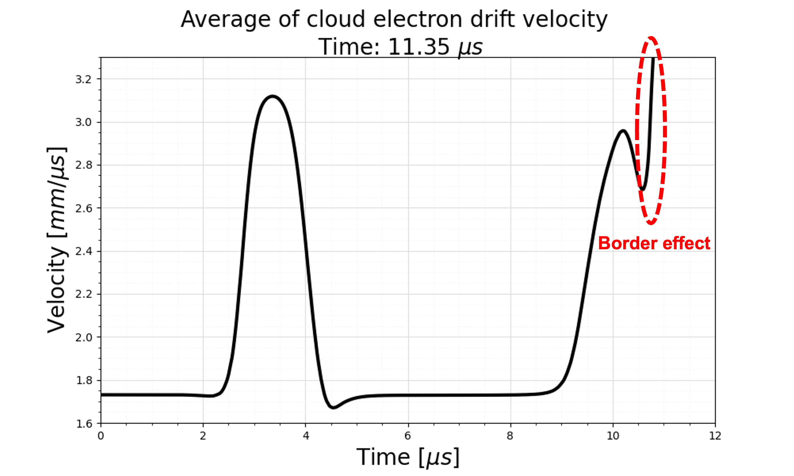
Electron cloud simulation
$$+1 000 V$$
Collection
Induction 2
$$0 V$$
Border effect near to the collection electrode
The field takes $∝1/r^{2}$ dependancy which will induce a high frequency signal
Electronic response will smooth the readout induced current
Induction 1
$$− 500 V$$
Shield
$$−1 500 V$$

Slide 14
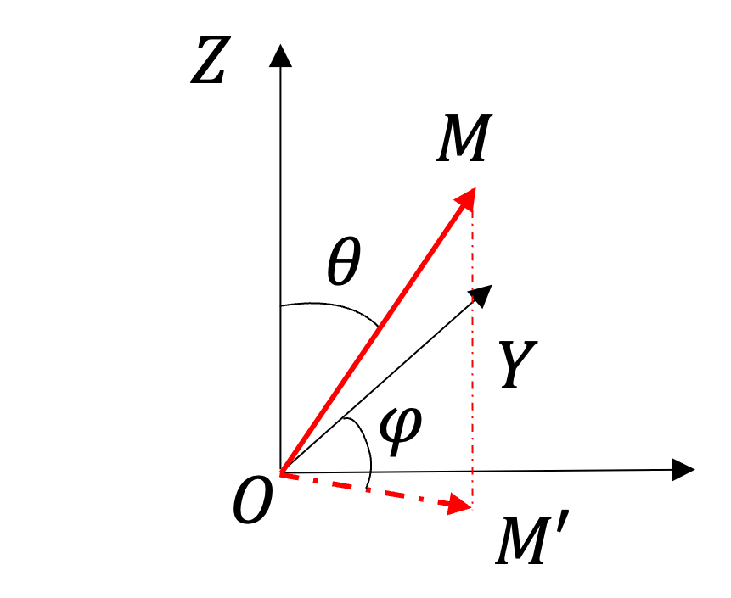
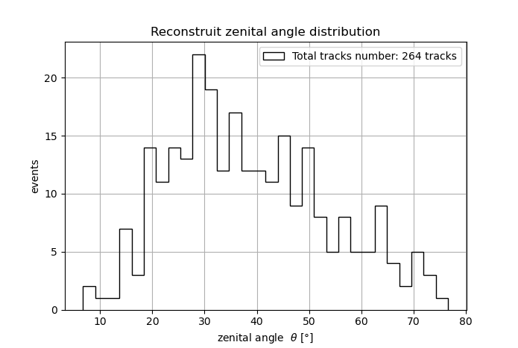
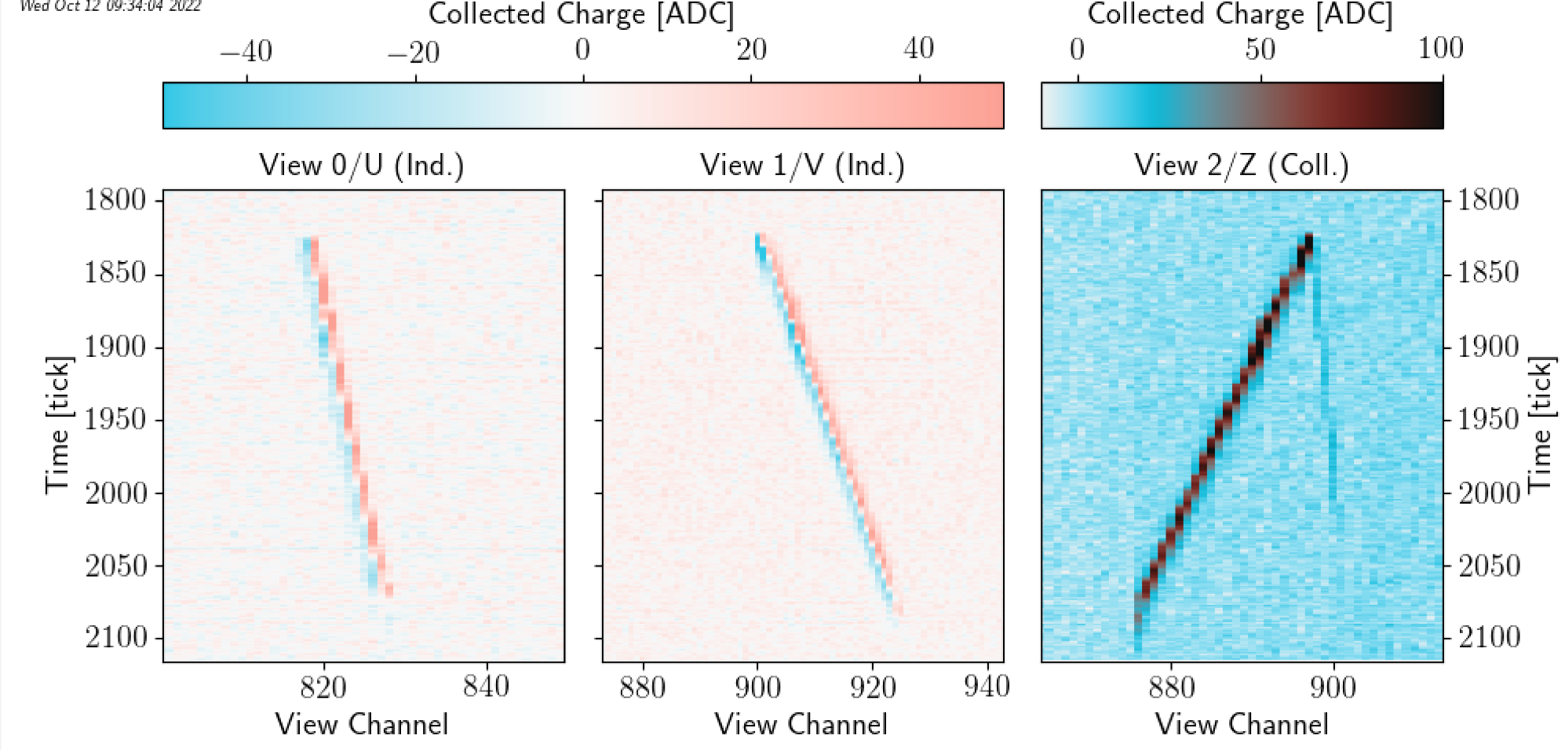
Data extraction
Coldbox’s data cuts
Tracks with reconstructed angle $θ>60°$
$φ$ in the cone with $45°$ from the strip readout
Track lengths $>20 cm$
Event Display
An example of cosmic ray track from the Coldbox
Reconstructed zenithal angle distribution
Data reconstruction with LARDON (software developed by L. Zambelli)
Select horizontal track to compare with simulation
Bipolar signals induction view
Muon events

Slide 15
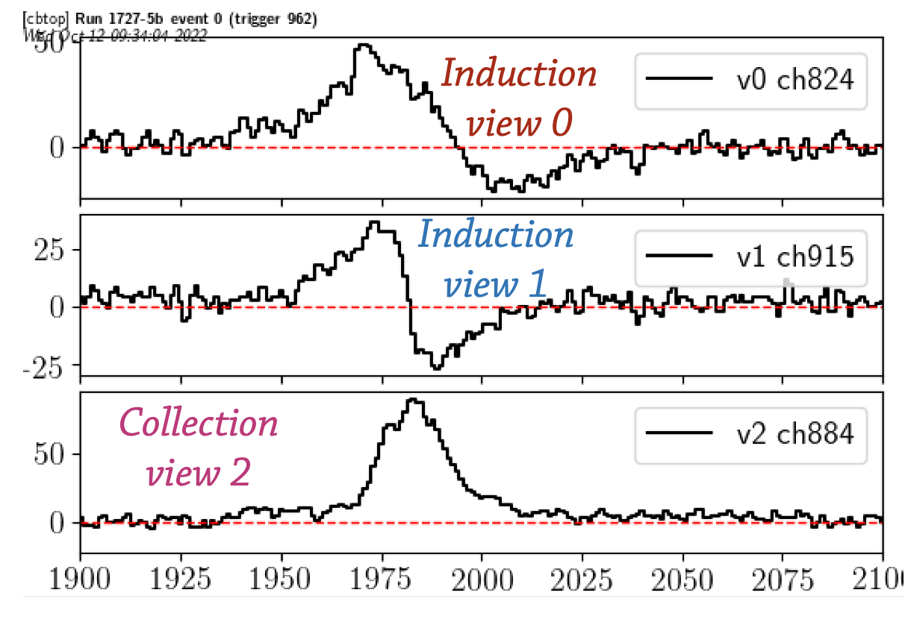
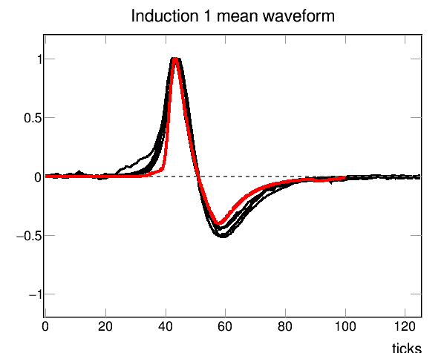
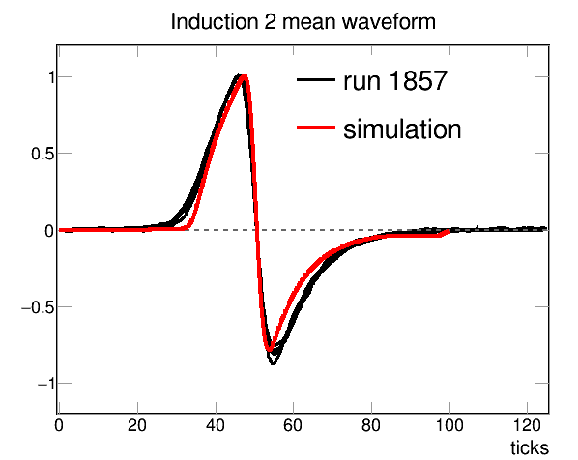
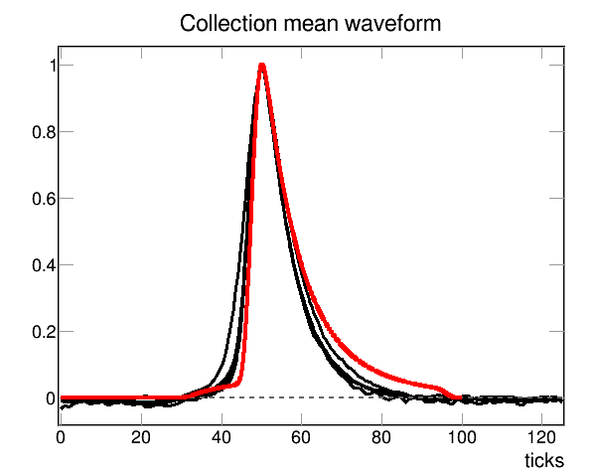
Comparison data VS simulation
Mean waveform
Signals summation on each readout channel
→ To reduce the incoherent noice
Mean signal calculation for each track
ADC
time
Aligned with the max
Aligned with the center
Aligned with the center
Simulated waveforms in agreement with data

Slide 16
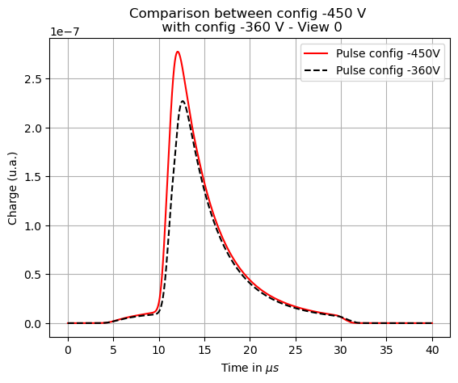
CRP transparency study
The simulation has shown a significative effect between two bias configurations used in the coldbox tests:
Config 1: $V_{id1}=−450 V$
Config 2: $V_{id1}=−360 V$
Work on signal amplitude to explore the different causes of charge loss
Using two PCB can lead to loss of total CRP transparency:
$$T=\frac{n_{e}^{collected}}{n_{e}^{generated}}$$
$$V_{c}$$
$$V_{id2}$$
$$V_{id1}$$
$$V_{s}$$
$$e$$
Some electrons are collected by the induction 1 plane
Collected charge decreases
Dependency on the bias voltage used
$$T_{sim}=\frac{Q_{tot}\left(−360\right)}{Q_{tot}(−450)}=14 \%$$

Slide 17
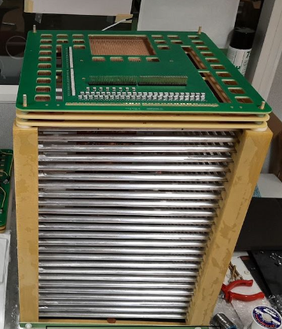
CRP transparency study
Coldbox’s data with same configuration:
dE/dx measured for muons
Comparison of the energy reconstruction
Result:
Increase of 6 % reconstructed energy for the “config -450 V”
A real effect but smaller than the simulation result
Difference Simulation/Measurements need to be understood
50 L TPC at CERN
$\sim 32×32 cm$ active area
52 cm drift
Cosmic and Bi207 sources
New measurements will be taken on the 50 L TPC (R&D)
Notes:
Why new ? We’ve already had data from this one but unfortunately, there were few cosmic events and some problems with the adapter boards.
For those who don’t know the 50 L TPC is a small TPC for the R&D at CERN.
It has the advantage of low sensibility to the space charge effect and to have more drift than the coldbox.

Slide 18
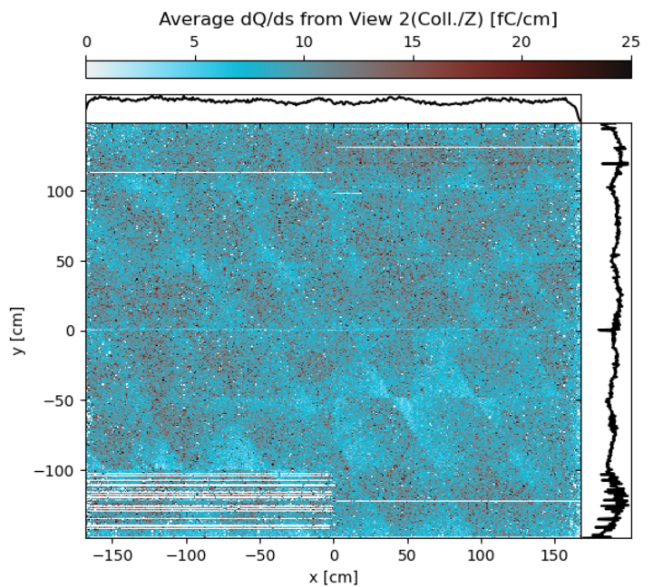
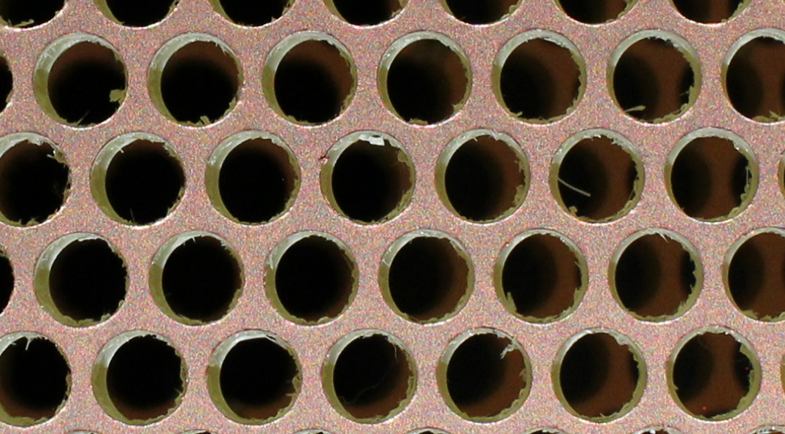
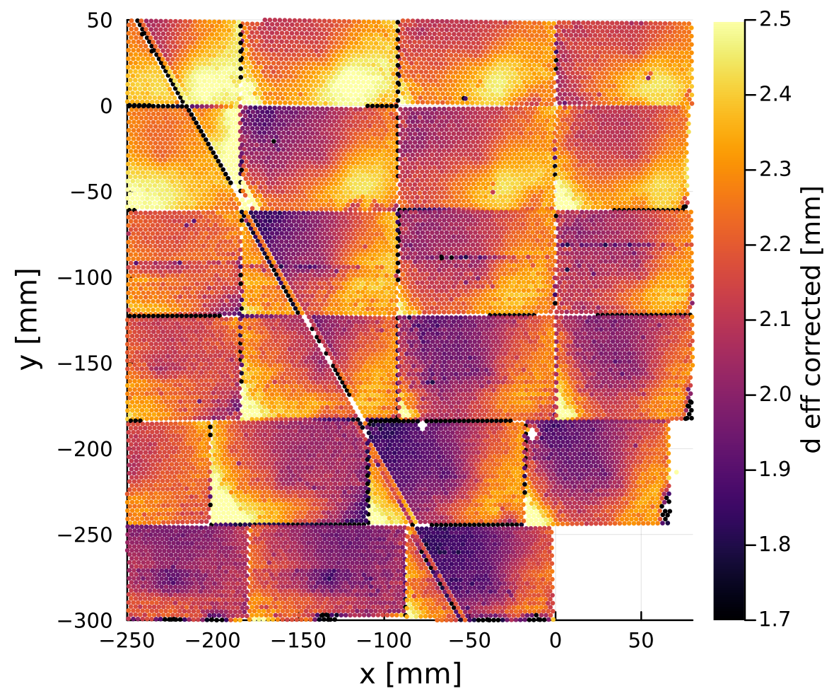
CRP 6 data explanation
Laura’s work**
Luis’ work*
Effective hole diameter modified
PCB shifted between shielding and view 0
Probably glue inside the holes
Consequences: charge lost
Draw a pattern along the induction strips
An effect that would seem to be a “charging-up”
Problem: no charge lost in the simulation and no “charging-up” effect
* Photo analysis for QA/QC of CRP anodes – Luis Manzanillas
** https://indico.fnal.gov/event/64225/contributions/288494/attachments/176651/240155/cb_crp6_iii_first_look.pdf

Slide 19
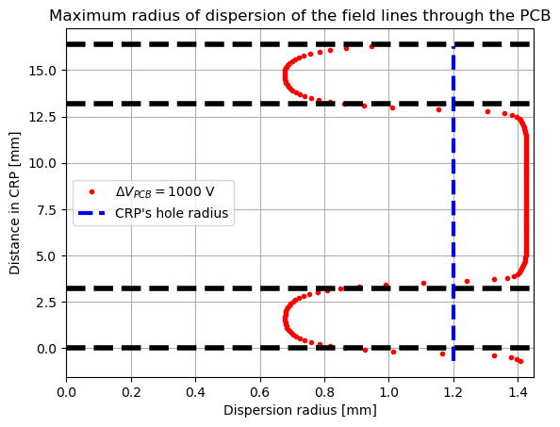
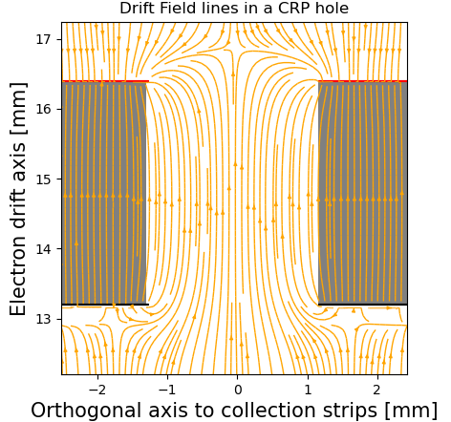
Holes covering and loss charge
Focalization of drift field lines in the CRP hole
Collection
Induction 2
Collection
Induction 1
Induction 2
Shield
Field line too focused to explain the loss of charge → Electron diffusion

Slide 20
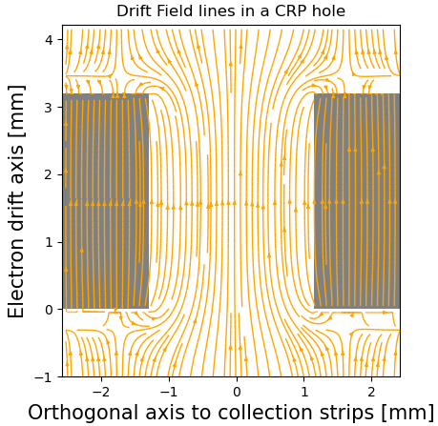
Electron diffusion
Electron loss on view 0 due to the diffusion
Transverse electron diffusion could cause a loss of charge in the CRP
$$\frac{∂n}{∂t}=D_{L}\frac{∂^{2}n}{∂z^{2}}+D_{T}\left(\frac{∂^{2}n}{∂x^{2}}+\frac{∂^{2}n}{∂y^{2}}\right)$$
Fick’s equation
Come in
Gaussian spatial distribution of the electrons over time
Average diffusion length given by:
$$σ_{L,T}=\sqrt{2D_{L,T}t}$$
Longitudinal and transverse diffusion coefficient:
$$D_{L}=\frac{ε_{L}μ}{e}$$
$$\frac{D_{L}}{D_{T}}=1+\frac{E}{μ}\frac{∂μ}{∂E}$$
$ε_{L}:$ longitudinal effective electron energy
(Einstein’s relation)
$μ:$ electron mobility
Come out
e
For next: only transverse diffusion is used (work in progress)

Slide 21
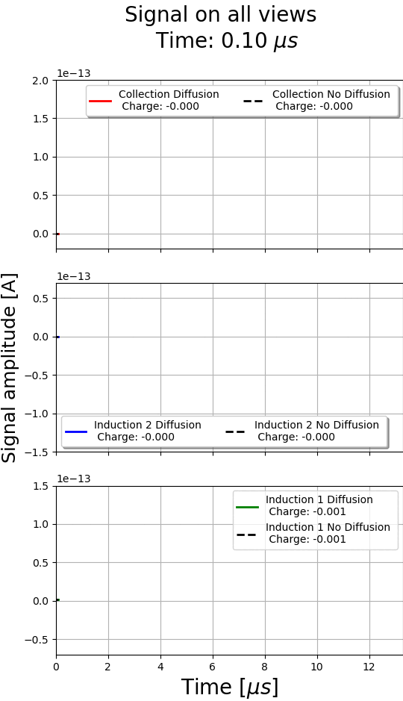
Transverse electron diffusion only
Collection
Induction 2
Induction 1
Shield
$D_{T}=13.23 cm^{2}/s$*
* https://lar.bnl.gov/properties/trans.html

Slide 22
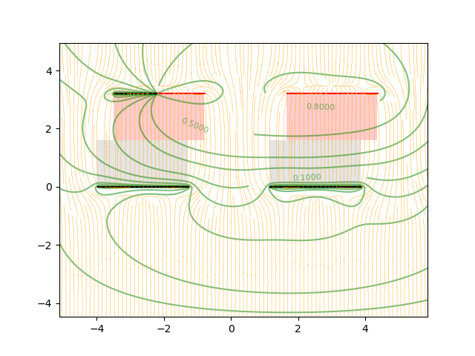
Field with hole shifted
Covering exact area given by:
$$𝒜_{analytic}=2R^{2}\left[\arccos{x}+2x\sqrt{1−x^{2}}\right]$$
with $x=\frac{\sqrt{R^{2}−{\left(x_{0}/2\right)}^{2}}}{R}$, $x_{0}:$ shifting, $R=1.2 mm$
Work in progress
FR4
Zoom
Ar
$$x_{0}=0.5 mm$$
Covering area : 52 %

Slide 23
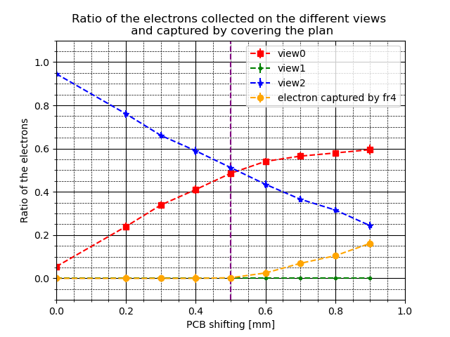
CRP6 transparency (simulation)
Work in progress
FR4
Ar
→ Have to implement the dielectric constant for the FR4
Even with diffusion: electron dispersion through a hole is insufficient
too focused to explain charging-up → Electron diffusion
Increased charge loss
Charging-up effect can be explain that if the electrons are captured by the FR4.
i.e. shifting > 0.5 mm
But Luis has measured a shifting max ~ 0.35 mm
Notes:
Perhaps explain that for a PCB shifting greater than 0.5 mm. However, Luis has shown that the holes shifting is equal to 0.35 mm for the maximum on the CRP6

Slide 24
Summary
Work done:
Numerical simulation conception to understand the formation of induction signals of all views
Coldbox’s data extraction → simulation is good agreement with this
What’s next ?
Keep working on the electron diffusion and the impact on the loss charge
Same study with longitudinal diffusion
Implement the drift field dependance → $D_{L}\left(\vec{E_{D}}, T\right)$, $D_{T}\left(\vec{E_{D}}, T\right)$
Implement the dielectric matrix to discriminate the change of medium (FR4 into Ar and vice versa)
Solving Generalized Poisson’s equation in 3D: $\vec{∇}.(ε_{r} \left(\vec{∇}φ\left(x,y,z\right)\right)=0$ (no source)
Extend the simulation in a bigger volume → track angle studies and position in the TPC (boundary conditions)

