Slide 1

The innovative Super-Fine Grained Detector (Super-FGD) for T2K and its front-end electronics
NGUYEN Quoc Viet
Laboratoire Leprince-Ringuet
IRN 2024 - LLR - Ecole polytechnique

Slide 2
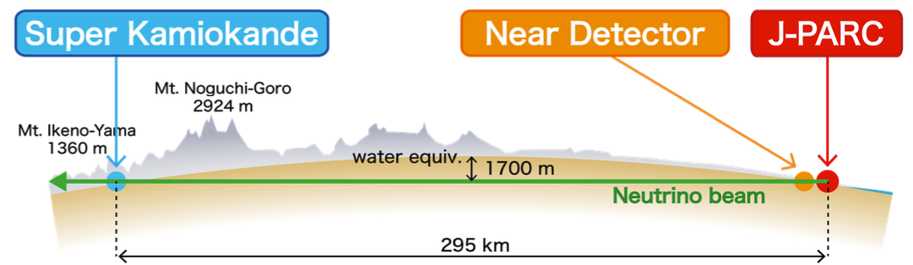




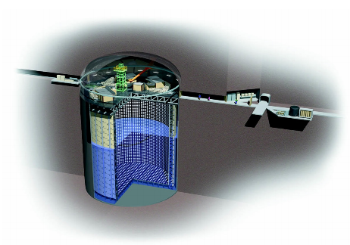
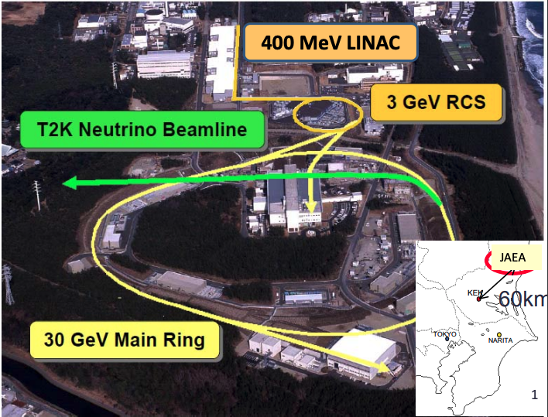
T2K experiment
T2K (Tokai to Kamioka) is a long-baseline neutrino oscillation experiment in Japan
My talk will focus on this
See Claudio’s talk for more
NGUYEN Quoc Viet
By changing the direction of magnetic field in the horns, we are able to create whether neutrino beam or anti-neutrino beam later.

Slide 3
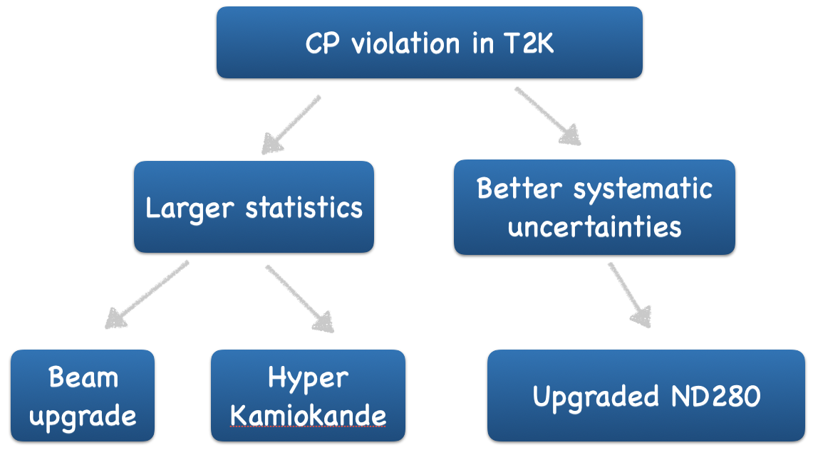
Road to cp violation discovery
For T2K oscillation analysis 2022: over a total systematic uncertainty of 5.2% ($ν_{e}$ appearance in neutrino mode), mainly comes from neutrino interaction processes.
Today, statistic is dominant, but this will become a problem soon.
To be ready for Hyper Kamiokande era, we started the second phase of T2K which contains
Near detector upgrade: better constrain $ν$-nucleus interactions and hence improve systematic uncertainties
NGUYEN Quoc Viet

Slide 4
T2K experiment: former Near detector (ND280)
Near detector ND280 is designed to constrain the neutrino flux$⊗$cross-section
The tracker includes 2 Fine Grained Detectors (FGD) and 3 Time Projection Chambers (TPC)
=> measure the momentum of charged particles and particle identification.
$$p$$
ND280 configuration
$$μ$$
QE-like sample at ND280
QE event at ND280 under magnetic field
NGUYEN Quoc Viet

Slide 5
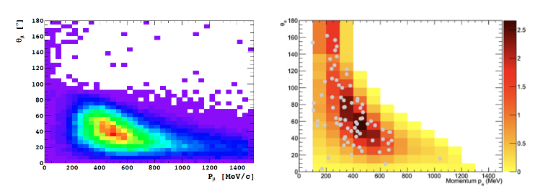
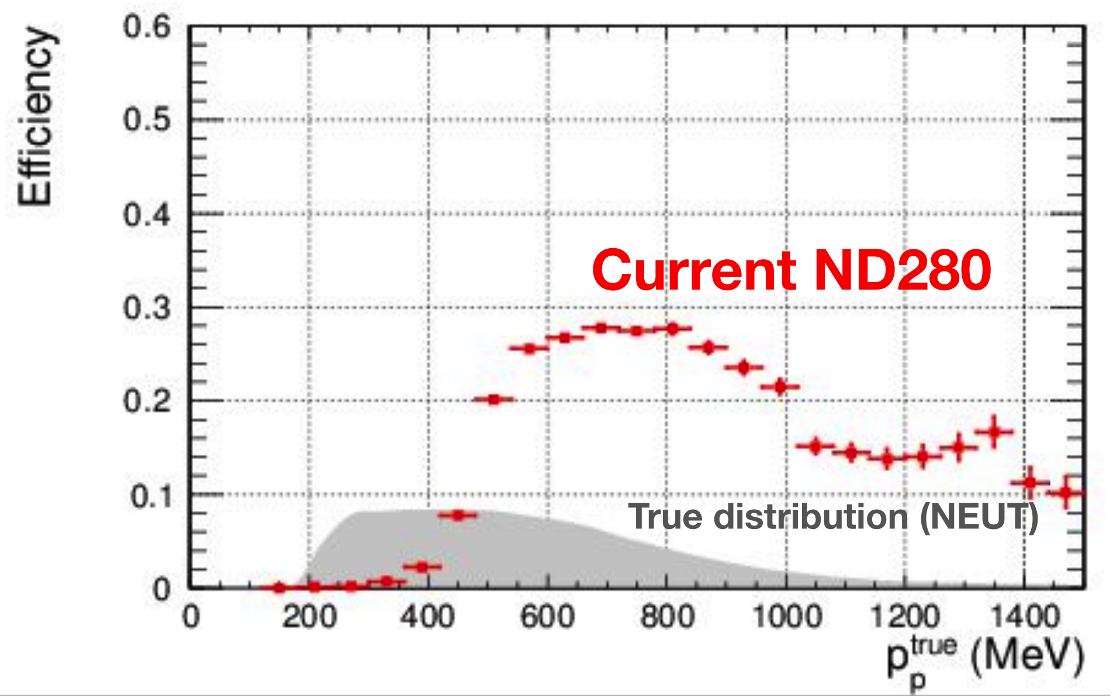
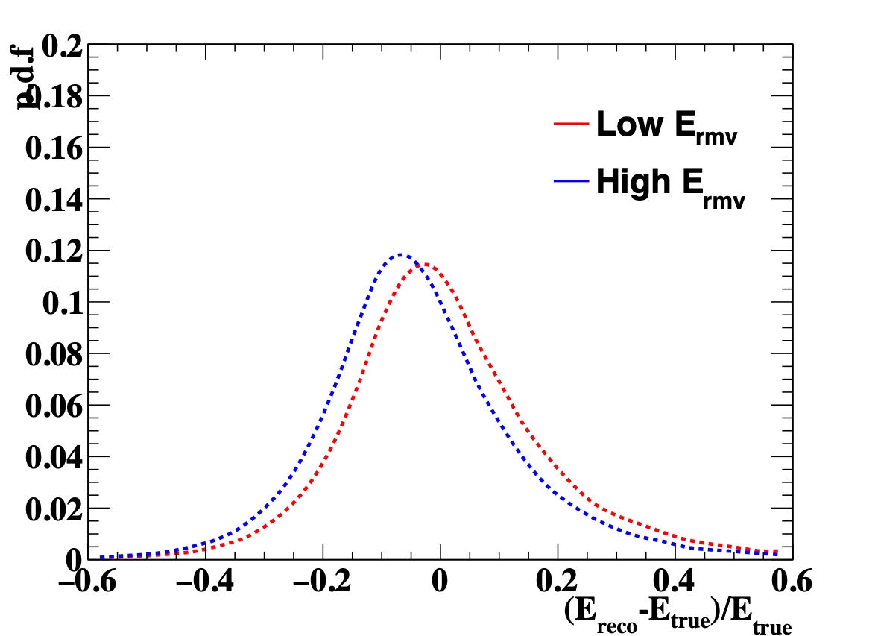
Former ND280 limitations
$$θ_{μ}$$
$$μ$$
$$θ_{μ}$$
ND280 acceptance
SK acceptance
$$ν$$
$$θ_{μ}$$
Put the ccqe Enu reconstruction plot
The polar angle acceptances are not comparable between near and far detector
The proton detection threshold is high
Only muon kinematics are used to reconstruct neutrino energy
Arbitrary unit
Proton detection efficiency
NGUYEN Quoc Viet

Slide 6
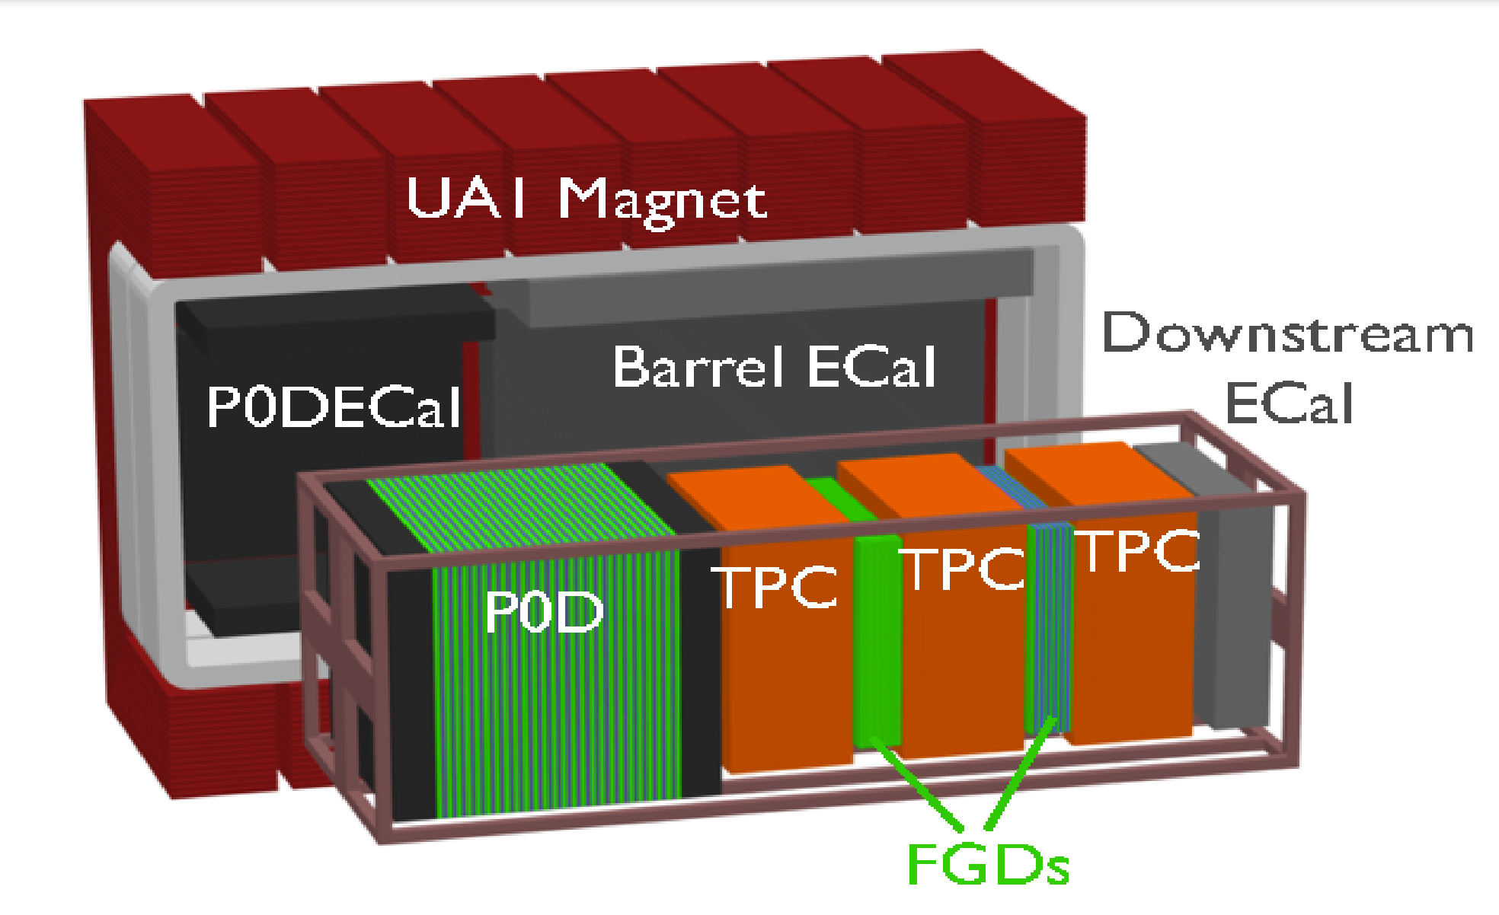

Upgraded near detector ND280: configuration
2 new High Angle TPC (HA-TPC) (see Ulysse 先生 talk right after me)
New Time Of Flight detector (TOF)
1 Super-fine-grained-detector (super-FGD) => the target of the near detector where the LLR is involved
NGUYEN Quoc Viet

Slide 7
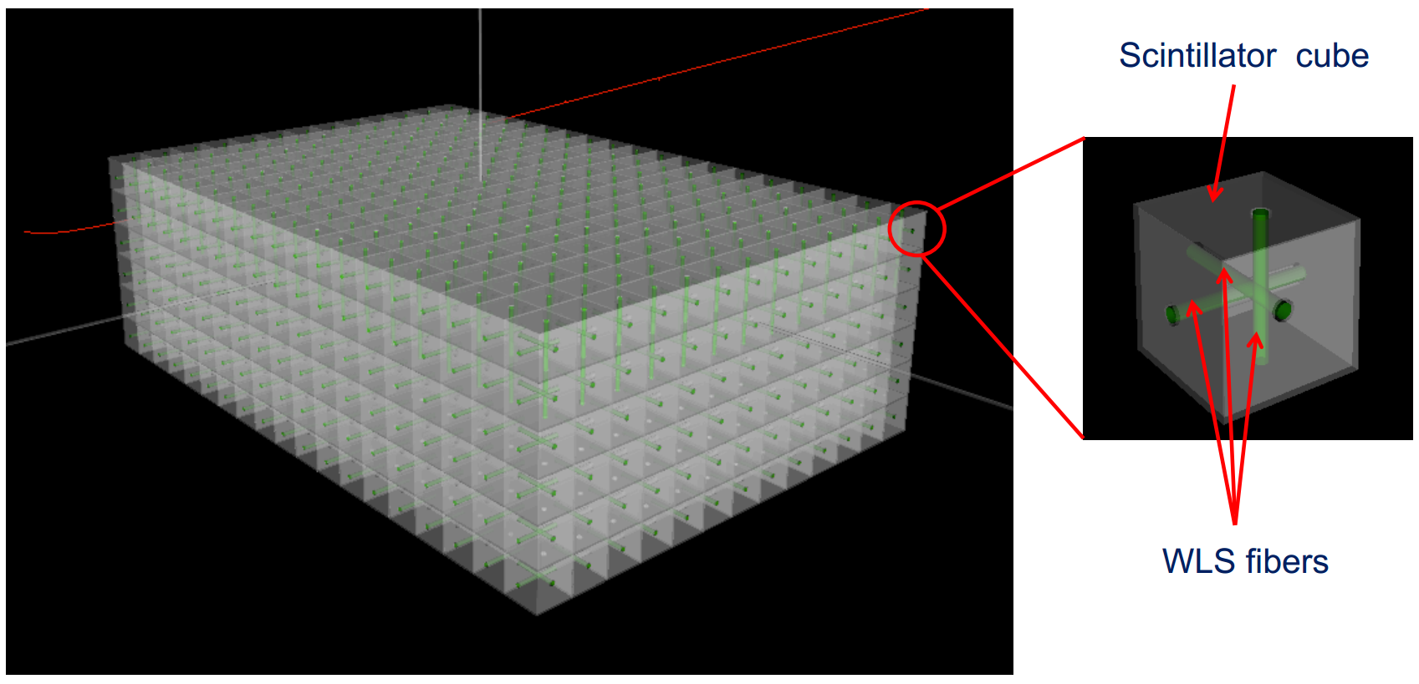
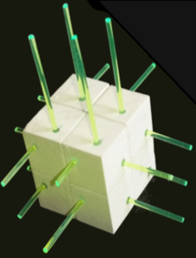
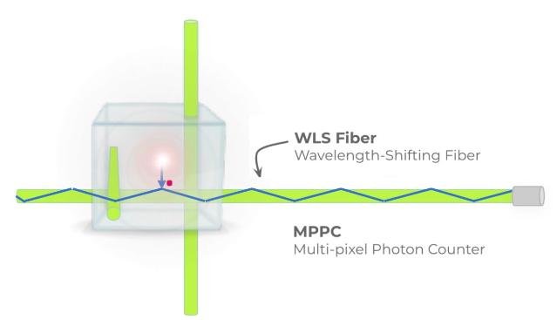
Super FGD detector
1 $×$ 1 $×$ 1 $cm^{3}$
Wavelength shifting (WLS) fibers are used to collect light from scintillator cubes. (70 km of WLS fiber in total)
One end of the fibers is connected to a Multi-Pixel Photon Counter (MPPC) the other end is mirrored.
=> around 60.000 channels.
Super-FGD: 182 × 192 × 56 scintillator cubes (2 million) with 3D readout => 2 tons of fully active target
NGUYEN Quoc Viet

Slide 8

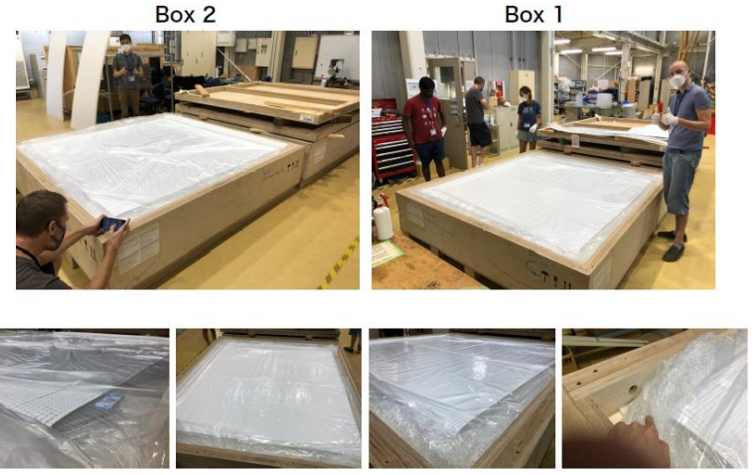
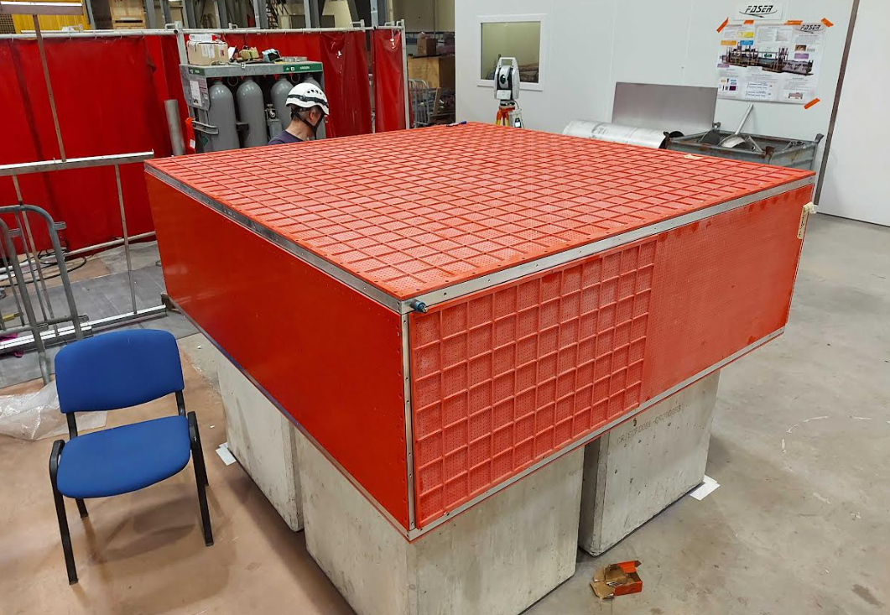
Super FGD assembly at J-parc (early 2023)
The cubes were shipped from Russia to Japan by plane
The Super-FGD box which carry all the cubes
NGUYEN Quoc Viet

Slide 9
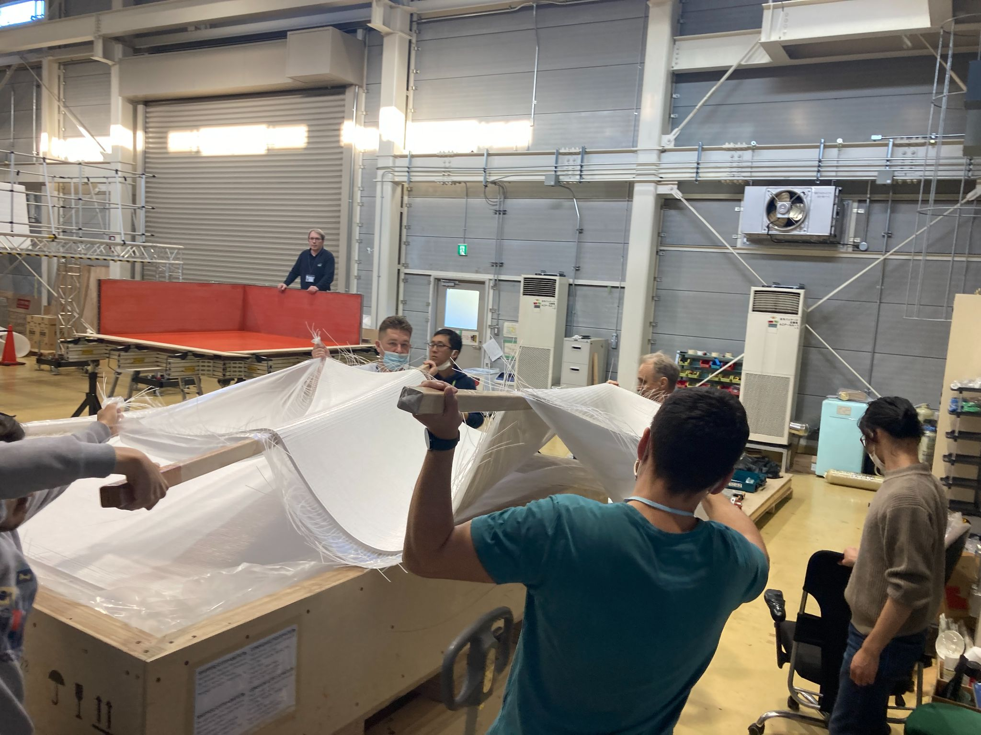
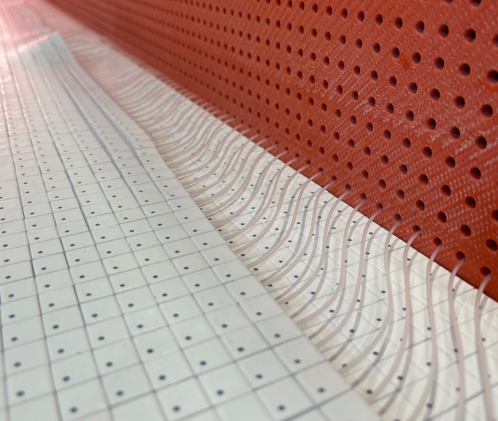
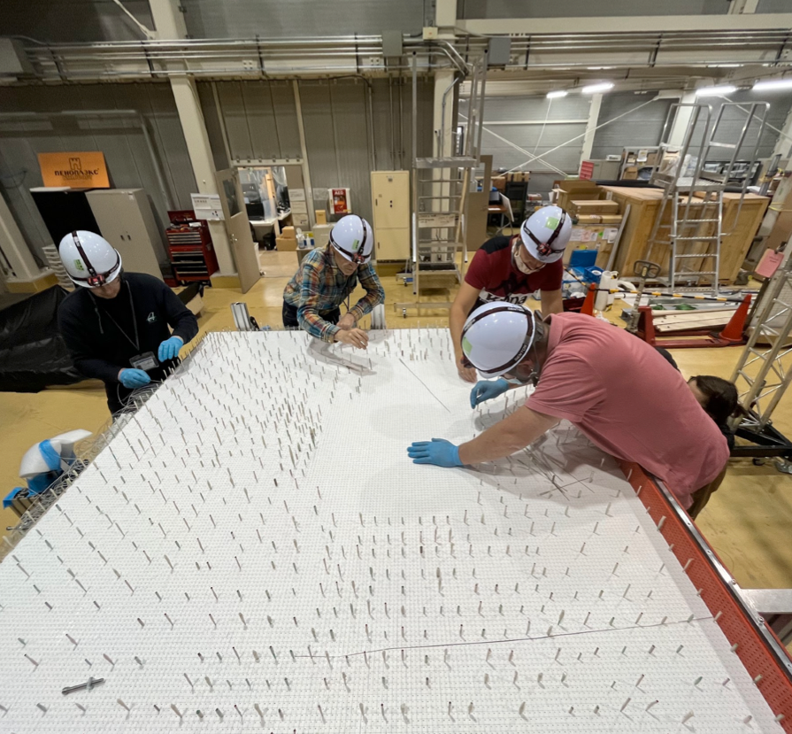
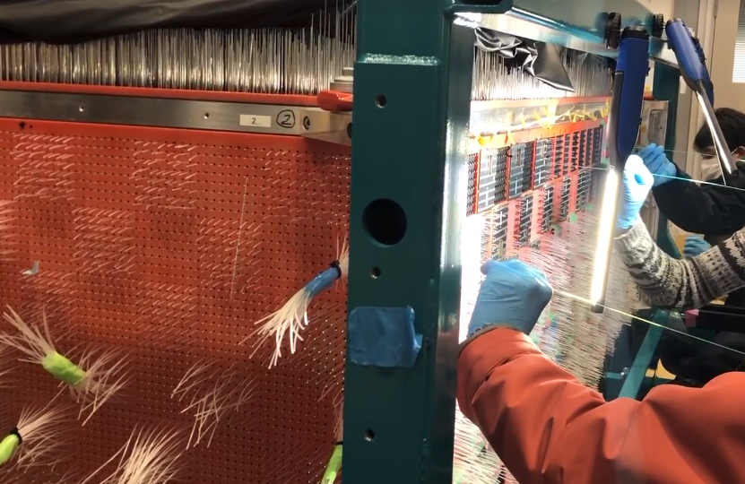
Super FGD assembly at J-parc (early 2023)
Insert the 2 million cubes in the Super-FGD box layer by layer
Insert the fishing lines
After closing the Super-FGD box, the fishing lines will be replaced by the wavelength shifting fibers
NGUYEN Quoc Viet

Slide 10
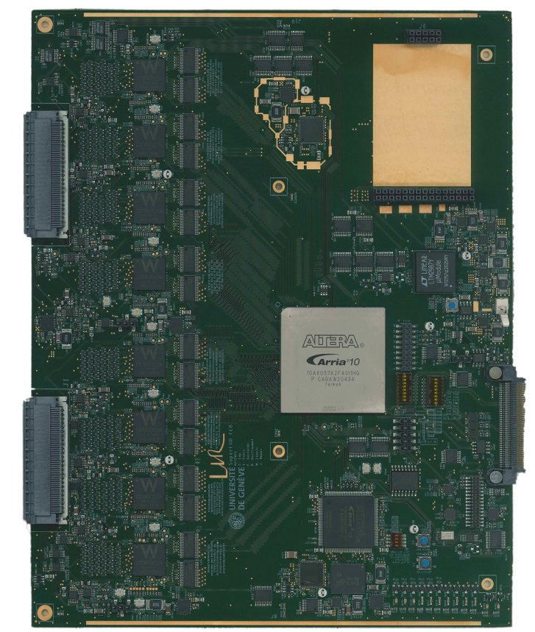
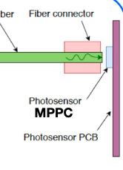
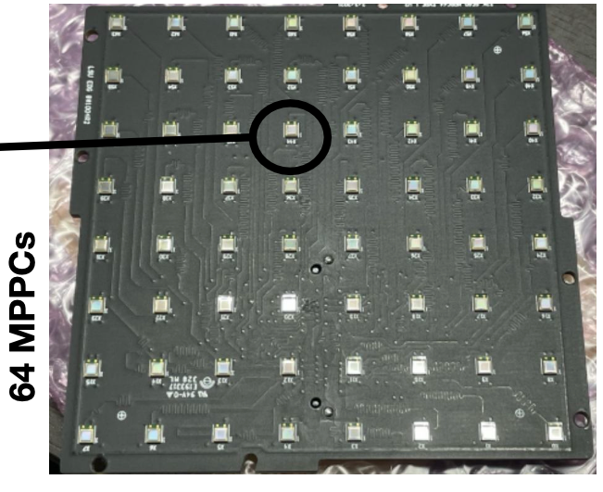
Super FGD detector readout
Front-End Board (FEB)
64 channels
X4 MPPC => 1 FEB
256 channels

Slide 11
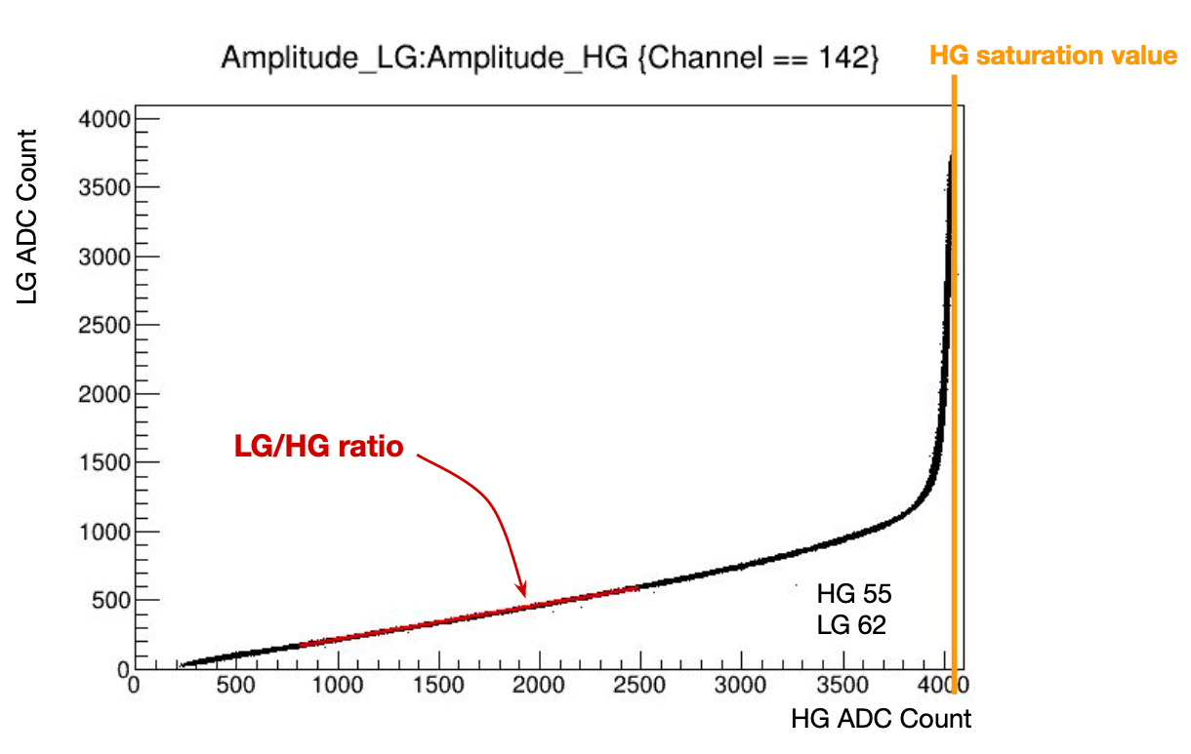

Front-end board (FEB)
Front-End Board (FEB) 256 channels
The FEB is the heart of the electronic system and it’s the joined LLR + Uni Geneva project.
Each CITIROC (Cherenkov Imaging Telescope Integrated Read Out Chip) can read 32 channels
  8 CITIROC <=> 256 channels for 1 FEB.
For each channel, the input is handled by two independent signal paths:
  Low gain (LG) path
  High gain (HG) path
LOW GAIN (LG)
AMPLITUDE
HIGH GAIN (HG)
Signal to each channel
Rising edge
TIME
Falling edge
NGUYEN Quoc Viet
The baseline design is structured around the CITIROC readout chip.

Slide 12
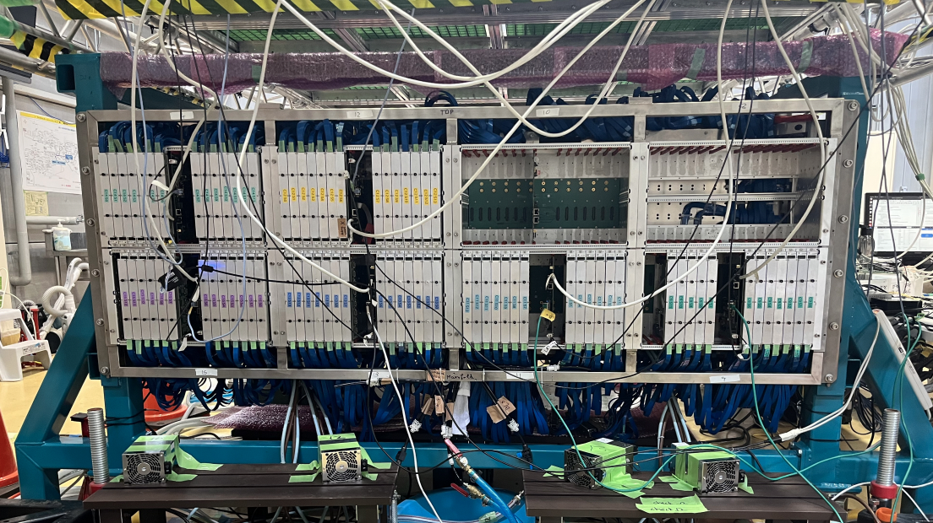
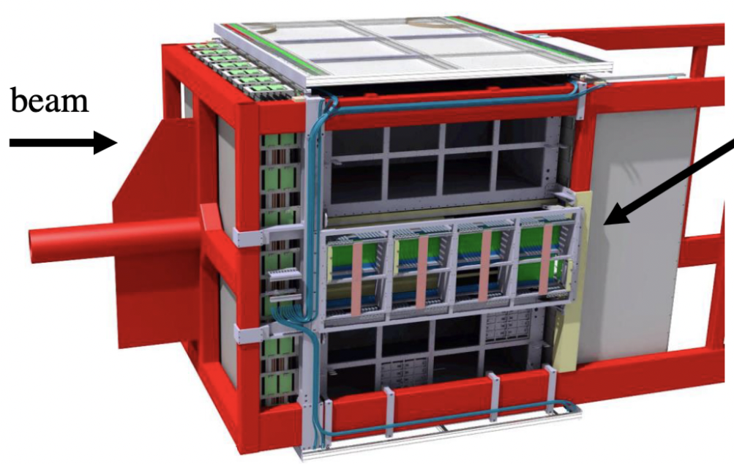
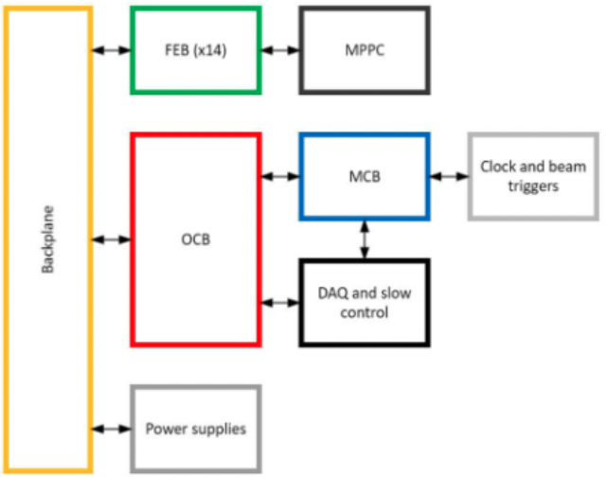
Overview of super-fgd electronic system
There are 16 crates in total, each mainly contains
  14 Front-End Board (FEBs)
  1 Optical Concentrator Board (OCB)
  1 backplane
SFGD electronic
NGUYEN Quoc Viet

Slide 13
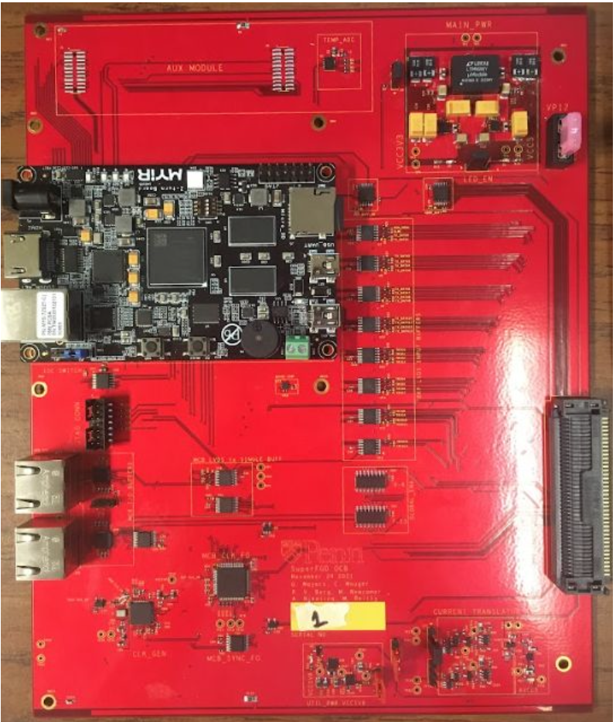
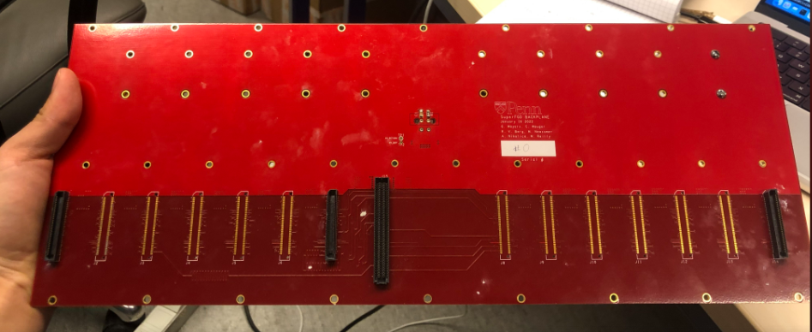


Relationship between boards
In document: the FEB is the heart of the electronic system.
In reality:
MCB: the OCB advisor
OCB: the master
Backplane: the whip
FEBs: the slaves
NGUYEN Quoc Viet

Slide 14
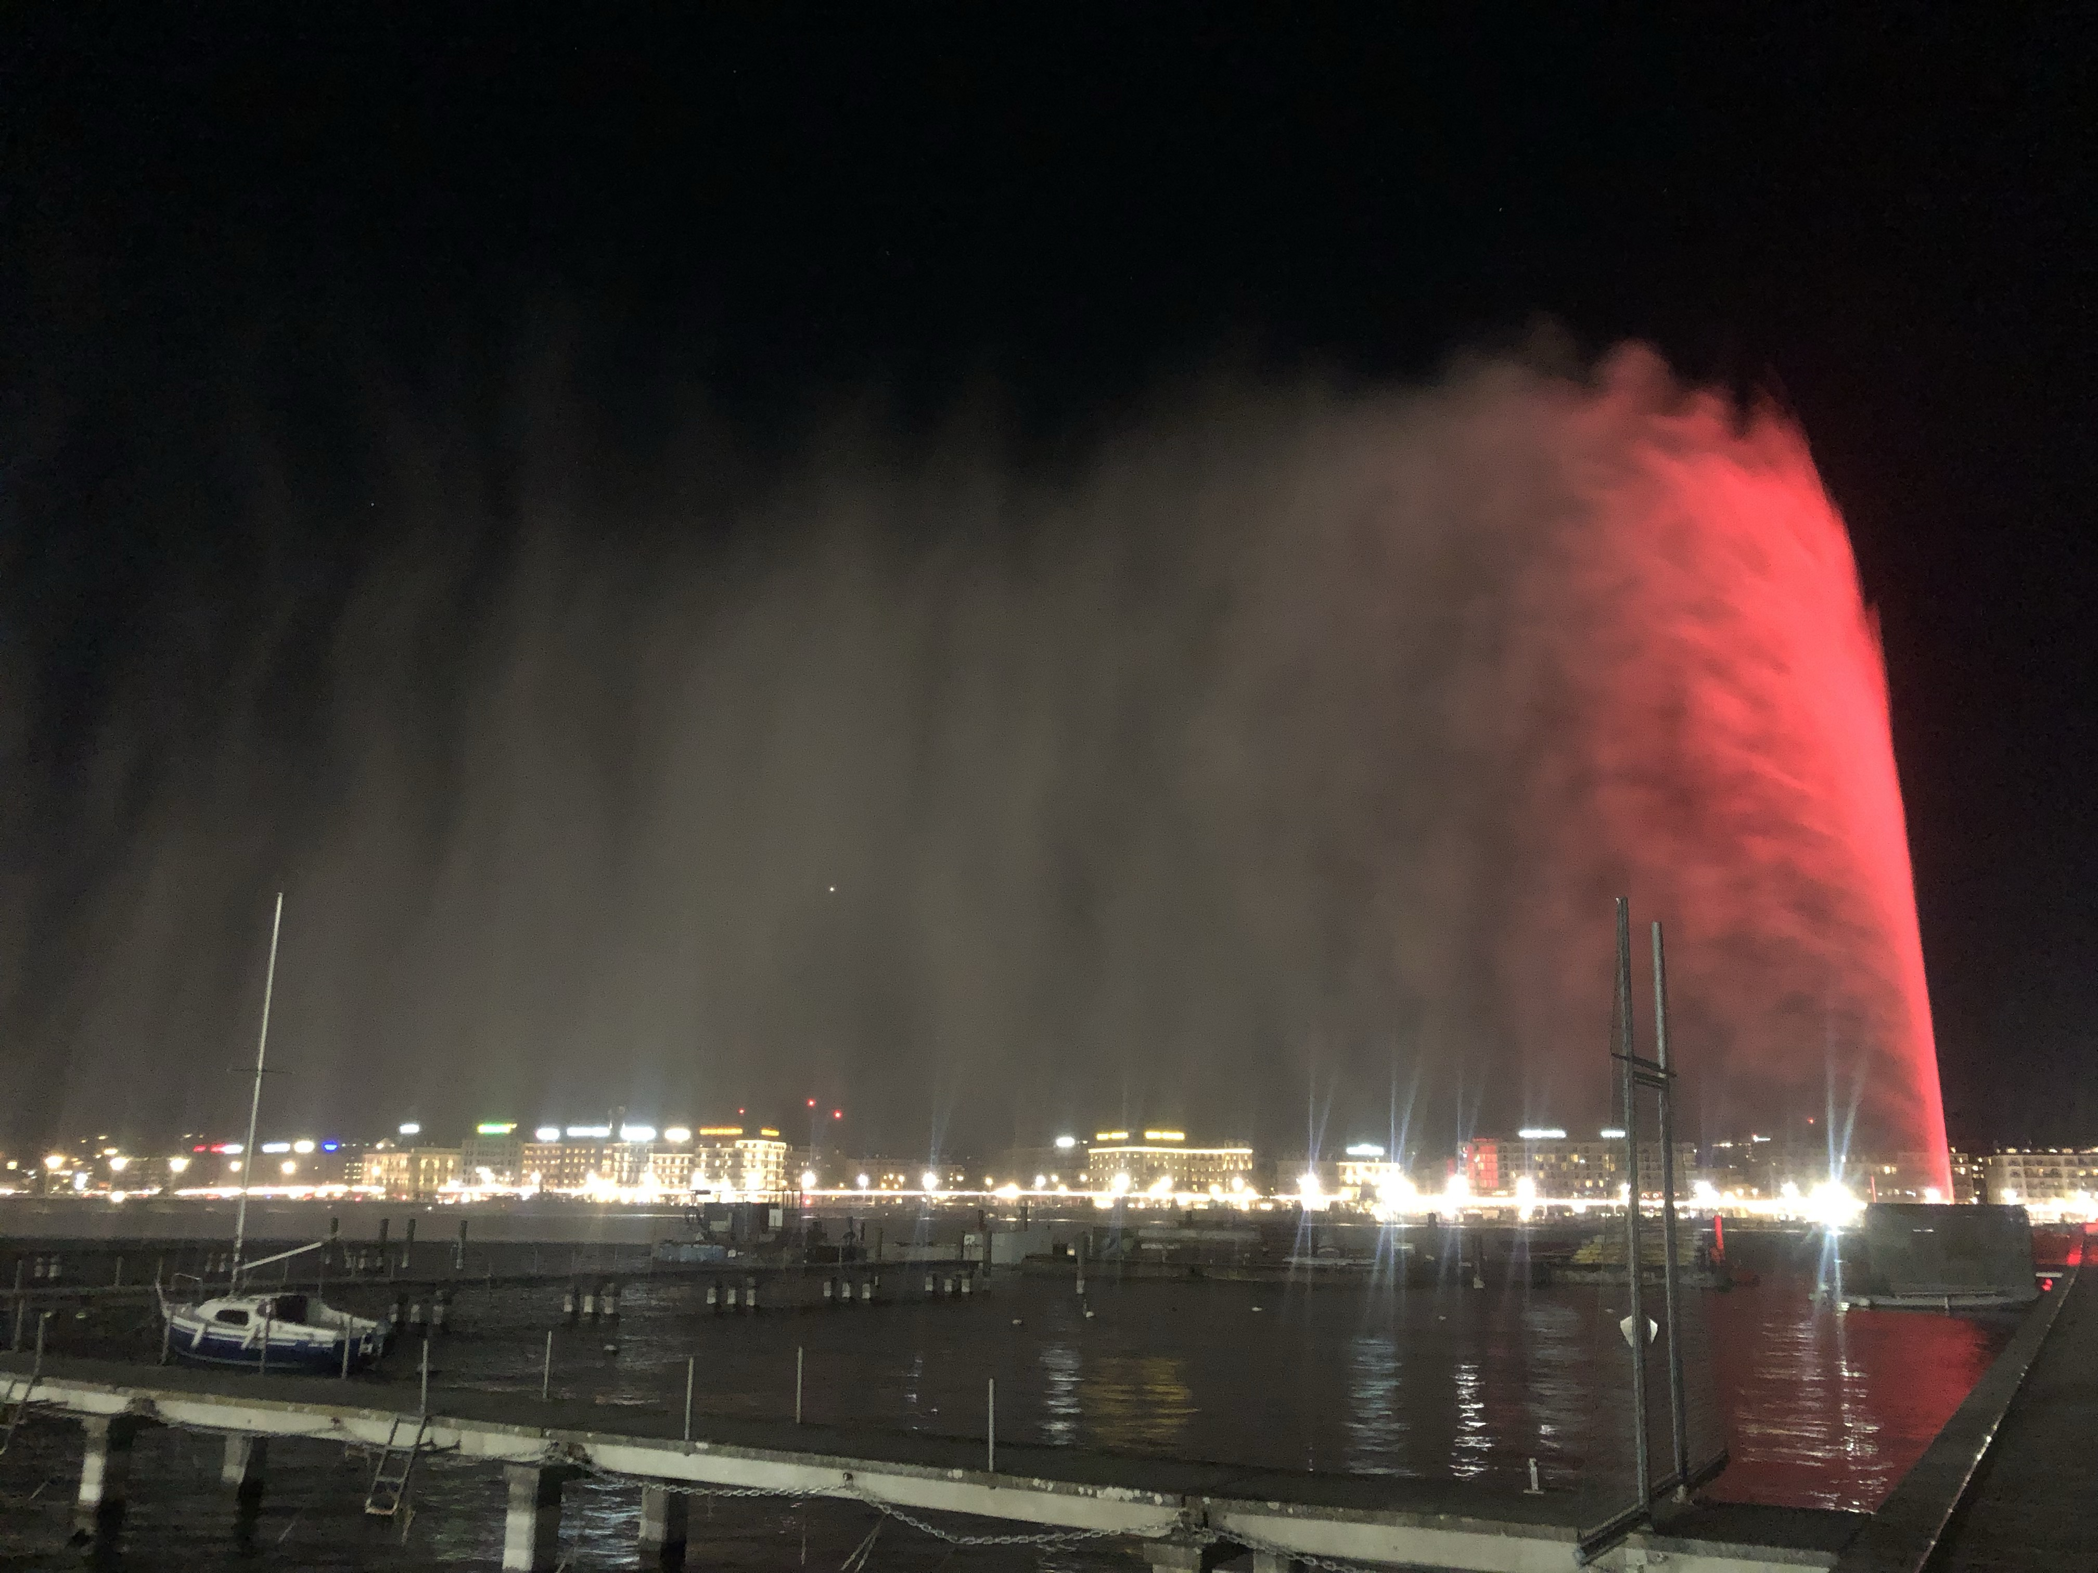
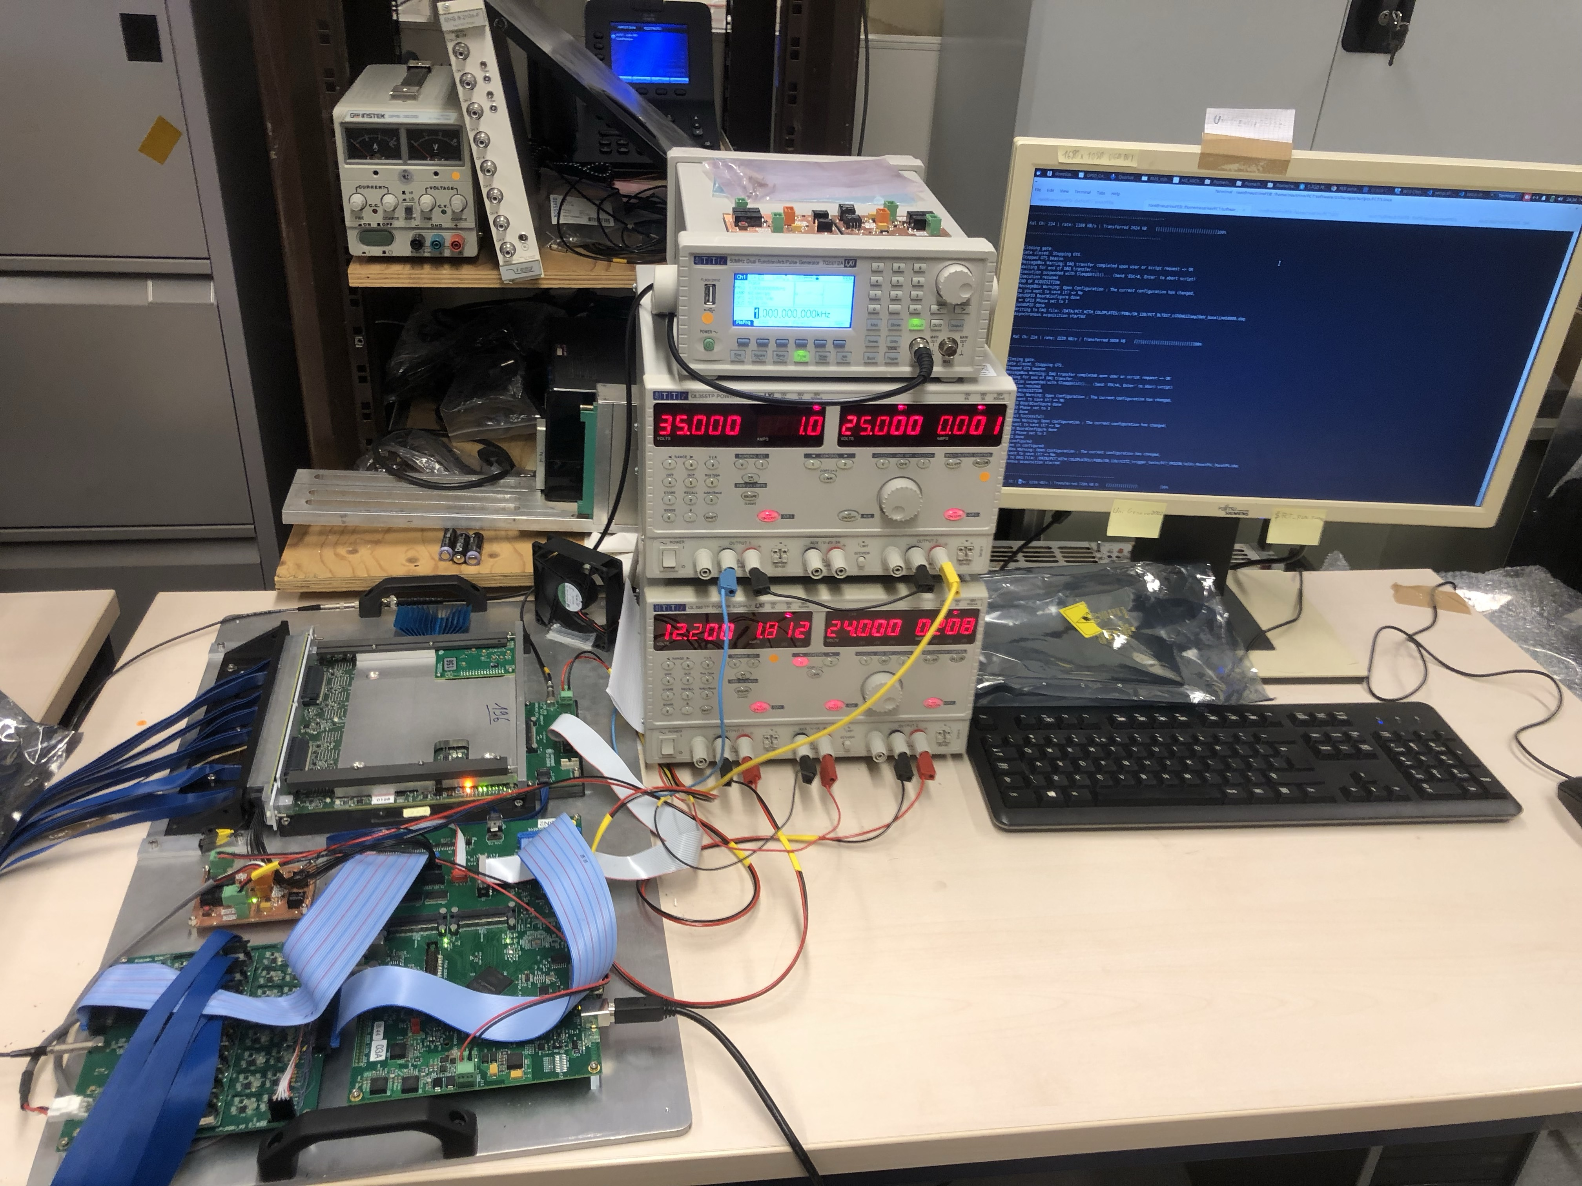

MIB & FEB functional test
University of Geneva
Léna Osu
Me
Andrés Muñoz
NGUYEN Quoc Viet

Slide 15
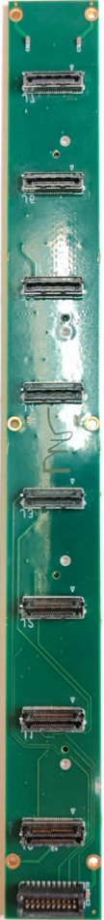

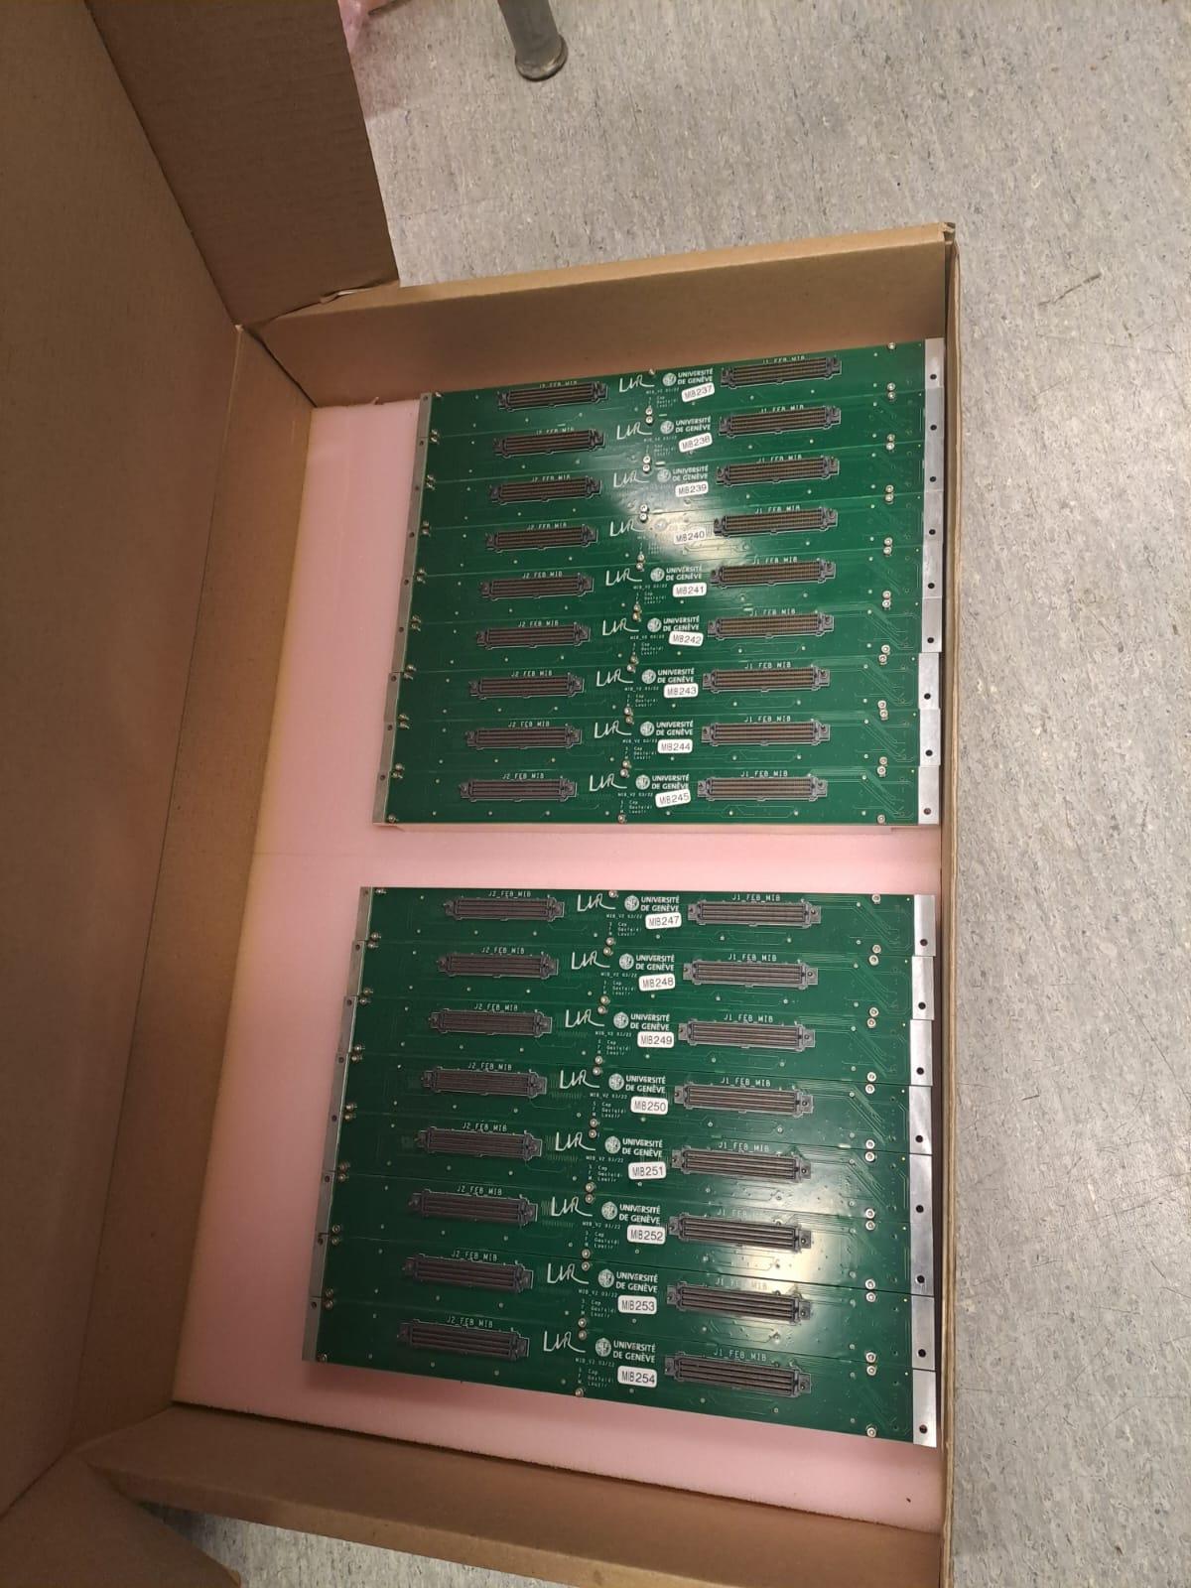
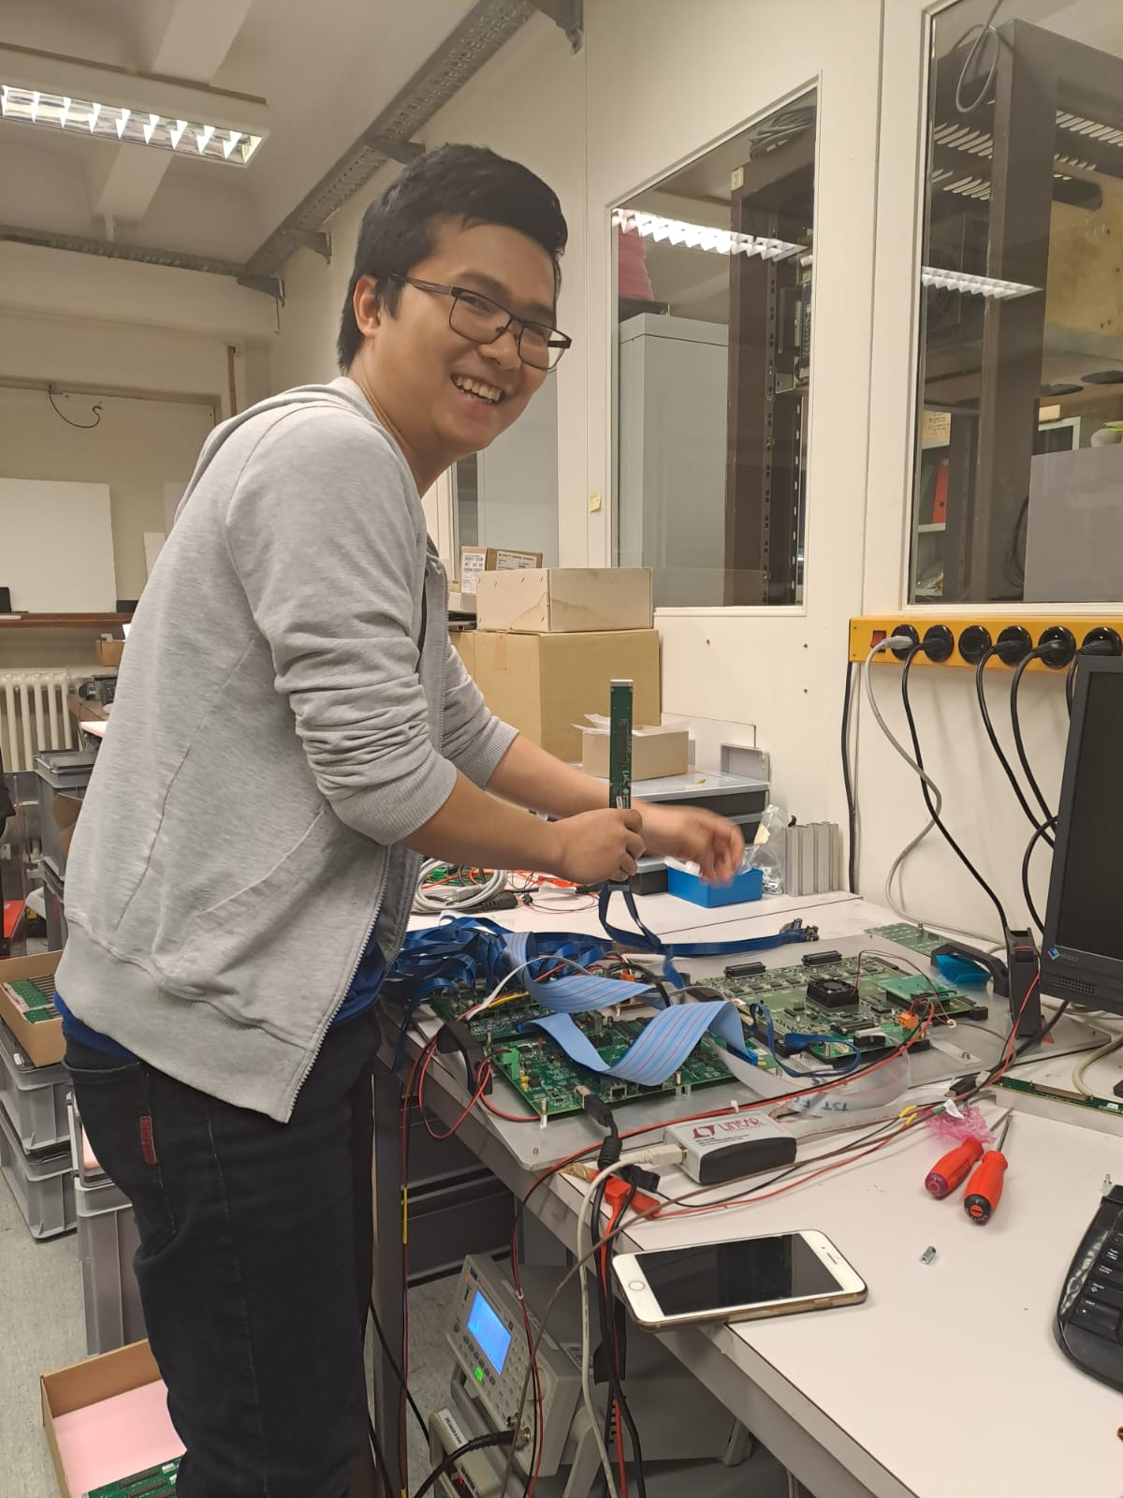



MIB functional test (March 2023)
The MIB is used to connect the cables from MPPC board to FEB.
The MIB test is to test the function of all the lines that pass through the MIB
The test includes:
  Housekeeping test: High Voltage, temperature
  Debug line test.
  Analog channels test.
Ready to be shipped to Japan
8 connectors, 32 channels each
Debug
MIB
The set up for test
Testing ongoing
NGUYEN Quoc Viet

Slide 16
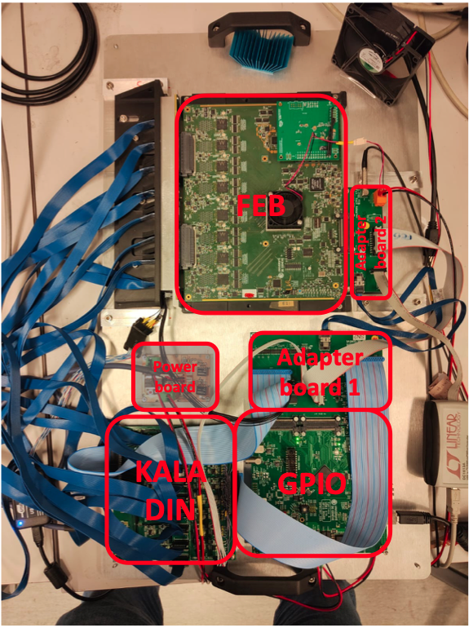


functional test for FEB (individual test)
FEB: Device under test. This set up can easily remove and install a FEB.
Functional test for individual FEB includes:
  Housekeeping and loopback
  Calibration
  All 256 channel test
Each FEB test takes 10-12min, and there were around 230 FEBs to be tested.
X
NGUYEN Quoc Viet

Slide 17
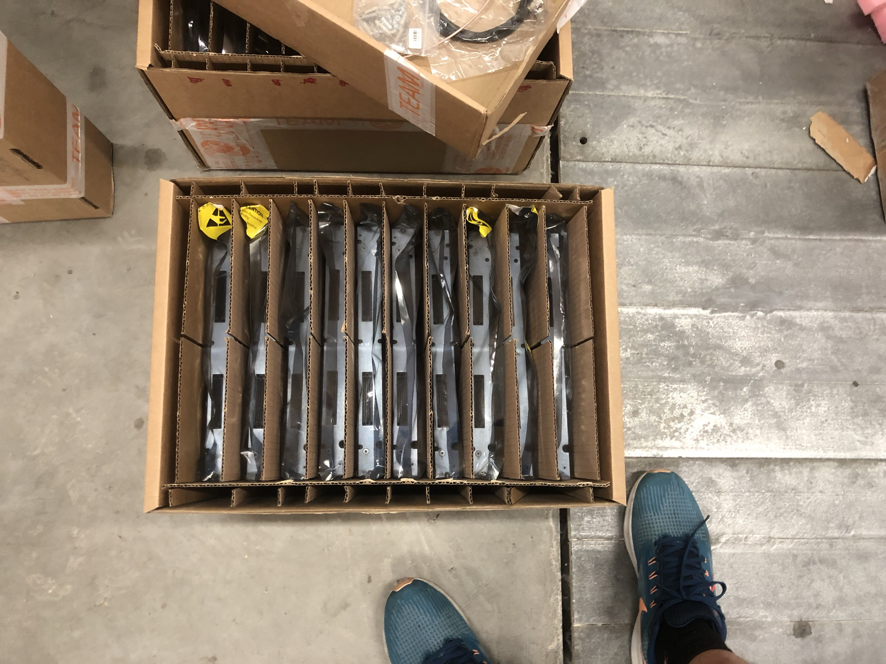
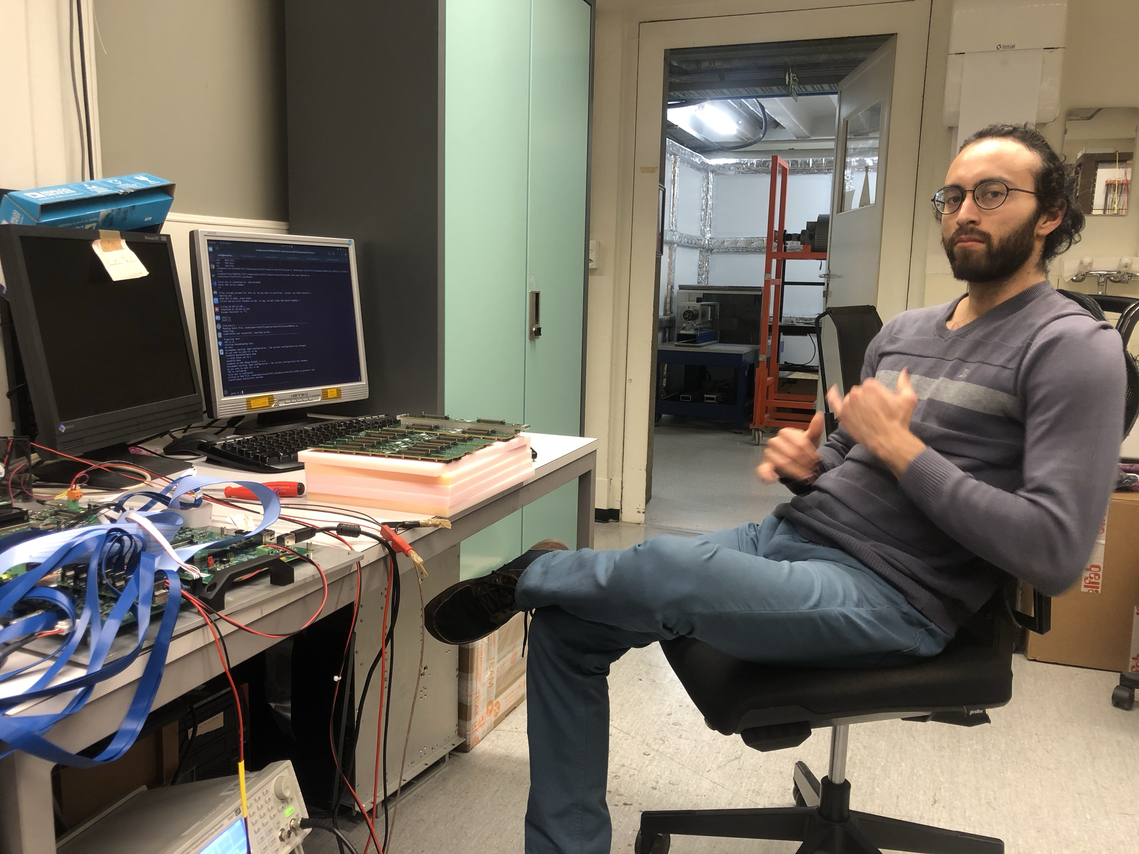
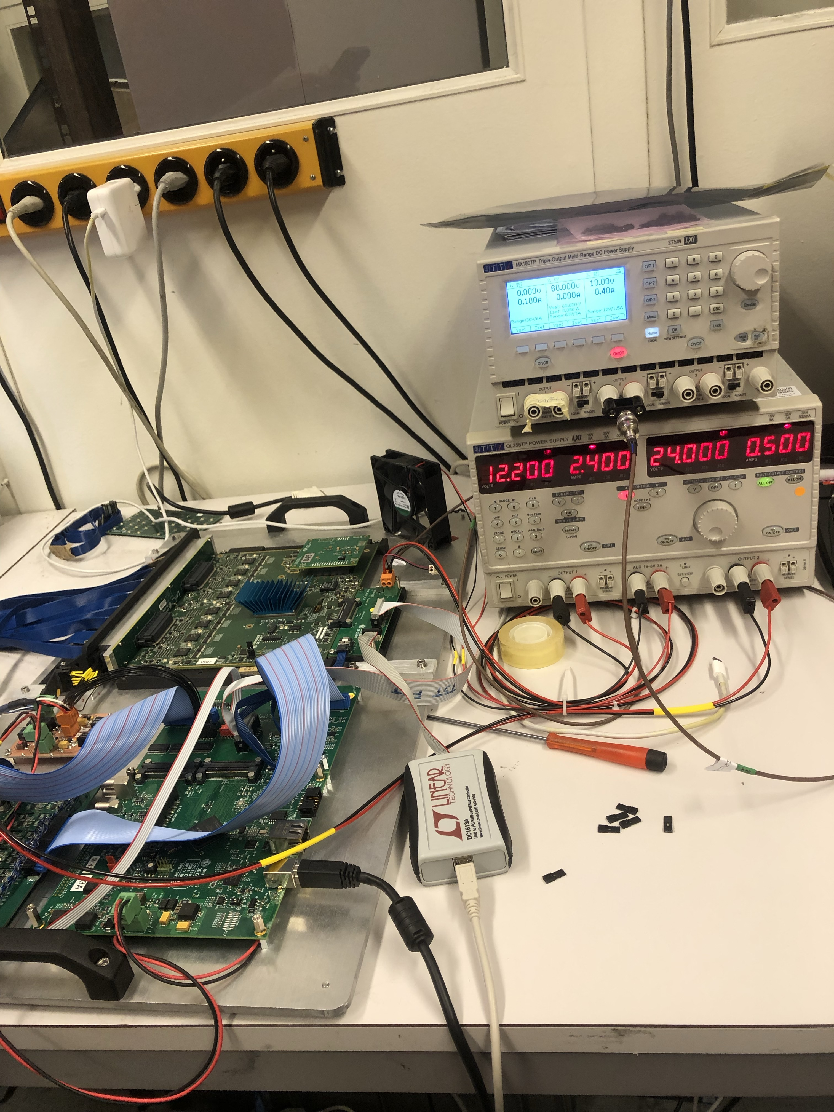
functional test for FEB
Box containing FEBs that pass the functional test, but not ready to send to Japan
=> Need more tests
NGUYEN Quoc Viet

Slide 18
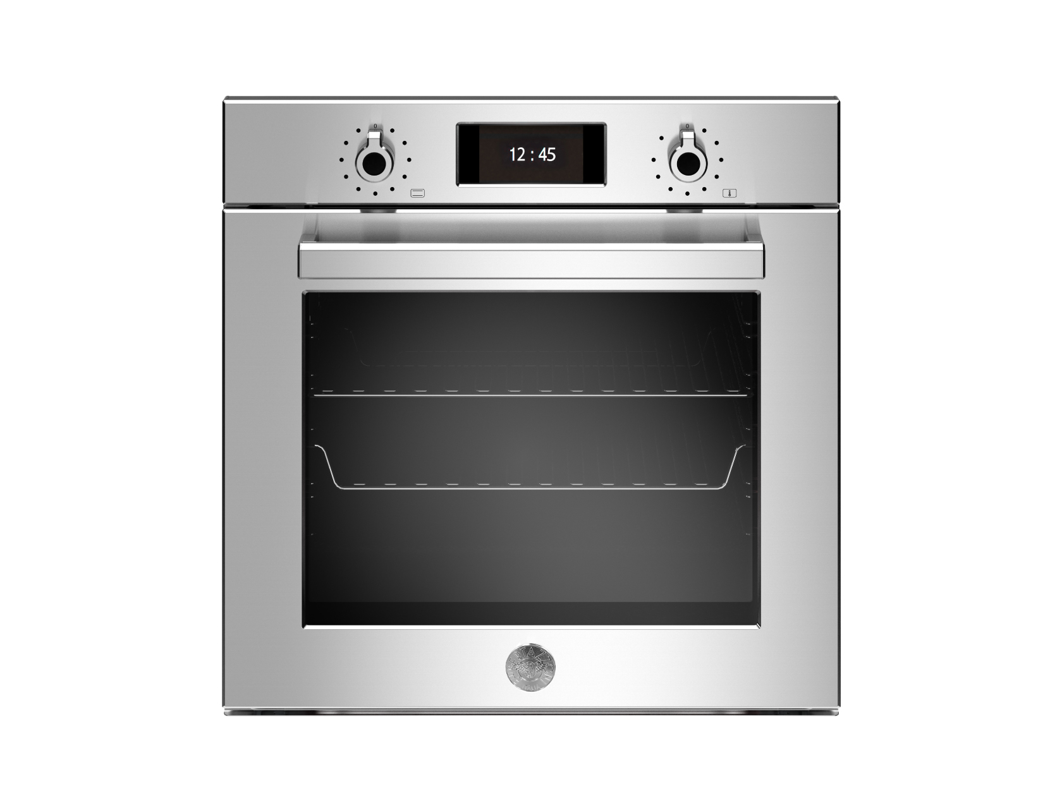

functional test for FEB (Burning test)
Early idea for the set up of burning test
And if you want to better control temperature
NGUYEN Quoc Viet

Slide 19
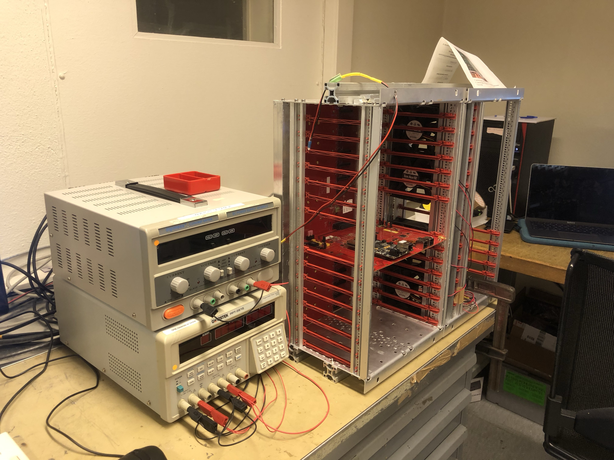
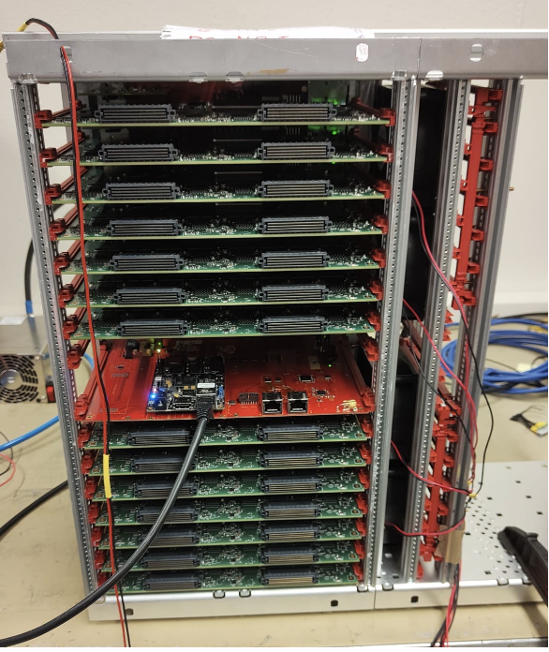
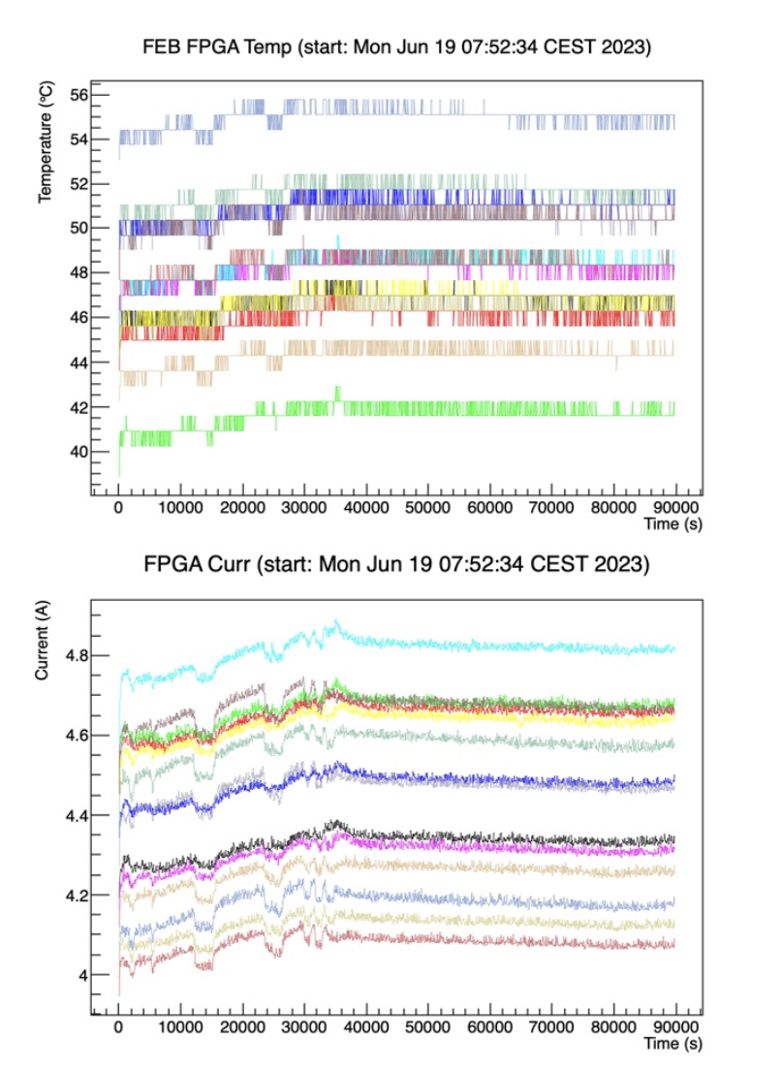
functional test for FEB (Burning test)
FEBs were set to run 24hours without cooling plates, only with fans.
After this test, FEB will be moulted to the cooling plates, then another final test.
Plots from Lorenzo Giannessi
NGUYEN Quoc Viet

Slide 20
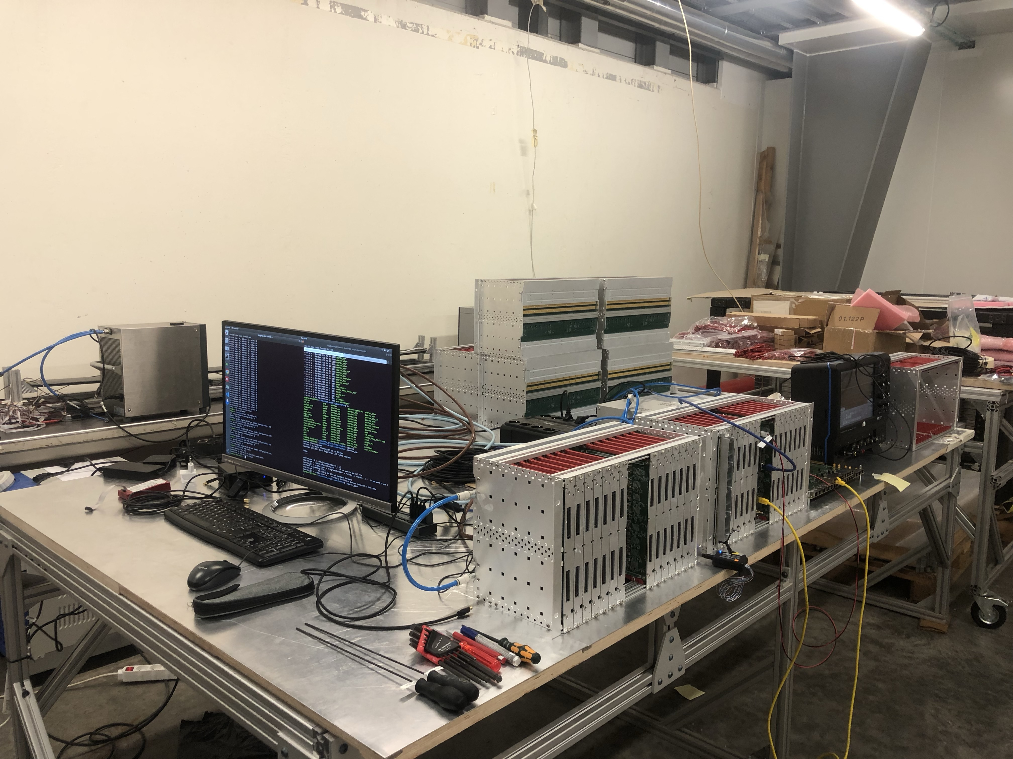
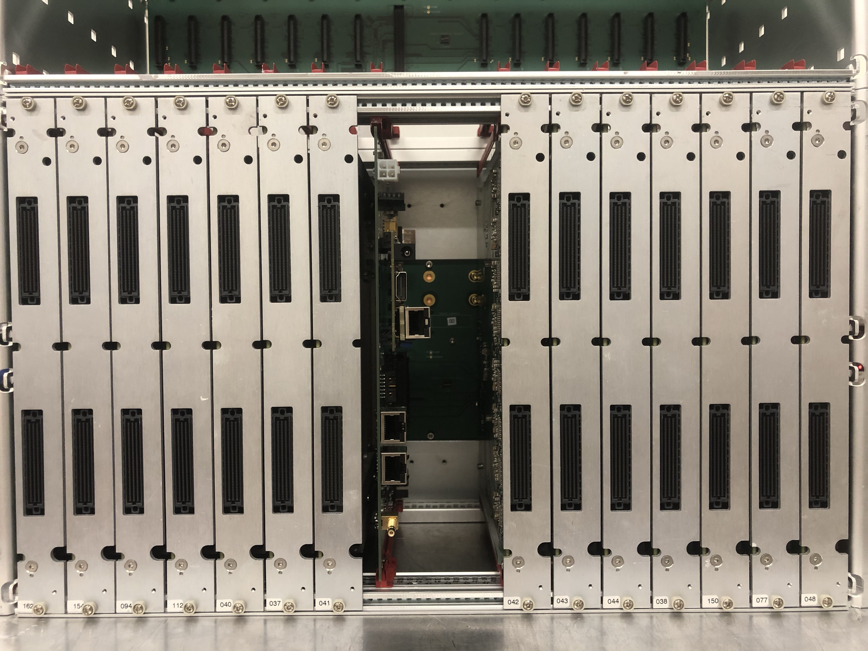
functional test for FEB (vertical slide test at cern)
This was the final test with the real configuration of electronic system in 1 crate
Full crate: installation with 14FEBs
Full crate slow control test
Test all the communication lines between OCB and 14FEBs
Housekeeping test for all FEBs
After these tests, FEBs are ready to be sent to Japan
NGUYEN Quoc Viet

Slide 21
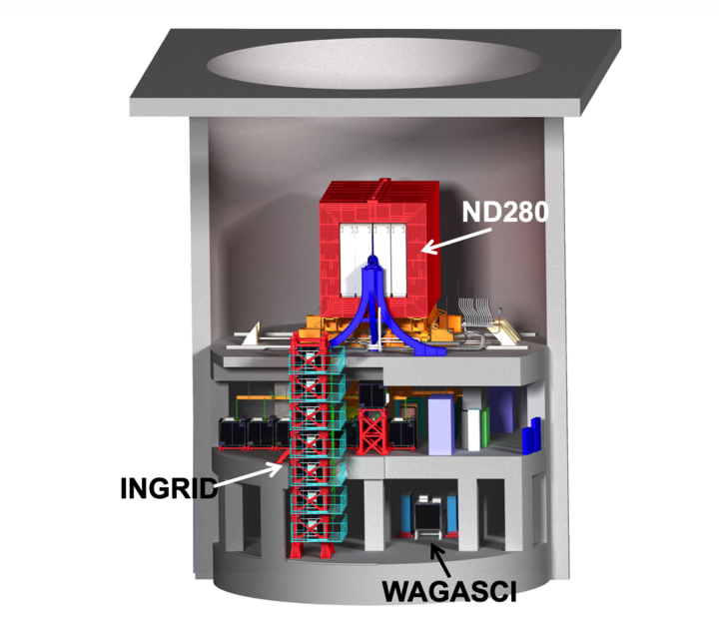
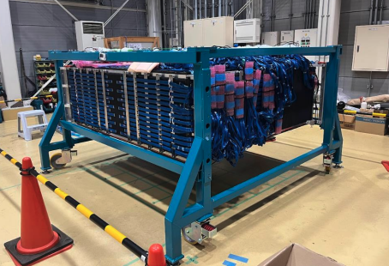
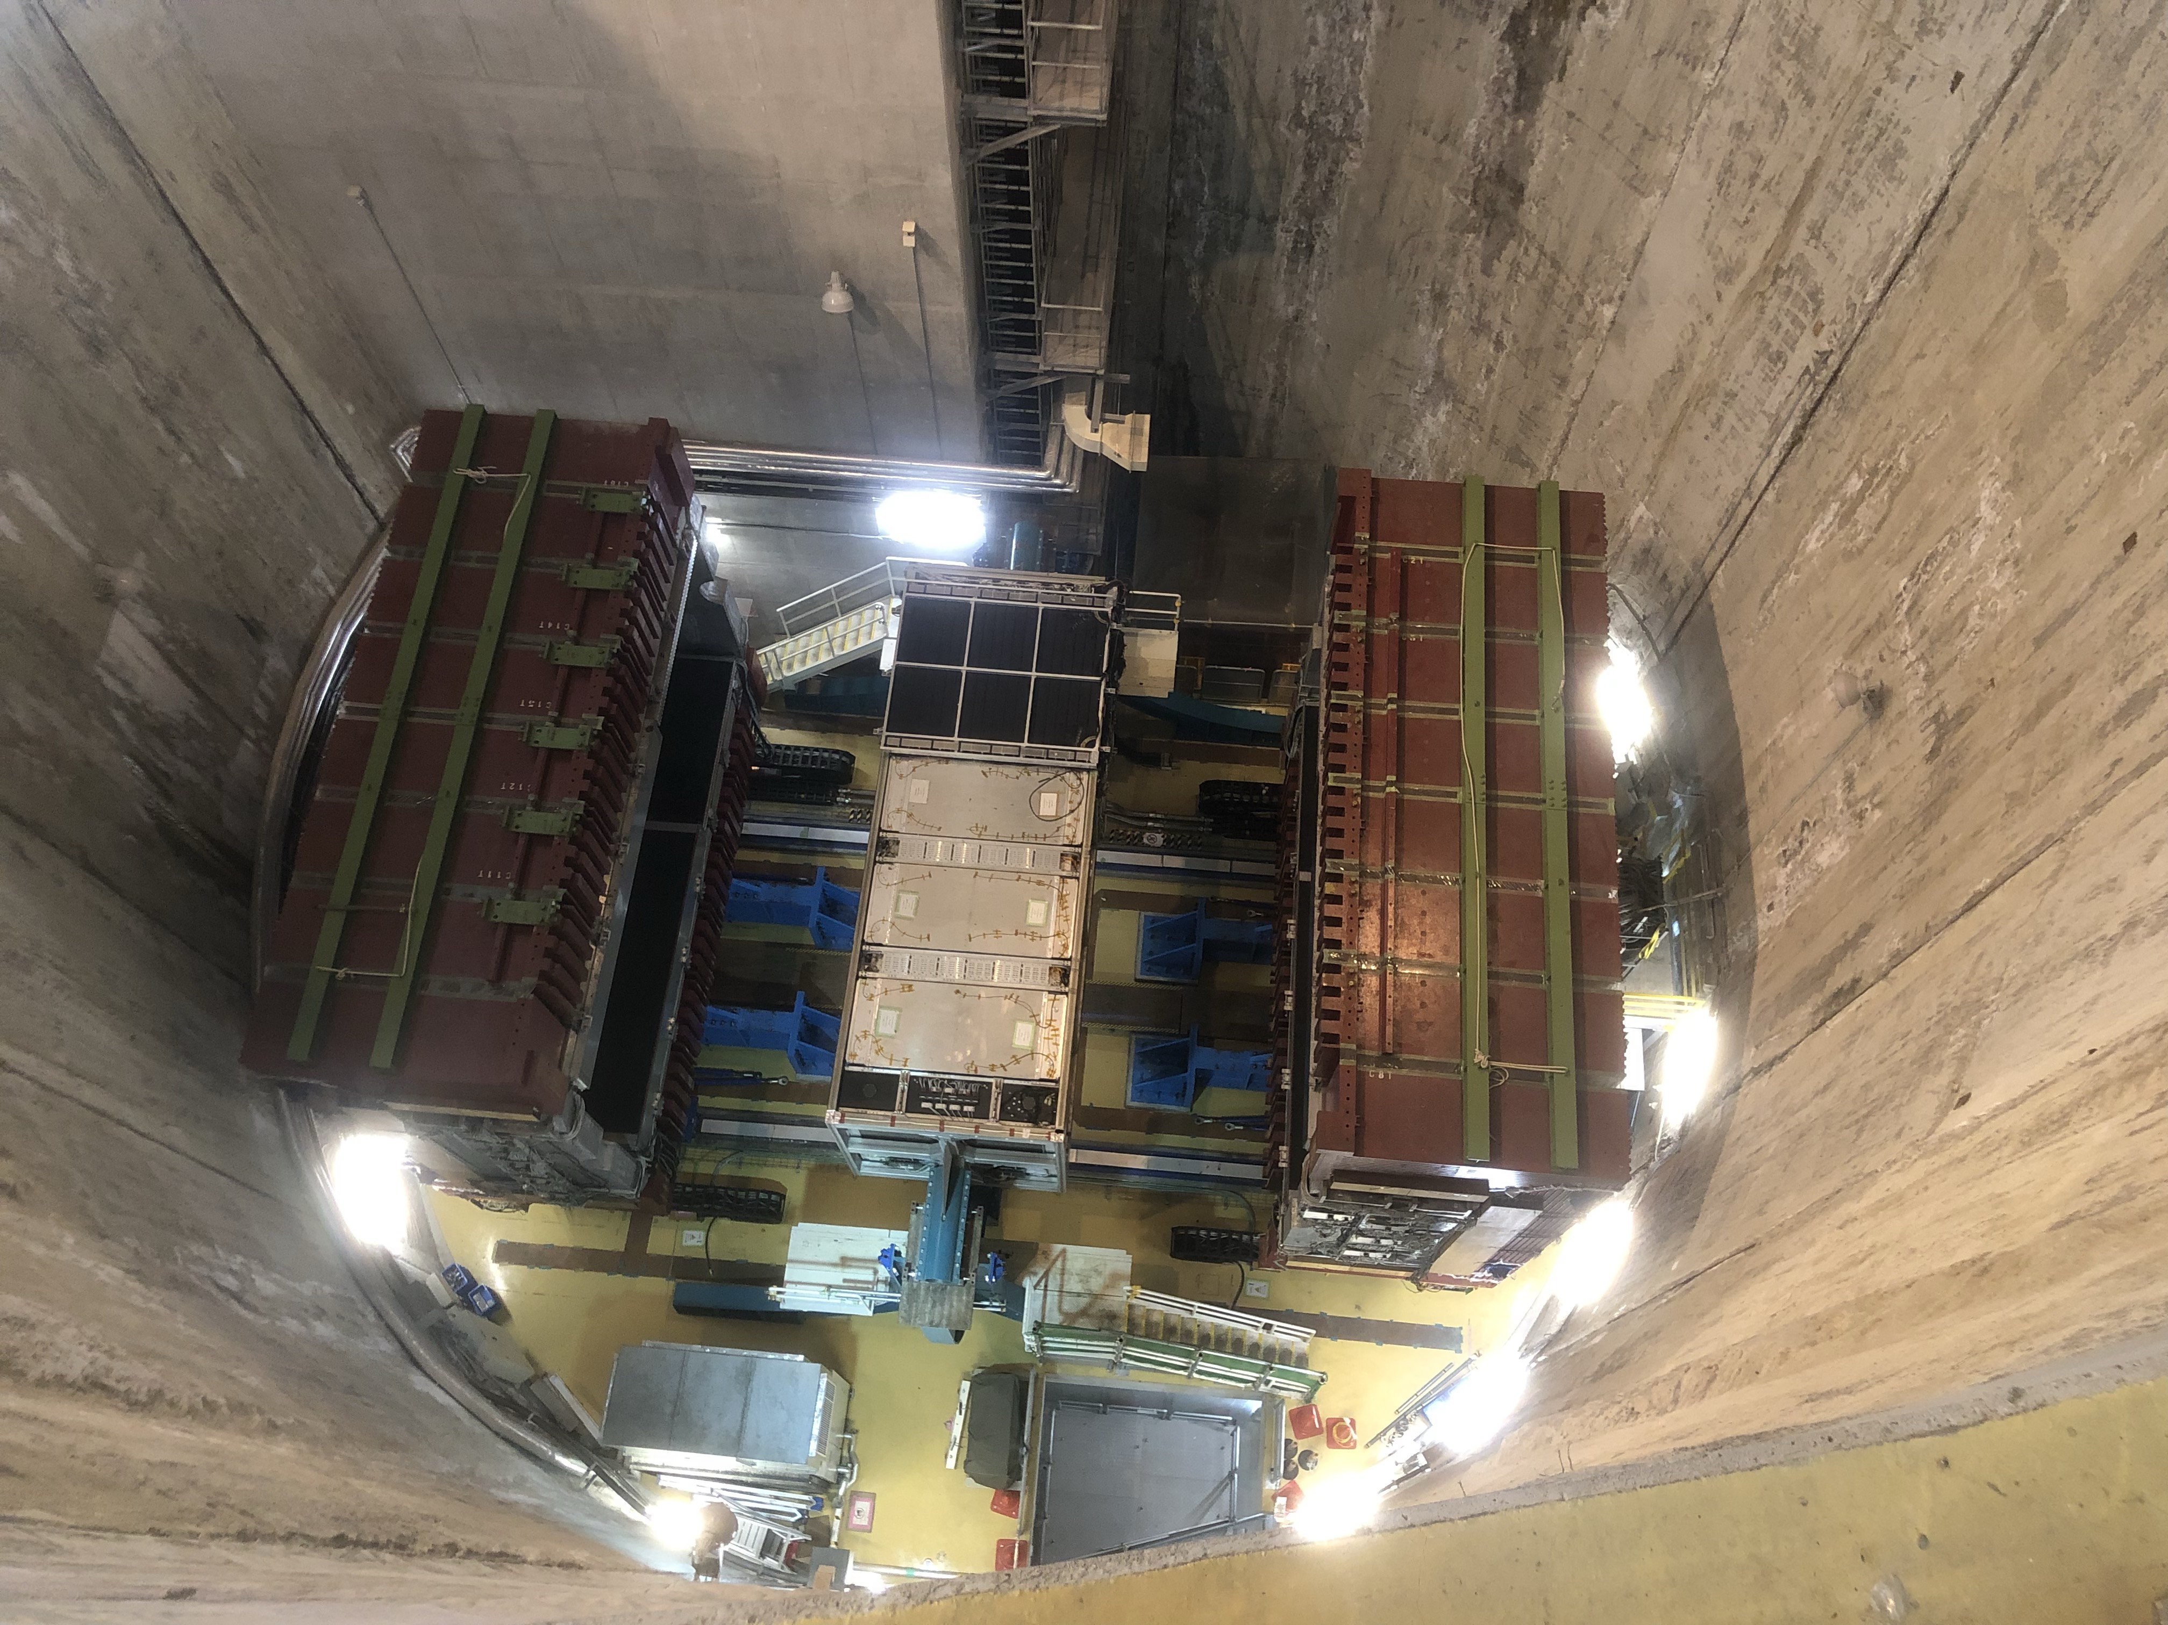
Super-FGD installation in the pit (October 2023)
Install
The pit from above
The pit of near detector complex
The SFGD and its electronic system at assembly building next to the pit
NGUYEN Quoc Viet

Slide 22
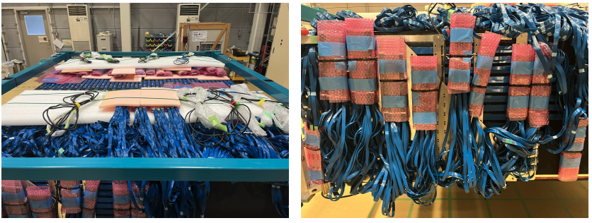
Super-FGD preparation for installation
Space around detector has been cleared
MIBs and cables were bundled in groups in bubble wrap, for easily connect in future
NGUYEN Quoc Viet

Slide 23
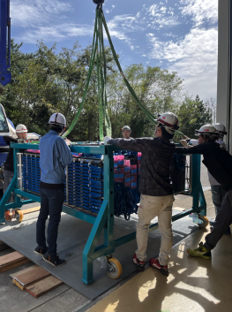
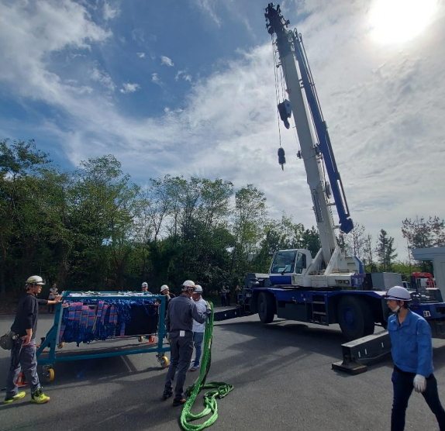
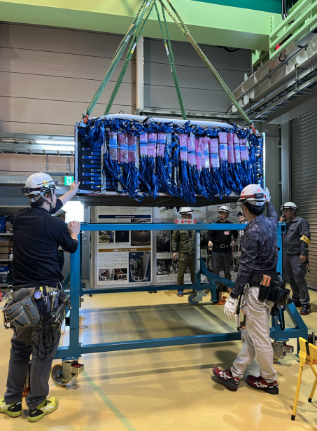
SFGD installation (October 2023)
SFGD was moved from assembly point to near the pit
NGUYEN Quoc Viet

Slide 24
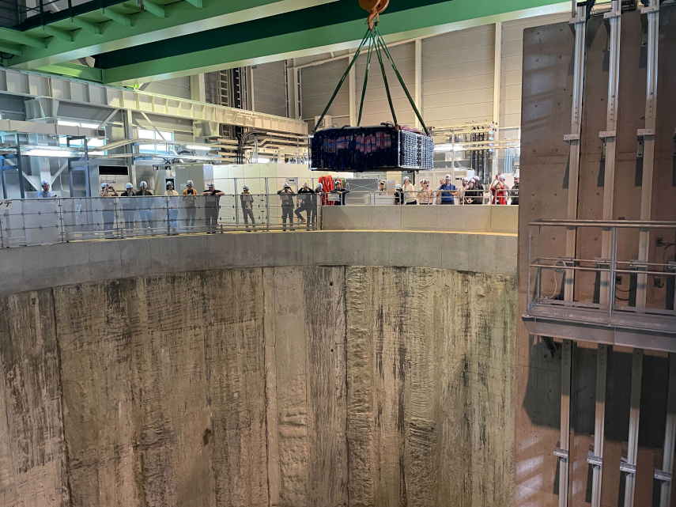
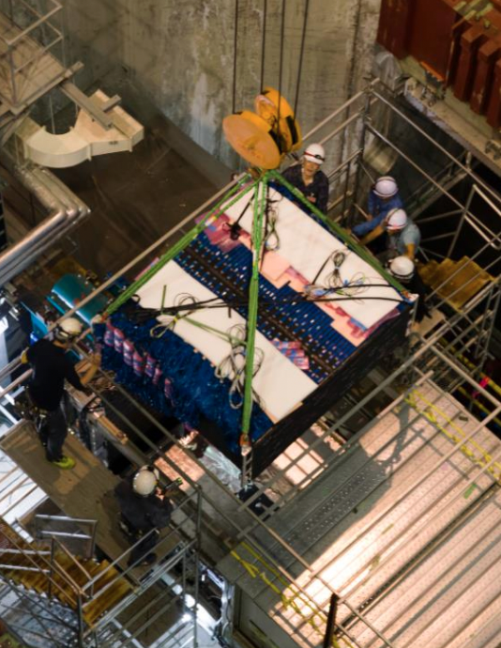

SFGD installation (October 2023)
SFGD was installed in ND280 near detector basket
NGUYEN Quoc Viet

Slide 25



SFGD electronic installation (October 2023)
A few days later, ~190 FEBs (out of ~230) were inserted into 2 frames, the rest were under debugging.
Left frame
Right frame
NGUYEN Quoc Viet

Slide 26




first events with upgraded Nd280 (12/2023)
CNRS press release: https://www.in2p3.cnrs.fr/fr/cnrsinfo/lexperience-t2k-redemarre-avec-un-detecteur-proche-ameliore
First neutrino events from un upgraded beam and detected with an upgraded detector!!!
Successful beam upgrade
These was a missing TPC, it was installed with missing Super-FGD electronic later in April 2024
Big milestone because……
NGUYEN Quoc Viet

Slide 27

first events with upgraded Nd280 (12/2023)
CNRS press release: https://www.in2p3.cnrs.fr/fr/cnrsinfo/lexperience-t2k-redemarre-avec-un-detecteur-proche-ameliore
First neutrino events from un upgraded beam and detected with an upgraded detector!!!
Successful beam upgrade
These was a missing TPC, it was installed with missing Super-FGD electronic later in April 2024
Big milestone because there is no more fire at JPARC
NGUYEN Quoc Viet

Slide 28


After the installation
After the installation, there were many things to be done:
  Got the SFGD running stably
  Slow control and calibration
  Check all channels to study gain and dead channels.
  Complete the software analysis chain
  Stability studies
SuperFGD is under a very active period with many people involved
Munoz-san installing electronic cables
Left frame
NGUYEN Quoc Viet

Slide 29

Calibration (High Gain)
Many procedures for calibration have been established: baseline/threshold tunings, High Gain/ pedestal calibration, High Voltage tuning.
NGUYEN Quoc Viet

Slide 30


Calibration (Low Gain)
Many procedures for calibration have been established: baseline/threshold tunings, High Gain/ pedestal calibration, High Voltage tuning, Low Gain calibration.
Work by L.Giannessi
NGUYEN Quoc Viet

Slide 31

Stability studies
Since this is a recently installed detector, many aspects must be taken care of to check its running stability. Many packages are under development for online monitor: timing monitor, hit rate stability, Light yield stability, Trigger rate stability.
NGUYEN Quoc Viet

Slide 32

SuperFGD full installation (March 2024)
In March 2024, SuperFGD was fully installed with all the OCB and FEB boards

Slide 33

SuperFGD full installation
Full hit map of SuperFGD is available. Super FGD is ready for the next beam run

Slide 34


ND280 upgrade installation complete (last week)
In 25th April 2024, Top High-angle TPC was installed
Last week, all the TOF modules were installed => Upgraded T2K near detector: Mission complete!!!

Slide 35

Super FGD expected performance
4$π$ coverage (isotropic)
NGUYEN Quoc Viet

Slide 36

Super FGD expected performance
4$π$ coverage (isotropic)
Lower proton momentum threshold (300MeV/c)
NGUYEN Quoc Viet

Slide 37


Super FGD expected performance
4$π$ coverage (isotropic)
Lower proton momentum threshold (300MeV/c)
Neutron kinematics reconstruction by time of flight technique (0.6 ns time resolution)
Neutron detection through time of flight technique
Neutron detection efficiency
NGUYEN Quoc Viet

Slide 38

Super FGD expected performance
4$π$ coverage (isotropic)
Lower proton momentum threshold (300MeV/c)
Neutron kinematics reconstruction by time of flight technique (0.6 ns time resolution)
Improved neutrino energy resolution with hadronic kinematic in addition
NGUYEN Quoc Viet

Slide 39






Upgraded near detector ND280: performance
Me
Phys. Rev. D 105, 032010
2027 statistic
Total x-sec&flux systematics at few % level
Pre-fit $E_{ν}$ resolution
Post fit $E_{ν}$ resolution w/o SFGD
At ultimate statistic, dramatic reduction on the uncertainties of all systematics parameters. These systematic play important role in neutrino energy reconstruction and thus on the oscillation analysis.
Post fit $E_{ν}$ resolution w SFGD
Post fit $E_{ν}$ resolution w SFGD
Post fit $E_{ν}$ resolution w SFGD + $E_{vis}$
GUNDAM fit results, the $E_{ν}$ resolution is improved with SFGD and becomes amazingly good with hadronic kinematic.
NGUYEN Quoc Viet

Slide 40
Upgraded ND280 helps to better measure high angle tracks, lower momentum particles, and better reconstruction of the hadronic part.
=> It is thus more sensitive to important nuclear effects for our oscillation analyses.
Summary
Thanks to the upgraded detector and beam, we expect to reach 3sigma sensitivity on CP conservation exclusion by 2027
The upgraded detector and beam represents the legacy from T2K to Hyper-Kamiokande that will start with a very well known and controlled near detector and neutrino flux.
The next beam run with full configuration of upgraded ND280 will be June 5th 2024.
Stay tuned for new results with upgraded ND280!
NGUYEN Quoc Viet
Upgraded ND280 is actively under installation and near to completion.
To be ready for the Hyper-K period, where the statistical uncertainty is reduced and the systematic uncertainty becomes dominant,
From December 2023.
  The neutrino beam power: 760kW,
  The electromagnetic horn current: from 250 kA to 320 kA
  Neutrino intensity increases by about 10%

Slide 41









Bonus slide: Proposal for Super-FGD use
To measure charged particles
To measure neutrinos
To train your AI: “which cube to put in a coffee?”
To make a necklace
NGUYEN Quoc Viet

Slide 42
Back up

Slide 43

Front-end board (FEB)
Front-End Board (FEB) 256 channels
The FEB is the heart of the electronic system and it’s the joined LLR + Uni Geneva project.
Each CITIROC (Cherenkov Imaging Telescope Integrated Read Out Chip) can read 32 channels
  8 CITIROC <=> 256 channels for 1 FEB.
For each channel, the input is handled by two independent signal paths:
  Low gain (LG) path
  High gain (HG) path
NGUYEN Quoc Viet

Slide 44





Front-end board (FEB) cooling plate production at LLR
In June 2023:
~230 cooling plates were produced at LLR with a lot of help from SK group and Mechanic group!!
NGUYEN Quoc Viet

Slide 45



Slide 46


Slide 47
Super FGD assembly at J-parc
Then the cables were attached on the MPPC64 boards and arranged.
Lena working on arranging the cables.
Move before 24
NGUYEN Quoc Viet

Slide 48


MIB functional test
The MIB is used to connect the cables from MPPC board to FEB.
The MIB test (March/2023 Geneva for 224 MIB) is to test the function of all the lines that pass through the MIB
The test includes:
  Housekeeping test: High Voltage, temperature
  Debug line test.
  Analog channels test.
8 connectors, 32 channels each
Debug
MIB
FEB

Slide 49
Next functional test for FEB
GPIO: auxiliary board that allow us to use the FEB without a backplane. It has ADCs that provide a reference for calibration
Kaladin (SOKENDAI): demultiplexer board that allows injecting signal in each channel individually with a single input signal. Controlled by the GPIO
FEB: Device under test. This set up can easily remove and install a FEB.
Functional test includes:
  Housekeeping and loopback
    Test all the backplane lines: SYNC, trigger, busy
    Test debug connector lines
    Housekeeping (HK) values (currents, temperature, voltage)
  Calibration
    Produce calibration parameters to be passed to DAQ
  All 256 channel test
    Short test of each channel
    Check ADC distribution in each channel
    Citiroc triggers, baseline, noise.

Slide 50

T2K statistic
NGUYEN Quoc Viet

Slide 51


T2K experiment: Current results
4 main oscillation channels in T2K: $ν_{μ}→ν_{μ}$ disappearance (dominated by $θ_{23}\text{and}Δm_{23}^{2}$) and $ν_{μ}→ν_{e}$ appearance (dominated by $θ_{13},θ_{23}\text{and}δ_{CP}$ and mass hierarchy) and similar two for anti-neutrino.
Data point around the maximum CP-violating value of $-π/2$
A wide region of $δ_{CP}$ space is excluded at 3$σ$ C.L.
The constraints for ${ν_{e}}/{{\overline{ν}}_{e}}$ appearance are still dominated by the statistical uncertainty
NGUYEN Quoc Viet

Slide 52





High Angle Time Projection Chamber
(HA-TPC)
Two new HA-TPCs
  Dimensions: 1.865 x 2.0 x 0.82 m${}^{3}$
  Track reconstruction in 3D, PID by measuring momentum and deposited charge
Main differences with current ND280 TPC
  High-Angle TPC contains a new type of detector which is the Resistive MicroMegas (ERAM modules) with better spatial resolution.
Bulk MicroMegas.
Resistive MicroMegas.
Charged particle
NGUYEN Quoc Viet
Test beam was high energy electron beam (1-5GeV), short chamber (15 cm drift distance)
Scan in in the detector plane and along drift distance
Scan in angle: 0, 20, 30, 45, 60, 80 degree MicroMegas rotation
Cern-2022 with micro megas

Slide 53


TIME OF FLIGHT DETECTOR (TOF)
Six TOF planes will cover 2 HA-TPCs and SuperFGD.
Each plane of 2.2 × 2.4 m${}^{2}$ consists of 20 scintillator bars.
Both ends readout by 8 MPPCs on each end of each bar.
Precise timing measurement for particles as they traverse the TOF modules (resolution of 150 ps during commissioning at CERN).
Determine the track direction and minimise background
It is used as the cosmic trigger to calibrate SuperFGD and HA-TPCs
NGUYEN Quoc Viet

Slide 54

Neutrino-nucleus interaction: Nuclear effects
A nucleon strongly correlates with another nucleon. => one additional nucleon in the final state and changes the interaction topology.
Final State Interactions (FSI): Particles in the final state re-interact before going out of the nucleus.
Fermi motion: Contribute to the energy transfer in the interaction
No nuclear effects
NGUYEN Quoc Viet

Slide 55




Neutrino-nucleus interaction
Neutrino energy reconstruction is based on the Charge Current Quasi-Elastic (CCQE) kinematics
$E_{QE}=\frac{m_{p}^{2}-m_{μ}^{2}-(m_{n}-E_{rmv})^{2}+2E_{μ}(m_{n}-E_{rmv})}{2(m_{n}-E_{rmv}-E_{μ}+p_{μ}^{z})}$
=> only lepton kinematics
Only single ring is selected at SK. Unfortunately, sometime the hadronic part is below Cherenkov threshold and hence not reconstructed. These modes could mimic CCQE events.
=> ND280 need to carefully model the QE and the non-QE interactions
These modes also contribute to reconstructed quasi-elastic events
The nuclear effects can change the final state topology and kinematic => Bias in neutrino energy reconstruction.
NGUYEN Quoc Viet

Slide 56
T2K experiment
T2K is the first experiment to report evidence for the neutrino appearance oscillation ($ν_{μ}→ν_{e}$) in 2013 (Phys. Rev. Lett:12:061802, 2014.)
The current goal of T2K is searching for the CP violation in the lepton sector by comparing the appearance probabilities of neutrino and antineutrinos. (T2K can produce either neutrino or anti-neutrino beam).
=> First hint of CP violation at 3sigma CL in 2020 (Nature 580, 339-344 (2020))
NGUYEN Quoc Viet
By changing the direction of magnetic field in the horns, we are able to create whether neutrino beam or anti-neutrino beam later.

Slide 57


T2K experiment: beam
An intense muon neutrino beam is sent through 295~km from Tokai to Kamioka, produced by high-intensity accelerated proton beam produced by the J-PARC beamline
T2K uses the off-axis beam technique => the flux is narrower at 0.6 GeV
which is sensitive to the first oscillation maximum with the 295Km baseline.
Since the flux peaks at 0.6 GeV, the Quasi-Elastic (QE) is the dominant interaction.
J-PARC
NGUYEN Quoc Viet

Slide 58

Function of different boards
The primary function of the Optical Concentrator Board (OCB) in the sFGD electronics system is to move and organise digital data and commands.
The DAQ and slow control systems are connected to 14 FEBs in a sFGD crate via the OCB.
Moreover, OCB functions as a link between the MCB and the 14 FEBs.
Backplane: Point-to-point and multi-drop signals that transit via the backplane make up the FEB - OCB communication.
LVDS
MCB is used to send digital signals such as the clock, SYNC (GTS, gate, event number), trigger.

Slide 59



Super FGD production and pre-assembly
The production of the 2 million cubes was done by Uniplast (Vladimir, Russia), with a rate of ~100,000 cubes/month, and took over 1.5 years
After quality checks, all the cubes were assembled layer by layer using fishing lines before delivering.
NGUYEN Quoc Viet

Slide 60



Super FGD assembly at J-parc
Attach MPPC boards on the sides of the box
Install LED calibration system
Install light barriers
How to read the light, LLR activity to do electronic from here. Move electronic after here
NGUYEN Quoc Viet

